Slide 1
Osteomyelitis
Michael Allen, DO
Gerard Chang, MD

Slide 2
Objectives
Define osteomyelitis
Review classification systems
Review workup
Discuss treatment options
Clinical case examples

Slide 3
Definitions
Osteomyelitis: Infection of the bone, with infection or inflammation of surrounding soft tissue
Acute
Infection of short duration
Characterized by suppuration (ie. abscess) but not Biofilm
Often hematogenous osteomyelitis
No osteonecrosis yet
Systemic symptoms common

Slide 4
Definitions
Chronic
Long lasting infection- Months to years
Characterized by necrotic bone and bacterial colonies in protein/polysaccharide matrix (biofilm)
Often no systemic symptoms
Occurs along spectrum with no clear time cutoff to separate acute vs chronic infection

Slide 5
Etiology
Hematogenous seeding from remote source
Most common form in young children
Sluggish metaphyseal capillaries
Contiguous spread from soft-tissue or joint infection
Common in older adults near arthroplasty
Lower extremity infections related to diabetes or vascular disease
Direct inoculation from penetrating trauma or surgery
Common in young adults

Slide 6
Classification schemes
Waldvogel in 1970 proposed three groups:
Hematogenous
Secondary to a contiguous focus of infection
post op wound, direct puncture, superficial infection
Associated with vascular disease
New England Journal of Medicine, 1970, 282(4), 198–206

Slide 7
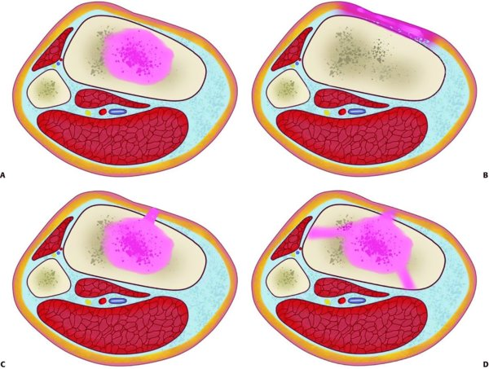
Classification schemes
Cierny-Mader based on location in the bone and the host comorbidities
12 clinical stages (4 types x 3 host class)
A: Type I: medullary osteomyelitis.
B: Type II: superficial osteomyelitis.
C: Type III: localized osteomyelitis.
D: Type IV: diffuse osteomyelitis.
Host
A - Healthy
B - Compromised locally (BL) or systemically (BS)
C - Requires suppressive or no treatment, Minimal disability, Treatment worse than disease, Not a surgical candidate
Paul Tornetta III, William M. Ricci, Robert F. Ostrum, Margaret M. McQueen, Michael D. McKee, Charles M. Court-Brown. Rockwood and Green's Fractures in Adults. Wolters Kluwer Health, 2019
Notes:
Host type B – systemic factors include malnutrition, renal and liver failure, alcohol abuse, immunodeficiency, chronic hypoxia (COPD), malignancy, diabetes, extremes of age, steroid therapy, tobacco use
Type B Local factors include chronic lymphedema and venous stasis, major vessel compromise affecting the infected area, arteritis affecting the infected area, extensive scarring and radiation fibrosis. These all predispose the affected area to poor circulation which allow the establishment of infection and difficulty for the host to eradicate the bacteria.
A type C host requires thoughtful clinical interpretation. These patients either are too sick to undergo the physiologic burden that the type of surgery required to eradicate the infection would impose, or the operation would cause more disability than simply living with the infection.

Slide 8
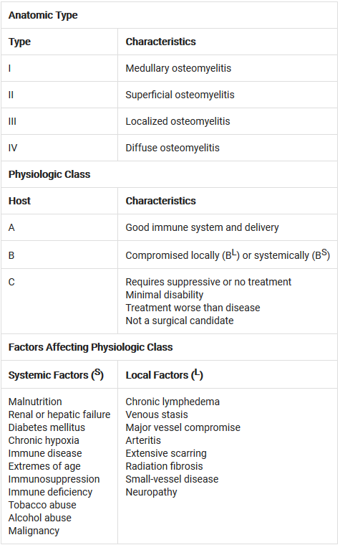
Classification schemes
Local and systemic factors
Address along with infection for best chance of resolution
In CM staging, the stage helps determine treatment
Paul Tornetta III, William M. Ricci, Robert F. Ostrum, Margaret M. McQueen, Michael D. McKee, Charles M. Court-Brown. Rockwood and Green's Fractures in Adults. Wolters Kluwer Health, 2019

Slide 9
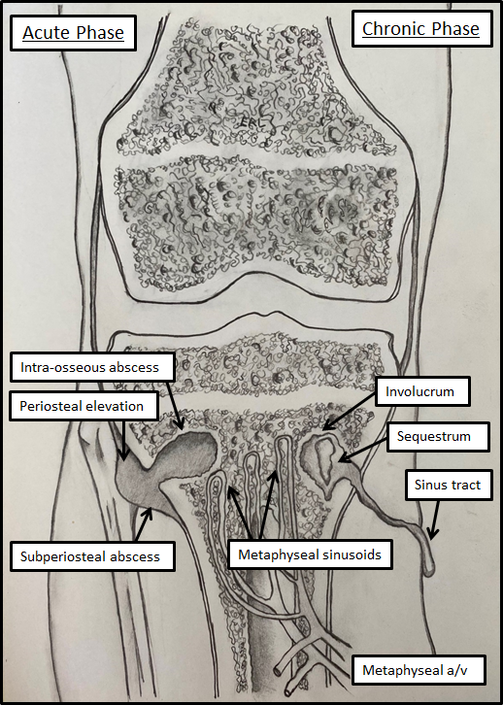
Hematogenous Pathophysiology
Bacteremia seeds long bones commonly around epiphyseal endplates
Slow capillary metaphyseal blood flow deposit bacteria
Local inflammatory response increases intramedullary pressure
Occludes normal blood flow causing necrosis
Forces infection to break through cortex and form subperiosteal abscess
Erosion through periosteum compromises bone blood supply further, worsening necrosis
Image courtesy of Ezra Levy, DO

Slide 10
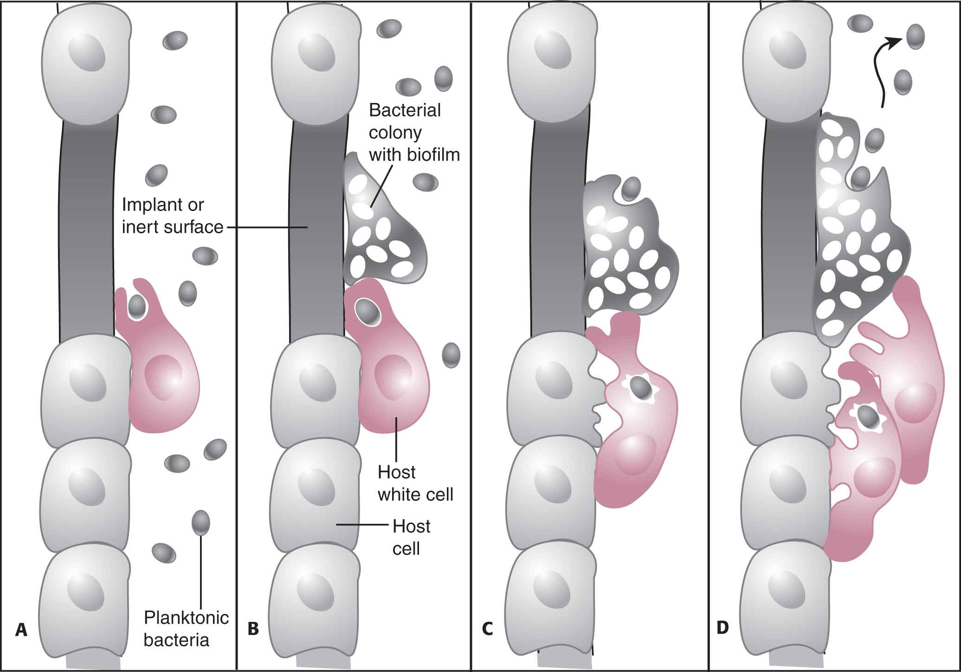
Hematogenous Pathophysiology
Bacteria bind to cell surface receptors and extracellular matrix
Create local microcolonies and biofilm
S. aureus forms Staphylococcal abscess communities (SACs)
Recruitment of phagocytes occurs creating metaphyseal abscess
Proteolytic enzyme release from phagocytes
Oxygen free radicals, cytokines
Decreased O2 tension, pH
Leads to osteolysis
Paul Tornetta III, William M. Ricci, Margaret M. McQueen, Michael D. McKee, Charles M. Court-Brown. Rockwood and Green's Fractures in Adults. Wolters Kluwer Health, 2014

Slide 11
Hematogenous Pathophysiology
SAC form in center of abscess surrounded by fibrin deposits
S. aureus releases coagulase and von Willebrand factor-binding protein
Activates prothrombin
Polymerizes fibrin network around SAC
Protects from immune clearance
Immune cells unable to penetrate network
Bacteria binding to sequestrum release extracellular polymeric substance matrix
Forms biofilm glycocalyx
Reduced O2 tension and metabolic activity of bacteria
Barrier prevents immune clearance and penetration of antibiotics

Slide 12
Pathophysiology
S. aureus and epidermidis can become intracellular inside osteoblasts
Further perpetuates chronic infection by limiting clearance by host immune system
Staphylococcus surface-associated material (SAM) stimulates osteoclast activity
release of IL-1, IL-6, TNF-α.
S. aureus protein A (SpA) binds to osteoblasts affecting metabolic activity and proliferation.
Induces RANKL secretion leading to osteolysis

Slide 13
Pathophysiology
Necrotic bone separates to form the Sequestrum
Mixture of bone and purulence
Reactive bone may form around the sequestrum, termed Involucum
May not completely surround sequestrum
Drainage from sequestrum may still occur through incomplete involucrum

Slide 14
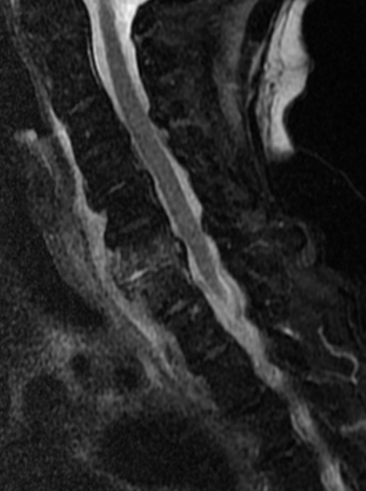
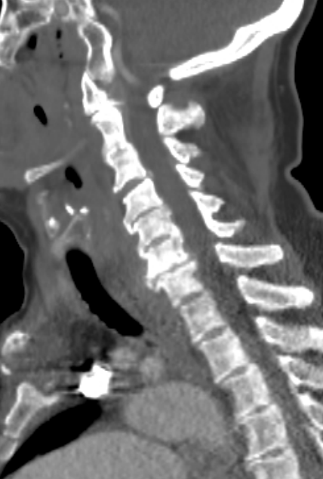
Vertebral Osteomyelitis
Bacteria seeded in metaphysis of vertebral bodies
Infection spreads through endplate into disc
Spread from disc space to adjacent vertebrae
Vascular structures between vertebrae allow communication with distant vertebral bodies
Batson’s venous plexus
Images courtesy of Michael Allen, DO

Slide 15
Microbiology
Organisms vary based on age, type of osteomyelitis and location
Hematogenous commonly monomicrobial
Contiguous or direct inoculation can be monomicrobial or polymicrobial
Children - S. aureus > S. pneumoniae > K. kingae
Sickle cell predisposes to Salmonella but S. aureus still more common
Adults - S. aureus, coag-neg Staph
Kremers et. Al, reviewed 41 years of osteomyelitis cases in Minnesota
S. aureus overall most common
Incidence of osteo increased with incidence of diabetes in population
J Bone Joint Surg Am. 2015 May 20; 97(10): 837–845.

Slide 16
Local microbiomes
Garcia del Pozo et. Al., Spanish series from 1994 - 2015, 344 cases
S. aureus 29.6%, P. aeruginosa 4.1%, MRSA 4.1%
Polymicrobial infection 35.4%.
Jiang et. Al., Chinese series 2010-2015, 394 cases
S. aureus 34.91%, P. aeruginosa 17.16%, E. coli 6.51%
Diabetic foot most common monomicrobial organism was P. mirabilis 20%
Hogan et. Al, German series 2008-2014, 401 cases
S. aureus NOT the most common in this location
S. epi 30%
S. aureus 29%
MRSE 13%
MRSA 6%
Rev Esp Quimioter. 2018 Jun; 31(3): 217–225.
Medicine (Baltimore). 2015 Oct; 94(42): e1874.
Arch Orthop Trauma Surg. 2013 Sep;133(9):1183-96
Notes:
These studies demonstrate that geography plays a role in organism. The Spanish series has a high rate of polymicrobial and some Pseudomonas. The Chinese study shows very high rates of Pseudomonas and in diabetic foot osteo there is high rate of Proteus. In the German series there was more Staph Epidermidis than Staph Aureus and very high rates of drug resistant organisms.
The Kremers series on slide 15 shows that in this Midwest US based population the most common organism overall was still Staph aureus, which the Spanish and Chinese study also demonstrated. The point of these references is to illustrate that local microbiomes are variable, so consult your Infectious Disease team to determine the most likely local organisms when you are picking empiric antibiotics. This is especially important for residents and fellows who may go on to practice in a new location with a different microbiome and resistance biogram.

Slide 17
Clinical Presentation
Acute
Pain
Erythema
Edema
+/- Fever (more common in pediatric)
Associated wound or sinus tract if direct/contiguous source
Chronic
Generalized/systemic signs less common
Localized pain and edema
Sinus tract, non-healing ulcerations in vasculopath
Vertebral may present with neurological symptoms

Slide 18
Workup
Clinical Exam
Laboratory
Imaging
CBC
CRP/ESR
Radiograph
Advanced (MR, PET, Bone scan)
Biopsy

Slide 19
Imaging
First step is plane radiograph (sensitivity 28-75%)
Soft tissue swelling after a few days of onset
Look for ulceration and subcutaneous gas
10-21 day lag before radiographic bony changes (osteopenia, periosteal reaction)
Cortical destruction later on with medullary lucency
CT often obtained in ED
Not as sensitive as preferred modalities acutely
Can show cortical destruction and soft tissues well (with contrast)
Useful in chronic cases to visualize involucrum and sequestrum
MR considered most useful when readily available

Slide 20
Magnetic Resonance
High sensitivity and specificity
90% sens, 79% spec (Clin Infect Dis. 2008 Aug;47(4):519-27.)
93% sens, 75% spec (Diabetes Care. 2017 Aug;40(8):1111-1120.)
Contrast is beneficial → soft tissue abscess, non-enhancing bone necrosis)
T2/PD fat suppressed/STIR will show enhancement
Presence of edema is non-specific
T1 decreased marrow intensity
The combination of T2 enhancement and decreased T1 signal is suggestive of osteomyelitis in the right clinical context

Slide 21
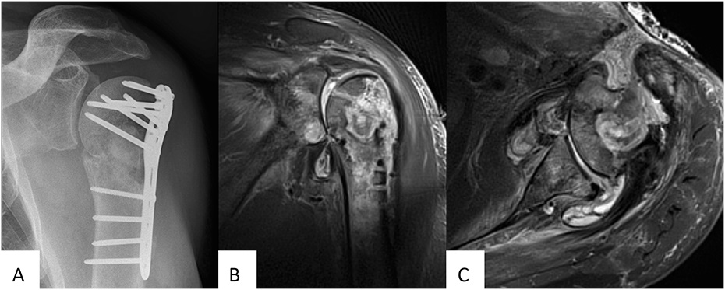
Magnetic Resonance
MR demonstrating T2 enhancement, sinus tract to anterior skin
Govaert GAM, Kuehl R, Atkins BL, Trampuz A, Morgenstern M, Obremskey WT, Verhofstad MHJ, McNally MA, Metsemakers WJ; Fracture-Related Infection (FRI) Consensus Group. Diagnosing Fracture-Related Infection: Current Concepts and Recommendations. J Orthop Trauma. 2020 Jan;34(1):8-17. Figure 1

Slide 22
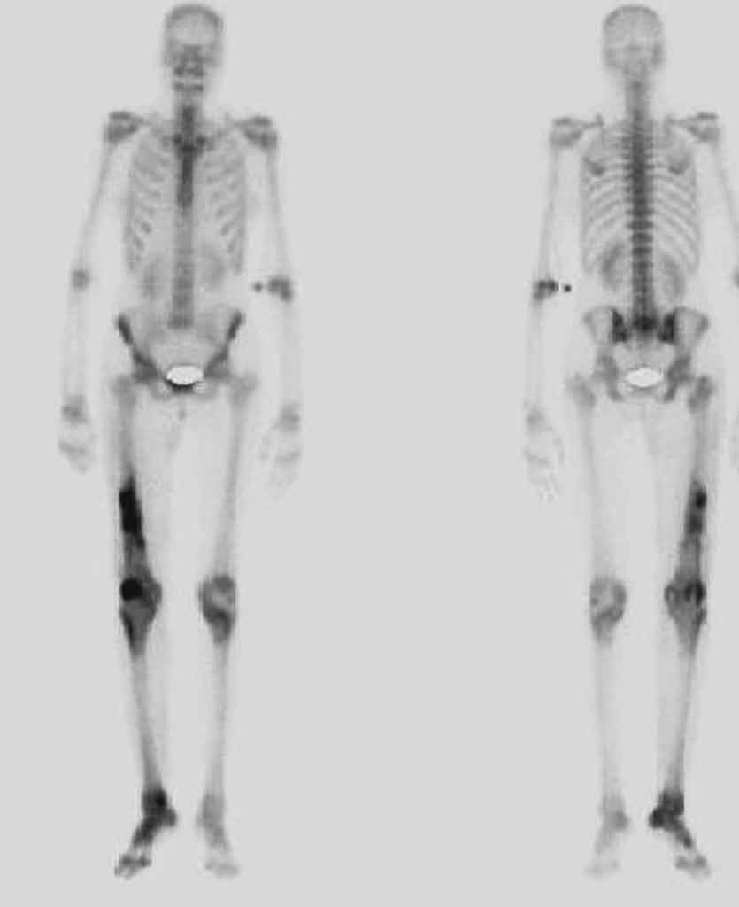
Further imaging
Technetium 99 phosphate bone scan
81% sens, 28% spec (Clin Infect Dis. 2008 Aug 15;47(4):519-27.)
91% sens, 92% spec (Diabetes Care. 2017 Aug;40(8):1111-1120.)
Indium 111 leukocyte scan
74% sens, 68% spec (Clin Infect Dis. 2008 Aug 15;47(4):519-27.)
92% sens, 75% spec (Diabetes Care. 2017 Aug;40(8):1111-1120.)
18-FDG PET scan
89% sens, 92% spec (Diabetes Care. 2017 Aug;40(8):1111-1120.)
Overall, the sensitivity and specificity across studies is inferior to MRI and these are adjunctive modalities, not first line
PET helpful in low grade spondylitis/discitis (Clin Radiol. 2016 Jul;71(7):632-46)
Paul Tornetta III, William M. Ricci, Margaret M. McQueen, Michael D. McKee, Charles M. Court-Brown. Rockwood and Green's Fractures in Adults. Wolters Kluwer Health, 2014

Slide 23
Labs
CRP and ESR (Clin Orthop Relat Res. 2019 Jul; 477(7): 1594–1602)
ESR>60 mm/h (74% sens, 56% spec) and CRP >7.9 mg/dL (49% sens, 80% spec) in predicting osteomyelitis of the diabetic foot
ESR *AND* CRP above cutoff = 36% sens and 91% spec
ESR *OR* CRP above cutoff = 87% sens and 45% spec
CRP >3.2 mg/dL or ESR >60 mm/hr and associated ulcer depth >3 mm had 100% sens for osteomyelitis in diabetic foot (J Foot Ankle Surg. Jan-Feb 2009;48(1):39-46.)
The key is recognizing elevated inflammatory markers and interpreting along with imaging and clinical presentation!

Slide 24
Combined imaging and labs
Tornetta et. Al investigated labs and imaging to diagnose infections in nonunions
Retrospective review of 95 nonunions who had preoperative serum WBC, CRP, ESR and nuclear med scan (In-111 WBC scan, Tc-99m scintigraphy, or combined)
Infection confirmed by positive by gross purulence intraop, positive intraop culture, gross infection immediately postop
Elevated CRP >1 mg/dL (OR=4.2, p=0.002), ESR >30 mm/hr (OR=5.2, p=0.0006) significant predictors of infection
WBC count >11k (OR=2.5, p=0.12) and In/Tc scanning (OR=2.5, p=0.29) not significant predictors
J Bone Joint Surg Am.2013;95:1409-12

Slide 25
Tornetta et. Al continued
When positives on these 4 tests, combined score predictive of infection:
0 = 18.3%
1 = 23.5%
2 = 50.0%
3 = 85.7%
Nuclear scan had high specificity (92%) but low sensitivity (19%) and costly
Just labs without nuclear scan:
0 = 19.6%
1 = 18.8%
2 = 56.0%
3 = 100.0%
J Bone Joint Surg Am.2013;95:1409-12

Slide 26
Biopsy and culture
Blood culture can isolate hematogenous seeding organism
More common in pediatric, less useful in adult
Superficial wound swab not reliable → lack of concordance with bone culture
Bone biopsy considered diagnostic “gold standard”
Targeted biopsy can guide medical therapy
Highest yield before antibiotics or after 14 day holiday.

Slide 27
Treatment strategies
Initial questions to guide therapy
What is the host type? Have they been medically optimized?
Is there osteomyelitis around retained hardware?
If so, is the hardware critical to stability?
Treatment requires team approach with surgeon, ID, PCP, wound care AND PATIENT all on board

Slide 28
Treatment strategies
Cierny-Mader Host
A → limb salvage, antibiotic therapy, surgery if indicated
BL → limb salvage, antibiotic therapy, likely surgery adjunct
BS → limb salvage, medical optimization first, address comorbid conditions, antibiotics and surgery
C → palliative, suppressive antibiotics vs amputation
Type
I → intramedullary debridement (removal of hardware if present)
II → debride soft tissue and bone until healthy base
III → excision of involved bone with medullary debridement
IV → complete segmental excision and reconstruction

Slide 29
Empiric antibiotics
Dudareva et. Al reviewed 223 chronic osteo patients undergoing definitive surgery from 2013-2017 compared with 157 from 2001-2004.
MRSA and VRE actually decreased, overall multi drug resistant organisms remained the same
Least resistance demonstrated to empiric combination of meropenem with vancomycin, followed by Piperacillin/Tazobactam with vancomycin
32.3% of patients were culture negative demonstrating the importance of selecting empiric antibiotics which have least rate of resistance in the local microbiome.
J Infect. 2019 Sep;79(3):189-198

Slide 30
Empiric antibiotics – vertebral osteo
358 cases of microbiologically proven hematogenous vertebral osteo 2005-2012
MSSA (33.5%), MRSA (24.9%), Enterobacteriaceae (19.3%), Streptococcus species (11.7%)
Oral regimens
73.5% of isolated pathogens susceptible to levofloxacin plus rifampicin
71.2% to levofloxacin plus clindamycin
64.5% to amoxicillin-clavulanate plus ciprofloxacin
Susceptibility rates were better for community acquired vs hospital acquired!
IV Vanco regimens
93.0 % combined with ciprofloxacin
94.1% with ceftriaxone
95.8% with ceftazidime or cefepime
PLoS One. 2019; 14(2): e0211888.

Slide 31
Antibiotic therapy
Treatment success depends on adequate penetration of antibiotic into infected bone
Different drug classes have variable bone penetration rates
β-Lactam bone levels range from 5-20% of parenteral serum level -> Oral only reach ~10% of parenteral serum levels and are unlikely to reach MIC in bone
Vancomycin/Daptomycin also poor bone penetration but serum levels are high
Oral fluoroquinolone, linezolid, TMP-SMX reach up to 50% of serum level in bone
Clindamycin reaches 40-70% of serum level
Metronidazole may reach serum levels in bone, useful for anaerobic infections
Rifampin reaches or exceeds serum levels, useful as adjunct therapy
Clin Infect Dis. 2012 Feb 1; 54(3): 393–407.
Notes:
The referenced review article by Spellberg and Lipsky goes in detail on the pharmacokinetics and absorptions as well as reviews all of the relevant studies up to 2012 and is an excellent reference source.

Slide 32
Antibiotic therapy
Nonrandomized trials -> chronic osteo treated for 4–6 weeks with parenteral β-lactam antibiotic shown to cure 60%–90% of cases
Studies are not consistent in terms of surgical debridement, length of follow up etc…
For long bone osteo, Vancomycin achieves low cure rates compared to β-lactams -> Odds ratio of recurrence 2.5 when vanco used
Daptomycin shows cure rates of 65%–75% in chronic osteo
Clin Infect Dis. 2012 Feb 1; 54(3): 393–407.

Slide 33
Antibiotic therapy: Oral fluoroquinolones
Oral fluoroquinolones are the most studied class for oral only therapy
Spellberg and Lipsky review up to 2012 demonstrates:
Cure rates 60-80%
Therapy usually 12-16 weeks and usually higher dose than for other infections
Not enough data to conclude that the longer duration and high dose is required
Most failures due to Pseudomonas and to a lesser extent S. aureus
Clin Infect Dis. 2012 Feb 1; 54(3): 393–407.

Slide 34
Antibiotic therapy: TMP-SMX
TMP-SMX next most commonly studied after fluoroquinolones
7 mg/kg/d of trimethoprim, with rifampin 600-1200 mg/day, and debridement cured 100% of Staph osteo (Enferm Infecc Microbiol Clin. 1997 Jan;15(1):10-3)
TMP-SMX for 6 months with debridement, 59/60 (98%) cured -> dose unclear (Rev Soc Bras Med Trop. Oct-Dec 1992;25(4):235-9)
TMP-SMX BID at 10mg/kg TMP and 50mg/kg SMX BID for infected hardware/PJI (Antimicrob Agents Chemother. 1998 Dec;42(12):3086-91.)
Intention to treat success 66.7% (26/39) and per protocol success 86.7% (26/30)
TMP-SMX (8 mg/kg/d) or linezolid, combined with rifampin cured 79%–89% of patients with infected orthopedic implants or chronic osteomyelitis. (Clin Microbiol Infect. 2009 Dec;15(12):1163-9)
Notes:
Antimicrob Agents Chemother. 1998 Dec;42(12):3086-91.
6 months for infected fracture hardware and THA, 9 months for TKA
Intention to treat success 66.7% (26/39) and per protocol success 86.7% (26/30)
71.4% (5/7 patients) for TKA, 75% (6/8 patients) for THA, and 100% (15/15 patients) for infected fracture hardware
17/28 (60.7%) without implant removed were cured. 11 (36.6%) patients had implants removed and 9 (81.8%) were then completely cured.

Slide 35
Antibiotic therapy: Oral agent summary
Oral fluoroquinolone and TMP-SMX at high doses are very successful for treating osteomyelitis
Multiple studies confirm the importance of concurrent surgical debridement and removal of hardware if necessary.
Rifampin may be useful as an adjunct
Longer duration regimen may be required but there is not enough data on this to state unequivocally

Slide 36
Antibiotic therapy
Cochrane review from 2013 concludes “The main finding of this review is the lack of evidence to guide practice.”
4 trials compared oral quinolones with parenteral antibiotic
No difference in rate of remission at the end of therapy (RR 1.04, 95% CI 0.92 to 1.18; four trials, 150 participants)
Most of the included studies were >20 years old as of 2013
There is no strong evidence supporting 4-6 weeks of IV therapy which is standard, or supporting longer courses of oral therapy
These durations are mostly historical and ongoing studies are needed to compare short durations
Cochrane Database Syst Rev. 2013 Sep 6;(9):CD004439
Clin Infect Dis. 2012 Feb 1; 54(3): 393–407.

Slide 37
The OVIVA trial
Oral versus Intravenous Antibiotics for Bone and Joint Infection published in NEJM 2019
Multicenter UK trial -> 1054 patients randomized to either 6 weeks of IV or oral therapy (527 in each group)
Infections included: native appendicular osteo, native joint infection requiring excision arthroplasty, PJI, fixation device infection, or vertebral osteo
Antibiotic selection left up to local specialists based on appropriate biogram
N Engl J Med. 2019 Jan 31;380(5):425-436

Slide 38
The OVIVA trial
Median duration therapy 78 days IV, 71 days oral (P = 0.63)
Treatment failure at 1 year primary endpoint
74/506 (14.6%) for IV, and 67/509 (13.2%) for oral
Oral therapy was non-inferior to IV therapy
Most common antibiotics
IV: glycopeptides 41.1%, cephalosporins 33.2%
Oral: quinolones 36.5%, combination therapy 16.6%, penicillins 15.9%
Nonsurgical costs £2,740 cheaper for PO with no difference in quality adjusted life years and similar rates of adverse events on both groups
N Engl J Med. 2019 Jan 31;380(5):425-436

Slide 39
Antibiotic therapy summary
Multiple studies including large RCT from 2019 support oral therapy being as successful as IV therapy
Antibiotic choice needs to be determined based on culture sensitivities and local resistance rates
Most common oral regimens include fluoroquinolone or TMP-SMX
Most common IV regimens include Vanco and β-Lactam
Oral Rifampin is a useful adjunct to both oral and IV regimens
Surgical debridement/removal of hardware must be considered

Slide 40
Surgical treatment principles
Excise ALL devitalized/infected bone and soft-tissue
Manage the dead space
Address soft-tissue envelope
Reconstruct the bone defect
Reconstruction always the last stage

Slide 41
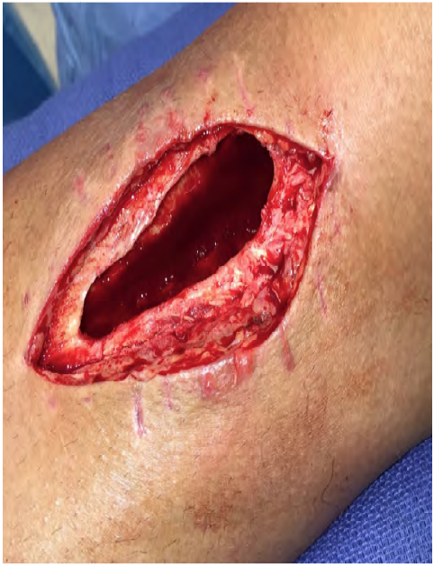
Debridement
Removal of nonviable soft-tissue surrounding infection site
Excise sinus tracts
Chronic infected tissue risk for Marjolin ulcer and future cancer
Systematic removal of all necrotic and/or infected bone
Be methodical without skipping around
High speed burr, rongeur
Debride to bleeding bone (“Paprika sign”)

Slide 42
Dead space management
Tissue dead space needs to be occupied to prevent reaccumulation of infection
Open space + poor vascularity = infection breeding ground
Antibiotic beads
PMMA + antibiotic
Antibiotic should be heat stable and hydrophilic
Commonly Vancomycin and Tobramycin/Gentamicin
Open wound with beads plus occlusive dressing = bead pouch
Bioactive glass -> forms hydroxyapetitie like surface which bonds to bone and can fill defects and provide antimicrobial effect as well (altered pH, Ag+ ion release)
Notes:
Bioglass:
J Funct Biomater. 2018 Mar; 9(1): 25.
Injury . 2015 Dec;46 Suppl 8:S3-7
Bead pouch:
Clin Orthop Relat Res. 1993 Oct;(295):54-62.

Slide 43
Dead space management: abx + PMMA
Choose heat stable antibiotics -> exothermic polymerization
Combined abx often used for synergistic effects -> both in increased elution and increased activity
Most common choices are gentamicin, vancomycin, tobramycin, clindamycin
Gent + vanco covers most pathogens including MRSA/MRSE
Maximum elution concentration at day 2-3, then drops from week 1-2
Smaller/more beads with greater surface area than larger bead/spacer -> higher elution rate and concentration
Spacer useful if attempting to maintain anatomic space
Front Microbiol. 2019 Jul 25;10:1626

Slide 44
Dead space management: abx + PMMA
Increasing abx concentration in PMMA may reduce structural integrity
Theoretical problem in PJI revision, not as much in beads/spacers which are not structural/load bearing
Variability in hand mixed formulations [J Orthop Surg (Hong Kong). May-Aug 2019;27(2)]
Cacciola et. Al found that PMM retains minimum compressive strength of 70 MPa until loaded with 12 g of abx per 40 g PMMA (J Orthop. 2018 Sep 6;15(4):1004-1007)
Increasing Tobramycin and Gentamicin increases Vancomycin elution in triple antibiotic formation
Hand mixing results in more air trapping which may increase elution rates (which also decreases structural integrity) [J Biomed Mater Res B Appl Biomater. 2009 Jul;90(1):467-75]
Notes:
Tobra and Vanco elution rates, synergy, cement strength profiles: J Orthop Res. 2018 Apr;36(4):1078-1085
2g of vanco per 40g/cement with strong mechanical properties: J Orthop Surg (Hong Kong). May-Aug 2019;27(2)
Strength and elution profiles of Tobra/Gent/Vano. ***One author is a consultant for the maker of the PMMA, must interpret critically*** J Orthop. 2018 Sep 6;15(4):1004-1007.

Slide 45
Dead space management: abx + PMMA
There is a paucity of data for prospective trials of different antibiotic concentrations
Many studies in arthroplasty literature for PJI
Most show good eradication with 2-4 g Vanco and 1.2-4.8 g Tobra/Gent per 40 g PMMA (Clin Infect Dis. 2012 Dec;55(11):1474-80)
Support in arthroplasty literature for achieving acceptable intraarticular concentrations with 4 g Vanco and ≥3.6 g Tobra
Retrospective group of 40 infected tibia defects treated with premixed gentamicin PMMA with 2 g vanco, as beads or spacer (BMC Musculoskelet Disord. 2017 Jun 12;18(1):256)
88.9% control with beads, 90.9% with spacer and induced membrane

Slide 46
Dead space management
Bead pouch used in initial debridement in 84 lower extremities (tibia to foot) [Injury. 2010 Mar;41(3):285-93]
Exchanged after 48-72 hours
Followed with bone and soft tissue reconstruction as indicated
Success without amputation in 69/84 cases (82.1%)
15 infected tibia fractures treated with debridement and bead pouch with temporary procine graft covering. (J Trauma. 1997 Aug;43(2):268-74)
1 week IV abx, definitive surgery 2-6 weeks later
15/15 erradicated infection prior to second stage fibula vascularized grafting

Slide 47
Dead space management
Negative pressure wound therapy (NPWT)
Can temporize a wound but not ideal when trying to achieve high antibiotic concentrations
Vac system may have ability to instill with antibiotic solution
Pelvis/LE osteo cases treated with debridement and NPWT instillation, 3/30 (10%) had recurrence at 8 months compared to historic control 55/94 (58.5%) [Wound Repair Regen. Mar-Apr 2009;17(2):278-86]
In goat contaminated wound model, bead pouch alone had 6x less bacteria than bead pouch with NPWT. (J Orthop Trauma. 2012 Sep;26(9):512-8)
High levels of antibiotic eluent in the NPWT drainage as expected

Slide 48
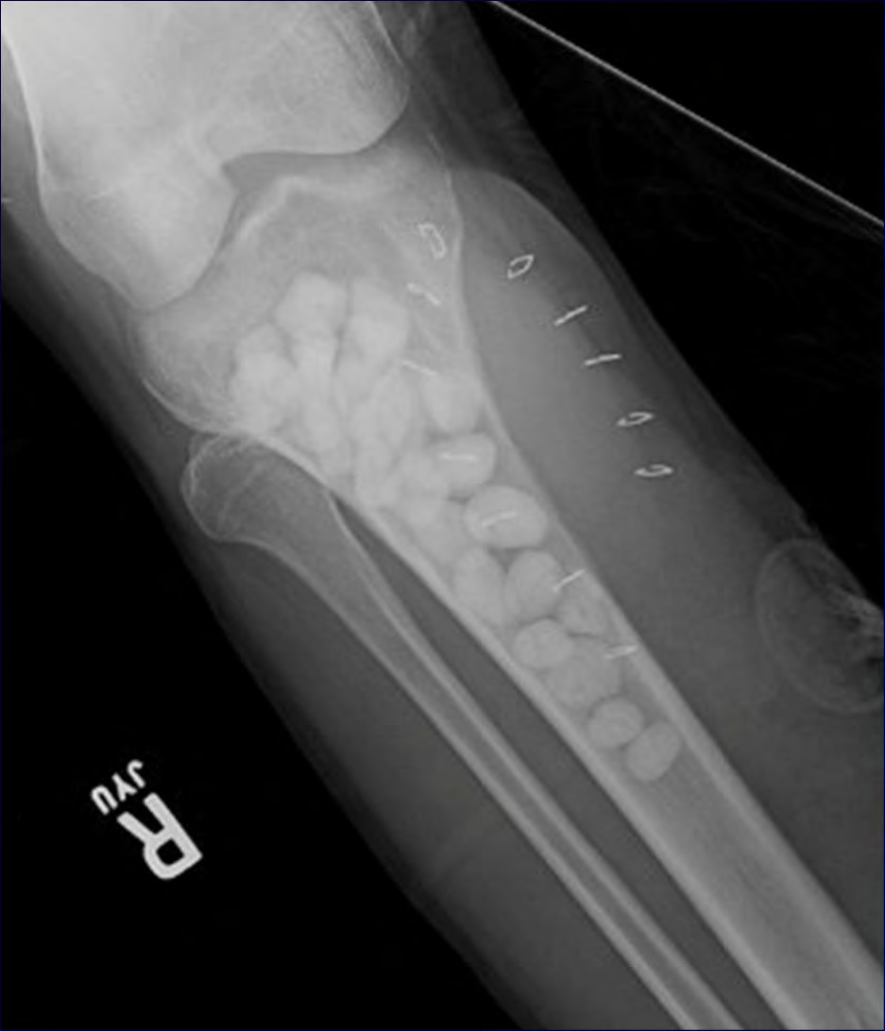
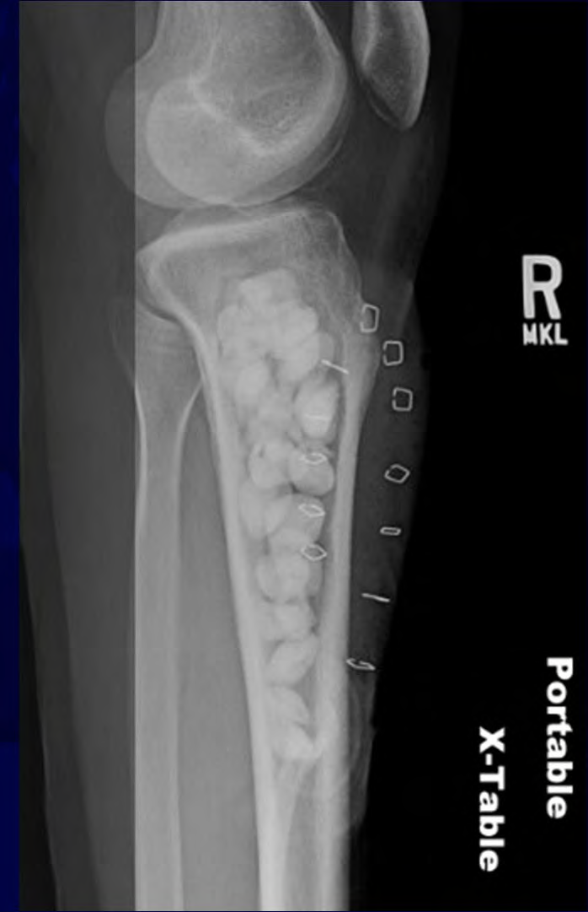
Dead space management: Bead pouch

Slide 49
Soft-tissue reconstruction
Reconstructive ladder:
Healing by secondary intention
Primary closure
Delayed primary closure
Split thickness graft
Full thickness skin graft
Tissue expansion
Random flap
Axial/Pedicle flap
Free flap
Defects often requires local or free-tissue transfer Must have skilled Microsurgeon available

Slide 50
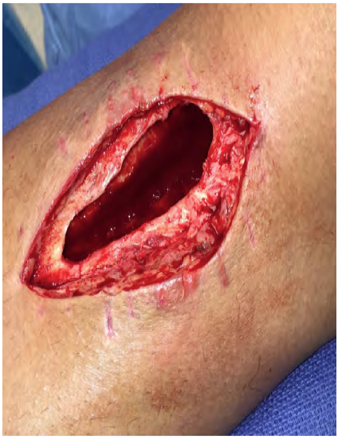
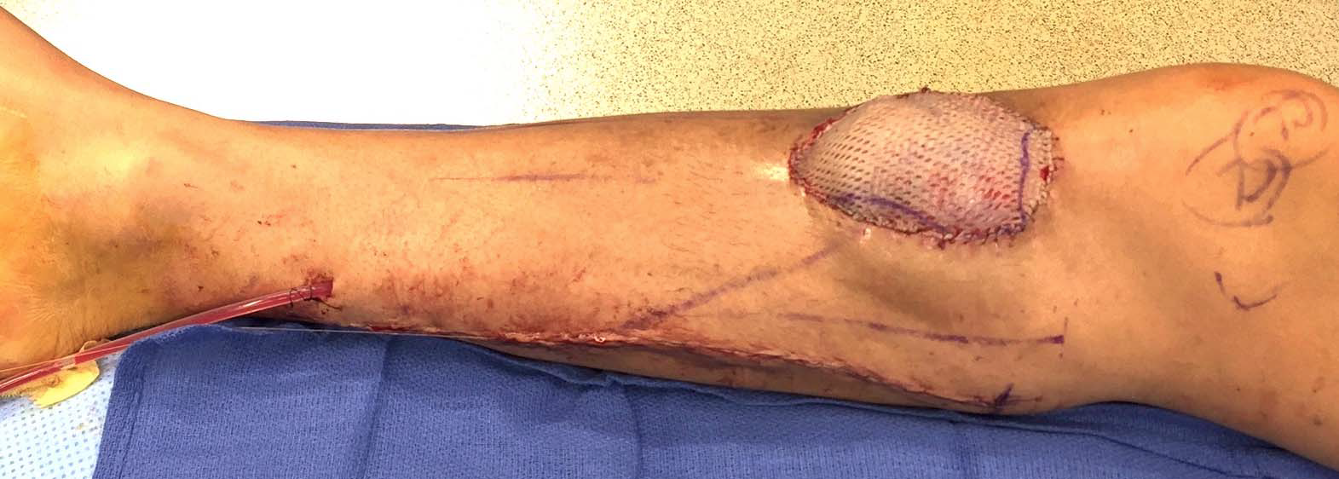
Example: medial gastroc flap

Slide 51
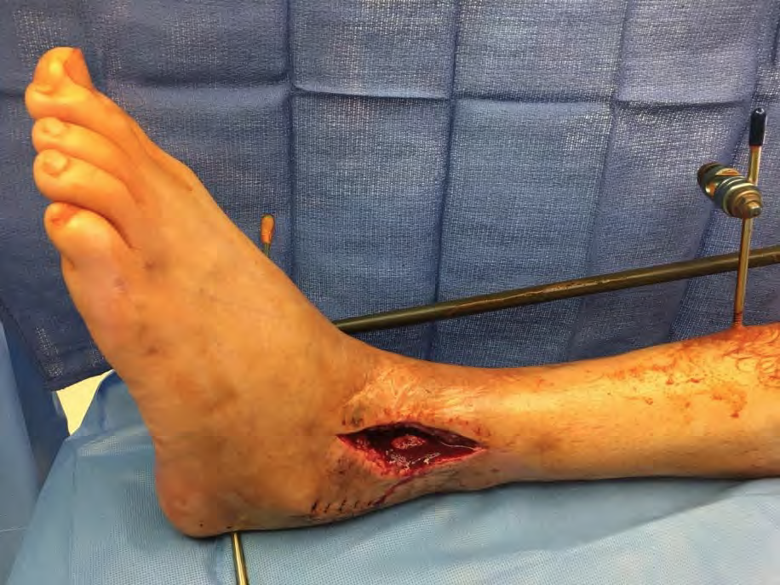
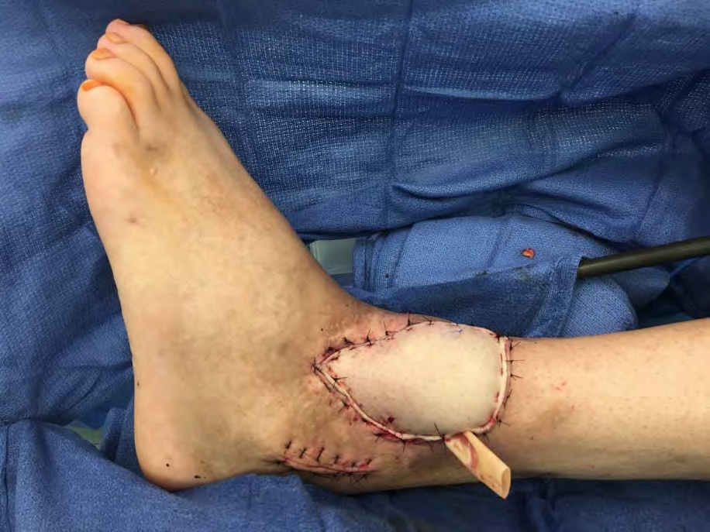
Example: Anterolateral thigh free flap

Slide 52
Bone reconstruction
Non-segmental defects
Additional stability may not be needed if there is cortical support
If large enough defect with structural concern, bone grafting 6-8 weeks after infection eradicated
Segmental defects
Shorten bone to fill defect or replacing lost bone
Need provisional stability (most commonly external fixator)
Plan for bone defect
Masquelet technique
Bone transport
Structural autograft (fibula)

Slide 53
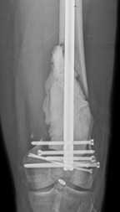
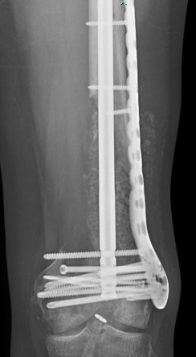
Masquelet technique (Induced membrane)
Antibiotic spacer placement and soft-tissue coverage
Pseudomembrane forms around spacer
Staged Bone grafting (4-6 weeks later)
Membrane secrets BMP-2, VEGF and other growth factors
Peak at 4 weeks after membrane induction then decreases rapidly
(Aho et al. JBJS 2013)
Reported success ~80% for implant dependent union
10-12 months for union, weight bearing

Slide 54
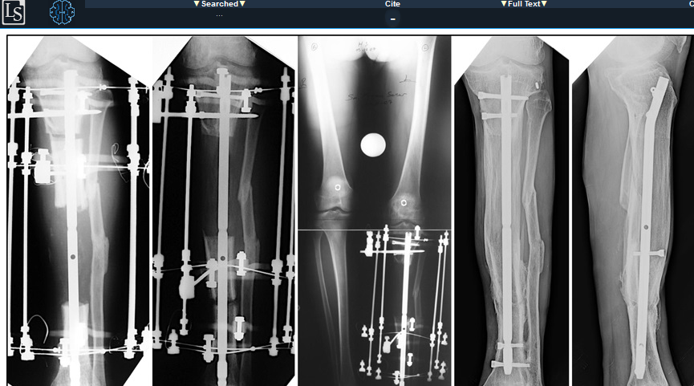
Bone transport
Corticotomy made on one side (or both) distant to the infection site to create a segment
Segment is fixed to IM rod, Ring fixator, etc., that allows for controlled movement
Segment is transported gradually towards the void, up to 1mm/day until original defect site is closed
New bone formed by distraction osteogenesis at the corticotomy site
J Orthop Trauma. 2020 Oct;34(10):e353-e359

Slide 55
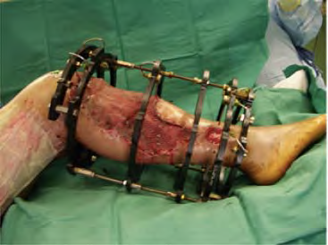
Circular fixation
Advantages
Many options for pin placement
Excellent stability
Allows multiplanar deformity correction in addition to lengthening/transport
Disadvantage
Pin site issues common
Technically demanding
Psychologically long process for patients

Slide 56
Acute Shortening
Acute shortening >3cm may cause arterial flow impairment
Results in limb length discrepancy and muscle shortening/dysfunction if length is not concurrently restored
Reasonable definitive option for small bone defects and/or resources limited

Slide 57
Shortening/Lengthening
Acute shortening of defect with concurrent lengthening of the bone through distraction osteogenesis distant to the infection defect
Tetsworth et al, successfully treated infected tibial nonunions with 5.8 cm average defect with acute shortening and lengthening through ex-fix
No reported vascular complications with acute shortening in this series
Injury. 2017 Oct;48(10):2276-2284
Sen et al, shortened 23 distal femur defects up to 7 cm acutely over supracondylar nail and lengthened with ex-fix
100% union rate
No vascular complications after shortening
J Orthop Trauma. 2020 Sep;34(9):476-481

Slide 58
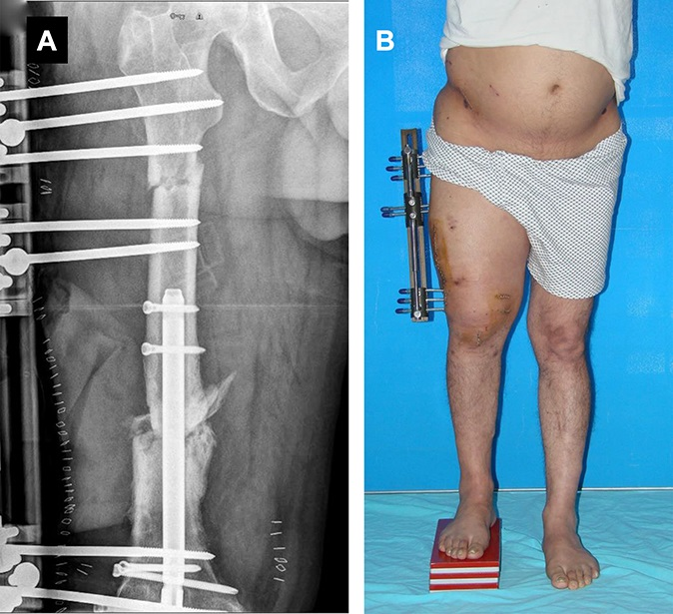
Shortening/Lengthening
Distal femur osteo and necrotic bone debrided
Distal femur retrograde nail
Proximal femur osteotomy gradually lengthened to eliminate discrepancy
Sen C, Akgül T, Tetsworth KD, Balci Hİ, Yildiz F, Necmettin T. Combined Technique for the Treatment of Infected Nonunions of the Distal Femur With Bone Loss: Short Supracondylar Nail-Augmented Acute Shortening/Lengthening. J Orthop Trauma. 2020 Sep;34(9):476-481. Figure 2.

Slide 59
Osteomyelitis around orthopedic implants
Three scenarios:
1. Stable hardware, fracture healed
2. Stable hardware, fracture not healed
3. Unstable hardware, fracture not healed

Slide 60
Stable hardware, fracture healed
Treat with I&D, removal of hardware
Follows Stage 3 treatment principles
Curette when possible, any remaining defect, hardware holes, pseudomembranes, etc.
If fracture is united and stable, without segmental defect, then no further instrumentation needed for stability

Slide 61
Stable hardware, fracture not healed
Stability is required to eradicate infection
For acute infections attempt I&D, retain hardware, suppress with antibiotics until fracture healing
Goal to convert from Stage 4 to Stage 3 osteomyelitis
71% success in achieving fracture healing with antibiotic suppression (Berkes et al. JBJS 2010)
Requires eventual hardware removal in ~30% cases
Hardware removal less likely in proximal (e.g. pelvis) vs. distal locations (e.g. tibia)
If fracture healing achieved, principles follow Stage 3 treatment

Slide 62
Unstable Hardware, Fracture Not Healed
I&D, removal of hardware
Equivalent to Stage 4 Osteomyelitis (i.e. Segmental Defect)
Requires strategy for bone stability (e.g. ring fixator, antibiotic nail, etc.) and management of segmental bone defect

Slide 63
Results (of Comprehensive, Multidisciplinary Treatment Protocol)
2207 cases from 1981 through 2007
1898 limb-salvage protocols
230 amputations (as primary treatment)
85% overall success (infection-free, functional reconstruction at 2 years)
A-hosts 96%
B-hosts 74%
Limb-salvage 84%
Amputation 91%
Plast Reconstr Surg. 2011 Jan;127

Slide 64
Results
Treatment failures (n=319)
43% aseptic nonunions
28% wound sloughs
15% unanticipated impairment
12% recurrent sepsis
2% deaths
82% success with retreatment
Overall 2 year success rate of 95%
99% A hosts
90% B hosts
Plast Reconstr Surg. 2011 Jan;127

Slide 65
Results of limb salvage for tibial osteomyelitis
67 patients with 3.9 year follow up
Debridement with abx beads/rods and plastic closure if needed
54 had fracture non-union with infection
61 patients ultimately had their infection controlled by limb salvage
48/54 non-unions achieved union
5 patients required amputation
1 patient on daily chronic antibiotics
Failure associated with
Diabetics with neuropathy
Increasing surgeries
J Bone Jt Infect. 2019 Dec 10;4(6):306-313

Slide 66
Summary
Commonly hematogenous or direct inoculation
Most common organism S. aureus
Assess modifiable patient risk factors like glucose control, comorbid conditions optimization
Cierny-Mader classification based on location in the bone, and comorbidities of the patient
Host type helps determine treatment options -> treatment may be worse than the disease
Standard therapy includes debridement and IV abx for 4-6 weeks
More research needed, current concept that oral abx may be as good as IV abx

Slide 67
Summary
Options for dead space management include antibiotic cement spacers, beads, pouches, wound vac.
Common abx regimen for cement is 2-4 g Vanco +/- 4 g Tobra/Gent
Soft tissue reconstruction follows a stepwise ladder, useful to have help of Plastic surgery for complex closures/flaps
Bone reconstruction options include transport, shortening/lengthening, induced membrane techniques
Selecting a patient specific treatment regimen can result in high success rates with eradication of infection, demands team approach between Orthopedics, Infections Disease, PCP!

Slide 68
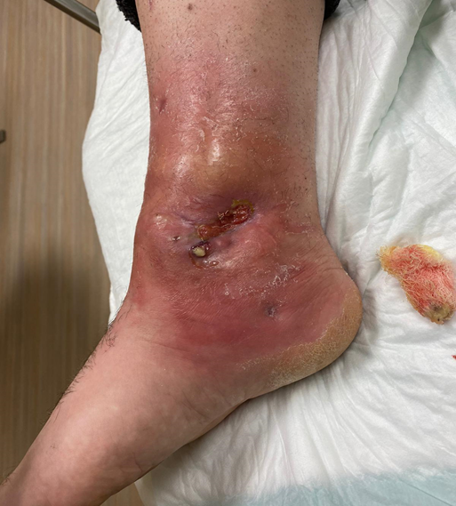
Case 1
26M MVA, treated at outside facility 3 months ago for pilon and ipsilateral platuea
Presenting with drainage from medial ankle, pain, fever.
Has had debridement, wound vac medially, PICC line with 6 weeks IV ceftriaxone.
Medial wound had closed and began draining a few days after completing abx
Images courtesy of Michael Allen, DO

Slide 69
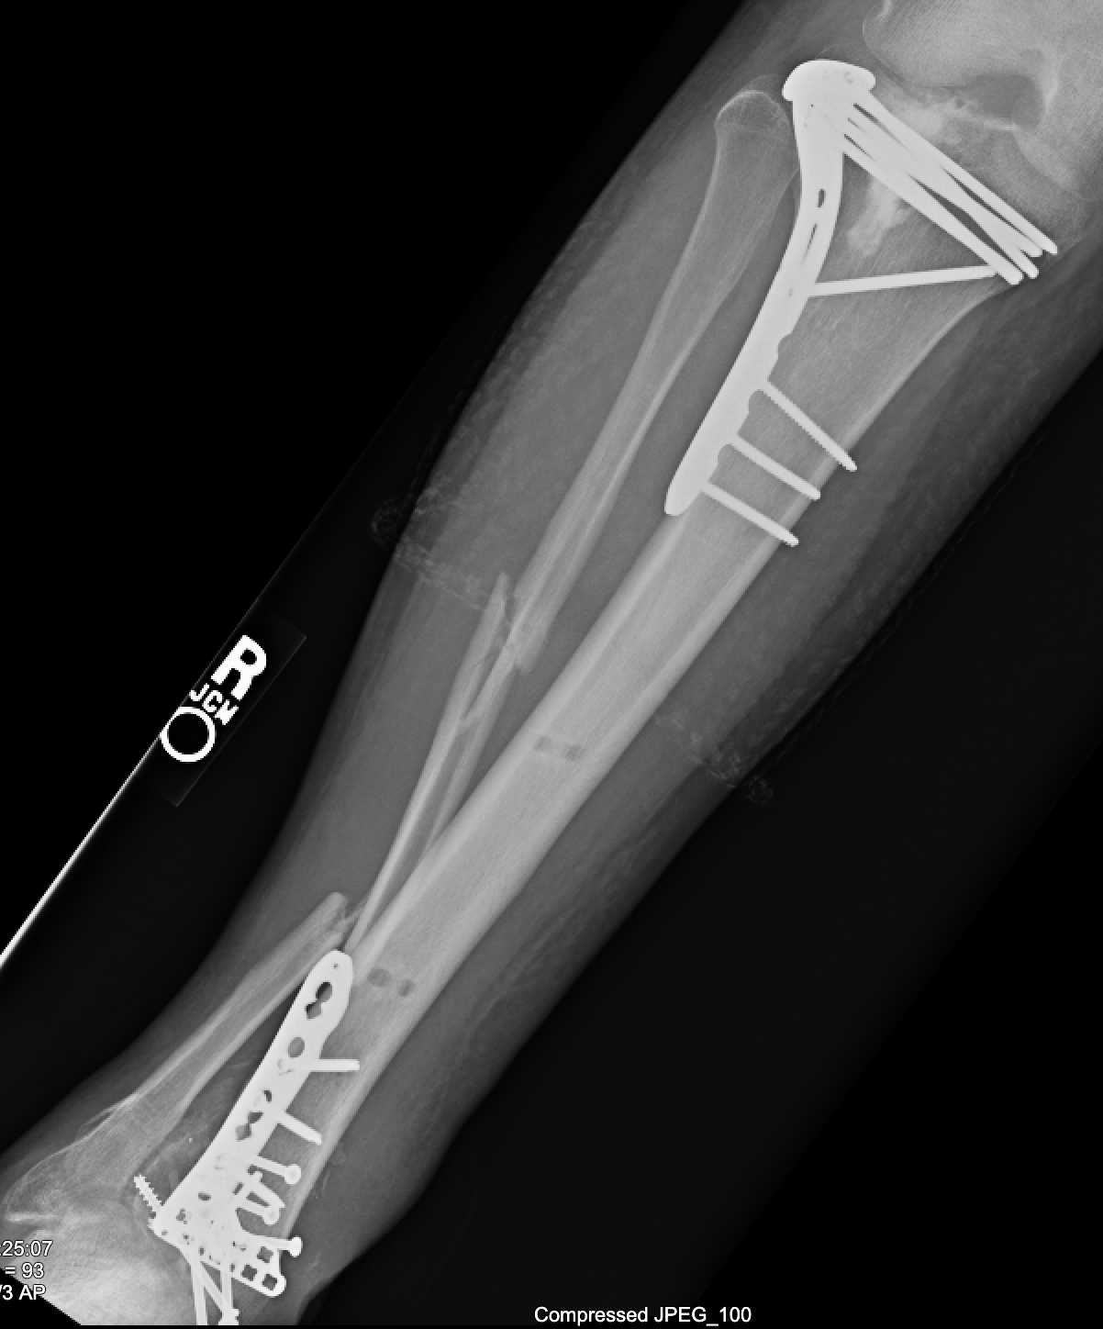
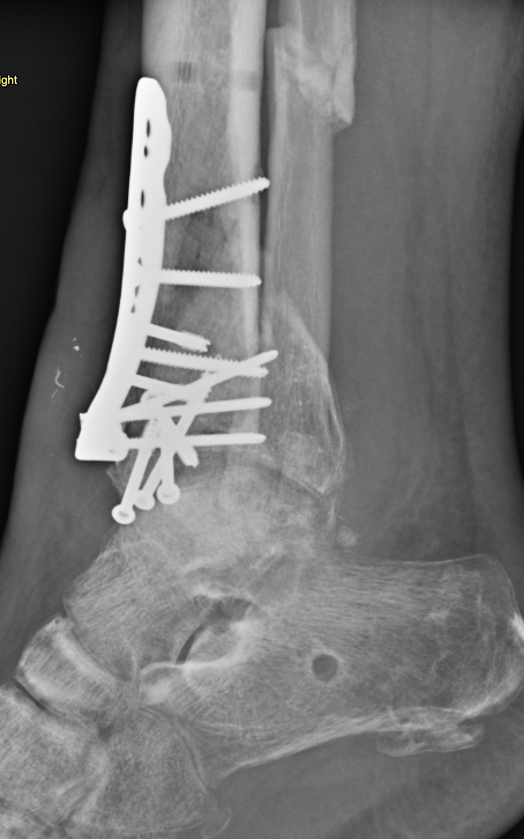
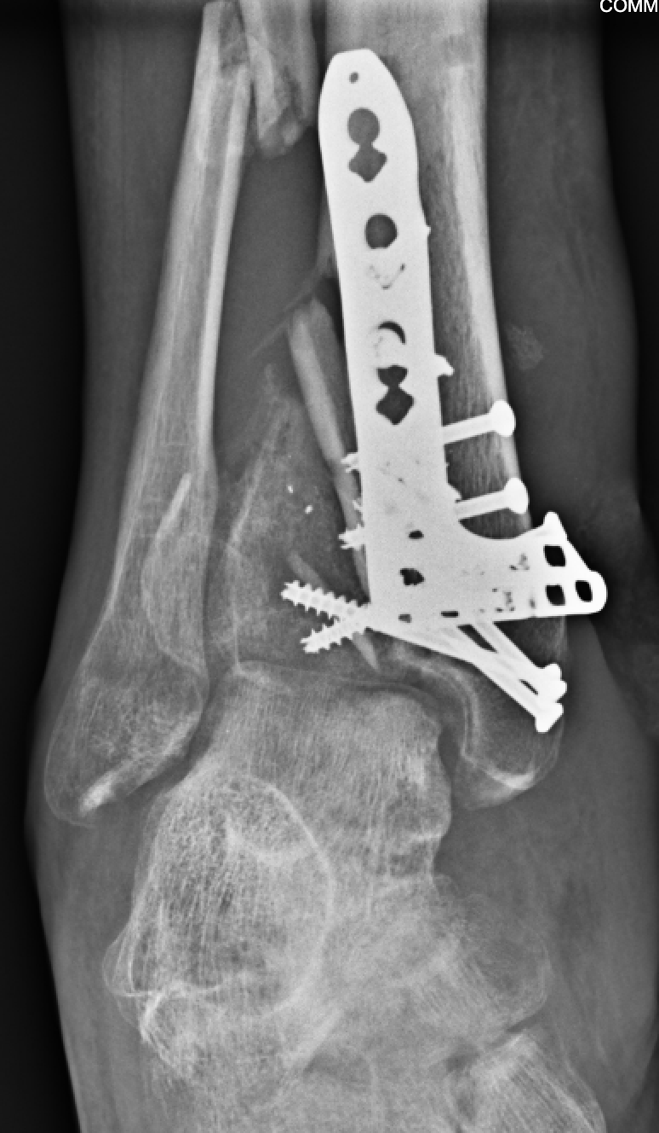
Case 1
ESR 100
CRP 16.7 mg/dL
WBC 12.8 k
Images courtesy of Michael Allen, DO

Slide 70
Case 1
26M with anxiety/depression, 1ppd smoker
Draining medial wound with positive inflammatory labs
Retained hardware, not in functional alignment
Fracture is not healed
CM Type 4, BL host → Discussion should include serial debridements, definitive fusion vs amputation, tobacco cessation, psychiatric comanagement
First step: infected hardware, dead bone, and compromised soft tissues need to come out

Slide 71
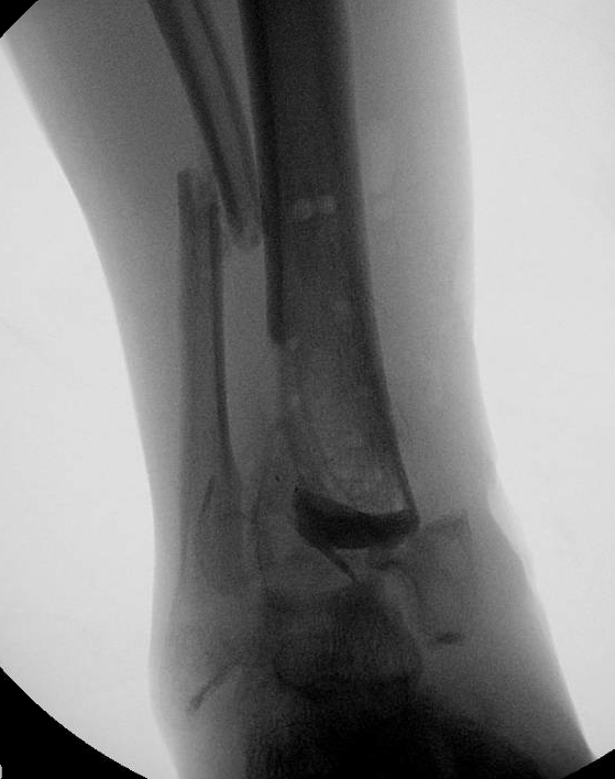
Initial debridement
Excise medial soft tissue tract and necrotic tissues
Closed primarily
Remove all necrotic bone -> currette/rongeur to healthy bone
Antibiotic spacer created to fill dead space
2 g Vanco per 40g cement
Spacer used to help preserve length
Initially on Vanco/Ceftriaxone until cultures result for MSSA -> switched to Ancef IV for 6 weeks
Images courtesy of Michael Allen, DO

Slide 72
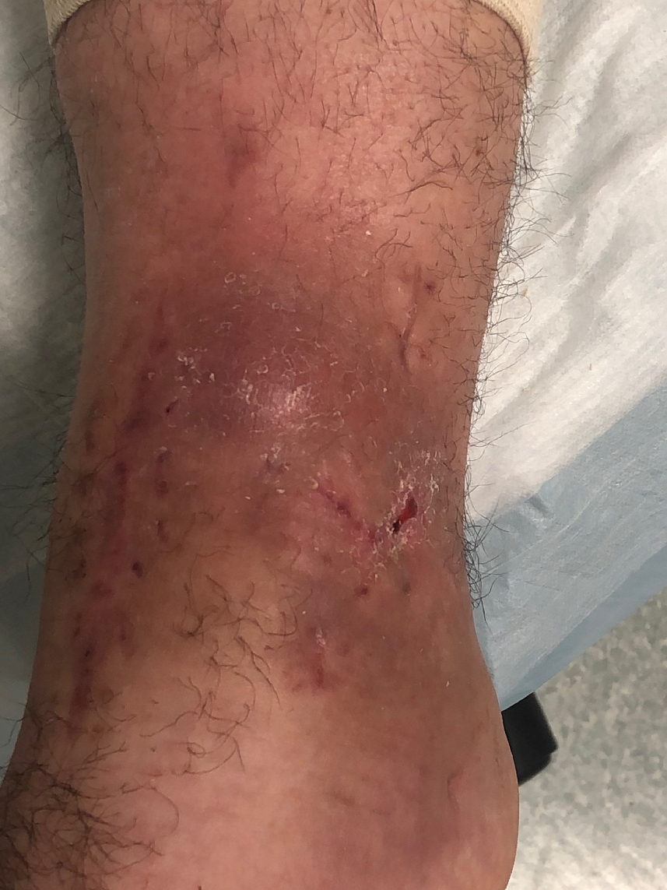
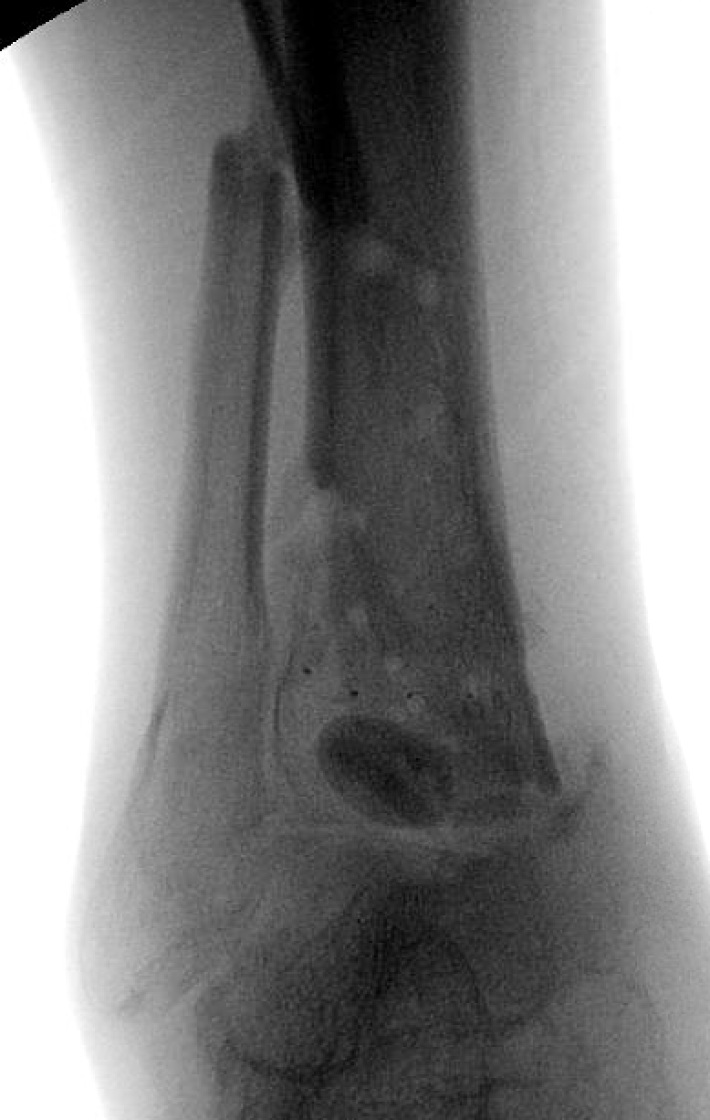
Clinical course
2 months later, continued minimal drainage
CRP 0.475 mg/dL, ESR 26
6 weeks Ancef finished, transitioned to doxycycline 100 mg PO BID
CRP/ESR normalizing but persistent drainage
Underwent repeat I&D, abx spacer exchange (2 g Vanco per 40g cement)
Spacer used instead of beads to help minimize shortening in preparation for definitive fusion
Images courtesy of Michael Allen, DO

Slide 73
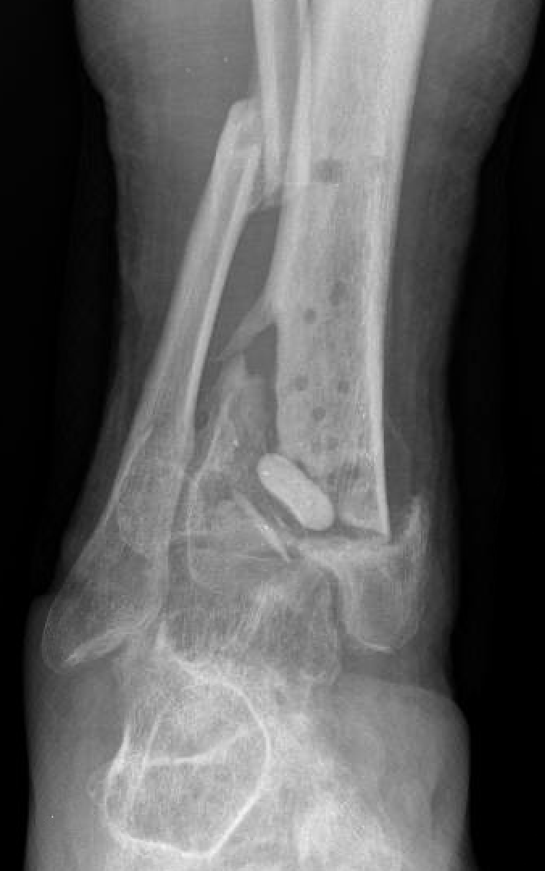
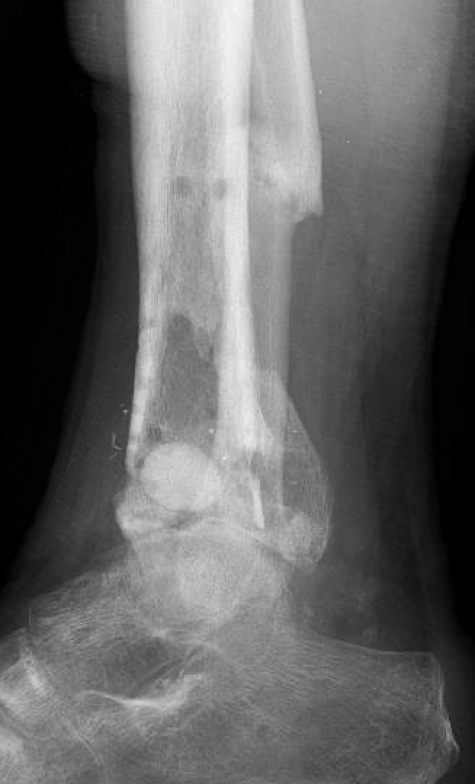
Clinical course
4 months after initial ROH
Continuing oral Doxy
CRP/ESR normal
Skin healed and no further drainage or fluctuance
Definitive ankle fusion planned
Images courtesy of Michael Allen, DO

Slide 74
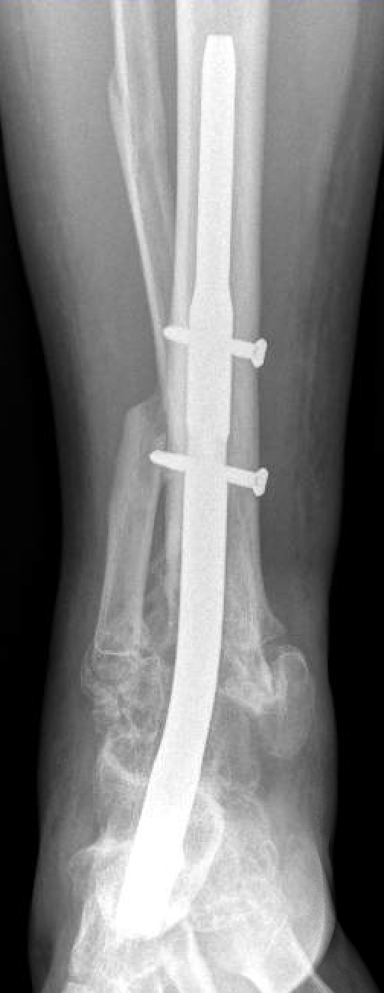
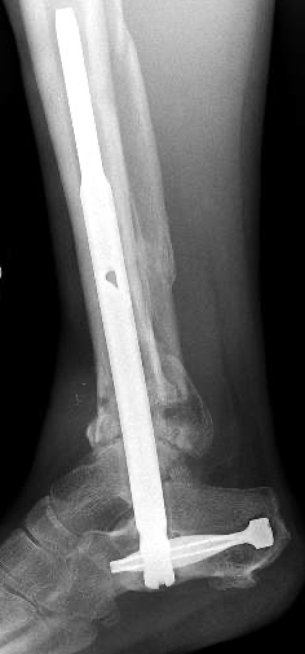
Definitive surgery
Fibula osteotomy
Spacer removed, nonviable bone removed
Viable fibula morselized and mixed with 1 g Vanco powder and used as graft
Hindfoot fusion success, plan for lifelong suppressive oral doxy
8 months post op
Images courtesy of Michael Allen, DO

Slide 75
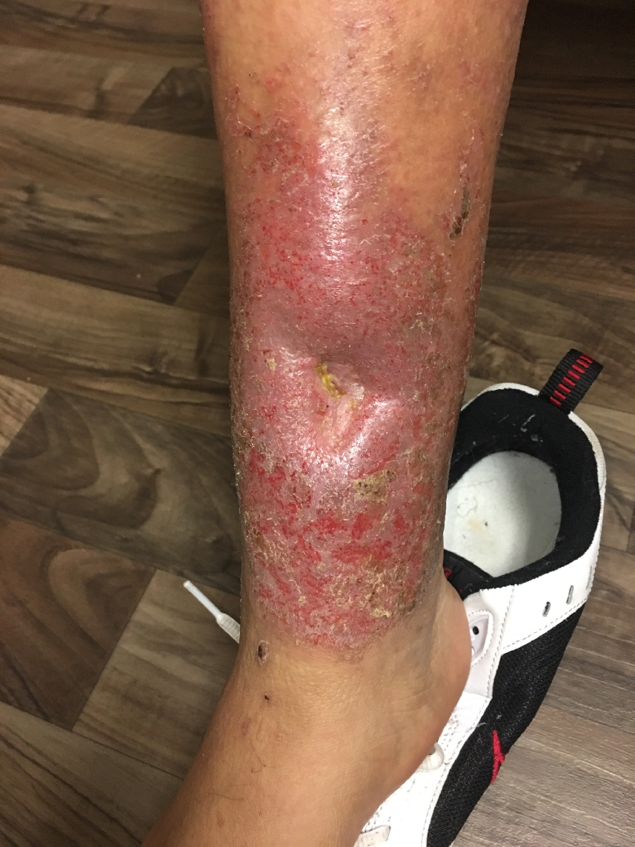
Case 2
48M MVA with open tibia fracture treated 18 months prior
Medial tibia skin defect never fully closed
Draining from sinus
Images courtesy of Michael Allen, DO

Slide 76
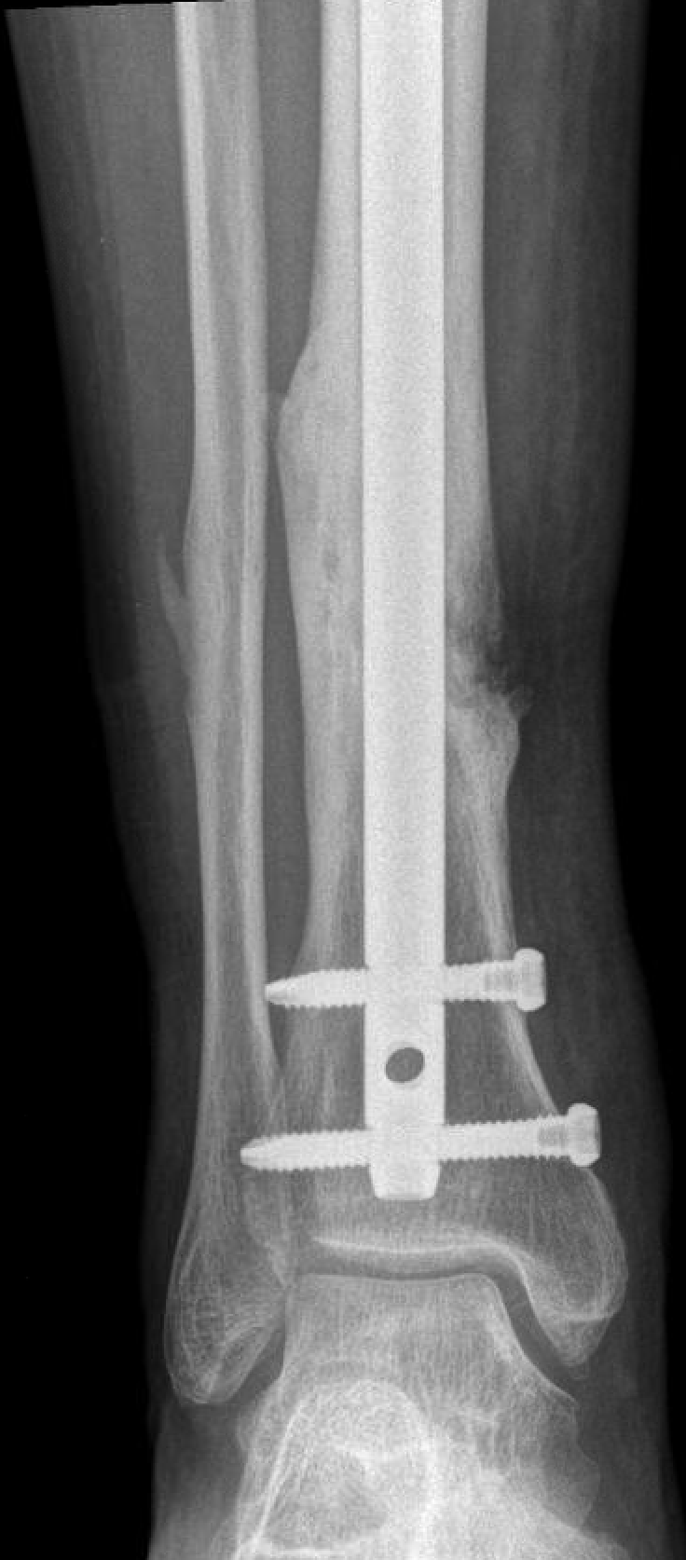
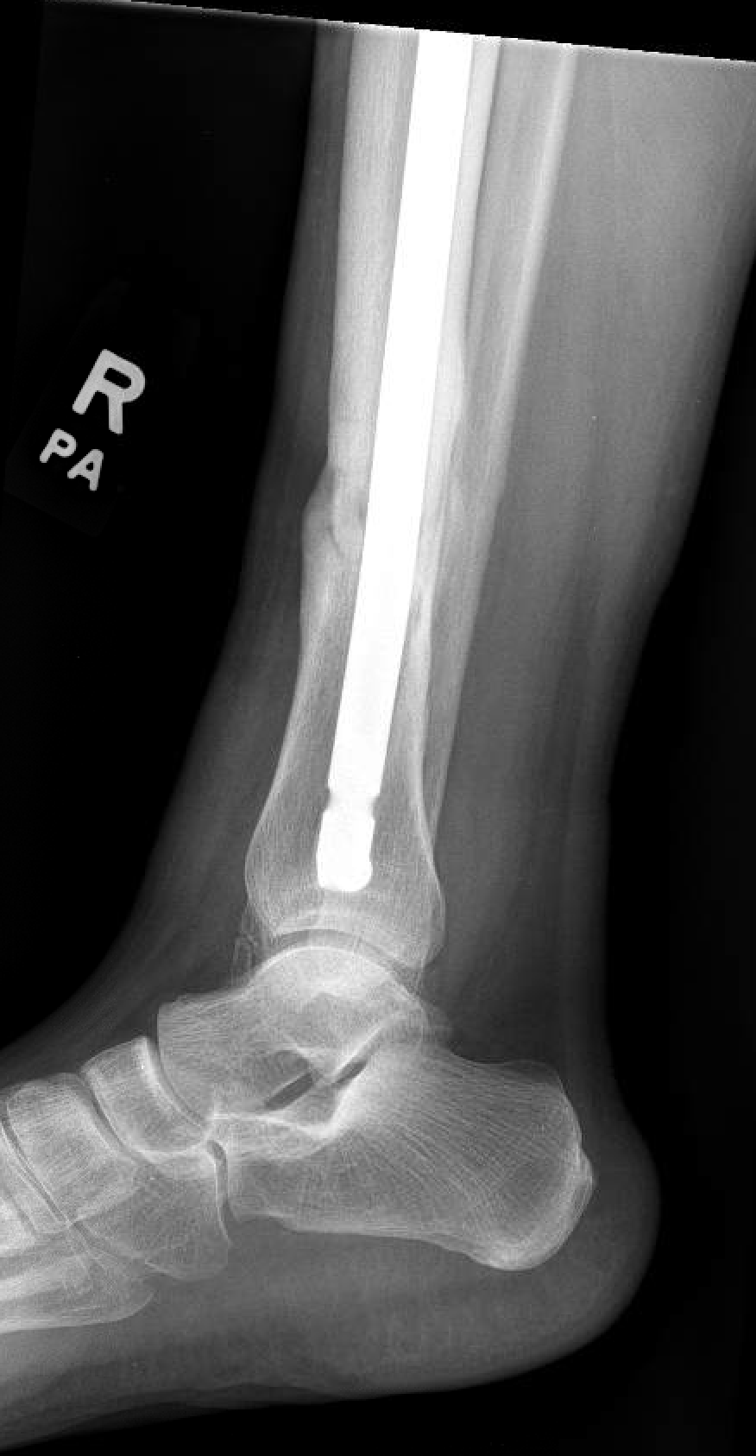
Images courtesy of Michael Allen, DO

Slide 77
Case 2
48M, 1ppd smoker
Healed fracture on radiograph, retained IMN
Overlying cellulitis/sinus
CRP 18.9 mg/L, ESR 14
CM Type III, BL host
Fracture is healed and stable → remove hardware, debride bone and tissue
How do you close the soft tissue defect?

Slide 78
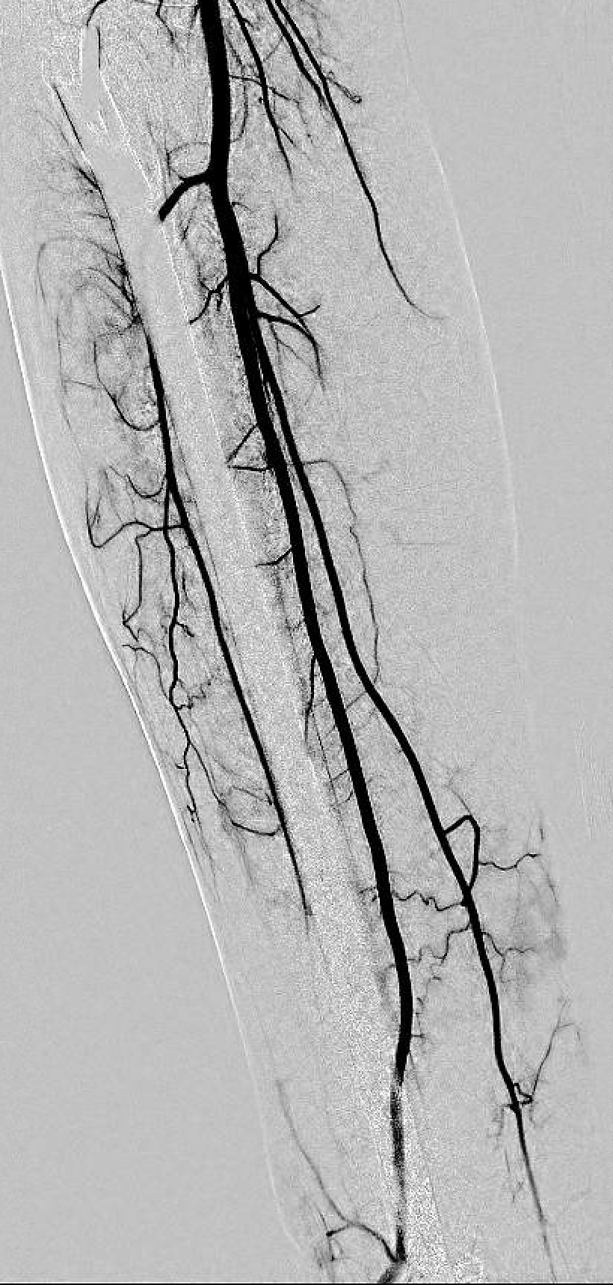
Plastic surgery consultation
Preop CT angio to assess circulation
Anterior tibial artery is occluded near wound
Normal peroneal and posterior tibial artery
Plan for reverse sural flap
Images courtesy of Michael Allen, DO
Notes:
https://otaonline.org/video-library/45036/procedures-and-techniques/multimedia/16723104/reverse-sural-artery-flap

Slide 79
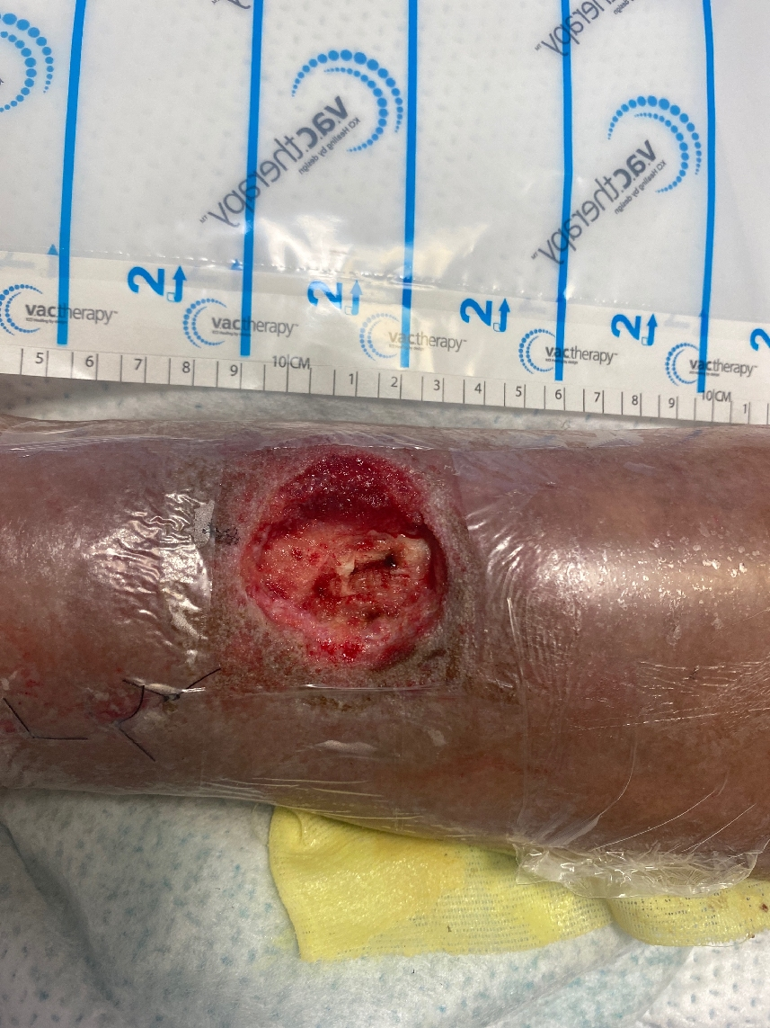
Nail removed → soft tissue sinus and necrotic tissue excised
Cortical window made under sinus tract and debrided back to healthy bleeding bone
Reamer Irrigator Aspirator used to debride canal
Wound covered with vac until delayed flap 2 weeks later
Cultures were polymicrobial including E. faecalis, MSSA, S marcescens, anaerobes
2 weeks IV vanco with PO moxifloxacin 400 mg QD, then 4 weeks of PO doxy 100 mg BID with moxifloxacin
Images courtesy of Michael Allen, DO
Notes:
The cortical window was small and left without any filler.

Slide 80
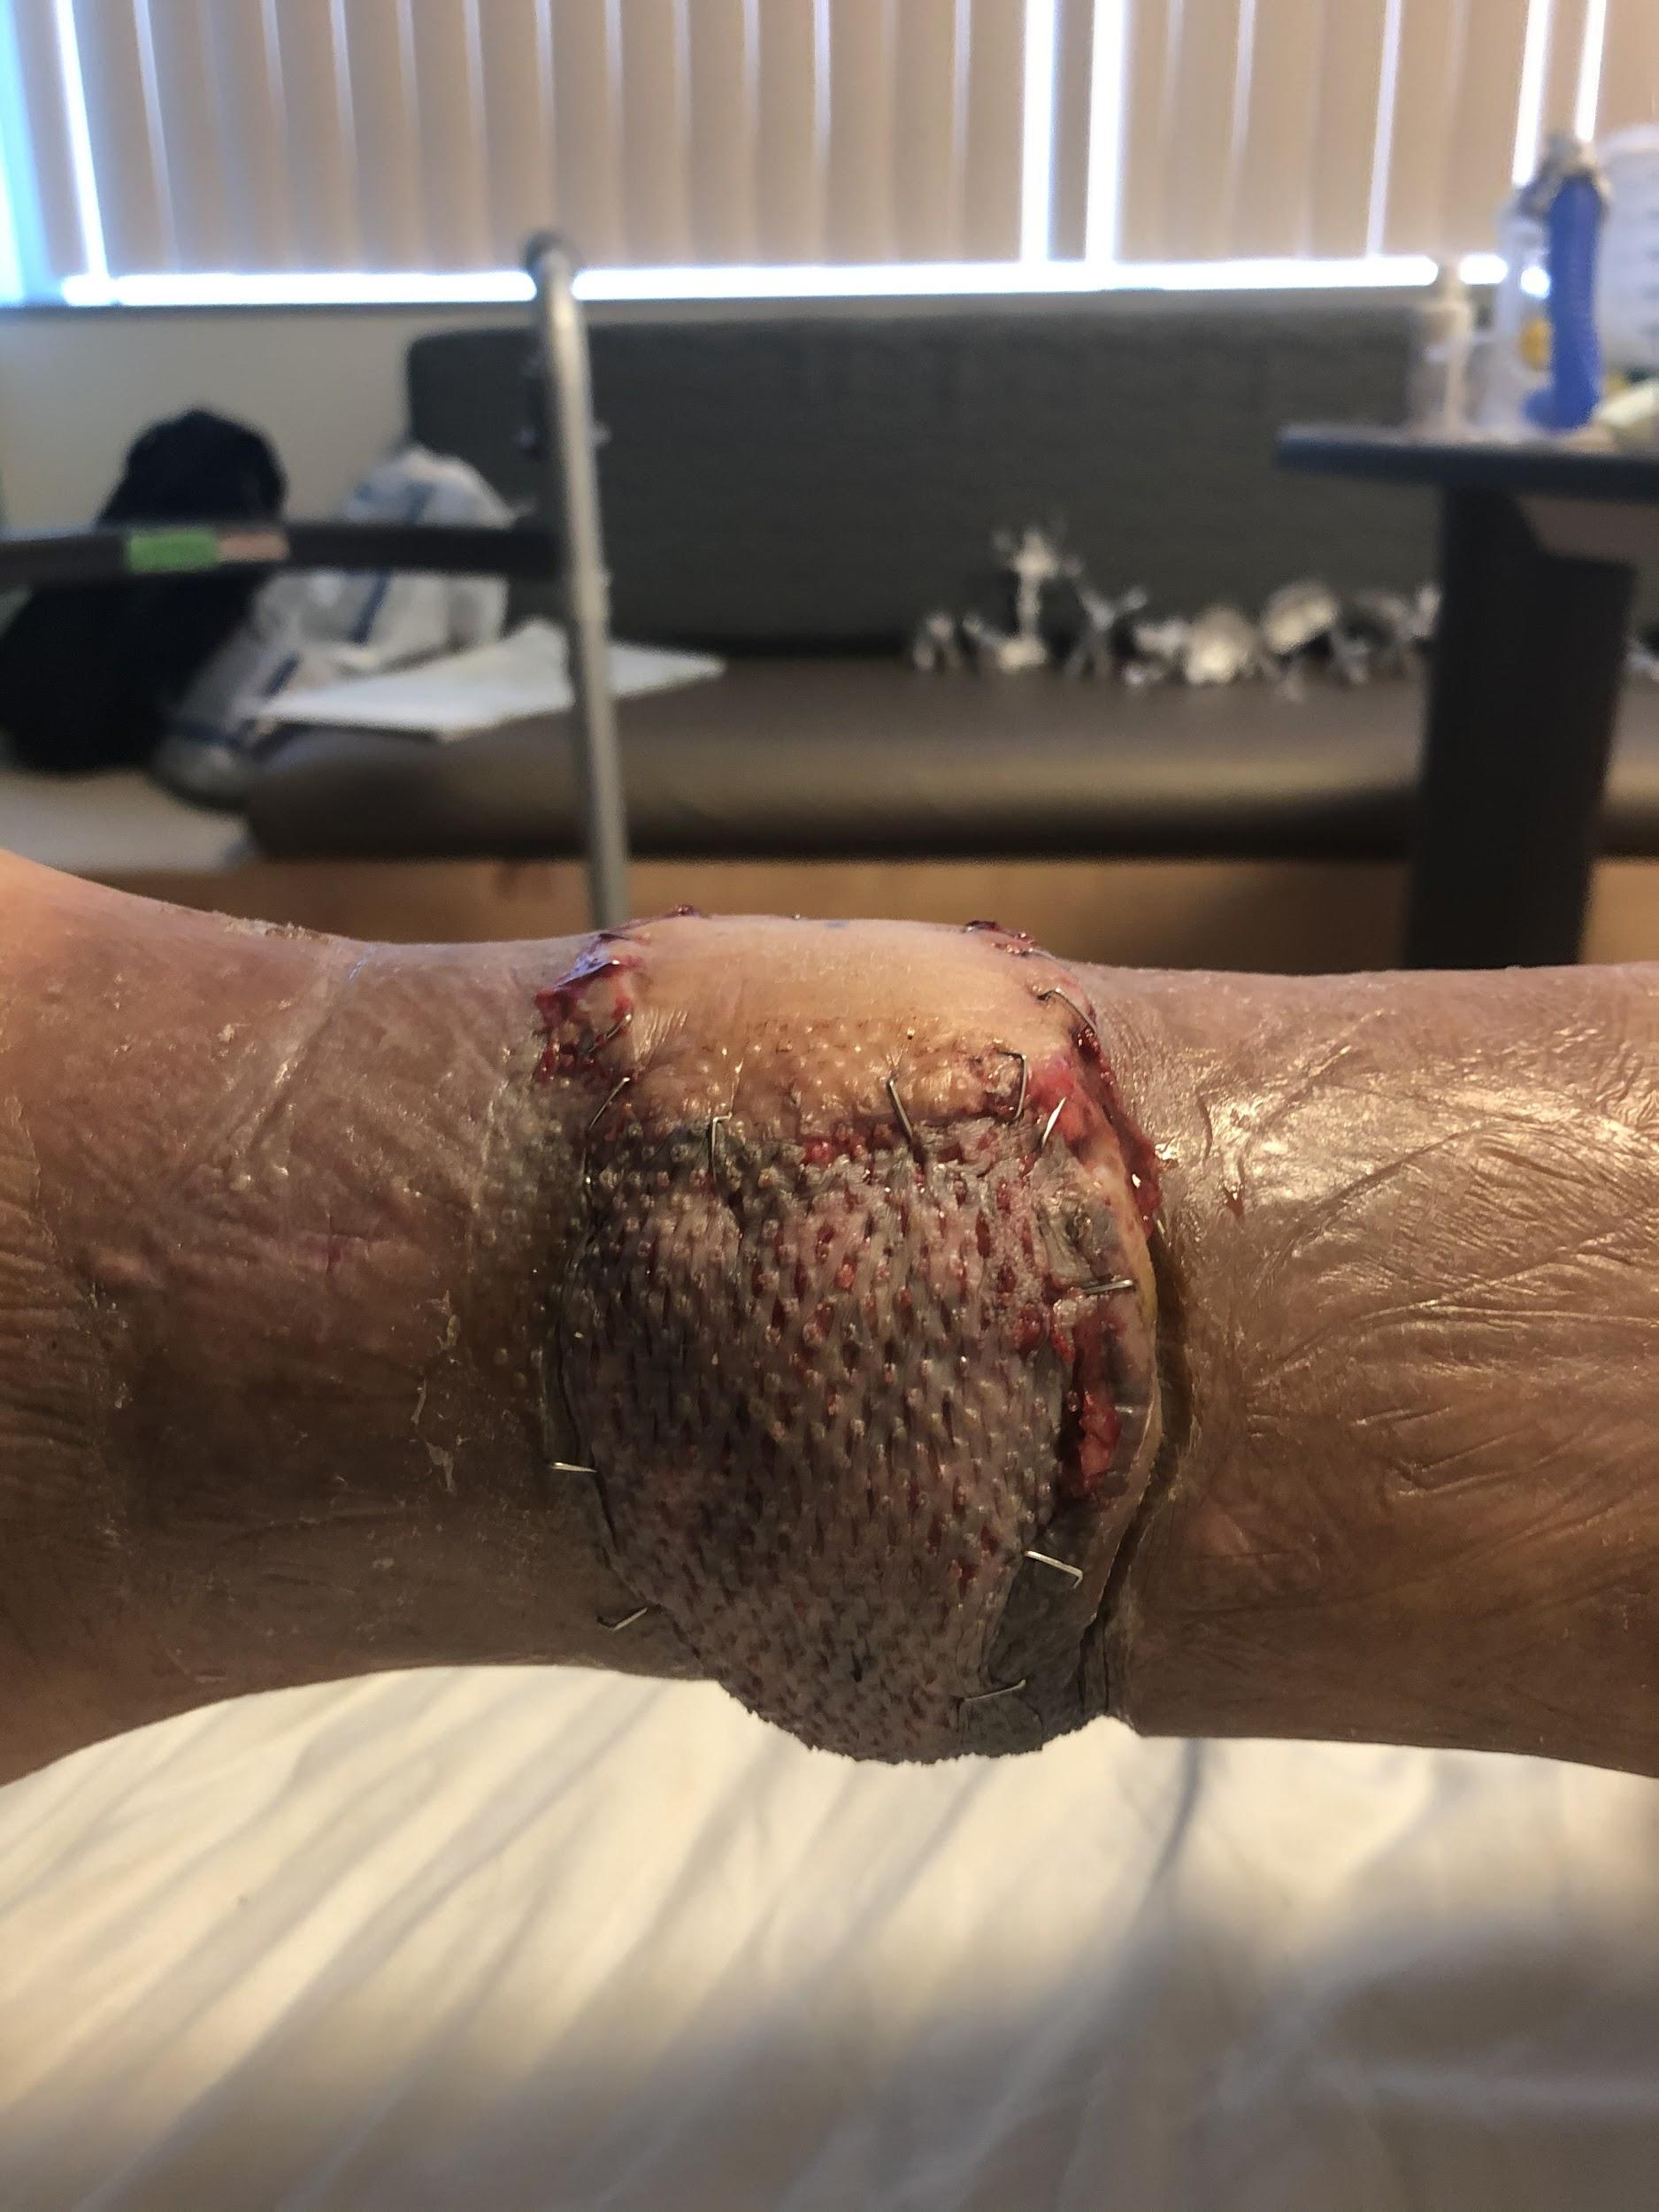
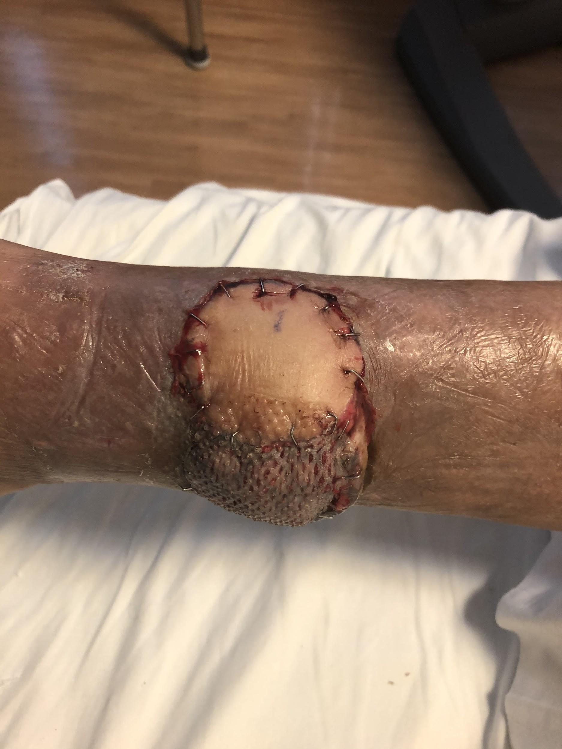
Delayed reverse sural fasciocutaneous flap two weeks later
Images courtesy of Michael Allen, DO

Slide 81
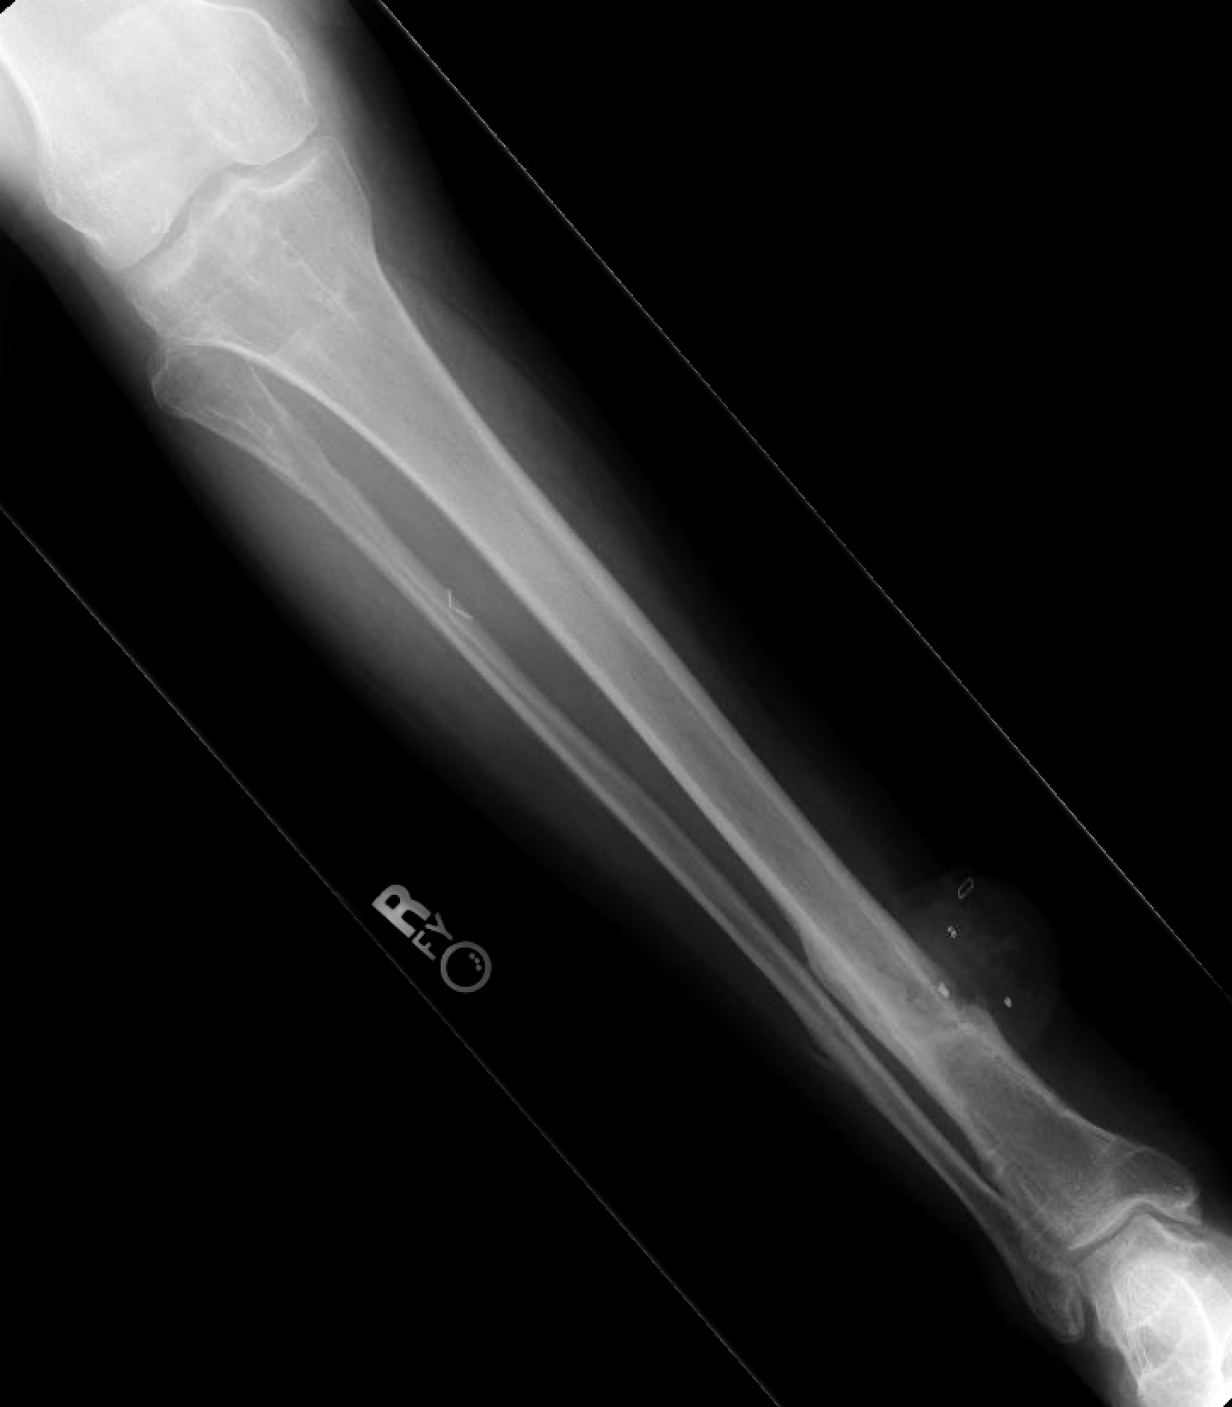
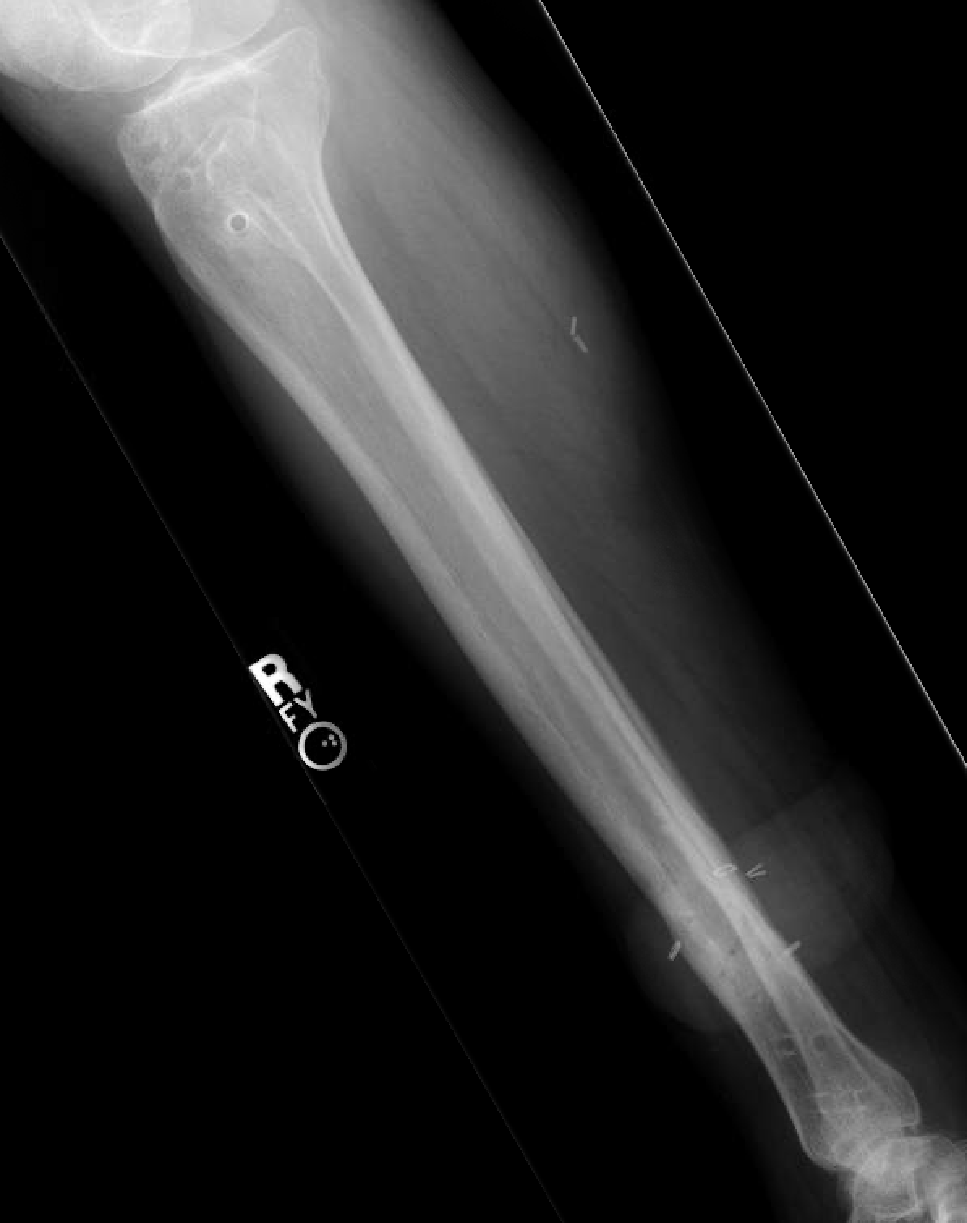
2 months post op
Healed and returned to work
Images courtesy of Michael Allen, DO

Slide 82
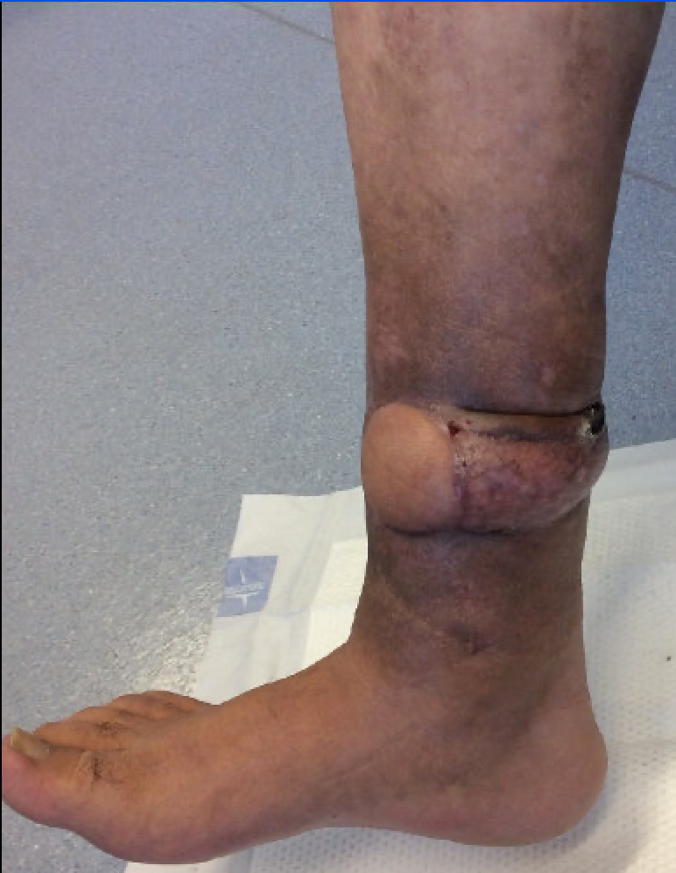
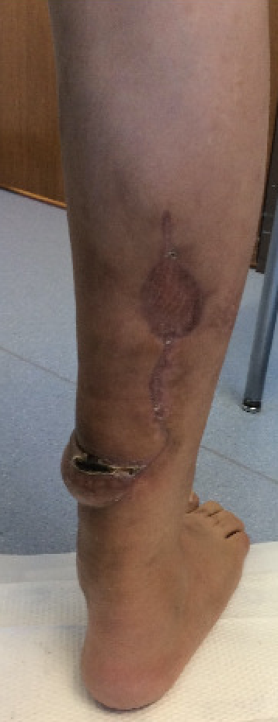
2 months post op
Healed and returned to work
Images courtesy of Michael Allen, DO

