Slide 1
Minimally Invasive Plate Osteosynthesis
Gele B Moloney, MD
Assistant Professor of Orthopaedic Surgery
University of Pittsburgh Medical Center
Pittsburgh, PA

Slide 2
Introduction
Minimally Invasive Plate Osteosynthesis (MIPO)
A mechanism of achieving plate fixation of a fracture though limited soft tissue windows with a goal of preserving fracture site biology to improve healing
Note: All images belong to Gele Moloney MD unless otherwise indicated

Slide 3
Objectives
Understand the principles of minimally invasive plate osteosynthesis
Understand the limitations of minimally invasive plate osteosynthesis
Review specific fracture patterns where MIPO is safe and effective
Learn technical strategies to achieve success with MIPO

Slide 4
AO Principles (2017)
Early and safe mobilization and rehabilitation of the injured part and the patient as a whole
Fracture reduction and fixation to restore anatomical relationships
Fracture fixation providing absolute or relative stability as the “personality” of the fracture, the patient, and the injury requires
Preservation of the blood supply to soft tissues and bone by gentle reduction techniques and careful handling
Aona.org

Slide 5
History
Early fracture surgery often involved anatomic reduction with fixation of all fracture fragments
At times this was accomplished with extensive exposure resulting in soft tissue stripping
This evolved to more “biologically friendly” surgery and focus on preservation of periosteal blood flow
Minimally invasive plating evolved from the concept of biologically friendly surgery

Slide 6
Evolution of Soft Tissue Handling
Open Plating
Open Plating with Meticulous Soft tissue handling
Minimally Invasive Plating

Slide 7
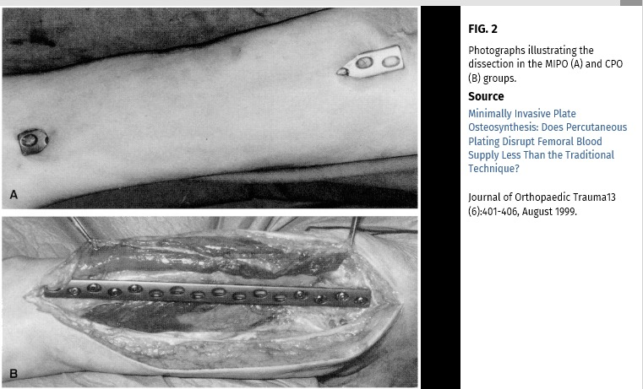
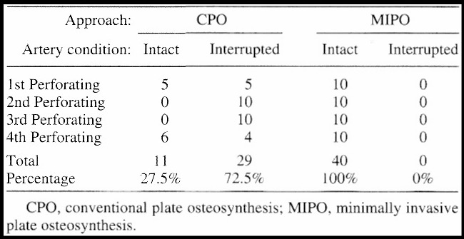
MIPO preserves vascularity
Cadaveric vascularity study demonstrated marked improvement in periosteal blood flow with MIPO of the distal femur compared with conventional plating (CPO)
Farouk O, Krettek C, Miclau T, Schandelmaier P, Guy P, Tscherne H. Minimally invasive plate osteosynthesis: does percutaneous plating disrupt femoral blood supply less than the traditional technique? J Orthop Trauma. 1999 Aug;13(6):401-406. jorthotrauma.com
Notes:
Farouk O, Krettek C, Miclau T, Schandelmaier P, Guy P, Tscherne H. Minimally invasive plate osteosynthesis: does percutaneous plating disrupt femoral blood supply less than the traditional technique? J Orthop Trauma. 1999 Aug;13(6):401-406. jorthotrauma.com

Slide 8
MIPO is:
A method of applying an implant in a soft tissue friendly manner through limited incisions
A technique to be used as part of a complete surgical plan
MIPO isn’t:
Always the answer
Necessarily a reduction strategy
Always safe

Slide 9
Minimally Invasive Reduction Techniques
As always, you still need to achieve fracture reduction
MIPO can be combined with open and minimally invasive or indirect reduction techniques

Slide 10
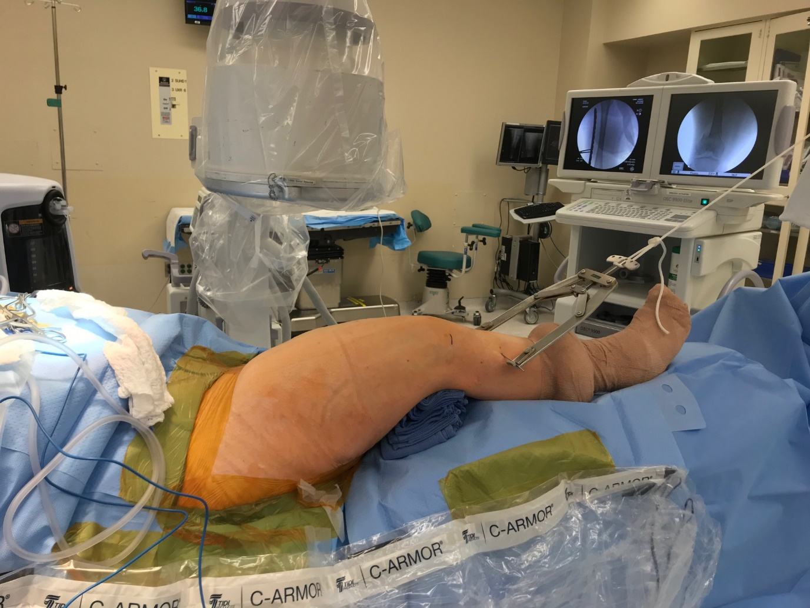
Reduction Techniques: Indirect
Indirect reduction with traction
Intraoperative application of skeletal traction
Bump under the knee to correct sagittal plane deformity

Slide 11
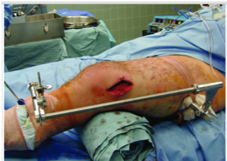
Reduction Techniques: Indirect
Intraoperative use of femoral distractor to regain length
Rockwood and Green Figure 53-15
Tornetta P, Ricci WM, eds. Rockwood and Green's Fractures in Adults, 9e. Philadelphia, PA. Wolters Kluwer Health, Inc; 2019.

Slide 12
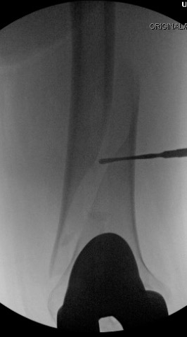
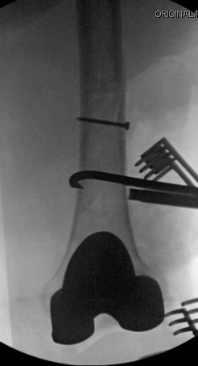
Reduction Techniques: Direct
Simple fracture patterns warrant direct anatomic reduction and compression
Colinear clamp
Pointed reduction clamps
Periarticular reduction clamps

Slide 13
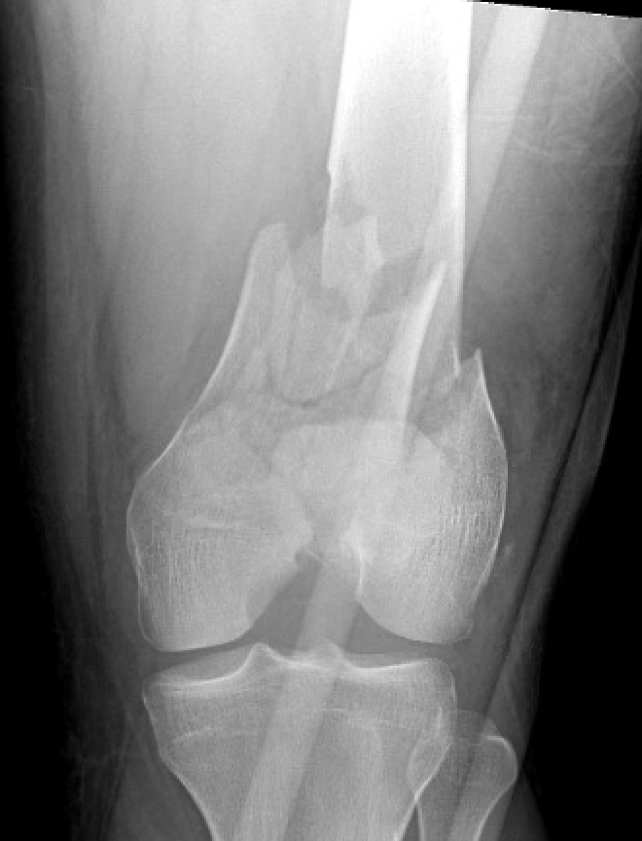
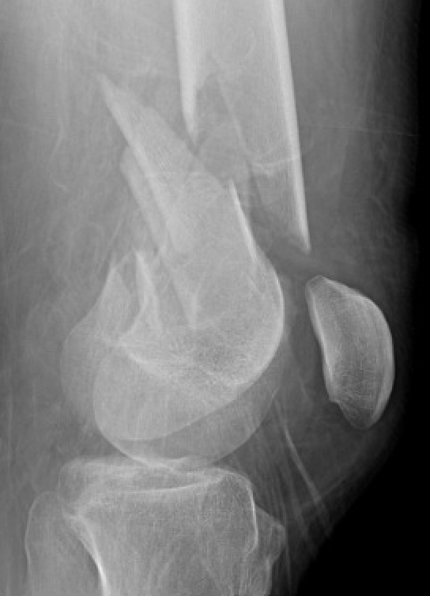
Reduction Techniques: Combined
Can use direct reduction techniques for articular surface reconstruction and minimally invasive techniques to bridge the metaphyseal component

Slide 14
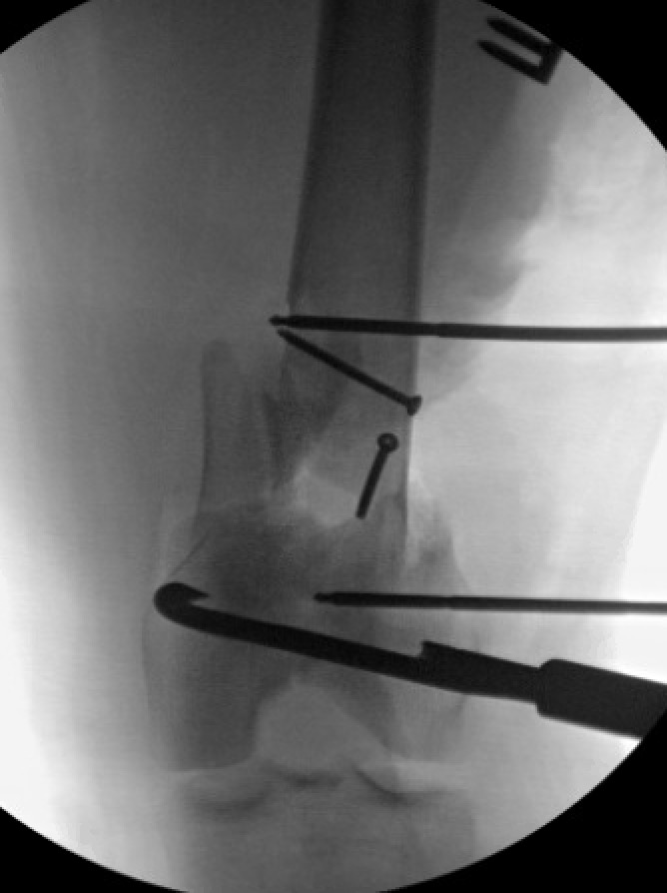
Direct reduction of articular surface
Lateral parapatellar arthrotomy to visualize articular reduction
Direct reduction utilizing shanz pins to control fracture fragments, colinear clamp to compress articular surface

Slide 15
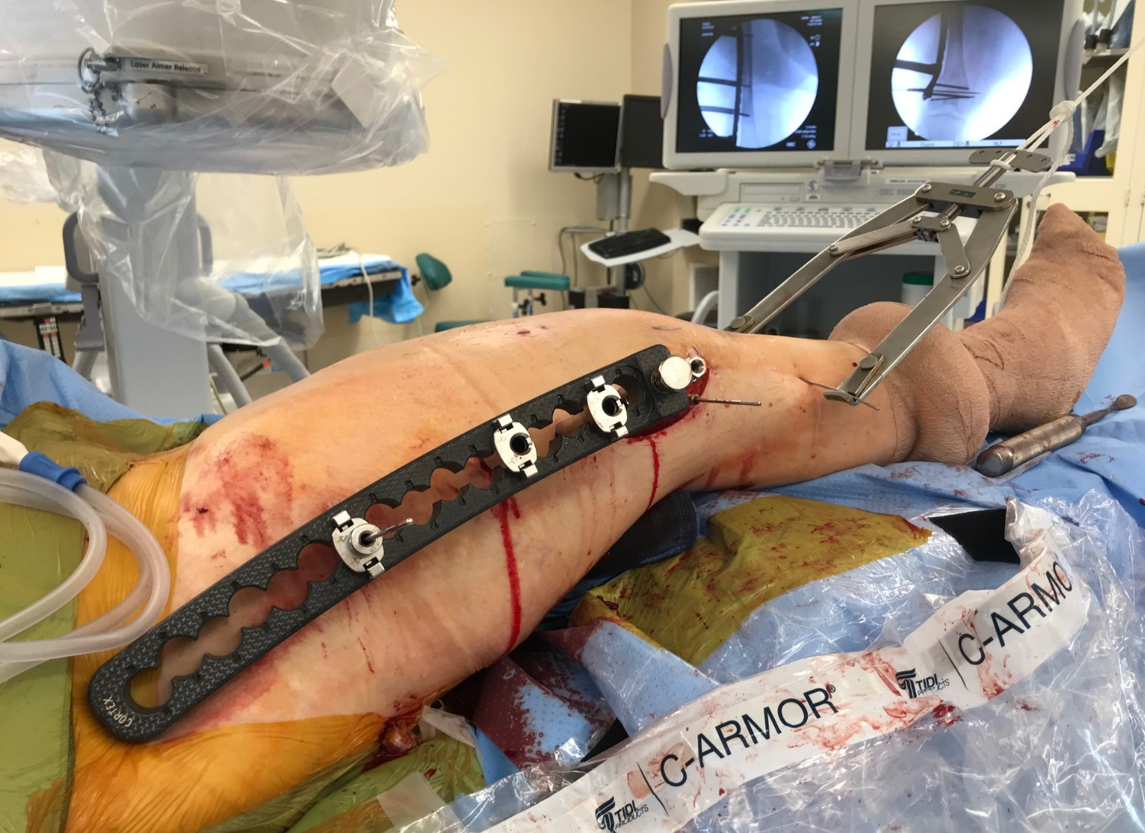
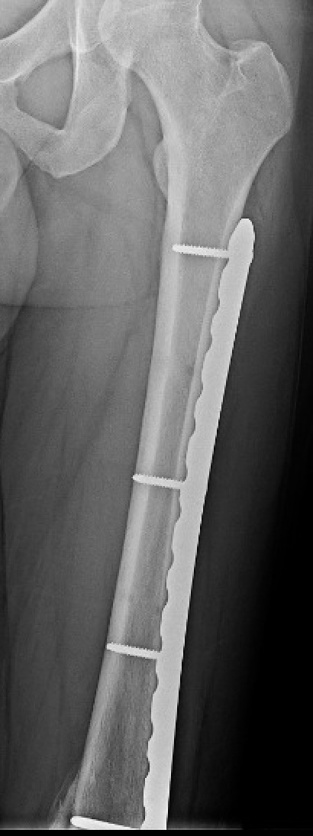
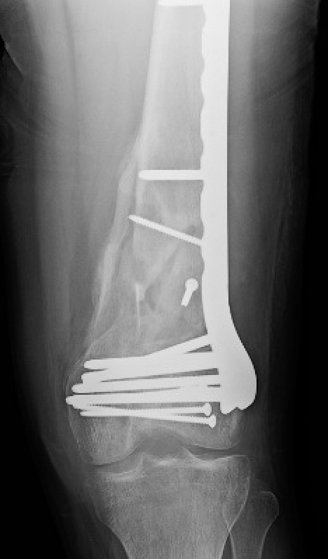
Proximal screws inserted percutaneously
Bridge plating of metaphyseal component

Slide 16
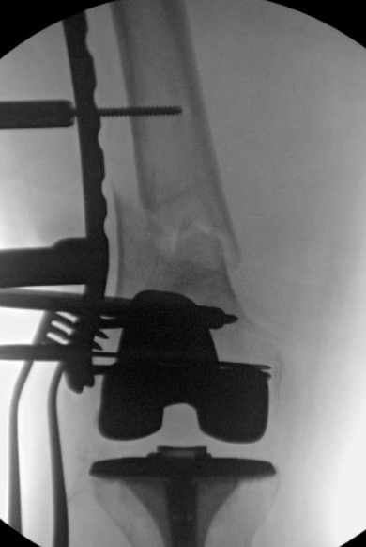
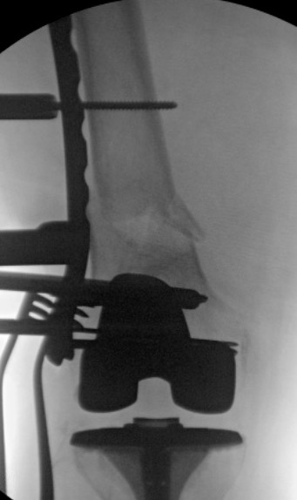
Cortical Screw as a Reduction Tool
Cortical screw can be placed percutaneously and tightened to lateralize the shaft as needed.

Slide 17
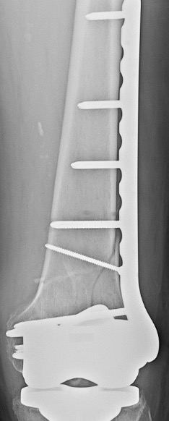
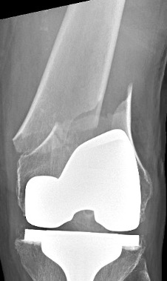
Direct Reduction
Neutralization plates can also be placed minimally invasively
Open approach to allow for direct reduction and lag screw placement followed by MIPO proximally

Slide 18
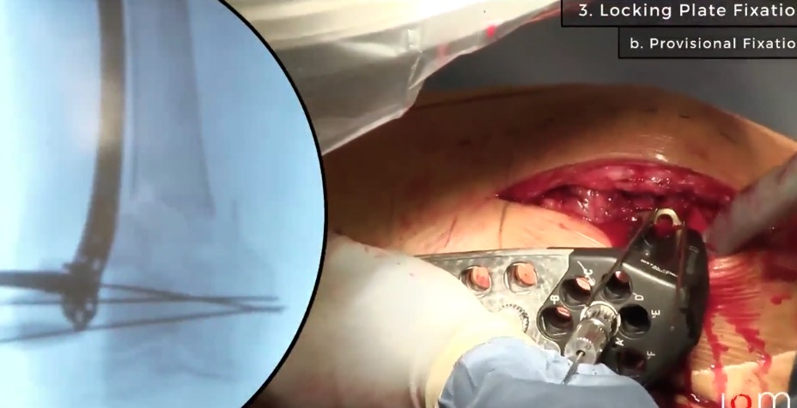
MIPO Intraarticular Distal Femur – LISS plate
https://otaonline.org/video-library/45036/procedures-and-techniques/multimedia/16731421/liss-system-for-stabilisation-of-a-distal-femur

Slide 19
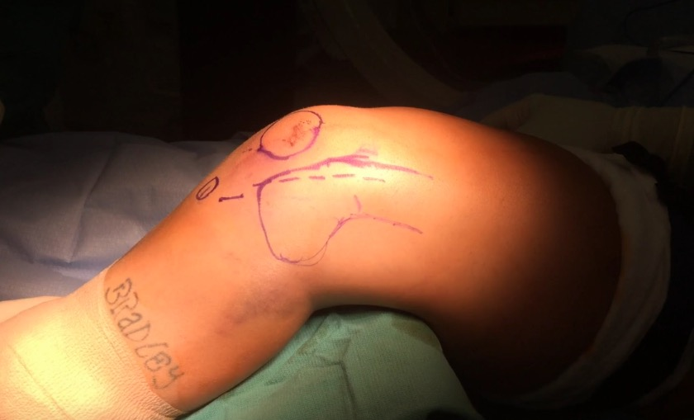
MIPO Intraarticular Distal Femur
https://otaonline.org/video-library/45036/procedures-and-techniques/multimedia/16731391/orif-with-submuscular-plating-of-an-intercondylar

Slide 20
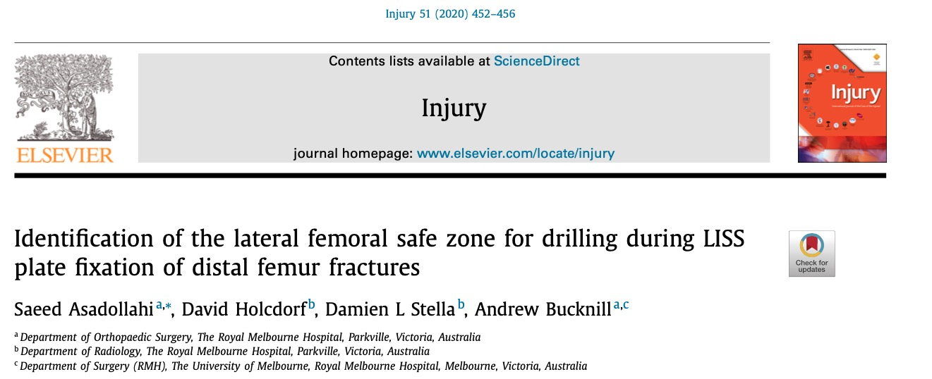
Distal Femur: Anatomic Concerns
Superficial femoral artery averages 21 mm from the screw tips placed through a lateral plate but can be as close as 8mm. LISS plate (Less Invasive Stabilization System) holes 6-10 are highest risk.
Be cautious about plunging drill bits and screws which are too long

Slide 21
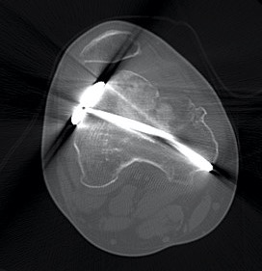
Distal Femur: Malreduction
MIPO distal femur can result in satisfactory coronal and sagittal plane alignment > 96% of the time
High risk of rotational malreduction ~50%
Potential for limb length inequality ~8%
Note lateral subluxation of the patella secondary to rotational malunion of the distal femur
Kim JW et al Injury 2017
Image courtesy of G. Moloney

Slide 22
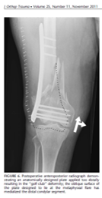
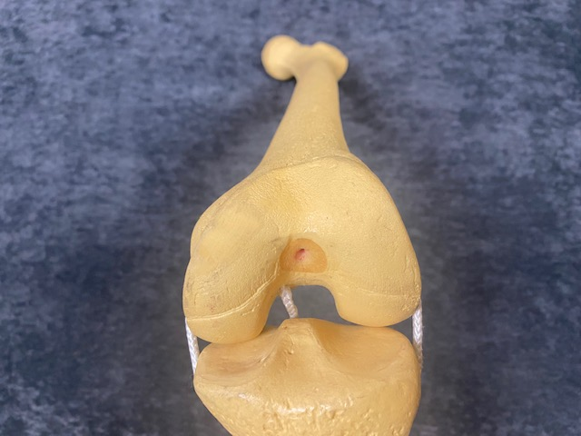
Distal Femur: Malreduction
When viewed end on the distal femur is a trapezoid
Placement of the plate too posterior or distal can cause medialization of the distal segment “golf club deformity”
Collinge CA, Gardner MJ, Crist BD. Pitfalls in the application of distal femur plates for fractures. J Orthop Trauma. 2011 Nov;25(11):695-706. jorthotrauma.com
JOT 2011

Slide 23
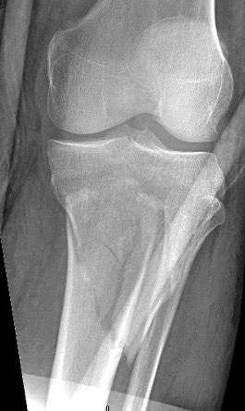
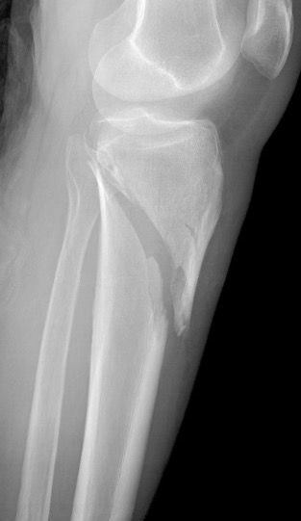
Proximal Tibia
Plate can be slid in submuscular fashion along the anterolateral tibia with distal fixation placed percutaneously

Slide 24
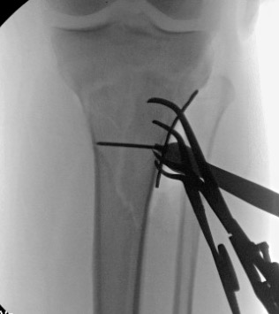
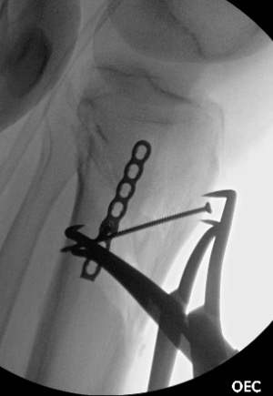
Limited incision with clamp and plate assisted reduction

Slide 25
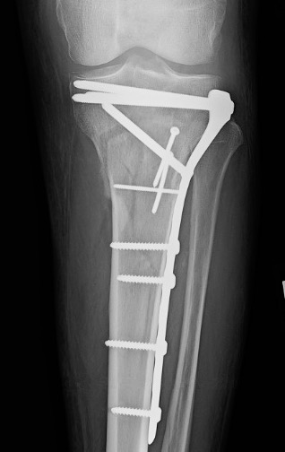
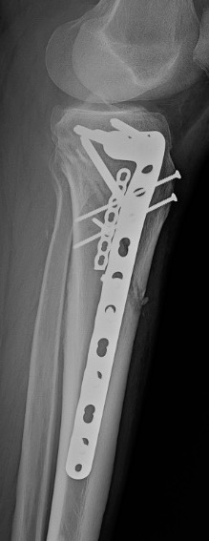
Distal screws placed percutaneously

Slide 26
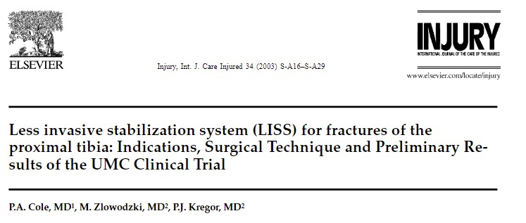
Less Invasive Stabilization System (LISS) Synthes
Early MIPO system which allowed percutaneous plate insertion and use of a targeting arm to place screws
Utilizes self drilling, self tapping, locked screws to create fixed angle construct “internal external fixator”

Slide 27
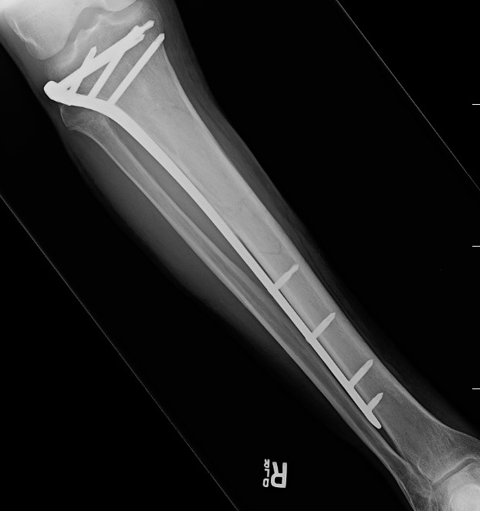
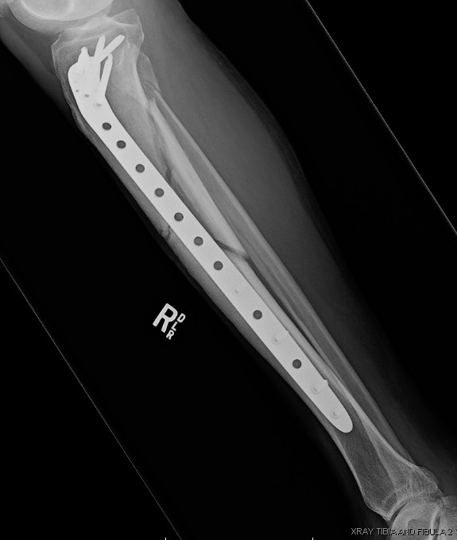
LISS – utilized here for open fracture with proximal fracture extension

Slide 28
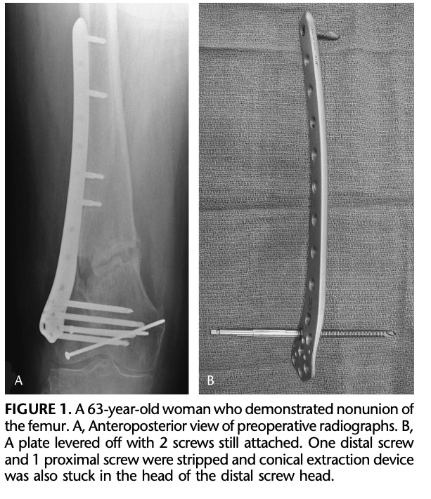
Difficulty removing screws secondary to cold welding of titanium screws to the plate is commonly encountered leading to lengthy and challenging hardware removal cases.
Reported in almost 40% of cases!
Suzuki T, Smith WR, Stahel PF, Morgan SJ, Baron AJ, Hak DJ. Technical problems and complications in the removal of the less invasive stabilization system. J Orthop Trauma. 2010 Jun;24(6):369-73. jorthotrauma.com

Slide 29
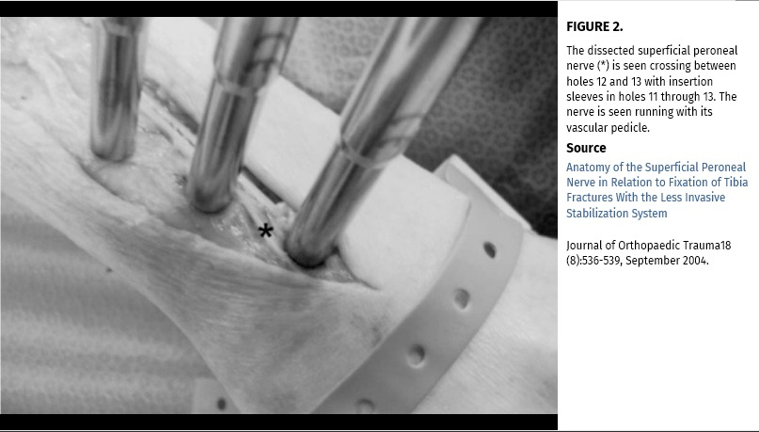
Proximal Tibia: Anatomic Concerns
Superficial peroneal nerve at risk during percutaneous screw placement in holes 11 through 13 of LISS plate
Equates to 26-30cm from the top and should be applied to all percutaneously placed screws
Consider larger open approach at that level
JOT 2004

Slide 30
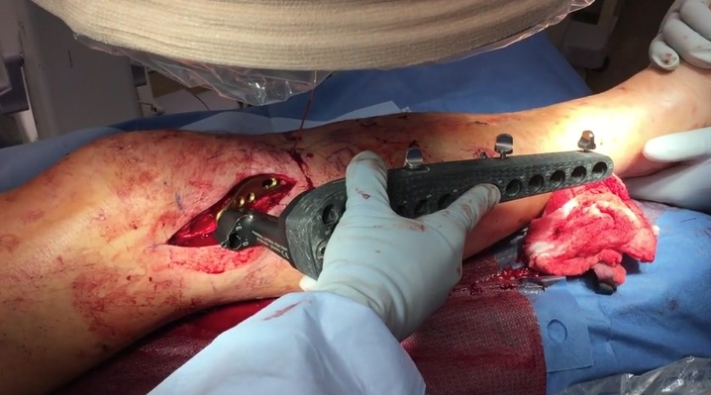
MIPO Proximal Tibia
https://otaonline.org/video-library/45036/procedures-and-techniques/multimedia/17165314/bridge-plating-of-proximal-tibia-metaphyseal

Slide 31
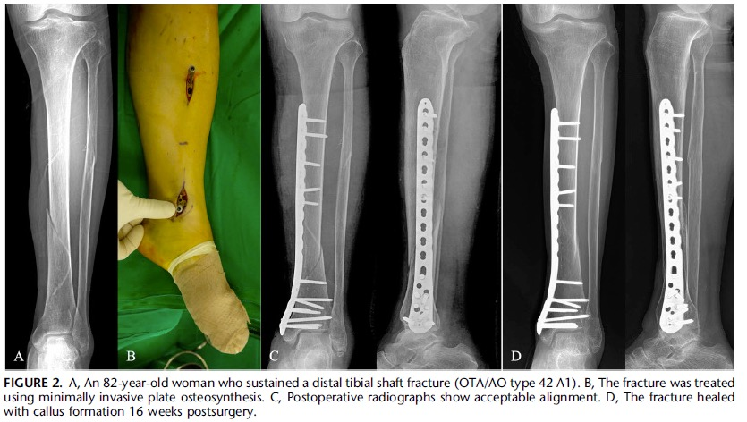
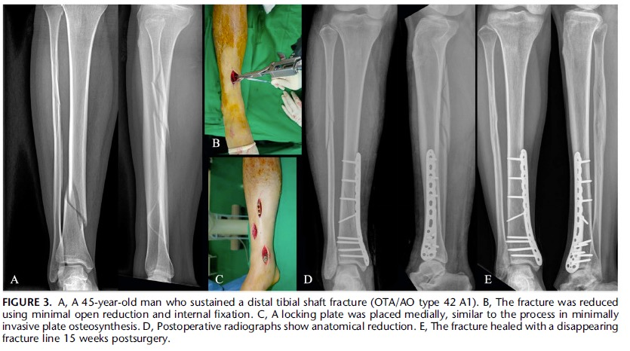
Distal Tibia
Can be performed using limited open reduction (separate from incisions used for plate insertion) as soft tissues allow without increasing complication rates.
In this series adding open reduction to percutaneous techniques alone decreased fluoro time and improved coronal plane alignment
Kim JW, Kim HU, Oh CW, Kim JW, Park KC. A prospective randomized study on operative treatment for simple distal tibial fractures-minimally invasive plate osteosynthesis versus minimal open reduction and internal fixation. J Orthop Trauma. 2018 Jan;32(1):e19-e24. jorthotrauma.com
Notes:
Vidovic Det al Injury (2015) “minimally invasive plate osteosynthesis In distal tibial fractures: results and complications” 2015 Nov; 46 suppl 6:s96-9
Kim JW, Kim HU, Oh CW, Kim JW, Park KC. A prospective randomized study on operative treatment for simple distal tibial fractures-minimally invasive plate osteosynthesis versus minimal open reduction and internal fixation. J Orthop Trauma. 2018 Jan;32(1):e19-e24. jorthotrauma.com

Slide 32
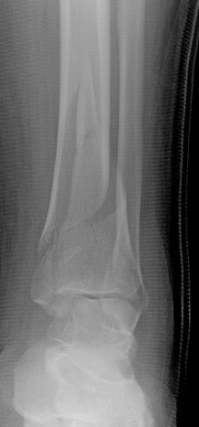
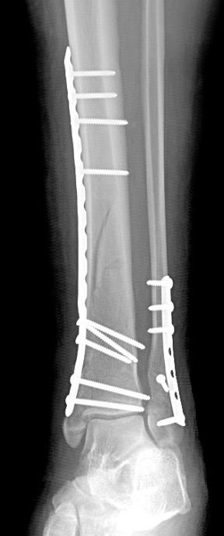
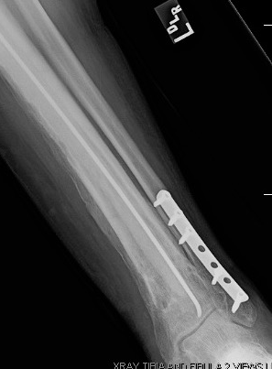
Risk of wound infection is primary concern given limited soft tissue envelope over the medial ankle
May lead to plate removal, debridement, need for flap coverage

Slide 33
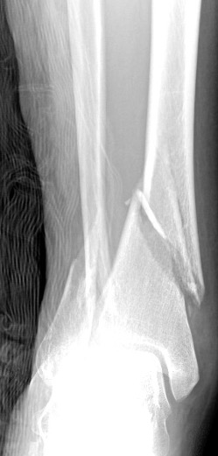
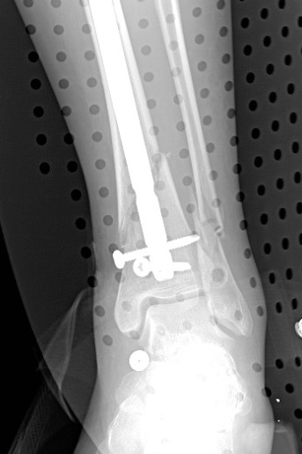
Distal Tibia
Or you could nail it…
Remember, MIPO is just one option

Slide 34
Humerus
Multiple approaches described
Technically demanding due to anatomic concerns
Percutaneous screw placement unsafe over the majority of the length of the humerus

Slide 35
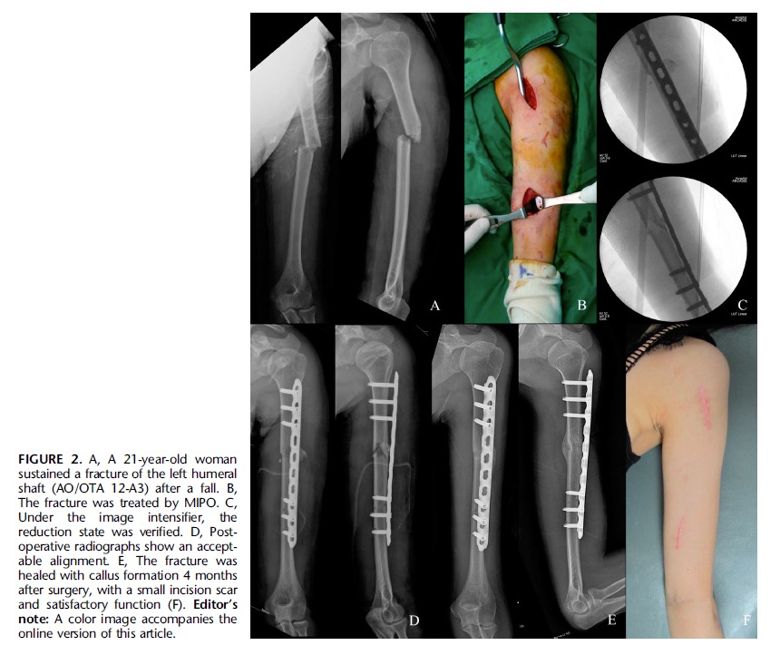
Humerus
Two limited incisions
Proximal interval: deltoid/biceps
Brachialis split distally
Plate slid in submuscular fashion
Kim JW, Kim HU, Oh CW, Kim JW, Park KC. A Prospective Randomized Study of Operative Treatment for Noncomminuted Humeral Shaft Fractures. J Orthop Trauma. 2015 Apr;29(4):189-194. jorthotrauma.com

Slide 36
Humerus
RCT comparing conventional plating to MIPO
Union rates and complications rates equivalent
Increased fluoro time with MIPO
Only experienced trauma surgeons included
Kim JW et al JOT 2015

Slide 37
Humerus
Two limited incisions
Delto-pectoral interval proximally
Brachialis split distally
As a percentage of humeral length measured from the lateral epicondyle: nerves most at risk during anterior approach MIPO
Musculocutaneous: 18 – 42%
Radial: 36 – 60% →risk of A to P screws injuring the nerve
Apivatthakakul T et al Injury 2010
Notes:
“Danger zone for locking screw placement in minimally invasive plate osteosynthesis (MIPO) of humeral shaft fractures: A cadaveric study”

Slide 38
MIPO Humerus: Anteromedial approach
Two incisions
Proximal interval: between biceps and deltoid
Distal interval: elevate brachialis from medial intramuscular septum
No percutaneous screws placed
As a percentage of humeral length measured from the lateral epicondyle, structures most at risk during anteromedial approach MIPO
Brachial Artery: 20 – 62%
Median Nerve: 20 - 62%
Musculocutaneus nerve: 20 – 75%
Note that these danger zones span nearly the entire humerus
Buranaphatthana T et al Injury 2019

Slide 39
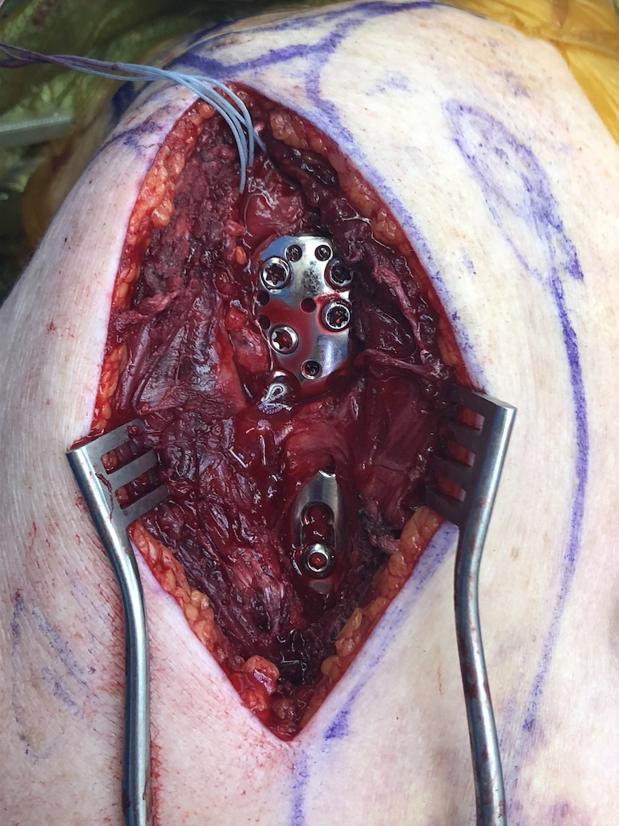
MIPO Proximal humerus
Described technique includes a limited anterolateral acromial approach/deltoid split to a point 5cm distal to the acromion (staying proximal to the axillary nerve) with percutaneous placement of distal screws using an aiming arm
Would be wary of this approach as the axillary nerve crosses at the level of the calcar screws which must be placed for successful proximal humerus ORIF

Slide 40
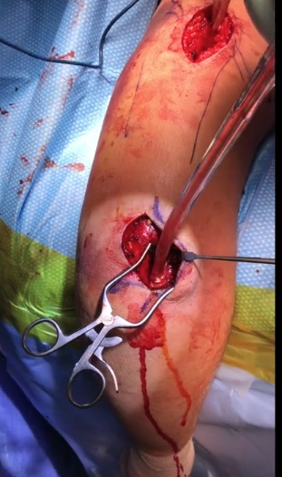
MIPO Humerus – Posterior approach
https://otaonline.org/video-library/45036/procedures-and-techniques/multimedia/18420128/posterior-mipo-humerus-plating
Two limited incisions
Between long and lateral head of triceps proximally
Radial to triceps tendon distally
Can also add triceps split distally
Plate slid under radial nerve

Slide 41
MIPO Clavicle
While MIPO clavicle can result in shorter operative times and shorter incisions, time to union is related to fracture reduction which may be more difficult to obtain via MIPO

Slide 42
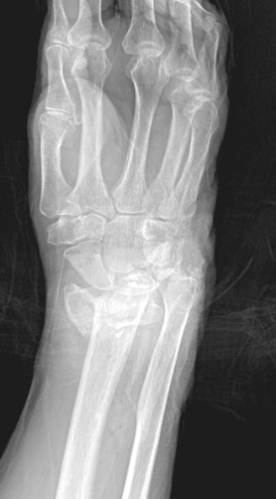
Distal Radius: Dorsal Spanning Plate
Compares favorably to external fixation of geriatric distal radius fractures with regard to patient outcomes, complex regional pain syndrome, and infection
Wang W et al J Wrist Surg 2020
Image courtesy of G. Moloney

Slide 43
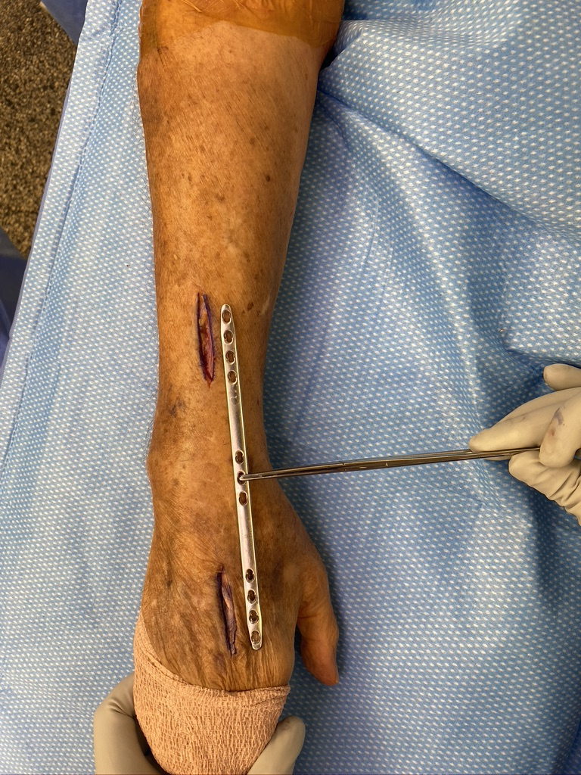
Distal Radius: Dorsal Spanning Plate
Limited Incision localized fluoroscopically
Centered between 2nd and 3rd metacarpal
Dorsal aspect of the radius
Deep exposure between 2nd and 3rd compartments
Superficial Radial Nerve at risk
Plate slid under the extensor retinaculum which is never exposed
Image courtesy of G. Moloney

Slide 44
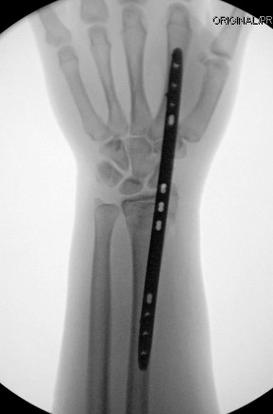
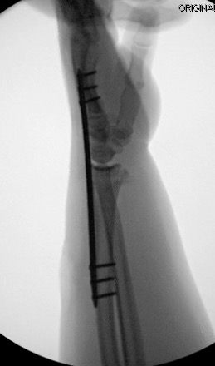
Plate can be placed on the 2nd or 3rd metacarpal
2nd metacarpal may assist in regaining radial height

Slide 45
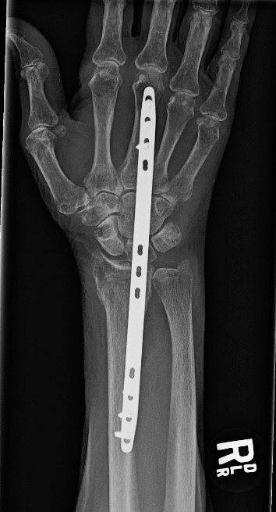
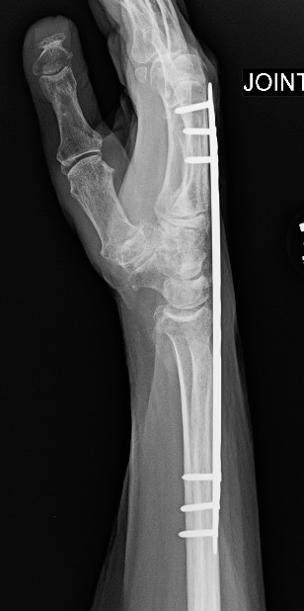
Plate can be attached to the metacarpal first and then used to regain length

Slide 46
Plate removal at 3 months if bony union and patient is physiologically appropriate and desires removal

Slide 47
Take Home
MIPO allows insertion of plates with minimal disruption of soft tissues and can be done safely with appropriate awareness of anatomy
MIPO is described for a wide variety of fractures
The most widely accepted and safe locations are the distal femur, proximal tibia, and distal radius
While there is literature to describe MIPO in other locations (humerus) anatomic concerns may mean the risks outweigh the potential benefits for most surgeons.

Slide 48
References
Farouk O et al “Minimally invasive plate osteosynthesis: does percutaneous plating disrupt femoral blood supply less than the traditional technique” JOT 1999 Aug;13(6):401-6
Hyatt BT et al “Bridge plating for distal radius fractures in low demand patients with assist devices” J Hand Surg 2019
Kim JW et al “A prospective randomized study on operative treatment for simple distal tibial fractures – minimally invasive plate osteosynthesis versus minimal open reduction and internal fixation” JOT 2018 32:e19-e24
Kim JW et al “A prospective randomized study of operative treatment for noncomminuted humeral shaft fractures: conventional open plating versus minimal invasive plate osteosynthesis” JOT 2015 29:189-194
Kim JW et al “A prospective randomized study of operative treatment for noncomminuted humeral shaft fractures: conventional open plating versus minimal invasive plate osteosynthesis” JOT 2015 29:189-194
Toogood P et al “Minimally invasive plate osteosynthesis versus conventional insertion techniques for osteosynthesis” Injury 2018
Wang W et al ”Dorsal Bridge plating versus external fixation for distal radius fractures” J Wrist Surg 2020

