Slide 1
VENOUS THROMBOEMBOLISM
JOHN WESTON MD
TENWEK HOSPITAL, BOMET KENYA

Slide 2
Objectives
Define DVT and PE and understand the basic pathophysiology
Know risk factors for VTE in the orthopedic patient
Understand evidence-based prevention strategies
Diagnose VTE in a timely fashion
Understand treatment strategies for DVT/PE

Slide 3
Definitions
Deep Vein Thrombosis (DVT)
A pathologic coagulation of blood within a deep vein in an extremity
Commonly in the lower extremity
Popliteal fossa or proximal at highest risk of embolization
Pulmonary Embolus (PE)
A pathologic coagulation of blood within a pulmonary artery
Ranges from small/subsegmental to massive

Slide 4
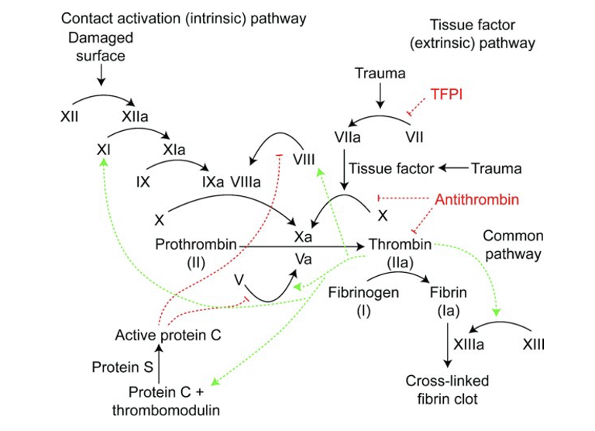
Pathophysiology
Coagulation
Blood transforms from liquid to fibrin based clot
Relies on interplay of endothelium, platelets, and circulating coenzymes
Hemostasis is a balance between clot formation and dissolution
Pathologic coagulation = thrombosis
Ahsan ZS, Firoozibadi R. 2020. Venous Thromboembolic Disease in Patients with Skeletal Trauma. Tornetta, Paul, III, Rockwood and Green’s Fractures in Adults 9e, Wolters Kluwer, 2020

Slide 5
Pathophysiology
Virchow’s Triad
Endothelial injury
Stasis
Hypercoagulable state
All three often present in patients with skeletal trauma
Ahsan ZS, Firoozibadi R. 2020. Venous Thromboembolic Disease in Patients with Skeletal Trauma. Tornetta, Paul, III, Rockwood and Green’s Fractures in Adults 9e, Wolters Kluwer, 2020

Slide 6
Traumatic Risk Factors
Polytrauma
Increasing Injury Severity Score → Increased rates of VTE
Blood transfusion
Spinal cord injury
Chest injury
Head injury

Slide 7
Fracture Specific Risk Factors
Orthopedic trauma patients have 69% incidence of VTE in the absence of prophylaxis
Pelvis and Acetabular fractures at greatest risk
More proximal lower extremity fractures = greater risk
^{40% femoral shaft}
^{43% tibial plateau}
^{22% tibial shaft}
^{12.5% tibial plafond}

Slide 8
Non-traumatic Risk Factors
Age > 55 years
Obesity
Diabetes mellitus
Malignancy
Coagulopathy
Tobacco use
Oral contraceptives, hormone replacement

Slide 9
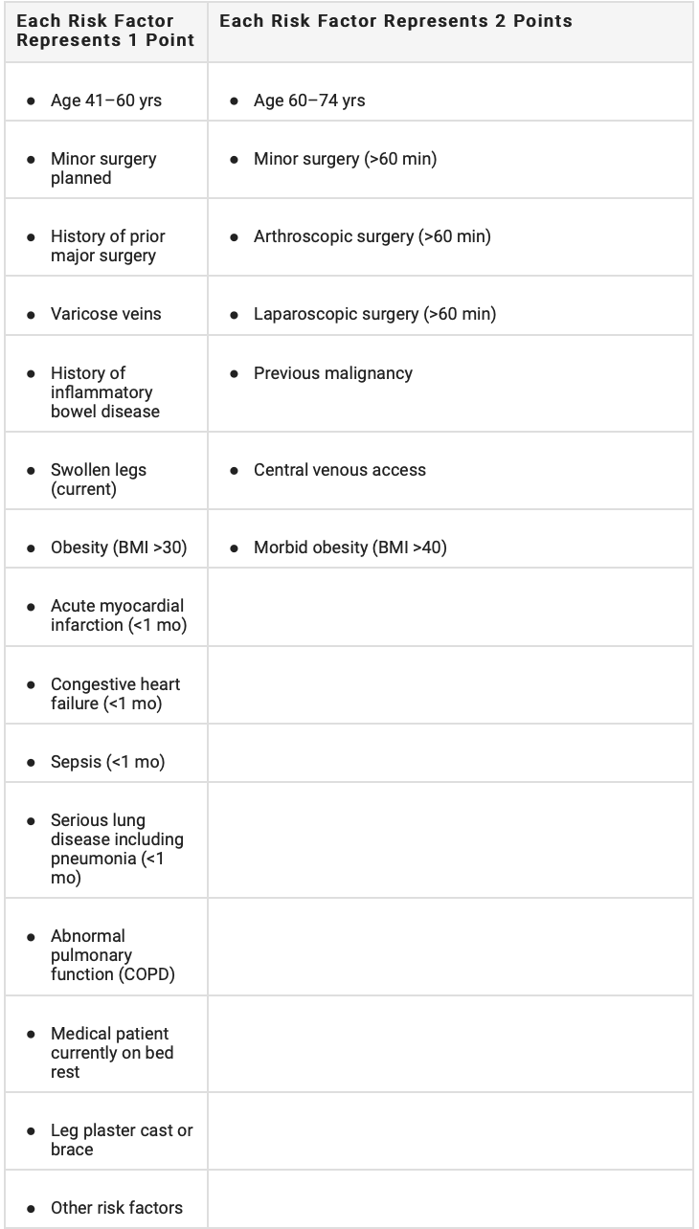
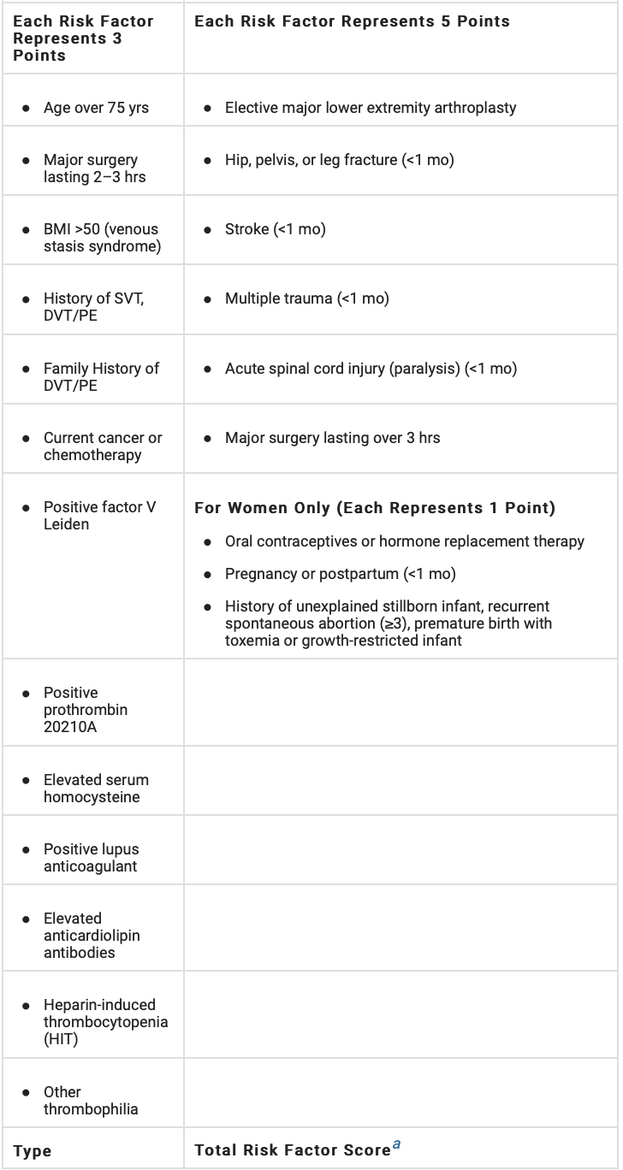
Risk Assessment
Caprini Index
Establishes composite individual risk
Stratifies patients into low (0-2 pts), moderate (3-4), high (5-8), or highest risk (>8)
Major lower extremity fracture = high risk
Moderate risk or greater may warrant chemoprophylaxis
Ahsan ZS, Firoozibadi R. 2020. Venous Thromboembolic Disease in Patients with Skeletal Trauma. Tornetta, Paul, III, Rockwood and Green’s Fractures in Adults 9e, Wolters Kluwer, 2020

Slide 10
Prevention
Three primary modalities
Mechanical Prophylaxis
Inferior Vena Cava Filters
Chemoprophylaxis

Slide 11
Prevention
Mechanical Prophylaxis
Intermittent Pneumatic Compression (IPC)
Stimulates venous flow in the extremities
May be as effective as LMWH
Per the American College of Chest Physicians (ACCP), chemoprophylaxis superior to mechanical alone
Combined IPC and chemoprophylaxis superior to either alone

Slide 12
Prevention
Mechanical Prophylaxis
Compressive Stockings
Minimize venous stasis
Multiple RCTs to suggest decreased incidence of DVT/PE

Slide 13
Prevention
Inferior Vena Cava Filter
In theory prevents migration of DVT to the pulmonary artery
Mixed evidence regarding efficacy
Numerous complications if left long term
ACCP recommends against use of IVC filters in polytrauma patients

Slide 14
Prevention
Chemoprophylaxis
Unfractionated Heparin (UFH)
Binds to antithrombin III → inactivates thrombin, factor Xa
Half life of 1-2 hours (dosed 2-3 times daily)
Reversible with protamine
Heparin Induced Thrombocytopenia (HIT) a potential complication

Slide 15
Prevention
Chemoprophylaxis
Low-Molecular-Weight Heparin (LMWH)
Also binds antithrombin III, but reduced anti-factor IIa activity
Half life of 4-5 hours (dosed once or twice daily)
Lab monitoring not required
Superior to UFH in terms of PE risk reduction
Concerns over wound drainage/bleeding complications
HIT still possible, but lower risk compared to UFH

Slide 16
Prevention
Chemoprophylaxis
Fondiparinux
Indirect factor Xa inhibitor
Half life of 17 hours (once daily administration)
No risk of HIT
Superior reduction of VTE compared to LMWH in hip fracture patients

Slide 17
Prevention
Chemoprophylaxis
Aspirin
Irreversible inhibitor of cyclooxygenase (COX)
Inhibits platelet aggregation for 8-9 days
Arthroplasty literature shows decreased VTE and fewer complications compared to other agents
Not well studied in the trauma population

Slide 18
Prevention
Chemoprophylaxis
Novel Oral Anticoagulants (NOACs)
Dabigatran: selective inhibition of thrombin
Rivaroxaban, Apixaban, Edoxaban: inhibit factor Xa
Half life of 5-15 hours
Efficacy not well studied in trauma population
Concerns include bioavailability of oral agents in hospitalized patients, bleeding complications, limited reversibility

Slide 19
24 Item questionnaire to members of OTA
Found wide variability in surgeon practices
Many practices not evidence based
Expert panel constructed evidence-based guidelines

Slide 20
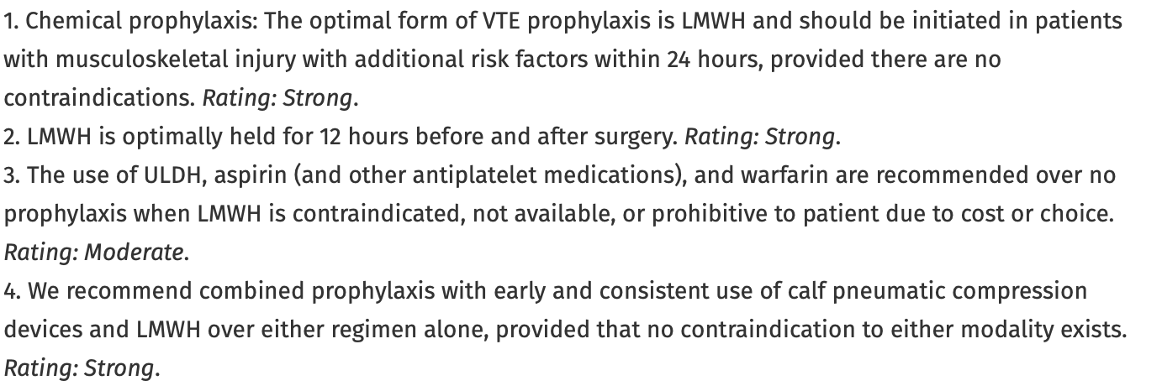

Slide 22
Other Risk Factors
Older than 40 years
Obesity (body mass index > 30)
Previous history of VTE (personal or familial)
History of malignancy
History of smoking
Hormonal birth control
Nonambulatory status
Spinal cord injury
Proximity of injury to the axial skeleton
Tourniquet use
Immobilization
Other hypercoagulability conditions (protein C and S deficiency)

Slide 23
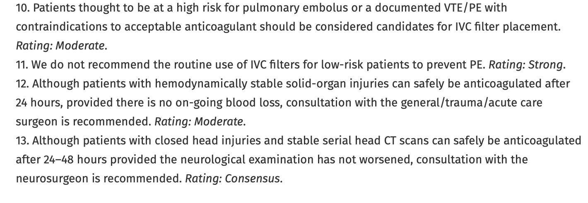

Slide 24
265 patients with below-knee fractures
Randomized to 14 days of LMWH vs placebo
Doppler of bilateral proximal leg veins at 14 days and 3 months
Overall incidence of clinically important VTE (CIVTE) was 1.9%
no significant difference between groups
Due to low incidence of CIVTE, trial recruitment was stopped early

Slide 25
Metanalysis of 5 randomized trials describing chemoprophylaxis of VTE after operative management of fractures of the tibia and distal bones
Assessed the incidence of any VTE vs clinically important VTE (CIVTE)
Incidence of any VTE was significantly reduced with chemoprophylaxis
No significant difference in CIVTE between LMWH and placebo

Slide 26
Review of 11,313 trauma patients treated from 2010-2017 in a large multicenter health care system database
Captured patients with ORIF of pelvis/acetabulum, femoral neck, and intertrochanteric fractures or intramedullary nailing (IMN) of the femur or tibia
All patients in the study were on chemical and mechanical prophylaxis
LMWH or Warfarin
Overall rate of VTE was 0.82% (0.39% DVT, 0.43% PE)
Pelvis/acetabulum 1.7%
Femoral IMN 1.33%

Slide 27
Diagnosis of DVT
Symptoms
Clinically silent in many cases
Limb swelling
Homan’s sign (calf pain with passive dorsiflexion of the ankle)
Tachycardia
Fever of unknown origin

Slide 28
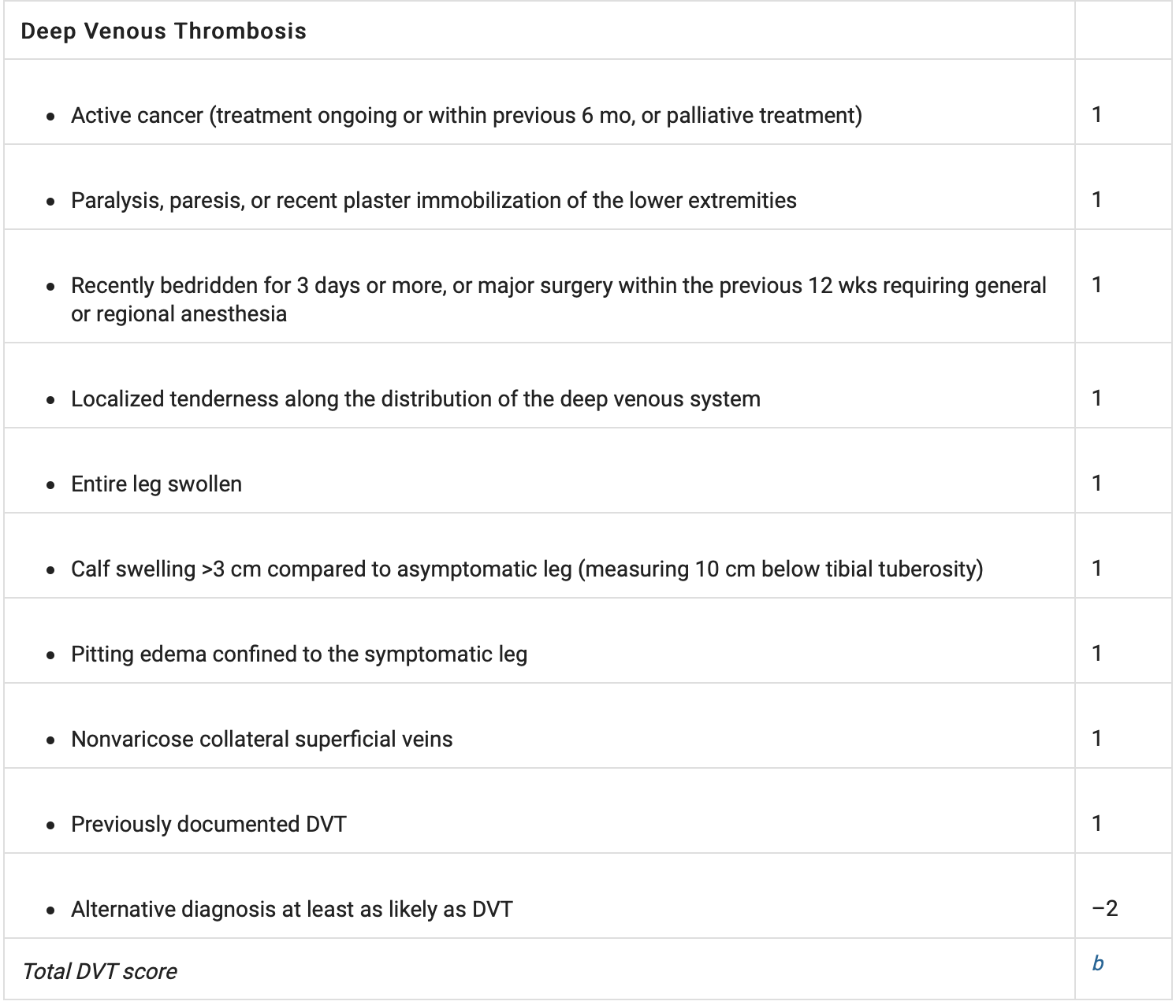
Diagnosis of DVT
Wells Score
3-8 points = High probability
1-2 points= moderate probability
-2-0 points= low probability
Ahsan ZS, Firoozibadi R. 2020. Venous Thromboembolic Disease in Patients with Skeletal Trauma. Tornetta, Paul, III, Rockwood and Green’s Fractures in Adults 9e, Wolters Kluwer, 2020

Slide 29
Diagnosis of DVT
Testing modalities
D-Dimer
Poor specificity
Venography
Historical
Venous Doppler Exam
Good sensitivity/specificity, but user dependent
MRI
Expensive, high false positive rate

Slide 30
Diagnosis of PE
Symptoms
Tachycardia
Shortness of breath
Chest pain
Hypoxia
Hemoptysis
Cyanosis

Slide 31
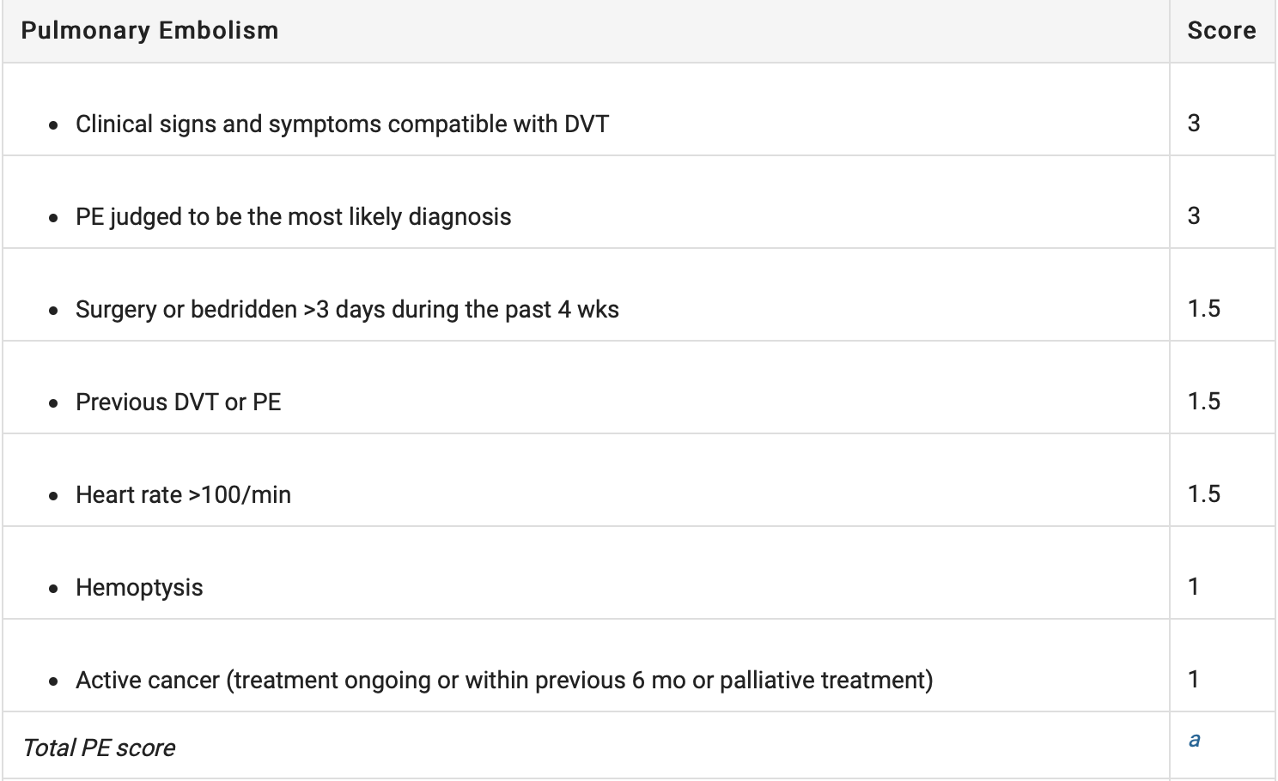
Diagnosis of PE
Wells Score
> 6 points = High probability
2-6 points= moderate probability
< 2 points= low probability
Ahsan ZS, Firoozibadi R. 2020. Venous Thromboembolic Disease in Patients with Skeletal Trauma. Tornetta, Paul, III, Rockwood and Green’s Fractures in Adults 9e, Wolters Kluwer, 2020

Slide 32
Diagnosis of PE
Testing modalities
Ventilation/Perfusion (V/Q) Scan
Historical gold standard
Remains useful for patients with contrast allergies or renal impairment
CT Pulmonary Angiography (CTPA)
Good sensitivity/specificity
Current gold standard

Slide 33
Treatment of DVT
Based on anatomic location and individual risk factors
Proximal to calf → aggressive treatment
Typically 3 months of anticoagulation (sometimes indefinite)
Novel oral anticoagulants preferred to warfarin or LMWH
Serial imaging of deep veins in patients at high risk of bleeding
No anticoagulation for stable thrombus

Slide 34
Treatment of PE
Subsegmental (proximal pulmonary artery not involved)
Rarely associated with cardiopulmonary complications
Low incidence of concomitant DVT or recurrent thromboemboli
Clinical surveillance recommended if no proximal DVT
Clinically Relevant PE
Respiratory and hemodynamic support as needed
Thrombolytic therapy if low risk of bleeding
If elevated bleeding risk → thrombus removal

Slide 35
Summary
DVT/PE are common in patients with skeletal trauma
Combined mechanical and chemical prophylaxis is recommended
LMWH is commonly used in the trauma population
IVC filters should be reserved for high risk patients with contraindications to an acceptable anticoagulant

Slide 36
Key References
Kearon C, Akl EA, Ornelas J, et al. Antithrombotic therapy for VTE disease: CHEST guideline and expert panel report. Chest. 2016;149(2):315–352.
Sagi HC, Ahn J, Ciesla D, et al. Venous Thromboembolism Prophylaxis in Orthopaedic Trauma Patients: A Survey of OTA Member Practice Patterns and OTA Expert Panel Recommendations [published correction appears in J Orthop Trauma. 2016 Jan;30(1):e35. Tornetta, Paul 3rd [added]]. J Orthop Trauma. 2015;29(10)
Ahsan ZS, Firoozibadi R. 2020. Venous thromboembolic disease in patient’s with skeletal trauma. Tornetta, Paul, III, Rockwood and Green’s Fractures in Adults 9e, Wolters Kluwer, 2020

