Slide 1
Atypical Femur Fractures
Bennet Butler
Assistant Professor of Orthopedic Surgery
Northwestern Memorial Hospital
John H Stroger Hospital of Cook County

Slide 2
Atypical Femur Fracture (AFF) Overview
Low energy femoral shaft fractures with a characteristic appearance
Caused by a combination of unfavorable femoral anatomy (varus, anterior bow) and impaired bone healing/remodeling
Frequently (but not always) associated with bisphosphonate use
Successful treatment requires a combination of medical and surgical management
Relatively high rates of delayed/nonunion compared to standard femoral shaft fractures
Disease process often manifests bilaterally… patients must be checked and monitored for developing AFF of the contralateral femur

Slide 3
Presentation Overview
AFF Definition/Characteristics
Pathogenesis
Association with Bisphosphonates
Diagnosis
Treatment
Surgical Considerations
Prognosis

Slide 4
ASBMR Definition of AFFs (1)
Femoral diaphyseal fracture w/ at least 4 of the following major criteria:
Minimal or no trauma
Fracture originates at lateral cortex and is substantially transverse in orientation
Complete fractures may be associated with a medial spike, incomplete fractures are lateral cortex only
Fracture is noncomminuted or minimally comminuted
Localized periosteal or endosteal thickening is present at the lateral cortex

Slide 5
ASBMR Definition of AFFs
Minor criteria may or may not be present
Generalized increase in cortical thickness of femur
Prodromal symptoms (thigh or groin pain)
Bilateral incomplete or complete fractures
Delayed fracture healing

Slide 6
Practical Definition
Low energy subtrochanteric or femoral shaft fracture frequently associated with bisphosphonate use with a characteristic set of features.
Lateral origin of fracture line
Localized cortical thickening or beaking at origin of fracture line
Transverse or short oblique fracture (possibly with a medial spike)
Minimal or no comminution

Slide 7
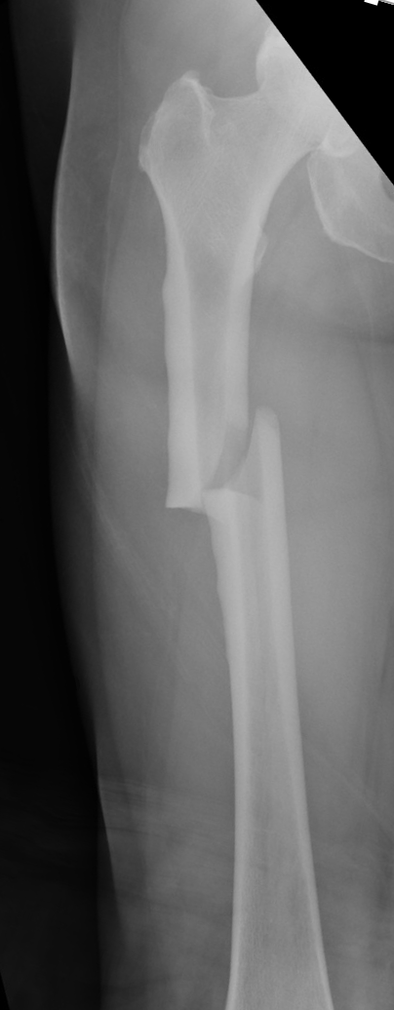
AFF Radiological Features
Subtrochanteric or femoral shaft fracture
Localized lateral cortical thickening/beaking
Fracture line propagates from lateral cortex
Substantially transverse or short oblique
Minimal or no comminution
Possibly associated with a medial spike

Slide 8
Pathogenesis of AFFs
Insufficiency fracture caused by a combination of…
Unfavorable mechanical environment
Impaired bone remodeling
**note-
insufficiency fracture = normal forces, abnormal bone
stress fracture = abnormal forces, normal bone

Slide 9
Pathogenesis of AFFs
Insufficiency fracture caused by a combination of…
Unfavorable mechanical environment
-lateral femoral cortex experiences significant tensile stresses during normal weightbearing
-in patients with relative femoral neck varus or anterolateral bowing these forces are increased
Impaired bone remodeling

Slide 10
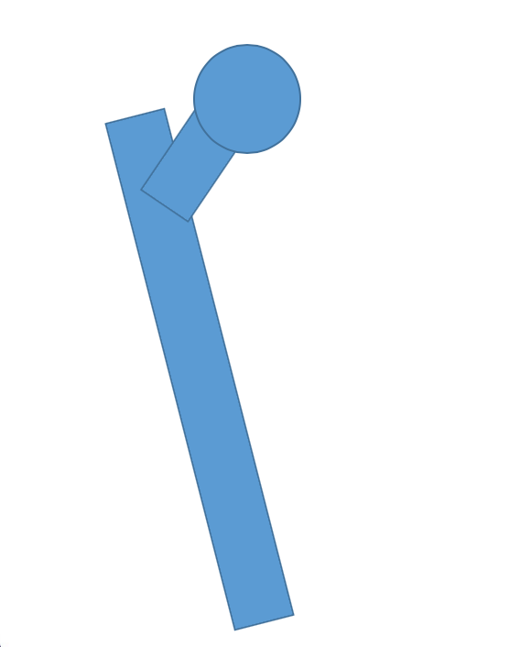
Pathogenesis of AFFs (Mechanical)
Normal Femur
Bowed/Varus Femur
Body Weight
Body Weight
Modest Tensile Forces Along Lateral Cortex
Excessive Tensile Forces Along Lateral Cortex

Slide 11
Pathogenesis of AFFs (2-5)
Evidence for mechanical contribution to AFF pathogenesis
Saita et al- location of AFF highly correlated with femorotibial angle (more varus = more distal fracture)
Sasaki et al- increased risk of AFF w/ increasing coronal plane femoral bowing
Hagen et al- increased risk of AFFs w/ increasing femoral neck varus
Oh et al- femoral neck varus associated with subtroch AFFs, femoral bowing associated with femoral shaft AFFs

Slide 12
Pathogenesis of AFFs
Insufficiency fracture caused by a combination of…
Unfavorable mechanical environment
Impaired bone remodeling
-under normal circumstances, stress formed microfractures are healed by callous formation followed by localized remodeling
-patients with impaired bone remodeling are at risk for propagation of unhealed/partially healed microfractures in high stress regions

Slide 13
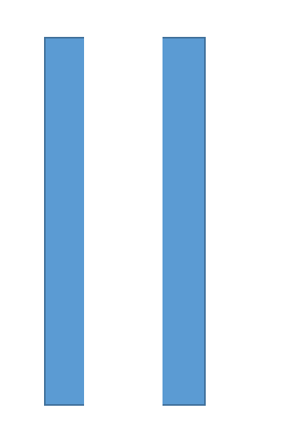
Pathogenesis of AFFs (Biological)
Normal Microfracture Repair
RANKL-mediated Osteoclast action
Callous formation for initial stabilization
Remodeling for final healing

Slide 14
Pathogenesis of AFFs
Impaired Microfracture Repair
RANKL-mediated Osteoclast action
Callous formation for initial stabilization
Failure of remodeling, microfx reforms/propagates

Slide 15
Pathogenesis of AFFs (2-5)
Evidence of biological contribution to AFFs
many studies linking bisphosphonate use to AFFs (future slides)
case reports of AFFs associated with denosumab use (RANKL inhibitor) [6,7]
case reports of AFFs associated with various metabolic bone diseases (hypophosphatasia, x linked hypophosphatemic rickets) [8]

Slide 16
Pathogenesis of AFFs (2-5)
Other risk factors for AFFs
Older age (9)
Female (9)
Asian or Hispanic race (9)
possibly related to increased anterolateral femoral bowing in these patient populations
Specific genetic mutations (GGPS1 mutations) (10)

Slide 17
Bisphosphonates and AFFs
Bisphosphonates (BPs) are potent osteoclast (bone resorption, remodeling) inhibitors
Common examples- alendronate, pamidronate, etidronate, ibandronate, zoledronate, risedronate
Indications
First line treatment for osteoporosis
Decrease rate of wrist, hip and vertebral fractures in high risk populations by 30-60% [11]
Decrease bone pain/fracture risk in patients with lytic bone lesions (multiple myeloma, metastatic disease)

Slide 18
Bisphosphonates and AFFs
Bisphosphonate use is a major risk factor for AFFs
AFFs first noted in medical literature in ~2007 in association with alendronate use (12)
Subsequent studies have demonstrated a population-wide increase in femoral shaft/subtroch fxs coinciding with onset of BP use (13)

Slide 19
Bisphosphonates and AFFs
Relative risk of AFF with BP use: 2-128 (1)
Absolute risk of AFF with BP use: 3.2-113/100K/year (1, 14)
Risk increases with duration of use: 1.8/100K/year w/ 2 year use, 113/100K/year w/ >8 year use (14)
Risk rapidly drops off after discontinuation of BPs: 70% decrease in risk 1 year after discontinuation (15)
***In spite of a significant increase in relative risk of AFFs with BP use, absolute risk of sustaining an AFF remains low

Slide 20
Balancing the Risks/Benefits of BPs (16)
Ultimately BPs prevent far more fractures than they create
Concern about AFFs should not prevent their routine use when indicated
AFF w/ >8 years BP
Hip fx w/out BP
Hip fx w/ BP
Wrist fx w/ BP
Vert fx w/out BP
Vert fx w/ BP
AFF w/ 2 years BP
Wrist fx w/ out BP

Slide 21
Balancing the Risks/Benefits of BPs
Possibly a role for bisphosphonate holiday in patients at lower risk for fragility fractures
FLEX study- continuing alendronate after 5 years of use decreases bone loss, vert compression fractures, NOT other fractures (17)
HORIZON study- continuing zoledronic acid after 3 years of use decreases bone loss, vert compression fractures, NOT other fractures (18)
Adler et al (16)- recommends discontinuation of BPs after 3-5 years if…
No fragility fractures before or during BP use
DEXA T score >-2.5
Low fracture risk (FRAX) score

Slide 22
Diagnosis
History and Physical
Low or no energy trauma
Prodromal thigh/groin pain (33-50%, mean onset 6 mos prior to fx) [19-21]
Specific risk factors
Bisphosphonate use (especially long term use)
Denosumab use
Asian or Hispanic race
Female
Older age

Slide 23
Diagnosis
Diagnostic Imaging
Standard AP and lateral radiographs of femur
Generally sufficient to diagnose complete or incomplete AFFs
Characteristic features defined by ASBMR guidelines (1)
MRI
Occasionally needed to diagnose developing lateral cortical stress reaction/fractures in high risk patients (eg BP use) with prodromal pain but negative radiographs (22)

Slide 24
Diagnosis
Best to diagnose AFFs before they happen!!
Obtain femoral XRs to rule out impending AFF in…
High risk patient (eg long term BP use) with thigh pain
Contralateral femur of patient with a known AFFs
Risk of contralateral AFF after initial AFF ~25% [20, 23]

Slide 25
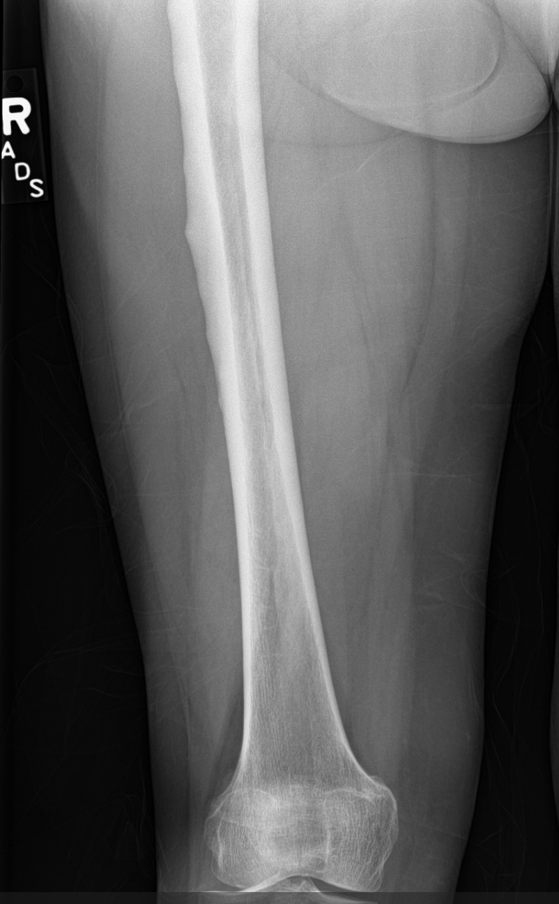
Diagnosis
Best to diagnose AFFs before they happen!!
XR of patient on BP therapy taken for thigh pain
Note beaking of lateral cortex
No action taken at time of imaging
Sustained complete AFF ~ 1 year after XR taken

Slide 26
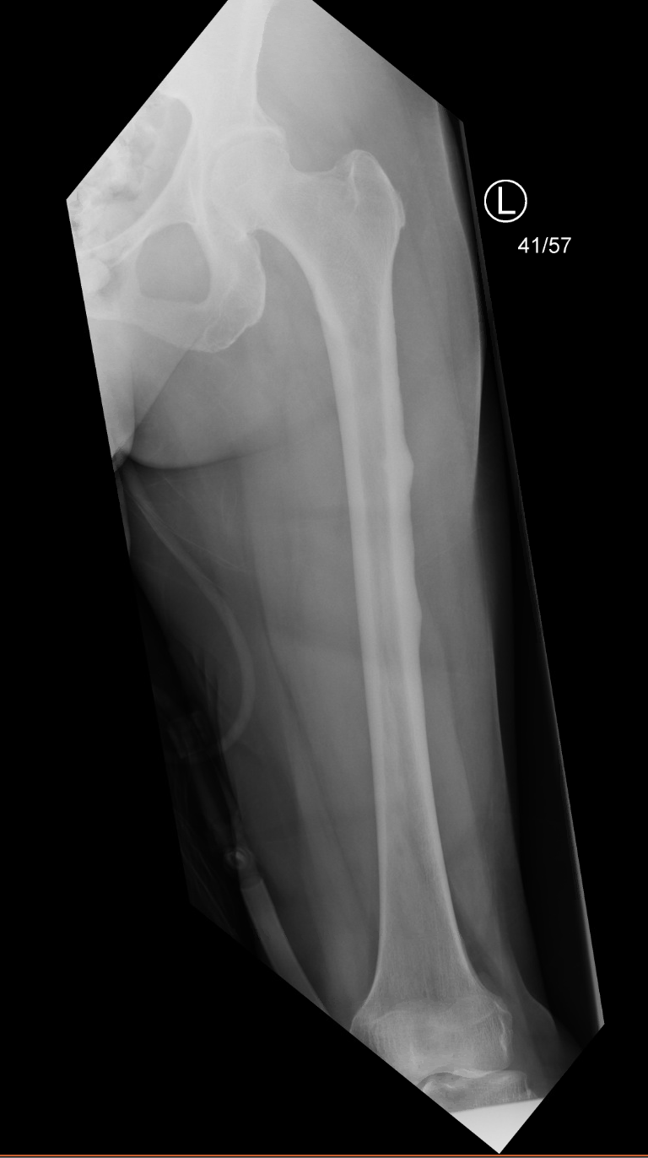
Diagnosis
Best to diagnose AFFs before they happen!!
XR of left femur of same patient following right sided complete AFF
Note beaking of lateral cortex
Patient noted to have left thigh pain
Treated with prophylactic nail

Slide 27
Treatment
Complete AFF (22)
Intramedullary nail stabilization
Endocrine consult
Discontinuation of BPs (if currently using)
Vit D/Calcium supplementation
Consideration of alternative osteoporosis medications (eg teriparatide)

Slide 28
Treatment
Developing or Incomplete AFF
Saleh et al (24)- w/ no radioluscent line in lateral cortex, 100% union with nonoperative management… w/ radioluscent line, 22% union w/ nonop management
Banffy et al (25)- w/ radioluscent line, 83% nonunion w/ nonop management
Egol et al (26)- incomplete AFFs, 100% union w/ prophylactic nailing, 18% union w/ nonoperative management
Jiang et al (27)- prophylactic fixation of contralateral femur in patients with AFF cost effective if “high risk” (Asian race, prodromal pain, varus proximal femur, femoral bowing, beaking, radioluscent line)

Slide 29
Treatment
Developing or Incomplete AFF (22)
Lower risk patients- initial course of nonoperative management reasonable
Protected weight bearing
Endocrine consult- discontinue BPs, consider alternative osteoporosis medication, vit D/calciyum supplementation
Higher risk patient
Prophylactic IMN
Endocrine consult
Surgeon should have low threshold for prophylactic fixation given relatively high rates of nonunion and progression to complete AFF with nonoperative management

Slide 30
Surgical Considerations
Operative fixation of AFFs frequently complicated by…
Anterolateral femoral bowing- risk of poor nail fit, mareduction, perforation
Localized lateral cortical thickening at fracture site- may deflect nail medially, creating varus malreduction
Poor bone quality- frequently sustained by patients with preexisting osteotoporosis and other comorbidities
High rates of delayed union- construct needs to survive a potentially long healing course

Slide 31
Surgical Considerations
Anterolateral femoral bowing- risk of poor nail fit, malreduction, perforation
Choose nail with smallest possible radius of curvature (28)

Slide 32
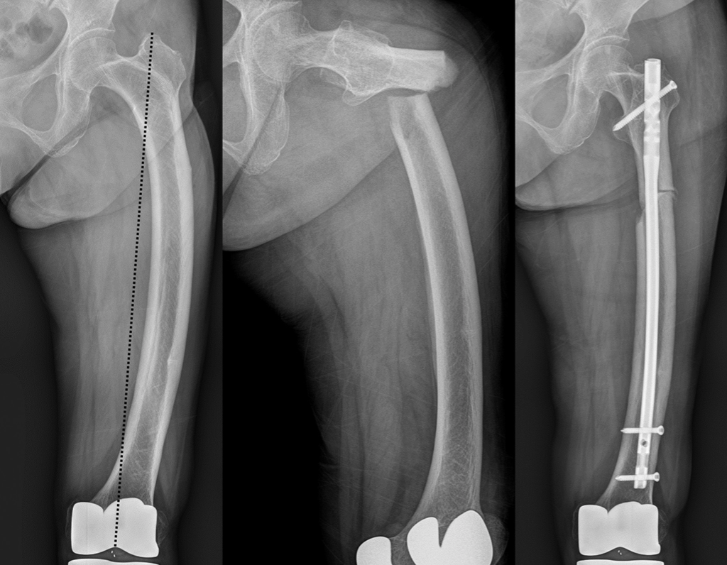
Surgical Considerations
Anterolateral femoral bowing-
Choose nail with smallest possible radius of curvature
Externally rotating nail may improve nail fit (29)
Converts normal anterior bow of nail into anterolateral bow, possibly improving nail fit

Slide 33
Surgical Considerations
Anterolateral femoral bowing-
Choose nail with smallest possible radius of curvature
Consider externally rotating nail if needed
Medialize start point to avoid varus malreduction (30)

Slide 34
Surgical Considerations
Anterolateral femoral bowing-
Choose nail with smallest possible radius of curvature
Consider externally rotating nail if needed
Medialize start point to avoid varus malreduction
Place blocking screws as necessary to fine tune nail path

Slide 35
Surgical Considerations
Anterolateral femoral bowing-
Choose nail with smallest possible radius of curvature
Consider externally rotating nail if needed
Medialize start point to avoid varus malreduction
Place blocking screws as necessary to fine tune nail path
Carefully advance nail to ensure it will not perforate anteriorly

Slide 36
Surgical Considerations
Anterolateral femoral bowing-
Choose nail with smallest possible radius of curvature
Consider externally rotating nail if needed
Medialize start point to avoid varus malreduction
Place blocking screws as necessary to fine tune nail path
Carefully advance nail to ensure it will not perforate anteriorly
Plate femur if nailing impossible due to anatomy (31)

Slide 37
Surgical Considerations
Localized cortical thickening at fracture site- may deflect nail medially, generating varus malreduction
Normal Cortices
AFF w/ Lateral Cortical Beaking
Lateral Cortical Thickening Generates Varus Malreduction

Slide 38
Surgical Considerations
Localized cortical thickening at fracture site
Use awl or rigid reamer to drill through lateral cortical thickening (32)

Slide 39
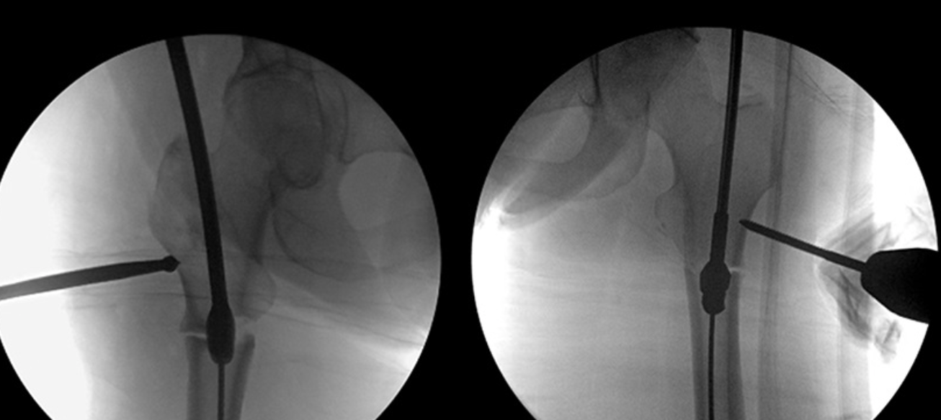
Surgical Considerations
Localized cortical thickening at fracture site
Use awl or rigid reamer to drill through lateral cortical thickening
Adduct proximal fragment with schanz pin or ball spike to allow reaming of lateral cortex (30)

Slide 40
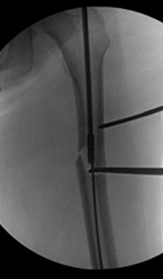
Surgical Considerations
Localized cortical thickening at fracture site
Use awl or rigid reamer to drill through lateral cortical thickening
Adduct proximal fragment with schanz pin or ball spike to allow reaming of lateral cortex (30)
Abduct guidewire with bone hook to allow reaming of lateral cortex (30)

Slide 41
Surgical Considerations
Localized cortical thickening at fracture site
Use awl or rigid reamer to drill through lateral cortical thickening
Adduct proximal fragment with schanz pin or ball spike to allow reaming of lateral cortex
Abduct guidewire with bone hook to allow reaming of lateral cortex
Open approach to burr down lateral cortical thickening directly (32)

Slide 42
Surgical Considerations
High rates of delayed union- construct needs to survive a potentially long healing course
Use multiple interlocks, blocking screws to increase longevity of construct

Slide 43
Surgical Considerations
High rates of delayed union
Use multiple interlocks, blocking screws to increase longevity of construct
Recommend use of recon or cephalomedullary nails to improve proximal fixation/protect against potential femoral neck fracture

Slide 44
Surgical Considerations
High rates of delayed union
Use multiple interlocks, blocking screws to increase longevity of construct
Recommend use of recon or cephalomedullary nails to improve proximal fixation/protect against potential femoral neck fracture
Further study needed to determine if bone grafting, LIPUS, BMP beneficial for AFF healing (33,34)

Slide 45
Prognosis
Important to counsel patients regarding high rates delayed union, nonunion, and reoperation
Giusti et al- delayed/nonunion rate 39% (higher w/ continued BP use) (33)
Cho et al- delayed/nonunion rate 41% (avg time to union 10.7 mos) (34)
Lim et al- nonunion rate 30% (35)

Slide 46
Atypical Femur Fracture (AFF) Summary
Low energy femoral shaft fractures with a characteristic appearance
Caused by a combination of unfavorable femoral anatomy (varus, anterior bow) and impaired bone healing/remodeling
Frequently (but not always) associated with bisphosphonate use
Successful treatment requires a combination of medical and surgical management
Relatively high rates of delayed/nonunion compared to standard femoral shaft fractures
Disease process often manifests bilaterally… patients must be checked and monitored for developing AFF of the contralateral femur

Slide 47
References
Shane E, Burr D, Abrahamsen B, Adler RA, Brown TD, Cheung AM, et al. Atypical subtrochanteric and diaphyseal femoral fractures: second report of a task force of the American society for bone and mineral research. J Bone Miner Res. 2014;29(1):1–23.
Saita Y, Ishijima M, Mogami A, Kubota M, Kaketa T, Miyagawa K, Nagura N, Wada T, Sato T, Fukasaku S, Gen H, Obayashi O, Nemoto M, Kaneko K. Association between the fracture site and the mechanical axis of lower extremities in patients with atypical femoral fracture. J Bone Miner Res. 2012; 27(Suppl 1).
Sasaki S, Miyakoshi N, Hongo M, Kasukawa Y, Shimada Y. Low‐energy diaphyseal femoral fractures associated with bisphosphonate use and severe curved femur: a case series. J Bone Miner Metab. 2012; 30:561–7.
Hagen JE, Miller AN, Ott SM, Gardner M, Morshed S, et al. Association of atypical femoral fractures with bisphosphonate use by patients with varus hip geometry. J Bone Joint Surg Am. 2014 Nov 19;96(22):1905-9.
Oh Y, Fujita K, Wakabayashi Y, Kurosa Y, Okawa A. Location of atypical femoral fracture can be determined by tensile stress distribution influenced by femoral bowing and neck-shaft angle: A CT-based nonlinear finite element analysis modeal for the assessment of femoral shaft loading stress. Injury. 2017 Dec;48(12):2736-43.
Paparodis R, Buehring B, Pelley EM, Binkley N. A case of an unusual subtrochanteric fracture in a patient receiving denosumab. Endocr Pract. 2013;19(3):e64–e68.
Schilcher J, Aspenberg P. Atypical fracture of the femur in a patient using denosumab--a case report. Acta Orthop. 2014;85(1):6–7.
Al-Ashqar M, Panteli M, Chakrabarty G, Giannoudis PV. Atypical fractures: An issue of concern or a myth? Injury. 2018 Mar;49(3):649-55.
Marcano A, Taormina D, Egol KA, Peck V, Tejwani NC. Are race and sex associated with the occurrence of atypical femoral fractures? Clin Orthop Relat Res. 2014 Mar;472(3):1020-7.
Roca-Ayats N, Balcells S, Garcia-Giralt N, et al. GGPS1 mutation and atypical femoral fractures with bisphosphonates. N Engl J Med. 2017 May 4;376(18):1794-5.
Cummings SR, Thompson DE, Applegate WB, et al. Effect of alendronate on risk of fracture in women with low bone density but without vertebral fractures: Results from the fracture intervention trial. JAMA. 1998. 280. 2077-82.
Goh SK, Yang KY, Koh JS, Wong MK, Chua SY, Chua DT, Howe TS. Subtrochanteric insufficiency fractures in patients on alendronate therapy: a caution. J Bone Joint Surg Br. 2007; 89:349–53.
Wang Z, Bhattacharyya T. Trends in incidence of subtrochanteric fragility fractures and bisphosphonate use among the US elderly 1996–2007. J Bone Miner Res. 2011; 26:553–60.
Dell RM, Adams AL, Greene DF, Funahashi TT, Silverman SL, Eisemon EO, et al. Incidence of atypical nontraumatic diaphyseal fractures of the femur. J Bone Miner Res. 2012;27(12):2544–2550.
Schilcher J, Michaëlsson K, Aspenberg P. Bisphosphonate use and atypical fractures of the femoral shaft. N Engl J Med. 2011;364(18):1728–1737.
Adler et al. Managing osteoporosis patients after long-term bisphosphonate treatment. J Bone Miner Res. 2016 Jan;31(1):16-35.
Black DM, Schwartz AV, Ensrud KE, Cauley JA, Levis S, Quandt SA, et al. FLEX Research Group. Effects of continuing or stopping alendronate after 5 years of treatment: the Fracture Intervention Trial Long-term Extension (FLEX): a randomized trial. JAMA. 2006;296(24):2927–2938.
18. Black DM, Reid IR, Boonen S, Bucci-Rechtweg C, Cauley JA, Cosman F, et al. The effect of 3 versus 6 years of zoledronic acid treatment of osteoporosis: a randomized extension to the HORIZON-Pivotal Fracture Trial (PFT) J Bone Miner Res. 2012;7(2):243–254.

Slide 48
References
19. Black JD, Kancheria VK, De Long WG Jr. A review of atypical femoral fractures from a tertiary care teaching hospital: An alarming trend? J Orthop Trauma. 2016 Apr;30(4):182-8.
20. Bogdan Y, Tornetta P 3rd, Einhorn TA, Guy P et al. Healing time and complications in operatively treated atypical femur fractures associated with bisphosphonate use: A multicenter retrospective cohort. J Orthop Trauma. 2016 Apr;30(4):177-81.
21. Egol KA, Park JH, Rosenberg ZS, Peck V, Tejwani NC. Healing delayed but generally reliable after bisphosphonate-associated complete femur fractures treated with IM nails. Clin Orthop Relat Res. 2014 Sep;472(9):2728-34.
22. Blood T, Feller RJ, Cohen E, Born CT, Hayda R. Atypical fractures of the femur: Evaluation and treatment. JBJS Reviews. 2015 Mar 3;3:3.
23. Dell RM, Greene D, Tran D. Stopping bisphosphonate treatment decreases the risk of having a second atypical femur fracture. Paper presented at: American Academy of Orthopaedic Surgeons (AAOS) Annual Meeting; 2012 Feb 7–11; San Francisco, CA, USA.
24. Saleh A, Hegde VW, Potty AG, Schneider R, Cornell CN, Lane JM. Management strategy for symptomatic bisphophonate-associated incomplete atypical femoral fractures. HSS J. 2012 Jul;8(2):103-10.
25. Banffy MB, Vraha SM, Ready JE, Abraham JA. Nonoperative versus prophylactic treatment of bisphosphonate-associated femoral stress fractures. Clin Orthop Relat Res. 2011 Jul;469(7):2028-34.
26. Egol KA, Park JH, Prensky CZ, Rosenberg ZS, Peck V, Tejwani NC. Surgical treatment improves clinical and functional outcomes for patients who sustain incomplete bisphosphonate-related femur fractures. J Orthop Trauma. 2013 Jun;27(6):331-5.
27. Jiang SY, Kaufman DJ, Chien BY, Longoria M, Shachter R, Bishop JA. Prophylactic fixation can be cost-effective in preventing a contralateral bisphosphonate-associated femur fracture. Clin Orthop Relat Res. 2019 Mar;477(3):580-90.
28. Park JH, Lee Y, Shon HC, Kim JW. Surgical tips of intramedullary nailing in severely bowed femurs in atypical femur fractures: Simulation with 3D printed model. Injury. 2016 Jun;47(6):1318-24.
29. Park YC, Song HK, Zheng XL, Yang KH. Intramedullary nailing for atypical femoral fracutre with excessive anterolateral nowing. J Bone Joint Surg Am. 2017 May 3;99(9):726-35.
30. Berkes MB, Shaw JC, Warner SJ, Achor TS. Medialized trochanteric start point and focused lateral endosteal beak reaming to optimize success of intramedullary nailing in atypical femur fractures: A technical trick and case series. J Orthop Trauma. 2019 Aug;33(8):e313-7.
31. Rollick NC, Bear J, Diamond O, Wellman DS, Helfet DL. Orthogonal plating with a 95-degree blade plate for salvage of unsuccessful cephalomedullary nailing of atypic femur fractures: A technical trick. J Orthop Trauma. 2019 Jun;33(6):e246-50.
32. Githens M, Garner MR, Firoozabadi R. Surgical management of atypical femur fractures associated with bisphosphonate therapy. J Am Acad Orthop Surg. 2018 Dec 15;26(24):864-71.
33. Giusti A, Neveen A, Papapoulos SE. Atypical fractures of the femur and bisphosphonate therapy: A systematic review of case/case series studies. Bone. 2010 Aug;47(2):169-80.
34. Cho JW, Oh CW, Leung F, Park KC, Wong MK et al. Healing of atypical subtrochanteric femur fractures after cephalomedullary nailing: Which factors predict union? J Orthop Trauma. 2017 Mar;31(3):138-45.
35. Lim HS, Kim CK, Park YS, Moon YW, Lim SJ, Kim SM. Factors associated with increased healing time in complete femoral fractures after long term bisphosphonate therapy. J Bone Joint Surg Am. 2016 Dec 7;98(23):1978-87.

