Slide 1
Geriatric Ankle Fractures
Tony Pedri, MD
Memorial Hospital of Sweetwater County

Slide 2
Objectives
Prevalence of Geriatric Ankle Fractures
Unique Challenges
Treatment Options
Outcomes
Case Examples
https://www.freepik.com/free-vector/active-elderly-people-concept-illustration_9558509.htm

Slide 3
Geriatric Ankle Fractures
American Population is Rapidly Aging
15% of population currently over the age of 65
20% By 2050
Advances in Technology and Medicine resulting in an aging population with continuously increasing activity levels

Slide 4
Increased number of injuries with increasing activity levels
1 in 4 Adults over the age of 65 experience at least one fall per year
Nearly 40% of these falls result in an injury requiring medical treatment.
In 2015, the total medical costs for falls totaled more than $50 billion. Medicare and Medicaid shouldered 75% of these costs.
Notes:
https://www.cdc.gov/mmwr/volumes/65/wr/mm6537a2.htm?s_cid=mm6537a2_w
https://www.cdc.gov/homeandrecreationalsafety/falls/adultfalls.html

Slide 5
Geriatric Ankle Fractures
Ankle fractures are third most common fracture among geriatric patients behind hip and wrist fractures
8.3 per 1000 Medicare patients experience and ankle fracture yearly
Notes:
Lynde MJ, Sautter T, Hamilton GA, Schuberth JM. Complications after open reduction and internal fixation of ankle fractures in the elderly. Foot Ankle Sug. 2012;18(2):103–107.

Slide 6
Challenges in Treating Geriatric Patients
Large, Heterogenous Population
Not all 65 y/o created equal
Not all 90 y/o created equal
Multiple Medical Comorbidities
Medicare patients >65 have on average 4 medical comorbidities
Poor Bone Quality
Treatment Must Match Patient – Maximize benefits while minimizing complications.
Notes:
Karlamangla A, Tinetti M, Guralnik J, Studenski S, Wetle T, Reuben D. Comorbidity in older adults: nosology of impairment, diseases, and conditions. J Gerontol A Biol Sci Med Sci. 2007;62(3):296–300.

Slide 7
Challenges in Treating Geriatric Patients
Unlike fractures about the hip and wrist in elderly patients, ankle fractures thought to be related to factors other than poor bone quality.
No correlation of ankle fractures to diagnosis of osteoporosis
Propensity to fall – i.e. Poor balance, poor coordination with inability to protect self/recover while falling.
Increased obesity
**Poor bone quality plays a major role when planning treatment/fixation techniques
Notes:
Mears SC, Kates SL. A guide to improving the care of patients with fragility fractures, edition 2. Geriatr Orthop Surg Rehabil. 2015;6(2):58–120
Strauss EJ, Egol KA. The management of ankle fractures in the elderly. Injury. 2007;38(suppl 3):S2–S9

Slide 8
Treatment Goals
Stable Joint
Ability for Patient to perform/participate in ADL’s as soon as possible
Minimize Complications
Notes:
Strauss EJ, Egol KA: The management ofankle fractures in the elderly.Injury2007;38(suppl 3):S2-S9

Slide 9
Historical Treatment
Non operative treatment was previous mainstay
Avoid chance of surgical complications
Decreased demands allow more tolerance with non-operative treatment compared to younger cohorts. --FALSE
Up to 21% Complication Rate with Surgical Fixation
Salai et al. – Higher AOFAS scores with non-operative treatment
**Patients with poor reduction or who lost reduction were moved to surgical group.
**Patients in surgical group likely had more severe injuries leading to worse AOFAS scores
Notes:
Srinivasan C, Moran C. Internal fixation of anklefractures in the very elderly. Inj Int J Care Inj 2001;32:559–63.7.Varenne Y, Curado J, Asloum Y, et al. Analysis ofrisk factors of the postoperative complications ofsurgical treatment of ankle fractures in the elderly:a series of 477 patients. Orthop Traumatol Surg Res2016;102S:S245–8.8.Zaghloul A, Haddad B, Barksfield R, et al. Earlycomplications of surgery in operative treatment ofankle fractures in those over 60: a review of 186cases. Injury 2014;45:780–3.9.Koval K, Zhou W, Sparks MJ, et al. Complicationsafter ankle fracture in elderly patients. Foot AnkleInt 2007;28:1249–55.

Slide 10
Disadvantage of Non-Operative Management
Limited Mobility
Delayed Rehab
Increase risk of complications related to immobility
Pulmonary Issues
Blood Clots
Bed Sores
Increased duration of splinting/casting
Requires diligent skin care, frequent radiographs and adjustments to splinting/casting
Increased chance of casting complications, especially given increased incidence of sensory deficits with elderly population (Neuropathy)
** 48%-73% Historical Rate of Malunion and Nonunion
Notes:
5. Ali MS, McLaren CA, Rouholamin E, O’Connor BT. Ankle fractures in the elderly: nonoperative or operative treatment. J Orthop Trauma 1987;1:275-80. [PubMed] [Google Scholar]
6. Anand N, Klenerman L. Ankle fractures in the elderly: MUA versus ORIF. Injury 1993;24:116-20. [PubMed] [Google Scholar]
7. Buckingham R, Hepple S, Winson I. Outcome of ankle fractures in the elderly. Foot Ankle Surg 2000;6:175-8. [Google Scholar]
8. Makwana NK, Bhowal B, Harper WM, Hui AW. Conservative versus operative treatment for displaced ankle fractures in patients over 55 years of age. A prospective, randomised study. J Bone Joint Surg [Br] 2001;83:525-9. [PubMed] [Google Scholar

Slide 11
Operative Treatment
Improved intrinsic stability
Decreased time to rehab
Decreased duration of immobilization
85% of patients return to pre operative level of function

Slide 12
Disadvantage of Operative Management
Up to 20% complication rate
10% wound complication rate

Slide 13
Operative Vs Non Operative Management
Increased mortality with non operative management
Increased hospital readmission with operative treatment
2x Increase in mortality of hospitalized Medicare patients with ankle fractures treated non operatively.
85% return to previous levels of function after operative treatment
Improved range of motion and functional outcomes with operative treatment
Outcomes of operative treatment similar to those expected with treatment of younger cohorts.
Notes:
Operative versus nonoperative treatment of geriatric ankle fractures: a Medicare Part A claims database analysis
Jason T Bariteau ¹ , Raymond Y Hsu ² , Vincent Mor ³ , Yoojin Lee ³ , Christopher W DiGiovanni ⁴ , Roman Hayda ²

Slide 14
Initial Work Up
Thorough History and Physical
Comorbidities
Previous level of function
Soft Tissue Envelope
Significant increase in mortality with open fracture
X-rays
Standard orthogonal x-rays
Stress Images
Advanced Imagining – low threshold

Slide 15
Radiographs – Complete Orthogonal Films
AP Mortise Lateral
Imperative to determine stability
Stable Pattern Allows Early Weightbearing with Non-Operative Management

Slide 16
Radiographs – Stress Exam
Non-Weightbearing
WB films demonstrate no instability
Weightbearing
Patient Treated with Weightbearing as tolerated with removal orthosis

Slide 17
3 Months Post Injury

Slide 18
Radiographs – Stress Exam Cont
Gravity Stress External Rotation Xrays
Non – Stress
Increased medial clear space with stress indicating instability
Gravity Stress

Slide 19
3 Months Post op
Surgical Treatment Chosen to decrease duration of immobilization and timing to weightbearing
No instability noted intra operatively after fixation. Allowed to WB with removable orthosis at 2 weeks post op once incision healed.

Slide 20
Advanced Imagining
Often X rays alone not sufficient alone to guide treatment
Increased incidence of comminution comparted to younger patients
Poor bone quality/Large soft tissue envelope leading to poor penetration
Difficulty positioning
Chronic Degenerative changes/Previous injuries
CT scan often required to further delineate injury and guide treatment
Improved Assessment of Syndesmosis and Posterior Mal
Patients more likely to be hospitalized due to injury and treatment guides discharge planning

Slide 21
CT Scan
Low energy fall, presented 3 days after injury due to continued pain with weightbearing
Evidence of Possible Instability
Concern for more complex injury

Slide 22
CT Scan
Low energy fall, presented 3 days after injury due to continued pain with weightbearing
Evidence of Possible Instability
Blue Arrow
Concern for more complex injury
Red Arrow

Slide 23
CT Scan – Cont.
Large Posterior Mal Fragment
Decision made for posterior fixation to stabilize PITFL
Potentially allow early weightbearing

Slide 24
Early WB allowed Once Incisions Healed

Slide 25
Fixation Techniques

Slide 26
Fixation Goals
Anatomic Alignment
Length/Alignment/Rotation
Minimize Soft Tissue Compromise
Optimize fixation construct to ensure best chance of healing while allowing for early mobilization
**Fracture Pattern Ultimately Dictates Fixation
**No two patients are alike. Each has unique treatment goals and challenges.

Slide 27
Fixation Techniques
Fibular Fixation

Slide 28
Plate Position – Lateral vs Posterior Lateral
Lateral
Neutralization
Reduce with clamps, lag, place plate
Posterior Lateral
Antiglide
Can utilize plate to assist with reduction if bone quality allows
Lag through plate

Slide 29
Plate Position – Lateral vs Posterior Lateral
Lateral position with standard plates biomechanically inferior
Especially evident in osteoporotic bone
Posterior plating allows longer screws, possible bicortical fixation distally in fibula
Lateral plate allows placement of syndesmotic fixation through plate for unstable injuries or to augment fixation.
Lateral plate can lead to symptomatic hardware
Posterior plate can cause peroneal tendon irritation
Notes:
elderly: our institutional experience. Injury 2013;44:S20–2.6.Srinivasan C, Moran C. Internal fixation of anklefractures in the very elderly. Inj Int J Care Inj 2001;32:559–63.7.Varenne Y, Curado J, Asloum Y, et al. Analysis ofrisk factors of the postoperative complications ofsurgical treatment of ankle fractures in the elderly:a series of 477 patients. Orthop Traumatol Surg Res2016;102S:S245–8.8.Zaghloul A, Haddad B, Barksfield R, et al. Earlycomplications of surgery in operative treatment ofankle fractures in those over 60: a review of 186cases. Injury 2014;45:780–3.9.Koval K, Zhou W, Sparks MJ, et al. Complicationsafter ankle fracture in elderly patients. Foot AnkleInt 2007;28:1249–55.10.Bariteau J, Hsu RY, Mor V, et al. Operative versusnonoperative treatment of geriatric ankle fractures:a Medicare Part A claims database analysis. FootAnkle Int 2015;36:648–55.11.Hsu R, Lee Y, Hayda R, et al. Morbidity and mortal-ity associated with geriatric ankle fractures: a Medi-care Part A claims database analysis. J Bone JointSurg Am 2015;97:1748–55.12.SooHoo N, Krenek L, Eagan MJ, et al. Complica-tion rates following open reduction and internal fix-ation of ankle fractures. J Bone Joint Surg Am 2009;91:1042–9.13.Ostrum RF. Posterior plating of displaced weber Bfibula fractures. J Orthop Trauma 1996;10:199–203.14.Shymon S, Harris T. Low-cost intra-articular distrac-tion technique using Kirschner wires and a toothedlamina spreader. J Foot Ankle Surg 2017;56:605–8.15.Minihane K, Lee C, Ahn C, et al. Comparison oflateral locking plate and antiglide plate for fixationof distal fibular fractures in osteoporotic bone: abiomechanical study. J Orthop Trauma 2006;20:562–6.16.Schaffer J, Manoli A. The antiglide plate for distalfibular fixation. A biomechanical comparison withfixation with a lateral plate. J Bone Joint Surg Am1987;69:596–604.
Minihane KP, Lee C, Ahn C, Zhang LQ, Merk BR. Comparison of lateral locking plate and antiglide plate for fixation of distal fibular fractures in osteoporotic bone: a biomechanical study. J Orthop Trauma. 2006 Sep;20(8):562-6. doi: 10.1097/01.bot.0000245684.96775.82. PMID: 16990728.

Slide 30
Locking Vs Non-locking
Risk of ankle fracture not correlated with diagnosis of osteoporosis but osteoporosis has profound affects on bone strength and healing after fixation
10 million adults in United States meet criteria for Osteoporosis
Results in Qualitative and Quantitative Changes to Bone
Increased risk construct failure including-
Loss of reduction
Screw pull out
Periarticular fracture
Notes:
Comparison of lateral locking plate and antiglide plate for fixation of distal fibular fractures in osteoporotic bone: a biomechanical study. Minihane KP, Lee C, Ahn C, Zhang LQ, Merk BR. J Orthop Trauma. 2006 Sep;20(8):562-6. doi: 10.1097/01.bot.0000245684.96775.82. PMID: 16990728
A biomechanical comparison of one-third tubular plates versus periarticular plates for fixation of osteoporotic distal fibula fractures. Davis AT, Israel H, Cannada LK, Bledsoe JG. J Orthop Trauma. 2013 Sep;27(9):e201-7. doi: 10.1097/BOT.0b013e318281a565. PMID: 23249893
Fixation of osteoporotic distal fibula fractures: A biomechanical comparison of locking versus conventional plates. Kim T, Ayturk UM, Haskell A, Miclau T, Puttlitz CM. J Foot Ankle Surg. 2007 Jan-Feb;46(1):2-6. doi: 10.1053/j.jfas.2006.09.009. PMID: 17198946
Reinforced fixation of distal fibula fractures in elderly patients; A meta-analysis of biomechanical studies. Dingemans SA, Lodeizen OA, Goslings JC, Schepers T. Clin Biomech (Bristol, Avon). 2016 Jul;36:14-20. doi: 10.1016/j.clinbiomech.2016.05.006. Epub 2016 May 11. PMID: 27195736 Review.
Locking plate technology and its role in osteoporotic fractures. Miranda MA. Injury. 2007 Sep;38 Suppl 3:S35-9. doi: 10.1016/j.injury.2007.08.009. PMID: 17723790 Review.

Slide 31
Advantage of Locked Plates In Osteoporotic Bone
Improved pullout strength
Angular stability
Higher torque to failure
Pre-contoured periarticular plates allow increased number of screws distal to fracture site
Disadvantages –
Increased Cost
Implants often bulky and can lead to hardware prominence
Differences only noted in osteoporotic bone
Notes:
Comparison of lateral locking plate and antiglide plate for fixation of distal fibular fractures in osteoporotic bone: a biomechanical study. Minihane KP, Lee C, Ahn C, Zhang LQ, Merk BR. J Orthop Trauma. 2006 Sep;20(8):562-6. doi: 10.1097/01.bot.0000245684.96775.82. PMID: 16990728
A biomechanical comparison of one-third tubular plates versus periarticular plates for fixation of osteoporotic distal fibula fractures. Davis AT, Israel H, Cannada LK, Bledsoe JG. J Orthop Trauma. 2013 Sep;27(9):e201-7. doi: 10.1097/BOT.0b013e318281a565. PMID: 23249893
Fixation of osteoporotic distal fibula fractures: A biomechanical comparison of locking versus conventional plates. Kim T, Ayturk UM, Haskell A, Miclau T, Puttlitz CM. J Foot Ankle Surg. 2007 Jan-Feb;46(1):2-6. doi: 10.1053/j.jfas.2006.09.009. PMID: 17198946
Reinforced fixation of distal fibula fractures in elderly patients; A meta-analysis of biomechanical studies. Dingemans SA, Lodeizen OA, Goslings JC, Schepers T. Clin Biomech (Bristol, Avon). 2016 Jul;36:14-20. doi: 10.1016/j.clinbiomech.2016.05.006. Epub 2016 May 11. PMID: 27195736 Review.
Locking plate technology and its role in osteoporotic fractures. Miranda MA. Injury. 2007 Sep;38 Suppl 3:S35-9. doi: 10.1016/j.injury.2007.08.009. PMID: 17723790 Review.

Slide 32
Intramedullary Fixation
Alternative to traditional distal fibula plating
Commercial implants, flexible intramedullary nails, standard cortex screw (i.e. 3.5mm fully threaded screw)
Can be placed with minimal tissue disruption in cases of poor tissue quality
Biomechanically similar to standard plate constructs
Multiple studies demonstrating good long term outcomes with maintenance of reduction, good functional outcomes, and low rates of complications.
**Small Learning curve, not appropriate for all fracture patterns, high implant removal rates in some studies
Notes:
Coifman O, Bariteau JT, Shazar N, Tenenbaum SA. Lateral malleolus closed reduction and internal fixation with intramedullary fibular rod using minimal invasive approach for the treatment of ankle fractures. Foot Ankle Surg. 2019 Feb;25(1):79-83. doi: 10.1016/j.fas.2017.08.008. Epub 2017 Sep 7. PMID: 29409300.
J Orthop Traumatol. 2014 Dec; 15(4): 245–254.
Published online 2014 Oct 11. doi: 10.1007/s10195-014-0320-0
PMCID: PMC4244552
PMID: 25304004
Intramedullary fixation of distal fibular fractures: a systematic review of clinical and functional outcomes
Loukachov VV, Birnie MFN, Dingemans SA, de Jong VM, Schepers T. Percutaneous Intramedullary Screw Fixation of Distal Fibula Fractures: A Case Series and Systematic Review. J Foot Ankle Surg. 2017 Sep-Oct;56(5):1081-1086. doi: 10.1053/j.jfas.2017.05.024. Epub 2017 Jun 21. PMID: 28647520.

Slide 33
Intramedullary Fixation – Cont.
94yo female low energy fall
Poor soft tissue envelope
Decision to treat with fibular nail to minimize soft tissue dissection
**Also small posterior fragment noted
Intramedullary nail allows placement of syndesmotic fixation to improve stability of construct

Slide 34
Intramedullary Fixation – Cont.

Slide 35
Fibula Fixation – Other Options
Augmented Fixation
Dual Plating Constructions
Posterior/Lateral Plating with additional anterior plate (mini-frag)
Captures Wagstaﬀ fragment
Nail/Plate Combinations
Intramedullary K-Wires can provide interference to allow better screw purchase while adding strength
Quad-Cortical Fixation
Augment fibula fixation with screws extending into tibia with or without syndesmotic destruction

Slide 36
Fixation Techniques
Medial Malleolus Fixation

Slide 37
Medial Malleolus Fixation
Isolated medial fractures rare
Obtain stress exams/CT scan to ensure stability
Follow closely clinically for signs of instability
Bimal and Trimal fractures typically unstable
Determine patient fitness for surgical intervention
**Medial skin frequently compromised**
**Fracture Pattern Determines Fixation**

Slide 38
Medial Malleolus Fixation
Majority of medial fractures treated with fixation perpendicular to fracture plane
Must pay close attention to bone quality and size of fragment requiring fixation during pre op planning so not to compromise construct

Slide 39
Tri-mal fracture
Medial fragment large and amenable to fixation with two 4.0 Cannulated screws

Slide 40
Reduction directly visualized
K wires placed for reduction and cannulated screw placement

Slide 41
History of previous trauma
Small medial fracture
Only enough bone for single 3.5mm screw

Slide 42
Compression with clamp and rotation control with supplemental small K-wire

Slide 43
Bicortical Fixation
Increase strength of medial fixation with bicortical fixation

Slide 44
Tension Band Construct
Especially useful with small or comminuted medial fracture patterns
K Wire fixation allows capture of diminutive fragments and tension allows compression of fragments as a unit
Can be done with limited soft tissue stripping

Slide 45
Supination Adduction Pattern
Cannot miss
Shear pattern leads to rapid loss of fixation if not addressed appropriately
Often large intra articular impaction medially that must be addressed

Slide 46
Non-operative
At times, medial skin will not allow fixation
Stage, fix lateral/posterior components and return when soft tissue is amenable
Percutaneous fixation
Stabilization of lateral/posterior and conservative treatment of medial side

Slide 47
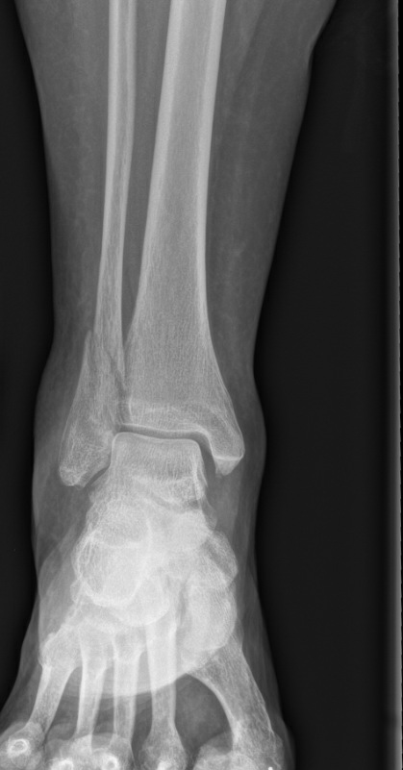
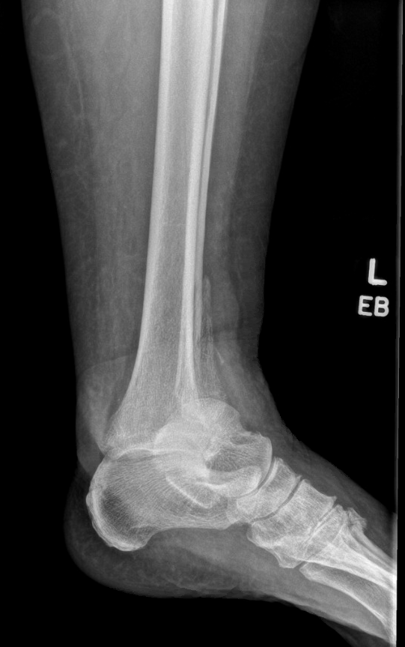
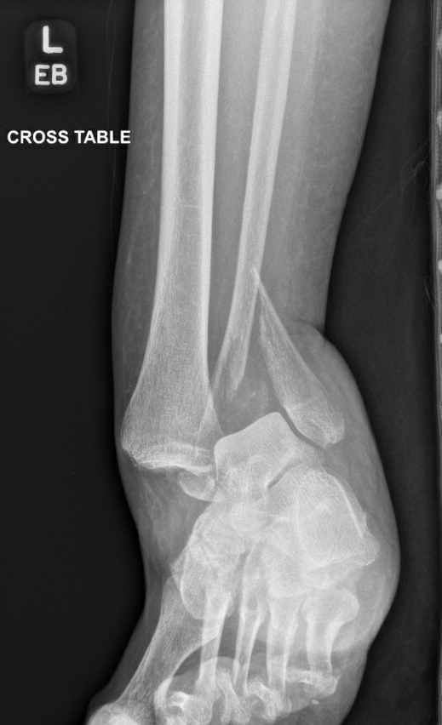
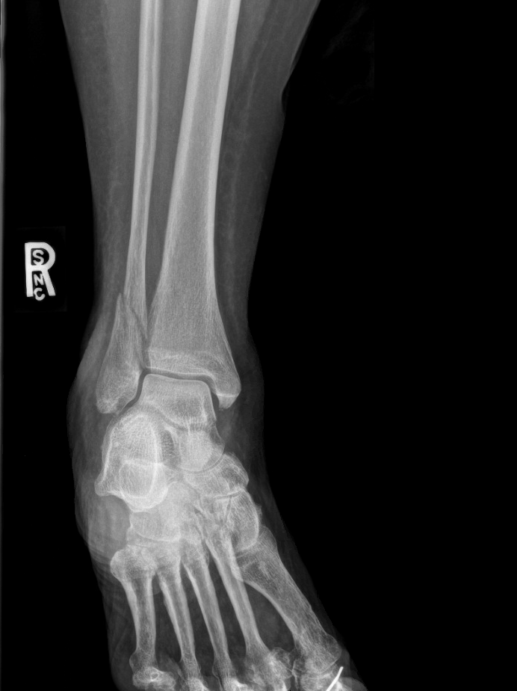
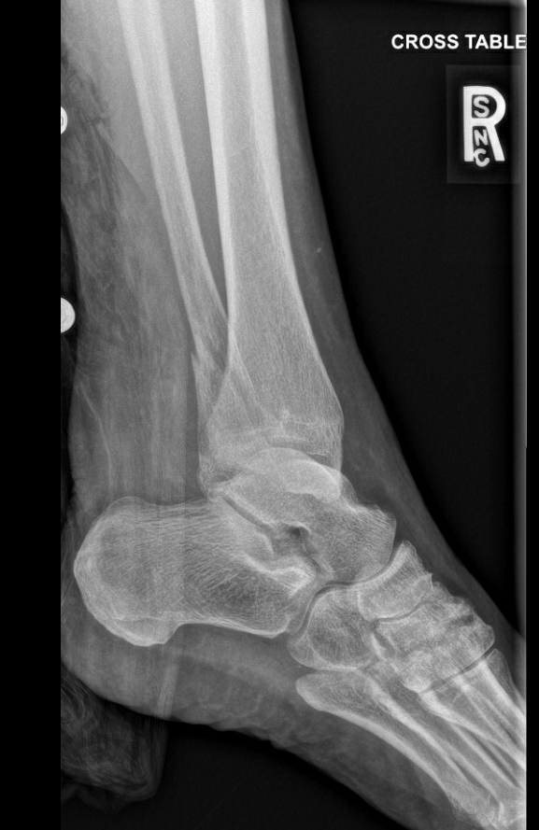
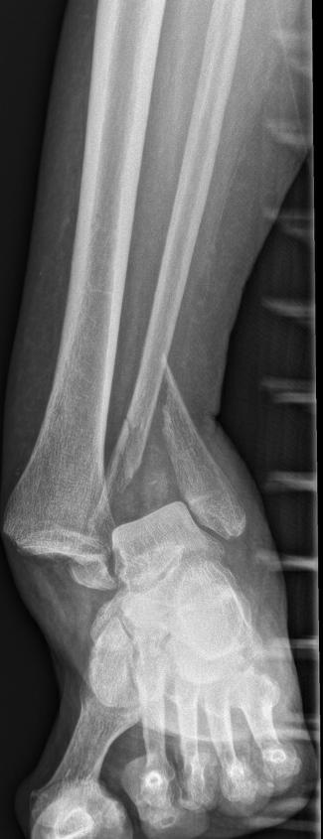
Non-operative – 89yo F B/L ankle fractures
Closed skin over medial mal on left but significantly swollen and very tenuous. Not amenable to surgical intervention.

Slide 48
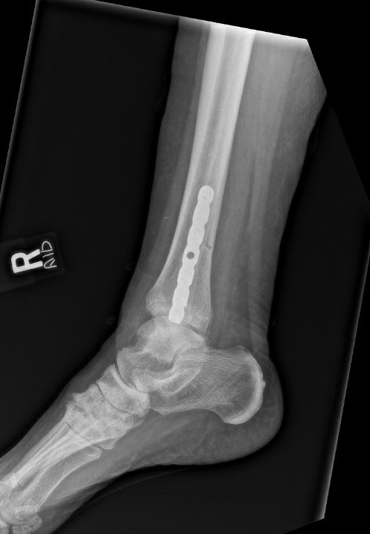
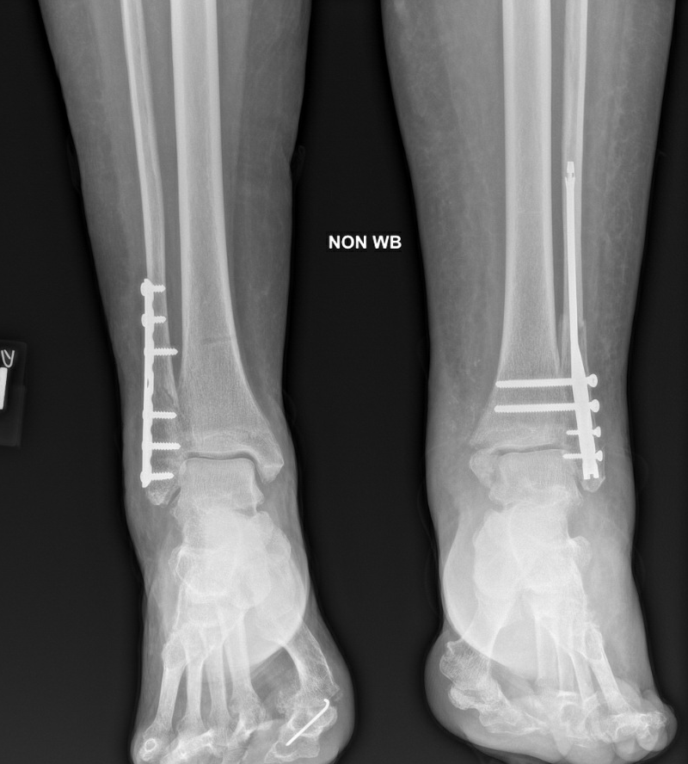
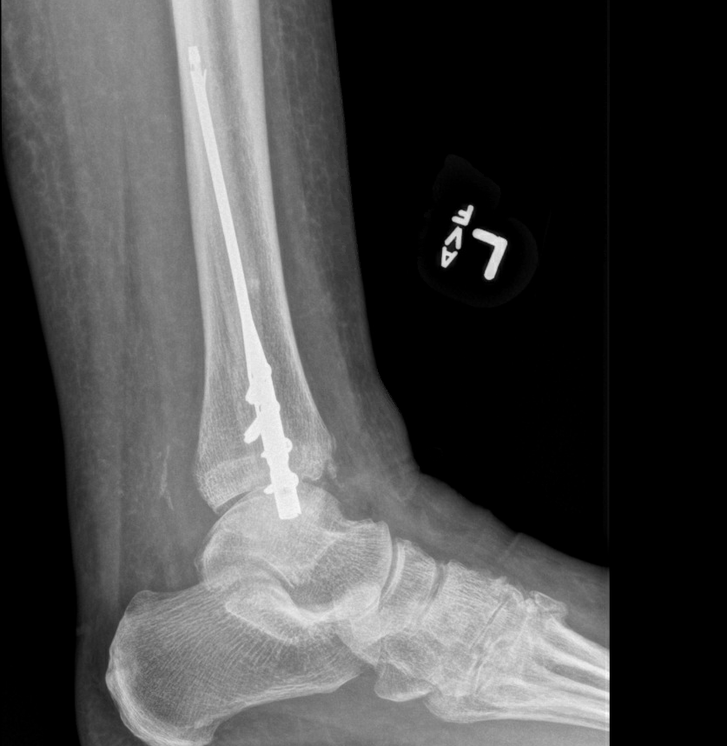
Cont -
Fibula nail with syndesmotic fixation utilized, minimal instability appreciated
No medial skin issues and patient did not require return trip to operating room

Slide 49
Fixation Techniques
Posterior Malleolus and Syndesmosis

Slide 50
Syndesmosis Fixation
Same principles for all ankles regardless of age
Determine stability
X-ray entire tibia
Look for any medial clear space or tib/fib widening
Obtain contralateral ankle x-rays
Stress X-ray
Very low threshold to CT
Missed syndesmotic injury can lead to poor patient outcomes

Slide 51
Syndesmosis Fixation
Fixation Technique – Surgeon Choice
Reduction Technique
Open vs closed
Ankle position at time of fixation
O-Arm?
Screw Fixation
1 or 2 screws
3 or 4 cortices
Remove screws or leave
Suture Fixation vs Screw Fixation

Slide 52
Syndesmosis – Authors preferred Algorithm
Reduction hand tight with ankle in neutral flexion
Pin in place with K wire outside of planned fixation
Confirm with x-ray and direct visualization anterior when possible
Compare to contralateral ankle
Determine bone quality and fracture pattern
Preference to use suture fixation
Comminuted fibula fracture and/or poor bone quality →Screw Fixation
Two screws through lateral plate to improve strength of fibula construct and syndesmotic fixation
Four cortices to increase strength and aide in removal if needed in future
In geriatric population, no plan for removal of screws. Counsel patient they may break once healed

Slide 53
Lateral Mal Fracture with evidence of syndesmotic injury
Remained unstable after fibular fixation
Good bone quality, no fibular comminution

Slide 54
Suture Fixation of syndesmosis performed
Stabile on stress exam afterward

Slide 55
Posterior Malleolus Fracture
Plays role in overall ankle stability
Attachment point of PITFL
Fixation technique dependent on fragment size, location, and often times more important patient comorbid conditions and soft tissue envelop.

Slide 56
Posterior Malleolus Fracture - Options
Direct Reduction with plate and screw construction
Most stable fixation
Often allows for anatomical reduction with direct visualization
In some instances can allow for earlier weightbearing
**Requires prone or lateral positioning (patient may not tolerate, makes medial fixation more challenging)
**Increased soft tissue dissection required, increased operating time
Indirect reduction and fixation with Anterior to Posterior screw fixation
No need for special positioning
Minimal soft tissue injury
**Reduction more difficult
**Risk of neurovascular injury with anterior dissection
Stabilization of ankle with syndesmotic type fixation and no fixation of posterior fragments
Minimal extra soft tissue dissection, no special positioning, no risk of anterior NV injury
**Risk of syndesmotic mal reduction
**Often requires longer immobilization than other techniques

Slide 57
Posterior Malleolus Fracture -
Indirect reduction and fixation with Anterior to Posterior screw fixation

Slide 58
Posterior Malleolus Fracture - Options
Stabilization of ankle with syndesmotic type fixation and no fixation of posterior fragments.
Trimal fracture Obese, diabetic male with chronic venous stasis issues

Slide 59
Posterior Malleolus Fracture
Poor candidate for prone or lateral position. Poor soft tissue envelope
Stabilization of medial and lateral components complete.
Continued concern for instability with stress exam (arrow)
Syndesmotic fixation added, no posterior fixation

Slide 60
Posterior Malleolus Fracture - Options
Direct Reduction with plate and screw construction
Large posterior fragment (>50% of joint)
Ex fix utilized until skin and patient appropriate for prone position and direct posterior fixation through posterior lateral approach.

Slide 61
Fixation Techniques
Non-operative Management

Slide 62
Fixation Techniques – Non operative
At times, surgery is not the correct answerer
Risks out weigh benefits
Patient Preference

Slide 63
Fixation Techniques – Non operative
Patient presented 2 weeks from injury, ambulating during that period.
Patient requested non-operative management.
Continued to WBAT in cast despite recommendations. Minimal pain at 2 months

Slide 64
Fixation Techniques – Non operative
Untreated pheochromocytoma. Blood pressures routinely 220/150’s.
Anesthesia and Hospitalist team deem to high risk for any procedure

Slide 65
Fixation Techniques – Non operative
Casting with limited WB for 8 weeks followed by progressive WB.
Minimal pain with ambulation at 8 months
No change in pheochromocytoma status

Slide 66
Conclusion
Geriatric ankle fractures are increasing as population ages
Present unique challenges
Patients have high amount of medical comorbidities
Operative treatment has increased risk of complications compared to non operative treatment but leads to superior functional outcomes and decreases morbidity
Each fracture is unique and fixation must be dictated by fracture pattern, bone quality, soft tissue condition
Optimize fixation to allow for early mobilization
Follow closely for complications

