Slide 1
Bone Health Management
OTA Core Curriculum
October 2020
Jill Martin, MD
Medical College of Wisconsin
Milwaukee, WI

Slide 2
Disclosures
I have no potential conflicts with this presentation.
My disclosures:
Reviewer - Journal of Surgical Education

Slide 3
Objectives
Review the definition, epidemiology and implications of osteoporosis and fragility fractures.
Learn how to identify fragility fractures.
Understand the work-up for osteoporosis.
Review current the current treatments for osteoporosis.
Understand our role as orthopaedic surgeons in the identification, work-up and treatment of osteoporosis and fragility fractures.

Slide 4
Case
68 yo caucasian female tripped and fell while taking her trash out.
Presents with left shoulder pain.
PMH: hypertension, rheumatoid arthritis
PSH:
right distal radius fracture ORIF 2 years ago (sustained after a ground level fall)
appendectomy
Medications: lisinopril, steroids for RA
Allergies: NKDA

Slide 5
Case
SH: former smoker
FH: mother had a hip fracture shortly before she died
PE:
BMI 30 (180 lbs; 5’5’’ tall)
Left upper extremity swollen and ecchymotic
NV intact
Pain with ROM of shoulder

Slide 6
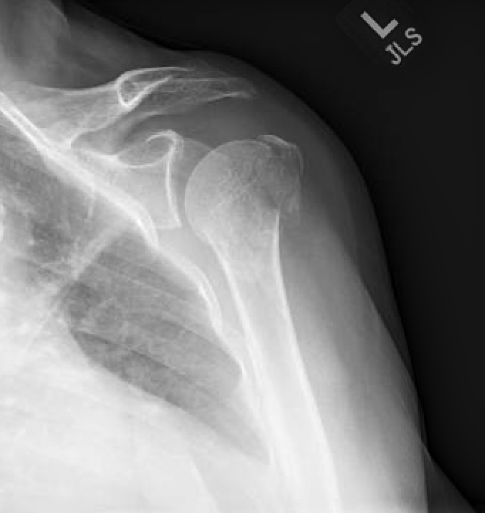
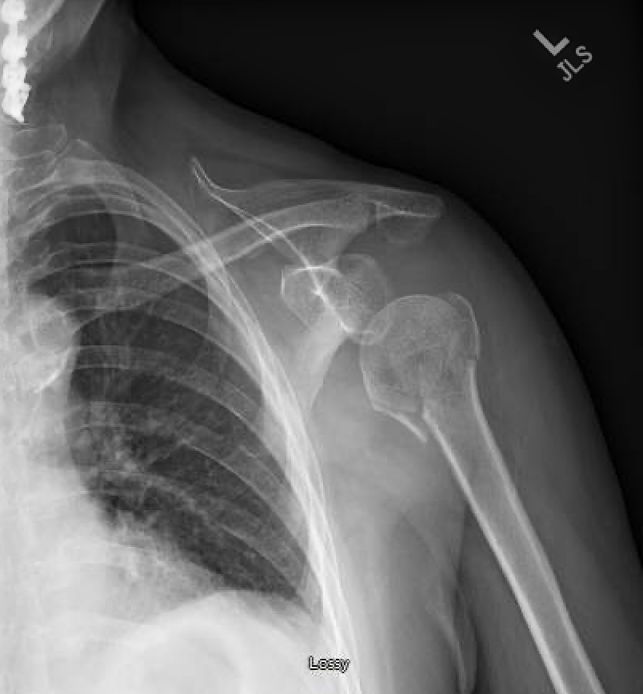
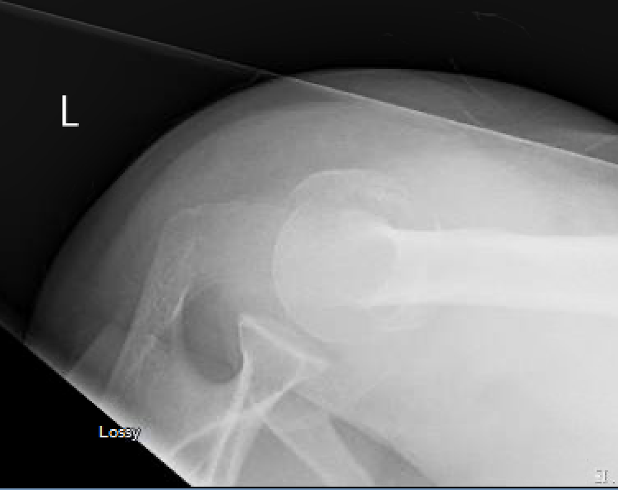
Case

Slide 7
Is this a fragility fracture?
YES!
WHO Definition of a Fragility Fracture:
“A fracture caused by injury that would be insufficient to fracture normal bone; the result of reduced compressive and/or torsional strength of bone.”²⁸
Fractures from low-energy mechanisms (falls from standing height)
Fractures with no identifiable trauma.

Slide 8
Why do we care?
Notes:
To answer that question, we need to delve into some background information about osteoporosis and fragility fractures.

Slide 9
What is osteoporosis?
A “bone disease that occurs when the body loses too much bone, makes too little bone, or both.”
-National Osteoporosis Foundation (NOF)²¹

Slide 10
Osteoporosis Epidemiology
54 million people in the US have low bone mass¹⁷
10 million have osteoporosis in the US¹⁷
More than 70 million people will be affected by 2030 according to the National Osteoporosis Foundation¹⁷

Slide 11
Osteoporotic Fracture Epidemiology
~9 million osteoporotic fractures occur worldwide per year²¹
That’s a fracture happening every 3 seconds!
61% of osteoporotic fractures occur in women²¹
Lifetime risk of an osteoporotic fracture for a man is more than 2x the lifetime risk of prostate cancer (27% vs 11.3%)!
1 in 2 women and 1 in 4 men over 50 years old will sustain an osteoporosis-related fracture.²³

Slide 12
Consequences of Osteoporosis & Fragility Fractures
“Geriatric fractures threaten independence, cause institutionalization, and increase mortality risk.”¹
Mortality after a hip fracture = 15-30% within the year!²³
52.4% of deaths occur in the first 3 months
72.5% occur within the first 6 months
1-year mortality is 20% greater in men compared to women²¹
Fragility fractures cost ~$19 billion annually in the US²⁷

Slide 13
Why do we care?
Fragility fractures are a huge source of morbidity and mortality!

Slide 14
Osteoporosis & Joint Replacements
~60% of patients with a total joint arthroplasty (TJA) have/develop osteopenia or osteoporosis!²²
77% of arthroplasty surgeons believe poor bone quality influences the choice of implant yet only 5% test for osteoporosis.¹
Identifying which patients have osteoporosis or osteopenia prior to joint replacement is helpful!

Slide 15
Osteoporosis & Joint Replacements
Treatment decreases peri-implant osteoporosis, periprosthetic fractures and need for revisions!¹
DXA after TKA and THA shows bone loss around the implants as high as 20%!
Limited data exists but a meta-analysis shows bisphosphonates after THA and TKA can prevent osteolysis and stress-shielding around implants → 52-55% decrease in periprosthetic fracture and revision!

Slide 16
Osteoporosis & Spine Surgery
69-84% of all patients undergoing elective spine surgery have low vitamin D.¹
Low vitamin D is associated with:
Increased severity of pain from lumbar spinal stenosis
Increased time to fusion after lumbar fusion
3.5x more likely to develop a pseudarthrosis

Slide 17
Osteoporosis & Spine Surgery
Up to 50% of patients have osteopenia or osteoporosis who undergo elective spine surgery.¹
Higher rates of failed fusion
50% of patients with osteoporosis have complications (kyphosis, hardware failure, fracture, screw loosening, subsidence, proximal junction fractures)
Treatment with bisphosphonates reduces the risk of these complications and decreases time to fusion¹

Slide 18
Does she have osteoporosis?
Notes:
We have identified this as a fragility fracture. Now we need to know, does she have osteoporosis. And to determine that, we will delve into the workup of osteoporosis.

Slide 19
Osteoporosis Workup
Labs:
CBC
Fasting comprehensive metabolic panel to evaluate:
creatinine
LFTs
nutritional status via total protein & albumin levels
Serum calcium, phosphate, magnesium
TSH
25-hydroxy vitamin D level
24-hr urine calcium and creatinine
Intact parathyroid hormone levels (PTH)
Testosterone levels in men
Other labs as indicated
Notes:
These help evaluate for secondary causes of osteoporosis. (i.e. hyperthyroidisim, hyperparathyroidism, hypogonadism)

Slide 20
Osteoporosis Workup
-25-hydroxy vitamin D level
normal is between 20 and 40 ng/mL

Slide 21
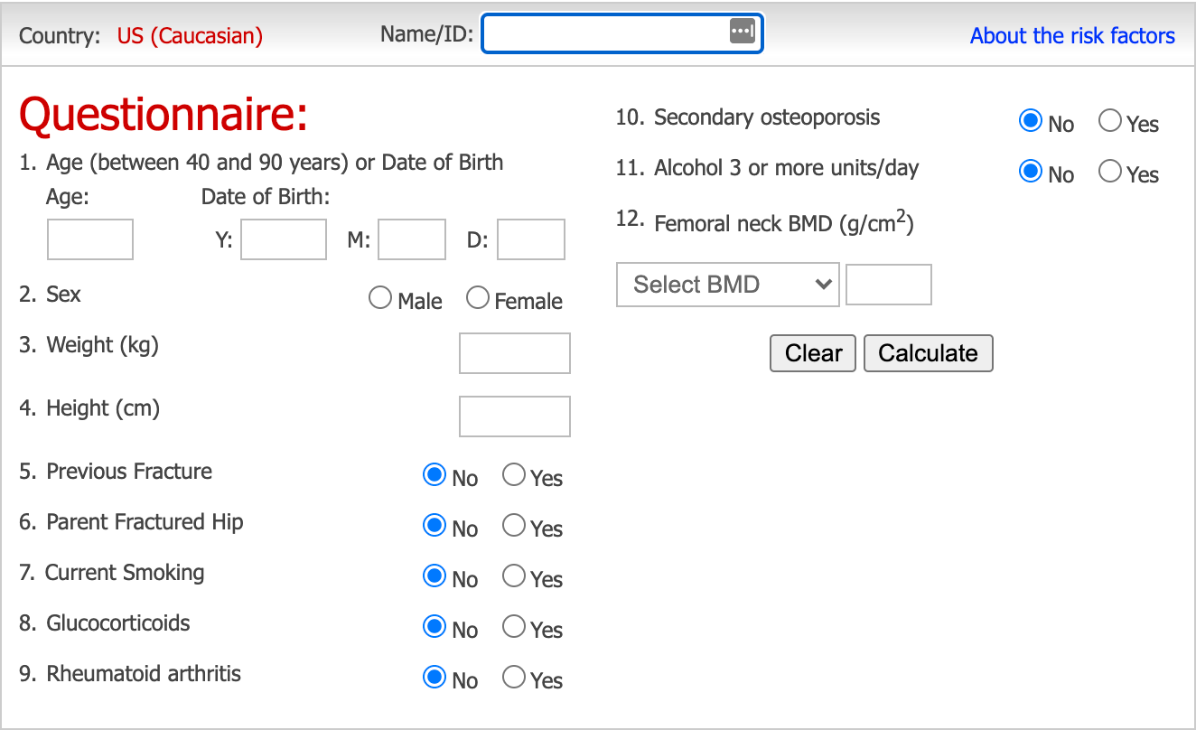
Fracture Risk Assessment Tool (FRAX)
Estimates the 10-year probability of a hip fracture or combined risk of major osteoporotic fracture (hip, spine, shoulder, or wrist) based on risk factors and femoral neck BMD.
https://www.sheffield.ac.uk/FRAX/tool.aspx
Validated with and without knowing the femoral neck BMD
Can be used to determine the need for pharmacologic therapy

Slide 22
Fracture Risk Assessment Tool (FRAX)
Free online calculator at: https://www.sheffield.ac.uk/FRAX/tool.aspx

Slide 23
What are her risk factors for osteoporosis?
68 yo caucasian female tripped and fell while taking her trash out.
PMH: hypertension, rheumatoid arthritis
PSH: right distal radius fracture ORIF 2 years ago (sustained after a ground level fall)
Medications: lisinopril, steroids for RA
Allergies: NKDA
SH: former smoker
FH: mother had a hip fracture shortly before she died
PE: BMI 30 (180 lbs; 5’5’’ tall)

Slide 24
What are her risk factors for osteoporosis?
68 yo caucasian F tripped and fell while taking her trash out.
PMH: hypertension, rheumatoid arthritis
PSH: right distal radius fracture ORIF 2 years ago (sustained after a ground level fall)
Medications: lisinopril, steroids for RA
Allergies: NKDA
SH: former smoker
FH: mother had a hip fracture shortly before she died
PE: BMI 30 (180 lbs; 5’5’’ tall)
Notes:
RIsk factors = age > 60, Caucasian, female, RA, hx of fragility fx, steroid use, current or former tobacco user, family history of osteoporosis

Slide 25
Other Risk Factors for Osteoporosis:
Excessive alcohol use (3+ drinks/day)
Low body weight
Limited exercise
Low calcium and vitamin D intake
Late menarche
Early menopause (before age 40) ^{21,23}

Slide 26
Causes of Secondary Osteoporosis
Hyperparathyroidism
Thyroid problems
Hypogonadism
Diabetes
Multiple myeloma
Inflammatory bowel disease
Inflammatory arthritis
Malabsorption problems
Radiation (regional osteoporosis)
Cushing’s disease
Eating disorders
20-30% of osteoporosis in women and >50% of cases in men are due to secondary causes!²⁴
*This is why a laboratory workup is important!

Slide 27
Causes of Secondary Osteoporosis
Medications:
Anticonvulsants
Glucocorticoids
Aromatase inhibitors
Androgen deprivation therapy
Proton pump inhibitors (PPIs)
SSRIs
Depo-Provera
Coumadin¹³
High-dose statins (low-dose statins may be protective!)¹⁸

Slide 28
What is our patient’s FRAX score?

Slide 29
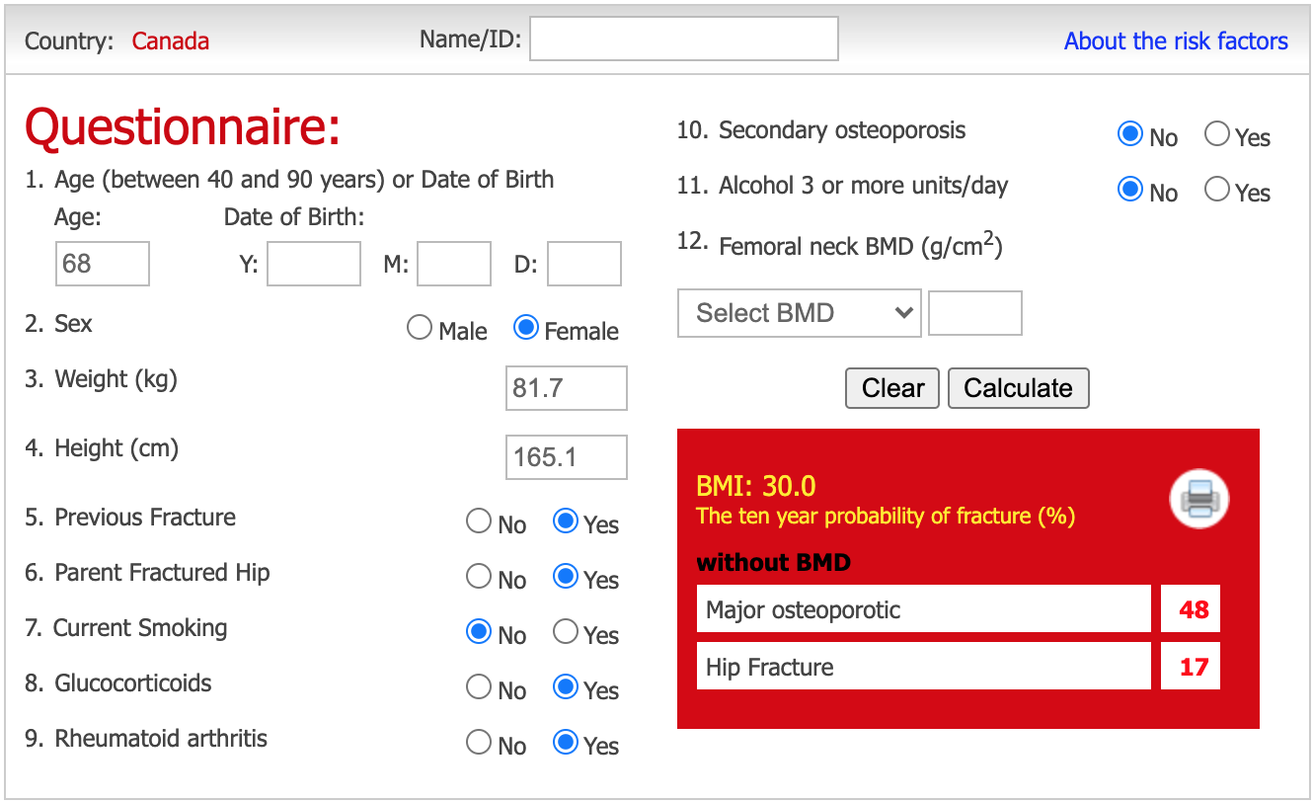
https://www.sheffield.ac.uk/FRAX/tool.aspx

Slide 30
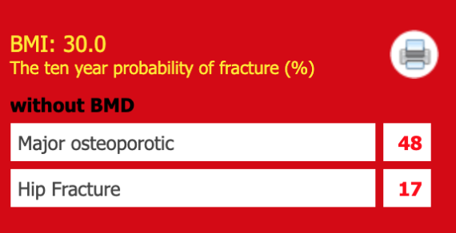
Fracture Risk Assessment Tool (FRAX)
>3% risk for hip fracture or greater than 20% for any major osteoporotic fracture → recommend medical treatment in postmenopausal women age 50+.^{21,23}
Our patient needs treatment!
https://www.sheffield.ac.uk/FRAX/tool.aspx

Slide 31
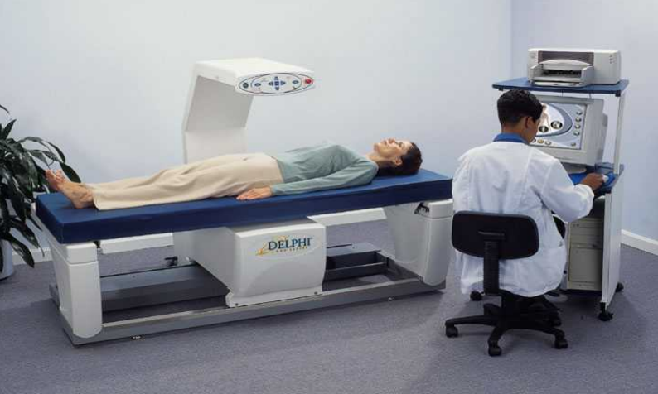
Dual X-ray Absorptiometry (DXA) Scanning
Determines the bone mineral density at the distal part of the radius, hip, and lumbar spine.
Indications:
Men >/= 70 yo
Women >/= 65 yo
Younger men and women with risk factors^{21,23, 28}

Slide 32
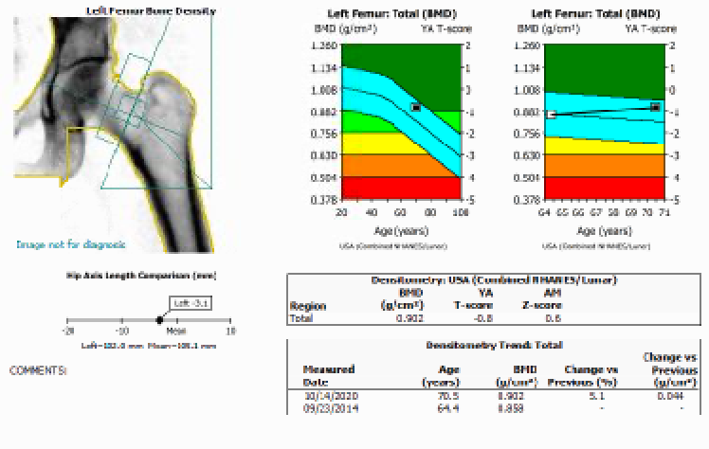
Dual X-ray Absorptiometry (DXA) Scanning
T-score: compares the patient’s BMD to a 30 y/o woman
Used to diagnose postmenopausal women and men > 50 yo
Notes:
Picture is evaluating the BMD at the L femoral neck.

Slide 33
Dual X-ray Absorptiometry (DXA) Scanning
 | T-Score
Healthy Individual | > -1
Osteopenia | -1 to -2.4
Osteoporosis | </= -2.5
*standard deviations below the mean
Severe osteoporosis = the addition of a fragility fracture²³

Slide 34
Dual X-ray Absorptiometry (DXA) Scanning
Z-score: compares the patient’s BMD to a healthy age-matched control of the same sex and race
Used in children and patients < 50 y/o
Z-score </= -2.0 in a premenopausal woman or a man < 50 y/o = low BMD for chronological age
→ look for secondary causes of osteoporosis.²¹

Slide 35
DXA scans are important for diagnosing osteoporosis, but...
Osteoporosis can be diagnosed based on low-energy hip or spine fracture, no matter what the DXA scan shows!

Slide 36
Case
The patient’s DXA results:
T-score: -2.5
Does she have osteoporosis and does she need treatment?
Yes! Her T-score indicates osteoporosis and her FRAX scores are high enough to recommend treatment!

Slide 37
Dual X-ray Absorptiometry (DXA) Scanning
Should be repeated every 3-5 years in at-risk patients.²³
Changes in DXA scans do not always correlate with fracture risk, even if on treatment.
Fracture risk decreases upon starting treatment, even before changes are seen on DXA scans.
Therefore, more frequent DXA scans are not indicated.
There is significant variability among DXA machines. Unless the scan is done on the same machine, results may not be comparable.

Slide 38
Can you tell if she has osteoporosis based on her xrays?
Osteoporosis cannot be formally diagnosed on xray, but osteoporotic changes can be seen on xray if there is at least 30-50% bone loss.¹⁴

Slide 39
Other Imaging Modalities
High-Resolution Peripheral Quantitative CT²¹
Assesses the microarchitecture of the distal skeleton → volumetric BMD of cortical and trabecular bone
Need more research on this.
Quantitative Ultrasound of the Heel (QUS)¹⁰
Predicts future hip fracture risk as well as DXA
Portable, cheaper, no radiation, & doesn’t require specially-trained technicians
Notes:
Things we might be hearing more of in the future!

Slide 40
Case
“So what do I do about my osteoporosis?”

Slide 41
Osteoporosis Treatment
Activity modification & lifestyle changes
Medical therapy

Slide 42
Activity Modification & Lifestyle Changes
Diet changes
Low protein levels are associated with fractures in the elderly.
Low vitamin K (in leafy green vegetables, soybean and canola oil) is also associated with osteoporosis.
Smoking cessation
Decreased alcohol consumption
Increased activity
Weight-bearing exercise
Resistance exercise

Slide 43
Osteoporosis Treatment - Exercise
Weight-bearing aerobic exercise:
Walking alone probably doesn’t improve overall BMD
>/= 12 months of Tai Chi may improve BMD
Resistance exercise:
Results in small, but significant localized improvements in BMD.³
Example: stair climbing and squats improve BMD in the hip and lumbar spine
3x/week x 1 year to be effective³

Slide 44
Why do weight-bearing exercises increase bone mineral density?
Wolff’s Law - bone remodels in response to mechanical stress

Slide 45
Osteoporosis Treatment - Exercise
Reduces the risk of falls.⁸
Exercise results in femoral neck and lumbar spine BMD improvements which reduce fragility fracture risk by 10%!⁸
120-300 minutes of moderate or higher intensity activity per week was associated with fewer hip fractures in older adults.
Adding in resistance and balance exercises → fewer falls²¹

Slide 46
Vitamin D & Calcium Supplementation
1 billion people are deficient or insufficient in vitamin D worldwide!!²⁶
77% of Americans
>50% of patients sustaining a fragility fracture have low vitamin D levels.⁶
1000-1200 mg calcium citrate
easier on the stomach and to digest
divided in 2 doses
2000 units vitamin D3
Improved absorption when taken with fat
Ergocalciferol is no longer recommended (due to issues with accurate laboratory measurements)!¹

Slide 47
Vitamin D & Calcium Supplementation
Risk of hip fractures by 30%²¹
Risk of all fractures by 15%²¹
Risk of hip fractures in a nursing home environment by 23%¹

Slide 48
Medical Treatment
Indications:
Low risk for future fractures → activity modification & vitamin D/calcium supplementation
High risk → above + medical therapy

Slide 49
Medical Treatment
Antiresorptive Drugs (Catabolic Agents):
Bisphosphonates
Denosumab
Calcitonin
Estrogen
Selective estrogen receptor modulators
Bone Stimulants (Anabolic Agents):
Recombinant parathyroid hormone
Romosozumab
Strontium ranelate
Notes:
We are only going to cover a few of these.

Slide 50
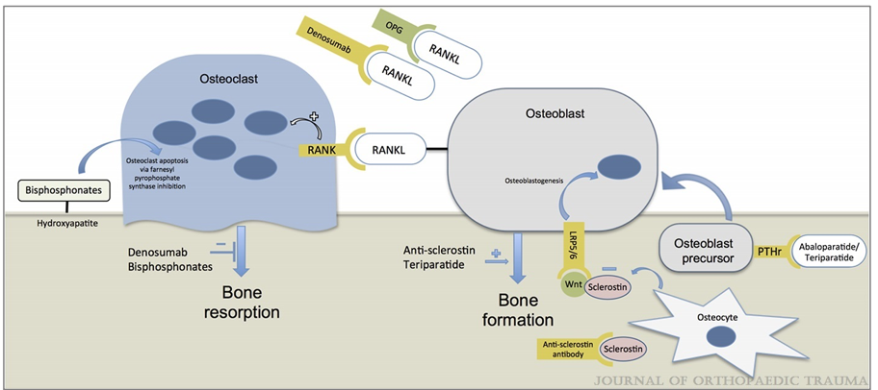
Illustration of mechanisms of anti-osteoporosis medications.
Image from: Cohn MR, Gianakos AL, Grueter K, et al. Update on the Comprehensive Approach to Fragility Fractures. Journal of Orthopaedic Trauma 32(9):480-490, September 2018.
doi: 10.1097/BOT.0000000000001244

Slide 51
Bisphosphonates
Pyrophosphate analogs that bind to calcium in bone and prevent bone loss due to osteoclast inhibition.²³

Slide 52
Bisphosphonates
Non-nitrogen-containing:
Make ATP analogs that build up in osteoclasts —> osteoclast apoptosis
Older, less potent
Examples: etodronate
Nitrogen-containing:
Inhibit farnesyl transferase in osteoclasts —> osteoclast apoptosis
More potent
Less frequent dosing
Examples:
alendronate (Fosamax)
zoledronic acid (Reclast & Zometa)
ibandronate (Boniva)
risedronate (Actonel)

Slide 53
Case
“I don't know doc. I've heard a lot of bad things about these drugs and I'm worried about the side effects.”
Notes:
I hear this all the time from patients in clinic.

Slide 54
Bisphosphonates
Risk of vertebral compression fractures by 45-70%¹
Risk of hip fracture by 40-45%¹
Risk of other fractures by 15-25%¹
Shown in multiple randomized controlled trials²³
Cost-effective!
Treating 1000 patients x 3 years prevents 100 fractures!
NNT: 10!

Slide 55
Bisphosphonate Risks
-The most common side effects are upper GI symptoms.^{21, 23}
20% to 30% will experience these side effects from oral medications
Increased risk in older individuals
Reduce the risk by avoiding NSAIDS, taking with plenty of water and remaining upright for 30 minutes after ingestion
Can avoid with IV administration (30% get flu-like symptoms)

Slide 56
Bisphosphonate Risks
Atypical femoral fractures:
1.74 fractures per 10,000 patient-years
Risk goes up with duration of treatment with bisphosphonates
Risk factors = Asian race, glucocorticoid use, decreasing height and increasing weight
Risk goes down rapidly with discontinuation!

Slide 57
Bisphosphonate Risks - Atypical Femur Fractures (AFF)
In a study in the NEJM, after 5 years of bisphosphonate treatment in white women:
286 hip fractures were prevented!
859 fragility fractures were prevented!
8 atypical femur fractures occurred!
The benefit far outweighs the risk of AFF!

Slide 58
Bisphosphonate Risks
Jaw osteonecrosis:
RARE!
0.7 per 100,000 persons per year
Reduce the risk by completing any possible dental work prior to starting the medication.

Slide 59
Bisphosphonate Therapy Duration
Bisphosphonates can last in bone for 30-60 years!!¹ → “bisphosphonate holidays”
Stop oral bisphosphonates after 5 years.
Stop IV bisphosphonate after 3 years.
Can be resumed with modified dosing when bone mass decreases on DXA scanning again.²³
“Bisphosphonate holidays” decrease the risks of bisphosphonates²³

Slide 60
Can bisphosphonates will delay fracture healing?
Probably not.
Some conflicting studies regarding this exist but the majority of studies do not show a negative effect on fracture healing.
Notes:
No formal recommendations regarding the timing of starting a bisphosphonate after a fracture.

Slide 61
Bisphosphonates & Fracture Healing
HORIZON Trial⁴
No difference in fracture healing between zoledronic acid and placebo.
No difference in fracture healing when zoledronic acid was started within 2 weeks after fracture vs 12 weeks post-fracture.

Slide 62
Denosumab
Monoclonal antibody that inhibits RANKL (receptor activator of nuclear factor kappa-B ligand)

Slide 63
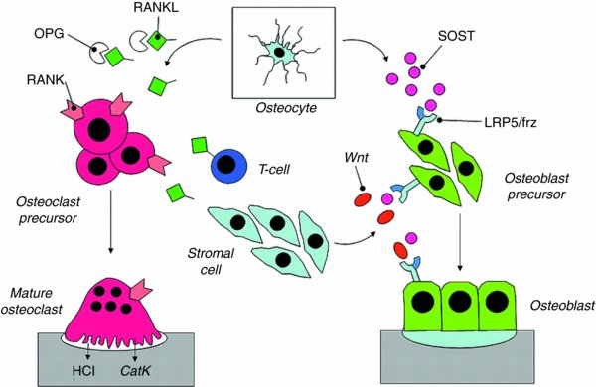
Denosumab
Prevents RANKL from activating osteoclasts²³
Image from: Ralston, SH. Osteoporosis and Metabolic Bone Disease. In: Tornetta P, Ricci WM, eds. Rockwood and Green's Fractures in Adults, 9e. Philadelphia, PA. Wolters Kluwer Health, Inc; 2019.
Notes:
Ralston, SH. Osteoporosis and Metabolic Bone Disease. In: Tornetta P, Ricci WM, eds. Rockwood and Green’s Fractures in Adults, 9e. Philadelphia, PA. Wolters Kluwer Health, Inc; 1969:
Todd VR. Visual information analysis: frame of reference for visual perception. In: Kramer P, Hinojosa J, eds. Frames of Reference for Pediatric Occupational Therapy. Philadelphia, PA: Lippincott Williams & Wilkins; 1999:205–256.
Ralston, SH. Osteoporosis and Metabolic Bone Disease. In: Tornetta P, Ricci WM, eds. Rockwood and Green’s Fractures in Adults, 9e. Philadelphia, PA. Wolters Kluwer Health, Inc; 1969:
Todd VR. Visual information analysis: frame of reference for visual perception. In: Kramer P, Hinojosa J, eds. Frames of Reference for Pediatric Occupational Therapy. Philadelphia, PA: Lippincott Williams & Wilkins; 1999:205–256.

Slide 64
Denosumab
Randomized controlled trials in women with osteoporosis show that compared to placebo, denosumab showed a significant reduction in:
vertebral fractures
non-vertebral fractures
hip fractures²³

Slide 65
Denosumab
Useful in renal insufficiency (bisphosphonates are contraindicated in CKD)
Osteonecrosis of the jaw is a rare side effect.
Rebound vertebral compression fractures can occur with discontinuation so treatment with a different osteoporosis medication should be considered when stopping denosumab.
Atypical femur fractures can also rarely occur.

Slide 66
Recombinant Parathyroid Hormone
When dosed intermittently (once daily), it has an anabolic effect on bone and leads to an increase in BMD.
More continuous dosing leads to bone resorption.
Teraparatide and Abaloparatide

Slide 67
Recombinant Parathyroid Hormone
Uses:
Patients with severe osteoporosis
Can’t tolerate bisphosphonates or need a bisphosphonate holiday
Teraparatide reduces the risk of vertebral fractures and other fractures, but not hip fractures²¹
Abaloparatide decreases the risk of all fractures²¹
Results in quicker healing of distal radius and pubic rami fractures

Slide 68
Recombinant Parathyroid Hormone
Risks:
Most common side effects: nausea, headache, transient hypercalcemia
BLACK BOX WARNING: Long-term use and use in Paget's disease is associated with osteosarcoma.
Contraindicated in Paget’s disease
Max treatment duration = 2 years
Not seen with low-dose, short-term use²³
Notes:
Osteosarcoma is not seen with low-dose and short term use

Slide 69
Recombinant Parathyroid Hormone
Switch to a bisphosphonate at the end of treatment with rPTH to avoid rapid bone loss.
Notes:
Osteosarcoma is not seen with low-dose and short term use

Slide 70
Romosozumab
Monoclonal antibody against sclerostin^{12, 25}
Sclerostin = cytokine secreted by osteocytes that inhibits the Wnt signaling pathway that controls osteoblast formation and activity^{12, 25}
Increases bone formation AND decreases bone resorption!^{12, 25}
Effectiveness at increasing bone formation decreases after 1 year.²⁵

Slide 71
Romosozumab
= Sclerostin
Image from: Ralston, SH. Osteoporosis and Metabolic Bone Disease. In: Tornetta P, Ricci WM, eds. Rockwood and Green's Fractures in Adults, 9e. Philadelphia, PA. Wolters Kluwer Health, Inc; 2019.

Slide 72
Romosozumab
ARCH study showed a 38% relative risk reduction of hip fracture compared to those taking alendronate!¹²
Indications¹²:
Post-menopausal women
Patients with contraindications to rPTH (history of previous radiation, CKD) or who have completed their 2-year treatment course with rPTH
BLACK BOX WARNING: may increase the risk of MI, stroke or CV death!^{12, 25}

Slide 73
What is our role as orthopaedic surgeons in the management of patients with fragility fractures?
It’s not enough to just treat their fracture!

Slide 74
< 25% of patients with a 1st time fragility fracture receive osteoporosis treatment.¹⁷
Rate of pharmacologic treatment for osteoporosis is only around 20%!¹
Having a fragility fracture is the greatest risk factor for having another fragility fracture!
It is our responsibility to get these patients the education and treatment they need!

Slide 75
“Own the Bone”
Nationwide initiative started by the American Orthopaedic Association (AOA) in 2009¹
Goals:
Set up a Fracture Liaison Service to identify, evaluate and treat patients > 50 yo who are at risk for osteoporosis
Prevent additional fractures

Slide 76
Prior to instituting “Own the Bone”, only ~1/3rd of women and 1/6th of men were being worked up & treated post-fragility fracture.
OWN THE BONE
53% of patients after a fragility fracture were tested for osteoporosis and treated!^{2,7}
Image courtesy of: https://ota.org/media/78904/10-Own-the-Bone-Fact-Sheet.pdf
Notes:
This number should be higher, but before the Own the Bone program, testing rates were actually decreasing with time!!

Slide 77
Fracture Liaison Services
FLS Coordinator (APP)
Improves identification of patients who need to be evaluated and treated.⁶
Fracture Liaison Service
Physician Champion
(Orthopedist, Endocrinologist, PCP, Geriatrician, or Gynecologist)
Nurse
Navigator
Image from: Cohn MR, Gianakos AL, Grueter K, Rosen N, Cong GT, Lane JM. Update on the Comprehensive Approach to Fragility Fractures. J Orthop Trauma. 2018 Sep;32(9):480-490. doi: 10.1097/BOT.0000000000001244. PMID: 30036208.

Slide 78
Inpatient Stay
Outpatient Follow-Up
Long-term Follow-Up
FLS coordinator & Nurse Navigator
Identifies at-risk patients in the hospital
Performs a Metabolic Bone Health Consult
Lab ordered and drawn prior to surgery (to ensure accuracy of their baseline health)
Recommends vitamin D & calcium
Provides education on lifestyle changes/activity modification
Outpatient referral
DXA
FRAX
Initiate pharmacologic therapy prn
Work on treatment compliance
Adherance to medication therapy is low! 30% at 1 year!¹⁷
Repeat DXA scan every 3 years
“Bisphosphonate holidays”
8. Cohn MR, Gianakos AL, Grueter K, Rosen N, Cong GT, Lane JM. Update on the Comprehensive Approach to Fragility Fractures. J Orthop Trauma. 2018 Sep;32(9):480-490. doi: 10.1097/BOT.0000000000001244. PMID: 30036208.

Slide 79
Our Role as Orthopaedic Surgeons
Identify at-risk patients & those with fragility fractures
Educate your patients
Is there a developed pathway for these patients in your hospital system?
If so, get them looped in!
If not, order necessary testing & start treatment if indicated.
Work to develop a pathway for these patients.

Slide 80
Take Home Points:
Osteoporosis and fragility fractures are a major source of morbidity and mortality.
The rate of osteoporosis treatment after fragility fractures is low.
Bisphosphonates are the first-line pharmacologic treatment of osteoporosis!
Identification of fragility fractures and getting these patients evaluated and treated for osteoporosis is our responsibility as orthopaedic surgeons!
In doing so, we can prevent future fragility fractures!

Slide 81
References
Anderson PA, Jeray KJ, Lane JM, Binkley NC. Bone Health Optimization: Beyond Own the Bone: AOA Critical Issues. J Bone Joint Surg Am. 2019 Aug 7;101(15):1413-1419.
Balasubramanian A, Tosi LL, Lane JM, Dirschl DR, Ho PR, O'Malley CD. Declining rates of osteoporosis management following fragility fractures in the U.S., 2000 through 2009. J Bone Joint Surg Am. 2014 Apr 2;96(7):e52. doi: 10.2106/JBJS.L.01781. PMID: 24695929.
Benedetti MG, Furlini G, Zati A, et al. The effectiveness of physical exercise on bone density in osteoporotic patients. Biomed Res Int 2018; 2018: 4840531. Published online 2018 Dec 23.
Black DM, Geiger EJ, Eastell R, et al. Atypical femur fracture risk versus fragility fracture prevention with bisphosphonates. N Engl J Med. 2020; 383:743-753
Bogoch ER, Elliot-Gibson V, Beaton D, Sale J, Josse RG. Fracture Prevention in the Orthopaedic Environment: Outcomes of a Coordinator-Based Fracture Liaison Service. J Bone Joint Surg Am. 2017 May 17;99(10):820-831. Doi:
Bogoch ER, Elliot-Gibson V, Wang RY, Josse RG. Secondary causes of osteoporosis in fracture patients. J Orthop Trauma. 2012 Sep;26(9):e145-52
Bunta AD, Edwards BJ, Macaulay WB Jr, et al. Own the Bone, a System-Based Intervention, Improves Osteoporosis Care After Fragility Fractures. J Bone Joint Surg Am. 2016;98(24):e109. doi:10.2106/JBJS.15.01494
Camacho PM, Petak SM, Binkley N, et al. American Association of Clinical Endocrinologists/American College of Endocrinology Clinical Practice Guidelines for the diagnosis and treatment of postmenopausal osteoporosis - 2020 Update. Endocrine Practice. 2020 May; 26(Suppl 1): 1-46.
Cohn MR, Gianakos AL, Grueter K, Rosen N, Cong GT, Lane JM. Update on the Comprehensive Approach to Fragility Fractures. J Orthop Trauma. 2018 Sep;32(9):480-490. doi: 10.1097/BOT.0000000000001244. PMID: 30036208.
Collinge C, LeBus G, Gardner MJ, Gehrig L. Osteoporosis in orthopaedic trauma patients: a diagnosis and treatment protocol. J Orthop Trauma. 2008 Sep;22(8):541-7; discussion 548-9. doi: 10.1097/BOT.0b013e31817d9c99. PMID: 18758285.
Colón-Emeric C, Nordsletten L, Olson S, et al. Association between timing of zoledronic acid infusion and hip fracture healing. Osteoporos Int. 2011 Aug;22(8):2329-36. Epub 2010 Dec 9.
Deal, Chad. Romosozumab: A New Era in Osteoporosis Treatment. November 7, 2019. Available at: https://consultqd.clevelandclinic.org/romosozumab-a-new-era-in-osteoporosis-treatment/. Accessed April 25, 2021.
Gage BF, Birman-Deych E, Radford MJ, Nilasena DS, Binder EF. Risk of Osteoporotic Fracture in Elderly Patients Taking Warfarin: Results From the National Registry of Atrial Fibrillation 2. Arch Intern Med. 2006;166(2):241–246.
Harris WH, Heaney RP. Skeletal renewal and metabolic bone disease. N Engl J Med. 1969 Jan 23;280(4):193-202 contd.
Holm JP, Hyldstrup L, Jensen JBE. Time trends in osteoporosis risk factor profiles: a comparative analysis of risk factors, comorbidities, and medications over twelve years. Endocrine. 2016 Oct; 54(1):241-255.
Jeray K, Swiontkowski M. Osteoporosis and Fragility Fractures: What Progress Have We Made?. JBJS Am. 2015;97:1553-4.
Kothawala P, Badamgarav E, Ryu S, Miller RM, Halbert RJ. Systematic review and meta-analysis of real-world adherence to drug therapy for osteoporosis. Mayo Clinic proceedings. 2007 Dec;82(12):1493–501.
Leutner M, Matzhold C, Bellach L, et al. Diagnosis of osteoporosis in statin-treated patients is dose-dependent. Annals of the Rheumatic Diseases 2019;78:1706-1711.
Lyles KW, Colón-Emeric CS, Magaziner JS, et al. Zoledronic acid and clinical fractures and mortality after hip fracture. N Engl J Med. 2007;357(18):1799. Epub 2007 Sep 17.
Ma D, Wu L, He Z. Effects of walking on the preservation of bone mineral density in perimenopausal and postmenopausal women: a systematic review and meta-analysis. Menopause. 2013 Nov;20(11):1216-26.
Matzkin EG, DeMaio M, Charles JF, Franklin CC. Diagnosis and Treatment of Osteoporosis: What Orthopaedic Surgeons Need to Know. JAAOS 2019 Oct 15; 27(20): e902-e912.
Miller A, Beyer D, Starring H, Leonardi C, Bronstone A, Dasa V. Importance of Routine Bone Mineral Density Screening Prior to Elective Total Joint Replacement. ORTHOPEDICS. 2019; 42: 310-312. doi: 10.3928/01477447-20191022-01 [link]
Morris J, Karkenny AJ, Toro JB. The management of osteoporosis after fragility fracture: The orthopaedic perspective. JBJS Reviews 2017;5(8):e4.
NIH Consensus Development Panel on Osteoporosis Prevention D Therapy. Osteoporosis prevention, diagnosis, and therapy. JAMA. 2001;285:785–795.
Romosozumab. Available at: https://reference.medscape.com/drug/evenity-romosozumab-1000158#0. Accessed April 25, 2021.
Sprague, Sheila PhD; Bhandari, Mohit MD, PhD, FRCSC; Devji, Tahira BSc; Scott, Taryn MSW; Petrisor, Brad MD, MSc, FRCSC; McKay, Paula BSc; Slobogean, Gerard P. MD, MPH, FRCSC Prescription of Vitamin D to Fracture Patients, Journal of Orthopaedic Trauma: February 2016 - Volume 30 - Issue 2 - p e64-e69
Why Own the Bone? [American Orthopaedic Association’s Own the Bone Website]. Available at: https://www.ownthebone.org/OTB/About/Why_Own_the_Bone/OTB/About/Why_Own_the_Bone.aspx?hkey=e655a654-77d6-43c2-9d35-931d7edad403. Accessed October 8, 2020.
World Health Organization. Guidelines for preclinical evaluation and clinical trials in osteoporosis. Geneva. 1998.

