Slide 1
Impending and Pathologic Fractures
Trey Gurich, MD
Faculty, Department of Orthopaedic Surgery
Prisma Health-Upstate
University of South Carolina School of Medicine- Greenville
Greenville, South Carolina

Slide 2
Objectives
Describe most common entities and epidemiology for osseous metastatic disease
Diagnosis and work-up of metastatic bony disease
Evaluation of impending pathologic fractures
Non-operative modalities/treatment
Estimation of prognosis/survival in order to plan fixation/reconstruction
Recognize disease-specific considerations
Treatment techniques for fixation and reconstruction

Slide 3
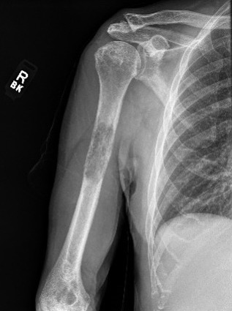
Epidemiology
American Cancer Society predicts ~1.7 million new cases of cancer per year
50% of which will metastasize to the skeleton
The role of the orthopedic surgeon is to:
1) Aid in diagnosis of bony metastatic disease
2) Aid in decision making regarding non-operative vs. operative modalities
3) Recognize disease specific considerations
4) Perform fixation or reconstruction

Slide 4
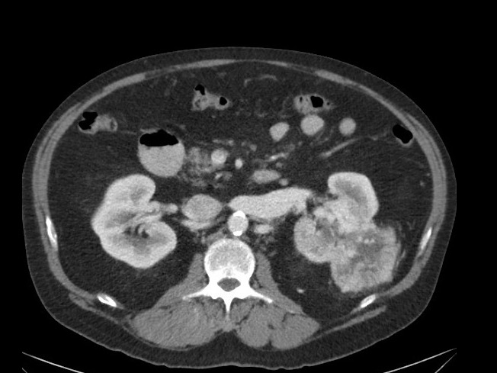
Epidemiology
Recognize the most common primary malignancies that metastasize to or affect the axial or appendicular skeleton (red = more common)
Carcinomas:
Breast
Thyroid
Renal
Lung
Prostate
Gastrointestinal (less common)
Other:
Lymphoma
Leukemia
Myeloma
Melanoma
Sarcoma (rare)

Slide 5
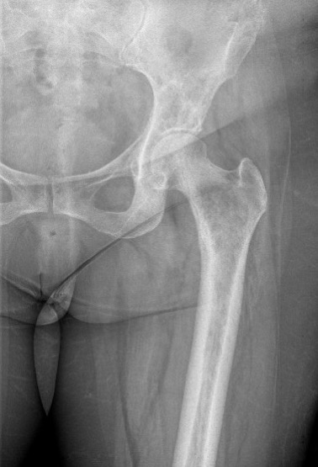
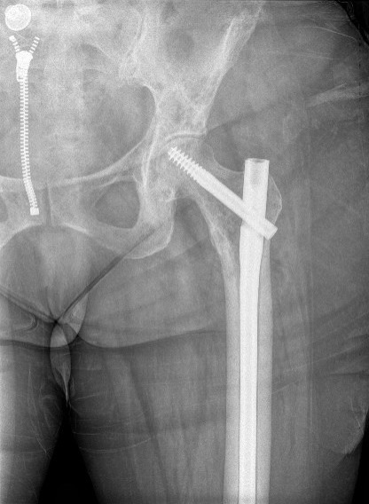
Epidemiology – Skeletal Related Events
“SREs”
Incidence varies based on primary cancer
Defined as a skeletal lesion that requires or involves one of the following:
-Pathologic fracture
-Surgery for a bone lesion
-Radiation of a symptomatic lesion
-Spinal cord compression due to a lesion
This is (for the most part) what we treat
Most medical modalities (immunotherapy, bisphosphonates, etc) are aimed at preventing SREs

Slide 6
How do you work up metastatic disease?
Symptoms/signs:
Pain is most common symptom
Some present with completed fracture (often from no traumatic event)
Very helpful to take detailed history
A lytic bone lesion in an adult needs further work-up
Most often is metastatic disease (especially age > 50 years) BUT:
Must rule out that lesion is NOT a primary bone sarcoma (treatment paradigm usually necessitates wide resection)

Slide 7
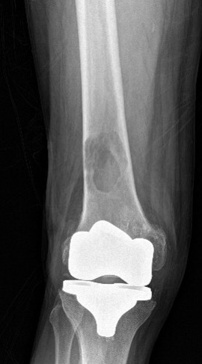
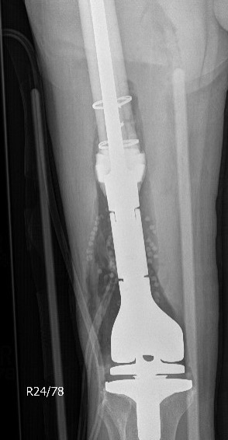
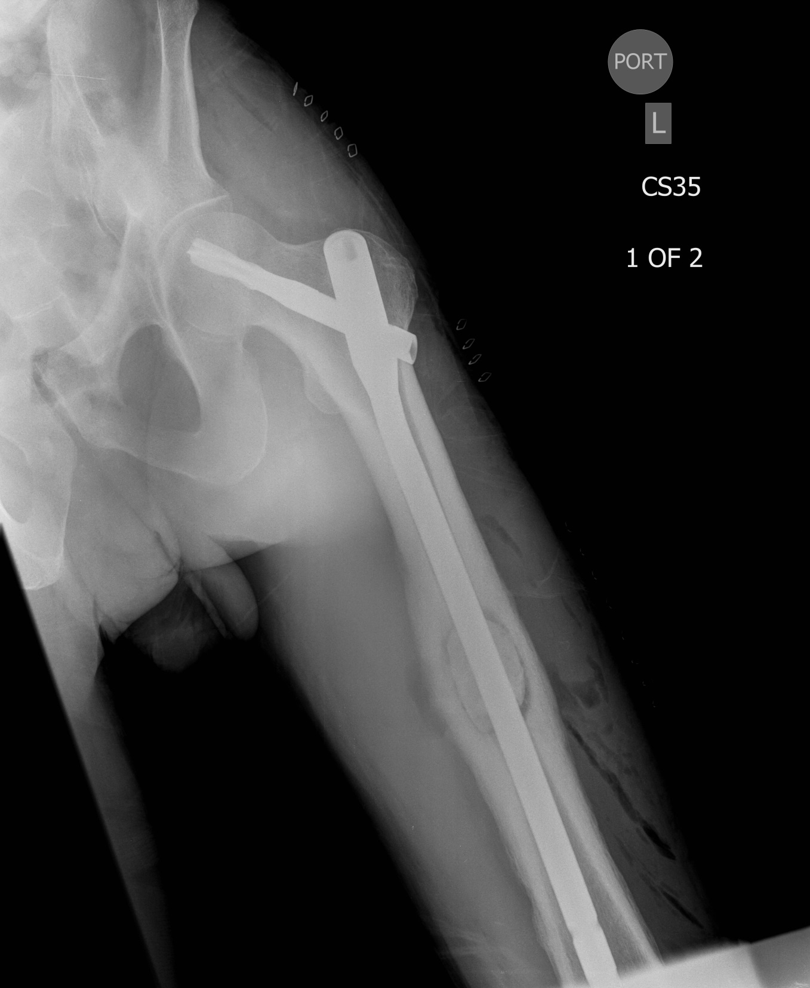
Metastatic Carcinoma
Sarcoma
Notes:
The two images on the left half of the screen show a radiolucent lesion at the femoral diaphysis. Ultimate work-up revealed metastatic carcinoma. Therefore, an intralesional procedure (prophylactic intramedullary fixation) can be pursued; metastatic carcinoma can be treated in this manner as postoperative radiation therapy can be given to decrease tumor burden.
For any solitary bone lesion in an adult, you must first exclude that the lesion in question is not a primary bone sarcoma.
In contrast, the images on the right half of the screen show a lesion a the distal metadiaphyseal femur. Ultimate work-up for this revealed a primary bone sarcoma. Primary bone sarcomas require a wide resection (not an intralesional procedure) to decrease the risk of local recurrence. This is illustrated in the far right image showing wide resection of the distal femur and endoprosthetic reconstruction.

Slide 8
Metastatic Bone Disease Work-Up
Goal is determine primary site of malignancy
Remember the most common malignancies that metastasize to bone and use diagnostic imaging/labs to target these
Follow the algorithm- will generally find the primary malignancy in 85% of cases*
*Rougraff BT, Kneisl JS, Simon MA. Skeletal Metastases of Unknown Origin. A prospective study of diagnostic strategy. J Bone Joint Surg Am. 1993;75:1276-1281.

Slide 9
Metastatic Bone Disease Work-Up
1) History and Physical Examination
2) Labs:
CBC and differential (lymphoma), metabolic panel, ESR/CRP (infection), Alkaline Phosphatase, SPEP (myeloma)
3) Imaging:
Radiographs of the entire bone
MRI with/without contrast
Not included in Rougraff’s original study
BUT, helps to define marrow and soft tissue involvement of suspected lesion
CT of chest/abdomen/pelvis (lung, kidneys, breast, prostate)
Bone scan (sensitive, not specific)
4) Biopsy
Notes:
Traditionally, plain radiographs were used to image these skeletal lesion. Therefore, MRI imaging of the bone/lesion in question was not included in this algorithm. However, now that MRI imaging is readily available, these may pursued during work-up of these bone lesions (although not always necessary).
MRI imaging helps to define the presence or absence of an extraosseous mass, bony extent or degree of marrow involvement, as well as the presence of any skip metastases. MRI imaging may not always be necessary, but in certain circumstances, can add information available.
Plain radiographs of the ENTIRE bone, as well as CT scan of the chest/abdomen/pelvis should always be included. If there is suspicion for myeloma, a skeletal survey should be added (these lesions are commonly “cold” on bone scan).

Slide 10
Work-Up: Finer Points on Imaging
Radiographs:
Examine in fine detail (associated soft tissue mass, cortical disruption, etc.)
Include entire bone to exclude presence of other lesions that may affect surgery

Slide 11
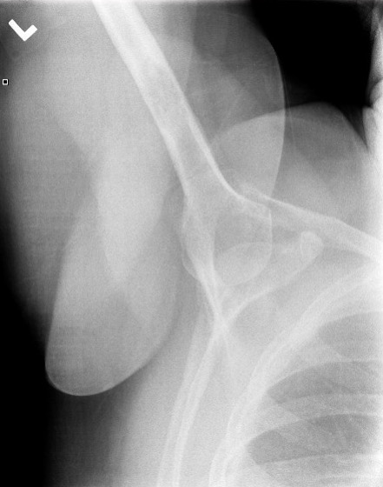
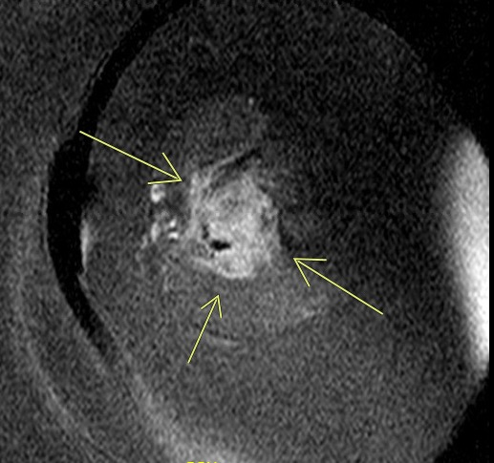
Radiographs
Associated soft tissue mass visualized on MRI
-Intramedullary lesion with cortical disruption
-Originally only observed on axillary view of shoulder series)

Slide 12
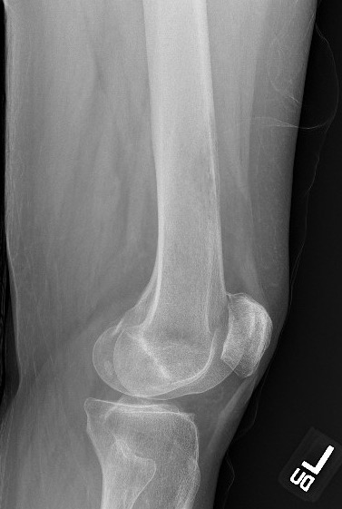
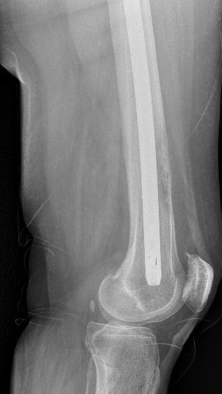
Full Length Radiographs
This patient was diagnosed with metastatic breast carcinoma. She had an impending pathologic intertrochanteric femur fracture. Full length radiographs also revealed the presence of a more distal lesion with cortical disruption.

Slide 13
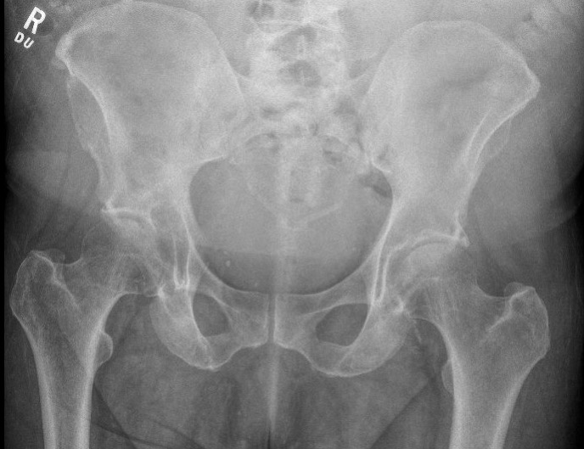
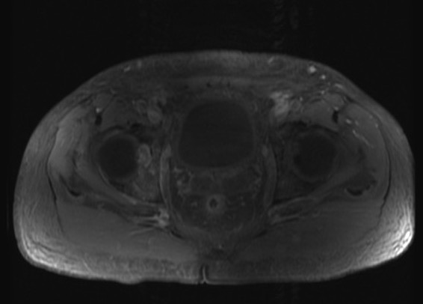
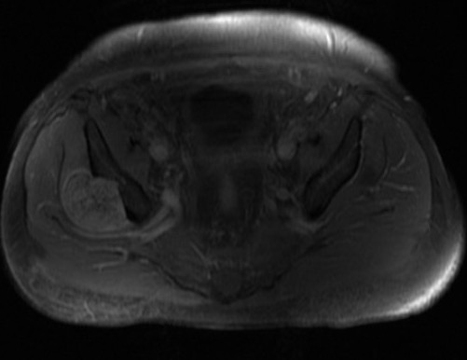
Imaging-MRI (with contrast)
Helps to delineate marrow or intraosseous extent of lesion
Helps to delineate associated soft tissue mass as well as proximity to adjacent structures
Notes:
MRI’s can be very helpful in the work-up of metastatic disease. If a lesion is identified, and MRI is convenient, axial imaging (MRI) will help to further to define the lesion and it’s bony involvement. If possible, these should be added to the work-up. However, situations such as a patient with a pathologic fracture may decrease the yield of this test (due to fracture hematoma, etc), but still may be pursued to confirm/deny the presence of an underlying bony lesion.
If ordered, these should always be performed WITH CONTRAST
If MRI is not readily available, a CT with contrast may be ordered and will usually suffice to show lesional involvement of the bone
Further, a CT will be able to show the structural content of the bone involved (or lack thereof) which may help to predict chance of fracture

Slide 14
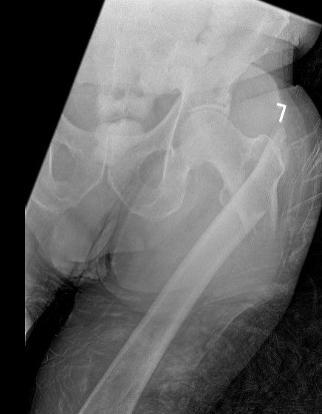
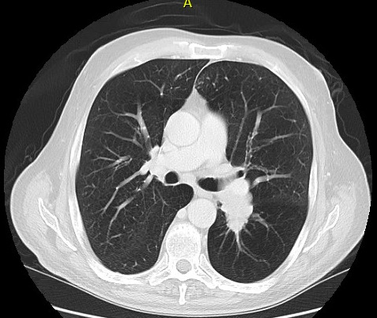
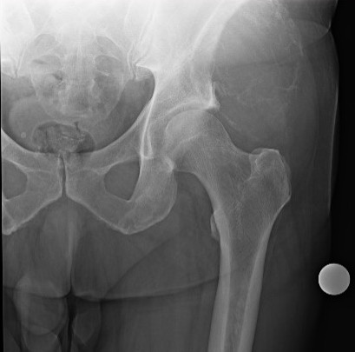
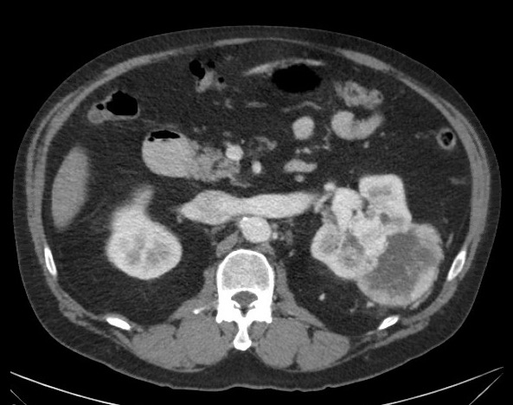
Imaging- CT Chest/Abdomen/Pelvis
Primary Lung Carcinoma
Primary Renal Carcinoma
Notes:
A CT of the chest/abdomen/pelvis should always be included in metastatic disease work-up. This helps to identify a possible primary site of disease (lung, kidney, or other organ), which will help to guide further work-up (biopsy) and decision making (disease specific considerations- covered later in this talk).
For example, if an adult patient is in the Emergency Department for leg pain and radiographs concerning for a pathologic lesion- next steps should be:
Full length radiographs
2) Labwork as outline previously
3) CT scan of the chest/abdomen/pelvis (can be with OR without contrast- radiologist’s preference)
AND if able:
4) MRI of the affected extremity WITH contrast (always with contrast)

Slide 15
Imaging- Bone Scan
Sensitive, not specific (many different bony processes will be “hot” on bone scan)
Metastatic lesions
Arthritis
Stress fractures
Detects osteoblastic activity; processes that are purely lytic may be missed ( “cold” on bone scan)
Myeloma- get skeletal survey instead
Occasionally, lung carcinoma
Utilities of a bone scan
1) Help to detect presence of widespread disease
2) Locate a more accessible lesion for biopsy (humerus versus acetabulum)
Notes:
Bone scans are sensitive and not specific. Further, they can be difficulty to obtain in a time-sensitive fashion. Therefore, their main utility is to show the presence of widespread bony disease OR to locate a more accessible lesion for biopsy (i.e. a humerus or clavicle lesion versus a periacetabular lesion).

Slide 16
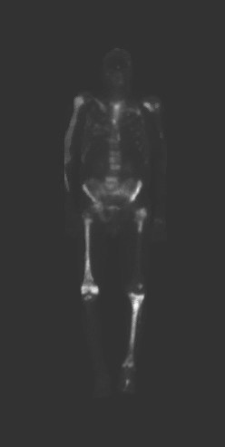
Bone Scan
Shows widespread bony involvement
This information can:
-Help to target your biopsy site (pick the most accessible)
-Help with surgical decision making (widespread metastasis versus solitary site)

Slide 17
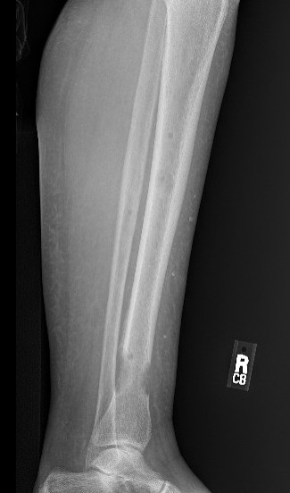
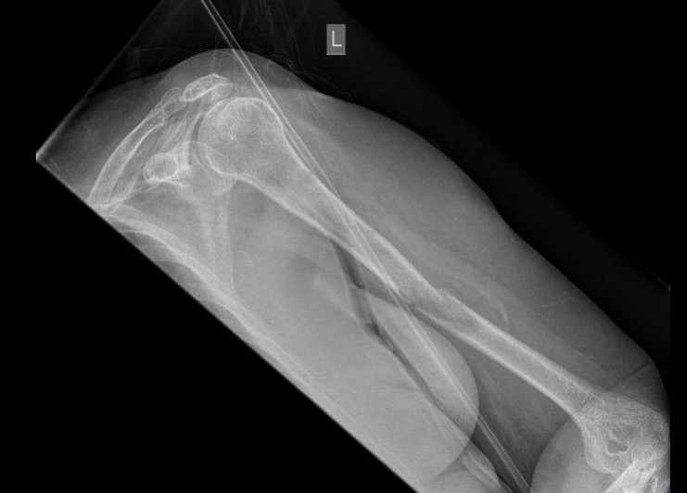
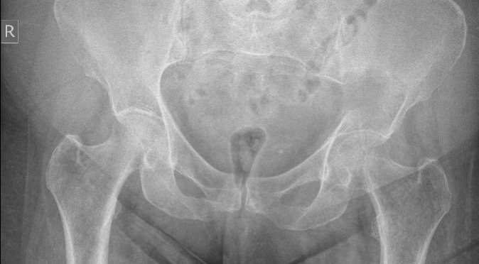
Skeletal Survey
Skeletal survey in this myeloma patient showed multiple lytic lesions with completed fracture or impending fracture
Useful for myeloma
Notes:
These lesions may not be present on bone scan. If there is concern for myeloma (imaging characteristics on plain films, + SPEP, elevated creatinine or calcium), a skeletal survey is a better option.

Slide 18
Work-Up: Biopsy
Usually the culmination of the aforementioned work-up
A few options on how to perform this:
Imaged guided core needle biopsy- usually performed by radiologist with CT or ultrasound
Open biopsy (+/- frozen section)
If performing open biopsy, adhere to the principles
Stay in one anatomic compartment, minimize contamination/hematoma, and make your incision in such a way that if a future resection is needed, this can be resected with the specimen (i.e. longitudinal incision on the extremities)
Notes:
Biopsies can be performed in an image-guided CORE needle fashion (need to be CORE needle and NOT fine needle aspiration) or open.
Core needle biopsies are usually performed with image-guidance (CT or ultrasound). This lends itself to a minimal contamination of the biopsy tract or surrounding tissues.
Open biopsies can be employed, but these require an incision, and by definition, a larger area of contamination at the site of the biopsy. If a primary bone sarcoma is identified, this biopsy tract will need to be resected with the final specimen in order to decrease the chance of local recurrence. Thus, a wider area will require resection versus a core needle biopsy.
If able, a core needle biopsy can be performed in a timely fashion (with good radiologist support). This is especially useful in the setting of a non-fracture extremity.
However, in a time sensitive fashion (pathologic fracture), in which increased morbidity may be realized if a delay is present while awaiting core needle biopsy/pathology results, an open surgical biopsy with frozen section may be employed followed by fixation or reconstruction (if a carcinoma is present). Als, open biopsies are sometimes pursued if a core needle biopsy is inconclusive.
Two common scenarios:
-A patient is seen as an outpatient for a concerning bony lesion; work-up has not been initiated. The aforementioned studies will be ordered. If there is decreased risk for imminent fracture, a core needle biopsy can be ordered for tissue diagnosis (smaller tract, less risk for fracture, can obtain adequate tissue).
-A patient is admitted to the hospital for a pathologic femur fracture. Radiographs and CT chest/abdomen/pelvis are ordered in the ED. A core needle biopsy may be performed, but this may delay surgical care for this patient while awaiting pathology results. Therefore, an open biopsy with INTRAOPERATIVE frozen section can be performed. The tissue is examined by the pathologist while the patient is in the OR; if a carcinoma/myeloma/lymphoma is found (or NO signs of sarcoma are identified), the surgeon can proceed with planned reconstruction of the extremity. If there is concern for sarcoma, the operation should be aborted until final pathology is available.

Slide 19
Biopsy
CT-guided core needle biopsy
Open Biopsy
Notes:
If an open biopsy is performed, the surgical incision should be made in-line with the planned future resection (if needed; usually in-line with long axis of the extremity) and should be performed only within one muscle compartment. A pituitary rongeur can be used to obtain lesional tissue for frozen section and permanent section/pathology (tissue be sent for permament pathology (in formalin) as well as “fresh” pathology (not sent in formalin, useful for examination for lymphoma/lyphmpopoetic processes)).

Slide 20
Biopsy
Send sample for:
Permanent pathology (in formalin)
Fresh pathology (not in formalin, allows for immunohistochemical testing for lymphoma, etc.)
Gram stain and culture
Frozen section:
Useful to get a real-time diagnosis- biopsy is performed in the same setting as planned fixation/stabilization/reconstruction
Pathologist may not be able to give ultimate diagnosis, but will be able to tell you if carcinoma is present (proceed with planned surgery)
If there is any possibility that biopsy shows sarcoma- do not proceed with planned fixation/reconstruction and await final diagnosis

Slide 21
Now that we have a diagnosis…

Slide 22
Decision-Making in Osseous Metastatic Disease
What is the risk of fracture and should we operate?
Is there any role for non-operative treatment?
What is the primary malignancy and what is the patient’s prognosis?
How can we accomplish our surgical goals (fixation versus reconstruction)?

Slide 23
How do we predict pathologic fracture?
In patients with bony metastatic disease, we must ascertain whether the source of their pain is due to:
-Impending fracture
OR:
-Bone turnover or tumor burden without impending fracture

Slide 24
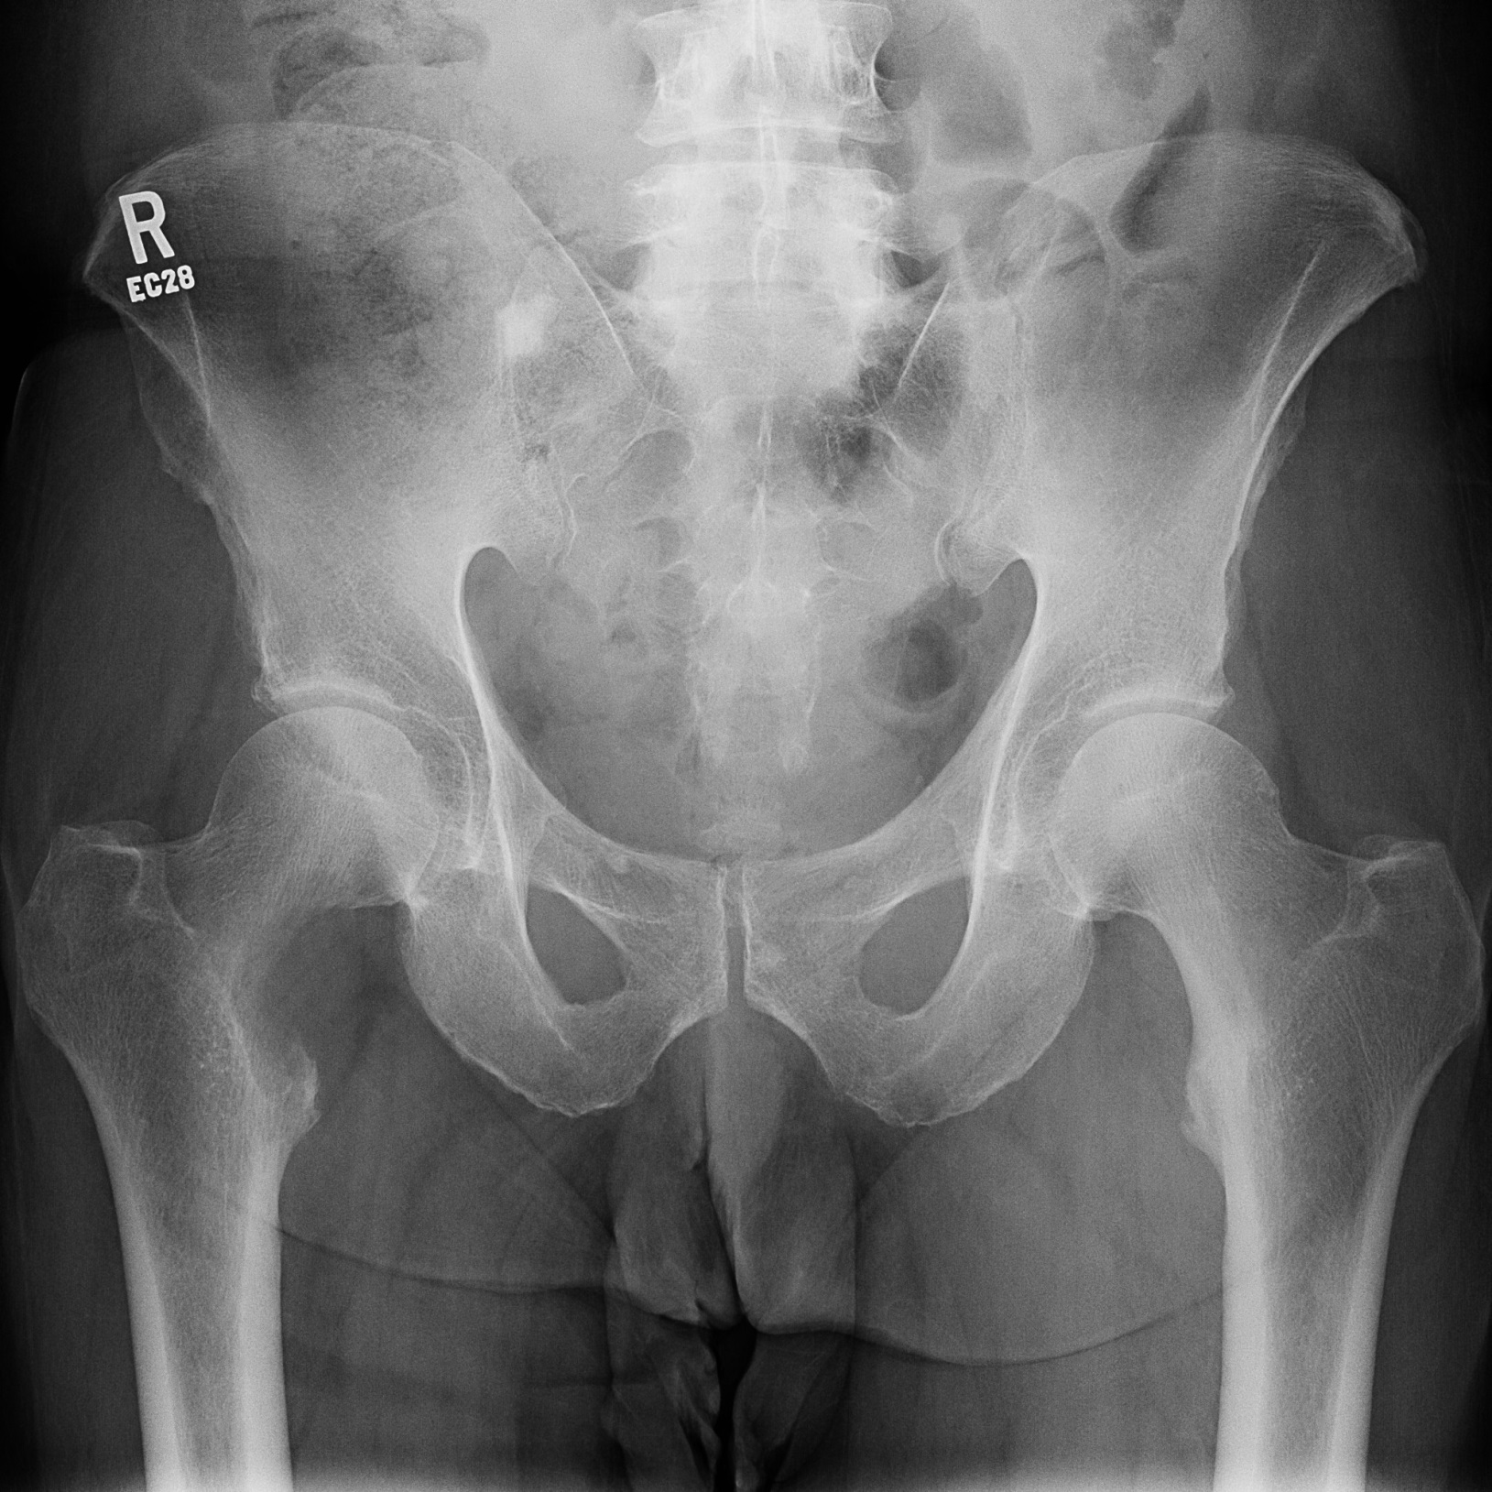
Predicting Pathologic Fractures: Harrington Criteria
Lesion is >50% of diameter of bone
Lesion is >2.5 cm in size
Persistent pain following radiation
Lesser trochanter fracture/avulsion
But:
This classification accounts only for the proximal femur
Does not take into account primary tumor subtype
Notes:
Certain subtypes of metastatic carcinomas may respond differently to nonoperative modalities (radiation therapy, percutaneous ablation or cementation, bisphosphonates/denosumab); also, certain subtypes of carcinomas (renal, thyroid) may be treated with a resection/reconstruction versus fixation. This will be covered later in this talk.

Slide 25
Predicating Pathologic Fractures: Mirel’s Scoring
 | Score
 | 1 | 2 | 3
Site | Upper extremity | Lower Extremity | Peritrochanteric Area
Pain | Mild | Moderate | Functional/Pain at rest
Lesion type | Blastic | Mixed | Lytic
Size | < 1/3 bone diameter | 1/3 – 2/3 diameter | > 2/3 diameter
Score > 8 usually portends prophylactic fixation
May lead to small degree of overtreatment as false positive rate is ~6 %
Mirels, H. CORR, 1989.
Notes:
In Mirel’s original article, lesions with a score of less than 7 were deemed acceptable to proceed with radiation without prophylactic fixation, and those lesions with a score of 8 or greater were recommended to be treated prophylactic fixation. However, what should we do with a score of 7?
Given the sequalea of pathologic fracture (increased morbidity, decreased fracture healing rates, increased cost of treatment), we tend to err on the side of caution when deciding between prophylactic fixation versus other modalties. As such, lesions with a score of 7 will usually receive prophylactic fixation. Congruently, there may be a small degree of overtreatment in this group.

Slide 26
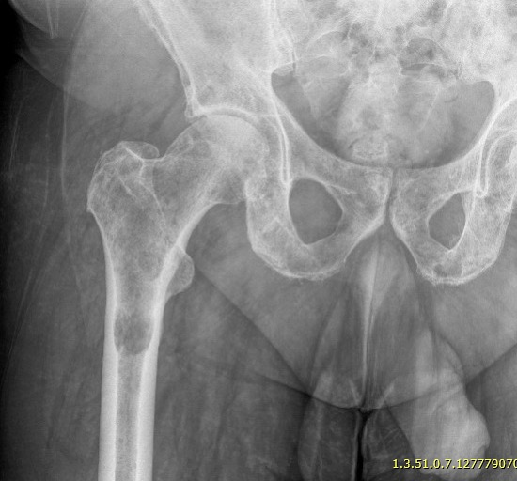
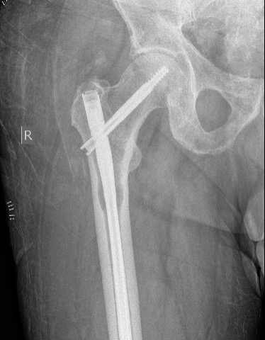
s
Site Peritrochanteric femur 3 points
Pain Moderate 2 points
Lesion type Lytic 3 points
Size >2/3 Diameter 3 points
11 points

Slide 27
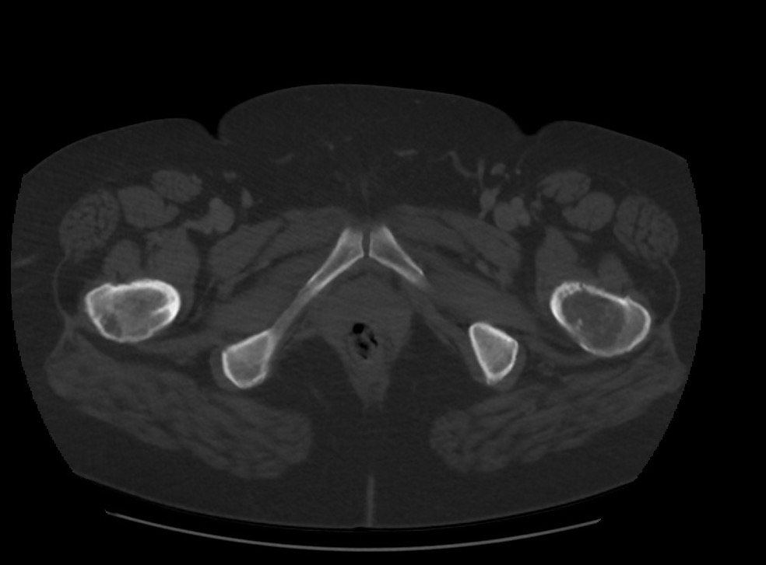
Predicting Pathologic Fractures: CTRA
CT-Based Structural Rigidity Analysis (CTRA)
Utilizes CT to quantify degree of bony involvement as compared to contralateral side or normal-matched controls
Using 35% reduction in bony rigidity as threshold, CTRA showed improved sensitivity and specificity as compared to Mirel’s threshold of > 8 points for risk of impending fracture
Damron et al. CORR. 2016.

Slide 28
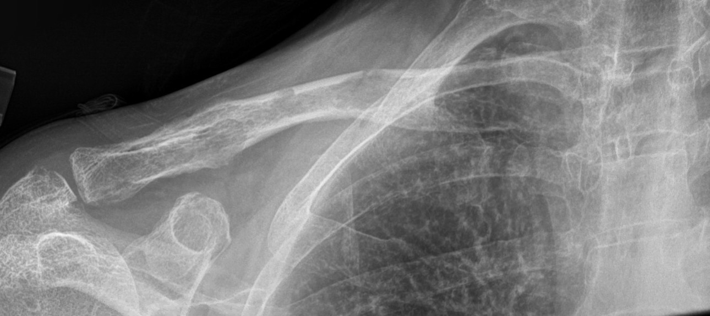
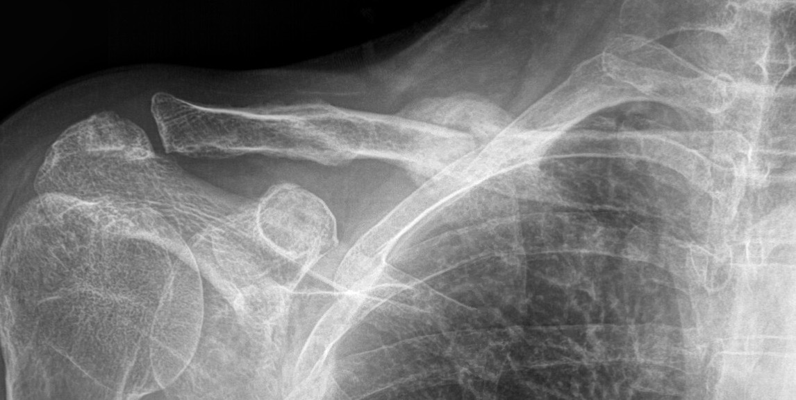
Non-Operative Treatment
As orthopedic surgeons, we must help to decipher if a patient’s pain is from tumor burden/bone turnover without risk of fracture VERSUS mechanical pain from impending fracture
If risk of fracture is low (or if fracture can be treated non-operatively), non-operative modalities may be used for palliation
Myeloma patient with multiple punctate lesion at the clavicle. Given location and myeloma diagnosis, these lesions (and fracture) were amenable to non-operative treatment and responded well to the patient’s myeloma medical treatments

Slide 29
Non-Operative Treatment
Non-operative modalities:
Chemotherapy/immunotherapy, etc. directed at primary diagnosis
Lesions from myeloma/lymphoma tend to reconstitute well after primary treatment initiated
Bisphosphonates or Denosumab
Radiation therapy (XRT)
Percutaneous radiofrequency ablation (RFA) or cryoablation

Slide 30
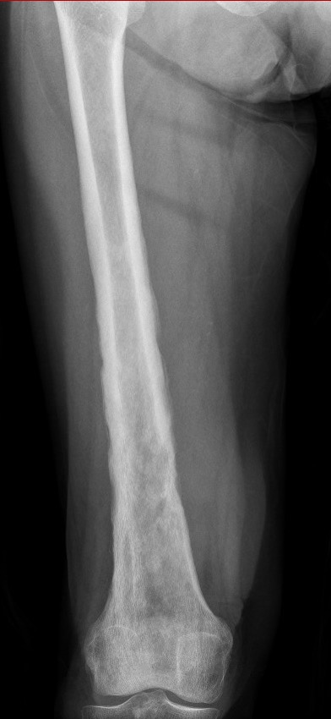
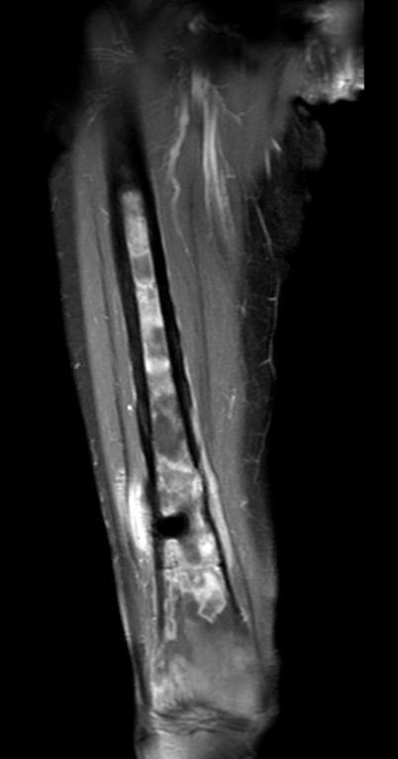
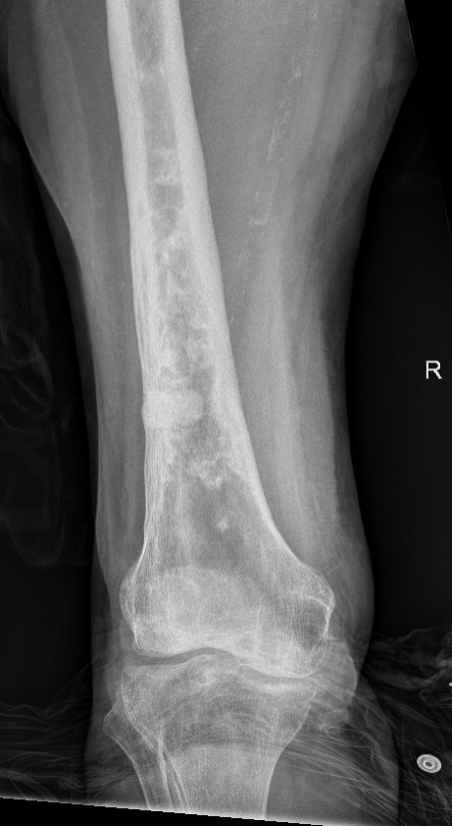
Non-Operative Treatment
This is a lymphoma patient. Radiograph (left) and MRI (center) obtained at presentation. Post-treatment radiograph (right) shown following initiation of systemic medical therapy and XRT; note the cortical reconstitution (cement plug seen at lateral cortex at site of biopsy). Frequently, in the setting in lymphoma, our role as surgeons is usually limited to tissue sampling, as this diagnosis responds well to medical/XRT treatments.

Slide 31
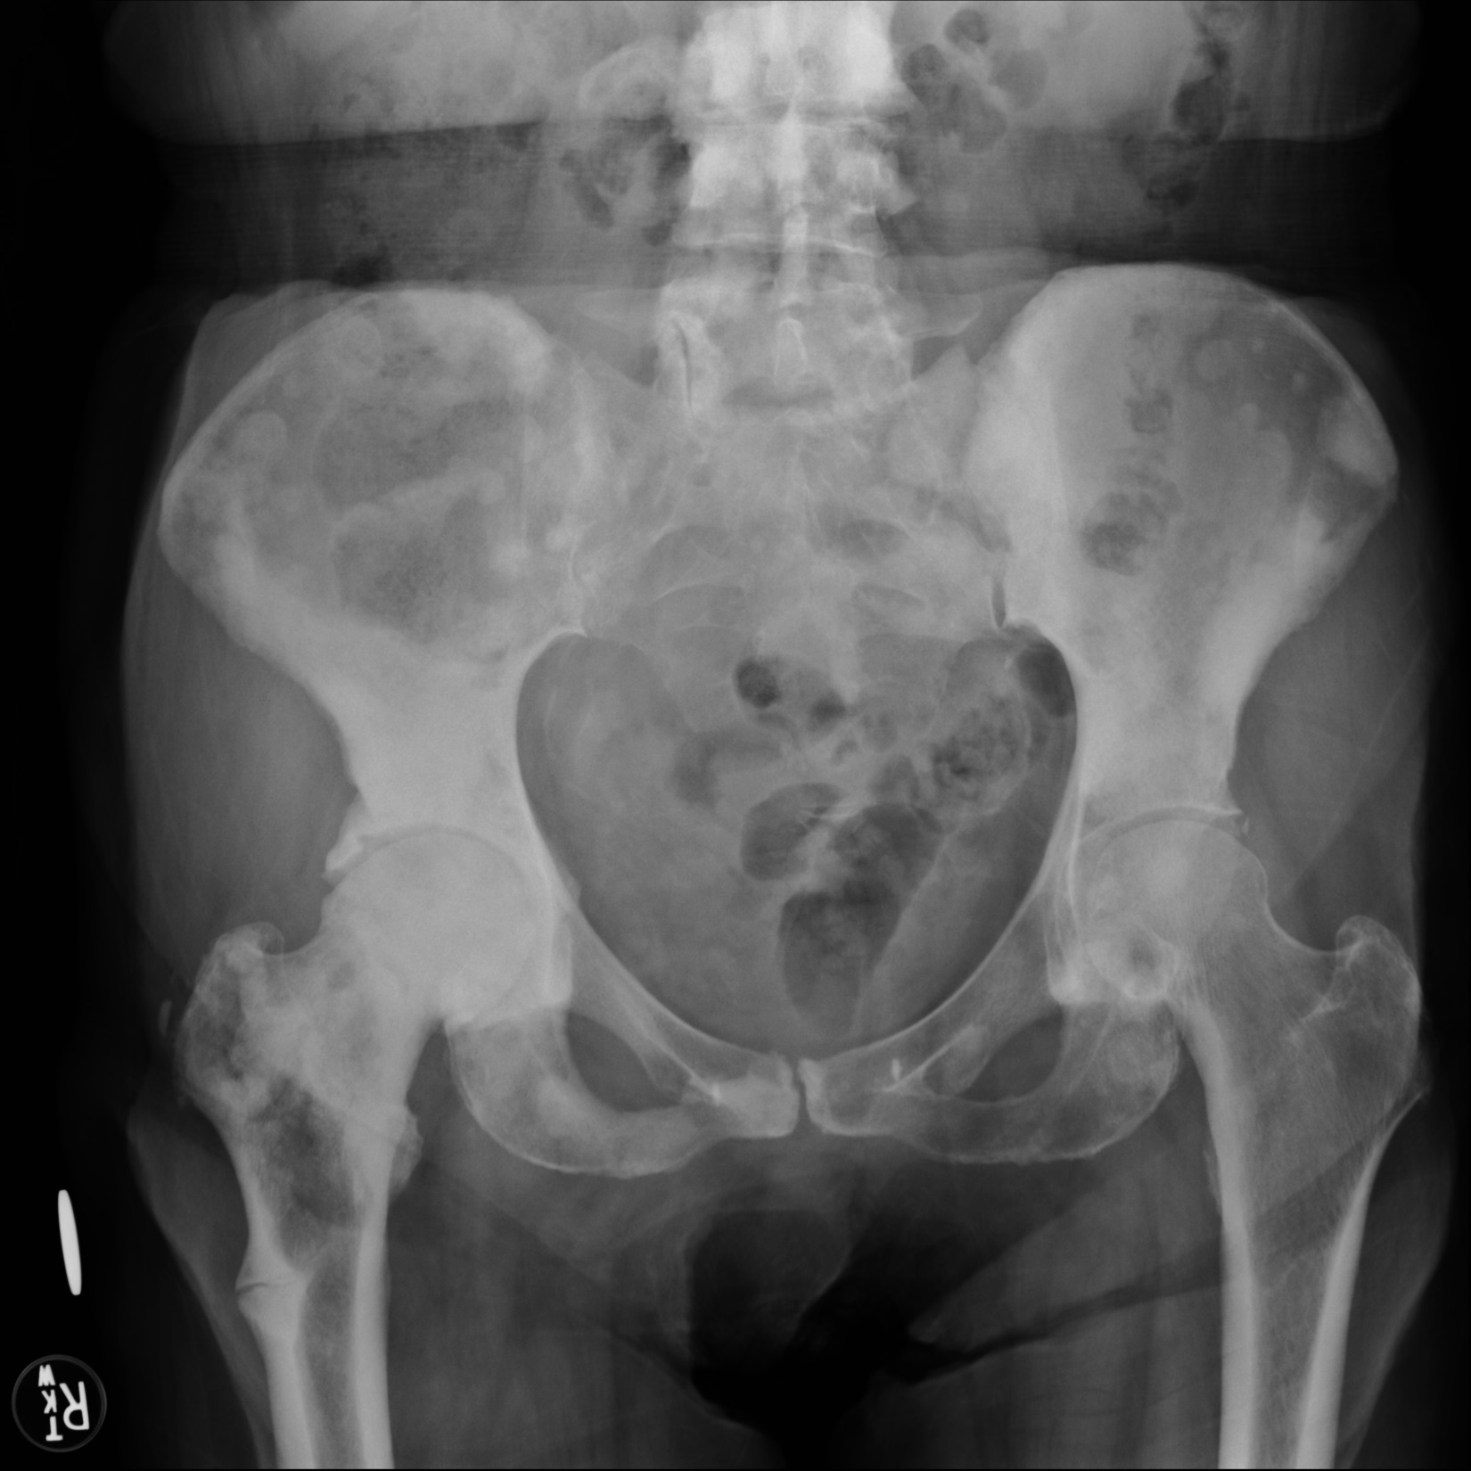
Non-Operative Treatment
Bone-targeted medications
Aimed at decreasing Skeletal-Related Events (SREs)
1)Bisphosphonates
Can also aid in treatment of malignant hypercalcemia (along with fluid hydration)
Be aware of atypical subtrochanteric fractures
2)Denosumab
Monoclonal antibody that competitively inhibits osteoclast binding to receptor activator nuclear factor (RANK) to RANKL
At least equivalent to bisphosphonates in decreasing SREs with possibly fewer complications
Wang et al. Oncol Lett 2014.
Atypical femur fracture in the setting of metastatic disease

Slide 32
Non-Operative Treatment
Radiation Therapy (XRT)
-Useful in treatment of painful metastases
-Can be given as single fracture or multiple fractions (equivalent pain relief)
-90% of patients will get some degree of pain relief
-Radiation-induced fractures are dose dependent
Increased dose of radiation = increased chance of fracture
These fracture are difficult as healing potential is low
Frassica et al. CORR 2003.
Lutz et al. Pract Radiat Oncol 2017.

Slide 33
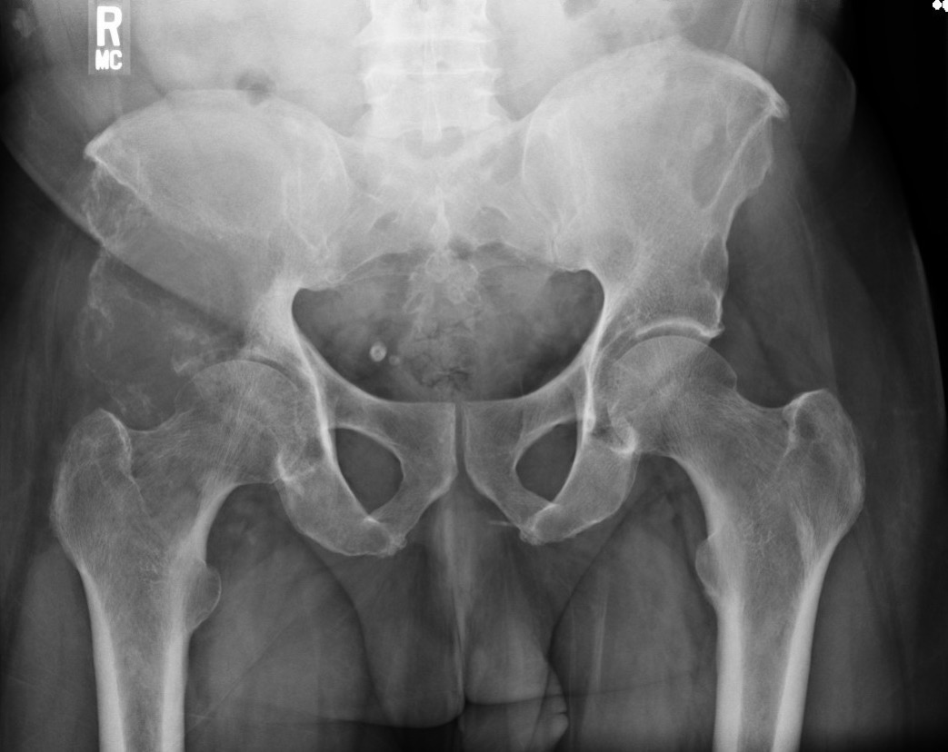
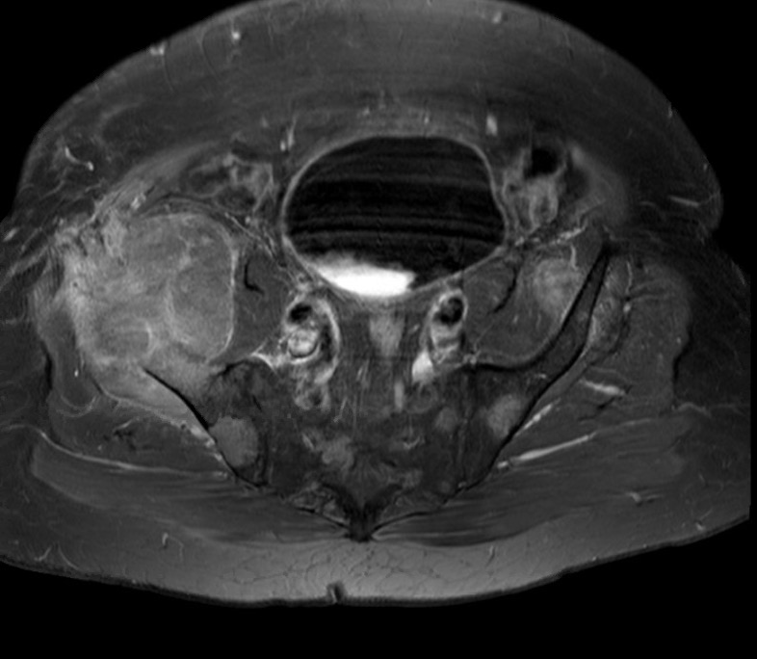
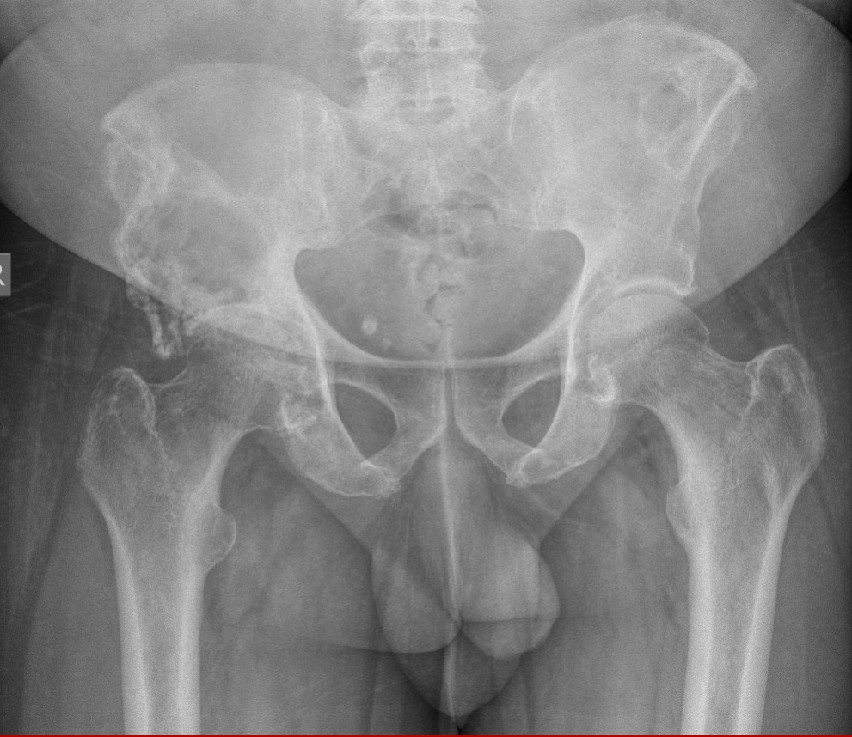
Non-Operative Treatment (XRT)
72 year old male that presented with right hip pain and a right femoral nerve palsy. Radiograph (left) and MRI (center) at presentation showed a large right periacetabular bone lesion and associated soft tissue mass. Work-up ultimately revealed metastatic prostate cancer. Given degree of soft-tissue involvement and the fact that this was a prostate primary (radiosensitive), he was given neoadjuvant XRT knowing that he may require reconstruction if this failed. Follow-up radiograph (right) showed marked reconstitution of periacetabular bone and his joint integrity was maintained.

Slide 34
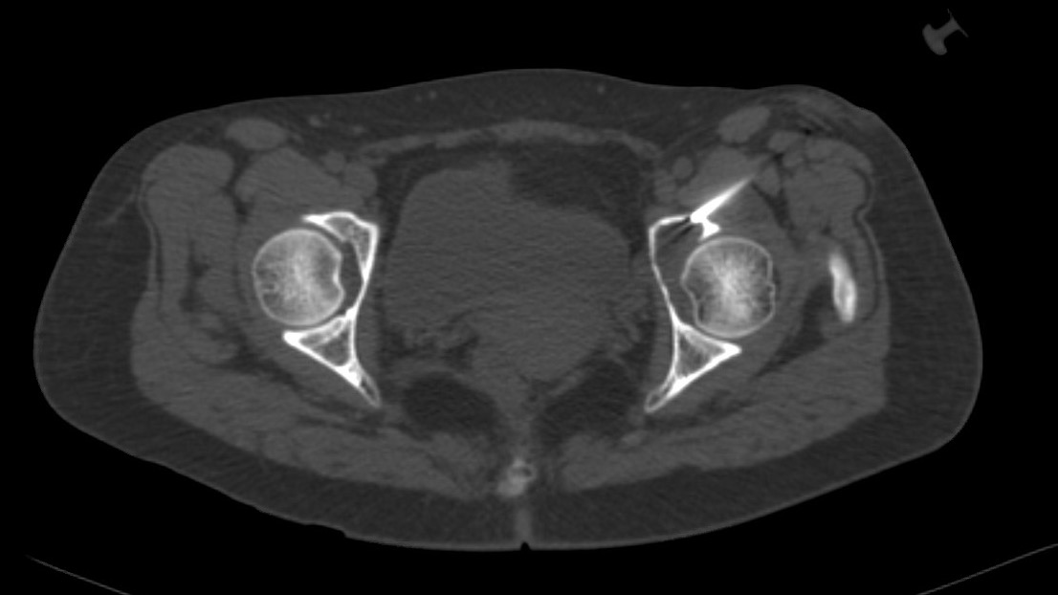
Non-Operative Treatment
Percutaneous ablation (radiofrequency or cryoablation)
-Can be used for palliation or local tumor control
-Relatively non-invasive and may be useful for axial locations that may require extensive surgical approach (pelvis)
-Shown to be efficacious in renal cell carcinoma
Cryoablation probe introduced under CT-guidance
Gardner et al. JBJS. 2017

Slide 35
Prognosis and Life Expectancy
With the advent of biologics and immunotherapy, metastatic carcinoma patients are realizing increased life expectancy
Many patients may survive several years after diagnosis (or surgery)
Be prepared to follow these patients; as survival increases, so does the chance of implant failure or re-operation
Orthopedic surgeons must keep this improved prognosis in mind when planning durable fixation or reconstruction
Gutowski et al. Surgical Management of Femoral Metastases in the Era of Biologics: A Shifting Paradigm. MSTS Annual Meeting Abstract 2017.

Slide 36
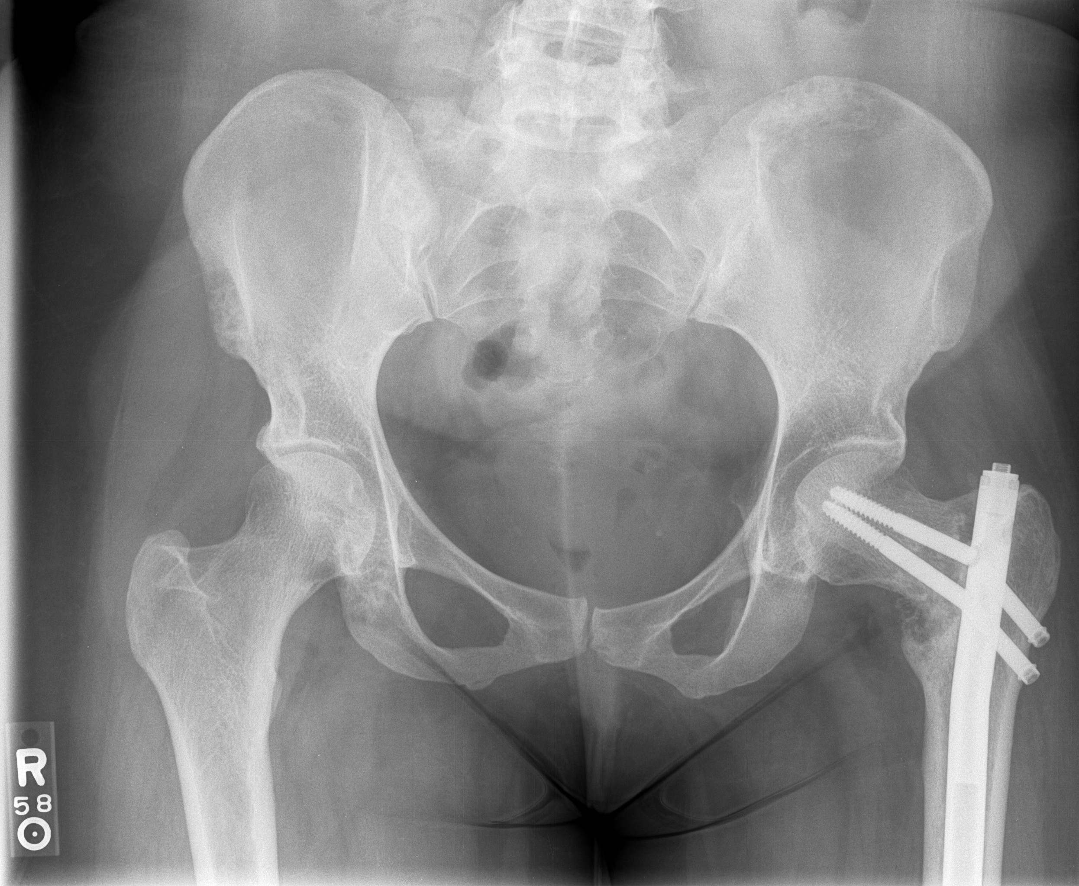
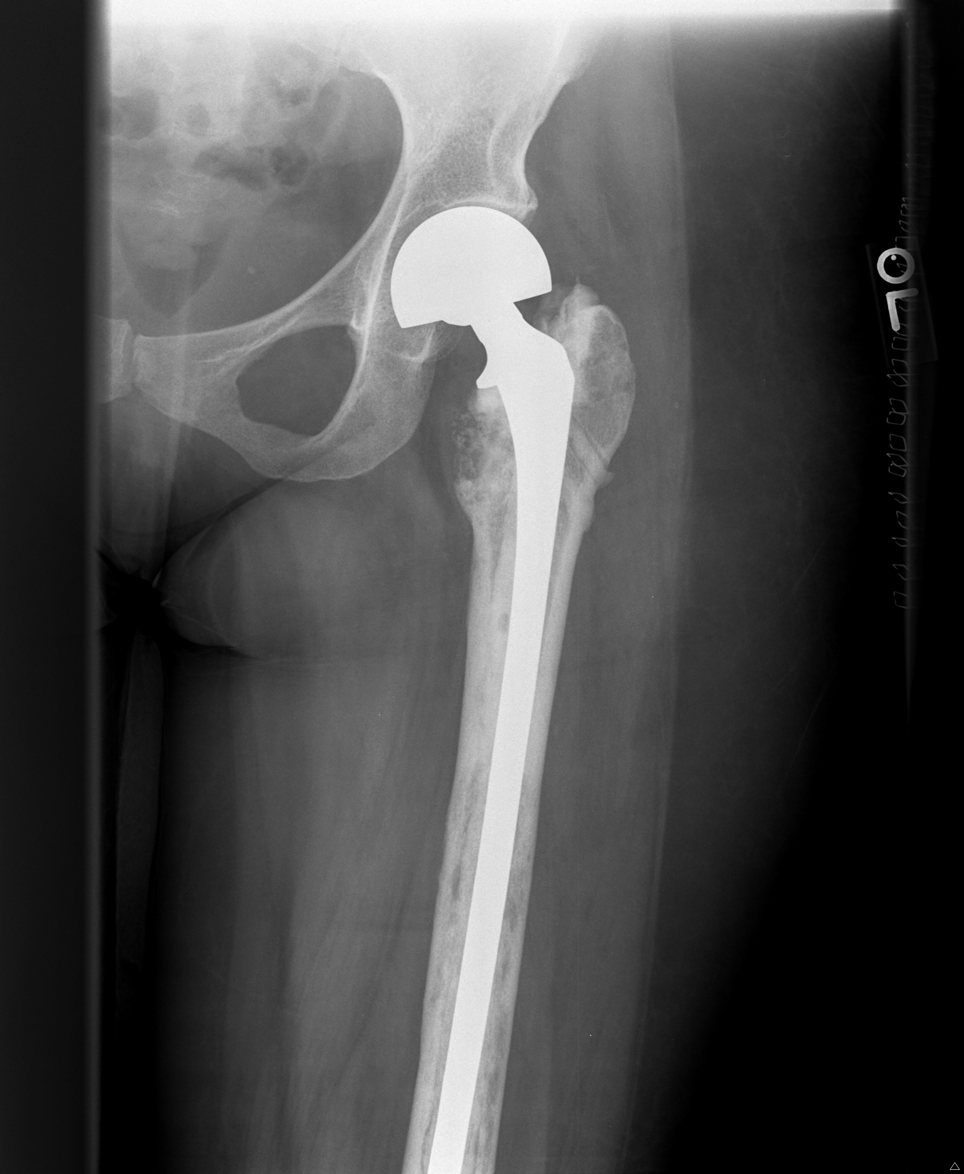
This is a patient with a pathologic pertrochanteric femur fracture from metastatic breast carcinoma. With follow-up, she was noted to have non-union at the fracture and construct failure. They were converted to arthroplasty to maintain function and mobility

Slide 37
Predicting Survival
Most often requires consultation with Medical Oncology or other services
Other variables include response to treatment, function level, etc.
Oligometasatic (less than 5 sites of disease) versus widespread metastatic disease
Synchronous versus metachronous skeletal metastatic disease
Notes:
Oligometastatic disese can be defined as having less than five sites of disease. For example, a patient with metastatic renal cell carcinoma that has a kidney mass (primary site), two pulmonary nodules, and a right femur lesion can be classified as “oligometastatic” disease. In contrast, a lung cancer patient with a lung mass, multiple/bilateral pulmonary nodules, adrenal lesions, and widespread bony metastases can be classified as widespread disease.
These definitions may help to guide prognosis. A patient with only a few sites of disease (oligometastatic disease) will likely realize better prognosis as overall tumor burden is lower. Further, these patients will sometimes undergo resection of ALL sites of disease in order to augment survival. Patients with widespread metastatic disease will realize lower life expectancy and palliative measures will likely be entertained.
Synchronous metastatic skeletal disease can be defined as metastatic skeletal lesions that are present at time of diagnosis. For example, a patient is found to have metastatic lung cancer with multiple sites of skeletal lesions already present can be classified as synchronous disease. Conversely, a patient with known metastatic lung cancer with only known visceral mets that then develops skeletal lesion AFTER known diagnosis can be classified as metachronous metastatic skeletal disease.
Usually, metachronous skeletal disease patient will realize better prognosis versus those patient that present with synchronous disease.

Slide 38
Predicting Survival: PathFx
PathFx^{3.0}
www.pathfx.org
Online- based tool
Allows for the input of clinical and patient-specific variables
Generates likelihood at survival at several time-points
May aid in decision-making regarding extent of planned surgery
Anderson AB et al. CORR. 2019

Slide 39
Disease Specific Considerations
Each primary malignancy has some idiosyncrasies that will likely play a role in orthopedic treatment
Each subtype has different prognosis/survival, fracture healing potential, sensitivity to medical or radiation treatments
These patients are hypercoagulable and at ~8x greater risk of sustaining a venous thromboembolic event (VTE)
Must consider VTE prophylaxis

Slide 40
Metastatic Lung Carcinoma
Traditionally, poor prognosis, but improved in recent years (especially in patients with PD-1 mutation that can be targeted with immunotherapy)
Usually lytic appearance on radiographs (may be “cold” on bone scan) and often cortically-based
Low propensity for fracture healing; sensitive to radiation
Frequently requires fixation adjuncts (PMMA, etc) when performing fixation due to bone loss and decreased chance of bony healing or reconstitution

Slide 41
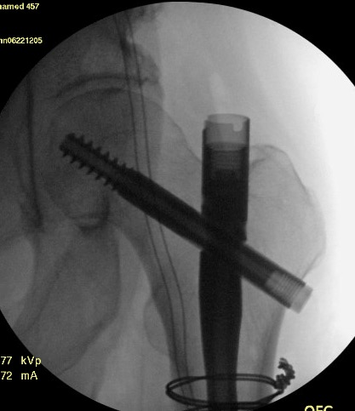
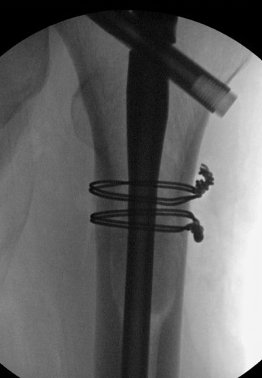
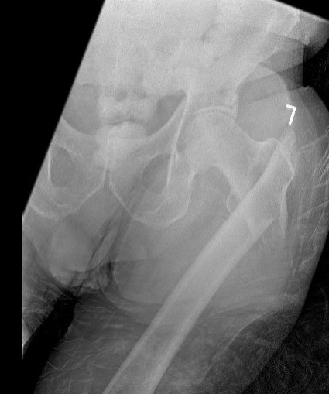
Metastatic Lung Carcinoma
PMMA

Slide 42
Metastatic Renal Cell Carcinoma
A few points:
Resistant/low sensitivity to radiation
Vascular tumors: always consider pre-operative embolization (especially when planning an intralesional procedure)
Some may consider wide resection/reconstruction of metastatic lesion in setting of oligometastatic disease (i.e. only a few sites of disease)
Local tumor progression is a real possibility following intralesional procedures

Slide 43
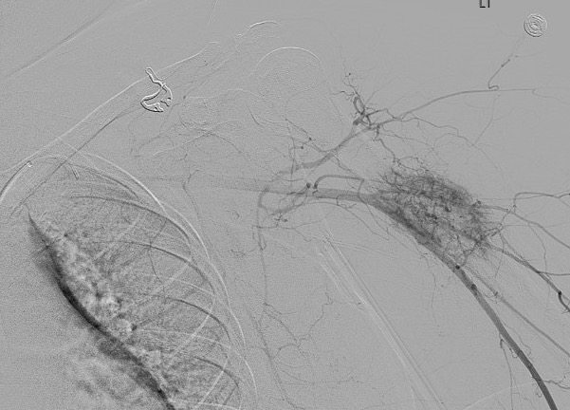
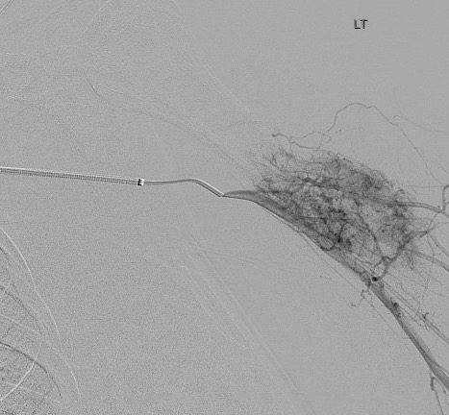
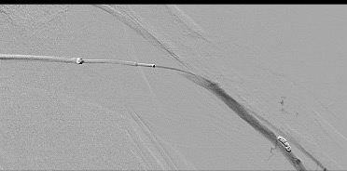
Embolization

Slide 44
Renal Cell: When to Resect?
One may consider metastectomy or resection/reconstruction in certain situations:
Oligometastatic disease- resection of all sites of disease may portend a survival benefit
Peri-articular location
Chance of local tumor progression or need for re-operation due to construct failure is high
Remember that metastatic RCC is radioresistant; therefore, we cannot always rely on postoperative radiation to inhibit tumor progression following an intralesional procedure
Lin et al. JBJS. 2007.

Slide 45
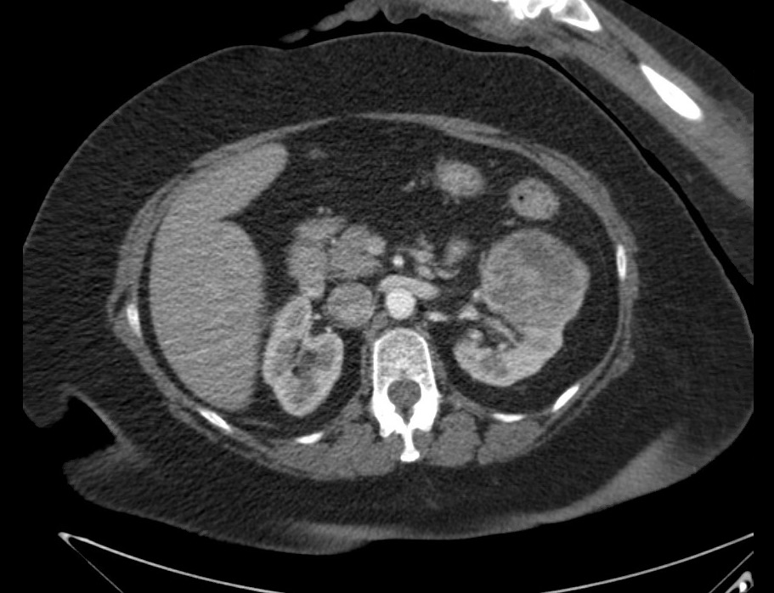
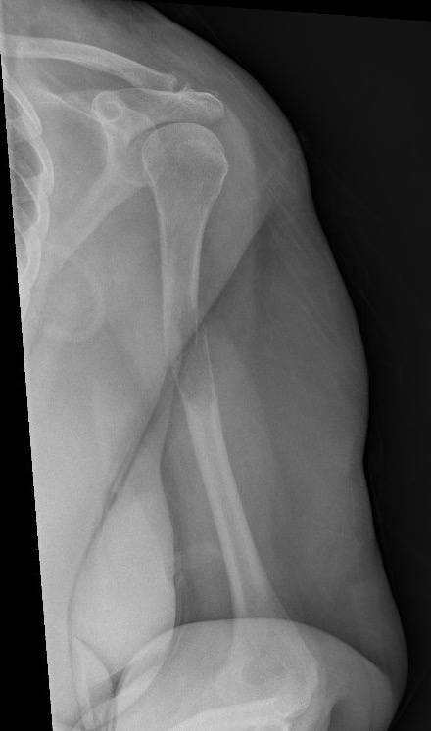
Renal Cell: When to Resect?
Oligometastatic Disease
60 year old female that was found to have metastatic renal cell carcinoma following a pathologic humerus fracture
Staging revealed two sites of disease (oligometastatic)
1) Kidney mass
2) Left humerus

Slide 46
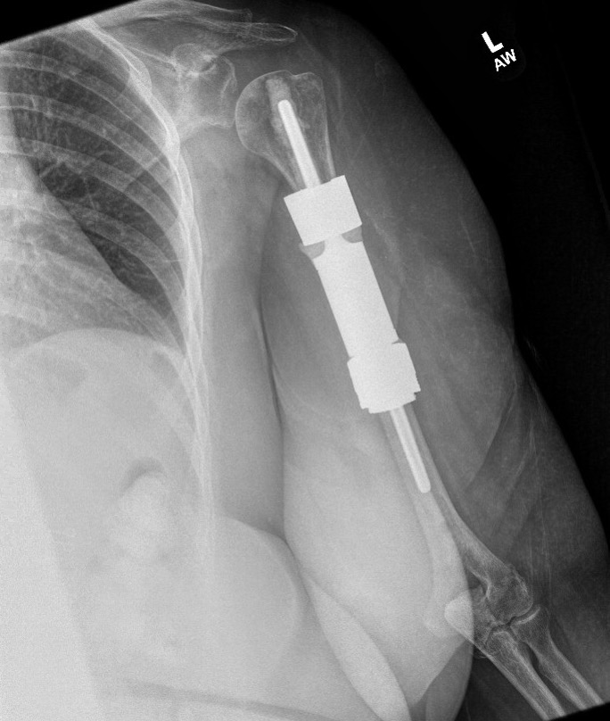
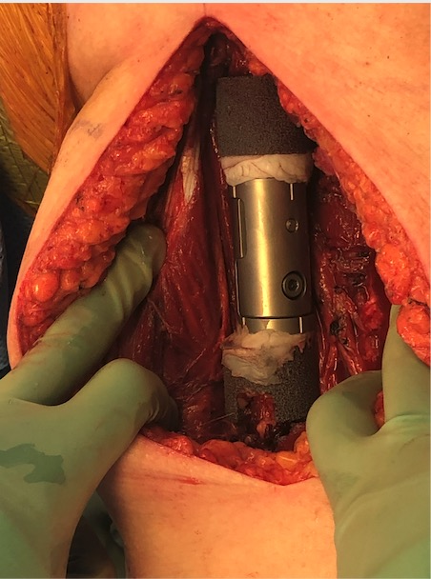
This patient underwent intercalary resection and reconstruction of the humerus as well as a nephrectomy (performed later) in order to resect all sites of disease and hopefully increase survival. Wide resection performed at the humerus also meant that the patient could avoid postoperative radiation.

Slide 47
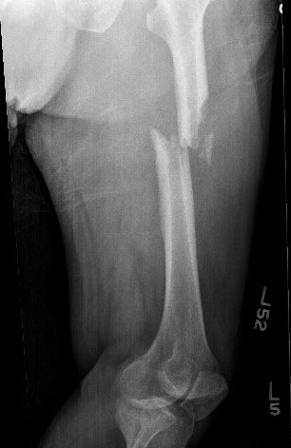
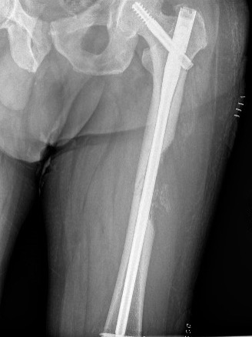
Tumor Progression
This patient presented with a pathologic femur fracture
Workup revealed metastatic renal cell carcinoma with widespread visceral and bony metastases
Elected to undergo fixation

Slide 48
Immediate postop and 3 month follow-up radiographs. At 3 months, significant tumor progression and bony destruction noted (although postop XRT was given). MRI revealed progression/recurrence of associated soft tissue mass

Slide 49
The patient underwent wide resection of the femur (including extraosseous mass) and endoprosthetic reconstruction to hopefully mitigate tumor recurrence or progression and allow durable reconstruction. Even in the setting of metastatic disease, his survival is still estimated at several years.

Slide 50
Metastatic Thyroid Carcinoma
Relatively good prognosis for most types
Relatively sensitive to XRT
Vascular- consider pre-op embolization as with RCC
Some also argue for metastectomy for solitary lesions or oligometastatic disease
Johnson et al. JAAOS. 2019.

Slide 51
Metastatic Breast Carcinoma
Medical treatments based on tumor expression of hormone receptors or HER-2/neu
Lesions usually mixed or blastic in appearance
Very sensitive to XRT

Slide 52
Pre- XRT
Post- XRT
Metastatic breast cancer patient that underwent prophylactic fixation for impending left proximal femur fracture. Also observed was a left periacetabular bone lesion. Both sites underwent XRT with excellent bony reconstitution, obviating the need for surgical intervention at the left acetabulum

Slide 53
Metastatic Prostate Carcinoma
High incidence of bony metastasis
Typically blastic in appearance
Very radiosensitive
If performing intramedullary fixation, beware of blastic lesions that may make this difficult
Re-cannulate intramedullary canal with drill bits, reamers, etc. under fluoroscopy

Slide 54
Surgical Treatment Techniques in Pathologic Fractures

Slide 55
What’s the primary diagnosis?
What’s the prognosis?
Where is the location of the lesion or fracture?
How much bone stock is left?

Slide 56
General Principles
Provide a durable construct that will outlive the patient
“One operation for one patient”
Provide a construct that allows for immediate weight-bearing and function
Potential for bone healing is less (pathologic bone, likely need for postop XRT); strongly consider augmented fixation or reconstruction (additional plates, PMMA, etc)

Slide 57
Fixation versus Reconstruction
Fixation
Reconstruction (Endoprosthesis)
Adequate bone stock
Bony healing or reconstitution possible (breast, prostate, myeloma, lymphoma)
Non-periarticular location
Inadequate remaining bone stock
Poor chance of bony healing
Solitary lesion or oligometastic disease in which resection/metastectomy is planned
Peri-articular location

Slide 58
Upper Extremity Guide to Reconstruction
Scapula/Clavicle
May consider non-op
Proximal Humerus
Adequate remaining bone- locked plating +/- PMMA
Poor remaining bone- arthroplasty (+/- reverse shoulder arthroplasty)
Diaphyseal Humerus
Adequate remaining bone- IMN or plate/screws +/- PMMA
Poor remaining bone- intercalary prosthesis
Distal Humerus
Adequate remaing bone- dual plating +/- PMMA
Poor remaining bone- consider arthroplasty (total elbow or distal humerus/total elbow arthroplasty)
Johnson et al. JAAOS. 2019.

Slide 59
Lower Extremity Guide to Reconstruction
Iliac crest or pubic rami
Consider non-op
If acetabular involvement- consider arthroplasty
Femoral head/neck
Adequate remaining bone stock- can consider fixation +/- PMMA
Poor remaining bone stock- arthroplasty (hemiarthroplasty versus total hip arthroplasty)
Pertrochanteric femur
Adequate remaining bone- cephalomedullary fixation +/- PMMA
Poor remaining bone- arthroplasty
Diaphyseal femur
Adequate reaming bone- intramedullary fixation +/- PMMA
Poor remaining bone- intercalary prosthesis
Distal femur
Adequate remaining bone- fixation +/- PMMA
Poor remaining bone- arthroplasty (TKA versus distal femur arthroplasty)
Proximal tibia
Adequate bone- fixation +/- PMMA
Poor bone- arthroplasty (TKA versus proximal tibia replacement)
Johnson et al. JAAOS. 2019.

Slide 60
Should we protect the entire bone?
Traditional teaching states that we should stabilize the entire bone in order to avoid future operations if new lesions present
Example #1) Cephalomedllary or recon-style screws across the femoral neck when stabilizing a diaphyseal femur lesion
Example #2) Use of long-stemmed arthroplasty stem for proximal femur periarticular lesion

Slide 61
Should we protect the entire bone?
However, complications do exist from using these implants
Particularly, long stemmed cemented femoral arthroplasty implants
Bone Cementation Implantation Syndrome (BCIS)
-Mechanism still unclear but appears to be embolic phenomenon that leads to acute cardiopulmonary collapse
-Risks factors include:
1) Use in the setting of metastatic or pathologic fracture
2) Use of long stemmed cemented implant
3) Underlying pulmonary disease

Slide 62
Should we protect the entire bone?
For most entities, the possibility of developing a new lesion not included in the original original construct is low
Myeloma and renal cell carcinoma may be exceptions to this
Further, although the incidence of BCIS is low, treatment is only supportive and mortality is high
Therefore, some argue that for proximal femur metastatic lesions requiring arthroplasty:
Short or medium stem length femoral stems options are acceptable
Long stemmed prostheses may be reserved for patients with concomitant diaphyseal lesions
Alvi et al. CORR. 2013.
Xing et al. CORR. 2013.

Slide 63
Considerations for Pelvis/Acetabulum Reconstruction
Degree of bone loss may warrant use of revision-style implants
Augments, cement, jumbo cups, etc.
Harrington-style reconstruction:
“Rebar and cement”
Utilizes screws or pins (inserted antegrade or retrograde) in the periacetabular defect and then filled with cement
Helps to restore continuity from the ilium to the pubic segment
Often requires lateral window/incision over crest to insert pins
Good short-term results, however long-term results appear to be intermediate or worse
Houdek et al. JBJS. 2020

Slide 64
Harrington Reconstruction

Slide 65
Acetabular Reconstruction
Newer techniques are now supplanting the traditional pins-and-cement with porous metal (tantalum) reconstruction
Have been used even in setting of previously irradiated bone
The possibility of bony-ingrowth may increase long-term durability
Houdek et al. JBJS. 2020
Khan et al. CORR. 2010
Houdek et al. JAAOS. 2020.

Slide 66
Right acetabulum bone lesion from metastatic renal cell carcinoma seen on radiograph (left) and MRI (center). This underwent curettage of the lesion (involving the medial and posterior acetabular walls) and total hip arthroplasty reconstruction utilizing a porous metal acetabular shell and multiple screws.

Slide 67
Acetabular Reconstruction Utilizing Fixation
Goal is to unitize the pelvis/acetabulum columns across bone loss
Can utilize traditional osseous fixation pathways for screw insertion
This patient underwent curettage and pelvis fixation. Curettage was performed first. Next, screws were inserted from the iliac crest to the peri-acetabular area followed by traditional “LC2” screws. Finally, a posterior column plate was applied and cement was used as reinforcement.

Slide 68
Case Example #1
57 year-old female presents with right arm pain, no trauma
Dominant arm
History of metastatic renal cell carcinoma with known bony and visceral metastases (previous biopsies already performed)
Right distal metadiaphyseal humerus lesion
Has previously undergone XRT to this area prior to consultation

Slide 69
XR prior to consultation
XR at consultation

Slide 70
Case Example #1
Key points to consider:
Pathologic fracture at right distal humerus
Diagnosis: metastatic renal cell carcinoma already confirmed (metastatic RCC): known bony mets
Prognosis: Fair at 1 year
Location: Distal humerus
Bone Stock: Decreased due to lesion/previous XRT; joint appears to be salvageable

Slide 71
Case Example #1
ORIF was chosen as surgical treatment
Fixation considerations
ORIF vs Resection/Reconstruction: known widespread mets, dominant arm and location (as resection would require elbow arthroplasty) were reasoning for ORIF in this patient
Planned intralesional procedure and metastatic RCC: consider pre-operative embolization
Bone loss: will need fixation augmentation (PMMA) to ensure construct durability
Location: will likely need dual plating, enough remaining bone stock to salvage joint

Slide 72
Step 1: Pre-op Embolization
Embolization performed due to planned intralesional procedure and vascular nature of RCC mets

Slide 73
Step 2: Operative Sequence
PMMA
1) Small fragment plate applied medially for provisional reduction/fixation 2) Posterolateral plate applied with provisional screws 3) Curettage performed at lesion, PMMA then placed 4) Completion of fixation construct

Slide 74
Case Example #2
48 year-old female presents with right shoulder pain x 2 months
Radiographs show pathologic fracture through lesion at proximal humerus
Further work-up pursued

Slide 75
Case Example #2
CT chest/abdomen/pelvis negative
SPEP shows monoclonal protein peak
Bone scan only showed pathologic activity at right proximal humerus
Skeletal survey showed multiple lytic lesions at ilium
Core need biopsy (CT-guided) at right shoulder shows myeloma

Slide 76
Case Example #2
Next steps?
Primary malignancy: multiple myeloma
Prognosis: Relatively good at 5 years
Location: Periarticular proximal humerus
Remaining bone stock: Poor

Slide 77
Given location (periarticular) and remaining bone stock for fixation (poor), this patient underwent resection and reconstruction with proximal humerus/reverse total shoulder arthroplasty as this was deemed the most durable reconstructive option. The rotator cuff and pectoralis tendons were secured to the prosthesis with heavy suture. The majority of the deltoid insertion was maintained (which will power the prosthesis), and the remaining portion was also repaired to the prosthesis.

Slide 78
Case Example #3
63 year old female presents to ED following a fall
Radiographs show pathologic fracture through distal femur lesion

Slide 79
Work-up:
Full length femur radiographs: proximal subtrochanteric lesion
MRI left femur: lesions corresponding to radiographs; no significant extraosseous mass
CT chest/abdomen/pelvis: Innumerable bony lesions, most blastic in appearance, a few pulmonary nodules
SPEP: normal
Plan:
Open biopsy with frozen section given high likelihood of metastatic carcinoma; if (+) for carcinoma, proceed with planned surgery
Pre-op axial imaging shows adequate bone stock distally for fixation
Fixation at distal femur with proximal fixation given subtrochanteric lesion

Slide 80
Case Example #3
1) Open biopsy with frozen section
Antero-lateral through vastus lateralis (one compartment, incision in-line with planned future resection if biopsy showed sarcoma)
Frozen section showed metastatic carcinoma, likely breast primary
2) Proceed with planned fixation

Slide 81
Fixation performed using plate/screw construct at distal femur and intramedullary implant to bypass the more proximal subtrochanteric lesion. This patient also received post-op XRT.

Slide 82
Case Example #3: Follow-up
Immediate Post-Fixation
6-month Follow-up
Incomplete healing, implant failure, and increased varus alignment noted

Slide 83
Case Example #3
Why did this fail?
Several possible factors:
Infection- ruled out with normal ESR/CRP and intraoperative cultures
Bone loss/pathologic bone with limited healing potential
Breast/Prostate/Myeloma usually respond well to primary treatments and radiation; however, healing rates are still lower than normal bone
Postop XRT
Perhaps original construct was too rigid; or, construct could have been augmented with PMMA or additional implants, etc. to increase rigidity given lower healing rates in the setting of post-op XRT

Slide 84
Case Example #3:
This patient was ultimately converted to a distal femur arthroplasty and proximal extramedullary implant. Arthroplasty was pursued given history of pathologic bone, poor remaining juxta-articular bone stock, and previous XRT making repair of the nonunion difficult. This construct did not rely on bony healing and also allowed immediate weight bearing.

Slide 85
Summary
Establish a diagnosis prior to making any surgical decisions
When in doubt, a well-done biopsy (and frozen section) can help establish a diagnosis
Prognosis should be estimated, and this may require input from Medical Oncology and Radiation Oncology
Patients with metastatic disease are living longer, and our role as orthopedic surgeons is to provide a durable reconstruction that allows for immediate weight bearing
Reconstruction options depend on the primary tumor, location of the lesion, and the amount of bone remaining
Be prepared to use fixation adjuncts to enhance the durability of the construct

Slide 86
References
Johnson CN, Gurich RW Jr., Pavey GJ, Thompson MJ. Contemporary Management of Appendicular Skeletal Metastasis by Primary Tumor Type. J Am Acad Orthop Surg. 2019 May 15;27(10):345-355.
Rougraff BT, Kneisl JS, Simon MA. Skeletal Metastases of Unknown Origin. A prospective study of diagnostic strategy. J Bone Joint Surg Am. 1993;75:1276-1281.
Gutowski CJ, Zmistowski B, Boland PJ, Healey JH. Surgical Management of Femoral Metastases in the Era of Biologics: A Shifting Paradigm. MSTS Annual Meeting Abstract. 2017.
Mirels, H. Metastatic Disease in Long Bones. A proposed scoring system for diagnosing impending pathologic fractures. Clin Orthop Relat. Res. 1989 Dec;(249):256-64.
Damron TA, Nazarian A, Entezari V, Brown C, Grant W, Calderon N, Zurakowski D, Terek RM, Anderson ME, Cheng EY, Aboulafia AJ, Gebhardt MC, Snyder BD. CT-based Structural Rigidity Analysis Is More Accurate Than Mirels Scoring for Fracture Prediction in Metastatic Femoral Lesions. Clin Orthop Relat Res (2016) 474:643-651.
Anderson AB, Wedin R, Fabbri N, Boland P, Healey J, Forsberg JA. External Validation of PathFx Version 3.0 in Patients Treated Surgically and Non-Surgically for Symptomatic Skeletal Metastases. Clin. Orthop Relat. Res. 2019. Publish ahead of print. 1-11.
Lin PP, Mriza AN, Lewis VO, Cannon CP, Tu SM, Tannir NM, Yasko AW. Patient survival after surgery for osseous metastates from renal cell carcinoma. J Bone Joint Surg Am. 2008 Aug;89(*):1794-801.
Wang X, Yang KH, Wanya P, Tian JH. Comparison of the efficacy and safety of denosumab versus bisphosphonates in breast cancer and bone metastases treatment: A meta-analysis of randomized controlled trials. Oncol Lett 2014;7:1997-2002.
Frassica FJ, Frassica DA: General principles of external beam radiation therapy for skeletal metastases. Clin Orthop Relat Res. 2003(415 suppl):S158-S164.
Lutz S, Balboni T, Jones J, et al. Palliative radiation therapy for bone metastases: Update of an ASTRO evidence-based guideline. Pract Radiat Oncol 2017;7:4-12.
Gardner CS, Ensor J, Ahrar K, Huang SY, Sabir SH, Tannir NM, Lewis VO, Tam AL. Cryoablation of bone metastases from renal cell carcinoma for local tumor control. J Bone Joint Surg Am. 2017 (99):22:1916-1926.
Alvi HM, Damron TA. Prophylactic stabilization for Bone Mastases, Myeloma, or Lymphoma: Do We Need to Protect the Entire Bone? Clin Orthop Relat Res. 2013 Mar;471(3):706-714.
Xing Z, Moon BS, Satcher RL, Lin PP, Lewis VO. A Long Femoral Stem is Not Always Required in Hip Arthroplasty for Patients with Proximal Femur Metatases. Clin Orthop Relat Res. 2013 May:471(5):1622-1627.
Houdek MT, Fegruson PC, Abdel MP, Griffin AM, Hevesi M, Perry K, Rose PS, Wunder jS, Lewallen DF. Comparison of Porous Tantalum Acetabular Implants and Harrington Reconstruction for Metastatic Disease of the Acetablulum. J Bone Joint Surg AM. 2020☹102(14:1239-1247
Khan FA, Rose PS, Yanagisawa M, Lewallen DF, Sim FH. Porous Tantlum Reconstruction for Destructive Nonprimary Periacetabular Tumors. Clin Orthop Relat Res (2012)470:594-601.
Houdek MT, Abdel MP, Perry KI, Salduz, A, Rose pS, Sim FH, Lewallen DG. Outcome of Patients Treated With Porous Tantalum Acetabular Implants for Neoplastic Periacetabular Lesions. J Amer Acad Ortho Sur. 2020; (28)6:256-262.

