Slide 1
Midfoot Fractures and Dislocations
Nicholas Romeo, DO
Assistant Professor, Orthopaedic Surgery
MetroHealth Medical Center
Case Western Reserve University

Slide 2
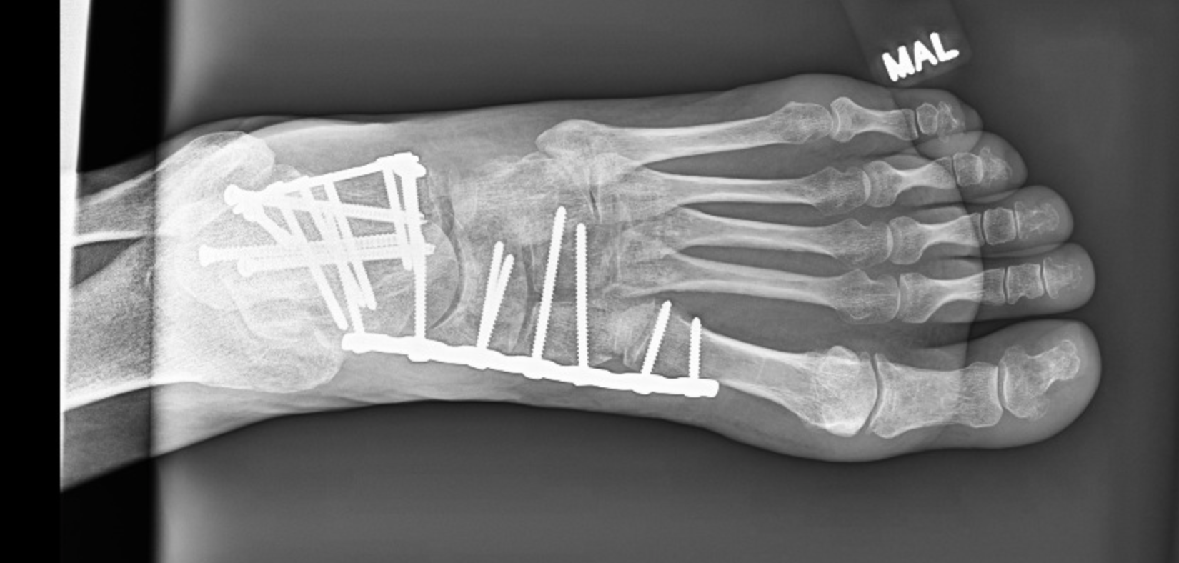
Objectives
Understanding of midfoot anatomy
Identify indications for advanced imaging/stress exam
Identify specific injury patterns
Comprehend goals of treatment
Understand indications for arthrodesis versus ORIF

Slide 3
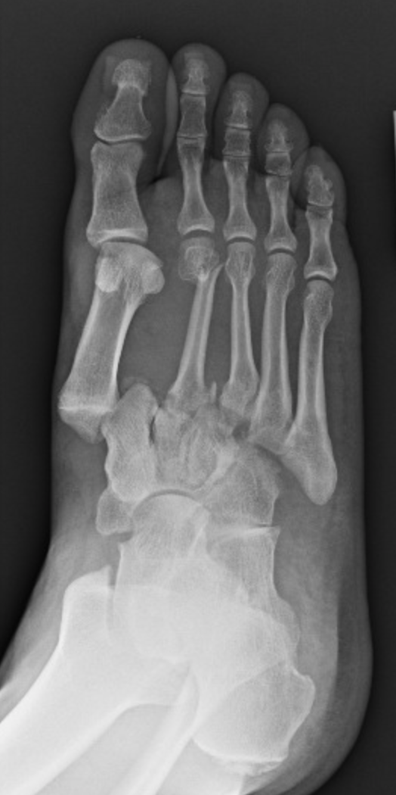
Outline
Midfoot anatomy
Physical exam
Imaging
Treatment/Outcomes
Tarsometatarsal joint complex injuries
Navicular Fracture/Dislocations
Cuboid Fractures
Cuneiform Fractures

Slide 4
Anatomy

Slide 5
Functional Anatomy
Column Theory
Mid/forefoot
Medial column (Yellow)
First TMT and NC joints
Limited mobility at first TMT
Mobile segment is the talonavicular joint
Yellow shading = medial column, red shading = intermediate column, green shading = lateral column
Notes:
TMT=tarsometatarsal joint
NC=Naviculocuneiform joint

Slide 6
Functional Anatomy
Column Theory
Intermediate column (Red)
2nd , 3rd TMT joints and NC joints
Rigid (no motion)
Yellow shading = medial column, red shading = intermediate column, green shading = lateral column

Slide 7
Functional Anatomy
Column Theory
Lateral Column (Green)
4th and 5th TMT joints
Mobile
Essential
Shock absorber
Yellow shading = medial column, red shading = intermediate column, green shading = lateral column
Notes:
Lateral column is essential for shock absorption on uneven surfaces

Slide 8
Functional Anatomy
2 Column Theory
Medial column
Rigid
Lever for propulsion
Lateral column is mobile
Shock absorber
Accommodate to uneven surfaces
Essential v non-essential joints
Thomas A. Schildhauer, Martin F. Hoffmann. Fractures and Dislocations of the Midfoot and Forefoot. In: Tornetta P, Ricci WM, eds. Rockwood and Green's Fractures in Adults, 9e. Philadelphia, PA. Wolters Kluwer Health, Inc; 2019.
Notes:
Tornetta, et al. Rockwood and Greens Fractures in Adults. 9th ed. 2019

Slide 9
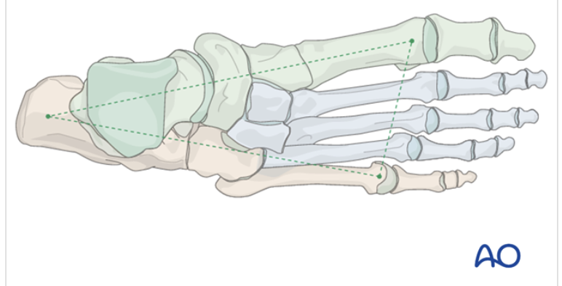
Anatomy – Midfoot Bony
Note alignment of talonavicular (TN) and naviculocuneiform joints
Notes:
Maintenance of medial and lateral column length is critical in restoration of the midfoot.

Slide 10
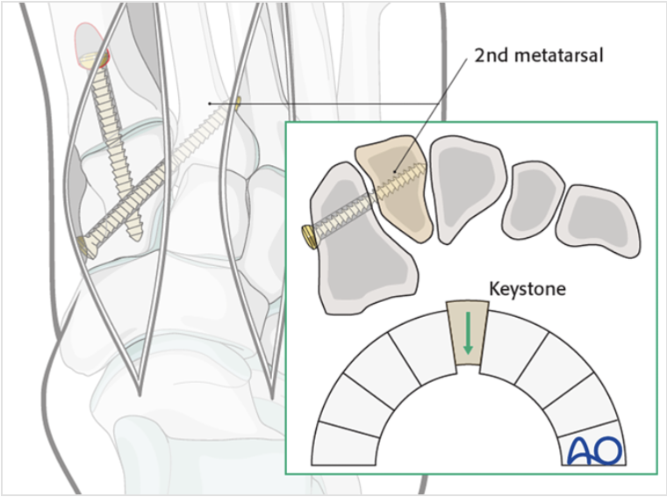
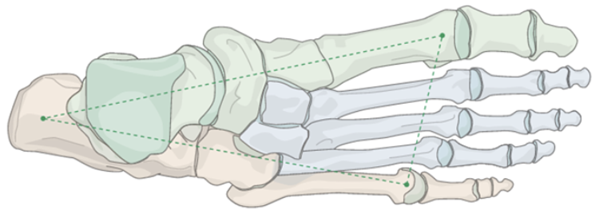
Midfoot Anatomy
Trapezoidal configuration
Recessed 2nd Tarsometatarsal (TMT) joint
“keystone” of the transverse arch
Individual joints are “flat on flat”
TMT joints have little inherent stability due to shallow articulation
Image obtained from AO surgery reference
Notes:
The tarsometatarsal joints have little inherent stability. When soft tissue attachments are removed the joints have shallow articulations.
Note the shallow articulations as outlined in red on image to left.

Slide 11
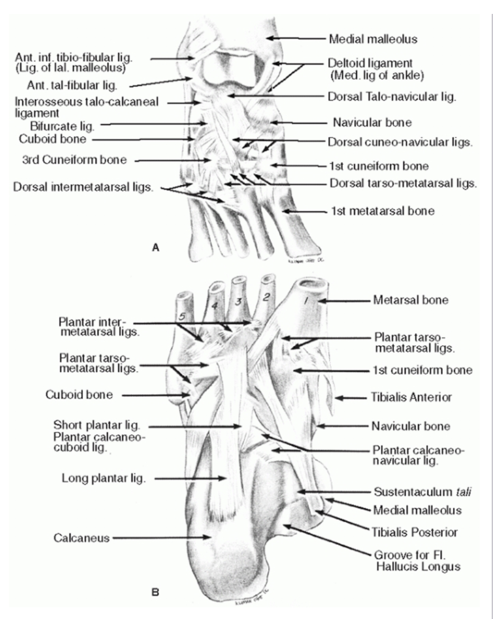
Midfoot Ligamentous Anatomy
Transverse Intermetatarsal ligaments secure M2-M5
No intermetatarsal ligament between M1-M2
Interosseous C1-M2 ligament = Lisfranc ligament
Plantar ligaments stronger than dorsal ligaments
Dorsal ligaments are first to fail under tension leading to dorsal subluxation of metatarsal bases
Thomas A. Schildhauer, Martin F. Hoffmann. Fractures and Dislocations of the Midfoot and Forefoot. In: Tornetta P, Ricci WM, eds. Rockwood and Green's Fractures in Adults, 9e. Philadelphia, PA. Wolters Kluwer Health, Inc; 2019.
Notes:
Plantar oblique ligament (C1-M2-M3) = Ligament of Sappey. The Dorsal ligaments fail first under tension leading to dorsal subluxation of metatarsal bases.
Dorsalis Pedis found just lateral to Extensor Hallucis Brevis (EHB) tendon at the level of tarsometatarsal joints

Slide 12
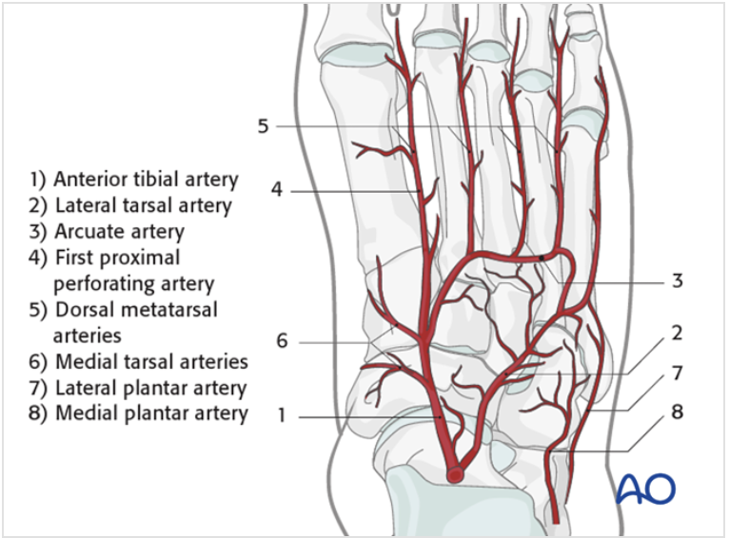
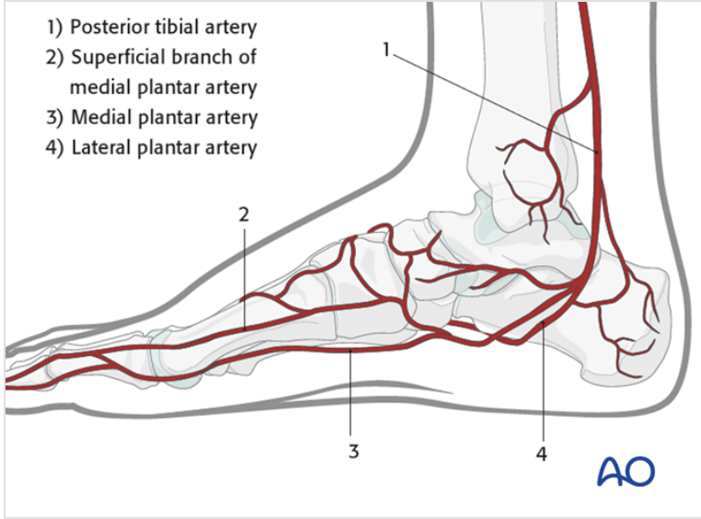
Midfoot Vascular Anatomy
Local blood supply should always be considered in evaluation surgical planning
Images obtained from AO surgery reference

Slide 13
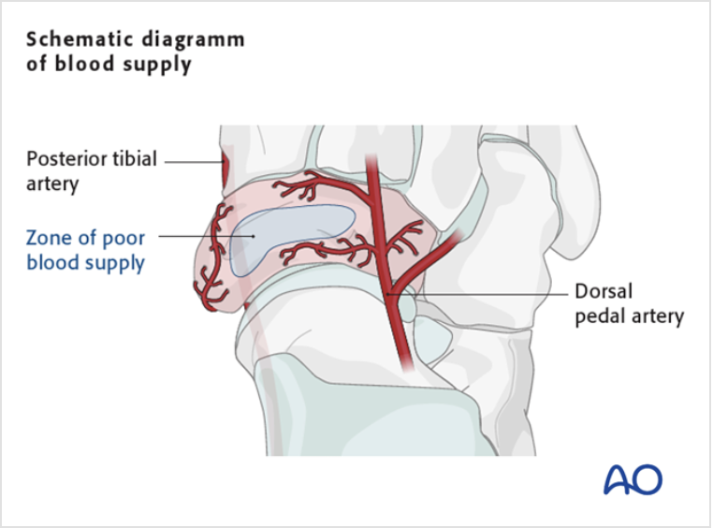
Vascular Anatomy - Navicular
Tenuous dorsal blood supply
Avoid dorsal soft tissue stripping during ORIF to prevent injury
Dorsal navicular blood supply
Image obtained from AO surgery reference

Slide 14
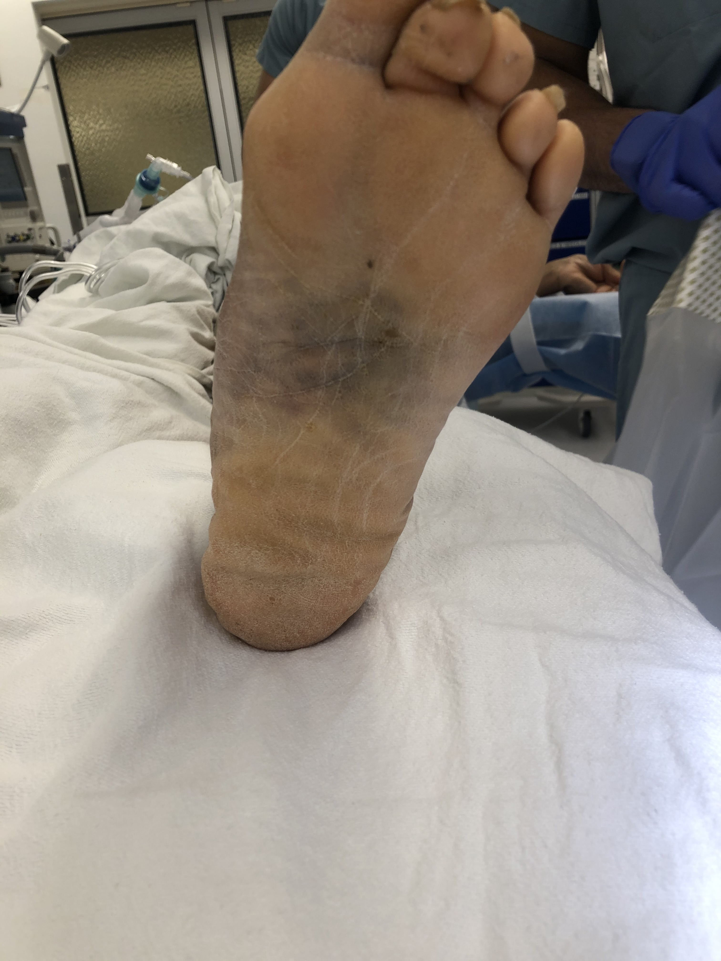
Initial Evaluation
Soft tissues
Skin tenting
Neurovascular evaluation
Plantar Ecchymosis
High suspicion of midfoot ligamentous injury
Plantar ecchymosis in patient with Lisfranc injury

Slide 15
Imaging

Slide 16
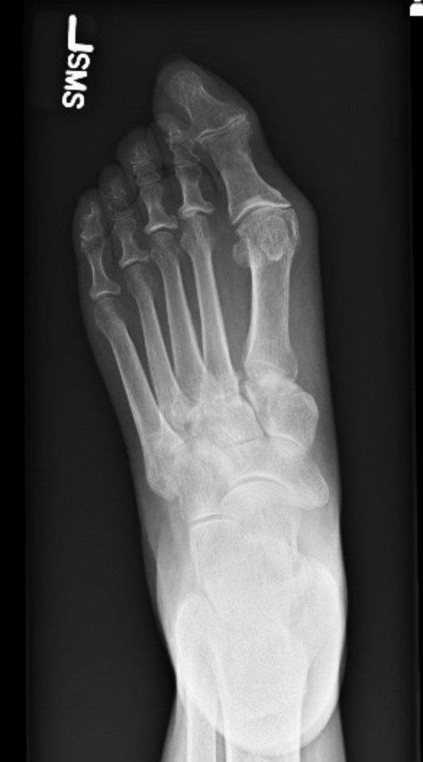
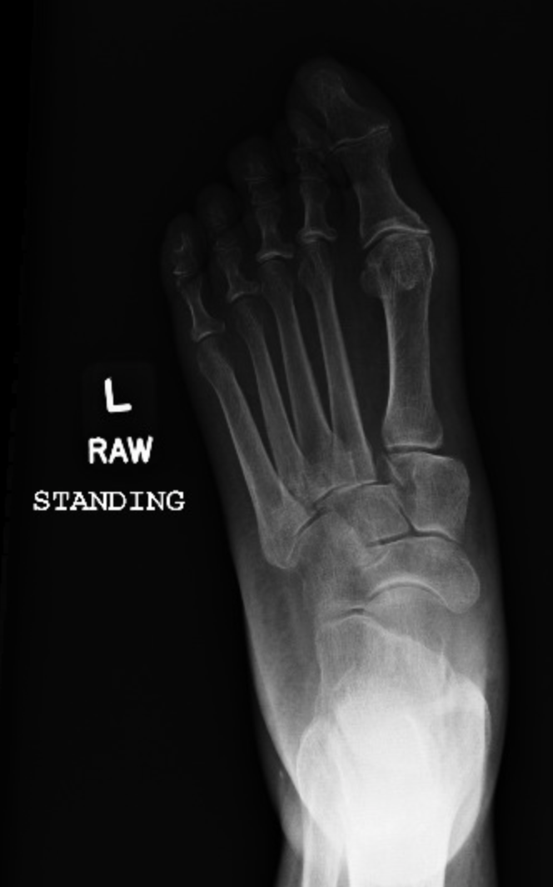
Imaging
XR
AP/Oblique/Lateral of the foot
AP
Oblique
Standing AP bilateral feet on same plate if tolerable
Intraoperative stress exam
CT – useful for evaluation of intra articular extension
MRI –evaluate ligamentous structures
Limited use as static evaluation
NWB AP XR Standing AP XR
Notes:
Standing stress exam may be challenging due to patient pain. An alternative option is intraoperative stress examination. This is performed by pronating, abduction and plantarflexing the forefoot.

Slide 17
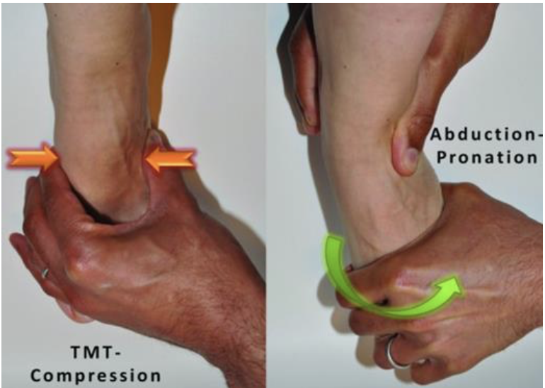
Imaging– Stress exam
Clinical test to identify TMT joint injury
Left: TMT squeeze test
Right: abduction-pronation maneuver

Slide 18
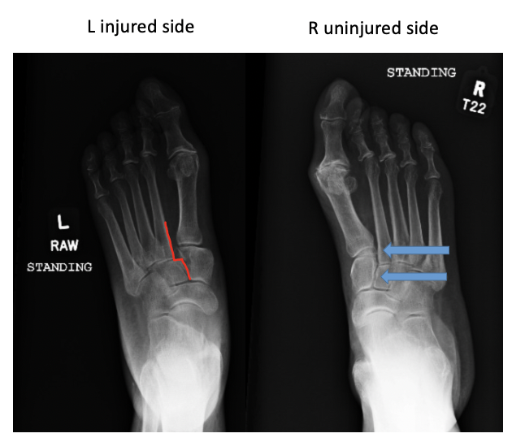
Imaging
XR
AP/Oblique/Lateral of the foot
AP
Medial base 2nd MT in-line with medial aspect of middle cuneiform
AP standing XR of bilateral feet displaying normal alignment
on right with evidence of TMT disruption on the left

Slide 19
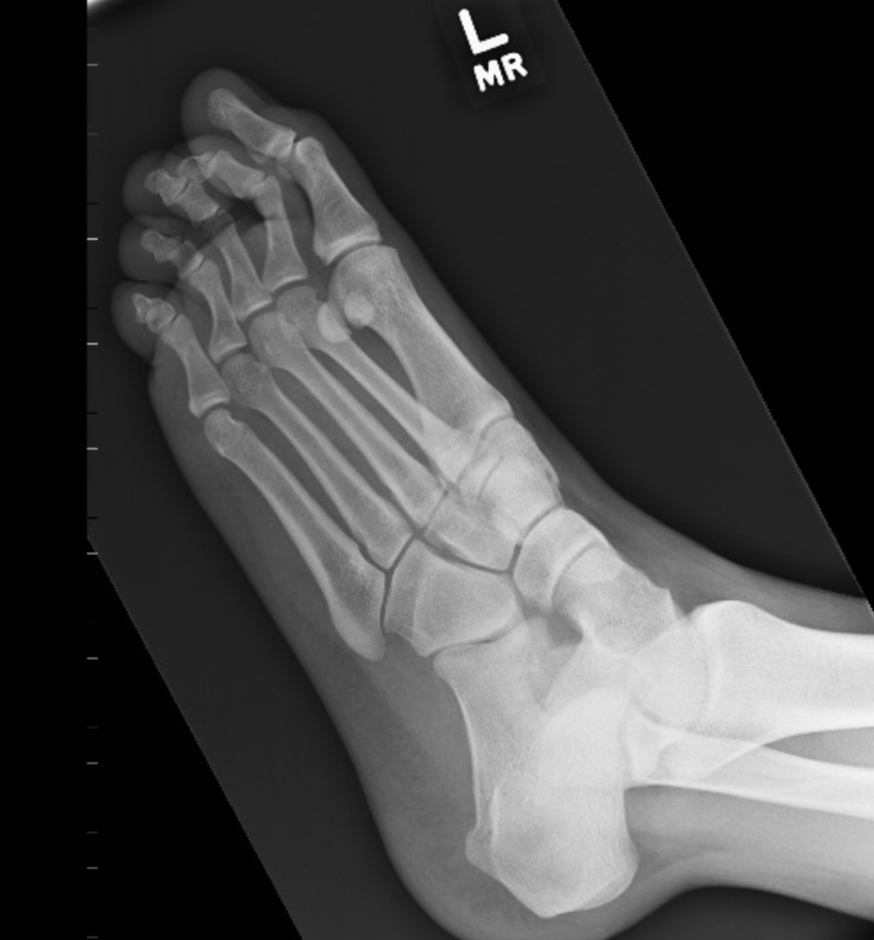
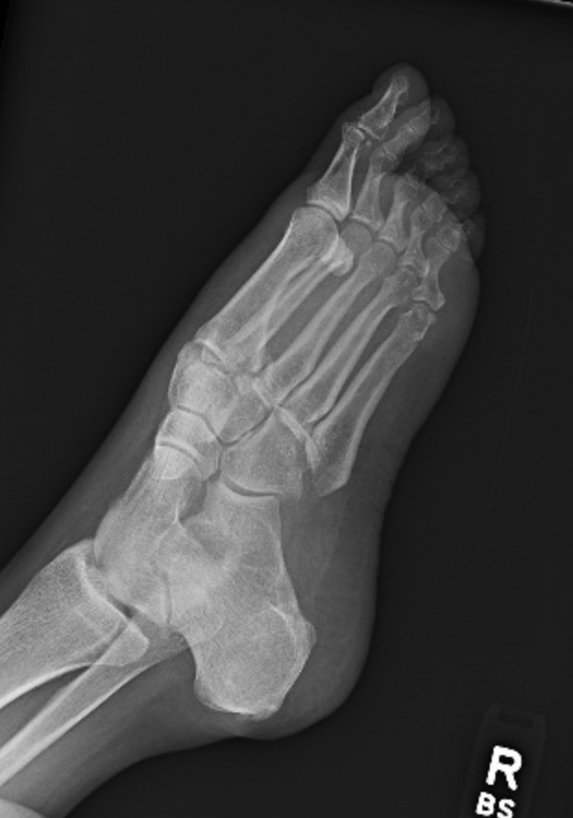
Imaging
XR
AP/Oblique/Lateral of the foot
AP
Oblique
Medial base 3rd MT in-line with medial aspect of lateral cuneiform
Medial base 4th MT in-line with medial aspect of cuboid
Uninjured
Injured

Slide 20
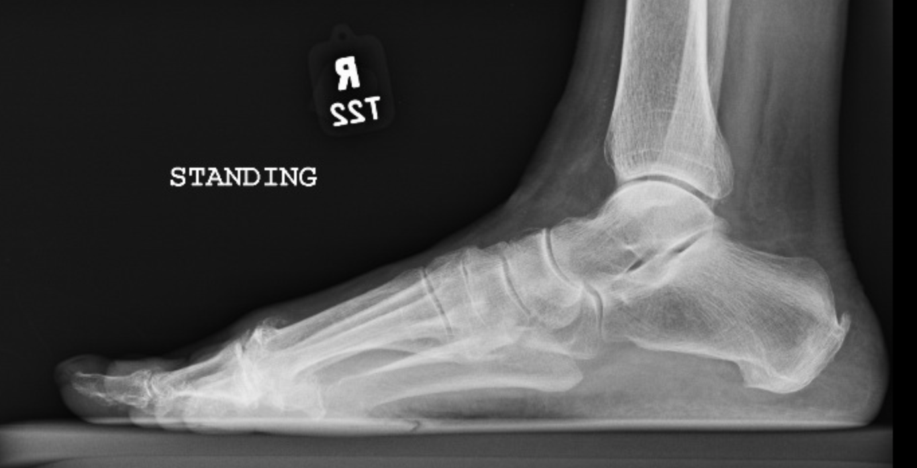
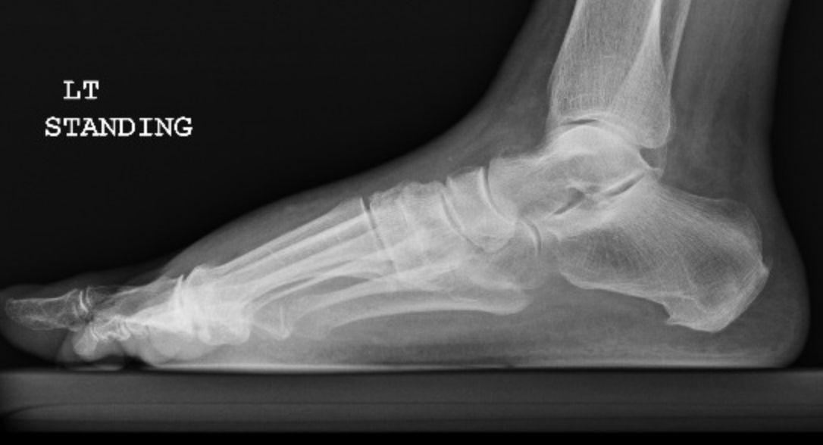
Imaging
XR
AP/Oblique/Lateral of the foot
AP
Oblique
Lateral
Metatarsal base should never be more dorsal than its respective tarsal bone
Standing view – better appreciate any discrepancy
L injured side (bottom image) with MT dorsal to cuneiform
Also note dorsal soft tissue swelling

Slide 21
Imaging
XR
AP/Oblique/Lateral of the foot
AP
Oblique
Standing AP bilateral feet on same plate
Uninjured side as reference
AP standing XR of bilateral feet displaying normal alignment
on right with evidence of TMT disruption on the left

Slide 22
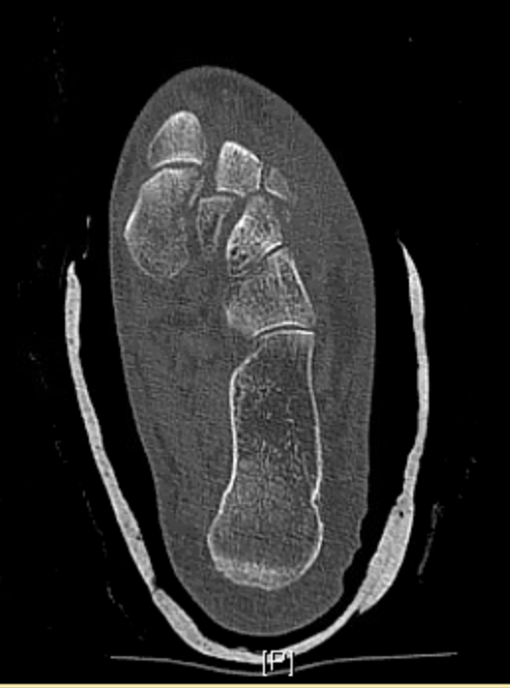
Imaging
XR
AP/Oblique/Lateral of the foot
Standing AP bilateral feet on same plate
”Fleck sign” - small avulsion fracture from base of second metatarsal or medial cuneiform.
CT – useful for evaluation of intra articular extension
MRI –evaluate ligamentous structures
Limited use as static evaluation
Axial CT displaying fracture of the medial cuneiform with lateral translation of the 1st – 3rd TMT joints

Slide 23
Specific Midfoot Injuries

Slide 24
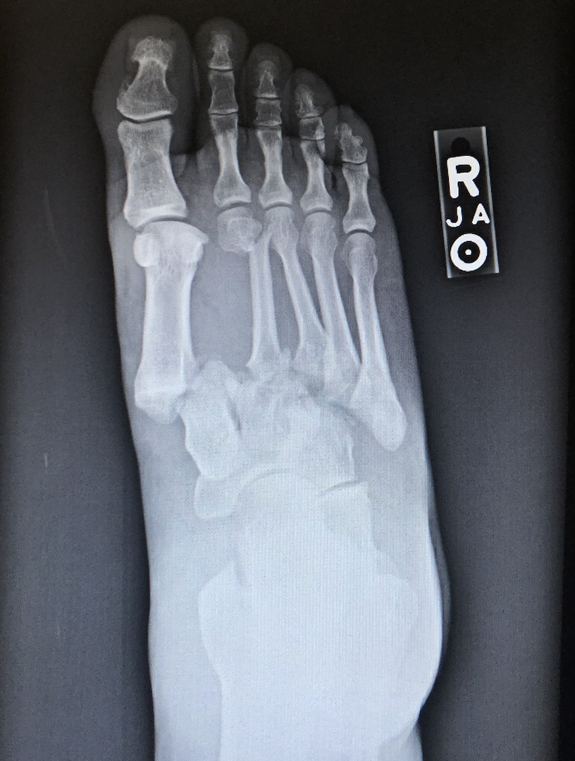
Tarsometatarsal (Lisfranc) Joint Injuries
Jacques L. Lisfranc, French gynecologist
First to describe amputation technique through TMT joint
Rare injuries (0.1-0.4% of all fractures)
Rockwood and Green’s Fractures in Adults 9th Ed
Purely ligamentous injures often misdiagnosed
TMT joint disruption

Slide 25
TMT Joint Injuries - Evaluation
As frequently overlooked must have high index of suspicion
Plantar ecchymosis often present
Plantar ecchymosis in patient with Lisfranc injury

Slide 26
TMT Joint Injuries - Evaluation
If concern present and no findings on static XR
Stress XR
Standing XR with boot feet on same plate for AP
Fluoroscopic stress exam
MRI – less helpful as static exam
Strain of ligament may not correlate with instability
Often occur with other midfoot injuries
Cuboid fracture
Intercuneiform instability/fracture
Standing radiographs of a patient with left TMT joint disruption
Notes:
Standing stress exam may be challenging due to patient pain. An alternative option is intraoperative stress examination. This is performed by pronating, abduction and plantarflexing the forefoot.

Slide 27
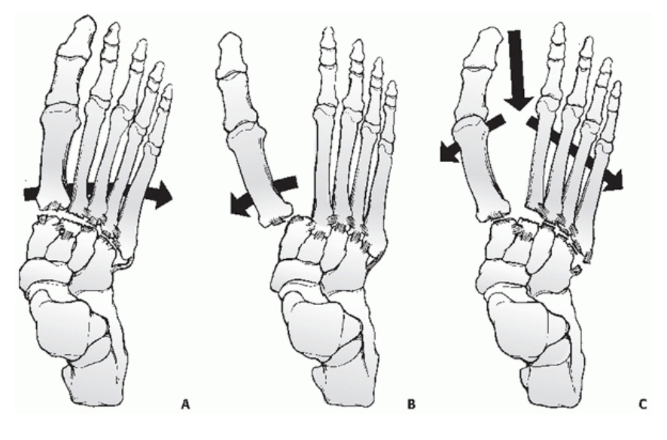
TMT Joint Injuries - Classification
OTA
Quenu and Kuss
Directional
Partial v complete
The common classification devised by Quénu and Küss.³⁰⁷
A: Depicts homolateral disruption where all metatarsals travel in the same direction. This group can be subdivided into medial or lateral to denote the direction of disruption. B: Partial disruption involves only the first metatarsal or all the lesser rays. C: Divergent dislocation occurs when there is complete disruption of the tarsometatarsal joints but the first ray and the lesser rays displace in opposite directions.
Thomas A. Schildhauer, Martin F. Hoffmann. Fractures and Dislocations of the Midfoot and Forefoot. In: Tornetta P, Ricci WM, eds. Rockwood and Green's Fractures in Adults, 9e. Philadelphia, PA. Wolters Kluwer Health, Inc; 2019.

Slide 28
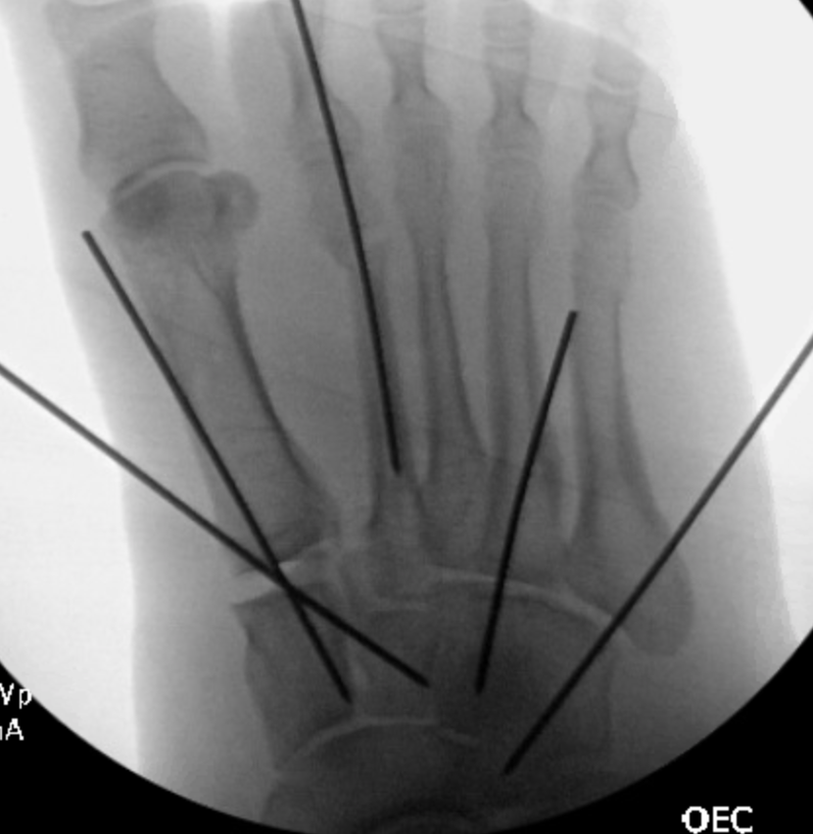
TMT Joint Disruption – Acute Management
Reduce dislocation
Split
CRPP
Unstable midfoot injuries with skin compromise or potential for such
Urgent when skin under tension
Pre and post reduction radiographs of patient with TMT disruption after crush injury

Slide 29
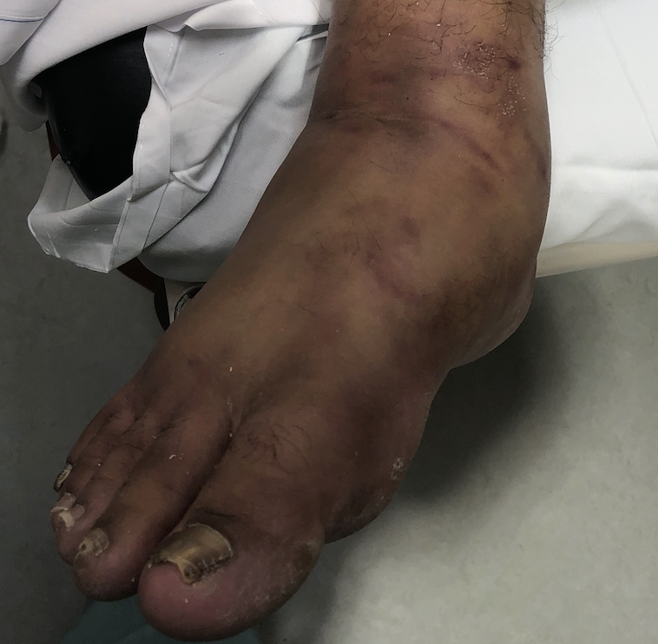
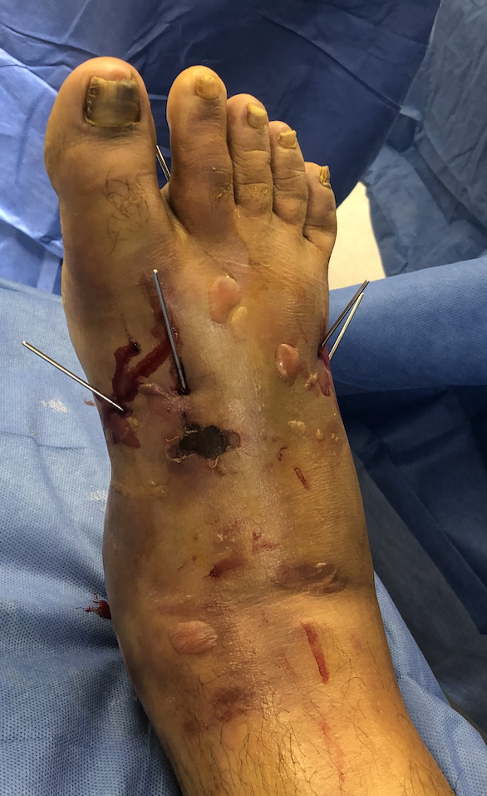
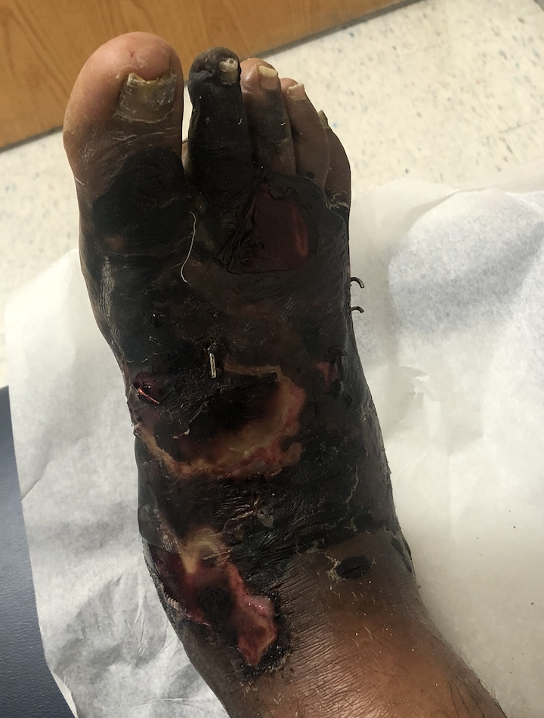
TMT Injuries – Soft Tissue Crush
Severe TMT disruption secondary to crush injury; presented 6 hours from injury
CRPP immediately (center image). Note dorsal eschar already forming upon presentation to OR same day of injury
Follow up image 1 week later (far right)

Slide 30
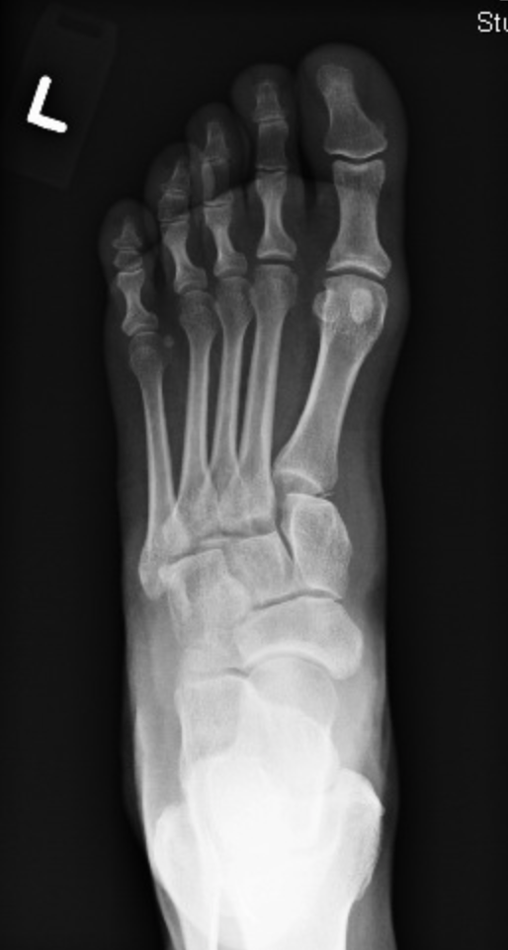
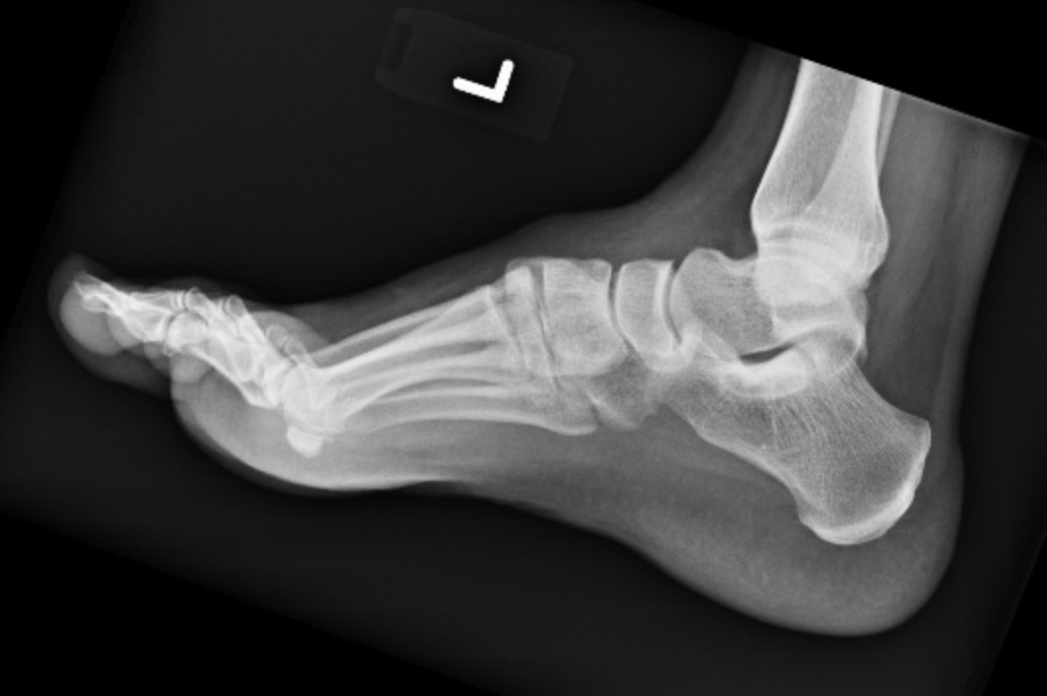
TMT Joint Disruption – Treatment
Acute ligamentous
ORIF v. arthrodesis
Purely ligamentous lesions treated with arthrodesis have been shown to have superior AOFAS scores
Ly ET al. JBJS 2006
Acute Fracture
ORIF
Traversing screws
Spanning dorsal plate
Avoids disruption of articular surface
No difference in clinical outcomes plate v screws
Lau et al JOT 2017
Subacute (>3 months) & chronic
Arthrodesis
Purely ligamentous TMT disruption
Notes:
Ly, Thuan V. ; Coetzee, J. Chris. Treatment of Primarily Ligamentous Lisfranc Joint Injuries: Primary Arthrodesis Compared with Open Reduction and Internal Fixation, JBJS: March 2006 - Volume 88 - Issue 3 - p 514-520.
Lau, Simon; Guest, Catherine; Hall, Marcus Tacey, Mark et al. Functional Outcomes Post Lisfranc Injury—Transarticular Screws, Dorsal Bridge Plating or Combination Treatment?, Journal of Orthopaedic Trauma: August 2017 - Volume 31 - Issue 8 - p 447-452.

Slide 31
TMT Joint Disruption – Evaluation
Complete evaluation of entire midfoot
Fluoroscopic stress
Compliments Brian Weatherford, MD
OTA core curriculum V4

Slide 32
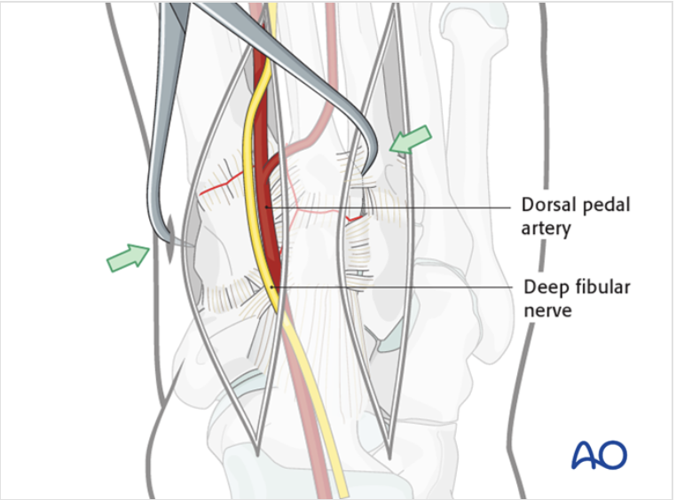
TMT Joint Disruption – Operative Management
Critical to have thorough surgical planning including approach, reduction sequence and fixation methods
Approaches
Plan surgical incisions accordingly
5cm skin bridge
Typically medial and lateral incisions
Image obtained from AO surgery reference
Notes:
Benirschke SK, Kramer PA. High energy acute Lisfranc fractures and dislocations. Tech Foot Ankle Surg. 2010;9(3):82-91

Slide 33
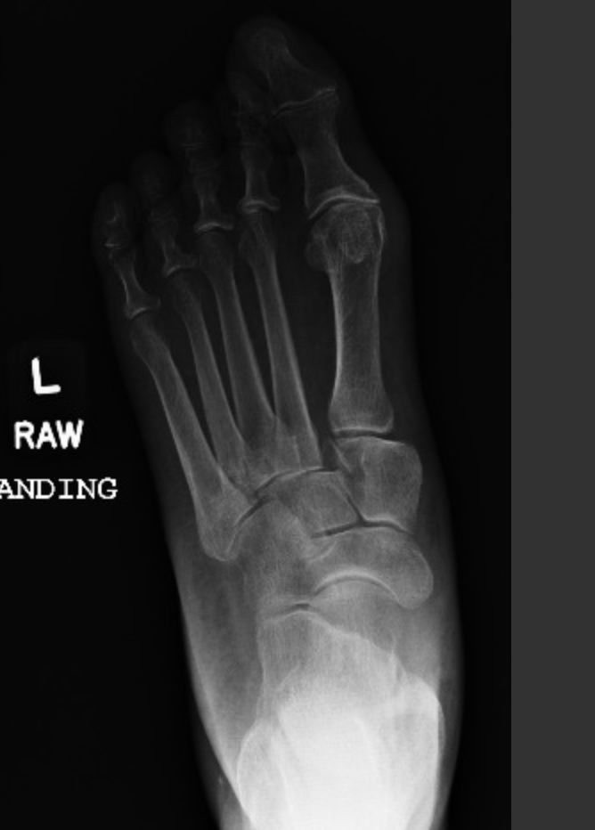
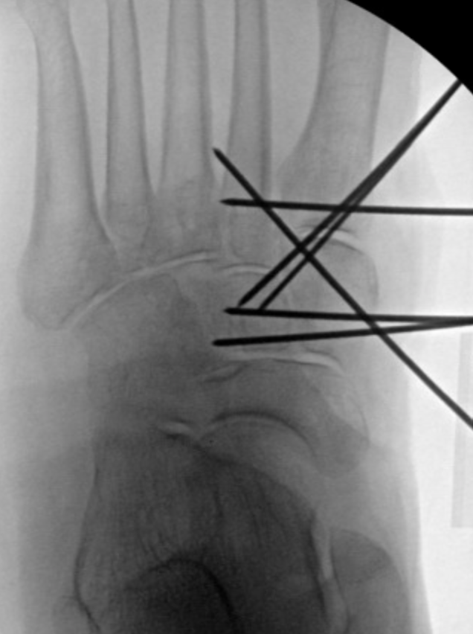
TMT Joint Disruption – Operative Management
Reduction sequence
Stabilize from proximal to distal and medial to lateral
Always assess for naviculocuneiform and intercuneiform disruption
Stabilize accordingly
Image on right displays reduction sequence with intercuneiform instability identified intraoperatively*
Reduction sequence
Notes:
Benirschke SK, Kramer PA. High energy acute Lisfranc fractures and dislocations. Tech Foot Ankle Surg. 2010;9(3):82-91

Slide 34
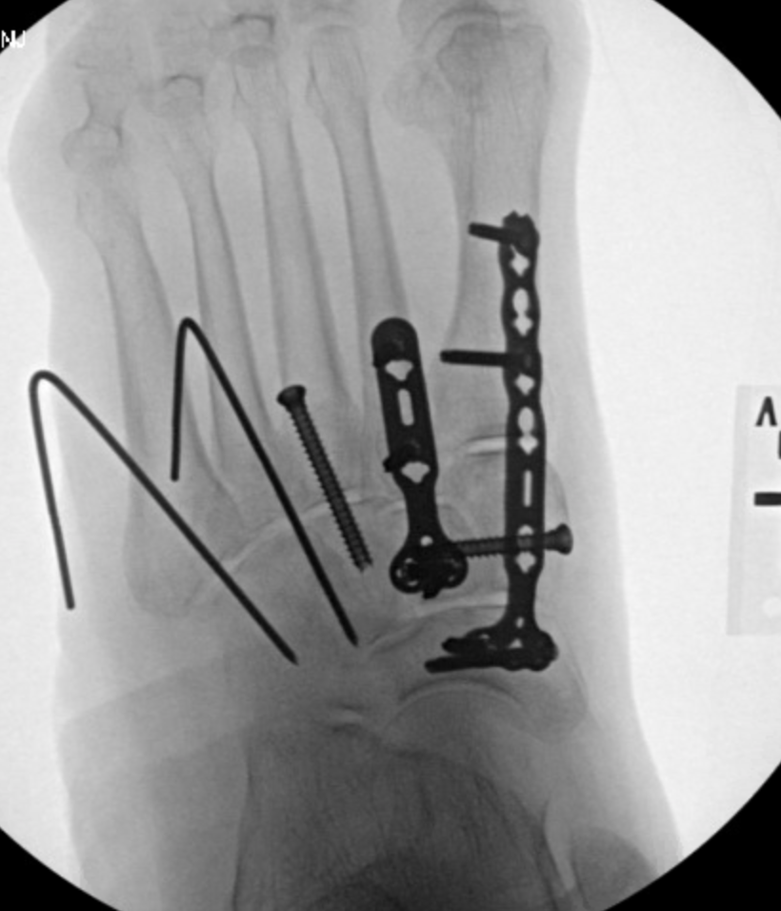
TMT Joint Disruption – Operative Management
Rigid fixation for 1-3rd metatarsals (medial column)
Screws crossing joint
Best for purely ligamentous
Spanning plate fixation
Fracture/comminution
Flexible fixation (CRPP) for 4&5th metattarsals (lateral column)
Typically 0.062 K-wires
Remove at 6+ weeks

Slide 35
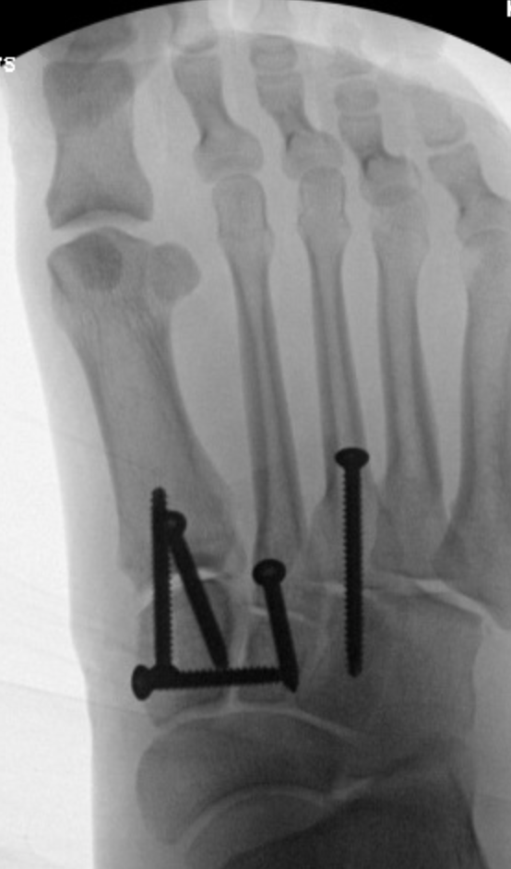
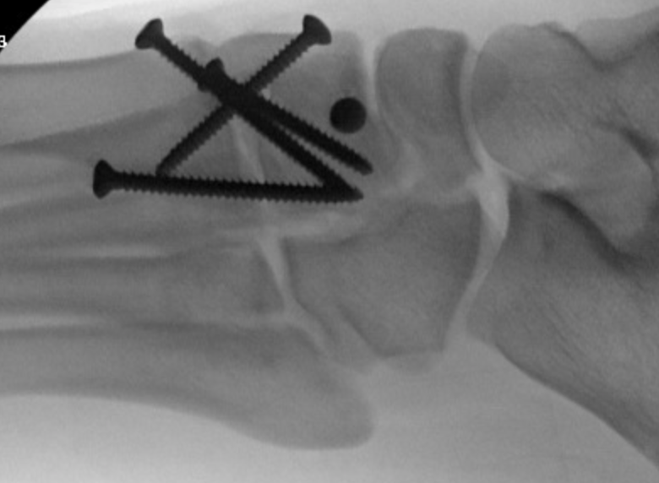
TMT Joint Disruption – Surgical Outcomes
Average AOFAS score, 79.0; FFI, 16.9, and VAS for pain, 2.5.
Stern R JBJS Am 2016
Accuracy of reduction correlates with clinical outcome
Kuo et al JBJS 2000
Lau et al. JOT 2017
Purely ligamentous injuries have superior outcomes when tx with arthrodesis over ORIF
Both with lower AOFAS scores compared to baseline
Ly et al. JBJS 2006
Henning FAI 2009
Midfoot arthrosis s/p TMT disruption
Notes:
Stern R, Dominguez D, Assal M. Clinical Outcomes and Development of Symptomatic Osteoarthritis 2 to 24 Years After Surgical Treatment of Tarsometatarsal Joint Complex Injuries. J Bone Joint Surg Am. 2016 May 4;98(9):713-20.
Kuo RS, Tejwani NC, Digiovanni CW, Holt SK, Benirschke SK, Hansen ST Jr, Sangeorzan BJ. Outcome after open reduction and internal fixation of Lisfranc joint injuries. J Bone Joint Surg Am. 2000 Nov;82(11):1609-18.
Henning JA, Jones CB, Sietsema DL, Bohay DR, Anderson JG. Open reduction internal fixation versus primary arthrodesis for lisfranc injuries: a prospective randomized study. Foot Ankle Int. 2009 Oct;30(10):913-22. doi: 10.3113/FAI.2009.0913.

Slide 36
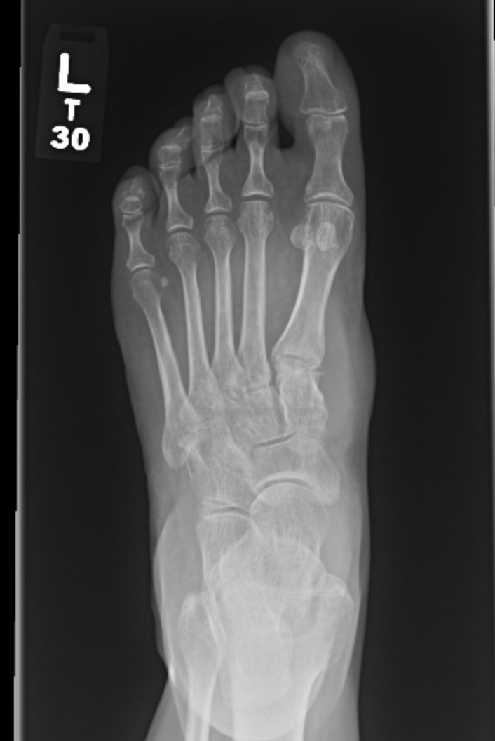
TMT Joint Disruption - Complications
Symptomatic implants
Higher rate of secondary surgery (implant removal and salvage arthrodesis) for ORIF v arthrodesis; 78.6% vs. 16.7%
Henning et al Foot Ankle Int 2009
Midfoot arthritis
Poor association between radiographic (72% of patients) and symptomatic (54% of patients) arthritis
Dubois-Ferrière JBJS Am 2016
Midfoot arthrosis s/p TMT disruption
Notes:
Henning JA, Jones CB, Sietsema DL, Bohay DR, Anderson JG. Open reduction internal fixation versus primary arthrodesis for lisfranc injuries: a prospective randomized study. Foot Ankle Int. 2009 Oct;30(10):913-22. doi: 10.3113/FAI.2009.0913.
Dubois-Ferrière V, Lübbeke A, Chowdhary A, Stern R, Dominguez D, Assal M. Clinical Outcomes and Development of Symptomatic Osteoarthritis 2 to 24 Years After Surgical Treatment of Tarsometatarsal Joint Complex Injuries. J Bone Joint Surg Am. 2016 May 4;98(9):713-20. doi: 10.2106/JBJS.15.00623. PMID: 27147683.

Slide 37
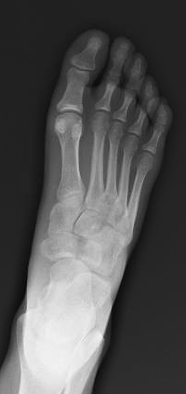
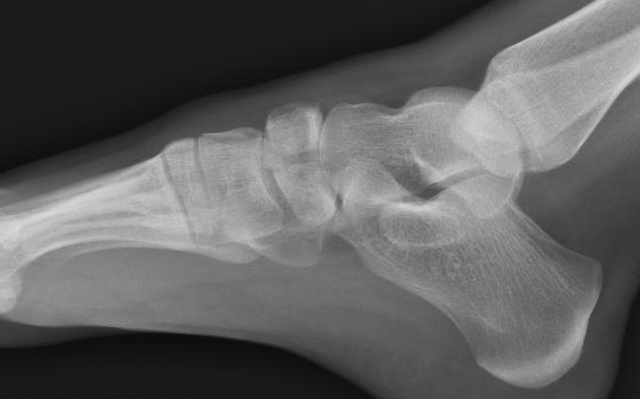
Tarsal Navicular Fractures
Rare injuries
Traumatic fractures most commonly occur with other associated midfoot trauma
Displaced navicular body fracture
Notes:
Sangeorzan BJ, Benirschke SK, Mosca V, Mayo KA, Hansen ST Jr: Displaced intra-articular fractures of the tarsal navicular. J Bone Joint Surg Am 1989;71(10):1504–1510

Slide 38
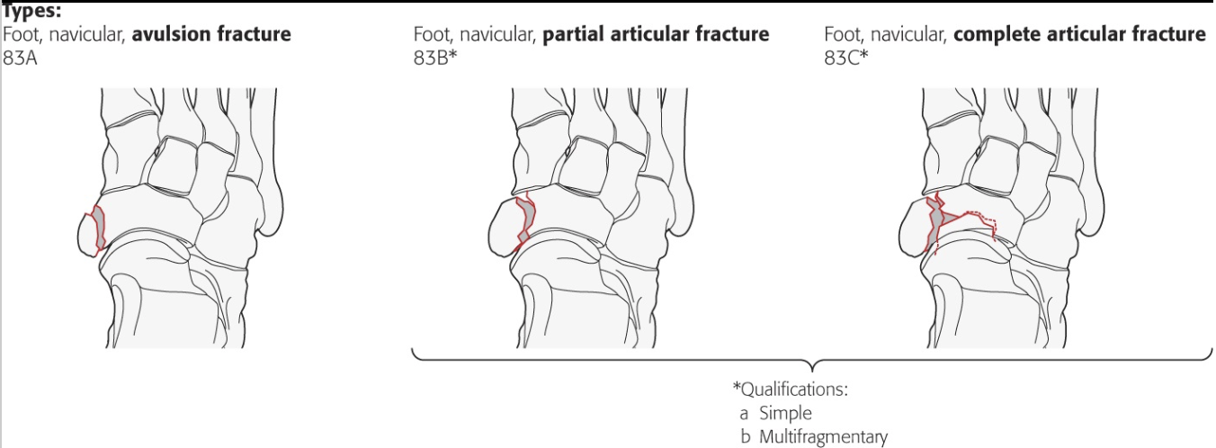
Tarsal Navicular Fractures - Classification
Stress fractures
Acute fractures
Avulsion
Tuberosity
Body
OTA classification
OTA/AO Fracture and Dislocation Classification Compendium
Notes:
Meinberg E, Agel J, Roberts C, et al. Fracture and Dislocation Classification Compendium–2018, Journal of Orthopaedic Trauma. Volume 32: Number 1; Supplement, January 2018.

Slide 39
Tarsal Navicular Fractures - Imaging
XR
CT scan particularly useful to determine full extent of injury/displacement
Displaced navicular body (red arrow) and cuboid fractures

Slide 40
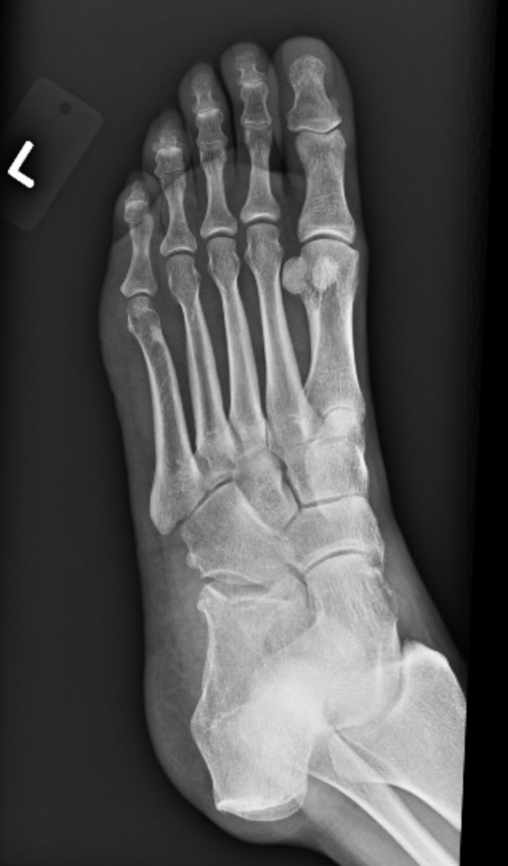
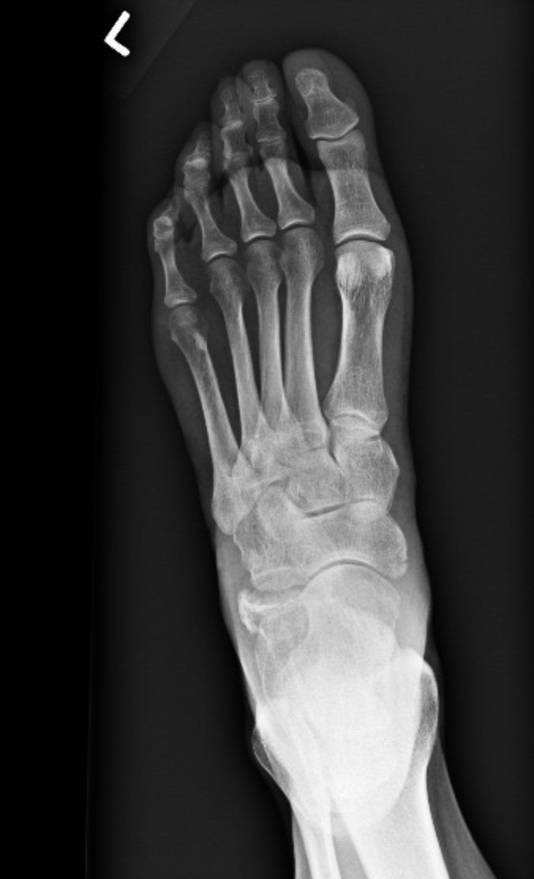
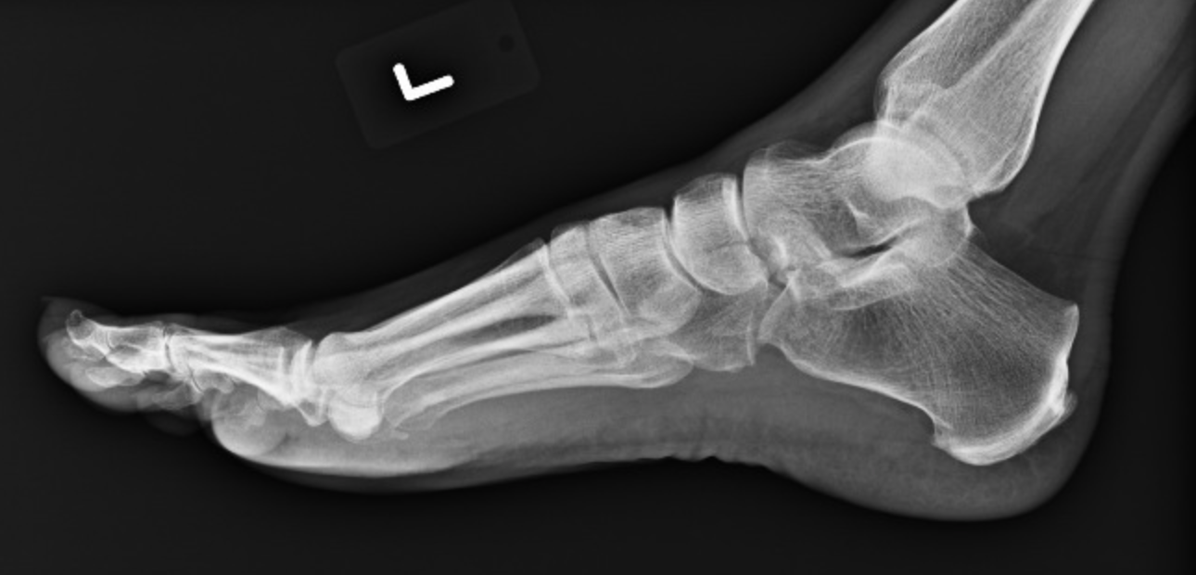
Tarsal Navicular Fractures - Management
Stress fracture
6-8 weeks short leg cast
Equivalent outcomes to operative management
Potter NJ et al. Br J Sports Med. 2006
Khan KM et a. Am J Sports Med. 1992
Avulsion fractures
Non operative management
Minimal displacement
No articular involvement
Nondisplaced navicular body fracture
Notes:
Potter NJ et al. Navicular stress fractures: outcomes of conservative and operative management. Br J Sports Med. 2006 Aug; 40(8): 692–695.
Khan K M, Fuller P J, Brukner P D.et al Outcome of conservative and surgical management of navicular stress fracture in athletes. Eighty‐six cases proven with computerized tomography. Am J Sports Med Nov-Dec 1992;20(6):657-66.

Slide 41
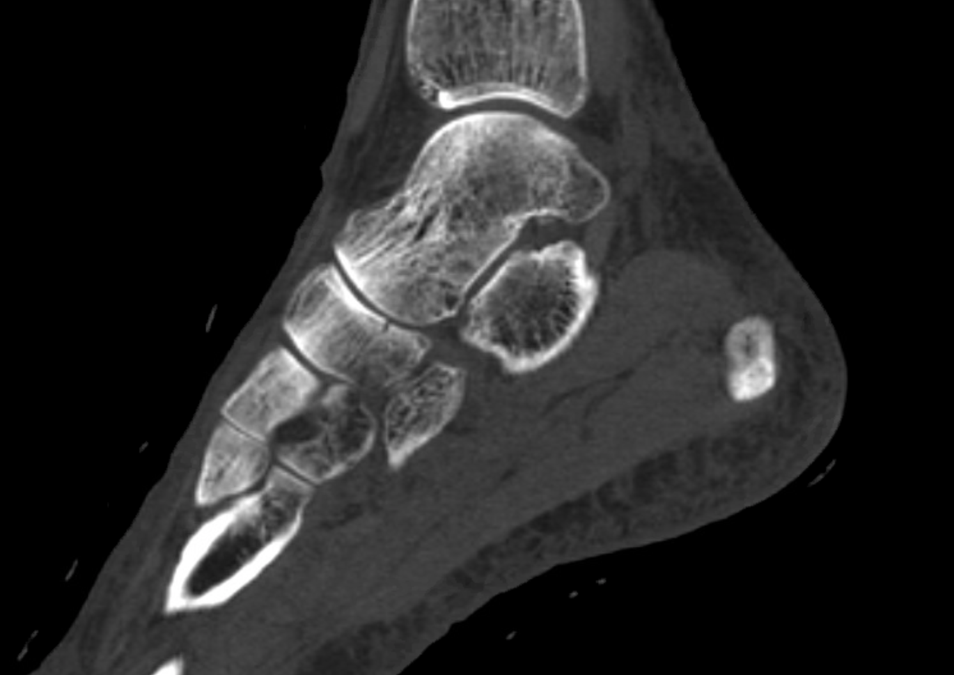
Management of Navicular Body fractures
Non operative management –
Isolated fractures without articular involvement
Nondisplaced articular fractures
Can be considered for conservative management but must be followed closely
CT scan confirming nondisplaced navicular body fracture

Slide 42
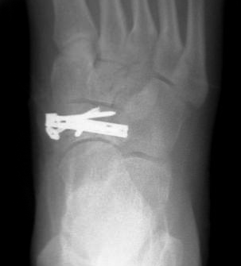
Management of Navicular Body Fractures
Operative management
Indications
Articular involvement with displacement
Unstable medial column
Those occurring with associated midfoot injuries
Techniques
As with any operatively managed injury it is critical to have thorough surgical planning including approach, reduction sequence and fixation methods
Navicular body fracture dorsal plating

Slide 43
Management of Navicular Body Fractures
Techniques
Lag screw fixation
Simple fractures without significant comminution
Plate fixation
Fractures not amendable to screw fixation alone
Multifragmentary/comminuted fractures
Fractures associated with dislocation and/or impaction that require spanning fixation to cuneiforms and/or talus
Navicular body fracture dorsal plating

Slide 44
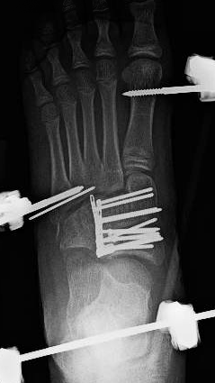
Tarsal Navicular Fractures - Outcomes/Complications
Post traumatic arthrosis most common sequala
Complex fracture patterns tend to result in long-term disability of foot
Simple patterns often have more promising outcome
Osteonecrosis
Deformity
Nonunion
Comminuted navicular fracture
Notes:
In this case an intraoperative external fixator was applied to allow for distraction of the medial and lateral columns of the foot. With this distraction the extensively comminuted navicular fracture is restored to its appropriate length. Further distraction of the joints allow for visualization and reconstruction of the articular surface. Spanning plate fixation from the navicular to the cuneiforms was utilized in this case due to extensive articular comminution to prevent shortening and further impaction of the articular surface that is now restored.

Slide 45
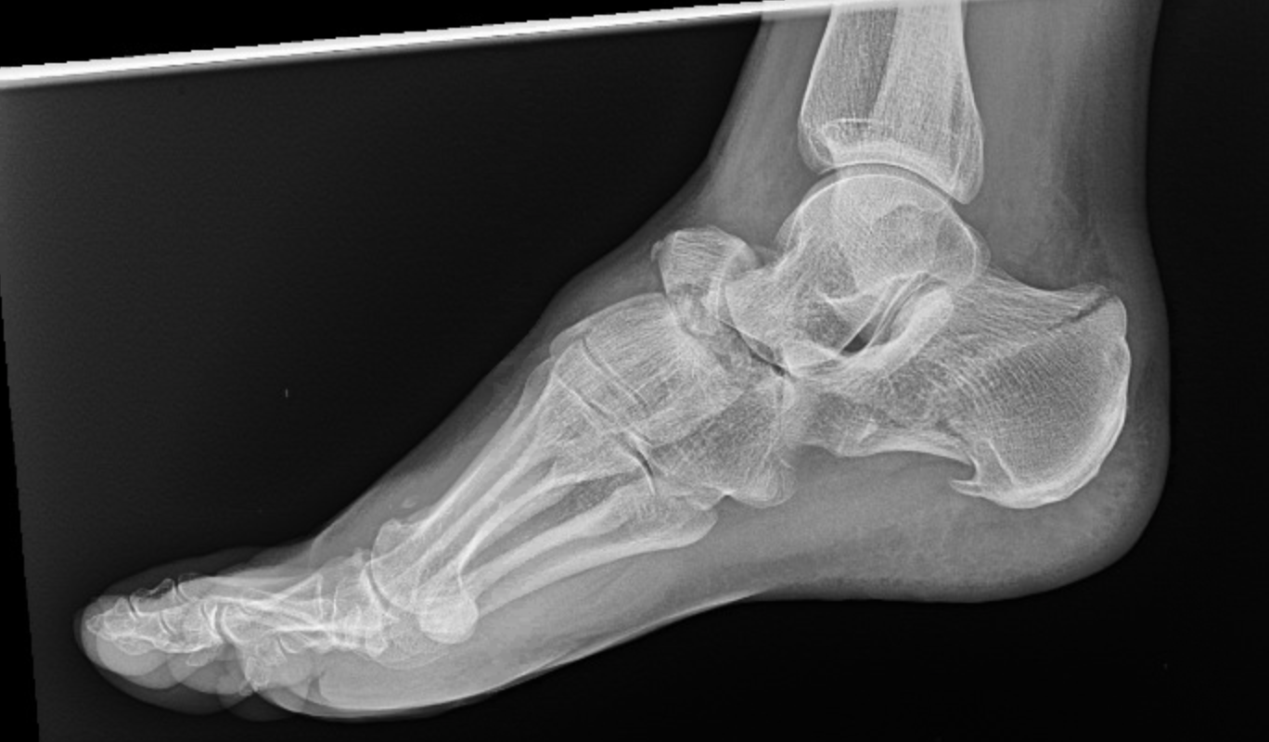
Navicular Dislocation
Typically occur along with fracture
Reduce acute dislocations
For unstable injuries with current or risk for skin compromise CRPP
Should be performed urgently to prevent further skin compromise
CRPP allows for earlier resolution of soft tissue swelling
Navicular fracture dislocation

Slide 46
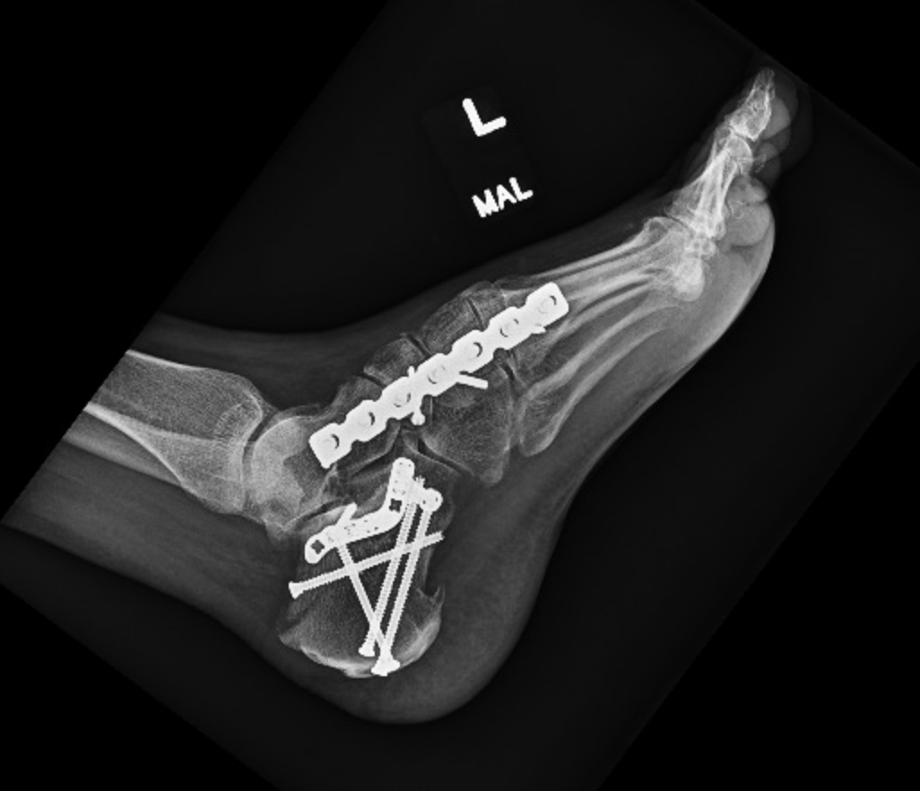
Navicular Dislocation - Definitive Management
Spanning plate fixation often required due to instability
Dependent on injury pattern can span to cuneiform alone or may require spanning fixation of entire medial column
Schildhauer et al JOT 2003
Spanning of TN joint must be temporary as this is an essential joint – remove at 2-4 months
Spanning medial column fixation
Notes:
Schildhauer TA, Nork SE, Sangeorzan BJ. Temporary bridge plating of the medial column in severe midfoot injuries. J Orthop Trauma. 2003 Aug;17(7):513-20.

Slide 47
Cuboid Fractures
Most frequently occur in conjunction with other midfoot injuries
High index of suspicion for TMT ligamentous or other mid foot fracture
“Nutcracker fracture”
Lateral column length

Slide 48
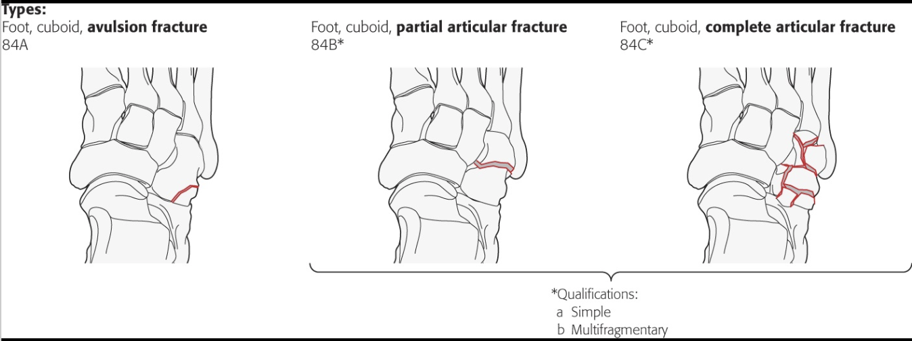
Cuboid Fractures – Imaging/Classification
CT scan
Operative planning
Articular impaction/comminution
Classification
OTA
AO/OTA classification

Slide 49
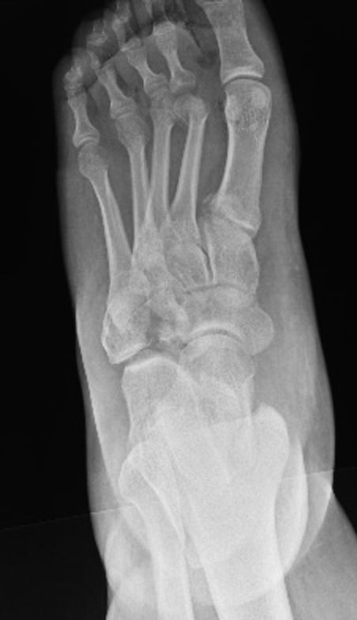
Cuboid Fractures – Management
Nonoperative Criteria
Isolated cuboid fractures
Non/minimally displaced
Maintained lateral column length
NWB in cast 6-8 weeks
Operative
Displaced fractures
Shortened lateral column
Associated injuries
Comminuted cuboid fracture with associated midfoot injuries

Slide 50
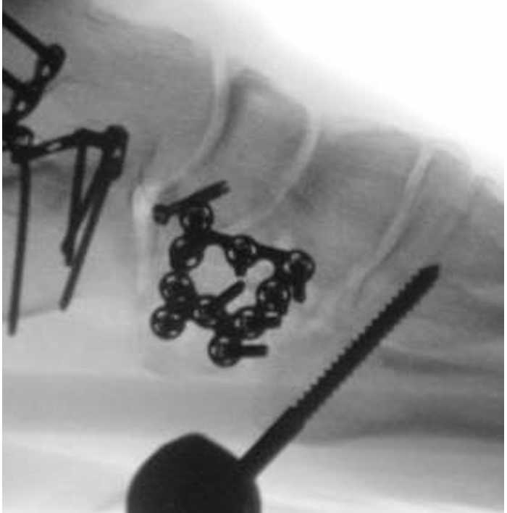
Cuboid Fractures – Operative treatment
ORIF
Most common intervention
Generally plate fixation
Anatomic plates or mini fragment
Lateral column external fixation
Can be used for intraoperative distraction during ORIF
As an adjunct to plate fixation
Extensively comminuted fractures not amendable to plate/screw fixation
Lateral column bridge plating
Can be utilized in severely comminuted fractures
Requires removal as prevents lateral column motion (essential joints)
Cuboid ORIF with lateral column external fixator utilized for intraoperative distraction

Slide 51
Cuboid Fractures – Outcomes
Arthritis in CC joint as well as 4/5 TMT joints is poorly tolerated
Shortening of lateral column can lead to foot abduction/deformity and subsequent pain
No long-term studies utilizing validated scoring systems
Simple, isolated fractures tend to have more favorable outcome that comminuted fractures with associated injuries

Slide 52
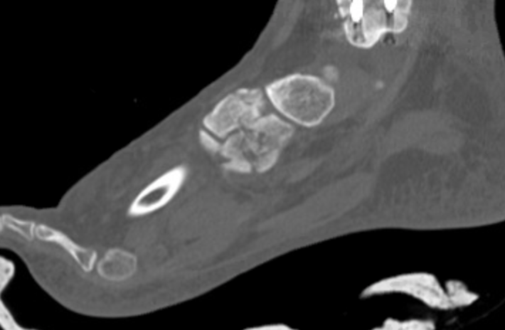
Cuneiform Injuries
Rarely occur in isolation
Most often occur in conjunction with TMT joint injuries
Bony disruption (fracture) or ligamentous (intercuneiform or naviculocuneiform joint disruption)
Stress XR – eversion/pronation stress to assess for midfoot ligamentous injury
CT scan for evaluation
Comminuted cuneiform fracture in multiply injured patient

Slide 53
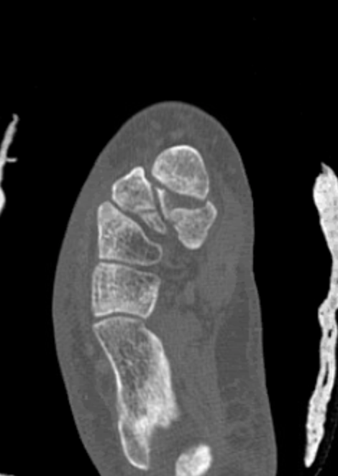
Cuneiform Injuries - Treatment
Non operative
Isolated
Nondisplaced
Operative
Displaced
Occurring with associated
midfoot injuries
CT scan displaying a comminuted cuneiform fracture with impaction

Slide 54
Cuneiform Injuries – Operative Treatment
Joint Disruption
Intercuneiform disruption most often treated with screw fixation traversing effected joints
Should be reduced and stabilized prior to reduction of TMT joints
Naviculocuneiform disruption most often stabilized by spanning plate fixation
Fractures
Spanning plate
Comminuted
Joint disruption
Screw fixation
Simple pattern
Comminuted cuneiform fracture with significant articular impaction
treated with reduction and spanning plate fixation
Note disruption of 2nd and 3rd TMT joints identified intraoperatively

Slide 55
Summary
Midfoot injuries are rare
Often associated with concomitant foot injuries
Always assess for other injuries – advanced imaging (CT scan, stress x-rays) as needed
Develop thorough surgical plan
Chronic discomfort is not infrequent

Slide 56
References
Tornetta, et al. Rockwood and Greens Fractures in Adults. 9th ed. 2019.
Siddiqui et al. Evaluation of the tarsometatarsal joint using conventional radiography, CT, and MR imaging. Radiographics. 2014.
Panchbhavi et al. Three-dimensional, digital, and gross anatomy of the Lisfranc ligament. Foot Ankle Int. 2013.
AO Surgery Reference
Ramadorai U, Beuchel M, Sangeorzan BJ. Fractures and Dislocations of the Tarsal Navicular, Journal of the American Academy of Orthopaedic Surgeons: June 2016 - Volume 24 - Issue 6 - p 379-389.
Sangeorzan BJ, Benirschke SK, Mosca V, Mayo KA, Hansen ST Jr: Displaced intra-articular fractures of the tarsal navicular. J Bone Joint Surg Am 1989;71(10):1504–1510.
Schildhauer TA, Nork SE, Sangeorzan BJ. Temporary bridge plating of the medial column in severe midfoot injuries. J Orthop Trauma. 2003 Aug;17(7):513-20.
Borrelli J, De S, VanPelt M. Fracture of the Cuboid, JAAOS: July 2012 - Volume 20 - Issue 7 - p 472-477.
Ly T, Coetzee JC. Treatment of Primarily Ligamentous Lisfranc Joint Injuries: Primary Arthrodesis Compared with Open Reduction and Internal Fixation, JBJS: March 2006 - Volume 88 - Issue 3 - p 514-520.
Lau S, Guest C, Hall M, et al. Functional Outcomes Post Lisfranc Injury—Transarticular Screws, Dorsal Bridge Plating or Combination Treatment?, Journal of Orthopaedic Trauma: August 2017 - Volume 31 - Issue 8 - p 447-452.

Slide 57
References (cont)
Benirschke SK, Kramer PA. High energy acute Lisfranc fractures and dislocations. Tech Foot Ankle Surg. 2010;9(3):82-91.
Kuo RS, Tejwani NC, Digiovanni CW, Holt SK, Benirschke SK, Hansen ST Jr, Sangeorzan BJ. Outcome after open reduction and internal fixation of Lisfranc joint injuries. J Bone Joint Surg Am. 2000 Nov;82(11):1609-18.
Stern R, Dominguez D, Assal M. Clinical Outcomes and Development of Symptomatic Osteoarthritis 2 to 24 Years After Surgical Treatment of Tarsometatarsal Joint Complex Injuries. J Bone Joint Surg Am. 2016 May 4;98(9):713-20.
Henning JA, Jones CB, Sietsema DL, Bohay DR, Anderson JG. Open reduction internal fixation versus primary arthrodesis for lisfranc injuries: a prospective randomized study. Foot Ankle Int. 2009 Oct;30(10):913-22. doi: 10.3113/FAI.2009.0913.
Meinberg E, Agel J, Roberts C, et al. Fracture and Dislocation Classification Compendium–2018, Journal of Orthopaedic Trauma. Volume 32: Number 1; Supplement, January 2018.

