Slide 1
Distal Femur Fractures
David J. Stockton, MD MASc
University of British Columbia
Department of Orthopaedics

Slide 2
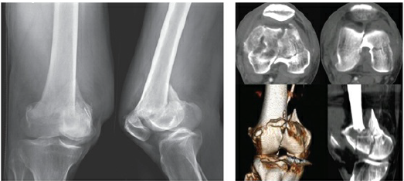
Top 5 Learning Objectives
Osteology & deforming forces
Fracture classification
Treatment options and considerations
Surgical approaches
Fixation options
(Collinge CA, Wiss DA. Distal Femur Fractures. In: Tornetta P, Ricci WM, eds. Rockwood and Green’s Fractures in Adults, 9e. Philadelphia, PA: Wolters Kluwer Health, Inc; 2019.)

Slide 3
Introduction
Account for 7% of all femur fractures
Bimodal distribution: High-energy injuries in the young, low-energy in the elderly
Historical treatment
1960’s and earlier: Skeletal traction favored
Neer et al. (JBJS 1967) advocated for closed, non-operative treatment based on poor results and high complications resulting from ORIF
1960’s: Angled blade plate introduced and subsequently the dynamic condylar screw (DCS) plate improved fixation options
1990’s: ORIF established as the standard of care (Butt et al., JBJS Br 1996)
2000’s: Early iterations of the lateral locking plates improved outcomes (Weight & Collinge, JOT, 2004)
2010’s: Improved plate design and ongoing experimentation with far cortical locking (FCL) and intramedullary (IM) nail design aim to improve non-union rates and allow for early weight-bearing

Slide 4
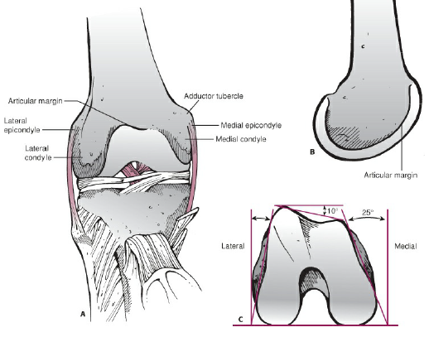
Osteology
Shaft of femur aligned with anterior half of lateral condyle
Anatomic axis 9° valgus (range 7-11°)
anatomic lateral distal femoral angle (aLDF) 81° (79°- 83°)
mechanical lateral distal femoral angle (mLDF) 87° (85° - 90°)
Sectioned axially, distal femur is trapezoidal
Ramifications for:
Implant placement
Screw prominence
(Collinge CA, Wiss DA. Distal Femur Fractures. In: Tornetta P, Ricci WM, eds. Rockwood and Green’s Fractures in Adults, 9e. Philadelphia, PA: Wolters Kluwer Health, Inc; 2019.)

Slide 5
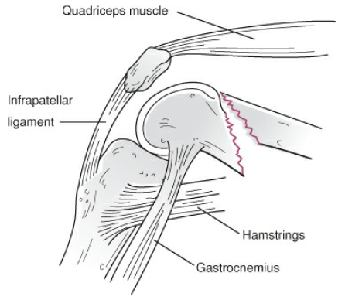
Injury Considerations
Mechanism of injury
Young patient: high energy (MVC, fall from height)
Elderly: low energy fall on flexed knee
Deforming forces
Quadriceps ➔ shortening
Hamstring ➔ shortening
Gastrocnemius ➔ apex posterior angulation, posterior displacement
Adductors ➔ varus
(Collinge CA, Wiss DA. Distal Femur Fractures. In: Tornetta P, Ricci WM, eds. Rockwood and Green’s Fractures in Adults, 9e. Philadelphia, PA: Wolters Kluwer Health, Inc; 2019.)

Slide 6
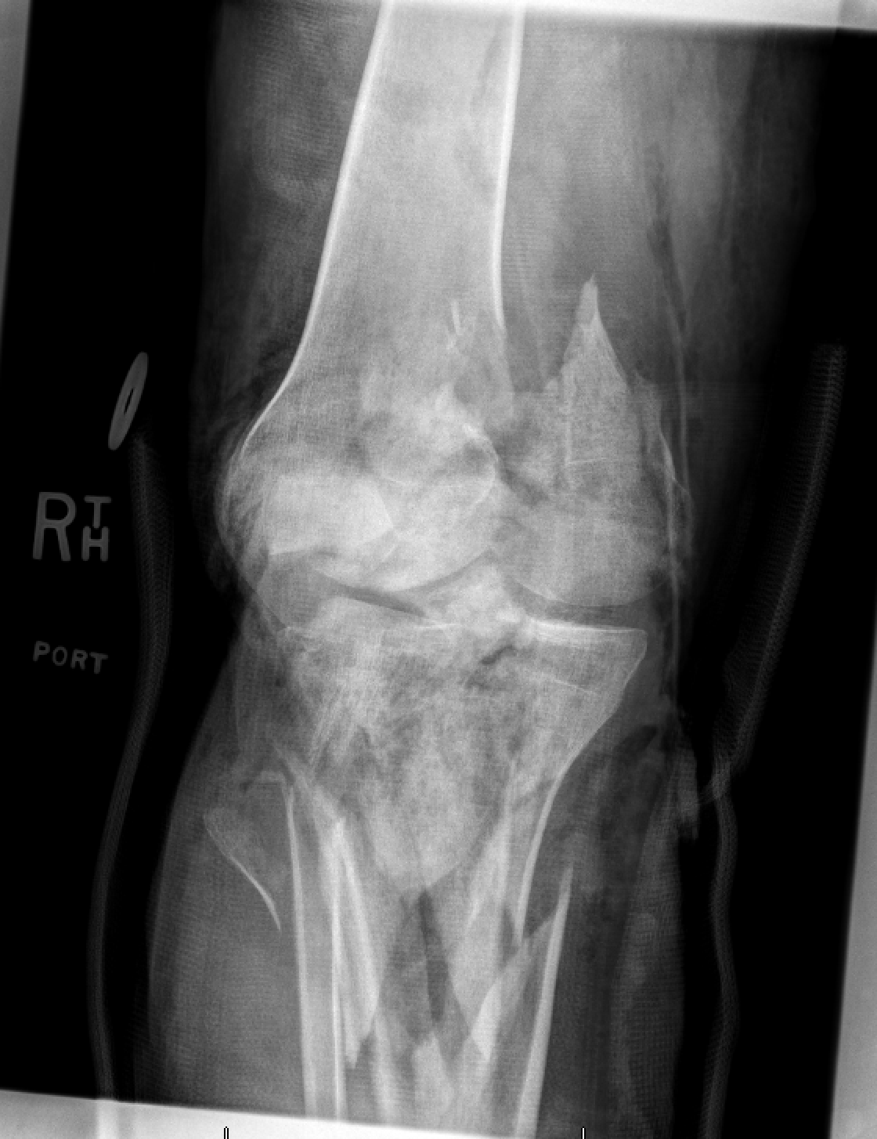
Injury Considerations
Associated injuries
Open fracture (5-10%)
Knee ligament injury (up to 20% of cases)
Tibial plateau fracture
Patella fracture
Acetabulum fracture
Femoral neck fracture
Femoral shaft fracture
Courtesy of Jeff Potter, MD

Slide 7
Injury Considerations
History
Mechanism of injury
Ambulatory status
Pre-existing knee arthritis
Physical exam
If high energy injury: ATLS
Examine for other injuries
Neurovascular status of limb
Ankle-brachial index/ CT angiogram if any discrepancy in pulses
Inspect for soft tissue injury
Indications for CT angiogram:
Diminished/ absent pulse
Expanding hematoma
ABI <0.9
Persistent arterial bleeding
Damage to associated nervous structures

Slide 8
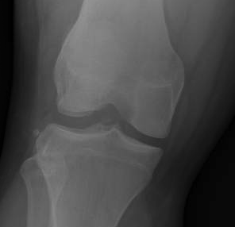
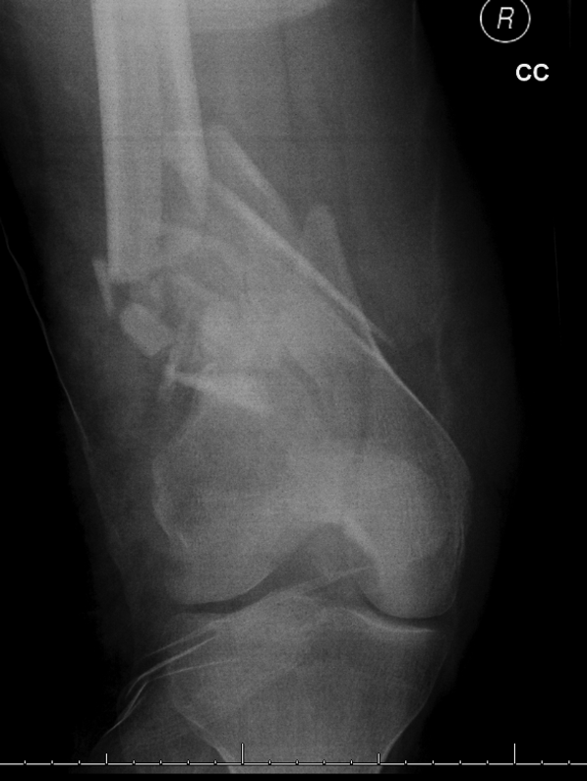
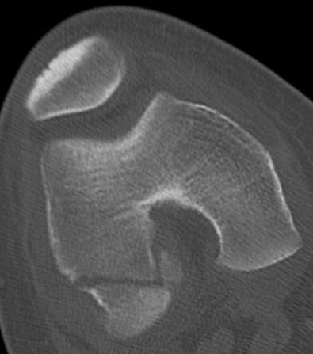
Injury Considerations
Double density sign
Paradoxical notch view
Workup
Orthogonal X-Rays
Double-density on AP X-Ray: Hoffa fragment
‘Paradoxical notch view’ on AP X-Ray: articular fragment in recurvatum
Image joint above and below
Low threshold for CT scan
Demonstrates intra-articular involvement
Reveals coronally oriented Hoffa fracture
38% incidence (Nork et al., JBJS 2005)
Lateral > medial condyle
Missed ~31% of the time
Hoffa fracture
Courtesy of Jeff Potter, MD

Slide 9
Injury Considerations
Prior to classifying the fracture, consider:
Amount of displacement
Degree of comminution
Extent of soft tissue injury
Damage to the articular surface
Bone quality
Associated fracture of patella or tibial plateau
Associated neurovascular injury
Presence of coronal fracture line

Slide 10
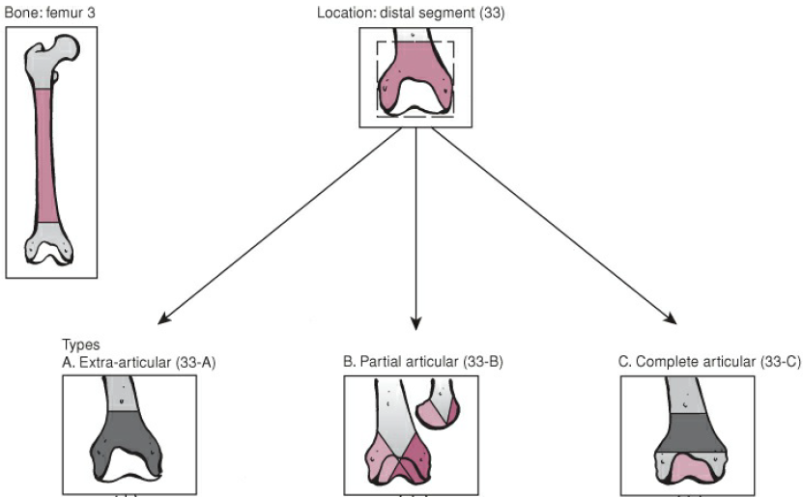
Fracture Classification: AO/OTA
(Meinberg EG, Agel J, Roberts CS, Karam MD, Kellam JF. AO/ OTA fracture and dislocation classification compendium 2018. J Orthop Trauma. 2018;32 Suppl 1:S1-S170.)

Slide 11
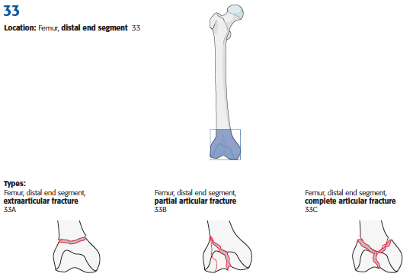
Fracture Classification: AO/ OTA
(Meinberg EG, Agel J, Roberts CS, Karam MD, Kellam JF. AO/ OTA fracture and dislocation classification compendium 2018. J Orthop Trauma. 2018;32 Suppl 1:S1-S170.)

Slide 12
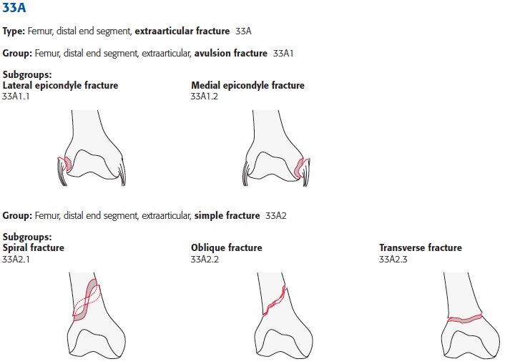
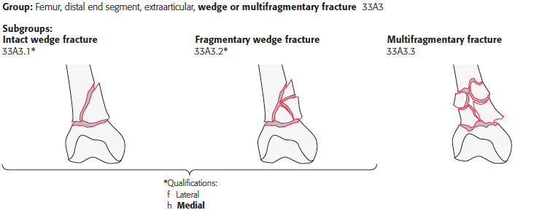
33A:
Extra-articular
(Meinberg EG, Agel J, Roberts CS, Karam MD, Kellam JF. AO/ OTA fracture and dislocation classification compendium 2018. J Orthop Trauma. 2018;32 Suppl 1:S1-S170.)

Slide 13
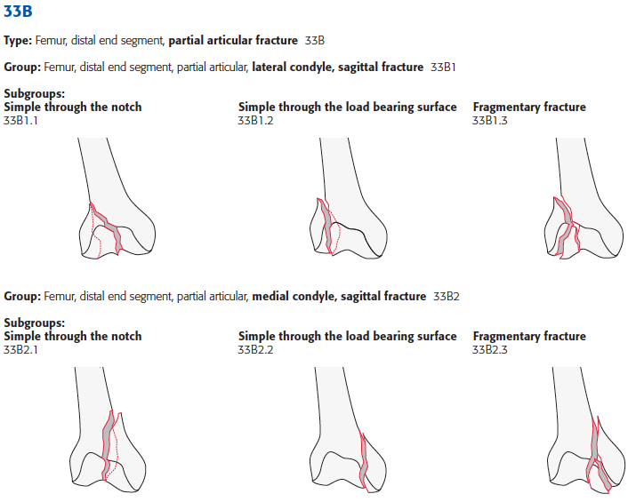
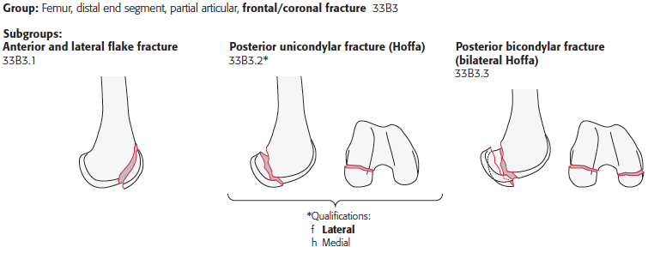
33B:
Partial articular
(Meinberg EG, Agel J, Roberts CS, Karam MD, Kellam JF. AO/ OTA fracture and dislocation classification compendium 2018. J Orthop Trauma. 2018;32 Suppl 1:S1-S170.)

Slide 14
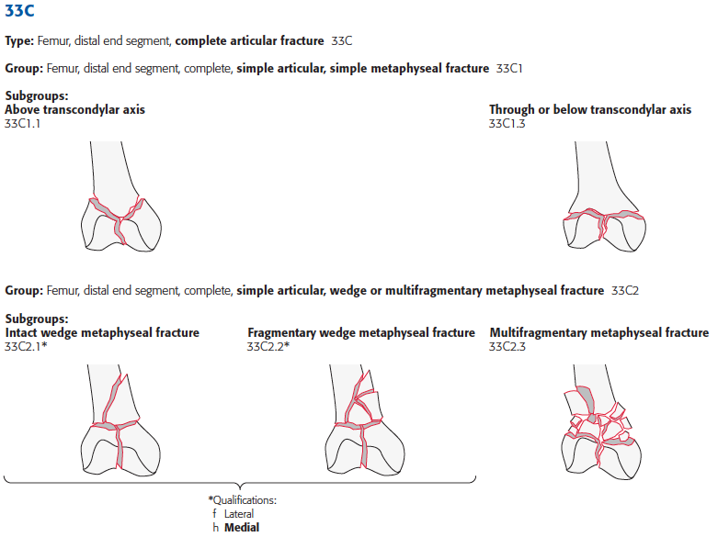
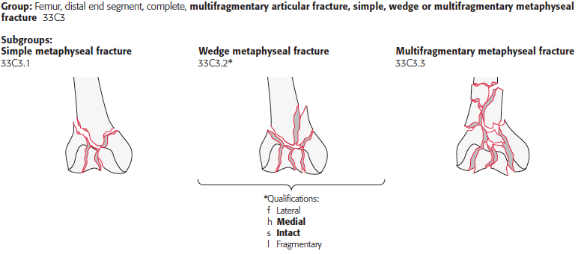
33C:
Complete articular
(Meinberg EG, Agel J, Roberts CS, Karam MD, Kellam JF. AO/ OTA fracture and dislocation classification compendium 2018. J Orthop Trauma. 2018;32 Suppl 1:S1-S170.)

Slide 15
Treatment options
Relative indications for non-operative management
Patient factors
Medical contraindication to surgery
Non-ambulatory
Fracture factors
Non-displaced fracture
Impacted, stable fracture
Non-reconstructable fracture
Severe osteopenia
Surgeon factors
Lack of experience with operative treatment
Lack of appropriate instrumentation or facilities available
Though non-operative treatment is rare, outcomes may be superior to poorly conceived and executed operative treatment

Slide 16
Treatment options
Non-operative treatment
Long-leg cast followed by hinged knee brace
Early range of motion is key to avoid stiffness
Evidence
Butt et al., JBJS Br 1996
RCT of 42 patients >60yrs old with displaced fractures to treatment with a Dynamic Condylar Screw versus skeletal traction with knee flexion exercises at 3-4 weeks
53% of patients in operative group had excellent or good results, versus 32% in non-op group
Significantly more complications in the non-op group, many related to extended period of immobility (UTI, pressure sores, DVT, and pressure sores)

Slide 17
Treatment options
Operative indications:
Majority of distal femur fractures do not meet non-operative indications
Operative Goals:
Anatomic reduction of articular surface
Functional reduction of the metaphysis restoring length, alignment, and rotation
Restoration of anatomic and mechanical axis of the limb
Stable fixation
Early range of motion

Slide 18
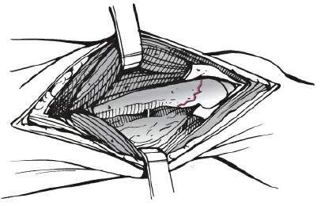
Surgical Approaches
Lateral
Most common approach
Skin incision in mid-lateral line of femoral shaft, curving slightly anteriorly over lateral femoral condyle towards tibial tubercle
Distal extent determined by need for joint arthrotomy if intra-articular reduction needs to be performed
Proximal extent determined by whether fracture will be directly or indirectly reduced
Divide IT band in line with its fibers
Incise vastus lateralis fascia and elevate fibers off septum, from distal to proximal, ligating femoral artery perforating vessels
(Collinge CA, Wiss DA. Distal Femur Fractures. In: Tornetta P, Ricci WM, eds. Rockwood and Green’s Fractures in Adults, 9e. Philadelphia, PA: Wolters Kluwer Health, Inc; 2019.)
Video demonstration: https://otaonline.org/video-library/45036/procedures-and-techniques/multimedia/16731389/lateral-distal-femur-plate-for-periprosthetic

Slide 19
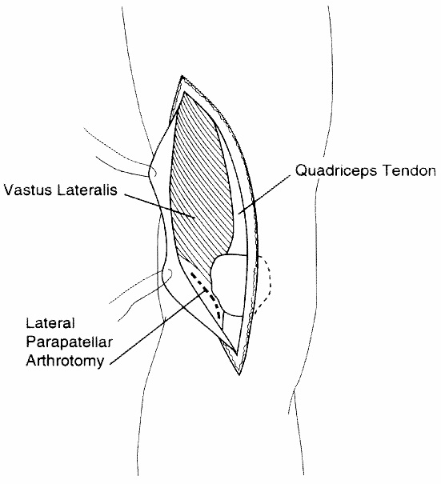
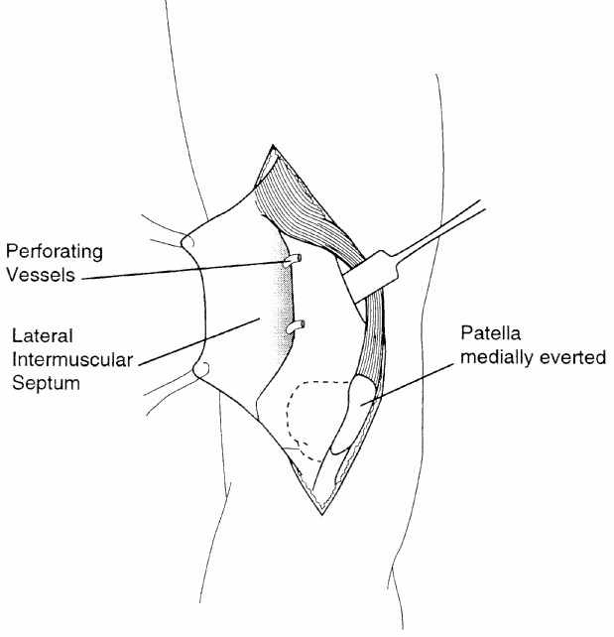
Surgical Approaches
Swashbuckler
Indicated when more articular reduction and fixation is needed
No tourniquet (prevents medial retraction of quads)
Midline anterior incision, curving laterally proximally
Quadriceps fascia incised in line with skin incision, connecting distally with a lateral parapatellar arthrotomy
Fascia & IT band elevated off vastus lateralis; IT band retracted laterally and quadriceps retracted medially
(Starr AJ, Jones AL, Reinert CM. The "swashbuckler": a modified anterior approach for fractures of the distal femur. J Orthop Trauma. 1999;13(2):138-140)
Video demonstration: https://otaonline.org/video-library/45036/procedures-and-techniques/multimedia/16776605/distal-femur-swashbuckler-exposure

Slide 20
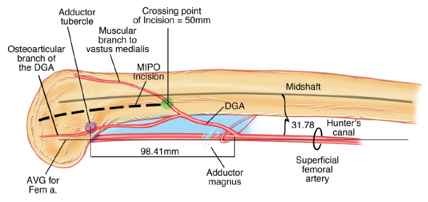
Surgical Approaches
Medial
Useful for isolated medial condyle fractures or severely comminuted fractures in which medial fixation is required
Straight medial incision extending distally to a point just anterior to adductor tubercle
Fascia divided in line with skin incision, anterior to sartorius
Vastus medialis elevated, care taken to avoid articular branch of descending geniculate artery (DGA) and muscular branch to vastus medialis
Muscular branch of DGA ~5cm and adductor hiatus ~16cm proximal to adductor tubercle
(Sirisreetreerux N, Shafiq B, Osgood GM, Hasenboehler EA. Medial knee approach: An anatomical study of minimally invasive plate osteosynthesis in medial femoral condylar fracture. J Orthop Trauma. 2016;30(11):e357-e361)
Video demonstration: https://otaonline.org/video-library/45036/procedures-and-techniques/multimedia/16731423/medial-femur-dissection

Slide 21
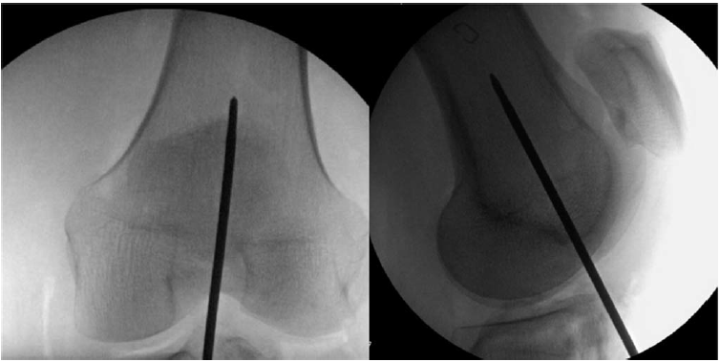
Surgical Approaches
Limited anterior approach for IM nailing
Trans-patellar tendon incision or medial to tendon
Start point just anterior to femoral origin of PCL
Centered in shaft on AP Xray
Anterior edge of Blumensaat’s line on perfect lateral Xray
(Beltran MJ, Gary JL, Collinge CA. Management of distal femur fractures with modern plates and nails: state of the art. J Orthop Trauma. 2015;29(4):165-172)
Video demonstration: https://otaonline.org/video-library/45036/procedures-and-techniques/multimedia/16731387/percutaneous-retrograde-supracondylar-femoral

Slide 22
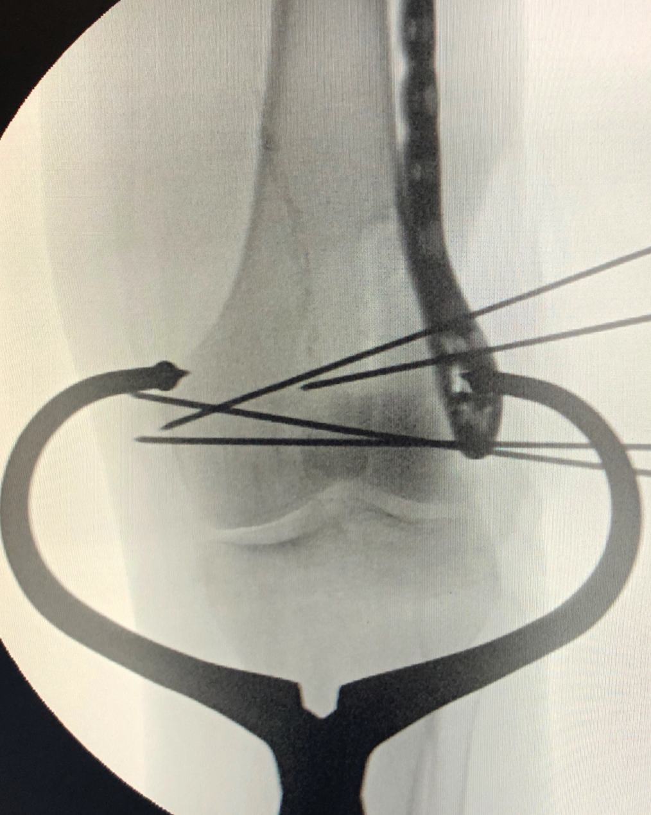
Reduction Tools
Chemical paralysis
Bump placed under knee corrects apex posterior deformity by relaxing gastrocnemius muscle
Adequate exposure
Femoral distractor
‘Pre-load’ Shanz pins (angle them slightly away from fracture) to account for angular deformity induced by distraction
K-wires
Reduction clamps
Large Weber clamps
Large peri-articular reduction clamp
Courtesy of Claude Sagi, MD

Slide 23
Types of Fixation
Lateral pre-contoured plates
May be used for most fracture patterns
Retrograde intramedullary nail
Most common for AO/OTA type A fractures
Some simple intra-articular patterns (AO/OTA type C1 & C2)
Dynamic condylar screw/ Angled blade plate
Distal femoral replacement
Elderly, pre-existing osteoarthritis, severely comminuted, with a need to immediately mobilize
Augmented fixation
Bilateral plates, plate/ nail combo
Buried screw fixation for Hoffa fractures

Slide 24
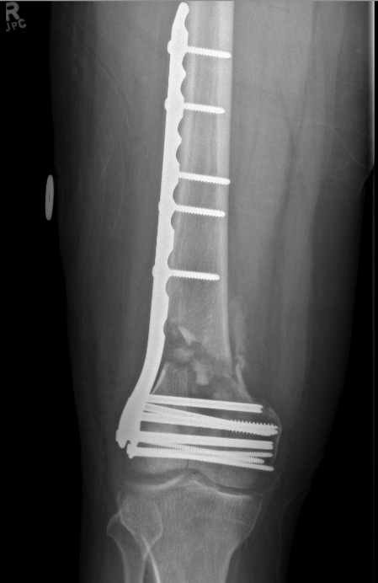
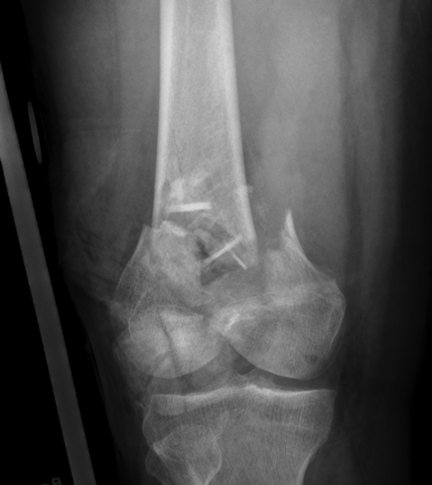
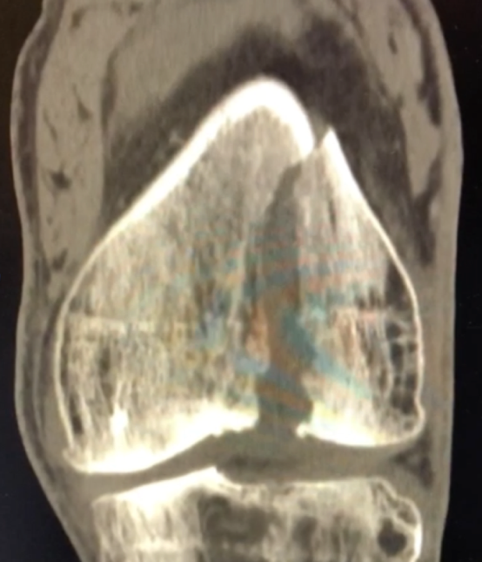
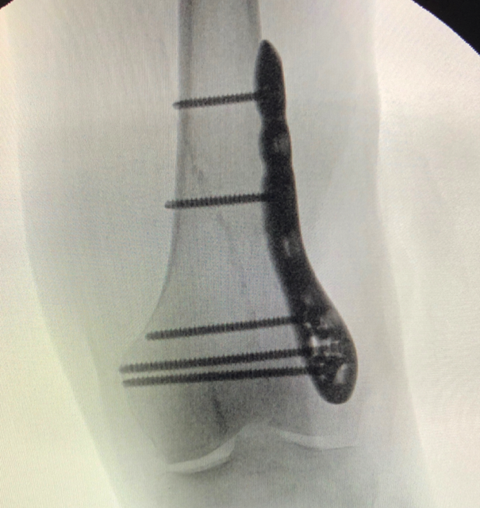
Fixation Options
Bridge plate fixation
Lateral pre-contoured plates
Modes of fixation:
Simple fractures: neutralization plate for an anatomically reduced fracture with lag screw fixation
Comminuted fractures: bridge plate
Vertical shear fracture fixation: buttress plate
Available with variable-angle locking, fixed-angle locking, and non-locking options
Have largely replaced the dynamic condylar screw and blade plate
Courtesy of Jeff Potter, MD
Buttress plate fixation
Courtesy of Claude Sagi, MD

Slide 25
Fixation Options
Pre-contoured lateral plates
Stress modulation: the concept of manipulating bridge plating variables to optimize the flexibility of the construct to allow callus formation (Beltran et al. JOT 2015)
Titanium vs. stainless steel
Locking vs. non-locking
Unicortical vs. bicortical screws
Plate length
Screw hole fill
Working length
Notes:
LKC: Can you add a reference or two on this
DJS: done

Slide 26
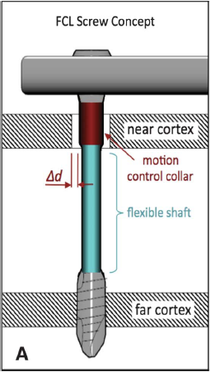
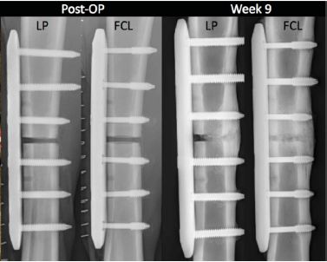
Fixation Options
Far-cortical locking plates
Biomechanical and animal studies show increased and more evenly distributed callus
Plumarom et al., JOT 2019
Retrospective cohort of AO/OTA type A, C, and periprosthetic fractures
42 treated with far-cortical locking plates and 15 with lateral locked plates
mRUST scores from blinded radiographs statistically higher in FCL group at 6, 12, and 24
91% union for FCL group vs. 82% for LLP group at one year
(Bottlang M, Feist F. Biomechanics of far cortical locking. J Orthop Trauma. 2011;25 Suppl 1:S21-28)

Slide 27
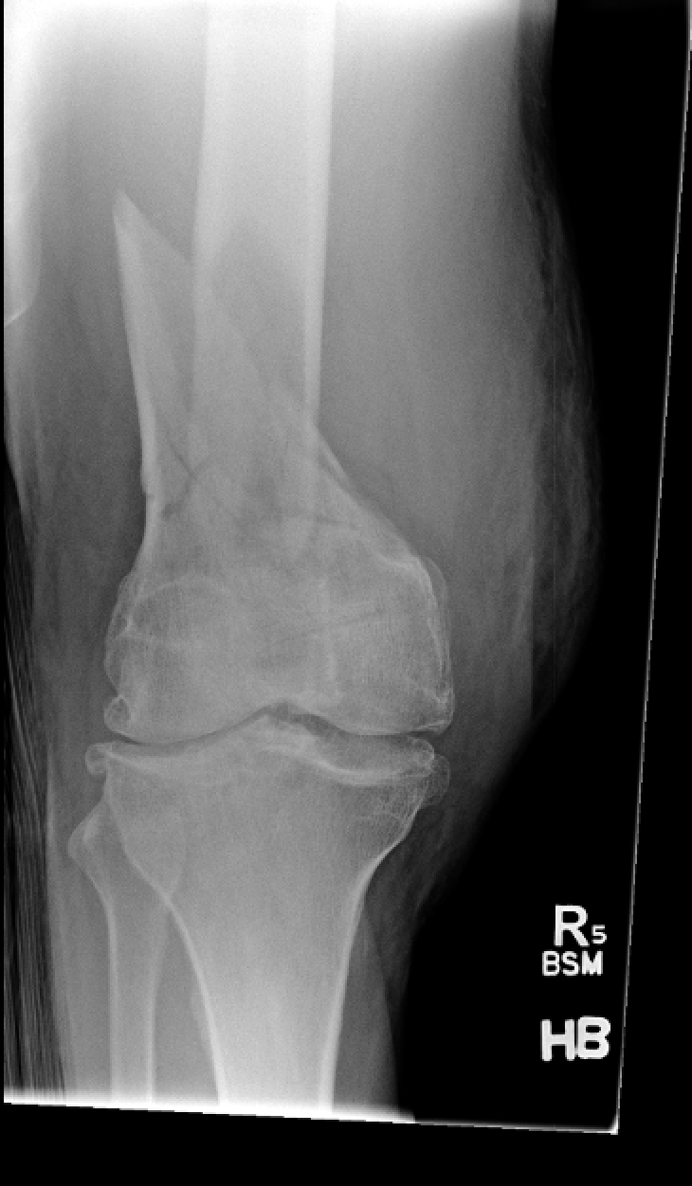
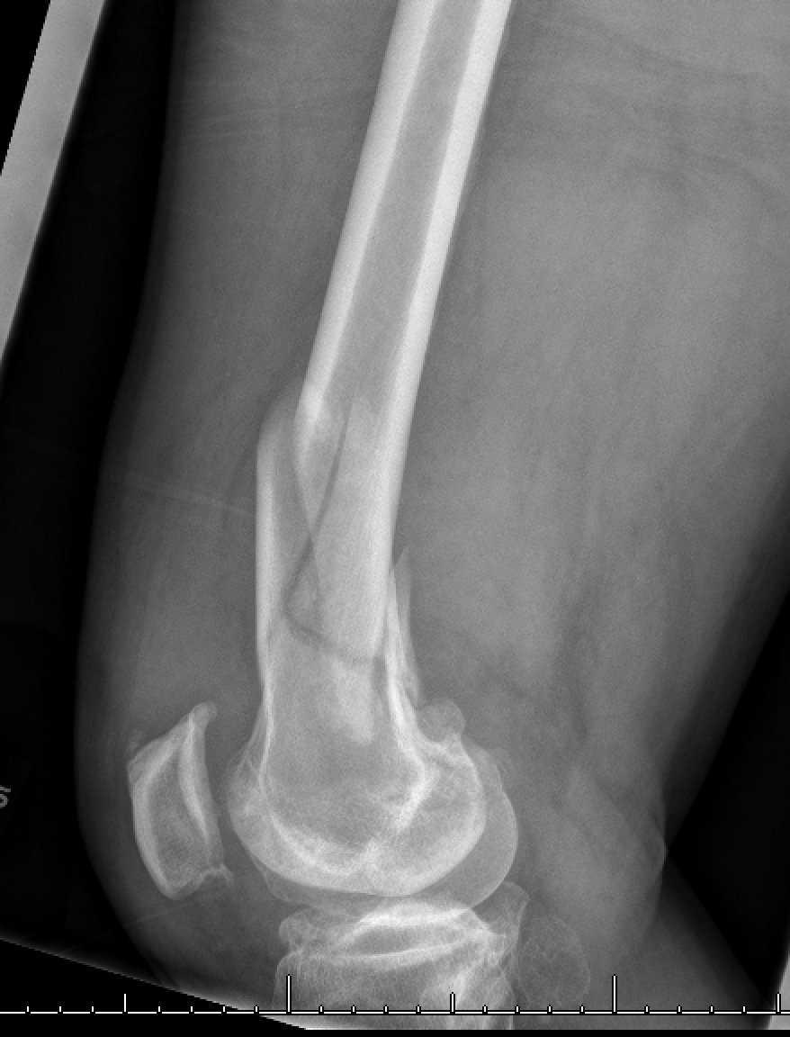
Case Example
59 year old male, workplace injury where a 250lb marble slab fell on his leg
Pre-existing severe knee osteoarthritis
Courtesy of Jeff Potter, MD

Slide 28
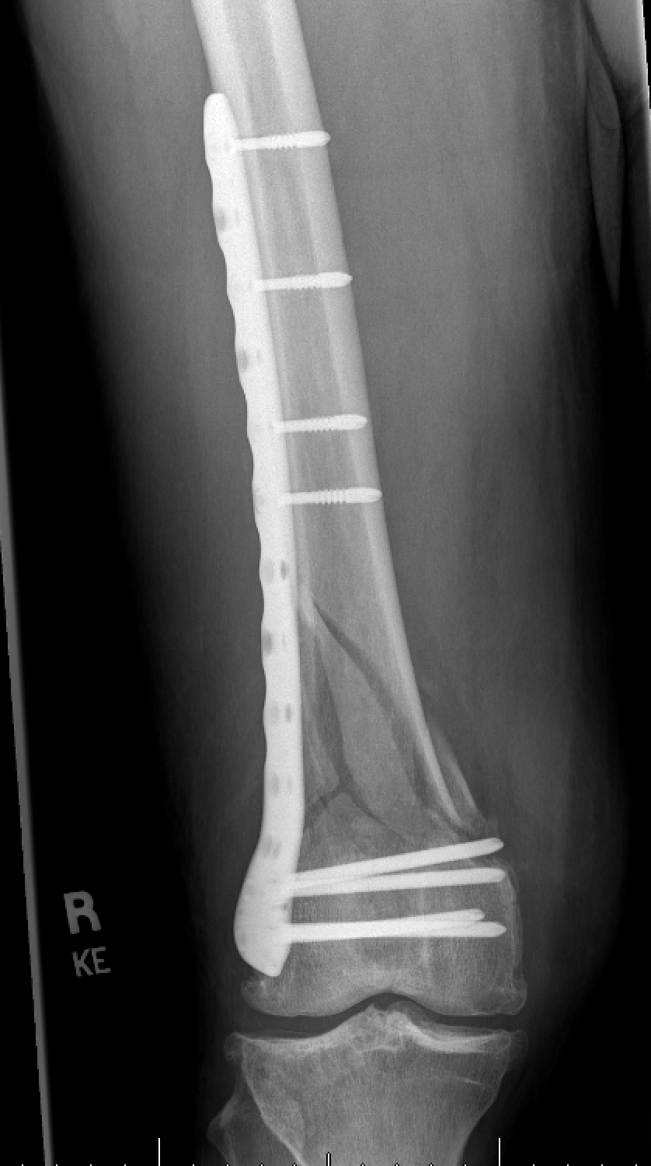
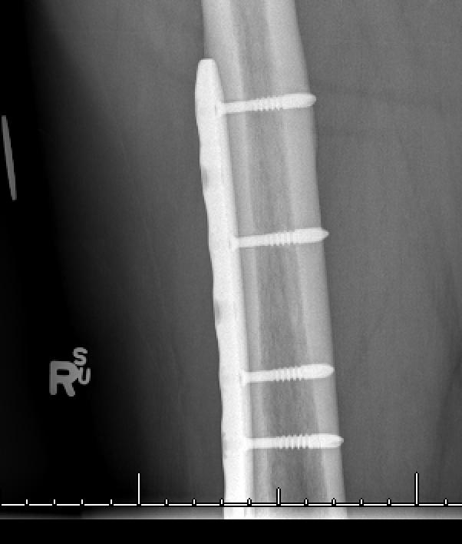
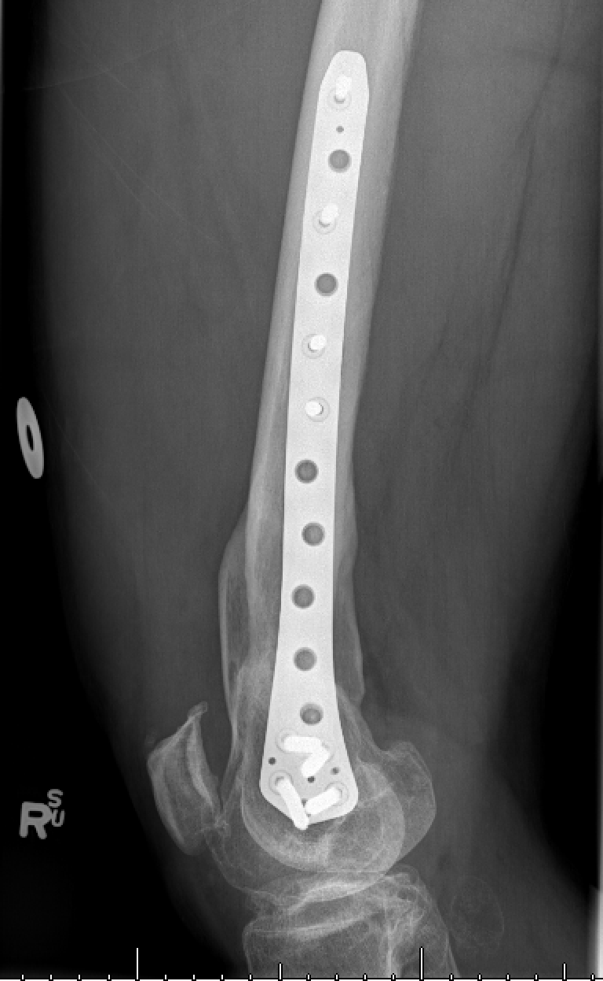
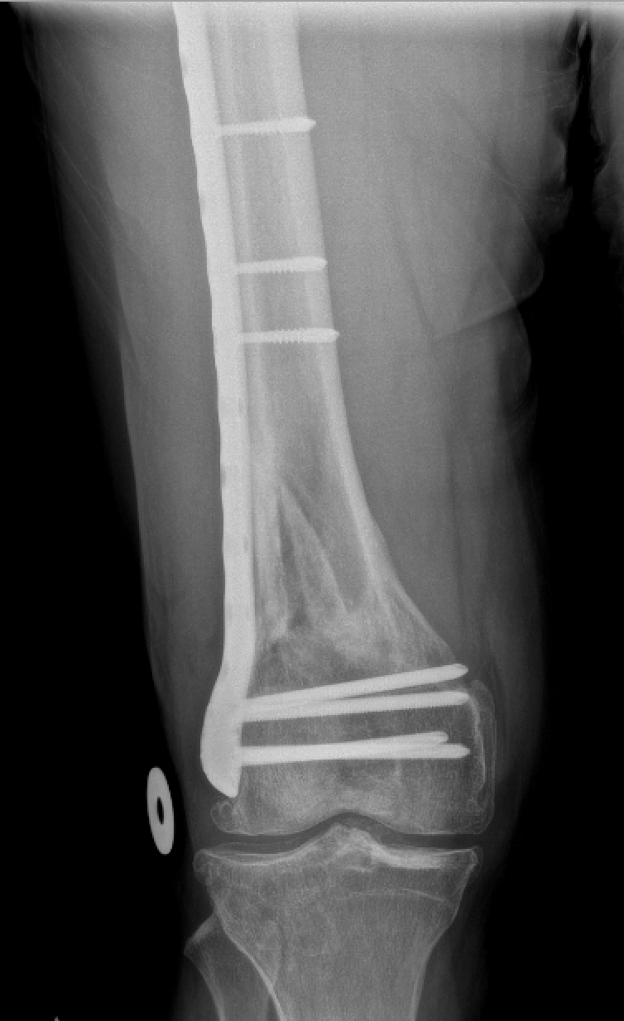
2 week post-op X-Ray
Final 1 year follow-up X-Ray
Courtesy of Jeff Potter, MD

Slide 29
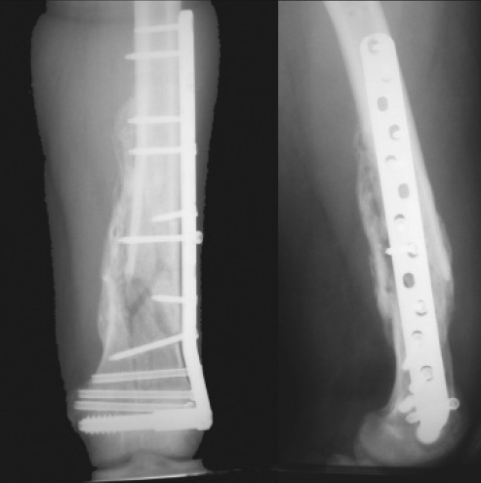
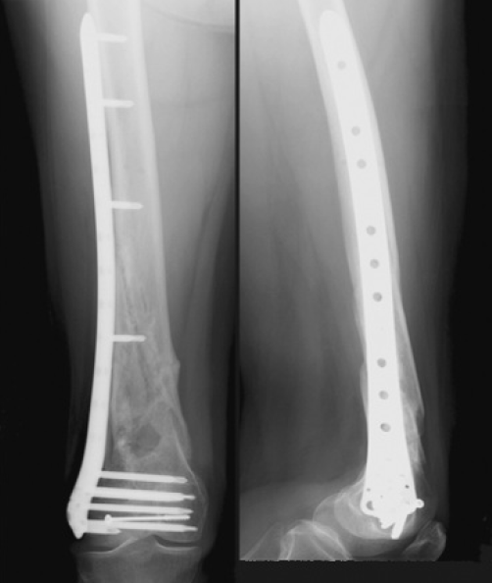
Fixation Options
Dynamic Condylar Screw (DCS) plate
Dynamic Condylar Screw (DCS) plate
Less Invasive Stabilization System (LISS)
Evidence:
COTS group, JOT 2016
RCT comparing LISS (28 patients) vs the DCS (24 patients)
52% of LISS group healed at 12 months vs. 91% in the DCS group
Both have largely been replaced by modern implants that have variable angle/ fixed angle, and non-locking options
Less Invasive Stabilization System (LISS)
(Collinge CA, Wiss DA. Distal Femur Fractures. In: Tornetta P, Ricci WM, eds. Rockwood and Green’s Fractures in Adults, 9e. Philadelphia, PA: Wolters Kluwer Health, Inc; 2019.)

Slide 30
Fixation Options
Limitations of lateral locked distal femur plates: non-union
Up to 31%
Rodriguez et al., JOT 2016
Retrospective study including 271 supracondylar femur fractures
Nonunion rate 13%
Plate material (stainless steel) and those with high rigidity scores were associated with nonunion
Rigidity score included: plate material, presence of screws across main fracture, and proximal screw density
Ricci et al., JOT 2014
Retrospective study including 335 AO/OTA Type A or C fractures
Nonunion rate 19%
Risk factors for reoperation to promote union include open fracture, diabetes, smoking, increased BMI, and shorter plate length

Slide 31
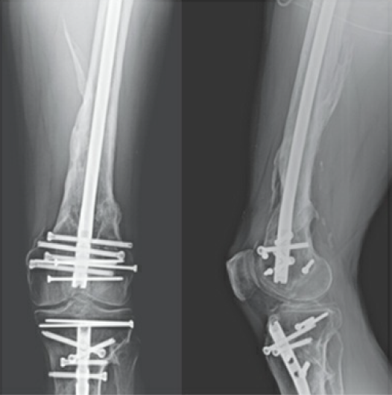
Fixation Options
Intramedullary nail
Minimizes disruption of soft tissues
Improved designs (multiple distal screw options and ability to lock distal screws to the nail) have expanded their indications
Retrograde nail should extend to the level of the lesser trochanter, or at least allow two proximal interlocking screws
Antegrade nails may be an option for high supracondylar fractures or segmental fractures
Reduce fracture prior to reaming
(Collinge CA, Wiss DA. Distal Femur Fractures. In: Tornetta P, Ricci WM, eds. Rockwood and Green’s Fractures in Adults, 9e. Philadelphia, PA: Wolters Kluwer Health, Inc; 2019.)

Slide 32
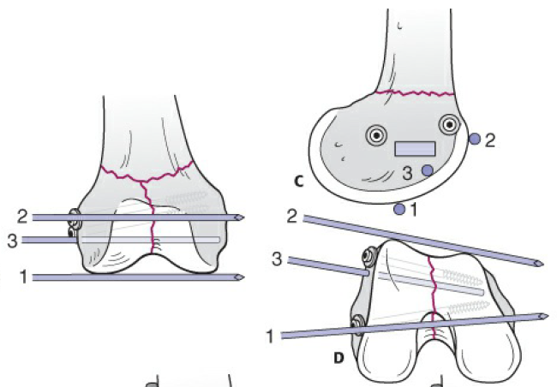
Fixation Options
Dynamic condylar screw/ angled blade plate
Currently, used at times for nonunion/ revision scenarios
Stiff constructs (stainless steel)
Condylar screw & blade must be inserted parallel to joint
Position in the articular fragment is critical to avoid malreduction
Blade positioning
(Collinge CA, Wiss DA. Distal Femur Fractures. In: Tornetta P, Ricci WM, eds. Rockwood and Green’s Fractures in Adults, 9e. Philadelphia, PA: Wolters Kluwer Health, Inc; 2019.)

Slide 33
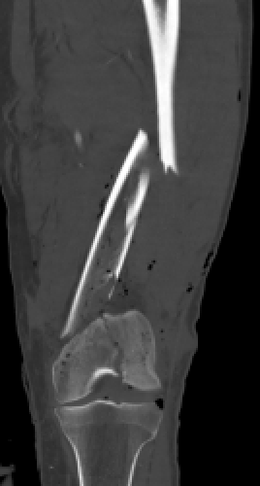
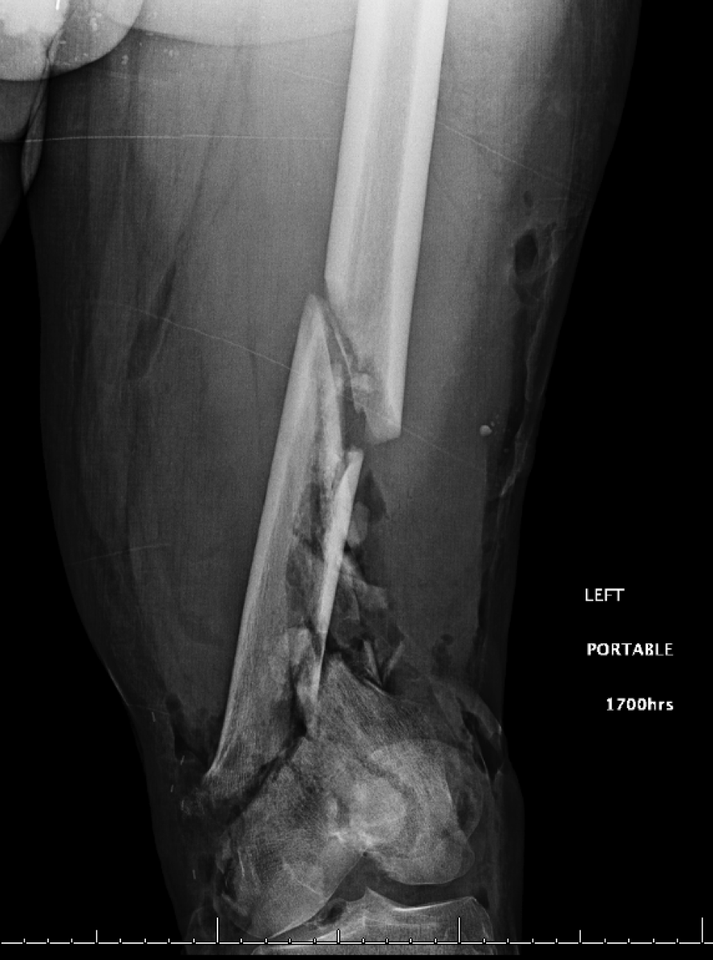
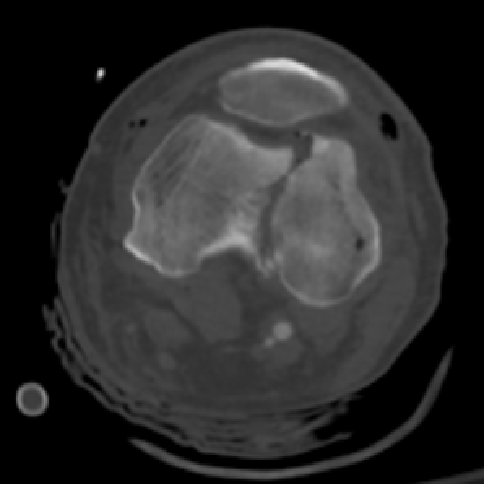
Case Example
68 year old man, left leg crushed when trailer fell off a jack and onto his leg
Open left segmental, comminuted distal femur fracture
Courtesy of Mike Moran, MD

Slide 34
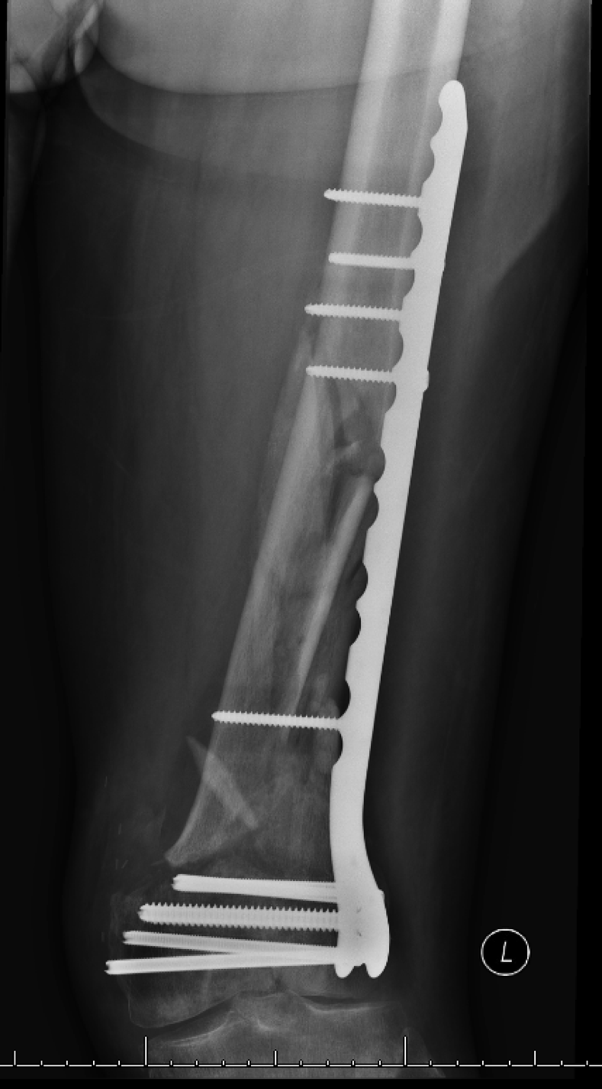
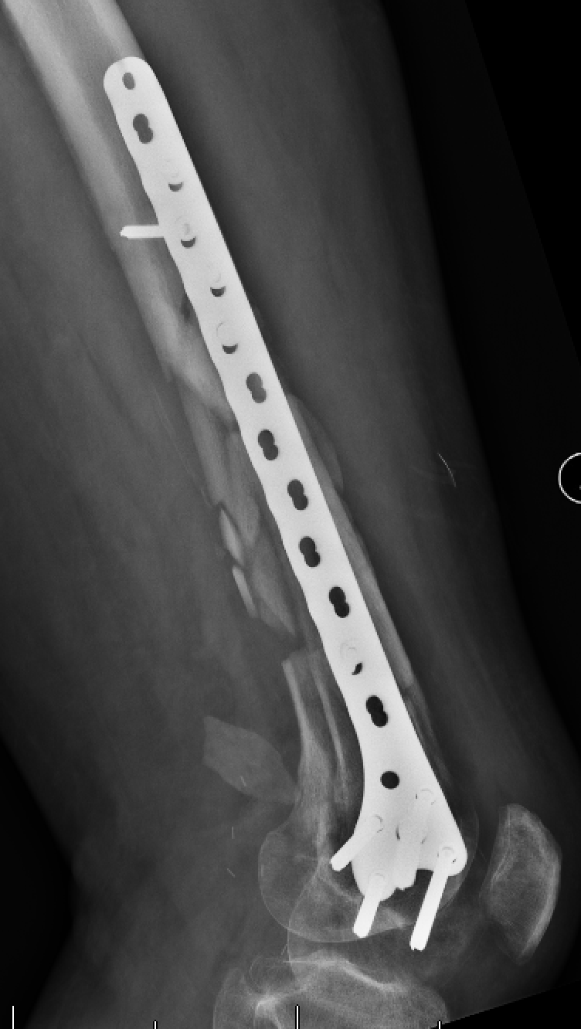
2 week follow-up X-Rays
Courtesy of Mike Moran, MD

Slide 35
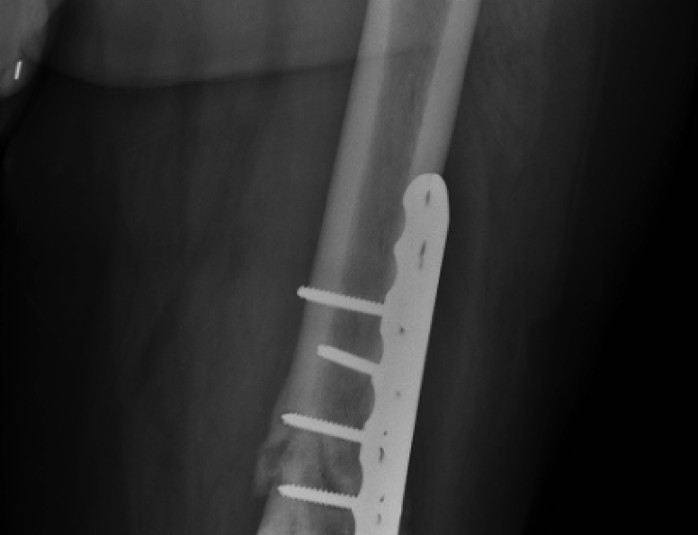
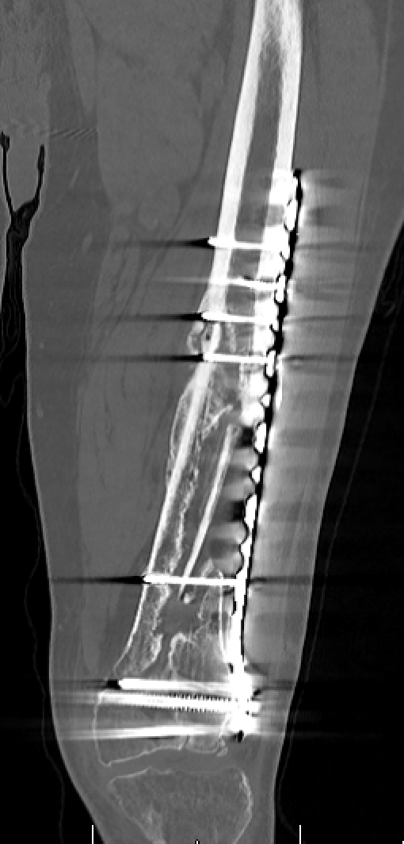
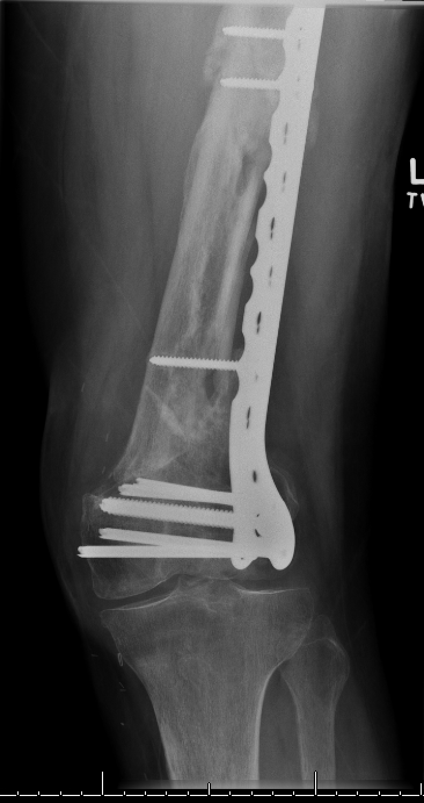
Distal femur & shaft fracture nonunion established at one year
Persistent pain, no infectious symptoms, skin healed with no draining sinus, CRP normal
Courtesy of Mike Moran, MD

Slide 36
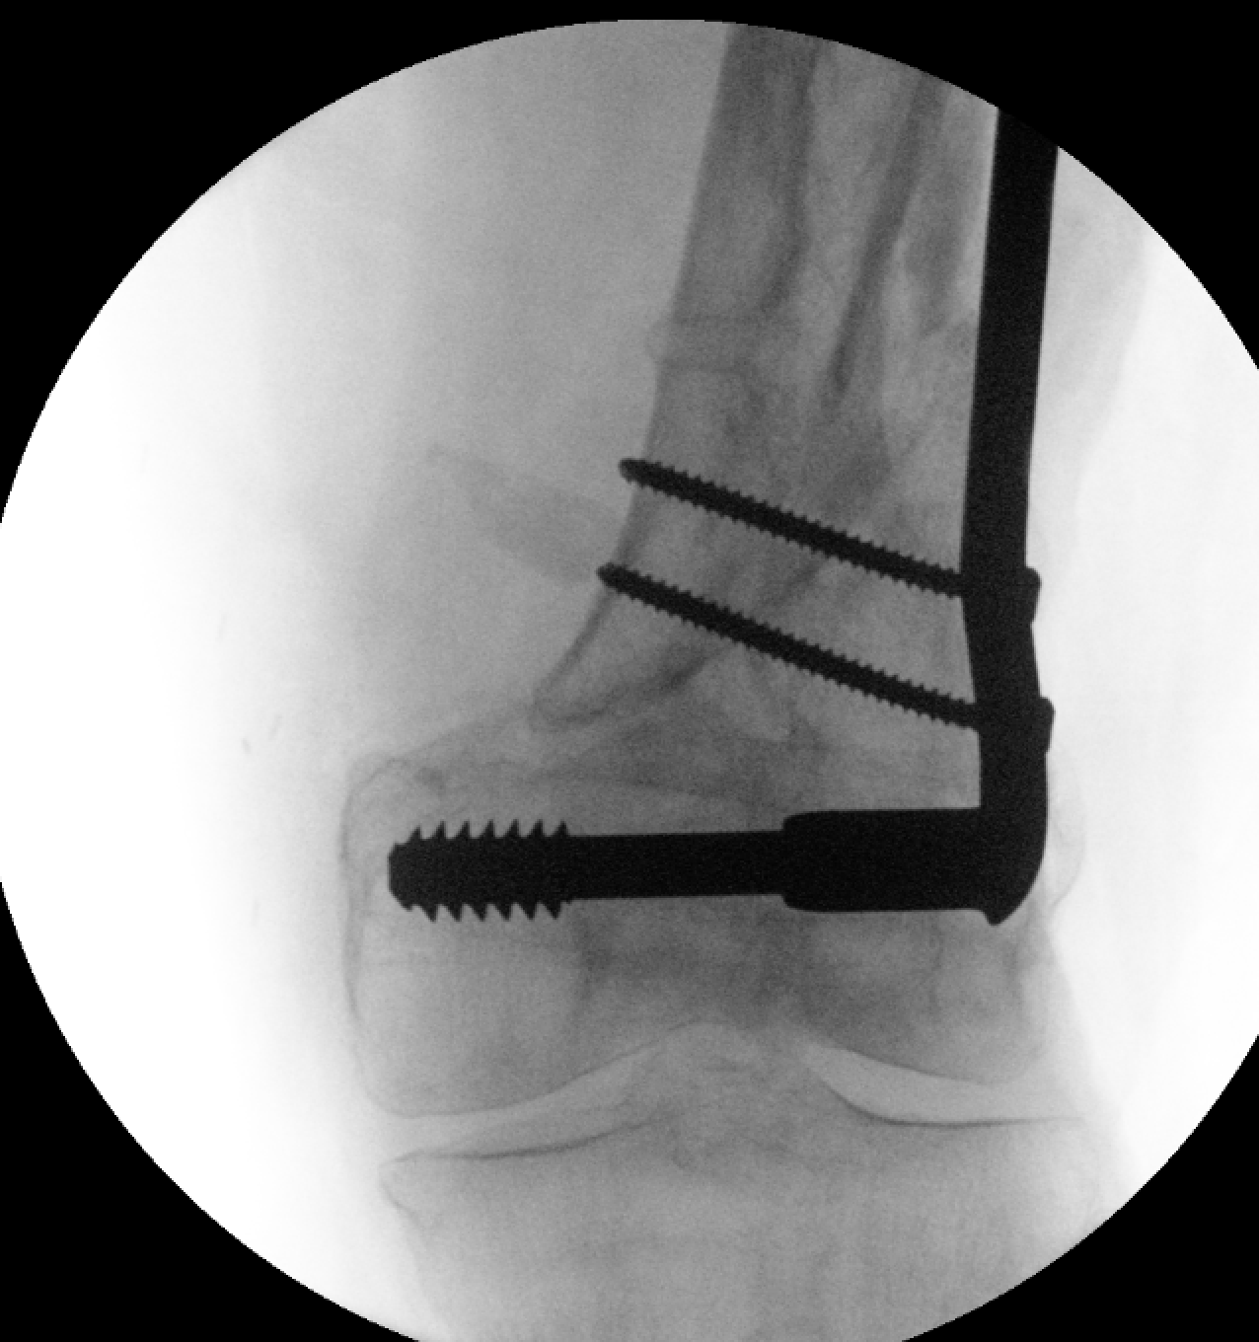
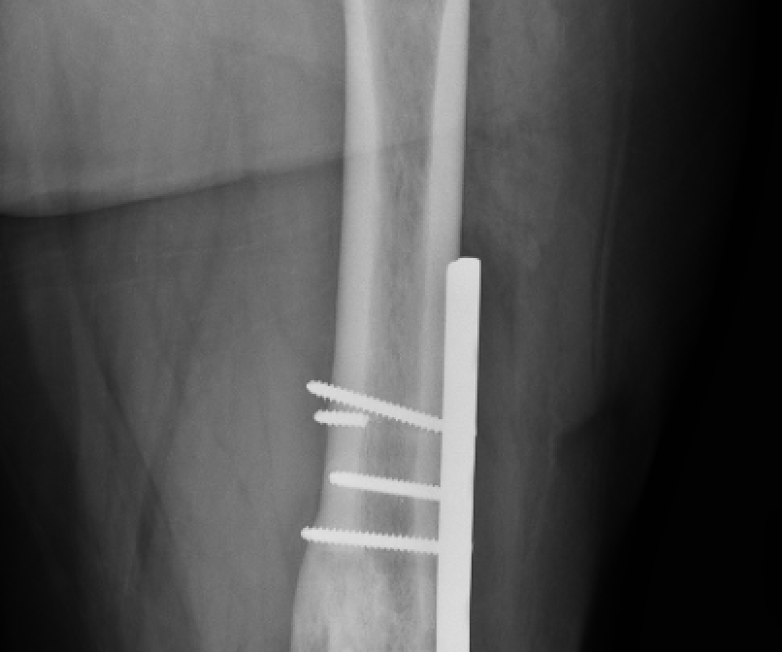
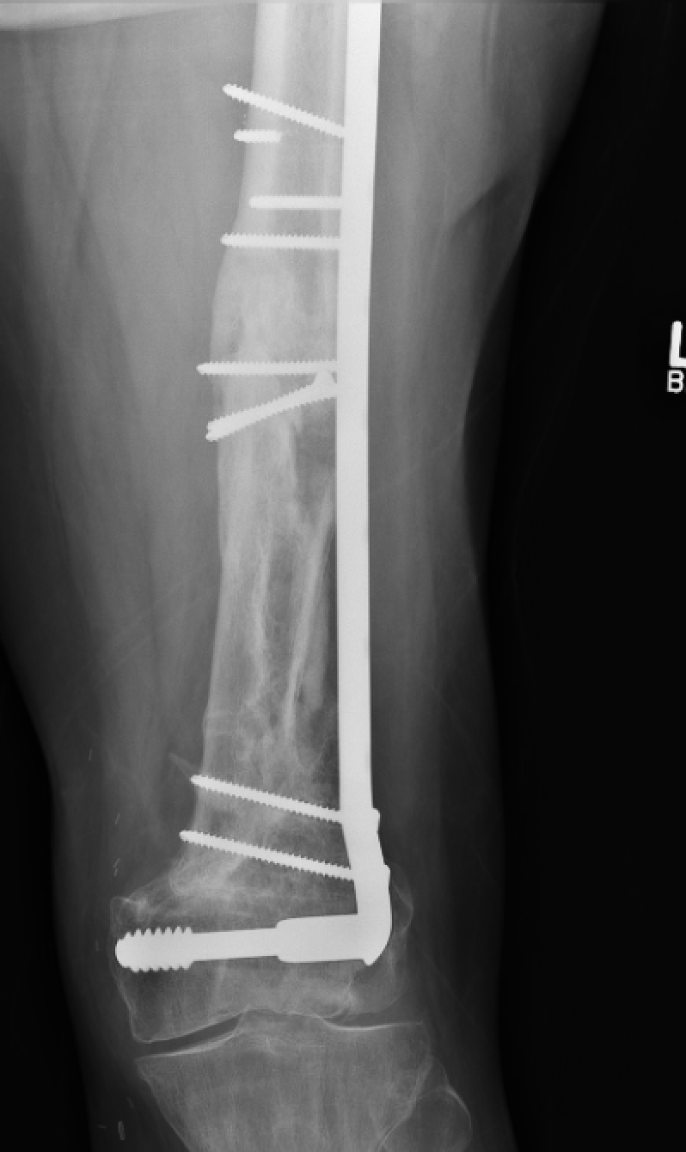
Union by 6 months post-op
Intra-op image confirming DCS placement
Courtesy of Mike Moran, MD

Slide 37
Fixation Options
Distal femur replacement
Advantages
Immediate weight-bearing, eliminates risks of nonunion, malunion, fixation failure, and post-traumatic OA (Meluzio et al. Injury 2020)
Disadvantages
Limited salvage options in cases of osteolysis, loosening, peri-prosthetic fracture, or infection

Slide 38
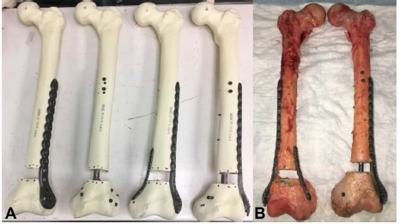
Fixation Options
Lateral plate augmented fixation with
Medial pre-contoured distal tibia plate
Medial 3.5mm recon plate
Retrograde IM nail
May be useful to avoid varus failure and permit early weight-bearing
Fontenot et al. J Orthop Trauma 2019
Biomechanical study using 28 synthetic femora
Both Lateral plate plus medial recon plate & lateral plate plus nail exhibited higher stiffness and load to failure
Wright et al. J Orthop Trauma 2020
Dual plate fixation had slightly higher torsional and axial stiffness
(Wright DJ, DeSanto DJ, McGarry MH, Lee TQ, Scolaro JA. Supplemental fixation of supracondylar distal femur fractures: A biomechanical comparison of dual-plate and plate-nail constructs. J Orthop Trauma. 2020;34(8):434-440)

Slide 39
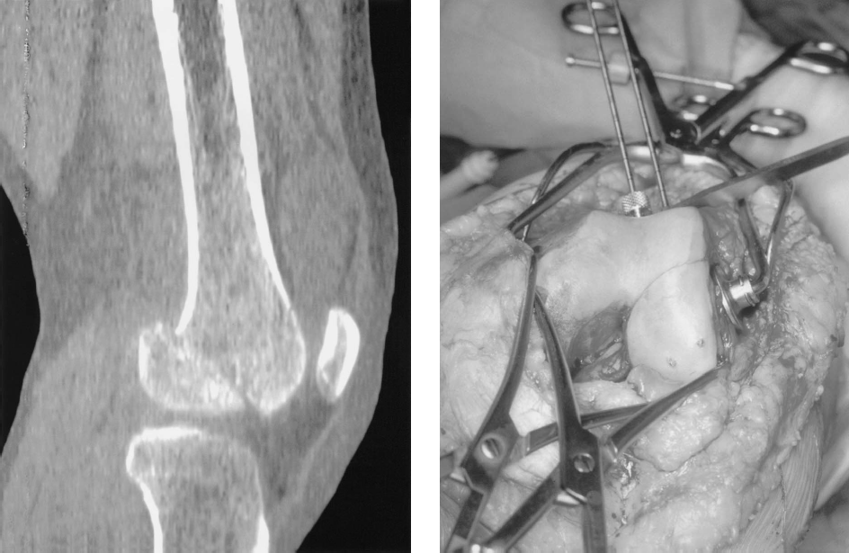
Fixation Options
Hoffa fracture fixation
Caused by shear moment through posterior condyle
Do not miss these fractures
Require independent screw fixation-prior to plate- in the sagittal plane
Flexion of knee helps to reduce fragment
Fixation outside articular margin when possible; buried/ headless screw when not
Very small posterior fragment may require posterior to anterior screw
(Holmes SM, Bomback D, Baumgaertner MR. Coronal fractures of the femoral condyle: A brief report of five cases. J Orthop Trauma. 2004;18(5):316-319)

Slide 40
Post-surgery Rehabilitation
Traditional had been NWB for up to 12 weeks
New evidence suggests immediate or early weight-bearing does not increase fixation failure rate
Poole et al., BJJ 2017
Case series of 127 fractures in patients with mean age 73 years old fixed with lateral distal femur locking plate
84% were allowed to weight-bear immediately. At minimum 1 year follow-up, 95% united and only 3% required re-operation for failure of fixation
Lieder et al., JOT 2020
Retrospective cohort of 135 patients with AO/OTA Type A and periprosthetic femur fractures allowed to either weight bear immediately or touch-down weight bear
No difference in adverse events (11% WBAT vs. 19% TDWB) including early fixation failure, nonunion, or infection
Range of motion initiated immediately post-op
Involve primary care physician and/or endocrinologist if osteoporosis is a concern

Slide 41
References
Neer CS, 2nd, Grantham SA, Shelton ML. Supracondylar fracture of the adult femur. A study of one hundred and ten cases. J Bone Joint Surg Am. 1967;49(4):591-613.
Butt MS, Krikler SJ, Ali MS. Displaced fractures of the distal femur in elderly patients: Operative versus non-operative treatment. J Bone Joint Surg Br. 1996;78(1):110-114.
Weight M, Collinge C. Early results of the less invasive stabilization system for mechanically unstable fractures of the distal femur (AO/OTA types A2, A3, C2, and C3). J Orthop Trauma. 2004;18(8):503-508.
Collinge CA, Wiss DA. Distal Femur Fractures. In: Tornetta P, Ricci WM, eds. Rockwood and Green’s Fractures in Adults, 9e. Philadelphia, PA: Wolters Kluwer Health, Inc; 2019.
Meinberg EG, Agel J, Roberts CS, Karam MD, Kellam JF. AO/ OTA fracture and dislocation classification compendium 2018. J Orthop Trauma. 2018;32 Suppl 1:S1-S170.
Nork SE, Segina DN, Aflatoon K, et al. The association between supracondylar-intercondylar distal femoral fractures and coronal plane fractures. J Bone Joint Surg Am. 2005;87(3):564-569.
Starr AJ, Jones AL, Reinert CM. The "swashbuckler": A modified anterior approach for fractures of the distal femur. J Orthop Trauma. 1999;13(2):138-140.
Sirisreetreerux N, Shafiq B, Osgood GM, Hasenboehler EA. Medial knee approach: An anatomical study of minimally invasive plate osteosynthesis in Medial Femoral Condylar Fracture. J Orthop Trauma. 2016;30(11):e357-e361.
Canadian Orthopaedic Trauma Society. Are locking constructs in distal femoral fractures always best? A prospective multicenter randomized controlled trial comparing the Less Invasive Stabilization System with the minimally invasive Dynamic Condylar Screw system. J Orthop Trauma. 2016;30(1):e1-6.
Beltran MJ, Gary JL, Collinge CA. Management of distal femur fractures with modern plates and nails: state of the art. J Orthop Trauma. 2015;29(4):165-172

Slide 42
References
Rodriguez EK, Zurakowski D, Herder L, et al. Mechanical construct characteristics predisposing to non-union after locked lateral plating of distal femur fractures. J Orthop Trauma. 2016;30(8):403-408.
Ricci WM, Streubel PN, Morshed S, Collinge CA, Nork SE, Gardner MJ. Risk factors for failure of locked plate fixation of distal femur fractures: An analysis of 335 cases. J Orthop Trauma. 2014;28(2):83-89.
Gwathmey FW, Jr., Jones-Quaidoo SM, Kahler D, Hurwitz S, Cui Q. Distal femoral fractures: Current concepts. J Am Acad Orthop Surg. 2010;18(10):597-607.
Bottlang M, Feist F. Biomechanics of far cortical locking. J Orthop Trauma. 2011;25 Suppl 1:S21-28.
Plumarom Y, Wilkinson BG, Marsh JL, et al. Radiographic healing of far cortical locking constructs in distal femur fractures: A comparative study with standard locking plates. J Orthop Trauma. 2019;33(6):277-283
Meluzio MC, Oliva MS, Minutillo F, Ziranu A, Saccomanno MF, Maccauro G. The use of knee mega-prosthesis for the management of distal femoral fractures: A systematic review. Injury. 2020;51 Suppl 3:S17-S22.
Fontenot PB, Diaz M, Stoops K, Barrick B, Santoni B, Mir H. Supplementation of lateral locked plating for distal femur fractures: A biomechanical study. J Orthop Trauma. 2019;33(12):642-648.
Wright DJ, DeSanto DJ, McGarry MH, Lee TQ, Scolaro JA. Supplemental fixation of supracondylar distal femur fractures: A biomechanical comparison of dual-plate and plate-nail constructs. J Orthop Trauma. 2020;34(8):434-440
Holmes SM, Bomback D, Baumgaertner MR. Coronal fractures of the femoral condyle: A brief report of five cases. J Orthop Trauma. 2004;18(5):316-319
Poole WEC, Wilson DGG, Guthrie HC, et al. 'Modern' distal femoral locking plates allow safe, early weight-bearing with a high rate of union and low rate of failure: five-year experience from a United Kingdom major trauma centre. Bone Joint J. 2017;99-B(7):951-957.
Lieder CM, Gaski GE, Virkus WW, Kempton LB. Is immediate weight-bearing safe following single implant fixation of elderly distal femur fractures? J Orthop Trauma. 2020.

