Slide 1
Tibial Plateau Fractures
John J. Wixted MD
Chief, Orthopedic Trauma Division
Beth Israel Deaconess Medical Center

Slide 2
Disclosure
Clinical images provided by the author.
Figures used with permission from Tornetta P, Ricci WM, eds. Rockwood and Green's Fractures in Adults, 9e. Philadelphia, PA. Wolters Kluwer Health, Inc; 2019.

Slide 3
Objectives
Describe initial evaluation and management of tibial plateau fractures
Identify common fracture patterns
Apply treatment principles and strategies
Partial articular fractures
Complete articular fractures
Discuss rehabilitation, complications, and outcomes

Slide 4
Objectives
Describe initial evaluation and management of tibial plateau fractures
Identify common fracture patterns
Apply treatment principles and strategies
Partial articular fractures
Complete articular fractures
Discuss rehabilitation, complications, and outcomes

Slide 5
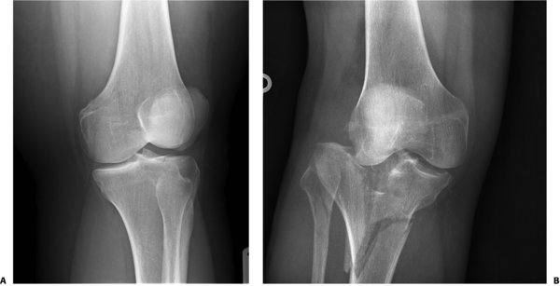
Plateau Fractures: Initial Presentation
1-2% of all fractures
Similar bimodal distribution to many peri-articular injuries
70% in young adult men, average age 43
Rockwood and Green, 9th edition

Slide 6
Age and mechanism dictate injury pattern
-Middle age and elderly with simple falls
-commonly split depressed patterns, or less common isolated medial side injuries
-Higher energy or sports related
-pure split injuries, or rim injuries with associated ligamentous
injuries to the knee and potential for instability
-High energy MVA, fall from height, pedestrians struck
-Often younger patients
-bicondylar patterns
-higher risk for neurovascular injury
-compartment syndrome and open fractures common

Slide 7
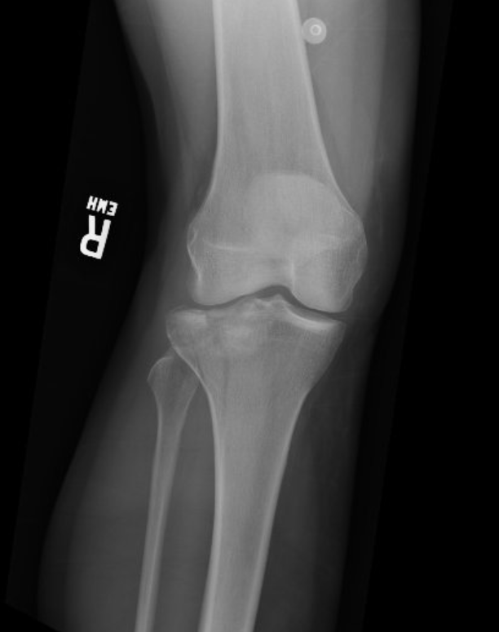
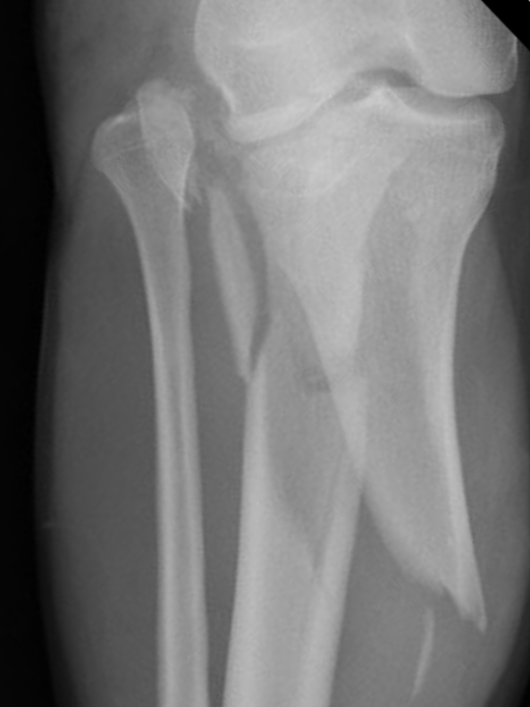
Initial presentation – mechanism matters!
Lower energy
Simple falls, struck from side
Remain length stable
Higher energy
Axial load, associated shearing
Compartment syndrome risk

Slide 8
Initial Management
Physical exam
Swelling – compartment syndrome
Distal pulses – vascular injury
?ABIs
Valgus Instability?
Splinting
Knee immobilizer
Compartment checks
DVT Prophylaxsis
Imaging
CT scan routinely obtained
Plain films
MRI for occult or suspected fractures, particularly in the elderly
Fracture-dislocation patterns: high risk for ligamentous damage, MRI indicated
Think about need for MRI prior to placing ex fix! Save yourself some phone calls!

Slide 9
Objectives
Describe initial evaluation and management of tibial plateau fractures
Identify common fracture patterns
Apply treatment principles and strategies
Partial articular fractures
Complete articular fractures
Discuss rehabilitation, complications, and outcomes

Slide 10
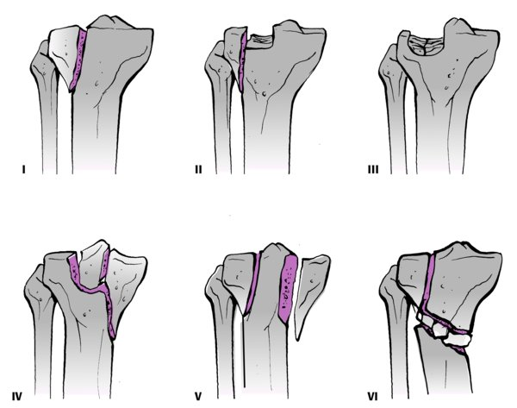
Schatzker Classification
Rockwood and Green, 9th edition

Slide 11
Schatzker Classification: Injuries isolated to the lateral plateau
I: Younger patients, better bone quality
II: Higher energy, with associated depression of the lateral chondral surface
III: Poor quality bone in elderly patients
Most common patterns

Slide 12
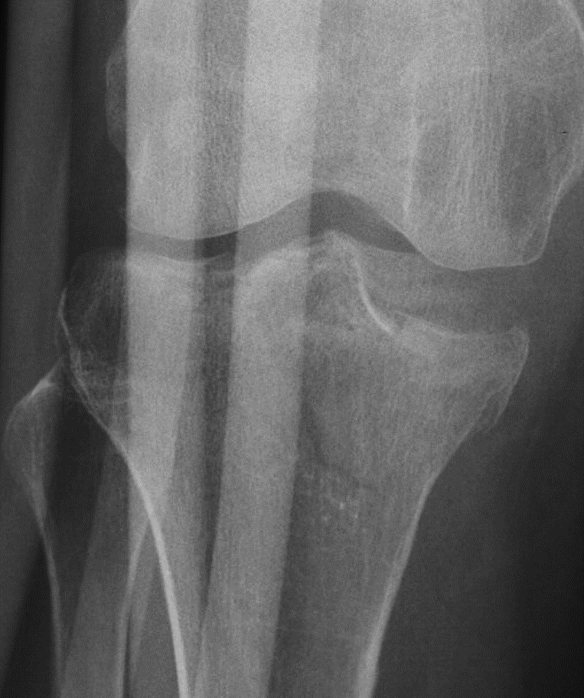
Schatzker Classification: Isolated medial fractures come in two flavors
Lower energy, elderly
Simple depression
Varus loading
Fracture lines exit medial to spines
Higher energy, young patients
Medial shearing
Higher risk for vascular injuries
Fracture lines exit lateral to spines
Called “fracture dislocation” variants

Slide 13
Schztzker Classification: Bicondylar injuries
Typically higher energy
Compartment syndrome risk
Vascular exam a must
Consider ABIs
Commonly open
Soft tissues at risk
Exam will progress over hours and often worsen with time
Includes varus hyperextension
Bicondylar variant*
Firoozabadi R, Schneidkraut J, Beingessner D, Dunbar R, Barei D. Hyperextension Varus Bicondylar Tibial Plateau Fracture Pattern: Diagnosis and Treatment Strategies. J Orthop Trauma. 2016 May;30(5):e152-7.
Notes:
.

Slide 14
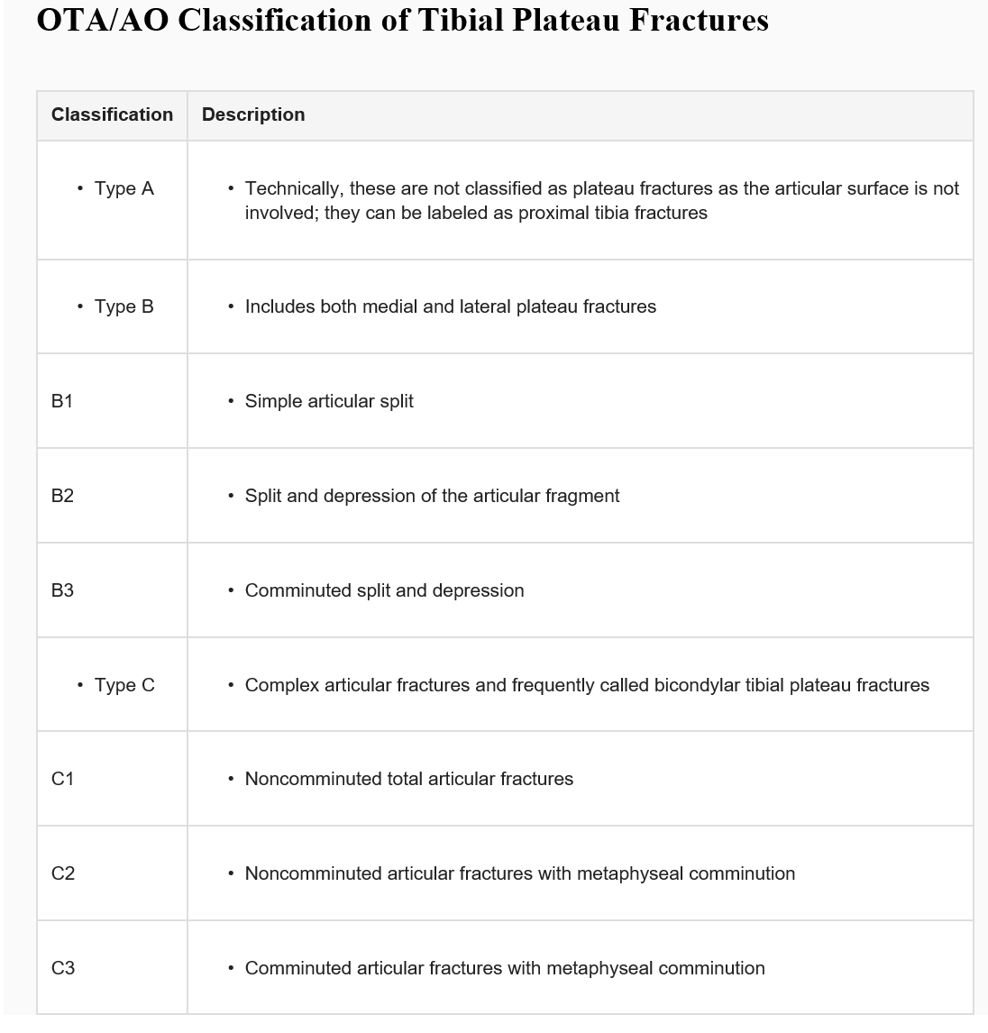
OTA Classification
Uniform classification
Captures all variants
A: Extra articular
B: Partial Articular
C: Complete Articular
Rockwood and Green, 9th edition

Slide 15
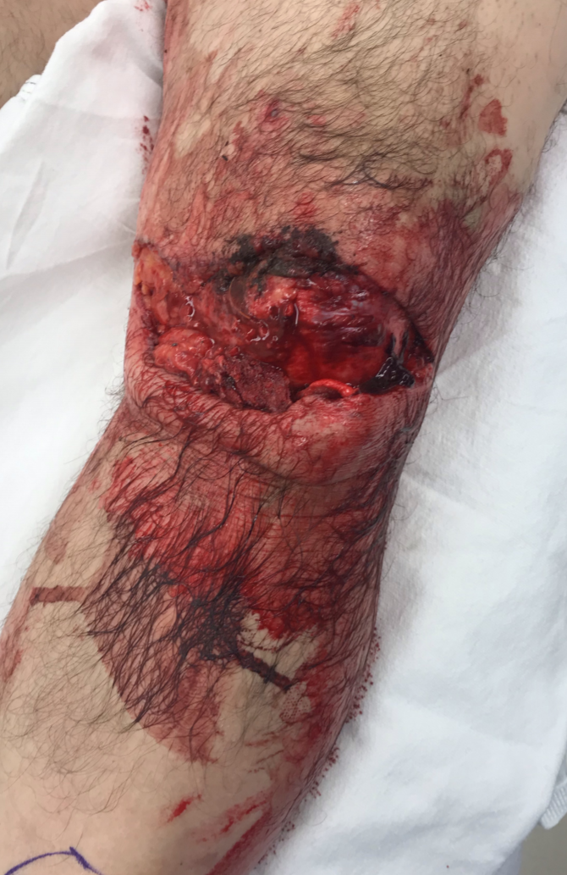
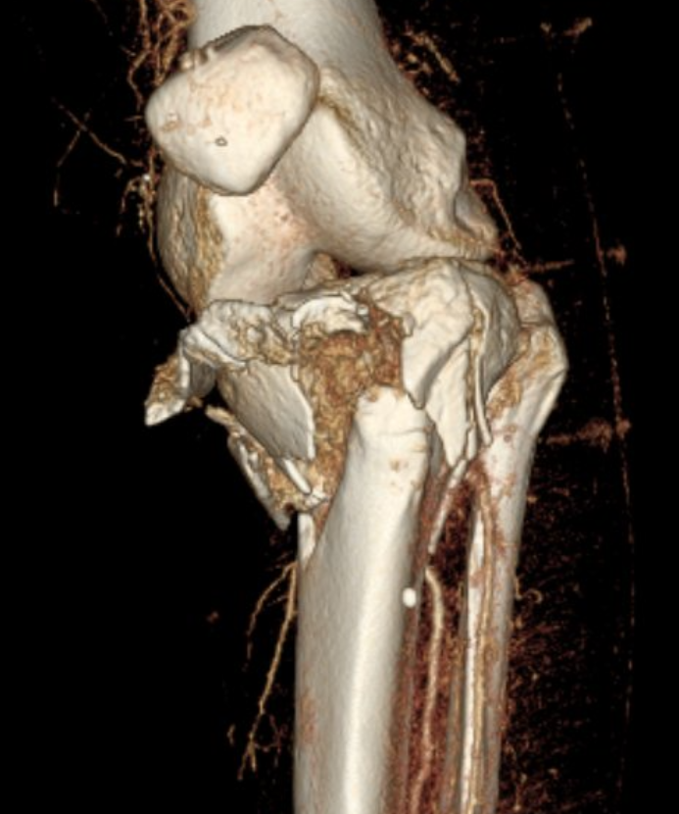
Important Variants – Open injuries
Open injuries
-antibiotics: ASAP
-tetanus
-vascular exam
Present challenges for coverage
Shaft extension
Early coverage within 72 hrs decreases late infection rate

Slide 16
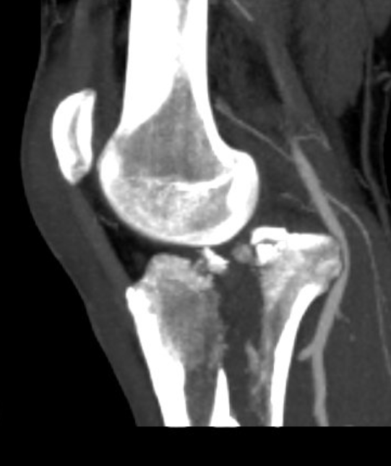
Fracture Dislocation patterns
High energy
Frequently with medial displacement and shortening
High association with vascular injury
Subluxation or dislocation thru the fracture causes traction injury to the vessels
Don’t always “fit” Schatzker
Hohl and Moore Classification may be more descriptive

Slide 17
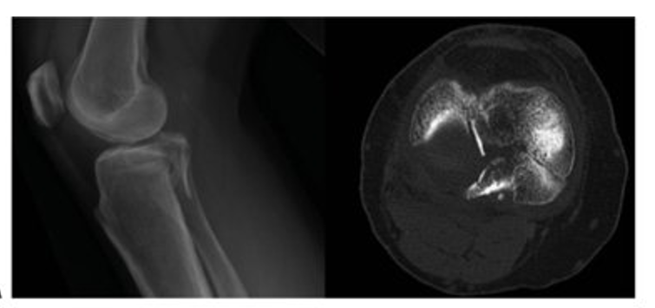
Posterior Shear Patterns
Commonly posteromedial patterns
“B-type” partial articular injury to the medial plateau
Often associated with
bicondylar patterns and less
commonly isolated fracture; lateral side seen as well
Rockwood and Green, 9th edition
Notes:
Kfuri M, Schatzker J. Revisiting the Schatzker classification of tibial plateau fractures. Injury. 2018 Dec;49(12):2252-2263. doi: 10.1016/j.injury.2018.11.010. PMID: 30526924.
Luo CF, Sun H, Zhang B, Zeng BF. Three-column fixation for complex tibial plateau fractures. J Orthop Trauma. 2010 Nov;24(11):683-92. doi: 10.1097/BOT.0b013e3181d436f3. PMID: 20881634.

Slide 18
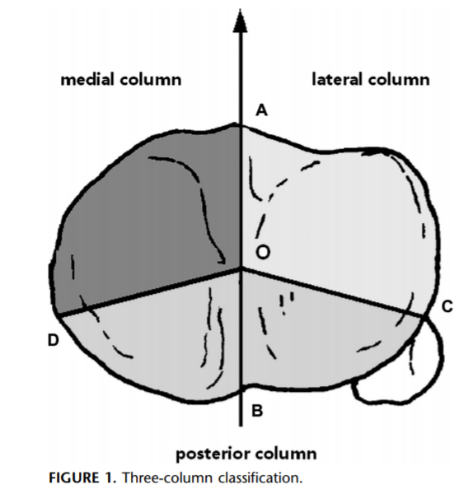
Three Column Concept of Plateau Fractures
Evolution of the Schatzker Classification
Better incorporates fractures involving posterior plateau
Help with determining appropriate fixation strategy
Luo CF, Sun H, Zhang B, Zeng BF. Three-column fixation for complex tibial plateau fractures. J Orthop Trauma.
2010 Nov;24(11):683-92. doi: 10.1097/BOT.0b013e3181d436f3. PMID: 20881634

Slide 19
Objectives
Describe initial evaluation and management of tibial plateau fractures
Identify common fracture patterns
Apply treatment principles and strategies
Partial articular fractures
Complete articular fractures
Discuss rehabilitation, complications, and outcomes

Slide 20
General Principles for Plateau Treatment
Fracture location and classification generally dictate approach
Anterolateral, posteromedial, direct medial most common
Visualization of the fracture – key for articular reduction
Direct visualization; ie anterolateral with submeniscal approach
Fluroscopic; ie minimally invasive reduction and plating
Arthroscopic; in conjunction with fluoroscopic
Use of temporary external fixation may be considered
Fractures which are length stable can be safely delayed with bracing alone

Slide 21
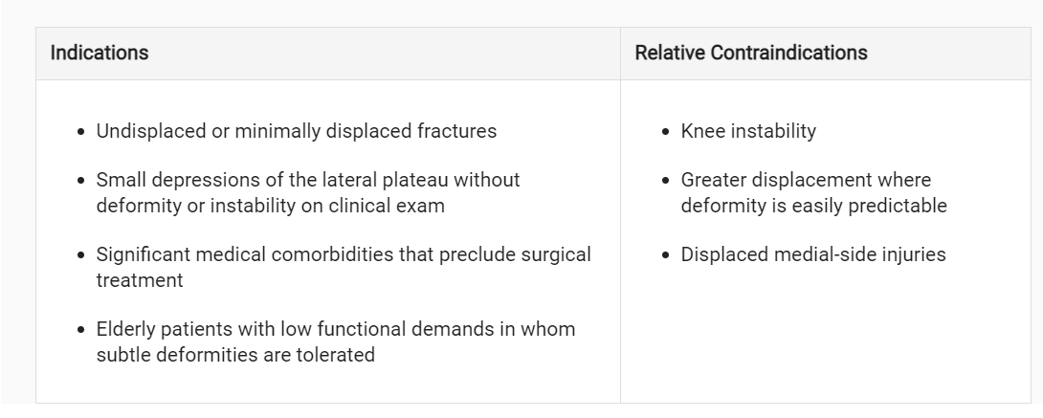
Nonoperative treatment: Indications and contraindications
Rockwood and Green, 9th edition

Slide 22
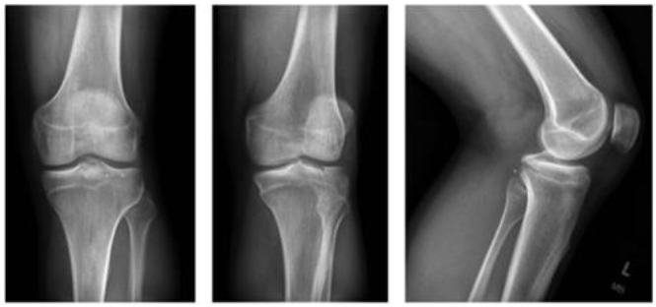
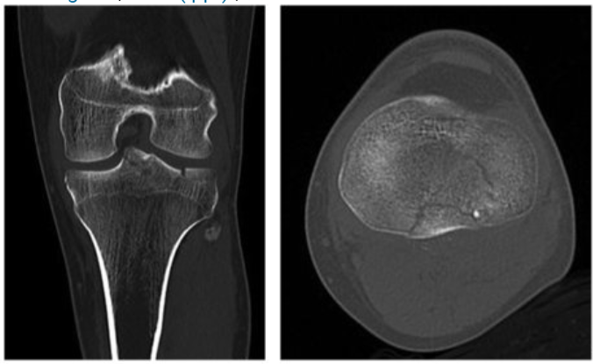
Nonoperative management
Valgus instability – 5-10 degrees
Articular step-off threshold is controversial
Isolated medial injuries: late varus collapse
In general, small isolated lateral injuries without valgus instability
Early ROM, limited wb x 8-12 weeks, +/- bracing
Angular malalignment poorly tolerated
Rockwood and Green, 9th edition

Slide 23
Goals of Surgical Fixation – plateau fractures
Restore alignment
Coronal
Sagittal
Slope
Normal Condylar width
Fully stable knee
Congruent Articular Surfacte

Slide 24
Lateral Plateau Fixation
Most common fracture pattern
Anterolateral approach
Key steps:
Anterolateral approach
Submeniscal arthrotomy
+/- distractor if needed
“book open” the split portion
Reduce the depressed articular segment and provisionally stabilize with K-wires
Fill voids as necessary
Reduce the split portion
Apply rafting screws and/or lateral plate
Click below for video link
Anterolateral Approach for the Treatment of Tibial Plateau Fractures
Mark Hake, Rajbir Hundal, Jacob Kirsch, Michael Yee

Slide 25
Lateral Plateau Fixation
Healthy, active 48 year old woman fell off scooter

Slide 26
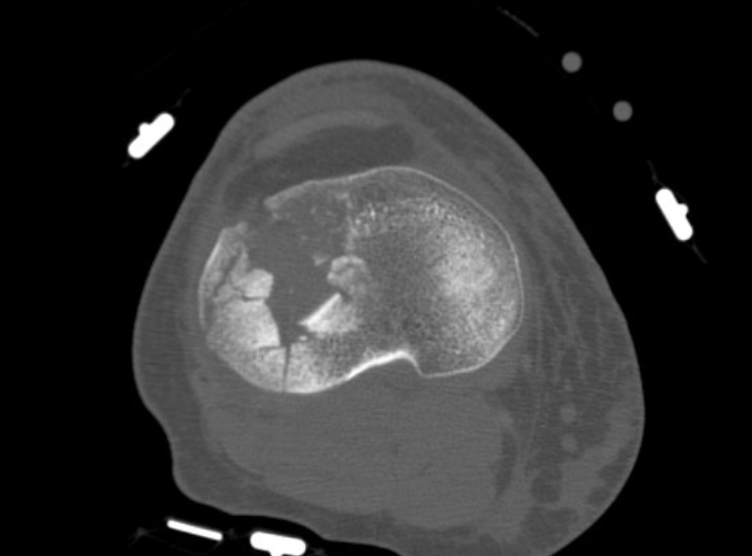
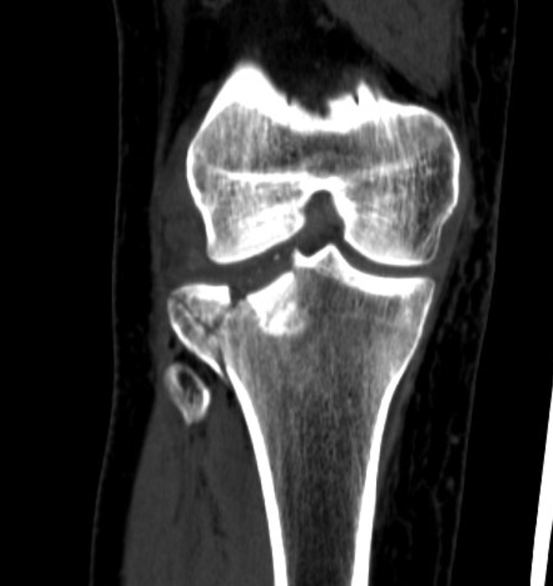
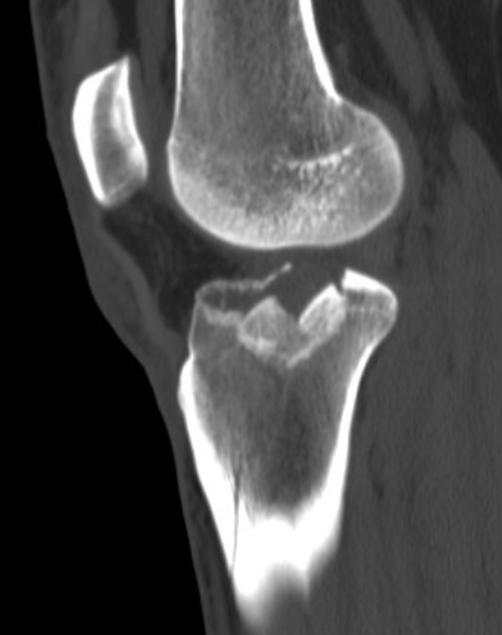
CT Imaging – axial cuts demonstrate approach

Slide 27
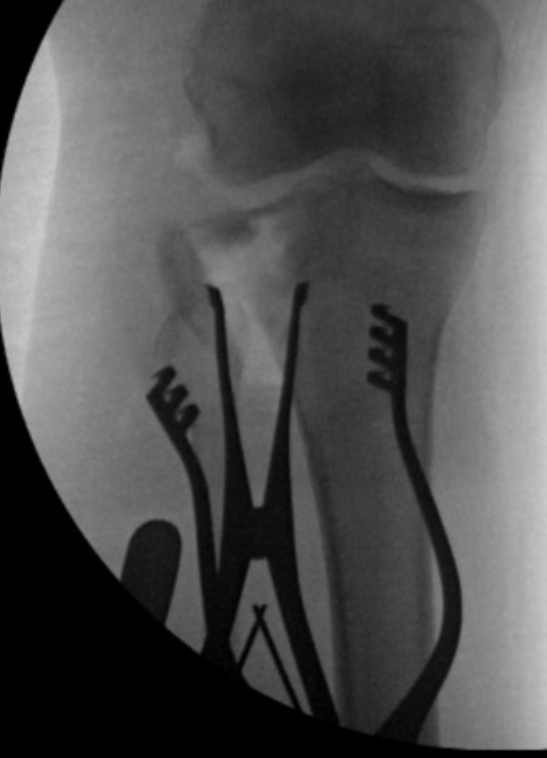
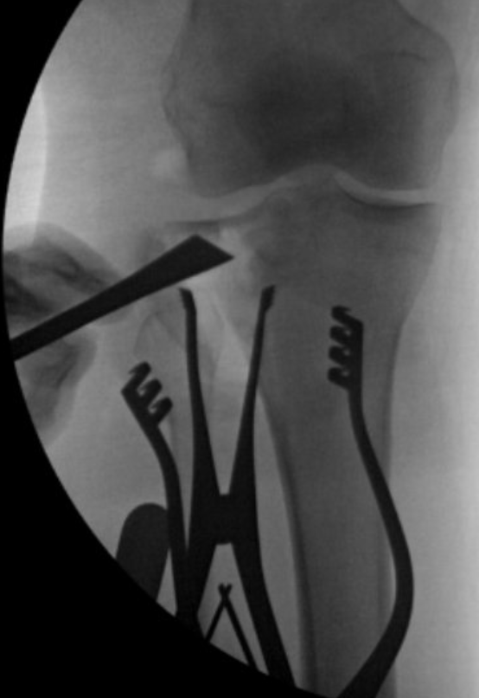
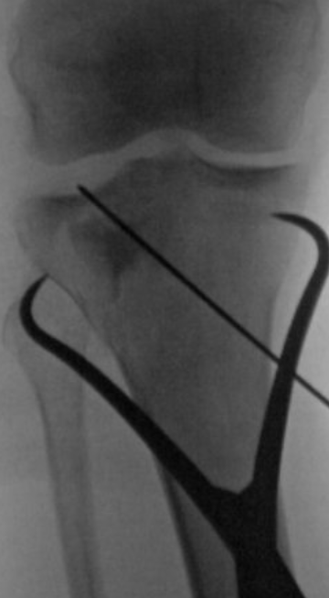
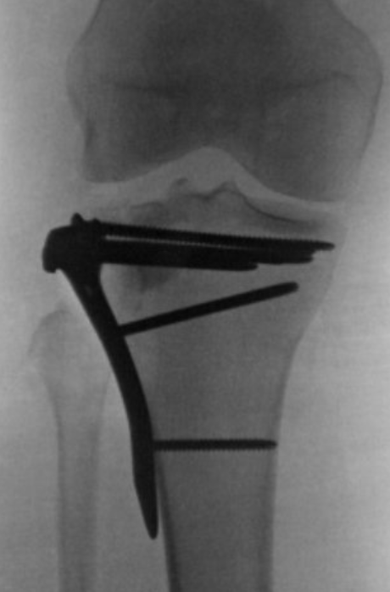
Anterolateral approach – visualize + reduce

Slide 28
Postoperative Care
Early ROM – trust your fixation
Protected WB
8 weeks tdwb, then adv to wbat over weeks 8-12
Bracing?
DVT prophylaxis

Slide 29
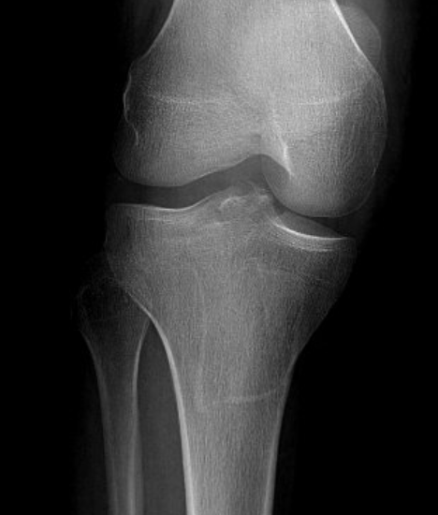
Isolated medial injuries
Much less common
Posteromedial approach
Key steps:
Generally buttress at the apex
Prone vs supine?
Supine – simple, allows for anterolateral approach, also adds significant rotation and varus often thru the fracture in bicondylar injuries
Posterior – inconvenient, but fewer deforming forces, simplifies fixation
Direct approach to apex
Indirect reduction at joint line
Fluroscopic reduction key
With Medial surface impaction – can perform submeniscal arthrotomy to visualize the surface

Slide 30
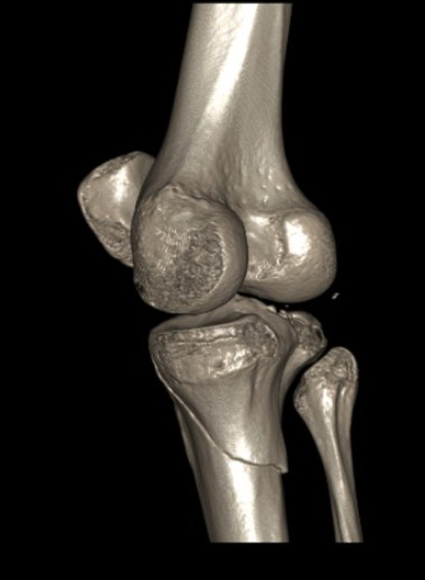
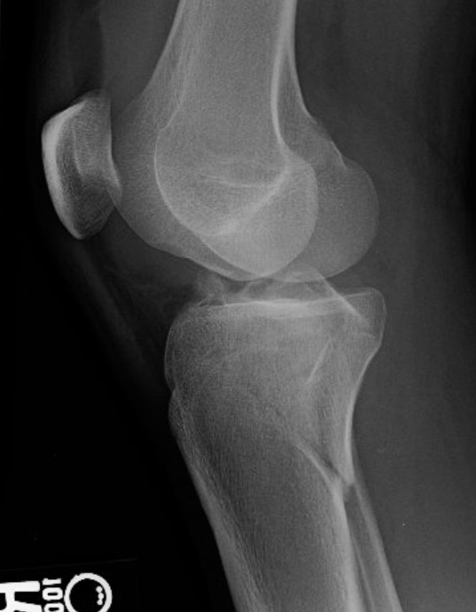
Isolated medial injuries – prevent late varus

Slide 31
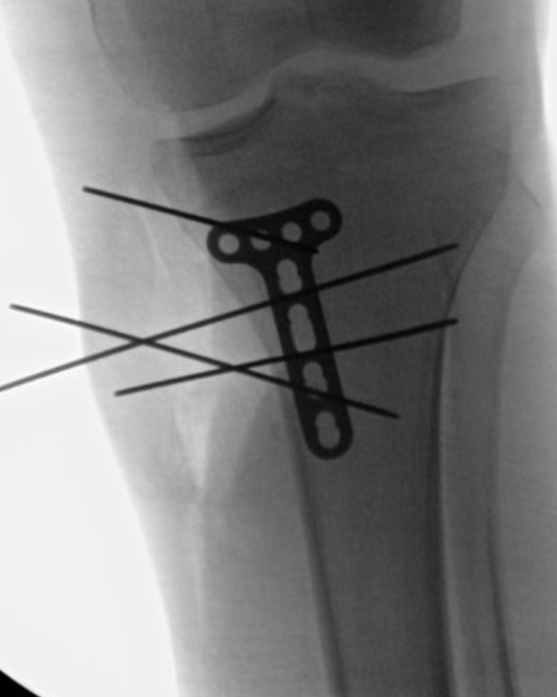
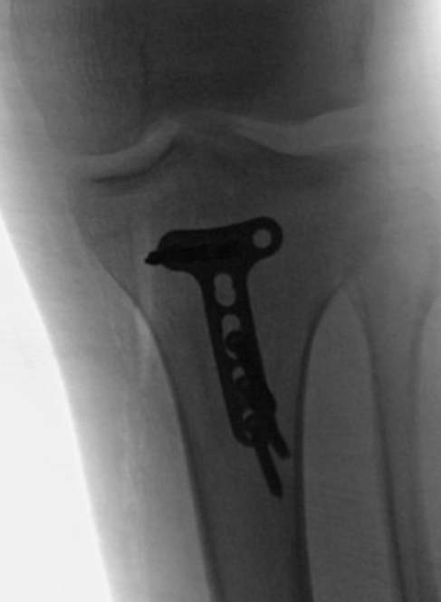
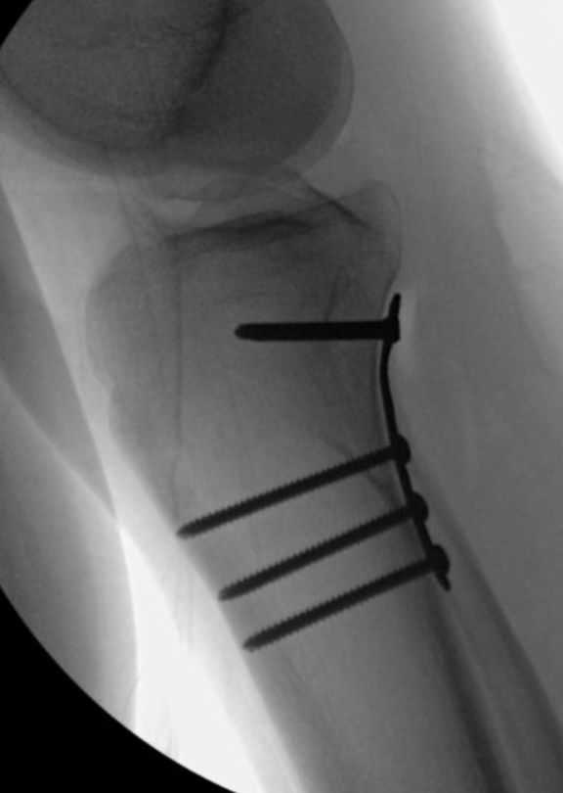
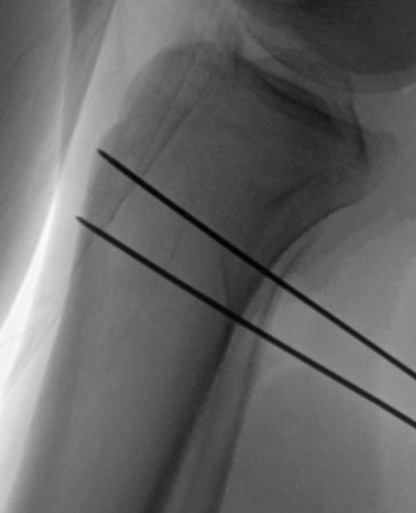
Lobenhoffer approach – interval between hamstring and medial head of the gastroc

Slide 32
More complex injuries…bicondylar plateau
-Neurovacular checks are crucial
-Exam can evolve
-applying external fixation can change the vascular exam
-restoring length can increase compartment pressure as well

Slide 33
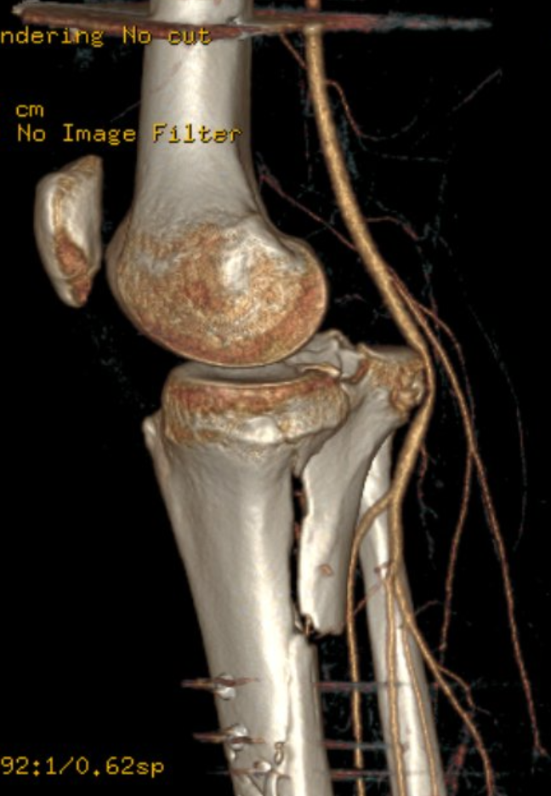
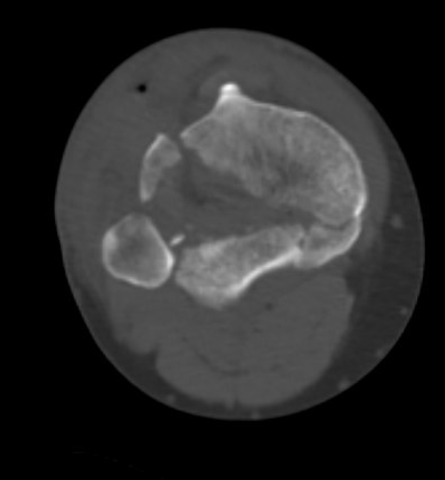
Extensile posteromedial approach
Standard Lobenhoffer approach with an extended proximal limb
Isolate the medial head of the gastroc at its femoral insertion
Release the medial head
Provides access to a portion of the posterolateral plateau as well
Orapiriyakul W, Apivatthakakul T, Phornphutkul C. Posterolateral tibial plateau fractures, how to buttress?
Reversed L posteromedial or the posterolateral approach: a comparative cadaveric study.
Arch Orthop Trauma Surg. 2018 Apr;138(4):505-513. doi: 10.1007/s00402-018-2875-3. Epub 2018 Jan 19
Notes:
Orapiriyakul W, Apivatthakakul T, Phornphutkul C. Posterolateral tibial plateau fractures, how to buttress? Reversed L posteromedial or the posterolateral approach: a comparative cadaveric study. Arch Orthop Trauma Surg. 2018 Apr;138(4):505-513. doi: 10.1007/s00402-018-2875-3. Epub 2018 Jan 19. PMID: 29352436.

Slide 34
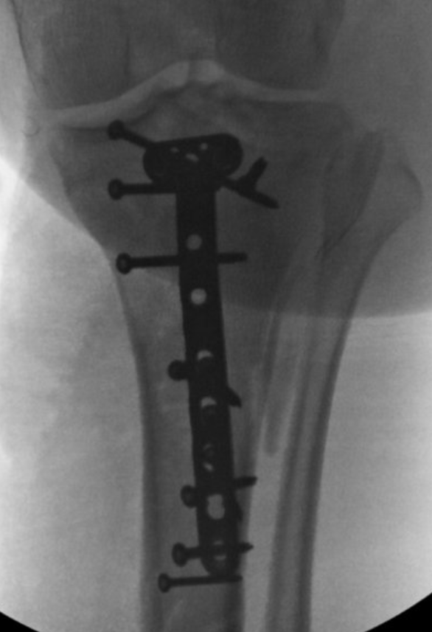
Extensile posteromedial approach - prone

Slide 35
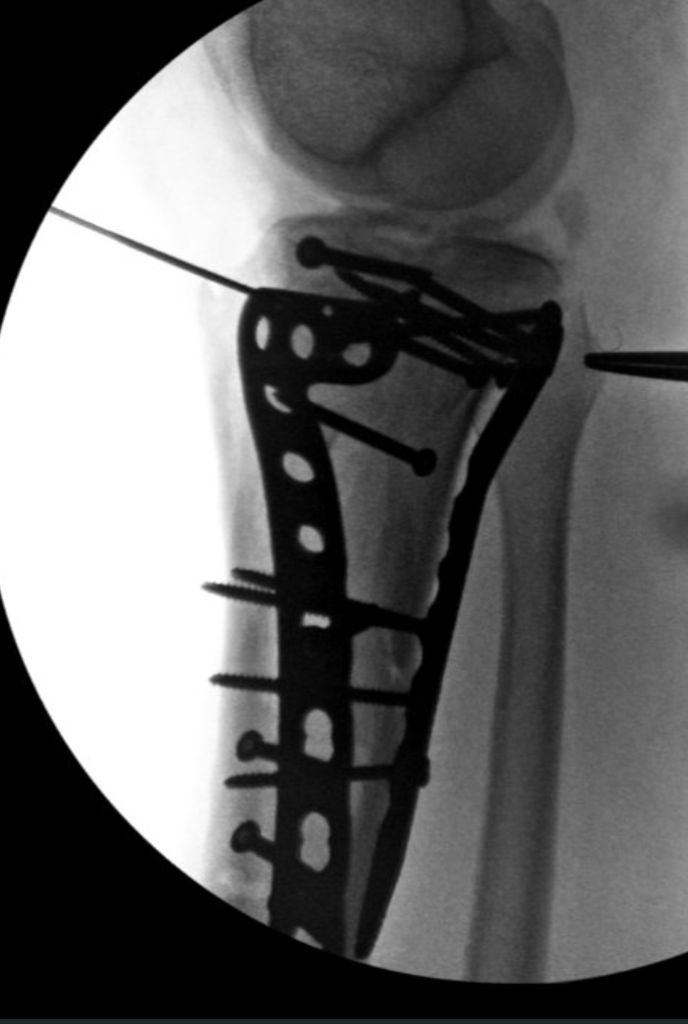
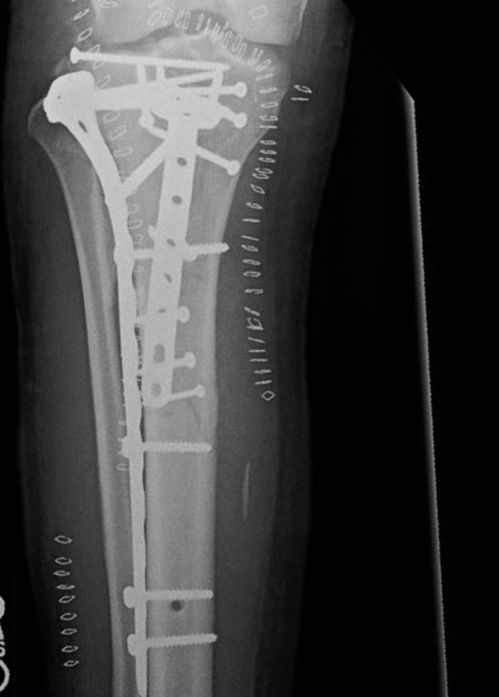
Second approach – anterolateral supine

Slide 36
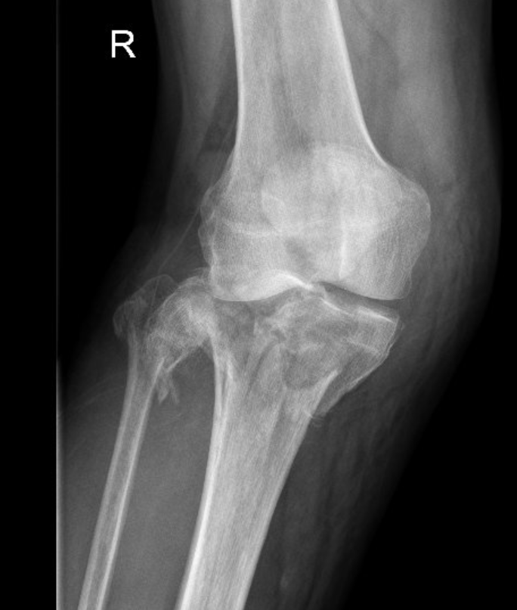
Bicondylar plateau – medial decision making
Medial side
? Posterior shear = posterior buttress
? Unstable medial column = direct medial plating
Axial CT scans helpful
Fixing from medial or lateral alone may entirely miss posteromedial fragments! Think three columms!
Buttress posterior fractures – at the apex!
Notes:
Image: Luo CF, Sun H, Zhang B, Zeng BF. Three-column fixation for complex tibial plateau fractures. J Orthop Trauma. 2010 Nov;24(11):683-92. doi: 10.1097/BOT.0b013e3181d436f3. PMID: 20881634.

Slide 37
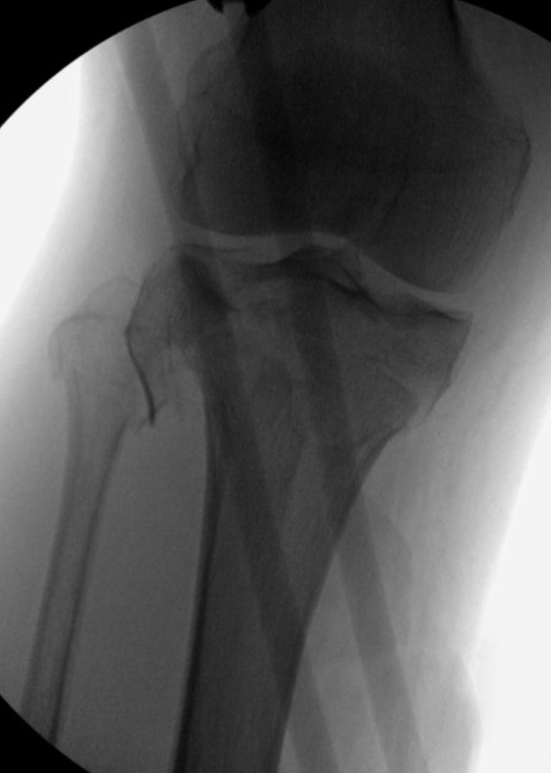
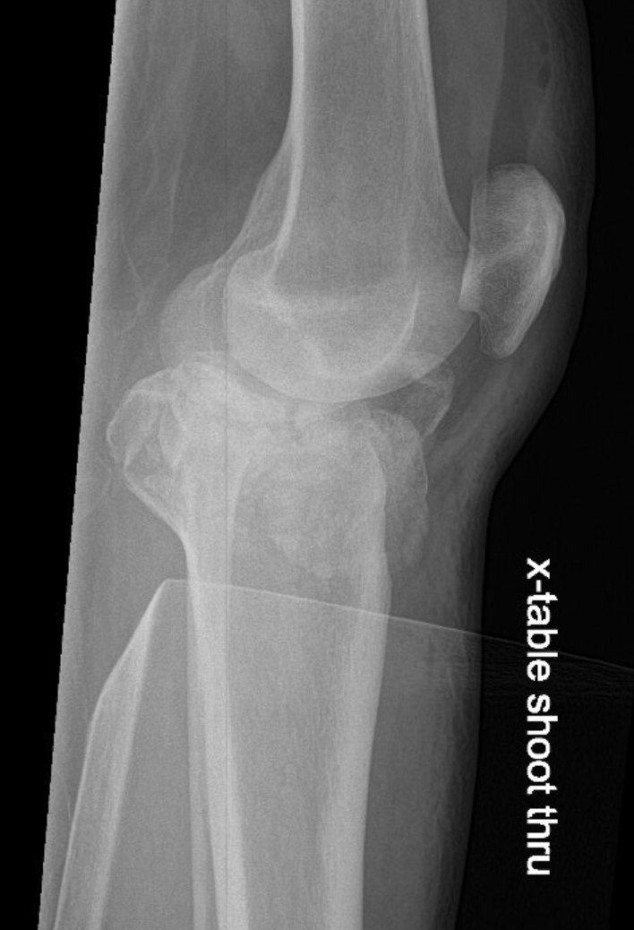
External fixation and 4 compartment fasciotomies required

Slide 38
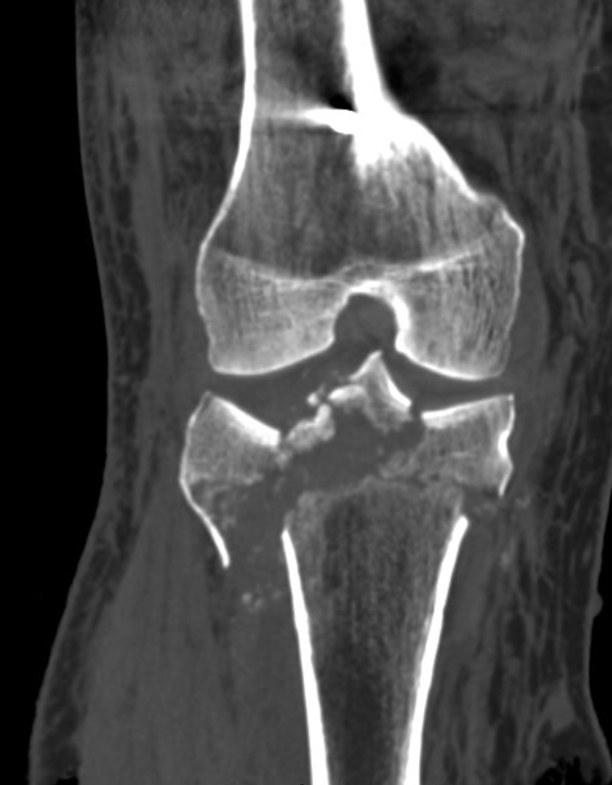
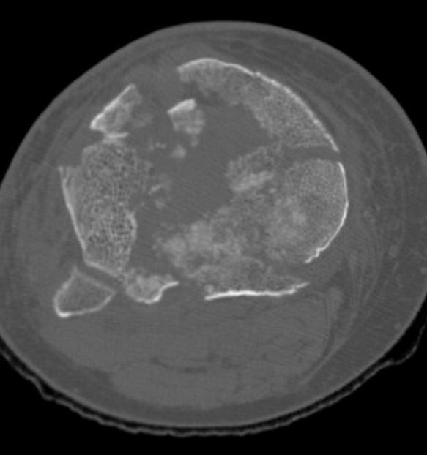
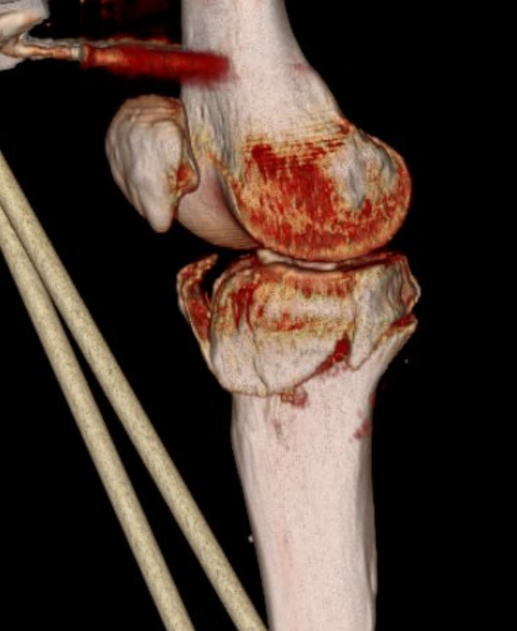
Bicondylar plateau – medial decision making: CT scan after external fixation applied
Requires bicondylar plating – with direct medial
plating, not posteromedial!

Slide 39
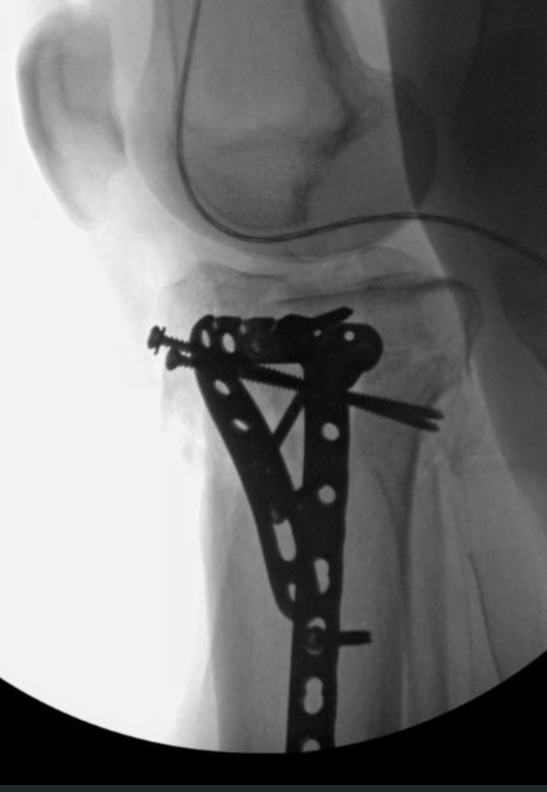
Medial side – limited proximal exposure and bridging distally
Medial first
Established length
Anterolateral
Clamp the two
plates together
-Axial alignment
-condylar width
-joint congruity

Slide 40
Bridge plating techniques
It the fracture a plateau, that extends into the shaft – or is it a shaft that happens to extend into the plateau?
Simple fracture lines call for anatomic reduction
Percutaneous bridge plating used for more comminuted diaphyseal fractures with proximal extension
Can the joint be reduced without a direct approach?
Is an IM nail in conjunction with plating beneficial?
Click below for video link
Bridge Plating of Proximal Tibia Metaphyseal Fracture by
Limited Open Technique
Michael Gardner, Benjamin Pulley

Slide 41
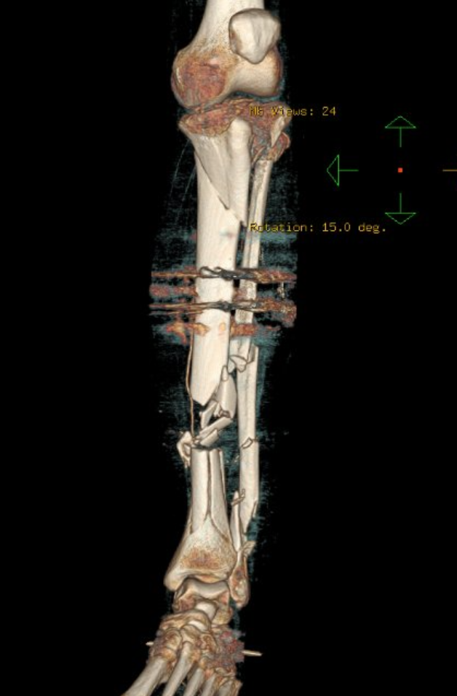
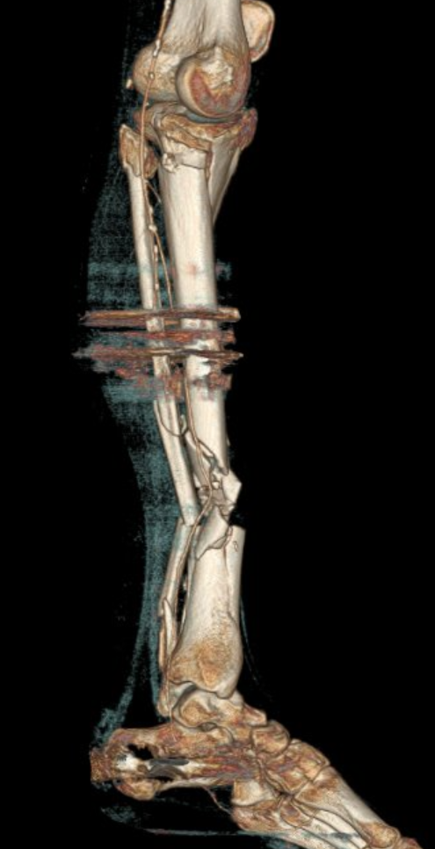
Associated shaft and plateau – combining techniques
Presents in extremis
Bilateral open tibias
Associated bicondylar plateau on the left
Emergent ex fix and VAC
Returns for fixation HD 2 in anticipation of free flap HD 3

Slide 42
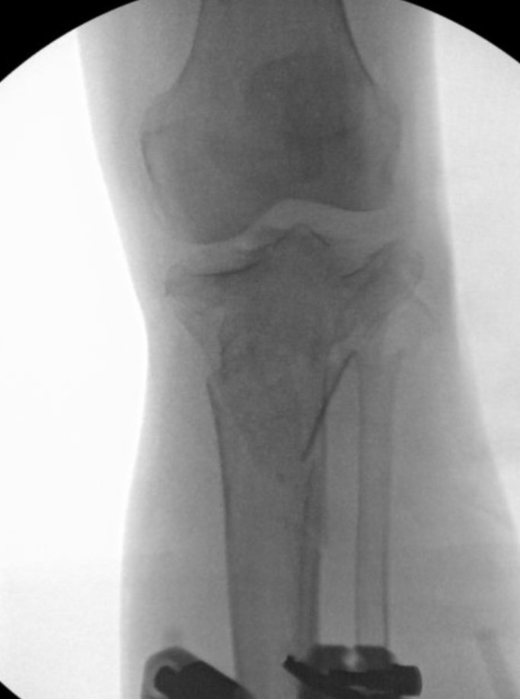
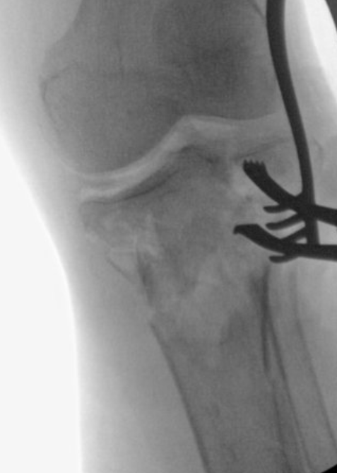
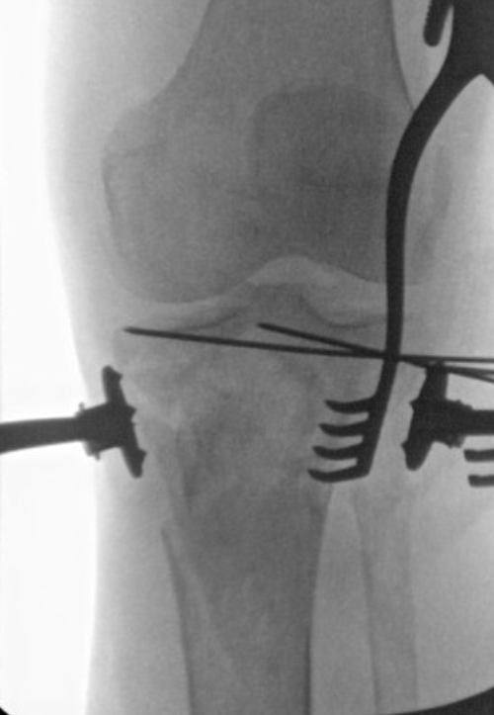
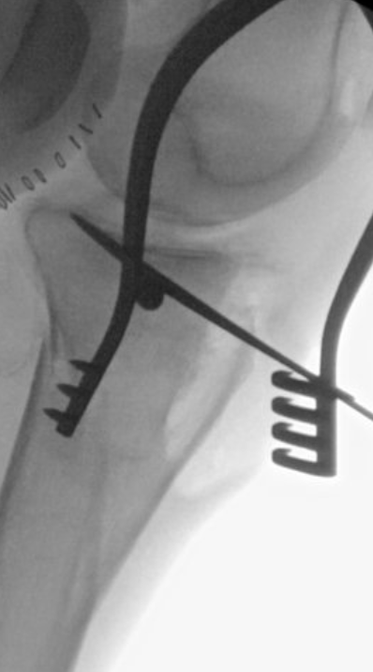
Limited anterolateral approach, percutaneous medial fixation, suprpatellar nailing

Slide 43
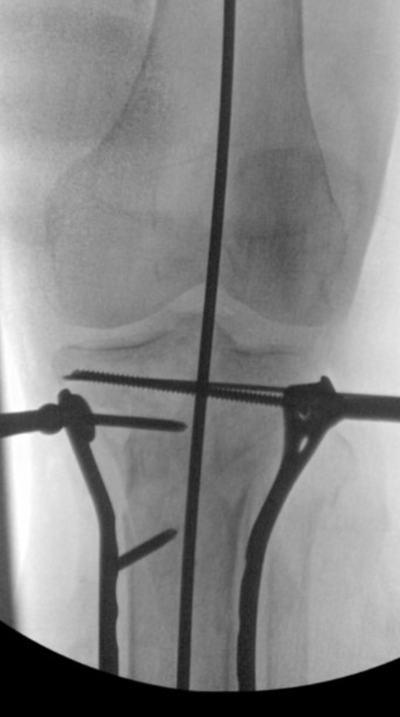
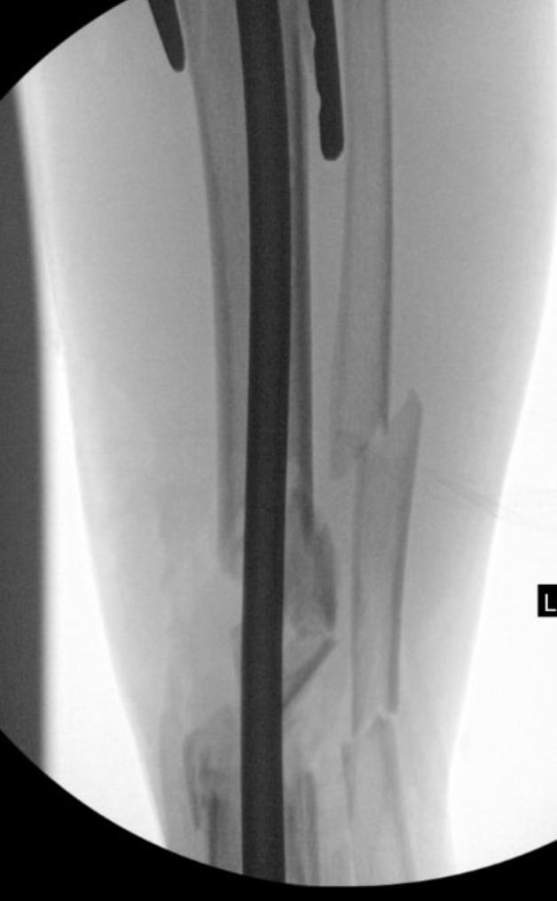
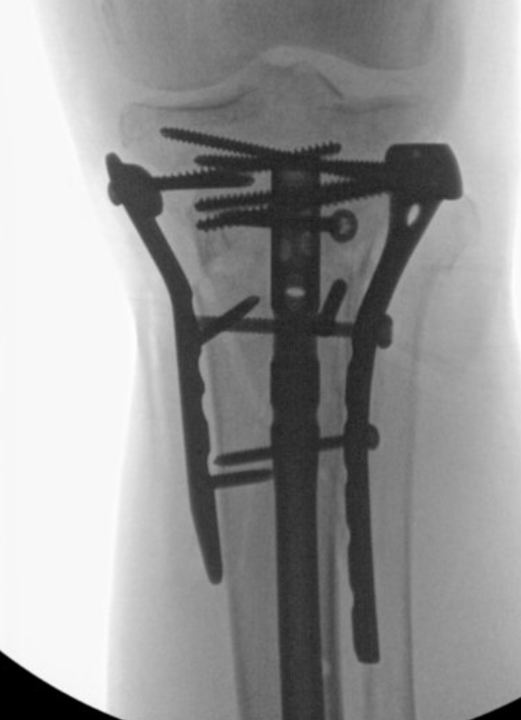
Limited plating, nail inserted, screws added

Slide 44
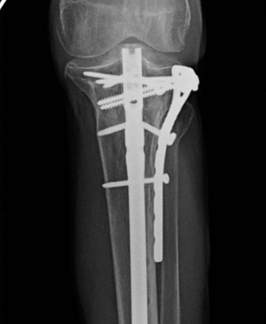
3 year f/u
*cement retained in diaphyseal fracture, shaft treated with posterolateral bone grafting

Slide 45
Bicondylar plateau – hyperextension mechanism from trampoline
HIGH RISK FOR NEUROVASCULAR INJURY!
Hyperextension causes
anterior slope

Slide 46
Plan for bicondylar plating, direct medial
External fixator applied
“Travelling traction”
Anterolateral approach
Medial extension deformity corrected with elevator from the anterolateral side
Second posteromedial approach allows for correction of the posterior translation of the plateau
Dual plating lateral and medial

Slide 47
Elevate slope!
Final correction

Slide 49
Objectives
Describe initial evaluation and management of tibial plateau fractures
Identify common fracture patterns
Apply treatment principles and strategies
Partial articular fractures
Complete articular fractures
Discuss rehabilitation, complications, and outcomes

Slide 50
Rehabilitation
Post op protocols :
Can vary by fracture severity
Goal of surgery – allow for complete ROM immediately postop
Unlocked hinged knee brace commonly used
Consider appropriate DVT prophylaxis
Touch down WB 8 weeks
Advance after 8 weeks depending on severity
Quad sets, isometrics important
Notes:
Patterson JT, Morshed S. Chemoprophylaxis for Venous Thromboembolism in Operative Treatment of Fractures of the Tibia and Distal Bones: A Systematic Review and Meta-analysis. J Orthop Trauma. 2017 Sep;31(9):453-460. doi: 10.1097/BOT.0000000000000873. PMID: 28459774.

Slide 51
Complications
Pre or postop compartment syndrome (increases with complexity of injury)
Can release anterior compartment easily from anterolateral approach
Infections more common after compartment release
Medial plating prevents late varus collapse
Residual valgus common with isolated lateral injuries
Rockwood and Green, 9th edition

Slide 52
Conclusions
Systematic approach to initial presentation
Evaluate neurovascular exam
Consider compartment syndrome
Evaluate in light of age and mechanism
Operative goals
Axial alignment, condylar width, joint congruity
Key Steps
Plan the approach, reduce the articular block, fill voids as necessary, re-establish length and alignment
Medial fixation: Direct medial or posteromedial buttress?
Bicondylar fixation: Bridge plating helpful for comminuted metaphyseal or diaphyseal extension injuries

