Slide 1
Pediatric Pelvis and Acetabulum Fractures
Ahmed Thabet MD
Assistant Professor, Orthopedics
Paul Foster School of Medicine
Texas Tech University Health Science Center at El Paso
Christopher D. Souder, MD
Assistant Professor of Surgery & Perioperative Care
Dell Medical School
University of Texas at Austin

Slide 2
Disclosure
Clinical and radiographic images provided are used with permission of Ahmed Thabet, MD or Chris Souder, MD, unless otherwise specified
Figures used with permission from Tornetta P, Ricci WM, eds. Rockwood and Green's Fractures in Adults, 9e. Philadelphia, PA. Wolters Kluwer Health, Inc; 2019.

Slide 3
Objectives
Differences between pelvis and acetabulum fractures in children and adults
Review the clinical assessment of pelvis and acetabulum fractures
Establish emergency treatment for pediatric pelvis and acetabulum in children
Discuss definitive treatment of pediatric pelvis and acetabulum fractures
Identify complications associated with pediatric pelvic and acetabular fractures

Slide 4
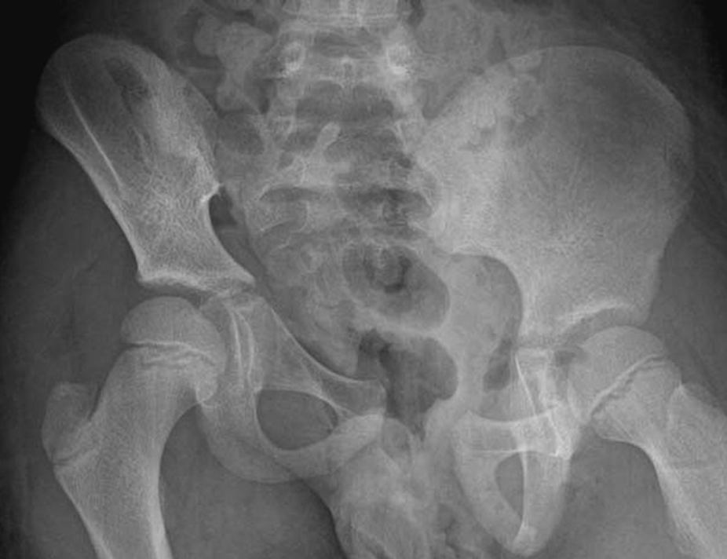
Unique Pediatric Considerations
Greater plasticity of the pelvic bones
Greater elasticity at the SI joint and pubic symphysis
Allows greater energy to be dissipated before fracture
10,000 N to break the pelvis of 1-year kid compared to 3000-6000 to cause fracture of 14-years
Higher likelihood of a single fracture of the ring
Can have significant intrapelvic injury with nondisplaced fractures
Presence of apophyses
Growth plates are weaker locations/more susceptible to injuries
Allow for occurrence of avulsion fractures
Notes:
IMAGE→Bilateral Sacroiliac Joint Dislocation (Anterior and Posterior) With Triradiate Cartilage Injury: A Case Report JOT 2011

Slide 5
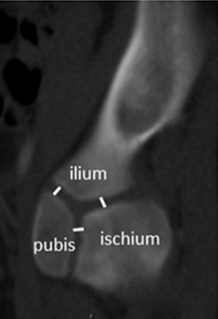
Patho-anatomy
The pelvis has three primary ossification centers joined at the triradiate cartilage (TRC)
Ilium
Pubis
Ischium
TRC fuses at 12-14 years
Notes:
Reference: Age-Based Normative Measurements of the Pediatric Pelvis JOT 2017

Slide 6
Pelvic fractures

Slide 7
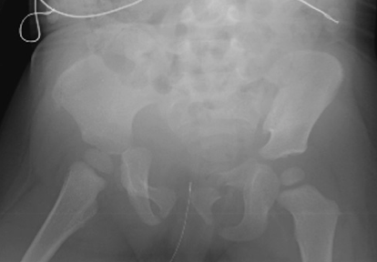
Epidemiology
Rare injuries
Less than 1% of all pediatric fractures
Found in 5% of admitted children to Level I trauma centers with blunt trauma
Mortality is high as high 25%
Notes:
Image from: Management of an Unstable Pelvic Ring Disruption in a 20-Month-Old Patient JOT 2009

Slide 8
Mechanism of Injury (MOI)
MVC:
Occupants of wheeled vehicles
Auto vs Pedestrian
Struck by motor vehicle while riding bike or motorcycle
Fall from heights

Slide 9
Associated injuries
Found in 58% to 87% of cases
Most common associated injury is another fracture
Associate with approximately half of children with pelvic fractures
Lower extremity
Spine
Traumatic brain injury (TBI) ----9%-50%
Leading cause of death
Thoracoabdominal injuries------14% -33%
2nd leading cause of death

Slide 10
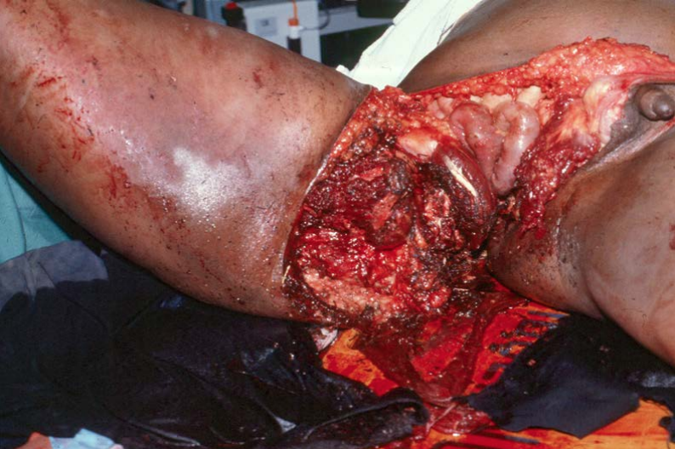
Associated injuries
Open fractures
Rare occurrence
High rates of infection
Must be identified promptly and treated with I&D and repair
Peripheral nerves injuries occur in ~3% of cases
Vascular injuries are found in less than 1%
Compared to 3.4% in adults
Low rates of hemorrhage in children due to:
Good vascular response by vascular constriction in response to hemorrhage

Slide 11
Associated injuries
Rectal or vaginal lacerations (2%-18%)
Most seen in open fractures
Rare in children
Genitourinary injuries (urethral and bladder lacerations) (4%)
Hematuria is present in up to 50% of pediatric pelvic fractures
17% have a GU injury

Slide 12
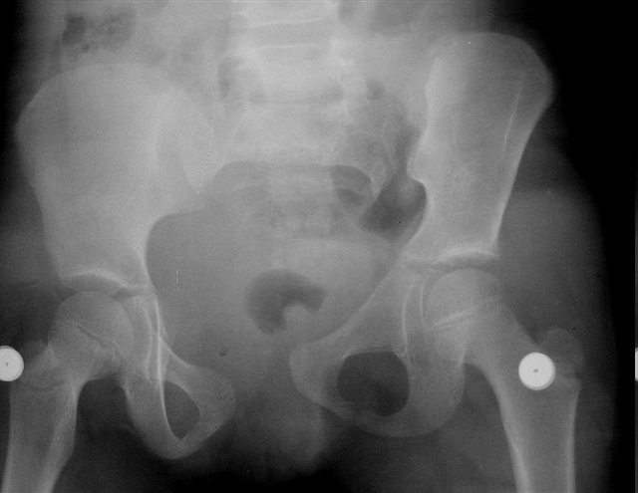
Morbidity and Mortality
Significant hemorrhage requiring transfusion occurs in up to 30%
Anterior and posterior injury
Unstable injuries
Mortality rates of 2- 12%
“Demetriades, J Trauma 2003, Heinrich SD 1994, JBJS A’’

Slide 13
Initial Evaluation and Management
ATLS protocol:
Primary survey
Airway
Breathing
Circulation
Disability
NV exams
GCS score: reliability of clinical exam is decreased when GCS <13

Slide 14
Initial inspection
Complete evaluation of pelvis and perineum area
Lacerations
Ecchymosis
MUST log-roll the patient for complete inspection
Morel-Lavallee lesion
Shearing off of skin and subcutaneous tissues from underlying muscles
Creates a large space which allows hematoma accumulation

Slide 15
Initial Evaluation
Palpation of pelvic bony landmarks
ASIS, AIIS, iliac crest, symphysis pubis
Manual manipulation should be carefully performed when needed
Painful
Can potentially disrupt a clot
Lead to further intrapelvic bleeding

Slide 16
Initial Evaluation
Inspect the perineum
Genitourinary evaluation
Urethral injury→blood at the meatus, gross hematuria
Retrograde urethrogram indicated if urethral injury suspected
Higher rates in males
Bladder injury
Intra- and/or extra-peritoneal injuries
Cystogram used for diagnosis
Rectal evaluation
Digital rectal exam indicated in high-risk scenarios
Widely displaced fractures with blood in the perineum
OTA core lectures

Slide 17
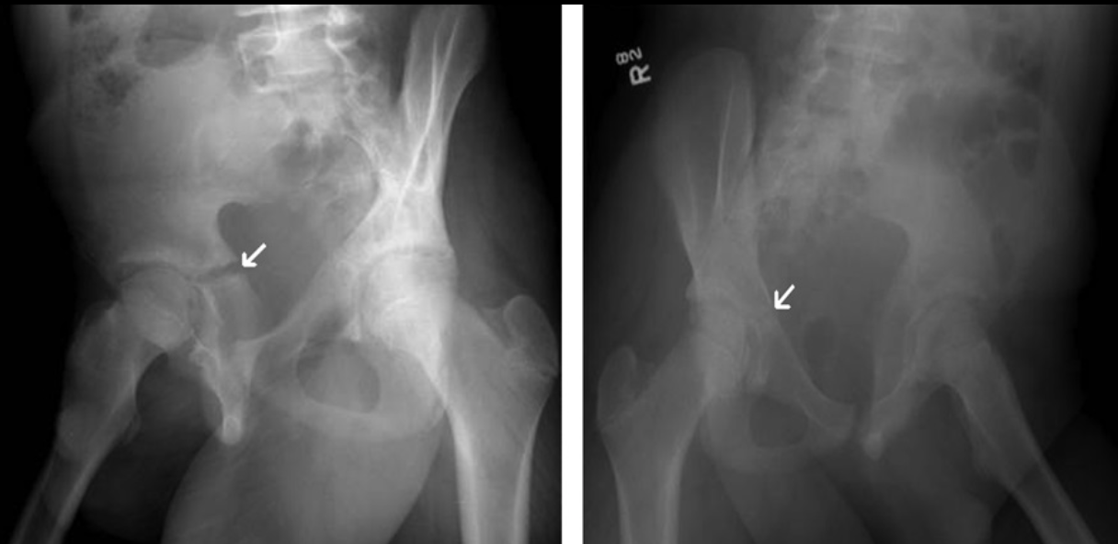
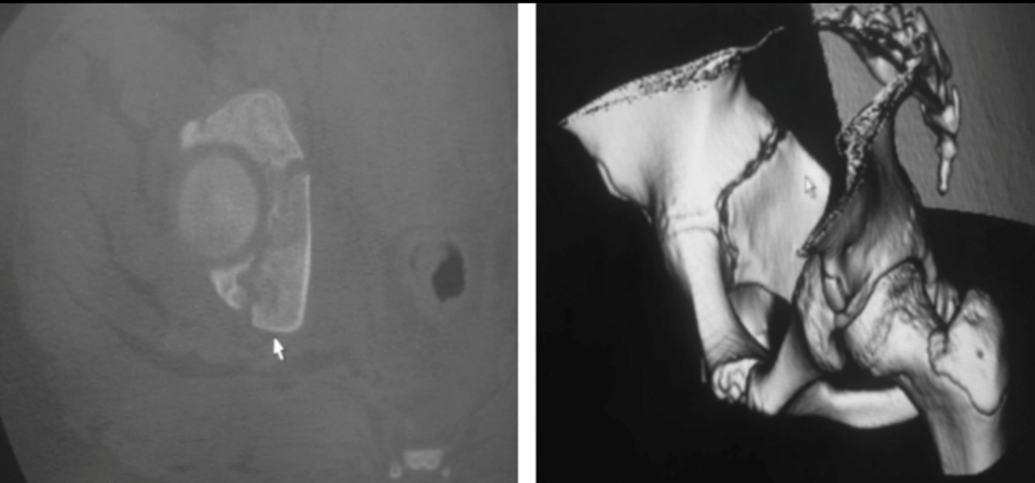
Imaging
AP pelvis XR obtained on all polytrauma patients
Component of initial trauma radiograph series
ATLS protocol
Additional images obtained when hemodynamically stable
Inlet
Outlet
CT scans
Improved visualization of SI joints and sacrum
Helpful for pre-operative planning
3D reconstructions

Slide 18
Fractures Classification
Modified Torode and Zieg classification:
Type I
Avulsion fracture
Type II:
Iliac wing fractures
Type III:
56% of all pediatric pelvic fractures
IIIA—Stable anterior ring disruption
IIIB—Stable anterior and posterior ring disruption
Increased need for transfusion, increase length of stay, more frequent admission to ICU, more associated injuries
Type IV
Unstable ring disruptions

Slide 19
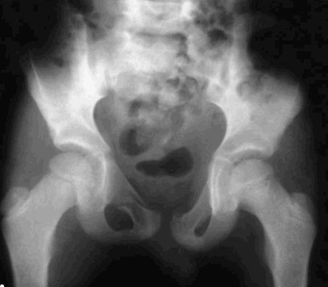
Fracture Classifications
Based on skeletal maturity
Immature
Open triradiate cartilage (TRC)
Rarely require surgical intervention
Mature
Closed triradiate cartilage (TRC)
Classified and treated as adults

Slide 20
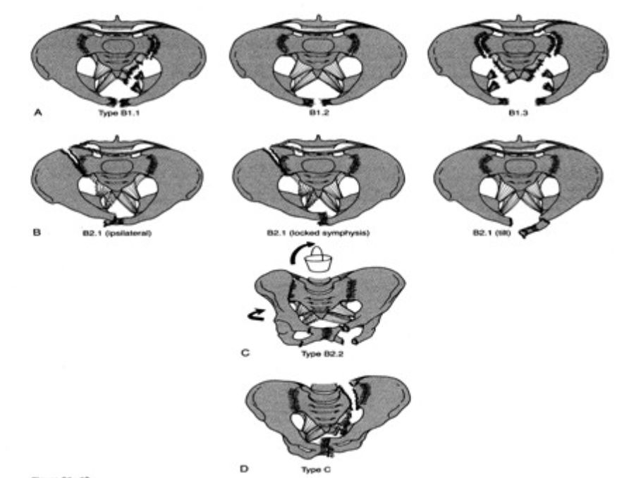
Tile Pelvis Fractures Classification in adults

Slide 21
Treatment
Life threating hemorrhage must be addressed
Follow ATLS protocol
Multidisciplinary approach for associated injuries:
Head
Thoracoabdominal injuries
Urogenital injuries

Slide 22
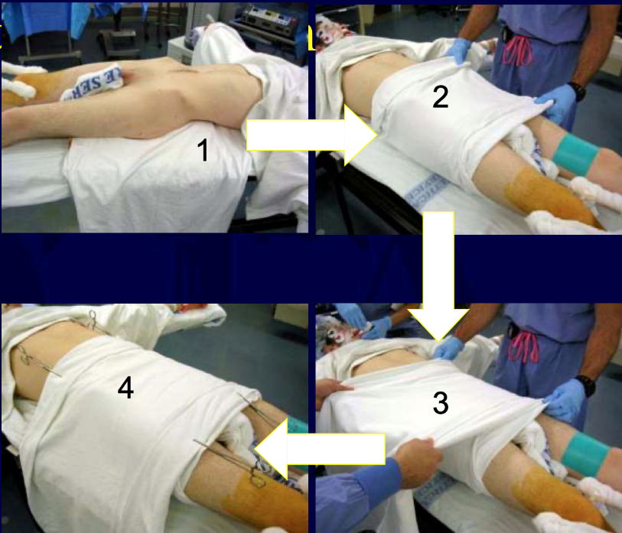
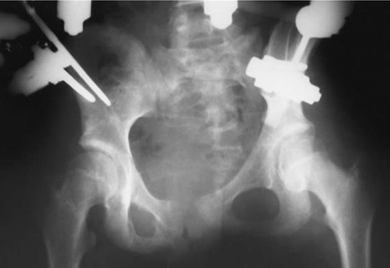
Initial Treatment
Resuscitation
Resuscitation
Resuscitation
ABCDEs of ATLS
Hemodynamically unstable patients:
Other sources of bleeding should be rule out 1st
Pelvic binder or sheet at the level of greater trochanters
Binder vs sheets application varies among institutions
Pelvic ex fix if hemodynamic instability persists
IR embolization indications
Arterial bleeding
Patient with hemodynamic instability and no other sources identified

Slide 23
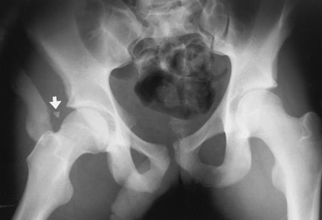
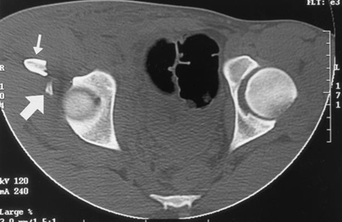
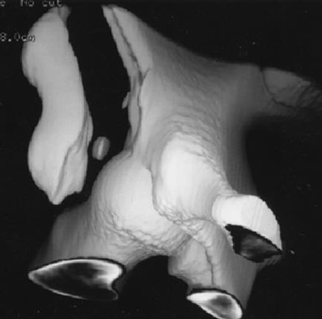
Treatment of Pelvic Ring Fractures
Isolated iliac wing fractures: (Torode and Zieg type II):
Rare (5%-14%)
More commonly seen in conjunction with additional pelvic fractures
Treatment guided by associated injuries
Pelvic ring injury
Abdominal injury
Fractures are treated non-operatively
Partial WB with crutches
ORIF is rarely needed
Notes:
Images from: Traumatic Unilateral Avulsion of the Anterior Superior and Inferior Iliac Spines With Anterior Dislocation of the Hip: A Case Report JOT 2001

Slide 24
Treatment of Pelvic Ring Fractures
Simple ring fractures (Torode & Zieg IIIA & IIIB)
Stable fractures
Typically, minimally displaced
Non-WB vs protected-WB
Close radiographic follow up to monitor fracture displacement
ORIF may be needed to aid in mobilization and pain control
Spica cast may be useful in younger kids to enforce restrictions
Expect recovery in 6-8 weeks

Slide 25
Treatment of Pelvic Ring Fractures
Widening of the symphysis pubis
Usually associated with posterior ring injuries
Plain radiographs and CT are helpful
Look for posterior involvement
Consider fixation if
Widening >2.5cm
Stress films demonstrate >1cm difference

Slide 26
Treatment of Pelvic Ring Fractures
Fractures near or through the sacroiliac (SI) joint:
Most are Type IIIB fractures
Disruption can occur thru the chondro-osseous physis instead of SI joint
Crescent fractures may be associated with rotational instability
Stable, minimally displaced fractures are treated non-operatively
Non-WB x 4-6 WEEKS
Spica cast is occasionally needed in young children

Slide 27
Treatment of Pelvic Ring Fractures
Unstable ring fractures (Torode & Zieg IV)
Double anterior ring disruptions (straddle injuries)
Beware of associated bladder injury
Produces a floating anterior segment
Weightbearing progressed as pain improves
Typical recovery in 6-8 weeks

Slide 28
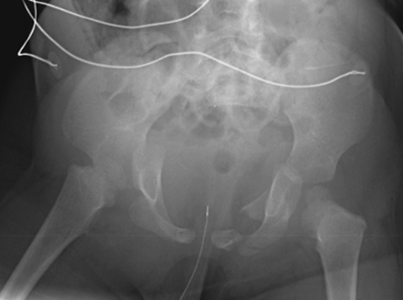
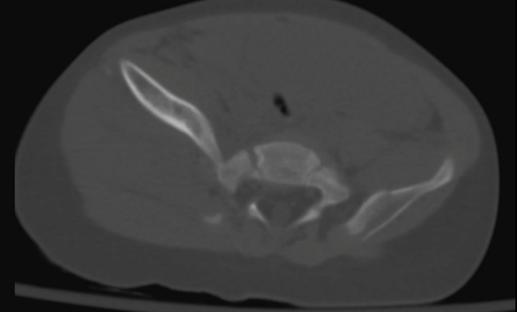
Treatment of Pelvic Ring Fractures
Unstable ring fractures (Torode & Zieg IV)
Anterior and posterior ring disruptions (double ring injuries)
Often associated with vertical instability (Malgaigne type)
Highest association with intra- and retroperitoneal bleeding
Intra-abdominal injuries may guide treatment
Minimally displaced fractures
Weightbearing restrictions with close radiographic follow-up
Spica cast in young children if needed for activity restrictions
Notes:
Management of an Unstable Pelvic Ring Disruption in a 20-Month-Old Patient JOT 2009

Slide 29
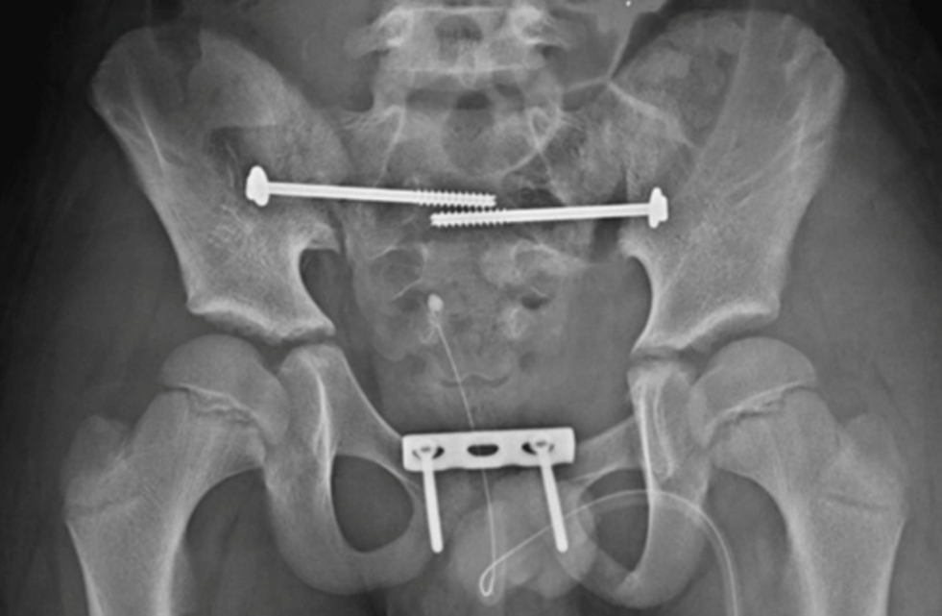
Treatment of Pelvic Ring Fractures
Unstable ring fractures (Torode & Zieg IV)
Anterior and posterior ring disruptions (double ring injuries)
Closed reduction and spica casting
Symphyseal disruptions
Skeletal traction
Vertical displacement
Traction required for 2-4 weeks until early healing occurs
ORIF
Relative indications
>1.1 cm of pelvic asymmetry is present
>2cm of displacement
Techniques and approaches similar to adults
Implant and fixation modifications needed in young children
Notes:
IMAGE from Bilateral Sacroiliac Joint Dislocation (Anterior and Posterior) With Triradiate Cartilage Injury: A Case Report JOT 2011

Slide 30
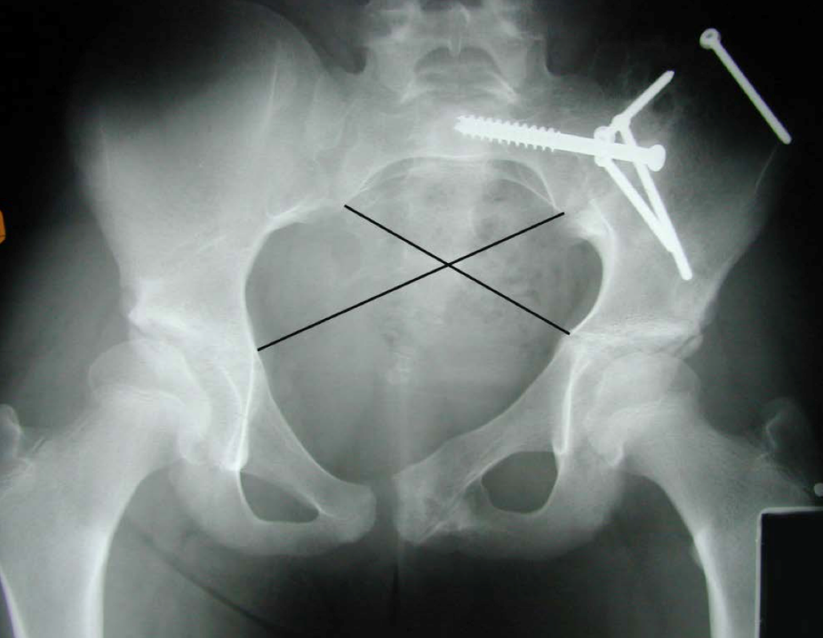
Treatment of Pelvic Ring Fractures
Pelvic asymmetry
Difference in length between two diagonal lines drawn from the border of the sacroiliac joint to the contralateral triradiate cartilage
Keshishyan et al. CORR 1995
This deformity does not remodel
Differences >1cm have been found to result in poor outcomes
Smith et al. JBJS 2005
Notes:
Image from past OTA Core curriculum lecture

Slide 31
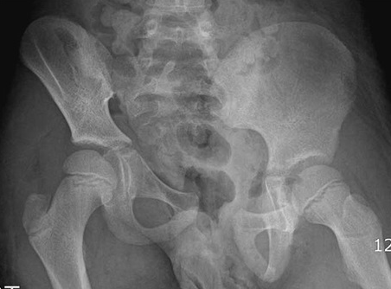
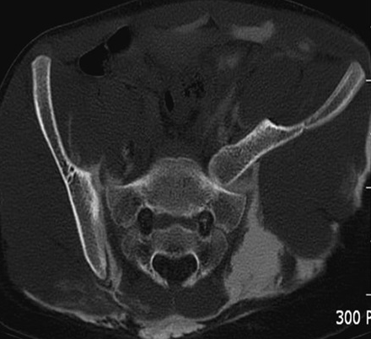
Treatment of Pelvic Ring Fractures
Unstable ring fractures (Torode & Zieg IV)
Multiple crushing injuries
Highest association of massive hemorrhage
High rate of concomitant GI or GU injury
Requires multidisciplinary approach
Associated injuries often times guides treatment
Treatment principles include
Stable pelvic fixation
Internal and/or external fixation
Multiple debridements (when associated with open fractures)
Soft-tissue management
Vigilant observation for infections
Notes:
IMAGE from Bilateral Sacroiliac Joint Dislocation (Anterior and Posterior) With Triradiate Cartilage Injury: A Case Report JOT 2011

Slide 32
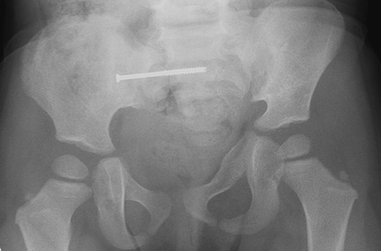
Treatment of Considerations
Pediatric pelvic fractures require less surgical fixation
Decreased association with severe hemorrhaging
Less need for surgical fixation to control bleeding
Thick periosteum and strong ligaments restrict amount of displacement
Decreases fracture motion and increases fracture healing
Decreases need for prolonged immobilization
Notes:
Image added Management of an Unstable Pelvic Ring Disruption in a 20-Month-Old Patient

Slide 33
Treatment of Considerations
Pediatric pelvic fractures posses some remodeling potential
Less need for anatomic reduction
Pelvic asymmetry, SI joint malposition, acetabular orientation DO NOT remodel
Long term morbidity is low after pediatric pelvic fractures

Slide 34
Complications
Pelvic deformity
Nonstructural scoliosis
Limb length discrepancy
Low back pain
Sacroiliac pain
Genitourinary complaints
Erectile dysfunction, incontinence
Psychiatric disturbance
Post-traumatic stress disorder (PTSD)
Depression

Slide 35
Pelvic avulsion fractures
Iliac crest
–external oblique
Classified as pelvic fractures
Accounts for up to 15% of all pelvic fractures
Differ greatly from more traumatic pelvic ring injuries
Commonly occur between the age 11-17
When secondary ossification centers are present
Anterior Superior Iliac Supine (ASIS)
–Sartorius
–Tensor fascia lata (TFL)
Anterior Inferior Iliac Supine (AIIS)
–Rectus femoris
Lesser Trochanter
–Ilioposas
Ischial Tuberosity
–Hamstrings

Slide 36
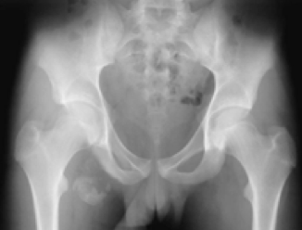
Pelvic avulsion fractures
Frequently associated with sporting activities
Forceful contraction of large muscles during rapid acceleration or deceleration moment
Muscles crossing both hip and knee joints
Muscles originating on a pelvic apophysis
Results in an avulsion of a secondary ossification center

Slide 37
Pelvic avulsion fractures
Most commonly presents in the outpatient setting
Present with localized swelling/tenderness at site of avulsion
Hip motion is limited due to guarding
Pain ranges from mild to severe
Pain exacerbated when involved muscle put on stretch
Ischial spine avulsion fractures—hip flexion and knee extension produces pain
Puts hamstring musculature on stretch

Slide 38
Pelvic avulsion fractures
Radiographs are typically sufficient
Comparison views may be helpful
AP pelvic radiographs allow for identification and comparison
Children with delayed presentation of these fractures may mimic malignancy so MRI may be needed
Thorough H&P is vital
Possible lab work

Slide 39
Treatment: Avulsion fractures
Non-OP treatment successful in almost all patients
Rest followed by structured rehab
Operative Rx for avulsion fractures:
Surgical consideration for ischial tuberosity with
Displacement over 15-20 mm
Goal is to avoid late symptoms
Late surgery considered in setting of
Chronic pain
Symptomatic prominence after healing
Anterior hip impingement with HO from AIIS fracture
Concern about labral involvement

Slide 40
Acetabulum fractures

Slide 41
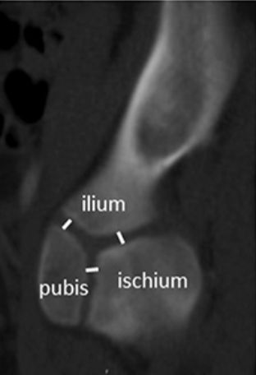
Acetabular fractures
Acetabulum fractures uncommon in children
2-17% of pediatric pelvic fractures
Overall, 0.5-0.7% of pediatric fractures
Involves the triradiate cartilage (TRC) in skeletally immature
Composed of
Ilium
Pubis
Ischium
Closes at 12-14 years of age
Potential for growth arrest after injury
Acetabular deformity
Acetabular dysplasia
Oetgen ME, et al. Age-Based Normative Measurements of the Pediatric Pelvis J Orthop Trauma. 2017; 37(7):e205-e209
Notes:
Top image and bottom left—R&W
The bottom right image is from: Age-Based Normative Measurements of the Pediatric Pelvis JOT 2017**

Slide 42
Mechanism of Injury
Most associated with high energy trauma
MVCs
Auto vs pedestrian
Less commonly seen with low energy sports injuries
Specific fracture pattern based on position of the leg at the time of impact
Direction of the force will determine

Slide 43
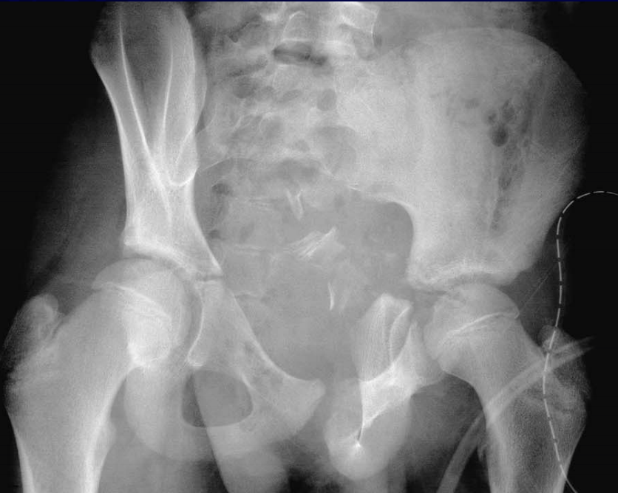
Classification
Watts classification:
Type A – Small fragments after hip dislocation
Type B – Stable linear fractures without displacement
Type C – Linear fractures with hip joint instability
Type D – Fracture secondary to central fracture-dislocation of the hip

Slide 44
Classification
Bucholz classification
According to Salter-Harris (SH) classification
SH I or II—shearing mechanism
Favorable prognosis
SH V—crush injury
Poor prognosis with frequent growth arrest
Adult classification can be applied in more mature patients
Letournel & Judet
de Ridder VA, et al. Operative Treatment of Pelvic and Acetabulum Fractures. J Orthop Trauma. 2019;33 Supple 8;S33-S37
Notes:
Image---Operative Treatment of Pediatric Pelvic and Acetabulum Fractures JOT 2019

Slide 45
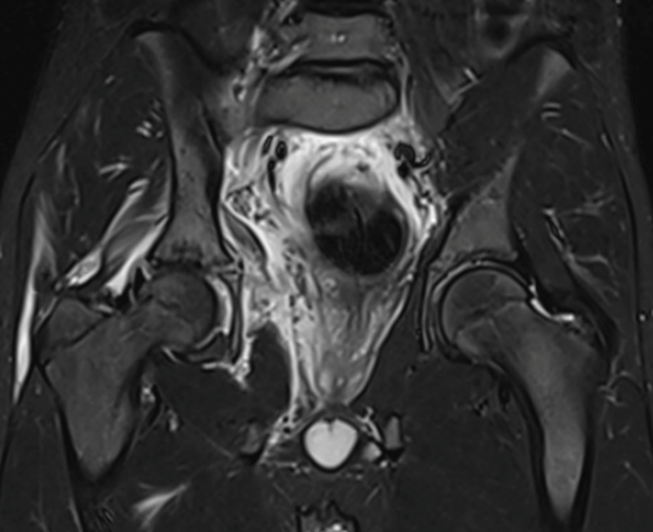
Imaging
AP of pelvis
Judet views
Obturator oblique
Iliac oblique
CT scan
Useful in more mature patients
MRI
Useful in evaluating TRC
Accurate size assessment of cartilaginous posterior wall fragments

Slide 46
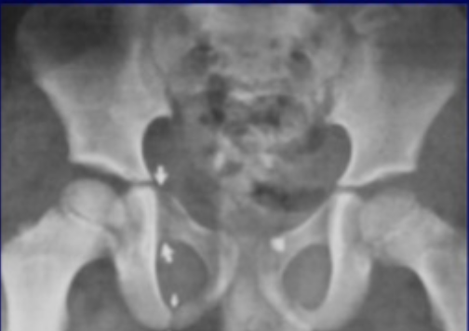
Treatment
Goals of treatment
Restore articular congruity
Preserve alignment of triradiate cartilage
Non-operative treatment
Minimally displaced (<2mm)
Non-weightbearing x 6-8 weeks
Close radiographic follow up
Spica cast used if child is unable to comply with weightbearing restrictions
Excellent outcomes expected if joint congruency maintained

Slide 47
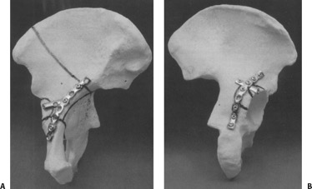
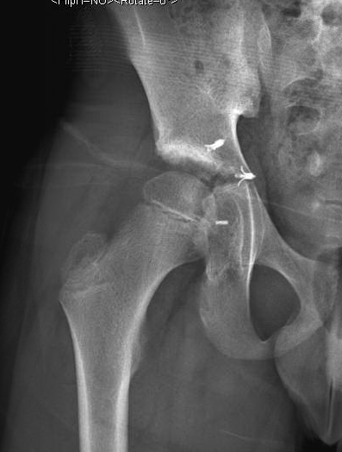
Treatment
ORIF
Joint displacement >2mm
Joint instability (posterior or anterior wall)
Incongruent joint
Bony fragments or soft tissue retained within articular surface
Malalignment of TRC
Displacement may lead to growth arrest
Subsequent dysplasia
Approach and fixation similar to adults
Cartilaginous fragments might require suture fixation

Slide 48
Complications
Outcomes are typically good if a congruent, stable joint is maintained
Patient should be informed about possibility of growth arrest
TRC arrests can lead to subsequent hip dysplasia and/or hip subluxation
MRI is useful tool to assess the closure of triradiate cartilage

Slide 49
Take home message
Pediatric pelvis and acetabulum fractures are rare injuries
Elasticity of pediatric bone, strong ligaments and the presence of physes distinguish pediatric pelvis and acetabulum fractures from adult fractures
Non-Op Rx is the main treatment modality
Pelvic asymmetry and LLD are the main complications of nonoperative treatment
Operative treatment is indicated in certain situations with marked displacement

