Slide 1
Pediatric Fractures of the Foot
Nicholas Frane DO
Zucker/Hofstra School of Medicine Northwell Health

Slide 2
Disclosure
Radiographic Images Courtesy of: Dr. Jon-Paul Dimauro M.D or Christopher D Souder, MD, unless otherwise specified

Slide 3
Overview
Talar Fractures
Calcaneal Fractures
Metatarsal Fractures
Phalangeal Fractures

Slide 4
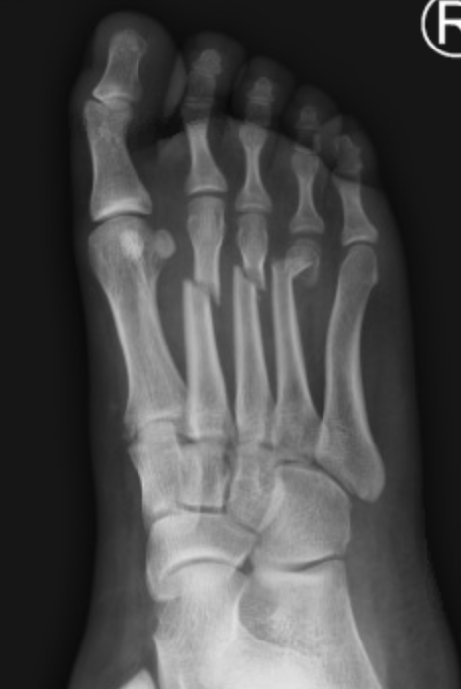
Epidemiology
<10% of fractures in children
More common in adolescents and teenagers
Pediatric foot
Cartilaginous →more elastic, absorptive, and flexible
As ossification occurs, injuries will more closely resemble adult patterns
Incidence: 10.5/10,000 (Cooper et al 2004)
Avg age of injury is 13 years
M=F
Most treated with nonoperative management
Notes:
IMAGE—cds personal image

Slide 5
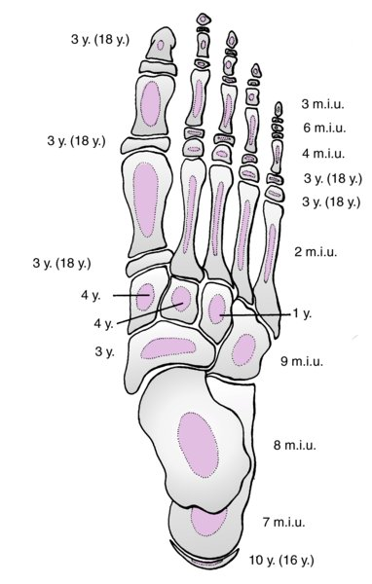
Pediatric Foot Anatomy
Anatomic Subdivisions:
Hindfoot
Talus, Calcaneus
Midfoot
Navicular
Cuboid
Cuneiforms
Forefoot:
Metatarsals
Phalanges
Variable number of sesamoids/accessory ossicles
Rockwood and Wilkins’ Fractures in Children, 9e, 2019
Notes:
Metatarsals: distal epiphyses except for 1st MT - proximal epiphysis
Distal 1st Metatarsal pseuodoepiphysis may occur

Slide 6
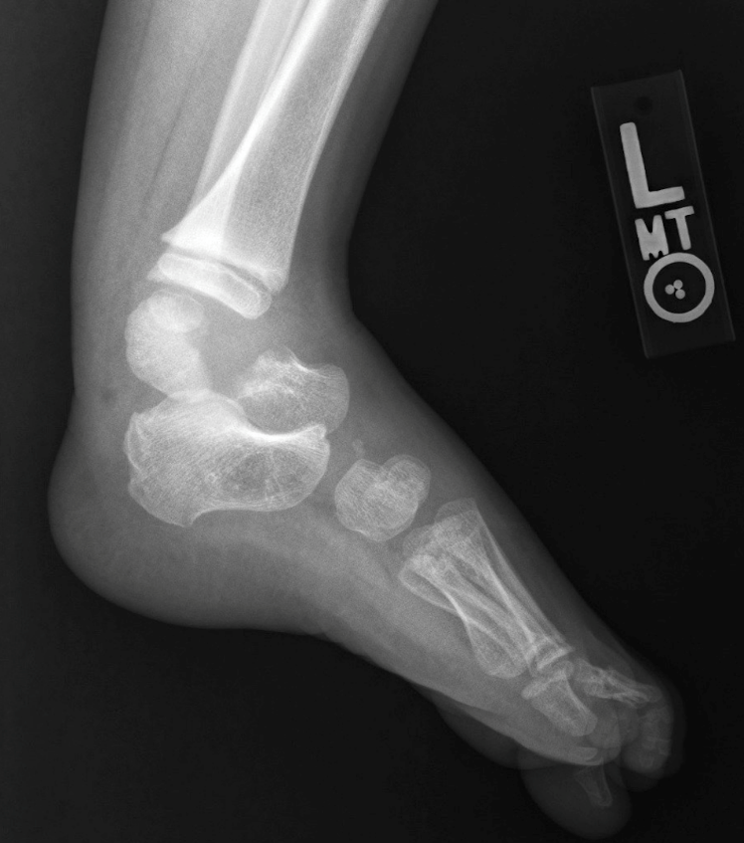
Talus Fractures
Rare, incidence between .01% and .08%
<2% of all pediatric foot fractures
Talar neck fractures most common
Tenuous blood supply
MOI:
Direct trauma (object falls on foot)
Axial load with a dorsiflexed foot
Majority treated with immobilization
Adolescent fractures treated like fractures in adults
Complication: AVN
Crawford AH. Fractures about the foot in children. A radiographic analysis. Cincinnati Children’s Hospital, Cincinnati, OH
Notes:
Image-cds personal image

Slide 7
Talus Anatomy
Fracture Locations
Neck
Body
Medial Process
Lateral Process
Superior and inferior views of the talus (stippling indicates the posterior and lateral processes)
Rockwood and Green's Fractures in Adults, 9e, 2019
Notes:
Figure 65-17 R&G
Ossification Details:
In the growing talus ossification begins in the region of the head and neck, then extends in a retrograde fashion into the body of the talus. Normal ossification of the talus is dependent on a normally functioning blood supply. The subchondral ankle mortise section of the talus is the last region of the talus to ossify
In general, it is this remarkable healing response of the non-ossified talar anlage that allows conservative treatment of talar fractures in children younger than 8 years of age. After age 10 years, when much of the ossification has occurred and the amount of vascularly dependent bone mass is increased, talar fractures resemble those in adults and generally are treated similarly.

Slide 8
Vascular anatomy of the Talus
*Anastomosis in pediatric patients more evenly distributed amongst the contributing arteries*
Rockwood and Green's Fractures in Adults, 9e, 2019
Notes:
Figure 65-20 Rockwood and Green Adults 2019
Osteonecrosis is the primary reason for any long-term disability after a fracture of the talus, in particular displaced talar neck fractures.
Its main supply comes from the dorsalis pedis, deltoid branches, and artery of the tarsal sinus and tarsal canal. Together they form a rich anastomotic network that provides the potential for healing despite significant injury and displacement
The posterior tibial artery feeds the artery of the tarsal canal. It forms an anastomotic sling with the artery of the tarsal sinus. This supplies the inferior aspect of the neck and posterior aspect of the body, and is thought by many to be the most important vascular source for the talus, as it provides vascularity to the lateral two-thirds of the body. The posterior tibial artery also gives rise to a deltoid branch that courses through the ligament and provides blood flow to the medial body. It also provides additional feeder vessels that form a plexus over the posteromedial talus. This plexus also has an anastomosis with branches of the peroneal artery that supplies the posterolateral talus. The anterior tibial artery or dorsalis pedis artery, as it passes distally, provides vascular branches that supply the dorsal aspect of the neck and some that supply the dorsal aspect of the talar head. These vessels can often be injured due to dorsal impaction of the neck on the plafond. Finally, the inferior talar head receives its blood supply from distal branches of the anastomotic tarsal sling.

Slide 9
Imaging
AP, lateral, oblique XR of foot & dedicated ankle
Canale-Kelly view
Talus largely cartilaginous until 2nd decade
CT
Fracture plane, comminution, degree of displacement
Useful when pain prohibits appropriate radiographs
Preoperative planning
MRI
Classifying osteochondral talus fractures
Evaluate AVN
Notes:
MRI and bone scan helpful in assessing AVN in pediatric patients as they will not always show a “Hawkins Sign”
Ogden pointed out that in children the talus is largely cartilage, especially in the ankle subchondral bone and, therefore, the Hawkins sign would not be easily
seen here. However, the availability of MRI has largely supplanted the need for reliance on the Hawkins sign or
the use of scintigraphy to look for cold spots indicative of a lack of vascularity.
In general, it is this remarkable healing response of the non-ossified talar anlage that allows conservative treatment of talar fractures in children younger than 8 years of age. After age 10 years, when much of the ossification has occurred and the amount of vascularly dependent bone mass is increased, talar fractures resemble those in adults and generally are treated similarly.
Often, there is a separate ossification center (os trigonum) that appears here on radiographs at 11 to 13 years of age in boys and 8 to 10 years of age in girls. It usually fuses to the talus 1 year after it appears

Slide 10
Special Radiographs
Canale and Kelly view of the foot
The foot is pronated to 15° and the xray tube is angled 75° to the tabletop
Rockwood and Green's Fractures in Adults, 9e, 2019
Notes:
Plain radiographs consisting of AP, lateral, and oblique views should be ordered routinely. Canale and Kelly⁸ described a technique to obtain an improved view in AP projection. The foot is pronated to 15° and the xray tube is angled 75° to the tabletop.
Image Rockwood and Green's Fractures in Adults, 9e, 2019

Slide 11
Talar Neck Fractures
Hawkins’ Classification (same as in adults)
Type I: nondisplaced
Type II: displaced talar neck involving subtalar joint
Type III: displaced talar neck fractures involving ankle and subtalar joints
Type IV: displaced talar neck fractures involving ankle, subtalar and talonavicular joints
<8, remodeling potential affords less than perfect reduction
Outcome in patients <12 years old is favorable in most cases
Hawkins LG: Fractures of the neck of the talus. J Bone Joint Surg 52A:991–1002, 1970.
Canale ST, Kelly FB: Fractures of the neck of the talus, long term evaluation of seventy one cases. J Bone Joint Surg 60A:143–156, 1978.
Notes:
Canele and Kelly accepted 5mm of displacement and 5 degrees of angulation in the historic series.
<8 years of age, a less than perfect reduction of the fracture can be accepted because of the remodeling potential
Outcome in patients less than 12 years old is favorable in most cases
CDS image

Slide 12
Treatment of Talar Neck Fractures
Type | Description | Treatment | Blood Supply | ON Rate (%)
Type I | Nondisplaced fracture through talar neck (<5mm and 5 degrees). | 6-8 weeks in cast, 4 weeks in CAM Walker. | Theoretical damage to only one vessel entering talar neck. | 0–10
Type II | Displaced fracture with subtalar joint involvement. | Immediate closed reduction. A near anatomic reduction delays surgical treatment. If displaced K wires can be used to hold. | Two of three blood supply vessels lost: Neck vessel and one entering the tarsal canal. | 20–50
Type III | Same as type II but with subluxation/dislocation of both the ankle and subtalar joint. | Direct to operating room for combined approach fixation w/ K wires vs Screws | All three sources of blood affected. | 80–100
Type IV | Very Rare. Type III with talonavicular joint displacement. | Same | Not related to blood supply. | 100
Rockwood and Wilkins’ Fractures in Children, 9e, 2019
Notes:
IMAGE—R&W
Hawkins Type 1:
Most Pediatric Talar Neck Fractures are type 1
Weight-bearing begins after the fracture appears consolidated on serial x-rays, and this often corresponds to when the cast comes off.
Hawkins Type II:
Closed reduction with gentle plantar flexion and pronation and the use of conscious sedation or general anesthesia should be attempted. If the reduction is successful, a long-leg cast with the foot in plantar flexion is worn for at least 4 weeks. Then the foot is brought to neutral position and placed into a below-knee cast for an additional 4 weeks of non–weight-bearing.
If reduction cannot be maintained with casting because of soft tissue swelling but can be maintained by direct palpation intraoperatively, two Kirschner wires from anterior to posterior can be used to maintain the reduction
Hawkins Type III:
This requires open reduction and internal fixation. Displaced fractures of the talar neck are considered an orthopaedic emergency, and management should proceed immediately.

Slide 13
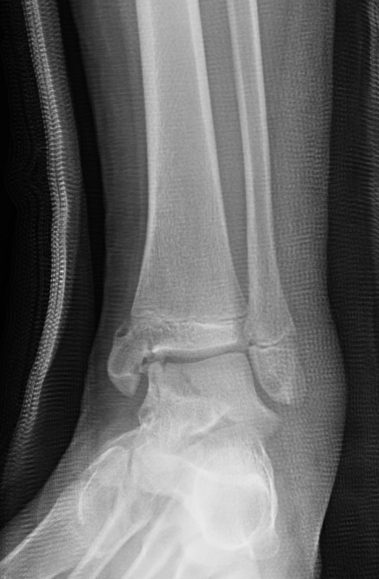
Adolescent with a displaced talar neck fracture with associated medial malleolar fracture
Notes:
From CDS personal images

Slide 14
Notes:
CDS image

Slide 15
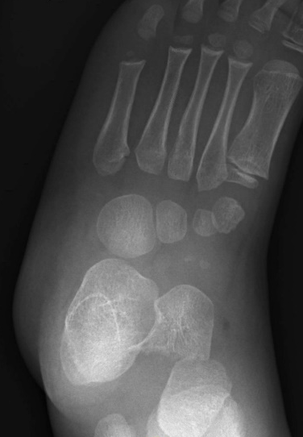
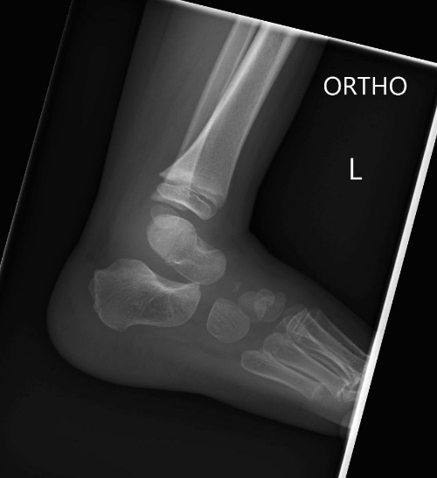
Talar AVN
Hawkins 3
CRC
AVN at 10m f/u
Notes:
CDS personal collection

Slide 16
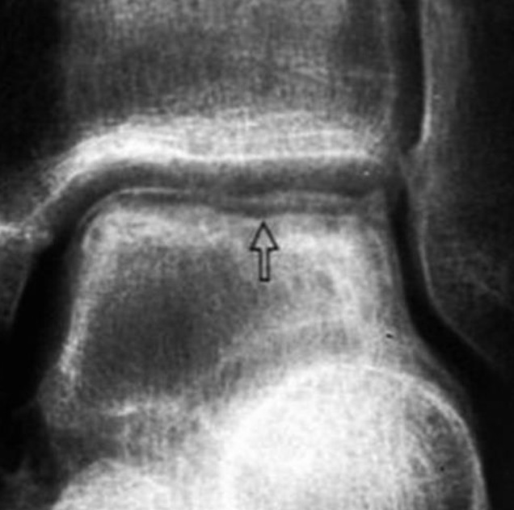
Hawkins Sign (A Good Sign)
Resportion of subchondral bone at talar dome
Indicates adequate vascularity
May not be visualized in children
Mostly cartilaginous talus
MRI or bone scan may be needed to evaluate for AVN
Notes:
From R&W

Slide 17
Osteochondral Talus Injuries
Inversion/plantar flexion injury
Posteromedial lesion (more common)
Eversion/dorsiflexion injury
Anterolateral lesion
Consider if pain and swelling persist following ankle injury over 2 months
MRI/MRI Arthrogram
Lateral lesions are more often associated with trauma and more symptomatic than medial lesions

Slide 18
Osteochondral Talus Injuries
Berndt and Harty Classification
Stage I lesions: nondisplaced
Stage II lesions: partially detached
Stage III lesions: detached but not displaced
Stage IV lesions: detached and displaced or rotated
Short Leg Cast/Walking boot (Weeks 1-6)
ROM and activity modification (Weeks 7-12)
If fail conservative treatment
Drilling lesion (antegrade or retrograde)
Curettage and Microfractures
Internal Fixation w/ bioabsorbable implant
Bone Graft and internal fixation
Berndt AL, Harty M: Transcondylar fractures (osteochondritis dissecans) of the talus. J Bone Joint Surg 41A:988–1020, 1959.
Notes:
Berndt and Harty¹² found that of 201 osteochondral lesions in adults 56% were on the medial side and 44% on the lateral side. Letts et al. found medial lesions in 79% of 24 children, lateral lesions in 21%, and central lesions in 1%.
Should be followed for 2 years

Slide 19
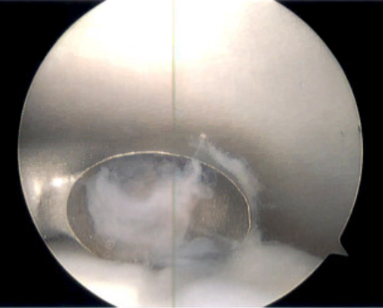
Talar Dome OCD Lesion, treated with arthroscopy and microfracture
Images Courtesy of: Dr. Adam Bitterman D.O.

Slide 20
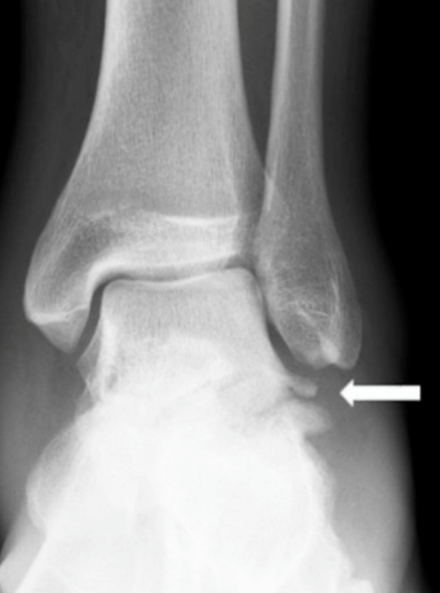
Lateral Process of Talar Body Fractures
“Snowboarders Fracture”
13% of snowboarding foot/ankle injuries
Initially missed in 40-50% of patients, mistaken for sprained ankle
Best viewed on ankle mortise film
MOI: Dorsiflexion, Internal Rotation
Produces pain over ATFL
Hawkins LG. Fracture of the lateral process of the talus: a review of thirteen cases. J Bone Joint Surg Am 1965;47:1170–1175
Kirkpatrick et al. The snowboarder's foot and ankle. Am J Sports Med. 1998 Mar-Apr;26(2):271-7.
Notes:
Kirkpatrick DP, Hunter RE, Janes PC, Mastrangelo J, Nicholas RA. The snowboarder's foot and ankle. Am J Sports Med. 1998 Mar-Apr;26(2):271-7. doi: 10.1177/03635465980260021901. PMID: 9548123.
Hawkins LG. Fracture of the lateral process of the talus: a review of thirteen cases. J Bone Joint Surg Am 1965;47:1170–1175.
IMAGE FROM R&G

Slide 21
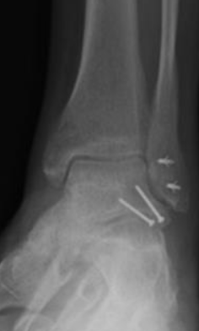
Lateral Process of Talar Body Fractures
Treatment
Nondisplaced fractures→6-8 weeks of NWB in a SLC
Displaced fractures may require ORIF
ORIF if joint surface step-off >2-3mm
Cannulated or mini frag screw(s) from lateral to medial
Mini frag plates for communited or large fragments
Nonunion has been reported when untreated
Flynn, J. M., In Skaggs, D. L., & In Waters, P. M. (2019). Rockwood & Wilkins' fractures in children.
Notes:
Kirkpatrick DP, Hunter RE, Janes PC, Mastrangelo J, Nicholas RA. The snowboarder's foot and ankle. Am J Sports Med. 1998 Mar-Apr;26(2):271-7. doi: 10.1177/03635465980260021901. PMID: 9548123.
Hawkins LG. Fracture of the lateral process of the talus: a review of thirteen cases. J Bone Joint Surg Am 1965;47:1170–1175.

Slide 22
Calcaneal Fractures
Rare
0.005% of fractures before 15 yo
MOI: Falls
Extra-articular fractures are more frequent
Approximately 65%
Associated soft tissue or skeletal injuries present in 50%
Lacerations/open fractures in lawn mower injuries
Less common (5.4%) incidence of spinal fractures than in adults
Kay R, Tang C. Pediatric foot fractures: evaluation and treatment. J Am Acad Orthop Surg. 2001;9(5):308-19.
Notes:
Associated soft tissue or other skeletal injuries are present in half of the children with Calcaneal fractures. Soft tissues injuries may include lacerations of the foot and ankle or open fractures in lawn mower injuries. Incidence of spinal fractures is less common than in adults (5.4%)
CDS image

Slide 23
Calcaneal Fractures
Can be nondisplaced and missed in young children
Stress fractures:
Toddlers beginning to walk
Patients with cerebral spasticity
Pain appreciated with squeezing the heel
Kay R, Tang C. Pediatric foot fractures: evaluation and treatment. J Am Acad Orthop Surg. 2001;9(5):308-19.
Notes:
Associated soft tissue or other skeletal injuries are present in half of the children with Calcaneal fractures. Soft tissues injuries may include lacerations of the foot and ankle or open fractures in lawn mower injuries. Incidence of spinal fractures is less common than in adults (5.4%)
CDS image

Slide 24
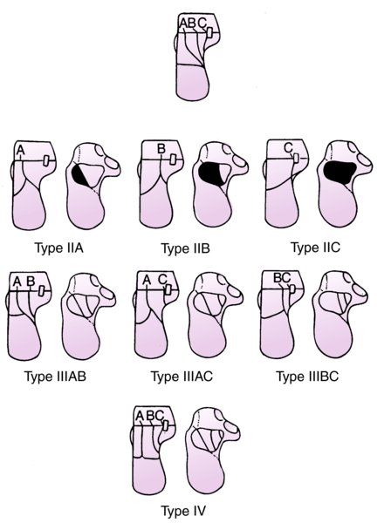
Classification
Sanders Classification appropriate to use for adolescents
CT-based classification of intra-articular fractures of the calcaneus
Sanders R. Intra-articular fractures of the calcaneus: present state of the art. J Orthop Trauma. 1992;6(2):252-265. doi:10.1097/00005131-199206000-00022

Slide 25
Imaging
PA, Lateral, Axial Views
Bohler’s Angle (B)
Normal 20-30 degrees
Crucial Angle of Gissane (A)
Normal: 95-105 degrees
Child's calcaneus does not resemble that of an adult until after 10 yo
CT to evaluate intraarticular extension
MRI
Anatomic angles for evaluation of fracture displacement and surgical reduction.
Rockwood and Green's Fractures in Adults, 9e, 2019
Notes:
The secondary ossification center appears around 6 to 8 years and is the crescentic epiphysis seen posteriorly. This epiphysis fuses to the body of the calcaneus between 14 and 16 years of age.
Images R&G and R&W

Slide 26
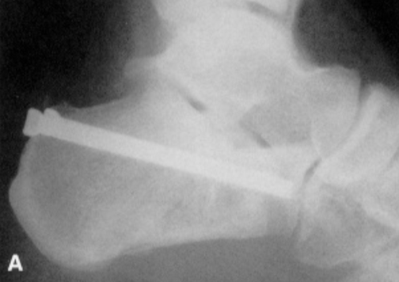
Treatment
Extra-articular fractures can be treated with Cast for 6 weeks
Tongue type fractures can be treated nonoperatively if posterior gap <1cm and not tenting the skin
Essex-Lopresti reduction if displaced
Intraarticular fractures with displacement and joint depression
ORIF when soft tissues amenable
Tornetta P 3rd. The Essex-Lopresti reduction for calcaneal fractures revisited. J Orthop Trauma. 1998;12(7):469-73.
Brunet JA: Calcaneal fractures in children. Long-term results of treatment. J Bone Joint Surg 82B:211–216, 2000.
Inokuchi S, Usami N, Hiraishi E, Hashimoto T: Calcaneal fractures in children. J Pediatr Orthop 18:469–474, 1998.
Petit CJ, Lee BM, Kasser JR, et al. Operative treatment of intraarticular calcaneal fractures in the pediatric population. J Pediatr Orthop. 2007;27(8):856–862.
Notes:
Image—JOT The Essex-Lopresti Reduction for Calcaneal Fractures Revisited 1998

Slide 27
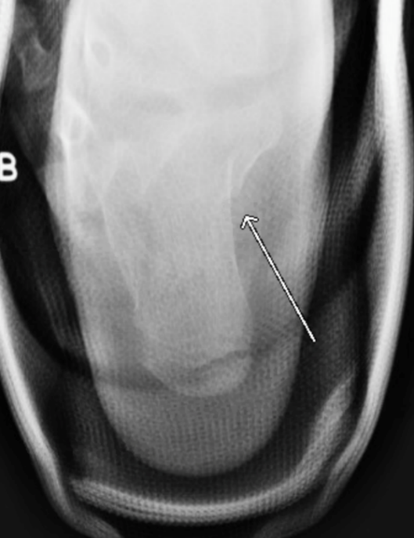
Axial “Harris” View of Calcaneus Fracture
Demonstrates presence of heel varus displacement
Sustentaculum tali is visualized

Slide 28
Complications
Wound complications
Incidence lower in children than adults
Complex Regional Pain Syndrome
Peroneal Tendonitis/Dislocation
Pickle A, Benaroch TE, Guy P, et al. Clinical outcome of pediatric calcaneal fractures treated with open reduction and internal fixation. J Pediatr Orthop. 2004;24(2):178–180

Slide 29
Lisfranc Injuries
Direct/indirect mechanisms of injury
Represent significant force
Fracture of base of 2nd MT →increased suspicion for Lis Franc injury
Associated cuboid fx → pathognomonic for TMT injury
Rockwood and Wilkins’ Fractures in Children, 9e, 2019
Notes:
R&W image
CDS image

Slide 30
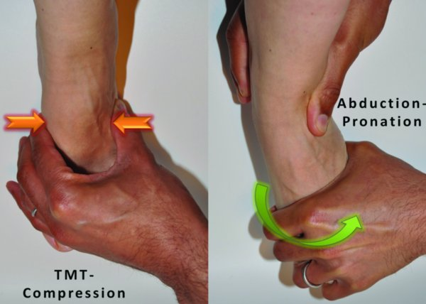
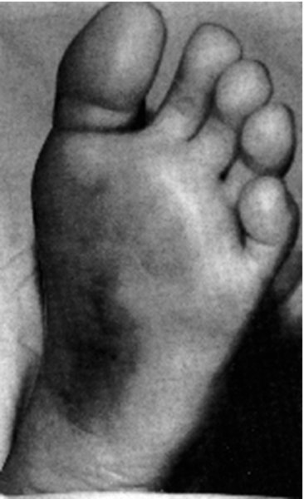
Lisfranc Injuries: Clinical Signs
Plantar ecchymosis
Inability to bear weight
TMT Compression test
Abduction Pronation test
Rockwood and Green's Fractures in Adults, 9e, 2019
Crawford AH. Fractures about the foot in children: a radiographic analysis. The Children’s Hospital Medical Center: Cincinnati.
Flynn, J. M., In Skaggs, D. L., & In Waters, P. M. (2019). Rockwood & Wilkins' fractures in children.

Slide 31
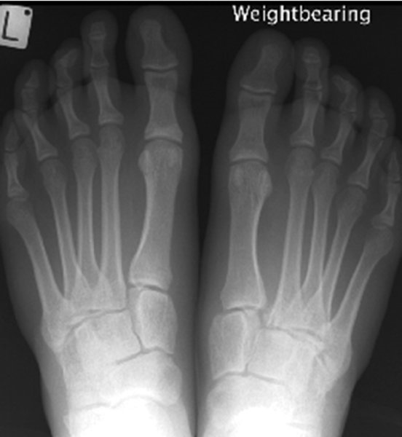
Lisfranc Injuries: Imaging
Radiographs
AP, Lateral, Oblique
Weightbearing when subtle injury is suspected
Contralateral comparison views allow detection of subtle widening
Lateral border of 1st MT and medial cuneiform should line up
Medial border of 2nd MT and intermediate cuneiform should line up
Distance between base of 2nd MT and medial cuneiform should be less than 2mm in children >6 years of age
CT/MRI can helpful in suspected cases with normal XR to identify ligamentous involvement

Slide 32
Lisfranc Injuries
Treatment - requires anatomic reduction
Treat soft tissues first with elevation
Non-displaced → SLC x 4-6 weeks
Displaced
Closed reduction + pinning can be useful in young children
ORIF with screws in older children/adolescents
Suture button fixation can be used for ligamentous injuries
Keystone is base of 2nd MT to medial cuneiform
Compartment syndrome can occur
Rockwood and Green's Fractures in Adults, 9e, 2019

Slide 33
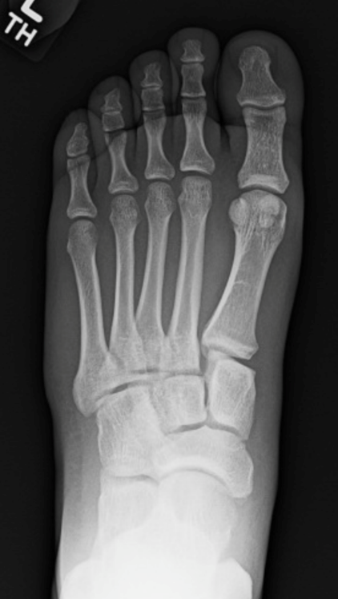
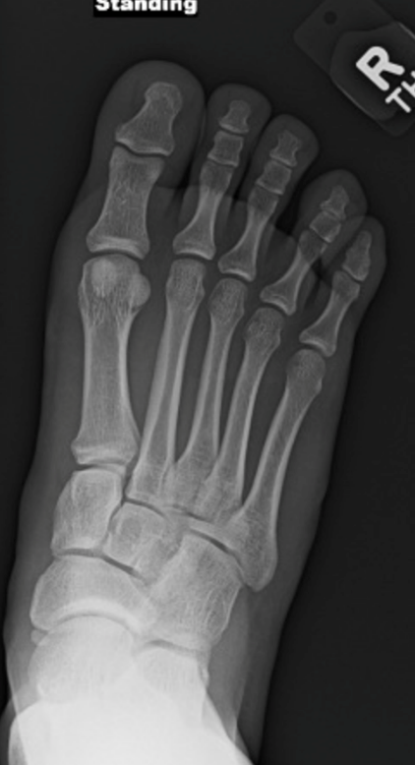
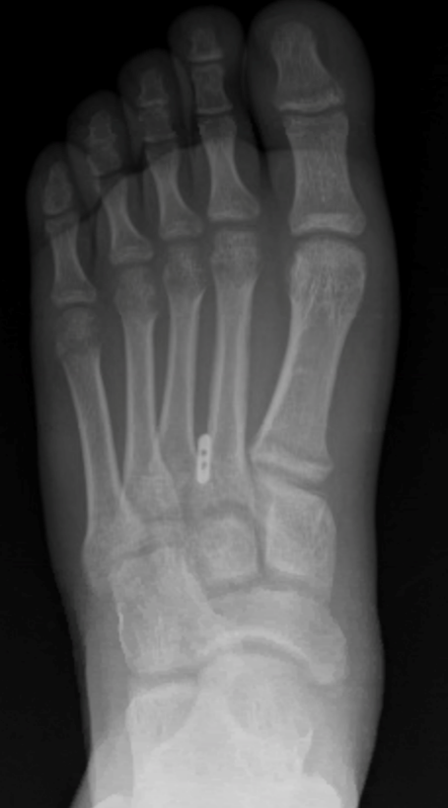
Lis Franc Injuries: Case Example
Injury
Suture button fixation—internal ligament brace
Contralateral (normal)
Notes:
CDS images

Slide 34
Metatarsal Fractures
Account for 60-70% of pediatric foot fractures
1st metatarsal most common (<5yo)
Physis located on proximal end
”Bunk bed injury”
5th metatarsal most common (>10yo)
2nd metatarsal prone to stress fractures from repetitive trauma (2nd decade)
“March Fractures”
Crawford AH. Fractures about the foot in children: a radiographic analysis. The Children’s Hospital Medical Center: Cincinnati.
Flynn, J. M., In Skaggs, D. L., & In Waters, P. M. (2019). Rockwood & Wilkins' fractures in children.
Notes:
CDS personal image

Slide 35
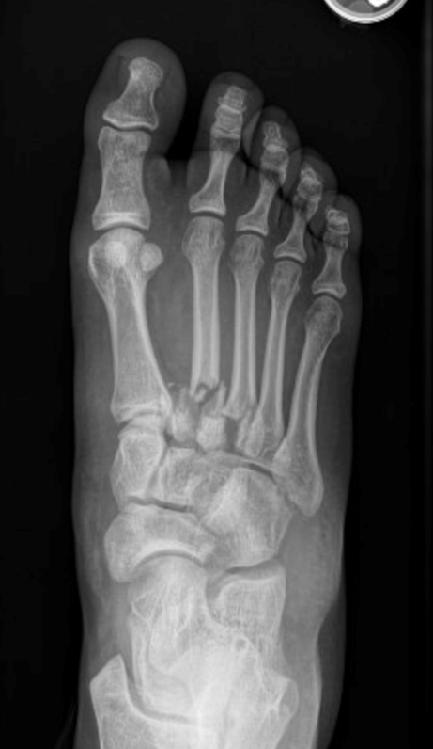
Metatarsal Fractures
MOI: Direct trauma, torsional stress, sports
<5 years old most commonly associated with a fall from height
“Bunkbed injury” with base of 1st metatarsal buckle fracture
>5 years old most likely results from sporting injury
Metatarsal base fractures produce concern for Lis Franc disruption
Crawford AH. Fractures about the foot in children: a radiographic analysis. The Children’s Hospital Medical Center: Cincinnati.
Flynn, J. M., In Skaggs, D. L., & In Waters, P. M. (2019). Rockwood & Wilkins' fractures in children.
Notes:
CDS personal image

Slide 36
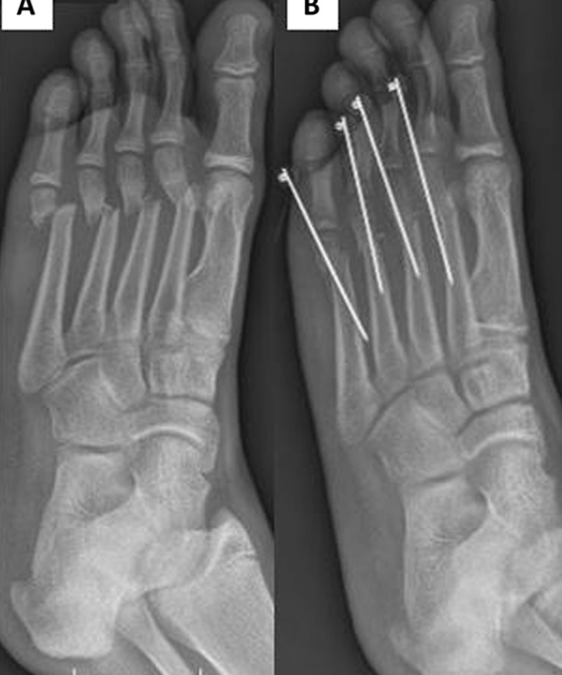
Treatment
Closed Reduction:
Completely displaced fracture
>20 degrees angulation
Significant dorsal/plantar angulation is not well tolerated
Below knee walking cast x 3-6 weeks
CRPP
Unstable reductions
Owen RJT, Hickey FG, Finlay DB: A study of metatarsal fractures in children. Injury 1995;26:537-538
Flynn, J. M., In Skaggs, D. L., & In Waters, P. M. (2019). Rockwood & Wilkins' fractures in children.
Notes:
Indications for closed reduction include completely displaced fractures in older children and fractures angled more than 20 degrees, especially apex-dorsal.
Indication for Surgical Reduction:
There are few absolute indications for surgical treatment of metatarsal fractures in children: (open fracture, associated compartment syndrome, nonunion, or displaced articular fracture)
Relative indications:
adolescent age and multiple concurrent metatarsal fractures. Significant translation (75% shaft width) is another relative indication for metatarsal surgical intervention in adolescent patients. Patients can be counseled that return to sports can take 2–4 months and is usually longer after surgical treatment than nonsurgical treatment of metatarsal fractures. Finally, patients should be followed to radiographic union also, as there can be a 15% delayed union rate with metatarsal fractures.7
IMAGE--The Community Orthopaedic Surgeon Taking Trauma Call: Pediatric Foot Fracture Pearls and Pitfalls JOT 2019

Slide 37
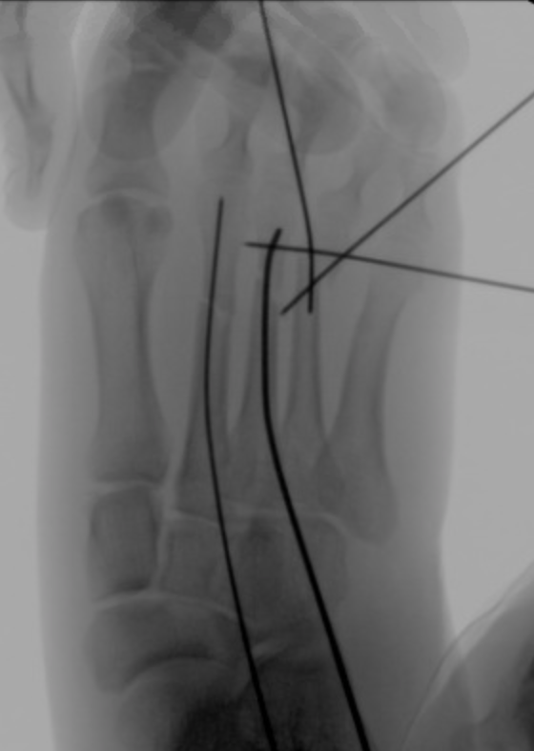
Treatment
Surgical Treatment
Retrograde pinning→1-2 K-wires in distal fragment exiting plantar skin
IM pinning
ORIF
Short Leg Non weight bearing cast, remove pins at 4-6 weeks
Absolute indications
Open fracture, associated compartment syndrome, nonunion, or displaced articular fracture
Relative
Adolescents
Multiple metatarsal fractures
Significant (75% shaft width) translation
15% delayed union rate
Owen RJT, Hickey FG, Finlay DB: A study of metatarsal fractures in children. Injury 1995;26:537-538
Flynn, J. M., In Skaggs, D. L., & In Waters, P. M. (2019). Rockwood & Wilkins' fractures in children.
Notes:
CDS Image

Slide 38
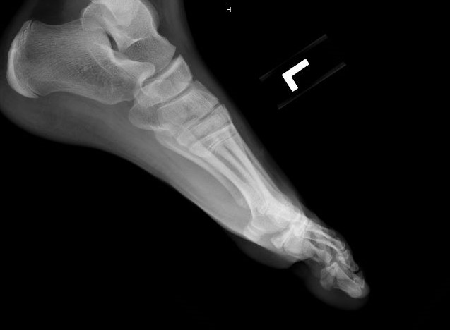
Adolescent female with multiple metatarsal fractures and proximal phalanx fracture of the hallux

Slide 39
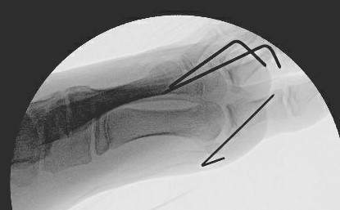

Slide 40
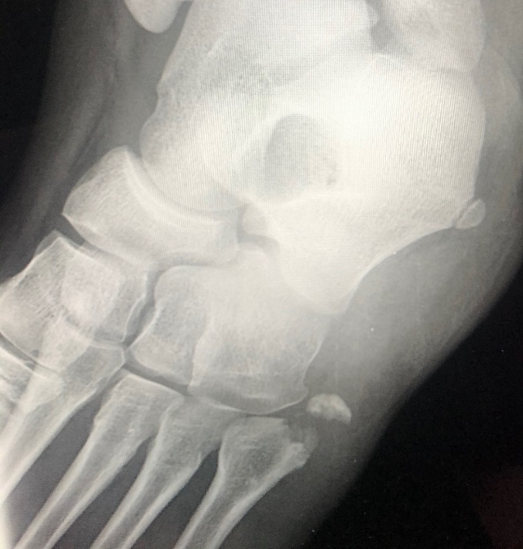
5th Metatarsal Fractures
Types of fractures:
Apophyseal avulsions (involving either part or all of the variably ossified apophysis)
Apophyseal stress fractures (Iselin disease)
Tuberosity avulsion fractures
Jones-type fractures through the metaphyseal-diaphyseal water-shaded area (typically a transverse fracture extending into the common articular facet of the fourth and fifth metatarsals)
Acute diaphyseal fractures
Stress fractures of the diaphysis
Mencio, Gregory A, Marc F. Swiontkowski, and Neil E. Green. Green's Skeletal Trauma in Children
Lawrence SJ. Technique tip: local bone grafting technique for Jones fracture management with intramedullary screw fixation. Foot Ankle Int. 2004;25:920–921
Notes:
The apophyseal growth center of the base of the fifth metatarsal appears by the age of 9 years and usually unites between the ages of 12 and 15 years. This apophyseal growth center (os vesalianum) is sagittal in orientation, which helps differentiate it from most fractures, which are oriented transversely
Lawrence SJ. Technique tip: local bone grafting technique for Jones fracture management with intramedullary screw fixation. Foot Ankle Int. 2004;25:920–921.
CDS personal image

Slide 41
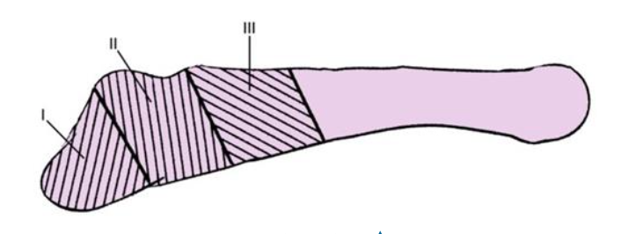
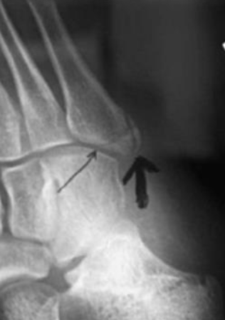
5th Metatarsal Base Fractures
Most common pediatric metatarsal fracture
50% of all metatarsal fractures
Apophysis is often misdiagnosed as a fracture
Os vesalianum appears by age 9 years
Unites with the metaphysis between ages 12 and 15 years
Apophysis runs parallel to metatarsal
Fractures are perpendicular
Fracture→thin arrow
Apophysis→thick arrow
Rockwood and Wilkins’ Fractures in Children, 9e, 2019
Notes:
Image from R&W

Slide 42
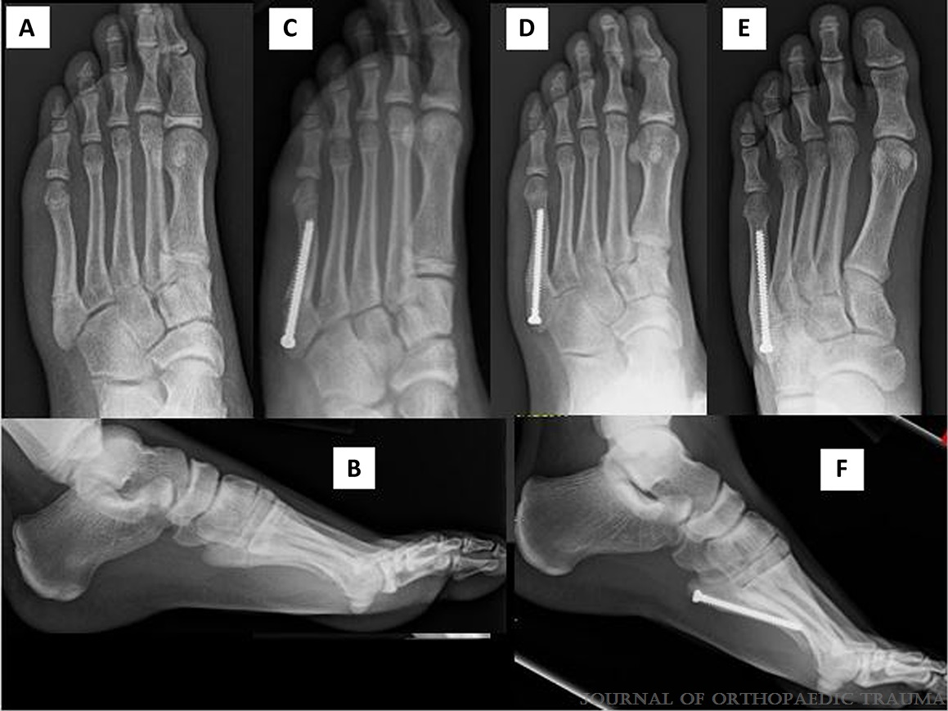
5th Metatarsal Base Fractures
Rockwood and Wilkins’ Fractures in Children, 9e, 2019
Zone I
Most commonly an avulsion injury
Protected weightbearing for 4-6 weeks
Radiographic healing lags behind clinical healing
Zone II
Jones type fractures
Most commonly in adolescents
Acute injuries do will with non-operative treatment
Chronic injuries often require IM screw fixation
Zone III
Typically stress fractures
Require prolonged immobilization
Occasionally require IM screw fixation + bone grafting
Parikh SN, Mehlman CT. The Community Orthopaedic Surgeon Taking Trauma Call: Pediatric Ankle Fracture Pearls and Pitfalls. J Orthop Trauma. 2017;31 Suppl 6:S27-S31.
Notes:
top Image from R&W
Bottom image from JOT 2019 The Community Orthopaedic Surgeon Taking Trauma Call: Pediatric Foot Fracture Pearls and Pitfalls

Slide 43
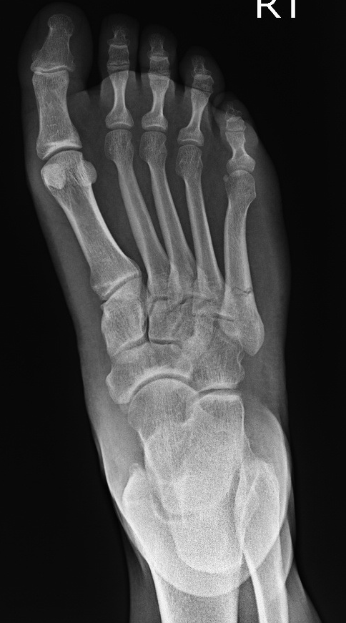
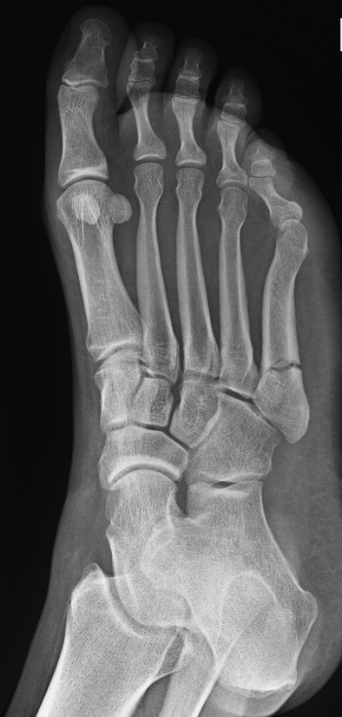
Images Courtesy of: Dr. Adam Bitterman D.O.

Slide 44
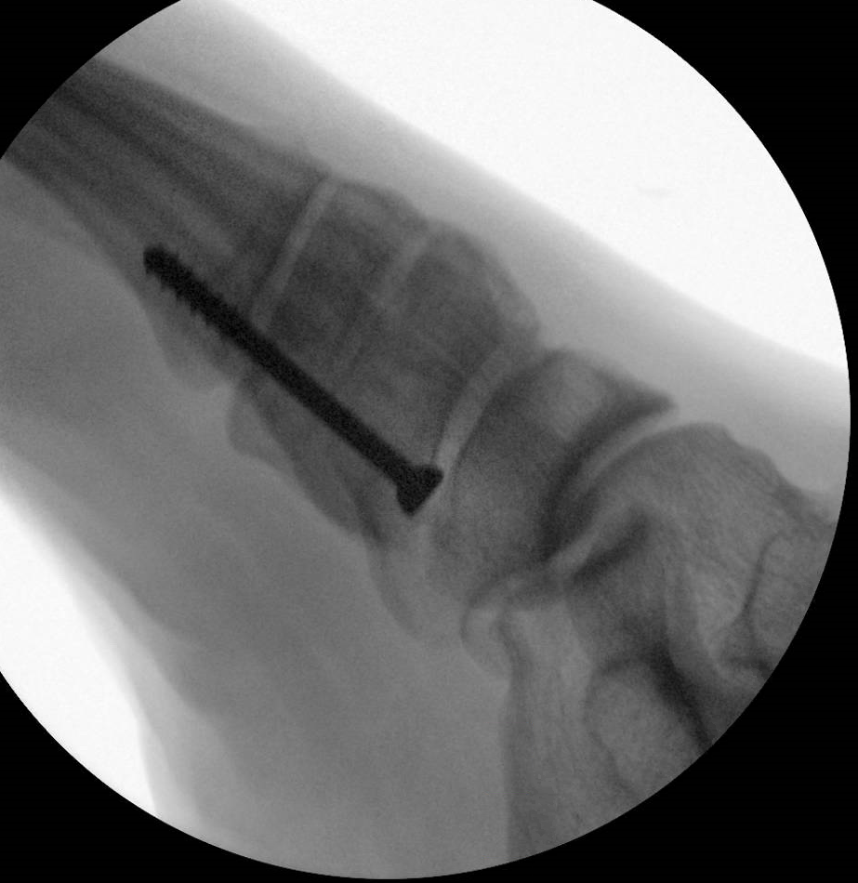
Images Courtesy of: Dr. Adam Bitterman D.O.

Slide 45
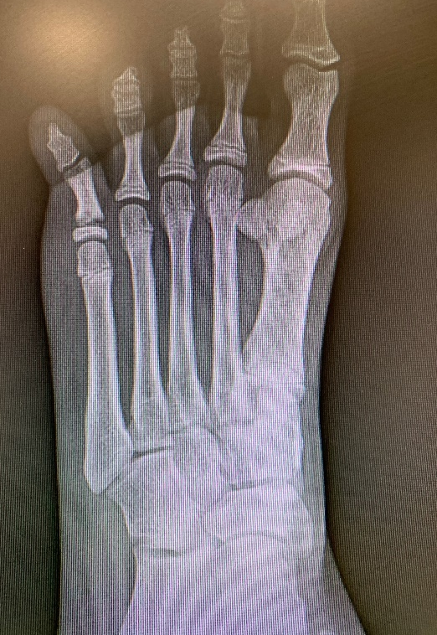
Pediatric Phalangeal Fractures
18% of children’s foot fractures
Proximal Phalanx > Middle Phalanx > Distal Phalanx
MOI: Direct trauma, barefoot stubbing
Look for a break in the skin
Base of nail avulsion with distal phalanx fractures→open fracture
Crawford AH. Fractures about the foot in children: a radiographic analysis. The Children’s Hospital Medical Center: Cincinnati.
Flynn, J. M., In Skaggs, D. L., & In Waters, P. M. (2019). Rockwood & Wilkins' fractures in children.

Slide 46
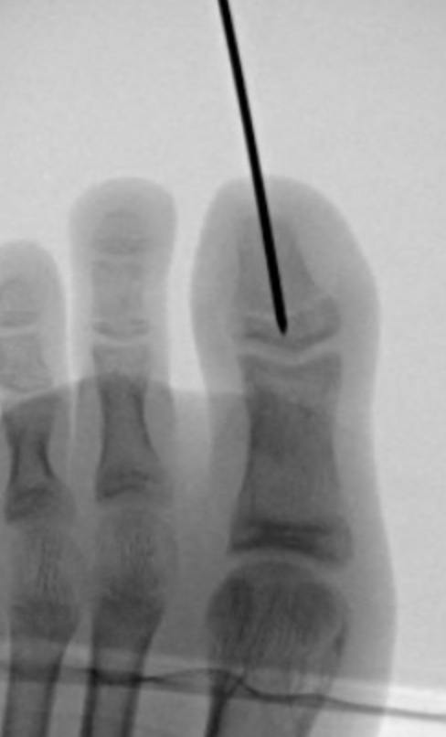
Pediatric Phalangeal Fractures
Treatment
Traction, closed reduction, buddy taping, hard sole shoe
Open injures require I&D/IV antibiotic
Pin if reduction is unstable
Meticulous nailbed repair if disrupted
Intra-articular fractures
Anatomic reduction and pinning
Indications:
>30% of articular surface involved
Displacement >2mm
Crawford AH. Fractures about the foot in children: a radiographic analysis. The Children’s Hospital Medical Center: Cincinnati.
Flynn, J. M., In Skaggs, D. L., & In Waters, P. M. (2019). Rockwood & Wilkins' fractures in children.
Notes:
CDS image

Slide 47
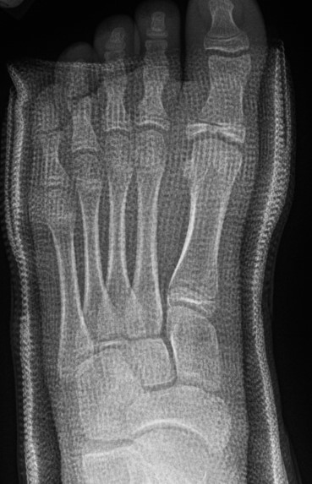
Proximal Phalanx SHIII Fracture 11 yo F
Loss of reduction 1 weeks into conservative management

Slide 48
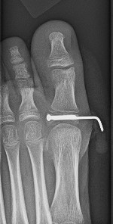
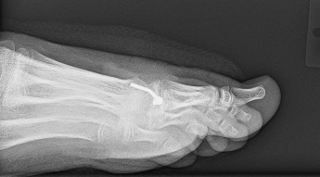

Slide 49
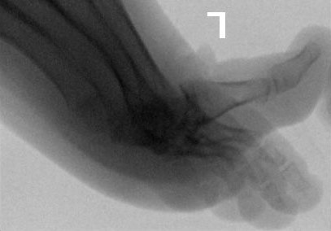

Slide 50
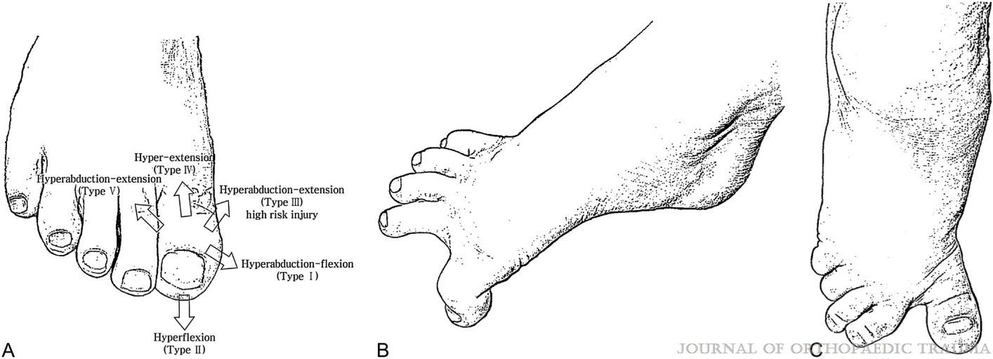
Barefoot Stubbing Injuries to the Great Toe in Children
High prevalence of hallux injuries from barefoot sports and activities in children
Open injuries at risk for osteomyelitis
HAbd-F, HF, HE, and HE-Add are associated with great outcomes
The HAbd-E group showed the worst prognosis
A, Classification of great toe barefoot sports injury mechanisms.
B, The figure shows hyperabduction–flexion injury to the great toe (type I injury mechanism).
C, The figure shows hyperabduction–extension injury to the great toe (type III injury mechanism).
Park DY, et al. Barefoot Stubbing Injuries to the Great Toe in Children: A New Classification by Injury Mechanism. J Orthop Trauma. 2013;27(11):651-655.
Notes:
Park, Do Y. MD*,†; Han, Kyeong J. MD*; Han, Seung H. MD, PhD‡; Cho, Jae H. MD, PhD§ Barefoot Stubbing Injuries to the Great Toe in Children: A New Classification by Injury Mechanism, Journal of Orthopaedic Trauma: November 2013 - Volume 27 - Issue 11 - p 651-655
doi: 10.1097/BOT.0b013e31828e5d39
The HAbd-E group showed the worst prognosis, resulting in posttraumatic (n = 2) arthritis and nonunion (n = 3). In all nonunion cases, the size of the fragment
was less than 1/3 of the joint surface width.
Lateral condyle avulsion fractures of the proximal phalanx should be regarded as a high-risk sign for nonunion. We propose a more aggressive approach for this group where
even minimally displaced fragments may benefit from open reduction and pinning.

Slide 51
Conclusions:
Lateral condyle avulsion fractures of the proximal phalanx should be regarded as a high-risk sign for nonunion
Propose aggressive approach for this group
Minimally displaced fragments may benefit from open reduction and pinning.
Type I (HAbd-F) injury, showing reduction of an open proximal interphalangeal dislocation.
Type I (HAbd-F) injury, showing typical dorsolateral wound of an open interphalangeal dislocation.
Type II (HF) injury showing mallet toe-like Salter-Harris type I distal phalanx fracture.
Type II (HF) injury showing an open wound on the eponychium.
Type III (HAbd-E) injury showing avulsion fracture of the lateral volar condyle of the proximal phalanx.
Type IV (HE) injury showing dorsal interphalangeal dislocation.
Type V (HE-Add) injury showing medial proximal phalanx base fracture.
Park DY, et al. Barefoot Stubbing Injuries to the Great Toe in Children: A New Classification by Injury Mechanism. J Orthop Trauma. 2013;27(11):651-655.

Slide 52
Summary
Fractures of the Pediatric Foot are infrequently described in the literature
The majority of these injuries can be managed conservatively with immobilization and follow up
Fractures in adolescents are treated similar to adults
Operative indications should be kept in mind as complications can occur

Slide 53
References
Brunet JA: Calcaneal fractures in children. Long-term results of treatment. J Bone Joint Surg 82B:211–216, 2000.
Canale ST, Kelly FB: Fractures of the neck of the talus, long term evaluation of seventy one cases. J Bone Joint Surg 60A:143–156, 1978
Crawford AH. Fractures about the foot in children. A radiographic analysis. Cincinnati Children’s Hospital, Cincinnati, OH.
Hawkins LG: Fractures of the neck of the talus. J Bone Joint Surg 52A:991–1002, 1970.
Hawkins LG. Fracture of the lateral process of the talus: a review of thirteen cases. J Bone Joint Surg Am 1965;47:1170–1175
Inokuchi S, Usami N, Hiraishi E, Hashimoto T: Calcaneal fractures in children. J Pediatr Orthop 18:469–474, 1998.
Kay R, Tang C. Pediatric foot fractures: evaluation and treatment. J Am Acad Orthop Surg. 2001;9(5):308-19
Kirkpatrick DP, Hunter RE, Janes PC, Mastrangelo J, Nicholas RA. The snowboarder's foot and ankle. Am J Sports Med. 1998 Mar-Apr;26(2):271-7. doi: 10.1177/03635465980260021901. PMID: 9548123

Slide 54
References
Lawrence SJ. Technique tip: local bone grafting technique for Jones fracture management with intramedullary screw fixation. Foot Ankle Int. 2004;25:920–921
Parikh SN, Mehlman CT. The Community Orthopaedic Surgeon Taking Trauma Call: Pediatric Ankle Fracture Pearls and Pitfalls. J Orthop Trauma. 2017;31 Suppl 6:S27-S31. doi:10.1097/BOT.0000000000001014
Park, Do Y. MD, Han, Kyeong J, Han, Seung H, Cho, Jae H. Barefoot Stubbing Injuries to the Great Toe in Children: A New Classification by Injury Mechanism, Journal of Orthopaedic Trauma: November 2013 - Volume 27 - Issue 11 - p 651-655. doi: 10.1097/BOT.0b013e31828e5d39
Petit CJ, Lee BM, Kasser JR, et al. Operative treatment of intraarticular calcaneal fractures in the pediatric population. J Pediatr Orthop. 2007;27(8):856–862
Pickle A, Benaroch TE, Guy P, et al. Clinical outcome of pediatric calcaneal fractures treated with open reduction and internal fixation. J Pediatr Orthop. 2004;24(2):178–180

Slide 55
References
Sanders R. Intraarticular fractures of the calcaneus: Present state of the art. J Orthop Trauma. 1992;6(2):252–265
Tornetta, Paul III The Essex-Lopresti Reduction for Calcaneal Fractures Revisited, Journal of Orthopaedic Trauma: September 1998 - Volume 12 - Issue 7 - p 469-473
Waters, Peter M, David L. Skaggs, John M. Flynn, and Charles M. Court-Brown. Rockwood and Wilkins' Fractures in Children. Philadelphia: Wolters Kluwer, 2020
Zaricznyj B, Shattuck LJ, Mast TA, et al. Sports-related injuries in school-aged children. Am J Sports Med. 1980;8:318–324.
Figures used with permission from Roy W. Sanders and John P. Ketz. Chapter 65: Fractures and Dislocations of the Talus. In: Tornetta P, Ricci WM, eds. Rockwood and Green's Fractures in Adults, 9e. Philadelphia, PA. Wolters Kluwer Health, Inc; 2019
Michel A. Taylor, Abdel Rahman Lawendy, and David W. Sanders. Chapter 66: Calcaneus Fractures. In: Tornetta P, Ricci WM, eds. Rockwood and Green's Fractures in Adults, 9e. Philadelphia, PA. Wolters Kluwer Health, Inc; 2019
Thomas A. Schildhauer and Martin F. Hoffman. Chapter 67: Fractures and Dislocations of the Midfoot and Forefoot. In: Tornetta P, Ricci WM, eds. Rockwood and Green's Fractures in Adults, 9e. Philadelphia, PA. Wolters Kluwer Health, Inc; 2019

