Slide 1
Fractures of the Spine in Children
K. Aaron Shaw, DO
Dwight D. Eisenhower Army Medical Center

Slide 2
Objectives
Review epidemiology of spine fractures in children
Discuss cervical spine anatomy and injury patterns
Review cervical spine precautions in children
Identify cervical spine clearance protocol in children
Discuss thoracolumbar spine anatomy and injury patterns
Review treatment approaches for spine fracture

Slide 3
Key Differences in the Pediatric Patient
Anatomical and Radiographic Differences
Increased elasticity
Larger Head-to-Body Ratio
Physeal/Synchondrosis/Periosteal tube fracture patterns
Surgery rarely indicated
Immobilization well tolerated

Slide 4
Epidemiology
Spine fractures are rare injuries
Potential for devastating complications
Incidence
93 – 107 per million
Annual incidence decreasing since 2000
Injury Pattern
Varies based on patient age
<8 years → upper cervical spine injuries
Adolescence → thoracolumbar/Sacral fracture
Sagittal MRI demonstrating C2 fracture with spinal cord disruption (R&W 8th ed. Figure 23-8)
Piatt & Imperato. J Neurosurg Pediatr. 2018; 21

Slide 5
Epidemiology
Cervical Spine most common for age 0-4 years
Mendoza-Lattes et al. Iowa Orthop J. 2015; 35

Slide 6
Epidemiology
Lumbar spine injuries more common for 5-20 years
Mendoza-Lattes et al. Iowa Orthop J. 2015; 35

Slide 7
Epidemiology
Motor vehicle accidents (MVAs) account for 52.9% of all injuries
Cervical spine injuries are much more common in youngest patients
0-3 years → ligamentous injury
4-9 years→ compression fracture
25% mortality rate in infants and toddlers
Neurologic injury occurs in 15% of spine fractures
50% of cervical fractures have neurologic injuries
Knox et al. J Pediatr Orthop. 2014; 34(7)
Mendoza-Lattes et al. Iowa Orthop J. 2015; 35

Slide 8
Epidemiology
Mortality
Rate of 2.5 – 3.7 per million
Mortality rate decreasing per annum
Piatt & Imperato. J Neurosurg Pediatr. 2018; 21
Mortality rate related to level of injury and associated injuries
Highest mortality rate in upper cervical spine injuries in young children
Orenstein et al. Pediatr Emerg Care. 1994. 10

Slide 9
Mechanism of Injury
Non-accidental trauma responsible for up to 19% of spine fractures in infants and toddlers
Knox et al. J Pediatr Orthop. 2014
Sports-related trauma increasing in adolescent patients
Most common in cycling and contact sports
Gupta et al. J Neurosurg Spine. 2019

Slide 10
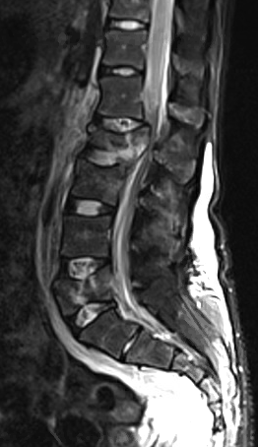
Noncontiguous Spinal Injuries (NCSI)
Occurs in approximately 11.8% of cases
Most common is two noncontiguous thoracic spine
16% of NCSIs are initially missed
Higher rates of neurologic injury than single level or contiguous injuries
24% vs 9.7%
Associated injuries found in 44% of cases
Recommend imaging to include at least 4 spinal levels above and below
14 year old M with L2 and L5 burst fractures (Image courtesy of Josh Murphy, MD)
Firth GB et al. Spine. 37(10):E599-608.

Slide 11
Pediatric C-spine Immobilization
Requires unique consideration in the pediatric patients
Especially true for children < 8 years
Children have disproportionately larger heads relative to the body
Produces a cervical flexion when on a flat surface
Anterior translation of C2 fracture in child placed on spine board. (R&W 8th ed. Image 23-6)

Slide 12
Appropriate Immobilization
Aim: to align external auditory meatus with shoulders
Requires either head cut-out or mattress to elevate torso
Proper positioning techniques for cervical spine immobilization in young children. (R&W 8th edition. Figure 23-14, page 854)

Slide 13
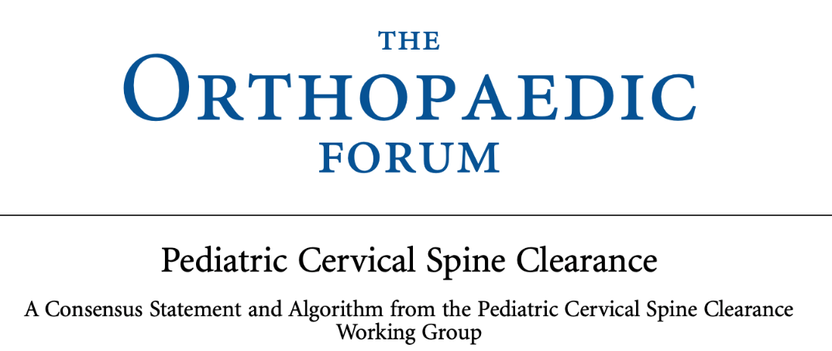
Cervical Spine Clearance
Clearance protocol is distinctly different from adult protocol
Pediatric Cervical Spine Clearance Working Group presented new clearance algorithm in 2019
Approach based upon mental state at presentation, potential for recovery, and radiographic interpretation
Subgroups: 1) GSC 14 or 15 2) GSC 9-13 3) GSC ≤ 8
Goals: (1) Reduce time to c-collar removal (2) Decrease radiation exposure
Herman et al. J Bone Joint Surg Am. 2019; 101

Slide 14
Used with permission from: Herman MJ, et al. Pediatric Cervical Spine Clearance: A Consensus Statement and Algorithm from the Pediatric Cervical Spine Clearance Working Group. J Bone Joint Surg Am. 2019 Jan 2;101(1):e1.

Slide 15
Glascow Coma Score (GCS) of 14-15
Physical Exam findings are sufficient for clearance
Cannot clear in the setting of:
Torticollis
Posterior MIDLINE tenderness
Difficulty with neck ROM
Distracting injury
Positive exam finding confirms need for plain radiographs

Slide 16
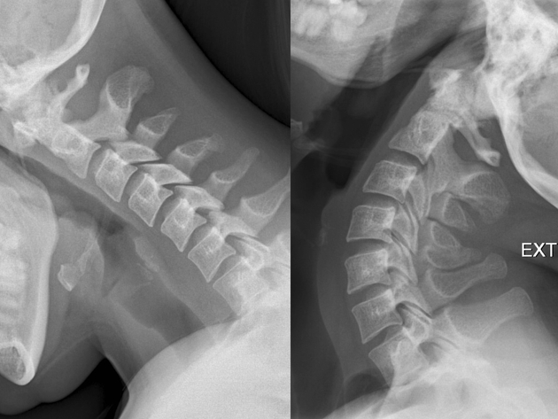
MIDLINE tenderness with a normal exam?
Treatment options
1) Place in rigid collar for 1-2 weeks with follow-up repeat examination
2) Lateral flexion/extension radiographs
To be cleared, radiographs must confirm:
> 30 deg flexion and extension for adequate assessment
No subluxation present
3.) Obtain spine consult
Example radiographs demonstrating adequate flexion/extension views of cervical spine.

Slide 17
GCS 9-13
Initial Work-up:
If expected mental status improvement → lateral cervical radiograph
If no improvement expected→ CT scan
If lateral radiograph normal→ repeat exam in 12 hours
If repeat exam is normal → c-spine can be cleared
If suspected abusive head trauma, obtain cervical spine MRI
Stronger consideration for imaging with higher risk mechanisms:
diving
axial loading
clothes-line
high-risk MVA

Slide 18
GCS ≤8
Initial imaging study:
Computed Tomography (CT)
Obtain MRI if:
If initial CT scan is negative and no anticipated mental status improvement within 72 hours
If abusive head trauma suspected
MRI is sufficient to clear cervical spine
3-year old with complete SCI after C2 fracture sustained during an MVC

Slide 19
Cervical Spine Trauma
Lateral cervical spine radiograph demonstrating C2 Hangman’s fracture. (R&W 8th ed. Figure 23-48

Slide 20
Embryology of the Cervical Spine
Understanding the embryology of the cervical spine can aid in identifying spinal injuries
Somites segmentation occurs in cranial to caudad direction
3 layers: 1) Sclerotome 2) Myotome and 3) Dermatome
Sclerotome→ develops into osseous structures and annulus fibrosis
Somites form around notochord and neural tube
Notochord → anterior vertebral body and nucleus pulposis
Neural tube→ spinal cord

Slide 21
Cranio-cervical Junction
Also referred to as the Atlanto-occipital (AO) junction
Consists of the articulation between occipital condyle and C1 lateral masses
Additional ligamentous component includes the odontoid
Articulation between C1 and occipital condyle is more horizontally oriented in young children
Coupled with a smaller occipital condyle increases vulnerability to injury
Sagittal CT image demonstrating normal occipital cervical articulation

Slide 22
C1 – Atlas
Composed of 3 ossification centers
Neural arch (x2) and body
Anterior arch ossification centers appears by 1 year of age
Present in 20% of children at birth
Posterior arches (D) fuse by age 3
Neurocentral synchondrosis (F) fuses by age 7 years
Ring reaches adult size by age 4 years
Illustration of C1 ossification centers (R&W 8th ed Figure 23-8)

Slide 23
C2 – Axis
Consists of 4 ossification centers
Dens (odontoid process), body, neural arch (x2)
Synchondroses
Odontoid and Body (Subdental)
Fuses by age 7 years
Located below C1-C2 articulation
Neurocentral synchondrosis
Formed between neural arch, odontoid and body
Fuses at 3-6 years of age
Neural Arches
Form the posterior arch
Fuse at 3-6 years
Illustration of C2 ossification centers (R&W 8th ed Figure 23-9)

Slide 24
Os Odontoideum
Corticated ossicle of the odontoid
Anatomical variant
Located well above C1-C2 articulation
Etiology is debatable
Sequelae of trauma vs congenital
Can be associated with C1-2 instability
Management depends on symptomatology and instability
Coronal CT image demonstrating an os odontoideum (R&W 8th ed Figure 23-10)

Slide 25
Subaxial Cervical Spine
3 ossification centers
Vertebral body and Neural arch (x2)
Neural arches fuse at 2-3 years
Neurocentral synchondrosis fuses at 3-6 years
Vertebral body: wedge-shaped until 7-8 years
Illustration of subaxial cervical ossification centers (R&W 8th ed. Figure 23-12)

Slide 26
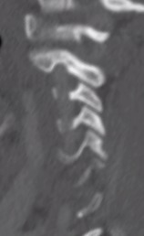
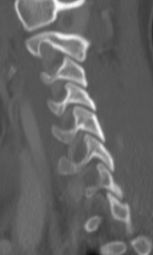
Facet Orientation
Undergo progressive change in orientation with age
Initial horizontal orientation may increase susceptibility to injury
C1 and C2 facet orientation
55 degrees at birth → increases to 70 degrees at maturity
Subaxial spine orientation
30 degrees at birth → increases to 60-70 degrees at maturity
A.
B.
Sagittal CT images demonstrating cervical facet orientation measuring 30 deg in a 3 year old patient (A), and 45 degrees in a 10 year old patient.
Pesenti et al. J Bone Joint Surg Am. 2018; 100(9)

Slide 27
Cervical Spine Imaging
Initial imaging depends on setting of evaluation
For trauma evaluation, follow protocol previously described
Imaging options include:
3 view plain radiographs
AP, lateral, open-mouth odontoid
Dynamic radiographs
Flexion and extension laterals
Computed tomography
Static and Dynamic
MRI
Open-mouth odontoid radiographs showing os odontoideum (R&W 8th ed. Figure 23-33)

Slide 28
Radiographic Evaluation
Key relationships to assess for the Craniocervical Junction
1) Occipital condyle – C1 facet distance
Should measure < 5 mm, increased distance indicated atlanto-occiptal injury
Lateral cervical spine radiographs showing atlanto-occipital dislocation with increased facet condylar distance (R&W 8th ed. Figure 23-25A)

Slide 29
Radiographic Evaluation
Key relationships to assess for the Craniocervical Junction
2) Foramen magnum relative to C1
Powers Ratio
Ratio of distances: BC/AO
(Basion-posterior arch)/(anterior arch- opisthion)
Normal = 0.7 – 1
> 1.0 is abnormal
Illustration of Powers Ratio (R&W 8th ed. Figure 23-1)

Slide 30
Radiographic Evaluation
Key relationships to assess for the Craniocervical Junction
2) Foramen magnum relative to C1
Wackenheim line along clivus
1) Position of odontoid tip relative to line
Proximal to line→ basilar invagination
2) angle between line and posterior vertebral body
<150 degrees suggests ventral cord compression
Illustration of upper cervical spine relationships (R&W 8th ed. Figure 23-2)
Benke et al. Am J Orthop. 2011; 40(10)

Slide 31
Radiographic Evaluation: C1
Isolated single point ring fractures can occur with patent synchondrosis
Key relationships:
Lateral mass displacement relative to C2
Combined displacement >7mm indicative of transverse ligament disruption
Results in C1-2 instability
Axial CT image of C1 demonstrating single point ring fracture with patent synchondrosis (R&W 8th ed. Figure 23-30A)
Spence et al. J Bone Joint Surg. 1970; 52(3)
Heller et al. J Spinal Disord. 1993; 6(5)

Slide 32
Radiographic Evaluation: C1-2
Most common measurements include:
1) Atlanto-dens interval (ADI)
>4.5 mm indicates instability in children
Space available for cord (SAC)
<13 mm increases risk for spinal cord injury
Illustration of upper cervical spine relationships (R&W 8th ed. Figure 23-2)
Spierings & Braakman. J Bone Joint Surg Br. 1982; 64(4)
Copley & Dormans. J Am Acad Orthop Surg. 1998; 6(4)

Slide 33
Radiographic Evaluation: C2
Children < 6 years: fractures commonly occur through synchondrosis
Can be difficult to visualize
Older children: resemble more adult fracture characteristics
Transverse fracture at level of articular surfaces
Lateral cervical radiograph and sagittal CT image demonstrate C2 fracture through the synchondrosis (R&W 8th ed. Figure 23-32)

Slide 34
Pseudosubluxation of C2-3
Apparent anterior translation of C2 on C3 on flexion views
Reduces with extension
Translation < 3 mm
Line of Swischuk remains intact
Line along anterior spinous process of C1 – C3
True injury also presents with significant pre-vertebral swelling
Lateral cervical radiographs demonstrating pseudosubluxation of C2-3 (R&W 8 ed. Figure 23-4)

Slide 35
Radiographic Evaluation: Subaxial Spine
Relationship of adjacent vertebral bodies relative to one another
Anterior and posterior vertebral body lines
Spinolaminar and spinous process lines
Identifies translational abnormalities
Loss of lordosis may be normal but no significant translation
Illustration demonstrating various vertebral relationships (R&W 8th ed. Figure 23-5)
Cattell & Filtzer. J Bone Joint Surg Am. 1965; 47(7)

Slide 36
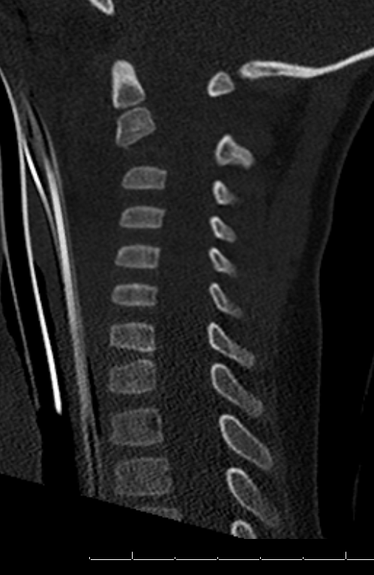
Do Forget the Soft Tissues!
Pediatric spinal fractures can be difficult to visualize
Soft tissue swelling can be an indicator of injury
Retropharyngeal soft tissue space:
C2→ < 6 mm
C6→ < 14 mm
3 year old male with C2 fracture and increased retropharyngeal soft tissue swelling > 6 mm at C2

Slide 37
Spinal Cord Injury
Rare in children
Improved prognosis compared to adults
Incomplete injuries are 3x more common
Mechanisms:
Child abuse
MVC
Association with forward-facing car seat in infants and toddlers
Breech delivery
3-year old with complete SCI after C2 fracture in MVC
Reilly CW. J Bone Joint Surg Am. 2007; 89(S1).
Ranjith et al. J Pediatr Orthop B. 2002; 11.

Slide 38
SCIWORA
Spinal Cord Injury Without Radiographic Abnormality
Distraction injury that is unique to children
Spinal column is more elastic than spinal cord
Spinal column can elongate 2 inches without disruption whereas spinal cord ruptures with ¼ inch elongation
Most common in upper cervical spine injuries and in children <8 years
50% complete injuries
Delayed onset of neurologic symptoms common in up to 52%
High Suspicion in GCS 3 w/ normal CT head
May be upper cervical spinal cord injury
Sagittal MRI demonstrating atlanto-occipital injury in child with SCIWORA
Pang & Wilberger. J Neurosurg. 1982; 57:114-129.
Parent. S et al. J Neurotrauma. 2011;28:1515.

Slide 39
What About High-Dose Steroid Therapy?
NASCIS trial excluded children < 13 years of age
Current recommendation against us of high-dose steroid in adult SCI
Initial NASCIS results were extrapolated to pediatric patients but there is no evidence to support improved neurologic outcome
High rate of complication
Hyperglycemia
GI complications
Parent. S et al. J Neurotrauma. 2011;28:1515.
Caruso MC et al. J Neurosurg Pediatr. 2017; 20(6)
Cage JM et al. J Pediatr Orthop. 2015; 35(7)

Slide 40
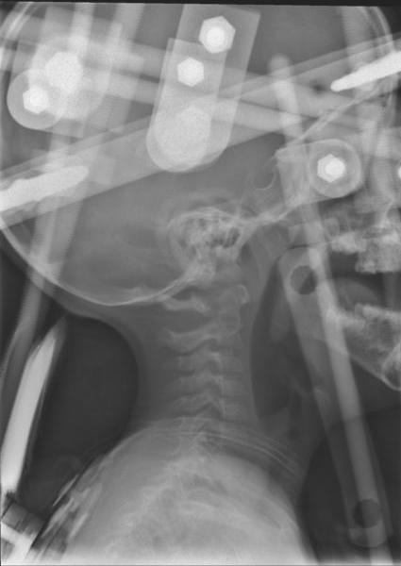
Cervical Spine Treatment Options
Varying based upon underlying injury and stability
Options:
Cervical Orthosis
Halo Fixator
Posterior Arthrodesis
Halo vest immobilization for upper cervical spine fracture

Slide 41
Thoracolumbar Injuries
Account for 1-2% of all pediatric fractures
MVCs are most common mechanism
Age difference in injury pattern
<8 years less likely to have thoracolumbar injuries
Modes of failure:
Distraction → Chance type injuries
Compression → Compression fracture, burst fracture
Sagittal CT image of an L1 bony Chance fracture (R&W 9th ed. Figure 21-6)

Slide 42
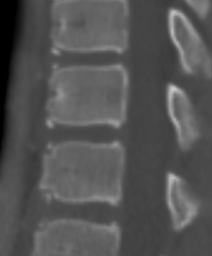
Anatomy
3 primary ossification centers
Vertebral body, Neural arch (x2)
5 secondary ossification centers
Spinous process, transverse process (x2), superior and inferior endplates (ring apophyses)
Additional rigidity of thoracic spine due to rib attachment
Sagittal CT image of T9-11 in a 13 year old male demonstration presence of apophyseal rings (arrow)
Bick EM & Copel JW. The ring apophysis of the human vertebra. Contributions to human osteogeny II. J Bone Joint Surg Am. 1951; 33(3): 783-7.

Slide 43
Radiographic Evaluation
Biplanar radiographs
CT useful to evaluating fracture displacement, spinal canal encroachment
Not recommended for initial screening
Must balance with radiation exposure risk
MRI favored when neurologic deficit present or concern for ligamentous injury
Sagittal CT Image of 2 yo with L2-3 fracture dislocation with canal compromise
Daniels AH et al. J Am Acad Orthop Surg. 2013; 21(12)

Slide 44
Injury Patterns
Compression fracture
Burst
Flexion-distraction
Fracture-dislocation
Ring apophyseal fracture
Lateral radiographs demonstrating an L2 burst fracture (R&W 8th ed. Figure 24-10B)

Slide 45
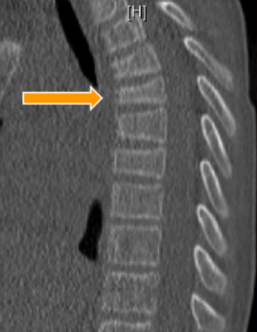
Compression Fracture
Most prevalent pediatric spinal fracture pattern
Most commonly affect the thoracolumbar spine
Low-energy mechanisms common
Stability is maintained if posterior elements/ ligamentous structures are intact
Anterior height loss >50% should raise concern for posterior injury and MRI is recommended
11 year old M with contiguous T4-5 compression fractures after motocross accident
Daniels AH et al. J Am Acad Orthop Surg. 2013; 21(12)

Slide 46
Burst Fracture
Axial compression mechanism
Involves anterior and middle column
More common in older adolescents
Retropulsion of bone can result in neurologic injury and/or dural tear
Signs of Instability:
Posterior ligamentous complex involvement
3 column injury
Focal Kyphosis
Retropulsion >50%
Lamina fracture
Facet subluxation
14 year old M with L2 and L5 burst fractures after a fall from 60 feet (Image courtesy of Josh Murphy, MD)
Daniels AH et al. J Am Acad Orthop Surg. 2013; 21(12)

Slide 47
Flexion-Distraction
Occur secondary to a flexion moment over a fulcrum (i.e. seat belt)
Tension forces in the posterior elements
Failure of posterior elements is propagated anteriorly
Injuries can be bony, ligamentous, or both
Concomitant intra-abdominal and head injuries occur in 40% of patients
Flexion-distraction injury at T12-1 evident by spinous process widening and anterior fracture (R&W 9th ed Figure 21-15)
Daniels AH et al. J Am Acad Orthop Surg. 2013; 21:707-16.

Slide 48
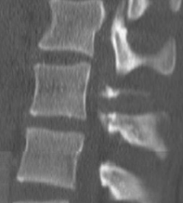
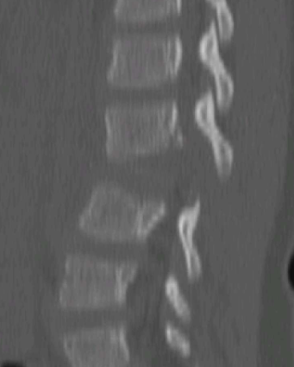
Flexion-Distraction Classification
Bony
Ligamentous
Bony and ligamentous
Daniels AH, Sobel AD, Eberson CP. J Am Acad Orthop Surg. 2013; 21:707-16.

Slide 49
Lap Belt sign
High association with intra-abdominal and lumbar spine injuries
Warrants lumbar spine imaging
Arkader et al. Pediatric chance fractures: a multicenter perspective. J Pediatr Orthop. 2011;31:741.

Slide 50
Fracture-Dislocation
Extremely high-energy mechanism
Often associated with neurologic injury
Treatment requires reduction and stabilization
Instrumentation principles:
2 levels above and below
If age < 10 years with complete SCI → expect paralytic scoliosis and can consider longer fusion constructs
2 year old with L2-3 fracture dislocation from non-accidental trauma.

Slide 51
Ring Apophyseal Fractures
Affects children most commonly 10 - 14 years
Ring apophysis separates from the vertebral spongiosa layer, usually of Inferior apophysis
Classic symptom: radicular pain following strenuous activity
Fractures can spontaneously reduce and may be difficult to visualize
MRI recommended for suspected injuries
In absence of neurologic symptoms, non-surgical intervention recommended
Surgery recommended if cauda equina compression present
16 year old with L5 apophyseal fracture involving the inferior end plate

Slide 52
Ring Apophyseal Variant
Normal variant anatomy can mimic acute fracture
Vertebral Body Shape
Vertebral body progresses from convex to concave morphology
Apophyseal Ring ossification
Apophyseal appears between 6-13 years and ossifies at the end of growth
Ossification can mimic an apophyseal fracture
Akhaddar A et al. J Neurosurg Spine. 2011; 14(4)
Jaremko JL et al. Pediatr Radiol. 2015; 45(4).

Slide 53
Thoracolumbar Injuries
Treatment options
Non-surgical:
Observation
Orthotic/Casting
Operative treatment:
Decompression
Instrumentation
(with or without arthrodesis)
How do we decide when to operate?
AP radiograph after L2 corpectomy with anterior reconstruction and lateral instrumented fusion. (R&W 9th ed. Figure 21-14E)

Slide 54
Thoracolumbar Injury Classification and Severity (TLICS) Score
Classifies injuries on three characteristics:
Fracture morphology
Integrity of the posterior ligamentous complex
Neurologic status
Injuries are given a numeric score 1- 10
Treatment recommendation is determined by score
Score ≤ 3 → Non-surgical treatment
Score ≥ 5→ Operative treatment
Vaccaro AR, Lehmann RA, Hurlbert JR et al. Spine. 2005; 30(20): 2325-33.

Slide 55
TLICS in Pediatric Patients?
TLICS is applicable in pediatric spine trauma
High inter-rater reliability and sensitivity
High levels of agreement between treatment recommendation based on TLICS scores and actual treatment provided
Savage JW et al. Spine. 2015; 400(18): E1014-8.
Dawkins RL et al. Neurosurgery. 2019; 84(6): E362-7.

Slide 56
Take Home Points
Cervical spine immobilization requires particular attention in younger children < 8 years
Age and mechanism of injury influence spine injury patterns
Proper knowledge of ossification patterns will aid in fracture recognition
Treatment differs by age and injury location/pattern
TLICS classification can be used to guide treatment in pediatric patients

Slide 57
References
1. Arkader A, Warner WC, Jr., Tolo VT, Sponseller PD, Skaggs DL. Pediatric Chance fractures: a multicenter perspective. J Pediatr Orthop. 2011;31(7):741-4.
2. Benke M, Yu WD, Peden SC, O'Brien JR. Occipitocervical junction: imaging, pathology, instrumentation. Am J Orthop (Belle Mead NJ). 2011;40(10):E205-15.
3. BICK EM, COPEL JW. THE RING APOPHYSIS OF THE HUMAN VERTEBRA: Contribution to Human Osteogeny. II. JBJS. 1951;33(3):783-7.
4. Cage JM, Knox JB, Wimberly RL, Shaha S, Jo C, Riccio AI. Complications Associated With High-dose Corticosteroid Administration in Children With Spinal Cord Injury. J Pediatr Orthop. 2015;35(7):687-92.
5. Caruso MC, Daugherty MC, Moody SM, Falcone RA, Bierbrauer KS, Geis GL. Lessons learned from administration of high-dose methylprednisolone sodium succinate for acute pediatric spinal cord injuries. J Neurosurg Pediatr. 2017;20(6):567-74.
6. Cattell HS, Filtzer DL. Pseudosubluxation and other normal variations in the cervical spine in children. A study of one hundred and sixty children. J Bone Joint Surg Am. 1965;47(7):1295-309.
7. Copley LA, Dormans JP. Cervical Spine Disorders in Infants and Children. JAAOS - Journal of the American Academy of Orthopaedic Surgeons. 1998;6(4):204-14.
8. Daniels AH, Sobel AD, Eberson CP. Pediatric Thoracolumbar Spine Trauma. JAAOS - Journal of the American Academy of Orthopaedic Surgeons. 2013;21(12):707-16.
9. Dawkins RL, Miller JH, Menacho ST, Ramadan OI, Lysek MC, Kuhn EN, et al. Thoracolumbar Injury Classification and Severity Score in Children: A Validity Study. Neurosurgery. 2019;84(6):E362-e7.
10. Firth GB, Kingwell SP, Moroz PJ. Pediatric noncontiguous spinal injuries: the 15-year experience at a level 1 trauma center. Spine (Phila Pa 1976). 2012;37(10):E599-608.
11. Gupta S, Hauser BM, Zaki MM, Xu E, Cote DJ, Lu Y, et al. Morbidity after traumatic spinal injury in pediatric and adolescent sports-related trauma. J Neurosurg Spine. 2019:1-7.
12. Hedequist DJ, Mo AZ. Os Odontoideum in Children. JAAOS - Journal of the American Academy of Orthopaedic Surgeons. 2020;28(3):e100-e7.
13. Heller JG, Viroslav S, Hudson T. Jefferson fractures: the role of magnification artifact in assessing transverse ligament integrity. J Spinal Disord. 1993;6(5):392-6.
14. Herman MJ, Brown KO, Sponseller PD, Phillips JH, Petrucelli PM, Parikh DJ, et al. Pediatric Cervical Spine Clearance: A Consensus Statement and Algorithm from the Pediatric Cervical Spine Clearance Working Group. J Bone Joint Surg Am. 2019;101(1):e1.
15. Herzenberg JE, Hensinger RN, Dedrick DK, Phillips WA. Emergency transport and positioning of young children who have an injury of the cervical spine. The standard backboard may be hazardous. J Bone Joint Surg Am. 1989;71(1):15-22.

Slide 58
References
16. Knox JB, Schneider JE, Cage JM, Wimberly RL, Riccio AI. Spine trauma in very young children: a retrospective study of 206 patients presenting to a level 1 pediatric trauma center. J Pediatr Orthop. 2014;34(7):698-702.
17. Mendoza-Lattes S, Besomi J, O'Sullivan C, Ries Z, Gnanapradeep G, Nash R, et al. Pediatric Spine Trauma in the United States--Analysis of the HCUP Kid'S Inpatient Database (KID) 1997-2009. Iowa Orthop J. 2015;35:135-9.
18. Orenstein JB, Klein BL, Gotschall CS, Ochsenschlager DW, Klatzko MD, Eichelberger MR. Age and outcome in pediatric cervical spine injury: 11-year experience. Pediatr Emerg Care. 1994;10(3):132-7.
19. Pang D, Wilberger JE, Jr. Spinal cord injury without radiographic abnormalities in children. J Neurosurg. 1982;57(1):114-29.
20. Parent S, Mac-Thiong JM, Roy-Beaudry M, Sosa JF, Labelle H. Spinal cord injury in the pediatric population: a systematic review of the literature. J Neurotrauma. 2011;28(8):1515-24.
21. Piatt J, Imperato N. Epidemiology of spinal injury in childhood and adolescence in the United States: 1997-2012. J Neurosurg Pediatr. 2018;21(5):441-8.
22. Ranjith RK, Mullett JH, Burke TE. Hangman's fracture caused by suspected child abuse. A case report. J Pediatr Orthop B. 2002;11(4):329-32.
23. Reilly CW. Pediatric spine trauma. J Bone Joint Surg Am. 2007;89 Suppl 1:98-107.
24. Savage JW, Moore TA, Arnold PM, Thakur N, Hsu WK, Patel AA, et al. The Reliability and Validity of the Thoracolumbar Injury Classification System in Pediatric Spine Trauma. Spine (Phila Pa 1976). 2015;40(18):E1014-8.
25. Spence KF, Jr., Decker S, Sell KW. Bursting atlantal fracture associated with rupture of the transverse ligament. J Bone Joint Surg Am. 1970;52(3):543-9.
26. Spierings EL, Braakman R. The management of os odontoideum. Analysis of 37 cases. J Bone Joint Surg Br. 1982;64(4):422-8.
27. Takata K, Inoue S, Takahashi K, Ohtsuka Y. Fracture of the posterior margin of a lumbar vertebral body. J Bone Joint Surg Am. 1988;70(4):589-94.
28. Vaccaro AR, Lehman RAJ, Hurlbert RJ, Anderson PA, Harris M, Hedlund R, et al. A New Classification of Thoracolumbar Injuries: The Importance of Injury Morphology, the Integrity of the Posterior Ligamentous Complex, and Neurologic Status. Spine. 2005;30(20):2325-33.

Slide 59
Figures Used with Permission from:
Warner WC & Hedequist DJ. Cervical Spine Injuries in Children. In: Flynn JM, Skaggs DL, & Waters PM eds. Rockwood and Wilkins Fractures in Children, 8e. Philadelphia, PA. Wolters Kluwer Health, Inc. 2015.
Warner WC & Hedequist DJ. Cervical Spine Injuries in Children. In: Waters PM, Skaggs DL, & Flynn JM eds. Rockwood and Wilkins Fractures in Children, 9e. Philadelphia, PA. Wolters Kluwer Health, Inc. 2019.
Newton PO & Luhmann J. Thoracolumbar Spine Fractures. In: Flynn JM, Skaggs DL, & Waters PM eds. Rockwood and Wilkins Fractures in Children, 8e. Philadelphia, PA. Wolters Kluwer Health, Inc. 2015.
Newton PO & Upasani VV. Thoracolumbar Spine Fractures. In: Waters PM, Skaggs DL, & Flynn JM eds. Rockwood and Wilkins Fractures in Children, 9e. Philadelphia, PA. Wolters Kluwer Health, Inc. 2019.

