Slide 1
When the fracture is more: Pathologic Fractures in the Pediatric Population
Adrienne R Socci, MD
Assistant Professor
Yale School of Medicine

Slide 2
Disclaimer
All clinical and radiographic images provided are used with permission of Adrienne Socci, MD and Chris Souder, MD, unless otherwise specified

Slide 3
Objectives
How to recognize a pathologic fracture
How to evaluate a pathologic fracture
Treatment principles in the management of pathologic fractures
Common pathologies encountered in the pediatric population

Slide 4
Recognizing a pathologic fracture
Be suspicious when
The mechanism of injury seems disproportionately minor
Example: a fall from standing results in a humerus fracture
The fracture pattern is atypical for location
Example: transverse fracture in a femur after a fall
The bone doesn’t look normal at the fracture site
Example: any lesion, or appearance that is cystic, lucent, sclerotic, or with surrounding reaction such as periosteal elevation

Slide 5
Evaluating a suspected pathologic fracture
Obtain a detailed history
Local and constitutional symptoms: confirm if any pain, particularly night pain, fever, weight loss, swelling, or lack of these
Current or past medical conditions
Family history
Physical exam
A thorough exam includes evaluation for skin changes, swelling, soft tissue mass, lymphadenopathy

Slide 6
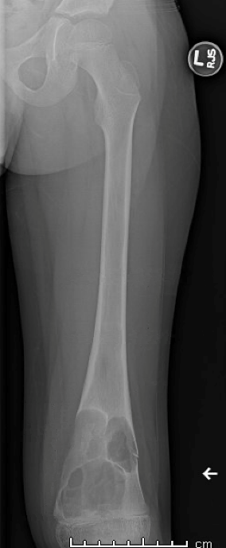
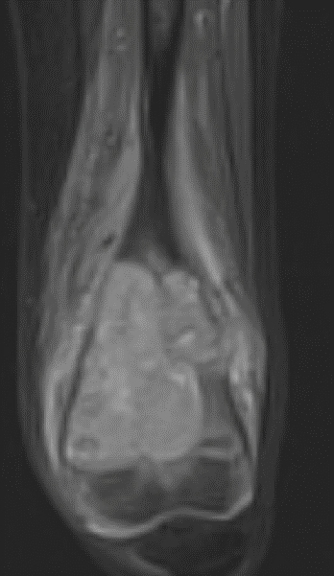
Evaluating a suspected pathologic fracture
Diagnostic imaging
Plain x-rays are typically done to identify the fracture
Ensure complete imaging of the whole bone
Advanced imaging can be useful
MRI, CT, bone scan

Slide 7
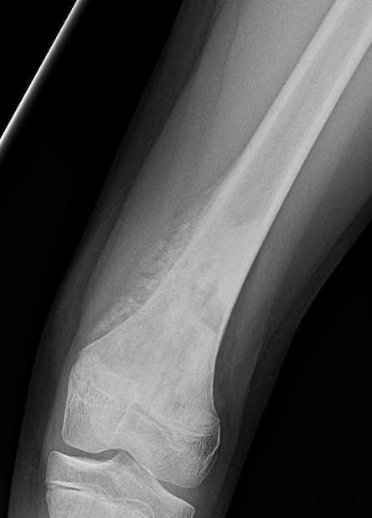
Evaluating a suspected pathologic fracture
Diagnostic imaging
Evaluate the lesion
Location
Diagnosis can be specific to epiphysis/metaphysis/diaphysis
Character
Consider the presence of cyst, calcification, or matrix in the bone
Reaction of the underlying bone
Is there periosteal elevation, is the shape of the bone normal, is there a clear border to the lesion

Slide 8
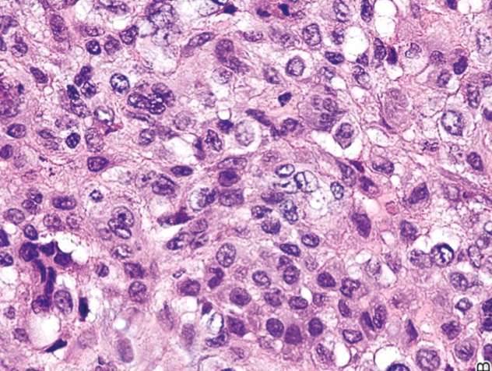
Evaluating a suspected pathologic fracture
Biopsy
May be needed for diagnosis or treatment planning
Sometimes performed at the time of operative fracture management
Principles of oncology must be followed in performing a biopsy
Consider possibility of malignancy and need for future resection
Send cultures as well as tissue specimen
Consider consultation with an orthopaedic oncologist prior to biopsy, particularly if there is concern for malignancy.

Slide 9
Treating a suspected pathologic fracture
Treat the fracture
Not all pathologic fractures require operative management
Some pathologic fractures can be treated as though there were no lesion
Treat the pathology
Some pathologies can be observed, or treated in a delayed fashion, i.e. after fracture healing.

Slide 10
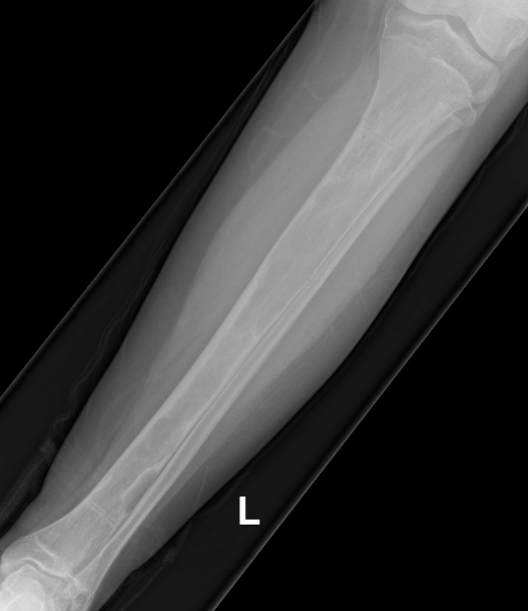
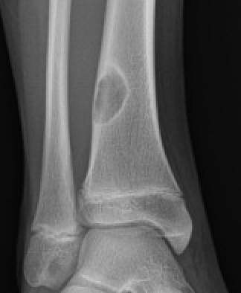
Common benign pathologies by location
Epiphysis:
Chondroblastoma
Giant cell tumor
Metaphysis
Osteomyelitis
Nonossifying fibroma
Unicameral bone cyst
Aneurysmal bone cyst
Fibrous dysplasia
Diaphysis:
Fibrous dysplasia
Osteofibrous dysplasia

Slide 11
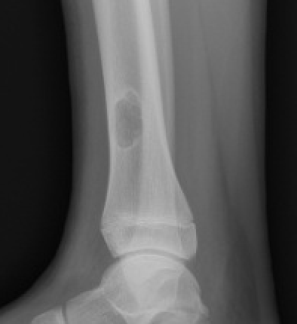
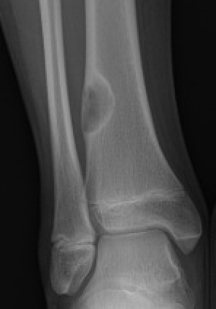
Nonossifying Fibroma
Most common benign lesion
Common incidental finding on xrays
Eccentric, metaphyseal, multilocular lucency with a sclerotic border
Often classic enough in appearance that no further imaging is necessary
Differential diagnosis: UBC, ABC
Other names for this include:
Fibrous cortical defect
Fibroxanthoma

Slide 12
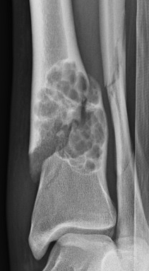
Nonossifying Fibroma
Observation is mainstay of treatment
Pathologic fracture may be treated nonoperatively with predictable healing
Large enough lesions causing fracture or bone pain may indicate surgical management
Curettage and grafting
Local recurrence rare

Slide 13
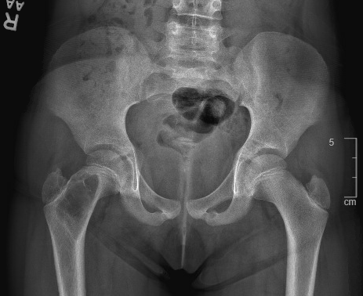
Unicameral Bone Cyst (UBC)
Benign cystic lesion
2:1 male:female ratio
Common between ages 4-10
Proximal humerus (59%) and proximal femur (26%) most common
Uncommon to grow or recur after skeletal maturity

Slide 14
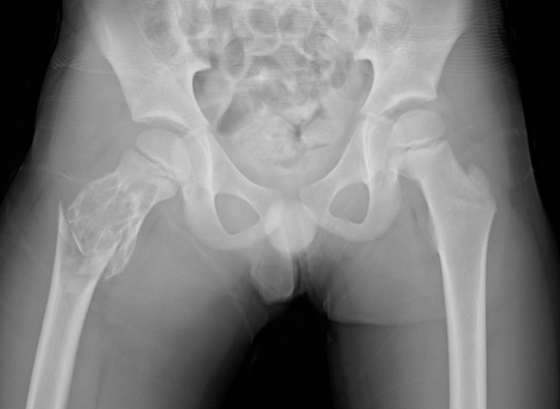
Unicameral Bone Cyst (UBC)
Well-defined, radiolucent lesion centrally located within the metaphysis
Cortical thinning
No periosteal reaction
Mild cortical expansion
NOT wider than the epiphysis
Fallen leaf sign
Fragment of bone floating inside the fluid-filled cavity
Typical after a fracture
Fallen leaf sign: cortical fragment within the lesion

Slide 15
Unicameral Bone Cyst (UBC)
Most commonly identified at time of fracture (85% of cases)
Thin cortical rim
Microfracture of this can lead to pain
Pathologic fracture possible after minor trauma, e.g. fall from standing
More potential for growth when closer to the physis
Active lesions are near physis
Latent lesions are remote from physis

Slide 16
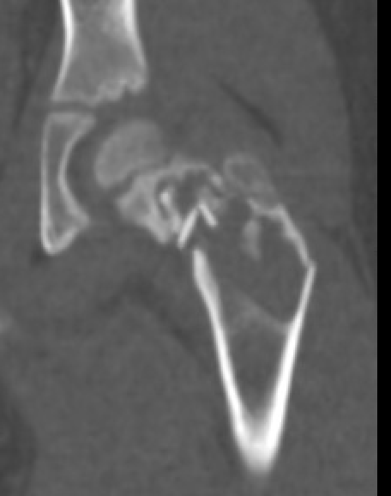
Unicameral Bone Cyst (UBC)
X-rays usually sufficient for diagnosis
CT or MR can be considered if diagnosis uncertain
Axial skeleton
Aspiration of straw-colored fluid is diagnostic

Slide 17
Unicameral Bone Cyst (UBC)
Treatment of the fracture can be guided by typical fracture treatment principles
Conservative treatment is most often indicated
Low rates of spontaneous healing of cyst with fracture healing

Slide 18
Unicameral Bone Cyst (UBC)
Treatment of the cyst can proceed upon fracture healing
Treatment goals include preventing recurrent fracture
Prevent complications of fracture→deformity or growth arrest

Slide 19
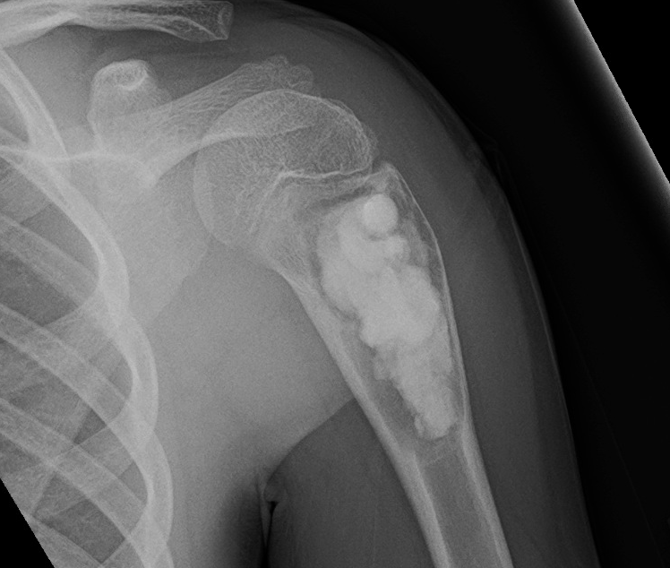
Unicameral Bone Cyst (UBC)
Treatment options include injection, decompression, and curettage with grafting
Comparable healing rates (~80%)
Bone marrow or steroid injection
Curettage and grafting with either autograft, allograft, or bone substitutes
Decompression with IM nails or cannulated screw

Slide 20
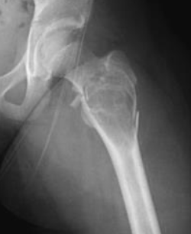
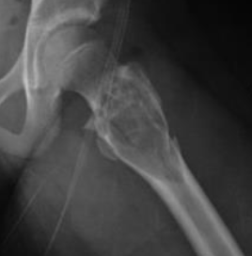
Aneurysmal Bone Cyst (ABC)
Benign, but locally aggressive tumor
Most commonly in teenagers (80%)
Much less common than UBC
Most common in long bones and spine
50% long bones
30% spine
Typically metaphyseal
Occasionally found in the epiphysis or diaphysis

Slide 21
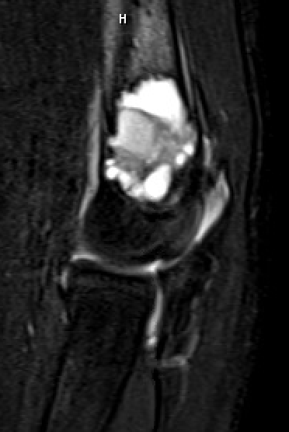
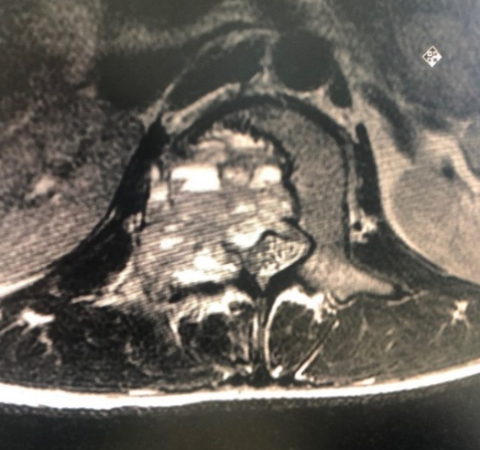
Aneurysmal Bone Cyst (ABC)
Radiolucent, eccentric, expansile lesion, most commonly in the metaphysis
May see periosteal reaction due to aggressive nature of this benign tumor
Fluid/fluid levels on MRI characteristic
Differential diagnoses: telangiectatic osteosarcoma, giant cell tumor, UBC, secondary ABC
Biopsy recommended to confirm diagnosis

Slide 22
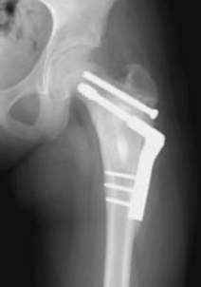
Aneurysmal Bone Cyst (ABC)
Treatment is most commonly curettage and grafting, with or without adjuvant therapy
Embolization used pre-operatively to reduce bleeding
High rate of local recurrence
Radiation limited to inoperable lesions

Slide 23
Fibrous Dysplasia
Benign lesion
Most common in long bones, pelvis
Long lesion in a long bone
Mutation in Gsα gene
Failure of maturation of bone
Immature matrix leads to decreased mechanical strength of bone
This can lead to pain, pathologic fracture, deformity
Clinical presentation with bone pain or fracture

Slide 24
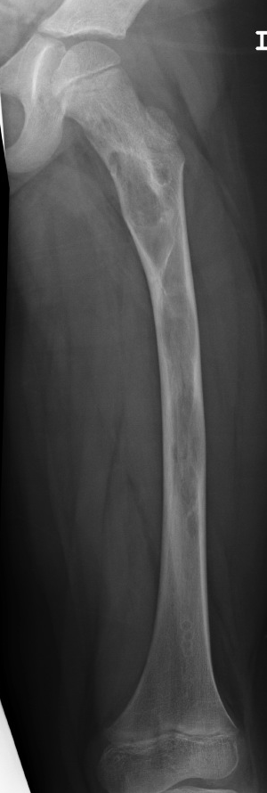
Fibrous Dysplasia
Monostotic more common
Femur most common site
Polyostotic form can be more severe
Larger lesions and secondary deformity
Deformity can be caused by microfracture and progressive structural deformation
Shepherd’s crook deformity of the proximal femur
Can be associated with endocrine abnormalities
McCune-Albright syndrome→precocious puberty

Slide 25
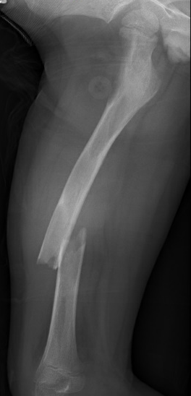
Fibrous Dysplasia –Imaging
Xrays will demonstrate a “ground glass”
Irregular, metaplastic woven bone replacing trabecular bone
Lesion may appear expansile, with endosteal scalloping
Periosteal reaction not typically seen
Differential diagnoses: UBC, NOF
”ground glass” appearance
Endosteal scalloping

Slide 26
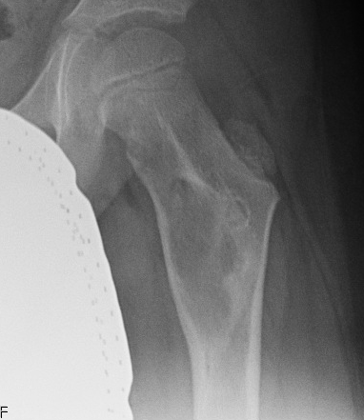
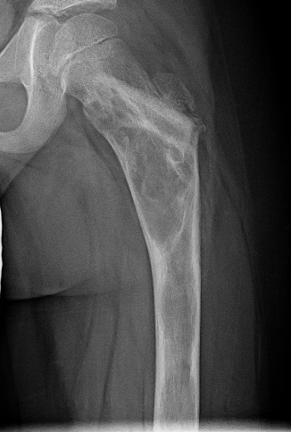
Fibrous Dysplasia - Treatment
Observation of asymptomatic or incidental lesions is recommended
Follow XR needed to ensure no progression or development of deformity
Progressive deformity is common in polyostotic disease
Rare in monostotic
Bisphosphonates can be used in polyostotic form to decrease bone pain
Proximal femoral varus developing

Slide 27
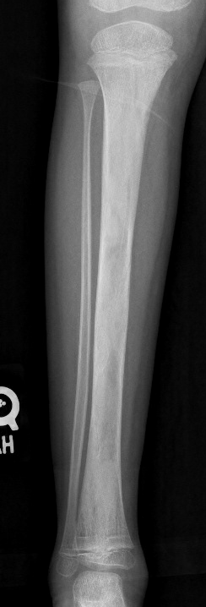
Fibrous Dysplasia – Conservative Treatment
Treatment of fracture
Conservative treatment most commonly indicated
Fractures heal rapidly
Good periosteal bone formation
Poor endosteal bone
Underlying bone will remain dysplastic
Curettage and grafting is NOT indicated
Graft is converted to FD bone

Slide 28
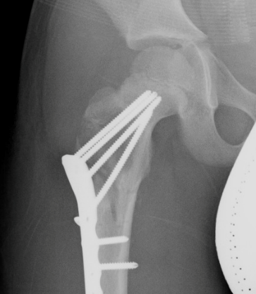
Fibrous Dysplasia – Surgical Treatment
Most often indicated for
Lower extremity/weightbearing bones
Polyostotic cases with deformity
Intramedullary fixation is ideal
Load-sharing implant
Protect the entire bone
Especially in polyostotic cases
Additional osteotomies often needed for associated deformities
Fixed angle constructs required in periarticular fractures when IM fixation is not sufficient

Slide 29
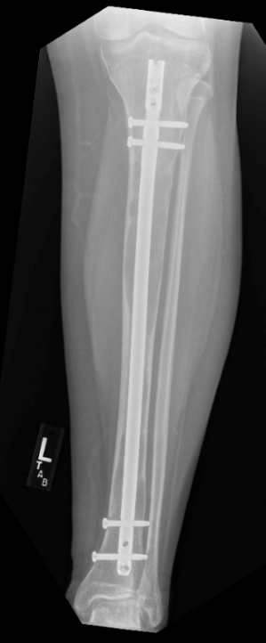
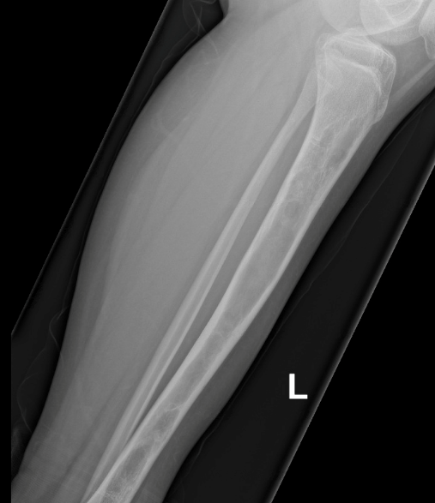
Fibrous Dysplasia – Prophylactic Treatment
Prevention of fracture
Prophylactic fixation in weightbearing bones with large lesions and/or progressing deformity
May also present with bone pain in the absence of visible fracture
Minor trauma can lead to pathologic fracture
Notes:
13 yo male with polyostotic fibrous dysplasia and left tibial bone pain, treated with prophylactic stabilization

Slide 30
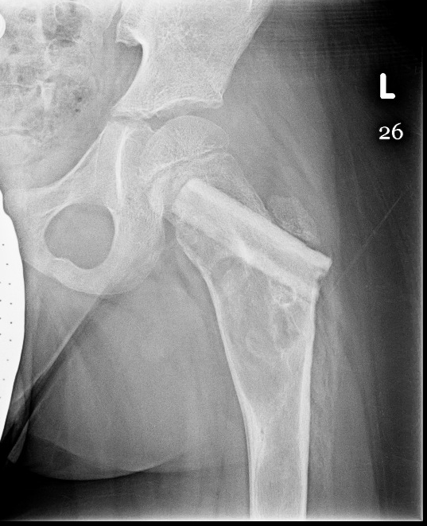
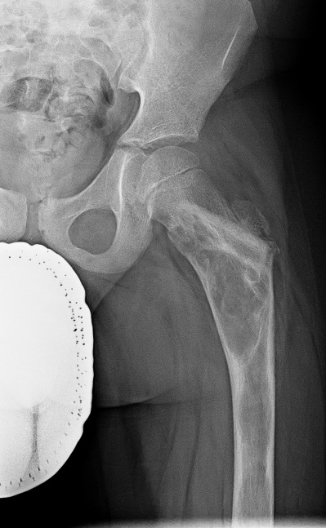
Fibrous Dysplasia - Augmentation
Augmentation with cortical strut allograft may also improve mechanical strength
Bone graft will be resorbed and replaced by fibrous dysplasia over time
Nonstructural allograft does not have a role in treating this condition
Resorption of cortical strut graft

Slide 31
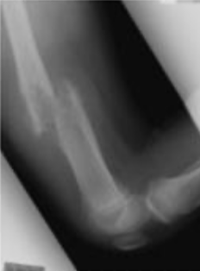
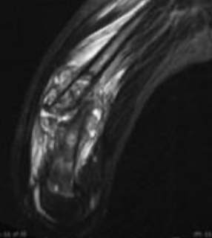
Malignant Tumors & Metastases
Malignant bone tumors may cause pathologic fractures
Osteosarcoma and Ewing’s sarcoma most common
Metastases
Signs of malignancy include
Aggressive appearance
Periosteal reaction
Bone forming and/or destructive lesions with poorly delineated borders
Not well circumscribed
Permeative appearance
Associated soft tissue mass

Slide 32
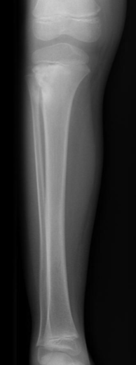
Malignant Tumors & Metastases
Identification and diagnosis is crucial for appropriate treatment
Work-up should be done by the treating orthopedic oncologist, especially biopsy
Do not perform fixation before diagnosis is made
Treatment of malignancy can include chemotherapy, radiation, and/or surgery
Limb salvage is often possible

Slide 33
Pediatric pathologic fractures
Pathologic fractures can happen from many different etiologies, both benign and malignant
Treatment of the fracture and treatment of the pathology are dependent on the etiology
Many benign etiologies do not require treatment distinct from the fracture treatment
An orthopaedic oncologist should be consulted when dealing with a suspected malignancy

Slide 34
References
Kadhim, M., Thacker, M., Kadhim, A. et al. Treatment of unicameral bone cyst: systematic review and meta analysis. J Child Orthop 8, 171–191 (2014). https://doi.org/10.1007/s11832-014-0566-3
Rapp TB, Ward JP, Alaia MJ.J Am Acad Orthop Surg. 2012 Apr;20(4):233-41. doi: 10.5435/JAAOS-20-04-233.
DiCaprio MR, Enneking WF. Fibrous dysplasia. Pathophysiology, evaluation, and treatment. J Bone Joint Surg Am. 2005 Aug;87(8):1848-64. doi: 10.2106/JBJS.D.02942. PMID: 16085630.
John A Herring. Tachdjian's Pediatric Orthopaedics: from the Texas Scottish Rite Hospital for Children. 5th edition. 2014. Elsevier Saunders: Philadelphia ISBN: 978-1-4377-1549-1.

