Slide 1
Pelvic and Acetabular Anatomy
Alesha N. Scott, DO, FAAOS
Medical Director of Orthopedic Trauma
Bryan Health

Slide 2
Pelvic Ring Anatomy
Learn the anatomy of the pelvis and acetabulum
Osteology
Ligamentous
Muscular
Neurovascular
Differentiate the palpable landmarks

Slide 3
Pelvic Ring Anatomy
Osteology
Ligamentous
Muscular
Neurovascular

Slide 4
Pelvic Osteology
3 bones
Innominate bones x2
Sacrum
Innominate bone
Sacrum
Photo courtesy of Alesha N. Scott, D.O.

Slide 5
Pelvic Osteology
Innominate Bone
Ilium
Pubis
Pubic root
Pubic body
Pubic tubercle
Ischium
Ilium
Pubic root
Pubic body
Pubic tubercle
Ischium
Photo courtesy of Alesha N. Scott, D.O.

Slide 6
Pelvic Osteology
Iliac crest
Palpable Anterior Landmarks
Iliac crest
Anterior superior iliac spine (ASIS)
Anterior inferior iliac spine (AIIS)
Pubic tubercle
ASIS
AIIS
Pubic tubercle
Photo courtesy of Alesha N. Scott, D.O.

Slide 7
Pelvic Osteology
Palpable Posterior Landmarks
Iliac crest
PSIS
Iliac crest
Posterior superior iliac spine (PSIS)
Ischial tuberosity
Ischial tuberosity
Photo courtesy of Alesha N. Scott, D.O.
Notes:
+Was the font increase done? They look big.
PM: Increase font size of labels

Slide 8
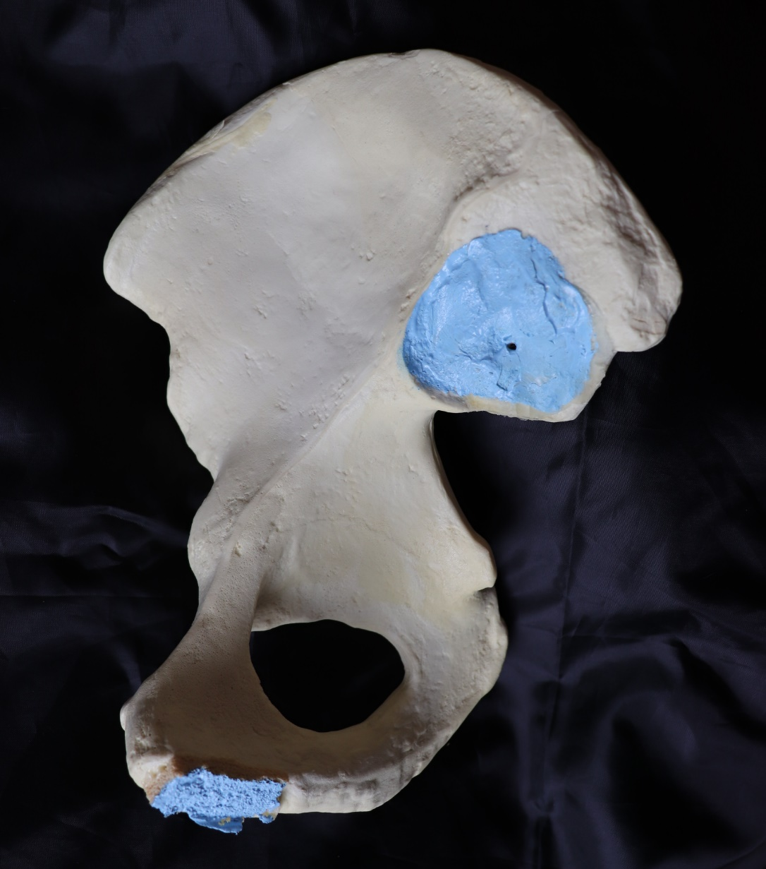
Pelvic Osteology
Iliac crest
Iliac fossa
Articular surface
Anterior superior iliac spine (ASIS)
Posterior superior iliac spine (PSIS)
Anterior inferior iliac spine (AIIS)
Posterior inferior iliac spine (PIIS)
Greater sciatic notch
Iliopectineal eminence
Ischial body
Lesser sciatic notch
Superior pubic ramus
Pubic body
Ischial ramus
Ischial tuberosity
Photo courtesy of Alesha N. Scott, D.O.
Notes:
+New photo of disassembled sawbone
LKC and PM: Would use anatomic model for this instead of drawing

Slide 9
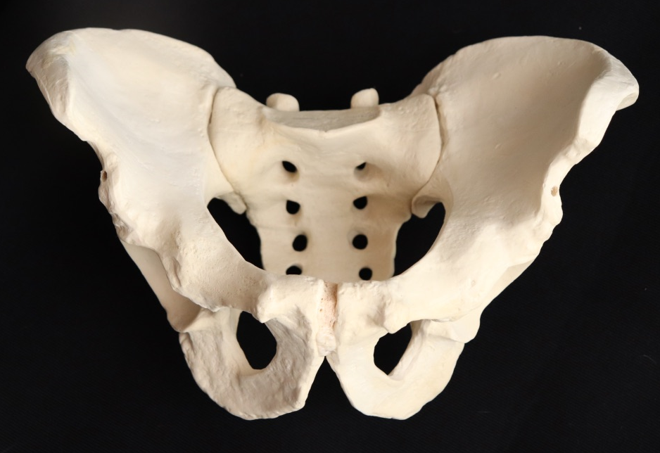
Pelvic Osteology
False and True Pelvis
False pelvis
Cranial to the pelvic brim
Sacral ala + iliac fossae
True pelvis
Caudal to the pelvic brim
False pelvis
True pelvis
Pelvic brim
Illustrations courtesy of Alesha N. Scott, D.O.
Photos courtesy of Alesha N. Scott, D.O.
Notes:
+Changed from illustration to sawbones photos
LKC and PM: Would use anatomical picture not drawing

Slide 10
Ligamentous Pelvic Anatomy

Slide 11
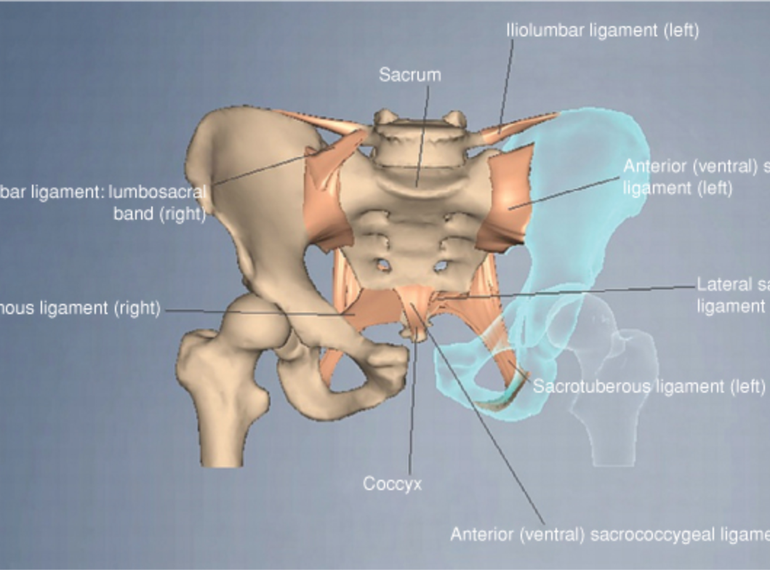
Ligamentous pelvic anatomy
Anterior
Symphysis pubis (+superior/inferior pubic ligaments)
Inguinal ligament
Posterior
Anterior aspect
Anterior sacroiliac ligaments
Iliolumbar ligament
Posterior aspect: strongest
Posterior (dorsal) sacroiliac ligaments
Interosseous sacroiliac ligaments
Iliolumbar ligament
Pelvic floor
Sacrospinous ligament
Sacrotuberous ligament
Iliolumbar ligament
Sacrum
Anterior sacroiliac ligaments
Iliolumbar ligament
Lateral sacrococcygeal ligament
Sacrospinous Ligament
Sacrotuberous Ligament
Symphysis pubis
Coccyx
Anterior sacrococcygeal ligament

Slide 12
Ligamentous Pelvic Anatomy
Anterior ligaments
Symphysis pubis: fibrocartilage
Superior pubic ligament
Inferior pubic ligament (arcuate ligament)
Inguinal ligament
Inguinal ligament
Superior pubic ligament
Symphysis pubis
Inferior pubic (arcuate) ligament
Illustration courtesy of Alesha N. Scott, D.O.
Notes:
+done
LKC: PLEASE SHOW THE READER WHERE THE INGUINAL LIGAMENT IS AS YOU HAVE 4 LIGAMENTS LISTED BUT ONLY SHOW 3

Slide 13
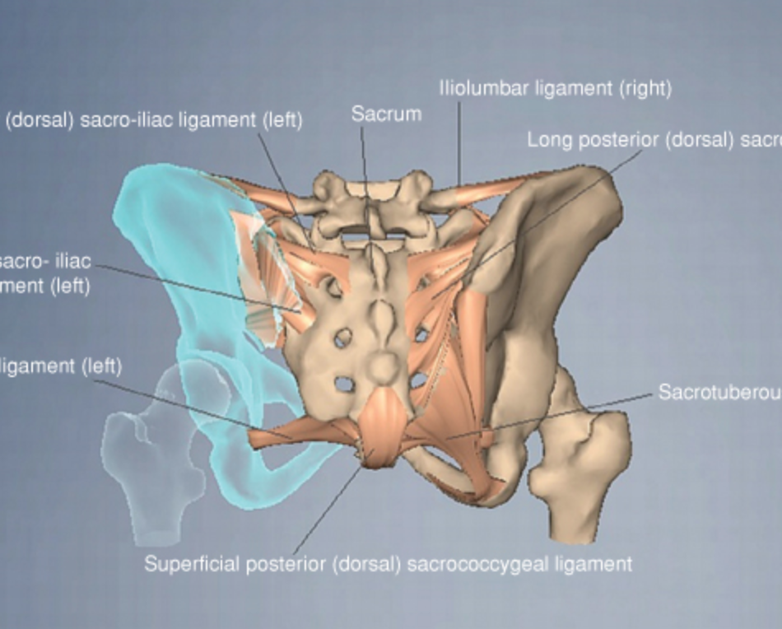
Ligamentous Pelvic Anatomy
Anterior
Symphysis pubis (+superior/inferior pubic ligaments)
Inguinal ligament
Posterior
Anterior aspect
Anterior sacroiliac ligaments
Iliolumbar ligament
Posterior aspect: strongest
Posterior (dorsal) sacroiliac ligaments
Interosseous sacroiliac ligaments
Iliolumbar ligament
Pelvic floor
Sacrospinous ligament
Sacrotuberous ligament
Iliolumbar ligament
Dorsal sacroiliac ligament
Sacrum
Dorsal sacroiliac ligament
Interosseous sacroiliac ligament
Sacrospinous ligament
Sacrotuberous ligament
Superficial dorsal sacrococcygeal ligament

Slide 14
Ligamentous Pelvic Anatomy
Ligaments
Functions
Anterior SI ligaments
Posterior SI ligament
Dorsal sacroiliac ligament
Iliolumbar ligament
Sacrospinous ligament
Sacrotuberous ligament
Resist external rotation
Resist cranial-caudal translation
Resist A-P translation
Resist rotation
Resist external rotation
Resist cranial-caudal translation and flexion

Slide 15
Muscular Pelvic Anatomy

Slide 16
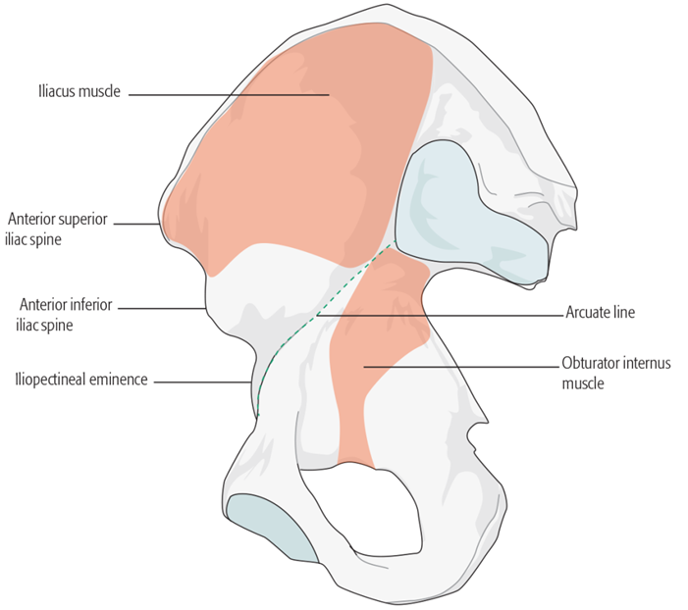
Muscular Pelvic Anatomy
Copyright by AO Foundation, Switzerland; "Fractures of the Pelvis and Acetabulum—Principles and Methods of Management- 4th Edition.”

Slide 17
Neurovascular Pelvic Anatomy

Slide 18
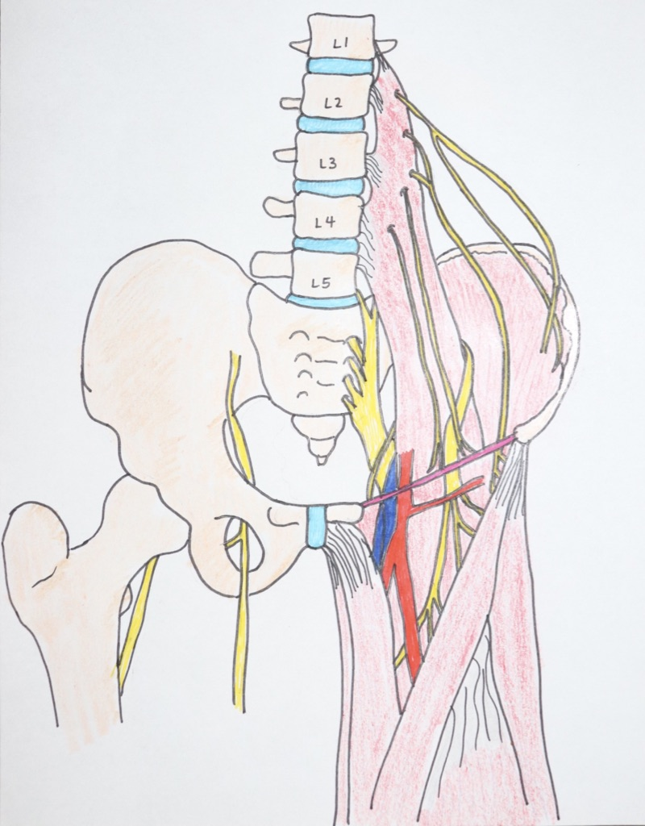
Neural Pelvic Anatomy
Lumbosacral plexus
Iliohypogastric n. (T12-L1)
Ilioinguinal n. (L1)
Genitofemoral n. (L1-2)
Lateral femoral cutaneous n. (L2-3)
Femoral n. (L2-4)
Obturator n. (L2-4)
Lumbosacral trunk
Superior gluteal n. (L4-S1)
Inferior gluteal n. (L5-S2)
Posterior femoral cutaneous n. (S1-3)
Pudendal n. (S2-4)
Sciatic n. (L4-S3)
Peroneal division
Tibial division
Ilioinguinal nerve
Genitofemoral nerve
Lateral femoral cutaneous nerve
Femoral nerve
Sciatic nerve
Obturator nerve
Illustration courtesy of Alesha N. Scott, D.O.

Slide 19
Neural Pelvic Anatomy
L4/L5 nerve roots
Courses over anterior sacrum
Sciatic Nerve
Exits through greater sciatic notch
Obturator nerve
Exits out lateral aspect of obturator foramen

Slide 20
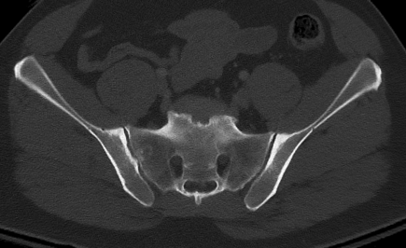
Neural Pelvic Anatomy
L5 nerve root at risk with percutaneous iliosacral screw placement
2cm medial to the SI joint

Slide 21
Vascular Pelvic Anatomy
Common iliac system
External iliac artery
Internal iliac artery
Courses medial to vein and splints into anterior and posterior branches
Posterior branch most likely injured
Sacral venous plexus
Majority of the hemorrhage following pelvic ring injuries
Close the potential space and allow for tamponade by using a pelvic binder/sheet →decreases the volume of the pelvic bowl
Center sheet/binder on greater trochanters
Animesh Agarwal. Pelvic Ring Injuries. In: Tornetta P, Ricci WM, eds. Rockwood and Green's Fractures in Adults, 9e. Philadelphia, PA. Wolters Kluwer Health, Inc; 2019. Figure 49-28.

Slide 22
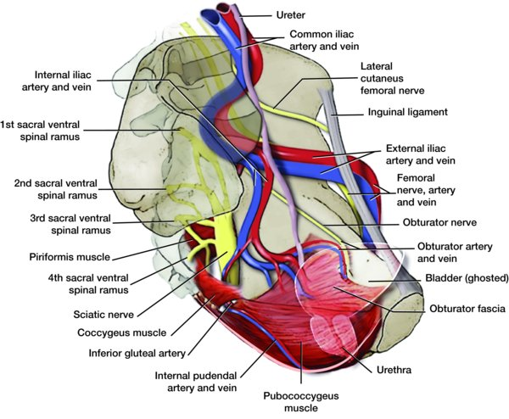
Vascular Pelvic Anatomy
Internal iliac system
Anterior division
Visceral branches
Obturator a.
Inferior vesical a.
Middle rectal a.
Posterior division
Superior gluteal a.
Iliolumbar a.
Limb/perineal branches
Inferior gluteal a.
Internal pudendal a.
Animesh Agarwal. Pelvic Ring Injuries. In: Tornetta P, Ricci WM, eds. Rockwood and Green's Fractures in Adults, 9e. Philadelphia, PA. Wolters Kluwer Health, Inc; 2019. Figure 49-27.

Slide 23
Vascular Pelvic Anatomy
Retropubic anatomy
Inferior epigastric artery
Small caliber anastomosis between obturator and external iliac/inferior epigastric systems are common (~70%)
Average of 6.2cm lateral to the symphysis
In small percentage, obturator artery can be of large caliber and originate from inferior epigastric or external iliac
“Corona mortis”
Inferior epigastric vein
Obturator vein
Obturator artery
Teague DC, Graney DO, Routt ML Jr. Retropubic vascular hazards of the ilioinguinal exposure: a cadaveric and clinical study. J Orthop Trauma. 1996;10(3):156-9. Figure 1.
Notes:
+Added some shapes and additional labels.
LKC: PLEASE SHOW CORONA MORTIS-THIS IS IMPORTANT

Slide 24
Acetabular Anatomy
Osteology
Ligamentous
Neurovascular

Slide 25
Acetabular Osteology
Berton R. Moed and John A Boudreau. Acetabulum Fractures. In: Tornetta P, Ricci WM, eds. Rockwood and Green's Fractures in Adults, 9e. Philadelphia, PA. Wolters Kluwer Health, Inc; 2019. Figure 50-8.

Slide 26
Acetabular Osteology
Inverted “Y” two column concept
Described by Judet and Letournel (1966)
Columns connected to SI joint by thick area of bone above sciatic notch (sciatic buttress)
Anatomical roof of acetabulum forms keystone of arch

Slide 27
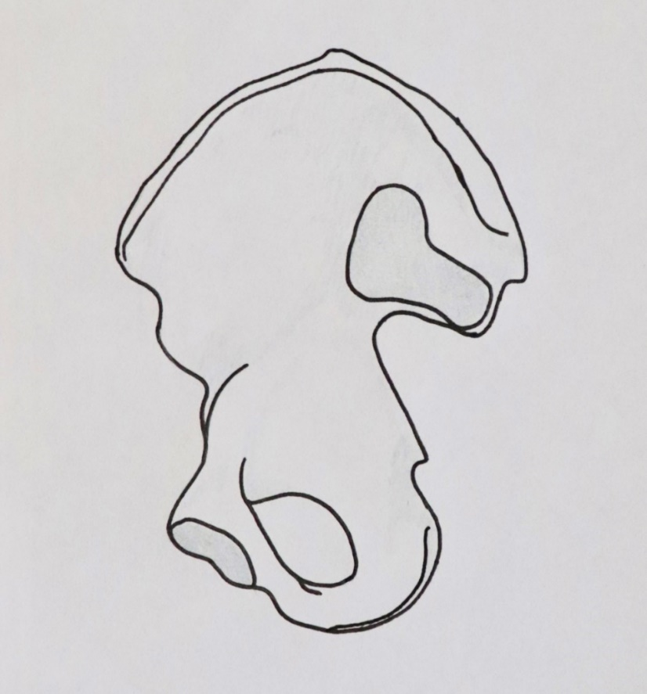
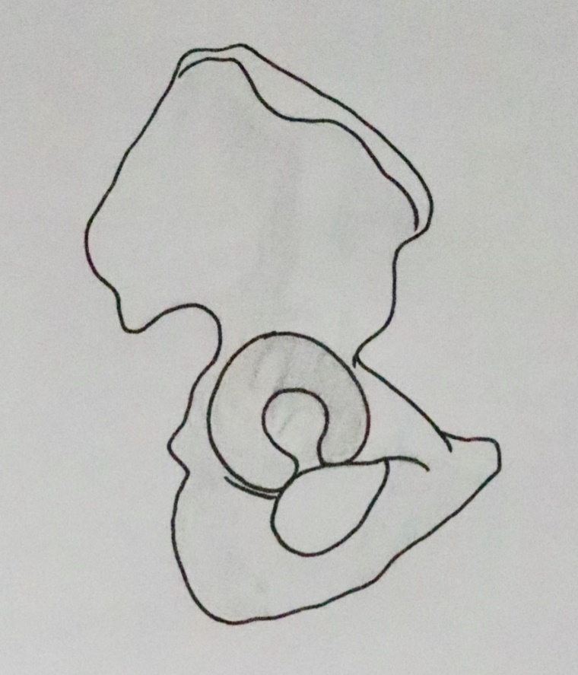
Acetabular Osteology
Columns
Anterior
Posterior
Walls
Anterior
Posterior
Quadrilateral surface/medial wall
Dome
Anterior column
Anterior wall
Posterior wall
Anterior wall
Posterior column
Illustrations courtesy of Alesha N. Scott, D.O.

Slide 28
Acetabular Osteology
Anterior column
Extends from anterior iliac crest to pubic symphysis
3 segments
Iliac segment
Acetabular segment
Pubic segment
Photo courtesy of Alesha N. Scott, D.O.

Slide 29
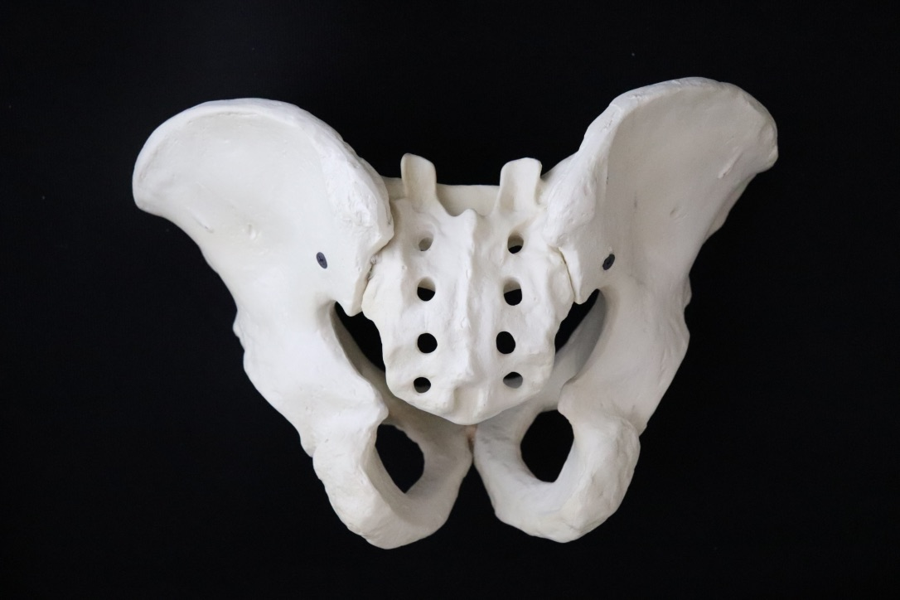
Acetabular Osteology
Posterior column
Extends from greater sciatic notch to inferior ischium
2 segments
Posteroinferior portion of ilium
Greater and lesser sciatic notches
Ischium
Photo courtesy of Alesha N. Scott, D.O.
Photo courtesy of Alesha N. Scott, D.O.

Slide 30
Acetabular Osteology
Anterior wall
Iliopectineal eminence
Represents the anterior and medial boundary of the acetabulum
Iliopsoas runs just lateral to the eminence
Iliopectineal eminence
Photo courtesy of Alesha N. Scott, D.O.
Photo courtesy of Alesha N. Scott, D.O.

Slide 31
Acetabular Osteology
Posterior wall
Most common acetabular fracture type
Photo courtesy of Alesha N. Scott, D.O.

Slide 32
Acetabular Osteology
Medial wall
Quadrilateral surface + acetabular fossa
Commonly involved in geriatric acetabular fracture patterns
Illustrations courtesy of Alesha N. Scott, D.O.
Notes:
LKC: PLEASE ADD A COMMENT THAT THIS IS OFTEN INVOLVED IN ELDERLY FRACTURES

Slide 33
Ligamentous Acetabular Anatomy

Slide 34
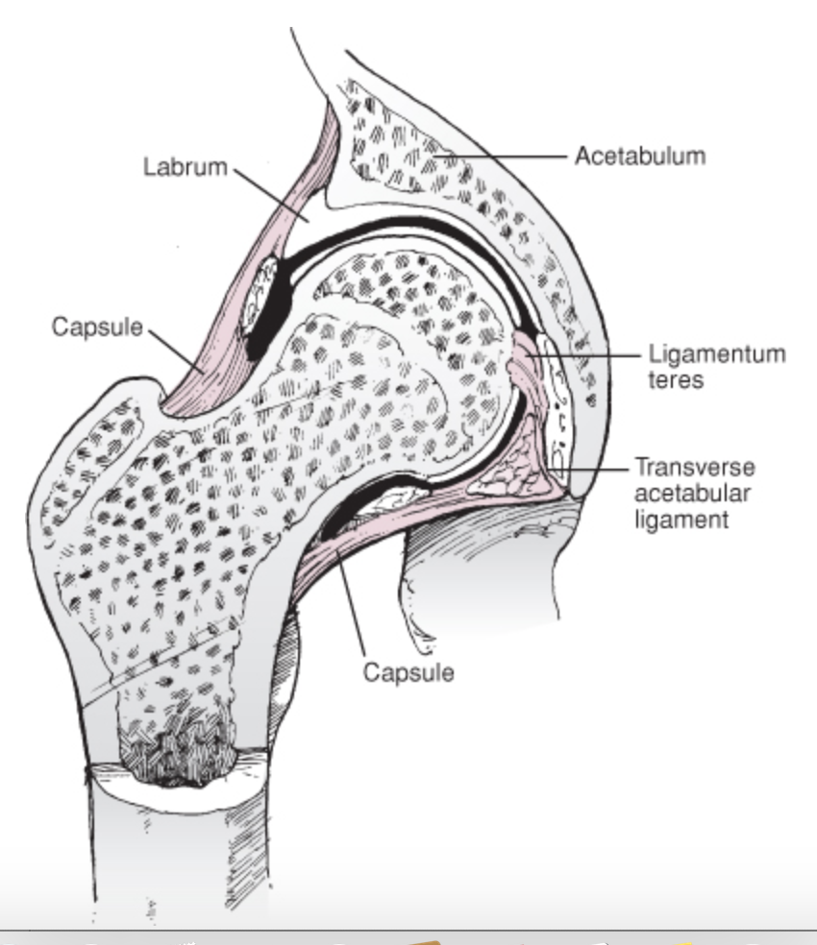
Ligamentous Acetabular Anatomy
Capsule
Labrum
Ligamentum teres
Transverse acetabular ligament
Michael S. Kain and Paul Tornetta III. Hip Dislocations and Femoral Head Fractures. In: Tornetta P, Ricci WM, eds. Rockwood and Green's Fractures in Adults, 9e. Philadelphia, PA. Wolters Kluwer Health, Inc; 2019. Figure 51-12.

Slide 35
Neurovascular Acetabular Anatomy

Slide 36
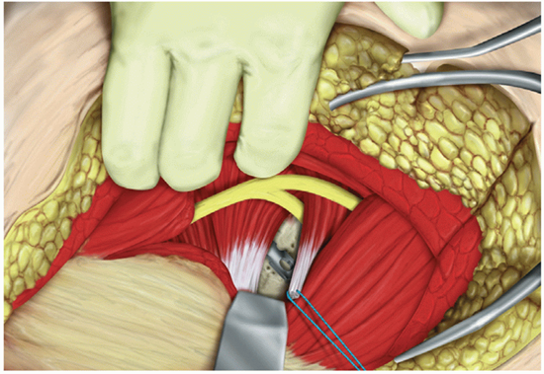
Neural Acetabular Anatomy
Sciatic nerve
Recognize variant anatomy!
CAUDAL
CRANIAL
Michael S. Kain and Paul Tornetta III. Hip Dislocations and Femoral Head Fractures. In: Tornetta P, Ricci WM, eds. Rockwood and Green's Fractures in Adults, 9e. Philadelphia, PA. Wolters Kluwer Health, Inc; 2019. Figure 51-14.
Berton R. Moed and John A Boudreau. Acetabulum Fractures. In: Tornetta P, Ricci WM, eds. Rockwood and Green's Fractures in Adults, 9e. Philadelphia, PA. Wolters Kluwer Health, Inc; 2019. Figure 50-50.

Slide 37
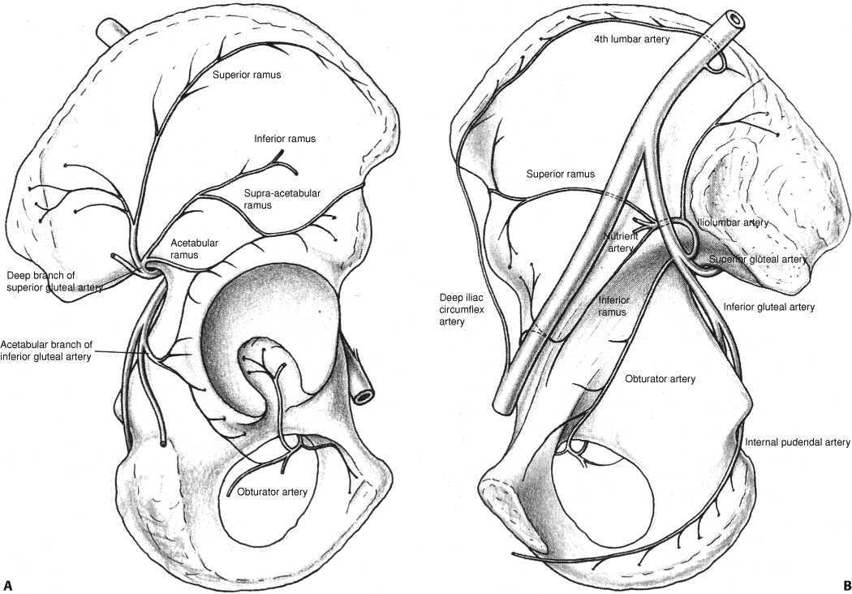
Vascular Acetabular Anatomy
Lateral (A)
Superior gluteal artery
Inferior gluteal artery
Medial femoral circumflex artery
Medial (B)
Iliolumbar artery
Obturator artery
A
B
Berton R. Moed and John A Boudreau. Acetabulum Fractures. In: Tornetta P, Ricci WM, eds. Rockwood and Green's Fractures in Adults, 9e. Philadelphia, PA. Wolters Kluwer Health, Inc; 2019. Figure 50-34.

Slide 38
Vascular Acetabular Anatomy
Iliolumbar artery
Origination
From posterior trunk of internal iliac OR from the obturator
Divisions
Superficial branch
Deep branch
Nutrient artery to ilium → 50% enter ilium anterior to SIJ, lateral to pelvic brim; 50% enter medial to pelvic brim
Berton R. Moed and John A Boudreau. Acetabulum Fractures. In: Tornetta P, Ricci WM, eds. Rockwood and Green's Fractures in Adults, 9e. Philadelphia, PA. Wolters Kluwer Health, Inc; 2019. Figure 50-34.

Slide 39
Vascular Acetabular Anatomy
Obturator artery
Branches
Quadrilateral surface
Superior pubic ramus
Acetabular branch
Enters deep to transverse ligament
May be the terminal supply to acetabulum
Anastomosis
With MFCA
Berton R. Moed and John A Boudreau. Acetabulum Fractures. In: Tornetta P, Ricci WM, eds. Rockwood and Green's Fractures in Adults, 9e. Philadelphia, PA. Wolters Kluwer Health, Inc; 2019. Figure 50-34.

Slide 40
Vascular Acetabular Anatomy
Superior gluteal artery (SGA)
Most important contribution to acetabular blood supply
Branches
Deep
Superior
Inferior
Supraacetabular
Acetabular
Berton R. Moed and John A Boudreau. Acetabulum Fractures. In: Tornetta P, Ricci WM, eds. Rockwood and Green's Fractures in Adults, 9e. Philadelphia, PA. Wolters Kluwer Health, Inc; 2019. Figure 50-34.

Slide 41
Vascular Acetabular Anatomy
Superior gluteal artery (SGA)
May be lacerated secondary to injury or retractor placement in the greater sciatic notch
Berton R. Moed and John A Boudreau. Acetabulum Fractures. In: Tornetta P, Ricci WM, eds. Rockwood and Green's Fractures in Adults, 9e. Philadelphia, PA. Wolters Kluwer Health, Inc; 2019. Figure 50-3.

Slide 42
Vascular Acetabular Anatomy
Inferior gluteal artery (IGA)
Acetabular branches
Deep to short external rotators
Between inferior gemellus and quadratus femoris
Anastomosis with MFCA
Berton R. Moed and John A Boudreau. Acetabulum Fractures. In: Tornetta P, Ricci WM, eds. Rockwood and Green's Fractures in Adults, 9e. Philadelphia, PA. Wolters Kluwer Health, Inc; 2019. Figure 50-34.

Slide 43
Vascular Acetabular Anatomy
Medial femoral circumflex artery (MFCA)
Ascending branch is main blood supply to femoral head
Deep to quadratus, obturator internus, and piriformis
Can be damaged with
Dislocation of femoral head
Taking down quadratus from femur
Dissecting piriformis and obturator internus tendons off femur without adequate 1 cm tag
Posterior

Slide 44
Objectives Completed
Learn the anatomy of the pelvis and acetabulum
Osteology
Ligamentous
Muscular
Neurovascular
Differentiate the palpable landmarks

Slide 45
References
Bucholz, R. W., Heckman, J. D., Court-Brown, C., & Tornetta, P. (2009). Rockwood and Green’s Fractures in Adults (7th ed.). Lippincott Williams & Wilkins.
Dean, D., & Herbener, T. E. (2007). Cross-Sectional Anatomy Human Anatomy. Lippincott Williams & Wilkins.
Letournel, E., Judet, R., & Elson, R. A. (1993). Fractures of the Acetabulum (2nd entirely rev. and enlarged ed.). Springer.
Md, F. N. H. (2006). Atlas of Human Anatomy, 4th Edition (Netter Basic Science) (4th ed.). Saunders.
Rohen, J. W., Yokochi, C., & Lutjen-Drecoll, E. (2006). Color Atlas of Anatomy: A Photographic Study of the Human Body (Color Atlas of Anatomy (Rohen)) (6th ed.). Lippincott Williams & Wilkins.
Tile, M., Helfet, D. L., Kellam, J. F., Vrahas, M., & AO Foundation, AO Education. (2015). Fractures of the Pelvis and Acetabulum (AO): Principles and Methods of Management (4th edition). AO Publishing, Davos.

