Slide 1
Surgical Approaches to the Acetabulum: Anterior Intrapelvic & Ilioinguinal
Jonathan Eastman, MD
Associate Professor
University of California, Davis

Slide 2
Learning Objectives
Appreciate anterior surgical approaches and associated access
Comprehend iliopectineal fascia and implications
Understand fracture patterns
Recognize limitations of anterior surgical approaches

Slide 3
Ilioinguinal Approach
Originally described by Letournel in 1961
Several modifications described since
Standard approach for anteriorly based acetabular fractures
Primary access to anterior column and quadrilateral plate
Fensky, Florian MD*; Lehmann, Wolfgang MD†; Ruecker, Andreas MD‡; Rueger, Johannes M. MD* Ilioinguinal Approach: Indication and Technique, Journal of Orthopaedic Trauma: August 2018 - Volume 32 - Issue - p S12-S13

Slide 4
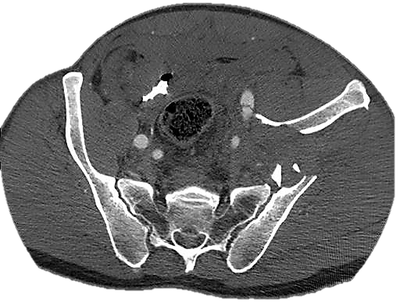
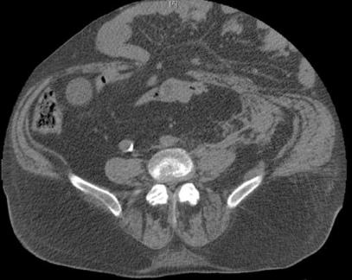
Thorough preoperative planning
Need detailed understanding of osseous injury
Understand normal and disturbed underlying pelvic anatomy
Role of previous surgeries: ex-lap vs. prior hernia
Search for non osseous pathology
- Iliac vein injury
- Bladder injury
- Hernias laterally and central/inguinal
Courtesy of Milton L. Chip Routt, Jr. MD

Slide 5
Ilioinguinal Approach
Contemporary hree separate intervals
Lateral
Middle
Medial
Mayo, Keith MD; Unno, Florence MD The Ilioinguinal Surgical Approach Using a Modified Medial Window: Origin, Evolution, and Applications. A 34-Year Perspective, Journal of Orthopaedic Trauma: February 2019 - Volume 33 - Issue - p S14-S20

Slide 6
Fractures typically addressed through ilioinguinal
Anterior wall fractures
Anterior column fractures
Associated both column fractures
Anterior column/wall and posterior hemitransverse fractures
Transverse fracture (with major displacement through anterior column)
T-shaped fracture (displaced anterior column segment and rarely posterior column)
Atypical or extended posterior wall fractures

Slide 7
Fractures not typically addressed through ilioinguinal
Typical posterior wall fractures
Posterior column fractures
Posterior column posterior wall fractures
Transverse posterior wall fractures
Transverse (with major displacement through posterior column)
T-shaped (displaced posterior column)

Slide 8
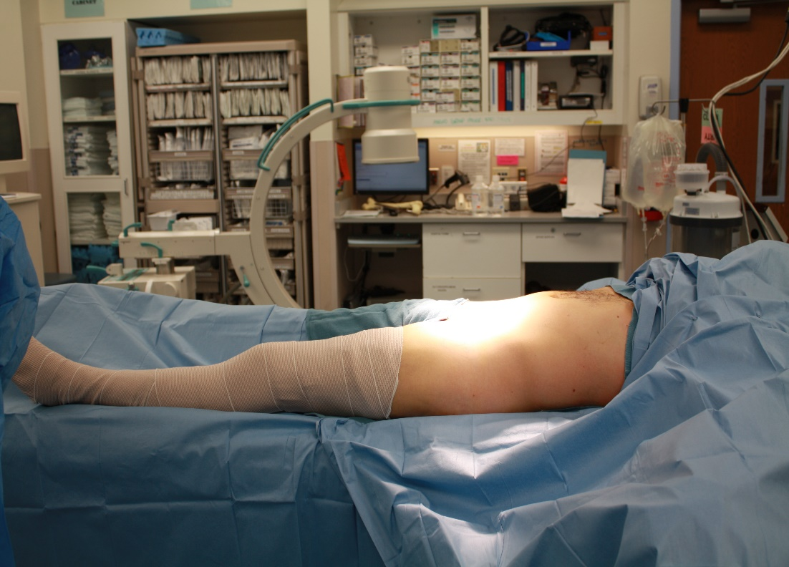
Positioning
Supine
Foley necessary
Flat top radiolucent table or traction table
Lumbosacral bump
Leg can be prepped out or in
Hip flexion to relax iliopsoas
- Towel bump, bone foam ramp, or table
Prep to chest cranially and buttock posteriorly
Courtesy of Dr. Routt and Dr. Mark Adams

Slide 9
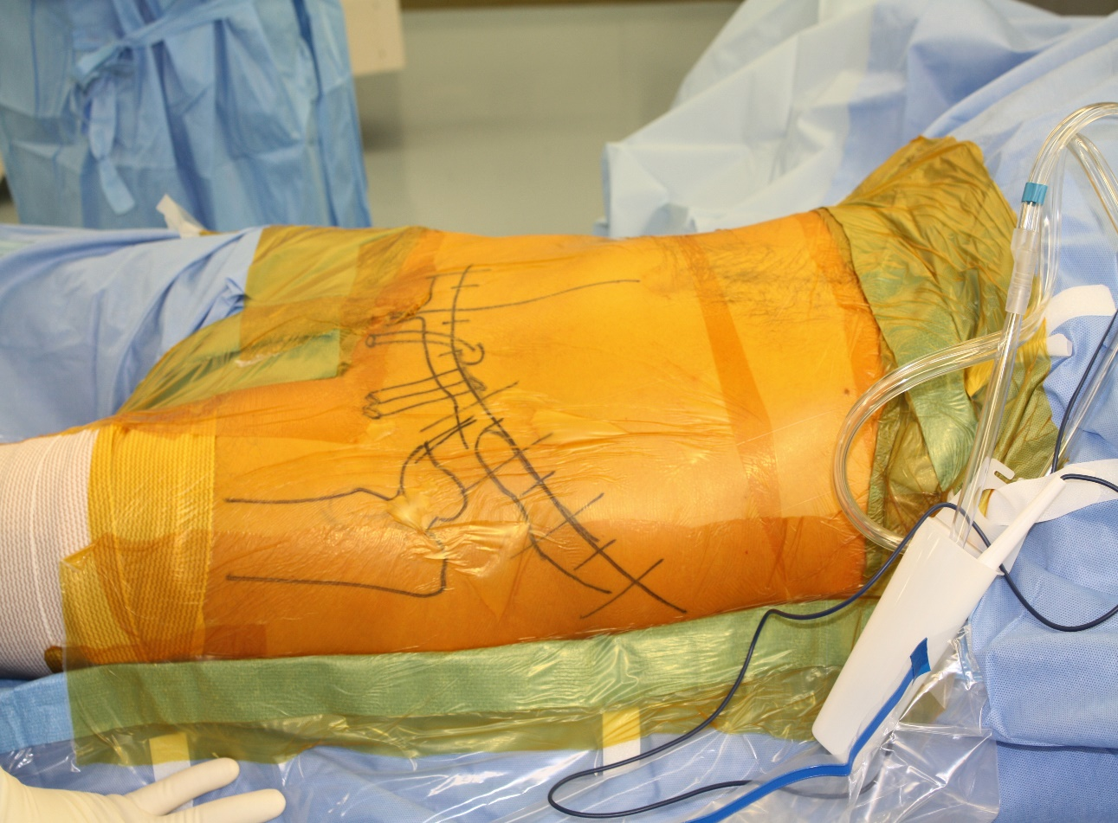
Superficial Landmarks
Iliac crest
ASIS
Pubic tubercle
Pubic symphysis
Courtesy of Milton L. Chip Routt, Jr. MD and Mark Adams, MD

Slide 10
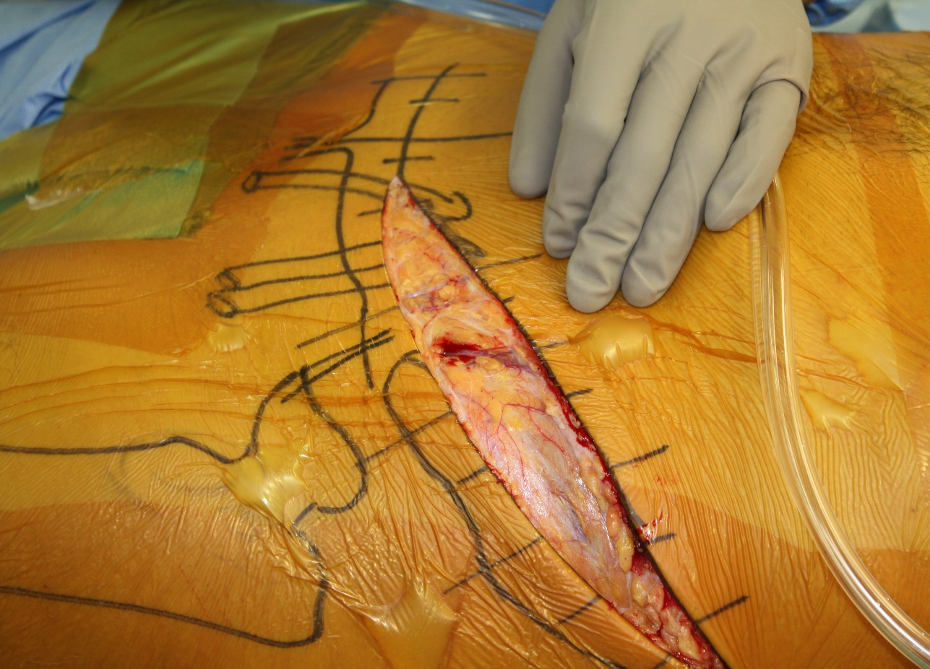
Superficial Landmarks
Incision:
- 2 cm cranial to symphysis
- Starting 2 cm on contralateral side
- Curve to ASIS
- Continue posterior along iliac crest
- Cauterize superficial epigastric vessels
Courtesy of Milton L. Chip Routt, Jr. MD and Mark Adams, MD

Slide 11
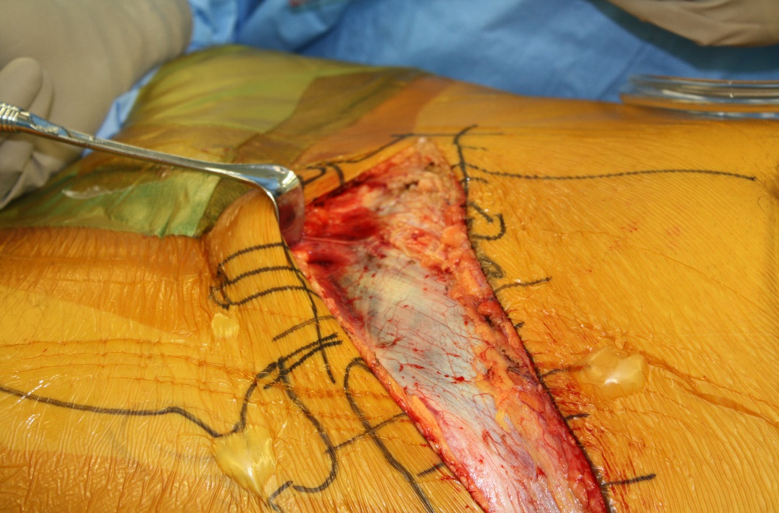
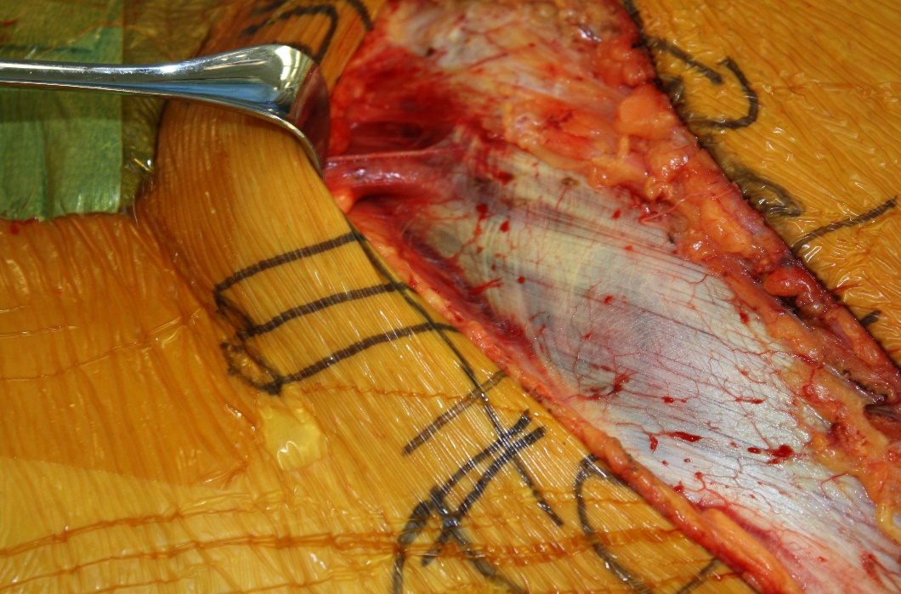
Superficial Dissection
Dissect to external oblique fascia throughout
Palpate ASIS
Identify:
- Inguinal ligament
- Spermatic cord
- External inguinal ring
- Linea alba
Courtesy of Milton L. Chip Routt, Jr. MD and Mark Adams, MD

Slide 12
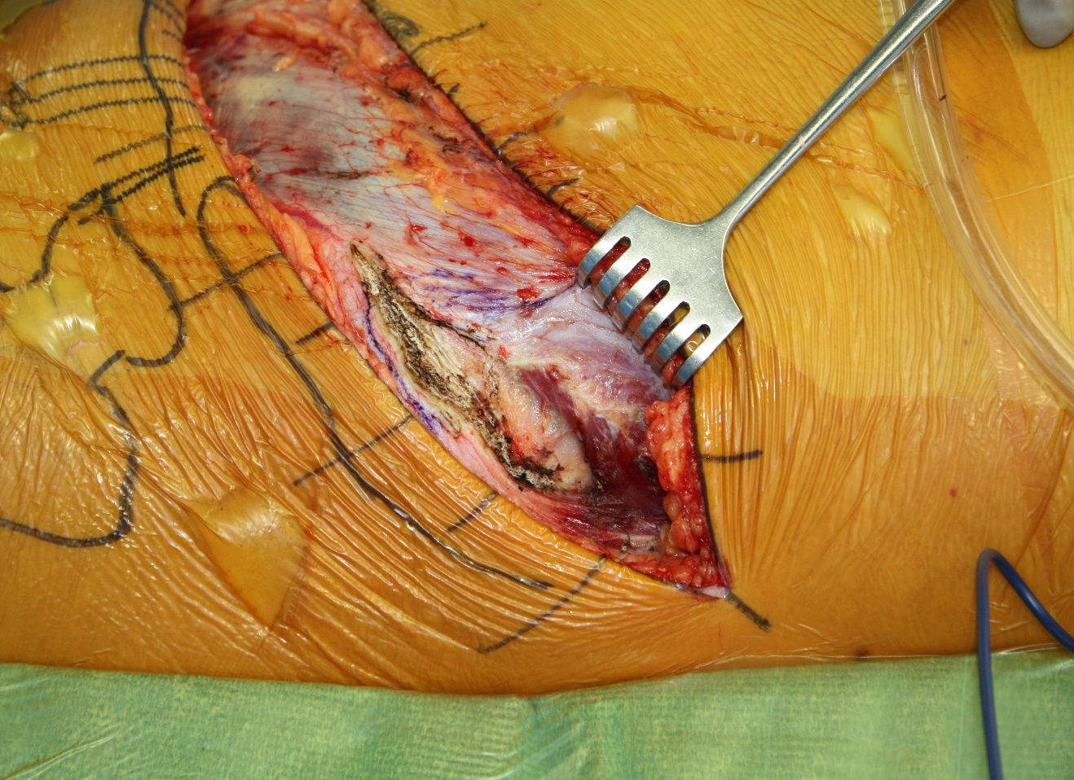
Lateral Window
Delineate external oblique insertion from tensor origin on iliac crest
Cautery between both on outer iliac crest starting at ASIS
Stay out of external oblique fascia until at least posterior to medius pillar
Incise external oblique fascia in line with muscle fibers
Courtesy of Milton L. Chip Routt, Jr. MD and Mark Adams, MD

Slide 13
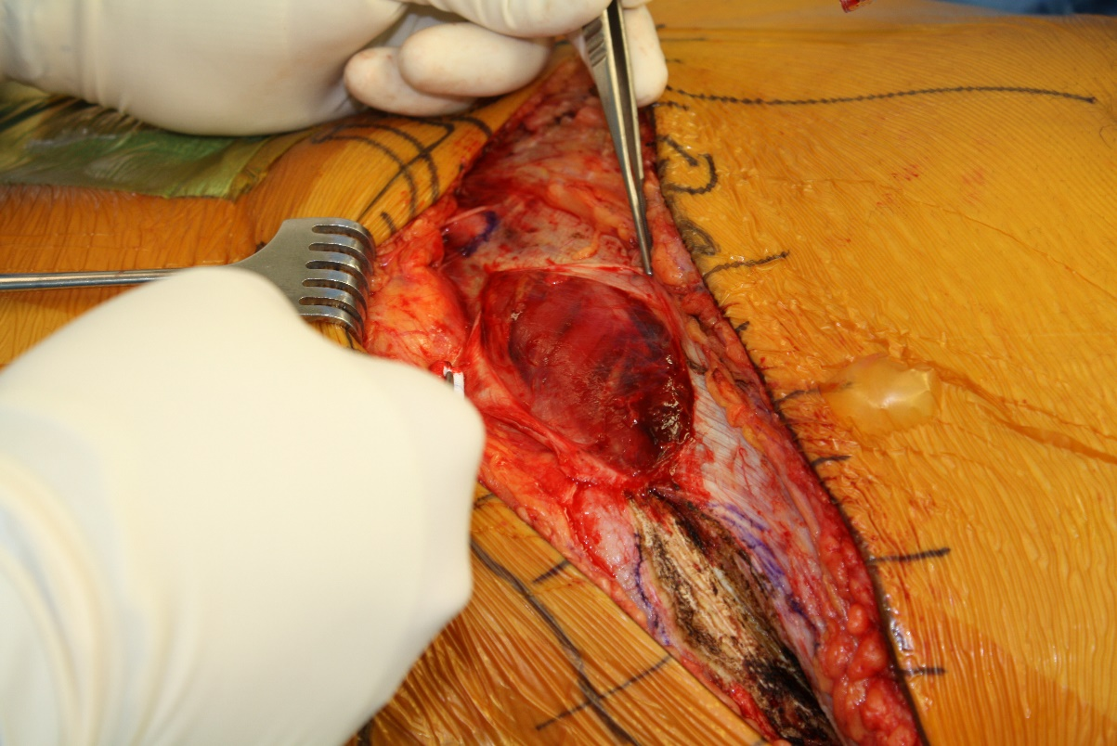
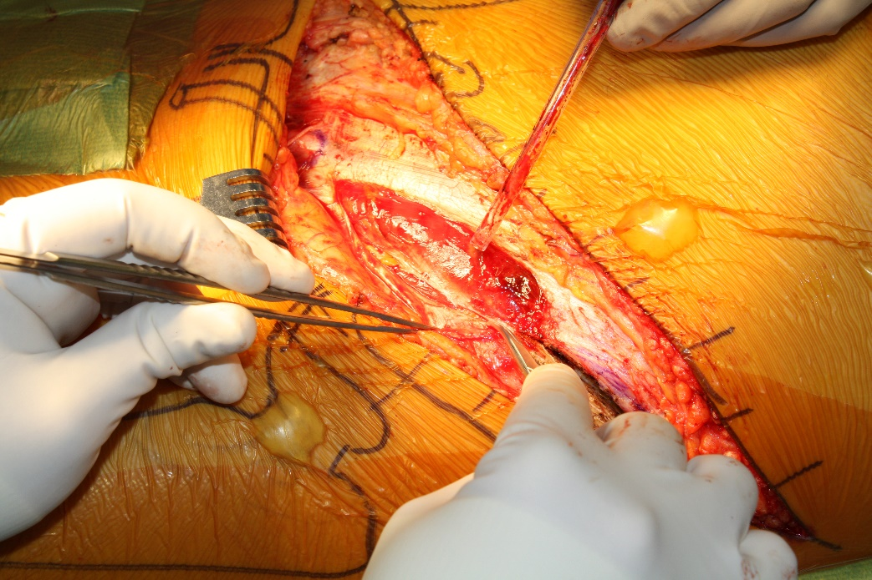
Middle Window
Incise 1-2 cm cranial to palpable inguinal ligament and just medial to external inguinal ring up to ASIS
Care taken to not damage ilioinguinal nerve below fascia
Mobilize canal contents proximally offinguinal ligament
Incise floor of ligament/inguinal canal leaving 2 mm cuff for later repair
Courtesy of Milton L. Chip Routt, Jr. MD and Mark Adams, MD

Slide 14
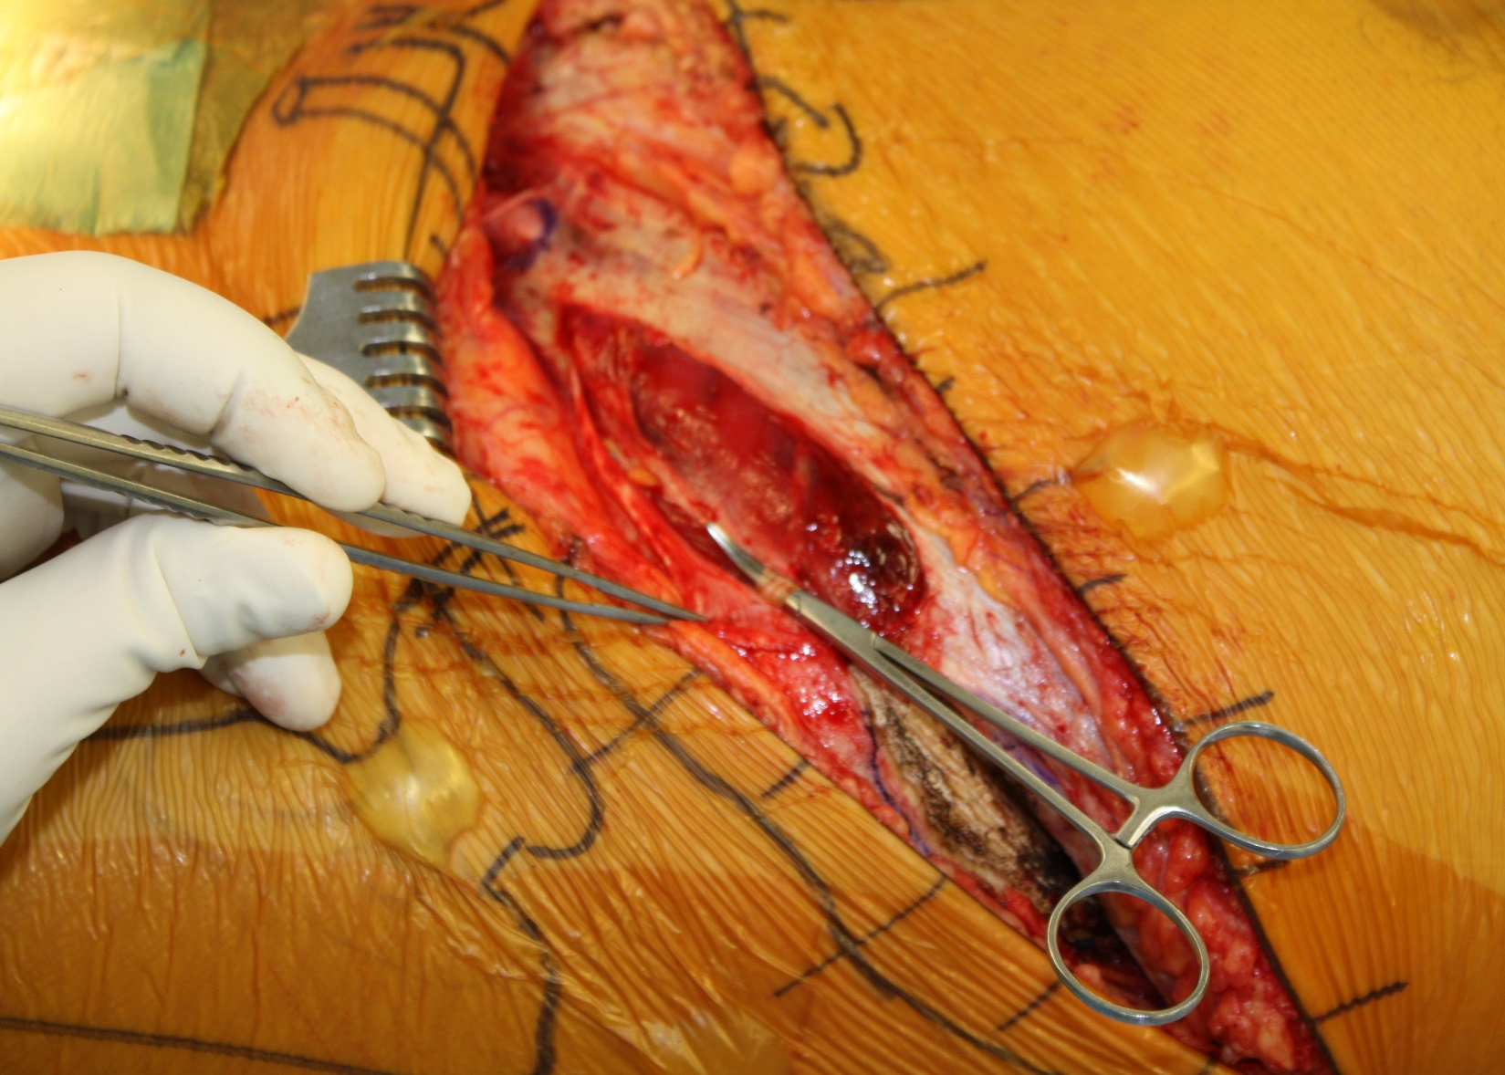
Middle Window
Identify lateral femoral cutaneous nerve medial to ASIS
Can do 2 cm segmental excision to minimize neuroma or mobilize
Courtesy of Milton L. Chip Routt, Jr. MD and Mark Adams, MD

Slide 15
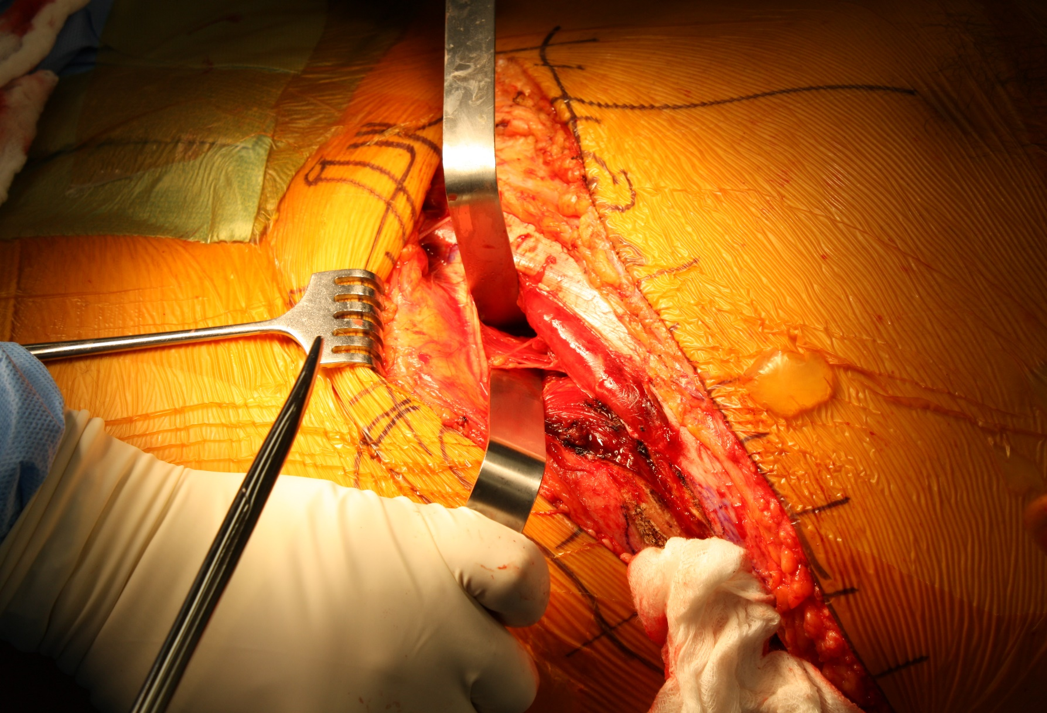
Middle Window
Identify iliopectineal fascia overlying iliopsoas and palpate femoral vessels medially
Bluntly dissect onto and just lateral to femoral artery.
Mobilize artery medial and retract iliopsoas and femoral nerve laterally
Courtesy of Milton L. Chip Routt, Jr. MD and Mark Adams, MD

Slide 16
Middle Window
Incise iliopectineal fascia down to pelvic brim
Cautious for perforating vessel within fascia
Release down to pelvic brim
Continue releasing anteriorly over ramus and posteriorly into true pelvis
Courtesy of Milton L. Chip Routt, Jr. MD and Mark Adams, MD

Slide 17
Medial Window/Anterior Intrapelvic Approach
Original Stoppa approach used for inguinal hernia repair with mesh
Cole and Hirvensalo described use for acetabular surgery in early 1990s
Depending on the fracture pattern, this interval can be used in isolation, along with lateral window, or as the medial window of ilioinguinal

Slide 18
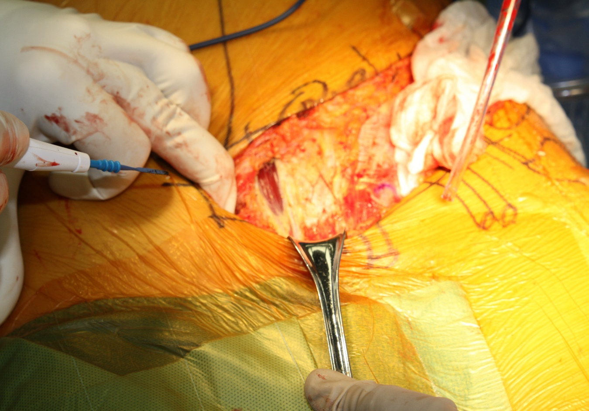
Medial Window/Anterior Intrapelvic Approach
Incise linea alba and extend 10 cm proximal to symphysis
Split rectus and carefully incise posterior rectus sheath
Use finger to free bladder off posterior rectus sheath and expose perisosteum of posterosuperior superior ramus surface
Courtesy of Milton L. Chip Routt, Jr. MD and Mark Adams, MD

Slide 19
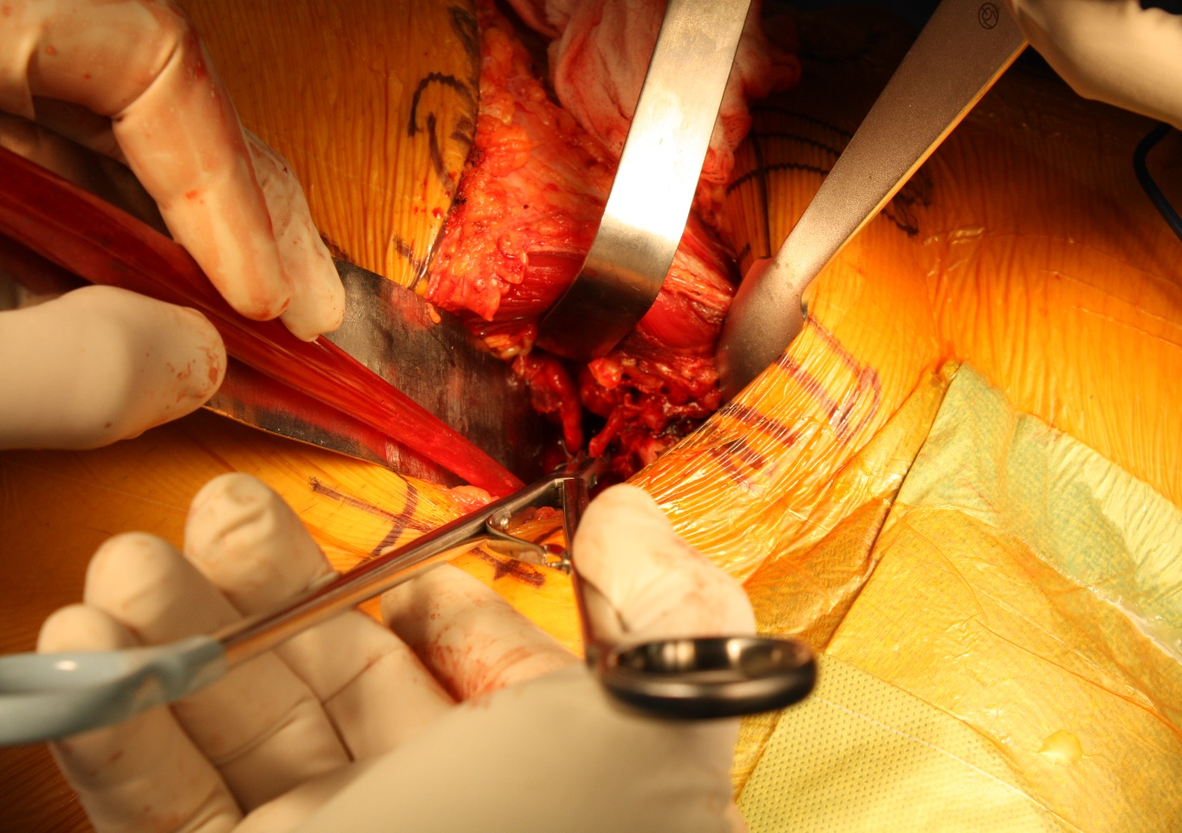
Medial Window/Anterior Intrapelvic Approach
Insert malleable retractor to mobilize bladder posteriorly
Release superior rectus insertion working laterally
Continue releasing iliopectineal fascia working laterally
Identify and ligate/cauterize/clip vascular anastomosis between iliac and obturator systems
Courtesy of Milton L. Chip Routt, Jr. MD and Mark Adams, MD

Slide 20
Medial Window/Anterior Intrapelvic Approach
Mobilize obturator neurovascular bundle
Can retract caudally and work superior to the bundle
Can also dissect caudal side of bundle, retract obturator bundle superiorly and work inferiorly
Release iliopectineal fascia back to sacroiliac joint and further expose internal iliac fossa
Sagi HC, Afsari A, Dziadosz D. The anterior intra-pelvic (modified rives-stoppa) approach for fixation of acetabular fractures. J Orthop Trauma. 2010 May;24(5):263-270

Slide 21
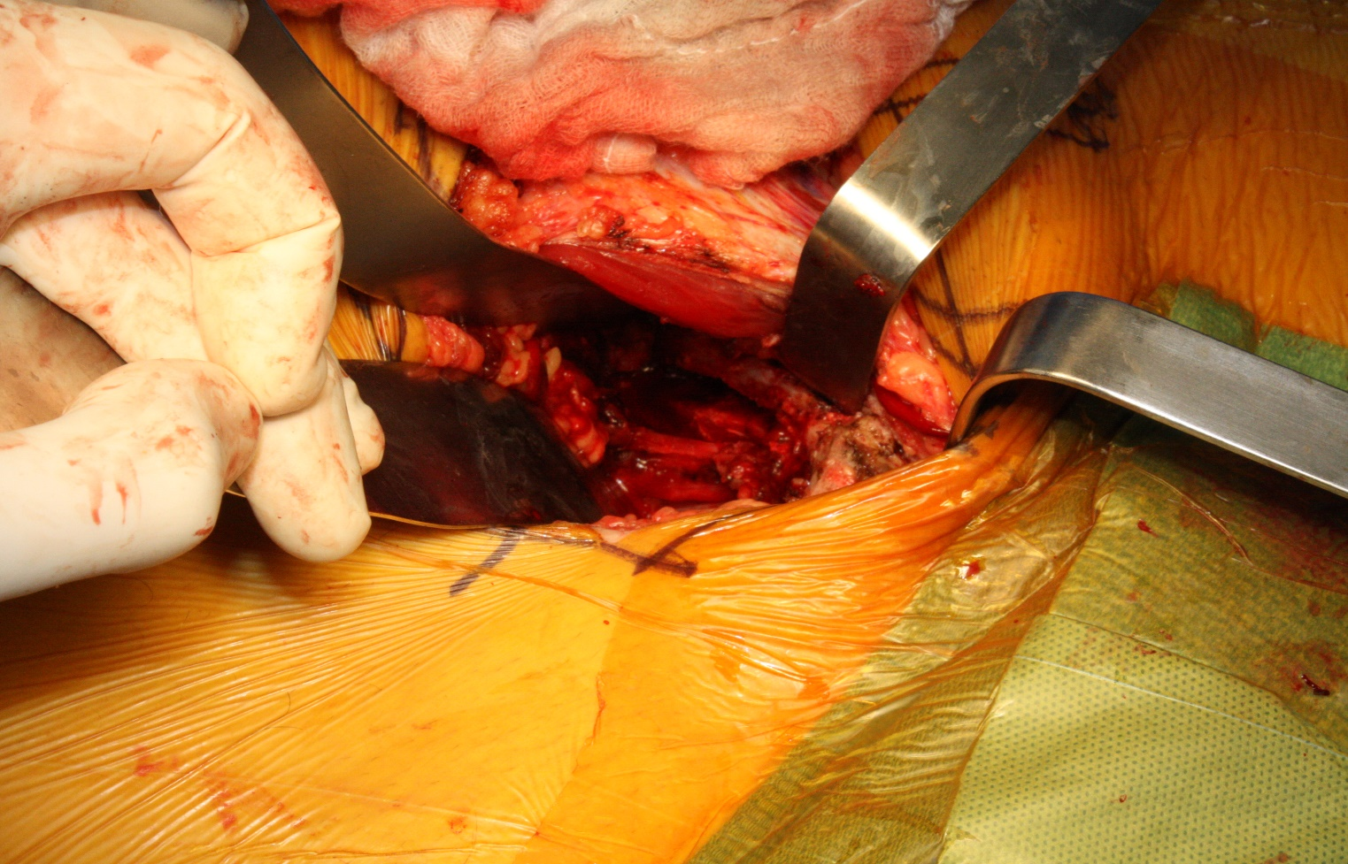
Medial Window/Anterior Intrapelvic Approach
Release obturator internus muscle to expose quadrilateral plate and posterior column
Courtesy of Milton L. Chip Routt, Jr. MD and Mark Adams, MD

Slide 22
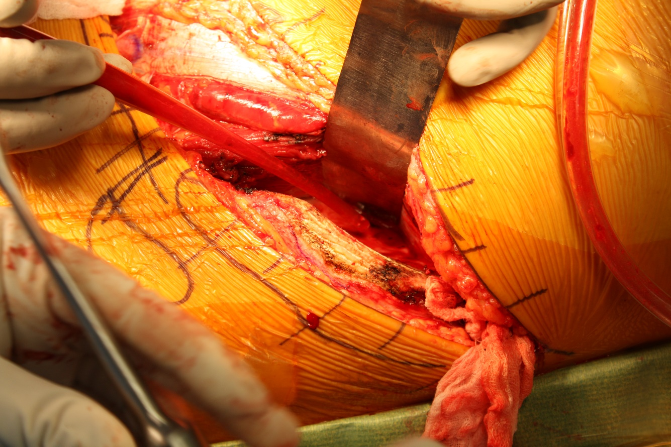
Lateral Window
If not already done, back to iliac crest and fully release obliques and then iliacus in subperiosteal fashion
Malleable or other retractor over brim or towards PSIS helps expose internal iliac fossa
Courtesy of Milton L. Chip Routt, Jr. MD and Mark Adams, MD

Slide 23
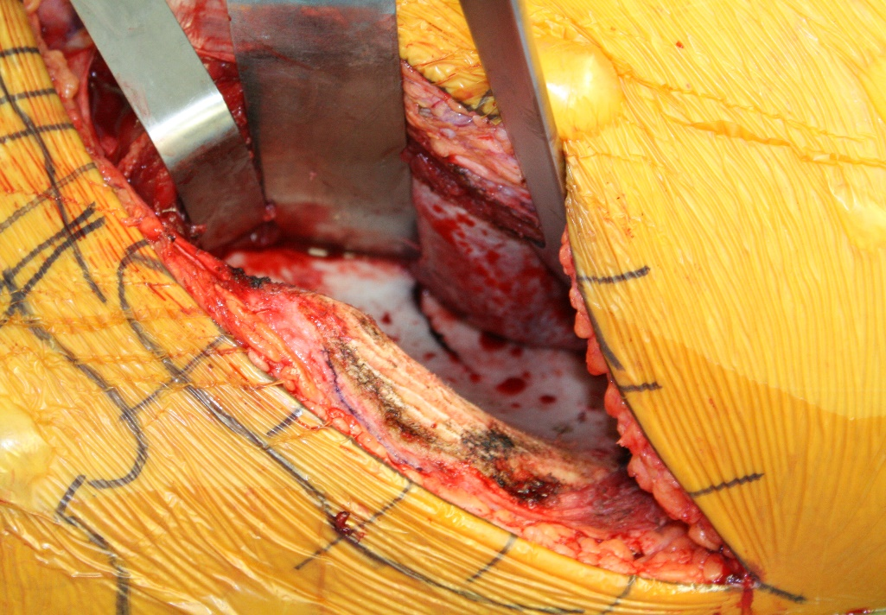
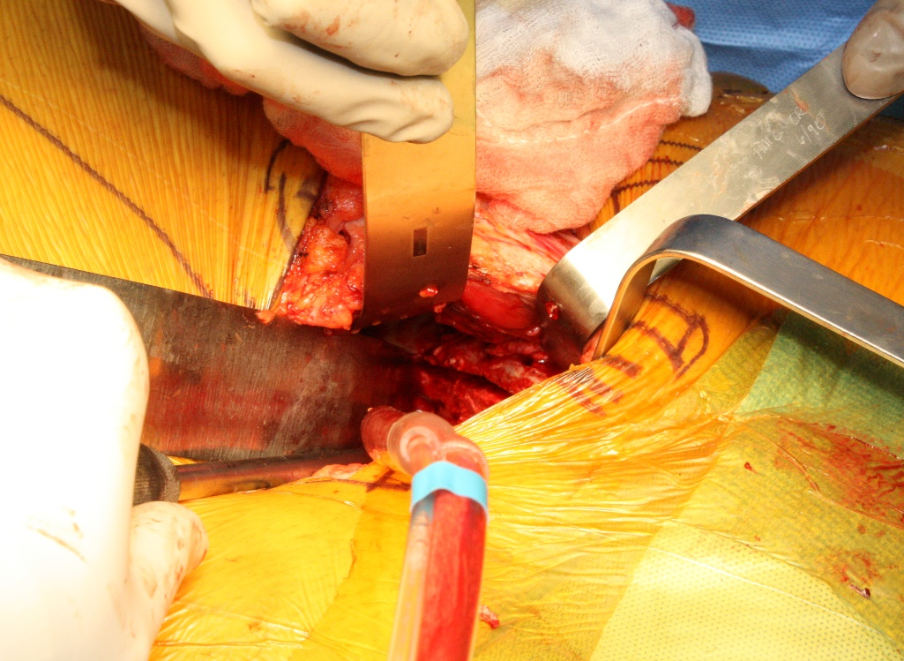
Fracture Exposure
Until now the fracture hematoma and tissue interposed in fracture has been left untouched
This minimizes creating new and ongoing bleeding while still exposing
Work through all intervals as needed to clean and irrigate fracture appropriately
Courtesy of Milton L. Chip Routt, Jr. MD and Mark Adams, MD

Slide 24
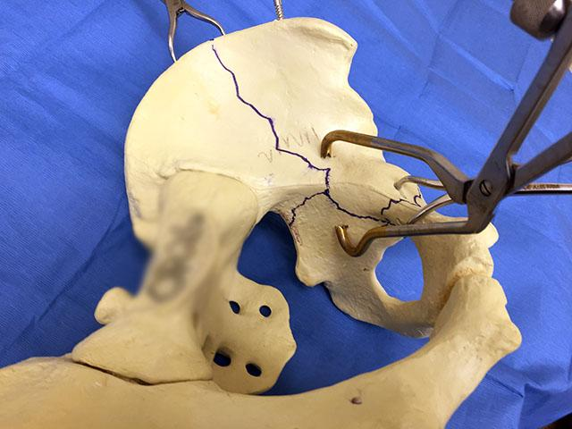
Fracture Reduction
Based off injury pattern and displacement
Shantz pin in medius pillar
Ball spike pusher with foot plate
Numerous clamp types and positions possible
Undercontoured plate can also help achieve reduction
Sagi HC, Afsari A, Dziadosz D. The anterior intra-pelvic (modified rives-stoppa) approach for fixation of acetabular fractures. J Orthop Trauma. 2010 May;24(5):263-270
Courtesy of Milton L. Chip Routt, Jr. MD

Slide 25
Fracture Fixation
Based off injury pattern, fracture morphology, displacement
Common plating surfaces include:
Superiorly on the pelvic brim and superior ramus
intrapelvic along the quadrilateral plate
Sequencing and placement of implants important and varies between injuries
Independent screws possible but care taken to ensure appropriate location as they can complicate plate contour and plate-bone opposition

Slide 26
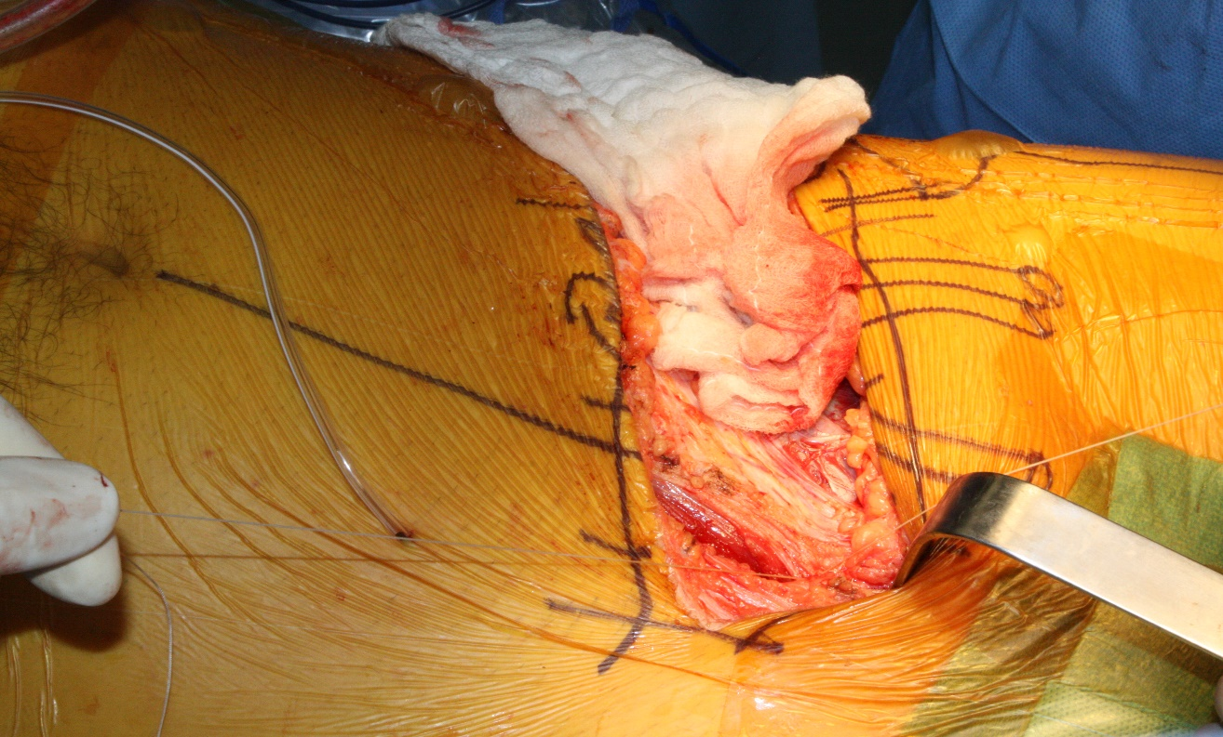
Wound Care and Closure
After fixation completed, copious irrigation performed
Surgical drains typically placed in Space of Retzius and internal iliac fossa to prevent deep hematoma formation
Closure of rectus insertion deep and linea alba with interrupted 0 or 2-0 vicryl
Courtesy of Milton L. Chip Routt, Jr. MD and Mark Adams, MD

Slide 27
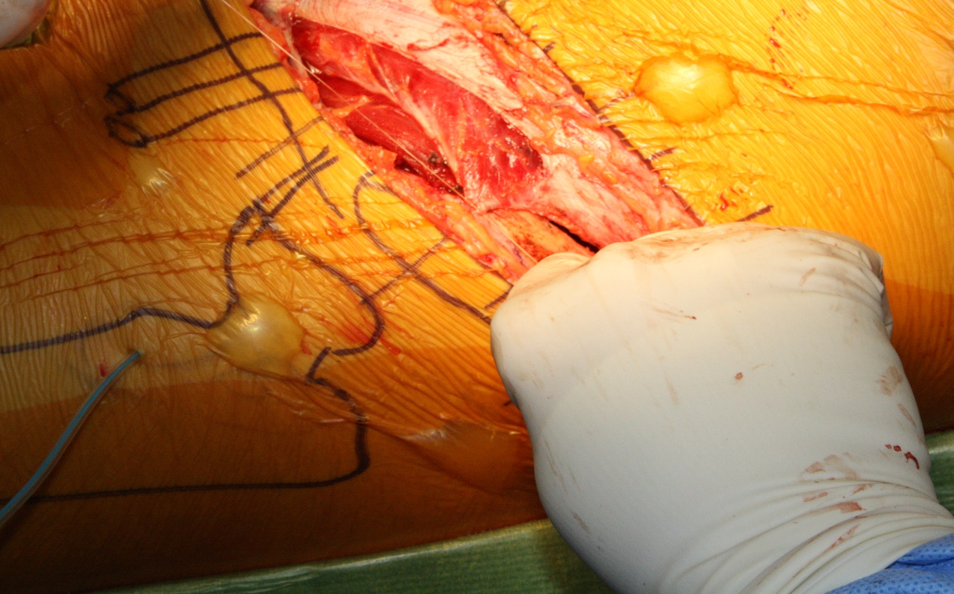
Lateral Window Closure
Initial 0 or 2-0 vicryl stitch to origin of inguinal ligament on ASIS
Sets ligament orientation and allows tension free repair of floor and roof of inguinal ligament
Courtesy of Milton L. Chip Routt, Jr. MD and Mark Adams, MD

Slide 28
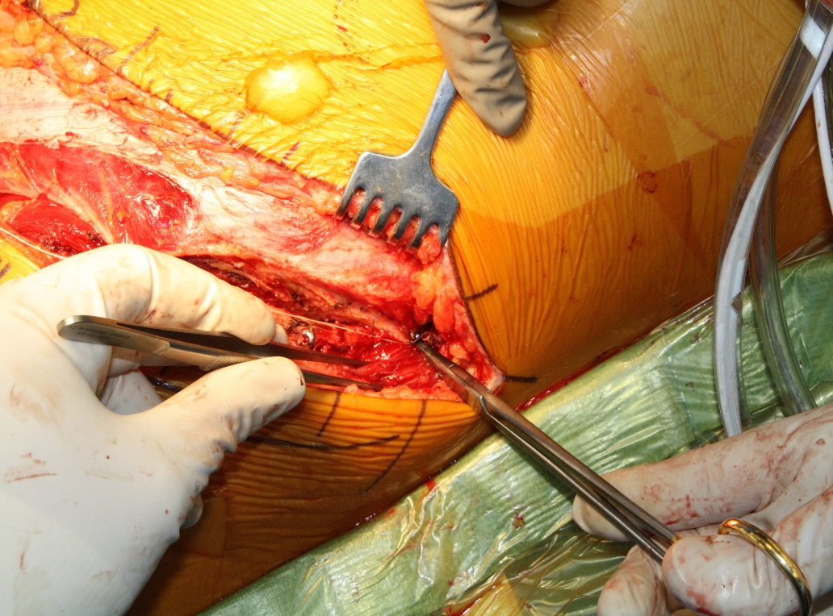
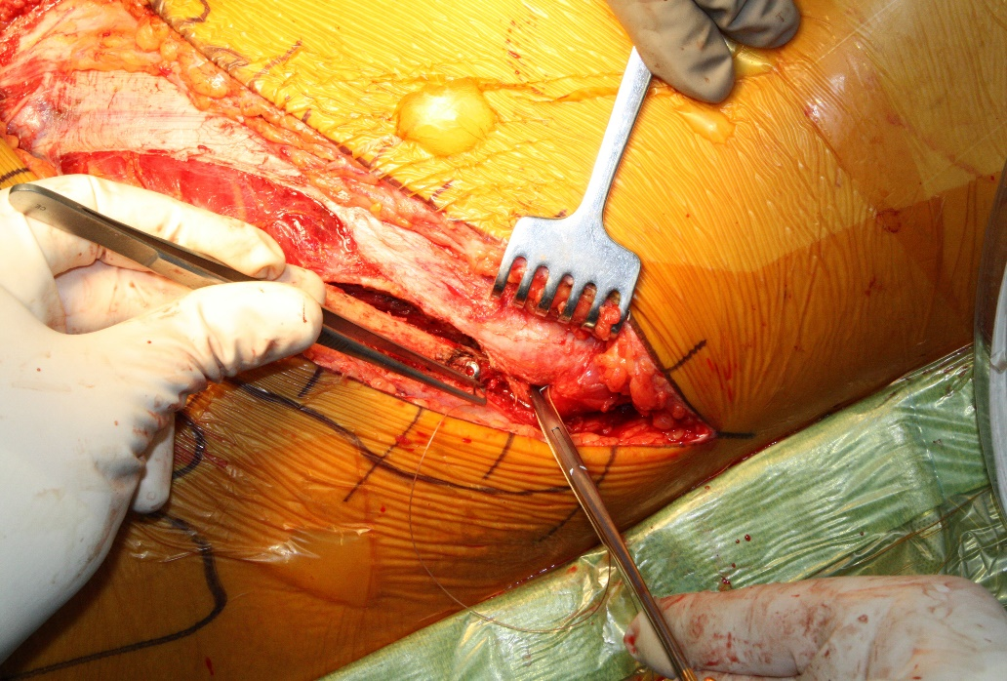
Lateral Window Closure
Layered closure with 0 or 2-0 vicryl
Internal oblique first deep to external oblique split.
Key to prevent potential hernia
External oblique fascia to crest and abductory fascia second
Courtesy of Milton L. Chip Routt, Jr. MD and Mark Adams, MD

Slide 29
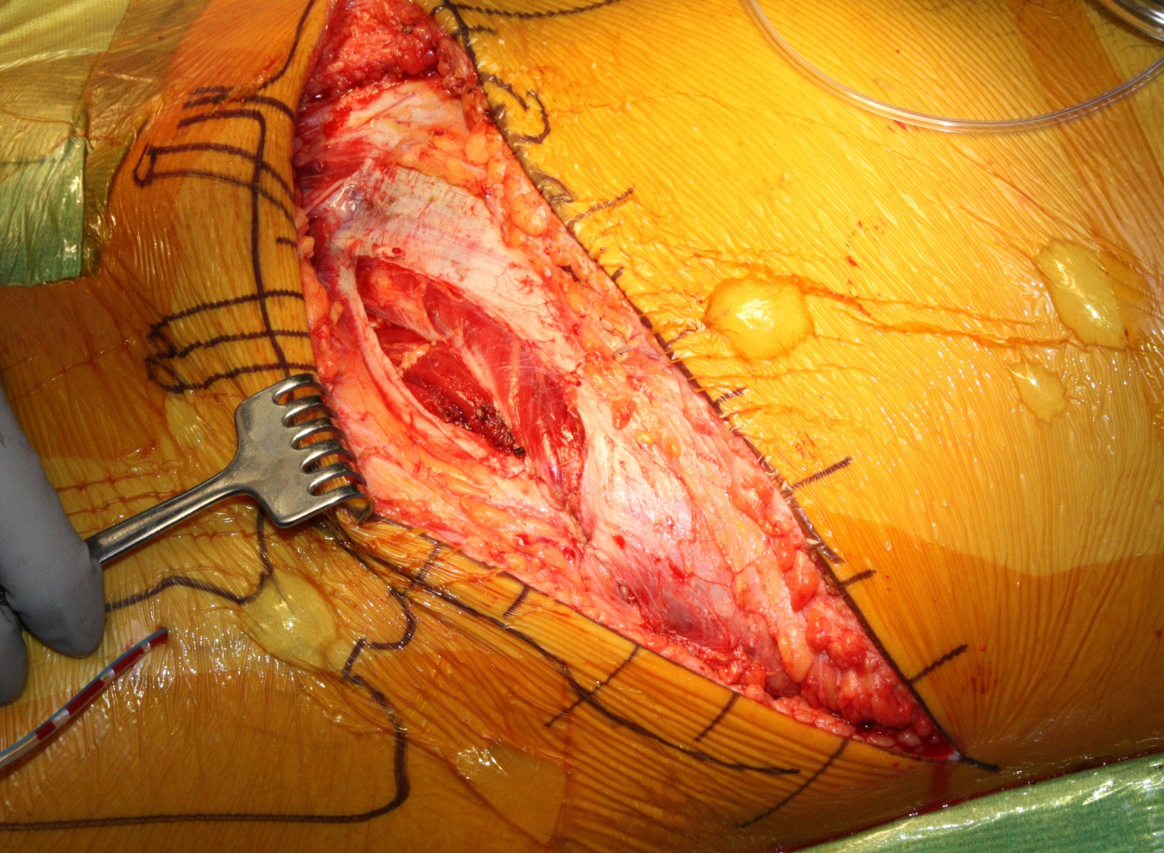
Lateral Window Closure
Final appearance of two layer lateral window closure
Courtesy of Milton L. Chip Routt, Jr. MD and Mark Adams, MD

Slide 30
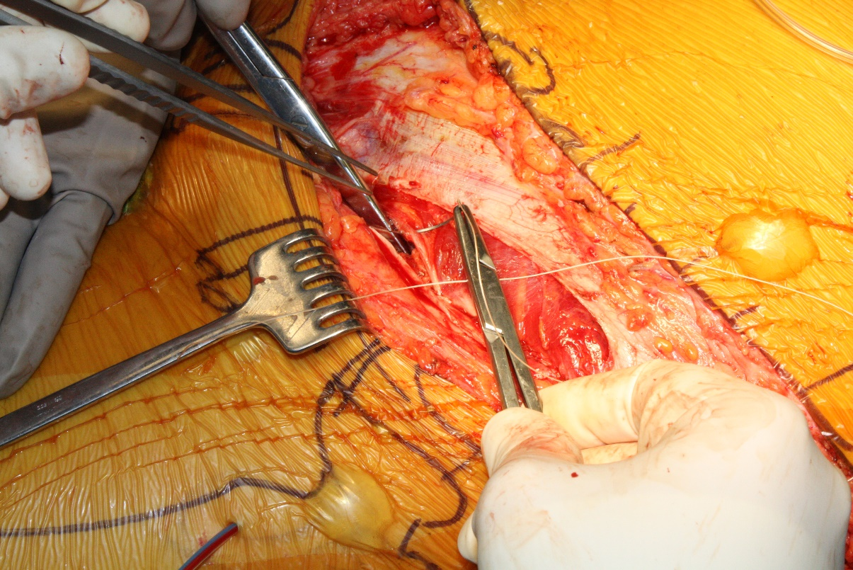
Middle Window Closure
Repair floor of inguinal canal/inguinal ligament first with 2-0 vicryl
Care taken to reapproximate prior 2 mm cuff of ligament and avoid tearing
Courtesy of Milton L. Chip Routt, Jr. MD and Mark Adams, MD

Slide 31
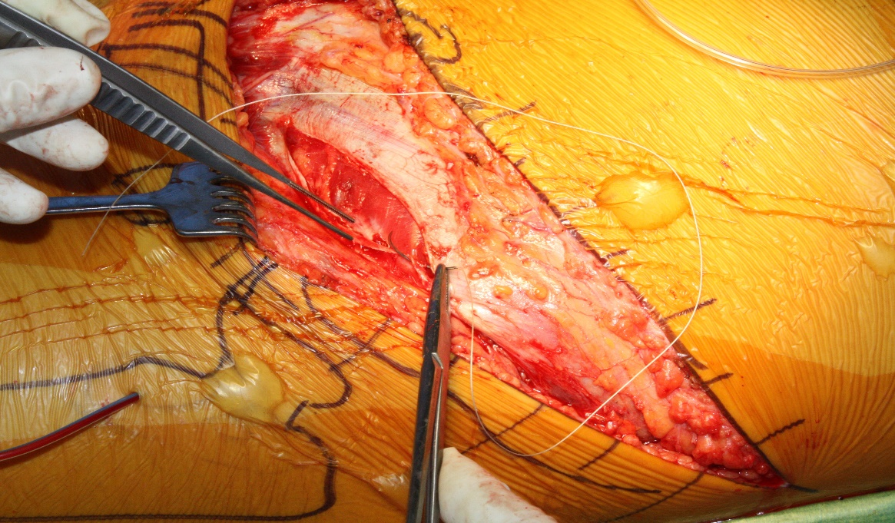
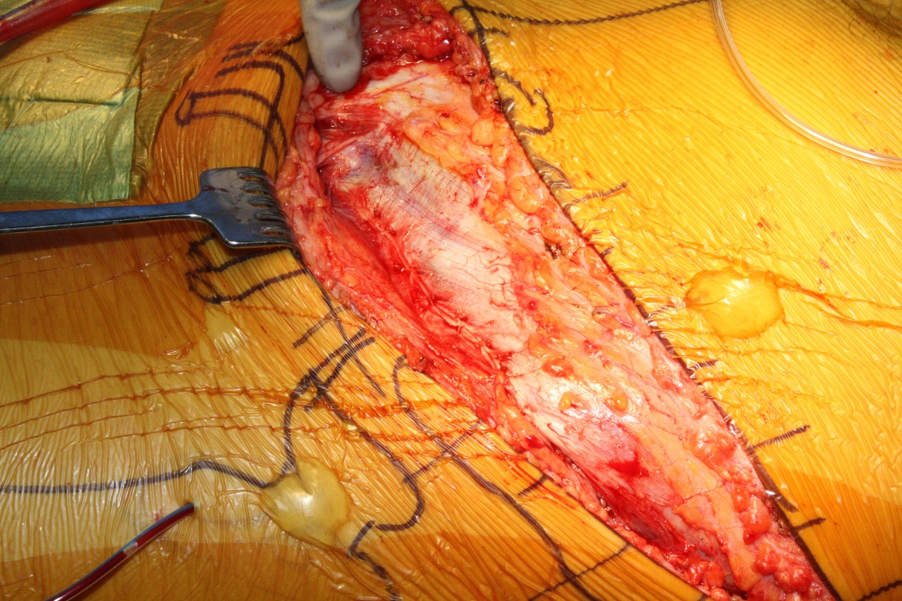
Middle Window Closure
Repair roof of canal/external oblique fascia with 0 or 2-0 vicryl
Take care to avoid ilioinguinal nerve on superior fascial limb
Complete fascial closure back to ASIS
Courtesy of Milton L. Chip Routt, Jr. MD and Mark Adams, MD

Slide 32
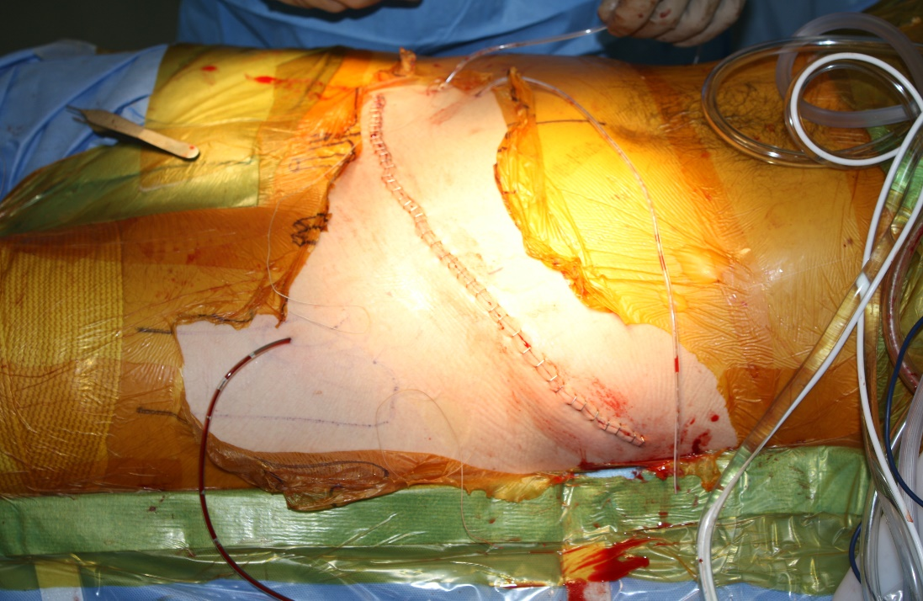
Wound Closure
Once all deep layers closed, irrigate superficial layer
Consider reattaching subcutaneous tissue back down to fascia to minimize dead space
Superficial drain if desired
Skin reapproximation with 2-0 vicryl
Skin closure
Courtesy of Milton L. Chip Routt, Jr. MD and Mark Adams, MD

Slide 33
References
Discussion and observation with Dr. Milton L. Chip Routt, Jr. 2011 – Present
Cutrera NJ, Pinkas D, Toro JB. Surgical Approaches to the Acetabulum and Modifications in Technique. J Am Acad Orthop Surg. 2015 Oct;23(10):592-603.
Tosounidis TH, Giannoudis VP, Kanakris et al. The Ilioinguinal Approach: State of the Art. JBJS Essent Surg Tech. 2018 Jun 27;8(2):e19
Fensky F, Lehmann W, Ruecker A, et al. Ilioinguinal Approach: Indication and Technique. J Orthop Trauma. 2018 Aug;32 Suppl 1:S12-S13
Sagi HC, Afsari A, Dziadosz D. The anterior intra-pelvic (modified rives-stoppa) approach for fixation of acetabular fractures. J Orthop Trauma. 2010 May;24(5):263-270
Hagen JE, Weatherford BM, Nascone JW, et al. Anterior intrapelvic modification of the ilioinguinal approach. J Orthop Trauma. 2015 Feb;29 Suppl2:S10-3.
Karunakar MA, Le TT, Bosse MJ. The modified ilioinguinal approach. J Orthop Trauma. 2004 Jul;18(6)379-83

Slide 34
Patient Example

Slide 35
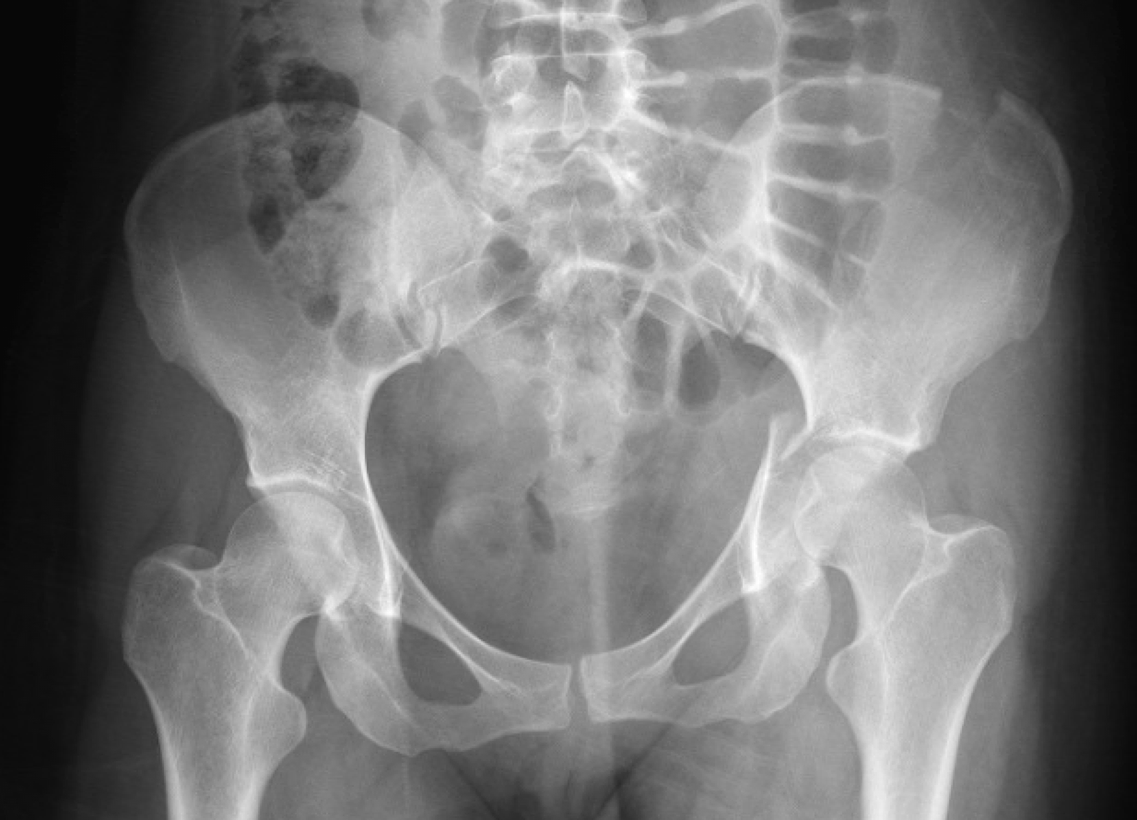
28 yo female
MVC
L hip pain
HD stable
NVI L LE

Slide 36
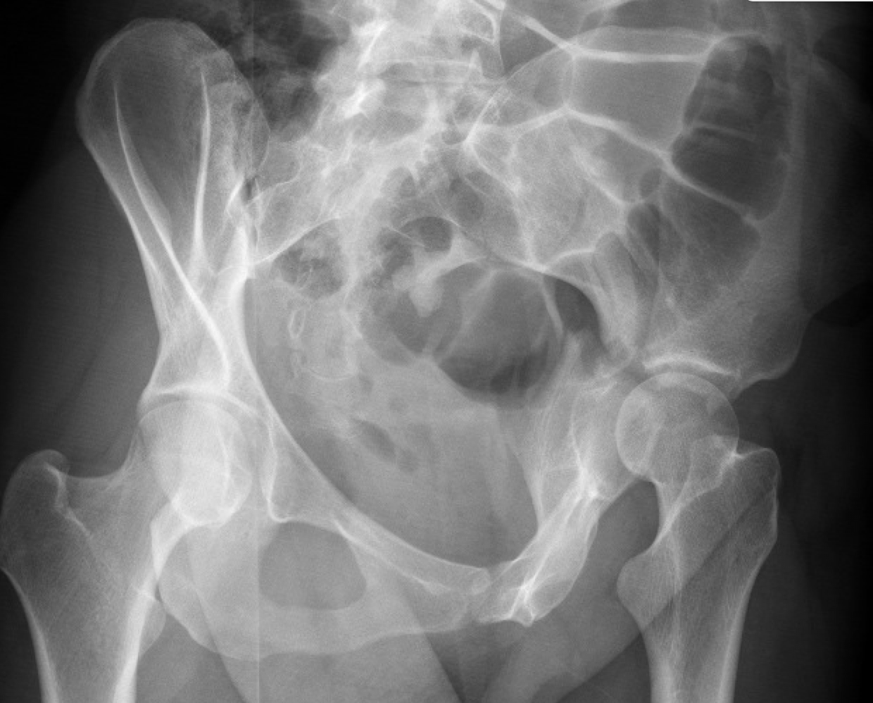
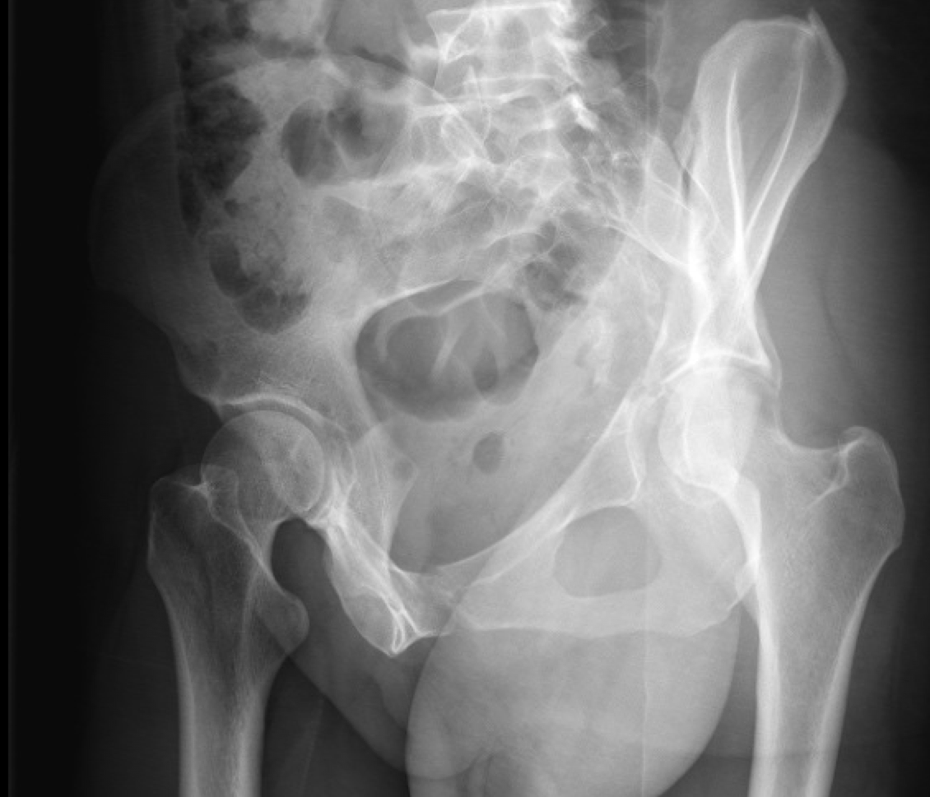

Slide 37
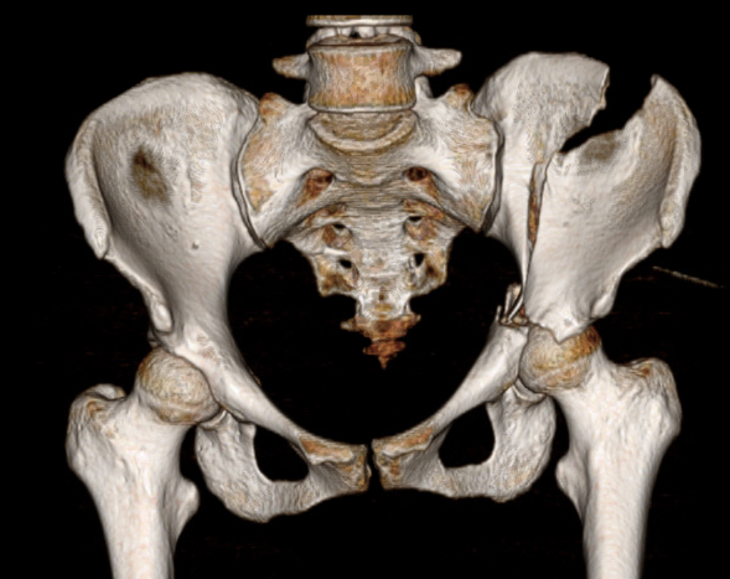
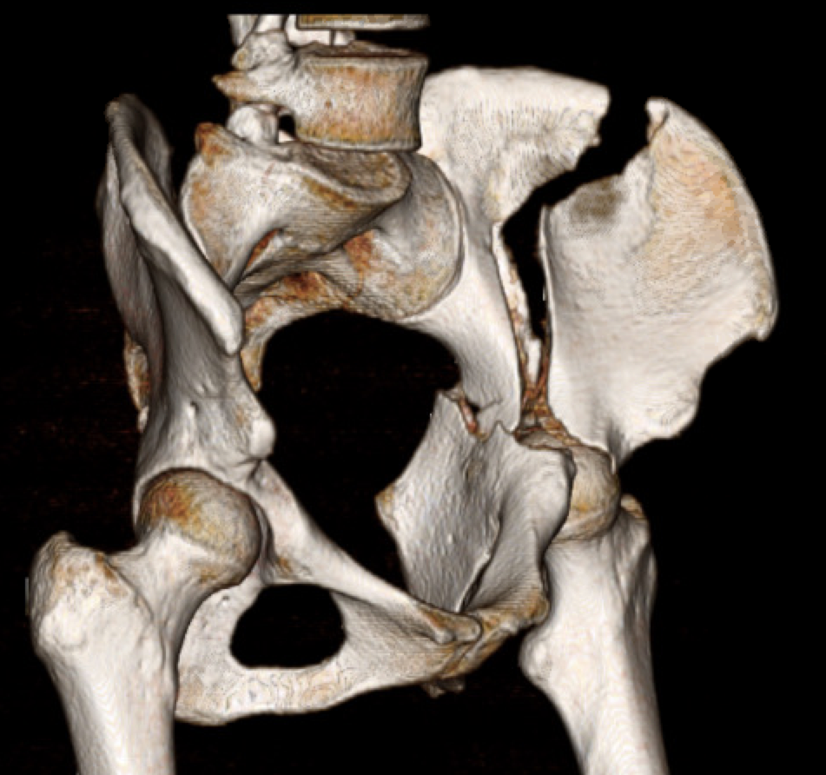

Slide 38
Diagnosis?
Associated Both Column
1
Anterior column fragment (1)
Posterior column fragment (2)
Intact ilium (3)
3
Both the anterior column and posterior column fragments are separate from the intact ilium
2

Slide 39
Operative Plan?
Ilioinguinal exposure:
Allows exposure of all fractures and is necessary for cleaning, reducing, and implant placement.
Reduce anterior column (1) to intact ilium (3)
Place pelvic brim plate and crest screw to buttress column and link anterior column to intact ilium
Reduce posterior column (2) to intact ilium (3) and anterior column (1)
Place screws from pelvic brim into posterior column and intrapelvic plate to buttress
1
3
2

Slide 40
Operative Plan?
1
Ilioinguinal exposure:
Allows exposure of all fractures and is necessary for cleaning, reduction, and implant placement
3
2

Slide 41
Reduction and fixation sequence:
Reduce anterior column (1) to intact ilium (3)
Place pelvic brim plate and crest screw to buttress column and connect anterior column to intact ilium
Now it is a two part fracture
Reduce posterior column (2) onto the intact ilium (3) and anterior column (1)
Place screws from pelvic brim down into posterior column
Place intrapelvic plate maintain reduction and buttress posterior column (2) to intact ilium (3) reduction
1
3
2

Slide 42
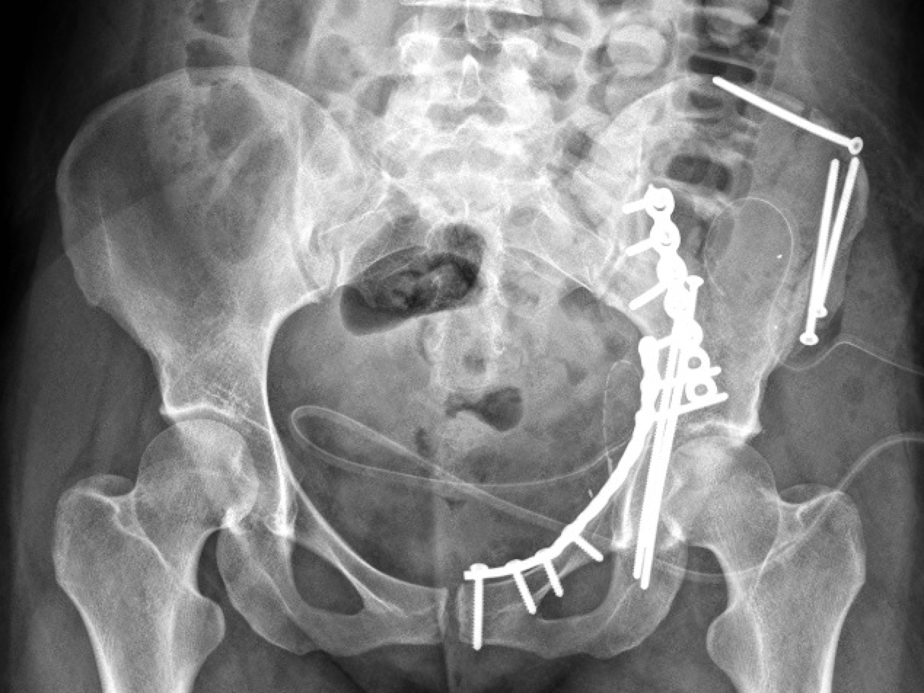

Slide 43
