Slide 1
Percutaneous Fixation of the Acetabulum
Joey P. Johnson, MD
Assistant Professor
Loma Linda University
All figures belong to Joey Johnson, MD unless otherwise noted

Slide 2
Objectives
Goals of operative management
Indications for intervention
Radiographic views
Fixation corridors
Special Cases
Combined open and percutaneous methods

Slide 3
Goals of Operative Management
As with all periarticular fracture work, anatomic reconstruction (particularly of the weightbearing dome) and stable fixation to allow for early mobilization are key
In some settings when anatomic reconstruction is not feasible (elderly patients with poor bone quality, prolonged dislocation, combined femoral head and acetabular injuries, etc) percutaneous means can be used in conjunction with total hip arthroplasty to allow for an optimal outcome
Minimizing morbidity and maximizing function are the goals of all surgical treatment and percutaneous fixation methods can offer a very useful tool in achieving these goals when used in isolation or in combination with open techniques

Slide 4
Indications for Intervention
Hip instability
>2mm displacement within the weightbearing dome
Fracture lines that are amenable to fixation through bony corridors
The presence of unstable posterior (and often anterior) wall components usually necessitates at least a partial open approach and percutaneous fixation of these in isolation is usually not recommended

Slide 5
Radiographic views- Obturator Oblique
“Percutaneous fixation is a surgery performed by the fluoro tech, where the surgeon assists him/her”
45 degrees roll over towards injured side (patient position, anatomy and fracture deformity can alter this number)
Visualization of posterior wall and anterior column
All of the following views are combinations of obturator and iliac obliques as well as inlet and outlet views
Berton R. Moed, John A. Boudreau. Acetabulum Fractures. In: Tornetta P, Ricci WM, eds. Rockwood and Green's Fractures in Adults, 9e. Philadelphia, PA. Wolters Kluwer Health, Inc; 2019.

Slide 6
Radiographic views- Iliac Oblique
45 degrees of roll over away from injured side, anterior wall and posterior column are visualized
If adequate radiographic views cannot be obtained, then percutaneous acetabular fixation cannot be performed
High quality fluoroscopy is dependent on the machine being used, the technologist using it, and the ability of the surgeon to communicate effectively
Berton R. Moed, John A. Boudreau. Acetabulum Fractures. In: Tornetta P, Ricci WM, eds. Rockwood and Green's Fractures in Adults, 9e. Philadelphia, PA. Wolters Kluwer Health, Inc; 2019.

Slide 7
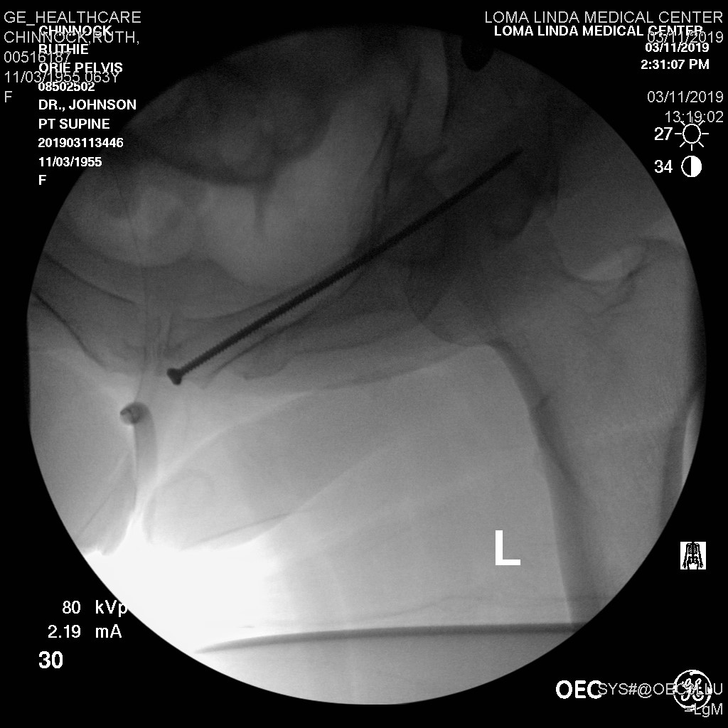
Radiographic views- Inlet
Beam tilted 25-40 degrees caudal (dependent upon patient’s sacral and pelvic anatomy, and positioning bumps/bone foam)
Rami should be superimposed on each other

Slide 8
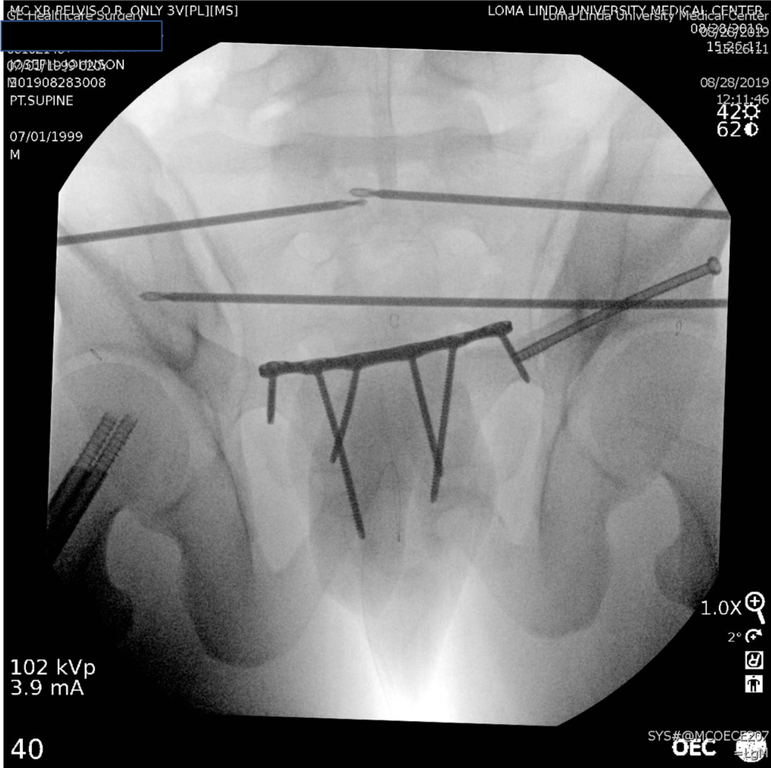
Radiographic views- Outlet
Beam angled 25-40 degrees cephalad (dependent on patient anatomy)
Symphysis should line up with spinous processes and sacral foramen should appear round

Slide 9
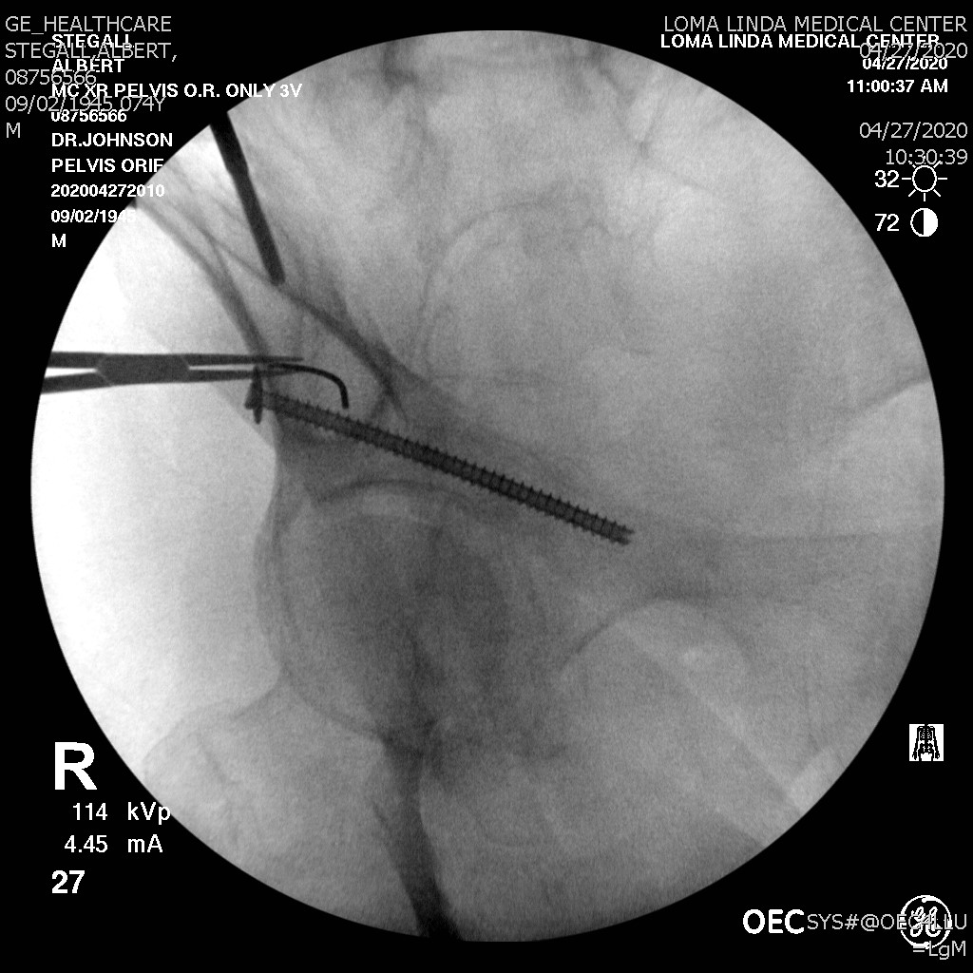
Radiographic views- Obturator outlet (teardrop)
This view shows the supra-acetabular corridor that runs from AIIS to PSIS (blue dots), also is a view used to confirm that an anterior column (or SPR) screw is not penetrating the acetabulum (yellow dots)
45 degrees of roll over towards injured side and 30 degrees of outlet

Slide 10
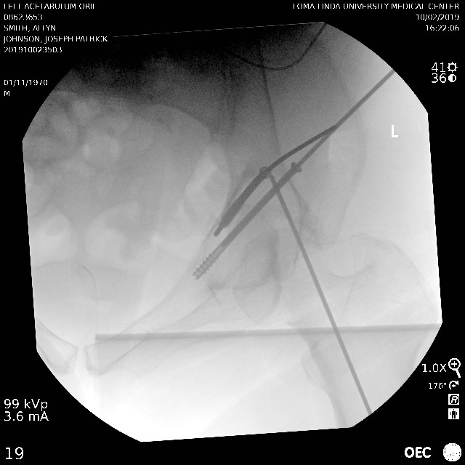
Radiographic views- Obturator Inlet (Leeds View)
The obturator inlet view allows for visualization of the inner and outer tables of the supra-acetabular corridor (Blue dots)
Useful for placing supra-acetabular (LCII) screws, anterior pelvic ex fix pins, or INFIX screws
45 degrees of rollover towards injured side and 25-40 degrees of inlet
Use of Inlet–Obturator Oblique View (Leeds View) for Placement of Posterior Wall Screws in Acetabular Fracture Surgery. T H Tosounidis, P V Giannoudis. JOT 2017. 31. 133-136
Notes:
45 degrees of rollover towards injured side and inlet tilt based upon patients pelvic and sacral morphology

Slide 11
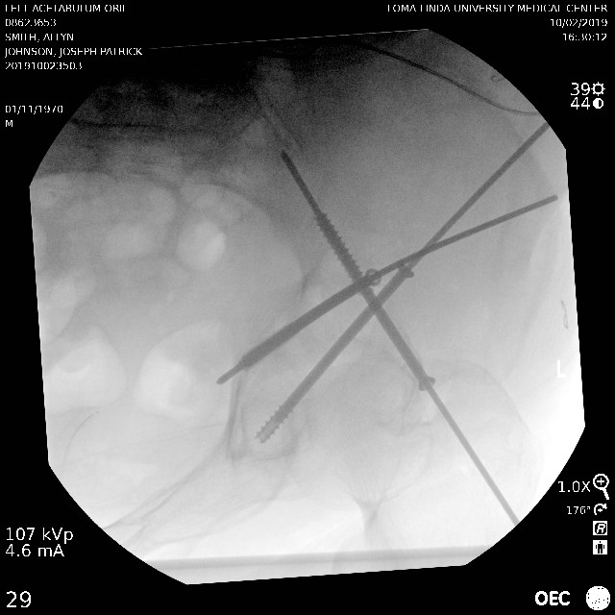
Radiographic views- Iliac Inlet
Allows for visualization of the sciatic notch (blue dots) and the pubic root (yellow dots)
45 degrees of roll over away from injured side and 25-40 degrees of cranial (inlet) tilt
Notes:
45 degrees of roll over away from the side of injury and inlet tilt specific to the patient

Slide 12
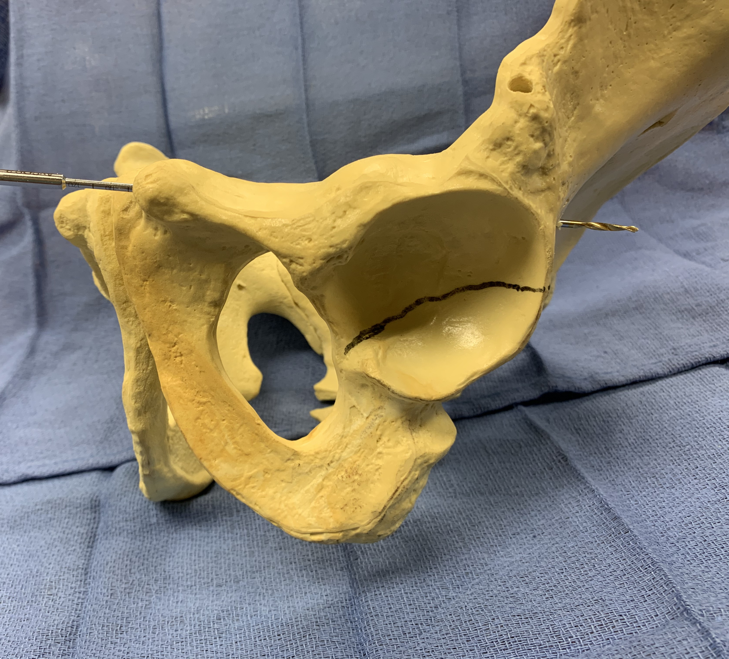
Fixation Corridors- Anterior Column/SPR
Can be done antegrade (starting behind the acetabulum, lateral to sciatic notch), or retrograde (starting lateral to the symphysis)

Slide 13
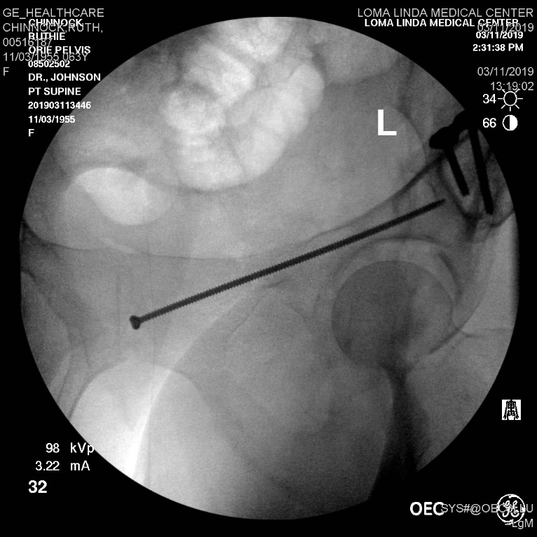
Fixation Corridors- Anterior Column/SPR (Retrograde)
Notes:
Based on preop measurements of the ramus screw sizes from 3.5-6.5 may be used, This patient had a relatively small corridor and a 3.5 screw was used

Slide 14
Fixation Corridors- Anterior Column/SPR (Retrograde)
Starting point is just lateral to the symphysis, the trajectory should be superior to the acetabulum
Obturator outlet view confirms that you are out of the acetabulum
Inlet, or iliac inlet, confirms that you are within the ramus
This connects the medial anterior column, or superior pubic ramus, to intact lateral anterior column, superior to, or behind the acetabulum
Screw length will be dependent on fracture location

Slide 15
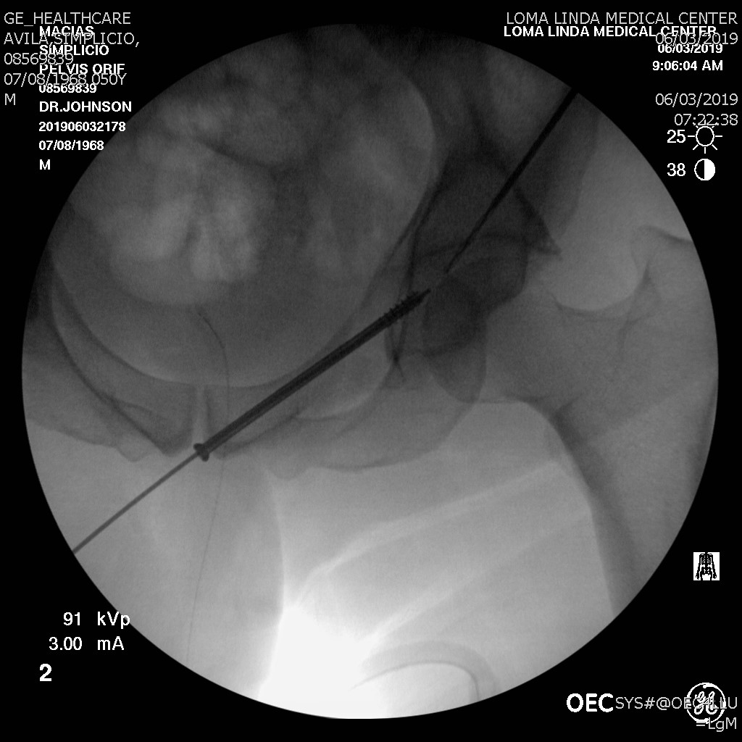
Fixation Corridors- Anterior Column/SPR (Retrograde)
CT scan should be used to assess the presence of comminution (an antegrade screw was attempted but because of the comminuted area the screw could not hit cortex and bend past it), and the size of the ramus
Solid or cannulated screw options can be used
Difficult in large patients because their thighs can get in the way, a sacral bump is useful to extend the hips and drop the thighs away
Keep C arm on the injury side of the patient

Slide 16
Fixation Corridors- Anterior Column/SPR (Retrograde)
Careful nick and spread technique and the use of cannulas/drill guides is recommended to prevent damage to surrounding structures
The skin incision is on the opposite side of the symphysis and inferior to the starting point to allow for the proper trajectory
Intra-pelvic penetration risks bladder injury, while exiting out the front of the ramus can injure the iliac vessels

Slide 17
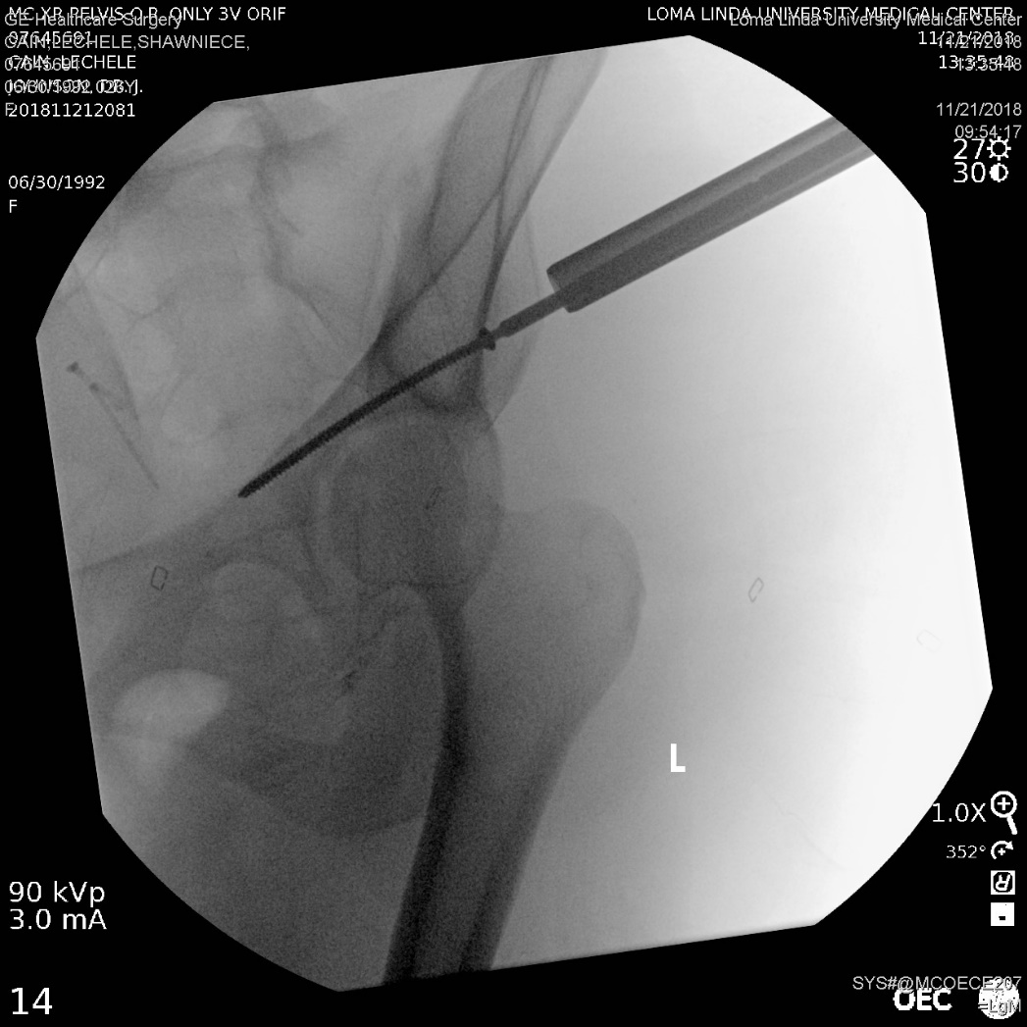
Fixation Corridors- Anterior Column/SPR (Antegrade)
For an antegrade column screw the starting point is retroacetabular and lateral to the sciatic notch
The skin incision starting point is nearly the same as the location of an S2 sacral screw, but the trajectory aims towards the symphysis (posterior to anterior)
Because of this, bumping the patient’s sacrum to allow dropping your hand is critical
Moving the patient so the injured hip is as lateral on the bed as possible is also helpful

Slide 18
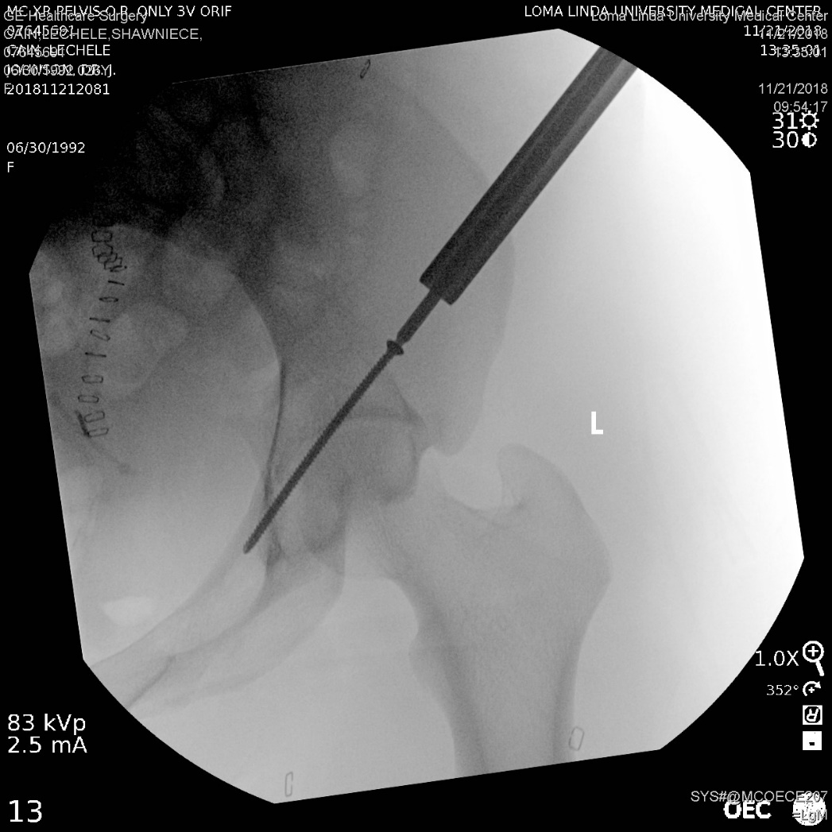
Fixation Corridors- Anterior Column/SPR (Antegrade)
The same views are used as retrograde anterior column screw (obturator outlet, and inlet or iliac inlet) but the C arm needs to be on the contralateral side
If using solid screw options, after breaching the lateral cortex, using a long 2.5 drill on oscillate can allow the bit and screw to “bounce” and avoid cortical penetration
A 1.6mm k wire can be used to find the starting point, and overdrilled first with a 3.2mm cannulated drill to “fine tune” our trajectory on inlet and obturator oblique views, after this, a 2.5mm drill can be introduced and drilled through the rest of the path
We find this technique through a cannula very useful in most percutaneous fixation techniques

Slide 19
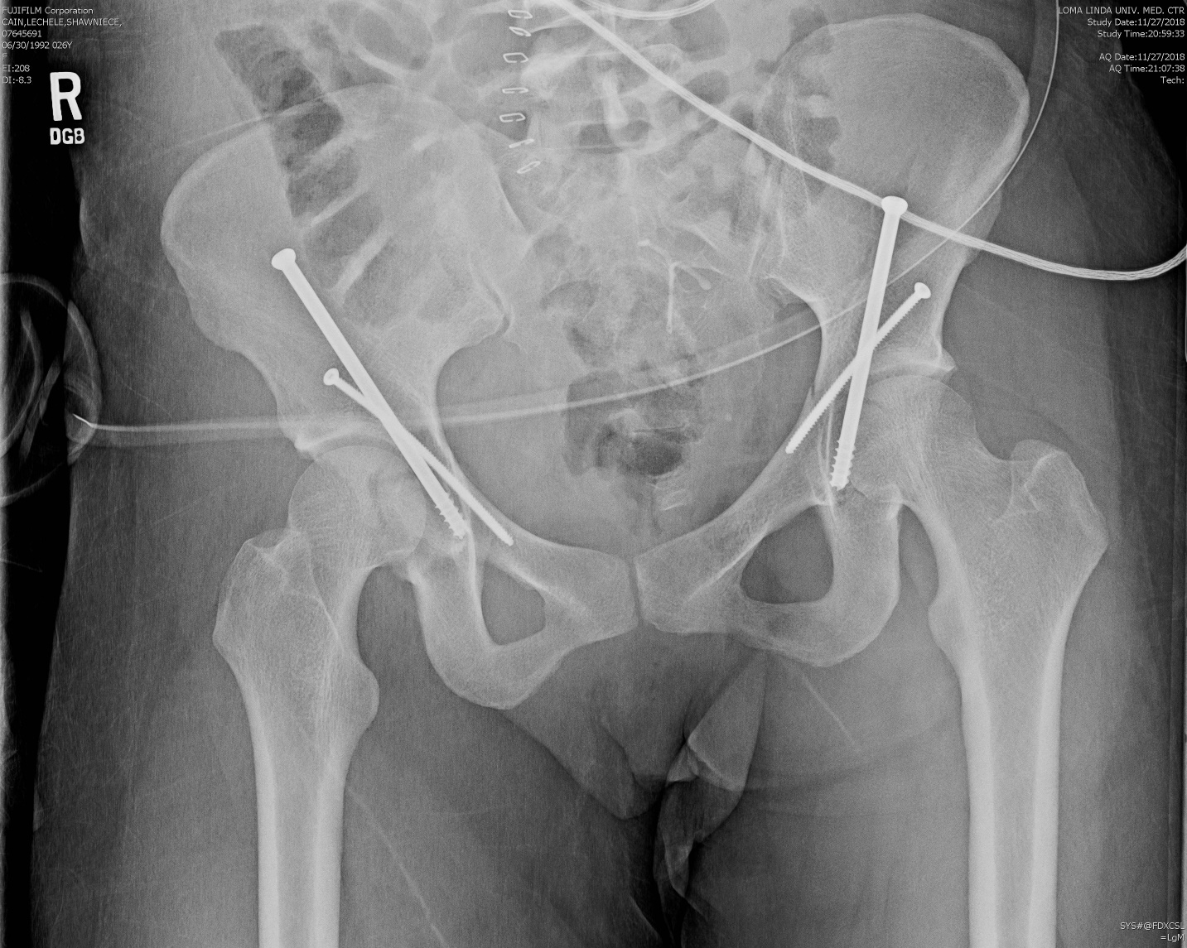
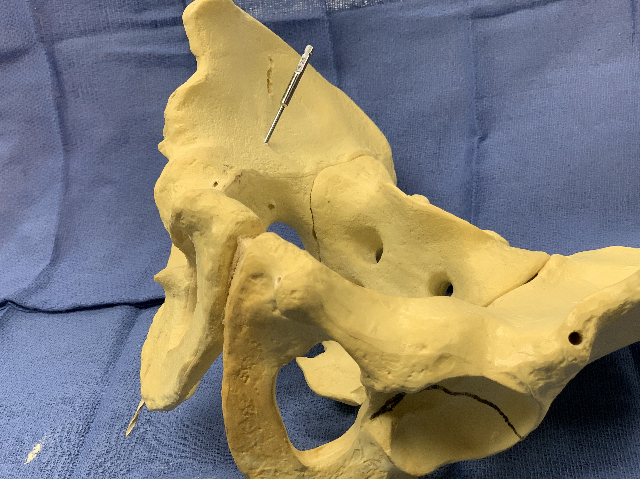
Fixation Corridors- Posterior Column (Antegrade)
This technique is not truly “percutaneous”
A small 3-4cm incision over the medius pillar is needed to allow safe screw placement, then cobb dissection down the inner table allows for identification of the start point

Slide 20
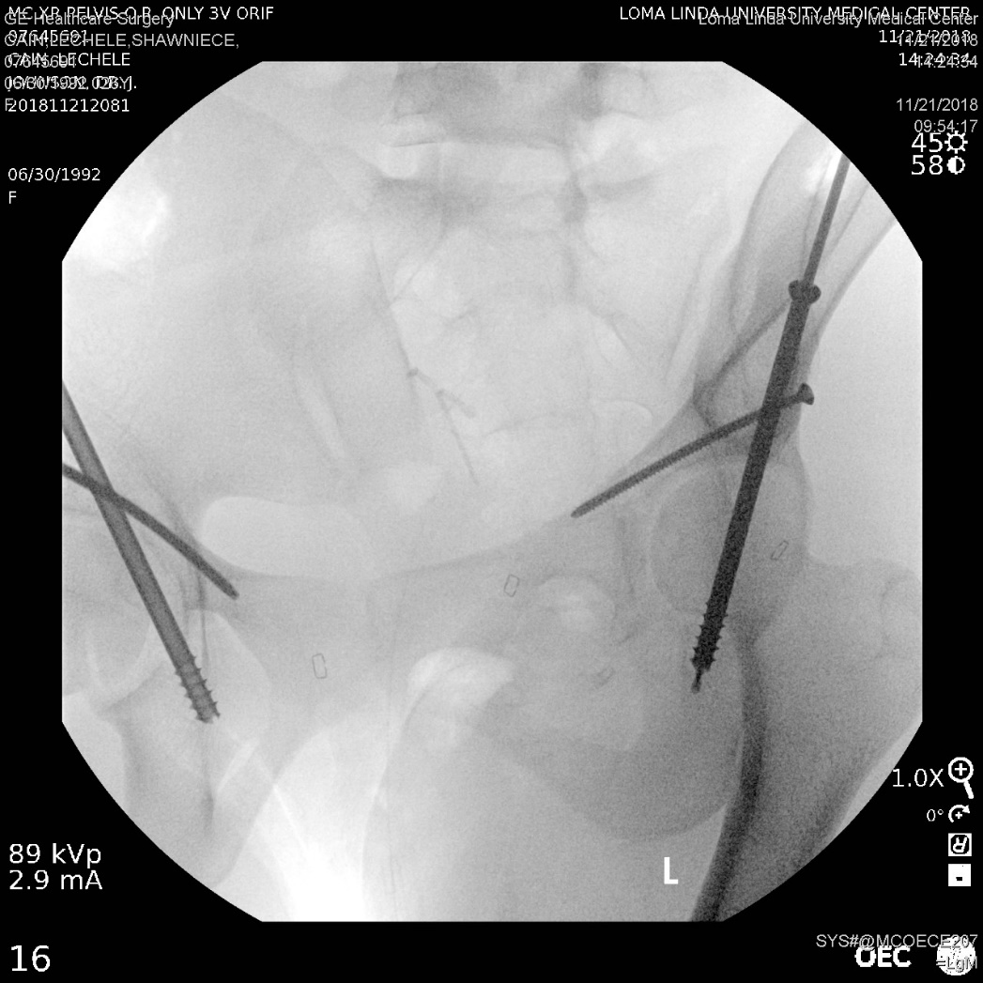
Fixation Corridors- Posterior Column (Antegrade)
The obturator outlet view confirms that you are staying within the ischium (blue dots), the target should be the middle of the ischium on this view
Trajectory runs from the inner table of the ilium to the ischial tuberosity
Keep C-arm on the uninjured side
The starting point is on the inner table and posterior to the acetabulum
This can be difficult or impossible with morbidly obese patients because of trajectory limitations from their abdomen

Slide 21
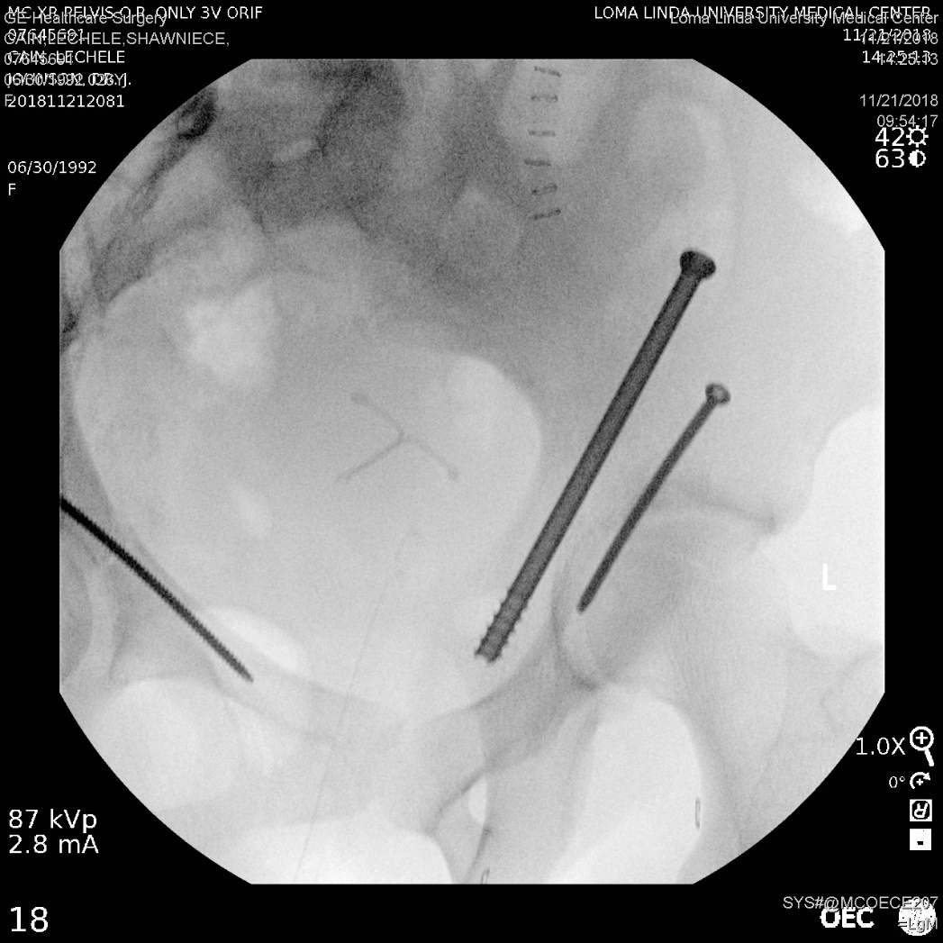
Fixation Corridors- Posterior Column (Antegrade)
This iliac oblique view confirms that you are outside of the acetabulum (blue dots) with a posterior column screw, it also provides a view of the ischial spine (yellow dots)
Note that on this view the anterior column screw appears to transit the acetabulum
Also note on this view, the anterior and posterior column screws appear parallel
Unless a full formal open lateral window is created, cannulated screw options are most useful

Slide 22
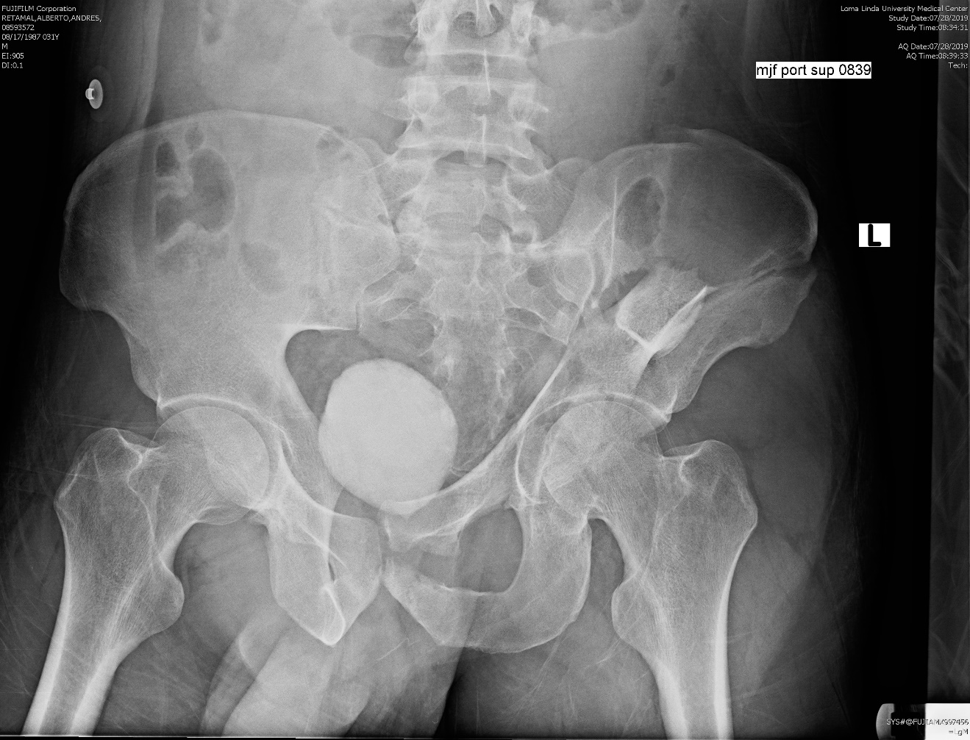
Fixation Corridors- Posterior Column (Retrograde)
This is a truly percutaneous technique, from the ischial tuberosity to the inner table of the ilium, setup is critical
One person must hold the leg with the hip flexed, and the ischial tuberosity must be prepped into the field
The patient must also be bumped enough to allow access to the ischial tuberosity

Slide 23
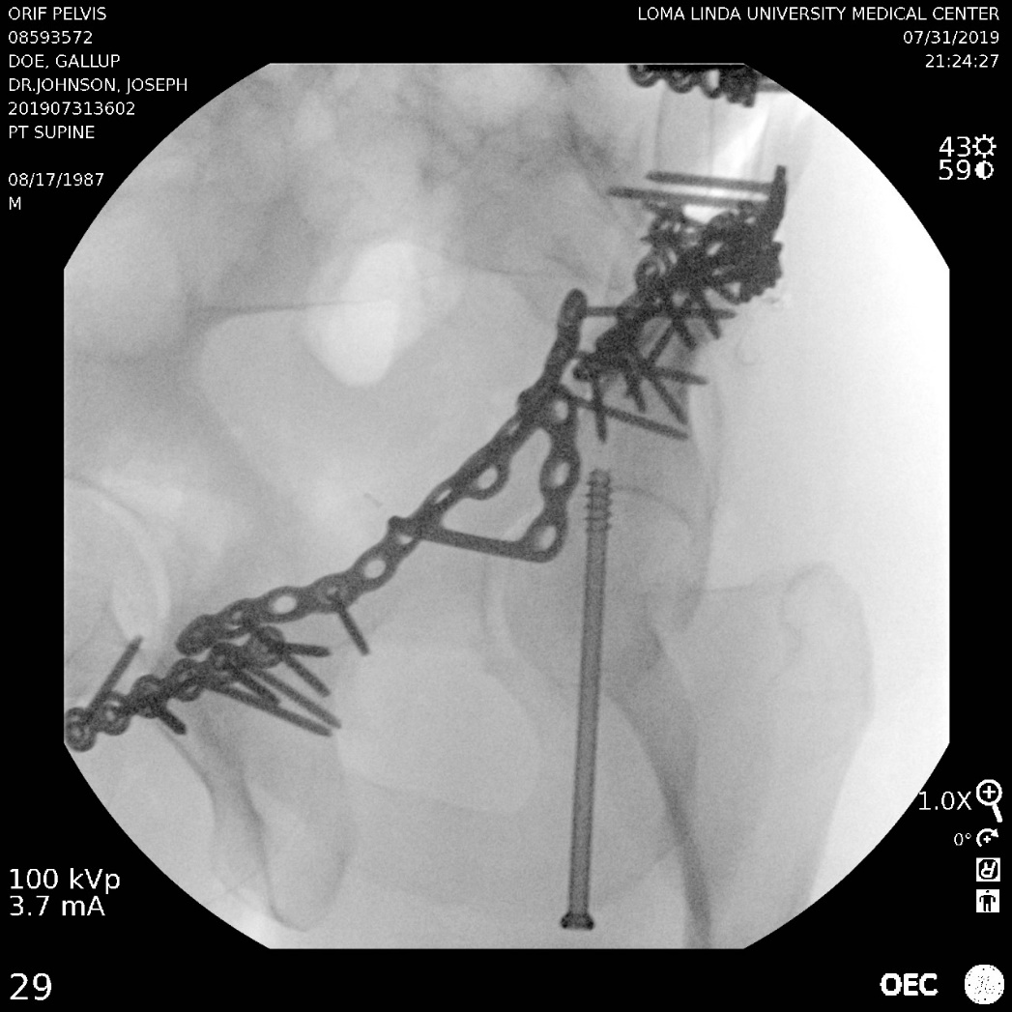
Fixation Corridors- Posterior Column (Retrograde)
The starting point is found on the ischial tuberosity and meticulous nick and spread technique is vital
Staying medial on the tuberosity protects the sciatic nerve (this is lateral)
The obturator outlet confirms that you are staying within the posterior column (blue dots), and staying medial on it

Slide 24
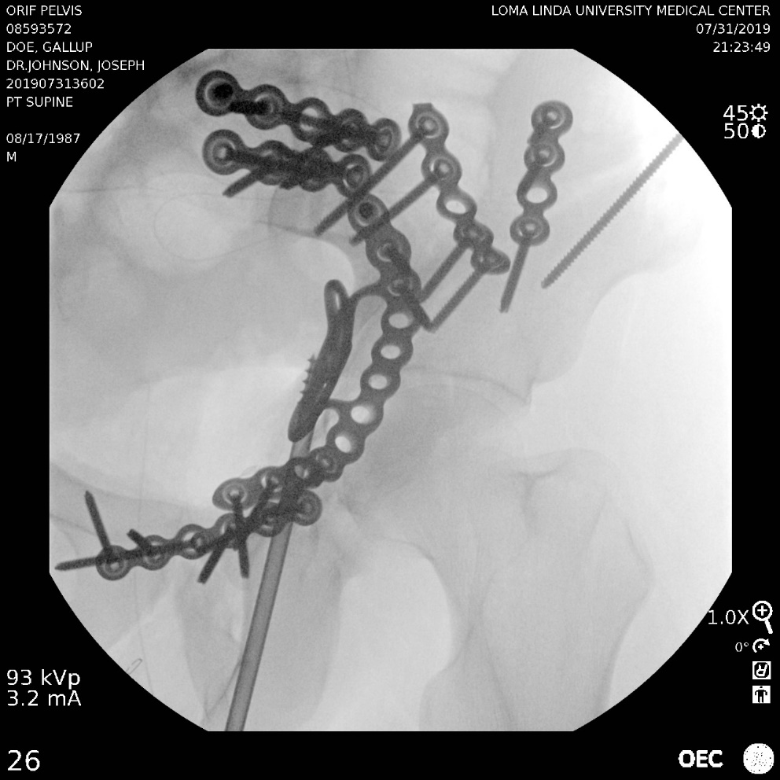
Fixation Corridors- Posterior Column (Retrograde)
An iliac oblique confirms that the screw is extra-articular
Drill tip guide wires are useful here as feedback on them can tell when you have reached a bony cortex (on the inner table of the ilium), this is difficult to evaluate radiographically
This technique is useful for low posterior column fracture components

Slide 25
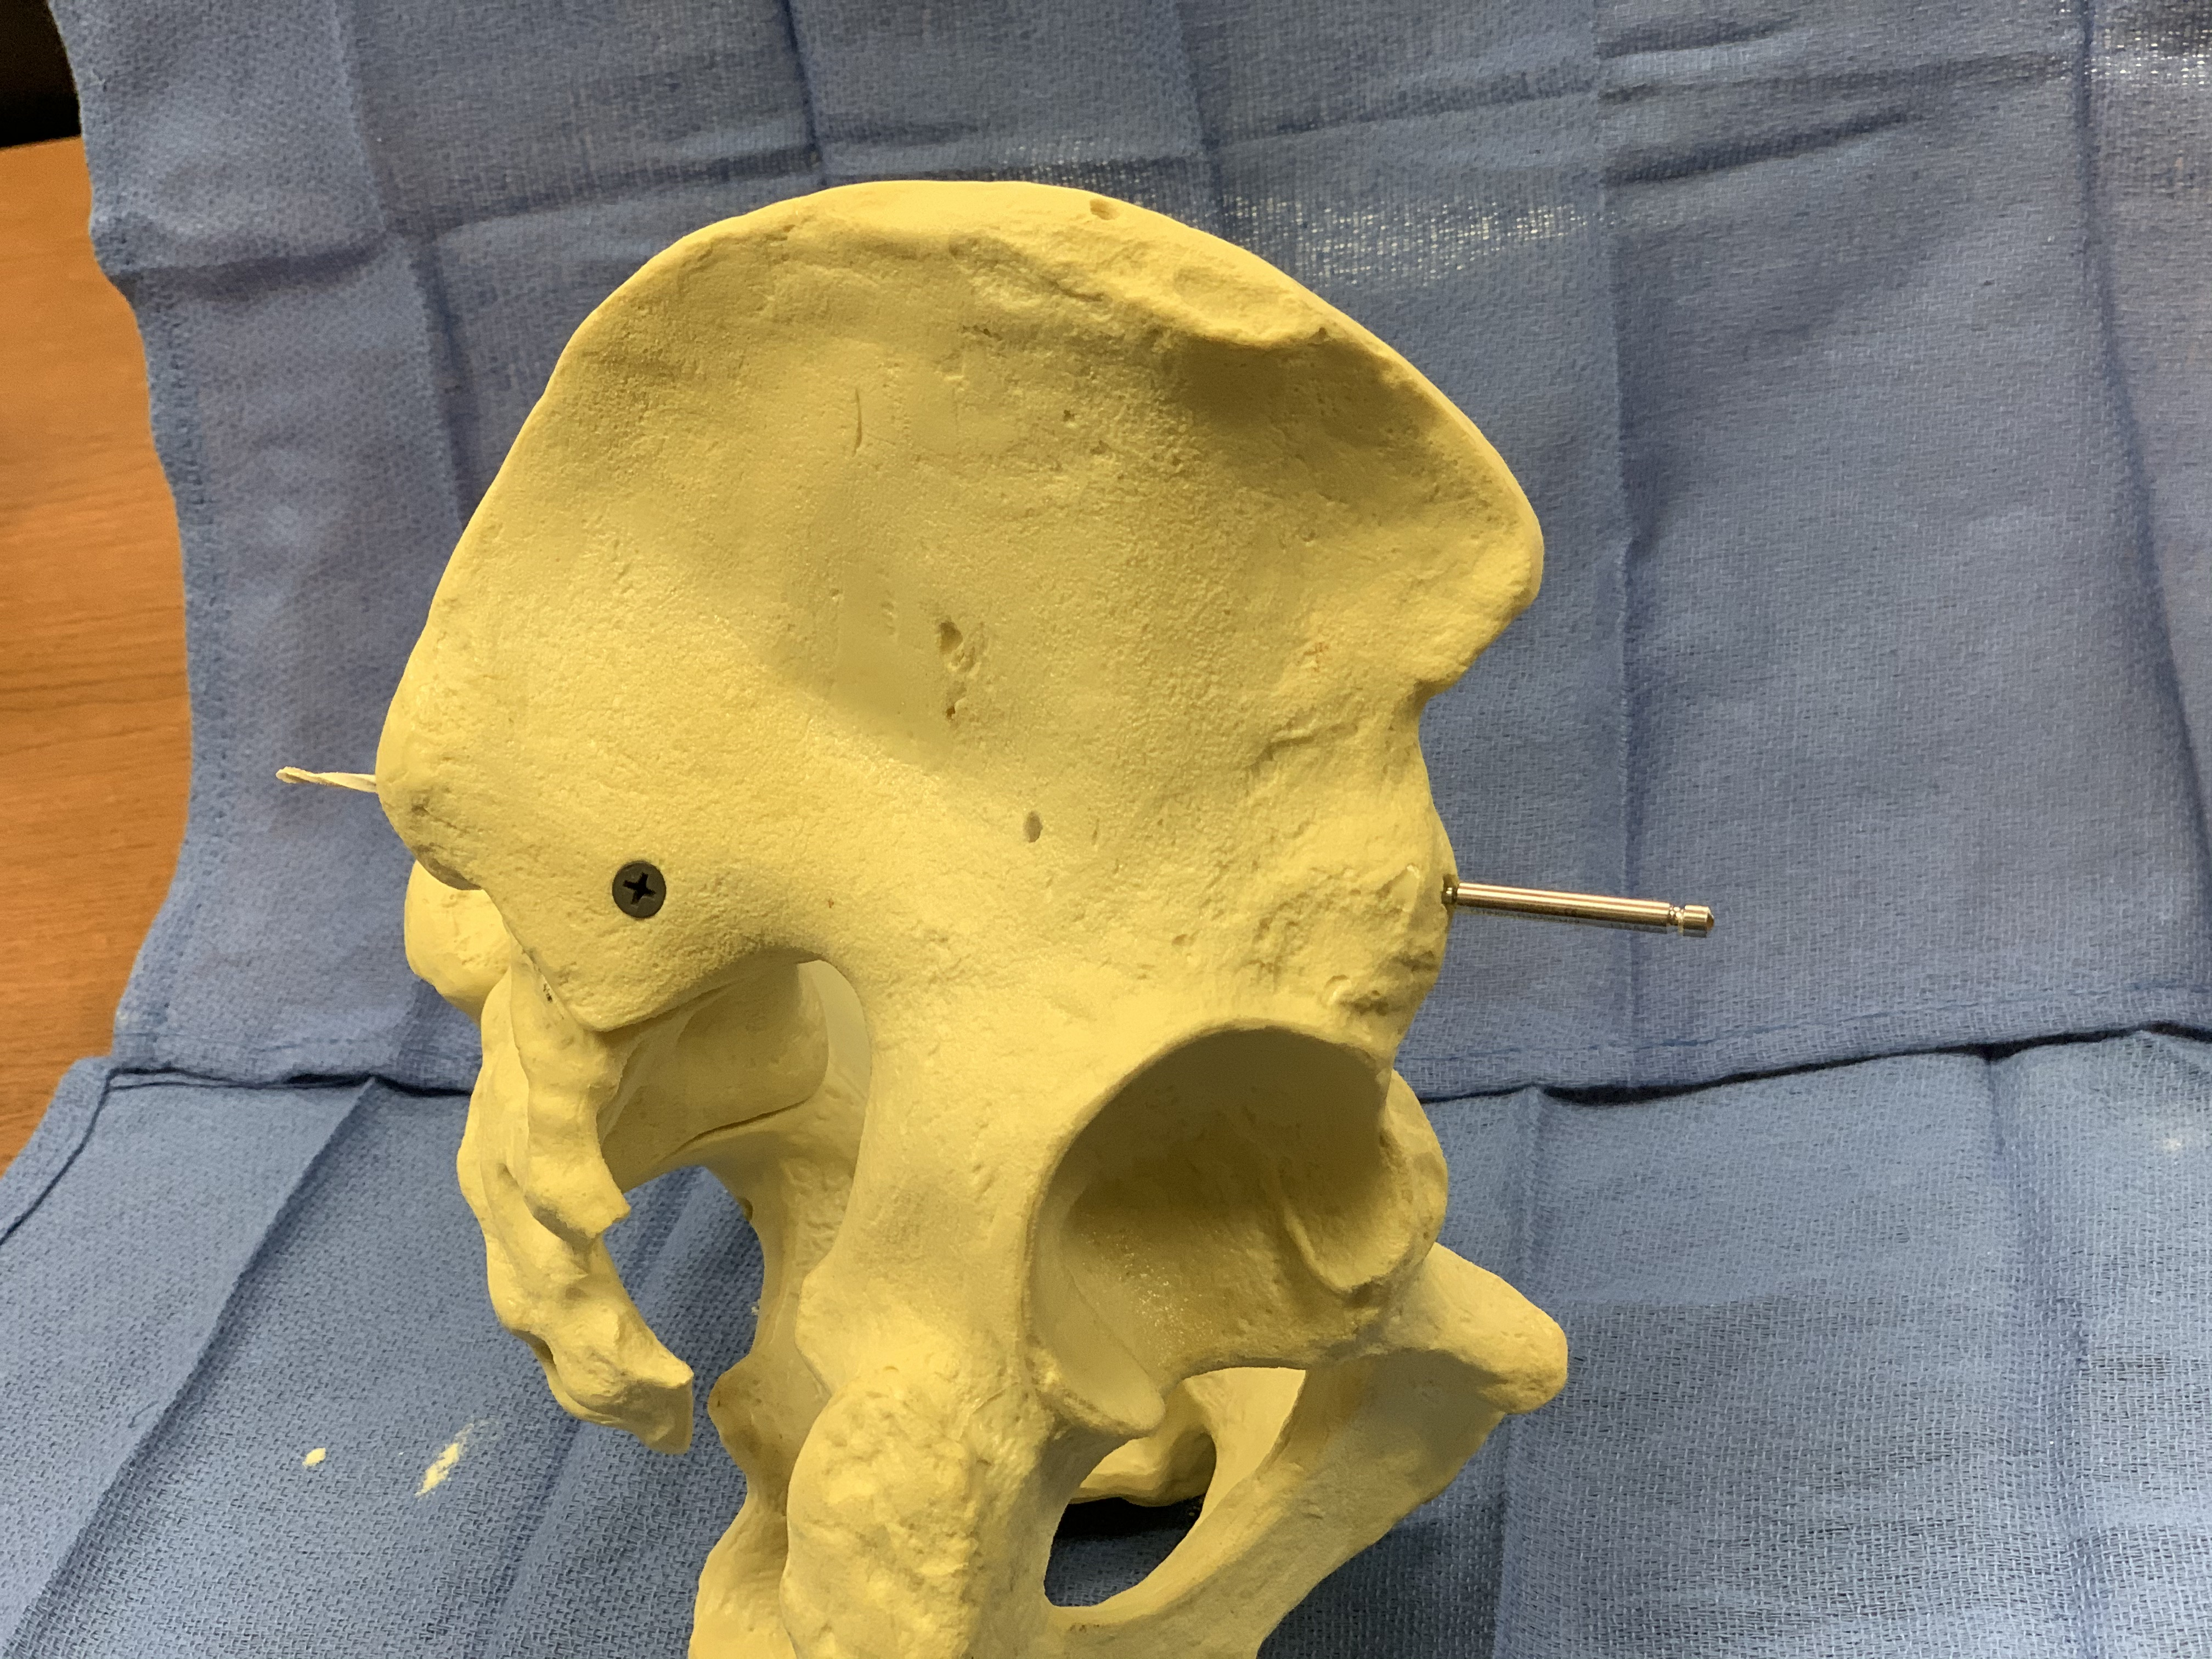
Fixation Corridors- Supra-acetabular corridor (LCII screw)
Corridor useful for acetabular fractures, pelvic exfix, pelvic infix and stabilization of LC pelvic ring injuries
Screw fixation here allows for fixation of anterior column components to the sciatic buttress/PSIS

Slide 26
Fixation Corridors- Supra-acetabular corridor (LCII screw)
The obturator outlet view provides a starting point within the “teardrop” (blue dots)
This corridor is usually broad enough to accommodate larger (6.5-8.0) cannulated screws

Slide 27
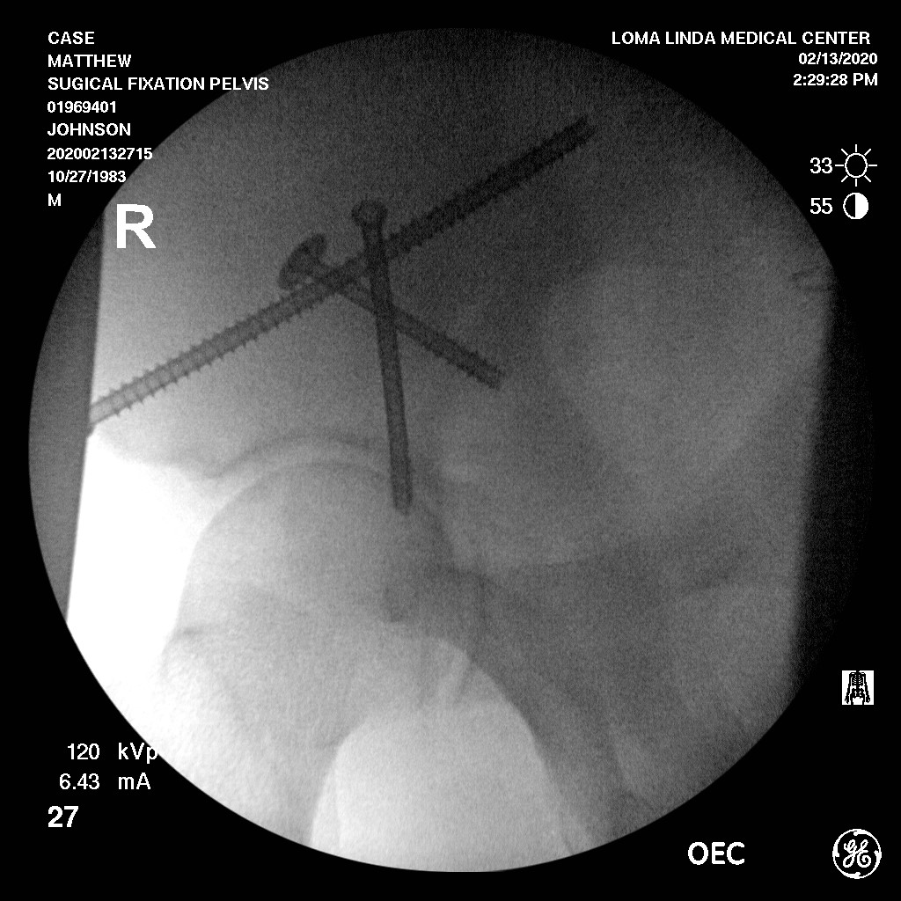
Fixation Corridors- Supra-acetabular corridor (LCII screw)
The iliac oblique view confirms that the screw is superior to the sciatic notch (blue dots)
This view also helps visualize the AIIS (yellow dots) which is often the starting point for this screw (though variations in individual anatomy and fracture characteristics can necessitate higher/lower starting points)
The trajectory of this screw is slightly lateral to medial and often slightly inferior to superior

Slide 28
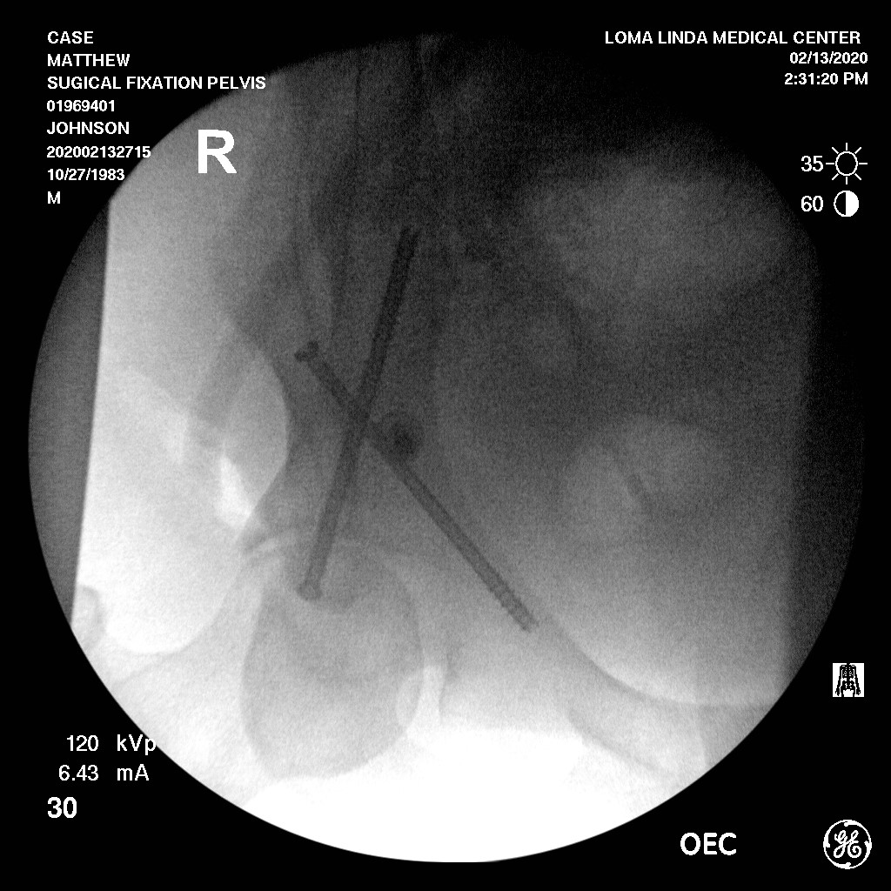
Fixation Corridors- Supra-acetabular corridor (LCII screw)
The obturator inlet view can be useful to advance the screw and keep the c-arm out of the way
This gives a ”between the tables” view confirming that the screw stays within the bony corridor
This can assist in determining screw length as well, care should be taken to prevent perforation of the PSIS and making this screw prominent posteriorly

Slide 29
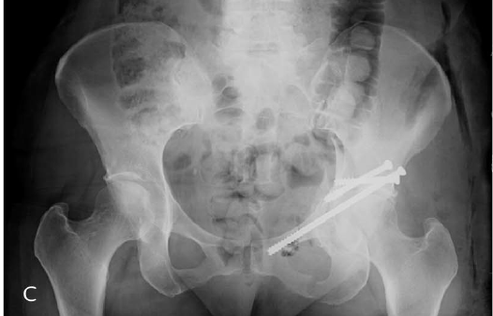
Fixation corridors- Magic screws
Start on the outer table and aim into the posterior column towards the ischial spine
The goal is to hold a quadrilateral plate reduction, or fixation alternative to a posterior column screw (sometimes necessary based on patient size/fracture location)
AP shows (c) that the start is superior to the hip, iliac oblique (e) shows it is retroacetabular
Functional Outcomes in Elderly Patients With Acetabular Fractures Treated With Minimally Invasive Reduction and Percutaneous Fixation; Gary et al. JOT; May 2012; 26(5) 278-83

Slide 30
Fixation corridors- transverse supra-acetabular screws
Used to support the weightbearing dome or the medial quadrilateral plate
Directed from lateral to medial directly superior to the dome
Using an AP (c) confirms trajectory, slight inlet/obturator (e) helps quadrilateral plate visualization
Functional Outcomes in Elderly Patients With Acetabular Fractures Treated With Minimally Invasive Reduction and Percutaneous Fixation; Gary et al. JOT; May 2012; 26(5) 278-83

Slide 31

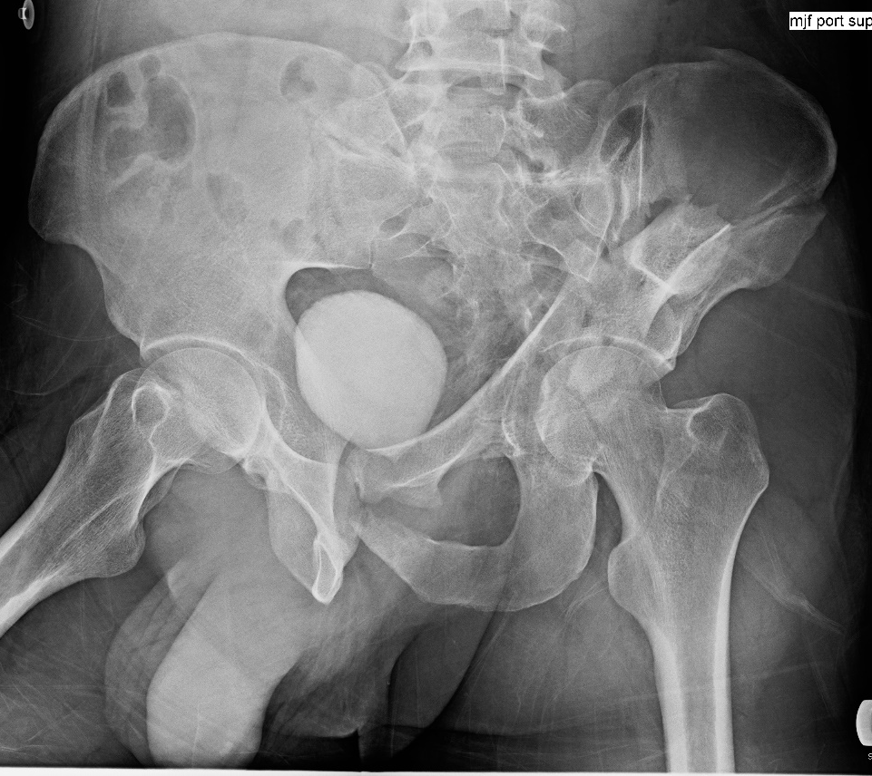
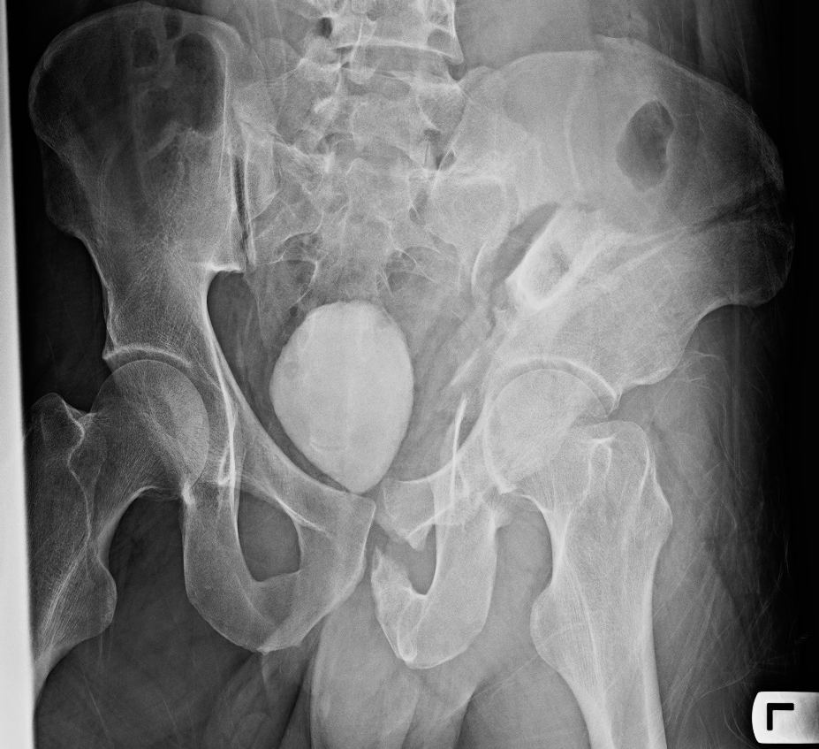
Cases- Combined Open and Percutaneous
36yo both columns acetabulum + symphyseal disruption; sciatic buttress was rotated 90 degrees, necessitating either an extended iliofemoral, or 2 approaches

Slide 32
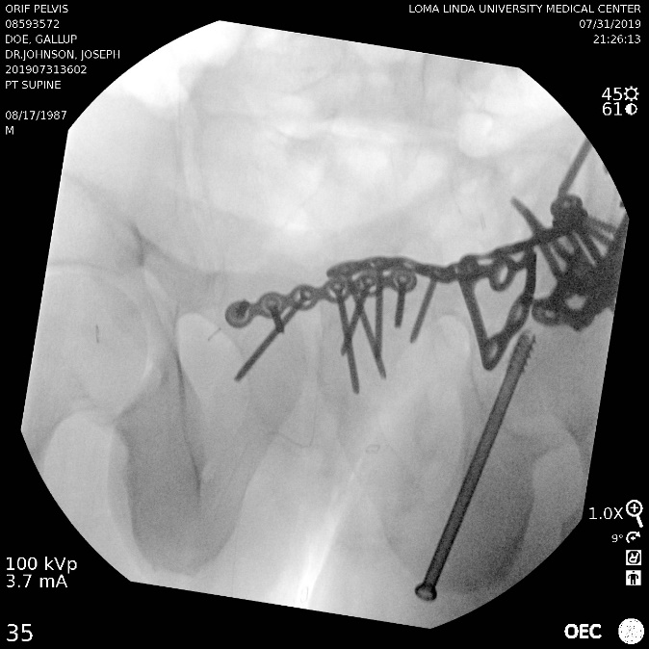

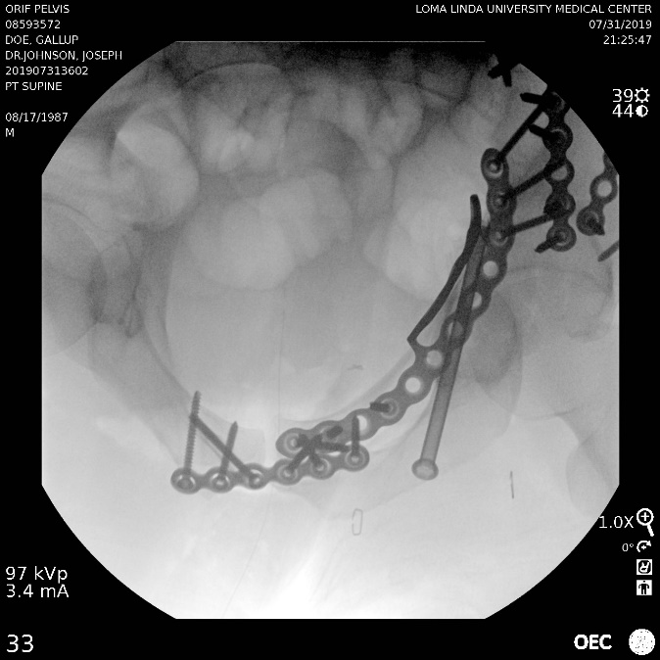
Cases- Combined Open and Percutaneous
Posterior SI/iliac approach used to reduce and fix the sciatic buttress, anterior approach (stoppa + lateral window) used for anterior column/wing/quadrilateral plate
Posterior column component was very low, and ideal for a retrograde column screw
Without this, a separate kocher incision, or a much more difficult (screw traffic) antegrade screw would have been needed

Slide 33
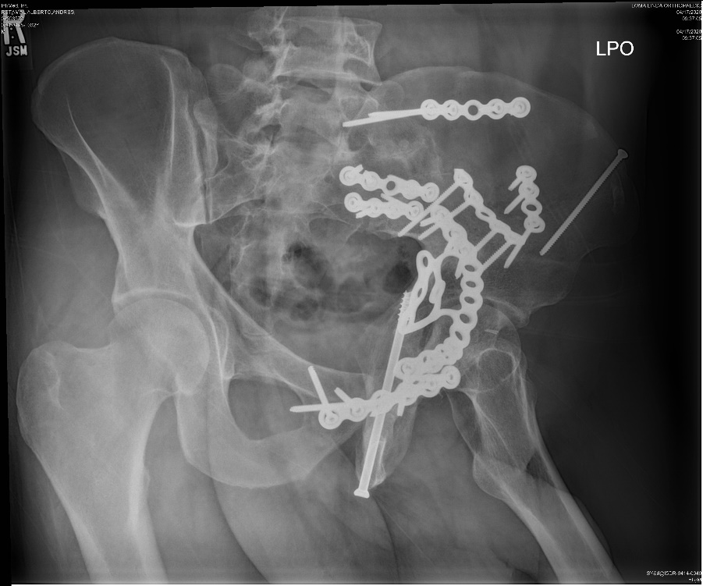
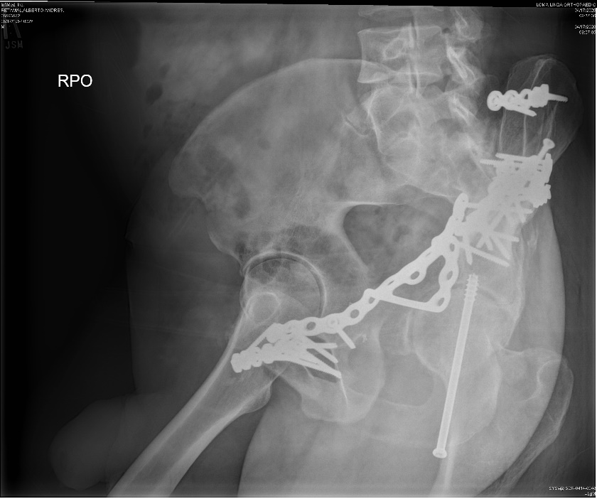
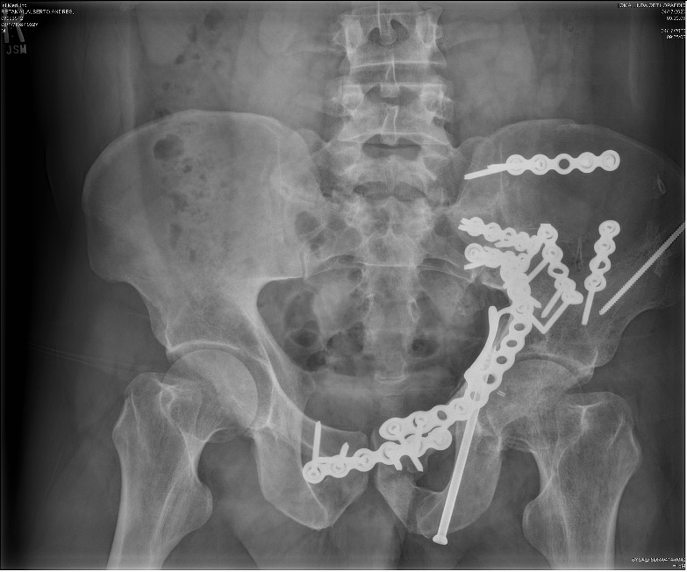
Cases- Combined Open and Percutaneous
Percutaneous column fixation prevented further dissection, and was ideal for this low posterior column component

Slide 34
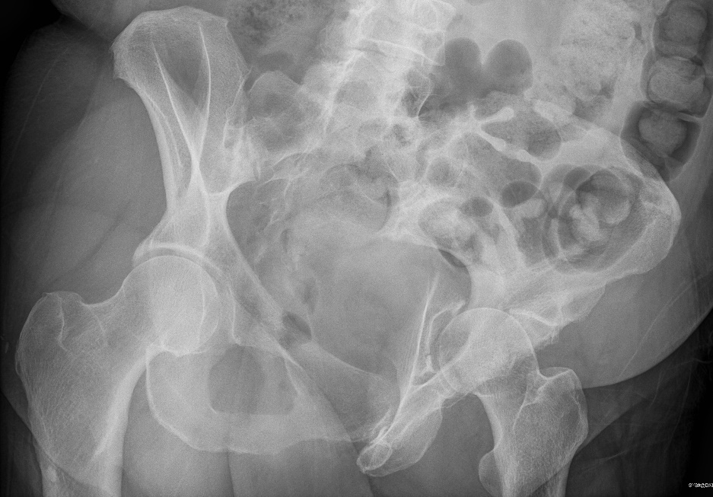
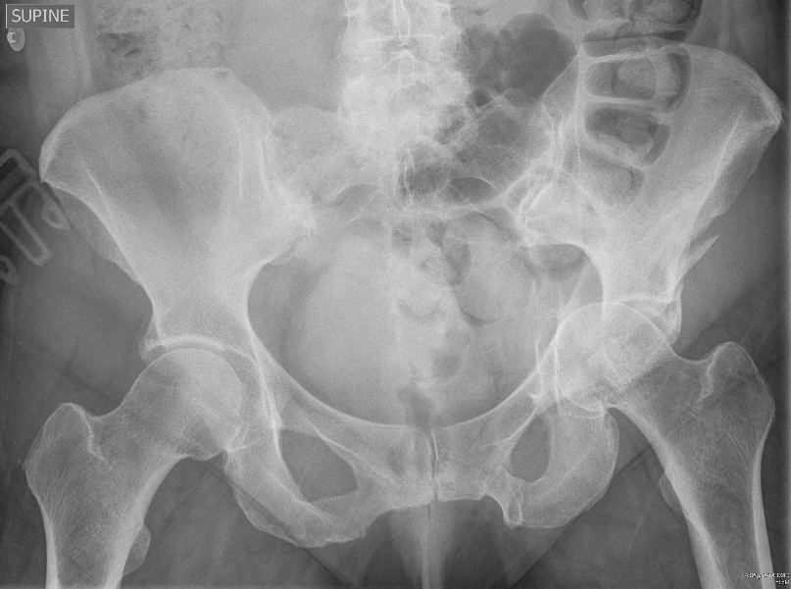
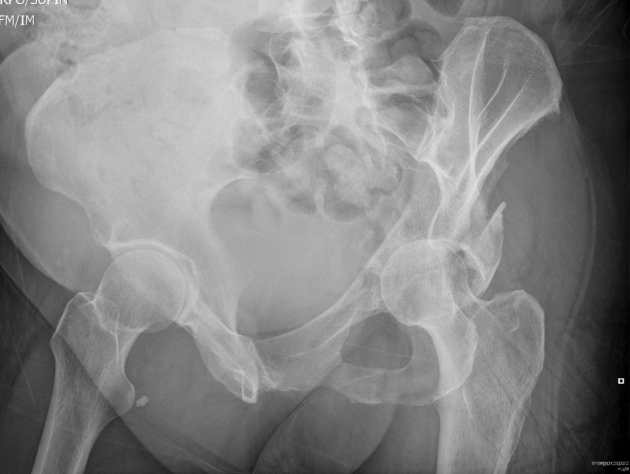
Cases- Combined Open and Percutaneous

Slide 35
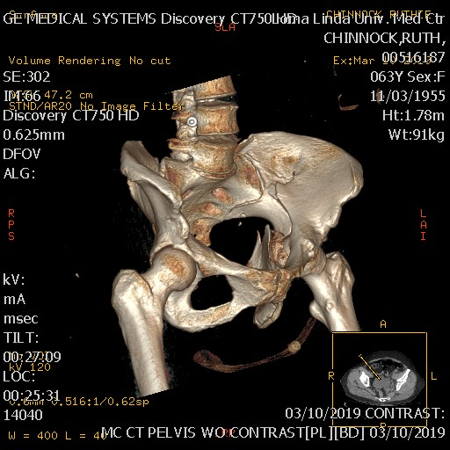
Cases- Combined Open and Percutaneous
62 yo f with a both columns with a large posterior wall component
The patient had had 2 prior C sections and a hysterectomy complicating her anterior dissection planes
An isolated lateral window, and percutaneous anterior column fixation was used in conjunction with a posterior approach to treat this fracture and prevent the morbidity of a larger anterior approach

Slide 36
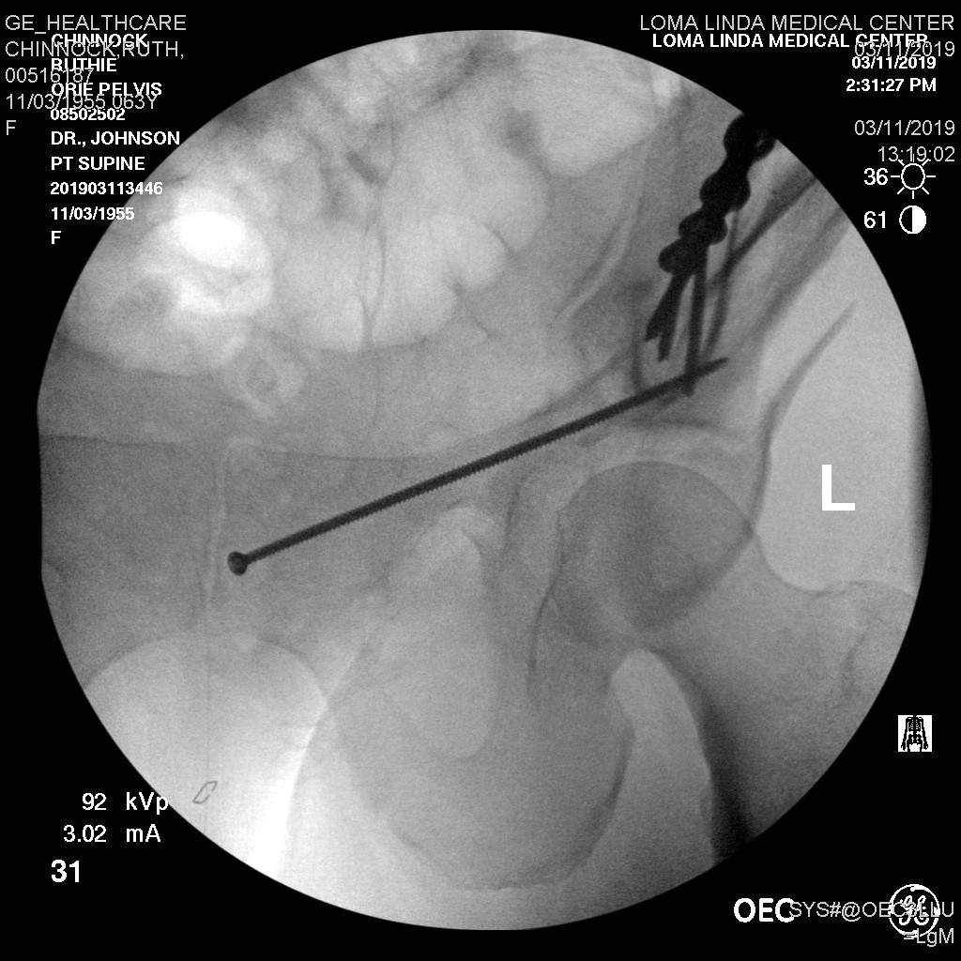
Cases- Combined Open and Percutaneous

Slide 37
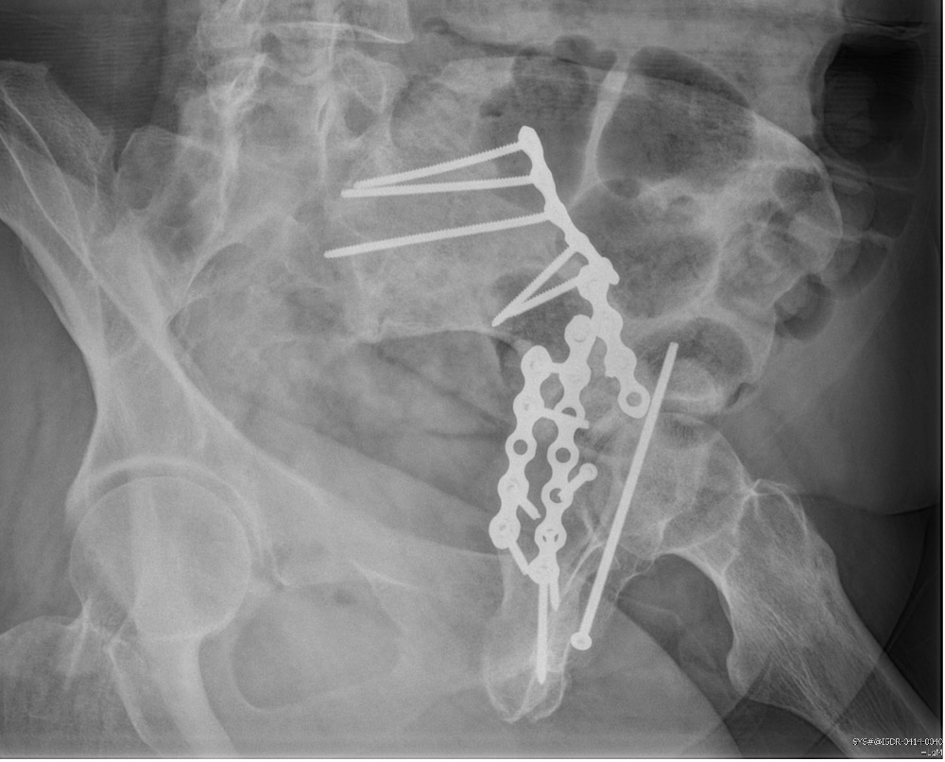
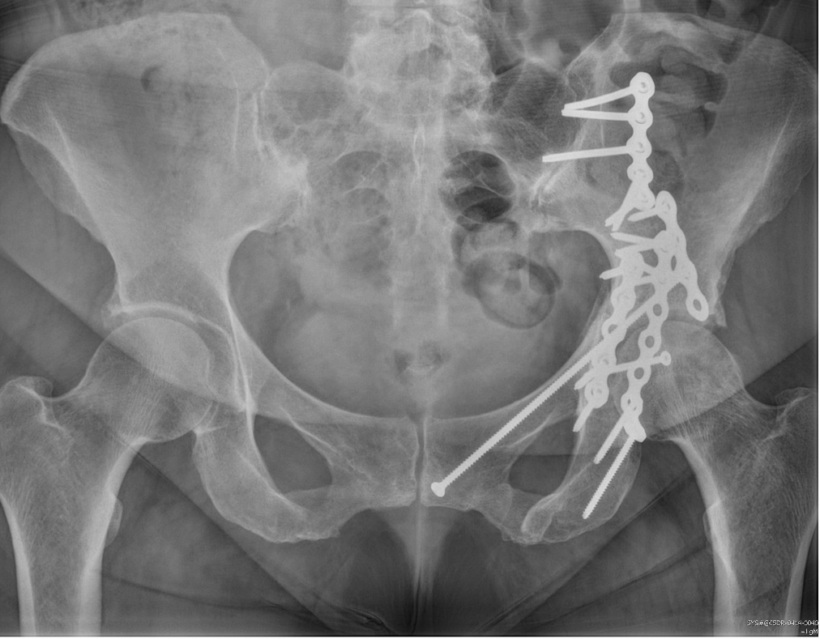
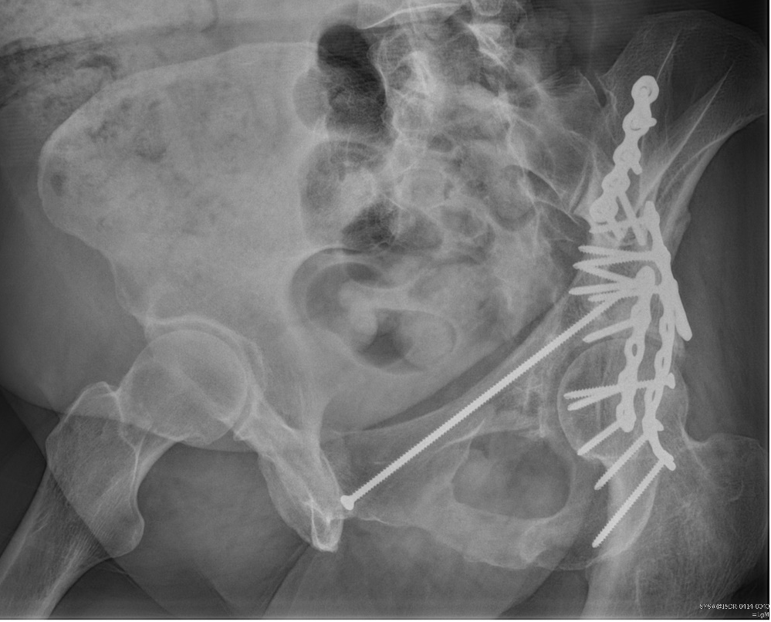
Cases- Combined Open and Percutaneous

Slide 38
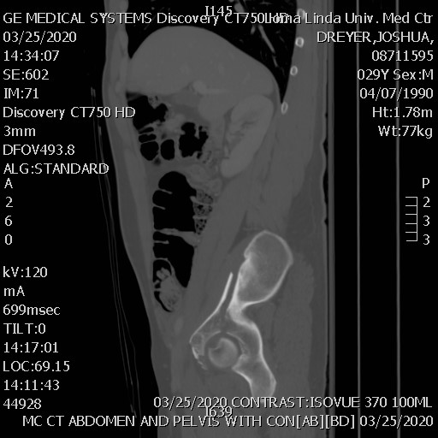
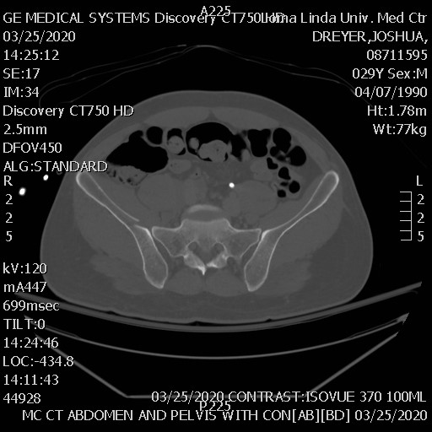
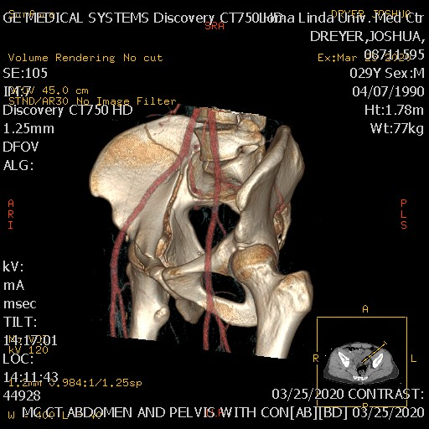
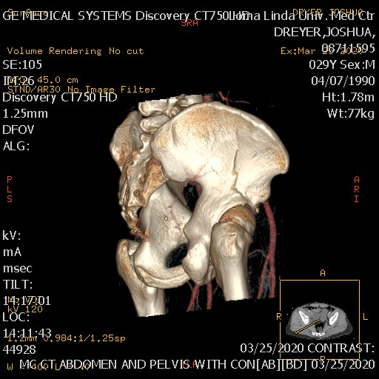
Cases- Combined Open and Percutaneous
29 yo male with an anterior column fracture
Femoral head starting to medialize and 5mm diastasis at the quadrilateral plate

Slide 39
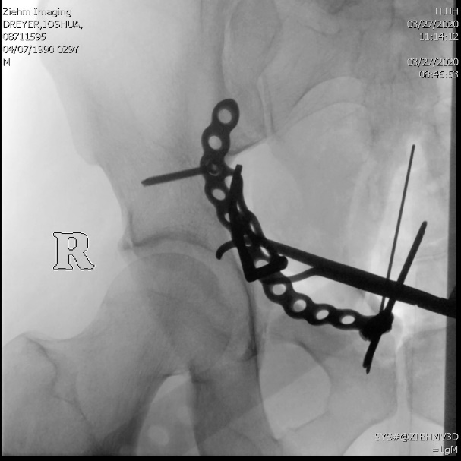
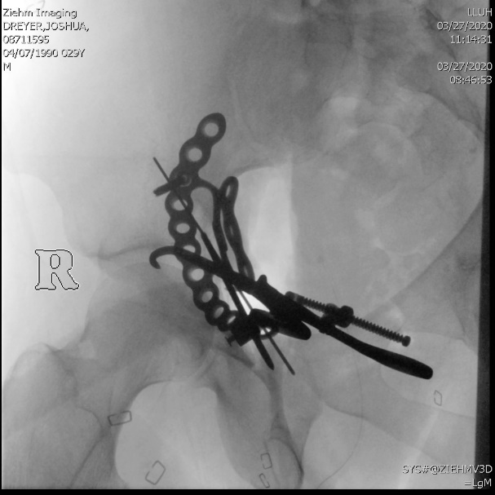
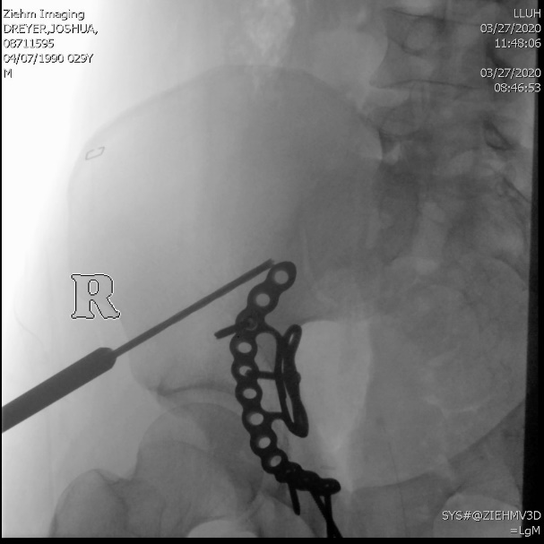
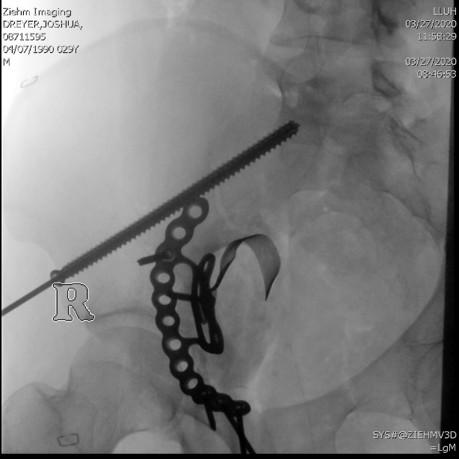
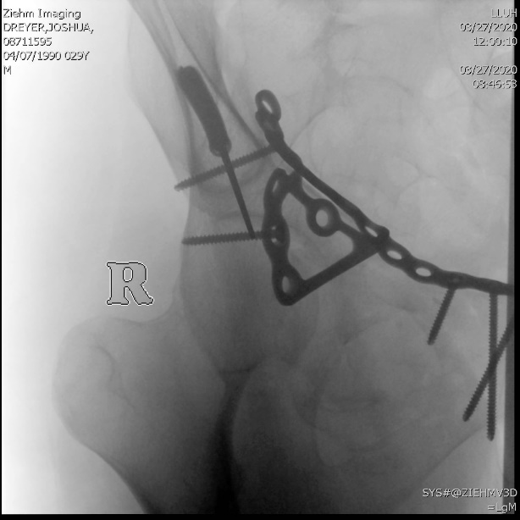
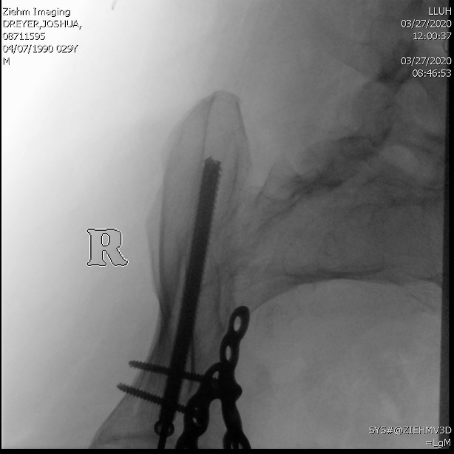
Cases- Combined Open and Percutaneous

Slide 40
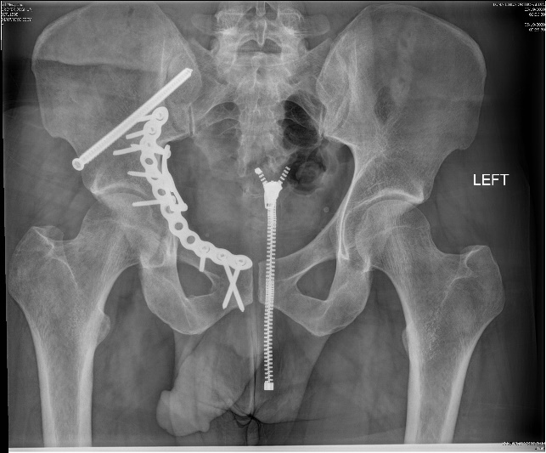
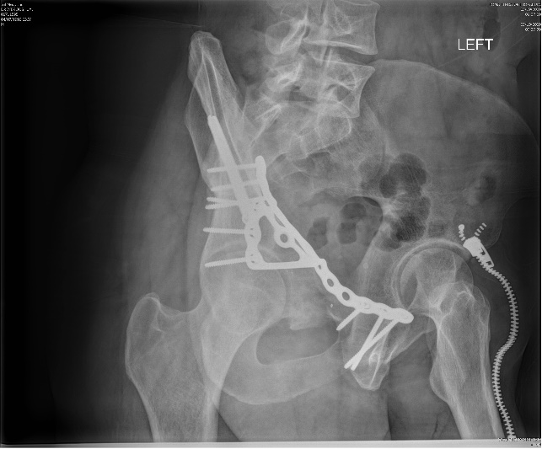
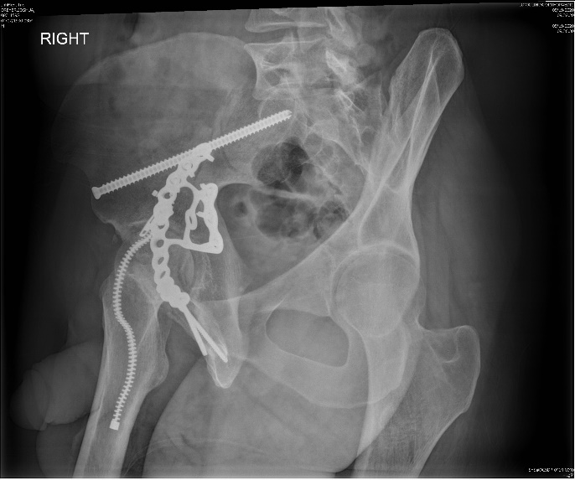
Cases- Combined Open and Percutaneous
Stoppa approach used to visualize and reduce his quadrilateral plate fracture diastasis
LCII screw used to connect his anterior column to his intact PSIS and support his plate fixation
This prevented the added surgical approach of a lateral window

Slide 41
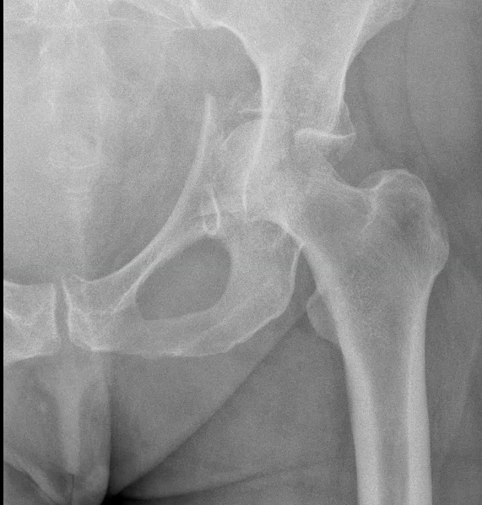
Cases- Combined Fix + THA
In geriatric acetabular fracture patients with significant marginal impaction, and/or concomitant femoral head fractures, percutaneous column fixation, and acute THA can allow earlier weightbearing, and very good functional outcomes
Percutaneous Column Fixation and Total Hip Arthroplasty for the Treatment of Acute Acetabular Fracture in the Elderly. Chakravarty et al. Journal of Arthroplasty. 2014. 29 (1) 817-821.

Slide 42


Cases- Combined Fix + THA
*Images donated by Dr. Andrew Evans

Slide 43


Cases- Combined Fix + THA
70 yo F, Anterior column fracture with protrusio, significant marginal impaction and a femoral head injury
Given her age, functional status and fracture characteristics, percutaneous fixation + THA was recommended

Slide 44




Cases- Combined Fix + THA

Slide 45

Cases- Combined Fix + THA
A 4.5 screw was used for the anterior column screw to be more malleable and an LCII screw was used to connect the anterior column to the PSIS
This allowed for her columns to be connected and allow cup placement
Femoral head was used to back graft and a multihole cup was used for her acetabular component

Slide 46



Cases- Combined Fix + THA
76 yo male s/p fall off of a ladder who was transferred with protrusio of his AC+PHT fracture 2 weeks after injury

Slide 47


Cases- Combined Fix + THA
Given the time from injury with medial dislocation, bone quality, patient age and functional status, percutaneous column fixation and THA was recommended

Slide 48



Cases- Combined Fix + THA
Percutaneous fixation of the posterior column with a posterior column screw (antegrade) and the anterior column with an anterior column screw (antegrade)
The anterior column screw was likely intra-articular at this time, but it was left in place and could be removed during the THA if it prevented seating of the cup

Slide 49


Cases- Combined Fix + THA
The anterior column screw prevented seating of the cup and it was removed, this necessitated the use of a multi-hole locking cup that locked into the fixated posterior column
Patient was allowed full weightbearing at 6 weeks and had returned to all activity at 5 months

Slide 50



Cases
Short term functional outcomes with appropriately selected fracture patterns are similar to open treatment of acetabular fractures
Short-term results of percutaneous treatment of acetabular fractures: functional outcomes, radiographic assessment and complications. Bozzio et al. International Orthopedics. 2016. 40. 1703-1708

Slide 51
Cases
49 yo s/p pedestrian struck, a1C of 12.5, minimally displaced but comminuted AC + PHT fracture, mild pre-existing OA
Bony corridors amenable to anterior column, posterior column and LCII fixation

Slide 52



Cases
Anterior column screw has the smallest corridor, if using cannulated screws, place this guidewire first, if using solid screws, place this screw first
Following this posterior column and LCII/supra-acetabular fracture fixation can be carried out

Slide 53



Cases
At 6 months he was ambulating without pain and had returned to work

Slide 54

Cases
Percutaneous treatment of geriatric acetabular fractures allows for decreased surgical morbidity, and similar functional outcomes to open fixation in many fracture patterns
Functional Outcomes in Elderly Patients With Acetabular Fractures Treated With Minimally Invasive Reduction and Percutaneous Fixation; Gary et al. JOT; May 2012; 26(5) 278-83

Slide 55


Cases
74 yo m, s/p fall off of a horse with a right sided Anterior column fracture; PMHS: DM, radical prostatectomy, obesity
Fracture pattern amenable to percutaneous fixation, and reduction through a lateral window

Slide 56



Cases
Lateral window used to visualize fracture, a shanz pin in the medius pillar, ball spike and a reduction clamp used to reduce fracture
Two intracortical screws placed to provisionally hold the reduction

Slide 57



Cases
Given corridor size, an anterior column screw was placed first
Obturator outlet views confirm extra-articular placement
Inlet confirms in bone- given bone quality a washer was used to prevent lateral cortical penetration
Screw sizes from 3.5-7.0 can be used for this based on patient anatomy (5.5mm in this case)

Slide 58



Cases
Once the anterior column screw was placed, an LCII/Supraacetabular screw was placed
Iliac oblique confirmed superior to sciatic notch, obturator outlet gives the starting point and the screw was advanced on obturator inlet to confirm it was between the cortical tables

Slide 59



Cases
Patient had returned to horseback riding at 6 months

Slide 60
Sources
1. Azzam K, Siebler J, Bergmann K, Daccarett M, Mormino M. Percutaneous retrograde posterior column acetabular fixation: Is the sciatic nerve safe? A cadaveric study. J. Orthop. Trauma. 2014;28:37–40.
2. Banaszek D, Starr AJ, Lefaivre KA. Technical Considerations and Fluoroscopy in Percutaneous Fixation of the Pelvis and Acetabulum. J. Am. Acad. Orthop. Surg. 2019;27:899–908.
3. Bozzio AE, Johnson CR, Mauffrey C. Short-term results of percutaneous treatment of acetabular fractures: functional outcomes, radiographic assessment and complications. Int. Orthop. 2016;40:1703–1708. Available at: http://dx.doi.org/10.1007/s00264-015-2987-0.
4. Chakravarty R, Toossi N, Katsman A, Cerynik DL, Harding SP, Johanson NA. Percutaneous Column Fixation and Total Hip Arthroplasty for the Treatment of Acute Acetabular Fracture in the Elderly. J. Arthroplasty. 2014;29:817–821. Available at: http://dx.doi.org/10.1016/j.arth.2013.08.009.
5. Gary JL, Vanhal M, Gibbons SD, Reinert CM, Starr AJ. Functional outcomes in elderly patients with acetabular fractures treated with minimally invasive reduction and percutaneous fixation. J. Orthop. Trauma. 2012;26:278–283.
6. Puchwein P, Enninghorst N, Sisak K, Ortner T, Schildhauer TA, Balogh ZJ, Pichler W. Percutaneous fixation of acetabular fractures: Computer-assisted determination of safe zones, angles and lengths for screw insertion. Arch. Orthop. Trauma Surg. 2012;132:805–811.
7. Schwabe P, Altintas B, Schaser KD, Druschel C, Kleber C, Haas NP, Maerdian S. Three-dimensional fluoroscopy-navigated percutaneous screw fixation of acetabular fractures. J. Orthop. Trauma. 2014;28:700–706.
8. Berton R. Moed, John A. Boudreau. Acetabulum Fractures. In: Tornetta P, Ricci WM, eds. Rockwood and Green's Fractures in Adults, 9e. Philadelphia, PA. Wolters Kluwer Health, Inc; 2019.

