Slide 1
Statistics
Kristof Reid
Assistant Professor
Medical University of South Carolina

Slide 2
Financial Disclosures
None

Slide 3
Further Disclosures
I am not a statistician
I do like making clinical decisions based on appropriately interpreted data

Slide 4
Learning Objectives
Understand why knowing statistics is important
Understand the basic principles and statistical test
Understand common statistical errors in the medical literature

Slide 5
Why should I care?
Indications for statistics

Slide 6
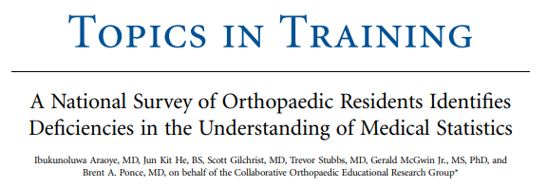
47% unable to determine study design
31% did not understand p values
38% did not understand sensitivity and specificity
83% could not use odds ratios
Araoye et al, JBJS 2020;102(5):e19

Slide 7
50% (or more!) of clinical research publications have at least one statistical error
Thiese et al, Journal of thoracic disease, 2016-08, Vol.8 (8), p.E726-E730

Slide 8
17% of conclusions not justified by results
39% of studies used the wrong analysis
Parsons et al, J Bone Joint Surg Br. 2011;93-B(9):1154-1159.

Slide 9
Are these two columns different?
Column A | Column B
19 | 10
12 | 11
10 | 9
20 | 19
10 | 17
14 | 10
21 | 19
24 | 13
12 | 18
17 | 8
12 | 17
17 | 10
9 | 9
24 | 10
21 | 9
18 | 18
13 | 4
18 | 8
12 | 14
15 | 15
14 | 17
You have been asked by your insurance carrier
to prove that your total hip patient outcomes
are not statistically different than your competitor
next door.
Column A is the patient reported score for you
and column B for your competitor
How would you prove you are different or better?

Slide 10
Are they still the same?
Column A: Mean=15
Column B: Mean=12
SD=4

Slide 11
We want to know if we're making a difference

Slide 12
What is statistics?
a. A class in medical school that I slept through during first year
b. Something for epidemiology nerds
c. A mathematical discipline that gives us tools to make decisions based on incomplete samples.
Answer = c

Slide 13
Who needs to know statistics?
a. Statisticians
b. Journal Editors
c. Anyone intending to change their practice based on the medical literature
d. Anyone interested in interpreting Patient Satisfaction Scores and Surveys
Answer = All of the above

Slide 14
Why do we need to know statistics?
Our intuition is often wrong
Potential errors in the medical literature
Understanding what statistical significance really means
Answer = Probably all the above

Slide 15
Intuition about statistics
“Trending to significance”
"The P-Value is low, but it’s a small sample size”
Statistics exists because we can't do the analysis without tools

Slide 16
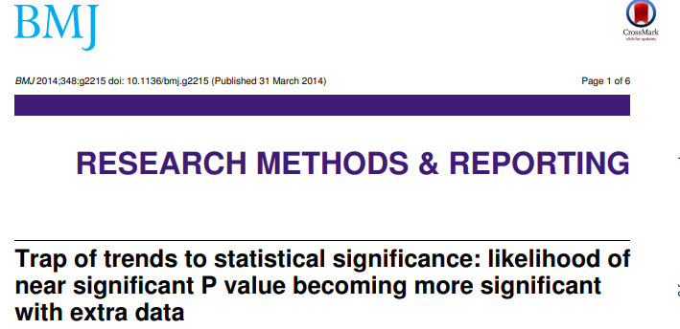
“trend to significance” is shaky at best
Wood, F. (2014). BMJ : British Medical Journal, 348(mar31 2), g2215–g2215

Slide 17
But, this is just for the OITE, right?
Most surgeons now do procedures they never learned in residency.
How do you decide what to add to your practice?
How can you judge results for a procedure you do rarely?

Slide 18
What do we need to know?
Interpret correctly reported statistics.
Descriptive statistics
Test results
Have a feel for common errors

Slide 19
Statistics Background
Statistical Methods
Underlying assumptions
Common Tests
Uncommon Tests
Study Design

Slide 20
Variable: quantity that can take various values
Types of Variables
Binary – only 2 possible categories e.g. yes or no, left or right
Categorical - individual belongs to one of a number of distinct categories e.g. Blood types
Numerical - values are discrete or continuous e.g. weight
Ordinal – categories placed in distinct order e.g. Patient Satisfaction (high, neutral, low)
Continuous – counts or measures that can have an infinity of values e.g. T score

Slide 21
Variable: quantity that can take various values
Categorical
Ordinal (ordered) e.g. disease stages 1, 2or 3
Nominal (unordered) e.g. blood groups A, B, Ab and O
Numerical
Discrete (integer) e.g. visit number
Continuous e.g. blood pressure in mmHg
A. Petrie
Statistics in orthopaedic papers
VOL. 88-B, No. 9, SEPTEMBER 2006 1121

Slide 22
Data distribution
Normal = data distributed about
the mean is symmetrical
68.3%
95.4%
99.7
3 2 1 0 1 2. 3
Standard Deviation From Mean
Symmetric Distribution
Skewed data distortion or asymmetry in a symmetrical bell curve, or normal distribution set of data.
Positive Skew
Negative Skew
Median

Slide 23
The Null Hypothesis (H_{o})
Formalized expression of the research idea containing both quantitative and qualitative components
Must be clear, unequivocal and answerable
The basic assumption for statistical testing
There are no differences between two measured groups – two measured groups are equally effective
Two measured groups come from the same population

Slide 24
Summary Measures for Variables Types
Categorical done on number per category e.g. percentage
Numerical is done with
Arithmetic mean = adding all the observations and dividing this sum by the number in the dataset, best for symmetrical distribution of data
Median = observation which falls in the middle of the set of observations when they are arranged in increasing order of magnitude, best for skewed data as less influenced by outliers
Mode = most commonly observed value. Equals the mean and median in a normal distribution. Helpful when interpreting in bar graphs or other noncontinuous data
Standard deviation (SD) is the average of the deviations of all the observations from the mean of the observations

Slide 25
Odds Ratio
Summary Measures for Variables Types
A measure of how strongly an event is associated with exposure.
- it is a ratio of the odds of the event occurring in an exposed group versus the odds of the event occurring in a non-exposed group.
- commonly are used to report case-control studies as it helps identify how likely an exposure is to lead to a specific event.
- The larger the odds ratio, the higher odds that the event will occur with exposure.
- Odds ratios smaller than one imply the event has fewer odds of happening with the exposure.
Szumilas M. Explaining odds ratios. J Can Acad Child Adolesc Psychiatry. 2010 Aug;19(3):227-9

Slide 26
Odds Ratio
Summary Measures for Variables Types
Relative probability
Comes with a confidence interval
If the confidence interval for the odds ratio includes the number 1 then the calculated odds ratio would not be considered statistically significant.

Slide 27
Confidence Interval
Summary Measures for Variables Types
The confidence interval indicates the level of uncertainty around the measure of an effect (precision of the effect estimate)
The confidence level is the probability that the confidence interval contains the true odds ratio. If the study was repeated and the range calculated each time, you would expect the true value to lie within these ranges on 95% of occasions.
- the narrower the better

Slide 28
Confidence Intervals
The chance that the true value lies within a range of numbers.
Ho et Al, Nat Methods. 2019 Jul;16(7):565-566

Slide 29
Confidence Intervals
The blue vertical line segments represent 50 realizations of a confidence interval for the population mean μ, represented as a red horizontal dashed line; note that some confidence intervals do not contain the population mean, as expected.

Slide 30
Statistical Tests –The Launching Point
Distinguish between results compatible with chance and those that no longer can be explained by chance
Used to determine if the null hypothesis holds true

Slide 31
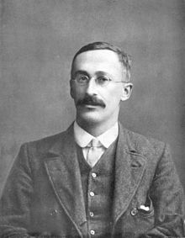
T-Test (Student T-Test)
Published in English literature in 1908 by Gosset and Pearson
Used to monitor the quality of Guinness Stout
Used the the pseudonym Student
Determines whether the means of two populations differ
Assumes normal(ish) distribution
Karl Pearson
William Sealy Gosset

Slide 32
Chi square Test
Published in 1900 by Pearson
Determines whether two categorical variables differ
Assumes normal(ish) distribution
Karl Pearson

Slide 33
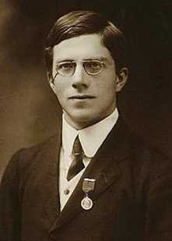
Analysis of Variance (ANOVA)
Generalized t-test to test variance among and between groups (2 or more) or population means
One way test used to compare means of two or more samples
Normal distribution, ordinal
Two way test used to analyze two different categorical independent variables on one continuous dependent variable scale
Ronald Fisher

Slide 34
Mann-Whitney U-Test
Also known as Mann-Whitney-Wilcoxon Test, Wilcoxon rank sum test
Non parametric - Not normally distributed
Independent observations from each group
Ordinal responses
Small samples

Slide 35
Other Tests
McNemar’s test – for paired nominal data
Cochran’s Q test – for non-parametric, matched sets of three or more frequencies or proportions
Kruskal Wallis test – non-parametric for 2 or more independent samples of equal or different sizes
Bonferroni’s correction – correction for multiple comparison of data or hypotheses, lessen the chance of a Type 1 error

Slide 36
Choice of a Statistical Test to prove the Hypothesis
4 Questions to answer:
Categorical or numerical variables?
How many groups are compared?
Independent or related groups?
Are all assumptions underlying the proposed test satisfied?
Test with no assumptions about distribution are non parametric
Tests assuming normal distribution are parametric

Slide 37
Choice of Hypothesis Test
Chi squared (perhaps for trend)
independent
Combine groups the Chi squared
or Fisher’s Exact test
> 2 groups
Cochran’s Test
Related
Exact test
A. Petrie
Statistics in orthopaedic papers
VOL. 88-B, No. 9, SEPTEMBER 2006 1121

Slide 38
Choice of Hypothesis Test
z-test of a single proportion
One Group
Sign test
Binary Variable
Chi squared
independent
Fishers’ Exact
Two Groups
(comparing 2proportions
McNamara's Test
Paired
Binomial Test
A. Petrie
Statistics in orthopaedic papers
VOL. 88-B, No. 9, SEPTEMBER 2006 1121

Slide 39
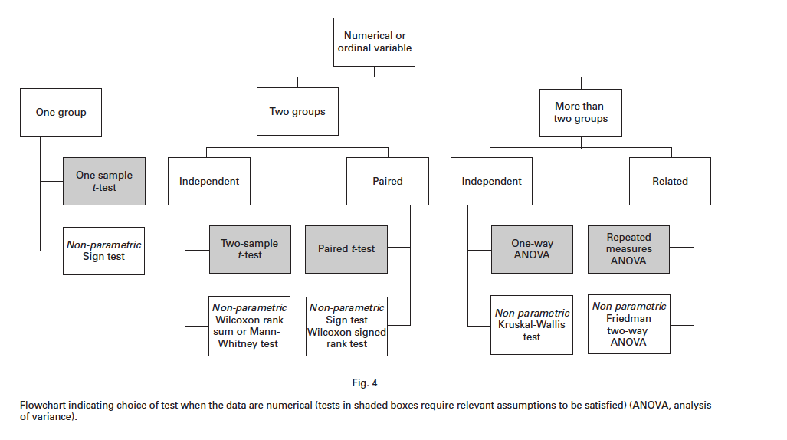
Choice of Hypothesis Test
A. Petrie
Statistics in orthopaedic papers
VOL. 88-B, No. 9, SEPTEMBER 2006 1121

Slide 40
P-Value
"The value for which P = 0.05, or 1 in 20, is 1.96 or nearly 2 ; it is convenient to take this point as a limit in judging whether a deviation is to be considered significant or not.
Fisher, Ronald (1925). Statistical Methods for Research Workers. Edinburgh: Oliver and Boyd. p. 46. ISBN 978-0-05-002170-5.
Ronald Fisher
It is the probability of the null hypothesis being false
The smaller the p-value the more unlikely the H_{o} is true and the more likely the measured event will occur (Fisher set p<0.05)
If p-value is large: then there is not enough evidence to reject H_{o} so result is statistically not significant
Probably the most mis-used statistic ever
Fisher

Slide 41
ASA Statement on p-Values
"the widespread use of 'statistical significance' (generally interpreted as 'p ≤ 0.05') as a license for making a claim of a scientific finding (or implied truth) leads to considerable distortion of the scientific process"
Wasserstein, Ronald L.; Lazar, Nicole A. (2016-04-02). "The ASA's Statement on p-Values: Context, Process, and Purpose". The American Statistician. 70 (2): 129–133.

Slide 42
Statistical Significance
P<α
α is usually set at 0.05
100% Arbitrary (Fisher)
It is for normal distribution with 2 tails
User:Repapetilto @ Wikipedia & User:Chen-Pan Liao @ Wikipedia

Slide 43
Type I and II Errors
 | H₀ is true Truly no difference | H₀ is false Truly a difference
Accept null hypothesis | Right decision | Wrong decision Type II Error (β)
Reject null hypothesis | Wrong decision Type I Error (α) | Right decision
Type I or alpha error is a false positive result
Type II or beta error is a false negative result
Avoid by having the right study group size – power analysis

Slide 44
Power
Probability of demonstrating a statistically significant difference given there is a difference between the experimental and control groups
Equal to 1-type II error
Based on the magnitude of observed effect and the sample size of the study
The larger the effect, the smaller the sample size
The smaller the effect, the larger the sample size
Must be done a priori (before collecting the data)
Calculating the minimum sample size required to detect an effect
Avoid a false negative result

Slide 45
Power Calculation – Sample size
A. Study Group Design
2 independent study groups
or
1 study group vs population data
B. Primary end points
Dichotomous
(yes or no)
Continuous
(means)
or
C. Statistical Parameters
Anticipated Outcome
Anticipated Error Rate
Known Population/Group1 %
Type 1 alpha error rate 0.05%
Group 2 %
Power 80%
https://clincalc.com/stats/samplesize.aspx

Slide 46
Receiver Operator Curve (ROC)
A graphical plot that illustrates the diagnostic ability of a binary classifier system as its discrimination threshold is varied.
1.0
Perfect classifier
Better
True Positive Rate
Worse
0.0
False Positive Rate
1.0
Area under the Curve (AUC) is equal to the probability that a classifier will rank a randomly chosen positive instance higher than a randomly chosen negative one

Slide 47
Survival Curve / Kaplan Meier
The visual representation of this function that shows the probability of an event at a respective time interval.
Survival probability is calculated as the number of subjects surviving divided by the number of patients at risk.
100
% surviving
0
250
Time (weeks)

Slide 48
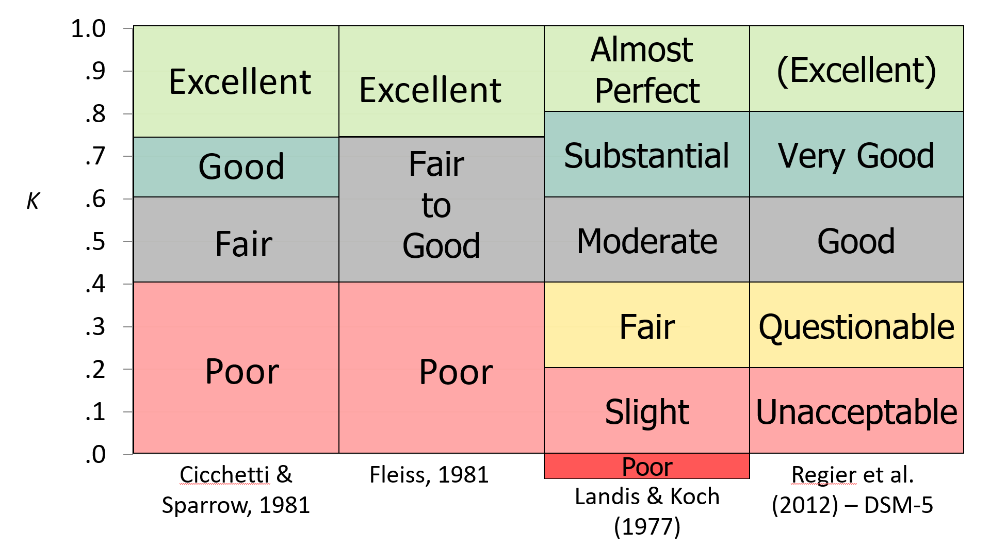
Cohen’s Kappa Coefficient - Inter-Observer Reliability
Kappa (κ)
0 = very poor agreement
0.6 considered reasonable
A relative measurement
By Eyoungstrom - Own work, CC BY-SA 4.0

Slide 49
Sensitivity and Specificity – Predictive Values
Proportions of positive and negative results in statistics and diagnostic tests that are true positive and true negative results,
Positive Predictive Value
Sensitivity X Prevalence
sensitivity X prevalence + (1 – specificity) X (1- prevalence)
Negative Predictive Value
Number of true negative
Number of true negatives + Number of false negatives

Slide 50
Study Design

Slide 51
Randomized Controlled Trial
Gold Standard
Must have a therapeutic uncertainty or equipoise
Many confounders in surgery
Many obstacles in surgery
Narrow definition of participants may make the results not clinical useful to wide range of patients

Slide 52
Analytical Observational Studies
Cohort: all patients with a specific intervention are studied
Prospective: define study parameters and enter patients as that intervention is applied and then followed for defined time period (looking forward)
More reliable, no data loss
Retrospective: define intervention that you wish to study as well as parameter and then review patients who have the intervention (looking back)
Less reliable, loss of data
Case-Control: matched patients
Retrospective
Good for rare outcomes when large patient population is not available
Collect all the patients with a problem whether they have had the intervention or not and then match the non interventional with interventional patients

Slide 53
Descriptive Observational Studies
Case Report
Case Series

Slide 54
Levels of Evidence
There are a number of systems
Tool for assessment of results
Needs context
JBJS levels of evidence
Level 1 – randomized controlled trial
Level 2 - prospective cohort or observational study with dramatic effect
Level 3 – retrospective cohort or case-controlled study
Level 4 – case series, historical controlled study
https://journals.lww.com/jbjsjournal/Pages/Journals-Level-of-Evidence.aspx

Slide 55
Pyramid of Evidence
Filtered
Information
Systematic
Reviews
Critically Appraised Individual
Articles (Evidence Synthesis
and Guidelines)
Critically Appraised Individual Articles
(Article Synopses)
Randomized Controlled Trials
Unfiltered
Information
Cohort studies
Case controlled, Case series/reports
Background information, expert opinion
https://journals.lww.com/jbjsjournal/Pages/Journals-Level-of-Evidence.aspx

Slide 56
Statistics gone wrong
Choice of test – not always the t-test, must know the data type, your data distribution etc.
Sources of bias and variation: channeling effect, publication bias, recall bias, data completeness bias
Multiple Comparisons: need to understand how to calculate P-value
Oversimplification of analysis: 69% of studies basic parametric tests
Inadequate reporting:37% inadequate reporting of numbers,20% introduced new statistics in results section, 23% no measurement of error for main outcome, 16% reported different numbers in Methods and Results
51.5% of studies misused statistics and in a BMJ Study – 89% unacceptable at submission, down to 16% at publication

Slide 57
Poor review at the journal level (1998)
Statistics misunderstood
52% - 27% chance of pre acceptance stats review
31-82% chance of stats consultant on staff
50% of time stats review led to an important change
Goodman et al. J Gen Int Med 1998
Poorly Reviewed (20 years later)
34% do not use stats review
23% for all articles
24% in between
>50% of reviews led to important changes
Hardwicke, Goodman, PLOS ONE Oct 1 2020

Slide 58
Summary
Why statistics are important
Basic statistical terms and test
Common statistical missteps

Slide 59
References
Biostatistics: The Bare Essentials, Norman, Geoffrey R.; Streiner, David L.
Statistics and Data Management, A Practical Guide for Surgeons, D Stengel, M Bhandari, B Hanson. Thieme 2009
Clinical Epidemiology and Biostatistics: A Primer for Orthopedic Surgeons, M Kocher and D Zurakowski J Bone Joint Surg. Am. 2004; 86: 607-620

Slide 60
Thank You

