Slide 1
Designing Your First Clinical Investigation
Eric Swart
Assistant Professor
University of Massachusetts
Arun Aneja
Assistant Professor
University of Kentucky
Thanks to Robert O’Toole, Mohit Bhandari, Herman Johal

Slide 2
Outline
Think of a topic
Vet the question
Identify the impact
Identify your goals
Preparation
Literature review
Build a team
Execution
Methodology
Funding opportunities
Research Support
Mentorship
Long term considerations

Slide 3
Case Example
You want to do a study to determine whether patients receiving NSAID require less opioid medication.

Slide 4
Before you start: Decide why you’re doing this!
It’s a long road
What are your motivations? Goals?
Improving patient care
Growing reputation
Career advancement
Teaching
Enjoy pure research
Be honest with yourself. Involve your mentors and family.
Multiple valid career paths.

Slide 5
Goals
Medical student research
Resident research
Fellow research
Faculty research
Local presentations
National presentations
Publish in lower tier journal
Publish in higher tier journal
Get industry grants
Get federal funding
Be a site for multi-center studies
Lead multi-center studies

Slide 6
What should you focus on?
Think of a topic:
What do you see at your institution a lot?
What are you good at?
What do you see that’s unusual?
Find a knowledge gap in the literature

Slide 7
Vet the question
Do your homework. Answer 3 questions before proceeding:
Is it Redundant? – Has it been done before?
Literature review
Is it Realistic? – Can it be accomplished with the resources at your institution?
Case volume? Follow up?
Is it Relevant? – If successful, how will the information change clinical practice?
What actionable information can you discover?

Slide 8
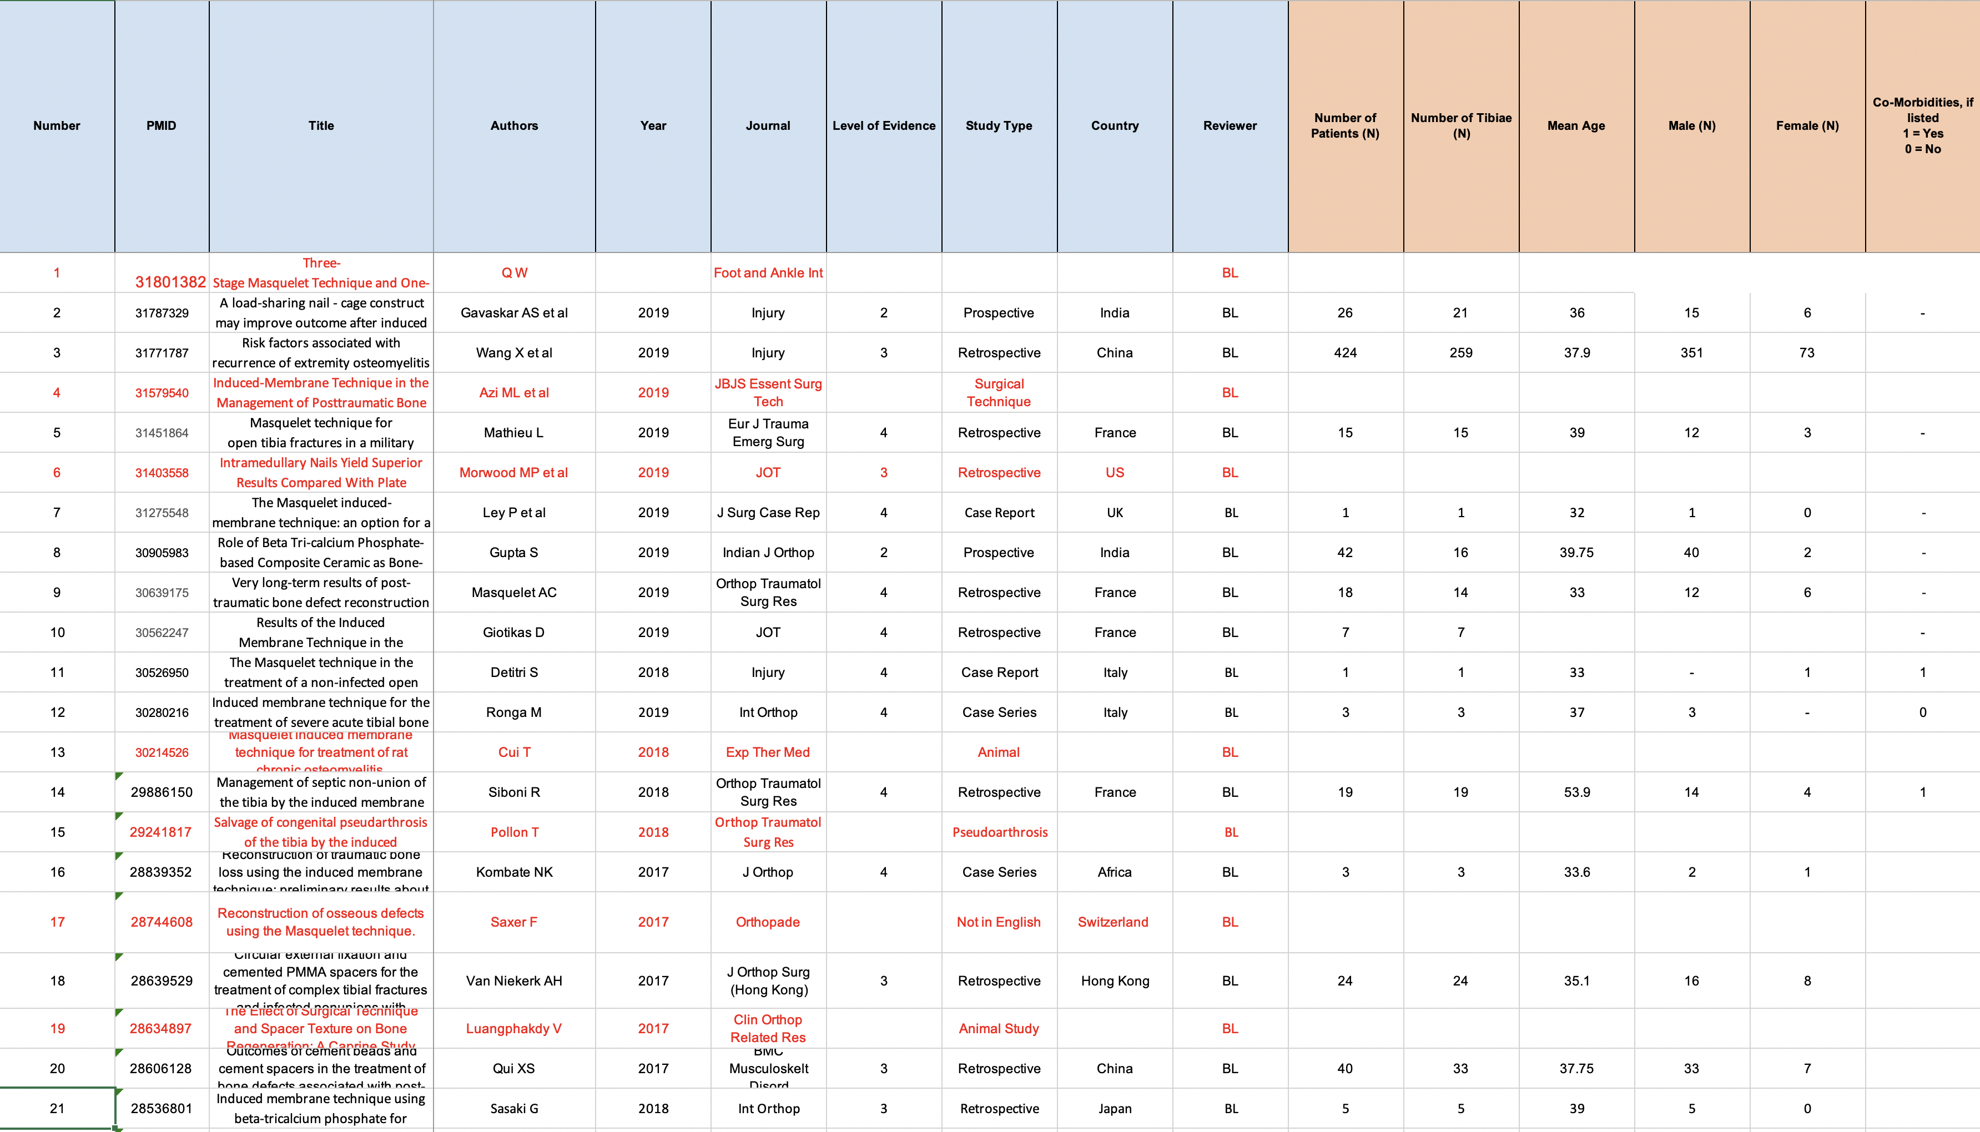
Perform an extensive, methodical literature review
Doing this in a reproducible, detail-oriented way will save work in the long run and serve for the foundation of all the writing required
Multiple examples of reference matrices available

Slide 9
Perform an extensive, methodical literature review
Pick a good reference management tool and commit to it
Endnote
Mendeley

Slide 10
Formulate “The Question”
Frame the research around a specific, testable hypothesis
Bad: Geriatric pelvis fractures have a high mortality rate
not testable? What is “high”?
Better: Geriatric pelvis fractures have a one year mortality rate comparable to geriatric hip fractures
The core of research design will hinge on addressing this question
Alternative framing: Think about what it would take for a study to prove your hypothesis wrong → do that study!

Slide 11
Develop specific aims
Required for grant writing
Useful exercise even when not applying for funding
Should be:
Based on specific hypotheses
Not interdependent
Incrementally more ambitious
A useful exercise to determine what “success” will look like at the conclusion of the study

Slide 12
Case Example - Develop specific aims
Aim 1: Determine whether patients who received Ketorolac treatment require less opioid medication throughout their hospital and post-operative course.
Aim 2: Determine if early scheduled administration of Ketorolac will reduce the inflammatory cytokines and patient morbidity.
Beware of being vague, having sequential aims dependent on one another,
having too many aims, over burdening your research facility and staff

Slide 13
Determine your outcome of interest
Based on the optimum way to test your specific aims / central hypothesis
Functional scores:
Patient rated outcome measures (PROM)
Performance based measures (PBM)
Radiographic measurements
Clinical outcomes:
Death, infection, readmission, fixation failure, etc
Selecting an appropriate primary outcome measure may be the most important step in study design
Reliability? Validity? Responsiveness?

Slide 14
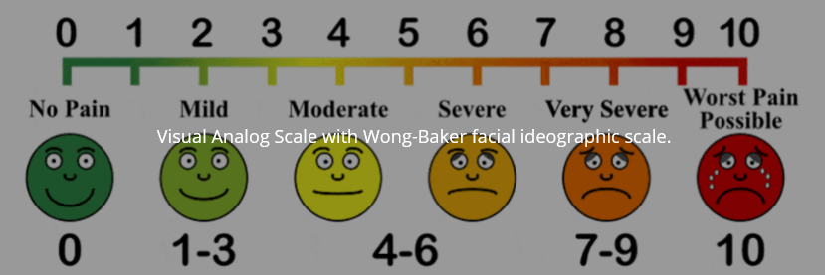
Case Example - Outcome of interest
Aim 1: Determine whether patients who received Ketorolac treatment require less opioid medication throughout their hospital and post-operative course.
Patients' subjective pain score (Visual Analog Score)
Morphine Milligram Equivalent intake
Group 1: Treatment vs Group 2: Placebo
Aim 2: Determine if early scheduled administration of Ketorolac will reduce the inflammatory cytokines and patient morbidity
IL-6, IL-10, IL-1
Secondary outcome: morbidity, hospital length of stay, ARDS/SIRS, Pneumonia

Slide 15
Build a team – Getting started
Bring in the help you realistically need to execute the research plan
Balance of time, funding, expertise, and assigning credit

Slide 16
Build a team – Study staff
Research coordinator
Requires funding, can act like an extension of the PI to keep paperwork, enrollment moving
Early in career, you may need to be your own coordinator!
Research Analysts/Assistants
Cost money, need funding
Medical students / Residents
A good resource for labor to help
Be realistic with them about their availability, your expectations
What is their reward! - academic credit
Requires supervision to ensure data integrity

Slide 17
Build a team – Statisticians
A crucial resource
Involve them before the study starts (e.g. power analysis)
Use them to help develop/build your data collection sheet
Frequently require funding, sometimes can get short amounts of time
They rely on you for clinical context and relevance
Provide them a detailed understanding of the medical details.

Slide 18
Build a team – Mentorship
Whatever you’re about to start, chances are others have some similar projects in the past
Inside your institution: know the ins-and-outs of getting work done at your center
Outside your institution: can give you big picture guidance on how to set up your study to maximize the chance of success
Learn from others’ mistakes so you don’t have to make the same ones
Lean on mentors when you hit bumps in the road and unexpected problems
NEVER BE AFRAID TO ASK FOR HELP – you will learn and gain respect

Slide 19
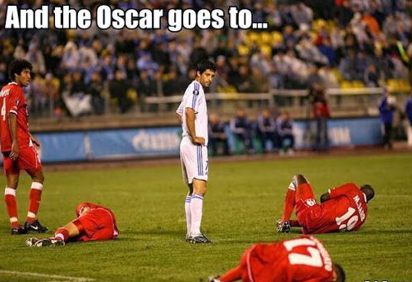
Case Example - Build a team
Principal Investigator (PI) – You
Co-PI – Mentor/Expert in the field
Key Personnel:
Pharmacist-clinical studies
Statistician
Immunologist – Cytokine analysis
Clinical Study Coordinator
Study Personnel:
Medical Students/Residents
Research Assistants: help with patient enrollment

Slide 20
Choose a Methodology
What methods have been used before?
What other validated ways exist to answer the question

Slide 21
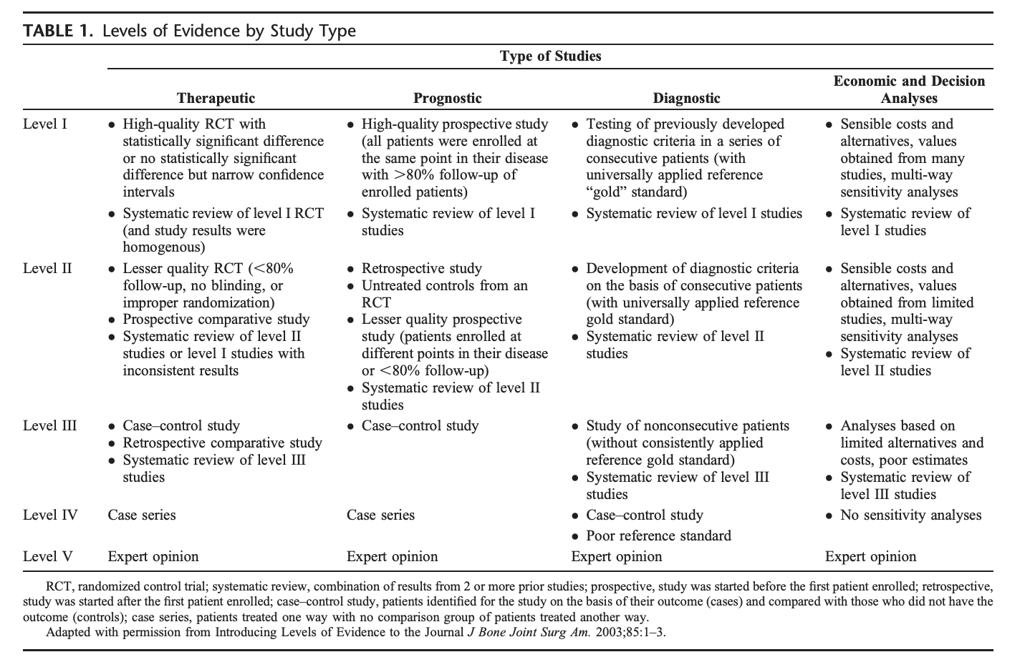
Identify the Level of Evidence
Prospective or retrospective?
Pick minimum Level of Evidence
to answer your question
meaningfully
Not everything needs a level 1 RCT
Slobogean G, Bhandari M. Introducing levels of evidence to the Journal of Orthopaedic Trauma: implementation and future directions. J Orthop Trauma. 2012 Mar;26(3):127-8.

Slide 22
Clinical Trials Design
Clinical Case Series – Level IV EBM
Easy to do
Requires few resources
May be prospective (best) or retrospective
Need a priori protocols, well defined inclusion/exclusion criteria
Will have a selection, recall, performance and expertise bias
Useful as a pilot study – generate hypotheses, power calculation for future studies, evaluate novel surgical techniques

Slide 23
Clinical Trials Design
Case controlled
Two groups – cases versus control
Retrospective
Compared for risk factors, characteristics of patients, fracture, disease, treatment
Get Odds ratio, regression analysis
Simple, cheap, good for rare outcomes
Will have a selection, recall, performance and confounding bias

Slide 24
Clinical Trials Design
Cohort Study
Two groups – exposed and unexposed group
Prospective – allocation naturally at baseline and followed
No recall bias, match for confounding variables, standardize eligibility and outcomes
Resource intensive, selection, detection, performance bias and attrition
Less strength in treatment effect inferences (vs. RCTs)
Retrospective - where exposure characteristics identified retrospectively (i.e. by type of treatment) and followed forward for the development of the outcome interest

Slide 25
Database study
Multiple large national / international databases exist with data that can be “mined”
NSQIP, TQIP, Medicare payor database, PearlDiver, etc
Pros
Very large sample size
Global uniform sample can eliminate expertise bias
Cons
Only as good as the data coded into it: “garbage in = garbage out”
Can become descriptive studies = just defining incidence and event rates, no core underlying clinical question answered
Most of the low hanging fruit may have already been explored
Only persue a large database study if:
You have a clearly defined clinical question
The data captured in the database is extremely well suited to address the question
You have expertise or access to experts in the complex statistical methods required

Slide 26
Clinical Trials Design
Randomized Controlled Trial
Highest quality evidence
Identify study prospectively and randomize based on strict inclusion/exclusion criteria
Mitigates selection and confounding bias
Efficacy and effectiveness may be determined
Needs proper strict randomization
Blinding if possible
Are expensive, time consuming
Busse JW, Bhandari M, Schemitsch EH. Randomized trails in surgery. Tech Orthop 2004; 19:77-82

Slide 27
Power Analysis – How many patients do you need?
Do this before starting!
Need to have a clearly defined primary outcome, a sense of what a clinically meaningful difference would be
Should be done with the help of a statistician
Retrospective studies: Often a sample of convenience
How do you know when you have enough patients?

Slide 28
Minimize Bias
Selection Bias
Error due to difference in study groups leading to differences
Recall Bias
Increased likelihood of patients with an adverse outcome to recall exposure
Detection Bias
Differential assessment of outcome by assessors due to knowledge of treatment
Performance Bias
Systematic differences in care between groups independent of the intervention
Attrition Bias
Difference in patients who drop out of a study compared to those who remain
Expertise Bias
Differential ability of treatment providers between interventions

Slide 29
Case Example - Methodology and Power Analysis
Prospective Randomized Clinical Trial
Double Blinded:
Neither research team nor patient aware of treatment group
Single Center vs Multicenter: Do I have the sample size?
Power Analysis: STATISTICIAN TO THE RESCUE
Aim 1: Utilizing a two-tailed t-test, a sample of 100 patients (50 per group) will be 90% powered to detect between group difference in opioid consumption.
Aim 2: A preliminary power analysis (using SAS Proc Power) shows that a sample size of 100 per group gives a power of 90% to detect a 20 percentage point difference in frequency of bacterial pneumonia and a power of 82% to detect a 15 percentage point difference in frequency of ARDS

Slide 30
Register your clinical trial
Prospective clinical trials should be registered at Clinicaltrials.gov
Most institutions have a liaison that can help with that process
Should be registered before you start data collection

Slide 31
Funding
Levels:
Intramural
Hospital Specific Startup Funds
Extramural
Pharmaceutical (disclosure and internal bias)
Society level (OTA, AO North America, MAOA, OREF)
Large Scale
NIH
Department of Defense
PCORI

Slide 32
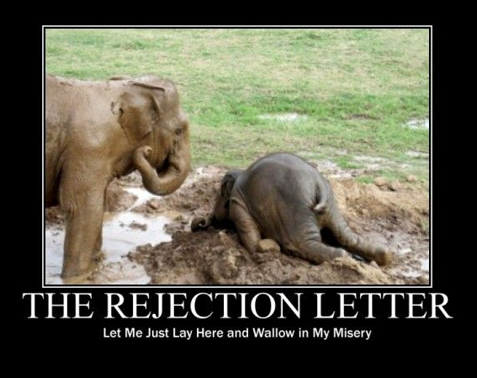
Funding
Be Prepared for Rejection
It is a process
Rejected
Recommend Changes
Reapply
Successful researchers average 8 rejections before 1 acceptance
How bad do you want it?
It is a learning experience – each rejection teaches you something

Slide 33
Case Example - Funding
OTA Full Faculty Grant ($80K over 2 years)
Obtain pilot funding
Seed money for preliminary data
Demonstrate feasibility
NIH RO1 / DoD Grant ($2 mil over 4 years)
For fully powered study
Multicenter trial

Slide 34
Ethics - IRB
Not just a chore
Opportunity to write the Intro and Methods for manuscript
Doing a good job now saves work in the long run
Save templates for future studies
Ask for help
The IRBs are for you and your patient’s protection – do not fight but cooperate with them

Slide 35
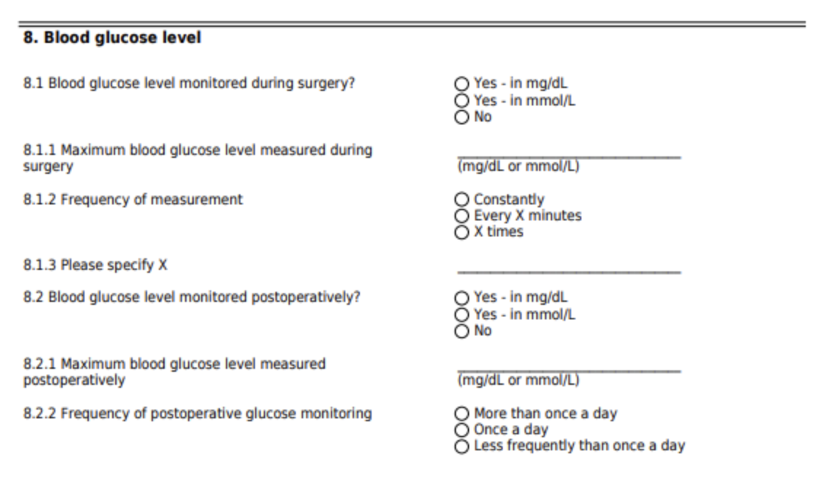
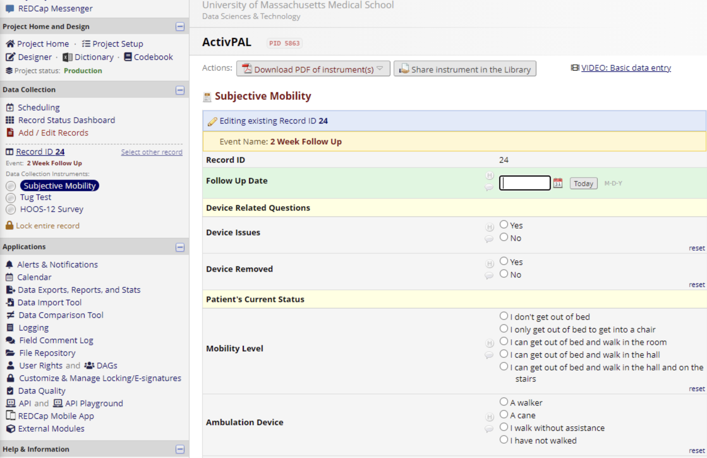
Data collection
Time put into good data collection preparation pays for itself at the end of a study!
Agree on a format and make a standardized form that forces data to be entered correctly (i.e. minimize free text responses)
Put data into a single secure location that everyone on the study knows
For multicenter studies, consider data management software designed specifically to coordinate clinical trials (e.g. REDCap)

Slide 36
Equipment/Infrastructure
What does my institution have:
High volume
Obesity
Geriatric
Opioid Epicenter
What other departments are doing excellent research at my institution:
Physiology
Engineering
Microbiology
Focus on your strengths and collaborate with others that have similar goals

Slide 37
Research Support from Department
Not required but helps
You need:
Seed Money
Resources: access to team personnel, lab
Time: “nights and weekends”

Slide 38
Case Example: Equipment/Infrastructure
Research support: given 15% protected research time/DOE
Equipment:
Support from Chair
Access to patients
Research coordinator/personnel to enroll patients
Investigational Drug Service to administer treatment
REDCap to assess patient outcome
PROMIS patient outcome scores

Slide 39
Courses to become a better researcher
AAOS
OREF
USBJI – YII (Young Investigator Initiative)
Local Hospital
NIH Grant Writing Workshops
Volunteer for Research Committees

Slide 40
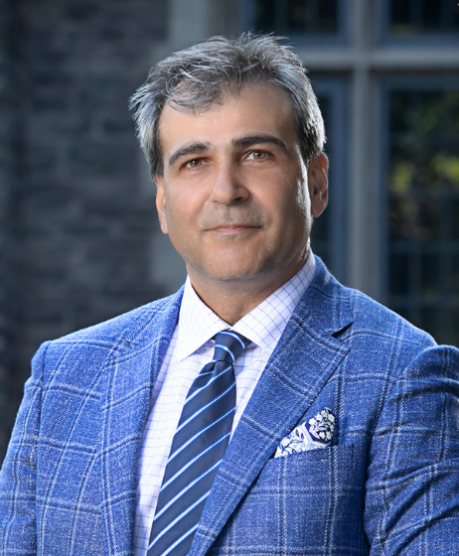
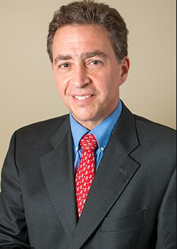
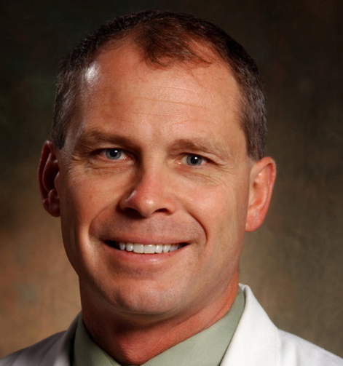
Best Way to Become a Better Researcher
Ask for Help
Build relationship with mentors
Seek out and collaborate with other good researchers
Dr. Bhandari
Dr. Tornetta
Dr. Obremskey

Slide 41
Ready?
Follow through on what you planned
Research should be:
Realistic
Achievable
Meaningful
Anything that gets funded MUST get completed
Summary Report
Build a reputation

Slide 42
Case Example - Ready
Table 3: Tentative time table of the proposed project
 | Inpatient |  |  |  |  |  |  | Outpatient
Procedures | Daily Screen | Day 1 | Day 2 | Day 3 | Day 4 | Day 5 | Discharge | 2 Week | 6 Week | 3 Month | 6 Month | 12 Month
Inclusion/Exclusion Review | X
Informed Consent | X
Blood Sample |  | X | X | X | X | X
Ketorolac Intervention |  | X | X | X | X | X
MME |  | X | X | X | X | X | X
Pain Assessment |  | X | X | X | X | X | X | X | X | X | X | X
SMFA |  |  |  |  |  | X |  |  | X | X | X | X
BPI |  |  |  |  |  |  | X

Slide 43
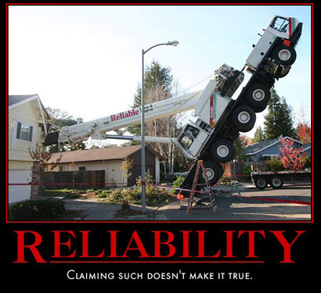
Reliability
Be a reliable person in the “multicenter study”
Say “yes” to stuff that is clinically meaningful
for you
Complete the task in timely fashion
Support other researchers around you

Slide 44
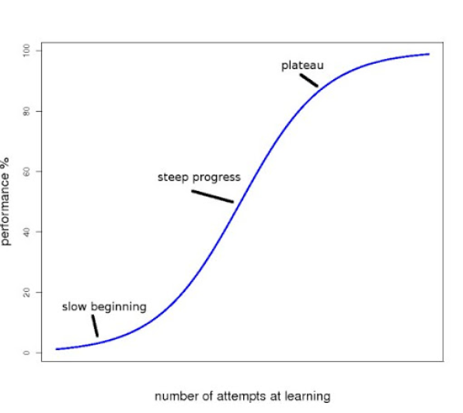
Reality
Your abstracts will be rejected
Your grants will be rejected
may not even be scored
Your publications will be rejected
You will not be 100% successful, but remember it is a process with a steep learning curve

Slide 45
Research Reputation
If you build it they will come!!
You will be successful
You will be part of a reliable network
of researchers

Slide 46
Do you really want to do this?
Big picture:
Will never make you rich but will
make you happy
Short term: Money loser
Long term: Good chance – money loser
If you do it well – could be positive for you
Big winner → institution (med school)

Slide 47
Thanks!

