Slide 1
Radiographic evaluation of the Spine
Alex M. Buteera, MD
Associate Professor and Chief Consultant Orthopedic Surgeon
Rwanda Military and King Faisal Hospital, Kigali

Slide 2
Objectives of Radiographic Examinations
Adjunct to history and physical examination in process of establishing diagnosis of spine injury.
Ascertain as definitively as possible whether there is a Spine injury
Define fully the nature of the Spine injury

Slide 3
Radiographic Examination

Slide 4
Radiographic Exam
Systematic Approach
- Steps

Slide 5
Radiographic Exam
Systematic Approach
If a Step is missed

Slide 6
Challenges of Radiographic Examination
Extremely sensitive but relatively non specific
Reveal abnormalities in 1/3 of asymptomatic patients
Differentiating between abnormalities with clinical implications and effects of ageing or healing

Slide 7
Radiographic Examination
Studies that are routine- Lateral C-Spine
(Part of Trauma Series)
Or Equivalent ( CT Scan with Sagittal recon)
Cervical spine imaging in patients with blunt trauma
Blackmore CC, Emerson SS et al, 1999

Slide 8
Radiographic Examination
If 1 Spine injury is detected
Do complete C, T, L and S of the Spine
10-20% non contiguous injury
Evaluation of risk of noncontiguous fractures of the spine in blunt trauma. Daniel William Nelson et al. J Trauma Acute Care Surg.2013 Jul.

Slide 9
Radiographic examination
Presence of facial trauma- C-Spine radiographs
Presence of face or neck abrasions from sit belts- C-Spine radiographs
Presence of lap belt contusion- T-L Spine radiographs
Presence of calcaneal fractures- T-L/ L-Spine radiographs

Slide 10
Cervical Spine
Spine Examination

Slide 11
Systematic
Upper Cervical
Lower Cervical
Start with PLAIN LATERAL FILM
85% of injuries
Initial radiographic evaluation of the spine after trauma , France John CM, Bono Christopher et al, 2005

Slide 12
Occipital Cervical junction injuries
Dislocations and Dissociation
Associated major trauma
Injury Detection is a challenge leading to missed diagnosis
CT scan is best option for these injuries.

Slide 13
Detecting O-C Junction injuries
Harris Lines
Basiondental Interval (BDI)
Distance from basion to the tip of the dens
Basionposterior Axial Line Interval (BAI)
Distance from the basion to a line drawn on the posterior aspect of C2
Harris Rule of 12
Both of these lines should be less than 12 mm
BAI
BDI
Notes:
Supplementary Text for the Slide:
Harris and his colleagues measured the BAI and BDI on lateral films of over 400 normal adults. The BAI was less than 12 mm in 98% of adults, and the BDI was less than 12 mm in 95% of adults. These measurements are commonly referred to as the Rule of 12 and can be used to detect OC injuries in Trauma patients.
Bono CM, Vaccaro AR, Fehlings M, Fisher C, Dvorak M, Ludwig S, Harrop J; Spine Trauma Study Group. Measurement techniques for upper cervical spine injuries: consensus statement of the Spine Trauma Study Group. Spine (Phila Pa 1976). 2007 Mar 1;32(5):593-600. doi: 10.1097/01.brs.0000257345.21075.a7. PMID: 17334296.

Slide 14
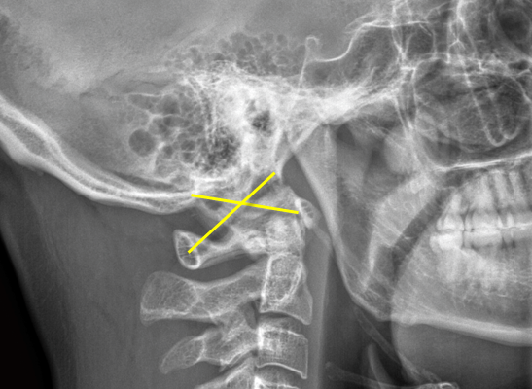
Detecting O-C Junction injuries
Power’s Ratio
Describes relationship between occiput and C1
Line drawn from
Basion to Posterior Aspects of the C1 Arch (BC)
Opisthion to Anterior Arch of C1 (OA)
Ratio of these lines should be less than 1 in normal patients
BC/OA < 1
B
O
A
C
Notes:
Bono CM, Vaccaro AR, Fehlings M, Fisher C, Dvorak M, Ludwig S, Harrop J; Spine Trauma Study Group. Measurement techniques for upper cervical spine injuries: consensus statement of the Spine Trauma Study Group. Spine (Phila Pa 1976). 2007 Mar 1;32(5):593-600. doi: 10.1097/01.brs.0000257345.21075.a7. PMID: 17334296.

Slide 15
Upper Cervical Instability
Widened ADI
Atlanto-dens Interval (ADI)
Horizontal distance between posterior border of anterior arch of C1 and the anterior border of the Dens
> 3.5 mm indicative of instability
Posterior atlanto-dens interval (PADI)
Horizontal distance between posterior border of dens and the anterior border of the posterior arch of C1
Commonly evaluated as Space Available for the Cord
The AP diameter of the canal at this level
ADI
PADI
Notes:
Bono CM, Vaccaro AR, Fehlings M, Fisher C, Dvorak M, Ludwig S, Harrop J; Spine Trauma Study Group. Measurement techniques for upper cervical spine injuries: consensus statement of the Spine Trauma Study Group. Spine (Phila Pa 1976). 2007 Mar 1;32(5):593-600. doi: 10.1097/01.brs.0000257345.21075.a7. PMID: 17334296.

Slide 16
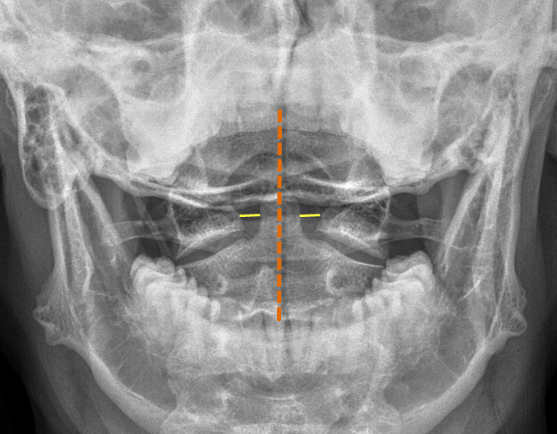
Upper Cervical: Open Mouth View: C1-C2
Normal C1-C2

Slide 17
Measuring Lateral Mass Overhang
Notes:
Image courtesy od Dr. Rizwan Akram
Rule of Spence: Combined lateral mass overhang greater than 6.9 mm on CT or 8.1 mm on plain films (secondary to magnification error) is indicative of transverse ligament disruption. Please see further details in the upper cervical spine trauma lecture.

Slide 18
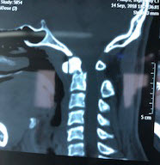
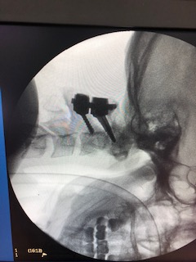
CT scan- C- spine
C1-C2 (Odontoid fracture)
Defines the nature of spine injury better
Aids decision on management
C-arm Image post fixation

Slide 19
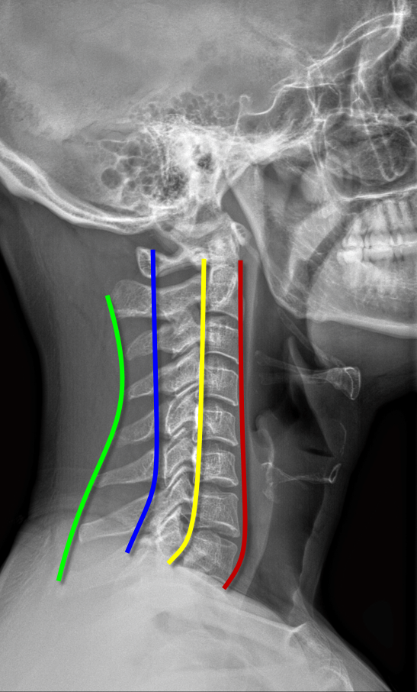
Cervical Spine: Lateral X-ray
Check the lines and soft tissues
Anterior VB line
Posterior VB line
Spinolaminar line
Posterior spinous line

Slide 20
Lower C-Spine detection
Spinous process gapping
Facet joint apposition
Intervertebral gaping
Angulation
Translation

Slide 21
Lower C-Spine detection
Spinous process gapping

Slide 22
Lower C-Spine detection
Facet Joint Apposition
Normal facets should have overlap (green)
Subluxed or Dislocated facets no longer show this overlap (red)

Slide 23
Lower C-Spine detection
Inter-vertebral gapping

Slide 24
Lower C-spine detection
Vertebral Angulation

Slide 25
Lower C-Spine detection
Vertebral translation

Slide 26
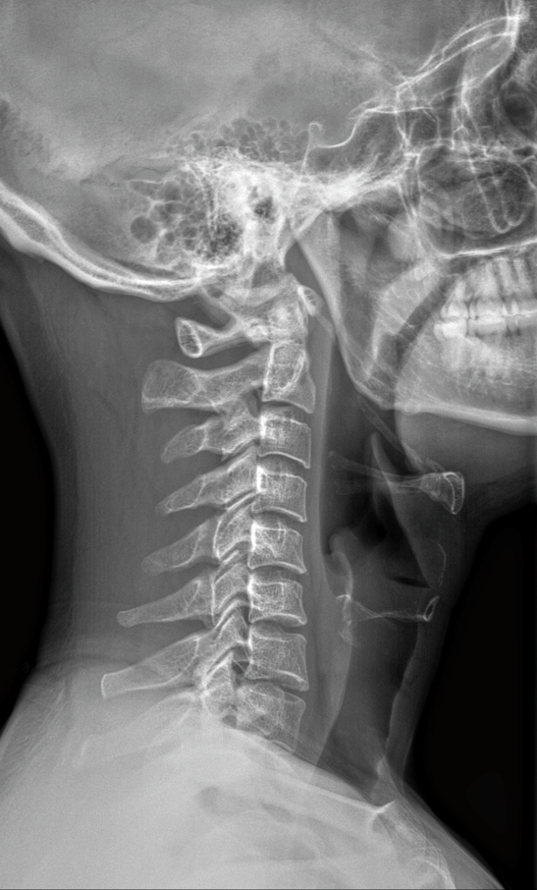
Subtle signs of injury
No obvious fracture/
dislocation
Check retrophangeal or
Prevertebral soft tissue
swelling
Presence:--> + injury
Absence: may not rule out injury

Slide 27
Soft tissue swelling
Using:
6mm at C3 ---> 59% Sensitivity
22mm at C6 ---> 5% Sensitivity
Doesn’t mean much if not there
DeBehn and Havel, 1994

Slide 28
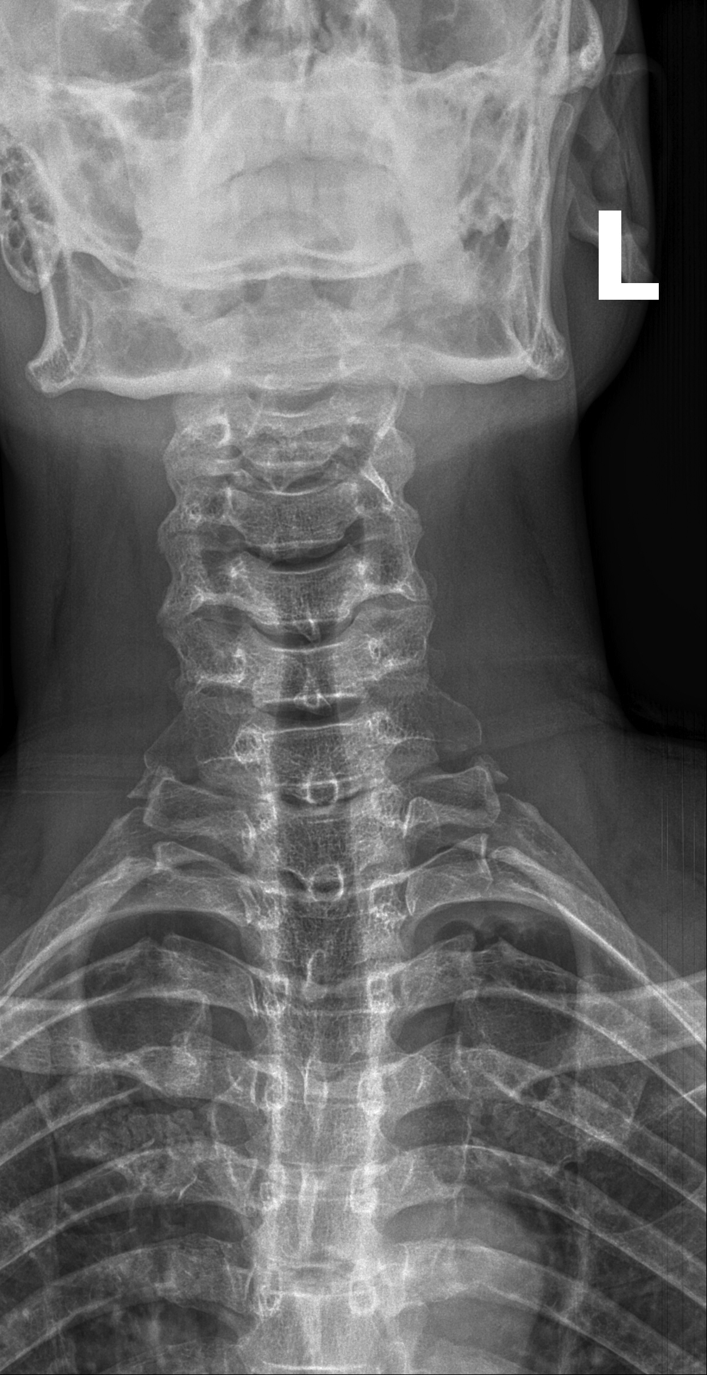
C-Spine: Anteroposterior view
Spinous process deviation
Lateral translation
Coronal deformity

Slide 29
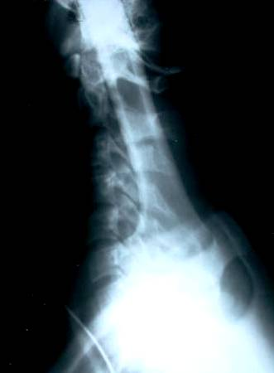
Cervicothoracic junction
Complete lateral
(Upper part of T1)
Swimmers view
CT Scan is better for
transition zones

Slide 30
CT Scan as- Screening Modality
CT with sagittal recon l
Most sensitive for fracture
detection
Especially transition zones
( C0-C1 and C7-T1)
Difficult with X-rays
Vascular injury
Michael Utz, Shadab Khan et al, Insights Imaging, 2014

Slide 31
MRI- best soft tissue definition
Negative plain Films
Negative CT Scan
But Clinically Suspicious
Check for:
Continuity of ligaments
Edema in soft tissues
Cord injury?

Slide 32
Safety: Contra-indications for MRI
Implanted devices that:
Subject to magnetically induced malfunction
Potentially harmful movement

Slide 33
MRI- best soft tissues definition
Clinical suspicion
Has neural deficit
Herniated disc
Cord injury

Slide 34
MRI- soft tissue definition
T1 sequences:
Excellent for surveying anatomy and caliber of spinal cord
T2 images with or without fat saturation:
epidural fluid collection, ligamentous disruption, edema and herniated discs

Slide 35
‘Clearing’ the C-Spine
Standardized Protocol
No consensus

Slide 36
Clearing C-Spine
Avoid missed injuries
Identify patients without significant injuries
Delay in diagnosis associated with worse outcome
Levi AD, Hubert RJ et al, Spine 2006

Slide 37
Injury detection- Thoracic and Lumbar Spine
Same principles
Landmarks and lines: Lateral View
Posterior vertebral body line
Anterior vertebral body line
Inter-spinous Distance
Translation

Slide 38
Injury detection- T and L Spine
AP View:
Spinous process to pedicles
Should be symmetric
Interpedicular distance
May be widened in burst
fractures
Translation

Slide 39
CT Scan: T-L Spine
More Common as initial study
Indicated if plain x-ray is suspicious
Best bony detail
Request multiple planes and recon
Axial alone can miss translation

Slide 40
Thoracic and lumbar injuries
What is normal angulation?

Slide 41
T-L Spine injuries
Height loss
Adjacent fracture

Slide 42
MRI- Best at soft tissues
MRI Can be useful to detect injuries to soft tissues, such as the posterior ligamentous complex (PLC)
Consists of
Supraspinous Ligament
Interspinous Ligament
Ligamentum Flavum
Facet Capsule

Slide 43
MRI- best for soft tissues
Assessing PLC using MRI
Continuity of the ligamentum flavum

Slide 44
Summary
Radiographic imaging serves as an adjunct to history and physical examination in process of diagnosing traumatic spinal injuries
Radiographic evaluation should be approached in a systematic manner
The advent of advanced imaging systems has led to improved detection, understanding, and diagnosis of spine trauma …
But understanding the principles of these injuries on plain films remains critically important

