Slide 1
Upper Cervical Spine Injuries
Ozarks Healthcare
Troy Caron DO

Slide 2
Objectives
Review Upper Cervical Spine injuries that can easily be overlooked!
Understand how to systematically review CT scans and MRI’s to avoid missing an upper cervical spine injury!
Review Common injuries
Occipital Condyle
Occipital Cervical Dissociation
C1 Ring
Odontoid
Rotatory Subluxation Atlanto axial Injuries
Hangmans fracture
Discuss anatomy and methods of surgical stabilization

Slide 3
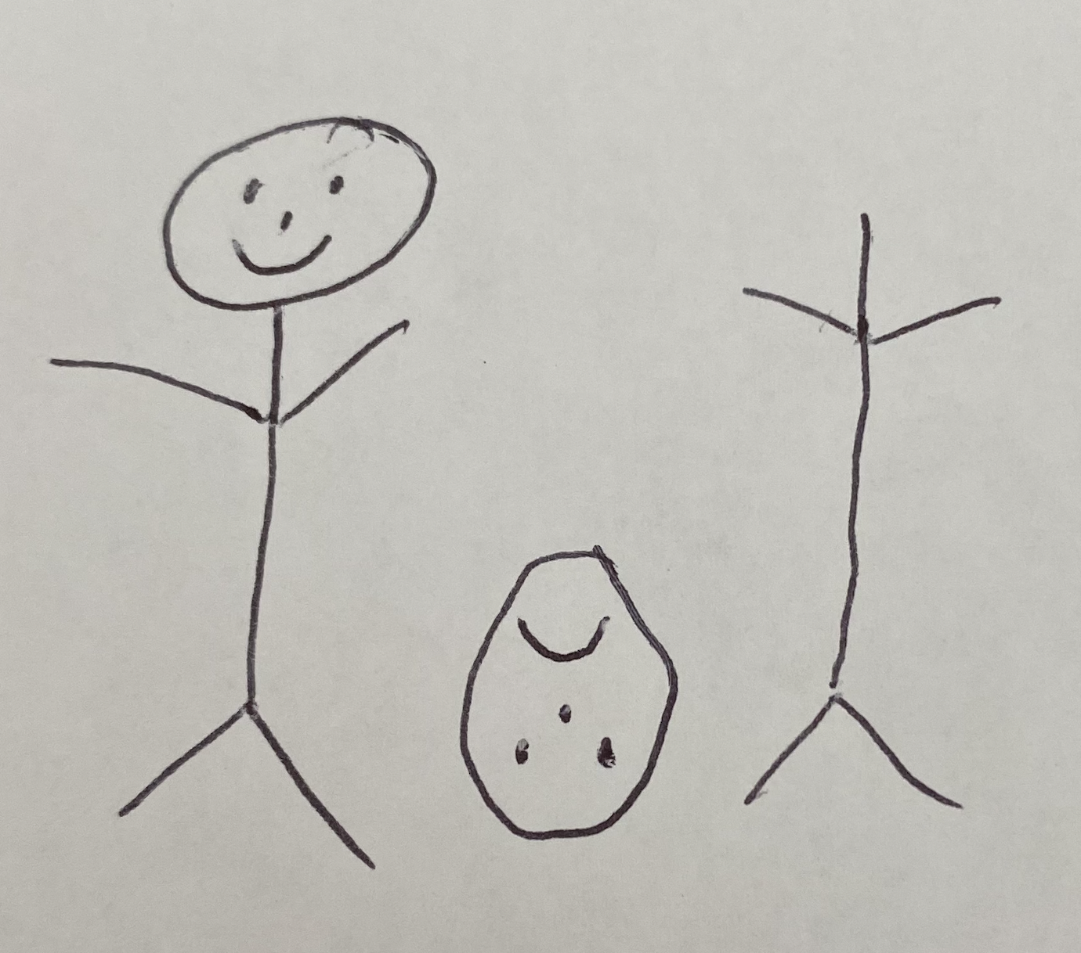
Do Not Miss an Upper Cervical Spine Injury!

Slide 4
Do Not Miss an Upper Cervical Spine Injury!
Complex bony and vascular anatomy
Relationship of atlas and axis with cranial base
Intrinsic stability that relies on ligaments and joint capsules
Can be missed on radiographic images

Slide 5
Do Not Miss an Upper Cervical Spine Injury?
Severe ligamentous injury can be missed with patient in the supine position while they are getting images done.
Bony alignment can be maintained
CT allows direct visualization of the AO and AA joints
Harris Lines most clinically relevant
BDI < =12
BAI <=12
BDI: Basion Dens Interval
BAI: Basion Axial interval

Slide 6
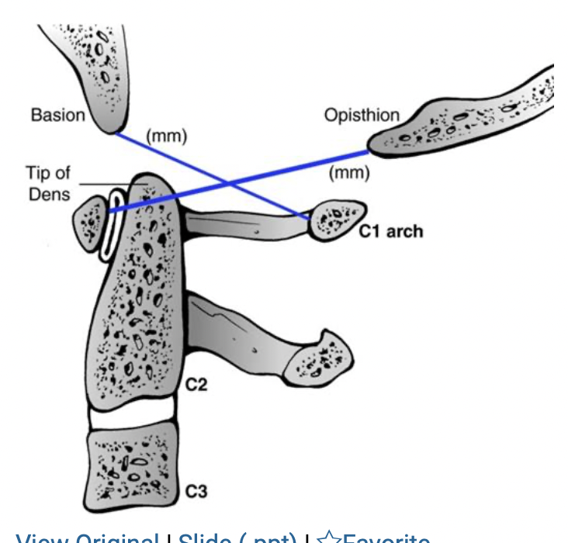
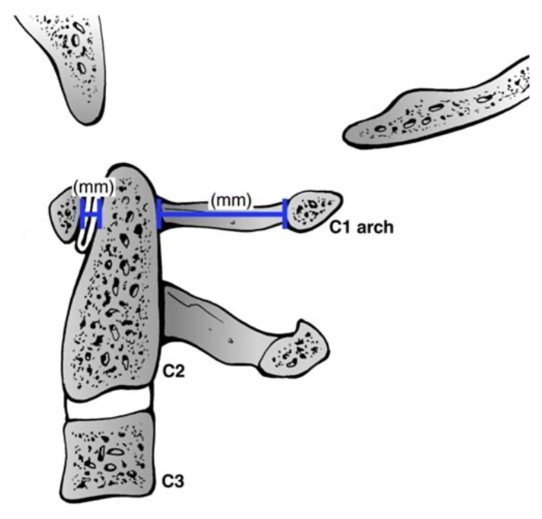
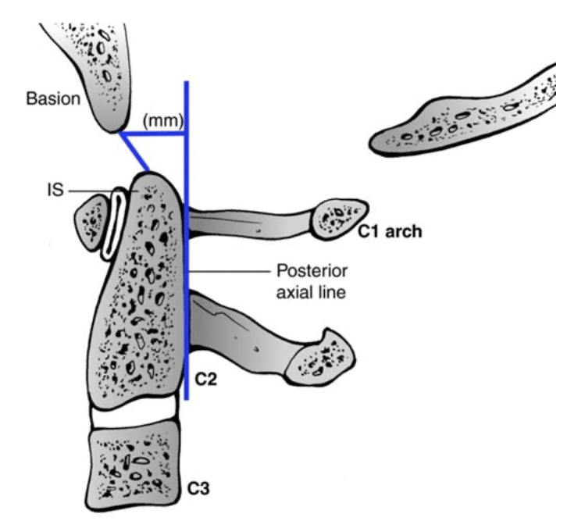
Do Not Miss an Upper Cervical Spine Injury?
MRI useful for evaluation of upper cervical ligaments
Harris measurement
“rule of 12”
Powers Ratio
Basion to C1 arch / Opisthion to anterior C1 arch
ratio >1 suggestive of atlanto occipital dislocation
Atlanto Dens Interval (should be <3mm)
Posterior Atlanto Dens Interval (should be >13mm)
Notes:
Andrew J Schoenfeld, Hai V. Le, Christopher M. Bono. Chapter 47 Cervical Spine Fractures and Dislocations . In: Tornetta P, Ricci WM, eds. Rockwood and Green's Fractures in Adults, 9e. Philadelphia, PA. Wolters Kluwer Health, Inc; 2019. Fig 47-1, 47-2, 47-3.

Slide 7
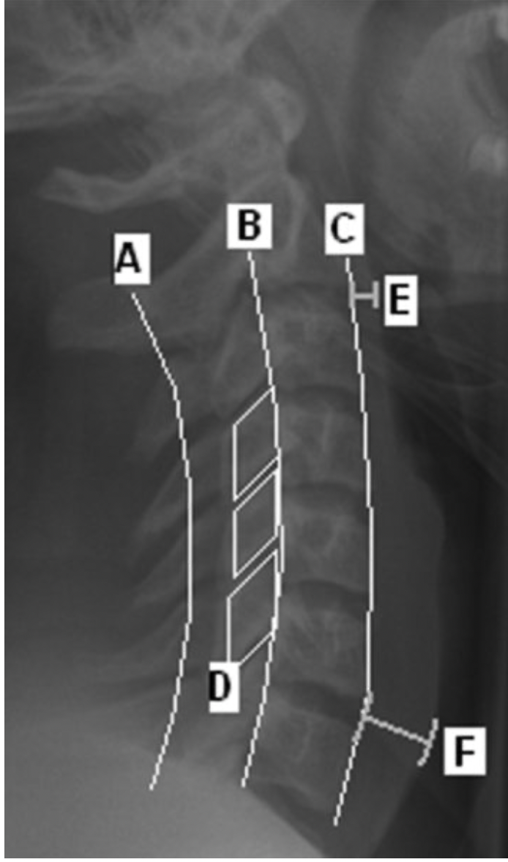
Plain Radiograph (Most patients already have a CT)
Pre vertebral swelling
Soft Tissue shadow
<6mm at C2
Atlanto – Occipital Joint Congruence
Open Mouth AP
Distraction
C1-C2 symmetry
Rule of spence (>7mm offset combined over C2)
Notes:
The spinolaminar line (A), posterior vertebral body line (B), and the anterior vertebral body line (C) are normally unbroken. On a perfect lateral view, the facet joints should appear as stacked parallelograms (D). The prevertebral soft tissue shadow is measured at the level of C2 (E) and C6 (F) vertebral bodies. Greater than 6 mm of soft tissue shadow at C2 and 22 mm at C6 are strongly suggestive of an underlying spinal injury.
Andrew J Schoenfeld, Hai V. Le, Christopher M. Bono. Chapter 47 Cervical Spine Fractures and Dislocations . In: Tornetta P, Ricci WM, eds. Rockwood and Green's Fractures in Adults, 9e. Philadelphia, PA. Wolters Kluwer Health, Inc; 2019. Fig 47-4.

Slide 8
Common Injuries of the Upper Cervical Spine

Slide 9
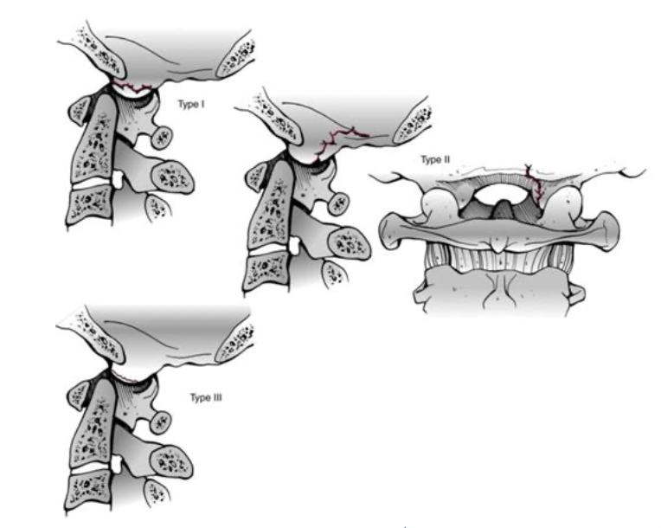
Occipital Condyle Fracture
Image Evaluation
Thin slice CT scan
Anderson and Montesano
I. Comminuted
II. Basilar Skull Fracture
III. Avulsed
I
II
III
Communicate with
foramen magnum
Tension from alar
ligament
Axial load
Notes:
Andrew J Schoenfeld, Hai V. Le, Christopher M. Bono. Chapter 47 Cervical Spine Fractures and Dislocations . In: Tornetta P, Ricci WM, eds. Rockwood and Green's Fractures in Adults, 9e. Philadelphia, PA. Wolters Kluwer Health, Inc; 2019. Fig 47-38.

Slide 10
Occipital Condyle Fracture
Usually occur with other cervical spine injuries
Commonly go undiagnosed
Suspicion for injury with:
Retropharyngeal soft tissue swelling
Lower cranial nerve paresis(CN IX-XII)
CN XII most common
Occipital pain

Slide 11
Occipital Condyle Fracture
Treatment
Dictated by ligamentous injury and craniocervical stability
May be necessary to evaluate with dynamic fluoroscopy
Instability considered with bilateral occipitoatlantoaxial joint complex injury
Type I - Type III injuries can treat non operative with external brace or with surgery.
Stability have to be evaluated
Instability considered when:
> 2mm widening or translation of Occipitoatlantal joint
Can evaluate with fluoroscopy
Surgery: Indicated for instability
Occiput to C2 PSF

Slide 12
Occipital Cervical Dissociation
Rarely seen in patients that survive
Associated injuries:
Submental lacerations
Mandible fractures
Posterior pharyngeal wall lacerations
Thought to be twice as common in children
50% missed injury rate
1/3 neurologic worsening
Davis et al, 1993
Occipital Condyle is displaced anteriorly on C1

Slide 13
Symptoms/Findings
Lower Cranial Nerve deficits (V,IV,VII,XII)
Horner’s syndrome
Cerebellar ataxia
Often associated with Wallenberg syndrome:
Involve occlusion of PICA
Nystagmus
CN X nerve palsy (dysphagia)
cerebellar ataxia
Ipsilateral Horner’s syndrome
Ipsilateral pain/temperature deficit over upper half of face
Contralateral pain/temperature deficit over body
Hiccups

Slide 14
Classification
Type 1 injury: ligamentous disruption
without displacement
Harborview Classification:
I. MRI evidence of craniocervical osseousligamentous injury, <2mm displacement with traction test
II. MRI evidence of craniocervical osseousligamentous injury, > 2mm displacement with traction test
III. Craniocervical malalignment of >2mm on static radiograph
Bellabarba et al. Spine 2006

Slide 15
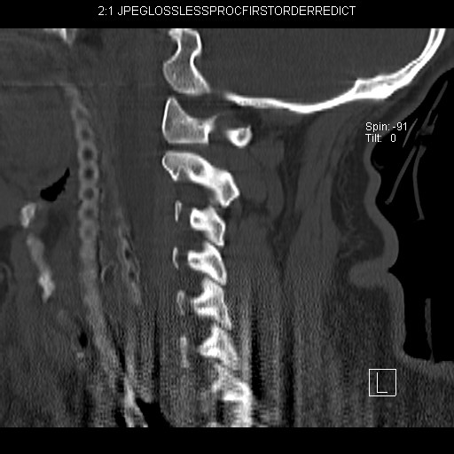
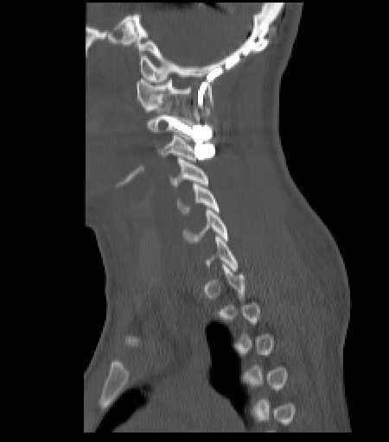
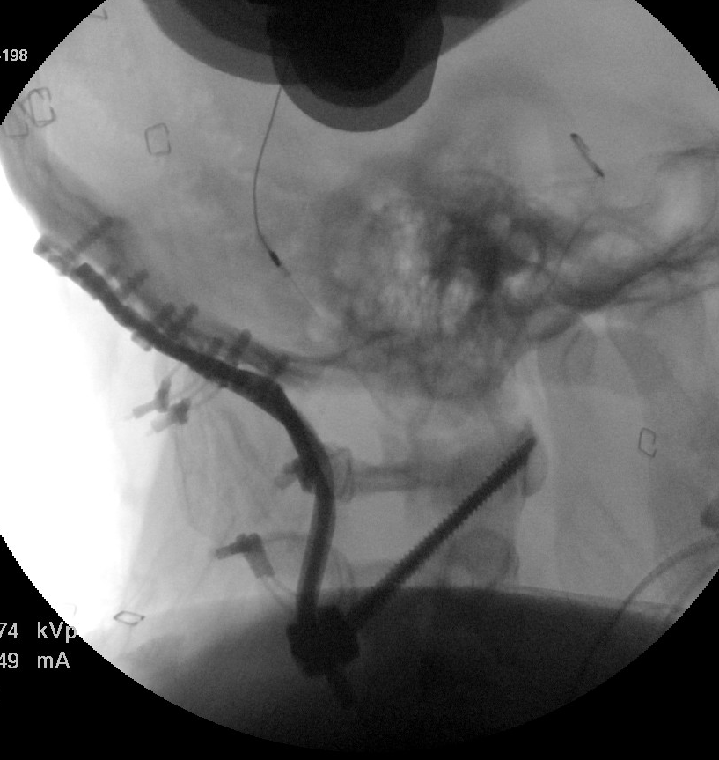
Occipital Cervical Dissociation
Treatment
Type I: Rigid Collar
Type II and III: Occipital Cervical fusion to at least C2

Slide 16
C1 Ring
Transition between cranium and C-Spine
Occiput –C1: 50% of cervical flexion and extension
Anatomy
No body
2 arches
Anterior
Posterior
Vertebral artery groove
Transverse atlantal ligament (TAL)
Constrains the posterior Dens to the anterior atlas arch
Look for other injuries in cervical spine
43% associated with C2 fracture

Slide 17
C1 Ring
Classification
Morphologic
Levine and Edwards
Transverse process
Posterior arch
Lateral mass
Anterior arch
Burst
“Jefferson type”
Transverse Process fracture: Stable watch for forament involvement
Posterior arch: Stable (hyperextension)
Anterior arch: “blowout” unstable
Comminuted or Unilateral split type: Unstable
Burst fracture: lateral displacement of lateral mass (concern for transverse ligament disruption-determines stability)

Slide 18
C 1 Ring
Image
Open mouth odontoid view
Congruence of C1 on C2
Lateral displacement of C1
7mm rule of Spence
Concern for transverse ligament
Evaluate with CT
>6.9mm
Spence et al. JBJS 1970

Slide 19
C1 Ring Treatment
Most isolated minimally displaced C1 injuries can be treated in cervical collar 3 months
Displaced can be reduced and placed in halo for 3 months
If associated with C2 can treat with C1-C2 fusion
If associated with atlantoaxial dissociation, consider Occiput to C2 fusion
Unstable: consider surgical stabilization
Halo falling out of favor for collar
C1 lateral mass displacement
treated with C1 stabilization with C1 lateral
mass screws and rod construct

Slide 20
C2
Fractures of the Axis (C2) make up 27% of cervical injuries
Odontoid make up 41% of C2 fractures
Bimodal distribution
Young – high energy, multi-trauma
Elderly – Low energy, isolated injury
Most common C-spine fracture of elderly

Slide 21
C2
Anatomy
Dens extends cranially from the axis to form a synovial articulation with posterior aspect of anterior atlas
Embryological C1 body
Base has watershed zone (poorly vascularized)
Flat C1-C2 joints: rotation
Vertebral artery foramen
Inferomedial to superolateral
Notes:
Change image

Slide 22
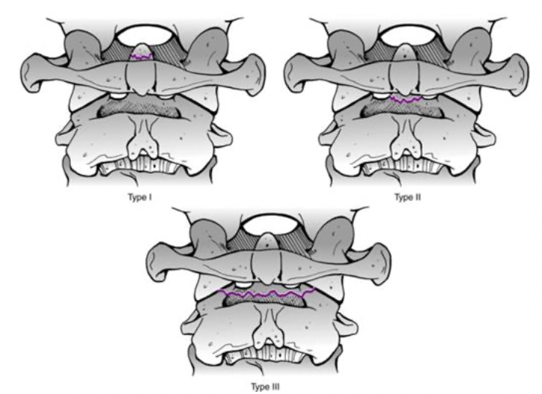
Odontoid
Anderson and D’Alonzo Classification:
Type I: located above the waist; consistent with an avulsion of alar ligament
Type II: located in the waist; covered by transverse ligament
IIa: (Hadley) segmentally comminuted at base of odontoid extending into the body
Type III: extend into the vertebral body
Notes:
Andrew J Schoenfeld, Hai V. Le, Christopher M. Bono. Chapter 47 Cervical Spine Fractures and Dislocations . In: Tornetta P, Ricci WM, eds. Rockwood and Green's Fractures in Adults, 9e. Philadelphia, PA. Wolters Kluwer Health, Inc; 2019. Fig 47-39.

Slide 23
Odontoid
Treatment
Type 1
C collar
Beware of unrecognized craniocervical dissociation
Type 3
C collar (10-15% nonunion)
SOMI brace
Halo vest

Slide 24
Odontoid
Type 2
C Collar
SOMI/Minerva
Halo vest
Odontoid screw
C1-2 PSF
Halo treatment is avoided in elderly patients
Halo option for younger patient to avoid surgery
Hard collars reserved for nondisplaced fractures or displaced fractures in elderly patients that will not tolerate surgery
may get painless fibrous nonunion
Notes:
Change image

Slide 25
Risk Factors for nonunion in type II odontoid fractures
Secondary to watershed blood supply
Higher ratio of cortical to cancellous bone
Displacement >6mm(associated with > 50% nonunion rate)
Age > 50 years old
Fracture comminution
Angulation >10 degrees
Treatment delay >4 days
Smoker
Koivikko et al. JBJS Br 2004

Slide 26
Anterior Odontoid screw
Indications:
Displaced type II and shallow type III
Polytrauma
Unable to tolerate halo-vest
Early displacement despite Halo
Reduces in extension
Contraindications:
Non-reducible
Reduces in flexion
Barrel Chest
Associated TAL injury
Subacute injury (>6 months)
Reverse obliquity
Elderly
Severely displaced or comminuted fractures
France JC, Bono CM, Vaccaro AR. Initial radiographic evaluation of the spine after trauma:
When, what, where and how to image the acutely traumatized spine. Jorthop trauma. 2005;19:640-9.

Slide 27
Anterior Odontoid screw
Advantages:
Direct fracture osteosynthesis
Maintenance of C1-C2 motion
Minimal EBL
Decreased wound issues vs. posterior approach
More useful for young patients
Disadvantages:
Require favorable patient anatomy
Must not have:
Barrel chest
Congenital cervical fusion
Thoracic kyphosis
Cervical kyphosis
Reverse obliquity/comminution
Irreducible fracture
Require intact transverse ligament
Higher incidence of dysphagia in elderly
Higher failure rate in osteoporotic bone

Slide 28
Treatment C2 Dens Fracture C1-C3 PSF
C2 Pars
screw
C1 lateral Mass
screw

Slide 29
Treatment of Dens fracture with C1 lateral mass, C2 trans- laminar (no room for pedicle screw because of large transverse foramen)
Study anatomy on CT prior
to surgery!

Slide 30
Rotatory Subluxation Atlantoaxial Injuries
Anatomy
AA articulation stability provided by ligamentous restraint
AA joint provide primarily rotatory motion
Most common in pediatric population
Evaluate with patient history and use of rotatory CT

Slide 31
Rotatory Subluxation
Three patterns:
Category A: rotationally displaced in the axial plane
Category B: translationally unstable in a sagittal plane because of injury to transverse atlantal ligament
Category C: multiplanar vertical atlantoaxial dissociation
Field and Hawkins
Type I. Rotation without translation
Type II. Unilateral lateral mass subluxation 3-5 MM
Type III. Unilateral subluxation >5 mm
Type IV. Posterior displacement of C1-2

Slide 32
Rotatory Subluxation
Treatment
Halo
Lateral facetectomy, reduction, fusion
Transoral facetectomy, reduction, fusion
Fielding and Hawkins JBJS 1977

Slide 33
Traumatic Spondylolisthesis of the Axis Hangman’s Fracture
Fracture through the pars interarticularis
Second most common axis fracture (odontoid #1)
Result of hyperextension and axial load
Neurologic injury is rare unless injury causes narrowing of spinal canal

Slide 34
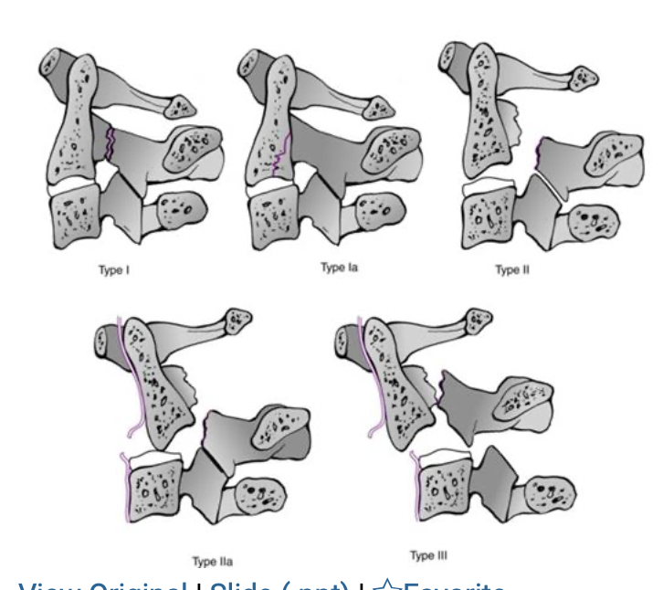
Hangman’s Fracture
Classification:
I. Minimally displaced
< 3mm translation
IA. Atypical
Oblique thru pars on one side
Anterior to pars thru body on other side
II. > 3mm translation
IIA. Kyphosis > translation
C2-C3 disk involved
PLL involved
III. Associated with dislocation of C2-C3 facet
Notes:
Andrew J Schoenfeld, Hai V. Le, Christopher M. Bono. Chapter 47 Cervical Spine Fractures and Dislocations . In: Tornetta P, Ricci WM, eds. Rockwood and Green's Fractures in Adults, 9e. Philadelphia, PA. Wolters Kluwer Health, Inc; 2019. Fig 47-40.

Slide 35
Hangman’s Fracture
Treatment
Type I and Ia: treat in cervical collar for 12 weeks
Type II: Halo for 12 weeks
Type IIa: ACDF C2/3 or posterior fixation
C2/3 acdf spares C1/2 motion segment
Posterior fixation
C1-C3
Directly treat pars fracture with reduction and Lag technique
Type III: posterior reduction and PSF
Notes:
change image

Slide 36
Conclusion
Do not Miss an Upper cervical spine injury
Critically evaluate imaging and patient
Be aware of patient's anatomy when choosing treatment option
Which type of technique to use
Many Upper cervical spine injuries can be managed nonoperatively
Do not miss the unstable ones!

