Slide 1
Classification of Fractures and Dislocations of the Thoracic and Lumbar Spine
Kevin J. DiSilvestro MD and Alan H. Daniels MD
Department of Orthopaedics, The Warren Alpert Medical School of Brown University, Providence, RI.

Slide 2
Objectives
Understand the anatomy and its impact on pathology
Learn the patterns of neurologic injury
Understand the widely used classification systems
Learn how to determine operative versus non operative management

Slide 3
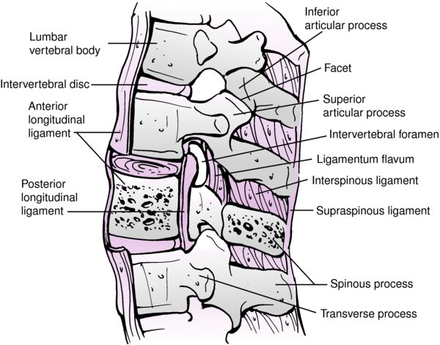
Introduction
Males > females
30% males in 30s
High energy injury
MVA >> Fall
Spinal column injury, 10-25% neurologic deficit
Thoracolumbar spine most common site of spinal injuries
Notes:
Rockwood and Green 9e figure 48-1

Slide 4
Introduction
Frequency (Gertzbein 1994)
T11-L1(52%) > L1-5(32%) > T1-10(16%)
Up to 50% have associated injuries
Intra-abdominal (liver, spleen)
Pulmonary injury- up to 20%
Up to 15% noncontiguous fractures
Notes:
A comprehensive classification of thoracic and lumbar injuries
F Magerl ¹, M Aebi, S D Gertzbein, J Harms, S Nazarian
Affiliations expand
PMID: 7866834
DOI: 10.1007/BF02221591

Slide 5
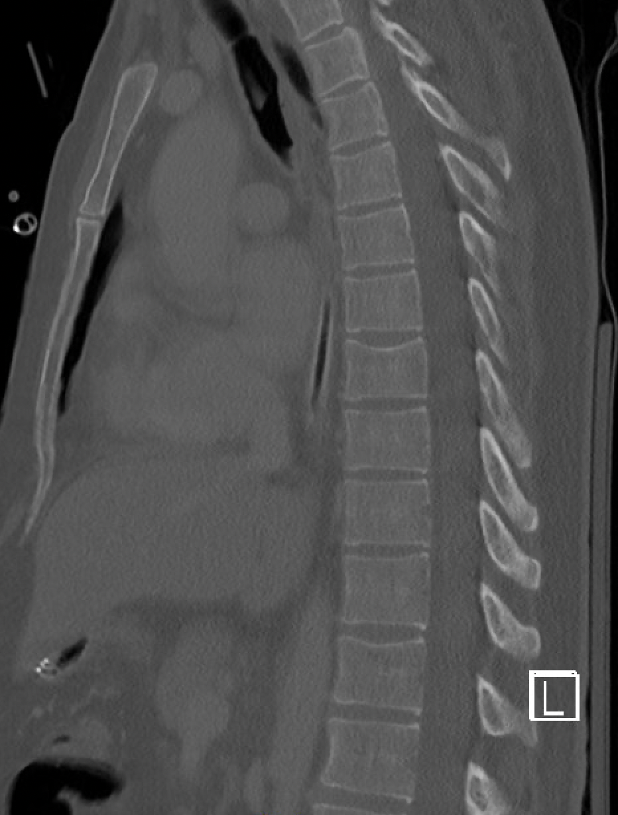
Clinical Anatomy
Thoracic spine
Kyphotic
Facets in coronal plane
Stabilized by ribs
2X Flexion stiffness
3X lateral bending stiffness
Prevent rotation
↓ canal:cord ratio (T2 to T10)
More susceptible to SCI

Slide 6
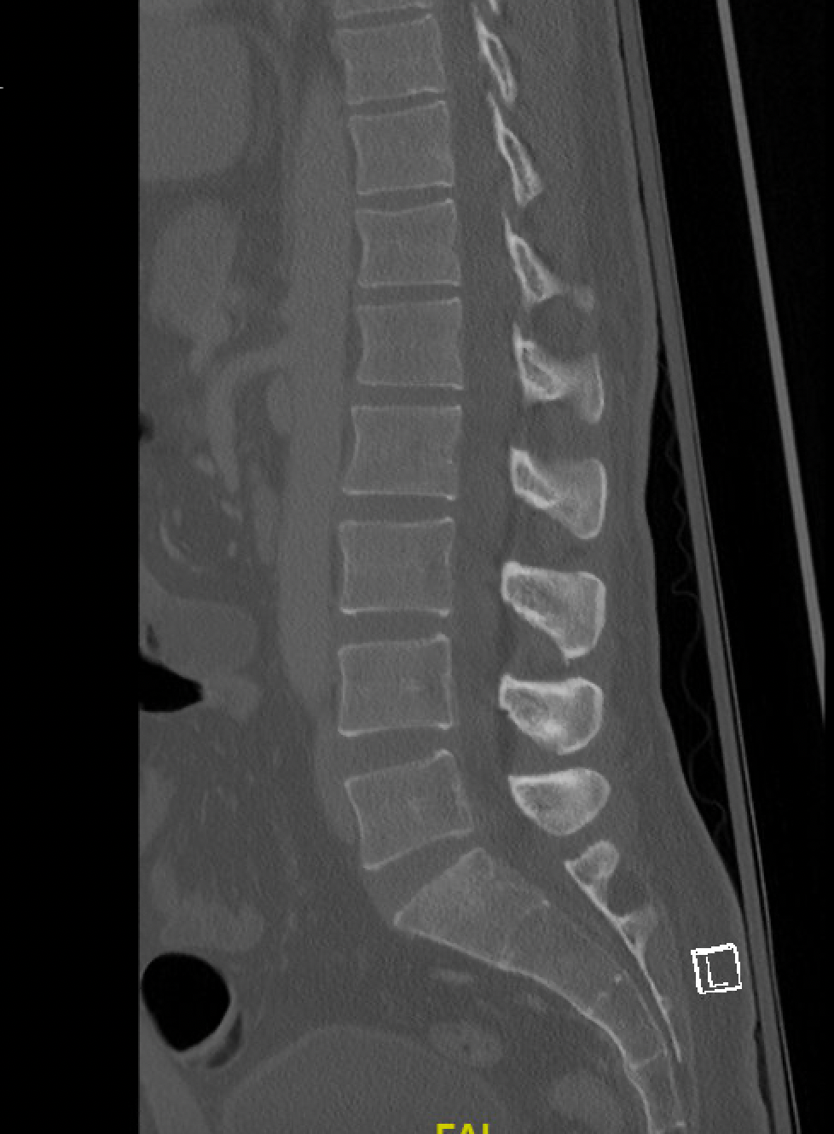
Clinical Anatomy
Lumbar spine
Lordotic
Oblique/sagittal facet orientation
Prevent rotation
Wider canal
Cauda equina

Slide 7
Clinical Anatomy
Thoracolumbar
Area of transition
Decreased stiffness (below rib cage)
Facet orientation (coronal → sagittal)
More vertical
Coronal to 45º inward
T11-12 “weak link”
Predisposed to rotational injuries
Absence of rib support with transitional facets
Notes:
Fractures often occur at the junction because it is a transition zone between the rigid thoracic spine and the relatively flexible cervical spine; Also, the plumb line often bisects this junction point so many compression/axial forces are transmitted through this area

Slide 8
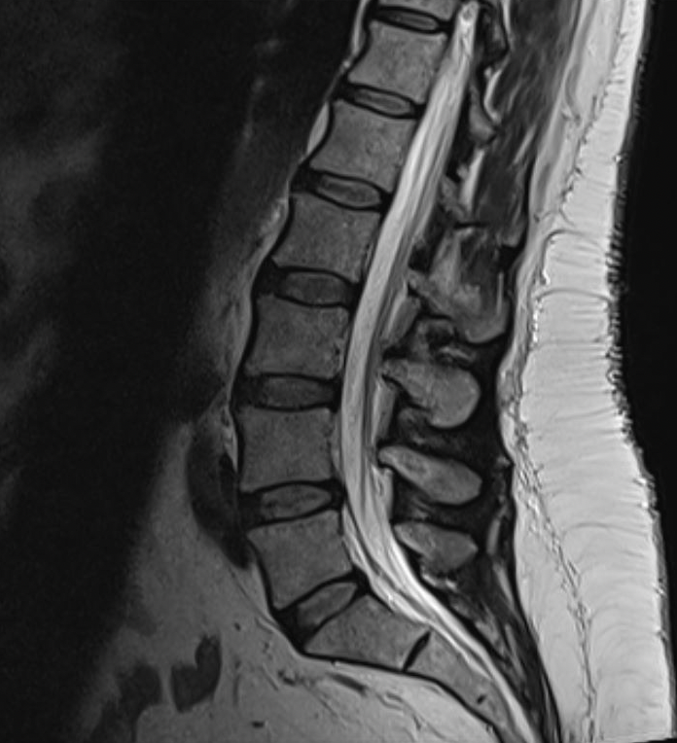
Neuroanatomy
Spinal Cord: C1-L1
Conus medullaris: L1-2
Cauda equina: L2-S5

Slide 9
Patterns of Neurologic Injury
Spinal cord injury
Complete versus incomplete
Conus medullaris syndrome
Root injury
Isolated root dysfunction
Cauda equina syndrome

Slide 10
ASIA Classification
A = Complete
No motor or sensory function is preserved in the sacral segments S4-S5
B = Incomplete
Sensory but no motor function is preserved below the neurological level and includes the sacral segments S4-S5
C = Incomplete
Motor function is preserved below the neurological level, and more than half of the key muscles below the neurological level have a muscle grade less than 3
D = Incomplete
Motor function is preserved below the neurological level, and at least half of the key muscles below the neurological level have a muscle grade of 3 or more
E = normal
Motor and sensory function are normal

Slide 11
Conus Medullaris Syndrome
Thoracolumbar cord injury
Presents with low back pain, lower extremity weakness, saddle anesthesia, bowel/bladder dysfunction
Injury to sacral myelomeres
Can involve both upper and lower motor neurons (+/- root escape)
Isolated: pure bowel, bladder & sexual dysfunction
Combined root/cord injury: lumbar traversing roots

Slide 12
Conus Medullaris Syndrome
Exam
Absent bulbocavernosus reflex
Bowel/bladder/sexual dysfunction more frequent than lower extremity weakness
Treatment: urgent decompression
Prognosis
? Improved with early decompression
Better for root recovery (L1-4) than cord recovery (L5-S)
Notes:
Definitions of traumatic conus medullaris and cauda equina syndrome: a systematic literature review
E Brouwers ¹, H van de Meent ², A Curt ³, B Starremans ⁴, A Hosman ⁵, R Bartels ¹
Affiliations expand
PMID: 28534496
DOI: 10.1038/sc.2017.54

Slide 13
Cauda Equina Syndrome
Injury below L1/2 level
Bowel and bladder dysfunction
Urinary retention ➔ overflow incontinence
Fecal incontinence
Bilateral motor/sensory deficits
Diminished perianal sensation and rectal tone

Slide 14
Cauda Equina Syndrome
Natural history: progressive weakness of lower extremities, loss of bladder/bowel function
Prognosis: presence of saddle anesthesia/bladder symptoms associated with worse outcomes
Treatment: Urgent decompression for best prognosis
Treatment after 48 hours associated with worse outcomes
Notes:
Cauda equina syndrome secondary to lumbar disc herniation: a meta-analysis of surgical outcomes
U M Ahn ¹, N U Ahn, J M Buchowski, E S Garrett, A N Sieber, J P Kostuik
Affiliations expand
PMID: 10851100
DOI: 10.1097/00007632-200006150-00010

Slide 15
Thoracolumbar Trauma Classification

Slide 16
Mechanisms of Injury
Axial compression
Flexion
Lateral compression
Flexion-Rotation
Flexion-Distraction
Shear
Extension

Slide 17
Thoracolumbar Trauma Classification
Decision to operate often challenging
>10 classification schemes described
A useful classification system should:
Be easy to remember, use, and communicate
Predict patient outcome
Drive treatment
Have high inter- and intra-oberver reliability

Slide 18
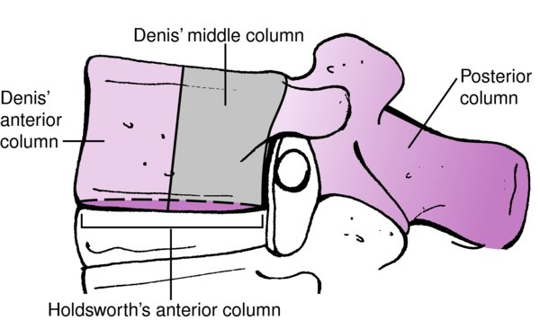
Denis Classification
1983: retrospective review of 412 thoracolumbar fractures
3 columns
Anterior: anterior body, disc, ALL
Middle: posterior body, disc, PLL
Posterior: interspinous ligament, supraspinous ligament, posterior elements
Middle column “crucial”
Notes:
Image: Rockwood and Green 9e figure 48-14
Spine (Phila Pa 1976). Nov-Dec 1983;8(8):817-31. doi: 10.1097/00007632-198311000-00003.
The three column spine and its significance in the classification of acute thoracolumbar spinal injuries
F Denis PMID: 6670016 DOI: 10.1097/00007632-198311000-00003

Slide 19
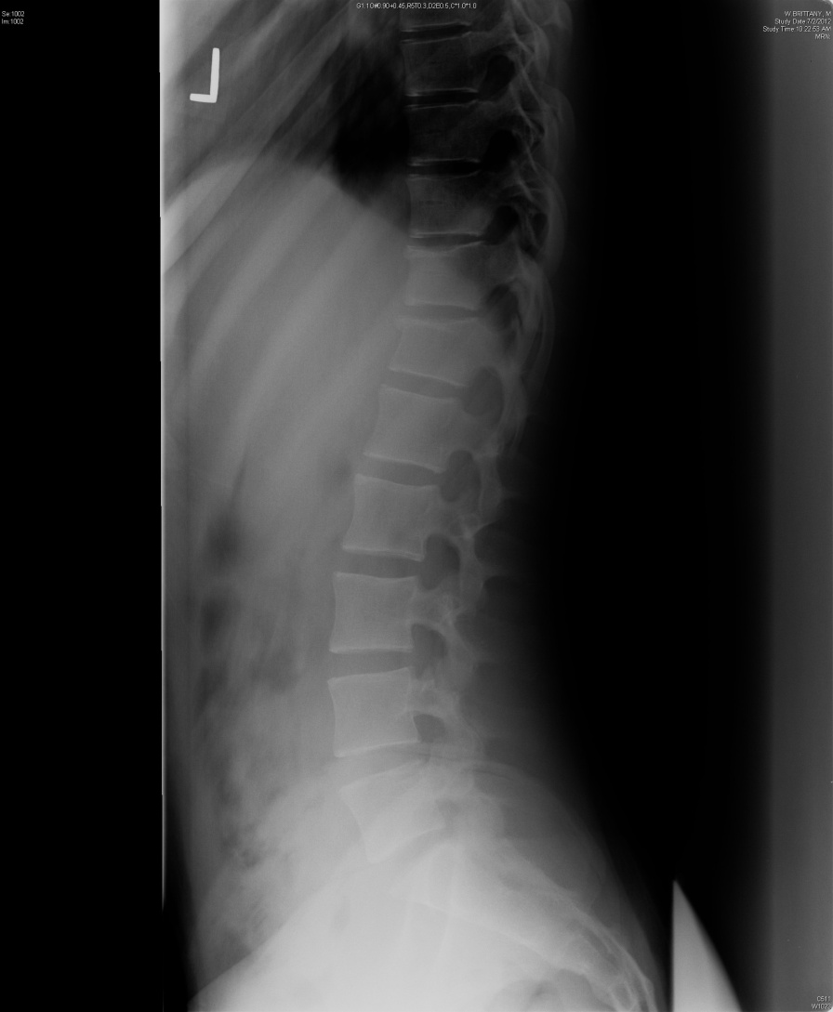
Compression Fracture
Failure of anterior column only
Anterior (or lateral)
Flexion (or lateral bending/compression)
Typically stable
Brace when near thoracolumbar junction

Slide 20
Burst Fracture
Involves middle column
Axial load +/- rotation, etc
Associated lamina fracture ➔ 70% dural tear
Stable (low lumbar) vs. unstable (thoracic, thoracolumbar, upper lumbar)
Notes:
Image Rockwood and Green 9e figure 48-10

Slide 21
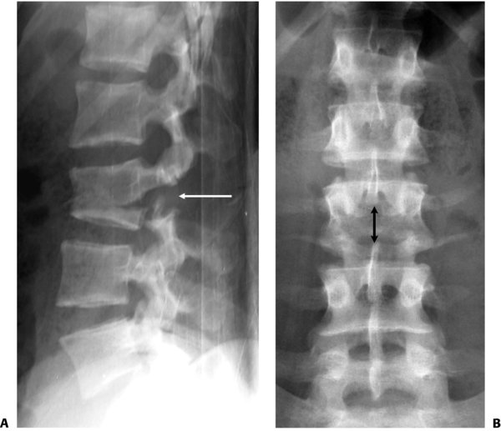
Flexion-Distraction
Seat belt injuries
Chance fracture (bony, ligamentous, both)
Distraction of posterior and middle columns
0-10% neuro involvement
Often requires surgery
Notes:
Image Rockwood and Green 9e figure 48-4

Slide 22
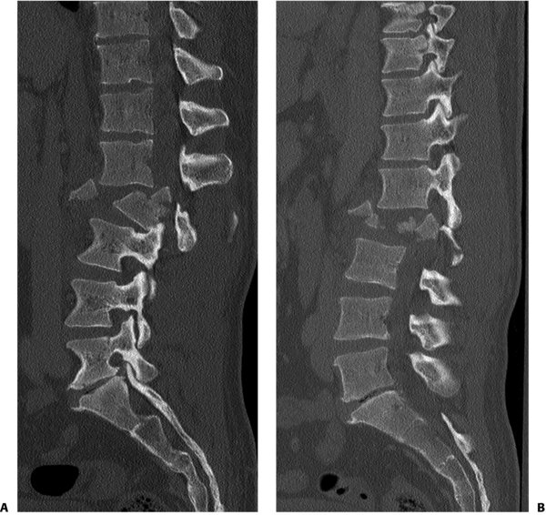
Fracture Dislocation
Injury to all three columns
Combination of high energy forces (shear)
High likelihood of neuro deficit
Always requires surgery
Notes:
Image Rockwood and Green 9e figure 48-9

Slide 23
Denis Classification: Fracture Dislocation
Notes:
A drawback of Denis classification is poor ability to drive treatment

Slide 24
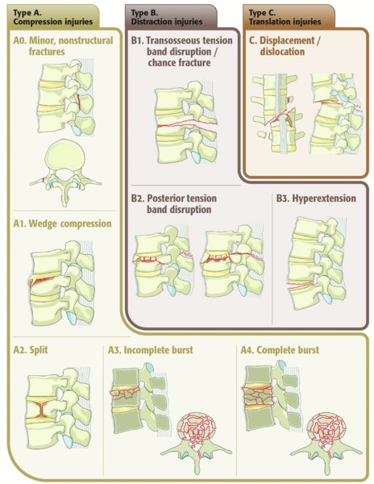
AO Classification
Notes:
Image: Rockwood and Green 9e image 48-16

Slide 25
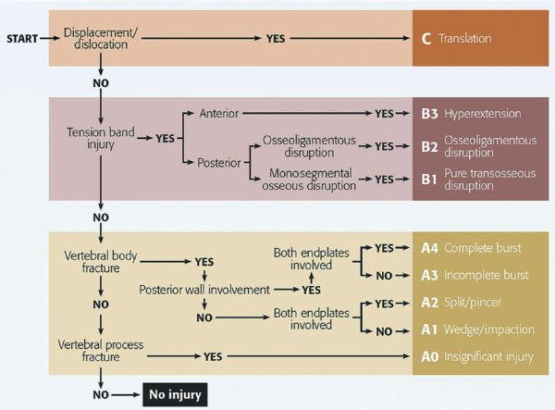
AO Classification
Notes:
Image: Rockwood and Green 9e figure 48-17

Slide 26
Thoracolumbar Injury Classification and Severity Score (TLICS)
Developed to drive surgical versus nonoperative management of thoracolumbar fractures (Vaccaro et al 2005)
Score based on 3 factors
Injury morphology/mechanism
Posterior ligamentous integrity
Neurologic injury
Notes:
A new classification of thoracolumbar injuries: the importance of injurymorphology, the integrity of the posterior ligamentous complex, and neurologic status.Vaccaro AR, Lehman RA Jr, Hurlbert RJ, Anderson PA, Harris M, Hedlund R, Harrop J, Dvorak M, Wood K, Fehlings MG, Fisher C, Zeiller SC, Anderson DG, Bono CM, Stock GH, Brown AK, Kuklo T, Oner FC.Spine (Phila Pa 1976). 2005 Oct 15;30(20):2325-33. doi: 10.1097/01.brs.0000182986.43345.cb.PMID: 16227897

Slide 27
TLICS: Injury Morphology
Compression = 1 point
Burst = +1 point
Translation/rotational = 3 points
Distraction = 4 points
Notes:
A New Classification of Thoracolumbar Injuries: The Importance of Injury Morphology, the Integrity of the Posterior Ligamentous Complex, and Neurologic Status.
Vaccaro, Alexander; Lehman, Ronald; Hurlbert, R; John MD, PhD; Anderson, Paul; Harris, Mitchel; Hedlund, Rune; Harrop, James; Dvorak, Marcel; Wood, Kirkham; Fehlings, Michael; MD, PhD; Fisher, Charles; MD, MHSc; Zeiller, Steven; Anderson, D; Bono, Christopher; Stock, Gordon; Brown, Andrew; Kuklo, Timothy; Oner, F; MD, PhD
Spine. 30(20):2325-2333, October 15, 2005.
DOI: 10.1097/01.brs.0000182986.43345.cb

Slide 28
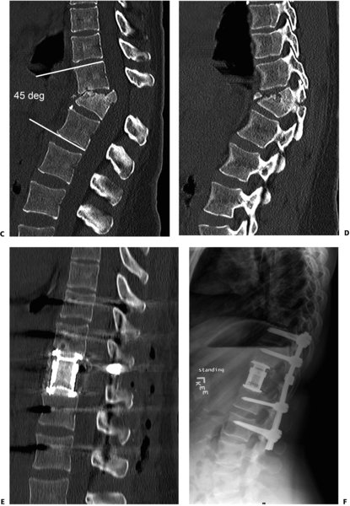
TLICS: PLC Integrity
PLC disrupted in tension, rotation, or translation
Intact = 0 points
Suspected/indeterminate = 2 points
Injured = 3 points
Notes:
Image: Rockwood and Green 9e, figure 48-5
A New Classification of Thoracolumbar Injuries: The Importance of Injury Morphology, the Integrity of the Posterior Ligamentous Complex, and Neurologic Status.
Vaccaro, Alexander; Lehman, Ronald; Hurlbert, R; John MD, PhD; Anderson, Paul; Harris, Mitchel; Hedlund, Rune; Harrop, James; Dvorak, Marcel; Wood, Kirkham; Fehlings, Michael; MD, PhD; Fisher, Charles; MD, MHSc; Zeiller, Steven; Anderson, D; Bono, Christopher; Stock, Gordon; Brown, Andrew; Kuklo, Timothy; Oner, F; MD, PhD
Spine. 30(20):2325-2333, October 15, 2005.
DOI: 10.1097/01.brs.0000182986.43345.cb

Slide 29
TLICS: Neurologic Status
Involvement
Intact = 0 points
Nerve root = 2 points
Cord, conus medullaris
Complete = 2 points
Incomplete = 3 points
Cauda Equina = 3 points
Notes:
Vaccaro AR, Lehman RA Jr, Hurlbert RJ, et al. A new classification of thoracolumbar injuries: the importance of injury morphology, the integrity of the posterior ligamentous complex, and neurologic status. Spine (Phila Pa 1976). 2005;30(20):2325-2333. doi:10.1097/01.brs.0000182986.43345.cb

Slide 30
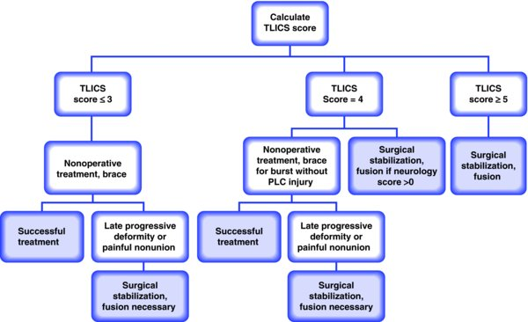
TLICS Score
Relatively simple, shown to predict treatment, high IRR
Notes:
Image: Rockwood and Green 9e figure 48-15
Vaccaro AR, Lehman RA Jr, Hurlbert RJ, et al. A new classification of thoracolumbar injuries: the importance of injury morphology, the integrity of the posterior ligamentous complex, and neurologic status. Spine (Phila Pa 1976). 2005;30(20):2325-2333. doi:10.1097/01.brs.0000182986.43345.cb

Slide 31
Stable vs. Unstable Injuries
White and Panjabi (Spine 1978)
“the loss of the ability of the spine under physiologic conditions to maintain relationships between vertebrae in such a way that there is neither damage nor subsequent irritation to the spinal cord or nerve root and, in addition, there is no development of incapacitating deformity or pain from structural changes”

Slide 32
Stable vs. Unstable Injuries
Stable (Burst fracture)
< 25-30º kyphosis
< 50% loss of height
< 30–50% canal compromise
Neuro intact
Unstable
Neurologic deficit
> 25-30º kyphosis
> 50% loss of height
>50-60% canal compromise
*No study to date has shown direct correlation between percentage of canal compromise and severity of neurologic injury following burst fracture

Slide 33
Surgical Decision Making
Goals
Maximize function
Facilitate nursing care
Prevent deformity/instability
Potentially improve neurologic function
Indications
? Instability
Neurologic compression
Posterior osteoligamentous disruption

Slide 34
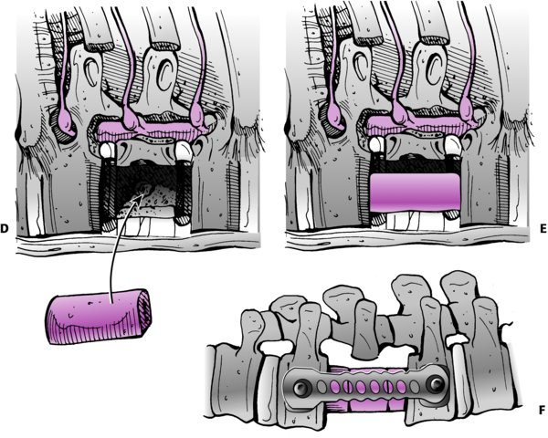
Surgical Approaches
Anterior
Transthoracic (T4- 9)
Thoracoabdominal (T10- L1)
Retroperitoneal (T12- L5)
Posterior
Indirect reduction possible: ligamentotaxis
Posterolateral
Transpedicular, costotraversectomy, etc
Lateral
XLIF, DLIF
Notes:
Image: Rockwood and Green 9e, anterior approach to thoracolumbar fracture

Slide 35
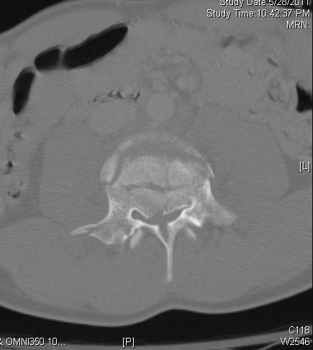
Surgery
Indicated in Unstable injuries
Anterior surgery for anterior compression at TL junction
Posterior surgery in lower Lumbar spine

Slide 36
Gunshot Wounds
Non-operative treatment standard
Steroids not useful (Heary, 1997)
10-14 days IV antibiotics for colonic perforations ONLY
Evidence for debridement and extraction of bullet fragments is controversial, however patients with incomplete injuries may improve (Scott 2019)
Notes:
Neurosurgery. 1997 Sep;41(3):576-83; discussion 583-4.doi: 10.1097/00006123-199709000-00013. Steroids and gunshot wounds to the spine R F Heary ¹, A R Vaccaro, J J Mesa, B E Northrup, T J Albert, R A Balderston, J M Cotler Affiliations expand PMID: 9310974 DOI: 10.1097/00006123-199709000-00013
Does Surgical Intervention Help with Neurological Recovery in a Lumbar Spinal Gun Shot Wound? A Case Report and Literature Review
Kyle W Scott ¹, Denslow A Trumbull 4th ², William Clifton ³, Gazanfar Rahmathulla ¹ Affiliations expand PMID: 31467812 PMCID: PMC6706263 DOI: 10.7759/cureus.4978

Slide 37
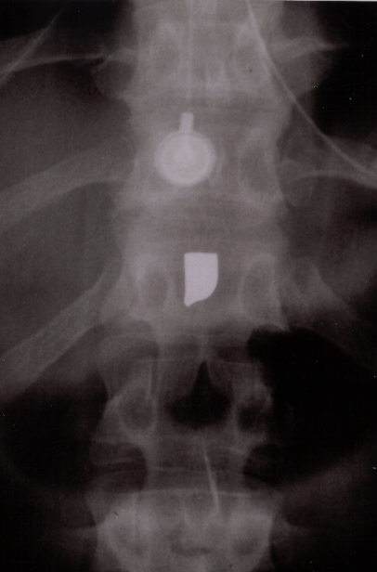
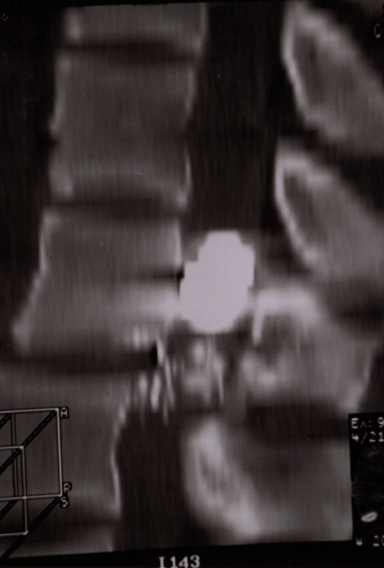
Treatment
Decompression rarely of benefit except for intra-canal bullet from T12-L5
Better motor recovery than nonoperative
Fractures usually stable despite “3-column” injury

Slide 38
GSW to the spine Outcome and Complications
Most dependent on SCI and associated injuries
High incidence of CSF leaks with unnecessary decompression
Lead toxicity rare, even with bullet in canal
Bullet migration rare: late neurological sequelae

Slide 39
Summary
There are several patterns of neurologic injury for thoracolumbar trauma
There are multiple classification schemes
Most thoracolumbar injuries, in the absence of neurologic deficit, are stable and can be treated successfully nonoperatively
Surgical intervention may be beneficial in improving patient mobilization and early functional return for unstable spine fractures
Indications for surgical intervention, timing of intervention, and approach remain controversial

Slide 40
Conclusions
The goals of managing thoracolumbar injuries are to maximize neurologic recovery and to stabilize the spine for early rehab and return to a productive lifestyle

Slide 41
Key References
Denis F. The three column spine and its significance in the classification of acute thoracolumbar spinal injuries. Spine (Phila Pa 1976). 1983;8(8):817-831. doi:10.1097/00007632-198311000-00003
Vaccaro AR, Lehman RA Jr, Hurlbert RJ, et al. A new classification of thoracolumbar injuries: the importance of injury morphology, the integrity of the posterior ligamentous complex, and neurologic status. Spine (Phila Pa 1976). 2005;30(20):2325-2333. doi:10.1097/01.brs.0000182986.43345.cb

Slide 42
Full References
Figures used with permission. Gendelberg D, Bransford RJ, Bellabarba C. Thoracolumbar Spine Fractures and Dislocations. In: Tornetta P, Ricci WM, eds. Rockwood and Green's Fractures in Adults, 9e. Philadelphia, PA. Wolters Kluwer Health, Inc; 2019.
Magerl F, Aebi M, Gertzbein SD, Harms J, Nazarian S. A comprehensive classification of thoracic and lumbar injuries. Eur Spine J. 1994;3(4):184-201.
Brouwers E, van de Meent H, Curt A, Starremans B, Hosman A, Bartels R. Definitions of traumatic conus medullaris and cauda equina syndrome: a systematic literature review. Spinal Cord. 2017;55(10):886-890.
Ahn UM, Ahn NU, Buchowski JM, Garrett ES, Sieber AN, Kostuik JP. Cauda equina syndrome secondary to lumbar disc herniation: a meta-analysis of surgical outcomes. Spine (Phila Pa 1976). 2000;25(12):1515-1522.
Denis F. The three column spine and its significance in the classification of acute thoracolumbar spinal injuries. Spine (Phila Pa 1976). 1983;8(8):817-831.
Spine. Journal of Orthopaedic Trauma. 2018;32(1):S145-S160.
Vaccaro AR, Lehman RA, Hurlbert RJ, et al. A new classification of thoracolumbar injuries: the importance of injury morphology, the integrity of the posterior ligamentous complex, and neurologic status. Spine (Phila Pa 1976). 2005;30(20):2325-2333.
White AA, Panjabi MM. The basic kinematics of the human spine. A review of past and current knowledge. Spine (Phila Pa 1976). 1978;3(1):12-20.
Heary RF, Vaccaro AR, Mesa JJ, et al. Steroids and gunshot wounds to the spine. Neurosurgery. 1997;41(3):576-583; discussion 583-584.
Scott KW, Trumbull DA, Clifton W, Rahmathulla G. Does surgical intervention help with neurological recovery in a lumbar spinal gun shot wound? A case report and literature review. Cureus. 2019;11(6):e4978.

