Slide 1
Clavicle Fractures
Gudrun Mirick Mueller, MD
Orthopaedic Traumatologist
Hennepin Healthcare, Minneapolis MN
Assistant Professor, University of Minnesota

Slide 2
Objectives
Understand the deforming forces affecting clavicle fractures
Discuss factors affecting the decision to treat fractures operatively vs non-operatively
Evaluate different operative techniques available

Slide 3
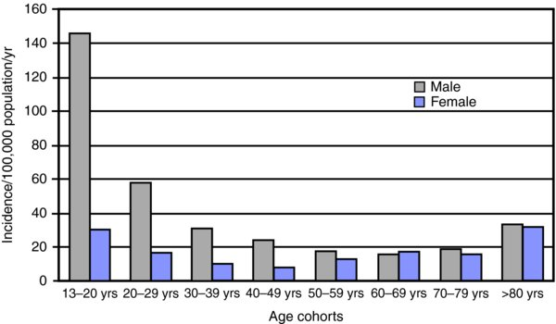
Epidemiology
2.6% of all fractures
Higher energy
MVC
Collision sports
Football
Hockey
Cycling
Demographic skews younger
Second peak later in life from osteoporotic patients with falls
*From: Rockwood & Green’s Fractures in Adults, 9th Ed. Robinson CM. Fractures of the clavicle in the adult: epidemiology and classification. J Bone Joint Surg Br. 1998;80(3):476–484

Slide 4
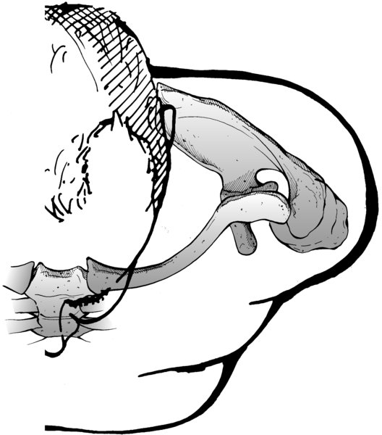
Function
“A strut for muscles to attach to”
Not a weight bearing bone (for most people)
Only connection between axial skeleton and the upper extremity
*Rockwood & Green’s Fractures in Adults, 9th Ed.

Slide 5
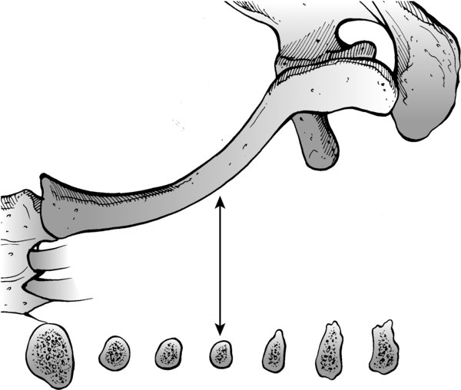
Anatomy
Shape
Flat lateral medially and laterally
Cancellous screws have better purchase
Tubular in central section
Cortical screws
Flat superior surface
S-shaped when viewed from above
Articulations
Sternoclavicular joint
Acromioclavicular joint
*Rockwood & Green’s Fractures in Adults, 9th Ed.

Slide 6
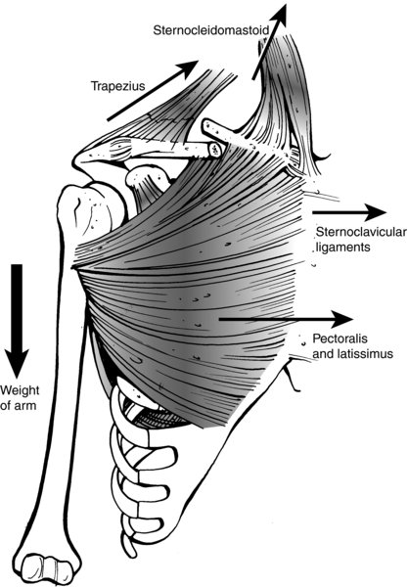
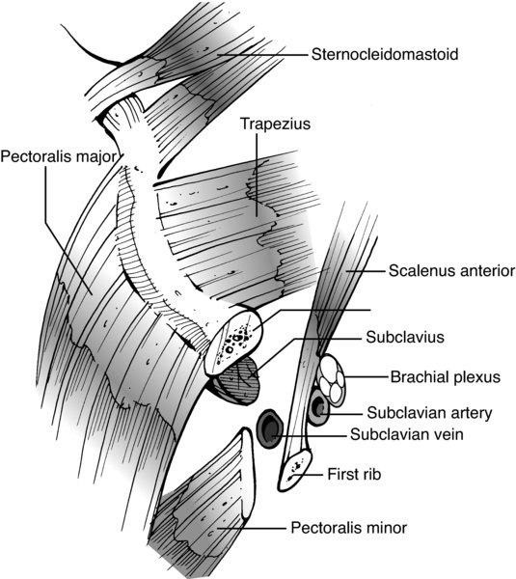
Anatomy/Deforming Forces
Muscular
Sternocleidomastoid
Covers medial 60% of superior surface
Pulls medial segment proximally
Deltoid
Covers lateral 40% of superior surface
Holds distal fragment stable
Trapezius
Posterosuperior coverage
Pectoralis
Originates from anteroinferior surface
Pulls medially causing shortening
Subclavius
Undersurface muscle
Protects NV structures
Medial
Lateral
*Rockwood & Green’s Fractures in Adults, 9th Ed.

Slide 7
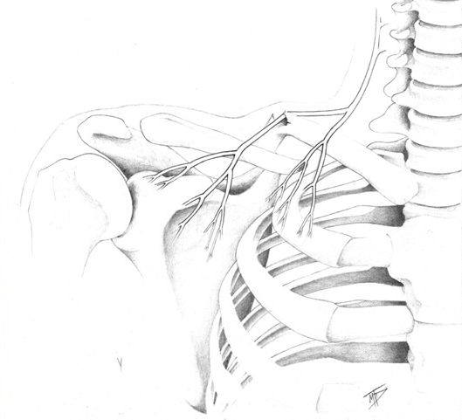
Anatomy
Neurovascular
Superficial
Supraclavicular nerves (C3-4)
Skin sensation running vertically
Frequently cut on approach to midshaft clavicle
Sensation generally improves with time
Deep
Subclavian vein
Subclavian artery
Brachial plexus
*Supraclavicular nerve entrapment and clavicle fracture. O'Neill, K; Stutz, C; Duvernay, M;
J Ortho Trauma. 26(6):e63-e65, June 2012.

Slide 8
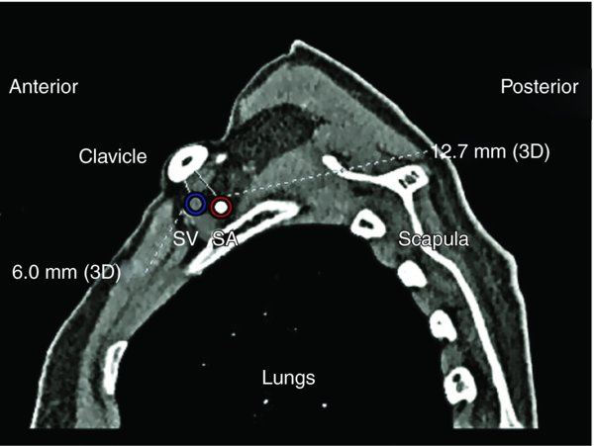
Anatomy: Deep
Subclavian Vein
Directly underneath clavicle separated only by subclavius mm
Closest to bone medially
Used for central lines
Subclavian Artery
More posterior than vein
Protected by the scalenus mm
Brachial Plexus
Also posterior to bone
Closest to bone in mid-portion of bone
*Rockwood & Green’s Fractures in Adults, 9th Ed. From Sinha A, Edwin J, Sreeharsha B, et al. A radiological study to define safe zones for drilling during plating of clavicle fractures. J Bone Joint Surg Br. 2011;93B:1247–1252.

Slide 9
Mechanism of Injury
Midshaft:
Most common: lateral compression results in bending and axial load
Less common: direct blow
Thinnest portion of bone, fewer soft tissue attachments and therefore more likely to break
Distal:
Lateral compression injuries
Older patients, lower energy
Medial:
Rare, usually high energy direct blow
*Rockwood & Green’s Fractures in Adults, 9th Ed.

Slide 10
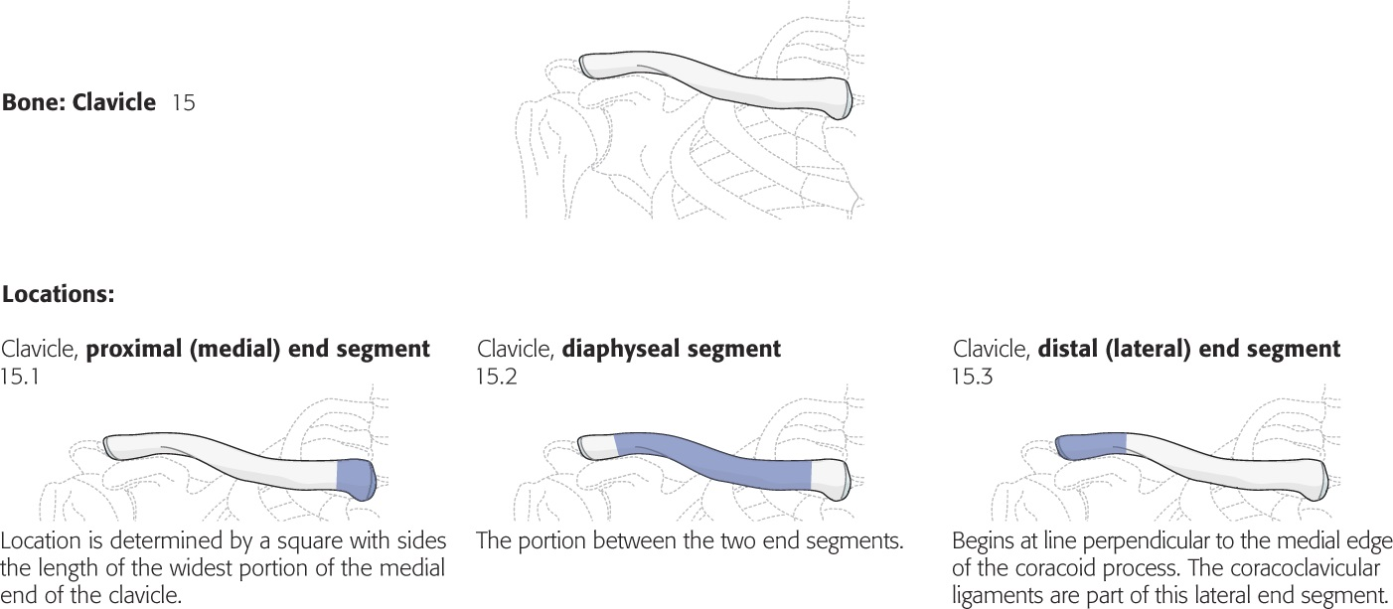
Classification: OTA vs Robinson – nearly the same
Robinson 3
Robinson 2
Robinson 1
~5% of fractures
~80% of fractures
~15% of fractures
*Journal of Orthopaedic Trauma 32:S105, January 2018.

Slide 11
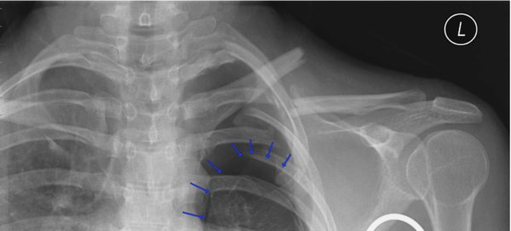
Associated Injuries
Rib fractures
Proximal humerus fractures
Pneumothorax
Scapular fractures
“Floating shoulder”
*Rockwood & Green’s Fractures in Adults, 9th Ed.

Slide 12
MIDSHAFT FRACTURES

Slide 13
Classification: OTA
~5% of fractures
~80% of fractures
~15% of fractures
*Journal of Orthopaedic Trauma 32:S105, January 2018.

Slide 14
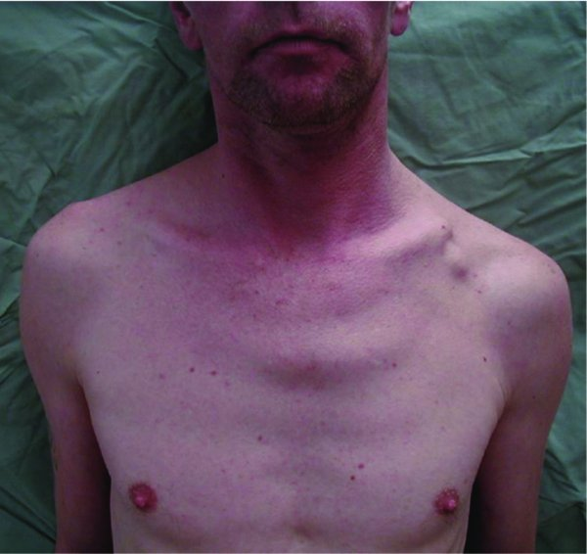
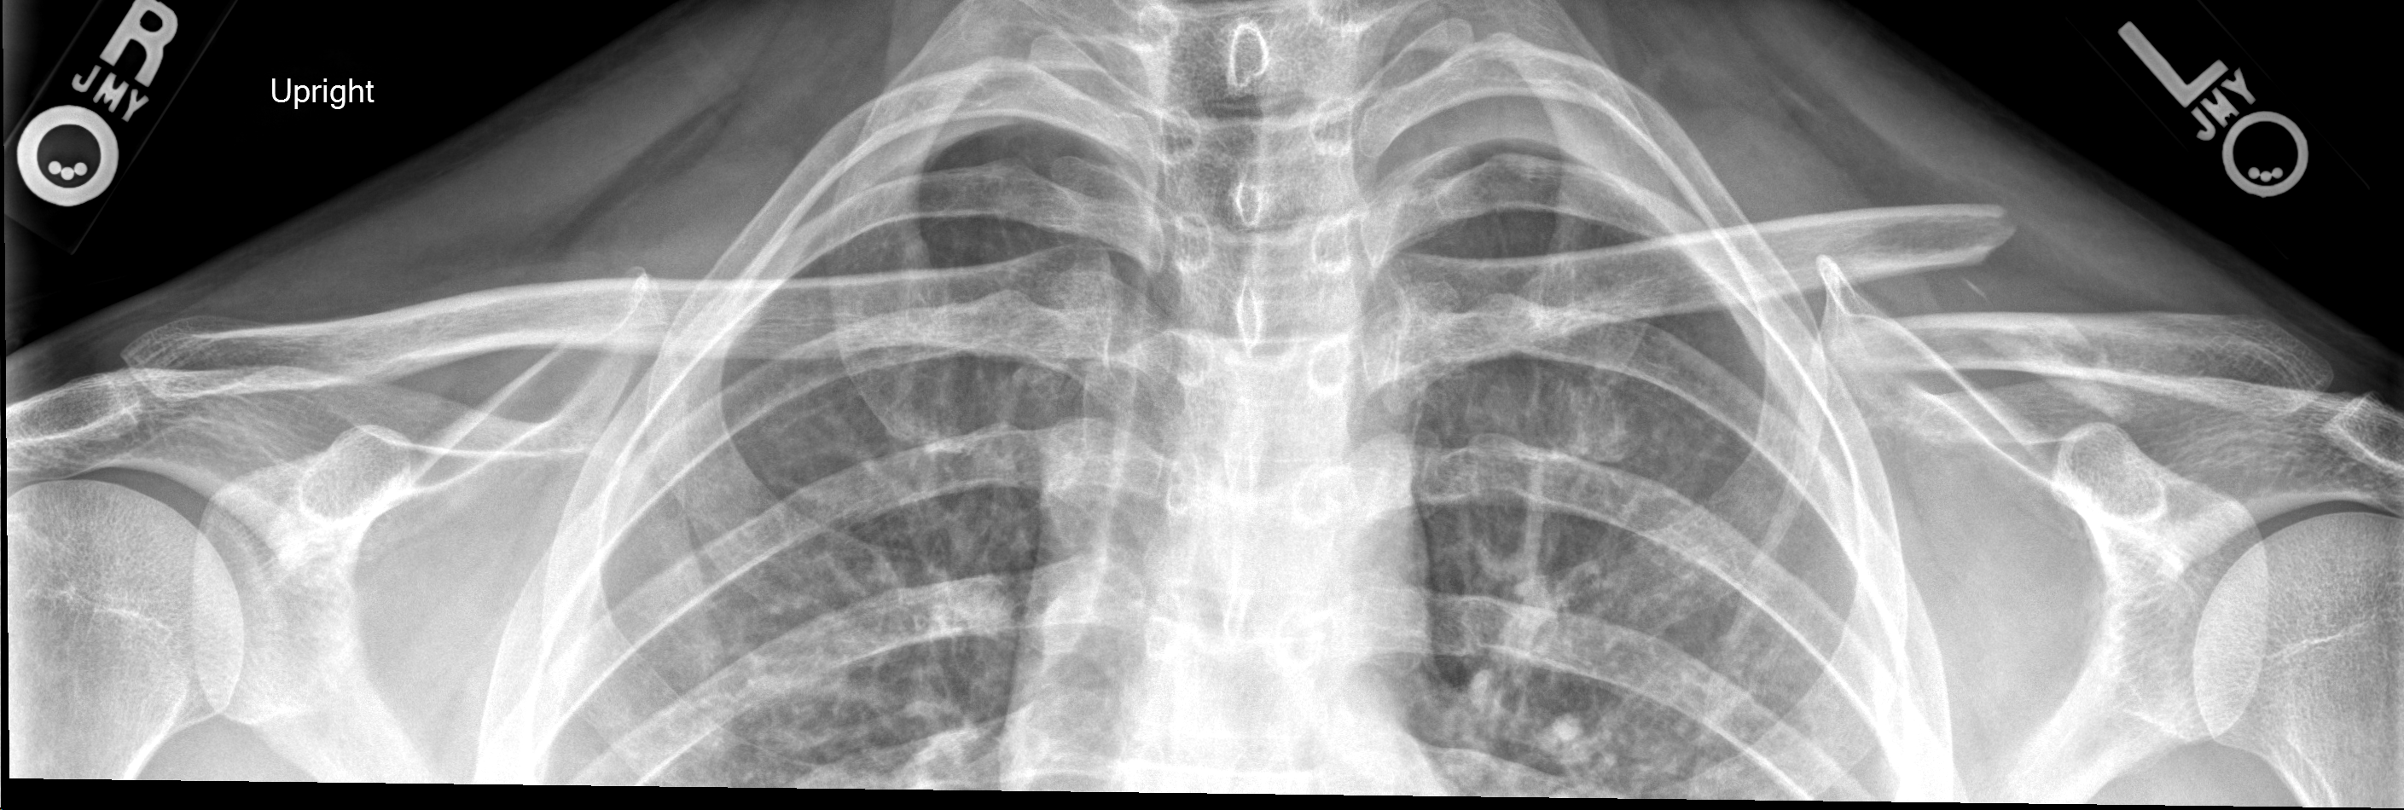
Workup
Physical Exam
Skin integrity
Overlying abrasions
Medial fragment can “button hole” through the platysma
NV status
Radiographs: AP + cephalic/Zanca view
Prefer upright bilateral clavicles on same cassette – allows comparison to normal
*Rockwood & Green’s Fractures in Adults, 9th Ed.
*XR courtesy of author

Slide 15
Operative vs Non-operative: deciding factors
Cosmesis: “bump or a scar”
Simple sling vs clavicle strap/”figure-of-8” brace: no benefit of strap
Sling for comfort only
Droopy shoulder?
Shoulder function
Nonunion: fracture and patient-specific characteristics
Associated Injuries
Polytrauma
*The Community Orthopaedic Surgeon Taking Trauma Call: Pediatric Midshaft Clavicle Fracture Pearls and Pitfalls. Vargas-Vila, M; Mehlman, C; Pennock, A. J Ortho Trauma: August 2019 - Volume 33 - Issue - p S1-S5.
Notes:
KJJ – maybe a couple of notes here to the presenter to help with dealing with your comment on the slide about droopy shoulder

Slide 16
Shoulder Function with Non-operative Care
McKee MD, Pedersen EM, Jones C, et al. Deficits following nonoperative treatment of displaced midshaft clavicular fractures. J Bone Joint Surg Am. 2006;88(1):35–40.
Motion preserved
Significantly reduced strength in max/endurance flexion, max/endurance abduction, max/endurance external rotation, max/endurance internal rotation.
Mean Constant score 71 points & mean DASH score 24.6 points = residual disability
However…. The amount of shortening not quantified
Hillen RJ, Schraa ER, van Essen T, Burger BJ, Veeger DH. Long-term follow-up of conservatively treated midshaft clavicular fractures on functional outcome. J Orthop. 2019 Sep 11;18:80-85.
13 year f/u, ~1 cm shortening; 18 adult patients
No significant long term deficits in strength
VS…
Minimal shortening = minimal deficit? Literature unclear!

Slide 17
Nonunion Risk
Liu W, Xiao J, Ji F, Xie Y, Hao Y. Intrinsic and extrinsic risk factors for nonunion after nonoperative treatment of midshaft clavicle fractures. Orthopaedics & Traumatology: Surgery & Research, 2015, Vol.101 (2), p.197-200.
Amount of displacement: more displacement = less likely to heal
2 cm displacement is frequently used in literature as a cutoff
Currently, specific number found to be less clear
Smoking
Fracture comminution: Z fragment
*XR courtesy of author
Notes:
KJJ – nice image of z deformity maybe a note here to help the presenter with this would be nice

Slide 18
Calculating Nonunion Risk: patient education
“Ready Reckoner” Score: Murray et al, Edinburgh 2013
Overall Displacement | Non-comminuted Fx | Comminuted Fx | Non-comminuted Fx | Comminuted Fx
(mm) | Non-smoker | Non-smoker | Smoker | Smoker
10 | 2 | 3 | 6 | 10
15 | 3 | 6 | 12 | 19
20 | 7 | 12 | 23 | 34
25 | 14 | 23 | 39 | 52
30 | 26 | 39 | 57 | 70
40 | 62 | 74 | 86 | 92
Smoking and comminution each automatically increases risk ~3+x
*Data from JBJS Am. 2013;95:1153-8.

Slide 19
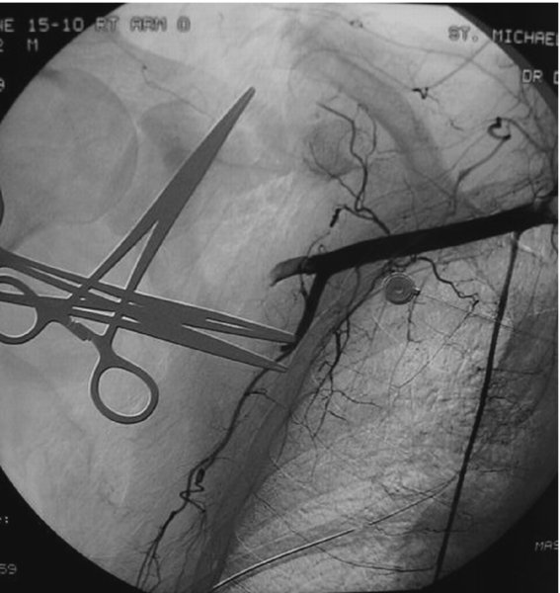
Associated Injuries: operative management
Severe chest wall trauma
Vascular injury requiring repair
Progressive neurologic deficit/plexus palsy
ORIF clavicle stabilizes the vascular or neuro repair!
Ipsilateral upper extremity injuries/fractures?
Multiple ipsilateral upper rib fractures?
Scapulothoracic dissociation
Traction injury
Widened space between scapula and spine
Distracted clavicle fracture
Beware of vascular & brachial plexus injuries!
*Rockwood & Green’s Fractures in Adults, 9th Ed.

Slide 20
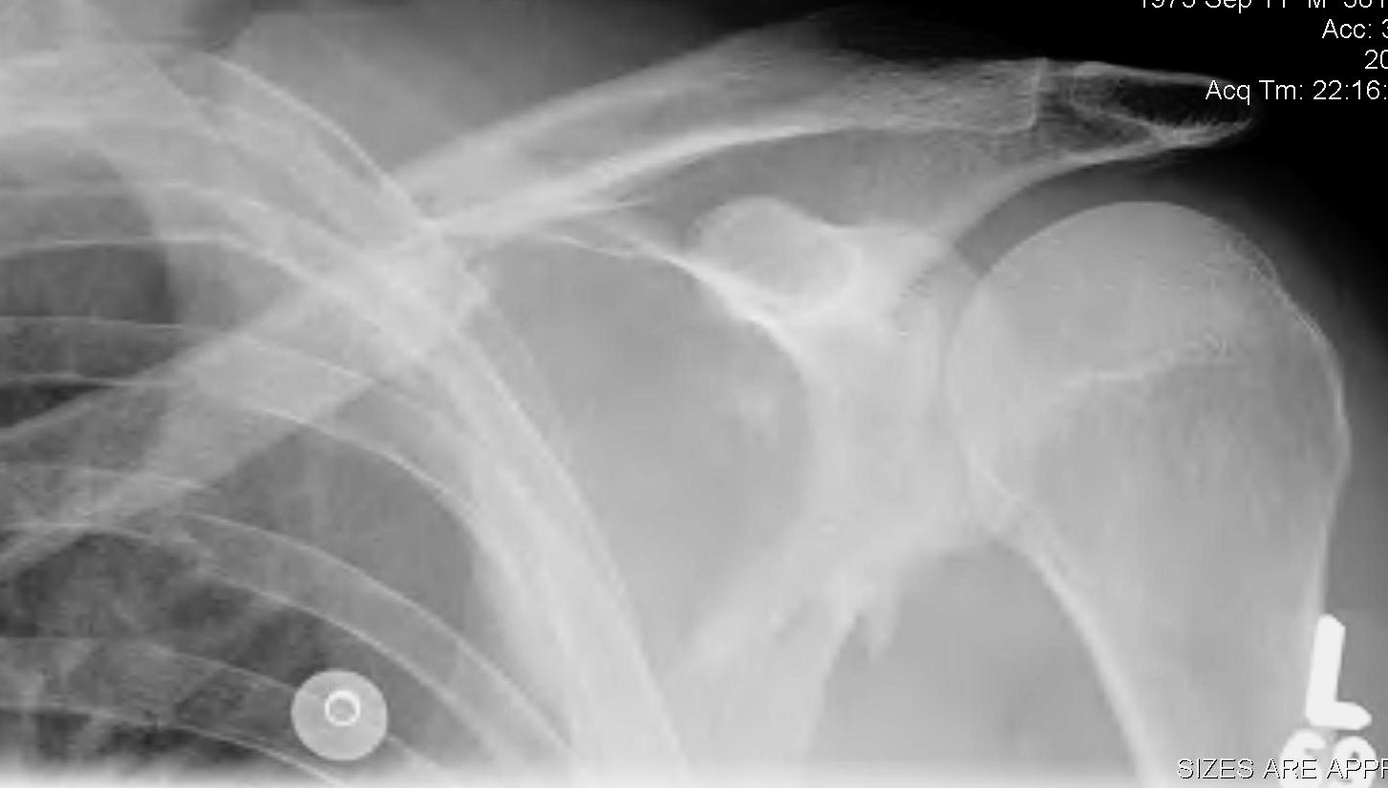
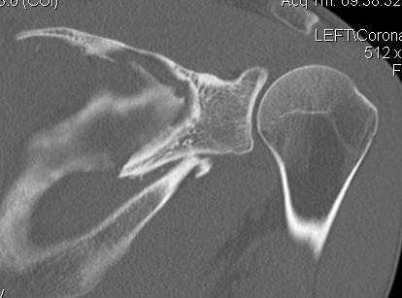
Associated Injuries: operative management
“Floating shoulder”
Associated displaced glenoid neck facture
Frequently can only fix the clavicle and the glenoid will reduce into acceptable alignment
Notes:
KJJ – is it necessary to fix? When do you decide? Can you tx closed (Ken Egol paper form CMC)? Maybe another slide on this topic as controversial a bit and not as clear as you make it seem in this slide, thanks,

Slide 21
Polytrauma
Fixation can help advance WB in a patient with B UE injuries
“Give them back an arm to use”
Facilitate physical therapy/mobilization
Shorten hospital stay
Minimize pain medication needs

Slide 22
Returning to Work as a Deciding Factor
Manual laborers?
Pro athletes?
NFL players returned to sport faster
Harris et al, Orthopaedics 2017
44% returned the same season
96% returned to sport at 1 year
However, QB’s and RB’s did worse compared to other positions
Dr Peter Millett @ Steadman Clinic: “For example, in certain instances where there was an important event, I have had some athletes back to competition in as little as 2 weeks.”

Slide 23
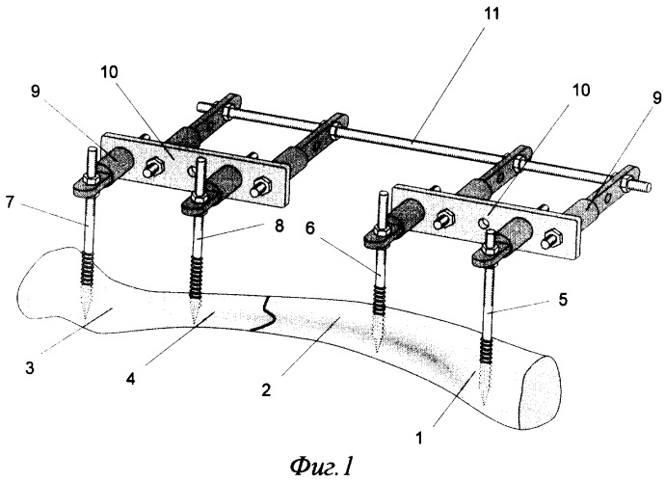
Operative: Options
ORIF: plating
Superior vs anterior
Intramedullary fixation
External fixation?
Not popular in the US
Ilizarov-type constructs

Slide 24
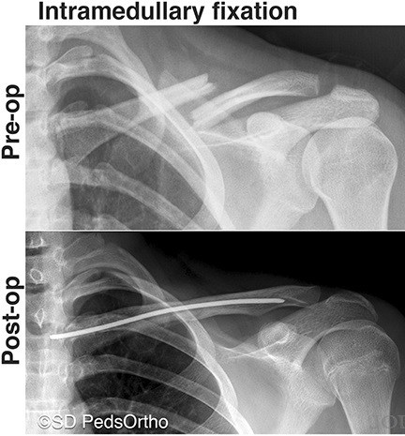
Intramedullary Implants
Takes advantage of IM canal in central 1/3
Advantage
Soft tissue friendly
Best for simple fracture patterns
Disadvantage:
Can’t lock rotation with most devices
Rate of reduction loss is high
High rate of ROH with unlocked implants
Fear: pin migration with unlocked/non-threaded!
Options
Commercially available products
Pediatric titanium elastic nails
Generic Steinmann pins
Cannulated screws
*The Community Orthopaedic Surgeon Taking Trauma Call: Pediatric Midshaft Clavicle Fracture Pearls and Pitfalls. Vargas-Vila, M; Mehlman, C; Pennock, A. J Ortho Trauma: August 2019 - V33, p S1-S5.

Slide 25
Fixation: Techniques
ORIF: mainstay in US
Obtain anatomic reduction
Lag screw + neutralization plating
Compression mode plating
Stabilize with rigid implants
Plate placement options
Superior = prominent, resists vertical translation, more extensile to both ends of bone
Anterior = less prominent, longer screws?, less extensile
*No RCT comparing different plate locations*
Dual mini-frag plates?
More soft tissue stripping but less (3.7%) removal of symptomatic hardware?
Czajka CM, Kay A, Gary JL, et al. Symptomatic implant removal following
dual mini-fragment plating for clavicular shaft fractures. J Orthop Trauma. 2017;31:236–240
*XR courtesy of author

Slide 26
ORIF Technique
Radiolucent OR table
Position: semi-supine vs beach chair, usually with central bump under spine to hyper-extend chest
XR views coming in from the head: AP + 30 deg cephalic tilt
Arm can be prepped in or out

Slide 27
Technique Videos
ORIF midshaft clavicle: NYU/Dr Egol
https://otaonline.org/video-library/45036/procedures-and-techniques/multimedia/16731455/displaced-comminuted-right-clavicle-fracture
IMN clavicle: Steadman Clinic/Dr Millett
https://otaonline.org/video-library/45036/procedures-and-techniques/multimedia/16731453/intramedullary-fixation-of-midshaft-clavicle
Notes:
KJJ – nice inclusion!

Slide 28
Rehab Protocols
Immediate post-op
Dry dressing over wound
Simple sling for comfort
Start pendulum exercises ASAP, OK for motion for hygiene as needed
My philosophy: “motion first, then lifting”
Start gentle lifting once can obtain ~120 degees elevation
No “real” lifting until 6 weeks
Avoid aggravating activities like heavy lifting, pushups until at least 3 months

Slide 29
Sequelae
Supraclavicular nerve iatrogenic laceration
Patients report a numb patch centered on the incision
Usually improves with time (months/years)
Can be irritating to women who can’t feel their bra strap and backpack wearers
Hardware Irritation/Removal of hardware: ~15-30%
Prefer > 1 year post-op to ensure complete healing
Backpackers, military personnel common to be irritated

Slide 30
Outcomes
Union
>95% union with ORIF
Clinical vs Radiographic Union
Asymptomatic nonunion does not necessarily need to be treated!
Shoulder function excellent
Generally plateau by a year post-op regardless of treatment chosen
Recent Data: 94-100% union rates!

Slide 31
DISTAL FRACTURES

Slide 32
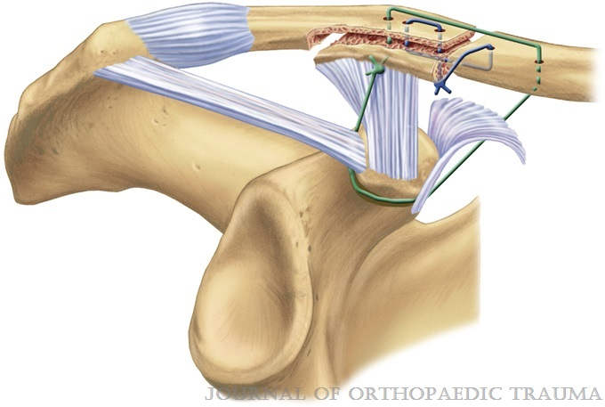
Distal: Anatomy
Trapezoid Ligament
Conoid Ligament
*Fragment stability determined by relationship to CC ligaments*
*Interfragmentary Suture Fixation for Displaced Acute Type II Distal Clavicle Fractures Duralde, X; Pennington, S; Murray, D. J Ortho Trauma 28(11):653-658, Nov 2014.

Slide 33
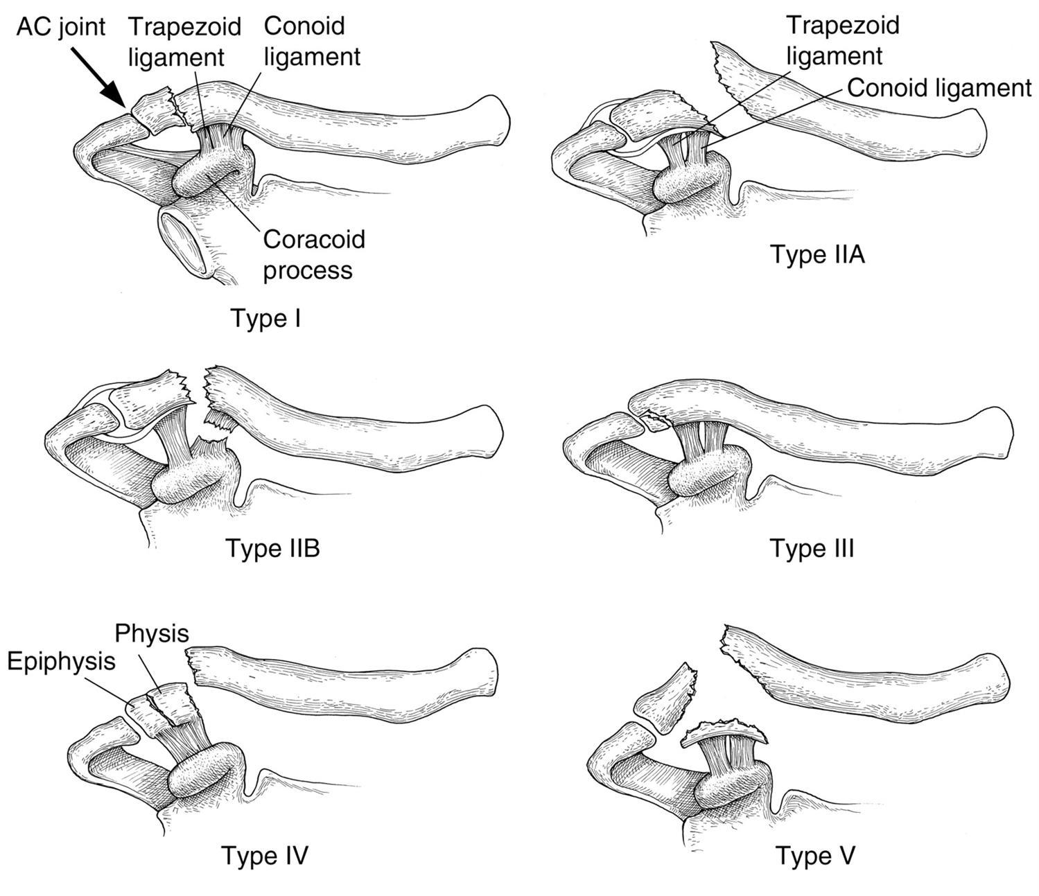
Distal: Neer Classification
Type I: CC ligaments intact
Type II: CC ligaments detached from the medial fragment, trapezoid attached to the distal fragment
IIA (Rockwood mod): Both conoid and trapezoid attached to the distal fragment
IIB (Rockwood mod): Conoid detached from the medial fragment
Type III: Extension into the AC joint.
Type IV: Pediatric physeal fx
Type V: Comminuted
*Rockwood & Green’s Fractures in Adults, 9th Ed.

Slide 34
Distal: Op vs Non-op
Why does this classification matter???
Pattern determines Plan
Type 2’s and Type 5 are notorious nonunion generators!
2A: 56% nonunion with non-op
2B: 30 – 45% nonunion with non-op

Slide 35
Distal: Fixation Challenges
Bone is largely cancellous laterally
Templating important: ensure adequate purchase in small lateral fragment

Slide 36
Distal: Surgical Options
ORIF with superior plating
ORIF with hook plating
Coracoclavicular ligament reconstruction

Slide 37
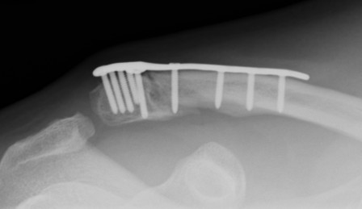
Distal: Superior plates
Lateral versions of anatomic plates
Have more screw holes clustered together to obtain maximal fixation
Goal: At least 4 screws in the distal segment
Locking options laterally
Can be augmented with CC ligament constructs
*Rockwood & Green’s Fractures in Adults, 9th Ed.
Notes:
KJJ – maybe not for this talk but how do you decide to add CC lig fixation? Maybe just an authors comment in the notes section to help presenter?

Slide 38
Distal: Superior plates
Anatomic lateral plates: augmented fixation via CC ligament constructs
CC screw augments
Suture/suture button fixation
Ligament allografts
*Rockwood & Green’s Fractures in Adults, 9th Ed.
*Fixation of Unstable Type II Clavicle Fractures With Distal Clavicle Plate and Suture Button. Johnston, P; Sears, B; Lazarus, M; Frieman, B.
J Ortho Trauma 28(11):e269-e272, November 2014.

Slide 39
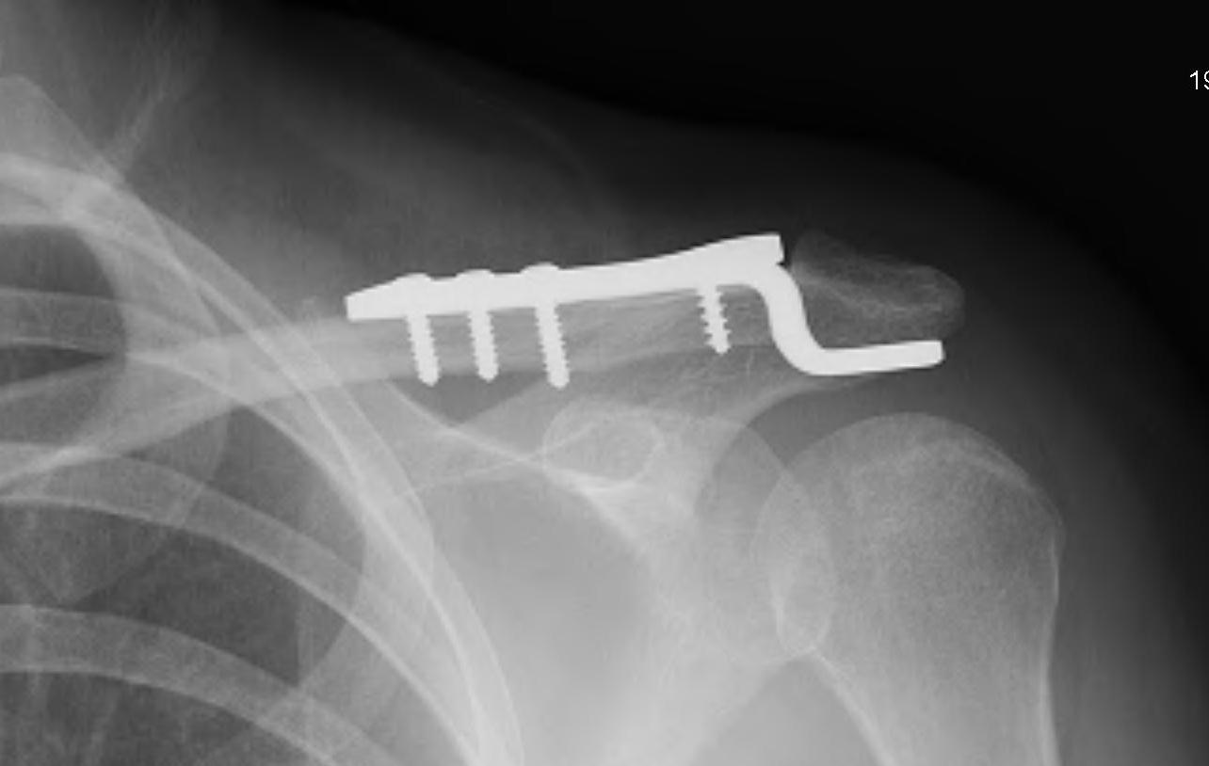
Distal: Hook plates
Design: Superior plate with attached hook that wedges into the posterior subacromial space
Advantage:
Resists superior displacement forces
Direct compression on the fracture fragment
Allows for slight motion at the AC joint
Disadvantages:
Has to be removed due to subacromial irritation
Very little fixation directly into the lateral fragment
Can over-reduce the lateral segment
Measure the depth of the hook desired!
*XR: Rockwood & Green’s Fractures in Adults, 9th Ed.

Slide 40
Technique Videos
ORIF using a hook plate: Michigan/Dr Hake
https://otaonline.org/video-library/45036/procedures-and-techniques/multimedia/16731459/distal-clavicle-fracture-orif-with-a-hook-plate
ORIF using lateral plate + CC suture augment: Dr Millett
https://www.arthrex.com/resources/video/WUcrUwQXLk-lnQFSiP8_vA/distal-clavicle-fracture-repair-utilizing-a-knotless-coracoid-fixation-device
Notes:
KJJ – how about a slide of outcomes for the surgeries and also if treated nonop? Complications?

Slide 41
MEDIAL FRACTURES

Slide 42
Medial
Rare! ~3% of all clavicle fractures
80% are non-displaced
~50% have associated thoracic/chest wall trauma
Can be a variation on a sternoclavicular dislocation
50% are intra-articular
Pediatric physeal fracture possible
80% of growth comes from medial physis
Physis may not be closed in 20-22 y/o patients

Slide 43
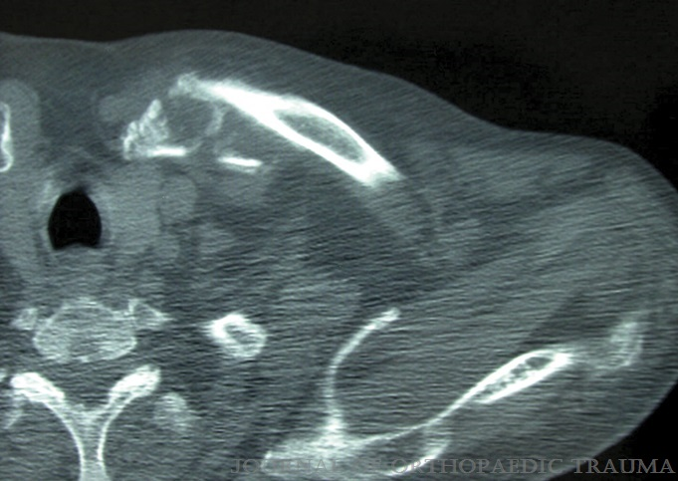
Medial
Nearly all will do well non-operatively, esp if non/minimally displaced
*Traumatic Floating Clavicle: A Case Report. Serra, JT; Tomas, J; Batalla, L; Pedemonte, J; Pacha, D; Molero, V; Carrera, L. J Ortho Trauma 25(10):e98-e99, Oct 2011.

Slide 44
Medial: Operative choices for displaced fx
ORIF
Frequently challenging due to small working area
ROH often needed
Good results when can get appropriate fixation
Other implants: k-wires, sternal wires, tension band constructs
Soft tissue-only repairs
Notes:
KJJ – any info on outocmes, nonunions, complications? A slide or two on this and tx would be beneficial. Thnaks,

Slide 45
Conclusions
Displaced midshaft clavicle fractures should be considered for fixation primarily if at risk for nonunion, though other criteria may affect decision making:
Smokers
Highly displaced
Comminuted
Distal fractures of the Neer 2 and 5 groups should be treated surgically due to the high risk of nonunion
ORIF with pre-contoured plates has a high success rate with few complications
Medial fractures can be managed non-operatively most of the time with good success

Slide 46
Additional References
Figures used with permission: McKee M. Clavicle Fractures. In: Tornetta P, Ricci WM, eds. Rockwood and Green’s Fractures in Adults, 9e. Philadelphia, PA. Wolters Kluwer Health, Inc; 2019.
Canadian Orthopaedic Trauma Society. Nonoperative treatment compared with plate fixation of displaced midshaft fractures: a multicenter, randomized clinical trial. J Bone Joint Surg Am. 2007;89(1):1–10.
Clement ND, Goudie EB, Brooksbank AJ, et al. Smoking status and the Disabilities of the Arm Shoulder and Hand score are early predictors of symptomatic nonunion of displaced midshaft fractures of the clavicle. Bone Joint J. 2016;98-B:125–130.
Hillen RJ, Schraa ER, van Essen T, Burger BJ, Veeger DH. Long-term follow-up of conservatively treated midshaft clavicular fractures on functional outcome. J Orthop. 2019 Sep 11;18:80-85.
McKee MD, Pedersen EM, Jones C, et al. Deficits following nonoperative treatment of displaced midshaft clavicular fractures. J Bone Joint Surg Am. 2006;88(1):35–40.
McKee RC, Whelan DB, Schemitsch EH, et al. Operative versus nonoperative care of displaced midshaft clavicular fractures: a meta-analysis of randomized clinical trials. J Bone Joint Surg Am. 2012;94(8):675–684.
Murray IR, Foster CJ, Eros A, Robinson CM. Risk factors for nonunion after non-operative treatment of displaced midshaft fractures of the clavicle. JBJS Am. 2013;95:1153-8.
Sinha A, Edwin J, Sreeharsha B, et al. A radiological study to define safe zones for drilling during plating of clavicle fractures. J Bone Joint Surg Br. 2011;93B:1247–1252.
Vannabouathong C, Chiu J, Patel R, Sreeraman S, Mohamed E, Bhandari M, Koval K, McKee MD. An evaluation of treatment options for medial, midshaft, and distal clavicle fractures: a systematic review and meta-analysis. J Shoulder Elbow Surg Intl. 2020 May 4;4(2):256-271.

