Slide 1
Acromioclavicular and Sternoclavicular Injuries
Jon B. Carlson, M.D.
University of Louisville

Slide 2
Goals and Objectives
Review AC and SC anatomy
Review AC and SC imaging
AC joint injuries
Nonoperative indications and management
Operative indications and management
SC joint injuries
Nonoperative indications and management
Operative indications and management

Slide 3
AC Joint Anatomy
Diarthrodial joint
Medial acromion
Lateral clavicle
Ligaments
AC – Primarily anterior to posterior stabilizers
Superior is the strongest
CC
Trapezoid
Conoid
Vertical stabilizers
Stronger than AC

Slide 4
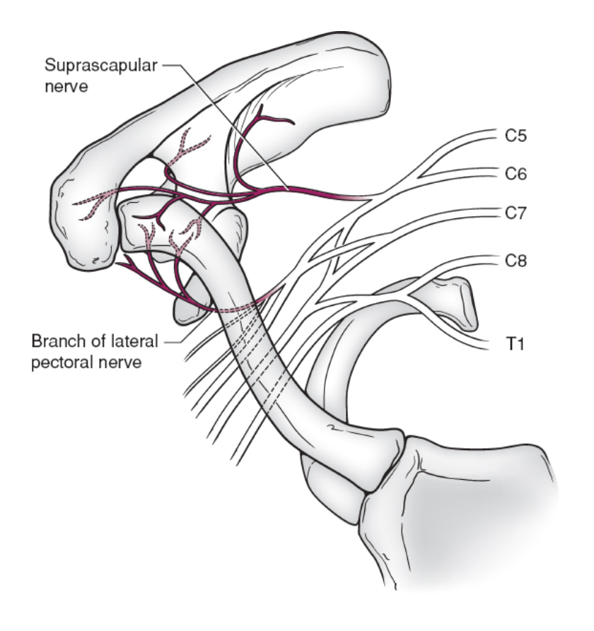
AC Joint Anatomy
Average dimensions of AC joint
9 x 19mm
Innervation – Branches of:
Axillary
Suprascapular
Lateral pectoral
Image from: Corey Edgar. (2019) ‘Acromioclavicular and Sternoclavicular Joint Injuries’, In: Tornetta P, Ricci W, Ostrum R, McQueen M, McKee M, Court-Brown C, (eds). Rockwood and Green’s Fractures in Adults, 9th ed. Philadelphia: Wolters Kluwer

Slide 5
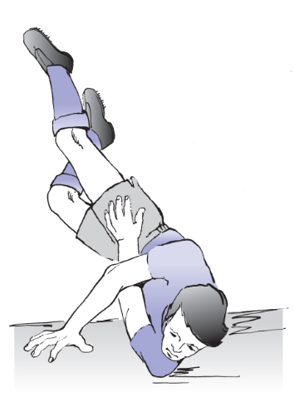
History / Mechanism:
Direct impact to the superior shoulder
Downward force vector
Sports injuries (hockey player checked into the boards)
Fall from height
Equestrian injuries
Motor vehicle crashes
Image from: Corey Edgar. (2019) ‘Acromioclavicular and Sternoclavicular Joint Injuries’, In: Tornetta P, Ricci W, Ostrum R, McQueen M, McKee M, Court-Brown C, (eds). Rockwood and Green’s Fractures in Adults, 9th ed. Philadelphia: Wolters Kluwer

Slide 6
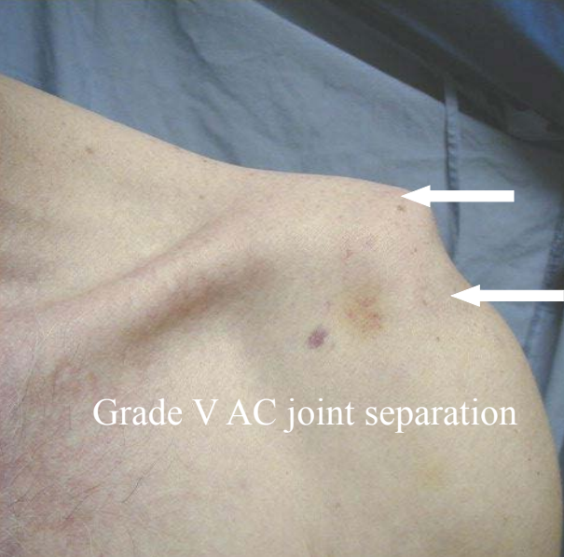
Physical Examination
Inspect skin to evaluate for open injury or threatened skin
Evaluate distal motor and sensory function
Evaluate distal extremity perfusion/pulses
Attempt to evaluate ROM
May be too painful in acute injury
If unilateral, compare to contralateral side
Palpation
Image courtesy of Prof. Michael D. McKee, MD, FRCS(C)

Slide 7
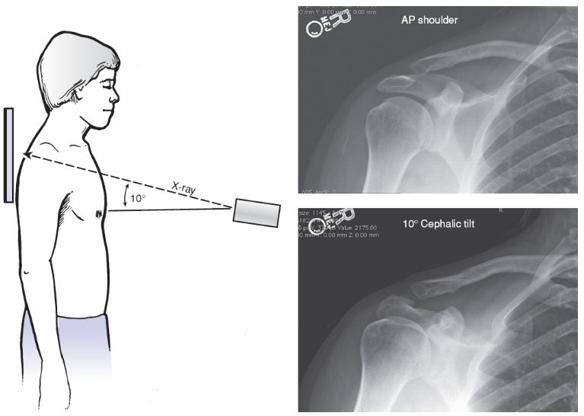
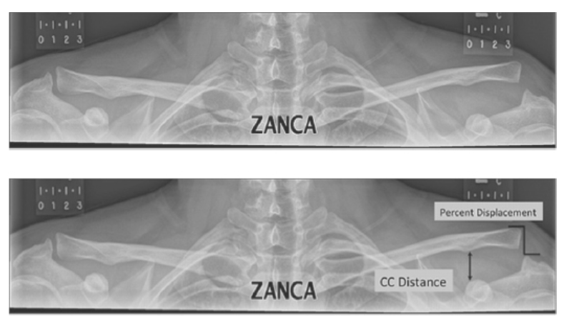
Radiographs
AP
Zanca view
AP centered on the AC joint with 10-15 degrees of cephalic tilt
Images from: Corey Edgar. (2019) ‘Acromioclavicular and Sternoclavicular Joint Injuries’, In: Tornetta P, Ricci W, Ostrum R, McQueen M, McKee M, Court-Brown C, (eds). Rockwood and Green’s Fractures in Adults, 9th ed. Philadelphia: Wolters Kluwer

Slide 8
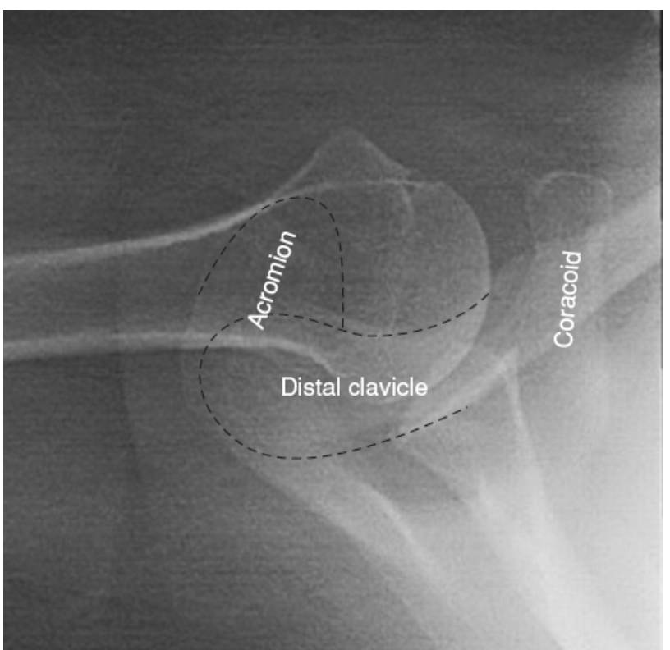
Radiographs
Stress view
Sit or stand upright with 10-pound weight in ipsilateral hand
Rarely used
Axillary lateral
Evaluate for posterior displacement
Beware, normal x-rays may mimic posterior clavicle subluxation
First two images courtesy of Prof. Michael D. McKee, MD, FRCS(C)
Next image from: Corey Edgar. (2019) ‘Acromioclavicular and Sternoclavicular Joint Injuries’, In: Tornetta P, Ricci W, Ostrum R, McQueen M, McKee M, Court-Brown C, (eds). Rockwood and Green’s Fractures in Adults, 9th ed. Philadelphia: Wolters Kluwer

Slide 9
Classification
Allman and Tossy
Initially classified 3 types (I, II and III)
Rockwood
Added types IV, V and VI
Inter- and intra-observer agreement on classification poor
Especially types III-V
Allman FL Jr. Fractures and ligamentous injuries of the clavicle and its articulation. JBJS 49A: 774-784, 1967.
Rockwood CA Jr and Young DC. Disorders of the acromioclavicular joint, In Rockwood CA, Matsen FA III: The Shoulder, Philadelphia, WB Saunders, 1990, pp. 413-476.

Slide 10
Type I
Sprain of acromioclavicular ligament
AC joint intact – normal x-rays
Coracoclavicular ligaments intact
Deltoid and trapezius muscles intact

Slide 11
Type II
AC joint disrupted
Sprain of the coracoclavicular ligaments
< 50% Vertical displacement on x-ray
CC ligaments intact
Deltoid and trapezius muscles intact

Slide 12
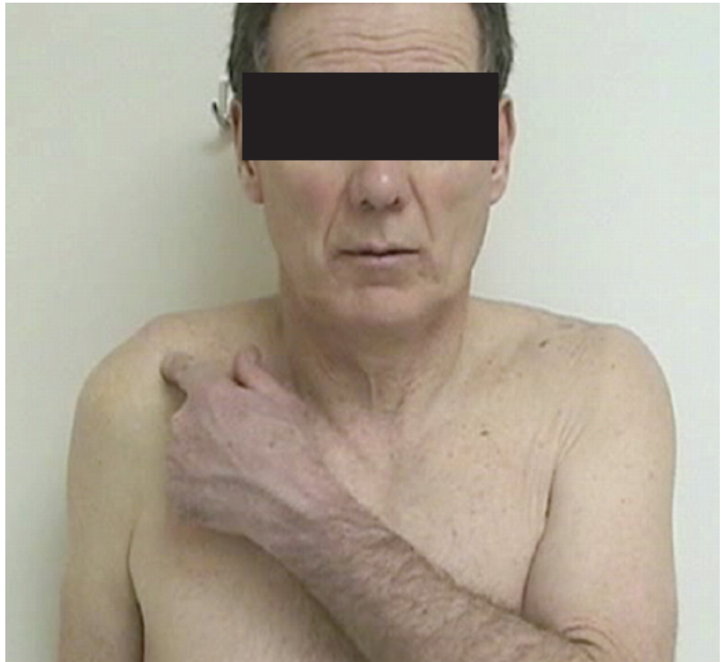
Type III
AC ligaments and CC ligaments all disrupted
AC joint dislocated and the shoulder complex displaced inferiorly
CC interspace greater than the normal shoulder(25-100%)
Deltoid and trapezius muscles usually detached from the distal clavicle
Images from: Corey Edgar. (2019) ‘Acromioclavicular and Sternoclavicular Joint Injuries’, In: Tornetta P, Ricci W, Ostrum R, McQueen M, McKee M, Court-Brown C, (eds). Rockwood and Green’s Fractures in Adults, 9th ed. Philadelphia: Wolters Kluwer

Slide 13
Type III variants
“Pseudo-dislocation”
Intact periosteal sleeve
Physeal injury
Coracoid process fracture

Slide 14
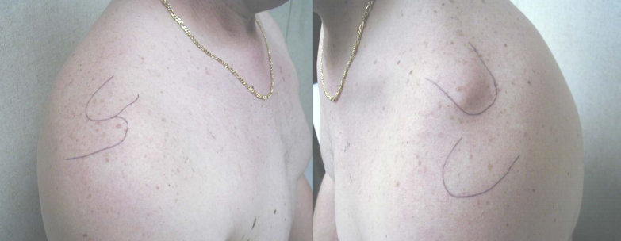
Type IV
AC and CC ligaments disrupted
AC joint dislocated and clavicle displaced posteriorly into or through the trapezius muscle
Deltoid and trapezius muscles detached from the distal clavicle
Clinical Image courtesy of Prof. Michael D. McKee, MD, FRCS(C)

Slide 15
Type V
AC ligaments disrupted
CC ligaments disrupted
AC joint dislocated and gross disparity between the clavicle and the scapula (100-300%)
Deltoid and trapezius muscles detached from the distal half of clavicle

Slide 16
Type VI
AC joint dislocated and clavicle displaced inferior to the acromion or the coracoid process
AC and CC ligaments disrupted
Deltoid and trapezius muscles detached from the distal clavicle

Slide 17
Treatment of Type I and II
Nonsurgical
Rest, ice and protection
Sling
1-2 weeks
Important to instruct patient to move distal joints to avoid stiffness
Return to sports as pain allows
Specialized braces generally not helpful

Slide 18
Surgical indications Type II
Chronic Pain after nonoperative treatment
Multiple techniques
Distal clavicle excision
Reconstruction of the coracoclavicular ligaments
Various techniques
Possible additional fixation (hook plate)

Slide 19
Treatment of Type III
Controversial
Nonsurgical management usually indicated
Consider surgical treatment
Throwing athletes
Overhead workers

Slide 20
Treatment of Type III
Surgical treatment
No significant difference with functional outcome
50% loss of reduction with follow up
10% infection rate
No significant improvement in cosmesis (bump vs scar)
Ceccarelli et al. J Orthopaed Traumatol 2008;9:105-108.

Slide 21
Treatment of Type III – V: Meta-Analysis
Systematic review and meta-analysis
19 studies, 954 patients
Better cosmetic outcome with surgery
Better radiographic outcome with surgery
Constant scores favored surgery
Small difference, may not be clinically relevant
Nonsurgical group: faster return to work, lower implant complications, fewer infections, no difference in DASH, return to sport, osteoarthritis on x-rays or need for surgery after failed management
Chang, Nicholas, Furey, Andrew, MD, MSc, Kurdin, Anton. Operative Versus Nonoperative Management of Acute High-Grade Acromioclavicular Dislocations: A Systematic Review and Meta-Analysis. J Orthop Trauma. 2018;32(1):1-9. doi:10.1097/BOT.0000000000001004.

Slide 22
Treatment of Type III – V: Randomized Clinical Trial
Multicenter randomized clinical trial
80 patients, 40 each group
Complete AC separation (III, IV and V)
No attempt to subclassify into specific types!
Canadian Orthopaedic Trauma S. Multicenter randomized clinical trial of nonoperative versus operative treatment of acute acromio-clavicular joint dislocation. J Orthopaedic Trauma. 2015;29:479–487

Slide 23
Treatment of Type III – V: Randomized Clinical Trial
Hook plate vs nonsurgical treatment
Better DASH scores at 6 weeks and three month in non-op group
No difference at 6 months, 1 year and 2 years
Better Constant scores in nonop group at 6 weeks, 3 months and 6 months
No difference at 1 year and 2 years
Both groups improved to good or excellent results at 2 year follow up
Canadian Orthopaedic Trauma S. Multicenter randomized clinical trial of nonoperative versus operative treatment of acute acromio-clavicular joint dislocation. J Orthopaedic Trauma. 2015;29:479–487

Slide 24
Treatment of Type III – V: Randomized Clinical Trial
Significantly higher reoperation in operative group
Implant removal average time 8.2 months
DASH scores better for non-op pts at 6 wk and 3 mo, no diff thereafter
Constant scores better in non-op pts 6 wk, 3 and 6 mo, no diff thereafter
Radiographs outcomes better with surgery at all time points (P<0.001)
2 years: 4/22 surgical vs 1/20 non-op had arthritic changes (p 0.36)
76% non-op back to work at 3 months vs 43% surgical (p=0.004)
No difference at 1 year
Over-reduction (narrowing) of the A-C joint was the most common cause of mechanical failure after surgery
Canadian Orthopaedic Trauma S. Multicenter randomized clinical trial of nonoperative versus operative treatment of acute acromio-clavicular joint dislocation. J Orthopaedic Trauma. 2015;29:479–487

Slide 25
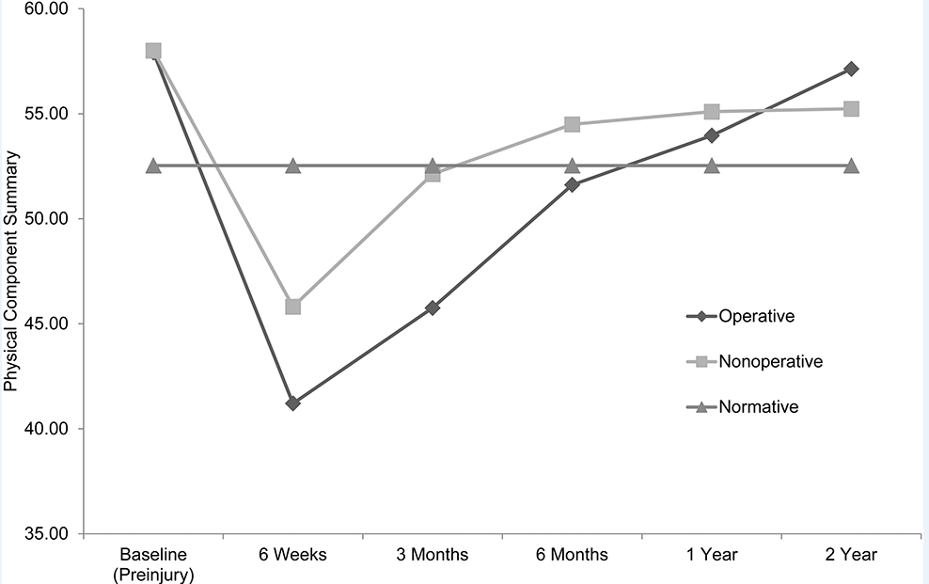
Treatment of Type III - V
Follow up to above study
Assessed health related quality of life
Mostly type III injuries in both groups
Physical health scores
Better in non-op group at 3 months then no difference through 2 years
Mental health scores
No difference at any time point
Physical health recovered to norms at 6 months in nonop, 1 year in operative group
Mental health recovered to norms at 3 months with surgery, 6 months without surgery
Canadian Orthopaedic Trauma S. Multicenter randomized clinical trial of nonoperative versus operative treatment of acute acromio-clavicular joint dislocation. J Orthopaedic Trauma. 2015;29:479–487

Slide 26
Options for surgical treatment
Over 50 described in the literature
Primary AC joint fixation
Primary CC ligament reconstruction
Usually allograft, often with augmentation
Distal clavicle excision
Dynamic muscle transfers

Slide 27
Weaver-Dunn Procedure
The distal clavicle is excised.
The CA ligament is transferred to the distal clavicle.
The CC ligaments are repaired and/or augmented with a coracoclavicular screw or suture.
Repair of deltotrapezial fascia
Original series described 28% failure rate¹
Modifications of the technique lead to improvements
89% satisfactory results²
All type III, mix of acute and chronic patients
27/27 return to work and sport, high satisfaction³
All type III, all chronic dislocations
From Nuber GW and Bowen MK, JAAOS, 5:11, 1997
Weaver JK, Dunn HK. Treatment of acromioclavicular injuries, especially complete acromioclavicular separation. J Bone Joint Surg Am. 1972 Sep;54(6):1187-94. PMID: 4652050.
Rokito AS, Oh YH, Zuckerman JD. Modified Weaver-Dunn procedure for acromioclavicular joint dislocations. Orthopedics. 2004 Jan;27(1):21-8. PMID: 14763525.
Galasso O, Tarducci L, De Benedetto M, et al. Modified Weaver-Dunn Procedure for Type 3 Acromioclavicular Joint Dislocation: Functional and Radiological Outcomes. Orthop J Sports Med. 2020;8(3) PMID: 32215276

Slide 28
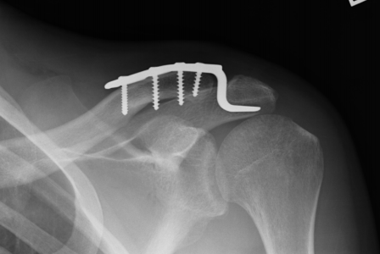
ORIF with hook plate
Biomechanical strength most similar to that of intact AC and CC ligaments¹
Can have high rates of removal
Concern for damage to rotator cuff
Possible impingement
Can have loss of reduction after removal
Be careful not to over-reduce
Pain, stiffness and early failure²
1) McConnell, Alison, Yoo, Daniel, J BSc, MD, et al. Methods of Operative Fixation of the Acromio-Clavicular Joint: A Biomechanical Comparison. J Orthop Trauma. 2007;21(4):248-253. doi:10.1097/BOT.0b013e31803eb14e.
2) Canadian Orthopaedic Trauma Society. Multicenter Randomized Clinical Trial of Nonoperative Versus Operative Treatment of Acute Acromio-Clavicular Joint Dislocation. J Orthop Trauma. 2015 Nov;29(11):479-87. doi: 10.1097/BOT.0000000000000437. PMID: 26489055.
Clinical Image from Prof. Michael D. McKee, MD, FRCS(C)

Slide 29
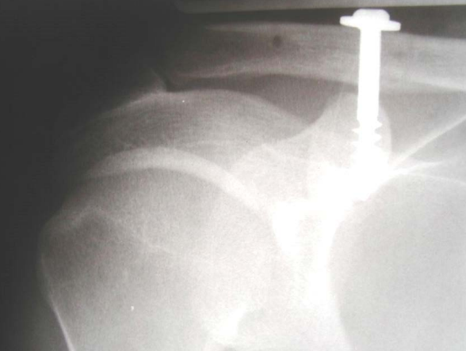
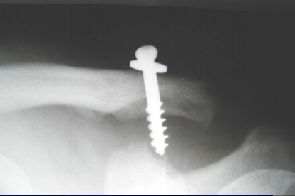
Bosworth screw
Biomechanically stronger than hook plates
Can be done open vs percutaneously
Can be used to augment suture tape or other constructs
Images from Prof. Michael D. McKee, MD, FRCS(C)

Slide 30
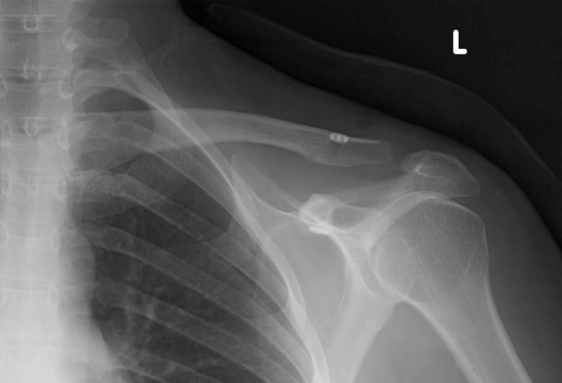
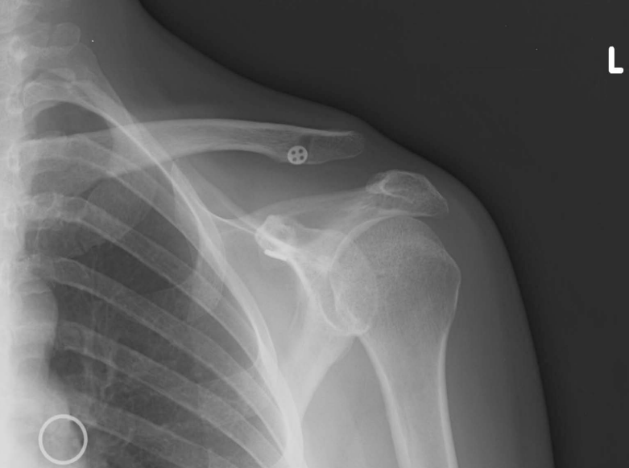
Suture button
Reports of high failure rates
Cook, et. Al, JSES 2012.
10 repairs
9 consecutive patients
80% failure
Average of 7 weeks
All active-duty military
Images from Prof. Michael D. McKee, MD, FRCS(C) Cook JB, Shaha JS, Rowles DJ, Bottoni CR, Shaha SH, Tokish JM. Early failures with single clavicular transosseous coracoclavicular ligament reconstruction. J Shoulder Elbow Surg. 2012 Dec;21(12):1746-52. doi: 10.1016/j.jse.2012.01.018. Epub 2012 Apr 21. PMID: 22521387.

Slide 31
Suture Button – meta-analysis
Suture button vs hook plate
8 studies
204 suture button patients
195 hook plate patients
Suture button
Better constant scores – may not be clinically significant
Lower VAS
No difference: operative time, reduction quality, complication, loss of reduction
Wang C, Meng JH, Zhang YW, Shi MM. Suture Button Versus Hook Plate for Acute Unstable Acromioclavicular Joint Dislocation: A Meta-analysis. Am J Sports Med. 2020 Mar;48(4):1023-1030. doi: 10.1177/0363546519858745. Epub 2019 Jul 17. PMID: 31315003.

Slide 32
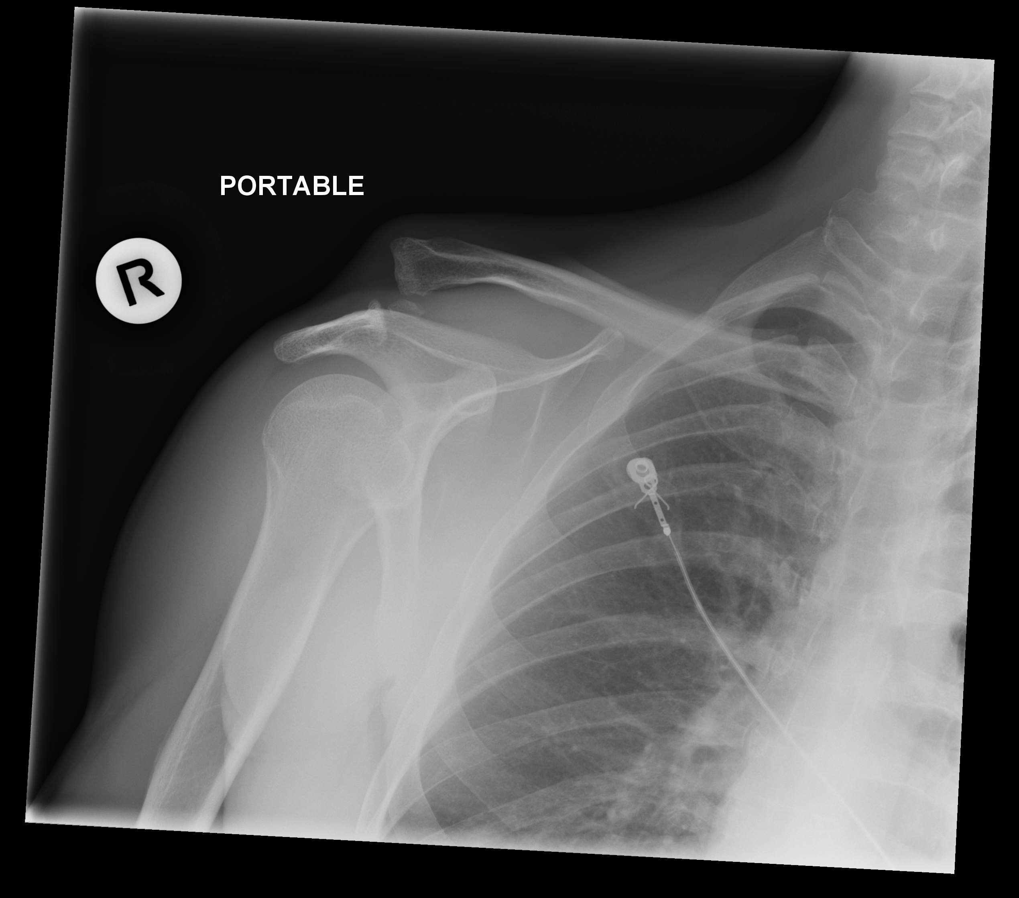
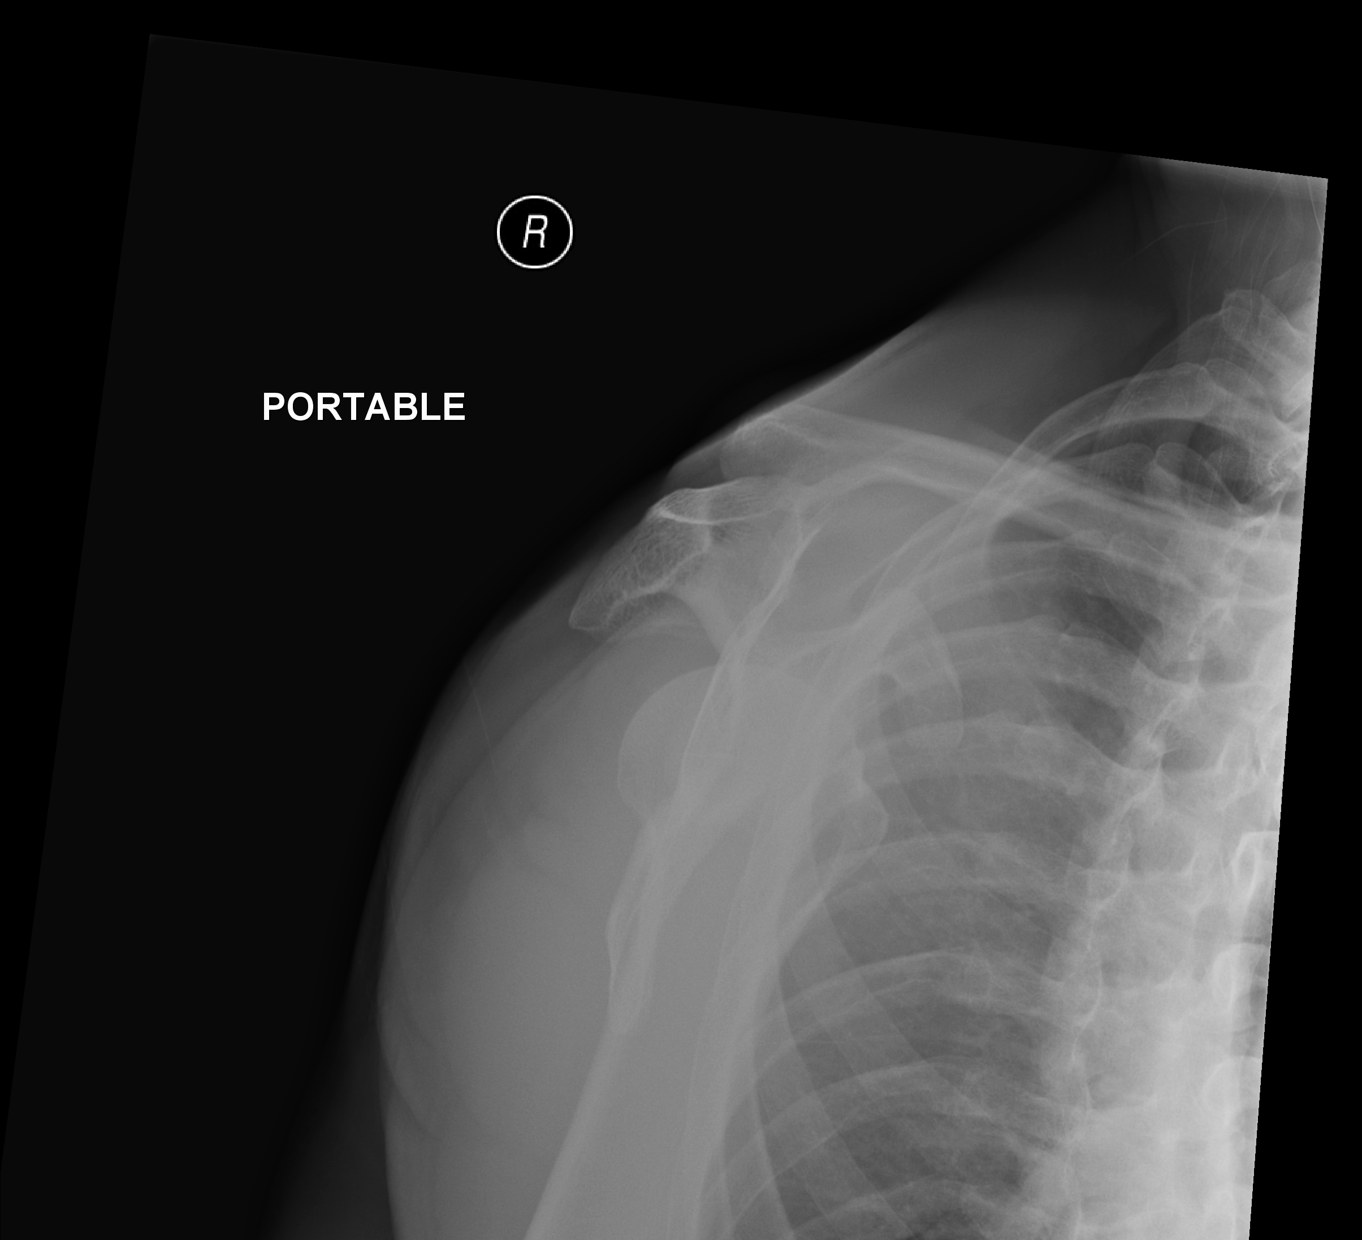
Suture Button – Case Example
48yo RHD M assault victim
Fell directly on to R shoulder
Works occasionally in construction
Homeless
½ ppd tobacco
Cocaine
Methamphetamine
Marijuana
Image courtesy of Dr. Jiyao Zou

Slide 33
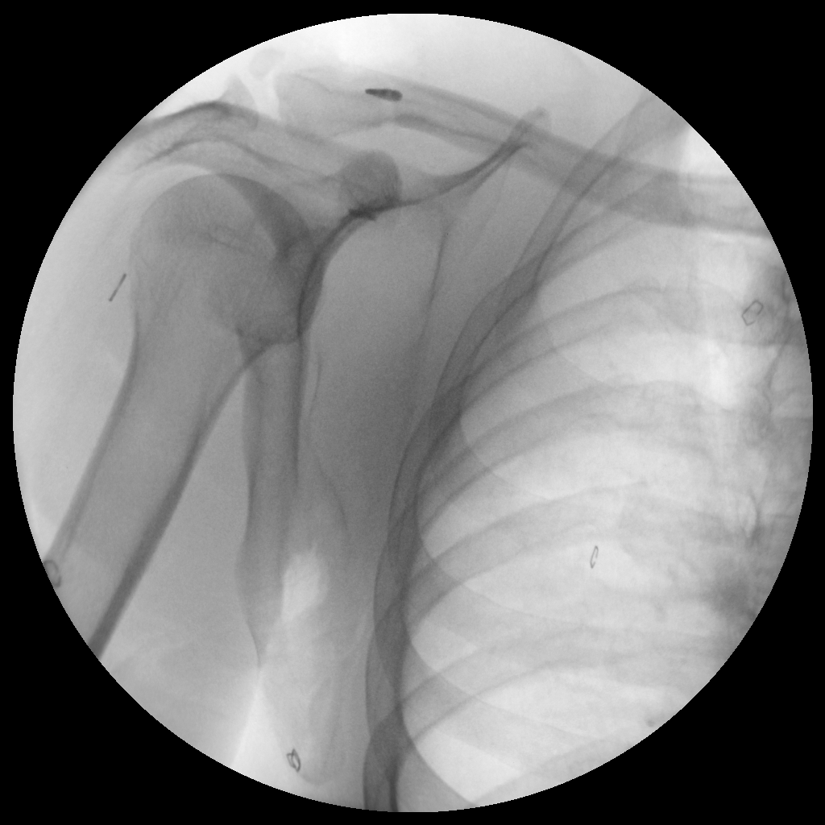
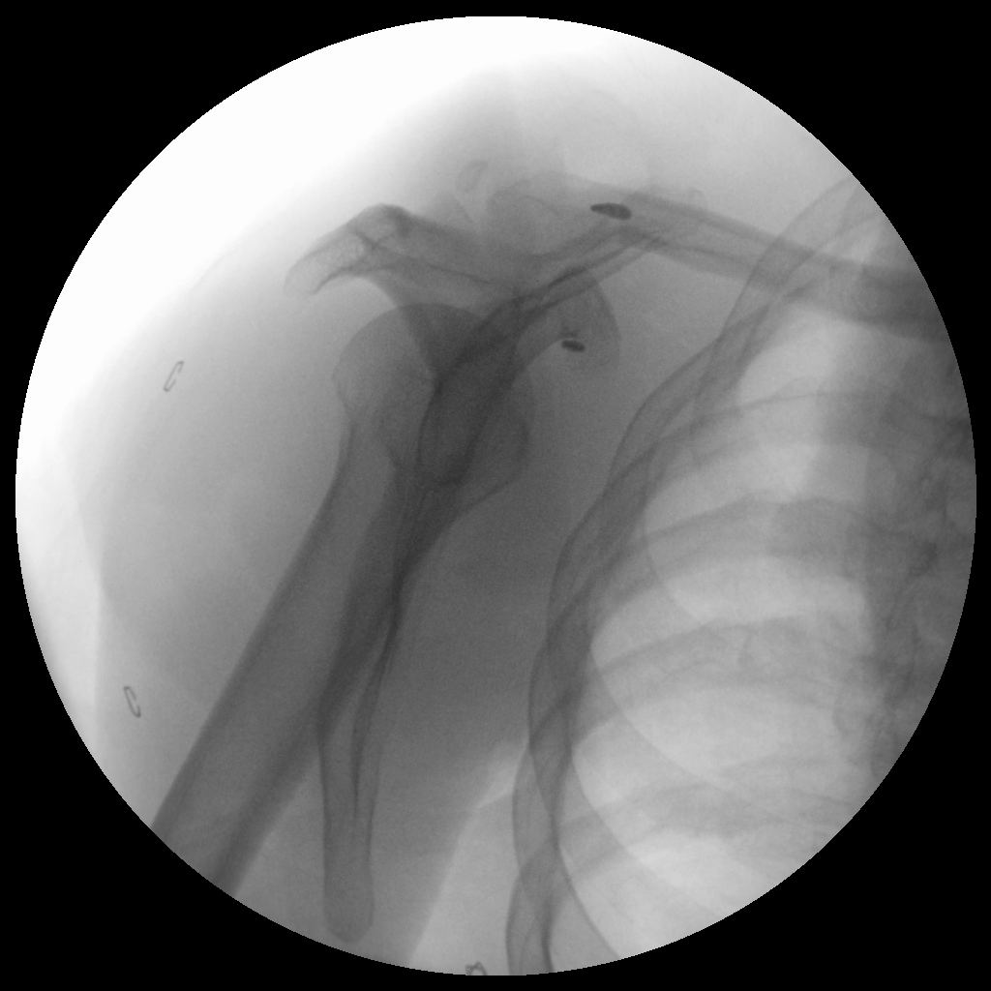
Suture Button – Case Example
CRPP
Image courtesy of Dr. Jiyao Zou

Slide 34
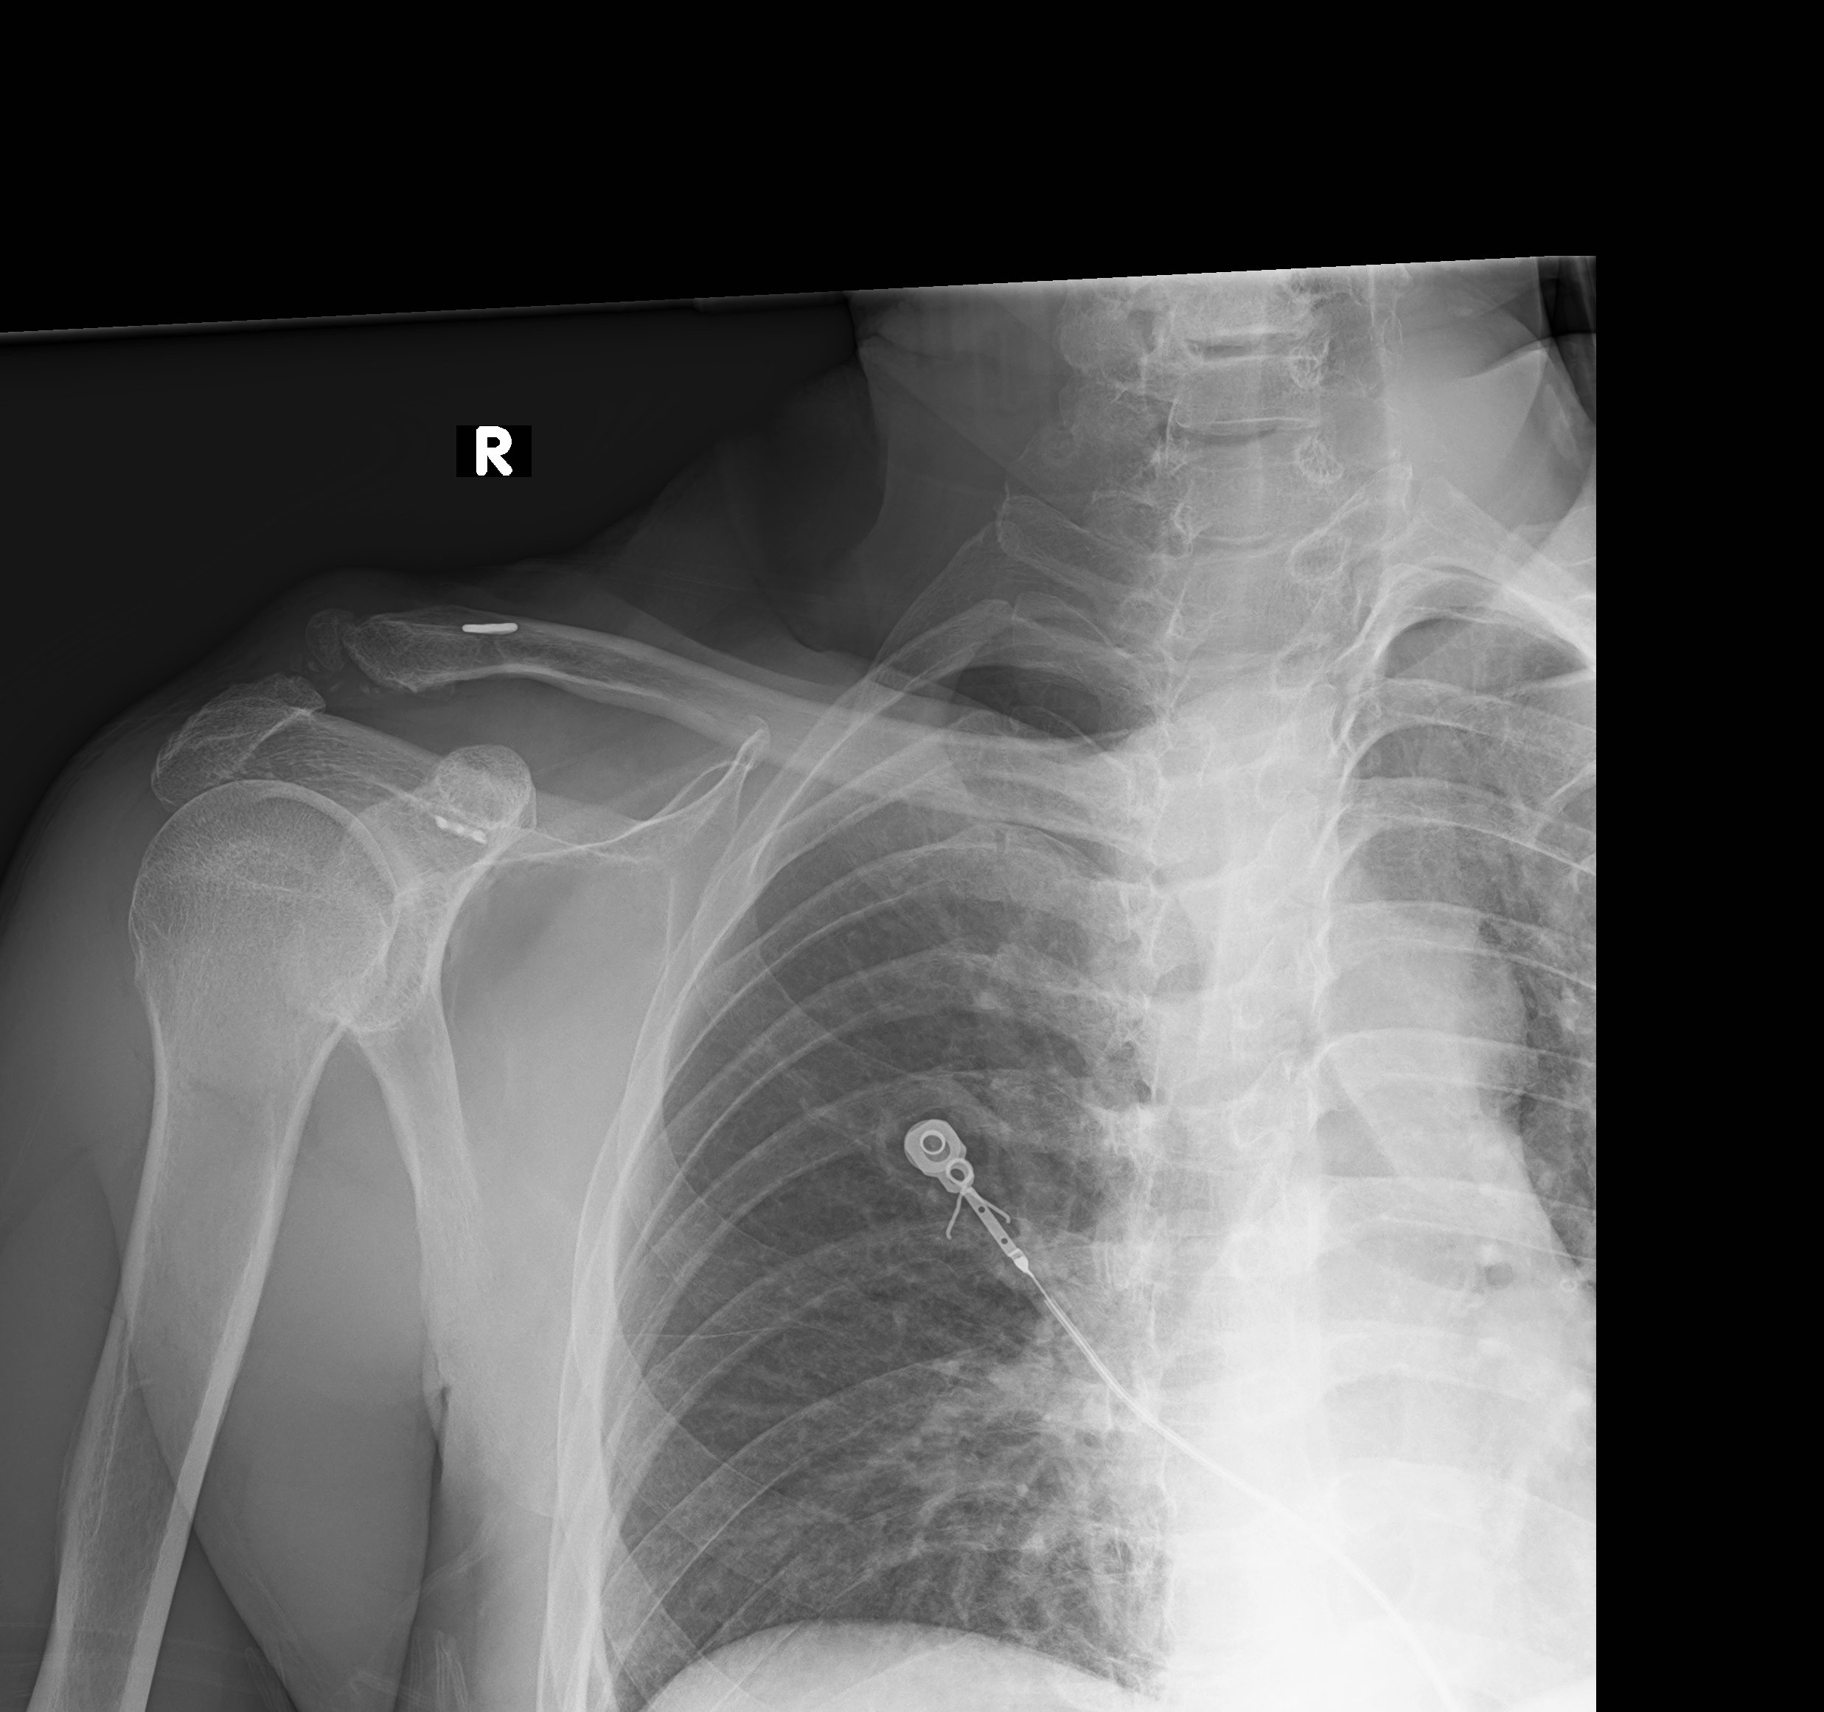
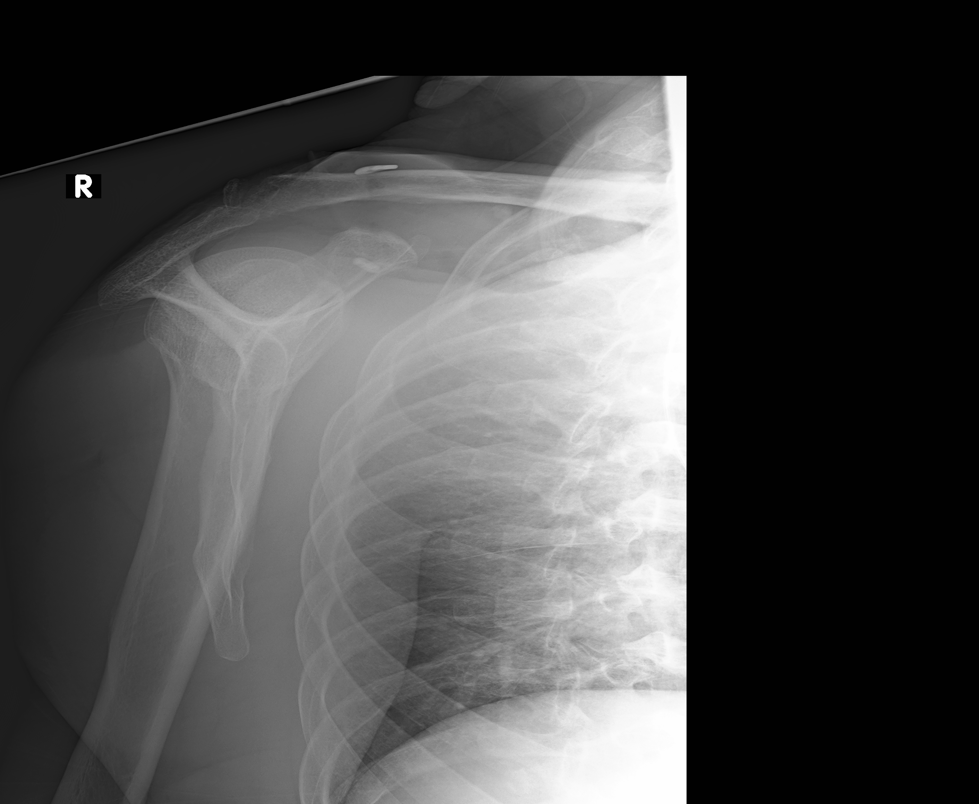
Suture Button – Case Example
Incidental follow up at 15 months after fall from height
Good maintenance of reduction on x-rays
No clinical f/u as we weren’t reconsulted
Image courtesy of Dr. Jiyao Zou

Slide 35
Relative indications for surgical treatment
Chronic dislocations with:
Pain
Concern with cosmetic deformity
Weakness

Slide 36
Outcomes of various treatments
Modifed Weaver-Dunn may lead to good functional results in patients with symptomatic chronic type III dislocations¹
Suspensory loop fixation may lead to better Constant-Murley scores vs hook plates and less post-operative pain vs hook plates²
Majority of studies (27/36) included type III injuries
Suture button fixation vs Bosworth screw³
Prospective, Randomized Trial. 34 pts each group
No difference in radiographic outcomes
No significant differences in Constant scores, Oxford Shoulder scores. DASH excellent in both groups.
No need for second surgery with suture button fixation
Galasso O, Tarducci L, De Benedetto M, et al. Modified Weaver-Dunn Procedure for Type 3 Acromioclavicular Joint Dislocation: Functional and Radiological Outcomes. Orthop J Sports Med. 2020;8(3) PMID: 32215276
Arirachakaran A, Boonard M, Piyapittayanun P, et al. Post-operative outcomes and complications of suspensory loop fixation device versus hook plate in acute unstable acromioclavicular joint dislocation: a systematic review and meta-analysis. J Orthop Traumatol. 2017;18(4):293-304.
Darabos N, Vlahovic I, Gusic N, Darabos A, Bakota B, Miklic D. Is AC TightRope fixation better than Bosworth screw fixation for minimally invasive operative treatment of Rockwood III AC joint injury? Injury. 2015 Nov;46 Suppl 6:S113-8. PMID: 26632500.

Slide 37
Rehab protocol for surgical treatment
Sling for 4-6 weeks
Encourage PROM during that time
No pushing, pulling, reaching
AROM starts at 6 weeks
Strengthening starts at 8 weeks
Return to contact sports at 16-20 weeks after removal of implants if planned
Cole PA, Jacobson AR. Shoulder Girdle Injuries. In: James P. Stannard and Andrew H. Schmidt, eds. Surgical Treatment of Orthopaedic Trauma, 2nd ed. New York: Thieme 2016:285-331

Slide 38
ORIF with hook plate and CC ligament transfer
McKee, Michael, MD, FRCS. Operative Fixation of Chronic Acromioclavicular Joint Dislocation With Hook Plate and Modified Ligament Transfer. J Orthop Trauma. 2016;30:S7-S8. doi:10.1097/BOT.0000000000000580.

Slide 39
Sternoclavicular Joint Injuries

Slide 40
Sternoclavicular joint - Anatomy
Diarthrodial joint
Saddle shaped with poor congruence
Intra-articular disc
Divides SC into 2 separate joint spaces
Costoclavicular ligament (rhomboid ligament)
Short, strong
Anterior and posterior fasciculi

Slide 41
Sternoclavicular joint - Anatomy
Interclavicular ligament
Connects superomedial aspects of each clavicle to
Capsular ligaments
Upper sternum
Capsular ligament
Covers anterior and posterior aspects of the joint
Thickenings of the capsule
Anterior is the stronger of the two

Slide 42
Sternoclavicular joint - Anatomy
Epiphysis of the medial clavicle
Last ossification center to appear in the body
Ossifies at age 18-20
Does not unite with clavicle until the 23rd – 25th year

Slide 43
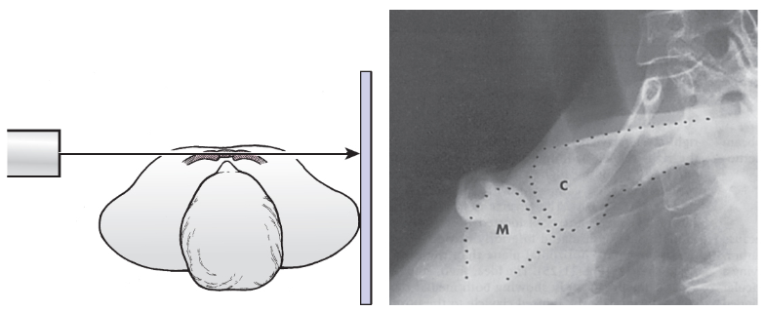
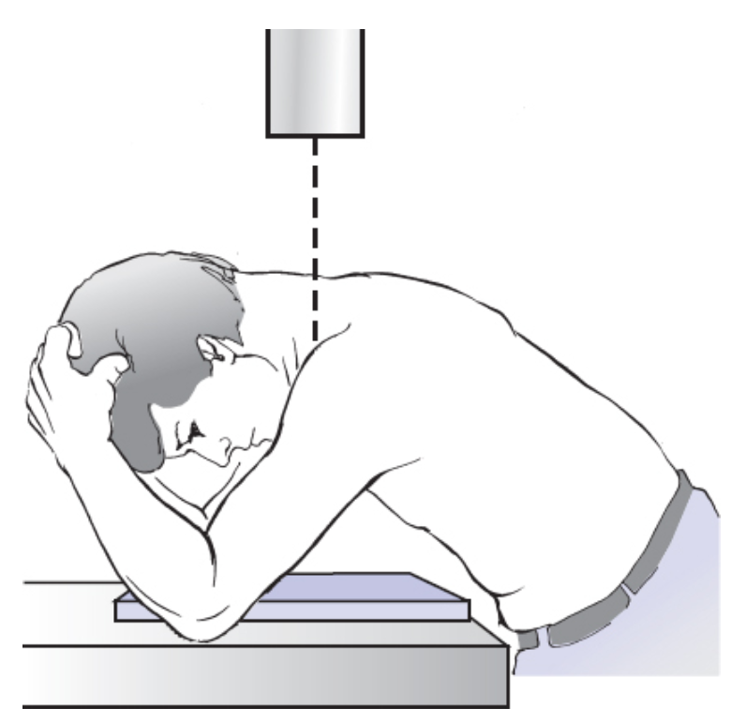
Sternoclavicular joint – Plain Radiographs
Heinig view
Hobbs view
Image from: Corey Edgar. (2019) ‘Acromioclavicular and Sternoclavicular Joint Injuries’, In: Tornetta P, Ricci W, Ostrum R, McQueen M, McKee M, Court-Brown C, (eds). Rockwood and Green’s Fractures in Adults, 9th ed. Philadelphia: Wolters Kluwer

Slide 44
Sternoclavicular joint - Imaging
CT Scan
Current gold standard for diagnosis
Also allows for evaluation of associated soft tissue injuries

Slide 45
Sternoclavicular joint – Treatment
Anterior dislocations
Non-surgical treatment usually recommended
NSAIDs/pain control
Immobilization for comfort
Closed reduction maneuvers often unsuccessful
Direct pressure over medial clavicle may lead to reduction
Often can’t be maintained
Functional results thought to be generally good
Can lead to cosmetic deformity

Slide 46
Sternoclavicular joint – Treatment
Anterior dislocations
Recent literature has questioned nonoperative treatment in active, young patients
Pain with activity and inability to return to throwing sports¹
Decreased function reported by 42% of patients²
Risk of post-traumatic arthritis^{3,4}
Noticeable cosmetic deformity^{3,4,5}
Savastano AA, Stutz SJ. Traumatic sternoclavicular dislocation. Int Surg. 1978;63:10–13
De Jong KP, Sukul DM. Anterior sternoclavicular dislocations: a long-term follow-up study. J Orthop Trauma. 1990;4:420–423.
Robinson CM, Jenkins PJ, Markham PE, et al. Disorders of the sternoclavicular joint. J Bone Joint Surg Br. 2008;90:685–696.
Yeh GL, Williamson GR Jr. Conservative management of sternoclavicular injuries. Orthop Clin North Am. 2000;31:129–203.
Kälicke T, Andereya S, Westhoff J, et al. Anterior sternoclavicular dislocation caused by indirect compression trauma. Eur J Trauma. 2003;29:327–330.

Slide 47
Sternoclavicular joint – Treatment
Posterior dislocations
Careful physical examination
Vascular compromise
Difficulty swallowing
Stridor
Hoarseness
If reduction required, have Thoracic Surgeon on standby or transfer to center with Thoracic Surgery available
Attempt closed reduction
Roll/bump between scapulae
Abduction/Adduction with traction
Percutaneous towel clip or pointed reduction forceps with anterior force

Slide 48
2018 Meta-analysis
38 articles reviewed, 26 quantitative
No level I, II or III studies. Expert opinion and case series only
4 questions
What is the expected outcome without treatment?
What are the indications for closed reduction?
What are the indications for open reduction?
Is there a need for availability of cardiothoracic surgery for open reduction?
Sernandez, Haley, Riehl, John. Sternoclavicular Joint Dislocation: A Systematic Review and Meta-analysis. J Orthop Trauma. 2019;33(7):e251-e255. doi:10.1097/BOT.0000000000001463.

Slide 49
2018 Meta-analysis
Non-reduced anterior dislocations
38-42% complication rates (pain, activity limitation, arthritis)
No posterior dislocations were left unreduced
Thus, closed reduction should be attempted for all dislocations
Successful 38% of the time in a series of 21 posterior SC dislocations
Indications for open treatment:
Irreducible posterior dislocation is an indication for open reduction
Irreducible anterior dislocation in young, active patients may be a relative indication
None of the 35 reported cases of open reduction (anterior or posterior) required the intervention of cardiothoracic surgery
However, recommended by 18 articles that they are available
Additionally, high rate of hazardous wire migration when K-wires were used to fix joint.
Sernandez, Haley, Riehl, John. Sternoclavicular Joint Dislocation: A Systematic Review and Meta-analysis. J Orthop Trauma. 2019;33(7):e251-e255. doi:10.1097/BOT.0000000000001463.

Slide 50
Open treatment options
Figure of 8 suture tape
Allograft reconstruction
Autograft reconstruction
Trans-articular plating
Sernandez, Haley, Riehl, John. Sternoclavicular Joint Dislocation: A Systematic Review and Meta-analysis. J Orthop Trauma. 2019;33(7):e251-e255. doi:10.1097/BOT.0000000000001463.

Slide 51
OTA Video
Insert video https://otaonline.org/video-library/45036/procedures-and-techniques/multimedia/18101485/sc-joint-fixation-surgical-technique
Bonyun, Marissa, MD, MEd, Nauth, Aaron, MD, MSc. Techniques for Reduction and Fixation of the Sternoclavicular Joint. J Orthop Trauma. 2020;34:S1-S2. doi:10.1097/BOT.0000000000001831.

Slide 52
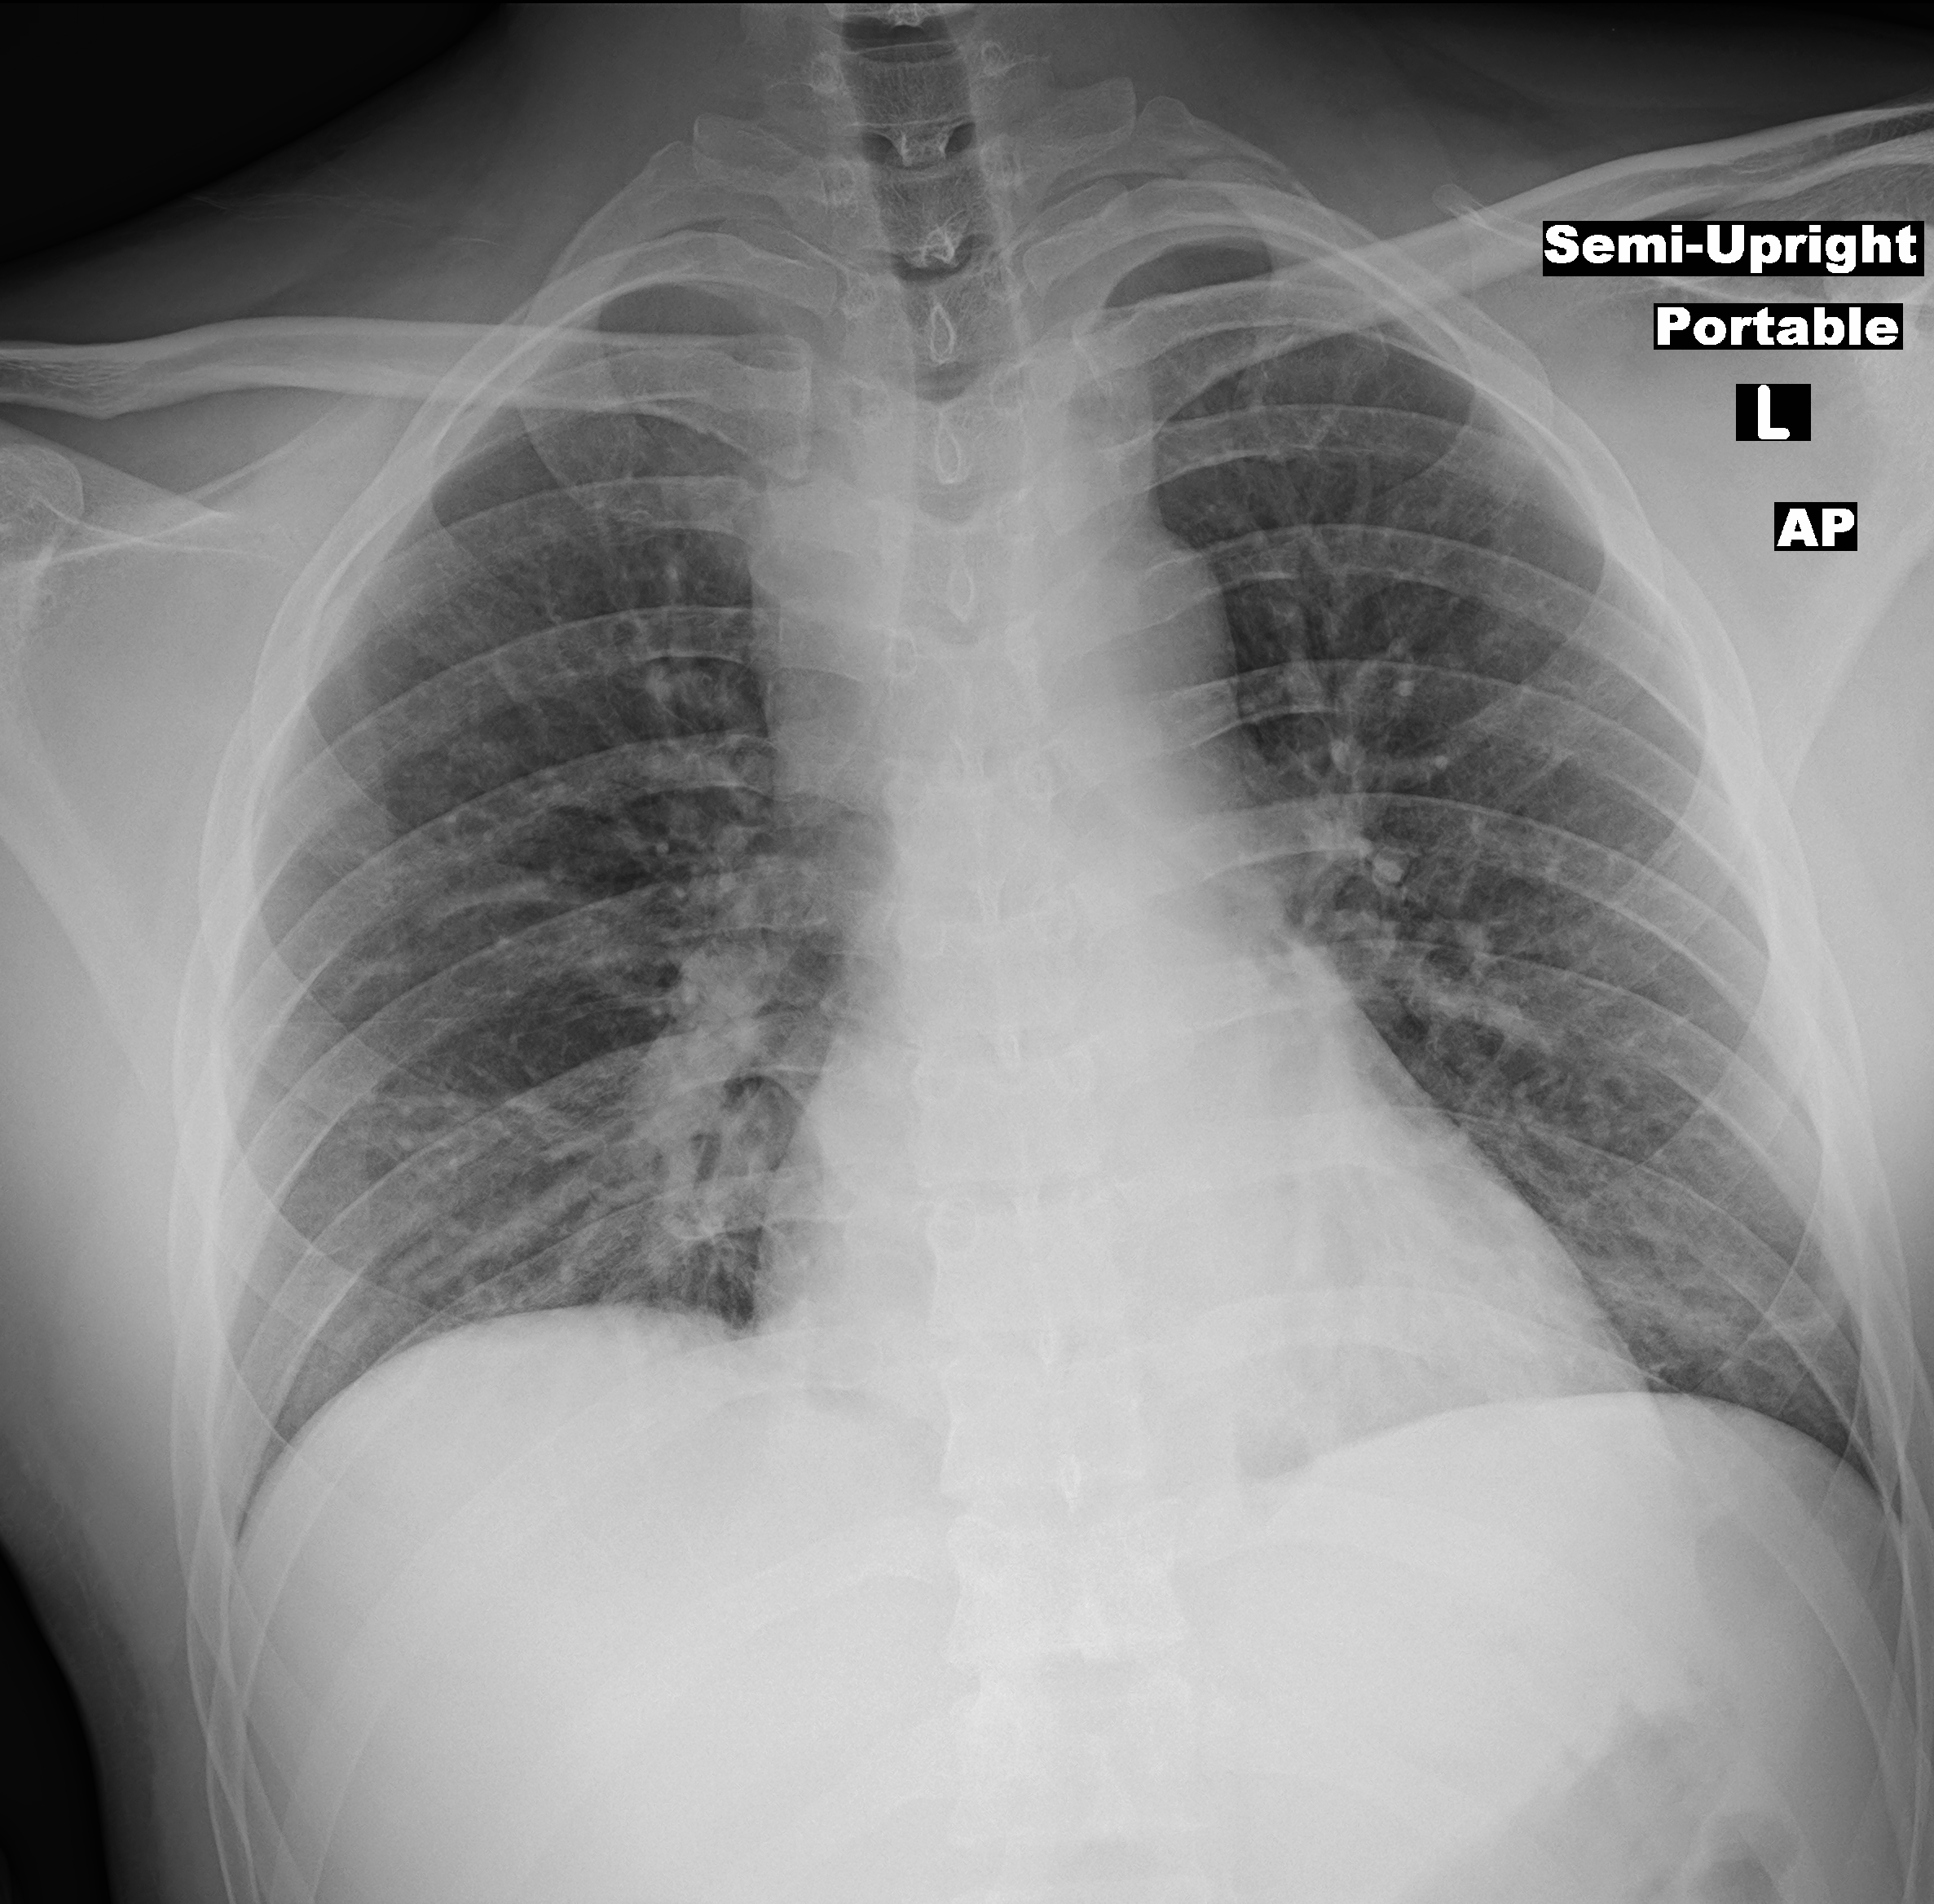
Case Example
29yo M
3 days from injury
Pain with swallowing
Shortness of breath with talking
Distally NVI
Posterior R SC dislocation
Tracheal deviation
Wide Mediastinum

Slide 53
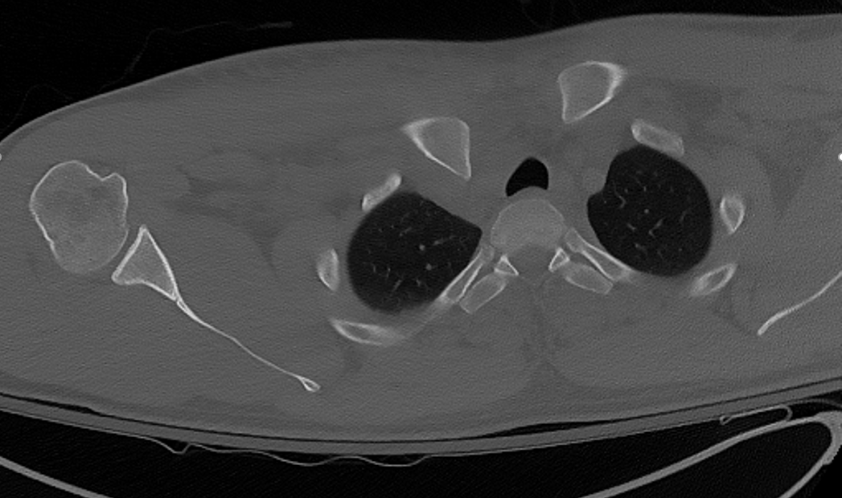
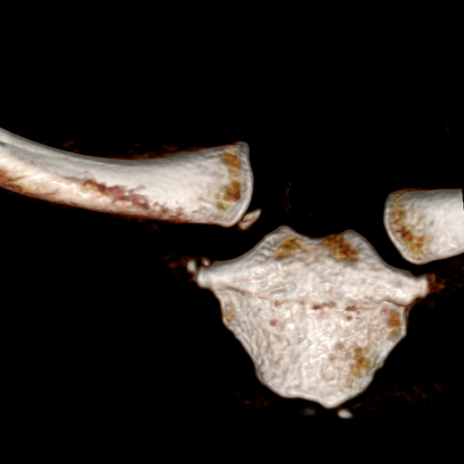
Case Example
29yo M
3 days from injury
Pain with swallowing
Shortness of breath with talking
Distally NVI
Posterior R SC dislocation
Tracheal deviation
Wide Mediastinum

Slide 54
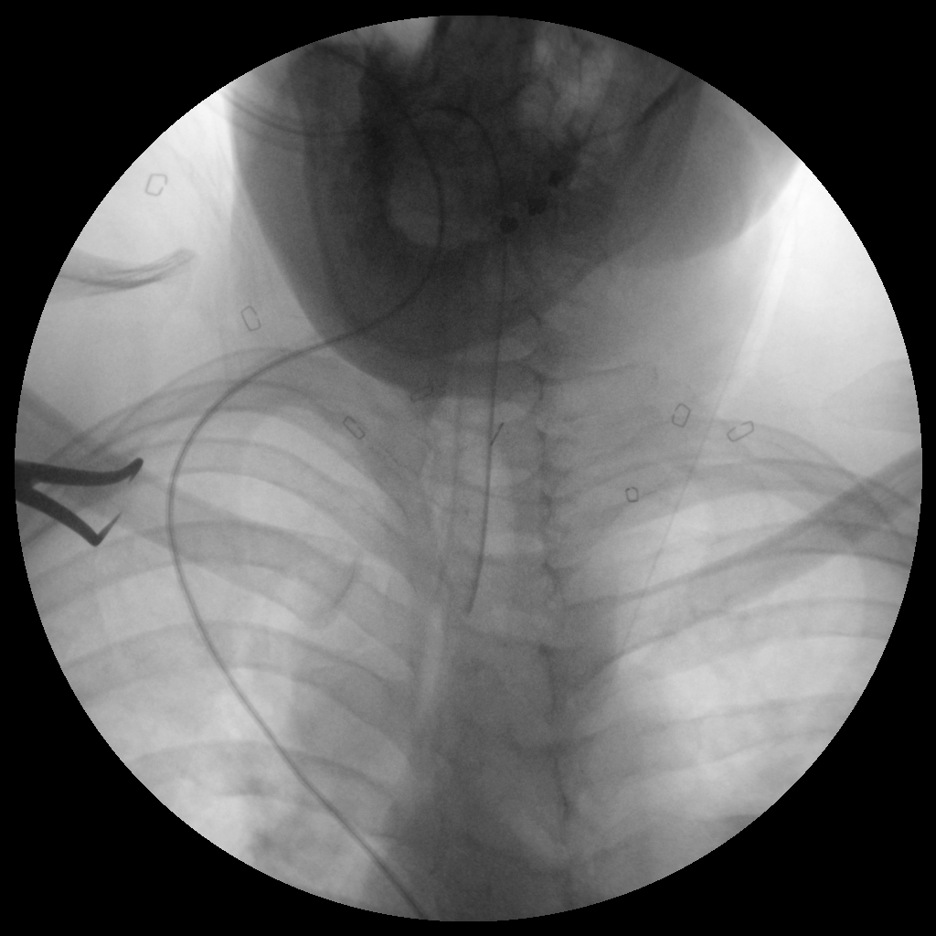
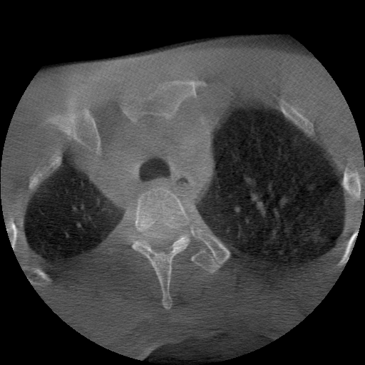
Case Example
Attempted closed reduction in OR – unsuccessful
Attempted percutaneous reduction → resubluxation
Confirmed with O-Arm

Slide 55
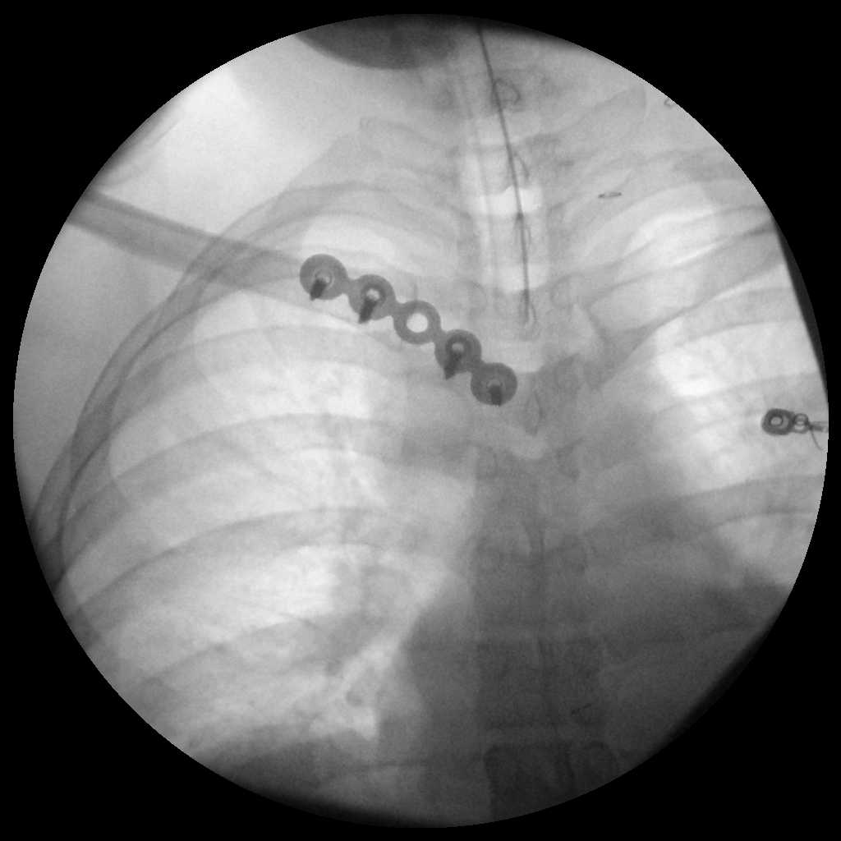
Case Example
Conversion to ORIF
Cardiothoracic surgeon available within 5 minutes
General Trauma surgeon immediately available
2 cortical screws, 2 locking screws
Planned removal at 6 months
Image courtesy of Prof. David Seligson

Slide 56
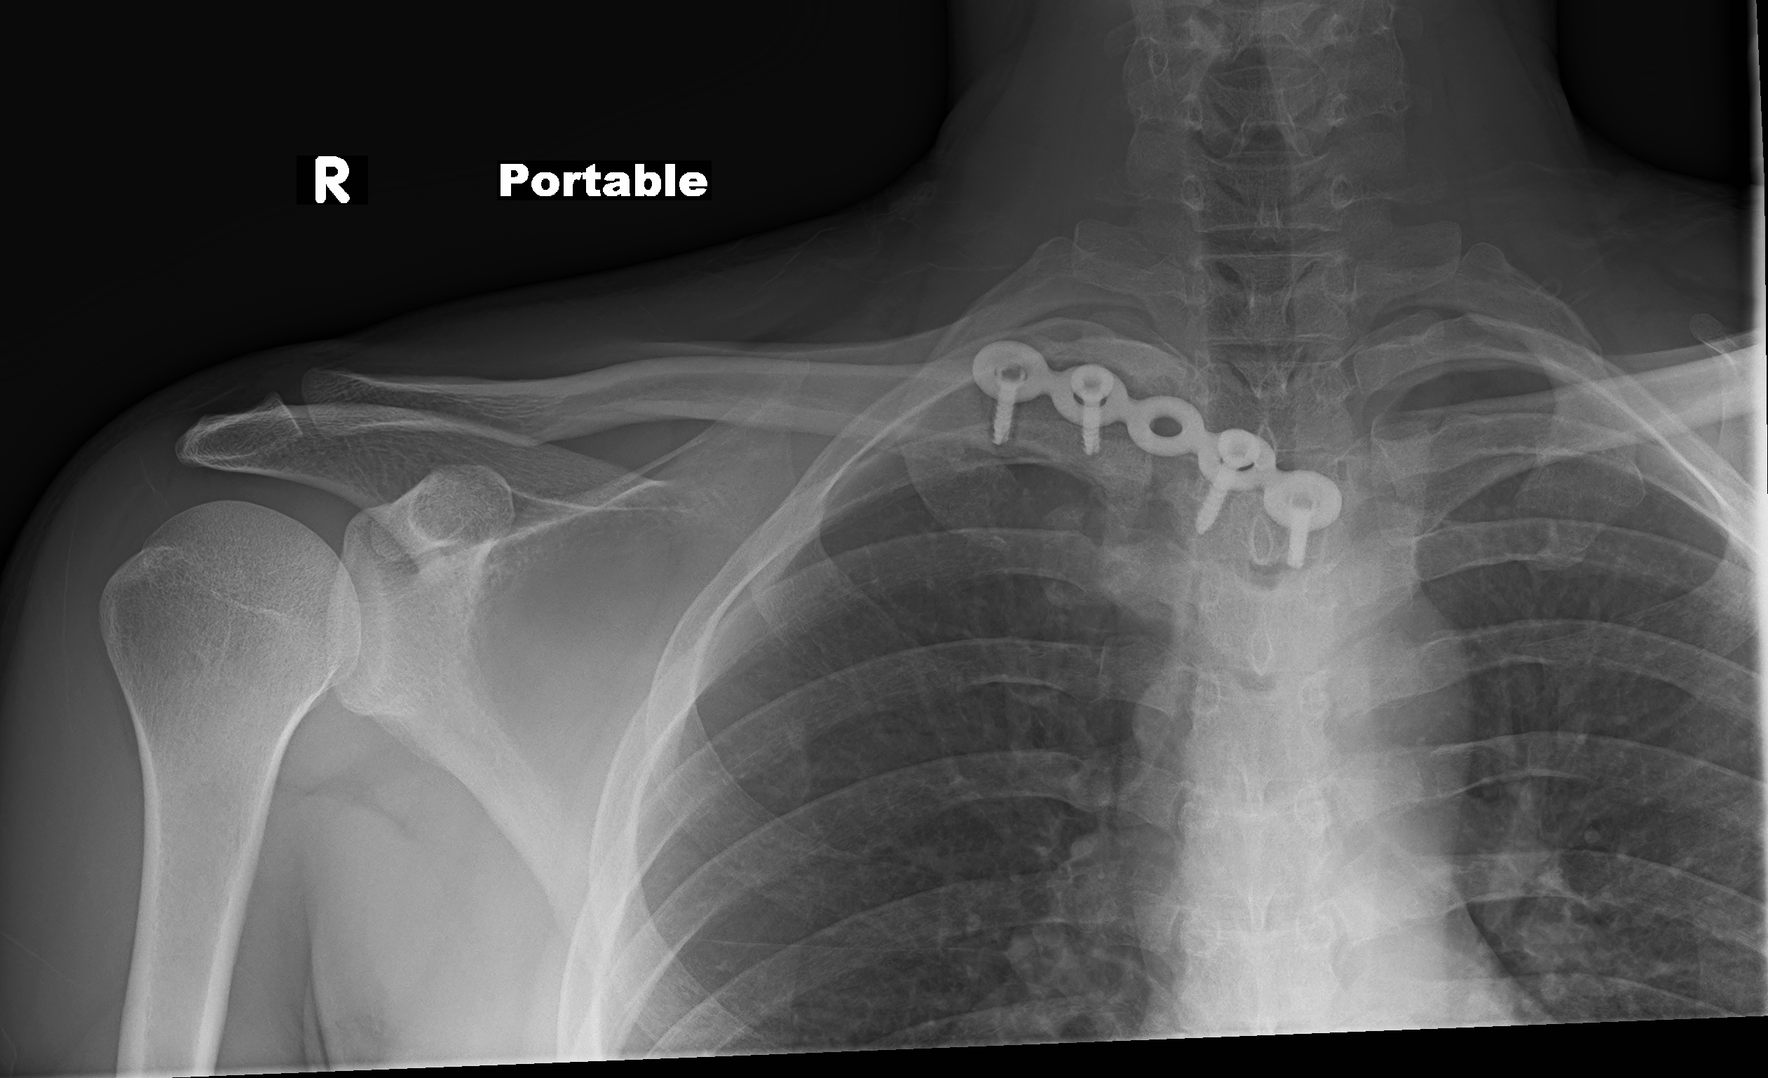
Case Example
Lost to follow up after 2.5 months
Image courtesy of Prof. David Seligson

Slide 57
Literature Summary
Bonyun, Marissa, MD, MEd, Nauth, Aaron, MD, MSc. Techniques for Reduction and Fixation of the Sternoclavicular Joint. J Orthop Trauma. 2020;34:S1-S2.
Sernandez, Haley, Riehl, John. Sternoclavicular Joint Dislocation: A Systematic Review and Meta-analysis. J Orthop Trauma. 2019;33(7):e251-e255.
McKee, Michael, MD, FRCS. Operative Fixation of Chronic Acromioclavicular Joint Dislocation With Hook Plate and Modified Ligament Transfer. J Orthop Trauma. 2016;30:S7-S8.
Cole PA, Jacobson AR. Shoulder Girdle Injuries. In: James P. Stannard and Andrew H. Schmidt, eds. Surgical Treatment of Orthopaedic Trauma, 2nd ed. New York: Thieme 2016:285-331
Wang C, Meng JH, Zhang YW, Shi MM. Suture Button Versus Hook Plate for Acute Unstable Acromioclavicular Joint Dislocation: A Meta-analysis. Am J Sports Med. 2020 Mar;48(4):1023-1030. Epub 2019 Jul 17. PMID: 31315003.
McConnell, Alison, Yoo, Daniel, J BSc, MD, et al. Methods of Operative Fixation of the Acromio-Clavicular Joint: A Biomechanical Comparison. J Orthop Trauma. 2007;21(4):248-253.
Canadian Orthopaedic Trauma Society. Multicenter Randomized Clinical Trial of Nonoperative Versus Operative Treatment of Acute Acromio-Clavicular Joint Dislocation. J Orthop Trauma. 2015 Nov;29(11):479-87.
Chang, Nicholas, Furey, Andrew, MD, MSc, Kurdin, Anton. Operative Versus Nonoperative Management of Acute High-Grade Acromioclavicular Dislocations: A Systematic Review and Meta-Analysis. J Orthop Trauma. 2018;32(1):1-9.

Slide 58
AC Joint Additional Literature
Calvo E, Lopez-Franco M, Arribas IM. Clinical and radiologic outcomes of surgical and conservative treatment of type III acromioclavicular joint injury. J Shoulder Elbow Surg. 2006;15(3):300-305.
Ceccarelli E, Bondi R, Alviti F, et al. Treatment of acute grade III acromioclavicular dislocation: a lack of evidence. J Orthopaed Traumatol 2008;9:105-108.
Lizaur A, Marco L, Cebrian R. Acute dislocation of the acromioclavicular joint. Traumatic anatomy and the importance of deltoid and trapezius. JBJS 1994;76B: 602-606.
Mikek M. Long-term shoulder function after type I and II acromioclavicular joint disruption. Am J Sports Med. 2008;36:2147-2150.
Nadarajah R, Mahaluxmivala J, Amin A, Goodier DW. Clavicular hook—plate: complications of retaining the implant. Injury 2005;36:681-683.
Spencer EE. Treatment of grade III acromioclavicular joint injuries: a systematic review. Clin Orthop Relat Res. 2007;455:38-44.

Slide 59
Acknowledgements
Many thanks to the previous authors for the use of their slide material and several images!
Andrew Schmidt, M.D.
T. J. McElroy, M.D.
Michael D. McKee, MD, FRCS(C)

Slide 60
Summary
AC Dislocations
Best, most recent literature seems to recommend non-surgical treatment for AC dislocations types I-III without other indications (skin, open injury, etc)
Possible exception for overhead workers and throwing athletes in type III
Treatment of types IV-VI likely surgical. Lack of good literature. Many authors are classifying type III-V as a single cohort.
Many options for fixation constructs and surgical techniques
SC Dislocations
Possibly increasing indications for reduction and fixation of anterior SC dislocations in younger, active patients. More literature is needed.
All posterior dislocations should be reduced whether closed or open
No reports of cardiothoracic surgeon intervention in the literature that I could find. However, due to anecdotal reports of death with S-C manipulation, many authors recommend that having CT Surgeon available.

