Slide 1
Proximal Humerus Fractures
Kevin J Perry, MD DPT
Associate Professor
Orthopaedic Trauma
LSU Health Shreveport

Slide 2
Disclosures
None

Slide 3
Objectives
Review the principles of diagnosis and management of proximal humerus fractures
Review fracture classification schemes
Review decision making and treatment options
Review outcomes and evidence
Review available resources for further education pertaining to proximal humerus fractures

Slide 4
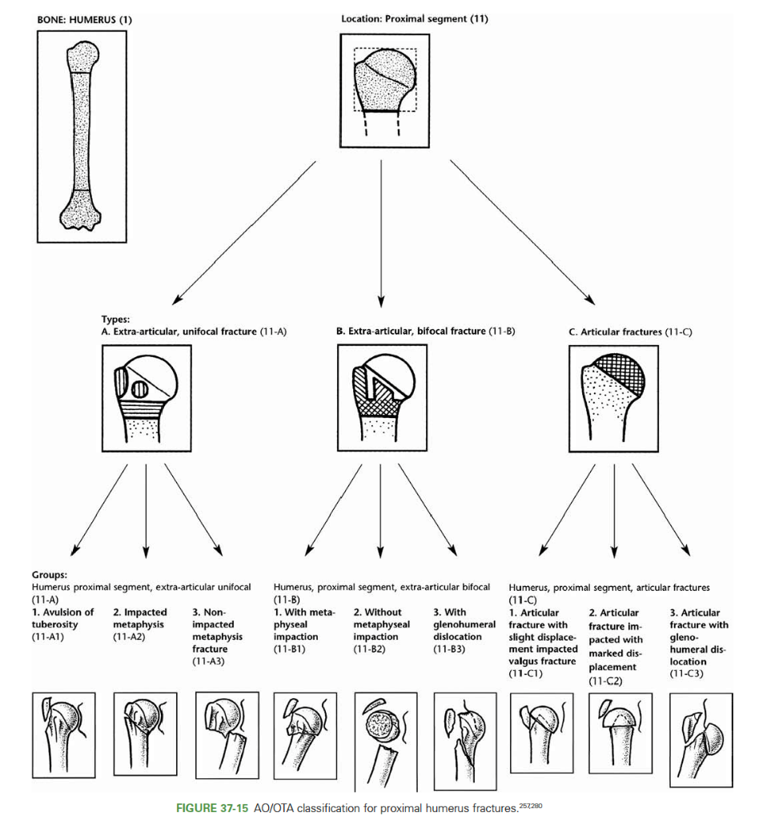
Proximal Humerus Fractures
Defined as fractures occurring at or proximal to the surgical neck
Notes:
Image: Rockwood and Green Fx in Adults
LWW Publications

Slide 5
Epidemiology
Females > Males
Bimodal distribution – young males, older females
Incidence increases with age
  As population ages the incidence of proximal humerus fractures is expected to increase
Highest risk in white females
Osteoporosis related fracture
  3rd most common nonvertebral osteoporotic fracture

Slide 6
Risk Factors
Other risk factors:
  Poor vision, Hearing aids, Diabetes, Depression, Alcohol consumption, Anticonvulsant medications, Maternal history of hip fracture, Personal history of spinal or extremity fracture
Protective Factors:
  Hormonal therapy, Calcium intake

Slide 7
Mechanisms of Injury
Ground level fall
  Vast majority
High energy trauma in younger population
3 Main Loading Modes:
  Compressive – Humeral head impacts at glenoid
  Bending – Angular forces at surgical neck
  Tension – Rotator cuff pulling on greater and less tuberosities
Fall on outstretched hand
  Valgus impacted proximal humerus fracture
Fall directly onto lateral shoulder
  Varus deformity with posterior rotational deformity

Slide 8
Associated Injuries
Majority are isolated low energy injuries
Other MSK injuries:
  Ipsilateral distal radius
  Hip fracture
  Pelvic fracture
  Head injury / Subdural hematoma
  Nerve palsy – Suprascapular, Axillary, Musculocutaneous or Brachial plexus palsy possible
  Vascular injury – Fracture dislocations at risk for axillary artery/vein injury

Slide 9
Clinical Presentation
Shoulder pain worse with motion
Immobility
Ecchymosis
Soft tissue swelling
Open fractures may occur in axilla but are rare
  Usually occur at lateral aspect of axilla as pec major displaces shaft medially

Slide 10
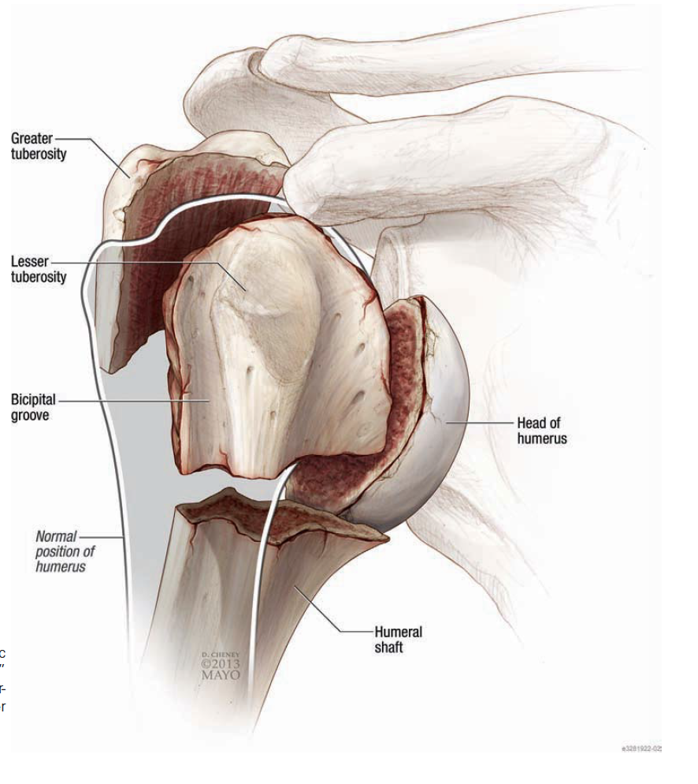
Anatomy/Deforming Forces/Parts
Parts:
  Head
  Greater tuberosity
  Lesser tuberosity
  Shaft
Notes:
Image: Rockwood and Green Fractures in Adults
LWW Publication

Slide 11
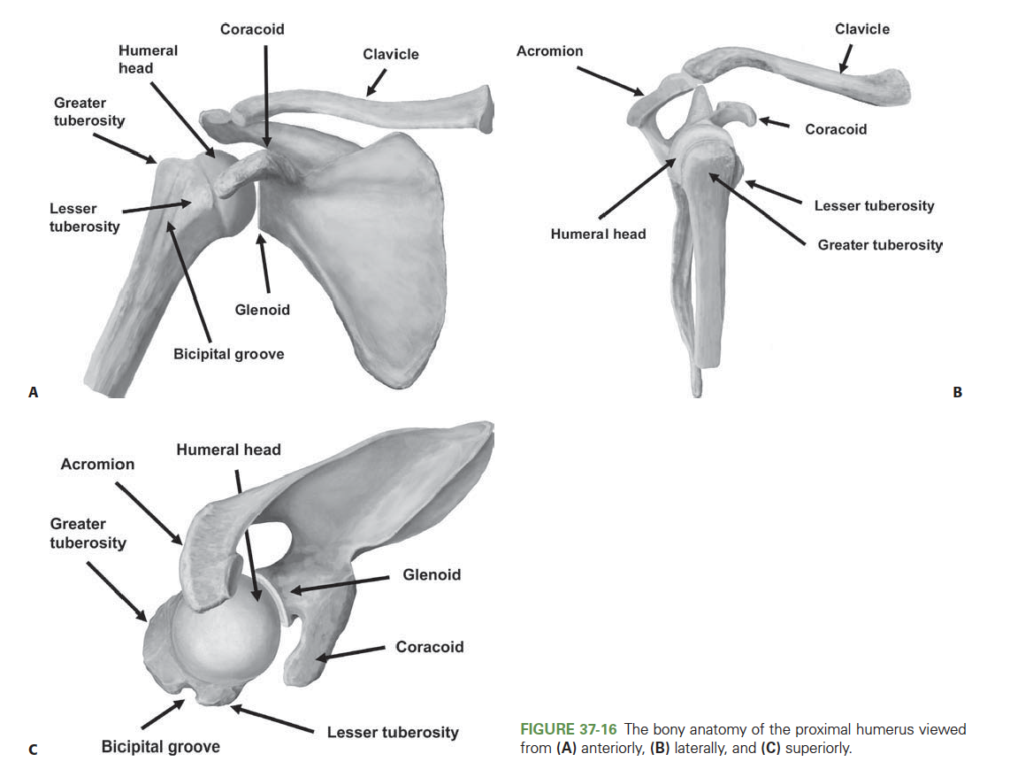
Anatomy/Deforming Forces/Parts
Notes:
Image: Rockwood and Green Fractures in Adults
LWW Publication

Slide 12
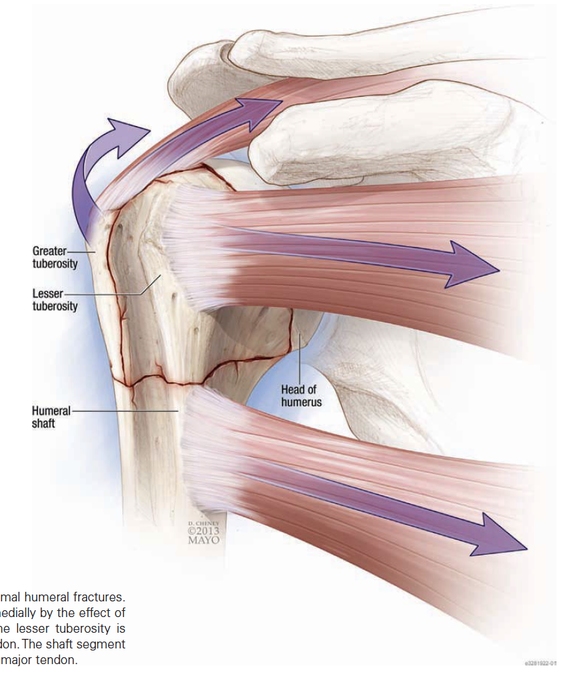
Anatomy/Deforming Forces/Parts
Deforming Forces
  Supraspinatus/Infraspinatus
    Displaces greater tuberosity superiorly and posteriorly
  Subscapularis
    Displaces lesser tuberosity medially
  Pectoralis major
    Displaces humeral shaft medially and anteriorly
  Deltoid
    Displaces humeral shaft proximally
Notes:
Image: Rockwood and Green Fractures in Adults
LWW Publication

Slide 13
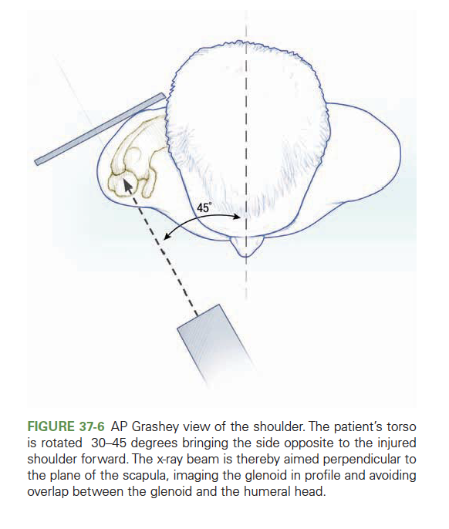
Imaging
Radiographs
  Standard
    Grashey (True AP) view
    Neer (Scapular Y) view
    Axillary lateral view
  Additional
    Velpeau view
    Traction view
Computed Tomography (CT)
Magnetic Resonance Imaging (MRI)
Ultrasound
Notes:
Image: Rockwood and Green Fractures in Adults
LWW Publication

Slide 14
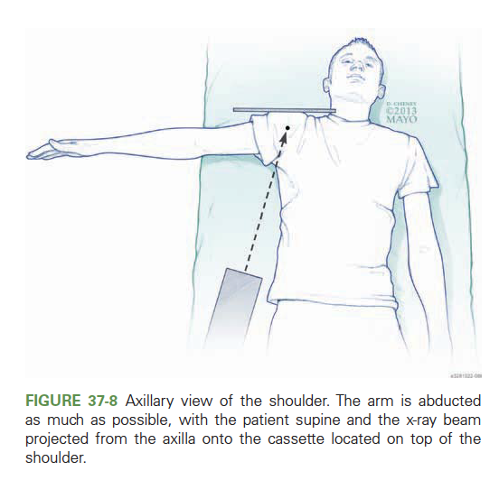
Imaging
Radiographs
Radiographs
  Standard
    Grashey (True AP) view
    Neer (Scapular Y) view
    Axillary lateral view
  Additional
    Velpeau view
    Traction view
Computed Tomography (CT)
Magnetic Resonance Imaging (MRI)
Ultrasound
Notes:
Image: Rockwood and Green Fractures in Adults
LWW Publication

Slide 15
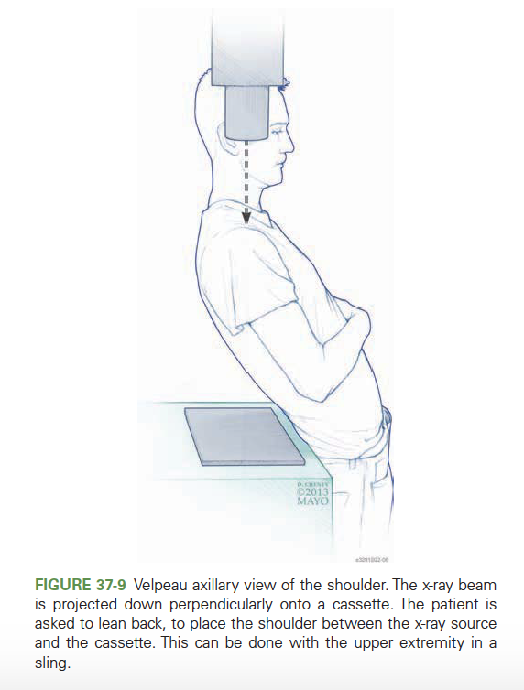
Imaging
Radiographs
Radiographs
  Standard
    Grashey (True AP) view
    Neer (Scapular Y) view
    Axillary lateral view
  Additional
    Velpeau view
    Traction view
Computed Tomography (CT)
Magnetic Resonance Imaging (MRI)
Ultrasound
Notes:
Image: Rockwood and Green Fractures in Adults
LWW Publication

Slide 16
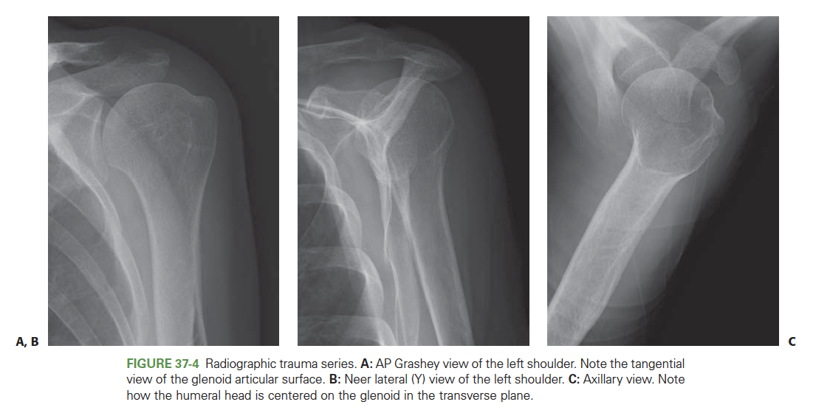
Imaging
Radiographs
Radiographs
  Standard
    Grashey (True AP) view
    Neer (Scapular Y) view
    Axillary lateral view
  Additional
    Velpeau view
    Traction view
Computed Tomography (CT)
Magnetic Resonance Imaging (MRI)
Ultrasound
Notes:
Image: Rockwood and Green Fractures in Adults
LWW Publication

Slide 17
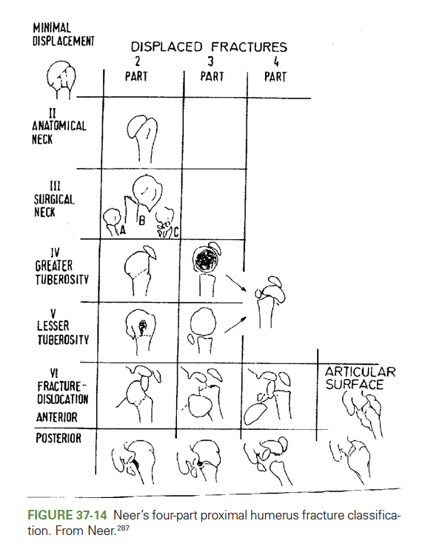
Classification
Neer
  4 Parts
    Head
    Greater Tuberosity
    Lesser Tuberosity
    Shaft
  In the Neer Classification, a part must be:
    Displaced ≥ 1 cm, or
    Angulated ≥45⁰
Greater tuberosity
    More stringent indications – still evolving
    > 5 mm of displacement may cause impingement
    >2-3 mm displacement in an athlete may effect rotator cuff tension
Notes:
Image: Rockwood and Green Fractures in Adults
LWW Publication

Slide 18
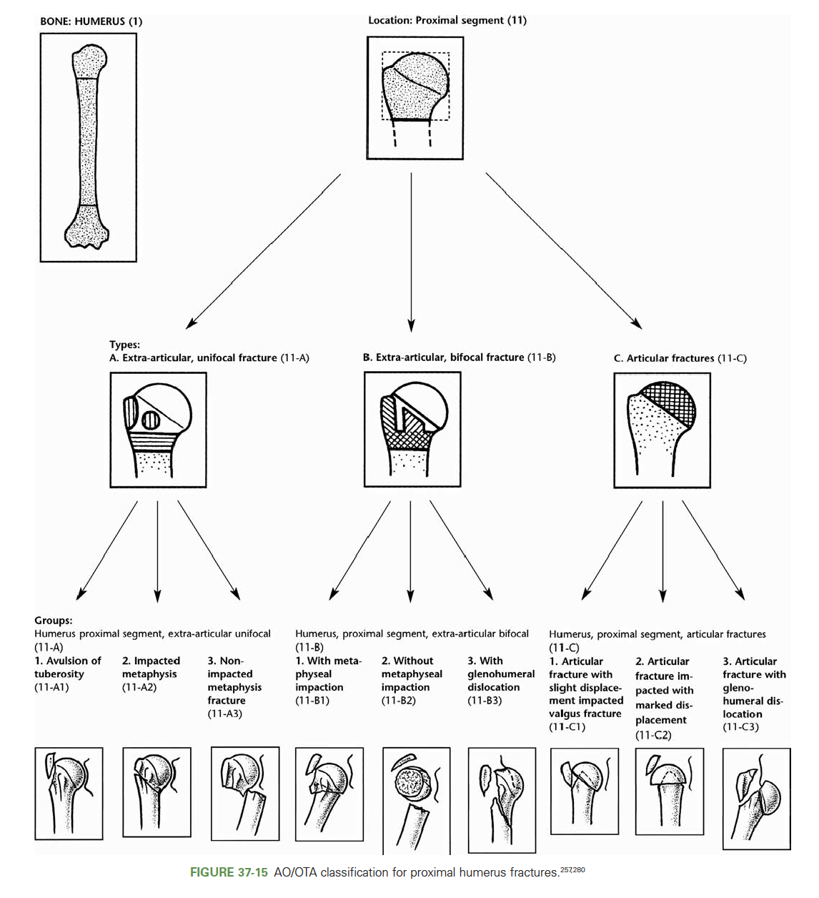
Classification
AO/OTA
  Bone = 1
  Segment = 1
  Pattern
    A = Extraarticular unifocal
    B = Extraarticular bifocal
    C = Intraarticular
Notes:
Image: Rockwood and Green Fractures in Adults
LWW Publication

Slide 19
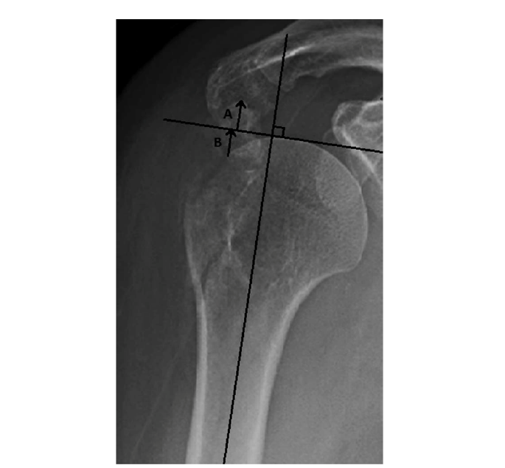
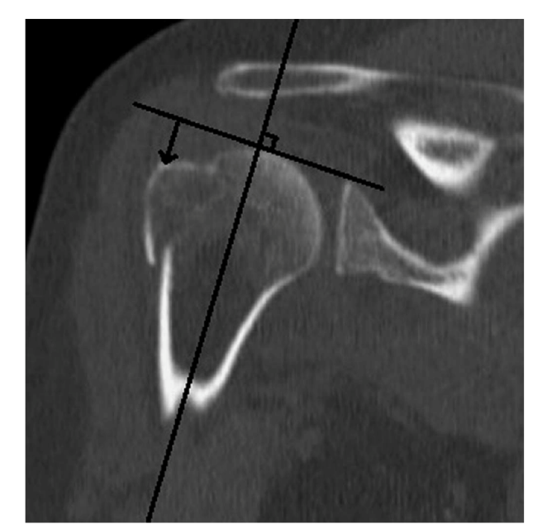
Classification
Greater tuberosity fragment surgical indications have evolved
  <3mm displacement in overhead athletes
  <5mm displacement in healthy adults
Notes:
Images: Mutch JAJ, Rouleau DM, Laflamme, GY, Hagemeister N. Accurate Measurement of Greater Tuberosity Displacement Without Computed Tomorgraphy: Validation of a Method on Plain Radiography to Guide Surgical Treatment. Journal of Orthopaedic Trauma 2014;28:445-451.

Slide 20
Blood Supply to Humeral Head / AVN
Vascular supply to humeral head
  Arcuate artery is the terminal supply to the humeral head from the anterior humeral circumflex artery
    Disrupted with anatomic neck fractures
  Posterior humeral circumflex artery supplies posteromedial metaphysis of humerus
    Less likely to be injured at time of fracture displacement
Predictors of Humeral Head AVN (Hertel’s Criteria)
  Distal metaphyseal extension <8 mm
  Disruption of medial hinge at level of calcar (Medial displacement of shaft)
  Fracture through the anatomic neck

Slide 21
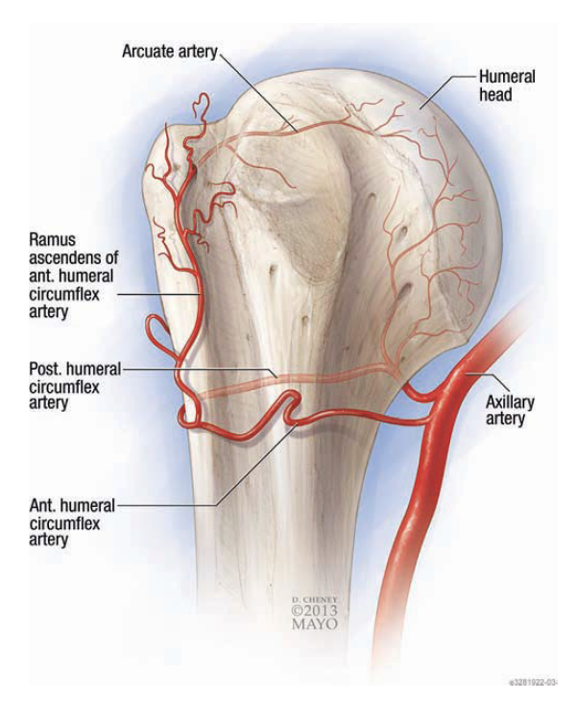
Blood Supply to Humeral Head
Notes:
Image: Rockwood and Green Fractures in Adults
LWW Publication

Slide 22
Hertel’s Criteria
Recently called into question
  Original study used intraoperative doppler flowmetry as well as visual bleeding from drill holes in the humeral head to determine vascular supply
  A lack of return of bleeding from drill holes was associated with AVN
  Campochiaro et al 2015
  Series of patients assessed for AVN after proximal humerus fx
  Hertel’s criteria were less predictive of AVN, whereas poor reduction was highly predictive.

Slide 23
Treatment Options
Nonoperative – majority (80%)
Operative
  Suture fixation
  Arthroscopic assisted repair
  Closed reduction and percutaneous pinning
  Open reduction internal fixation
  Intramedullary nail
  Arthroplasty

Slide 24
Nonoperative Treatment
Indications for nonoperative management:
  Older age
  Lower demand
  Unfit for surgery
  Stable nondisplaced or minimally displaced patterns
  Valgus impacted 2 or 3 part fractures
Sling
Sling and swathe
Sling with abduction pillow
Shoulder immobilizer
Early active-assisted motion including pendulums may prevent stiffness

Slide 25
The PROFHER Randomized Clinical Trial
JAMA 2015
1250 patients with proximal humerus fractures
250 patients met surgical indications and were randomized to operative vs nonoperative treatment
No difference in outcomes at 2 years follow up
  Controversy regarding groups and treatment conversion
    87 had “clear indication for surgery” and were not included in study
    16/125 were randomized to surgery and did not receive surgery
    66 surgeons involved
Regardless, supports nonoperative management in select patients

Slide 26
Treatment Options
Nonoperative
Operative
  Suture fixation
  Arthroscopic assisted repair
  Closed reduction and percutaneous pinning
  Open reduction internal fixation
  Intramedullary nail
  Arthroplasty

Slide 27
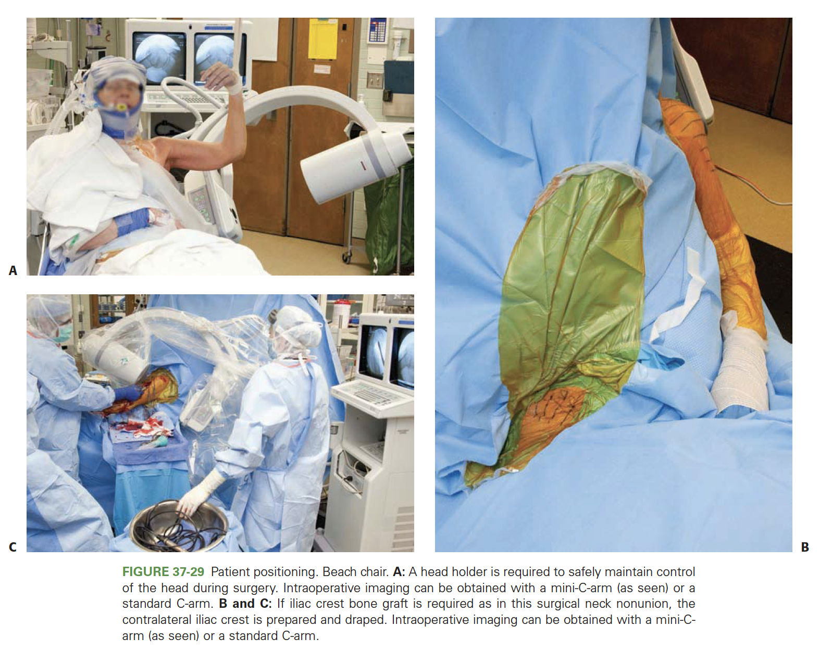
Positioning
Beach chair
Semi-supine
Notes:
Image: Rockwood and Green Fractures in Adults
LWW Publishing

Slide 28
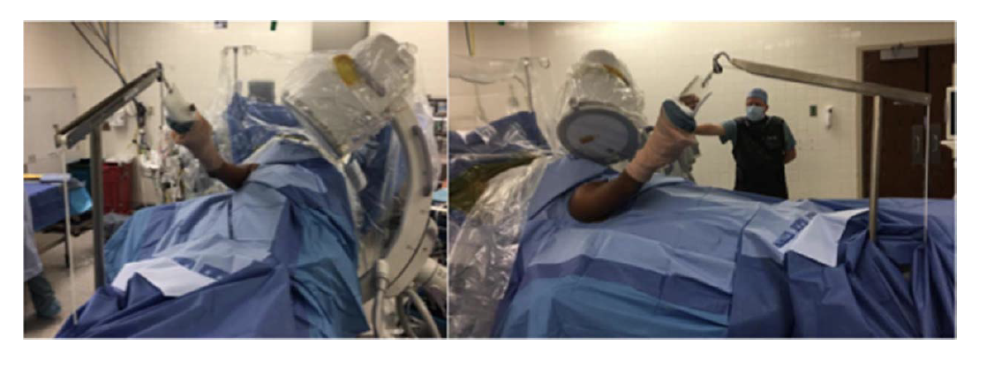
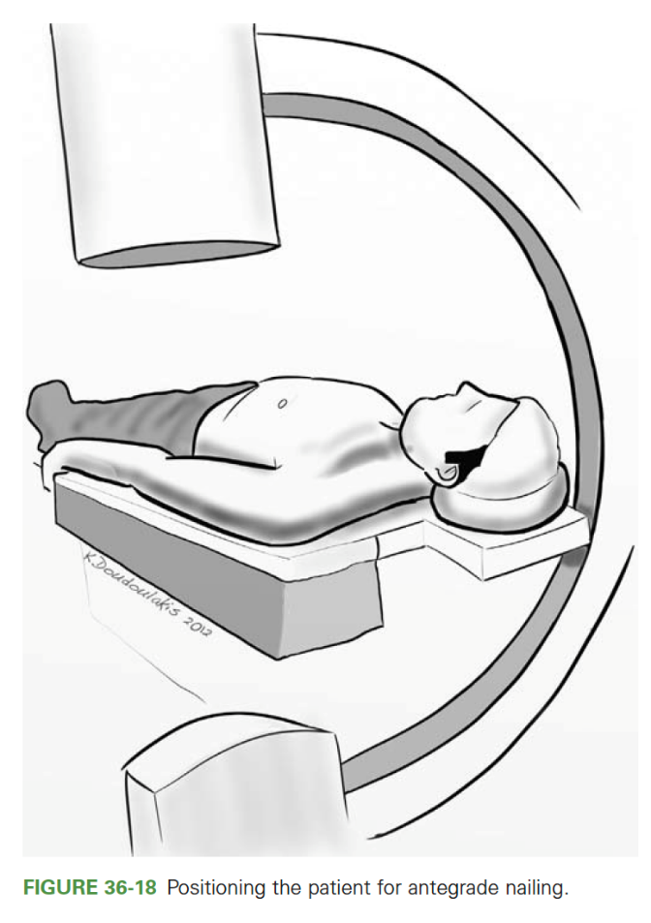
Positioning
Beach chair
  Beware of blood pressure cuff on gravity dependent leg that will give incorrect indication of perfusion elsewhere (i.e. brain)
Semi-supine
Notes:
Image: Top Image: Hightower C, Mobley K, Jones T. Semisupine Positioning for Proximal Humerus ORIF Using Arthroscopic shoulder distractor. JOT 2020;34:e148-e152.
Figure 36 Rockwood and Green Fractures in Adults
LWW Publishing

Slide 29
Approaches
Deltopectoral
  Can visualize the joint for head split fractures with lesser tuberosity peel vs osteotomy
  Extensile
Deltoid Splitting
  Easier plate placement laterally
  Axillary nerve protection (5-7 cm inferior to acromion)
  Less retraction and positioning needed for lateral plate placement
  Can be extensile if you dissect and protect axillary nerve

Slide 30
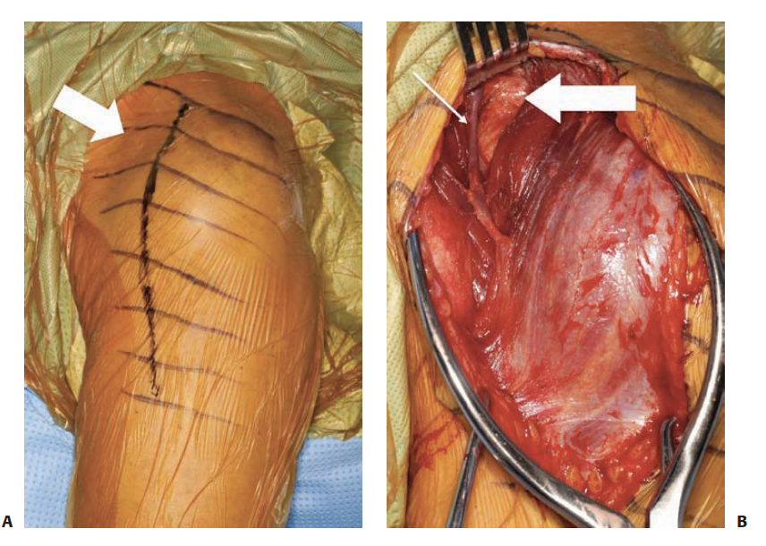
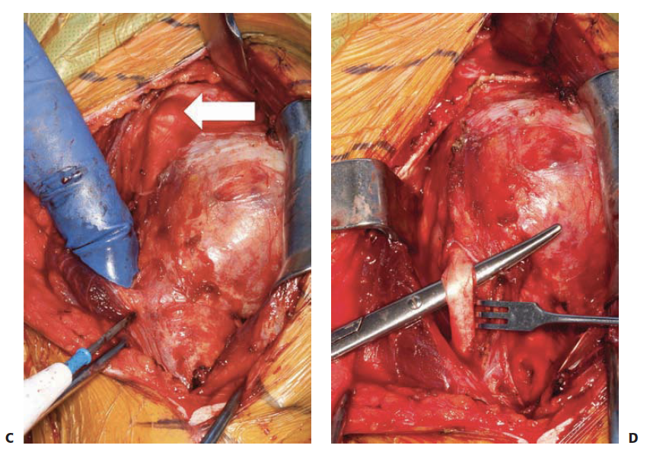
Approaches
Notes:
Images: Rockwood and Green Fractures in Adults
LWW Publishing

Slide 31
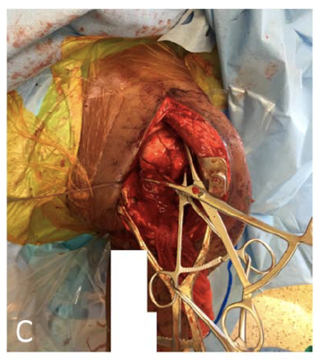
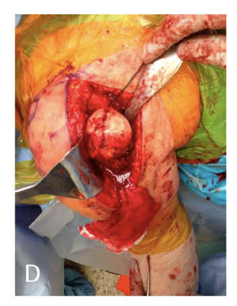
Approaches
Notes:
Image: Cherney SM, Murphy RA, Achor TS, Choo AM. Subscapularis Peel for Open Reduction and Internal Fixation of Proximal Humerus Fractures with a Head Split. JOT 2018; 32;12:E487-91.

Slide 32
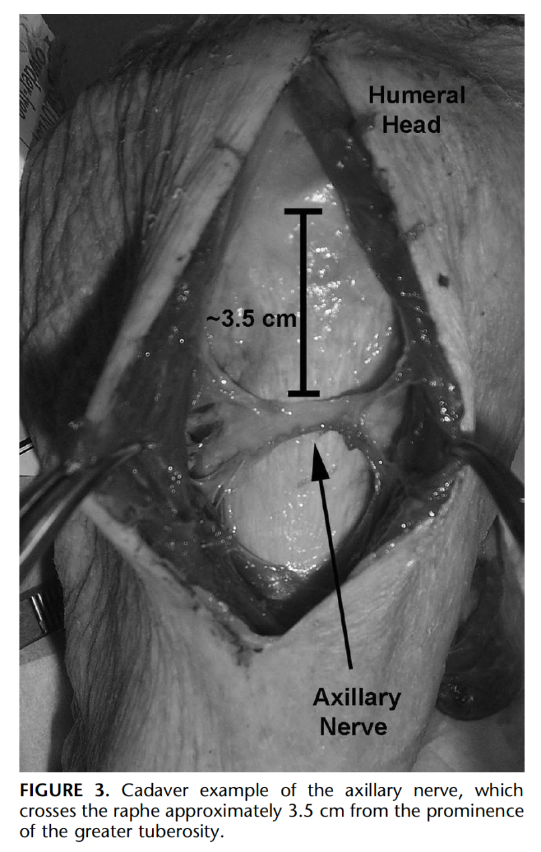
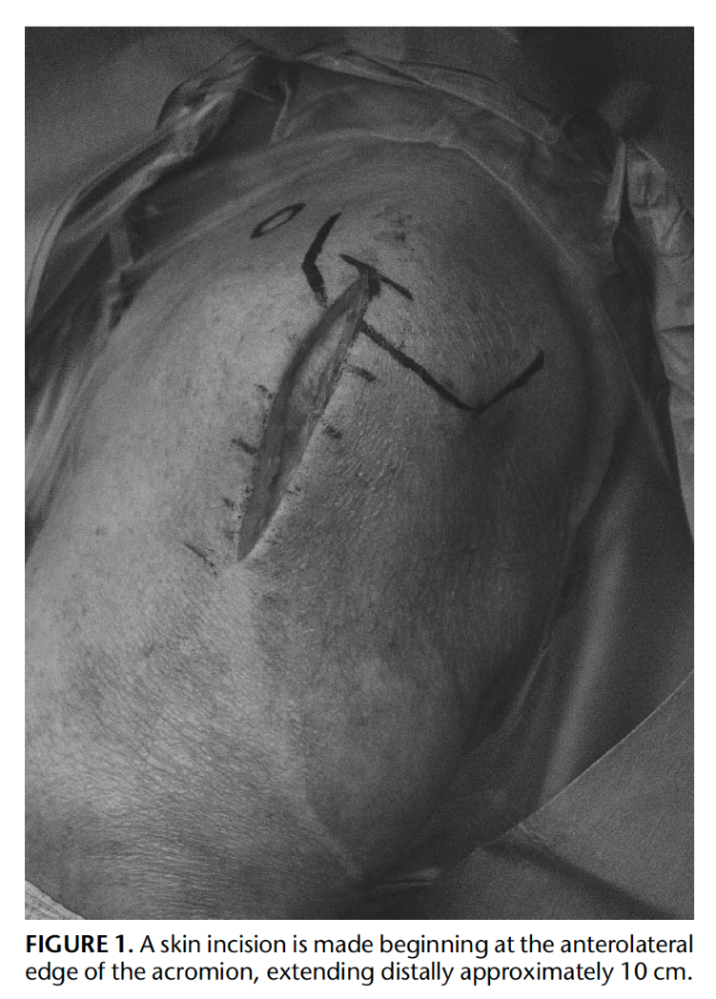
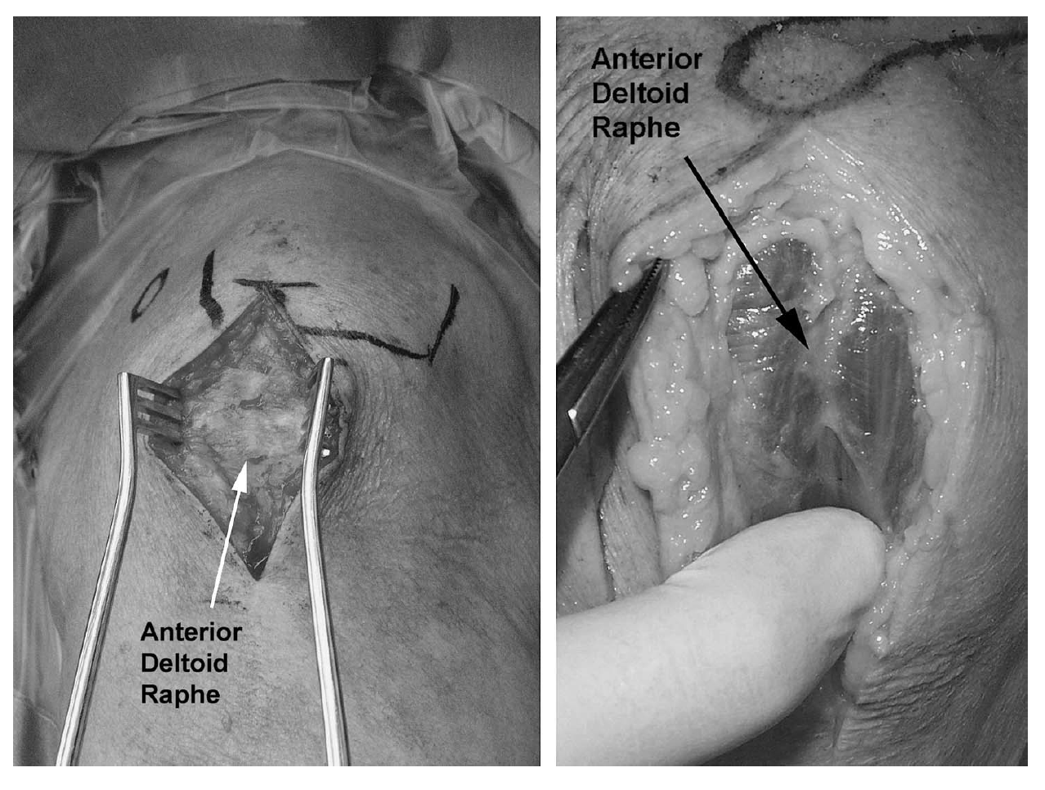
Approaches
Notes:
Images: Gardner MJ, Boraiah S, Helfet DL, Lorich DG. The Anterolateral Acromial Approach for Fractures of the Proximal Humerus. JOT 2008;22:132-137.

Slide 33
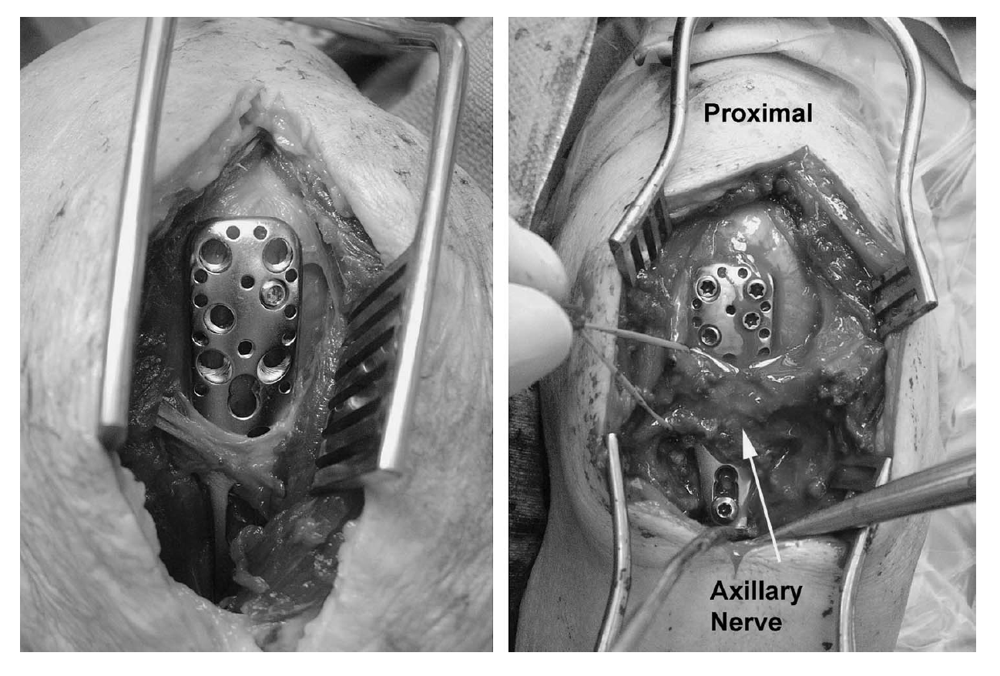
Approaches
Notes:
Images: Gardner MJ, Boraiah S, Helfet DL, Lorich DG. The Anterolateral Acromial Approach for Fractures of the Proximal Humerus. JOT 2008;22:132-137.

Slide 34
Reduction Techniques
Closed reduction usually accomplished with arm abducted and externally rotated
  Match the location of the proximal fragment with the distal segment
If adequate reduction can be obtained by closed means, percutaneous fixation can follow with K wires, percutaneous screws, or retrograde intramedullary nails

Slide 35
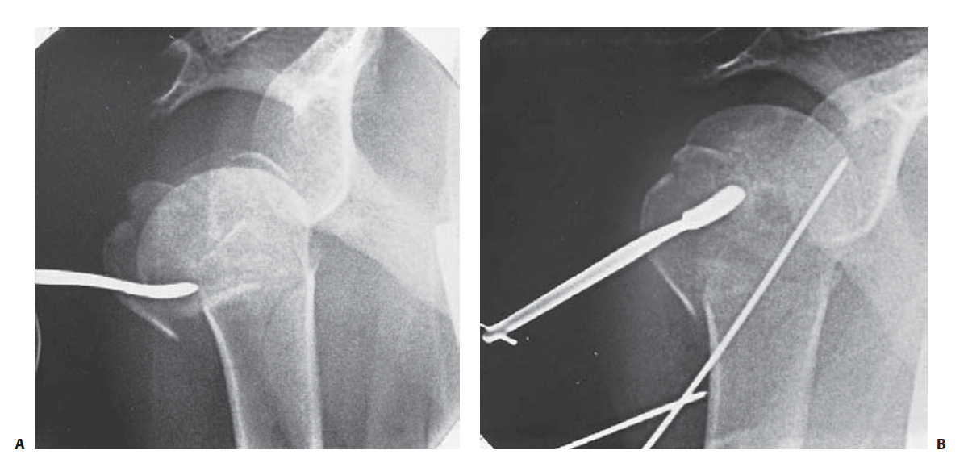
Reduction Techniques
Work through greater tuberosity fracture line to manipulate head fragment
  K-wire joysticks
  Elevator as broad surface to manipulate head fragment
  K-wire provisional fixation to shaft fragment
Notes:
Images: Rockwood and Green Fractures in Adults
LWW Publishing

Slide 36
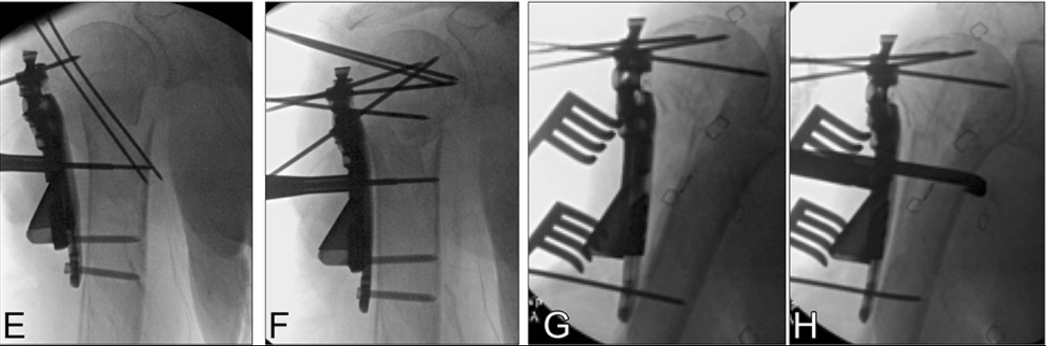
Reduction Techniques
Reduce the medial hinge with the head fragment in valgus
  Common deformity
Apply lateral plate to translate greater tuberosity fragment and improve valgus reduction
Notes:
Intramedullary Cage Fixation for Proximal Humerus Fractures Has Low Reoperation Rates at 1 Year: Results of a Multicenter Study
Journal of Orthopaedic Trauma34(4):193-198, April 2020.

Slide 37
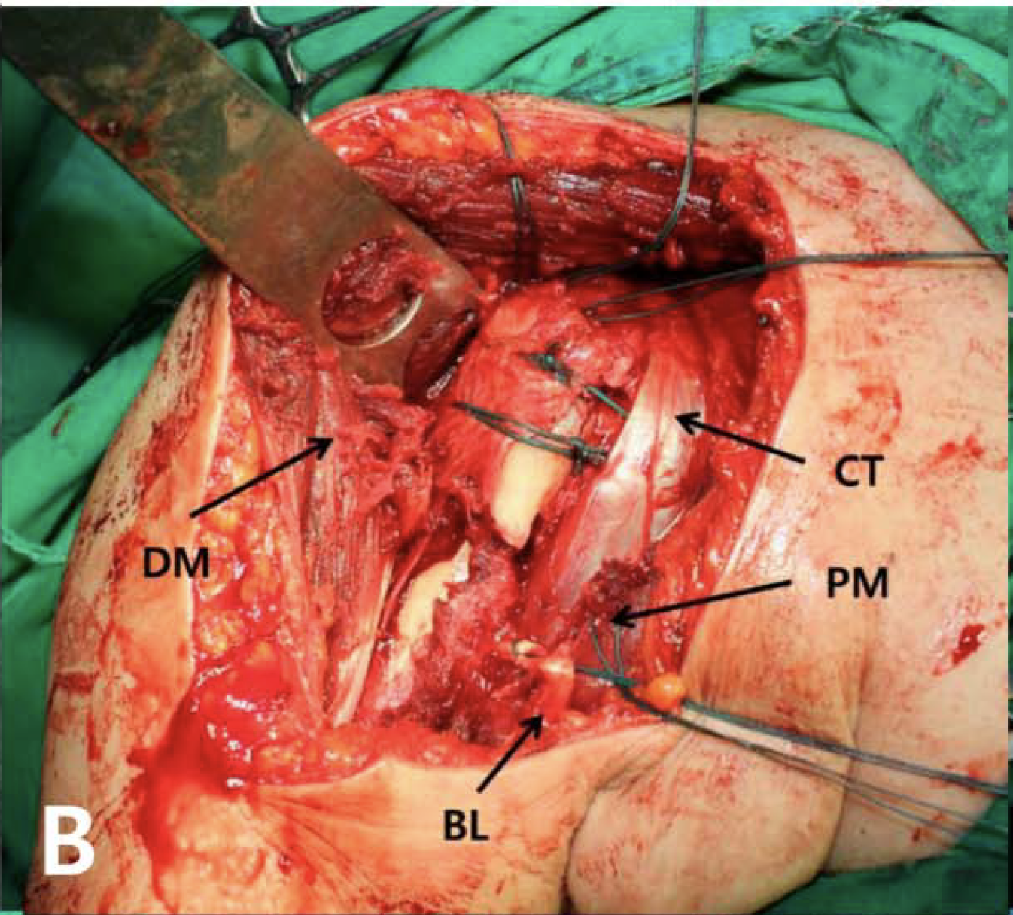
Reduction Techniques
Sutures in rotator cuff insertions can be helpful to manipulate greater and lesser tuberosity fracture fragments
Sutures can be incorporated into plate and may supplement fixation
Unstable head fragment can be pinned to glenoid with K wires to provide provisional stability
Notes:
Image:
Park S, Ko, Y. Medial Buttress Plating for Humerus Fractures With Unstable Medial Column. Journal of Orthopaedic Trauma 2019;33:e352-359.

Slide 38
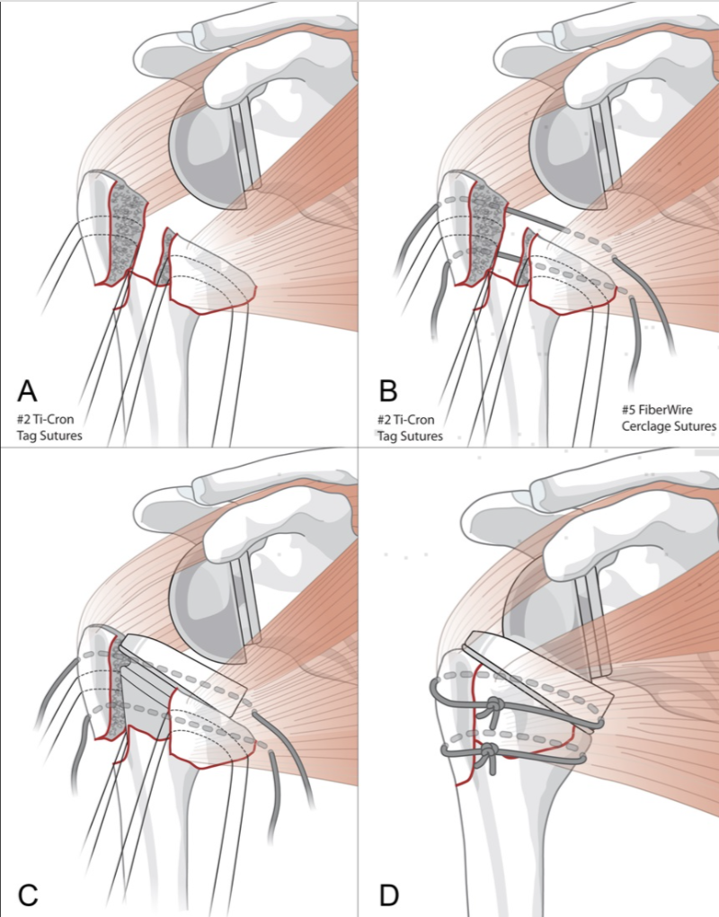
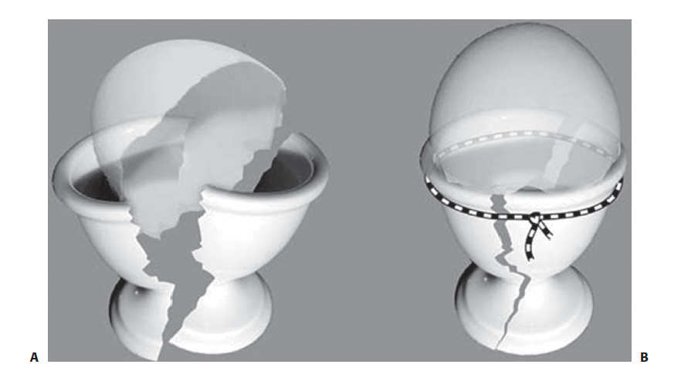
Notes:
Images:
Left image: Wright JO, Ho A, Kalma J, Koueiter D, Esterle J, Marcantonio D, Wiater JM, Wiater B. Uncemented Reverse Total Shoulder Arthroplasty as Initial Treatment for Comminuted Proximal Humerus Fractures. JOT 2019;33;7:e263-9.
Hertel Egg Shell - Rockwood and Green Fractures in Adults
LWW Publication

Slide 39
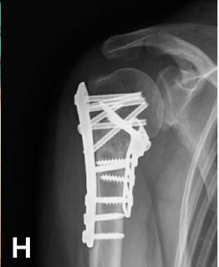
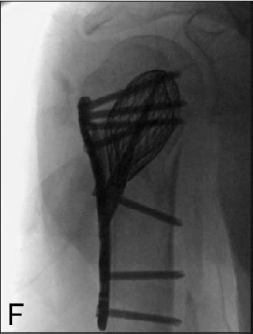
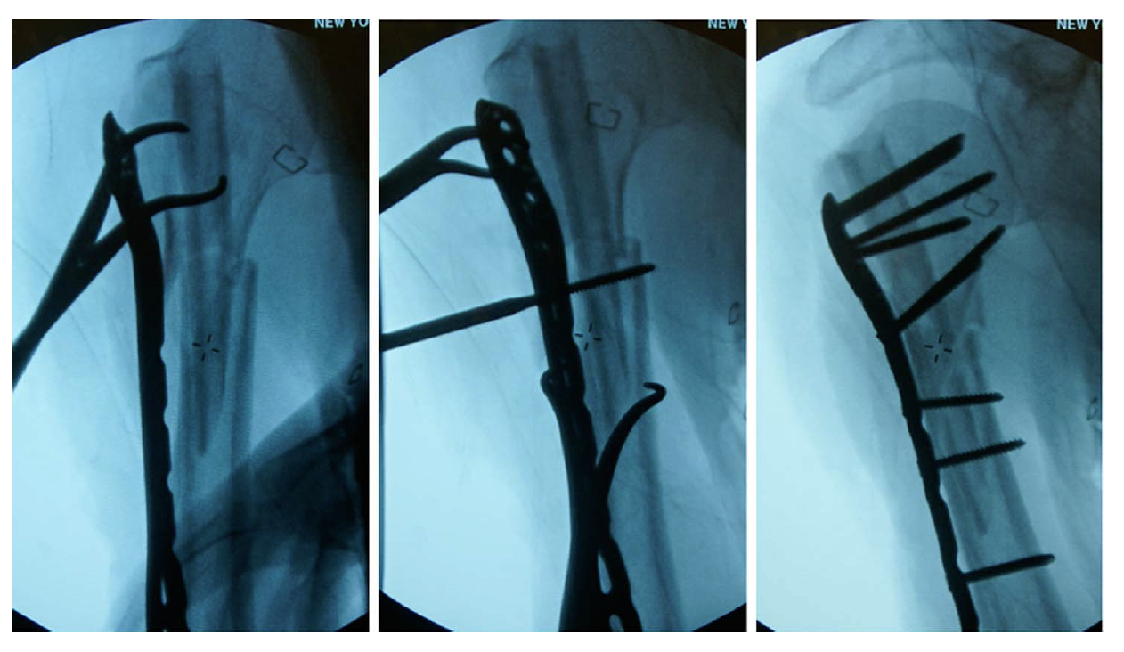
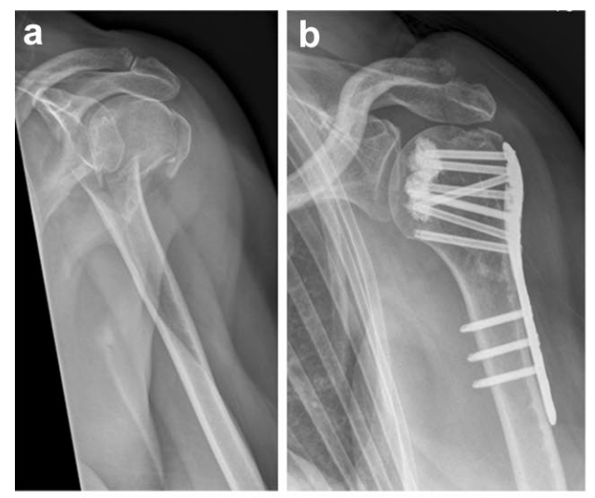
Augments to ORIF
Medial buttress plate
Rotator cuff sutures
Intramedullary fibula allograft
Titanium mesh cage
PMMA/Calcium Phosphate
Notes:
Images:
H: Park S, Ko, Y. Medial Buttress Plating for Humerus Fractures With Unstable Medial Column. Journal of Orthopaedic Trauma 2019;33:e352-359.
F: Goodnough, LH et al. Intramedullary Cage Fixation for Proximal Humerus Fractures Has Low Reoperation Rates at 1 Year: Results of a Multicenter Study. Journal of Orthopaedic Trauma 2020;34:193-198.
Berkes MB et al. Intramedullary Allograft Fibula as a Reduction and Fixation Tool for Treatment of Complex Proximal Humerus Fractures with Diaphyseal Extension. JOT 2014;28:e56-e64.
AB: Knierzinger D, Crepaz-Eger U, Hengg C, Kralinger F. Does cement augmentation of the screws in angular stable plating for proximal humerus fractures influence the radiological outcome: a retrospective assessment. Archives of Orthopaedic and Trauma Surgery 2020; 140:1413-1421.

Slide 40
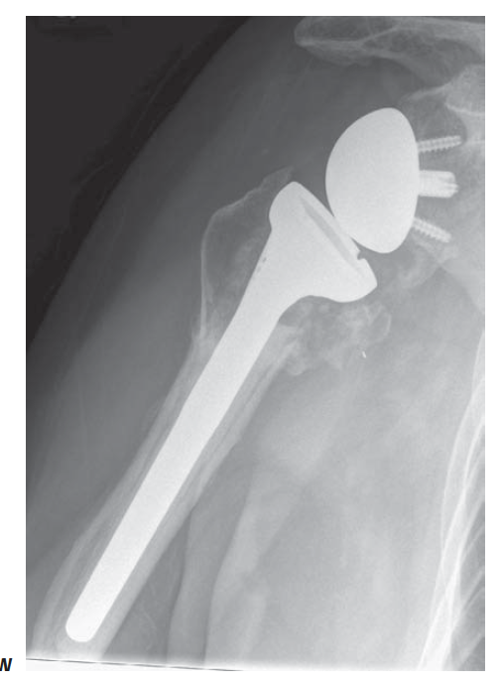
Arthroplasty
May be preferable in some patients for immediate motion and in presence of poor bone quality
Reverse total shoulder arthroplasty outcomes are less dependent on tuberosity healing/reduction and have lower reoperation rate
Notes:
Images:
Rockwood and Green Fractures in Adults
LWW Publication

Slide 41
Decision Making
Age, functional status, bone quality, and fracture pattern can all be used to guide surgical decision making and implant selection
Younger patients with good bone quality and a viable humeral head are ideally treated with ORIF
Older frail patients with lower functional requirements are ideally treated with arthroplasty

Slide 42
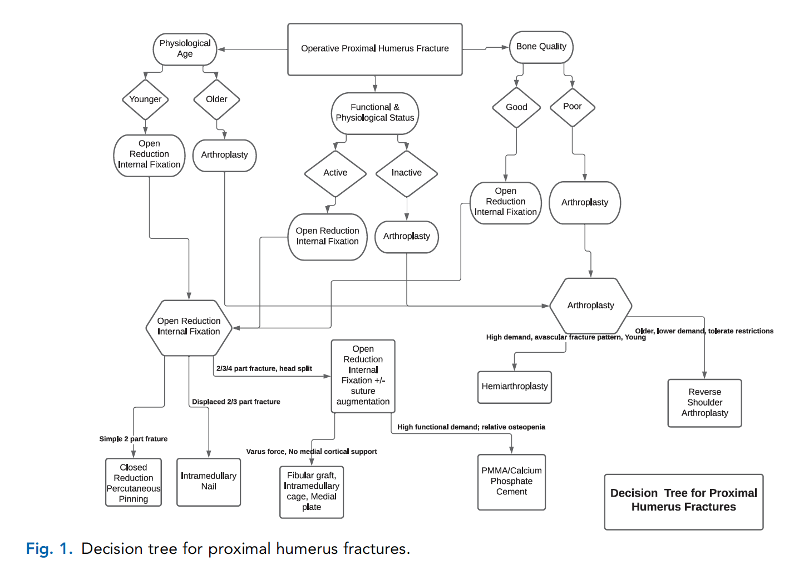
Notes:
Adeyamo A, Bertha N, Perry KJ, Updegrove G. Implant Selection for Proximal Humerus Fractures. Orthop Clinics 2021;52:167-175.
Image produced by author and published elsewhere. Should have rights to reproduce as it is my own work.

Slide 43
Complications
AVN
Impingement
Screw cut out
Loss of reduction
  Medial support, calcar screw placement
  Combined cortical thickness
  Deltoid tuberosity index
Nonunion
  Risk factors: Smoking, Alcohol abuse, Osteoporosis, Inflammatory arthropathy
Malunion
  Tuberosity malunion can cause symptoms of rotator cuff weakness or impingement
Stiffness
Infection

Slide 44
Complications
Impingement
  Avoid with ideal plate placement just lateral to bicipital groove and 5-8 mm distal to greater tuberosity
  Tx: Hardware removal after union if symptomatic
Screw cut out
  Avoid screws in superior head
  Advance screws to subchondral bone without penetrating articular surface for ideal purchase
  Pre-op CT thickness of central humeral head is predictive of screw cut out
    > 25 mm thickness is protective, <15 mm thickness predictive of screw cut out
  Tx: May remove prominent screws without removal of all hardware if fracture unites in acceptable position
Notes:
Stern L, Gorczyca MT, Gorczyca JT. Preoperative measurement of the thickness of the center of the humeral head predicts screw cutout after locked plating of proximal humerus fractures. JSES 2021;30:80-88.

Slide 45
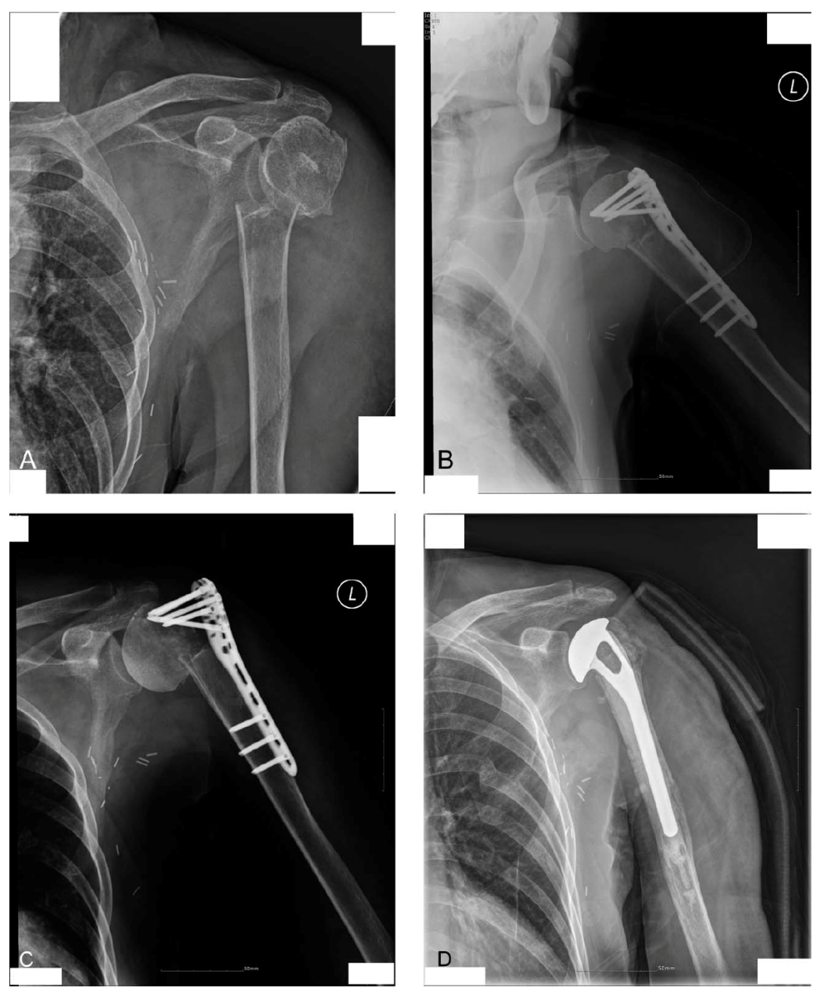
Complications
Risk factors for loss of reduction
  Older age
  Osteoporosis
  Varus displacement
  Medial comminution
  Inadequate reduction
  Insufficient medial support
Notes:
Images: Jung SW et al. Factors that Influence Reduction Loss in Proximal Humerus Fracture Surgery. JOT 2015;29:276-282.

Slide 46
Complications
Malunion
  Not all malunions are symptomatic
  Tuberosity malunion may cause rotator cuff dysfunction
  Symptomatic malunions are often salvaged with arthroplasty
Nonunion
  Tx: Repair of nonunion vs arthroplasty
AVN
  Minor humeral head collapse is often tolerated with minimal symptoms
  Symptomatic AVN often salvaged with arthroplasty

Slide 47
More Resources:
OTA Videos
  OTA Techniques and Procedures: Proximal Humerus
OTA Online Education Resources
  OTA Online Education

Slide 48
References
Reuther F, Peterman M, Stangl R. Reverse Shoulder Arthroplasty in Acute Fractures of the Proximal Humerus: Does Tuberosity Healing Improve Clinical Outcomes? J Orthop Trauma 2019;33:e46-e51.
Mutch JAJ, Rouleau DM, Laflamme G, Hagemeister N. Accurate Measurement of Greater Tuberosity Displacement Without Computed Tomography: Validation of a Method on Plain Radiography to Guide Surgical Treatment. J Orthop Trauma 2014;28:445-451.
Reid JS. Fractures of the proximal humerus. Current Opinion in Orthopaedics 2003;14:269-280.
Gupta AK, Harris JD, Erickson BJ, Abrams GD, Bruce B, McCormick F, Nicholson GP, Romeo AA. Surgical Management of Complex Proximal Humerus Fractures – A Systematic Review of 92 Studies Including 4500 Patients. J Orthop Trauma 2015;29:54-59.
Iyengar JJ, Devcic BS, Sproud RC, Feeley BT. Nonoperative Treatment of Proximal Humerus Fractures: A Systematic Review. J Orthop Trauma 2011;25:612-617.
Merendez ME, Ring D. A Comparison of the Charlson and Elixhauser Comorbidity Measures to Predict Inpatient Mortality After Proximal Humerus Fracture. J Orthop Trauma 2015;29:488-493.
Wu C, Ma C, Yeh J, Yen C, Yu S, Tu Y. Locked Plating for Proximal Humerus Fractures: Differences Between the Deltopectoral and Deltoid Splitting Approaches. J Trauma 2011;71:1364-1370.
Court-Brown, CM, McQueen MM. Nonunions of the Proximal Humerus: Their Prevalence and Functional Outcome. J Trauma 2008;64:1517-1521.
Lescheid J, Zdero R, Shah S, Kuzyk PR, Schemitsch EH. The Biomechanics of Locked Plating for Repairing Proximal Humerus Fractures With or Without Medical Cortical Support. J Trauma 2020;69:1235-1242.
Goodnough LH, Campbell ST, Githens TC, DeBaun MR, Bishop JA, Gardner MJ. Intramedullary Cage Fixation for Proximal Humerus Fractures Has Low Reoperation Rates at 1 Year: Results of a Multicenter Study. J Orthop Trauma;2020:193-198.
Shah KN, Sobel AD, Paxton S. Fixation of a Proximal Humerus Fracture Using a Polyaxial Locking Plate and Endosteal Fibular Strut. J Orthop Trauma 2018;32:S8-S9.
Gardner MJ. Proximal Humerus Fracture Plating Through the Extended Anterolateral Approach. J Orthop Trauma 2016;30:S11-12.

Slide 49
References
Cherney SM, Murphy RA, Achor TS, Choo AM. Subscapularis Peel for Open Reduction and Internal Fixation of Proximal Humerus Fractures With a Head Split. J Orthop Trauma 2018;2018;32:e487-e491.
Park S, Ko Y. Medial Buttress Plating for Humerus Fractures With Unstable Medial Column. J Orthop Trauma 2019;33:e352-359.
Walker R, Casteneda P, Putnam JG, Schemitsch EH, McKee MD. A Biomechanical Study of Tuberosity-Based Locked Plate Fixation Compared with Standard Proximal Humeral Locking Plate Fixation for 3-Part Proximal Humeral Fractures. J Orthop Trauma 2020;34:e233-e238.
Belayneh R, Lott A, Haglin J, Konda S, Zuckerman JD, Egol KA. Osteonecrosis After Surgically Repaired Proximal Humerus Fractures Is a Predictor of Poor Outcomes. J Orthop Trauma 2018;32:e387-e393.
McDonald E, Kwiat D, Kandemir U. Geometry of Proximal Humerus Locking Plates. J Orthop Trauma 2015;29:e425-e430.
Donohue DM, Santoni BG, Stoops K, Tanner G, Diaz MA, Mighell M. Biomechanical Comparison of 3 Inferiorly Directed Versus 3 Superiorly Directed Locking Screws on Stability in a 3-Part Proximal Humerus Fracture Model. J Orthop Trauma 2018;32:306-312.
Arvesen JE, Gill SW, Sinatra PM, Eng M, Bledsoe G, Kaar SG. Biomechanical Contribution of Tension-Reducing Rotator Cuff Sutures in 3-Part Proximal Humerus Fractures. J Orthop Trauma 2016;30:e262-266.
Traver JL, Guzman MA, Cannada LK, Kaar SG. In the Axillary Nerve at Risk During a Deltoid-Splitting Approach for Proximal Humerus Fractures? J Orthop Trauma 2016;30:240-244.
Nowak LL, Davis AM, Mamdani M, Beaton D, Kennedy C, Schemitsch EH. A Systematic Reivew and Standardized Comparison of Available Evidence for Outcome Measures Used to Evaluate Proximal Humerus Fracture Patients. J Orthop Trauma 2019;33:e256-e262.
Gardner MJ, Weil Y, Barker JU, Kelly BT, Helfet DL, Lorich DG. The Importance of Medial Support in Locked Plating of Proximal Humerus Fractures. J Orthop Trauma 2007;21:185-191.
Jung S, Shim S, Kim H, Lee J, Lim H. Factors that Influence Reduction Loss in Proximal Humerus Fracture Surgery. J Orthop Trauma 2015;29:276-282.
Davids S, Allen D, Desarno M, Endres NK, Bartlett C, Shafritz A. Comparison of Locked Plating of Varus Displaced Proximal Humeral Fractures With and Without Fibula Allograft Augmentation. J Orthop Trauma 2020;34:186-192.

Slide 50
References
Carofino BC, Leopold SS. The Neer Classification for Proximal Humerus Fractures. Clin Orthop Relat Res 2013;471:39-43.
Wallace MJ, Bledsoe G, Moed BR, Israel HA, Kaar SG. Relationship of Cortical Thickness of the Proximal Humerus and Pullout Strength of a Locked Plate and Screw Construct. J Orthop Trauma 2012;26:222-225.
Berkes MB, Little MTM, Lazaro LE, Cymerman RM, Pardee NC, Helfet DL, Dines JS, Lorich DG. Intramedullary Allograft Fibula as a Reduction and Fixation Tool for Treatment of Complex Proximal Humerus Fractures with Diaphyseal Extension. J Orthop Trauma 2014;28:e56-e64.
Mehta S, Chin M, Sanville J, Namdaria S, Hast MW. Calcar screw position in proximal humerus fracture fixation: Don’t miss high! Injury 2018:624-629.
Campochiaro G, Rebuzzi M, Baudi P, Catani F. Complex proximal humerus fractures: Hertel’s criteria reliability to predict head necrosis. Musculoskelet Surg 2015;99:S9-S15.
Dillon MT, Prentice HA, Burfeind WE, Chan PH, Navarro RA. The increasing role of reverse total shoulder arthroplasty in the treatment of proximal humerus fractures. Injury 2019:676-680.
Rouleau DM, Mutch J, Laflamme G. Surgical Treatment of Displaced Greater Tuberosity Fractures of the Humerus. J Am Acad Orthop Surg 2016;24:46-56.
Vallier HA. Treatment of Proximal Humerus Fractures. J Orthop Trauma 2007;21:469-476.
Sobel AD, Shah KN, Paxton ES. Fixation of a Proximal Humerus Fracture With an Intramedullary Nail. J Orthop Trauma 2017;31:S47-S49.
Spross C, Meester J, Mazzucchelli RA, Puskas GJ, Zdravkovic V, Jost B. Evidence-based algorithm to treat patients with proximal humerus fractures – a prospective study with early clinical and overall performance results. J Shoulder Elbow Surg 2019;28:1022-1032.

Slide 51
References
Court-Brown CM, Heckman JD, McQueen MM, Ricci WM, Tornetta P. Rockwood and Green’s Fractures in Adults. 2015. Wolters Kluwer Health.
Konrad G et al. Open Reduction and Internal Fixation of Proximal Humerus Fractures with Use of the Locking Proximal Humerus Plate: Surgical Technique. JBJS 2010;92:85-95.
Gardner MJ, Henley MB. Harborview Illustrated Tips and Tricks in Fracture Surgery. Wolters Kluwer 2011.
Jost B, Spross C, Grehn H, Gerber C. Locking plate fixation of fractures of the proximal humerus: analysis of complications, revision strategies and outcome. JSES 2013; 22:542-549.
Stern L, Gorczyca MT, Gorczyca JT. Preoperative measurement of the thickness of the center of the humeral head predicts screw cutout after locked plating of proximal humerus fractures. JSES 2021;30:80-88.
Jost B, Spross C, Grehn H, Gerber C. Locking plate fixation of fractures of the proximal humerus: analysis of complications, revision strategies and outcome. JSES 2013; 22:542-549.
Knierzinger D, Crepaz-Eger U, Hengg C, Kralinger F. Does cement augmentation of the screws in angular stable plating for proximal humerus fractures influence the radiological outcome: a retrospective assessment. Archives of Orthopaedic and Trauma Surgery 2020; 140:1413-1421.
Wright JO, Ho A, Kalma J, Koueiter D, Esterle J, Marcantonio D, Wiater JM, Wiater B. Uncemented Reverse Total Shoulder Arthroplasty as Initial Treatment for Comminuted Proximal Humerus Fractures. JOT 2019;33;7:e263-9.
Adeyamo A, Bertha N, Perry KJ, Updegrove G. Implant Selection for Proximal Humerus Fractures. Orthop Clinics 2021;52:167-175.

