Slide 1
Humeral Shaft Fractures
Christopher B Sugalski, MD
Orthopaedic Trauma Surgery
Ochsner Medical Center
New Orleans, LA

Slide 2
Disclaimer:
Figures used with permission. Christos Garnavos. Humeral Shaft Fractures. In: Tornetta P, Ricci WM, eds. Rockwood and Green's Fractures in Adults, 9e. Philadelphia, PA. Wolters Kluwer Health, Inc; 2019

Slide 3
Objectives
Understand the anatomy and surgical approaches to the humeral shaft
Understand the indications for nonoperative vs operative management of humeral shaft fractures
Understand the use of functional bracing in humeral shaft fractures
Understand the literature comparing ORIF vs IMN
Understand the literature on MIPO technique for humeral shaft fractures
Develop a strategy for treating extraarticular distal 3rd humerus fractures
Develop a treatment algorithm for management of radial nerve palsy in the setting of humeral shaft fractures

Slide 4
Epidemiology and Classification

Slide 5
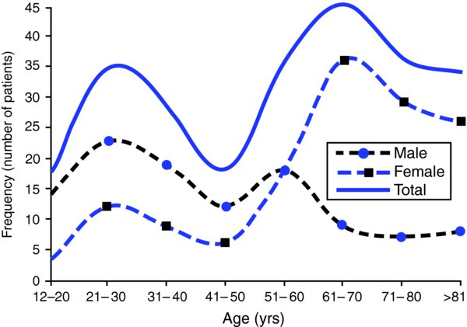
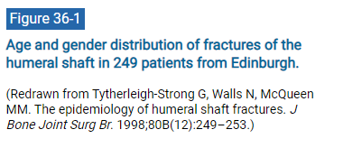
From: 36 Humeral Shaft Fractures
Rockwood and Green's Fractures in Adults, 9e, 2019

Slide 6
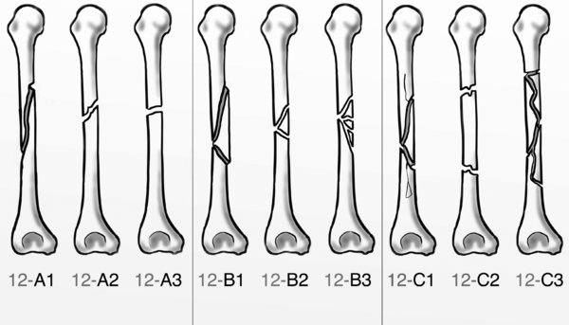
AO/OTA classification of diaphyseal humeral fractures.

Slide 7
Anatomy

Slide 8
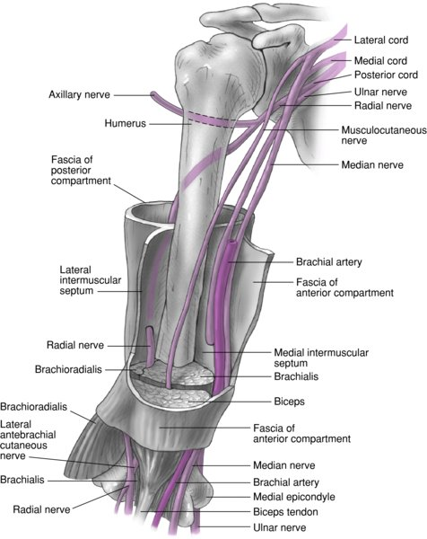
From: 36 Humeral Shaft Fractures
Rockwood and Green's Fractures in Adults, 9e, 2019
Humeral diaphysis extends from the superior border of the insertion of the pectoralis major proximally to the supracondylar ridge distally
Medullary canal ends proximal to olecranon fossa
Radial nerve travels from medial to lateral and is directly posterior to shaft at mid diaphysis
Radial nerve is tethered to, and often in direct contact with, the lateral shaft distally.
Fracture alignment is determined by the location of the fracture relative to the major muscle attachments, most notably the pectoralis major and deltoid attachments

Slide 9
Deforming Forces
Example of a fracture distal to pectoralis major attachment and proximal to deltoid tuberosity
This results in adduction of the proximal fragment
Reproduced with permission from Epps H Jr., Grant RE: “Fractures of the shaft of the humerus” in Rockwood CA Jr., Green DP, Bucholz RW (Eds.) Rockwood and Green’s Fractures in Adults Ed 3, Philadelphia, PA JB Lippincott, 1991, Vol. 1, pp: 843-869

Slide 10
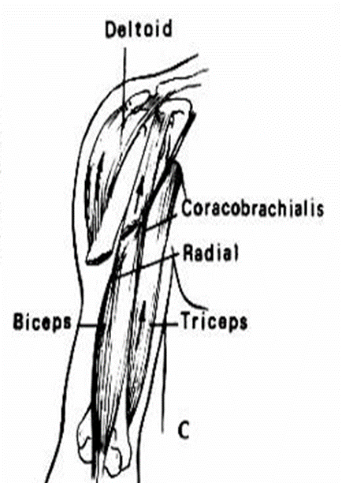
Deforming Forces
Example of a fracture distal to deltoid tuberosity
The proximal fragment is abducted and shortening occurs at fracture site due to pull of biceps and triceps
Reproduced with permission from Epps H Jr., Grant RE: “Fractures of the shaft of the humerus” in Rockwood CA Jr., Green DP, Bucholz RW (Eds.) Rockwood and Green’s Fractures in Adults Ed 3, Philadelphia, PA JB Lippincott, 1991, Vol. 1, pp: 843-869

Slide 11
Applied Surgical Anatomy of the Humerus
Zlotolow et al, JAAOS, 2006
Axillary nerve
3-7 cm distal to acromion
Radial nerve
16-20cm proximal to medial epicondyle
10-14cm proximal to lateral epicondyle

Slide 12
Surgical Approaches
Anterolateral Posterior Lateral Medial
IMN
MIPO

Slide 13
Anterolateral Approach

Slide 14
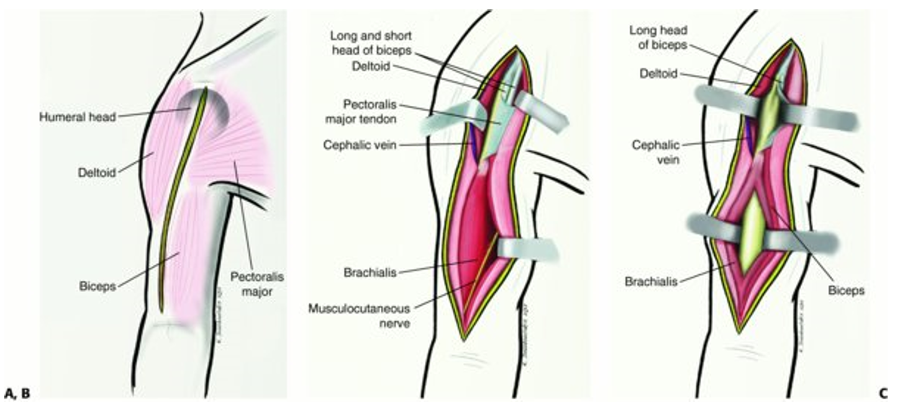
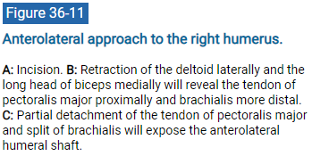
From: 36 Humeral Shaft Fractures
Rockwood and Green's Fractures in Adults, 9e, 2019

Slide 15
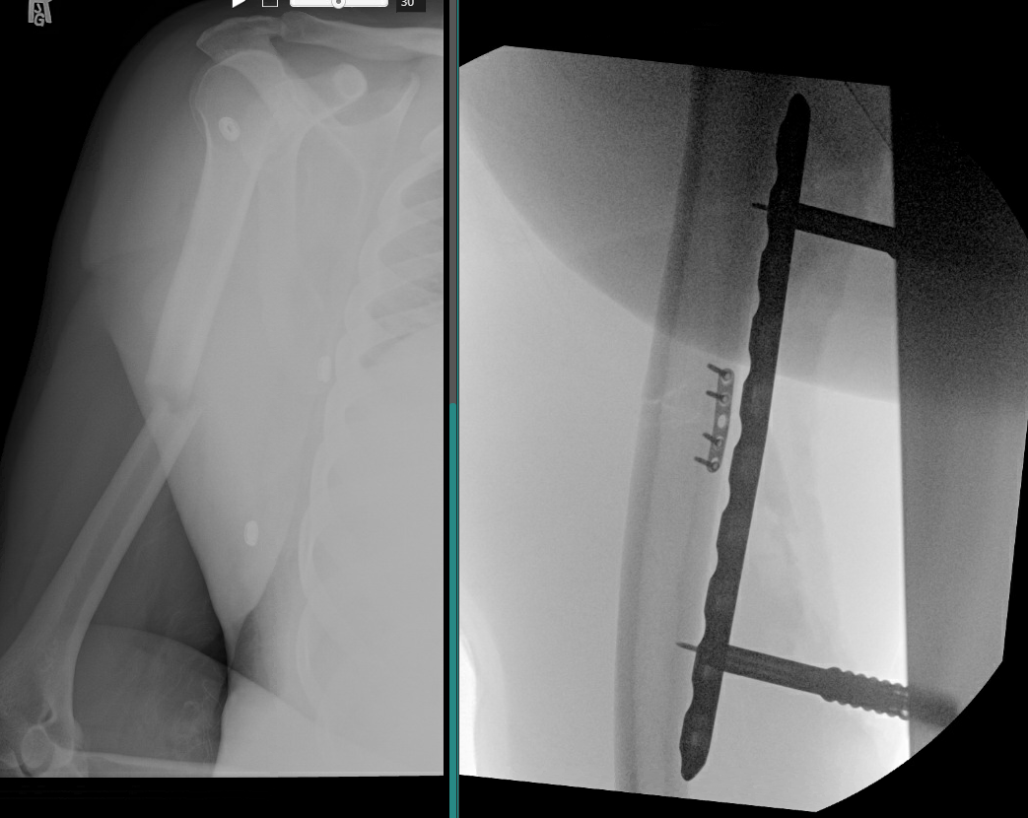
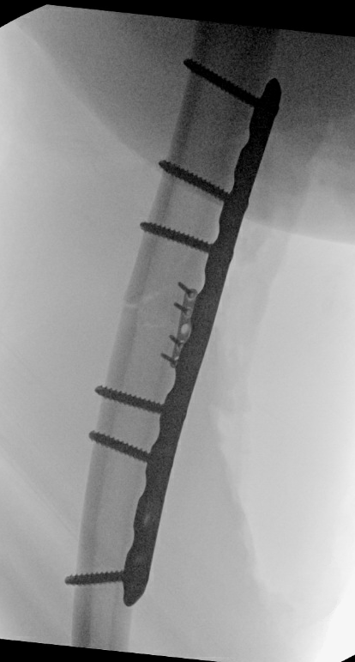
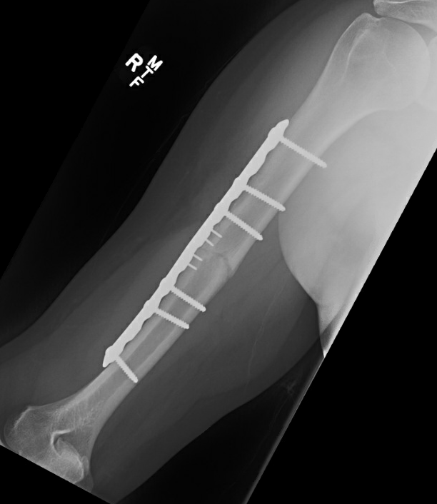
Healed at 6 months postop
51M, RHD, transverse humeral shaft fx. Pt elected for surgery
Anterolateral approach, brachialis split, mini frag assisted reduction
Compression plating (plate undercontoured) placed anterolateral between deltoid/pec insertions

Slide 16
https://otaonline.org/video-library/45036/procedures-and-techniques/multimedia/16731323/surgical-technique-anterolateral-approach-to-the

Slide 17
Posterior Approach

Slide 18
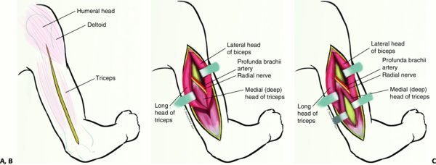
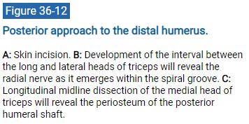
From: 36 Humeral Shaft Fractures
Rockwood and Green's Fractures in Adults, 9e, 2019

Slide 19
Posterior Approach to Humerus
Gerwin et al, JBJS 1996
Triceps split approach will expose 55% of the posterior humeral diaphysis
Triceps split, release of lateral intermuscular septum, and mobilization of radial nerve will expose 76% of the posterior humeral diaphysis
Triceps split, mobilization of radial nerve, and elevation of medial and lateral heads of triceps will expose 96% of the posterior humeral diaphysis

Slide 20
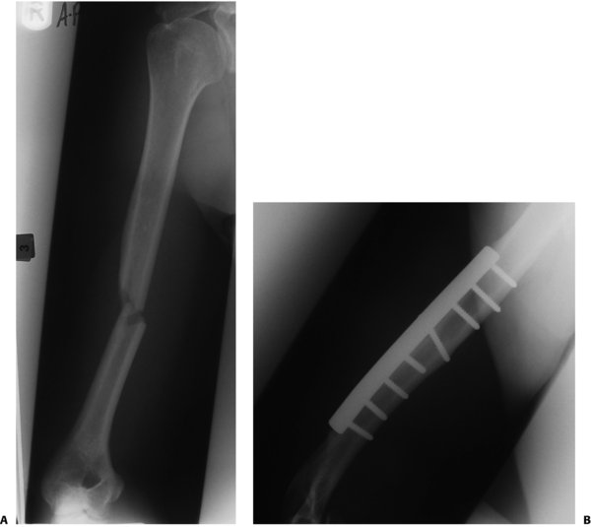
A: Transverse fracture of the mid-distal humeral diaphysis.
B: Fixation with traditional plating technique through a posterior approach.

Slide 21
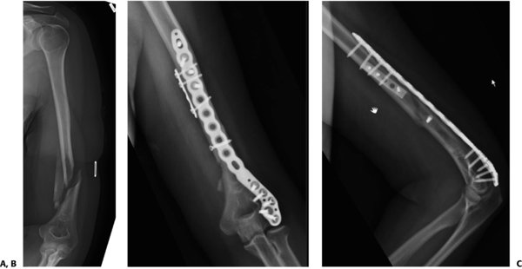
From: 36 Humeral Shaft Fractures
Rockwood and Green's Fractures in Adults, 9e, 2019
A: Fracture of the distal humeral diaphysis.
B+C: Fixation with a posterolateral plate that allows screw fixation of the lateral column.

Slide 22
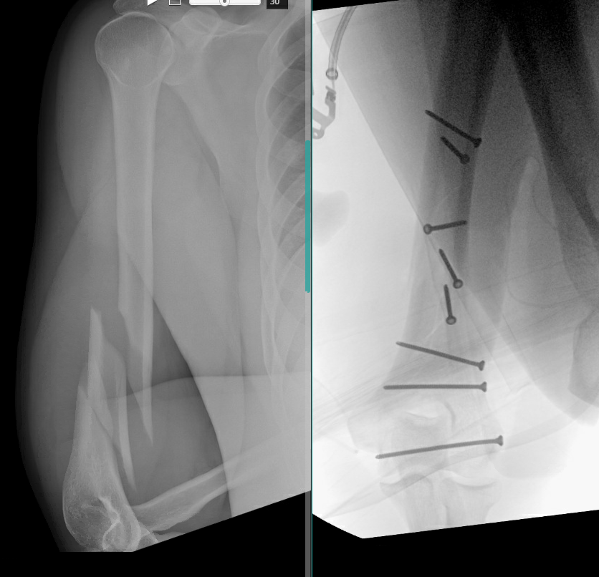
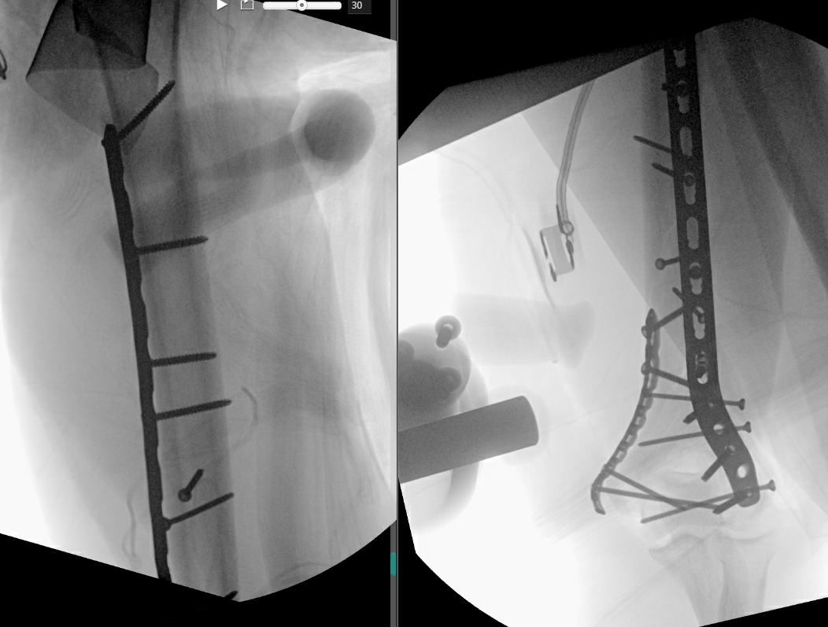
34M, RHD, segmental R distal 3rd humeral shaft fx w/ nondisplaced intraarticular extension
Posterior approach, lag screw fixation
Neutralization plate + supplementary med plate

Slide 23
https://otaonline.org/video-library/45036/procedures-and-techniques/multimedia/16776523/orif-of-the-humerus

Slide 24
Lateral Approach

Slide 25
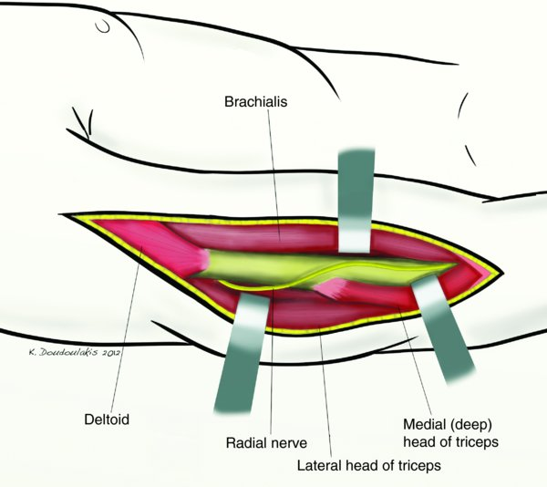
Lateral approach to the distal humerus
Allows exploration of radial nerve through length of incision.
carries a higher risk of iatrogenic damage
But in some cases is the best option.
Supine positioning
Muscle splitting not required
Plate placement Ant/Lat/Post
Extensile proximally and distally
Zlotolow et al, JAAOS, 2006

Slide 26
Medial Approach

Slide 27
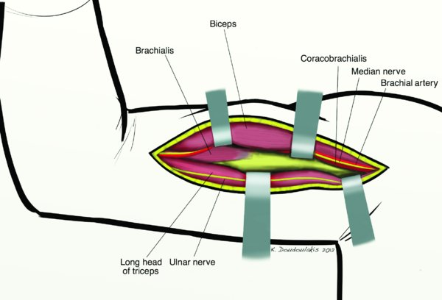
Nearby neurovascular structures at risk
Difficult exposure of shaft
Rarely used for fracture fixation

Slide 28
Intramedullary Nail
Antegrade
Retrograde

Slide 29
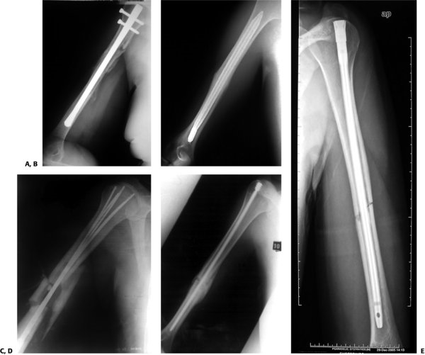
From: 36 Humeral Shaft Fractures
Rockwood and Green's Fractures in Adults, 9e, 2019
Nails with interference fit
Seidel nail
Fixion nail
Marchetti-Vincenzi nail
True-Flex nail
Garnavos nail

Slide 30
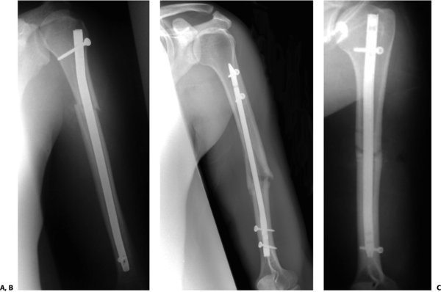
Nails with both proximal and distal interlocking screws
Russel-Taylor Nail
Unreamed Humeral Nail
T2 Nail

Slide 31
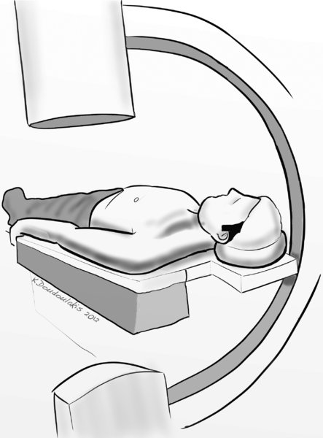
From: 36 Humeral Shaft Fractures
Rockwood and Green's Fractures in Adults, 9e, 2019
Radiolucent table
In this set-up, C arm is positioned on opposite side

Slide 32
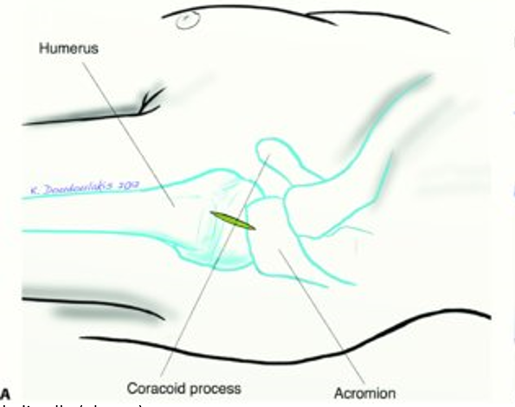
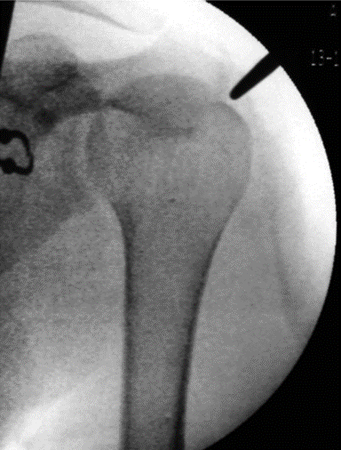
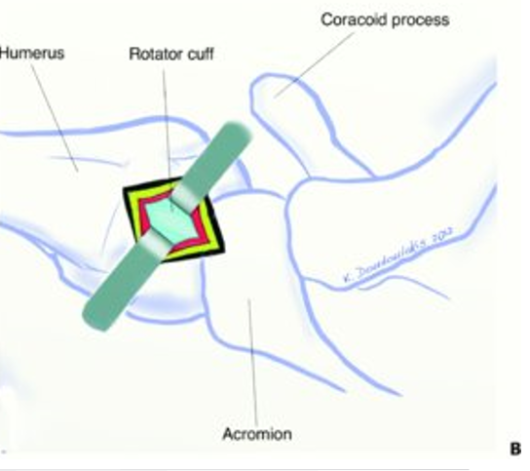
Antegrade Intramedullary Nailing Technique
Expose rotator cuff
Verify position with blunt radiolucent object
1 cm incision to rotator cuff as medial as possible at the apex of the head
open cortex with hand awl
Reduce fracture using fluoroscopic guidance
Pass guidewire across fracture
Ream canal
begin reaming with reamer inside bone
do not ream across fracture in order to prevent radial nerve injury
Stop reaming when reamer is within humeral head
Be sure to remove all reaming debris from shoulder joint
Maintain fracture reduction during nail insertion
Do not allow fracture distraction
Be sure nail is not prominent
Lock nail proximally
Lock distally (always)
Cautious distal interlocking to prevent neurovascular injury

Slide 33
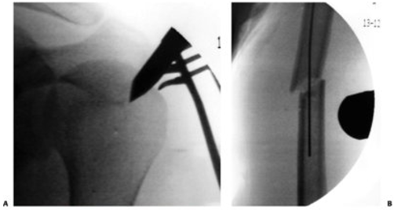
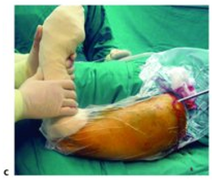
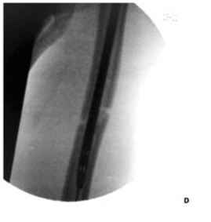
Antegrade Intramedullary Nailing Technique
Expose rotator cuff
Verify position with blunt radiolucent object
1 cm incision to rotator cuff as medial as possible at the apex of the head
open cortex with hand awl
Reduce fracture using fluoroscopic guidance
Pass guidewire across fracture
Ream canal
begin reaming with reamer inside bone
do not ream across fracture in order to prevent radial nerve injury
Stop reaming when reamer is within humeral head
Be sure to remove all reaming debris from shoulder joint
Maintain fracture reduction during nail insertion
Do not allow fracture distraction
Be sure nail is not prominent
Lock nail proximally
Lock distally (always)
Cautious distal interlocking to prevent neurovascular injury

Slide 34
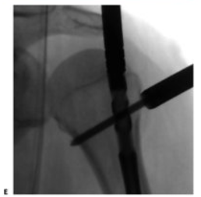
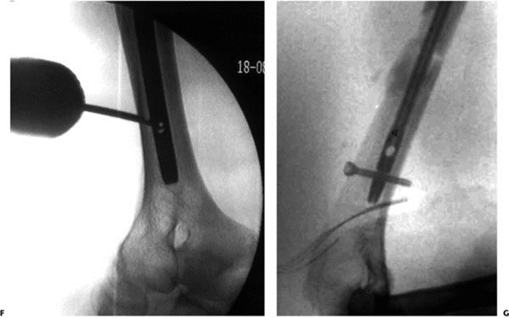
Antegrade Intramedullary Nailing Technique
Expose rotator cuff
Verify position with blunt radiolucent object
1 cm incision to rotator cuff as medial as possible at the apex of the head
open cortex with hand awl
Reduce fracture using fluoroscopic guidance
Pass guidewire across fracture
Ream canal
begin reaming with reamer inside bone
do not ream across fracture in order to prevent radial nerve injury
Stop reaming when reamer is within humeral head
Be sure to remove all reaming debris from shoulder joint
Maintain fracture reduction during nail insertion
Do not allow fracture distraction
Be sure nail is not prominent
Lock nail proximally
Lock distally (always) with free hand technique
Cautious distal interlocking to prevent neurovascular injury

Slide 35
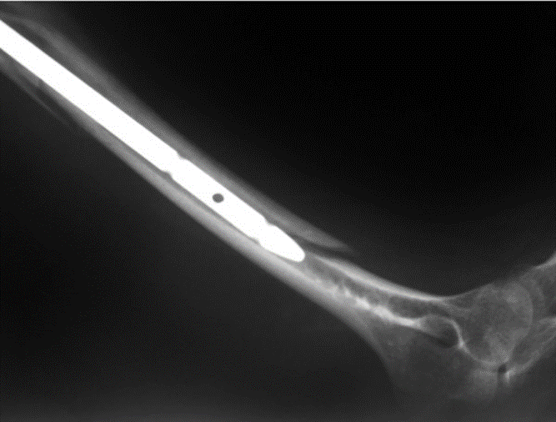
Intraoperative Pitfalls and Prevention
Image Intensifier Views Inadequate
Take time to position and check images before prepping
Consider location of assistants and OR table to prevent contamination
Leaving nail unlocked distally
Need some type of interference
Injury to rotator cuff
Make small (1-1.5 cm incision in cuff
Proper entry point for nail
Distal neurovascular structures at risk with distal interlocking
Use open incision for safe visualization

Slide 36
https://otaonline.org/video-library/45036/procedures-and-techniques/multimedia/16731325/humeral-shaft-fracture-intramedullary-nailing

Slide 37
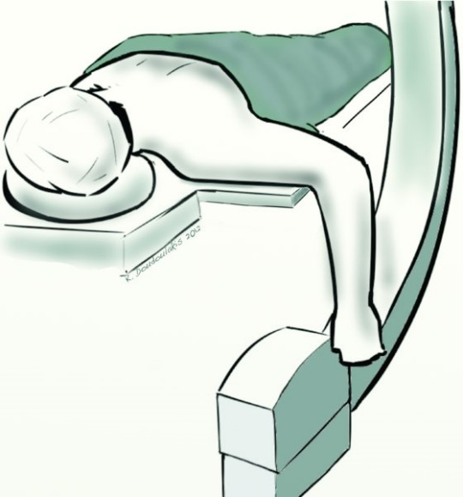
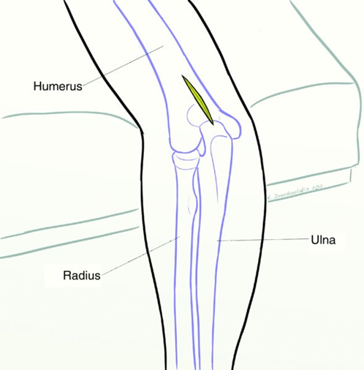
From: 36 Humeral Shaft Fractures
Retrograde Nailing of Humerus: Key Steps
Expose Posterior supracondylar cortex
Open a 1x2 cm cortical home with drill holes and chisel
Reduce the fracture under fluoroscopy
Pass guidewire across the fracture
Hand ream the distal canal to reduce risk of fracture with nail passage
Beware of reaming at fracture for mid- and distal humeral shaft fractures
Advance nail to final position
Cautious advancement.
Ream larger canal if nail passage is difficult.
Maintain fracture alignment during nail placement
Do not allow the fracture to distract
Lock nail distally with targeting device
Larger incision for visualization and safety
Lock proximally with freehand technique
Rockwood and Green's Fractures in Adults, 9e, 2019

Slide 38
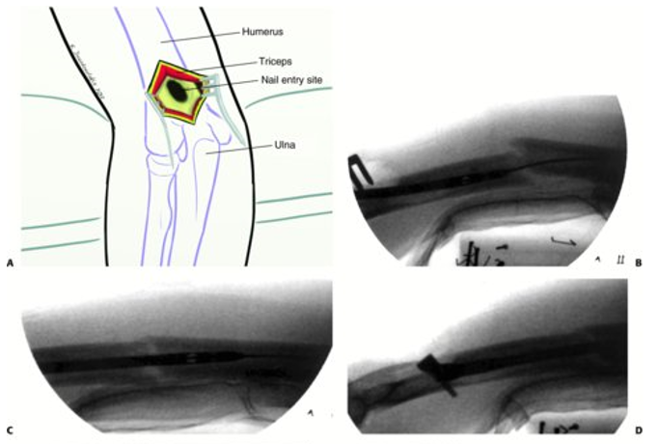
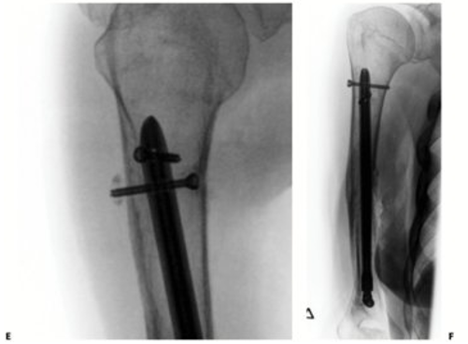
From: 36 Humeral Shaft Fractures
Rockwood and Green's Fractures in Adults, 9e, 2019
Entry portal
Nail insertion
Nail passed across fracture
Final position with direct visualization of distal interlocking screw
E. Proximal interlock inserted freehand technique, distal to surgical neck to avoid iatrogenic nerve injury.
F. Final AP radiograph

Slide 39
Retrograde Insertion of IM Nail for Humeral Shaft Fractures: Pitfalls and Prevention
Problems with intra-op fluoroscopic viewing
Position patient to avoid metal objects that would obstruct view
Clear planning of positions for assistant and scrub nurse to avoid contamination of OR field.
Not locking proximally
Canal is conical in shape and widest proximally, so it must be locked proximally
Underestimating risk of iatrogenic supracondylar fracture
Open large entry hole
Enlarge distal canal with careful hand reaming.

Slide 40
MIPO
Minimally Invasive Plate Osteosynthesis

Slide 41
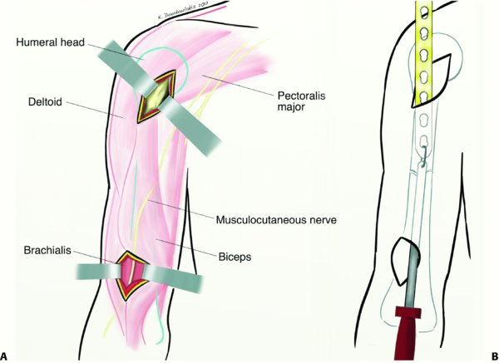
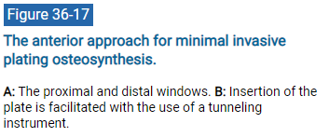
From: 36 Humeral Shaft Fractures
Rockwood and Green's Fractures in Adults, 9e, 2019
Legend:
The anterior approach for minimal invasive plating osteosynthesis.

Slide 42
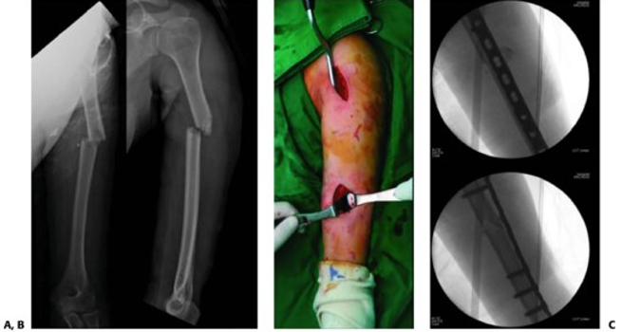
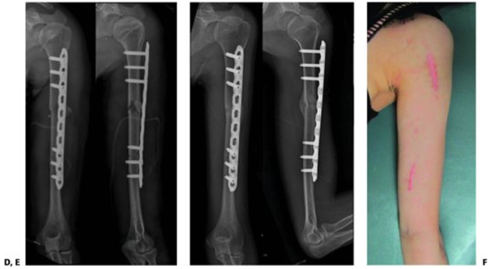
From: 36 Humeral Shaft Fractures
Rockwood and Green's Fractures in Adults, 9e, 2019
A: X-rays of a 21-year-old woman who sustained a fracture of the left humeral shaft (AO/OTA 12-A3 after a fall).
B: The fracture was treated by MIPO.
C: The reduction was verified under the image intensifier.
D: Postoperative radiographs showed an acceptable alignment.
E and F: The fracture healed with callus formation 4 months after surgery, with small incision scar and satisfactory function. (Reproduced with permission from Kim JW, Oh CW, Byun YS, et al. A prospective randomized study of operative treatment for noncomminuted humeral shaft fractures: conventional open plating versus minimal invasive plate osteosynthesis. J Orthop Trauma. 2015;29(4):189–194.)

Slide 43
Minimally Invasive Plate Osteosynthesis (MIPO) of Humeral Shaft
Expose the “windows” of the approach
Identify and protect the neurovascular structures that are nearby
Reduce the fracture with longitudinal traction
Apply external fixator or distractor if necessary
Create an extraperiosteal tunnel alongside the surface of the humerus
Use tunneling instrument to align and position the plate on the humerus
Be cautious to avoid iatrogenic neurovascular injury
Use 4.5 mm narrow DC plate
Secure plate to proximal shaft and to distal shaft with one screw on each side while fracture is reduced.
Confirm quality of reduction, then insert remainder of screws
Check screw length with fluoroscopy.
Do not put screws in area of comminution.
Confirm reduction and plate length with fluoroscopy prior to closure.

Slide 44
Minimally Invasive Plate Osteosynthesis: Pitfalls and Prevention
Unacceptable fracture reduction
Use fluoroscopy
Reduce length with traction without overdistraction
Unstable fixation
Use 4.5 mm DCP or 4.5 mm LCP
Aim for 3-4 screws in each fragment
Iatrogenic nerve injury
Avoid; or Identify and protect nerves
Musculocutaneous nerve with anterior approach
Radial nerve with lateral and posterior approaches
ORIF in presence of radial nerve palsy
Exclude neurologic problem through clinical exam and documentation prior to surgery

Slide 45
https://otaonline.org/video-library/45036/procedures-and-techniques/multimedia/18420128/posterior-mipo-humerus-plating

Slide 46
Indications
Nonoperative vs Operative management

Slide 47
Indications for Nonoperative Management
Strong Indication
Isolated, acute closed fracture in cooperative and ambulatory patient
Relative Indication
Type A Fracture (AO-OTA Classification)
Proximal third, long oblique fracture
Segmental fracture
Low velocity gunshot fracture without neurovascular injury
Noncompliant patient
Relative Contraindications
Multiple Injuries
Additional injuries to ipsilateral arm (e.g. floating elbow; Open fracture)
Brachial plexus injury or increasing nerve dysfunction
Bilateral fractures
Periprosthetic Fractures
Contraindications
Significant Vascular Injury
Pathologic Fracture
Nonunited fracture

Slide 48
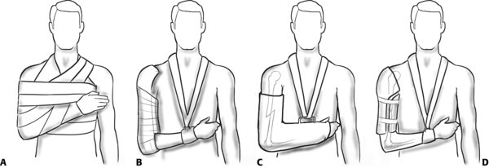
From: 36 Humeral Shaft Fractures
Rockwood and Green's Fractures in Adults, 9e, 2019
A: Velpeau's bandage.
B: U-slab.
C: Hanging cast.
D: Functional brace.

Slide 49
https://otaonline.org/video-library/45036/procedures-and-techniques/multimedia/16723112/coaptation-splint-application-technique

Slide 50
Indications for Operative Management
Indications
Inability to maintain satisfactory reduction
Multiple injuries
Bilateral fractures
Floating elbow
Intra-articular extension of fracture
Progressive nerve palsy
Significant vascular injury
Nonunion/infected nonunion
Pathologic fracture
Relative Indications
Open fractures
Segmental fractures
Long oblique fracture of the proximal humerus, especially with valgus angulation
Large soft tissue wounds or burns that require frequent care
Noncompliant patients
Obesity
Periprosthetic fractures
Type A fracture in the mid-shaft

Slide 51
ORIF of Diaphyseal Humeral Fractures: Surgical Pitfalls and Preventions
Excessive stripping of soft-tissue
Familiarity with anatomy of arm
Careful dissection
Unacceptable reduction of fracture
Adequate surgical exposure
Use of fluoroscopy
Can accept 2-3 cm shortening, but no more
Consider staged bone grafting for larger gaps
Unstable fixation
4.5 mm DCP or LCP
3-4 screws in each fragment
Appropriate use of lag screws
Incorporate condyles or use 2 plates for distal fractures
Iatrogenic neurovascular injury
Familiarity with anatomy of arm
Careful dissection: Identify and protect nearby vessels and nerves
Avoid excessive traction
Avoid cerclage wiring
Be careful with drills and screws from opposite cortex

Slide 52
Functional Bracing of Humeral Shaft Fractures

Slide 53
Fractures of the Shaft of the Humerus
Klenerman, JBJS(Br) 1966
98 patients: 87 (89%) treated nonoperatively
32 pts available for interview/XR after fx healing
Sagittal deformity tolerated to 20 degrees w/o clinical impact/deformity
Varus deformity tolerated to 30 degrees w/o clinical impact/deformity
Shortening 3cm w/o clinical impact/deformity
“Most fractures of the shaft of the humerus are best treated by simple splintage. The degree of radiological deformity that can be accepted is far greater than in other long bones. In this group anterior bowing of 20 degrees or varus of 30 degrees was present before it became clinically obvious and even then the function of the limb was good.”

Slide 54
Functional Bracing of Fractures of the Shaft of the Humerus
Sarmiento et al, JBJS, 1977
51 patents treated with functional bracing
Splint/cast until pain subsides (1 week) then plastic brace
Brace + sling x 1 week
Active ROM encouraged
Average time in brace 7 weeks
All fractures healed and there was restoration of motion in all joints before fracture healing
“The early introduction of functional activity to the entire extremity appears to provide a desirable physiological environment conducive to rapid healing.”

Slide 55
Functional Bracing for Treatment of Fractures of the Humeral Diaphysis
Sarmiento et al, JBJS, 2000
922 patients treated with functional bracing
Excluded polytrauma, high velocity GSW
67% follow-up (620 pts)
155 (25%) Open fractures (mainly low-velocity gunshot wounds)
67 had radial nerve palsy
Nonunion:
1.5% (closed)
5.8% (open)
3% required operative intervention
Angulation
Varus: >10⁰ (24%); >25⁰ (2%)
Sagittal: >10⁰ (14%); >15⁰ (7%)
Motion loss
Shoulder: >10⁰ (11%)
Elbow: >10⁰ (8%)

Slide 56
Outcome after Closed Functional Treatment of Humeral Shaft Fractures
Ekholm et al, J Orthop Trauma, 2006
78 pts with isolated humeral shaft fxs
50 pts available for functional outcome assessment @ avg 26 months
90% union
10% radial nerve palsy
50% full recovery in healed fx
0% full recovery in fx that went on to nonunion and required ORIF
The authors recommended Randomized Clinical Trial to compare brace vs ORIF

Slide 57
Outcome of Nonoperative vs Operative Treatment of Humeral Shaft Fractures: A Retrospective Study of 213 Patients
Denard et al, Journal of Orthopaedics, 2010
213 pts
2 trauma centers
Significant difference in:
Nonunion
Malunion
 | Brace | ORIF
Nonunion | 20% | 8%
Malunion | 12% | 1%
Infection | 3% | 4%
Radial nerve palsy | 9% | 2%
Time to Union | 4.7 months | 4.8 months
Elbow ROM | 136 deg | 130 deg

Slide 58
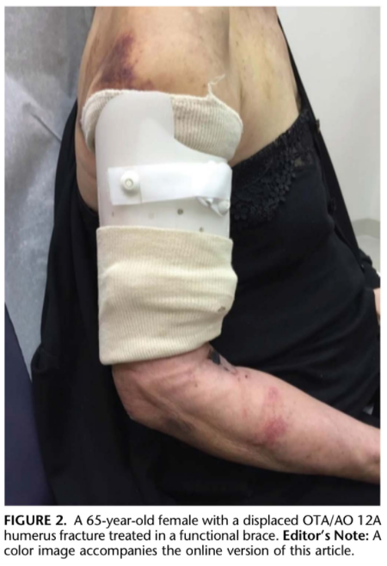
Fracture Site Mobility at 6 Weeks After Humeral Shaft Fracture Predicts Nonunion Without Surgery
Driesman et al, J Orthop Trauma, 2017
84 pts with humeral shaft fractures treated nonoperatively
87% healed at 6 months postoperatively
Fracture mobility 6 weeks post injury predicted nonunion
82% sensitive, 99% specific

Slide 59
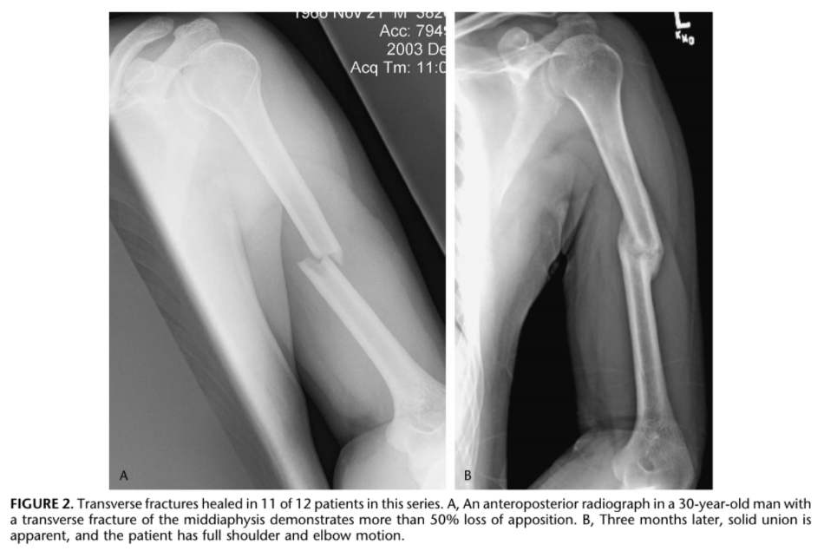
Treatment of Diaphyseal Fractures of the Humerus Using a Functional Brace
Rutgers and Ring, J Orthop Trauma, 2006
52 pts nonop humeral shaft fxs
90% union
Nonunion
Prox 3rd – 29%
Mid 3rd – 4%
Dist 3rd – 0%
Motion – no greater than 15⁰ loss of shoulder/elbow motion

Slide 60
Effect of Surgery vs Functional Bracing on Functional Outcome Among Patients With Closed Displaced Humeral Shaft Fractures - The FISH Randomized Clinical Trial
Rämö et al, JAMA, 2020
Finland, RCT, 2012-2018, 82 pts
30% nonop group crossed over to surgery
25% nonunion in nonop group
Functional outcome
6 wks = ORIF improved scores
3 months = ORIF improved scores
12 months = no significant difference (DASH)

Slide 61
Modern Results of Functional Bracing of Humeral Shaft Fractures: A Multicenter Retrospective Analysis
Serrano et al, J Orthop Trauma, 2020
9 institutions, 2005-2015
1182 fractures initially treated nonoperatively with a functional brace
29% (344) ultimately required surgery
60% nonunion
24% malalignment
12% inability to tolerate brace
4% persistent radial nerve palsy warranting exploration

Slide 62
Conservative vs. operative treatment for humeral shaft fractures: a meta-analysis and systematic review of randomized clinical trials and observational studies
Van de Wall et al, J Shoulder Elbow Surg, 2020
12 studies
1262 pts
Nonunion
Brace 15%
Surgery 6%
No difference
Radial nerve palsy
Time to union
DASH

Slide 63
Operative Treatment of Humeral Shaft Fractures

Slide 64
Treatment of Humeral Shaft Fractures: A Critical Analysis Review
Attum and Obremskey, JBJS Reviews, 2015
Recommendations for care with Grade of Supporting Evidence
Most humeral shaft fractures will heal with nonoperative management
Grade B
When indication for operative treatment is met, plate fixation is reliable and safe
Grade A
Nail fixation may be helpful in pathologic or highly comminuted fractures, but routine use of nails is associated with more shoulder dysfunction
Grade A
Radial nerve palsy in closed fractures usually resolved without surgical intervention
Grade B

Slide 65
ORIF vs IMN

Slide 66
Treatment of Humeral Shaft Fractures: A Critical Analysis Review
Attum and Obremskey, JBJS Reviews, 2015
ORIF (multiple series) – 547 pts
Iatrogenic radial nerve palsy - 3%
Time to union – 21 wks
Infection – 4%
Nonunion – 5%
IMN (multiple series) – 240 pts
Iatrogenic radial nerve palsy - 3%
Time to union – 13.5 wks
Infection – 2%
Nonunion – 5%

Slide 67
ORIF vs IMN
Shoulder impingement/Problems
IMN 28% (McCormack, 2000)
IMN RR 7.3; (Ouyang, 2013)
IMN 15%; RR 6.8; (Wang, 2013)
Plate 4% (McCormack, 2000)
Plate RR 0.1 (Bhandari, 2006)

Slide 68
Early post-operative outcomes of plate versus nail fixation for humeral shaft fractures
Putnam et al, Injury, 2019
National Surgical Quality Improvement Program (NSQIP) data 2005-2016
2009 patients
1418 ORIF
591 Intramedullary nail
30 day mortality ORIF 0.8% vs IMN 5.4%
Patients selected for IMN had more comorbidities
“Suggests that surgeons may be choosing IMN for patients who may not be ideal surgical candidates”
“Nail fixation may not be a safer option in patients with multiple co-morbidities and low-energy humeral shaft fractures”.
LOS, complications and readmission rates did not differ after propensity score adjustment.

Slide 69
Length of stay and 30-day readmissions after isolated humeral shaft fracture open reduction and internal fixation compared to intramedullary nailing
Merrill et al, Injury, 2020
Nationwide readmissions database query, 2015-2016
406 patients propensity matches IMN vs ORIF
30 day readmission = no difference
6.4% IMN
4.9% ORIF
LOS = 3 days for both groups

Slide 70
MIPO technique
(Minimally invasive plate osteosynthesis)

Slide 71
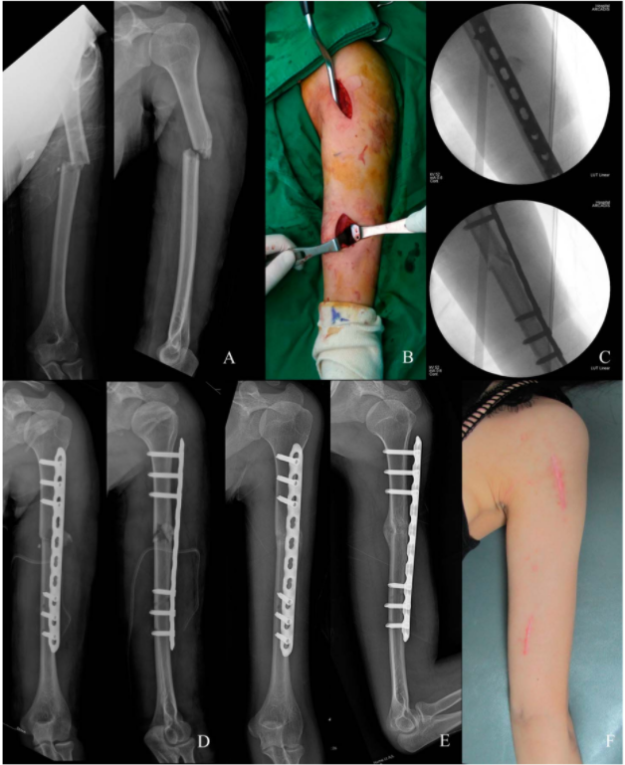
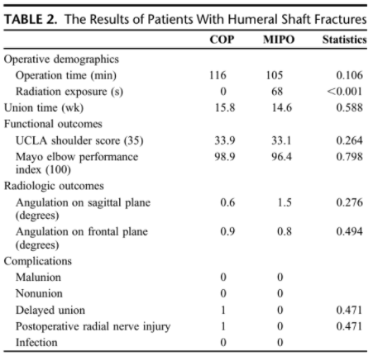
RCT, 2010-2011, 5 trauma centers, Korea
68 pts, simple humeral shaft fxs
ORIF v MIPO
Large frag plate (4.5mm)
ORIF 97% healed
MIPO 100% healed
No significant difference
OR time
Complications
functional outcomes
union

Slide 72
Minimally Invasive Osteosynthesis with a Bridge Plate Versus a Functional Brace for Humeral Shaft Fractures:
A Randomized Controlled Trial
Matsunaga et al, JBJS, 2017
RCT, 2012-2015, single center, Brazil
110 patients, MIPO vs brace
Large frag plate (4.5mm)
DASH @ 6 months
MIPO – 10.9 (better)
Brace – 16.9
Nonunion
MIPO – 0%
Brace – 15%
Sagittal alignment
MIPO – 2 deg
Brace – 10 deg
MIPO Complications
2% superficial infection
4% radial nerve palsy (transient)
8% hypertrophic scarring
No difference
SF-36, pain
Constant-Murley
Coronal displacement

Slide 73
Minimally Invasive Plate Osteosynthesis of Humeral Shaft Fractures: Current State of the Art
Tetsworth et al, JAAOS 2018
MIPO review
24 studies, 581 pts
Nonunion – 2.6%
Infection – 1.5%
Nerve injury – 2.8%

Slide 74
Antegrade intramedullary nail versus plate fixation in the treatment of humeral shaft fractures
Wen et al, Medicine, 2019
Meta-analysis
15 trials, 839 pts
Similar results in operative time, ASES score, nerve injury, delayed union, and reoperation rate.
Blood loss
Plate = 183 mL
IMN = 105 mL
Infection
MIPO = 7%
IMN = 2%
Nonunion
MIPO = 5%
IMN = 17%

Slide 75
Extraarticular distal 3rd humeral shaft fractures

Slide 76
Extra-Articular Distal-third Diaphyseal Fractures of the Humerus:
A Comparison of Functional Bracing and Plate Fixation
Jawa et al, JBJS 2006
Retrospective comparison
2 trauma centers, 2000-2004
51 pts, 6 month f/u
ORIF
Loss of fixation – 5%
Iatrogenic radial nerve palsy – 15%
Loss of shoulder/elbow motion – 5%
Brace
Converted to ORIF – 10%
Malunion >30 deg – 5%
Skin breakdown – 10%
Loss of elbow/shoulder motion – 10%

Slide 77
Extra-Articular Distal-third Diaphyseal Fractures of the Humerus:
A Comparison of Functional Bracing and Plate Fixation
Jawa et al, JBJS 2006
Conclusions for extraarticular distal humerus fxs:
Operative management
Provides more predictable alignment, potentially quicker return to function
But risks iatrogenic nerve injury, infection, need for reoperation
Bracing
Can cause skin issues and varying degrees of angular deformity
But function and ROM are usually excellent

Slide 78
Are two plates necessary for extraarticular fractures of the distal humerus?
Watson et al, Current Orthopaedic Practice, 2014.
Biomechanical cadaveric study
Extraarticular supracondylar humerus fx
Single precontoured posterolateral locked plate is biomechanically similar to Orthogonal dual plates
Thus, single plating can be used
This offers the potential for: decreased exposure, shorter surgical time, less medial dissection, decreased ulnar nerve irritation, improved outcomes
 | Stiffness | Cycles to failure | Force to failure
Single plate | 1072 N/mm | 3586 | 428 N
Dual plate | 722 N/mm | 2772 | 380 N

Slide 79
A paradigm shift in the surgical reconstruction of extra-articular distal humeral fractures: Single-column plating
Meloy et al, Injury, 2013
Multicenter retrospective comparative study, 2 trauma centers
105 pts
Dual column plating (triceps split)
Single column precontoured posterolateral plate (paratricipital approach)
Similar Results
Union (dual 100%, single 97%)
Alignment (97% w/in 5 deg anatomic)
Single column plating
Improved ROM (10 deg)
Fewer complications (hardware irritation, radial nerve injury)
“Patients treated with single-column plating had similar union rates and alignment. However, single-column plating resulted in a significantly better range of motion with less complications.”

Slide 80
Review Article: Best care paradigm to optimize functionality after extra-articular distal humeral fractures in the young patient
Ayoub and Tarkin, J Clin Orthop and Trauma, 2018
Sarmiento
85 pts w/ distal 3rd fx in original series
33% lost to f/u
96% union rate w/ brace
Varus malunion 81%
Elbow motion
Decreased flex/ext in 25%
Shoulder motion
Decreased ER in 45%
Decreased abduction in 15%
Post-Sarmiento bracing studies
Nonunion rates 10-15%
Not fully recovered 50%
Excellent outcomes 50%

Slide 81
Review Article: Best care paradigm to optimize functionality after extra-articular distal humeral fractures in the young patient
Ayoub and Tarkin, J Clin Orthop and Trauma, 2018
Brace inconvenience
10% skin breakdown
Compliance issues
4+ wks of fx motion/pain, limited arm function
Intervention after failed brace treatment
Higher complications
More difficult surgery
Scarring from partial healing
Radial nerve palsy 4-20%
Lost productivity, excess time off work, stiffness, muscle wasting – all of these are especially concerning for the young active pt who would otherwise be active/productive

Slide 82
Review Article: Best care paradigm to optimize functionality after extra-articular distal humeral fractures in the young patient
Ayoub and Tarkin, J Clin Orthop and Trauma, 2018
Surgical treatment
Less stiffness
Decreased malunion rates
Faster return to ADLs/normalcy
Consider pt characteristics
job/work needs
Caregivers for others
polytrauma
dominant arm
walker use
age, medical comorbidities
pt desires
obesity, pendulous breasts
compliance w/ bracing
Radial nerve injury
Consider entrapment of nerve at fx site – better to dig it out fresh or scarred in?
Nonunion surgery following humerus fx: Iatragenic radial nerve palsy 4-19%

Slide 83
Review Article: Best care paradigm to optimize functionality after extra-articular distal humeral fractures in the young patient
Ayoub and Tarkin, J Clin Orthop and Trauma, 2018
Triceps split
“Falling out of favor”
Paratricipital
Better proximal exposure
Less muscle trauma, scarring
Improved elbow ROM/triceps strength
Low incidence of radial nerve palsy
Single plating vs dual plating
Decreased ulnar nerve irritation
Improved ROM
Less periosteal stripping, blood loss, surgical time

Slide 84
Radial nerve palsy

Slide 85
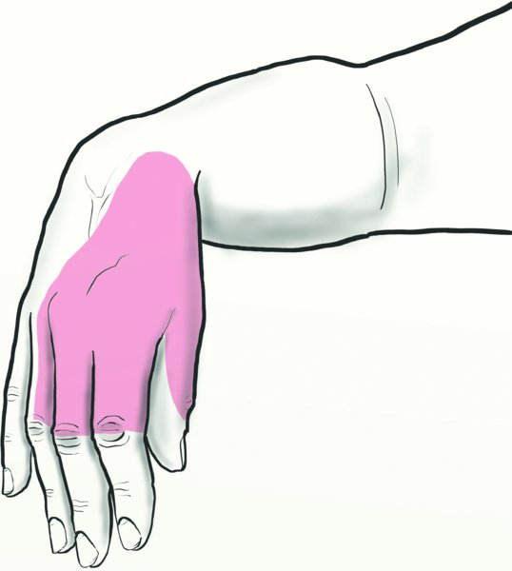
From: 36 Humeral Shaft Fractures
Rockwood and Green's Fractures in Adults, 9e, 2019
Legend:
The clinical picture of a radial nerve palsy.

Slide 86
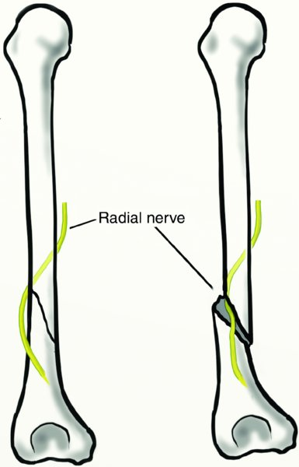
From: 36 Humeral Shaft Fractures
Rockwood and Green's Fractures in Adults, 9e, 2019

Slide 87
Radial nerve palsy associated with fractures of the shaft of the humerus: A SYSTEMATIC REVIEW
Shao et al, JBJS(Br), 2005
1964-2004, 21 papers, 4517 patients
11.8% radial nerve palsy
Increased frequency
Mid shaft, mid-distal
Transverse, spiral fractures
Recovery
Spontaneous – 70%
Overall – 88%

Slide 88
Iatrogenic Nerve Palsy Occurs with Anterior and Posterior Approaches for Humeral Shaft Fixation
Streufert et al, J Orthop Trauma, 2020
Retrospective study, 2 trauma centers
261 pts, ORIF extraarticular humerus fx
Preop radial nerve palsy
74% resolved, avg 5.5 months
22% required tendon transfer/wrist fusion
Iatrogenic rad nerve palsy
95% resolved, avg 4.1 months
0% required tendon transfer/wrist fusion

Slide 89
Radial Nerve Palsy Recovery with Fractures of the Humerus: An Updated Systematic Review
Ilyas et al, JAAOS, 2020
2000-2017
23 articles
7,262 humerus fxs
12% radial nerve palsy
77% spontaneous recovery
Nerve exploration > 8wk
68% recovery
Nerve exploration < 3 wk
89% recovery
Early exploration is associated with better recovery of nerve function, but it is not clear if there was causation.

Slide 90
Nonunion

Slide 91
The Radiographic Union Score for HUmeral fractures (RUSHU) predicts humeral shaft nonunion
Oliver et al, Bone Joint J, 2019
Modification of RUST score (used for Tibias)
Each cortex scored from 1-3 on callus and “bridging”
Fractures with RUSHU <8 @ 6 wks were 12 times more likely to develop nonunion
NNT = 1.5 (to avoid one nonunion)

Slide 92
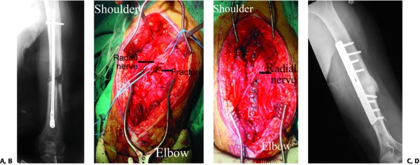
From: 36 Humeral Shaft Fractures
Rockwood and Green's Fractures in Adults, 9e, 2019
A: Nonunited fracture in a polytrauma patient who was treated with intramedullary nailing 4 months after the accident and the nailing operation.
B: Intraoperative picture (posterior approach) showing the nail removed, the radial nerve identified, and the nonunion debrided.
C: The plate and bone graft has been applied and all screws tightened.
D: Six months later, there was sound union of the fracture.

Slide 93
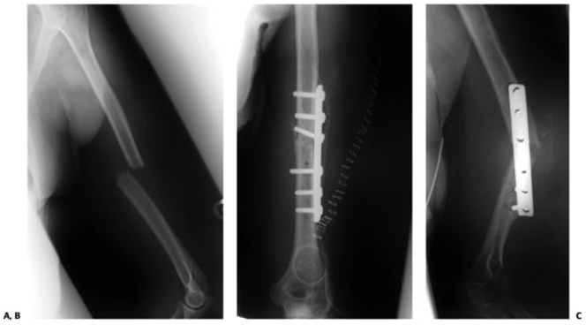
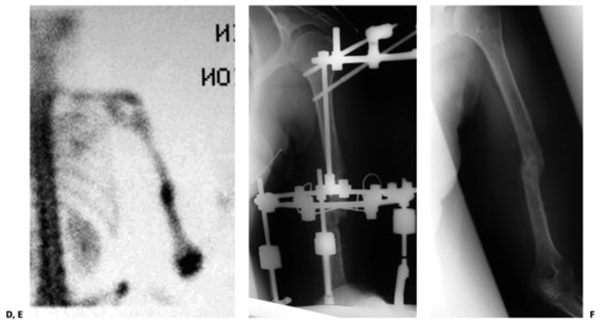
From: 36 Humeral Shaft Fractures
Rockwood and Green's Fractures in Adults, 9e, 2019
A: A transverse fracture of the middle third of the humeral diaphysis, treated with functional bracing, as appeared on the follow-up 3 months post-accident.
B: Open reduction and internal fixation with a six-hole plate.
C: Three months later, the fixation became painful, and the arm was swollen and warm. The x-ray showed loss of reduction and nonunion.
D: The bone scan confirmed the clinical diagnosis of infected nonunion.
E: The plate was removed, the nonunion site was debrided thoroughly, IV antibiotics were administered, and Ilizarov-type external fixator was applied.
F: Six months later, the infection was eradicated and the fracture healed.

Slide 94
Summary
Most uncomplicated humeral shaft fxs will do well with nonoperative management in a functional brace, but recent studies report nonunion rates 10-25%, which is in different from Sarmiento’s stellar results
Anterolateral approach = prox/middle third fxs
Posterior approach = distal third fxs
Plates/IMN offer similar outcomes with the exception of increased shoulder issues with antegrade IMN, 15-30%
MIPO plating is evolving as an attractive alternative treatment
Single column precontoured plate is a safe treatment option for extraarticular distal third humeral shaft fxs
Radial nerve palsy = 12% incidence in humeral shaft fxs. 77% spontaneous recovery.
Iatrogenic radial nerve palsy = 12% with operative intervention

Slide 95
References
Garnavos C: “Humeral Shaft Fractures”. In: Tornetta P, eds. Rockwood and Green's Fractures in Adults. 9th ed. Vol. 1. Philadelphia, PA: Wolters Kluwer; 2020: 1231-1291.
Epps H Jr., Grant RE: “Fractures of the shaft of the humerus” in Rockwood CA Jr., Green DP, Bucholz RW (Eds.) Rockwood and Green’s Fractures in Adults Ed 3, Philadelphia, PA JB Lippincott, 1991, Vol. 1, pp: 843-869
Zlotolow DA, Catalano LW III, Barron OA, et al. Surgical exposures of the humerus. J Am Acad Orthop Surg. 2006;14(13):754–765.Klenerman L. Fractures of the shaft of the humerus. J Bone Joint Surg Br. 1966;48(1):105–111.
Sarmiento A, Kinman PB, Galvin EG, et al. Functional bracing of fractures of the shaft of the humerus. J Bone Joint Surg Am. 1977;59(5):596–601.
Sarmiento A, Zagorski JB, Zych GA, et al. Functional bracing for the treatment of fractures of the humeral diaphysis. J Bone Joint Surg Am. 2000;82(4):478–486.
Ekholm R, Tidermark J, Tornkvist H, et al. Outcome after closed functional treatment of humeral shaft fractures. J Orthop Trauma. 2006;20(9):591–596.
Denard A Jr, Richards JE, Obremskey WT, et al. Outcome of nonoperative vs operative treatment of humeral shaft fractures: a retrospective study of 213 patients. Orthopedics. 2010;33(8):doi: 10.3928/01477447-20100625-16.
Driesman A, Fisher N, Karia R, et al. Fracture site mobility at 6 weeks after humeral shaft fracture predicts nonunion without surgery. Journal of Orthopaedic Trauma. 2017;31:657-662.
Rutgers M, Ring D. Treatment of diaphyseal fractures of the humerus using a functional brace. J Orthop Trauma. 2006;20(9):597–601.
Ramo L, Sumrein B, Lepola V, et al. Effect of surgery vs functional bracing on functional outcome among patients with closed displaced humeral shaft fractures: The FISH randomized clinical trial. JAMA. 2020;323(18):1792-1801
Serrano R, Mir H, Sagi H, et al, Modern Results of Functional Bracing of Humeral Shaft Fractures: A Multicenter Retrospective Analysis. J Orthop Trauma 2020 Apr;34(4):206-209.
Van de Wall B, Ochen Y, Beeres F, et al. Conservative vs. operative treatment for humeral shaft fractures: a meta-analysis and systematic review of randomized clinical trials and observational studies. J Shoulder Elbow Surg. 2020;29,1493-1504
Attum B, Obremskey W. Treatment of humeral shaft fractures: a critical analysis review. JBJS reviews 2015;3(9):e5
McCormack RG, Brien D, Buckley RE, et al. Fixation of fractures of the shaft of the humerus by dynamic compression plate or intramedullary nail. A prospective, randomised trial. J Bone Joint Surg Br. 2000;82(3):336–339.
Ouyang H, Xiong J, Xiang P, et al. Plate versus intramedullary nail fixation in the treatment of humeral shaft fractures: an updated meta-analysis. J Shoulder Elbow Surg (2013) 22, 387-395
Wang X, Chen Z, Shao Y, et al. A meta-analysis of plate fixation versus intramedullary nailing for humeral shaft fractures. J Orthop Sci, 2013;18:388-397

Slide 96
References
Bhandari M, Devereaux P, Mckee M, et al. Compression plating versus intramedullary nailing of humeral shaft fractures – a meta-analysis. Acta Ortho, 2006;77:2,279-284
Putnam J, Nowak L, Sanders D, et al. Early post-operative outcomes of plate versus nail fixation for humeral shaft fractures. Injury, 2019;50,1460-1463
Merrill R, Low S, Arvind V, et al. Length of stay and 30-day readmissions after isolated humeral shaft fracture open reduction and internal fixation compared to intramedullary nailing. Injury, 2020;51, 942-942
Kim JW, Oh CW, Byun YS, et al. A prospective randomized study of operative treatment for noncomminuted humeral shaft fractures: conventional open plating versus minimal invasive plate osteosynthesis. J Orthop Trauma. 2015;29(4):189–194.
Matsunaga FT, Tamaoki MJ, Matsumoto MH, et al. Minimally invasive osteosynthesis with a bridge plate versus a functional brace for humeral shaft fractures: a randomized controlled trial. J Bone Joint Surg Am. 2017;99(7):583–592.
Tetsworth K, Hohmann E, Glatt V. Minimally invasive plate osteosynthesis of humeral shaft fractures: current state of the art. JAAOS. 2018;26:652-661.
Wen H, Zhu S, Li C, et al. Antegrade intramedullary nail versus plate fixation in the treatment of humeral shaft fractures – an update meta-analysis. Medicine. 2019 Nov; 98(46): e17952
Jawa A, McCarty P, Doornberg J, et al. Extra-articular distal-third diaphyseal fractures of the humerus: a comparison of functional bracing and plate fixation. J Bone Joint Surg Am. 2006;88(11):2343–2347.
Watson J, Kim H, Becker E, et al. Are two plates necessary for extraarticular fractures of the distal humerus? Current Ortho Practice. 2014;25(5)
Meloy G, Mormino M, Siska P, et al. A paradigm shift in the surgical reconstruction of extra-articular distal humeral fractures: single-column plating. Injury. 2014;44:1620-1624
Ayoub M, Tarkin I. Best care paradigm to optimize functionality after extra-articular distal humeral fractures in the young patient. J clin ortho trauma. 2018;9S:S116-S122.
Shao YC, Harwood P, Grotz MR, et al. Radial nerve palsy associated with fractures of the shaft of the humerus: a systematic review. J Bone Joint Surg Br. 2005;87(12):1647–1652.
Streufert B, Eaford I, Sellers T, et al. Iatrogenic nerve palsy occurs with anterior and posterior approaches for humeral shaft fixation. J Ortho Trauma. 2020;34:163-168.
Ilyas A, Mangan J, Graham J. Radial nerve palsy recovery with fractures of the humerus: an updated systematic review. JAAOS. 2020;28:e263-e269.
Oliver W, Smith T, Nicholson J, et al. The radiographic union score for humeral fractures (RUSHU) predicts humeral shaft nonunion. Bone Joint J. 2019 Oct;101-B(10):1300-1306

