Slide 1
Fractures of the Distal Humerus
Dr. Edgar Villegas Robles

Slide 2
Objectives
Background: Anatomy & Epidemiology
Clinical Evaluation
Classification
Approaches
Conclusions

Slide 3
1. Background: Anatomy & Epidemiology
1950-1960 – Mainly nonsurgical management
Difficult injury to manage due to:
Complex anatomy
Limited bone stock
Proximity to neurovascular structures

Slide 4
Epidemiology
2-6% of all fractures
30% of elbow fractures
Bimodal Distribution:
Young (men) high-energy injuries
Over 60 years (women) low-energy injuries

Slide 5
Broad Management Options
Open reduction and internal fixation (ORIF) with plates and screws has been the preferred surgical option for most of these fractures.
Elbow arthroplasty has emerged as an alternative surgical option for elderly patients.
Nonoperative management “Bag of Bones” is an option for low demand, medically unwell patients

Slide 6
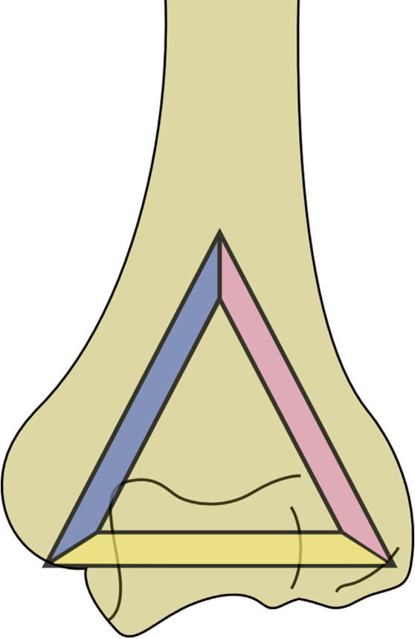
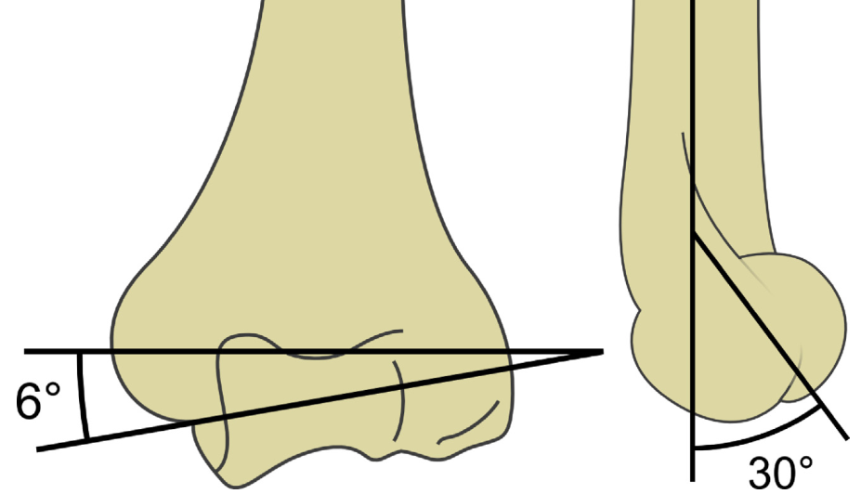
Anatomy
Essential Architecture:
3 columns forming a triangle.
Mechanical restoration of the columns and articular surface is essential
Internal Rotation 5-7º
Valgus 5-8º
Recurvatum 30º
medial column
side column
Articulate
Figures courtesy of AO Foundation

Slide 7
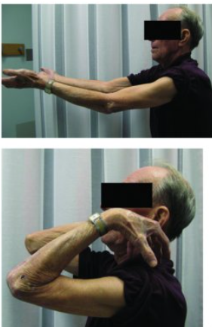
Dynamic structures are important:
Lateral epicondyle - collateral ligament and muscles: supinators and extensors
Medial epicondyle (most prominent) - ulnar collateral ligament and muscles: pronators and flexors
Normal ROM is 0⁰ extension to 140⁰ flexion
Functional ROM is 30⁰ to 130⁰
Photos from Athwal GS and Raniga S. Distal Humerus Fractures. In: Tornetta P, Ricci WM, eds.
Rockwood and Green's Fractures in Adults, 9e. Philadelphia, PA. Wolters Kluwer Health, Inc; 2019

Slide 8
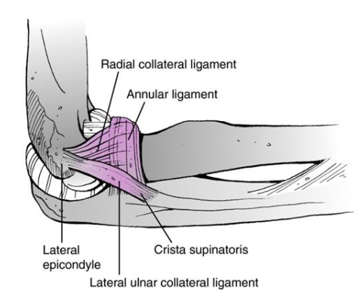
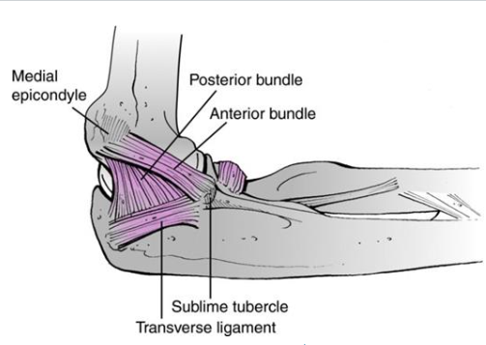
Lateral View
Medial View
Illustrations from Athwal GS and Raniga S. Distal Humerus Fractures. In: Tornetta P, Ricci WM, eds.
Rockwood and Green's Fractures in Adults, 9e. Philadelphia, PA. Wolters Kluwer Health, Inc; 2019

Slide 9
Clinical Evaluation
History of trauma
Deformity and pain
Neurovascular exam: ulnar nerve
Monitored for development of compartment syndrome: Pain with passive stretch, paleness, pulse and pressure

Slide 10
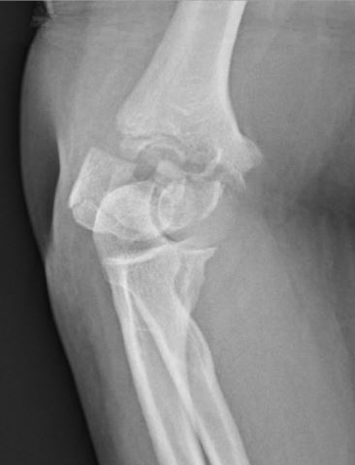
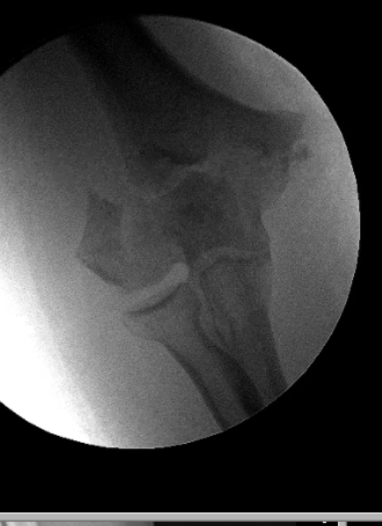
Images
Xrays - AP and Lateral
gold standard
difficult on occasion because of the pain
Traction Xray helps identify components
CT scan assists with proper articular visualization

Slide 11
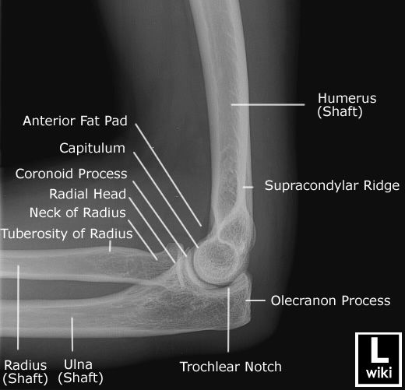
AP Xray Lateral Xray

Slide 12
OTA/AO Classification
Extra Articular
Partial Articular
Includes isolated capitellum and trochlea fractures
Complete Articular
C1 simple articular and metaphyseal
C2 simple articular and multifragmentary metaphyseal
C3 multifragmentary articular

Slide 13
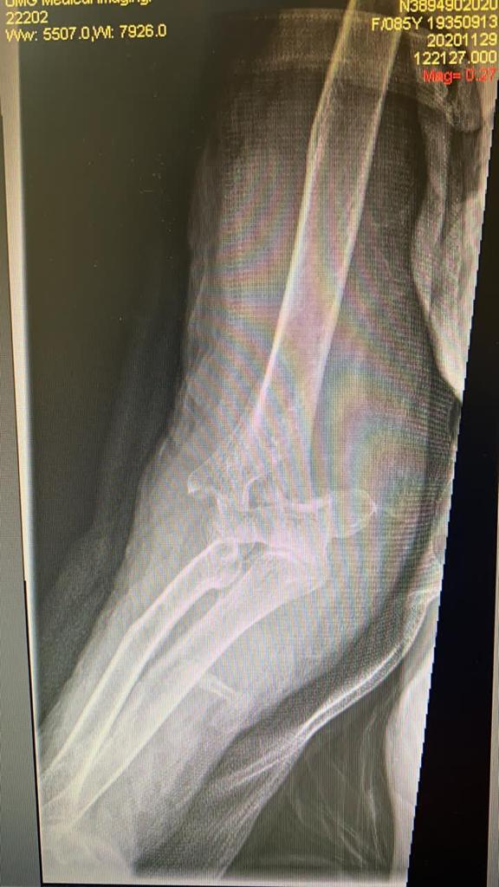
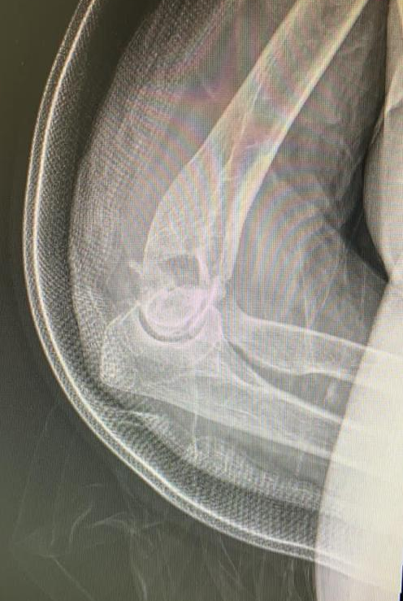
AO. 13 A 2. 2

Slide 14
Therapeutic Approach
This injury is often the result of high-energy accidents so it requires a comprehensive assessment ATLS
I. Conservative Treatment
Patients at high surgical risk
Low physical demand (non-dominant arm)
Complications include:
Loss of motion
Chronic pain
Nonunion
Aesthetic issues

Slide 15
Nonoperative treatment
Indications
Minimal/no displacement and stable fracture
No nerve or vessel injury
Unacceptable surgical risk
Supracondylar humeral fractures in children – type 1
Contraindications
Noncompliant patient
Displacement
Advantages
Avoid surgical risks
Disadvantages
Risk of secondary displacement
Immobilization
Subsequent joint stiffness
Patient discomfort

Slide 16
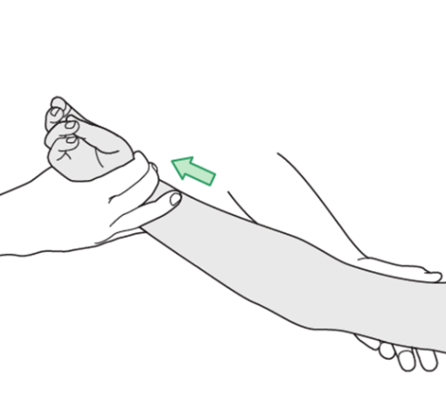
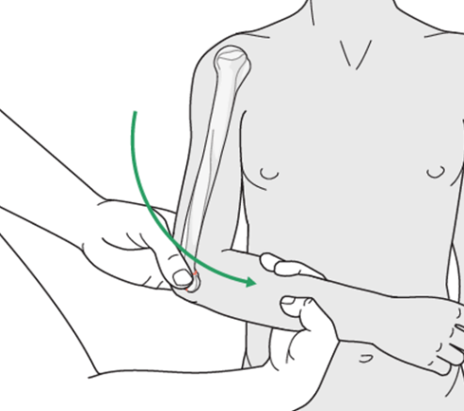
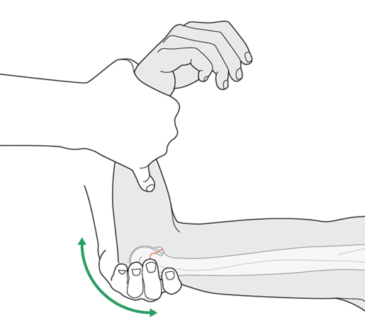
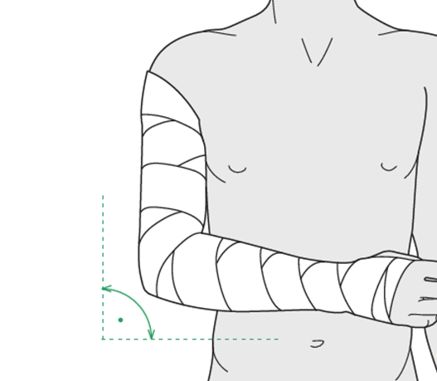
Closed Reduction and Splinting
For pediatric supracondylar humerus fractures, or in situations where operative treatment is not a possibility for adult patients
Distract with traction
Flex elbow
Correct rotation
Immobilize the elbow in 90° flexion and the forearm in neutral rotation.
Follow up The patient should be seen weekly for follow-up examination and x-rays for 4 weeks, and thereafter every 4-6 weeks, until union is secure and full functional range of motion and strength have returned.
Load bearing Minimum of 6-8 weeks after the fracture.
Figures courtesy of surgeryreference.aofundation.org.
Apply splint

Slide 17
Surgical
Indications - Most fractures:
Difficult to reduce
Difficult to maintain by external means
Frequently articular
Anatomic reduction
Stable fixation
Early mobilization
Key points

Slide 18
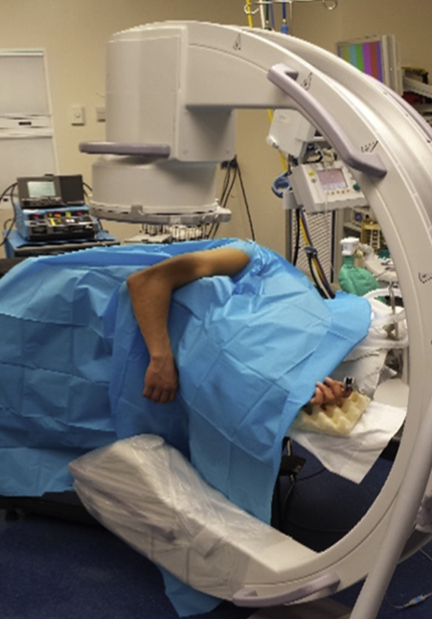
Lateral Positioning
Regional anesthesia may be employed, for the management of post-surgical pain
Lateral beanbag, elbow in flexion
C-arm
Arm over bolster – allows gravity to assist in maintaining reduction - ligamentotaxis
A mayo stand cover may be used to collect drainage

Slide 19
Prone Positioning
Allows easier access with C-arm for imaging
Gravity ligamentotaxis
In general less favored by anesthesia
Facilitates bilateral surgery

Slide 20
ORIF
a. Olecranon Osteotomy (Chevron).
View 57% of articular surface
Reintervention 8-13% for non-union
Useful in type B3 and C, especially when articular surface is multifragmentary
Finishing cut with an osteotome creates more irregular ends to allow for interdigitation
Complications:
Nonunion
Prominent hardware
Inraoperative images from Athwal GS and Raniga S. Distal Humerus Fractures. In: Tornetta P, Ricci WM, eds.
Rockwood and Green's Fractures in Adults, 9e. Philadelphia, PA. Wolters Kluwer Health, Inc; 2019

Slide 21
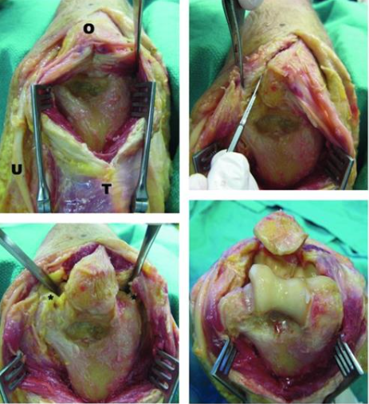
b. Triceps Split
Advantages
Does not disrupt extensor mechanism
Preserve bone
Avoids the possibility of prominent osteotomy fixation
Disadvantages
More limited view than osteotomy
May limit ability to perform osteotomy if needed
McKee et al (JBJS Br 2000) : The use of a triceps-splitting approach did not compromise the quality of the reduction
Inraoperative images from Athwal GS and Raniga S. Distal Humerus Fractures. In: Tornetta P, Ricci WM, eds.
Rockwood and Green's Fractures in Adults, 9e. Philadelphia, PA. Wolters Kluwer Health, Inc; 2019

Slide 22
Approaches
Wilkinson (Wilkinson JM, Stanley D 2001) reported no differences in functional outcome after treatment of closed intra-articular fractures of the distal humerus through either of these approaches
In some open fracture, it seems logical that incorporating the defect in the triceps into the surgical approach may involve less trauma and give a better functional outcome than compromising the extensor mechanism further by performing an olecranon osteotomy.
Triceps-splitting procedures are simpler to perform but critics suggest that they offer a limited exposure
Whatever approach is used, the ulnar nerve must be dissected free to prevent injury.

Slide 23
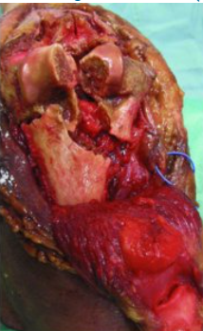
What to do with the ulnar nerve?
Identify and protect
Decompress and release
Translate: Controversial! doing so is decided intraoperatively
Chen reports up to 33% neuritis in those that don't translate
No difference if the patient had no symptoms pre-operatively
In a large RCT, the Ulnar Nerve Entrapment Score, the Mayo Elbow Performance Score (MEPS), VAS and 2-point discrimination were not significantly different at any time point between patients who underwent did and did not undergo anterior transposition,
Dehghan et at, J Orthop Trauma, 2021
Inraoperative image from Athwal GS and Raniga S. Distal Humerus Fractures. In: Tornetta P, Ricci WM, eds.
Rockwood and Green's Fractures in Adults, 9e. Philadelphia, PA. Wolters Kluwer Health, Inc; 2019

Slide 24
Operative Technique
Identify the anatomy and mechanism of the fracture
The most important thing is joint congruence (remembering anatomy)
Gentle handling of soft tissues and ulnar nerve
Provisional reduction and stabilization of articular block with k wires and/or clamps
May further stabilize articular block with 2.0 and 2.7mm that do not interfere with planned plate placement

Slide 25
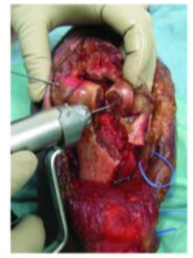
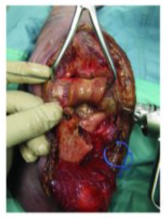
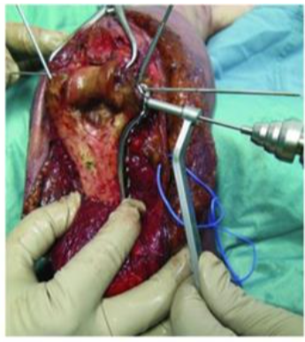
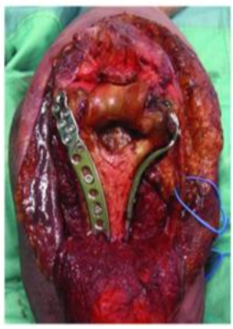
Next, re-establish columns, and attach articular block
Fragments can be used as a graft that increases stability but beware of shortening, which may lead to limitation in extension
Inraoperative images from Athwal GS and Raniga S. Distal Humerus Fractures. In: Tornetta P, Ricci WM, eds.
Rockwood and Green's Fractures in Adults, 9e. Philadelphia, PA. Wolters Kluwer Health, Inc; 2019

Slide 26
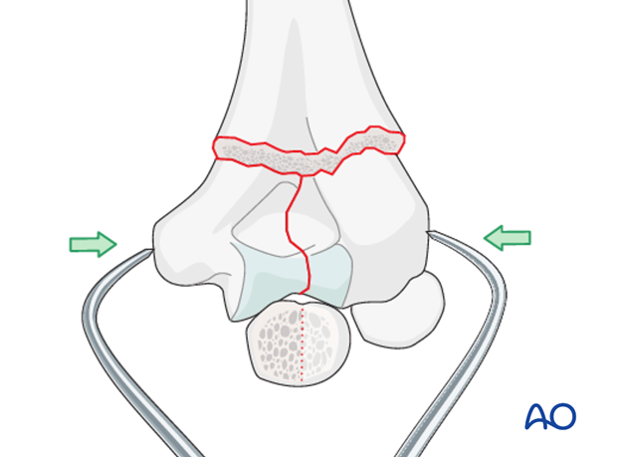
Compression with pointed reduction forceps
Reduction and provisional fixation
Figures courtesy of AO Foundation

Slide 27
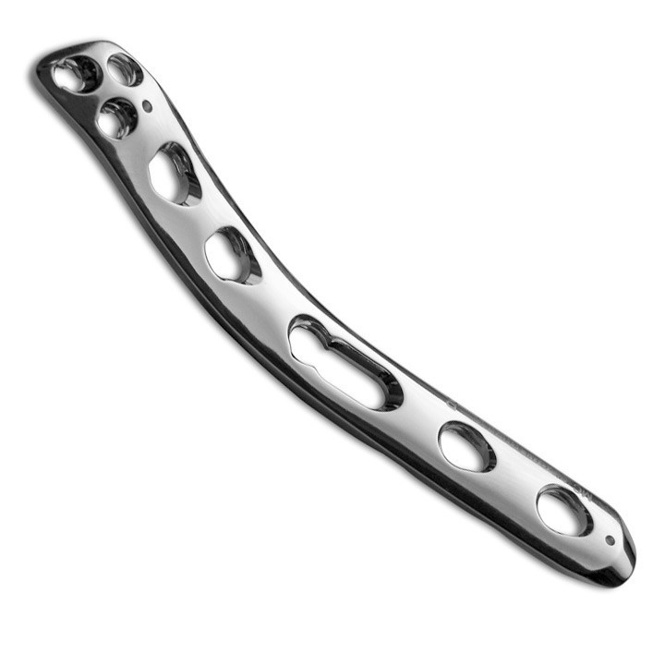
Implant
Plate
Anatomic: allows more screws in distal segment
Reconstruction: easier to mold
DCP 3.5: difficult to shape
Figures courtesy of AO Foundation

Slide 28
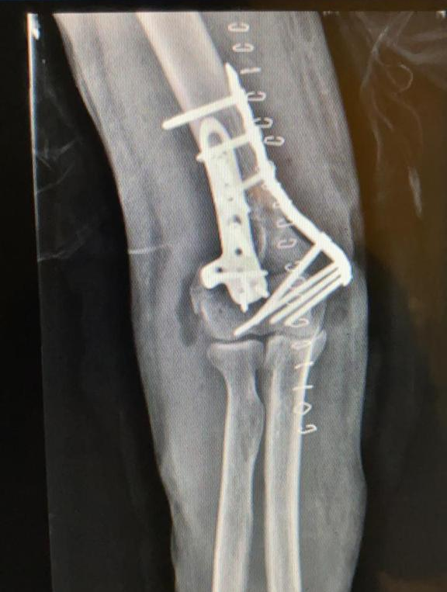
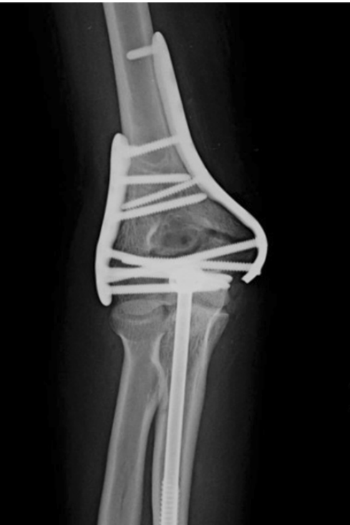
Surgery
Consensus in surgical management is dual column plates
The optimal plate configuration has been controversial. The two proposed
constructs are parallel and orthogonal (perpendicular) plating

Slide 29
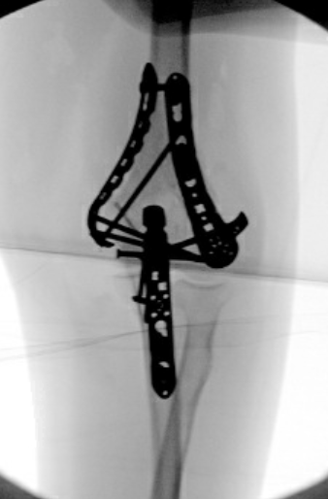
Parallel configuration
Demonstrates more biomechanical stability (Douglas et al. JOT 2016)
More stable to rotation
Perpendicular configuration
May be useful in fractures with coronal plane fracture of the lateral components (i.e. capitellum fracture)

Slide 30
Plate Configuration
Remember the personality of the fracture
It's not a cookbook recipe
Both configurations are uesful when applied thoughtfully

Slide 31
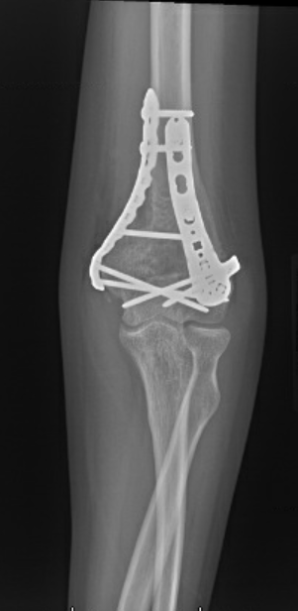
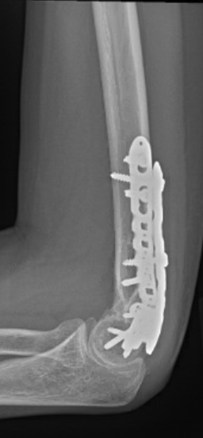
Post surgery
Early motion is important!
Some surgeons Will place in splint at 60º of flexion for 10 – 14 days
Gradual mobilization 2- 6 weeks
Xrays: no clear evidence
6 week
12 week

Slide 32
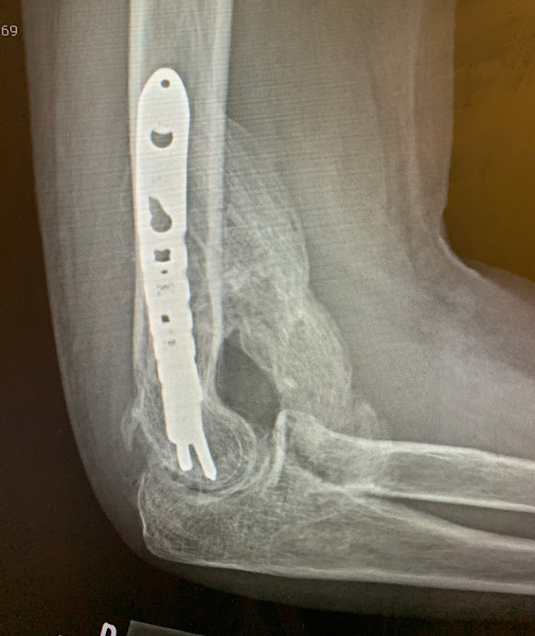
Complications
61% at 15 months (Nydick et al. 2020)
heterotopic ossification, beware especially in patients with head injury
Nerve injury (Ulnar 38% Ilyas et al. 2012)
Contracture: key to prevention is early mobilization
Prominent hardware – usually in cases of olecranon osteotomy and fixation
Infection – rare
Nonunion – osteotomy nonunion is rare with proper technique (2% in Ring’s series (JOT 2004))

Slide 33
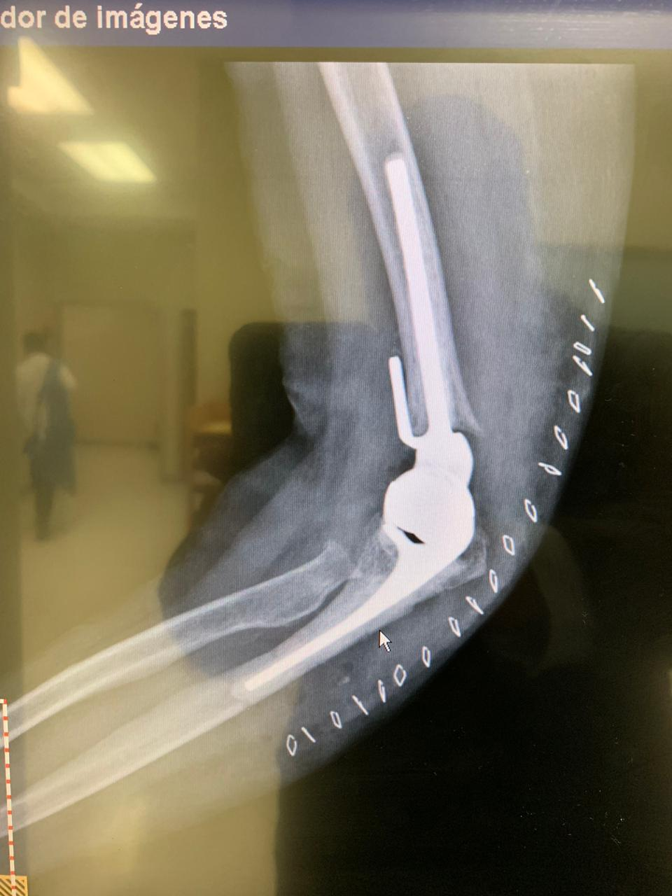
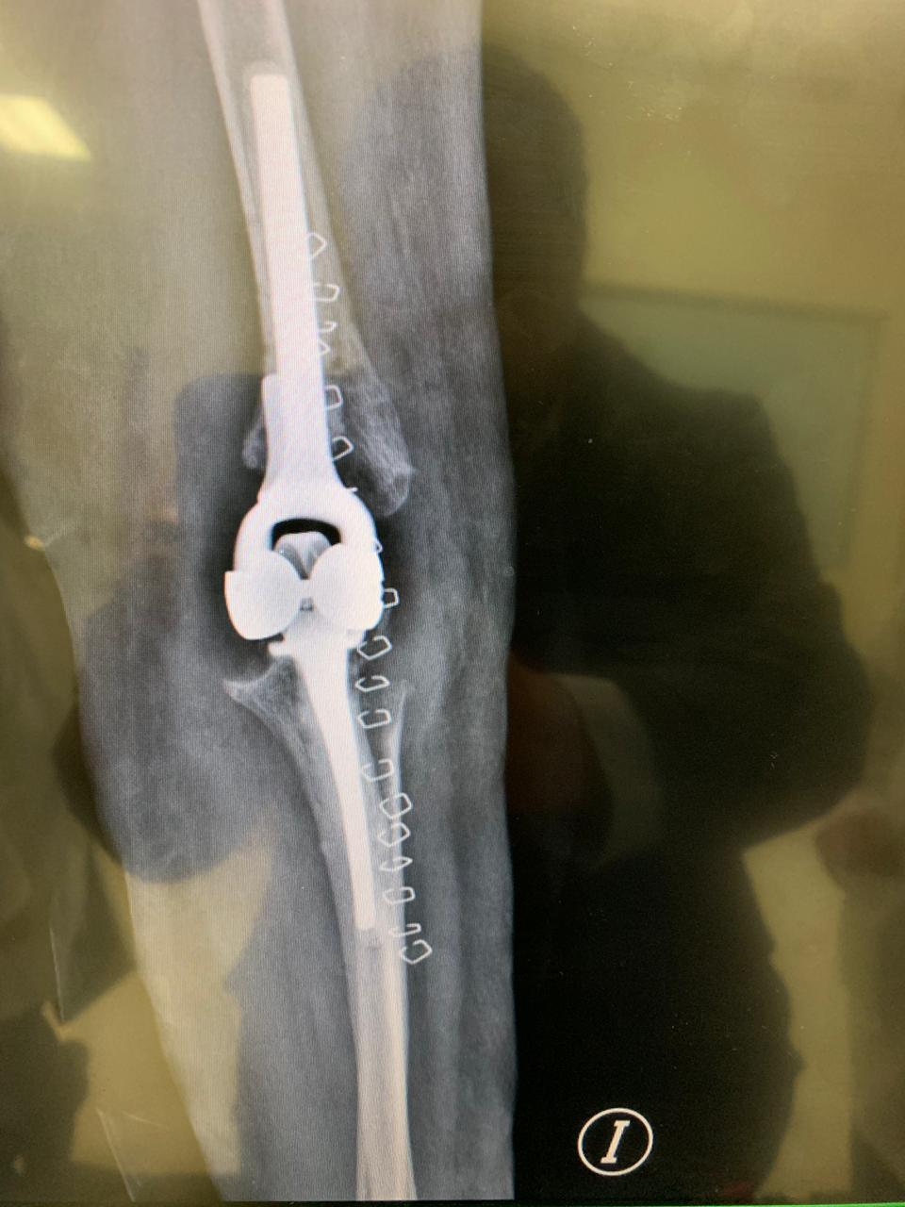
Total Elbow Replacement
Indication: Elderly, low functional demand patients with unreconstructable joint
Average age 72 years, arthritis 65 years
Elderly patients have an increased baseline DASH score and appear to accommodate to objective limitations in function with time.
McKee et al, JSES 2009

Slide 34
CONCLUSIONS
Young people (average 35 years) 92% excellent results
ORIF has worse outcome in those >65 – consider prosthesis in complex articular injuries
Difficult injury to manage due to complex anatomy and complex articular injuries
Dual plating is the gold standard for fixation
With other exposures, olecranon osteotomy may be avoided in most cases

Slide 35
6. Anatomic plate may help by using as template for reduction and for more points of fixation in distal fragments
7. Fracture personality guides plate orientation
8. Release and protect ulnar nerve – do not transpose routinely

Slide 36
THANK YOU

Slide 37
Basic References
Robinson CM, Hill RM, Jacobs N, Dall G, Court-Brown CM (2003) Adult distal humeral metaphyseal fractures: epidemiology and results of treatment. J Orthop Trauma 17:38–47
Charalampos G. Zalavras & Efthymios Papasoulis. (2018) Intra-articular fractures of the distal humerus—a review of the current practice. International Orthopaedics https://doi.org/10.1007/s00264-017-3719-4
Wilkinson JM, Stanley D (2001) Posterior surgical approaches to the elbow: a comparative anatomic study. J Shoulder Elb Surg 10:380–382
Ramsey ML, Bratic AK, Getz CL, et al.(2006) Open reduction and internal fixation of distal humerus fractures. Tech Shoulder Elbow Surg :44–51.
Webb L. Fractures of the distal humerus. In: Rockwood CA Jr, Gree DP, Bucholz RW, et al, editors. Fractures in adults. Philadelphia: Lippincott-Raven; 2001. p. 953–72
Mark A. Mighell, Brent Stephens, Geoffrey P. Stone, Benjamin J. Cottrell, (2015). Distal Humerus Fractures Open Reduction Internal Fixation
Pollock JW, Athwal GS, Steinmann SP. (2008) Surgical exposures for distal humerus fractures: a review. Cliin Anat:757–68
J. Korner, H. Lill, L.P. Muller, P.M. Rommens, E. Schneider, B. Linke, The LCPconcept in the operative treatment of distal humerus fractures–biological, biomechanical and surgical aspects, Injury 34 (Suppl 2) (2003) B20–B30
Xianbin Yu1, Linzhen Xie1, Jinwu Wang1, Chunhui Chen, Chuanxu Zhang, Wenhao Zheng (2019). Orthogonal plating method versus parallel plating method in the treatment of distal humerus fracture: A systematic review and meta-analysis. International Journal of Surgery 69. 49-60
ATLS, Apoyo Vital Avanzado en Trauma 10. Manual para el alumno.
Bustamante-Suárez de Puga D, Cebrián-Gómez R, Villegas-Robles E, Sanz-Reig J, Más-Martínez J, Verdú-Román CM, Morales-Santías M, Martínez-Giménez E (2017). Rigidez postraumática de codo: resultados a corto plazo de la artrólisis artroscópica Acta Ortopédica Mexicana 2017; 31(5): Sep.-Oct: 233-238
Worden A, Ilyas AM. Ulnar neuropathy following distal humerus fracture fixation. Orthop Clin North Am 2012;43(4):509–14.
Imagen 1, 2 <iframe src="https://assets.pinterest.com/ext/embed.html?id=397724210815399183" height="433" width="345" frameborder="0" scrolling="no" ></iframe>
McKee MD, Kim J, Kebaish K, Stephen DJ, Kreder HJ, Schemitsch EH. Functional outcome after open supracondylar fractures of the humerus. The effect of the surgical approach. J Bone Joint Surg Br. 2000 Jul;82(5):646-51. doi: 10.1302/0301-620x.82b5.10423. PMID: 10963158.

