Slide 1
Radial Head and Neck Fractures
Thomas Krupko M.D.
Assistant Professor – Orthopaedic Trauma
University of Florida

Slide 2
Objectives
Anatomy
Elbow Instability
Radial head fractures
Classification
Treatment
Radial neck fractures
Treatment
Essex-Lopresti Injuries

Slide 3
Anatomy

Slide 4
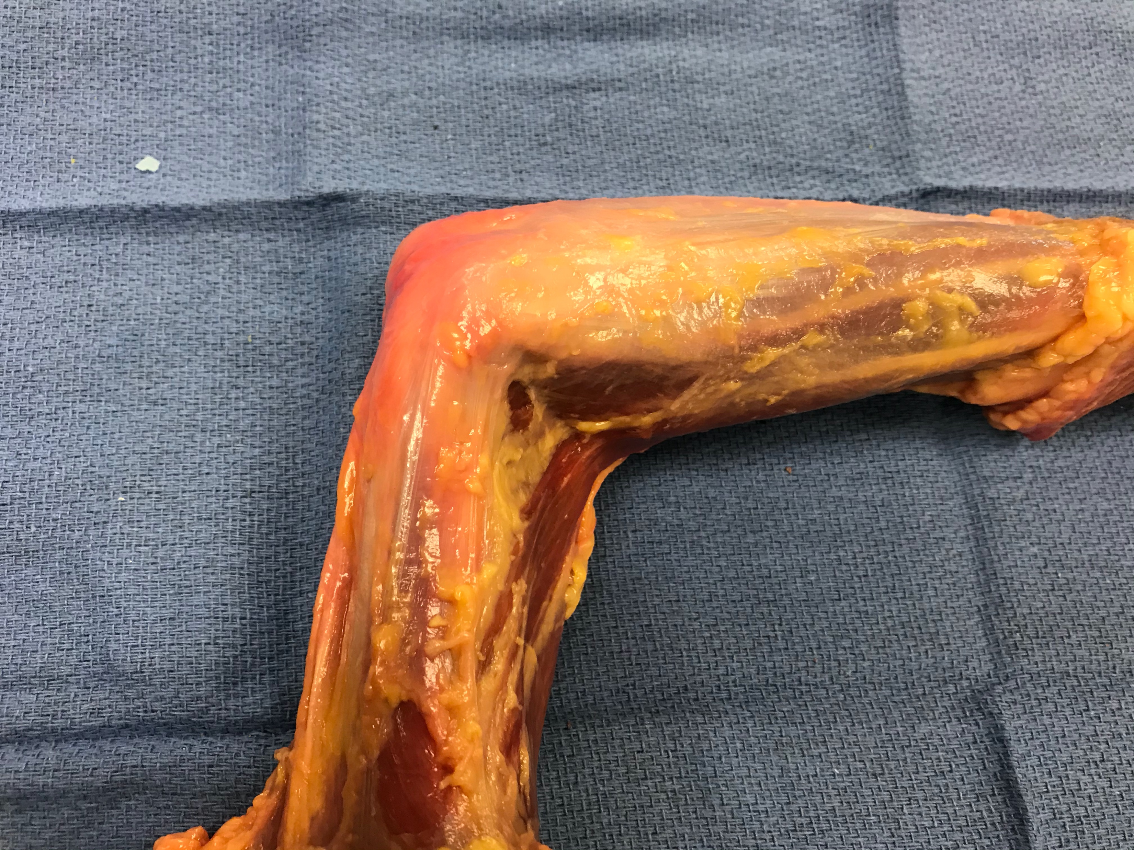
Anatomy – Superficial Lateral Elbow
Biceps
Triceps
Lateral Epicondyle
Common Extensor Origin
Olecranon
Reference: Clinical Library of Thomas Krupko MD

Slide 5
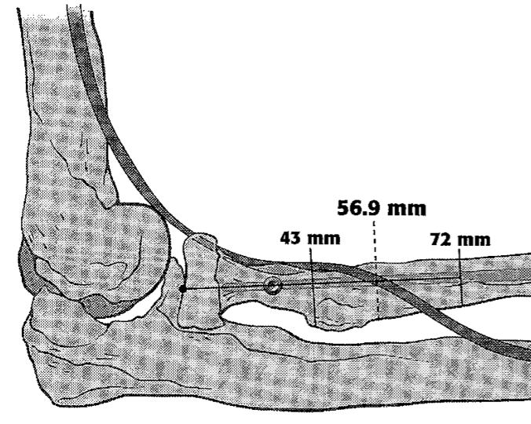
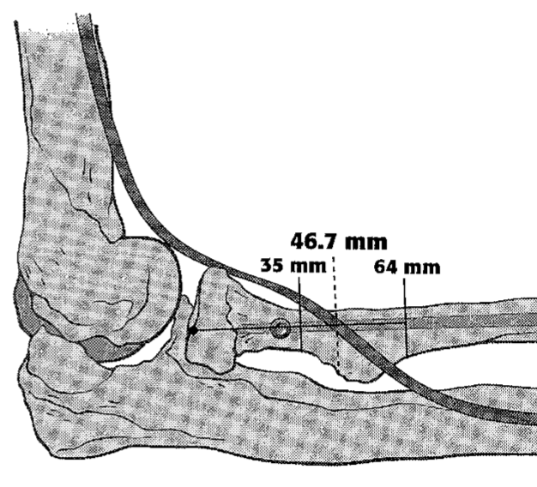
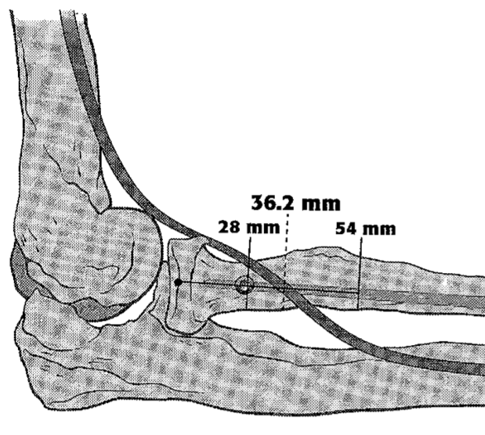
Anatomy - PIN
Pronation
Neutral
Supination
Reference: Tabor Jr, Owen B., et al. "Iatrogenic posterior interosseous nerve injury: is transosseous static locked nailing of the radius feasible?." Journal of orthopaedic trauma 9.5 (1995): 427-429.

Slide 6
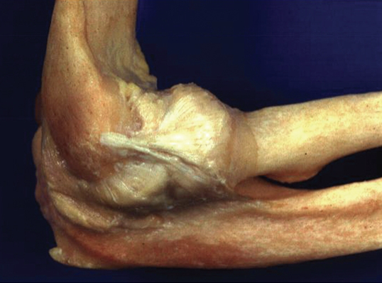
Anatomy – Deep Lateral Elbow
Annular Ligament
Radial Collateral Ligament
LUCL
Reference: Rockwood and Green’s - Figure 32.2

Slide 7
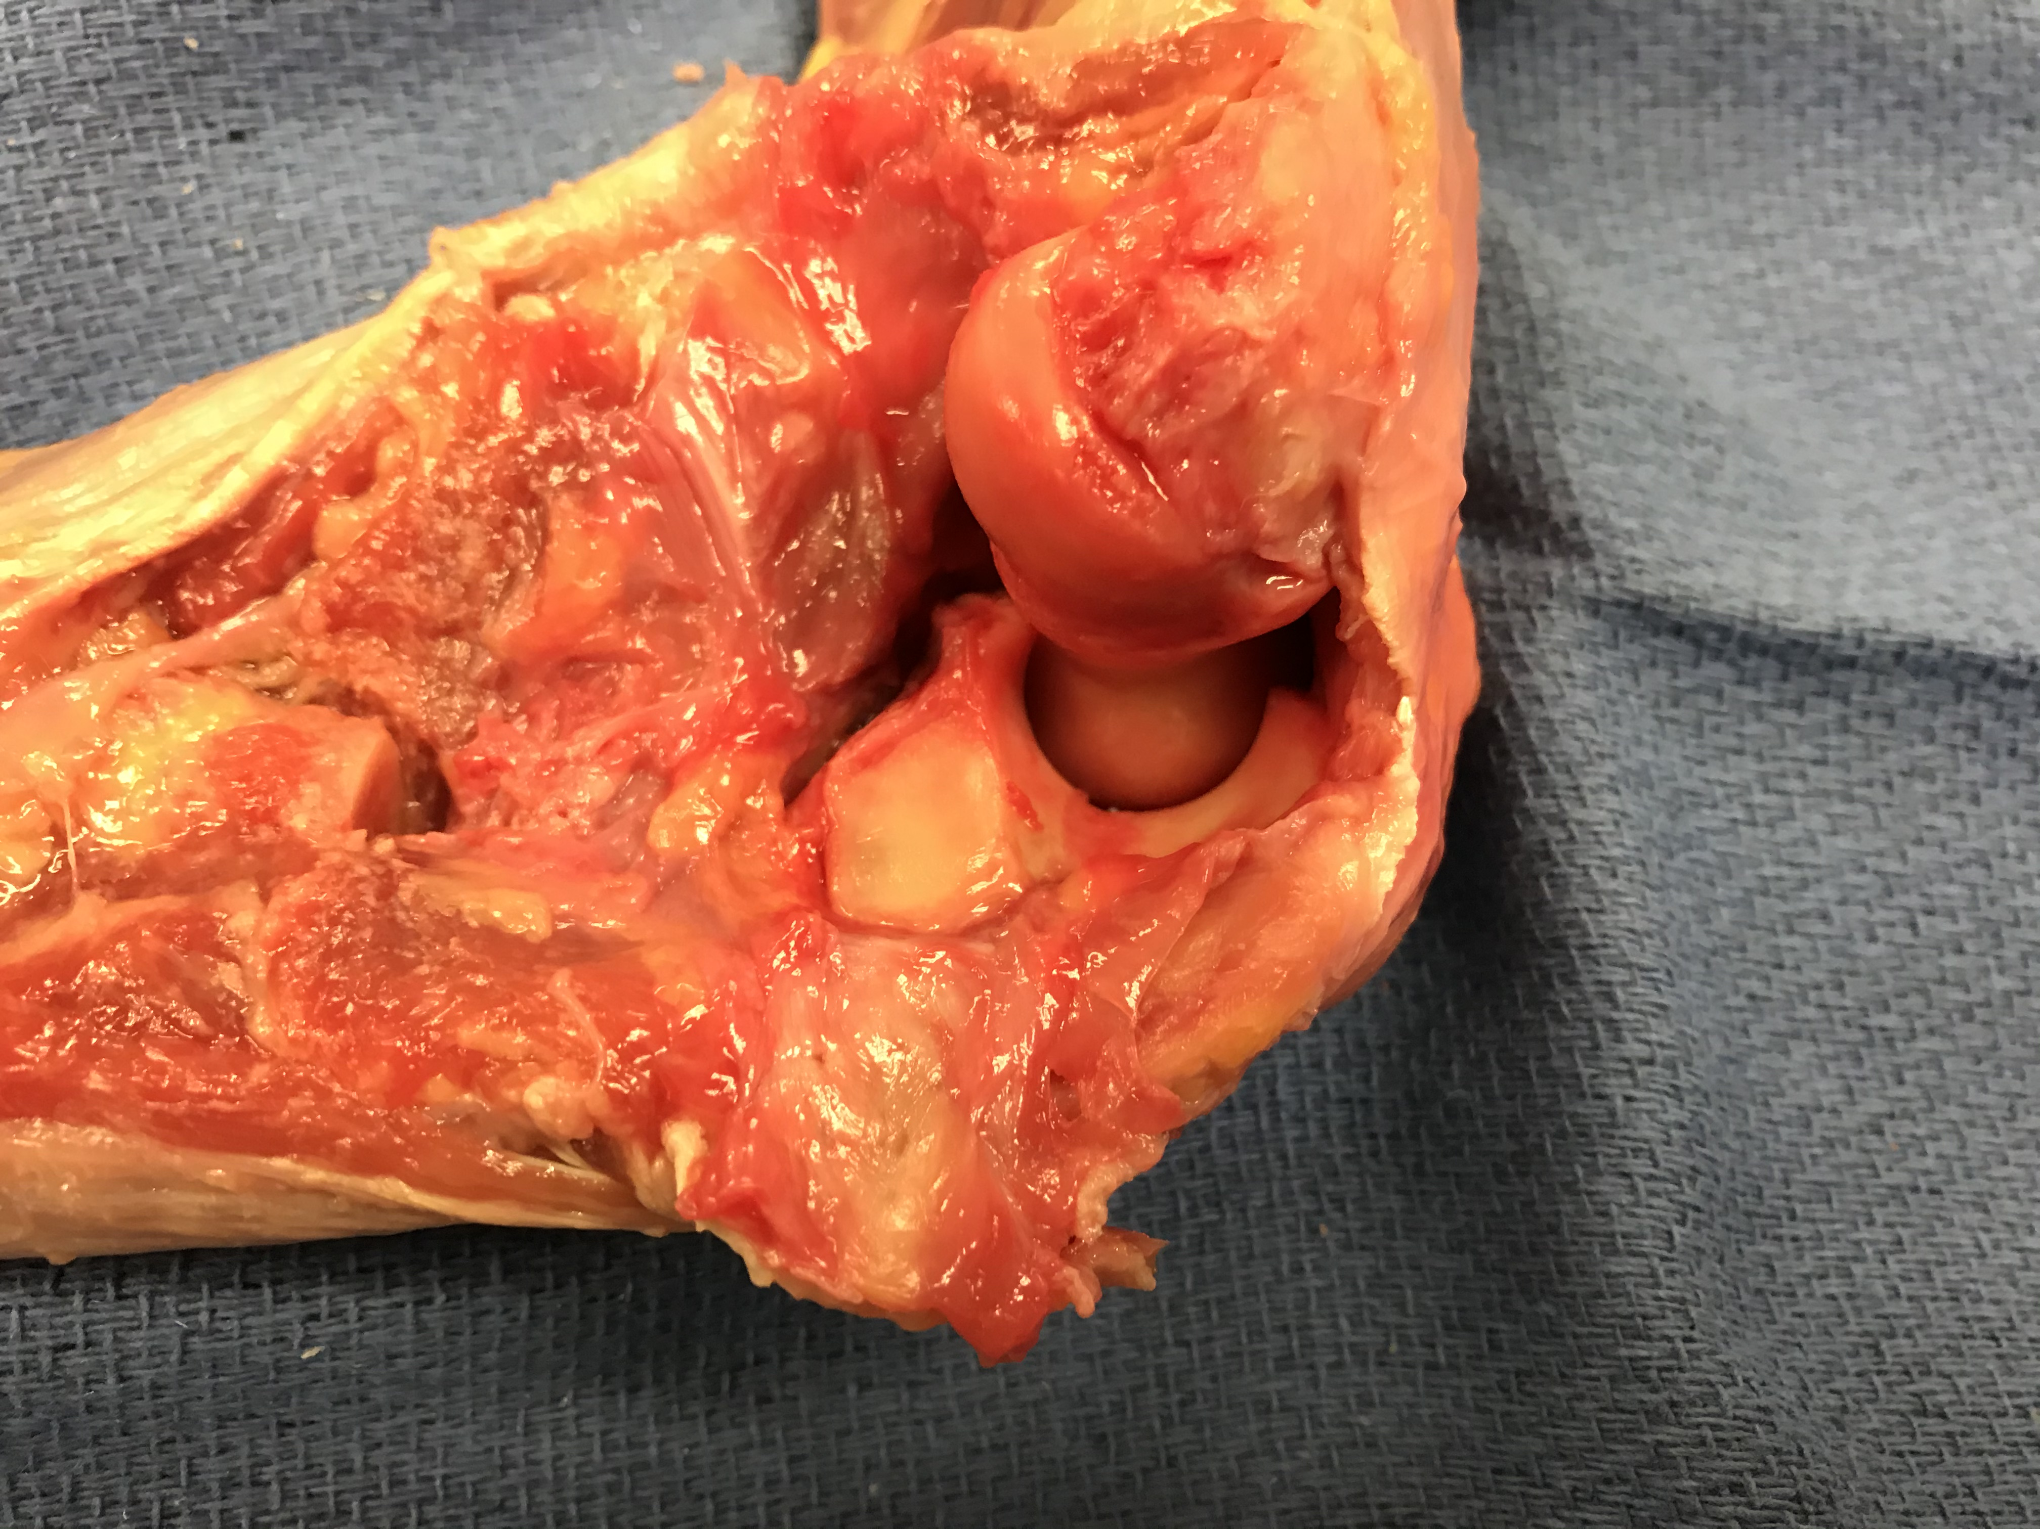
Anatomy – Lateral Elbow
Lateral Epicondyle
Coronoid
Greater Sigmoid Notch
Radial Notch
Radius (head resected)
Olecranon
Supinator Crest
LUCL
Reference: Clinical Library of Thomas Krupko MD

Slide 8
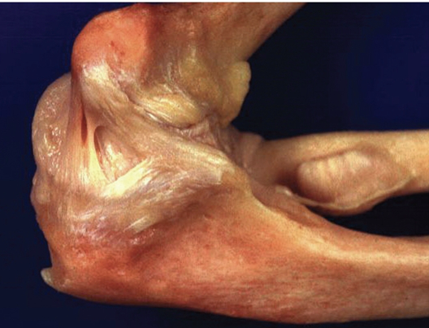
Anatomy – Medial Elbow
Anterior Bundle
Posterior Bundle
Transverse Bundle
Reference: Rockwood and Green’s - Figure 32.2

Slide 9
Elbow Stability

Slide 10
Elbow Stability
Static
Ulno-humeral joint
Radio-humeral Joint
LUCL
Anterior bundle of MCL
Dynamic
Common flexor origin
Common extensor origin
Biceps
Brachialis
Triceps
Radius resists axial load and valgus

Slide 11
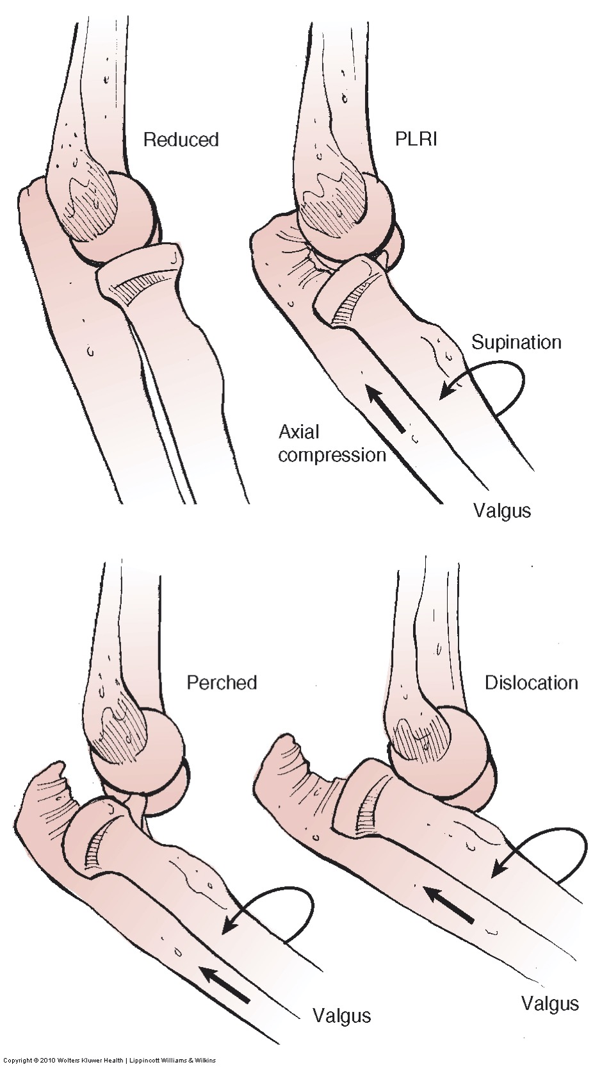
Mechanism of Injury
Typically fall onto outstretched hand
Axial loading
Valgus force
Radial head/neck fractures occur along a spectrum of elbow instability
Any treatment requires complete understanding of the injured bone and soft tissue
CT scan can provide valuable info
Reference: Rockwood and Green’s - Figure 32.16

Slide 12
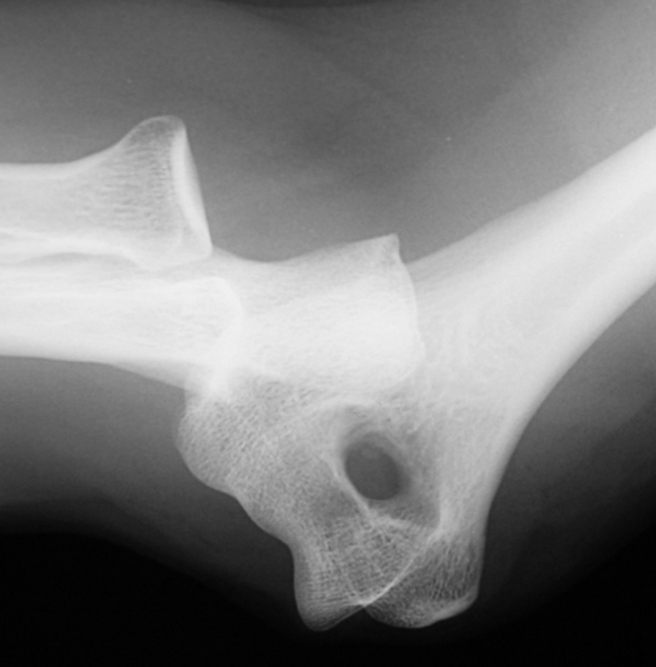
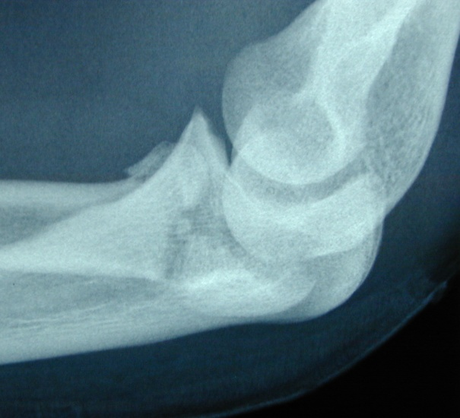
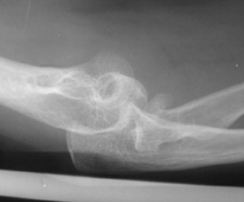
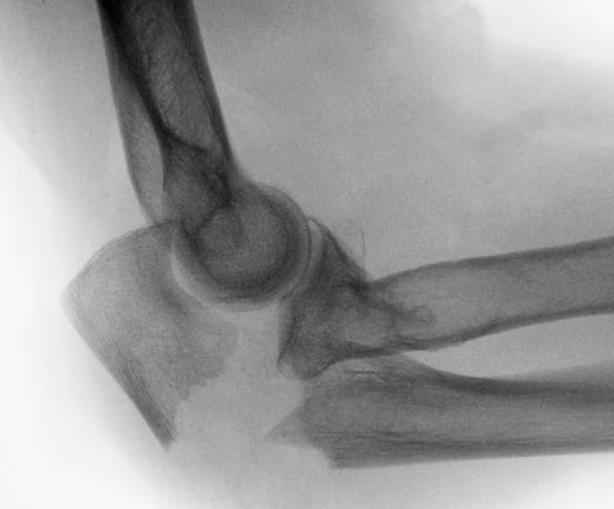
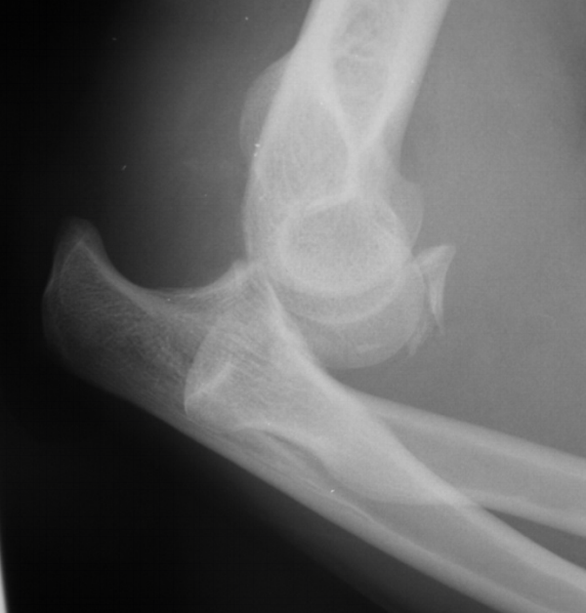
Elbow Instability
Stable
Unstable
Simple dislocation
Radial Head Fx
Radial Head Fx + Dislocation
Post Trans Olecranon Fx Dislocation
Terrible Triad
Reference: Previous OTA Slides

Slide 13
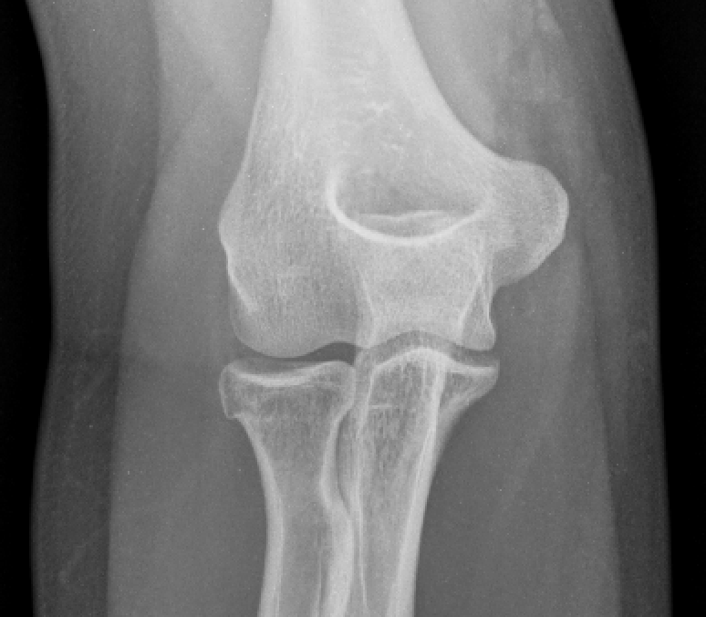
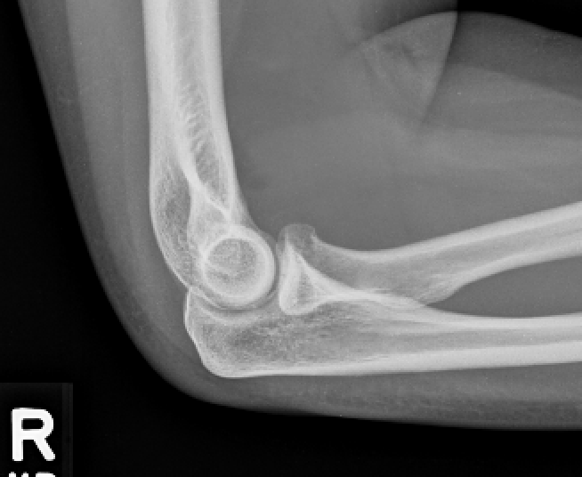
Radial Head Fractures
Mason Classification – Type 1
Non- displaced fx or minimally displaced (<2mm)
No mechanical block to forearm rotation
Reference: Previous OTA Slides and the Clinical Library of Thomas Krupko MD

Slide 14
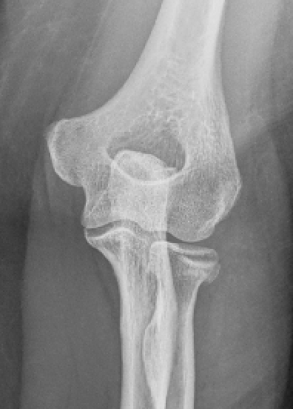
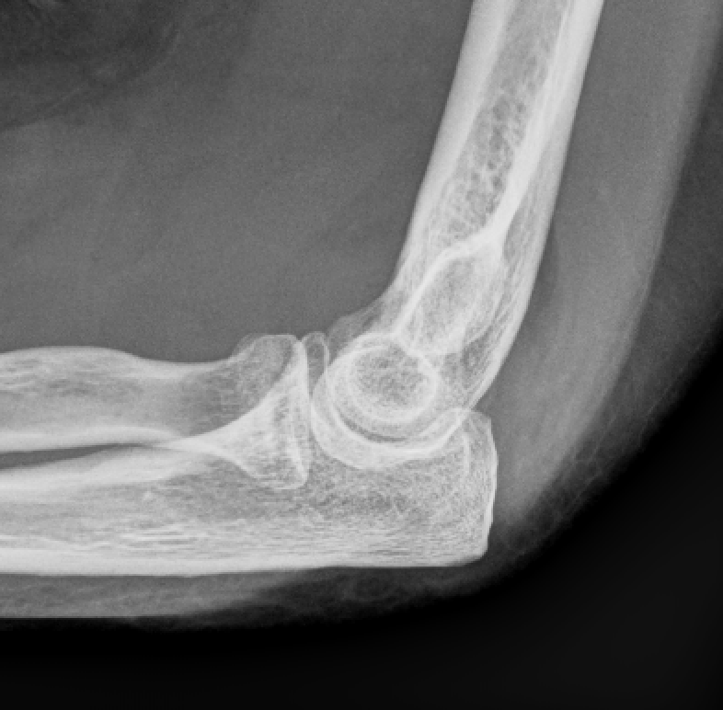
Radial Head Fractures
Mason Classification – Type 2
Displaced >2mm or angulated
Possible block to rotation
Reference: Previous OTA Slides and the Clinical Library of Thomas Krupko MD

Slide 15
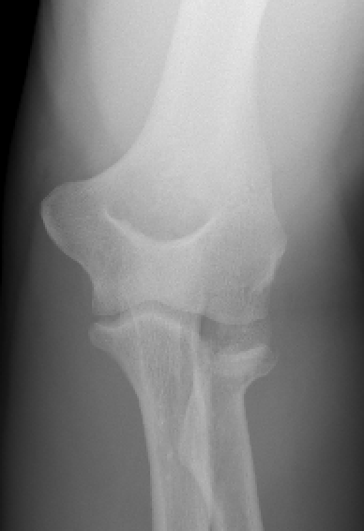
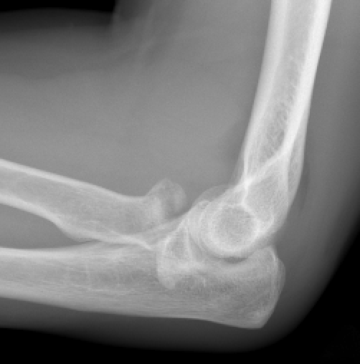
Radial Head Fractures
Mason Classification – Type 3
Comminuted
Displaced
Obvious block to rotation
Reference: Previous OTA Slides and courtesy of Thomas Wright MD

Slide 16
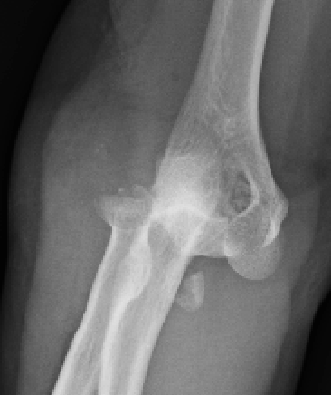
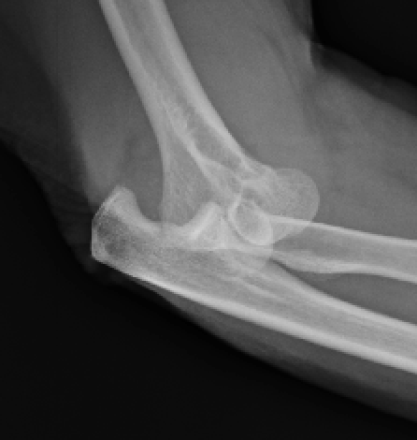
Radial Head Fractures
Mason Classification – Type 4
Hotchkiss Modification
Bridges the gap with more complex elbow instability
Radial head fx with elbow dislocation
Beware LUCL avulsion and coronoid fx (terrible triad)
Reference: Clinical Library of Thomas Krupko MD

Slide 17
Radial Head Fractures – Treatment Algorithm
Fracture Size > 25%
No
Yes
Displacement > 2mm
Displacement > 2mm
No
Yes
No
Yes
Early Motion
Motion Limited
Motion Limited
3 or More Fragments
No
Yes
No
Yes
No
Yes
Early Motion – Close F/U
Excision of Fragment
Early Motion – Close F/U
ORIF
Arthroplasty
Reference: Revised from Previous OTA Slides

Slide 18
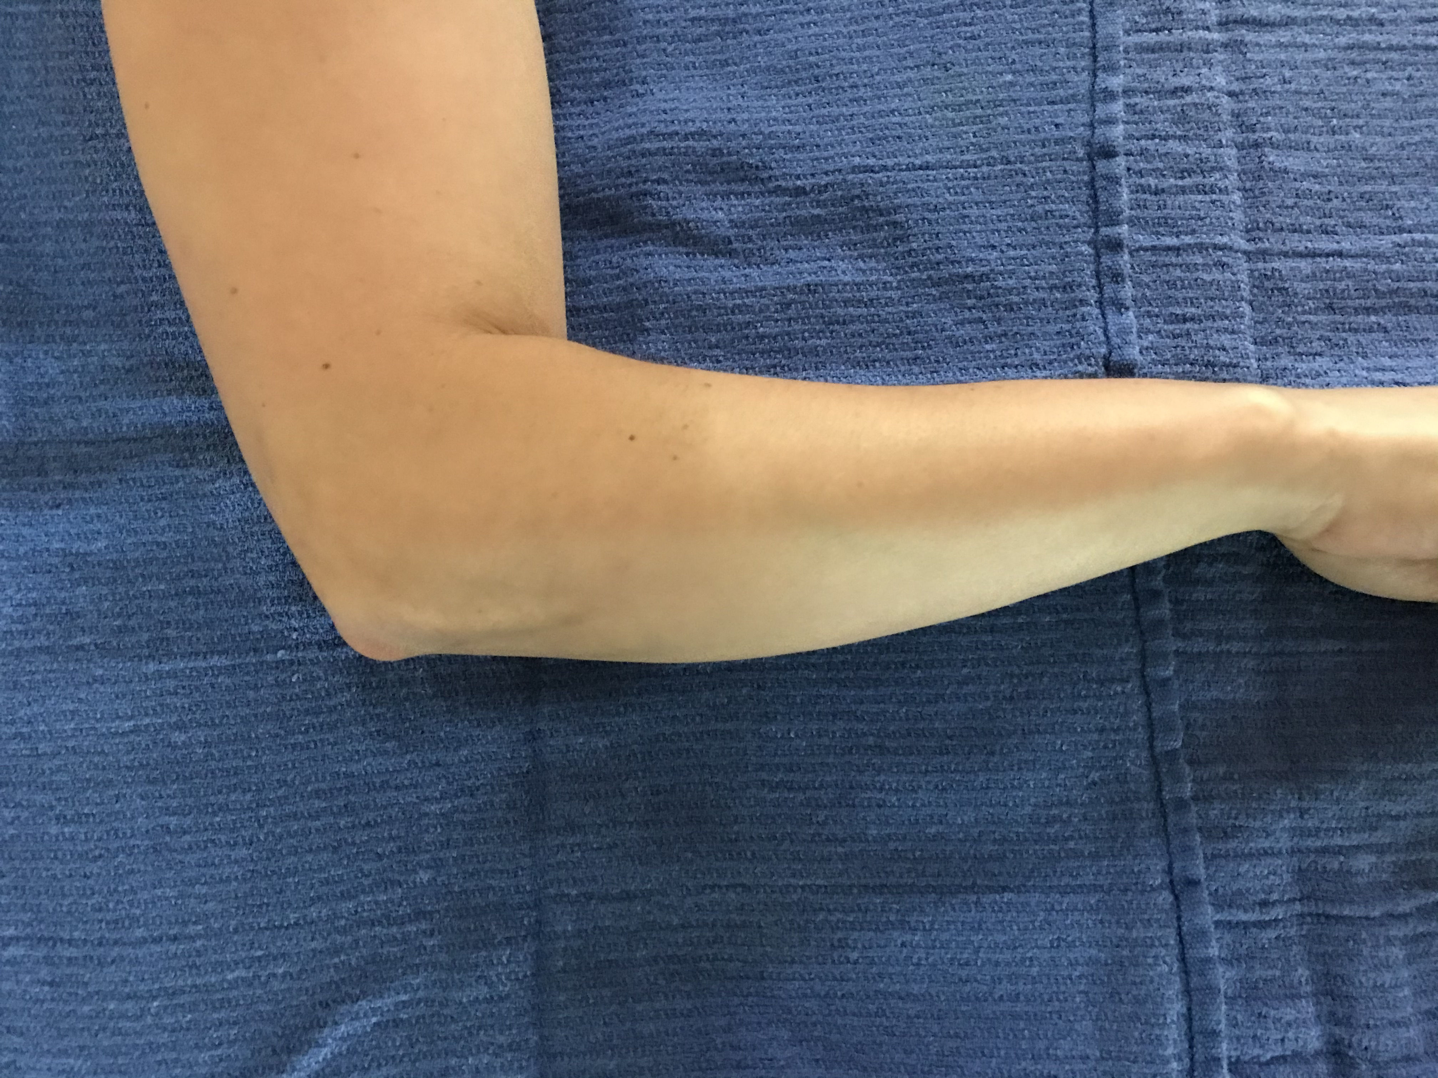
Lateral Elbow – Approaches
Kocher
Most often utilized for radial head
Interval
Anconeus – Radial Nerve
ECU – PIN
5cm incision from lateral epicondyle distally
Angled posteriorly 30-45 degrees
Often deep soft tissues will be disrupted by injury
OTA Online Video
Reference: Clinical Library of Thomas Krupko MD

Slide 19
Lateral Elbow – Approaches
Kocher Pitfalls
Damage to LUCL
Stay on anterior half of radial head
Damage to PIN
Pronate the arm to move nerve distally
Carefully dissect distal to annular ligament
Reference: Rockwood and Green’s - Figure 32.2

Slide 20
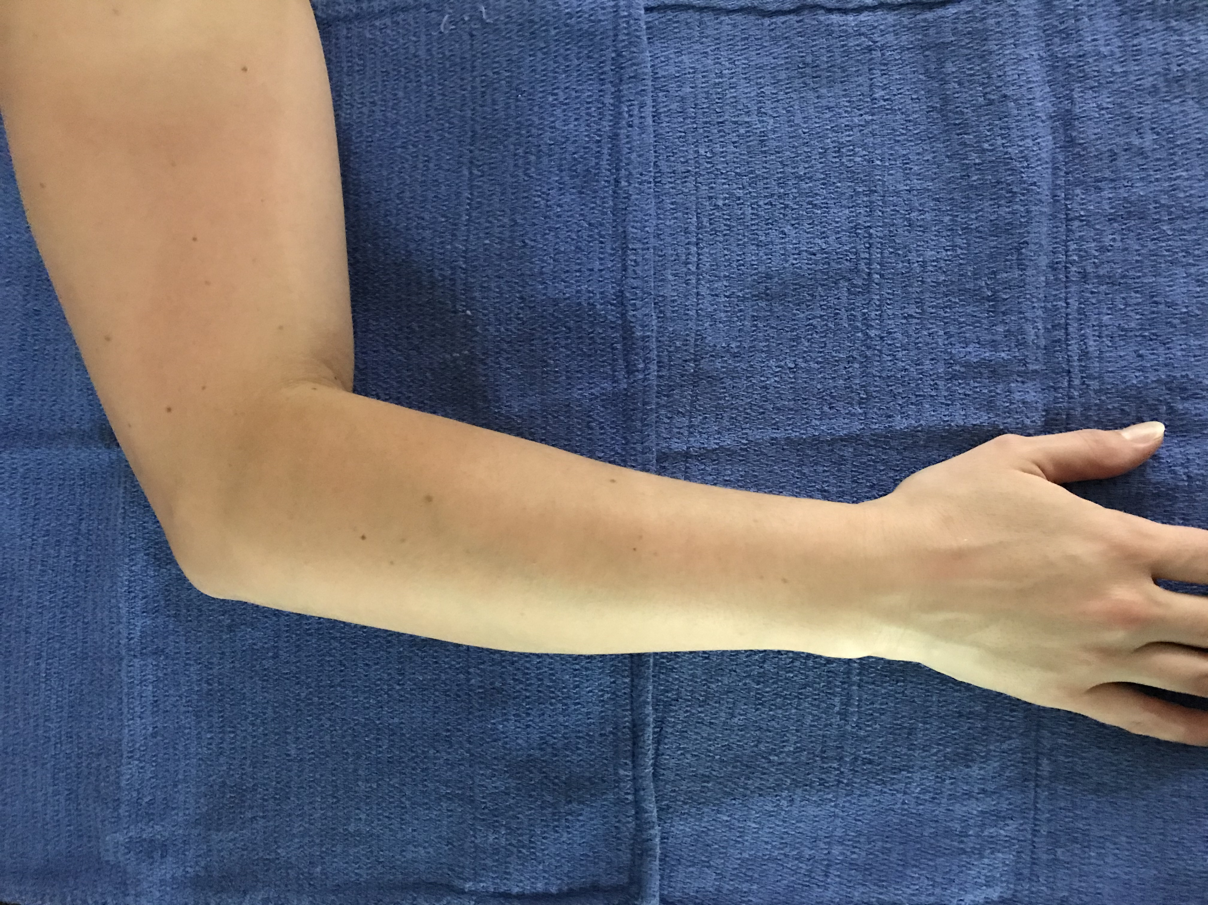
Lateral Elbow– Approaches
Kaplan
Distal extension becomes dorsal Thompson approach
More often used for radial neck/proximal radial shaft fxs
Interval
ECRB – Radial nerve or PIN (variable)
EDC – PIN
10cm incision from lateral epicondyle to Lister’s Tubercle
OTA Online Video
Reference: Clinical Library of Thomas Krupko MD

Slide 21
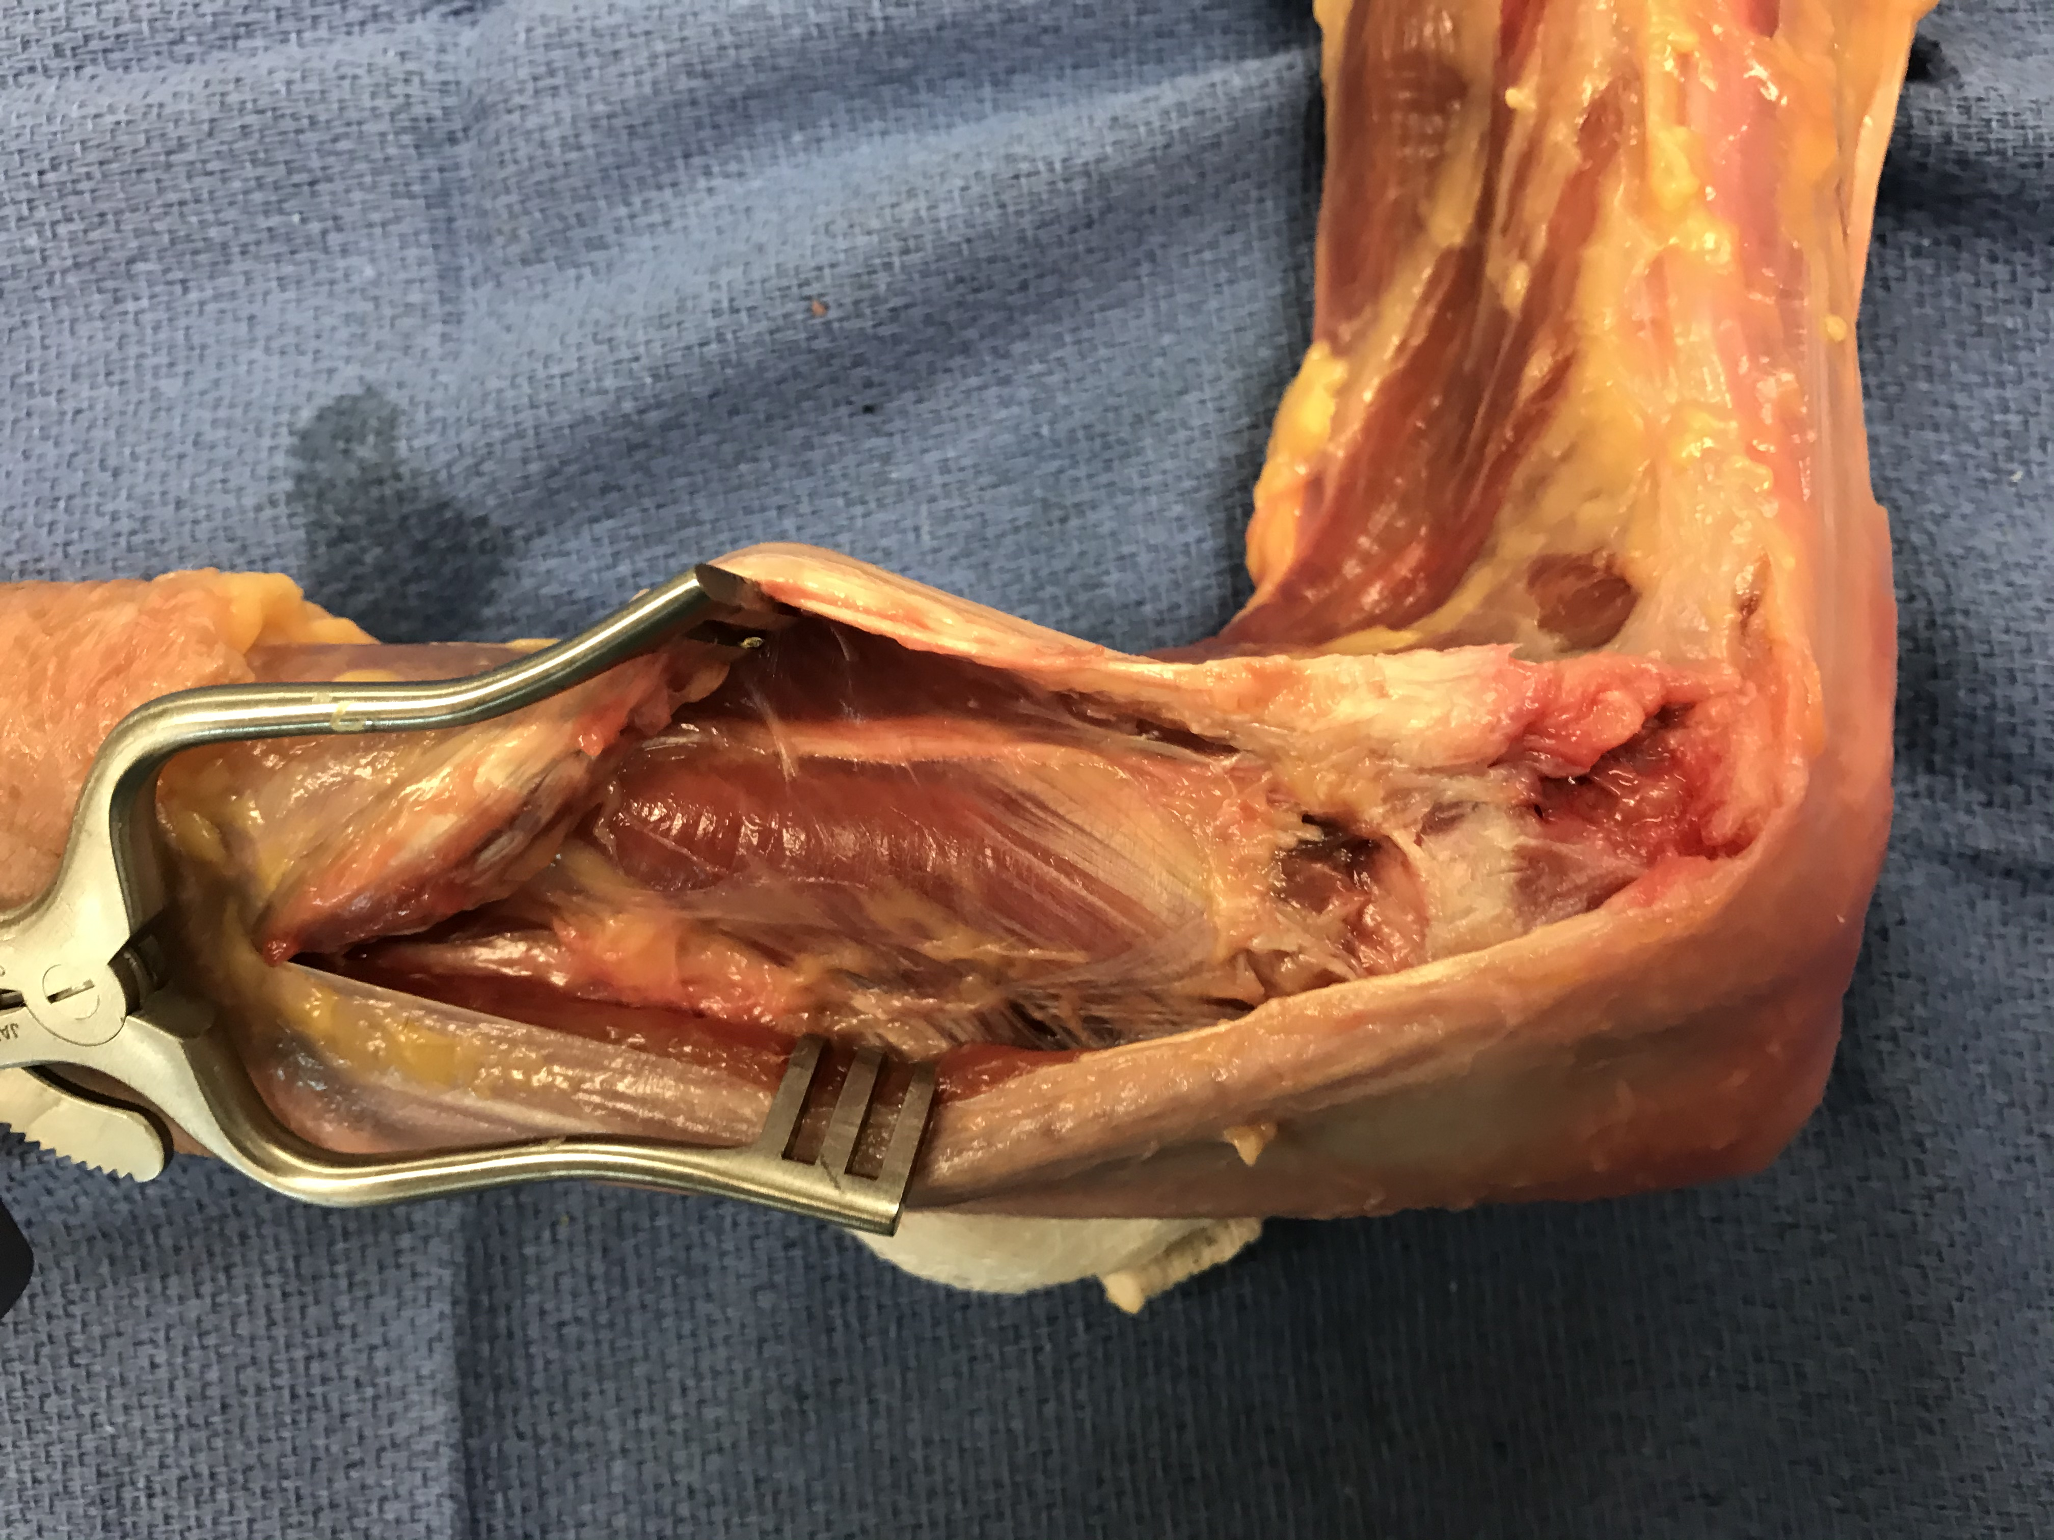
Lateral Elbow– Approaches
Mobile Wad
Supinator
Kaplan Pitfalls
PIN injury
Palpable between two heads of supinator.
Distal dissection can be utilized to locate the nerve (see image)
Can also split supinator (next slide)
Lateral Epicondyle
Dorsal Compartment
Find PIN here!
Reference: Clinical Library of Thomas Krupko MD

Slide 22
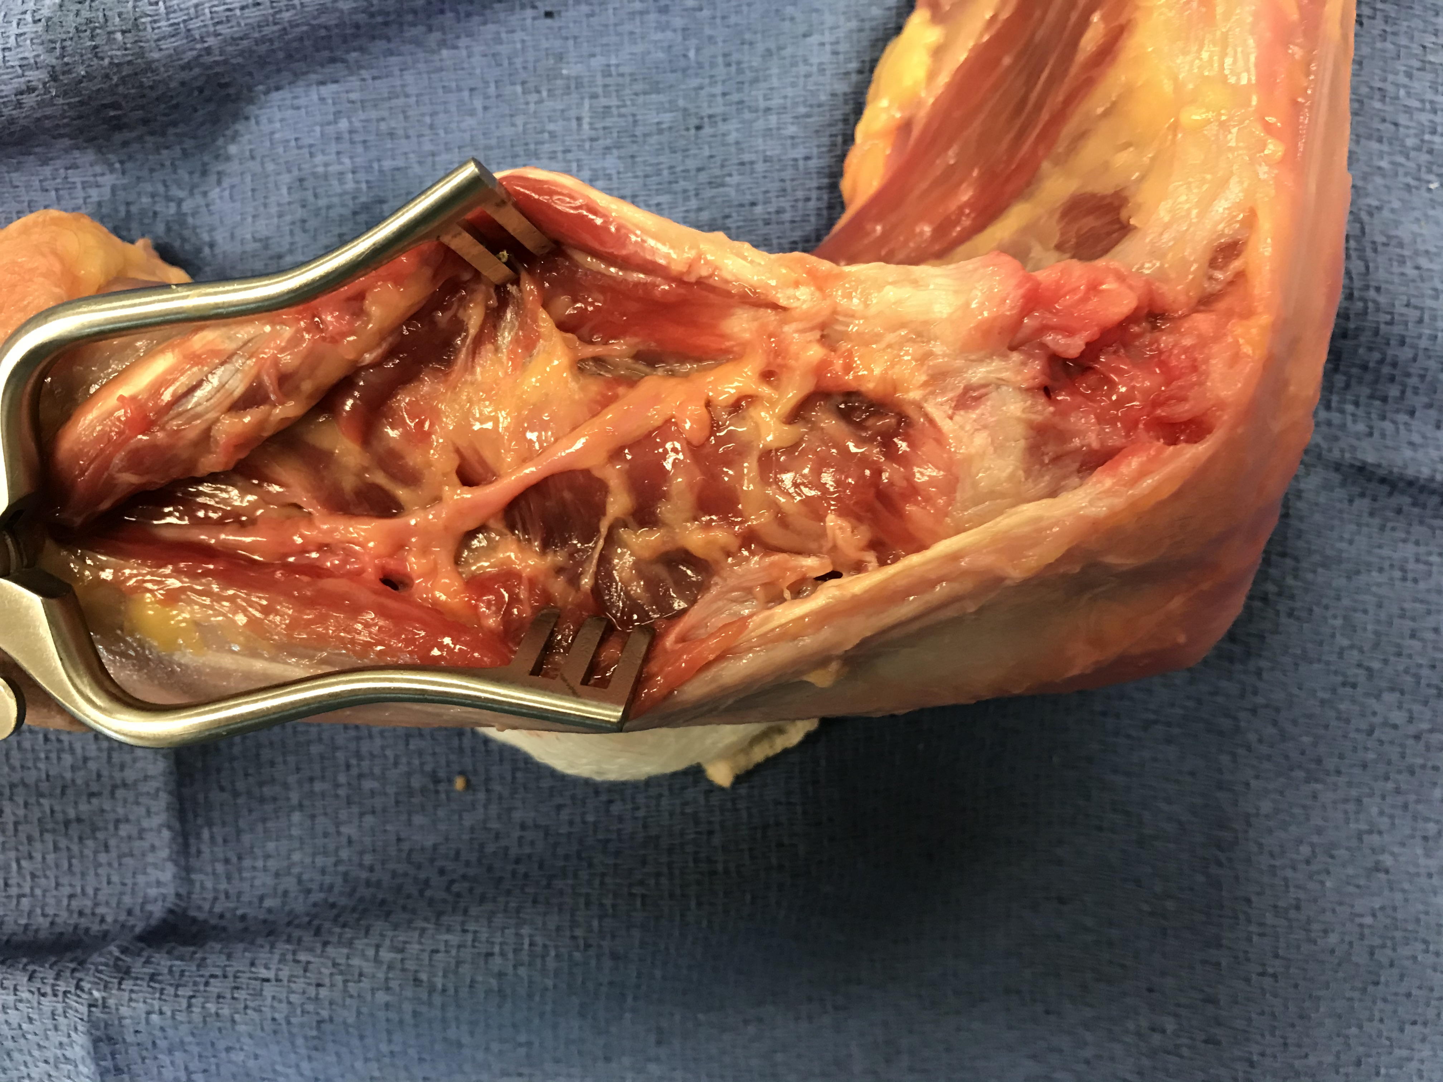
Lateral Elbow– Approaches
Kaplan Pitfalls
PIN injury
Palpable between two heads of supinator.
Image shows supinator split and nerve exposed
Supinator (Superficial head split)
PIN
Reference: Clinical Library of Thomas Krupko MD

Slide 23
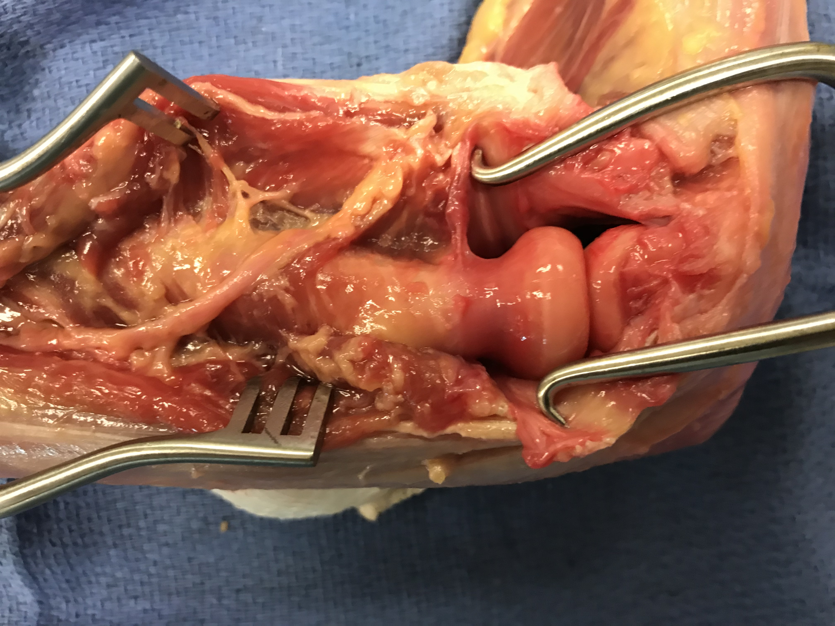
Lateral Elbow– Approaches
Kaplan Pitfalls
PIN injury
Final approach gives significant exposure of radial head, neck, and proximal shaft for more complex fractures
Reference: Clinical Library of Thomas Krupko MD

Slide 24
Lateral Elbow – Less Common Approaches
EDC Split
Roughly half way between Kocher and Kaplan
Pros and Cons the same as these approaches
Modified Boyd
Posterior approach
Elevate LUCL from lateral epicondyle
Can be used for combined olecranon/radial head fxs
Possible risk of synostosis
See references for complete technique

Slide 25
Radial Head Fractures – Treatment Algorithm
Fracture Size > 25%
No
Yes
Displacement > 2mm
Displacement > 2mm
No
Yes
No
Yes
Early Motion
Motion Limited
Motion Limited
3 or More Fragments
No
Yes
No
Yes
No
Yes
Early Motion – Close F/U
Excision of Fragment
Early Motion – Close F/U
ORIF
Arthroplasty
Reference: Revised from Previous OTA Slides

Slide 26
Radial Head Fractures – Excision
Isolated radial head (stable joint)
Partial or complete resection can be a reliable option
Beware subtle instability
May lead to PLRI or radial shortening long term
Radial head fx with ulno-humeral or longitudinal instability
Complete resection is contra-indicated
Partial resection a viable treatment option for small fragments (<25% of joint)
See References for more on long-term outcomes

Slide 27
Radial Head Fractures – Treatment Algorithm
Fracture Size > 25%
No
Yes
Displacement > 2mm
Displacement > 2mm
No
Yes
No
Yes
Early Motion
Motion Limited
Motion Limited
3 or More Fragments
No
Yes
No
Yes
No
Yes
Early Motion – Close F/U
Excision of Fragment
Early Motion – Close F/U
ORIF
Arthroplasty
Reference: Revised from Previous OTA Slides

Slide 28
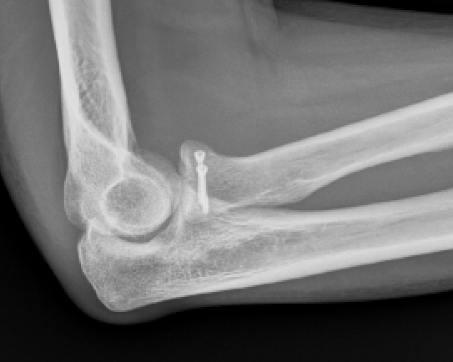
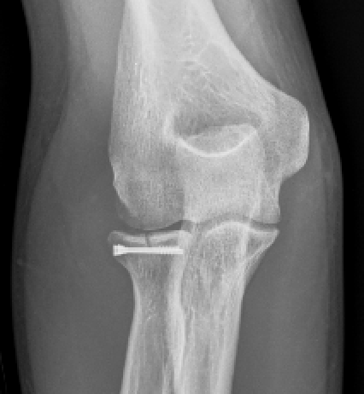
Radial Head Fractures - ORIF
Articular fx
Anatomic reduction
Compression
Implants
Mini-frag screws
Headless compression
OTA Online Video
Reference: Courtesy of Matthew Patrick MD

Slide 29
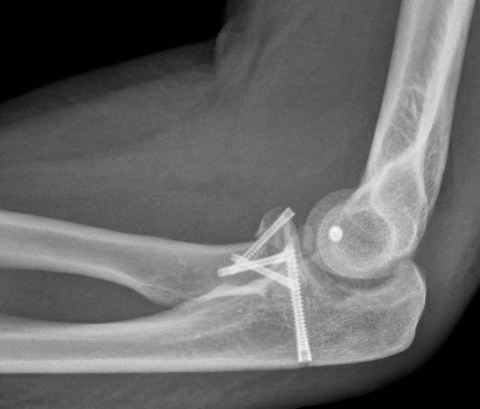
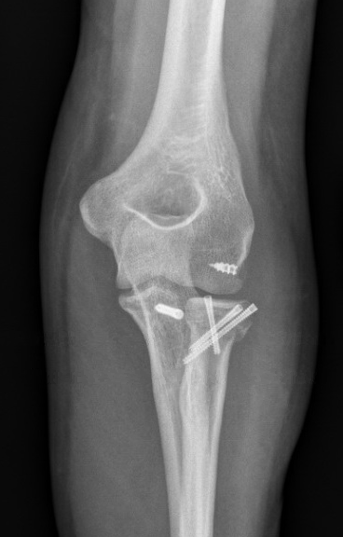
Radial Head Fractures - ORIF
Articular fx
Anatomic reduction
Compression
Implants
Headless compression
Tripod Technique
See references for technique guide
Reference: Courtesy of Jacqueline Geissler MD

Slide 30
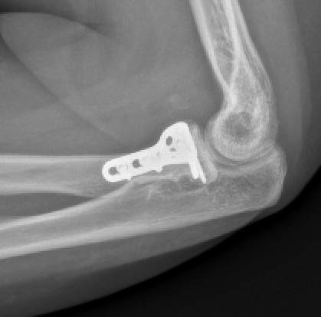
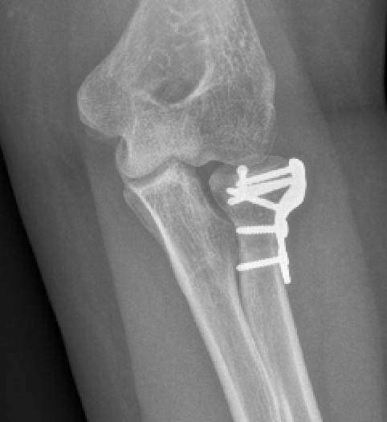
Radial Head Fractures - ORIF
Articular fx
Anatomic reduction
Compression
Implants
Periarticular locking plates
OTA Online Video
Reference: Courtesy of Matthew Patrick MD

Slide 31
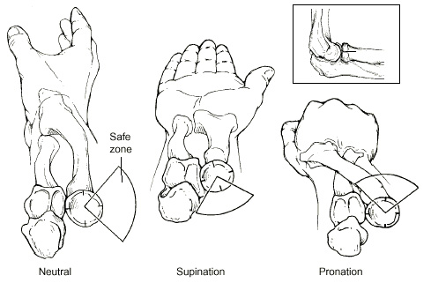
Radial Head Fractures – Implant Placement
Care must be taken to keep implants out of the proximal radio-ulnar joint
Block to supination and pronation
Safe zone
100 degree area
Between tip of radial styloid and Lister’s Tubercle
Reference: Previous OTA Slides

Slide 32
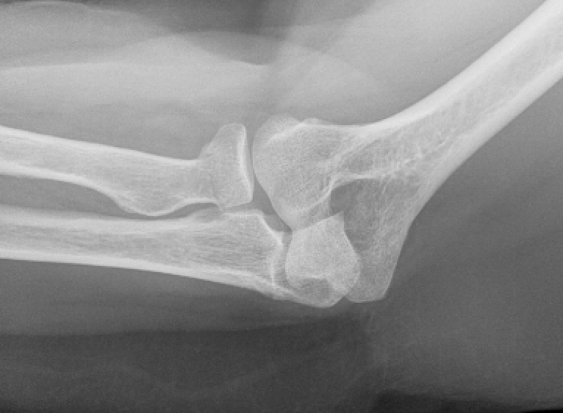
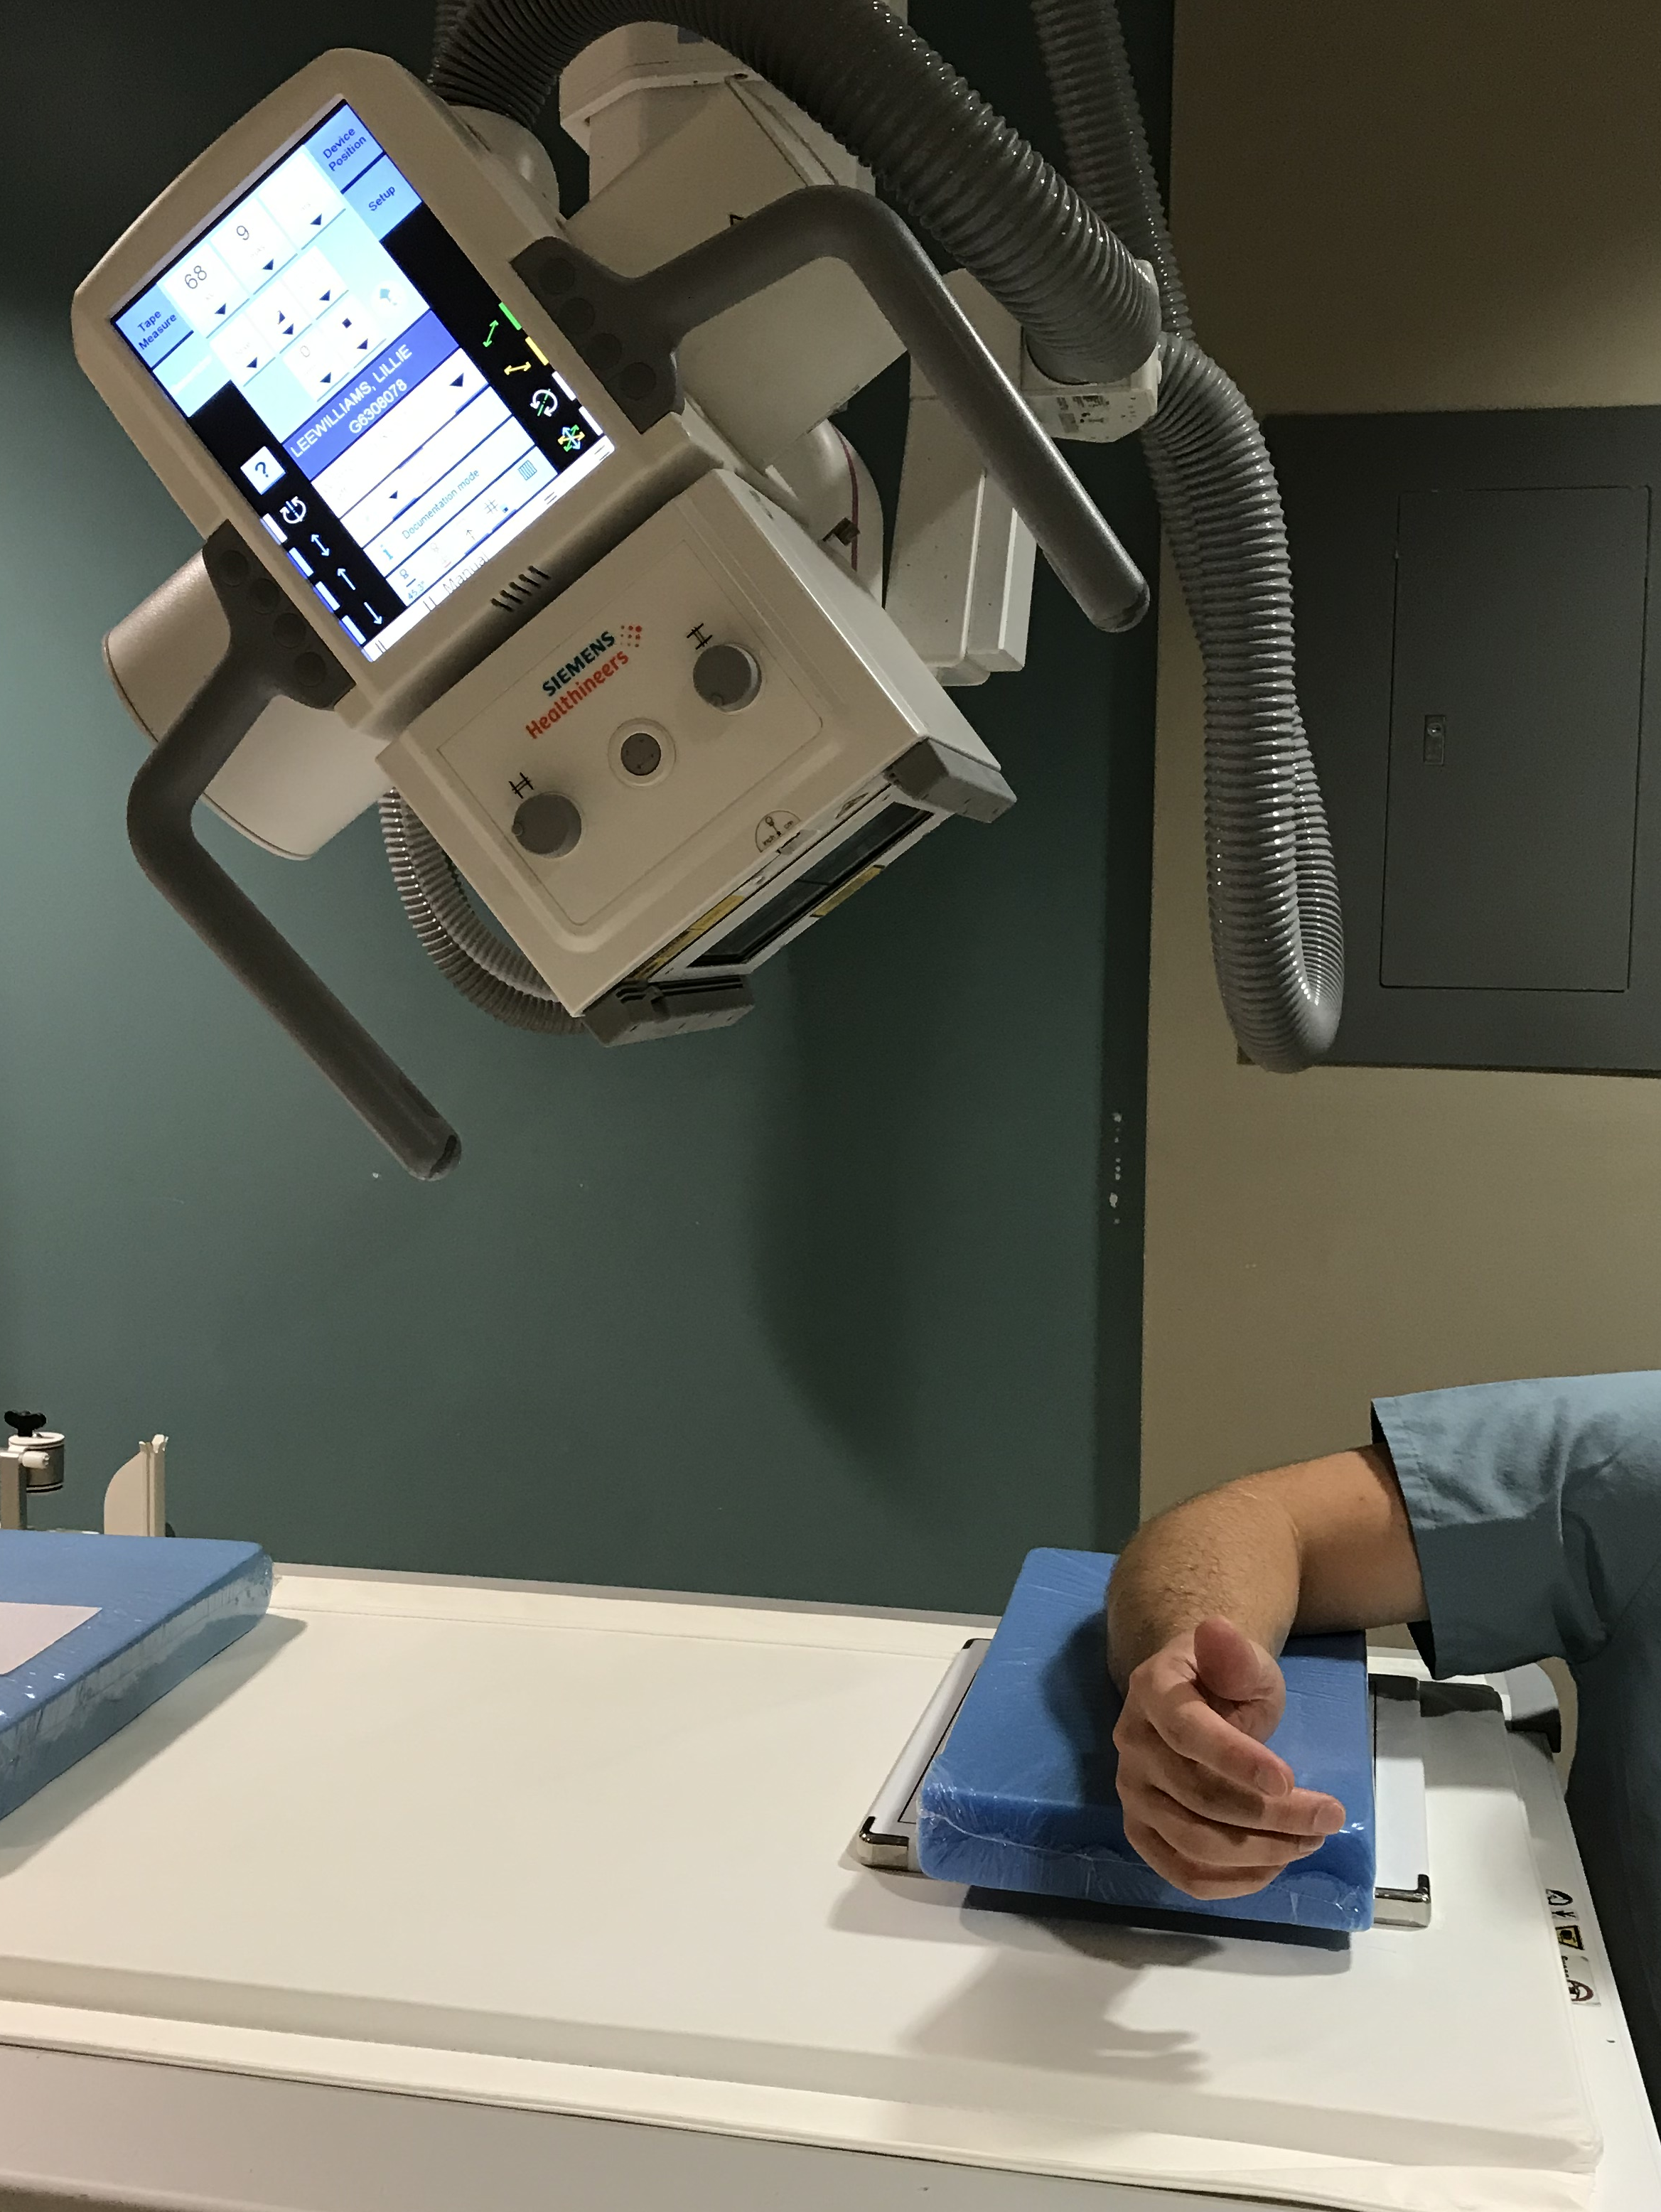
Radial Head Fractures – Greenspan View
Reference: Clinical Library of Thomas Krupko MD

Slide 33
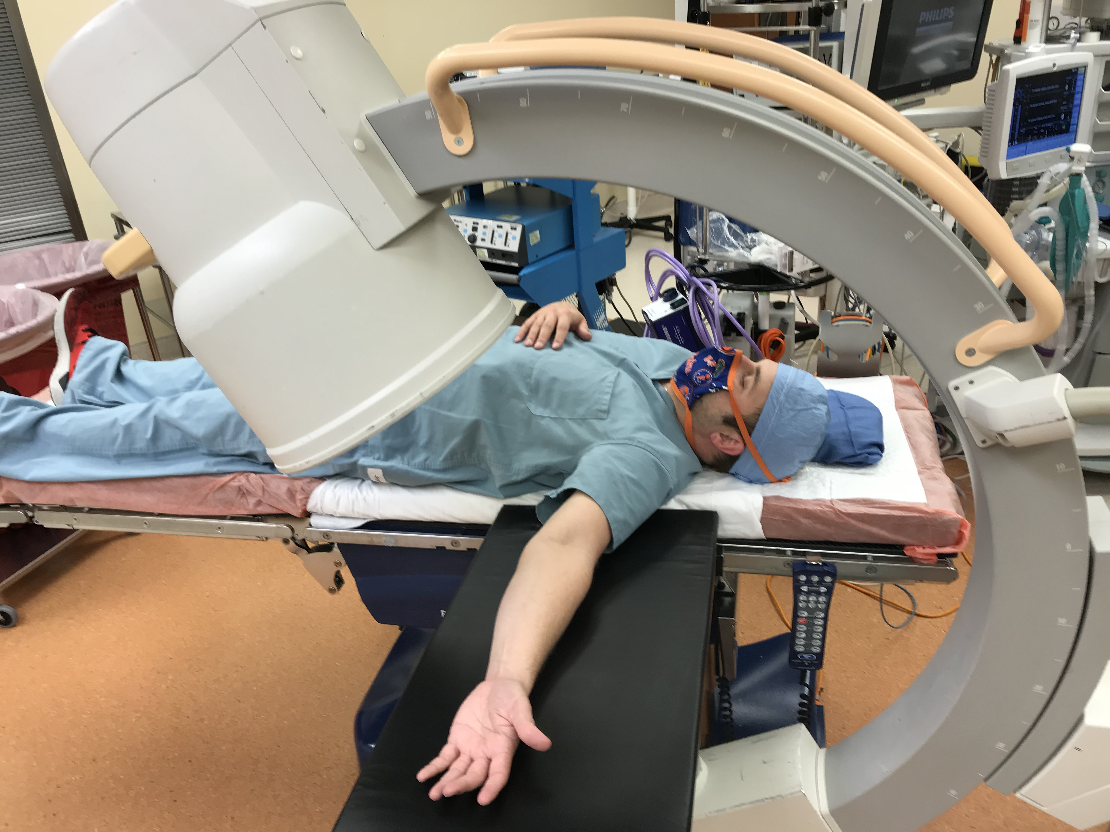
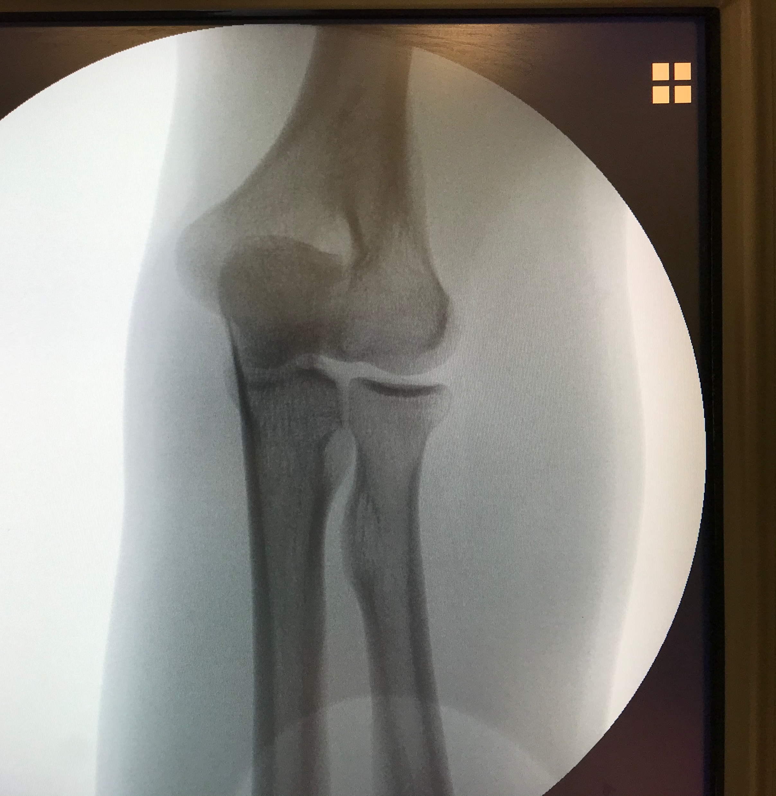
Radial Head Fractures – Intra-op Greenspan
Reference: Clinical Library of Thomas Krupko MD

Slide 34
Radial Head Fractures – Treatment Algorithm
Fracture Size > 25%
No
Yes
Displacement > 2mm
Displacement > 2mm
No
Yes
No
Yes
Early Motion
Motion Limited
Motion Limited
3 or More Fragments
No
Yes
No
Yes
No
Yes
Early Motion – Close F/U
Excision of Fragment
Early Motion – Close F/U
ORIF
Arthroplasty
Reference: Revised from Previous OTA Slides

Slide 35
Radial Head Fractures - Replacement
Head options
Round
Easier placement
Eccentric
Mimics native anatomy
More difficult to place
Bipolar
Articulates at the head/neck junction
Dislocation can occur
Stem options
Smooth
Loose fitting stem
Allows implant to find proper alignment
Porous/Pressfit
Can loosen causing pain
Can result in dilatory remodeling
Cemented
Typically used for salvage
OTA Online Video

Slide 36
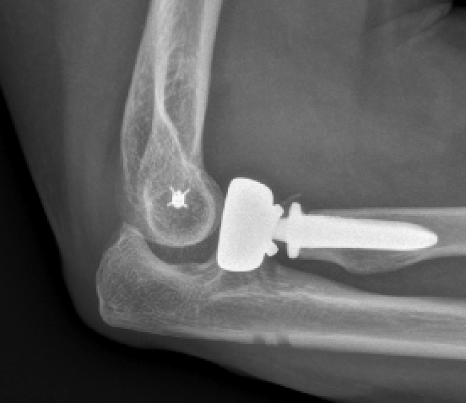
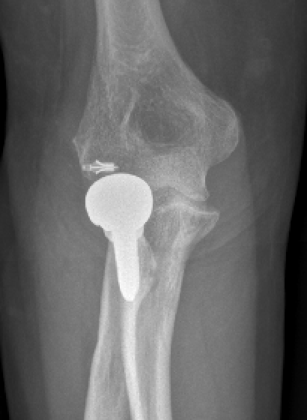
Radial Head Fractures - Overstuffing
Radial head height typically 0.9mm proximal to lateral coronoid process
Only 2mm overstuffing causes 1mm of ulno-humeral gapping
Common complication
Especially in unstable elbows that allow for the placement of large implants
Leads to….
Possible increased rate of capitellar erosion
Decreased flexion
Medial subluxation of the ulna
Reference: Clinical Library of Thomas Krupko MD

Slide 37
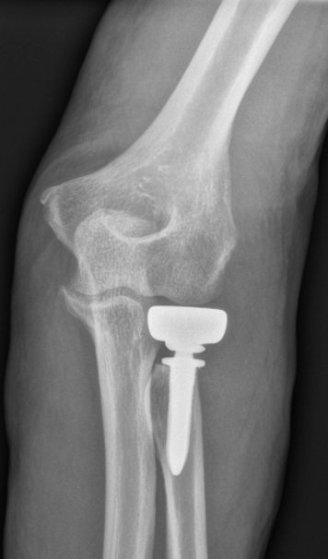
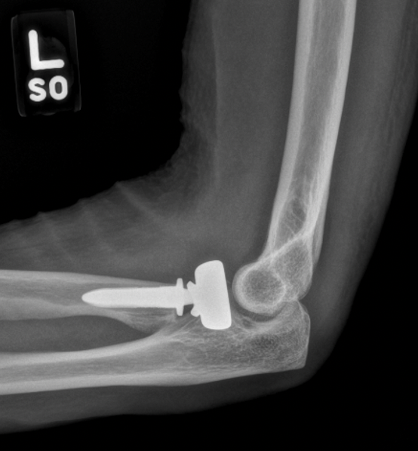
Radial Head Fractures - Overstuffing
Correct Size
Overstuffed
Reference: Clinical Library of Thomas Krupko MD and Courtesy of Thomas Wright MD

Slide 38
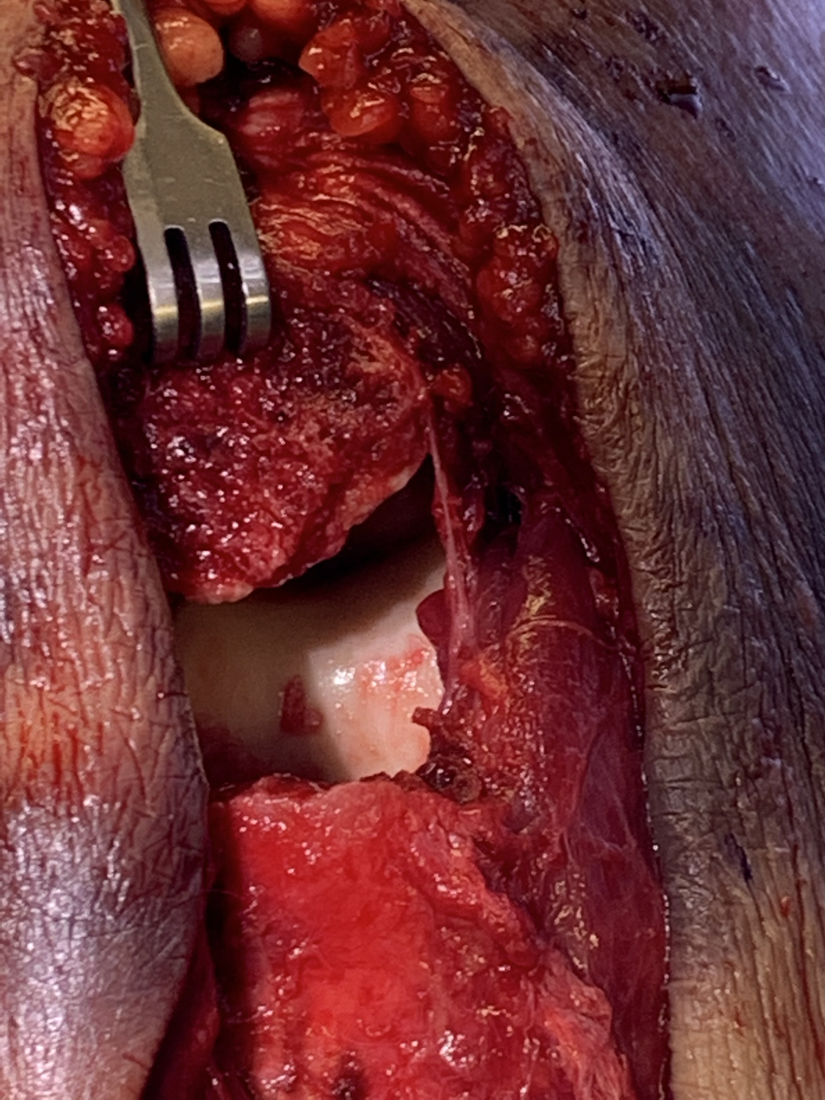
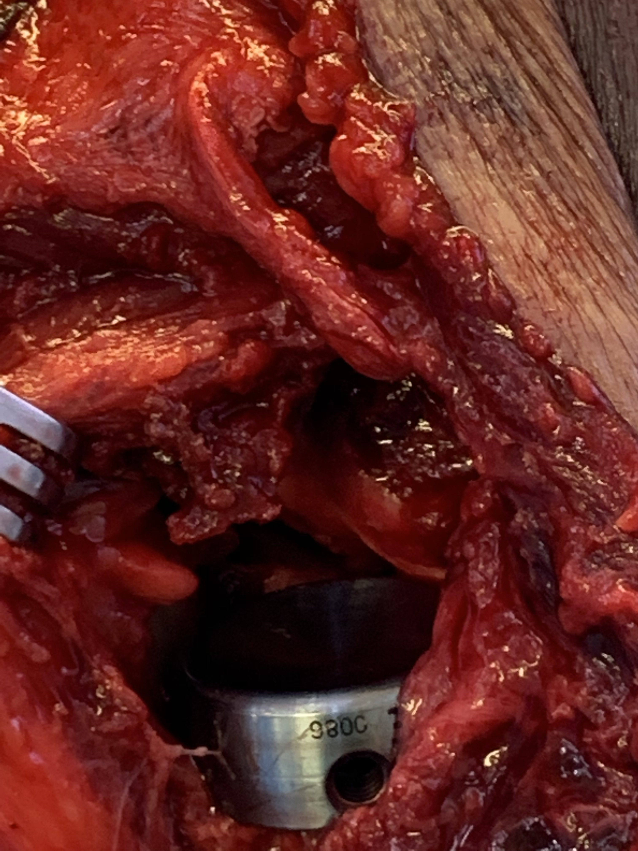
Radial Head Fractures - Overstuffing
Direct visualization
Most accurate way to determine appropriate head size
Radial head should be just at or proximal to radial notch of the ulna
Pictures show appropriate placement
Intra-op Fluoro
Needs to be assessed in flexion and extension
Less reliable
> 6mm overstuffing must be present to consistently be seen on fluoro
Radial notch
Reference: Courtesy of Matthew Patrick MD

Slide 39
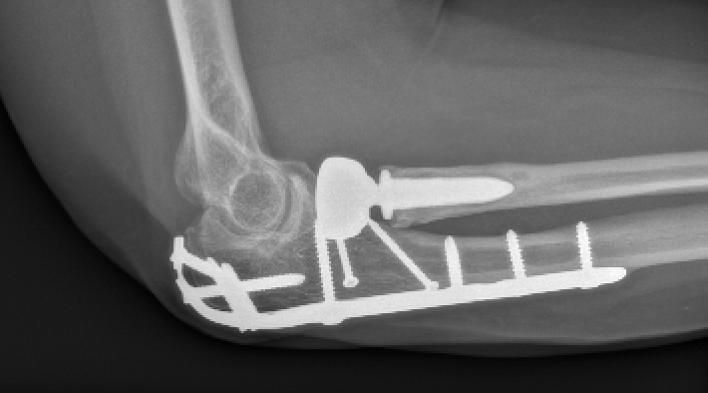
Radial Head Fractures – Stem Loosening
Immediate post-op
Occurs with press-fit stems
Typically within 1 year of surgery
Significant dilatory remodeling of the proximal radius can also occur
Removal of the implant may lead to proximal migration of the radius
Cemented arthroplasty can be used for salvage if needed
2 years post-op
Reference: Courtesy of Matthew Patrick MD

Slide 40
Radial Head Replacement – Outcomes
Mid to long term outcomes are good to excellent typically
Elbow stiffness is most common complication
Average approx. 10-135 degrees
Loss of flex/ext strength of approx. 10%
Peri-implant lucency common, but rarely requires revision
Rate of OA approx 30%

Slide 41
Radial Neck Fractures

Slide 42
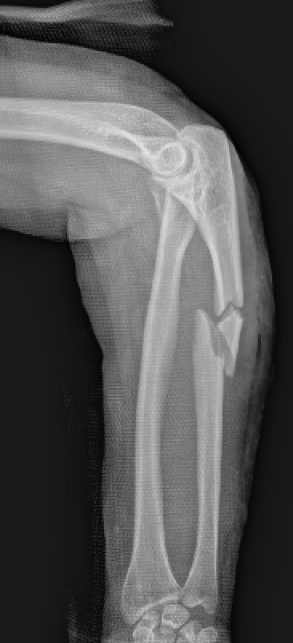
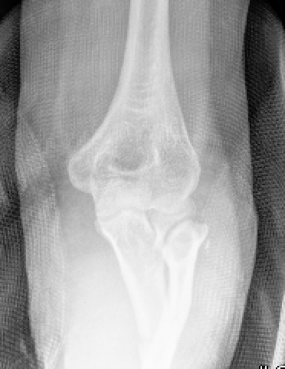
Radial Neck Fractures - Treatment
Similar to radial head
Non displaced
Non-op
Displaced
No block to motion
Non-op
Block to motion
ORIF
Reference: Clinical Library of Thomas Krupko MD

Slide 43
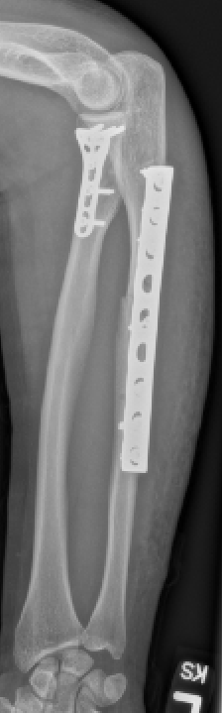
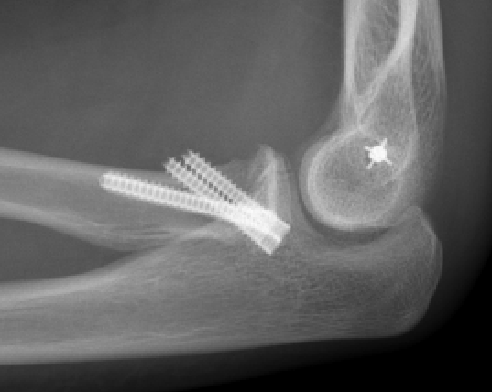
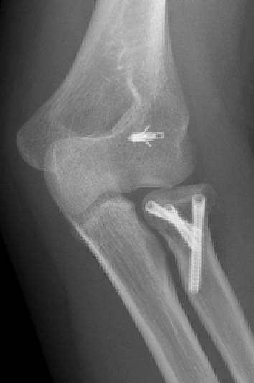
Radial Neck Fractures - ORIF
Kocher approach
Transverse neck fractures
Kaplan/Thompson approach
Extension into the proximal radius
Kickstand screws
Simple fx patterns only
Plating (mini-frag vs anatomic)
Comminution
Reference: Clinical Library of Thomas Krupko MD

Slide 44
Complications
Similar to radial head
PIN injury
Impingement of implants
Stiffness
Most common
Functional ROM of flexion/extension is 30-130 degrees
Reference: Previous OTA Slides and the Clinical Library of Thomas Krupko MD

Slide 45
Essex-Lopresti Injuries

Slide 46
Essex-Lopresti Injuries
Radial head/neck fracture with:
Interosseous membrane disruption
DRUJ disruption
Physical exam
Palpation of DRUJ for tenderness and shucking of the joint is critical
Radiographs
Be sure to evaluate entire film
Contralateral films may help in diagnosis
Reference: Courtesy of Thomas Wright MD

Slide 47
Essex-Lopresti Injuries
Treatment (Controversial!!)
Step 1 – Obtain contralateral films
Step 2 – Pin the DRUJ vs repair of TFCC
- Attempt to match contra side
Step 3 – ORIF or arthroplasty of radial head
Step 4 – Possible reconstruction of interosseous ligament
Pre-op contralateral films are essential to restore length and wrist alignment
Reference: Courtesy of Thomas Wright MD

Slide 48
Post-op Protocol

Slide 49
My Post-op Protocol
For all stabilized fxs and dislocations regardless of fixation
Initially
Immobilization for 10-14 days
Secondarily
Early ACTIVE range of motion
Allows dynamic stabilizers to help hold reduction of joint
Will reduce pseudosubluxations
Limits elbow stiffness
Some limit active shoulder abduction if LUCL was repaired

Slide 50
Summary
Anatomy
Lateral elbow ligaments and PIN location are critical
Elbow Instability
Make sure that you understand the injury
Radial head fractures
Classification (Mason)
Treatment
Radial neck fractures
Treatment
Essex-Lopresti Injuries
Don’t miss!

Slide 51
References
Acevedo DC, Paxton ES, Kukelyansky I, Abboud J, Ramsey M. Radial head arthroplasty: state of the art. JAAOS-Journal of the American Academy of Orthopaedic Surgeons. 2014 Oct 1;22(10):633-42.
Cheung EV, Steinmann SP. Surgical approaches to the elbow. JAAOS-Journal of the American Academy of Orthopaedic Surgeons. 2009 May 1;17(5):325-33.
Grassmann JP, Hakimi M, Gehrmann SV, Betsch M, Kröpil P, Wild M, Windolf J, Jungbluth P. The treatment of the acute Essex-Lopresti injury. The bone & joint journal. 2014 Oct;96(10):1385-91.
Hildebrand AH, Zhang B, Horner NS, King G, Khan M, Alolabi B. Indications and outcomes of radial head excision: a systematic review. Shoulder & elbow. 2020 Jun;12(3):193-202.
Lipman MD, Gause TM, Teran VA, Chhabra AB, Deal DN. Radial head fracture fixation using tripod technique with headless compression screws. The Journal of hand surgery. 2018 Jun 1;43(6):575-e1.
Marsh JP, Grewal R, Faber KJ, Drosdowech DS, Athwal GS, King GJ. Radial head fractures treated with modular metallic radial head replacement: outcomes at a mean follow-up of eight years. JBJS. 2016 Apr 6;98(7):527-35.
Ring D. Radial head fracture: open reduction–internal fixation or prosthetic replacement. Journal of shoulder and elbow surgery. 2011 Mar 1;20(2):S107-12.

Slide 52
References
Ring D, Quintero J, Jupiter JB. Open reduction and internal fixation of fractures of the radial head. JBJS. 2002 Oct 1;84(10):1811-5.
Robinson PM, Li MK, Dattani R, Van Rensburg L. The Boyd interval: a modification for use in the management of elbow trauma. Techniques in hand & upper extremity surgery. 2016 Mar 1;20(1):37-41.
Smith GR, Hotchkiss RN. Radial head and neck fractures: anatomic guidelines for proper placement of internal fixation. Journal of shoulder and elbow surgery. 1996 Mar 1;5(2):113-7.
Soyer AD, Nowotarski PJ, Kelso TB, Mighell MA. Optimal position for plate fixation of complex fractures of the proximal radius: a cadaver study. Journal of orthopaedic trauma. 1998 May 1;12(4):291-3.
Tabor JO, Bosse MJ, Sims SH, Kellam JF. Iatrogenic posterior interosseous nerve injury: is transosseous static locked nailing of the radius feasible?. Journal of orthopaedic trauma. 1995;9(5):427-9.
Tashjian RZ, Katarincic JA. Complex elbow instability. JAAOS-Journal of the American Academy of Orthopaedic Surgeons. 2006 May 1;14(5):278-86.
Tejwani NC, Mehta H. Fractures of the radial head and neck: current concepts in management. JAAOS-Journal of the American Academy of Orthopaedic Surgeons. 2007 Jul 1;15(7):380-7.

