Slide 1
Forearm Fractures
Sean T. Campbell, MD
Assistant Attending
Orthopedic Trauma Service
Hospital for Special Surgery, New York, NY

Slide 2
Objectives
Understand rationale for surgery for forearm fractures
Understand which segment is unstable based on injury pattern
Identify goals of surgery based on injury pattern
Review surgical techniques

Slide 3
Introduction: Forearm Fractures
Young patients
Typically high energy injuries
Geriatric/osteopenic patients
May be low energy events
Mechanism
Fall on outstretched extremity
Direct blunt trauma

Slide 4
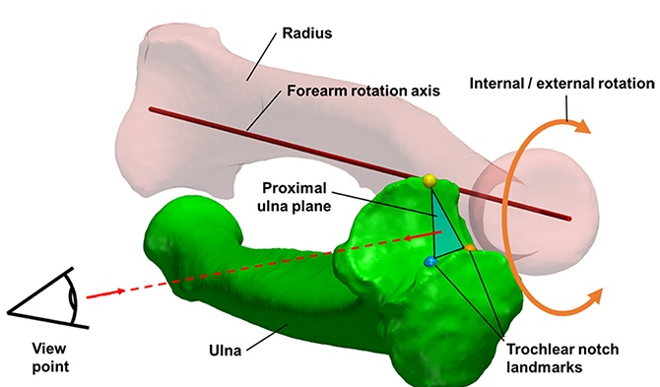
Anatomy
Two bones that function as a forearm joint to allow rotation
Radius
Radial bow in coronal plane
Ulna
Proximal dorsal angulation in sagittal plane
Not a straight bone
Distinct bow in coronal plane (see next slides)
Proximal radioulnar joint (PRUJ)
Articulation of radial head with proximal ulna
Distal radioulnar joint
Articulation of ulnar head with distal radius
Interosseous membrane
Hreha J+, Snow B+
Image from: Jarvie, Geoff C. MD, MHSc, FRCSC*; Kilb, Brett MD, MSc, BS*,†; Willing, Ryan PhD, BEng‡; King, Graham J. MD, MSc, FRCSC‡; Daneshvar, Parham MD, BS* Apparent Proximal Ulna Dorsal Angulation Variation Due to Ulnar Rotation, Journal of Orthopaedic Trauma: April 2019 - Volume 33 - Issue 4 - p e120-e123 doi: 10.1097/BOT.0000000000001408

Slide 5
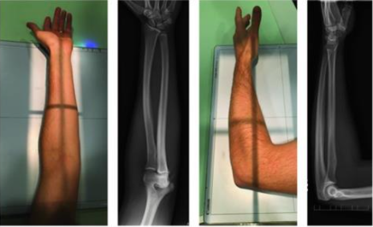
Anatomy
Radial bow allows for pronosupination
Must be restored surgically when compromised
Multiple methods for assessment of radial bow
Comparison to contralateral images
Direct anatomic reduction of simple fractures
Biceps tuberosity 180 degrees of radial styloid
Note opposite apex medial bow of ulna
Not a straight bone
Image from: Rockwood and Green, 9e, fig 41-9

Slide 6
Anatomy
Depiction of ulnar shape, noting proximal ulnar dorsal angulation (PUDA) in the top image, and varus angulation in the bottom image
Image from: Jarvie, Geoff C. MD, MHSc, FRCSC*; Kilb, Brett MD, MSc, BS*,†; Willing, Ryan PhD, BEng‡; King, Graham J. MD, MSc, FRCSC‡; Daneshvar, Parham MD, BS* Apparent Proximal Ulna Dorsal Angulation Variation Due to Ulnar Rotation, Journal of Orthopaedic Trauma: April 2019 - Volume 33 - Issue 4 - p e120-e123 doi: 10.1097/BOT.0000000000001408

Slide 7
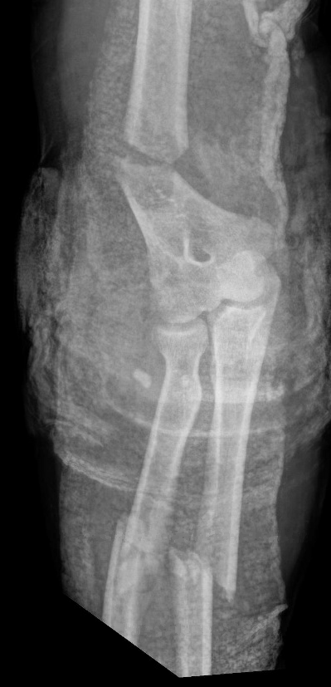
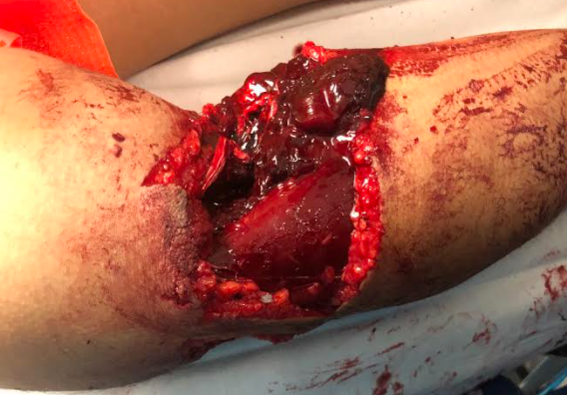
Initial Presentation
Antibiotics for open fractures
Careful attention to neurovascular status
Physical and radiographic exam of wrist and elbow joints
Temporizing splint immobilization above the elbow
High risk for compartment syndrome
Especially high energy mechanisms
Be familiar with technique for forearm compartment release: OTA video library

Slide 8
Surgical Indications
Most fractures are operative in adults
Both bone fractures- inherently unstable
Loss of radial bow interferes with pronosupination
Single bone diaphyseal injuries
Often result in
PRUJ instability (Monteggia)
DRUJ instability (Galeazzi)
Exceptions
Some nondisplaced single bone injuries (i.e. nightstick fracture of ulna)
With intact PRUJ/DRUJ
Outcomes
In general good
Moderate decrease in perceived strength*
* Droll+

Slide 9
Essex-Lopresti Injuries
Radial head or neck fracture with DRUJ injury, and intraosseous membrane (IOM) injury
Wrist exam and imaging mandatory for elbow fractures
Some authors have described MRI exam of IOM
Not required to meet standard of care
Treatment- surgical fixation or radial head arthroplasty
DRUJ stabilization as needed
Avoid radial head excision – proximal migration of radius and ulnar positivity at the wrist
IOM reconstruction has been described, usually as salvage for chronic injury +
Outcomes
Good, when injury detected and treated *
+ Adams+; * Grassman+

Slide 10
Surgical Goals for All Forearm Fractures
Restoration of forearm anatomy
Length/alignment/rotation (L/A/R) + correct bow
Stable and congruent elbow and wrist joints
Address fracture of sigmoid notch or radial head
Robust fixation to allow early motion
Avoid thin/tubular plates
Intelligent fixation based on fracture pattern
Simple patterns- anatomic reduction and compression
Comminuted patterns- restoration of L/A/R/bow with bridge plating

Slide 11
Surgical Toolbox: Diaphyseal Both Bone
Positioning
Supine, radiolucent hand table
Preferred: Most diaphyseal and distal fractures
Disadvantage: must flex (and hold flexed) elbow to approach ulna
Addressing radius first typically easier in this position
Gives stability to forearm for treatment of ulna in the elbow-flexed position
Lateral with elbow flexed 90 degrees
Advantage: Complex proximal ulna fracture; transolecranon fracture-dislocation
Disadvantage: unfamiliar positioning for radius- may require repositioning
Indications:
Difficult/segmental proximal ulna fracture
Ipsilateral humerus fracture to be addressed with same anesthetic

Slide 12
Surgical Toolbox: Diaphyseal Both Bone
Exposure
Separate approach for each bone
Radius Exposure
Volar Henry:
Brachioradialis/FCR interval
Radial artery is mobilized to ulnar side
Extensile distally and proximally
Trans-FCR approach: OTA video link
Dorsal/Thompson approach: OTA video link
Splits extensors to access radius
PIN at risk proximally
Extensile to radial head
Ulnar exposure
ECU/FCU split: OTA video library example

Slide 13
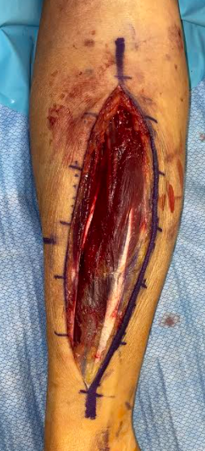
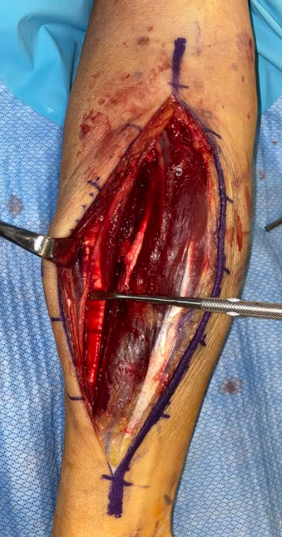
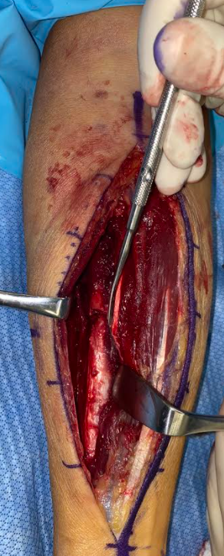
Surgical Toolbox: Diaphyseal Both Bone
Clinical photos demonstrating the volar approach to the radius.
Middle: Elevator is pointing at the superficial branch of the radial nerve.
Right: The fracture has been exposed (elevator at fracture line). The white structure just ulnar to the elevator is the pronator teres tendon. White arrow points to radial artery.

Slide 14
Surgical Toolbox: Diaphyseal Both Bone
Ulnar Exposure
ECU/FCU split
Be aware of ulnar bow
Ulna is not truly “subcutaneous” throughout full length
ECU/FCU interval may “cross” over border of the bone
Utilize correct interval to preserve muscle as possible
Extensile proximally into posterior approach to humerus
OTA video library example

Slide 15
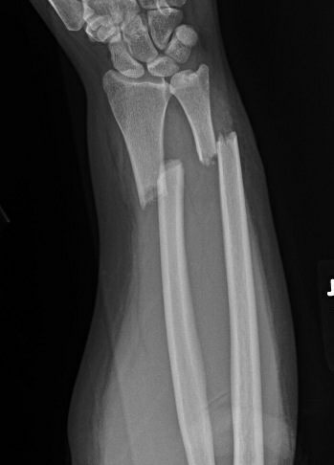
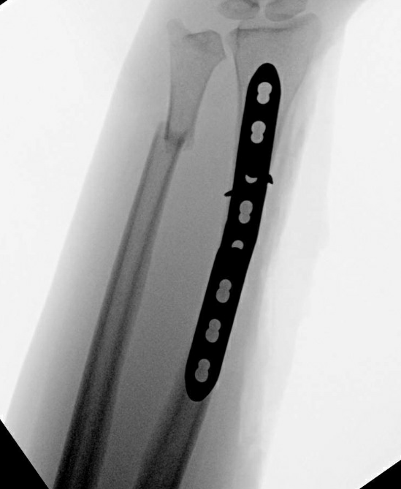
Surgical Toolbox: Reduction of Diaphyseal BBFF
Simple fractures
Traction via reduction forceps proximally and distally to restore length
Pointed reduction clamps for oblique fracture
Modified “straight-straight” clamps for transverse fractures
Most transverse fractures will be inherently stable once length restored
Lag simple fragments to simplify fracture
Ensures correct restoration of length and radial bow
Complex fractures with comminution/bone loss
Contour straight plate for bowed bone; option precontoured (“anatomical”) plate
Clamp to reduce bone to plate
Focus on L/A/R/Bow
Above, a 22 year old woman who fell from a skateboard with a closed injury

Slide 16
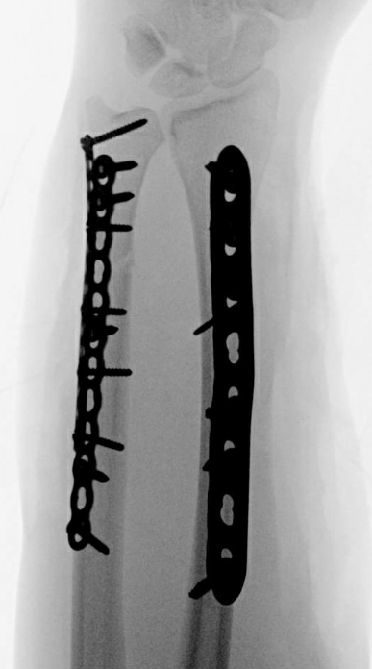
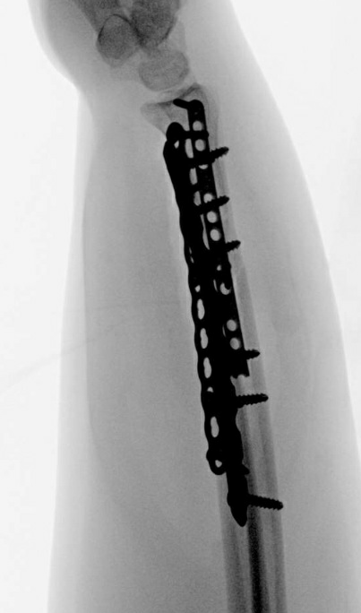
Surgical toolbox: Fixation of Diaphyseal BBFF
Simple fractures
Lag screw/neutralization plating for obliquity fracture
Countersink volar 2.4mm lag screws if under plate
Dynamic compression plating for transverse fracture
Mini-fragment plate can be used for provisional reduction
Plate selection
3.5mm LCDCP or similar on radius and ulna
2.7 DCP in smaller patients on ulna
Avoid tubular or flexible plates
Slight prebend needed if compression plating
Comminuted/Segmental bone loss fractures
Long contoured plates with well balanced screw spread preferred
Full length films (flat plates) can be useful for assessing radial bow
Consider comparison views of contralateral side

Slide 17
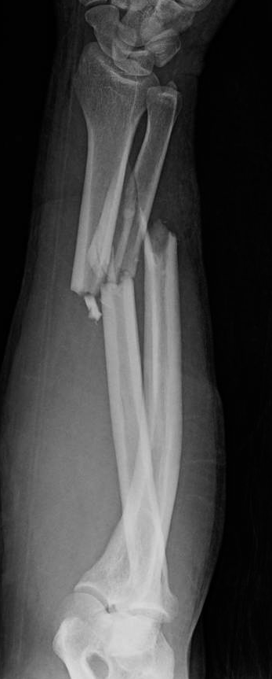
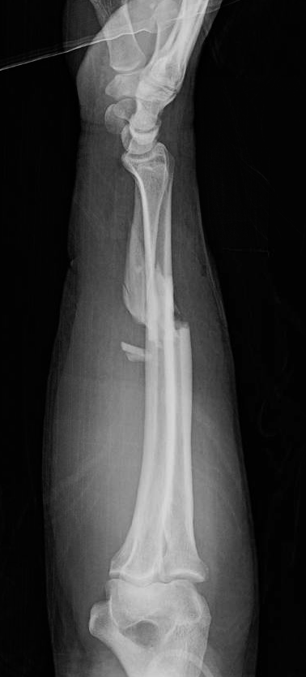
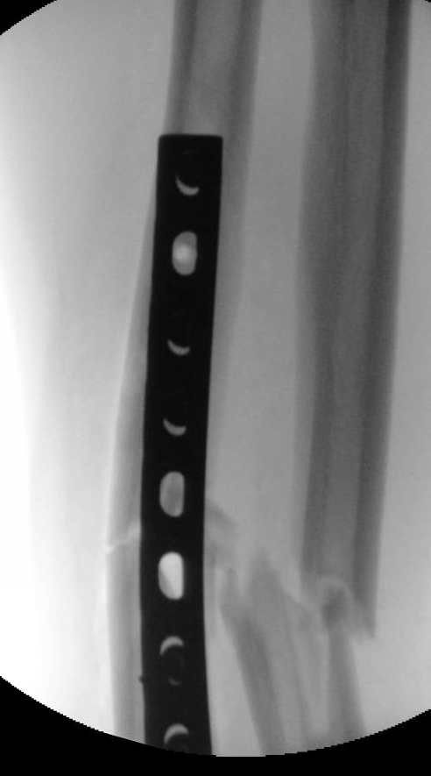
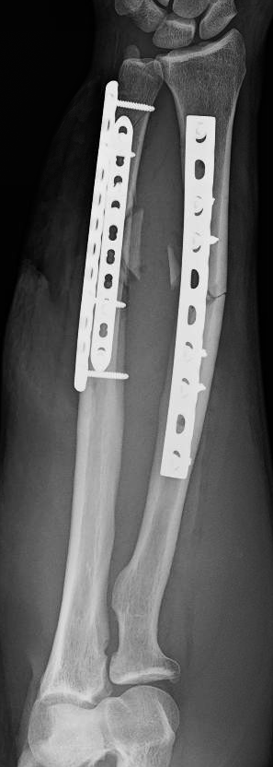
Case Example: Both Bone Forearm Fracture
Bridge plating due to comminution
Eccentric straight plate highlights restored radial bow

Slide 18
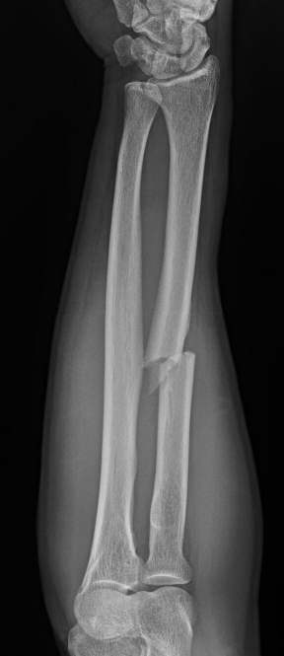
Galeazzi Fracture
Distal 1/3 radial shaft fracture with potential DRUJ instability
Requires surgery to restore forearm stability
Radius→ ORIF
Then clinically and radiographically examine DRUJ after ORIF
If DRUJ remains unstable→ address
Above, a 61 year old man who had a car tire fall on his arm when his tire jack failed with a closed injury

Slide 19
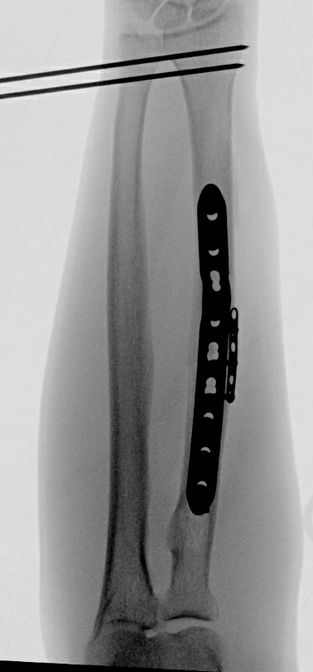
Surgical Toolbox: Galeazzi
Preoperative examination of contralateral DRUJ
Clinical exam after radius fixation to determine next steps
Restoration of radius length and bow often restores DRUJ stability
if unstable: TFCC repair, splinting in position of reduction/stability, pinning in position of reduction/stability (usually supination)
Typically dorsal instability, but volar instability possible
Author’s protocol for DRUJ
If lax compared to contralateral, splint in stable position x2 weeks
If dislocating with pronosupination, pin in reduced position x4 weeks
In general, good outcomes if anatomy restored*
*Giannoulis+

Slide 20
Monteggia Fracture
Ulna shaft fracture with radial head dislocation (PRUJ instability)
Classification system based on direction of dislocation (next slide - diagram of classification)
Associated injuries:
LUCL injury, radial head fracture, coronoid fracture
Outcomes
In general, good
Poorer with Bado type II fractures (see next slide), associated radial head and coronoid fractures*
*Sreekumar+

Slide 21
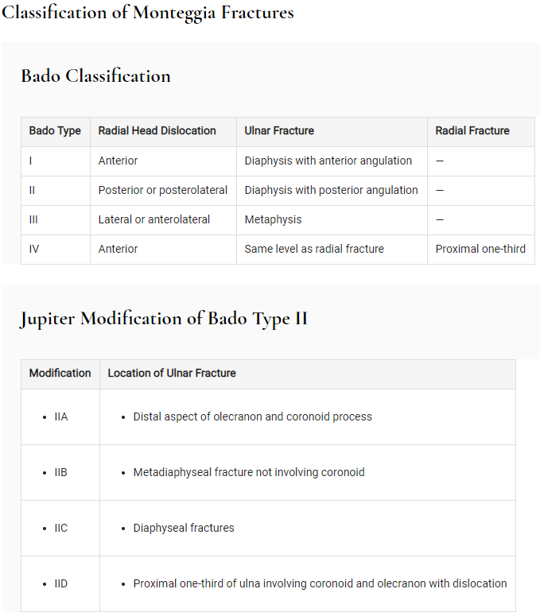
Monteggia Fracture
Reproduced from Rockwood and Green 9e, chapter 46

Slide 22
Surgical Toolbox: Monteggia
Restoration of ulnar shape is the goal
Mal-reduced ulna = persistent radiocapitellar instability
Surgical strategy for more complex injuries
Careful preoperative assessment of radial head, coronoid
Coronoid fragment and radial head fracture can be addressed in lateral position
Posterior exposure via fracture line or modified Boyd
Alternative separate lateral approach with elevated flaps through same posterior incision

Slide 23
Surgical Toolbox: Monteggia
Sequence: radial head arthroplasty trial → provisional reduction of ulna→ assessment of radial head size → definitive radial head arthroplasty → re-reduction and definitive fixation ulna → assessment of lateral ligament complex (see next case example)
Postop: typically splint for 1-2 weeks then early motion
If ligament repair required, avoid varus stress

Slide 24
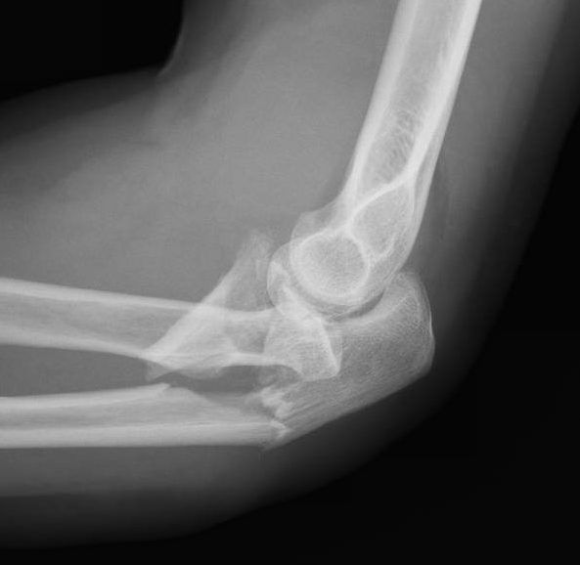
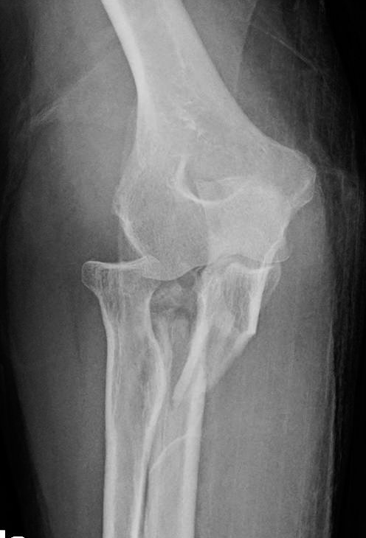
Case Example: Monteggia
Posterior monteggia fracture with posterior radial head dislocation and radial head fracture

Slide 25
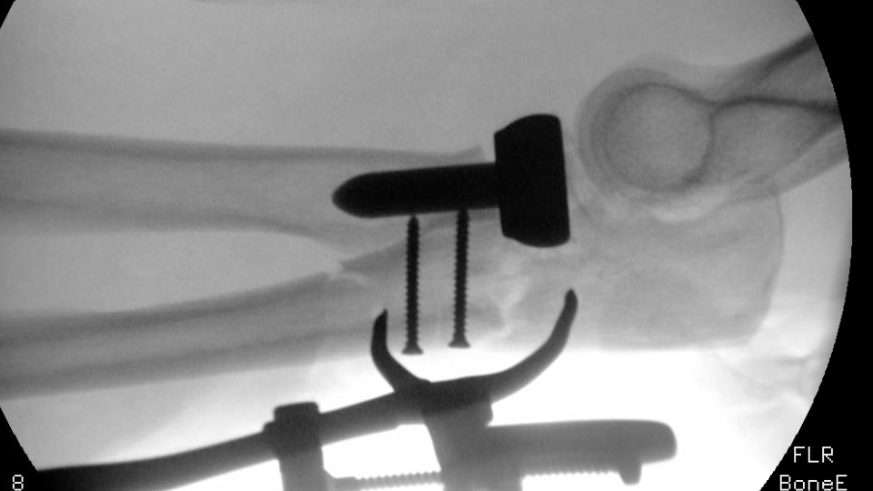
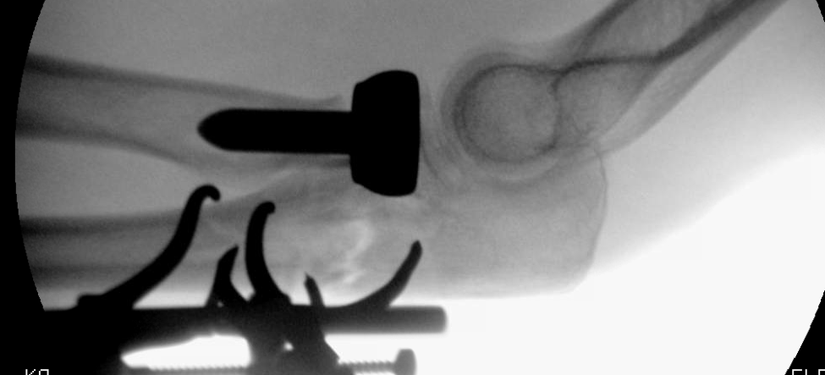
Case Example: Monteggia
In the top image, malreduction of the ulna results in persistent radiocapitellar subluxation
In the bottom image, the reduction has been corrected and the radiocapitellar joint is reduced

Slide 26
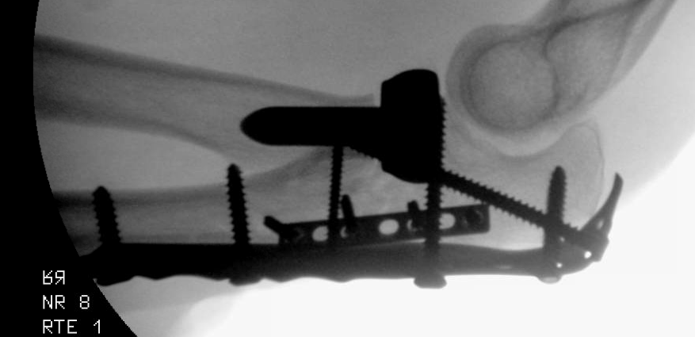
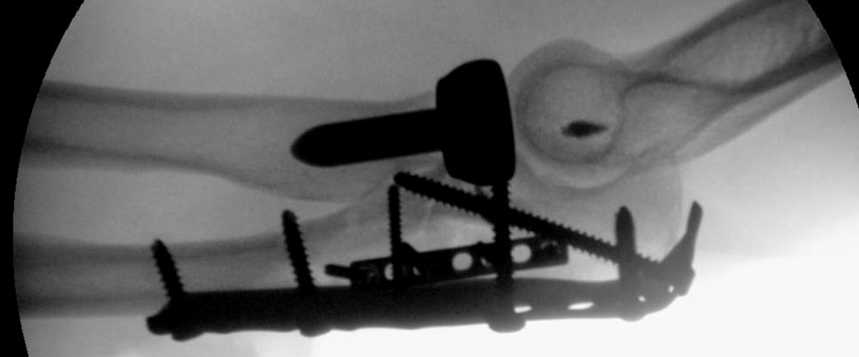
Case Example: Monteggia
In this case, there was persistent elbow instability which prompted an evaluation of the LUCL complex
The LUCL was found to be injured
Once repaired with a suture anchor, elbow stability was restored
Patient was splinted x10 days, then started on a rehab protocol including early motion with varus elbow precautions to protect the LUCL repair

Slide 27
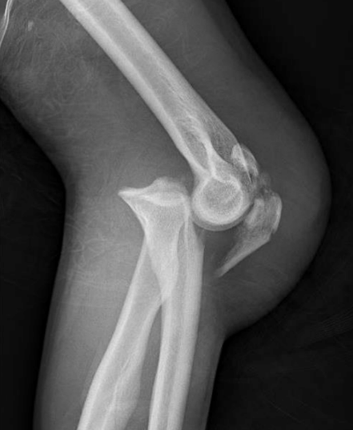
Trans-olecranon Fracture-dislocation
Distinct from monteggia fracture- PRUJ is intact
Distal humerus drives through proximal ulnar articular surface
Often significant articular injury of the greater sigmoid notch
Outcomes:
In general excellent
Poorer with radial head, coronoid fractures, and ligamentous injuries*
*Haller+

Slide 28
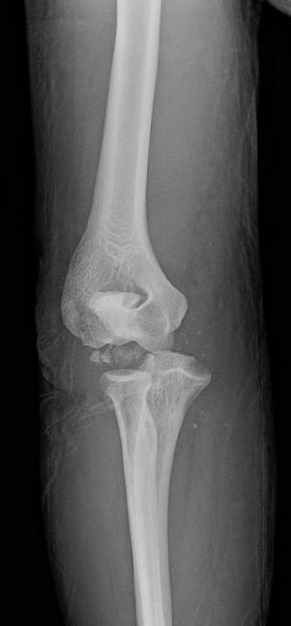
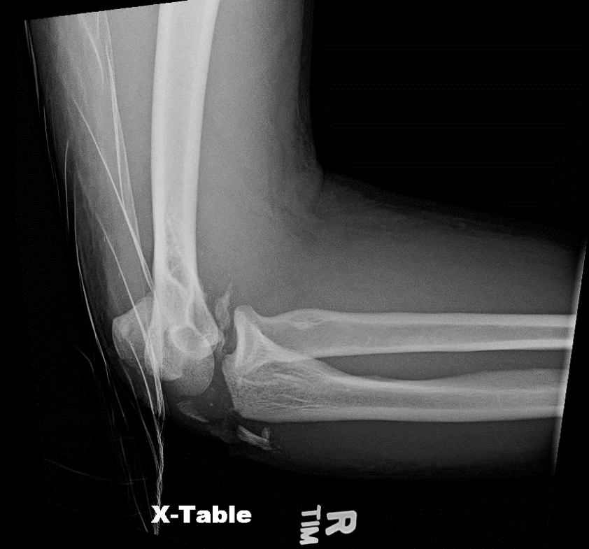
Case Example: Trans-olecranon Fx-dislocation
Case example of young patient with a high energy, open trans-olecranon fracture
There is articular injury, bone loss, and concern for ligamentous injury

Slide 29
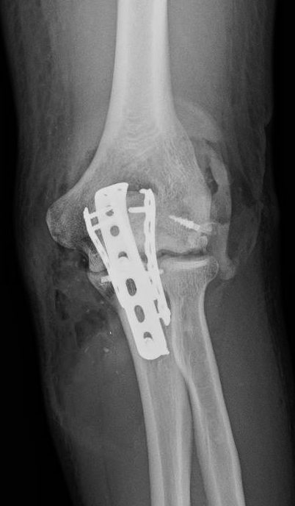
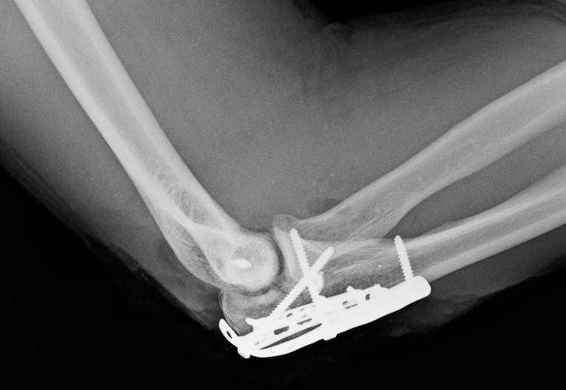
Case Example: Trans-olecranon Fx-dislocation
The articular surface is reduced directly
Multiple plates are used to “cage in” the comminution
Nonlocking screws are used in a stout plate to anchor the unstable distal segment
The lateral ligamentous complex is repaired
This particular patient had a head injury and was unable to follow a typically rehab protocol
Typically, the patient is placed in a splint for 10-14 days, following which early motion with varus elbow precautions is prescribed

Slide 30
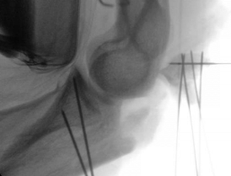
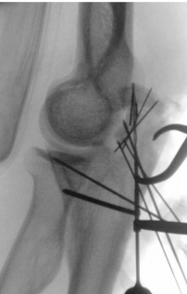
Surgical Toolbox: Trans-olecranon Fracture
Reduce and work distal to proximal
Anatomic reduction of articular injury
Free articular fragments provisionally wired
Dis-impaction of articular surface on intact segments may be required
Anticipate need for allograft/void filler
Retained threaded wires, mini-fragment implants can be useful
“Pilon of the elbow”
Assess elbow radiographically at conclusion
Occasionally LUCL injury needs to be repaired

Slide 31
Peri-implant Fractures
Can occur adjacent to existing implants
Often fracture is through peripheral existing screw hole
Remove old implants
Reduction can be challenging- be aware potential for pre-existing non-anatomic union
If fracture is through screw hole- restoration of screw hole shape, compared to adjacent, can be helpful
Use a long implant spanning entire old zone of injury
Notes:
.

Slide 32
Bone Loss
May occur in conjunction with high energy open fractures, ballistic fractures
If in radius- anticipate need for bending plate on the flat, or consider a precontoured plate as a reduction aid
PMMA spacer and induced membrane technique - viable option
Consider stiff implant or two plates to last through duration of healing
Bone transport- described, potentially useful depending on patient compliance and surgeon skillset

Slide 33
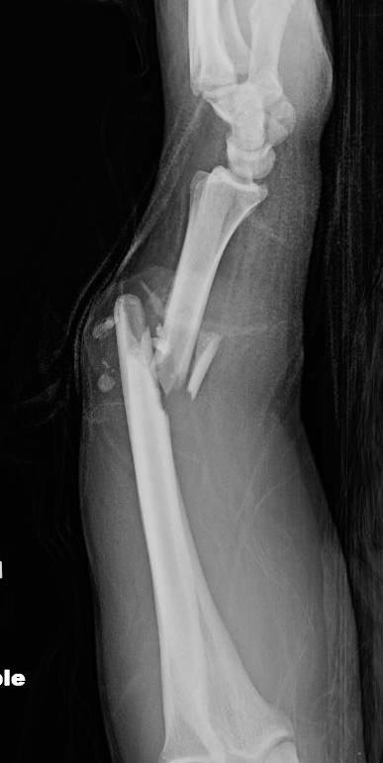
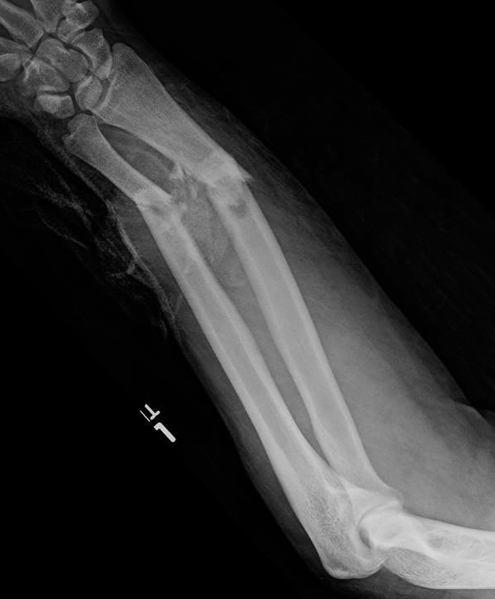
Case Example: Bone Loss
This patient with a high energy open both bone fracture had both radial and ulnar bone loss

Slide 34
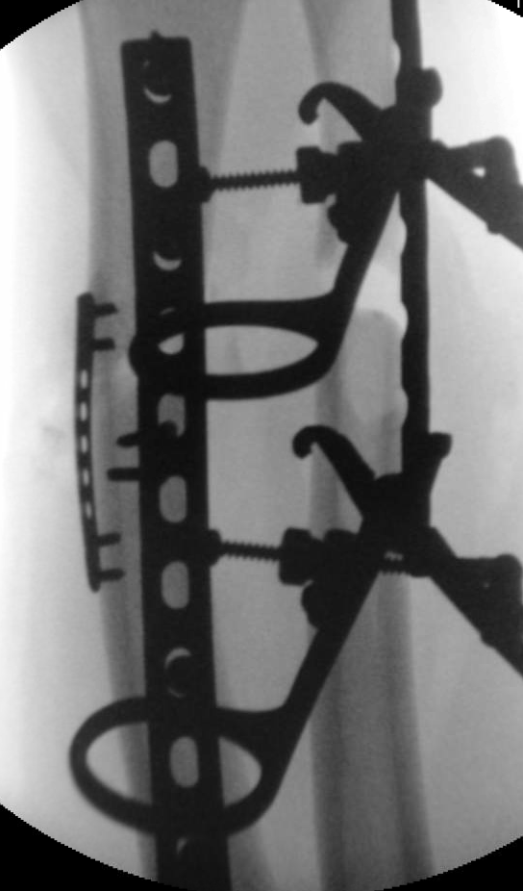
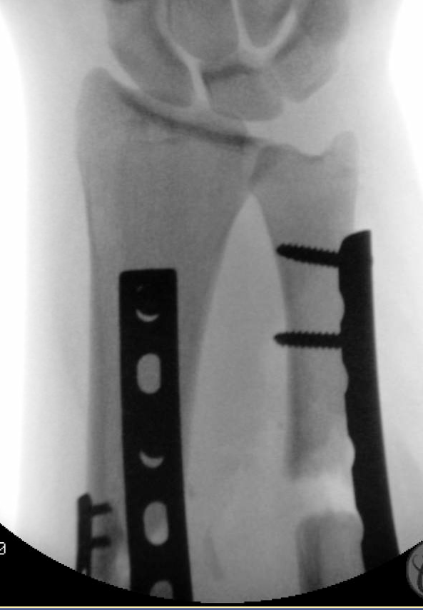
Case Example: Bone Loss
Far left image demonstrates the degree of bone loss
The ulna in particular is missing a segment after length is restored

Slide 35
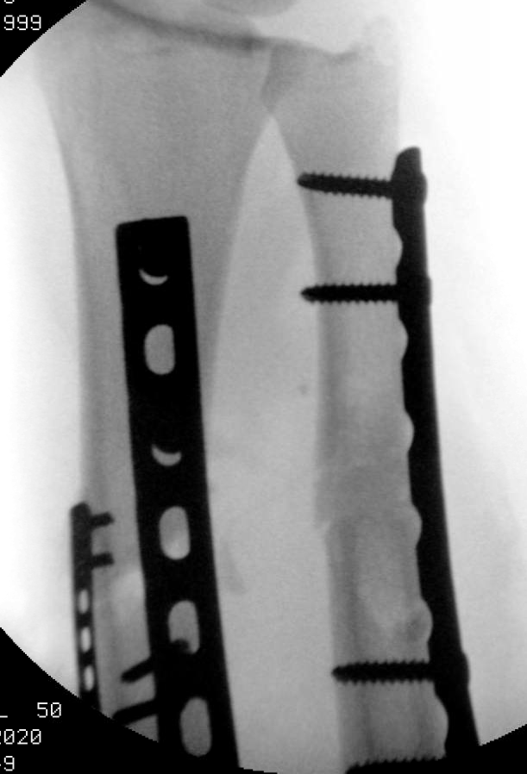
Case Example: Bone Loss
In this case PMMA cement was used to fill the void, with the intent to come back and bone graft the defect later

Slide 36
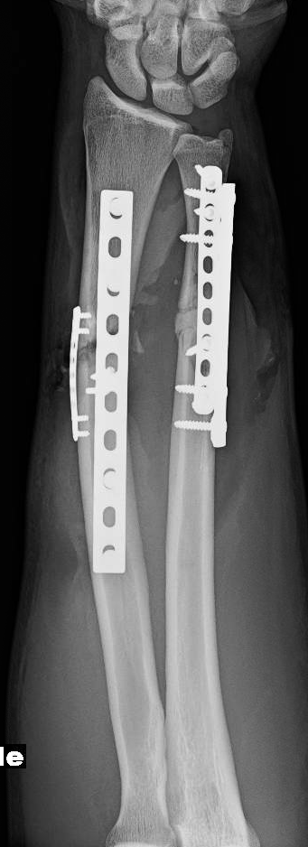
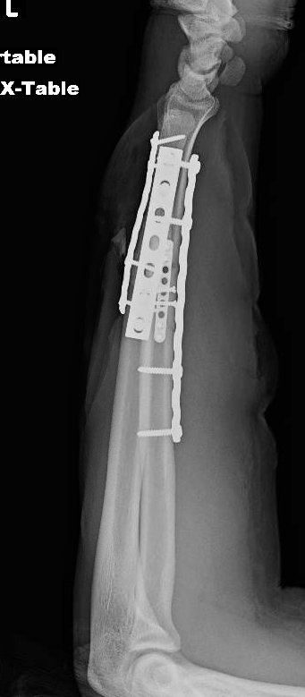
Case Example: Bone Loss
Two plates were used on the ulna to strengthen the construct in anticipation of a long period prior to healing
Again, note the eccentric plate placement on the radius- one sign that radial bow has been restored

Slide 37
Postop-protocols
Variable depending on injury severity, soft tissue injury, and fracture pattern
In general (author preference)
Diaphyseal fractures, DRUJ/PRUJ unaffected: immediate range of motion
Radius fx with DRUJ instability
After fixation, if DRUJ lax compared to contralateral, splint in stable position x2 weeks
If dislocating with pronosupination, pin in reduced position x4 weeks
Ulna fx with PRUJ instability
If elbow stable after fixing bony injury- immediate ROM
If lateral ligament repair required- splint x10 days, then varus elbow precautions and supine gravity assisted flexion/extension x6 weeks
If severe soft tissue injury
Consider splint x2 weeks for soft tissue rest

Slide 38
Summary: Forearm Fractures
Typically operative injuries
“Fractures of necessity”
May be associated with sequelae of high energy trauma
Compartment syndrome, open fractures, bone loss
Restoration of length, alignment, rotation and correct shape is critical to forearm function
Proximal fractures may have articular injuries to address
Ensure the wrist and elbow joints are stable
Different fracture patterns have different unstable segments
Anticipate the predicted failure mechanism and plan fixation to prevent it

Slide 39
References
Small RF, Yaish AM. Radius and Ulnar Shaft Fractures. [Updated 2020 May 21]. In: StatPearls [Internet]. Treasure Island (FL): StatPearls Publishing; 2020 Jan-. Available from: https://www.ncbi.nlm.nih.gov/books/NBK557681/
Hreha, Jeremy MD; Congiusta, Dominick V. MPH; Ahmed, Irfan H. MD; Vosbikian, Michael M. MD What Is the Normal Ulnar Bow in Adult Patients?, Clinical Orthopaedics and Related Research: January 2020 - Volume 478 - Issue 1 - p 136-141 doi: 10.1097/CORR.0000000000000999
Grassmann JP, Hakimi M, Gehrmann SV, Betsch M, Kröpil P, Wild M, Windolf J, Jungbluth P. The treatment of the acute Essex-Lopresti injury. Bone Joint J. 2014 Oct;96-B(10):1385-91. doi: 10.1302/0301-620X.96B10.33334. PMID: 25274926.
Adams JE, Culp RW, Osterman AL. Interosseous membrane reconstruction for the Essex-Lopresti injury. J Hand Surg Am. 2010 Jan;35(1):129-36. doi: 10.1016/j.jhsa.2009.10.007. PMID: 20117315.
Droll KP, Perna P, Potter J, Harniman E, Schemitsch EH, McKee MD. Outcomes following plate fixation of fractures of both bones of the forearm in adults. J Bone Joint Surg Am. 2007 Dec;89(12):2619-24. doi: 10.2106/JBJS.F.01065. PMID: 18056493.
Snow, Brian J. MD*,‡; Javidan, Pooya MD*; Itamura, John M. MD‡; Lee, Thay Q. PhD*,† The Effects of Varus or Valgus Malalignment of Proximal Ulnar Fractures on Forearm Rotation, Journal of Orthopaedic Trauma: March 2014 - Volume 28 - Issue 3 - p 143-147. doi: 10.1097/BOT.0b013e31829f5ebc
Giannoulis FS, Sotereanos DG. Galeazzi fractures and dislocations. Hand Clin. 2007 May;23(2):153-63, v. doi: 10.1016/j.hcl.2007.03.004. PMID: 17548007.
Jarvie, Geoff C. MD, MHSc, FRCSC*; Kilb, Brett MD, MSc, BS*,†; Willing, Ryan PhD, BEng‡; King, Graham J. MD, MSc, FRCSC‡; Daneshvar, Parham MD, BS* Apparent Proximal Ulna Dorsal Angulation Variation Due to Ulnar Rotation, Journal of Orthopaedic Trauma: April 2019 - Volume 33 - Issue 4 - p e120-e123 doi: 10.1097/BOT.0000000000001408
Sreekumar R, Gray J, Kay P, Grennan DM. Methotrexate and post operative complications in patients with rheumatoid arthritis undergoing elective orthopaedic surgery--a ten year follow-up. Acta Orthop Belg. 2011 Dec;77(6):823-6. PMID: 22308630.
Rehim SA, Maynard MA, Sebastin SJ, Chung KC. Monteggia fracture dislocations: a historical review. J Hand Surg Am. 2014 Jul;39(7):1384-94. doi: 10.1016/j.jhsa.2014.02.024. Epub 2014 May 3. PMID: 24792923; PMCID: PMC4266382.
Haller JM, Hulet DA, Hannay W, Cardon J, Tashjian R, Beingessner D. Patient Outcomes After Transolecranon Fracture-Dislocation. J Am Acad Orthop Surg. 2021 Feb 1;29(3):109-115. doi: 10.5435/JAAOS-D-20-00254. PMID: 32433427.
OTA video library. Exposures Upper/Fasciotomy: Planning. https://otaonline.org/video-library/45036/procedures-and-techniques/multimedia/16776637/exposures-upper-fasciotomy-planning
OTA video library. Dorsal Thompson Approach to the Radius. https://otaonline.org/video-library/45036/procedures-and-techniques/multimedia/17896823/dorsal-thompson-approach-to-the-radius
OTA video library. Exposures Upper/Distal Radius- Volar: Deep Dissection. https://otaonline.org/video-library/45036/procedures-and-techniques/multimedia/16776529/exposures-upper-distal-radius-volar-deep
OTA video library. Exposures Upper/Ulna: Planning. https://otaonline.org/video-library/45036/procedures-and-techniques/multimedia/16776569/exposures-upper-ulna-planning

