Slide 1
Carpal Fractures and Dislocations
Brian J Page, MD
Douglas S Fornfeist, MD
Baylor Scott and White Memorial Hospital, Temple, TX
*All figures belong to Brian J Page, MD and/or Douglas S Fornfeist, MD unless otherwise indicated.

Slide 2
Objectives
Anatomy
Mechanism of Injury
Imaging
Scaphoid Fractures
Perilunate Injuries
Other Carpal Fractures

Slide 3
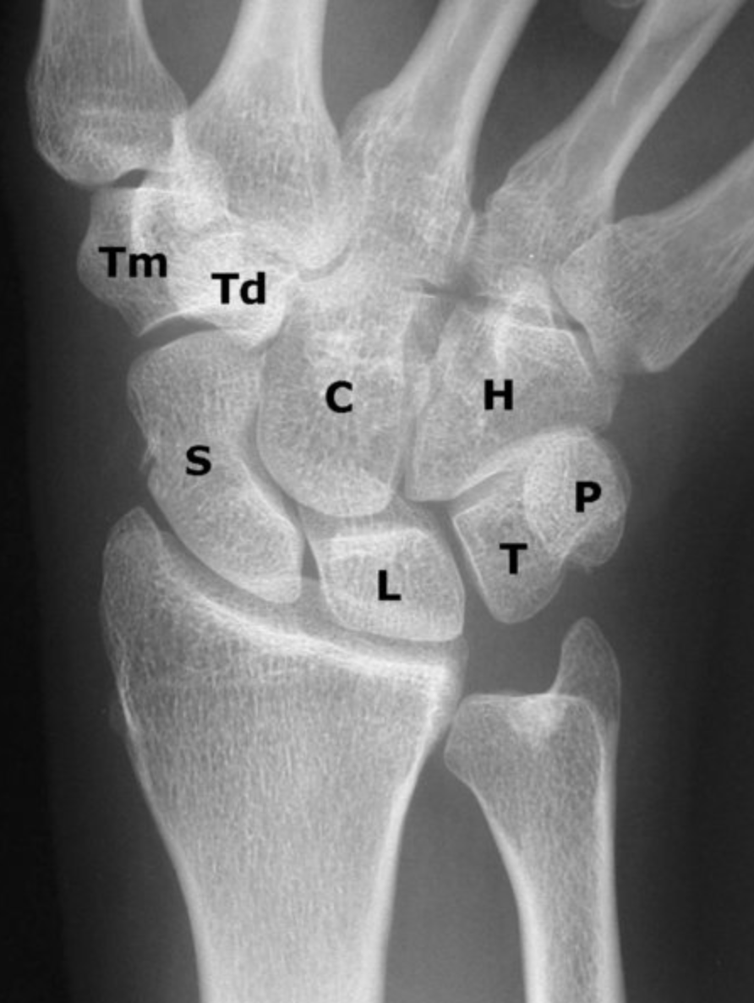
Anatomy
8 bones in 2 rows
Bridge the forearm and hand
Proximal carpal row provides wrist movement and congruency
Scaphoid, lunate, triquetrum
Distal carpal row is relatively more fixed to the metacarpals
Trapezium, trapezoid, capitate, hamate
Pisiform – sesamoid, not part of either row
Duckworth AD, Strelzow J. Chapter 43. In: Tornetta P, Ricci WM, eds. Rockwood and Green's Fractures in Adults, 9e. Philadelphia, PA. Wolters Kluwer Health, Inc; 2019.

Slide 4
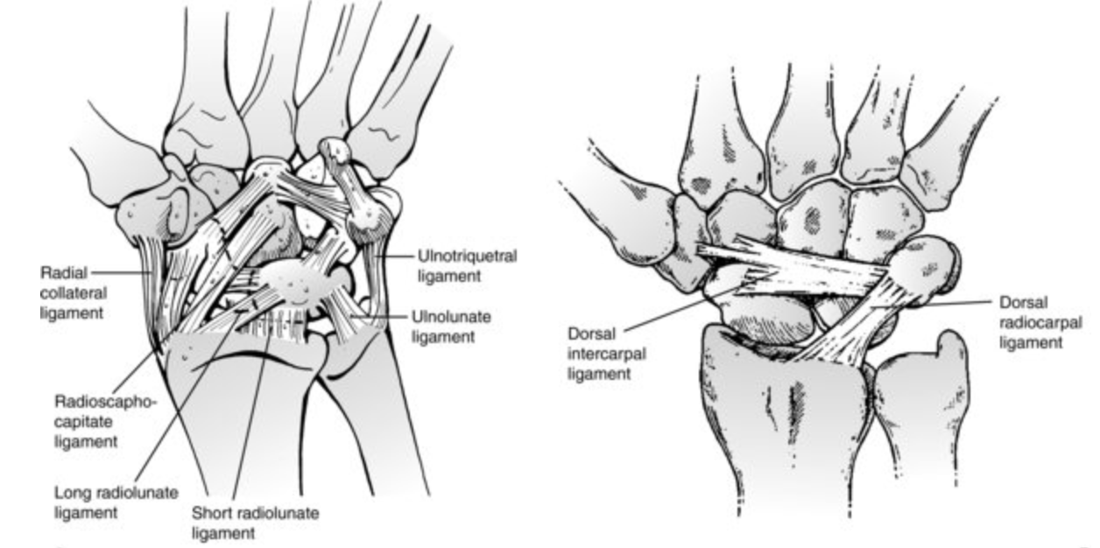
Anatomy
Ligaments of wrist are predominantly contained within the joint capsule (extrinsic ligaments)
Carpal bones tightly linked by capsular (extrinsic) and interosseous (intrinsic) ligaments
Duckworth AD, Strelzow J. Chapter 43. In: Tornetta P, Ricci WM, eds. Rockwood and Green's Fractures in Adults, 9e. Philadelphia, PA. Wolters Kluwer Health, Inc; 2019.
Capsular (extrinsic) ligaments connect carpal bones to forearm bones (proximally) and metacarpal bones (distally)
Interosseous (intrinsic) ligaments traverse the carpal bones

Slide 5
Mechanism of Injury
Most common is fall on outstretched hand (axial compression)
Hyperextension causes both tensile and shear stresses
Tensile forces cause most linear fractures
Compressive and shear forces cause comminution
Direct vs. indirect

Slide 6
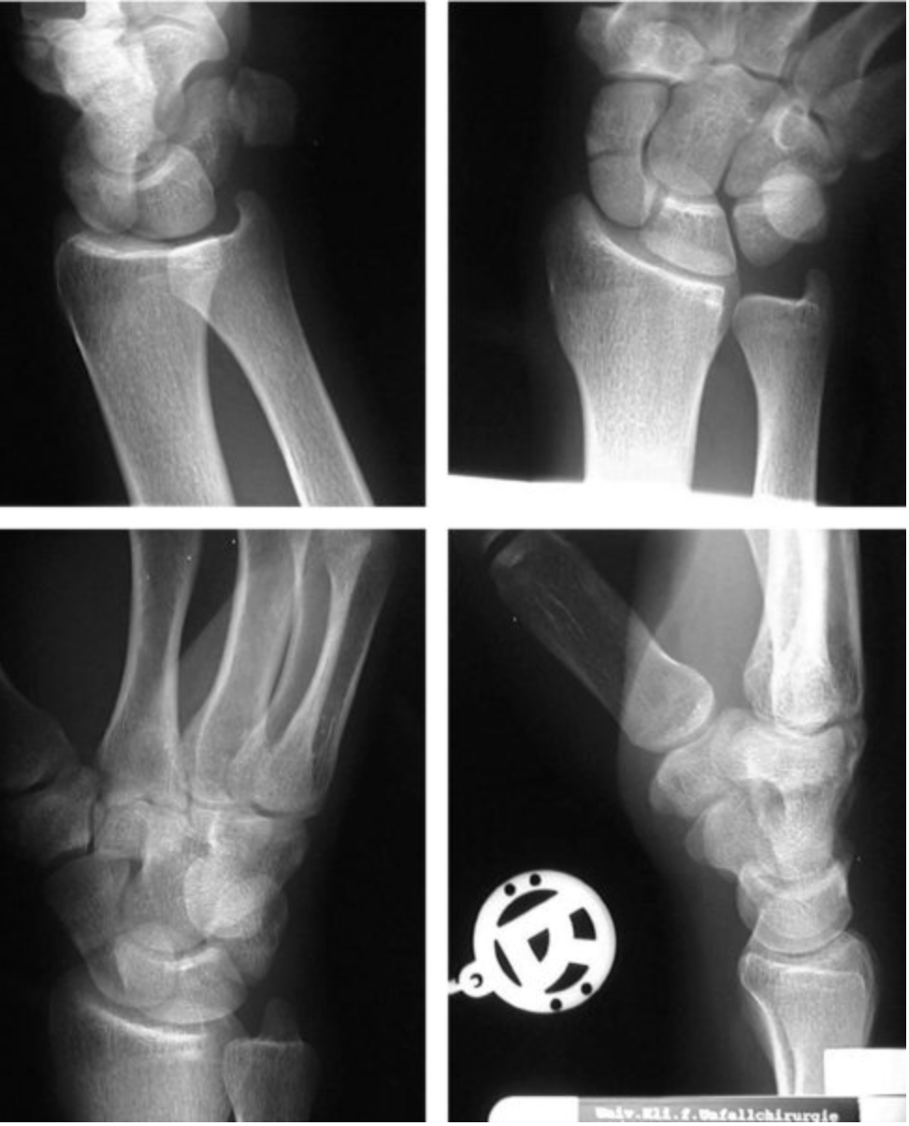
Imaging
Plain radiographs (multiple views necessary):
Most carpal fractures:
Posteroanterior (PA)
Lateral
Obliques (45-degree radial oblique, 45-degree ulnar oblique)
Scaphoid view (ulnar deviation)
Intercarpal ligament injury:
Clenched-fist AP
Clenched pencil view (modified clench-fist view)
https://pubmed.ncbi.nlm.nih.gov/12772096/
Duckworth AD, Strelzow J. Chapter 43. In: Tornetta P, Ricci WM, eds. Rockwood and Green's Fractures in Adults, 9e. Philadelphia, PA. Wolters Kluwer Health, Inc; 2019.

Slide 7
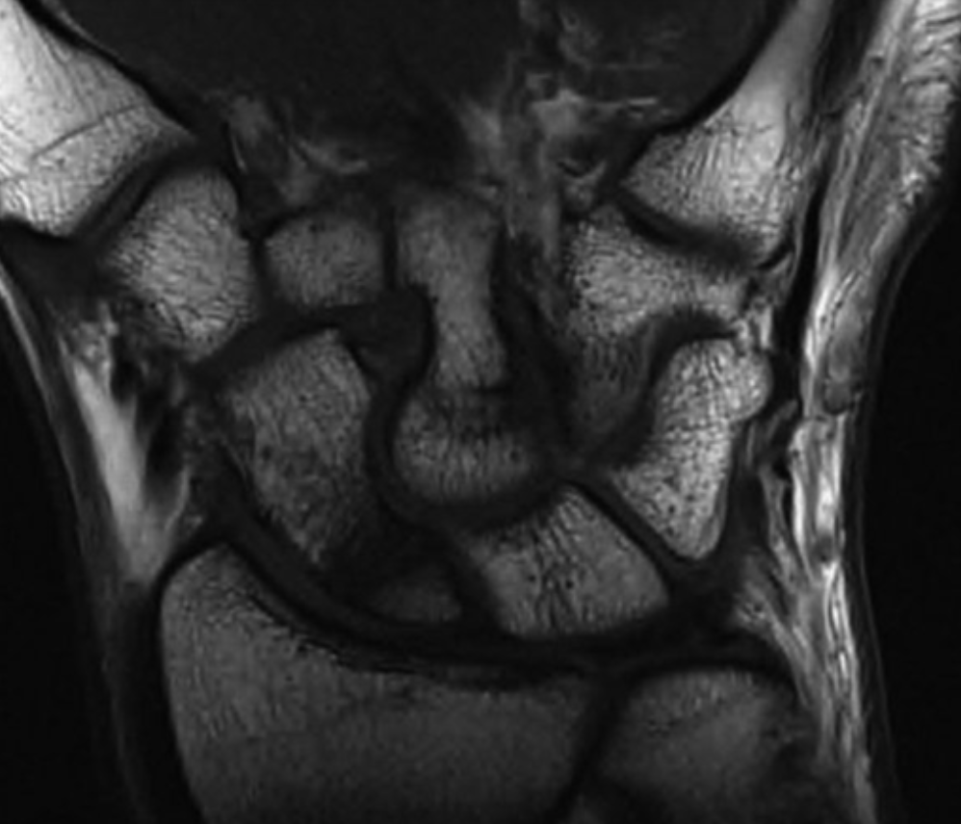
Advanced Imaging
CT scan
Useful for suspected (occult) carpal fractures, fracture displacement, malunion, nonunion, and bone loss
Assessment of union
MRI
Useful for suspected (occult) carpal fractures
Assessment of AVN
Ligament injuries
Ultrasound
Suspected carpal fractures, ligament injuries
Bone scintigraphy
Suspected carpal fractures, avulsion fractures
Scaphoid nonunion on T1 MRI
Duckworth AD, Strelzow J. Chapter 43. In: Tornetta P, Ricci WM, eds. Rockwood and Green's Fractures in Adults, 9e. Philadelphia, PA. Wolters Kluwer Health, Inc; 2019.a

Slide 8
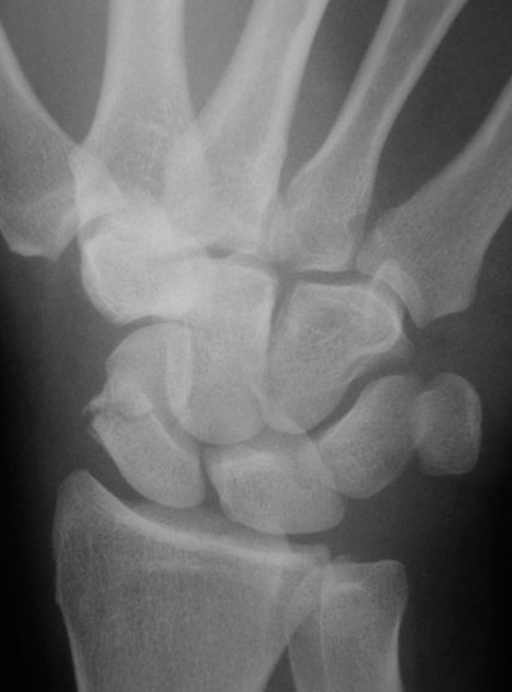
Scaphoid Fractures
2-7% of all orthopedic fractures
Most common carpal bone fractured (~15% of all wrist fractures)
Frequently missed
X-rays may miss nondisplaced fractures
Tenuous blood supply leads to potential complications
Complications
Nonunion
Malunion
Avascular necrosis
Carpal collapse
Scaphoid Fracture
Duckworth AD, Strelzow J. Chapter 43. In: Tornetta P, Ricci WM, eds. Rockwood and Green's Fractures in Adults, 9e. Philadelphia, PA. Wolters Kluwer Health, Inc; 2019.a

Slide 9
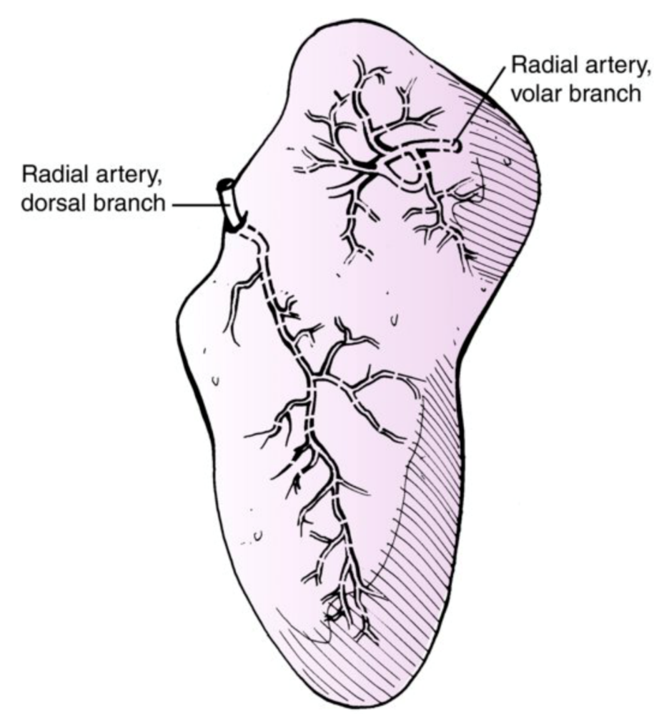
Scaphoid Anatomy
Retrograde blood supply
Two vascular pedicles originating from the scaphoid branches of the radial artery
Dorsal branch
Enters via the small foramina along the spiral groove and dorsal ridge of the scaphoid
Supplies 70-80% of the scaphoid proximally (including the proximal pole)
Volar branch
Enters via the scaphoid tubercle
Supplies 20-30% of distal scaphoid
Duckworth AD, Strelzow J. Chapter 43. In: Tornetta P, Ricci WM, eds. Rockwood and Green's Fractures in Adults, 9e. Philadelphia, PA. Wolters Kluwer Health, Inc; 2019.a

Slide 10
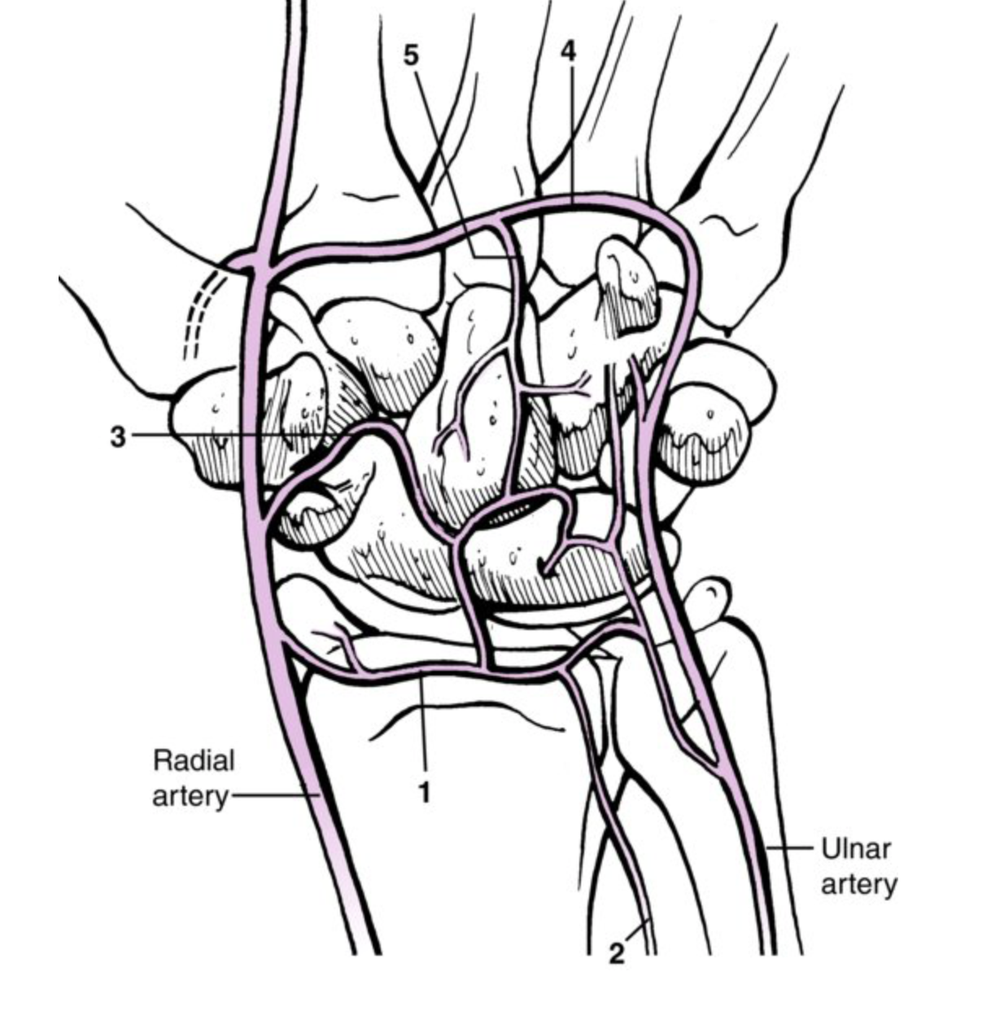
Scaphoid Anatomy
“skaphos”-Greek word for boat
Bridges proximal and distal rows
Twisted peanut or “S” shaped
45-degrees from longitudinal and horizontal axes of the wrist
>80% of surface area is covered with articular cartilage
Increased risk for delayed union and nonunion
Duckworth AD, Strelzow J. Chapter 43. In: Tornetta P, Ricci WM, eds. Rockwood and Green's Fractures in Adults, 9e. Philadelphia, PA. Wolters Kluwer Health, Inc; 2019.a

Slide 11
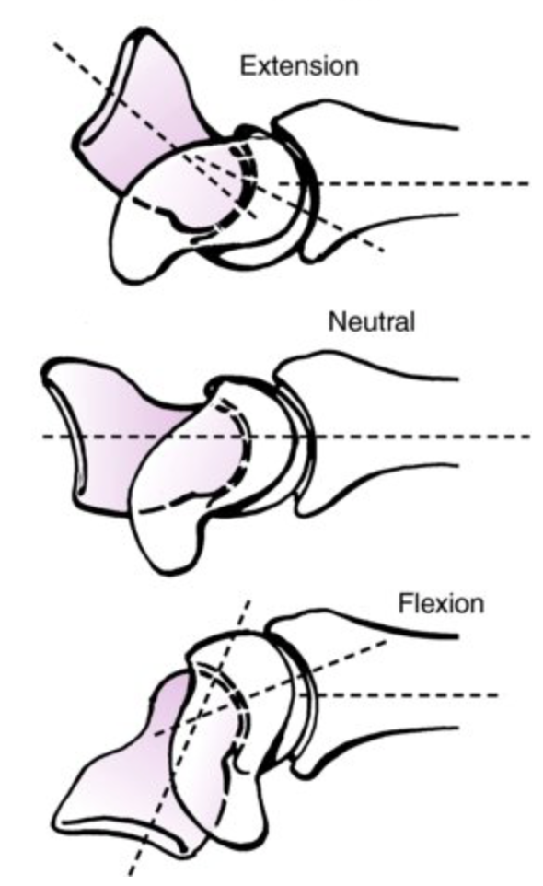
Scaphoid Anatomy
>80% covered with articular cartilage (implications)
Heals with little/no callus (intramembranous ossification)
Proximal pole is cover almost completely with cartilage
Little, if any, perforating vessels → high incidence of osteonecrosis
Scaphoid flexes with wrist flexion and extends with wrist extension
Duckworth AD, Strelzow J. Chapter 43. In: Tornetta P, Ricci WM, eds. Rockwood and Green's Fractures in Adults, 9e. Philadelphia, PA. Wolters Kluwer Health, Inc; 2019.

Slide 12
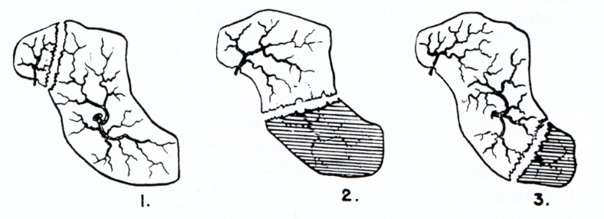
Scaphoid Anatomy
Divided into 3 regions:
Proximal pole (10-25% of fractures)
Waist (65-80% of fractures)
Distal pole and tubercle (5-10% of fractures)
Image taken from previous OTA Core Curriculum Lecture.

Slide 13
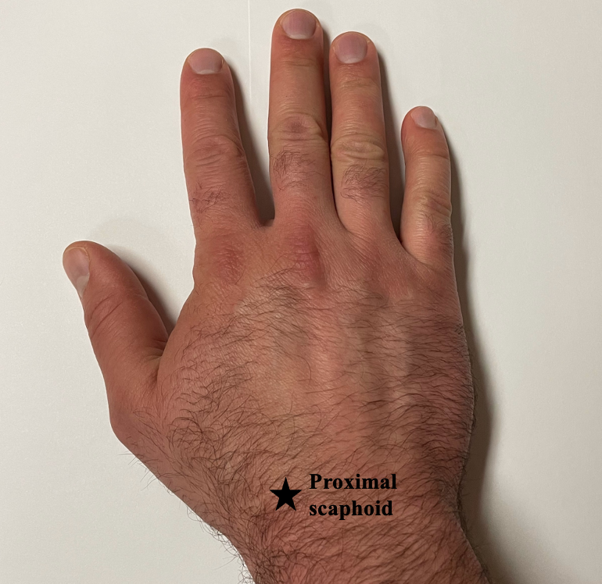
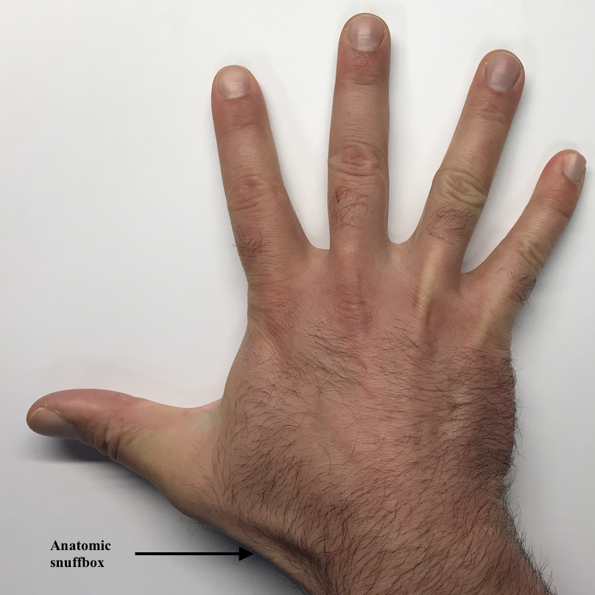
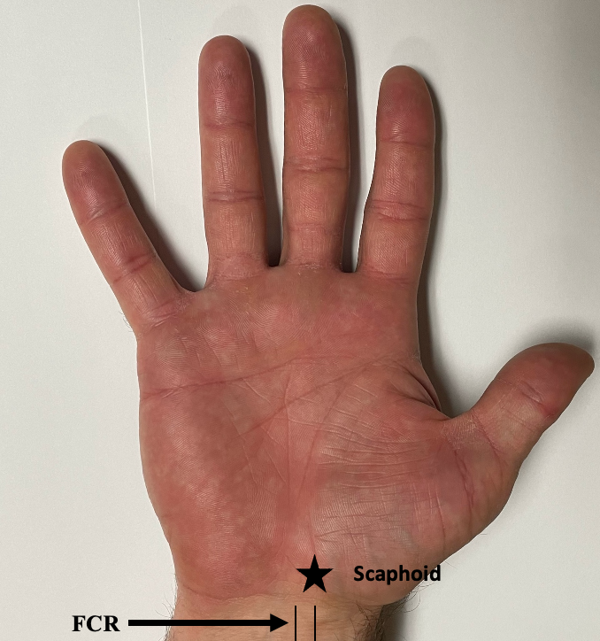
Scaphoid Fracture - Exam
Surface anatomy of the wrist
Anatomic snuffbox bordered by the EPL tendon ulnarly and the EPB radially
Physical Exam Findings
Anatomic “Snuffbox” tenderness
Ulnar deviation exposes scaphoid waist for easier palpation
Pain with palpation of the scaphoid tuberosity
Pain over SL ligament with the wrist flexed to palpate the proximal pole
Limited painful wrist ROM, especially forced dorsiflexion
Beware of the “wrist sprain” that may actually be an occult scaphoid fracture

Slide 14
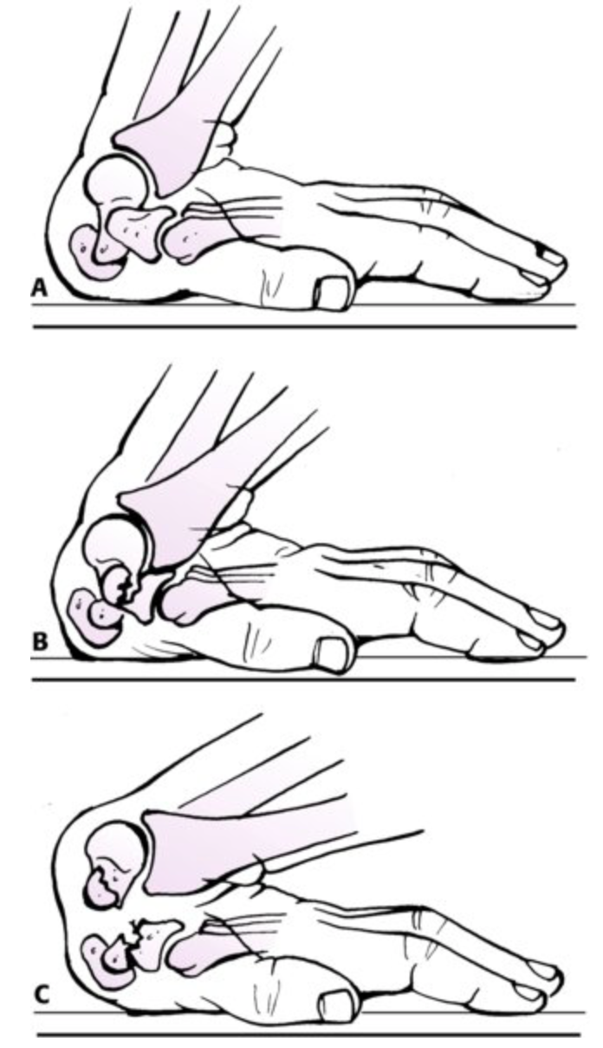
Mechanism of Injury
Axial load across hyperextended and radially deviated wrist
Hyperextension of wrist past 95 degrees
Wrist in extreme flexion and ulnar deviation
Duckworth AD, Strelzow J. Chapter 43. In: Tornetta P, Ricci WM, eds. Rockwood and Green's Fractures in Adults, 9e. Philadelphia, PA. Wolters Kluwer Health, Inc; 2019.a

Slide 15
Differential Diagnosis
Scapholunate instability
Pain and clicking in wrist
Tender just distal to Lister’s tubercle
Positive “Watson” test
FCR tendon rupture or tendinitis
Radial styloid fracture
De Quervain’s tenosynovitis (radial styloid tenosynovitis)
CMC (basal) joint arthrosis
Radio-scaphoid arthrosis

Slide 16
Watson Test (Scaphoid Shift Test)

Slide 17
Diagnosis of Scaphoid Fractures
X-rays – false negative up to 25% of the time
CT scan
MRI – most accurate
Bone scan – rarely used these days

Slide 18
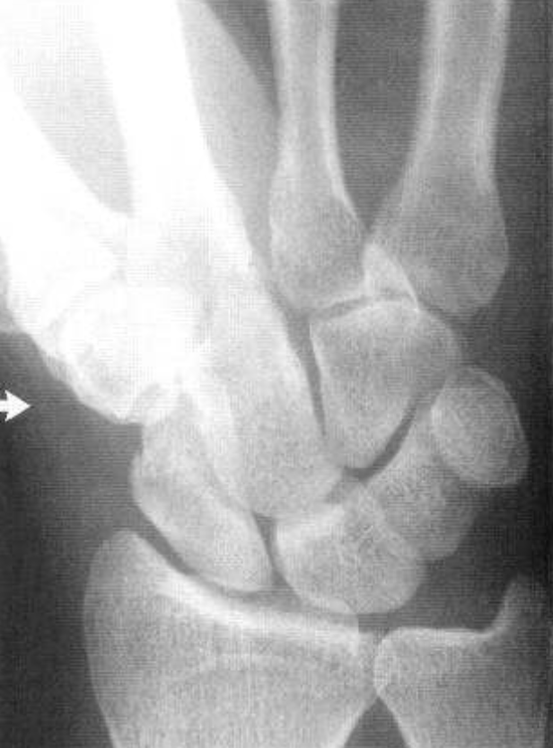
Diagnosis of Scaphoid Fractures
Plain radiographs
PA, Lateral, Pronated Oblique, and Ulnar deviation (scaphoid view) views
“Occult” fracture
Repeat x-ray in 2 weeks if suspicion remains high after initial negative x-ray
Karl JW, Swart E, Strauch RJ. Diagnosis of occult scaphoid fractures: a cost-effectiveness analysis. J Bone Joint Surg Am. 2015;97(22):1860-1868.
https://pubmed.ncbi.nlm.nih.gov/26582616/
“Stripe” sign
Obliteration or radial displacement of the fat pad normally seen between the radial collateral ligaments and the EPB/APL tendon complex
https://pubmed.ncbi.nlm.nih.gov/14521890/
https://pubmed.ncbi.nlm.nih.gov/2794717/
Image from: Dias JJ, Finlay DB, Brenkel IJ, Gregg PJ. Radiographic assessment of soft tissue signs in clinically suspected scaphoid fractures: the incidence of false negative and false positive results. J Orthop Trauma. 1987;1(3):205-208.

Slide 19
Classification of Scaphoid Fractures
Usually by location:
Proximal third (10-25%)
Middle third (waist) (65-80%)
Distal third and Tuberosity (5-10%)
Why is this so important?
Primary vascular supply enters dorsal ridge and runs retrograde to the proximal scaphoid
The more proximal the fracture, the more likely are healing complications
Notes:
. Proximal pole (10-25% of fractures)
Waist (65-80% of fractures)
Distal pole and tubercle (5-10% of fractures)

Slide 20
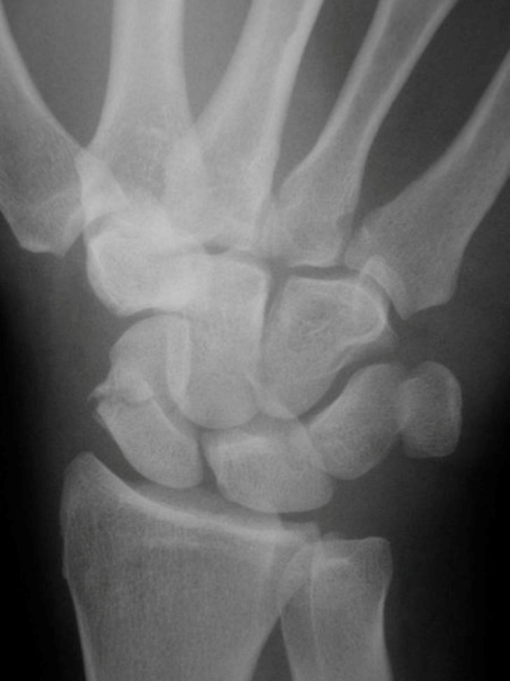
Treatment of Acute Scaphoid Fractures
Non-Operative Management
Short vs Long-arm cast (still controversial)
Apparently equivalent SAC vs. LAC & spica vs. standard cast
Duration
Distal pole and tubercle fractures: 6-8 weeks
Waist fractures: 8-10 weeks
Proximal pole fractures: 10-12 weeks or longer
Operative Management
Percutaneous pin or screw fixation
ORIF
Duckworth AD, Strelzow J. Chapter 43. In: Tornetta P, Ricci WM, eds. Rockwood and Green's Fractures in Adults, 9e. Philadelphia, PA. Wolters Kluwer Health, Inc; 2019.a
Notes:
.

Slide 21
Indications for Surgical Intervention
Displacement ≥1 mm
Lateral intrascaphoid angle > 35°
Height-to-length ratio >0.65
Bone loss or comminution
Perilunate fracture-dislocation
Dorsal intercalated segmental instability
Any proximal pole
Poor patient compliance

Slide 22
Operative Management
Open reduction, internal fixation (ORIF)
Headless screws
K-wires (probably mainly for salvage procedure)
Percutaneous fixation with cannulated screw
Volar approach for distal fractures
Dorsal approach proximal fractures
Either can be used for scaphoid waist fractures

Slide 23
Distal Tubercle Fractures
More common in children
Should be treated with cast immobilization for 6-8 weeks
Could be old
Don’t miss more proximal extension

Slide 24
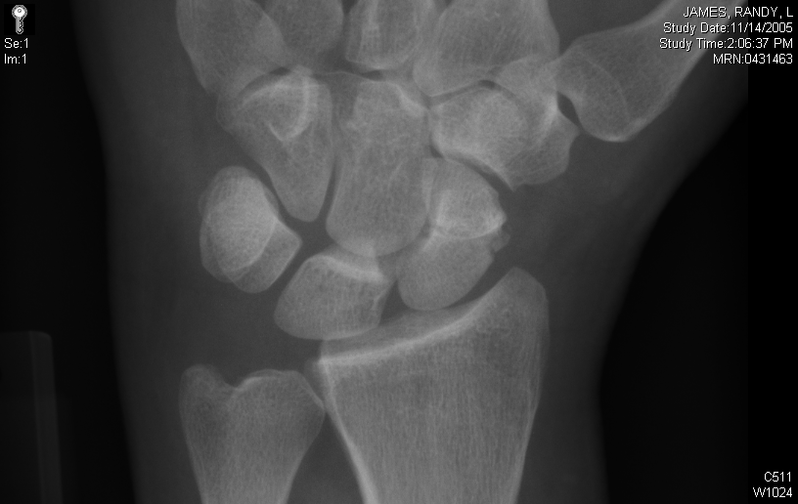
Waist Fractures
Non-displaced fractures
Cast immobilization for 8-10 weeks
Percutaneous cannulated screw fixation
https://pubmed.ncbi.nlm.nih.gov/31895249/
Displaced fractures (>1mm) or vertical/oblique fractures
Open reduction and internal fixation
https://pubmed.ncbi.nlm.nih.gov/32175096/
Volar approach

Slide 25
Volar Approach-Exposure
Gentle zig-zag incision directly over the course of the flexor carpi radialis tendon

Slide 26
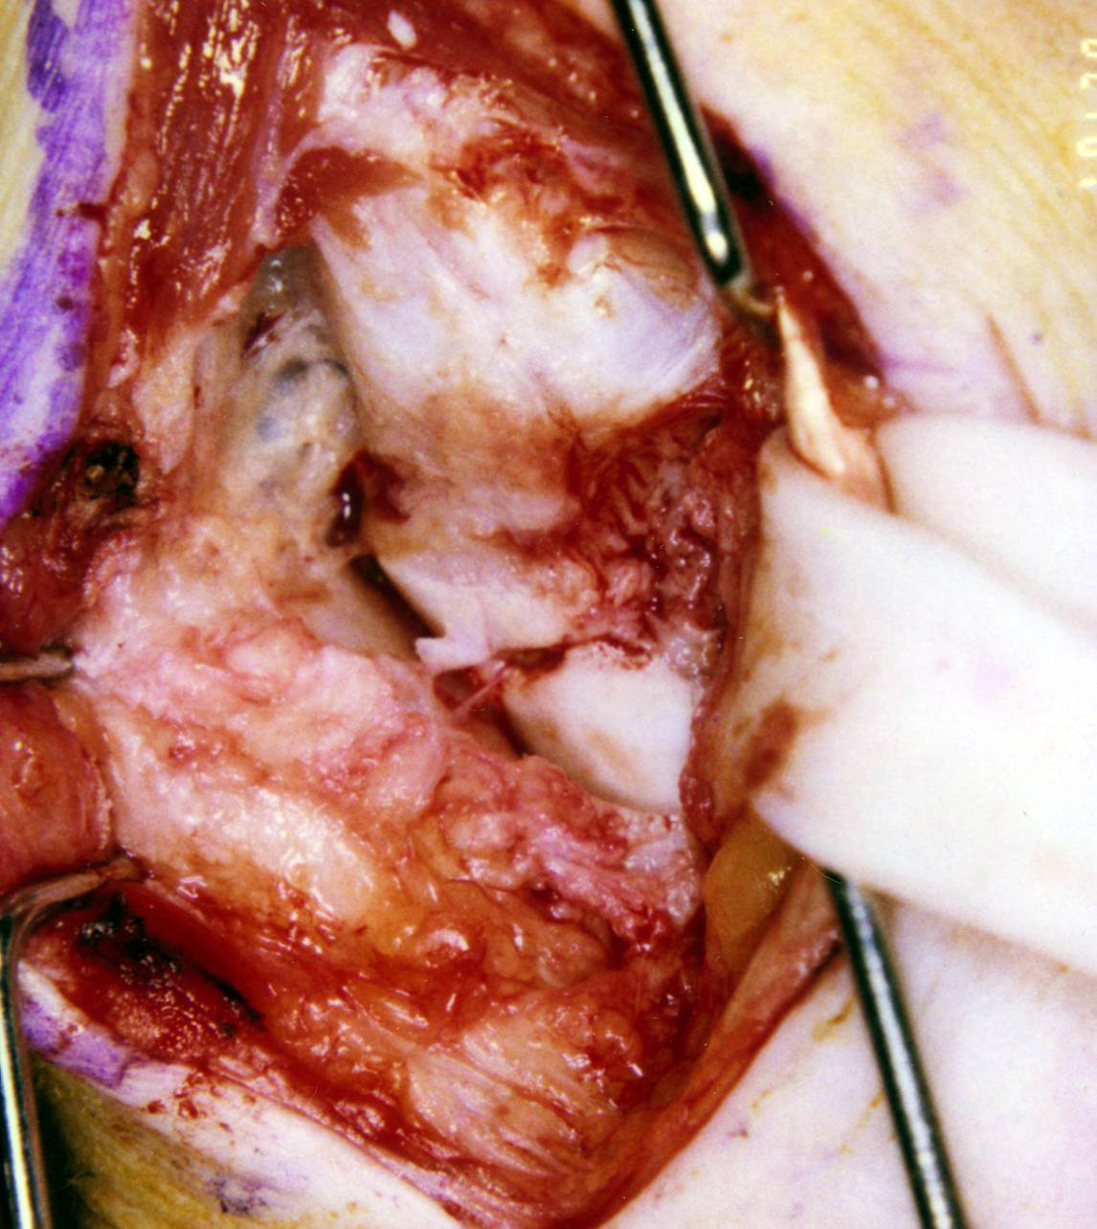

Slide 27
OTA ONLINE VIDEO – Scaphoid ORIF
https://otaonline.org/video-library/45036/procedures-and-techniques/multimedia/16776659/scaphoid-orif

Slide 28
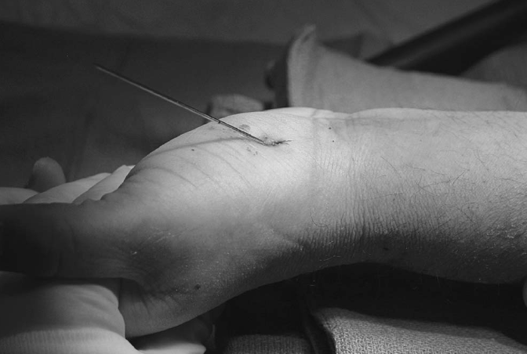
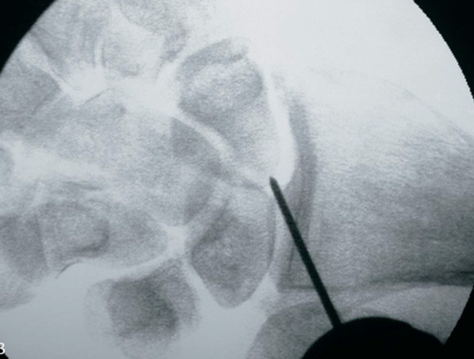
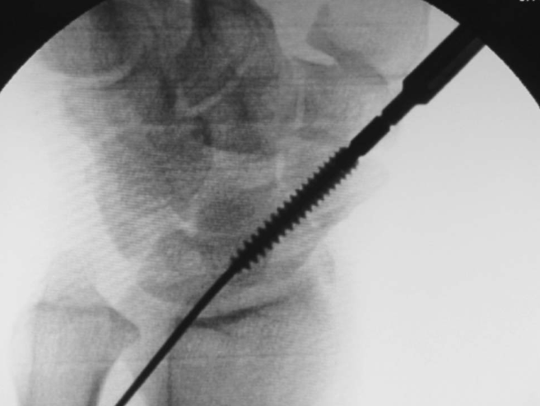
Percutaneous Fixation
Cannulated headless compression screw
Retrograde (volar) or anterograde (dorsal)
Pirela-Cruz MA, Battista V, Burnette S, Hansen T. A technical note on percutaneous scaphoid fixation using a hybrid technique. J Orthop Trauma. 2005;19(8):570-573.

Slide 29
Proximal Pole Fractures
High rate of nonunion-50%
Best treated with early internal fixation
Exposure typically from dorsal approach
If nonunion, may benefit from vascularized bone graft?
MRI can help determine if there is AVN

Slide 30
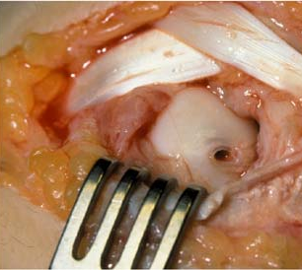
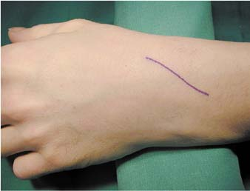
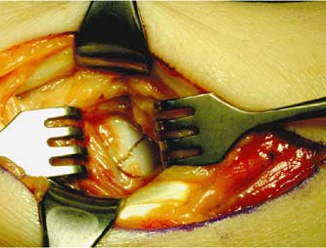

Slide 31
Author Proposed Algorithm for Suspected Scaphoid Fractures
Wrist Injury
(+) Physical Exam
X-rays: Normal
(-) Physical Exam
X-rays: Scaphoid fracture
Treat according to fracture type
Immobilize 7-10 days (thumb spica)
Symptomatic: Repeat X-rays
Treat other injuries accordingly
X-rays: Normal
X-rays: Scaphoid fracture
Treat according to fracture type
MRI
Recast & follow up at 3 weeks
MRI or CT (if early diagnosis is necessary)
Asymptomatic: No X-rays
Treatment complete
Treat according to advanced imaging findings
https://pubmed.ncbi.nlm.nih.gov/26582616/

Slide 32
Complications
Avascular necrosis (proximal pole)
Malunion
Nonunion
Approximately 10%
Location of nonunion will determine approach to scaphoid
Waist:
Volar approach
Deformity correction
Bone graft
Proximal pole:
Dorsal approach
Consider vascularized bone graft
Scaphoid Nonunion Associated Collapse (SNAC)

Slide 33
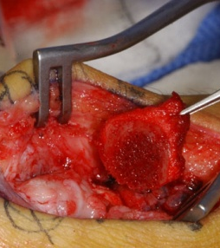
Scaphoid Fractures
Scaphoid nonunion surgery with placement of bone graft

Slide 34
Carpal Instability
Lunate is the key to carpal stability
Linked to scaphoid and triquetrum by strong interosseous ligaments
Injury to scapholunate or lunotriquetral ligaments lead to dissociative carpal instability patterns
(SL →DISI > LT→VISI)
Proximal and distal carpal rows are attached by capsular ligaments (extrinsic ligaments) on each side of the lunocapitate joint
Injury to these ligaments leads to abnormal motion between the two rows, and non-dissociative wrist instability patterns
Much rarer than DISI or VISI
https://www.ncbi.nlm.nih.gov/pmc/articles/PMC4514919/
https://www.ncbi.nlm.nih.gov/pmc/articles/PMC4117698/
Duckworth AD, Strelzow J. Chapter 43. In: Tornetta P, Ricci WM, eds. Rockwood and Green's Fractures in Adults, 9e. Philadelphia, PA. Wolters Kluwer Health, Inc; 2019.a

Slide 35
Perilunate Injuries - General Information
Young individuals with high demands
Frequently missed
High risk of post-traumatic degenerative change
https://pubmed.ncbi.nlm.nih.gov/19931988/
Surgical reduction/repair outperforms closed reduction with casting
https://pubmed.ncbi.nlm.nih.gov/26205701/
https://pubmed.ncbi.nlm.nih.gov/25207292/
Often associated with ligamentous injury
High incidence of associated nerve injury
https://www.ncbi.nlm.nih.gov/pmc/articles/PMC4642473/
Vascular and/or tendon injury possible (less common)
Uncommon, but most common form of wrist dislocation
Perilunate dislocation (PLD) vs Perilunate fracture-dislocation (PLFD)

Slide 36
General Information
Spectrum of injuries involving the carpus
Variable disruption of carpal anatomy
Ligamentous vs. bony
Some consistent patterns
Constant feature
Lunate-Capitate relationship is disrupted

Slide 37
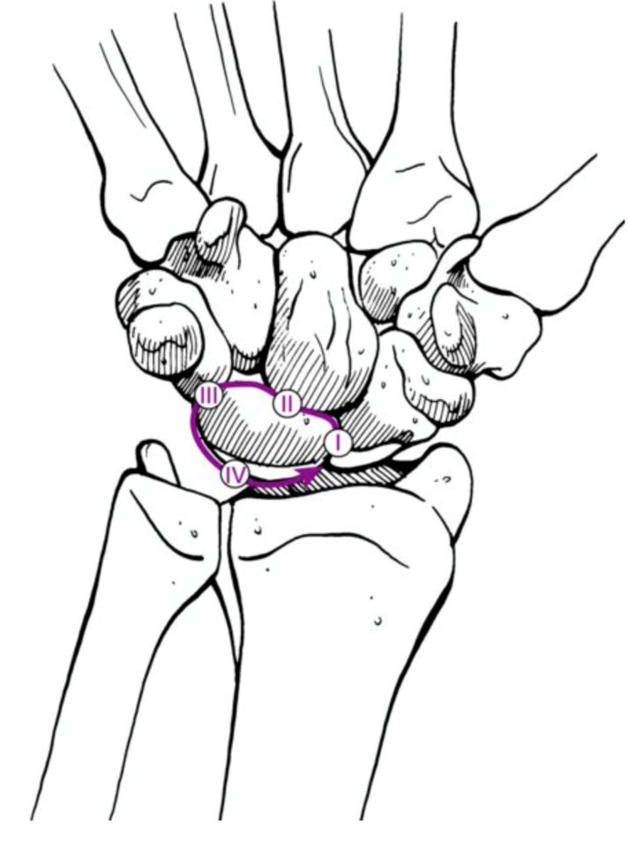
Injury Progression (Mayfield 1980)
Scapholunate (SL) Dissociation or Scaphoid Fracture
Lunocapitate Dislocation through the space of Poirier
Lunate Triquetrum Disruption or Triquetrum Fracture
Dorsal Perilunate Dislocation
Complete Palmar Lunate Dislocation
Duckworth AD, Strelzow J. Chapter 43. In: Tornetta P, Ricci WM, eds. Rockwood and Green's Fractures in Adults, 9e. Philadelphia, PA. Wolters Kluwer Health, Inc; 2019.a

Slide 38
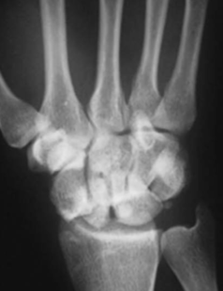
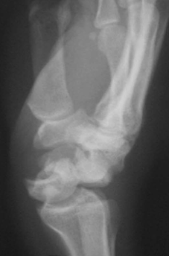
Perilunate Variations
Purely ligamentous (PLD)
Fracture through greater arc combined with ligamentous injury (PLFD)
Trans-scaphoid perilunate fx-dislocation most common
97% of PLFD
95% scaphoid fractures at waist
Komurcu M, Kürklü M, Ozturan KE, Mahirogullari M, Basbozkurt M. Early and delayed treatment of dorsal transscaphoid perilunate fracture-dislocations. J Orthop Trauma. 2008;22(8):535-540.

Slide 39
3 Most Common Patterns
Perilunate dislocation
Transscaphoid perilunate fracture-dislocation
Lunate dislocation

Slide 40
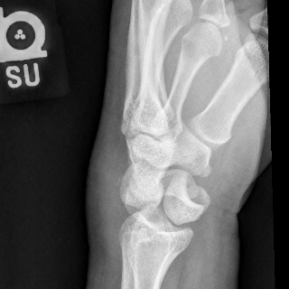
Perilunate Dislocation

Slide 41
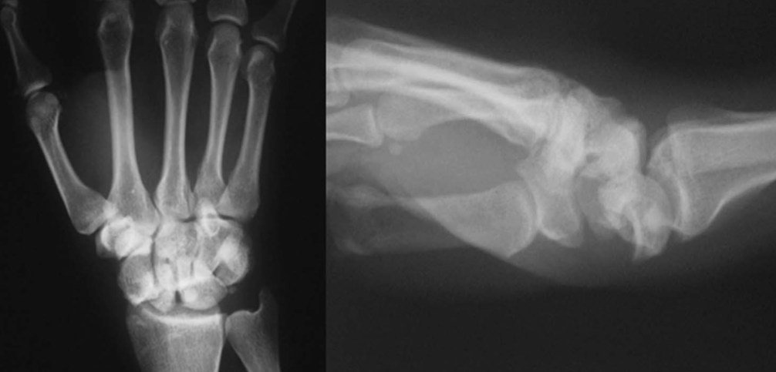
Transscaphoid Perilunate Fracture-Dislocation
Images from: Komurcu M, Kürklü M, Ozturan KE, Mahirogullari M, Basbozkurt M. Early and delayed treatment of dorsal transscaphoid perilunate fracture-dislocations. J Orthop Trauma. 2008;22(8):535-540.

Slide 42
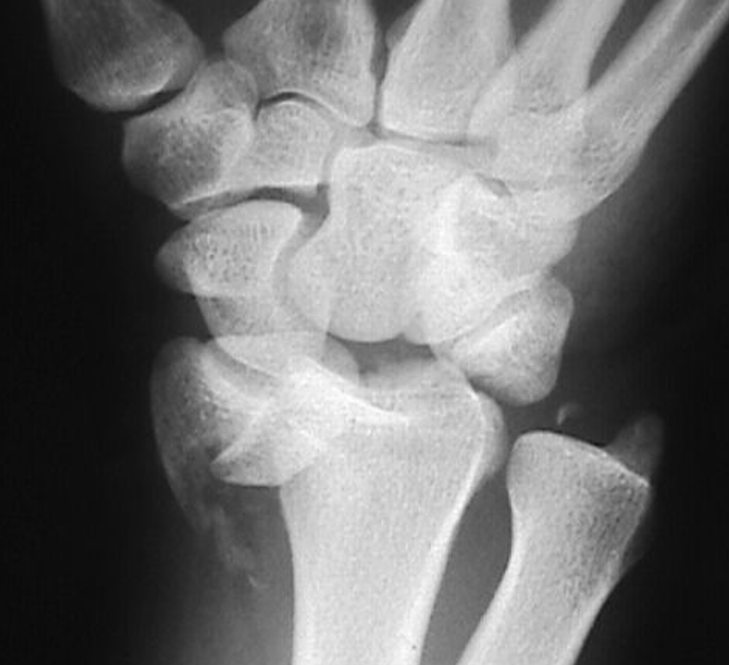
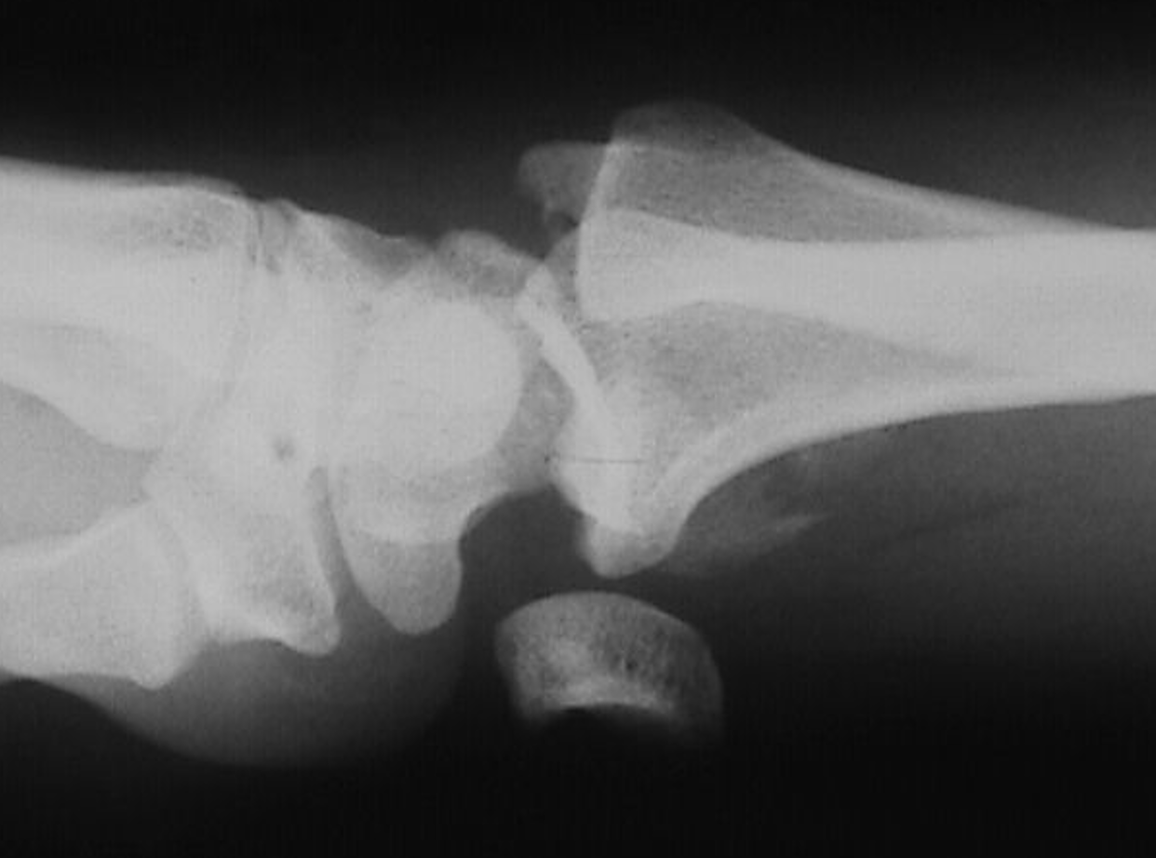
Lunate dislocation

Slide 43
Mechanism of Injury
Most common is fall on outstretched hand (axial compression)
Hyperextension causes both tensile and shear stresses
Ulnar deviation
Tensile forces cause most linear fractures
Compressive and shear forces cause comminution
Direct vs. indirect

Slide 44
Gilula’s Lines
Duckworth AD, Strelzow J. Chapter 43. In: Tornetta P, Ricci WM, eds. Rockwood and Green's Fractures in Adults, 9e. Philadelphia, PA. Wolters Kluwer Health, Inc; 2019.

Slide 45
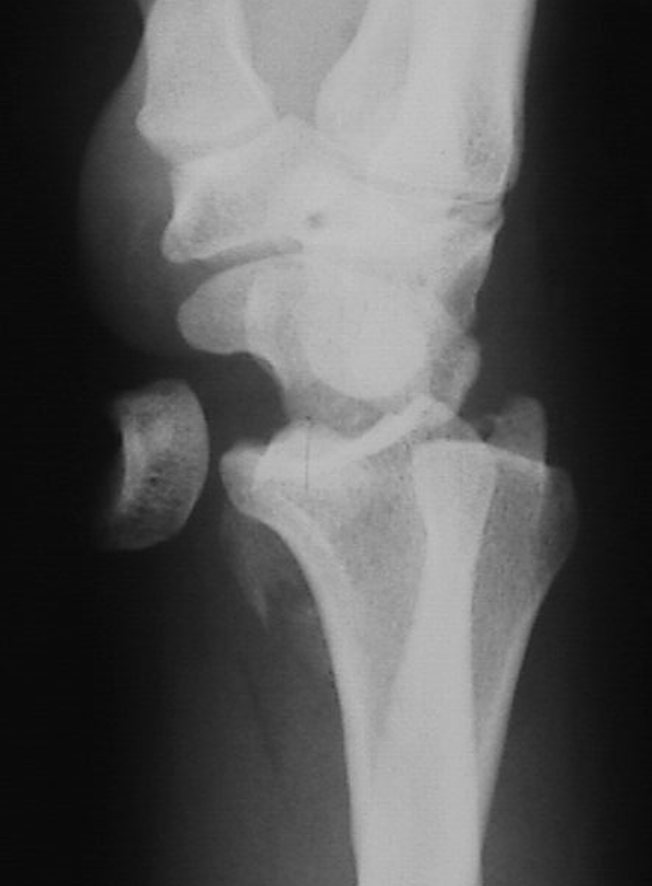

Slide 46
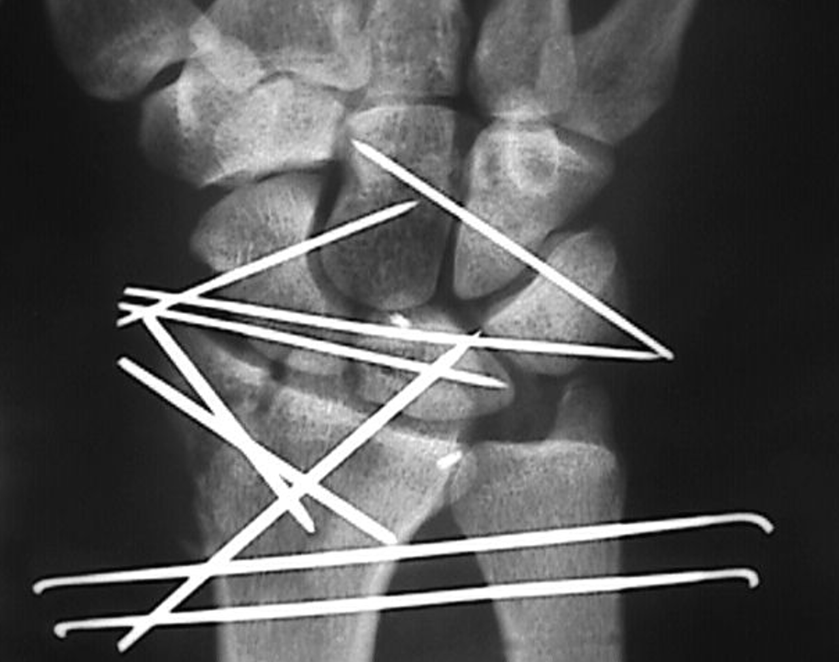
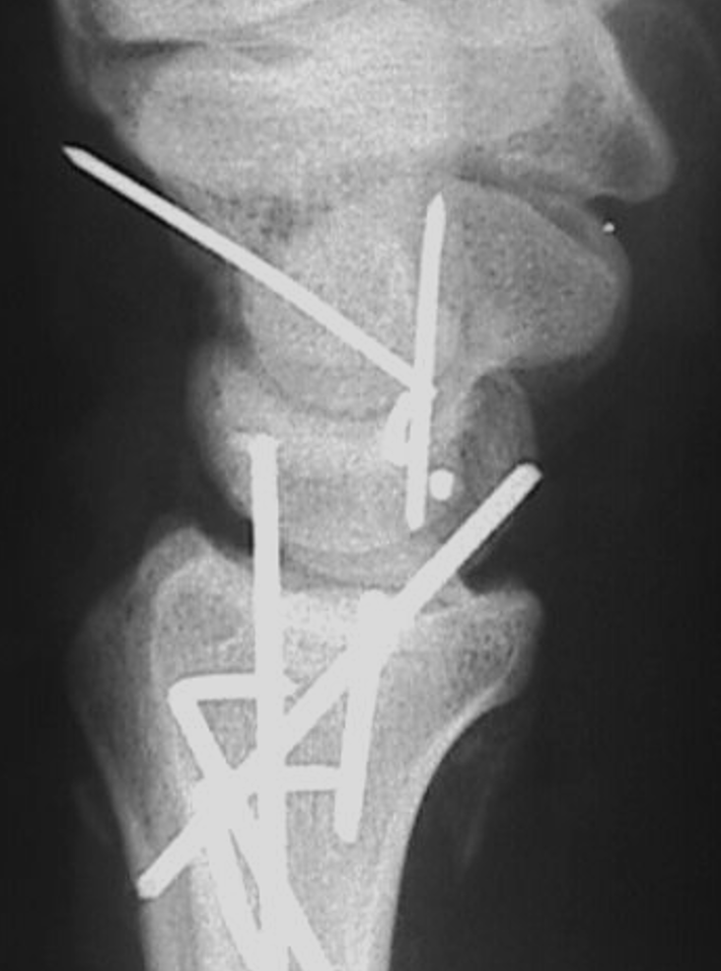

Slide 47
Physical Exam
Moderate/Severe Swelling
Must be evaluated for acute carpal tunnel syndrome >>compartment syndrome of forearm/hand
Acute carpal tunnel syndrome warrants urgent surgical release
Neuropraxia may be only exam finding (finger flexors innervated proximally)
Short and thick wrist
Limited motion / crepitus
Palmar or Dorsal prominence
Median nerve symptoms may be present if lunate dislocated

Slide 48
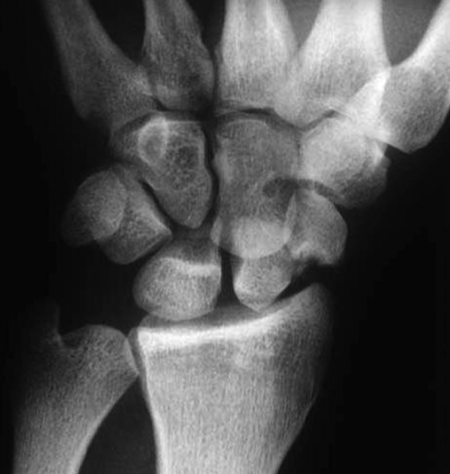
Imaging
Good quality PA/ lateral/ oblique
20% misinterpreted on initial radiographs
PA in traction sometimes helpful

Slide 49
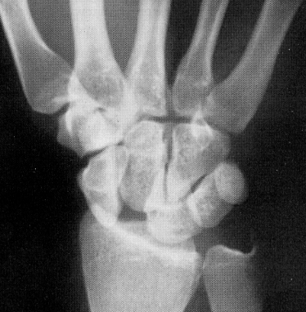
Radiographic Studies
PA
Disruption of arcs - Gilula
Cortical ring sign
Abnormal interosseus spacing
Overlap of proximal / distal rows
Associated greater arc fractures
Radial styloid fracture

Slide 50
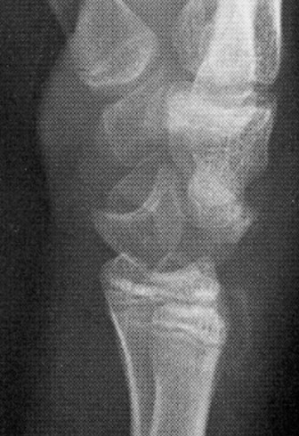
Imaging
Lateral (True lateral with wrist in neutral)
Lunate and/or Distal Row not aligned with radius
Abnormal Scapholunate/Radiolunate angles
Spilled Teacup

Slide 51
Initial Treatment
Closed reduction with adequate sedation
In finger traps with 10-15 lbs. traction for 5-10 minutes
Maneuver
Wrist extension
Counterpressure - palmar over lunate
Gradual wrist flexion with direct pressure over capitate

Slide 52
Closed Reduction Percutaneous Pinning
Closed Reduction Percutaneous Pinning
Most injuries require fixation to maintain reduction
Requires anatomic reduction
Reduce and pin lunate to radius
Reduce and pin capitate to lunate
Reduce and pin scaphoid to lunate
Reduce and pin lunate to triquetrum
Reduce and pin scaphoid to capitate
Difficult to assess alignment, osteochondral injury
Median nerve compression

Slide 53
Open Reduction Internal Fixation
ORIF Preferred (Green ; Herzberg)
Direct visualization
Ligamentous repair
Decompression of median nerve
Several Approaches – no hard evidence supporting one vs. another
Dorsal
Volar
Combined dorsal /volar Repair of fractures (dorsal/volar)
Repair SL and LT ligaments (dorsal)
Repair of palmar radiocarpal ligaments (volar)
Decompression of median nerve palmar (volar)

Slide 54
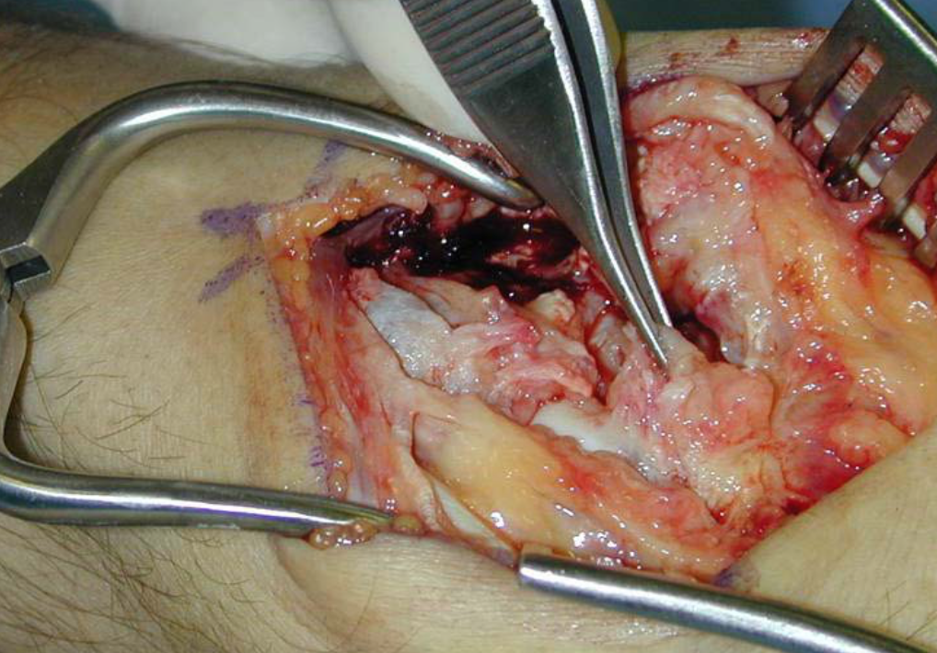
Dorsal Approach – Repair SL ligament

Slide 55
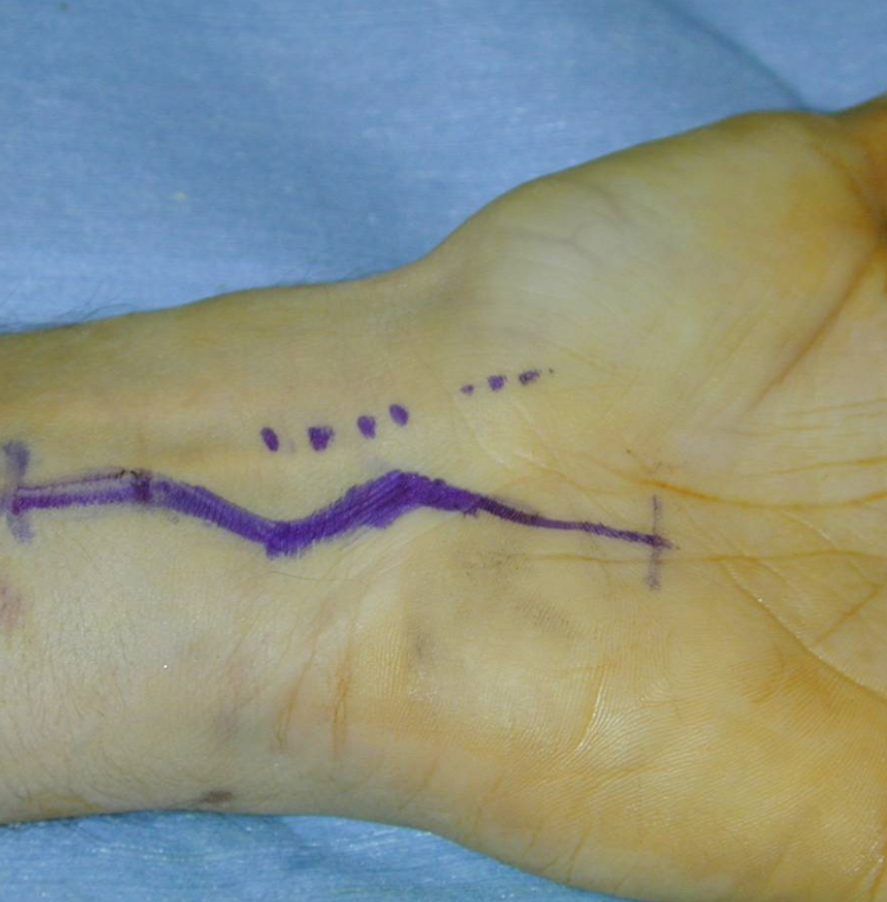
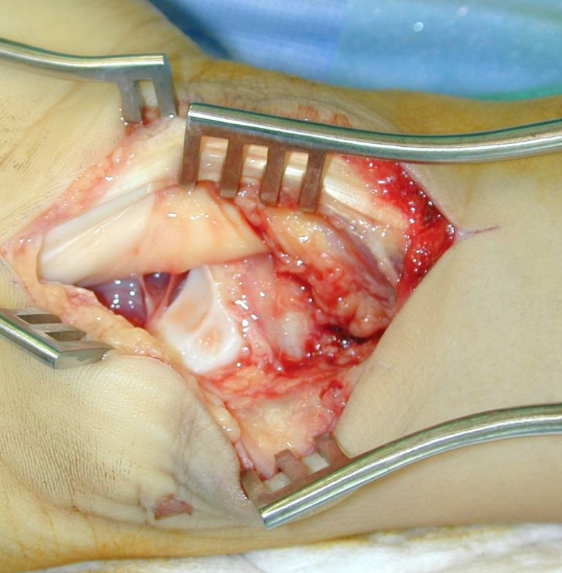
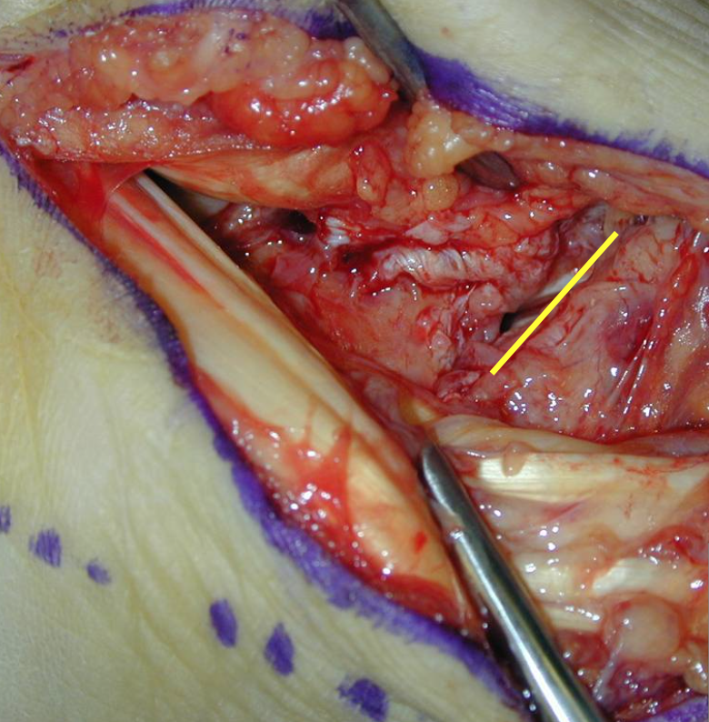
Volar Approach
Lunate may be dislocated volarly
Volar mid-carpal ligament tear

Slide 56
Salvage Procedure
Salvage Procedures
Proximal Row Carpectomy (PRC)
Severe open injury
Chronic injury
consider repair 3-12 weeks
reduction may be difficult after 2-3 weeks
> 12 weeks - PRC vs. arthrodesis

Slide 57
Complications
Arthrosis
Avascular necrosis of scaphoid /lunate
Transient ischemia more common
https://pubmed.ncbi.nlm.nih.gov/6715820/
Median neuropathy
Residual carpal instability

Slide 58
Outcomes
Poor prognosis for full return to full previous function
Poor prognostic factors:
Open injuries
Delayed treatment
Osteochondral fractures of the head of the capitate
Carpal malalignment
Nearly all patients experience decreased grip strength and range of motion
Arthritis on imaging does not correlate with functional outcome scores
Usually stiff, low pain, functional wrist despite arthrosis
https://pubmed.ncbi.nlm.nih.gov/21885701/
https://pubmed.ncbi.nlm.nih.gov/30403823/
https://pubmed.ncbi.nlm.nih.gov/33194101/

Slide 59
Other Carpal Fractures
Young active individuals with high demands
Not a common injury
Frequently missed (radiographs can be misleading)
High risk of post-traumatic degenerative change with non-anatomic reductions
Often associated with ligamentous injury
High incidence of associated nerve, vascular, and tendon injury

Slide 60
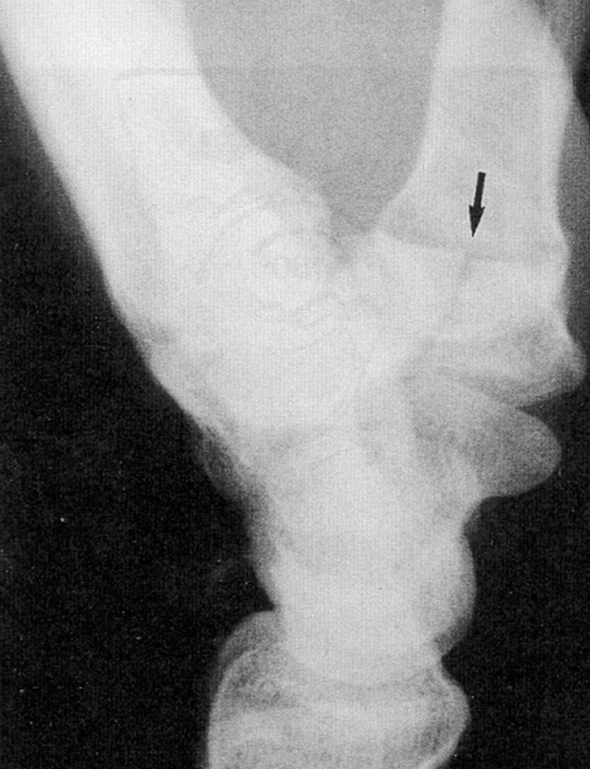
Trapezium Fractures
Third most common carpal bone fractured
6% of all carpal fractures
Associated with fractures of the thumb metacarpal (e.g. Bennet fracture) and/or the radius
5 patterns:
Vertical transarticular (most common)
Horizontal
Fractures of the dorsoradial tuberosity
Fractures of the anteromedial ridge
Comminuted fractures

Slide 61
Trapezoid Fractures
Corner-stone of the carpal arch
Wedge-shaped: wider dorsally
Isolated fractures are very seldom
Fewer than 20 cases in the literature

Slide 62
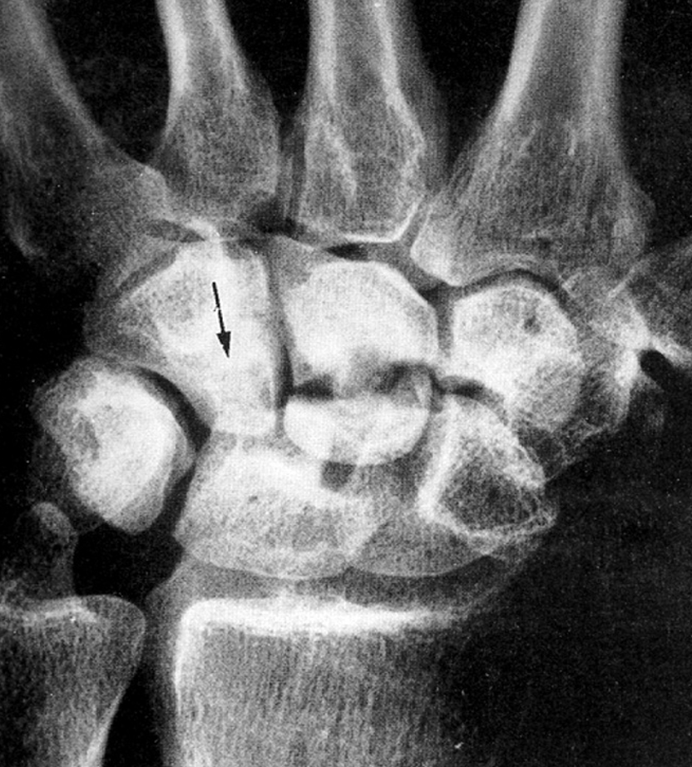
Capitate Fractures
1-2% of all carpal fractures
Isolated injury or in association or trans-scaphoid perilunate fracture-dislocation (aka scaphocapitate syndrome)
Mx: High-energy fall with hyper-extended and radially deviated wrist
4 patterns:
Transverse fracture of the proximal pole
Transverse fracture of the body (most common)
Verticofrontal fracture
Parasagittal fracture

Slide 63
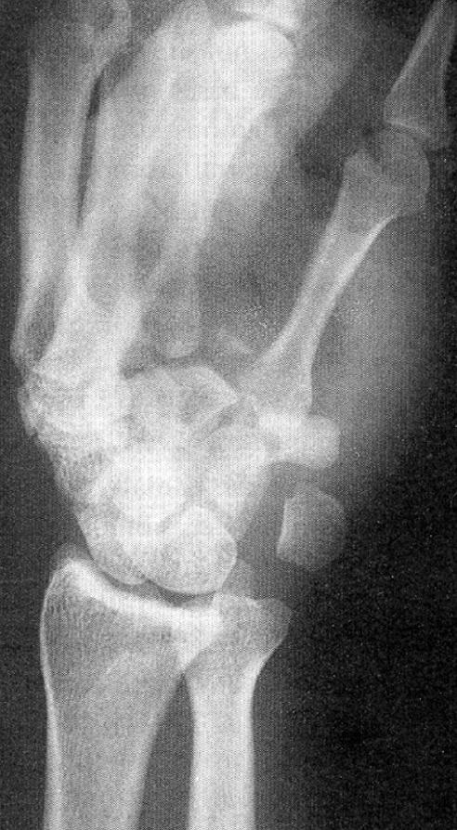
Hamate Fractures
2% of all carpal fractures
2 major patterns of fractures
Hook of the hamate
Common in stick-handling sports (e.g. golf, baseball, tennis)
3 types
Avulsion of tip (FCU)
Fracture through the base
Fracture through the waist
Body of the hamate

Slide 64
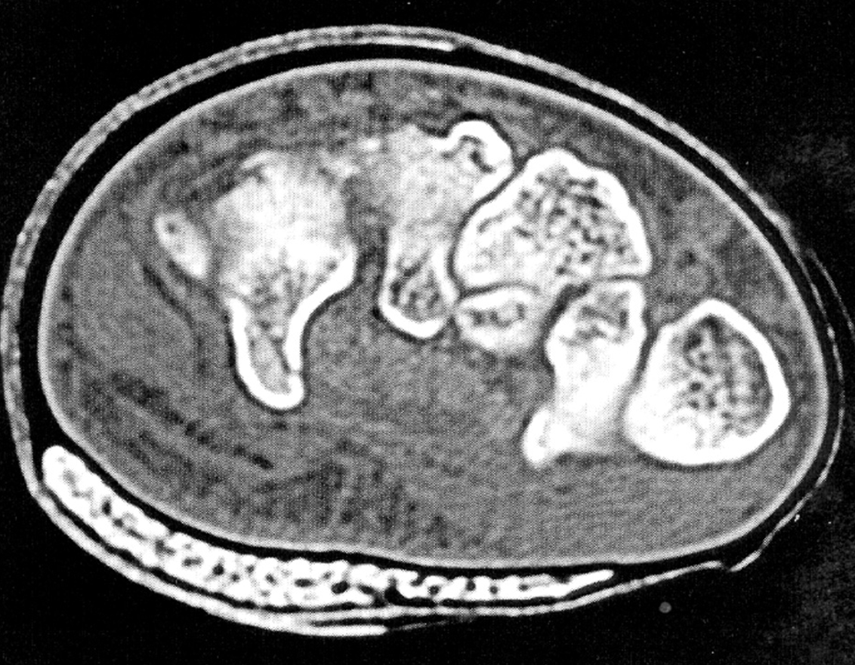
Hook of Hamate Fractures
2-4% of all carpal fractures
Mx: Direct blow to hamate bone
(e.g. sports with gripping baseball, golf, etc.)
Commonly missed on standard X-ray
Carpal tunnel view (image) can be helpful
CT and MRI may help
Deep branch of ulnar nerve lies under hook
Tx: Patient dependent, time to presentation dependent
Conservative: Immobilization (<3m)
Surgery: Excision vs ORIF (>3m)

Slide 65
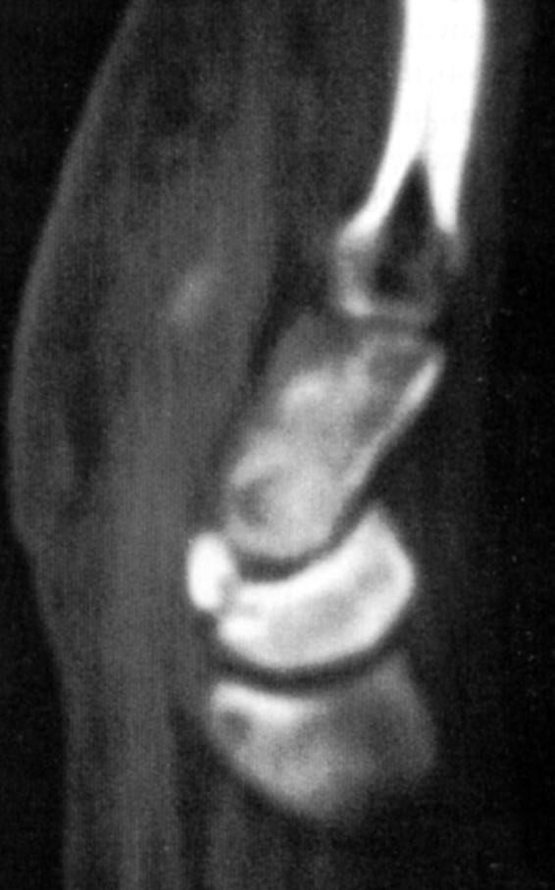
Lunate Fractures
1% of all carpal bone fractures (most occur as part of perilunate injury)
5 groups
Frontal fractures of the palmar pole
Osteochondral fractures of the proximal joint
Frontal fractures of the dorsal pole
Horizontal fractures of the body
Transarticular frontal fractures of the body

Slide 66
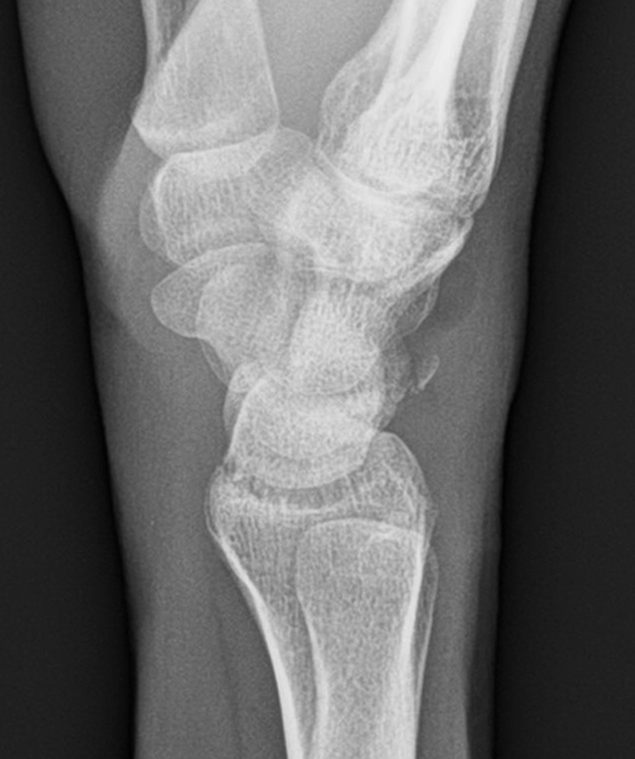
Triquetrum Fractures
2nd most common carpal fracture
2 major groups
Chip fractures of the dorsal rim (dorsal rim/cortical avulsion fractures)
Most can be treated with immobilization if there is not wrist instability
“Pooping duck” sign (see image)
https://pubmed.ncbi.nlm.nih.gov/33483875/
Fractures through the body

Slide 67
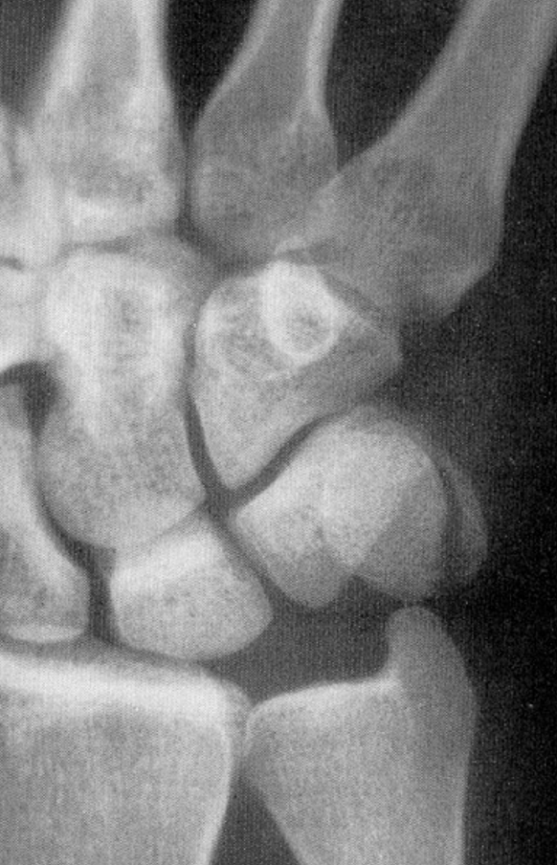
Pisiform Fractures
Functions as a sesamoid within FCU tendon sheath
2% of all fractures of the carpal bones
4 types
Transverse: most common
Parasagittal
Comminuted: neurovascular injury
Pisotriquetral impaction

Slide 68
Treatment of Carpal Fracture (other than scaphoid)
Unified concept of treatment
4-6 weeks of cast immobilization for stable, non-displaced fractures
exceptions are the head of the capitate and the “waist” of the hook of the hamate due to poor vascularity—relative indication for ORIF
for unstable and/or displaced fractures: open anatomic restoration and ligament repair

Slide 69
References
Court-Brown CM, Heckman, JD, McQueen MM, et al. Rockwood and Green’s: Fractures in Adults Volume 1, Eighth edition, Wolters Kluwer Health, 2015.
Wolfe S, Pederson W, Kozin SH, et al. Green’s Operative Hand Surgery, Sixth edition, Churchill Livingstone, an imprint of Elsevier Inc, 2011.
Egol KA, Koval KJ, Zuckerman JD, et al., Handbook of Fractures. 5th ed. Wolters-Kluwer Health, 2015.
Lawand A, Foulkes GD. The “clenched pencil” view: a modified clenched fist scapholunate stress view. J Hand Surg Am. 2003;28(3):414-418; discussion 419-420.
Gellman H, Caputo RJ, Carter V, Aboulafia A, Mckay M. Comparison of short and long thumb-spica casts for non-displaced fractures of the carpal scaphoid. J Bone Joint Surg Am. 1989;71(3):354-7.
Lawton JN, Nicholls MA, Charoglu CP. Immobilization for scaphoid fracture: forearm rotation in long arm thumb-spica versus Munster thumb-spica casts. Orthopedics. 2007;30(8):612-4.
Trumble TE, Salas P, Barthel T, Robert KQ. Management of scaphoid nonunions. J Am Acad Orthop Surg. 2003;11(6):380-91.
Janowski J, Coady C, Catalano LW. Scaphoid Fractures: Nonunion and Malunion. J Hand Surg Am. 2016;41(11):1087-1092.
Kawamura K, Chung KC. Treatment of scaphoid fractures and nonunions. J Hand Surg Am. 2008;33(6):988-97.
Russe O. Fracture of the carpal navicular. Diagnosis, non-operative treatment, and operative treatment. J Bone Joint Surg Am. 1960;42-A:759-68.
Merrell GA, Wolfe SW, Slade JF. Treatment of scaphoid nonunions: quantitative meta-analysis of the literature. J Hand Surg Am. 2002;27(4):685-91.
Stark HH, Rickard TA, Zemel NP, Ashworth CR. Treatment of ununited fractures of the scaphoid by iliac bone grafts and Kirschner-wire fixation. J Bone Joint Surg Am. 1988;70(7):982-91.
Pinder RM, Brkljac M, Rix L, Muir L, Brewster M. Treatment of Scaphoid Nonunion: A Systematic Review of the Existing Evidence. J Hand Surg Am. 2015;40(9):1797-1805.e3.
Buijze GA, Ochtman L, Ring D. Management of scaphoid nonunion. J Hand Surg Am. 2012;37(5):1095-100.
Jiranek WA, Ruby LK, Millender LB, Bankoff MS, Newberg AH. Long-term results after Russe bone-grafting: the effect of malunion of the scaphoid. J Bone Joint Surg 1992;74A:1217–1228.
Fernandez DL. A technique for anterior wedge-shaped grafts for scaphoid nonunions with carpal instability. J Hand Surg Am. 1984;9(5):733-7.
Tambe AD, Cutler L, Stilwell J, Murali SR, Trail IA, Stanley JK. Scaphoid non-union: the role of vascularized grafting in recalcitrant non-unions of the scaphoid. J Hand Surg Br. 2006;31(2):185-90.
Aguilella L, Garcia-elias M. The anterolateral corner of the radial metaphysis as a source of bone graft for the treatment of scaphoid nonunion. J Hand Surg Am. 2012;37(6):1258-62.
Green DP. The effect of avascular necrosis on Russe bone grafting for scaphoid nonunion. J Hand Surg Am. 1985;10(5):597-605.
Pirela-Cruz MA, Battista V, Burnette S, Hansen T. A technical note on percutaneous scaphoid fixation using a hybrid technique. J Orthop Trauma. 2005;19(8):570-573.
Komurcu M, Kürklü M, Ozturan KE, Mahirogullari M, Basbozkurt M. Early and delayed treatment of dorsal transscaphoid perilunate fracture-dislocations. J Orthop Trauma. 2008;22(8):535-540.
Segalman K, Graham T. Scaphoid Proximal Pole Fractures and Nonunions. J of Amer Soc Surg Hand, pp.233-249
Shin A, Bishop AT. Pedicled Vascularized Bone Grafts for Disorders of the Carpus: Scaphoid Nonunion and Kienbock’s Disease. J Amer Acad Ort Surg, pp.210-216.
Herbert T, Krimmer H, Watson H, Weinzweig J, Green D, Bishop AT, Berger R. Scaphoid Fractures. Master Techniques in Orthopedic Surgery: The Wrist, pp. 111-159.
Annamalai G, Raby N. Scaphoid and pronator fat stripes are unreliable soft tissue signs in the detection of radiographically occult fractures. Clin Radiol. 2003;58(10):798-800.
Karl JW, Swart E, Strauch RJ. Diagnosis of occult scaphoid fractures: a cost-effectiveness analysis. J Bone Joint Surg Am. 2015;97(22):1860-1868.
Garala K, Taub NA, Dias JJ. The epidemiology of fractures of the scaphoid: impact of age, gender, deprivation and seasonality. Bone Joint J. 2016;98-B(5):654-659.
Dodds SD, Rush AJ, Staggers JR. A mini-open, dorsal approach for scaphoid fracture fixation with a ligament sparing arthrotomy. Tech Hand Up Extrem Surg. 2020;24(1):32-36.
Lee DJ, Elfar JC. Carpal ligament injuries, pathomechanics, and classification. Hand Clin. 2015;31(3):389-398.
De Smet L, Verhaegen F, Degreef I. Carpal malalignment in malunion of the distal radius and the effect of corrective osteotomy. J Wrist Surg. 2014;3(3):166-170.
Muppavarapu RC, Capo JT. Perilunate dislocations and fracture dislocations. Hand Clin. 2015;31(3):399-408.
Bagheri F, Taraz-Jamshidi MH, Birjandinejad A, et al. Trans-scaphoid perilunate fracture-dislocation and isolated perilunate dislocations; surgical versus non surgical treatment. Arch Bone Jt Surg. 2013;1(2):74-77.
Forli A, Courvoisier A, Wimsey S, Corcella D, Moutet F. Perilunate dislocations and transscaphoid perilunate fracture-dislocations: a retrospective study with minimum ten-year follow-up. J Hand Surg Am. 2010;35(1):62-68.
Wickramasinghe NR, Duckworth AD, Clement ND, Hageman MG, McQueen MM, Ring D. Acute median neuropathy and carpal tunnel release in perilunate injuries can we predict who gets a median neuropathy? J Hand Microsurg. 2015;7(2):237-240.
Stanbury SJ, Elfar JC. Perilunate dislocation and perilunate fracture-dislocation. J Am Acad Orthop Surg. 2011;19(9):554-562.
Bagheri F, Taraz-Jamshidi MH, Birjandinejad A, et al. Trans-scaphoid perilunate fracture-dislocation and isolated perilunate dislocations; surgical versus non surgical treatment. Arch Bone Jt Surg. 2013;1(2):74-77.
Savvidou OD, Beltsios M, Sakellariou VI, Papagelopoulos PJ. Perilunate dislocations treated with external fixation and percutaneous pinning. J Wrist Surg. 2015;4(2):76-80.
White RE, Omer GE. Transient vascular compromise of the lunate after fracture-dislocation or dislocation of the carpus. J Hand Surg Am. 1984;9(2):181-184.
Dias JJ, Finlay DB, Brenkel IJ, Gregg PJ. Radiographic assessment of soft tissue signs in clinically suspected scaphoid fractures: the incidence of false negative and false positive results. J Orthop Trauma. 1987;1(3):205-208.
George J, Kumar KK, Vijayakumar G, Ravishankar M. Functional outcome of surgically managed perilunate injuries. Indian J Orthop. 2020;54(Suppl 2):270-276.
Goodman AD, Harris AP, Gil JA, Park J, Raducha J, Got CJ. Evaluation, management, and outcomes of lunate and perilunate dislocations. Orthopedics. 2019;42(1):e1-e6.
Davis DL. Hook of the hamate: the spectrum of often missed pathologic findings. AJR Am J Roentgenol. 2017;209(5):1110-1118.
Guo RC, Cardenas JM, Wu CH. Triquetral fractures overview. Curr Rev Musculoskelet Med. Published online January 23, 2021.

