Slide 1
Upper Extremity Amputations
Paul Henkel DO
Orthopaedic Trauma Surgery
Piedmont Athens Regional Medical Center
Athens, GA
Jeffrey Marchessault MD
Orthopaedic Hand Surgery
East Tennessee State University
Johnson City, TN

Slide 2
Epidemiology
Hand Blast Injury
Of the 1.6 million people in the US with limb loss, 34% (541K) have an upper extremity amputation¹
92% of upper extremity limb loss is due to trauma²
Multispecialty care is necessary for these patients including PM&R, surgery, internal medicine, occupational/physical therapy, mental health/social work, nursing, and prosthetics.
Inclusion of patient and family in the decision-making process, treatment, and rehab is key to successful outcomes³
Photograph courtesy of Jeffrey Marchessault MD

Slide 3
Initial Wound Management
Blast injury after debridement
Must take into account overall condition of the patient, most have multisystem injuries⁴
Unique and vital function of the upper extremity require the surgeon to attempt salvage, including replantation when possible⁸
When amputation is likely, it should be delayed until patient/family can be involved in the decision making process⁹
Photograph courtesy of Jeffrey Marchessault MD

Slide 4
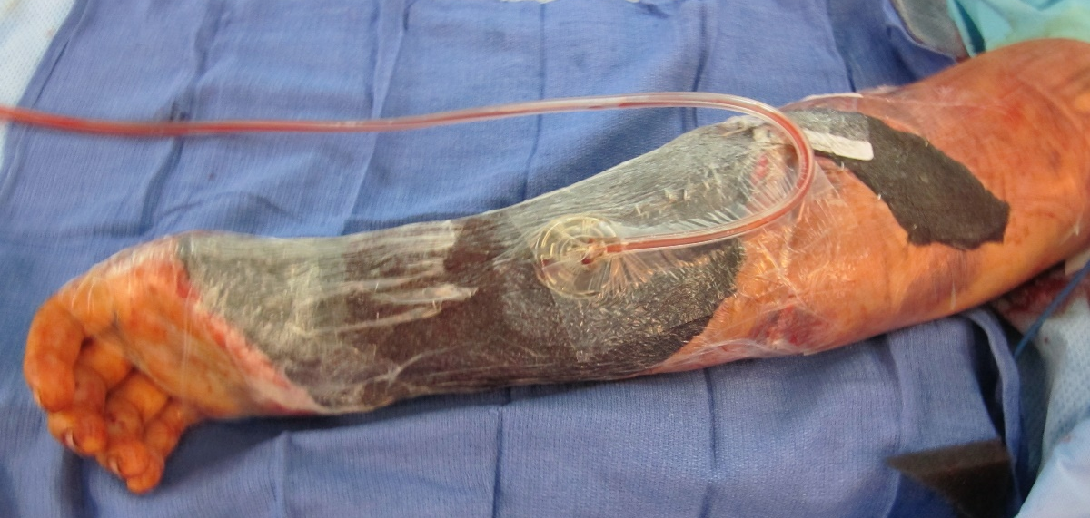
Early Surgical Management – 3 Basic Tenets
Thorough sharp debridement of contaminated tissue
Retention of all viable tissue for subsequent reconstruction amputation coverage
Maintenance of the highest potential for patient function with/without a prosthesis¹¹
Photographs courtesy of Jeffrey Marchessault MD

Slide 5
Early Surgical Management
Initial focus is often on the bony injury, but the status and handling of soft tissues are often the best predictors of limb length and final closure options⁹
Nerve injuries can be addressed later with repair, reconstruction, or nerve/tendon transfer
Ultimately, decision to amputate is made when limb salvage results in a less functional outcome than the amputation AND the patient understands/agrees with the surgical decision
Photograph courtesy of Jeffrey Marchessault MD

Slide 6
Early Surgical Management
Best to delay upper limb amputation until patient and family are in agreement
But, surgeon input into need for amputation carries weight
Patients getting prosthesis <60 days from amputation more likely to use it
Multidisciplinary approach best in non-emergency situations
Prosthetist and patients with prosthetic are invaluable resources
Photograph courtesy of Jeffrey Marchessault MD

Slide 7
Once Amputation is Chosen…
Preservation of length and joint function are of paramount concern
Techniques to preserve limb length when residual soft tissue is inadequate to allow stump closure:
Skin grafts
Dermal substitutes
Filleted flaps
Free tissue transfer
Photograph courtesy of Jeffrey Marchessault MD

Slide 8
Latissimus Dorsi Flap to Preserve Length
Preservation of length following failed arm replantation using latissimus dorsi flap to accommodate upper extremity prosthesis. Consultation with a prosthetist to determine level of amputation can be helpful if available
From: Marchessault JA, McKay PL, Hammer WC. Management of upper limb amputations J Hand Surg Am. 2011;36A:1718-1726.

Slide 9
Finger Amputation
Consider primary amputation when 4 or more of 6 basic components injured
Bone
Vessels
Tendons
Nerves
Skin
Joint
Revascularization of this severely injured finger will result in stiff, insensate finger later requiring amputation
Photograph courtesy of Jeffrey Marchessault MD

Slide 10
Finger Amputation
Injury often dictates level of amputation
Fingers’ primary function to bring objects to palm¹⁷
Preserve metacarpophalangeal joint to preserve rudimentary finger flexion toward palm
Resect digital nerves away from suture line
Photograph courtesy of Jeffrey Marchessault MD

Slide 11
Thumb Amputation
Thumb provides 40% of hand function.¹⁷
Multiple options for soft tissue coverage
Preserve carpometacarpal joint to improve thumb function
Consult hand surgeon colleagues to discuss reconstruction plan
Photograph courtesy of Jeffrey Marchessault MD

Slide 12
Partial Hand Amputation
Preservation of two sensate digits, able to oppose each other, will allow some prehension¹⁶ – the ability to approach, grasp and release objects with the hand
Salvage of a third digit allows for a more stable terminal pinch, improving precision motions¹⁷
Ray resection will reduce hand width, leading to decreased grip strength, but improving the appearance of finger loss¹⁷
Try to “eliminate a gap” between adjacent fingers -(objects fall thought the hand: nails, screws, coins)
From: Marchessault JA, McKay PL, Hammer WC. Management of upper limb amputations J Hand Surg Am. 2011;36A:1718-1726.

Slide 13
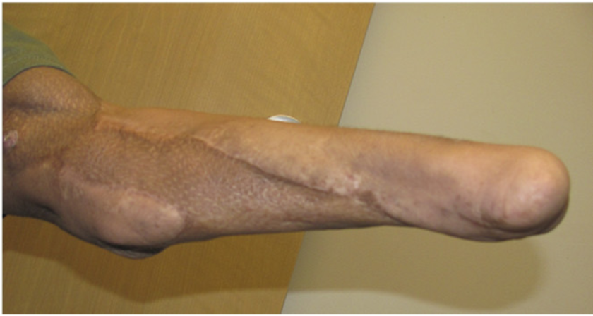
Wrist Disarticulation
Controversial level with pros and cons that requires patient education and input.
Pros: Increased limb length serves as better assist to opposite hand
Amputation through the wrist preserves 100⁰ to 120⁰ of pronosupination ²¹
Cons: Insufficient space for myoelectric hand prosthesis
From: Marchessault JA, McKay PL, Hammer WC. Management of upper limb amputations J Hand Surg Am. 2011;36A:1718-1726.

Slide 14
Transradial Amputation
Transradial forearm amputation is the most common level of upper extremity amputation²²
Remaining muscles serve to trigger myoelectric prosthesis
Residual soft tissue (muscle) must provide adequate soft tissue coverage of the radius and ulna
Myodesis of deep forearm muscles to the radius and ulna provide stable bone coverage and prevents bone-on-muscle motion that can lead to bursitis²³
Photograph courtesy of Jeffrey Marchessault MD

Slide 15
Transradial Amputation Basic Tenets
Myodesis – attachment of tendon/muscle to bone
Prevents bursa formation at distal end residual limb²³
Myoplasty – attachment of muscle layers to each other, allowing tension free skin closure
23. Singh R, Hunter J, Philip A. Fluid collections in amputee stumps: a common phenomenon Arch Phys Med Rehabil. 2007;88:661-663.
Photograph courtesy of Jeffrey Marchessault MD

Slide 16
Transradial Amputation
Mobilization of deep flexor muscles
Myodesis of flexors to bone
Photographs courtesy of Jeffrey Marchessault MD

Slide 17
Transradial Amputation
Mobilization of deep flexors “over” distal bone ends
Closed irregular skin flaps, commonly required in traumatic amputations
Photographs courtesy of Jeffrey Marchessault MD

Slide 18
Transradial Amputation
10cm proximal to the wrist joint is advocated for increased prosthetics options²²
Forearm amputation at least 5cm DISTAL to the elbow will allow fitting of a prosthesis²⁴
Short amputation reduces effective pronosupination
Irregular flaps utilized to spare length of this short below the elbow amputation, preserving elbow function
From: Marchessault JA, McKay PL, Hammer WC. Management of upper limb amputations J Hand Surg Am. 2011;36A:1718-1726.

Slide 19
Elbow Disarticulation
Controversial level with pros and cons, need to discuss with patient
Pros – condyles provide rotational control of prosthesis
Cons - Length makes fitting pre-made prosthetic elbow difficult without extending limb length
Photograph courtesy of Jeffrey Marchessault MD

Slide 20
Elbow Disarticulation
A – Failed attempt at replantation
B – Biceps, brachioradialis provide coverage over cartilage
C – Leave flexor/extensor muscles attached for additional padding of distal end
D – Leave long posterior skin flap to rotate anteriorly over muscle
From: Marchessault JA, McKay PL, Hammer WC. Management of upper limb amputations J Hand Surg Am. 2011;36A:1718-1726.

Slide 21
Above-Elbow Amputation
When the condyles cannot be preserved, amputation of the humerus 10cm proximal to the olecranon tip enables the use of all available prosthetics²⁴
Allows fitting of a variety of passive, body-powered, myoelectric, and activity-specific elbows with adequate length to suspend and control the prosthesis
From: Marchessault JA, McKay PL, Hammer WC. Management of upper limb amputations J Hand Surg Am. 2011;36A:1718-1726.

Slide 22
Above-Elbow Amputation
Rotational control of the prosthetic at this level can be aided by a Marquardt angulation osteotomy
Creates an angle of 70º to 110º at the distal humerus through a dorsal or volar osteotomy²⁶
Straightening of the osteotomy over time has been seen in patients less than 16 years of age²⁶
From: Pierrie AN, Gaston RG, Loeffler BJ. Current concepts in upper-extremity amputations. J Hand Surg Am. 2018;43(7):657-667.
26. Neusel E, Traub M, Blasius A, Marquardt E. Results of humeral stump angulation osteotomy. Arch Orthop Trauma Surg 1997;116:263-265.

Slide 23
Above-Elbow Amputation
Preservation of shoulder function improves the amputee’s likelihood of prosthetic use²⁵ because the shoulder girdle will stabilize the limb while in space
Transhumeral amputations should preserve at least 5-7 cm of the proximal humerus to maintain deltoid muscle function, improve prosthetic fit, and provide a more acceptable shoulder contour²⁴
From: Marchessault JA, McKay PL, Hammer WC. Management of upper limb amputations J Hand Surg Am. 2011;36A:1718-1726.

Slide 24
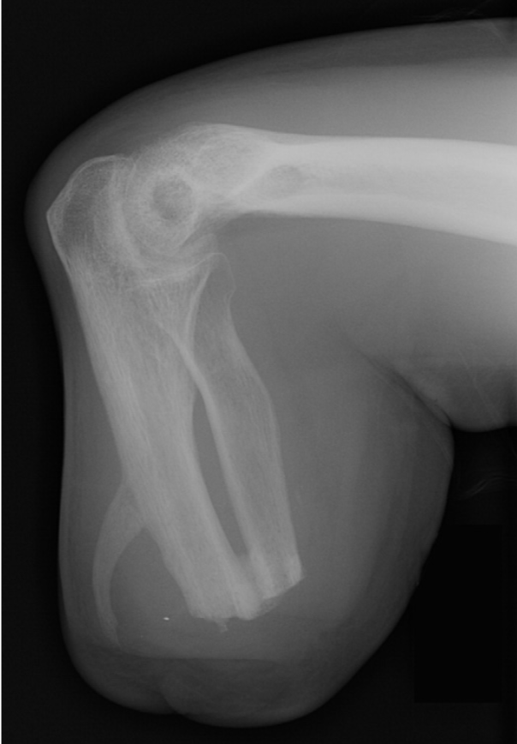
Surgical Complications
Causes for revision surgery in 42 of 100 combat upper limb amputees:³⁰
Heterotopic ossification (HO) – most common
Infection
Painful neuromas
Scars
Joint contracture
HO can cause pain, interfering with prosthetic wear, and joint stiffness
Prophylactic radiation and NSAID adjunct treatments are not standardized³⁴
From: Marchessault JA, McKay PL, Hammer WC. Management of upper limb amputations J Hand Surg Am. 2011;36A:1718-1726.
30. Tintle SM, Baechler MF, Nanos GP, Forsberg JA, Potter BK. Operative complications following combat-related major upper extremity amputations. J Hand Surg 2010;35A(Suppl 1):S53-S54.
34. Ring D, Jupiter JB. Operative release of anklyosis of the elbow due to heterotopic ossification. J Bone Joint Surg 2004;86A(Suppl 1):2-10.

Slide 25
Surgical Complications
Neuroma. Photograph courtesy of Jeffrey Marchessault MD
Neuroma formation/Phantom Pain
Any nerve lacerated with amputation can become painful
Many treatments, including resection, bury in muscle
Emerging techniques for decreasing Amputation Nerve Pain
Targeted Muscle Reinnervation (TMR)
Regenerative peripheral nerve interface (RPNI)
31. Pierrie SN, Gaston RG, Loeffler BJ Current concepts in upper-extremity amputations J Hand Surg Am. 2018;43(7):657-667. upper-extremity
32. Preemptive Treatment of Phantom and Residual Limb Pain with Targeted Muscle Reinnervation at the Time of Major Limb Amputation . J Am Coll Surg 2019;228:217e226.

Slide 26
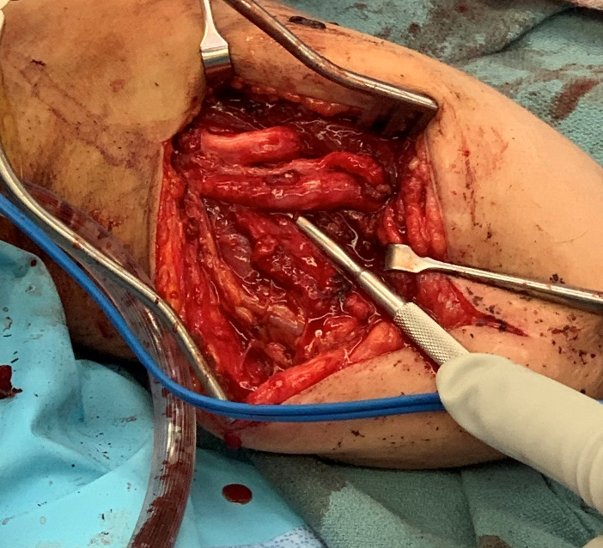
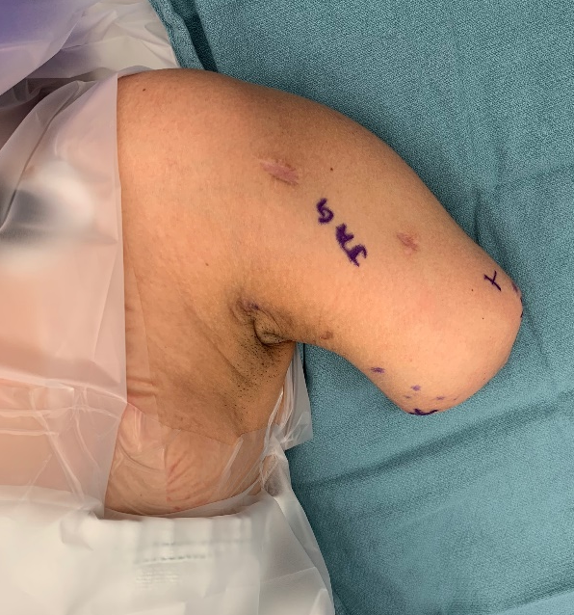
Targeted muscle reinnervation (TMR)
Nerve transfer/Rerouting decreases pain, provides intuitive myoelectric control
Initially used for proximal arm amputations, now transradial level too³¹
Decreases neuroma pain and amputation pain
Emerging evidence for prophylactic TMR³²
Amputation tips allowing for TMR:
Avoid aggressive traction neurectomy so nerves have enough length for transfer
Bury nerve ends into muscle for later
TMR intraop. Photograph Courtesy of Jackie Geissler, MD.
32. Preemptive Treatment of Phantom and Residual Limb Pain with Targeted Muscle Reinnervation at the Time of Major Limb Amputation . J Am Coll Surg 2019;228:217e226.
33. Kuiken, Barlow, Hargrove, Dumanian. Tech Orthop. 2017 June ; 32(2): 109–116.
Targeted Muscle Reinnervation for the Upper and Lower Extremity.

Slide 27
Psychological Considerations
94% patients with severe hand injury report signs/symptoms of PTSD³² – don’t ignore it
PTSD is most common disabling non-amputation diagnosis in military amputees³³
Surgeon should:
Be hopeful, informative about amputation
Recognize need for mental health consultation for PTSD, depression with persistent/chronic pain
34. Grunnert BK, Smith CJ, Devine CA, et al. Early psychological aspects of severe hand injury . J Hand Surg Br 1988;13:177-180.
35. Tennent DJ, Wenke JC, Rivera JC, Krueger CA. Characterization and outcomes of upper extremity amputations. Injury. 2014;45:965-969.
Photograph courtesy of Jeffrey Marchessault MD

Slide 28
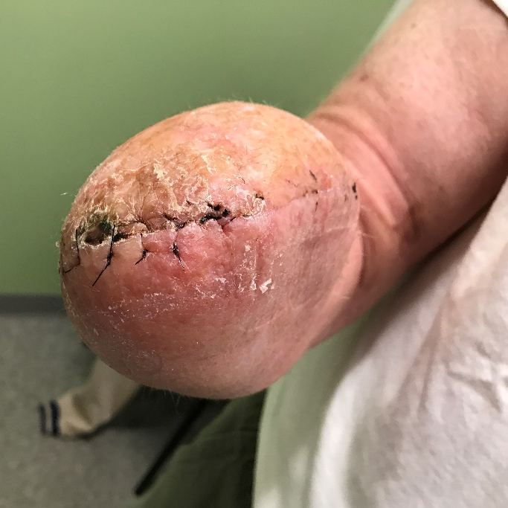
UE Amputation Summary
Upper limb amputation is the final result when surgical salvage is not possible
Preserving bony length, as well as shoulder/elbow function, improves the successful use of a prosthesis by the patient and can be accomplished with a multitude of techniques
The ULTIMATE goal of amputation surgery is to:
Provide a sensate residual limb that can best interact with the patient’s environment with and without a prosthesis
Photographs courtesy of Jeffrey Marchessault MD

Slide 29
Other References
Marchessault, Jeffrey A., Patricia L. McKay, and Warren C. Hammert. "Management of upper limb amputations." The Journal of hand surgery 36.10 (2011): 1718-1726.

