Slide 1
Distal Radius Fractures
Hans P. Van Lancker, MD, FRCSC, FAAOS

Slide 2
Impact of Distal Radius Fractures
Common injury: 650,000+/yr in USA, ~17% of all fractures
Increasing as population ages
High potential for functional impairment and complications

Slide 3
Introduction
Fractures through the distal metaphysis of the radius
May involve articular surface (50%)
Often involve the ulnar styloid
Often result from a fall on the outstretched hand
forced extension of the carpus
impact loading of the distal radius
Bimodal old low energy, younger high energy
Associated injuries may accompany distal radius fractures
TFCC, DRUJ, SLL, LTL.

Slide 4
Diagnosis: History
Mechanism of injury
Handedness
Type of work the patient does
Pre-existing carpal tunnel symptoms
Assessment of pain
Compartment syndrome is a possibility in high energy injuries

Slide 5
Acute Compartment Syndrome
Diagnosis of physical exam
Pain on passive stretch and out of proportion with injury are key symptoms not to miss
Also assess for acute carpal tunnel syndrome
Compartment pressure needle assessment in unconscious or otherwise difficult to examine patient with concern (high energy or swollen arm)
positive finding of pressure delta between compartment and diastolic <30
Pallor, pulselessness and paresthesias are late symptoms

Slide 6
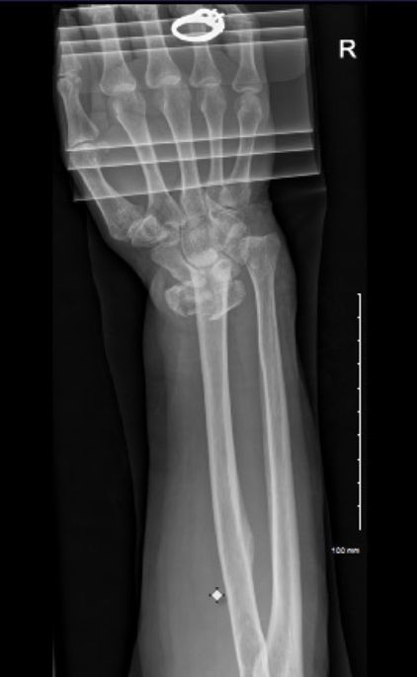
Diagnosis: Physical Exam
Visible deformity of the wrist is usually noted
hand most commonly displaced in the dorsal direction
Movement of the hand and wrist are painful
Adequate assessment of the neurovascular status of the hand is imperative
concomitant acute carpal tunnel syndrome is possible and should be addressed
Evaluation of the injured joint and joints above and below
REMOVE
ASAP
Image courtesy of Khare Wilson PA-C

Slide 7
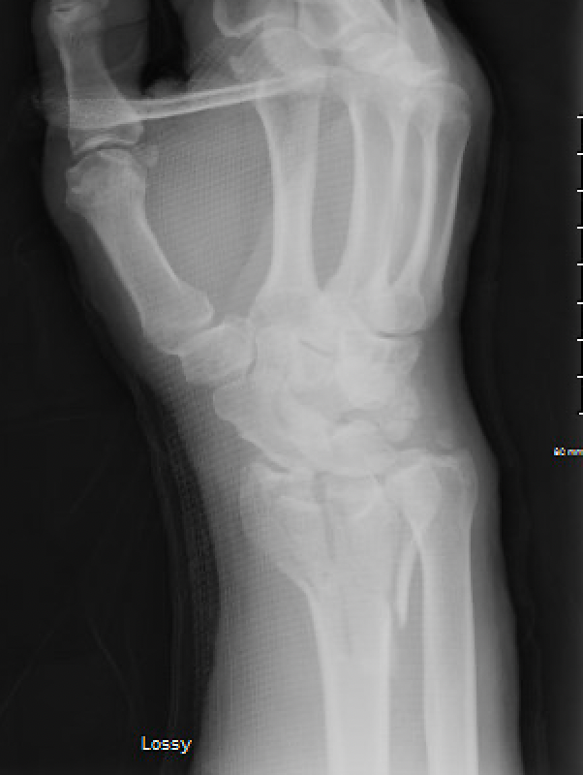
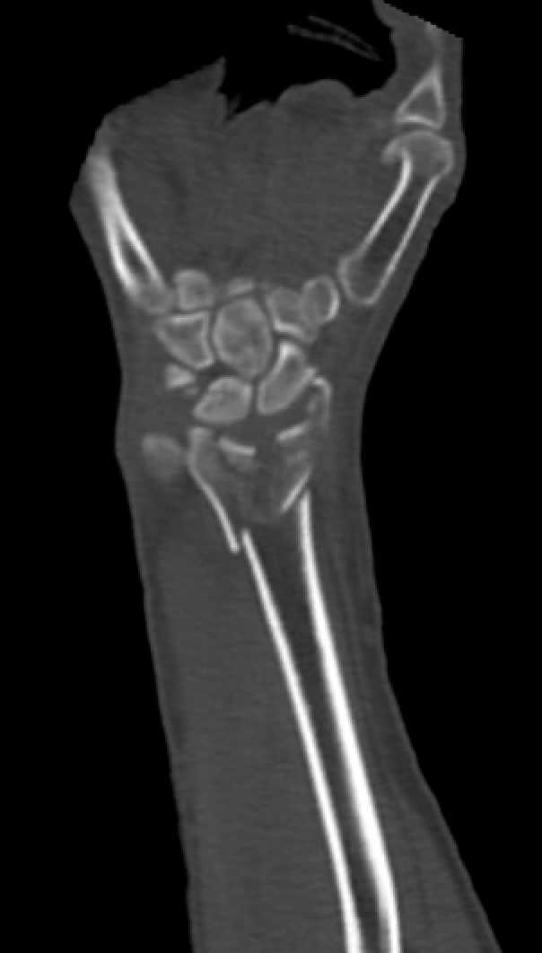
Diagnosis: Diagnostic Tests and Examination
Radiographs of the injured wrist
Radiographs of other areas, if symptoms warrant.
CT scan of the distal radius in cases with complex intra-articular injury or unclear DRUJ involvement

Slide 8
Treatment Goals
Preserve hand and wrist function
Length, alignment and rotation of normal osseous anatomy
Articular congruency
DRUJ alignment
Achieve complete bony healing
Early active finger and elbow ROM

Slide 9
Osseous Anatomy
Distal radius – 80% of axial load
Scaphoid fossa
Lunate fossa
Distal ulna – 20% axial load
Sigmoid notch – DRUJ

Slide 10
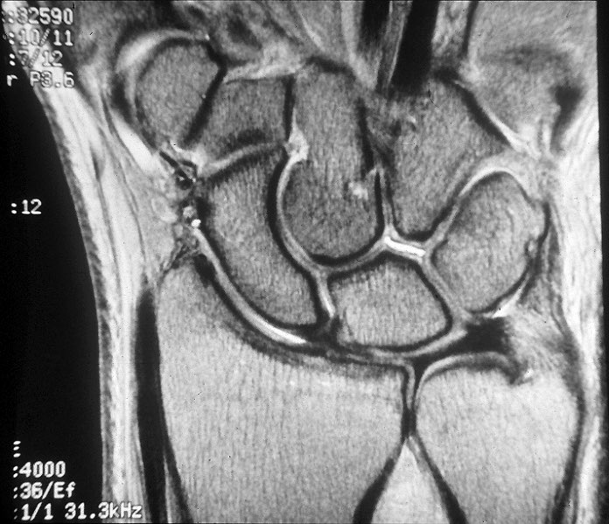
Anatomy
Scaphoid and lunate fossa
small ridge normally exists between these two
Sigmoid notch: second important articular surface
Triangular fibrocartilage complex(TFCC): distal edge of radius to base of ulnar styloid

Slide 11
Radiographic alignment
Radial inclination = 22°
Both radial length and volar tilt ~11°
Radial length (terms “height” and “length” used interchangeably)
11-12mm height of radial styloid
ulnar neutral
Volar (palmar) tilt = 11-14°
Scapho-lunate angle
47° +/- 15°

Slide 12
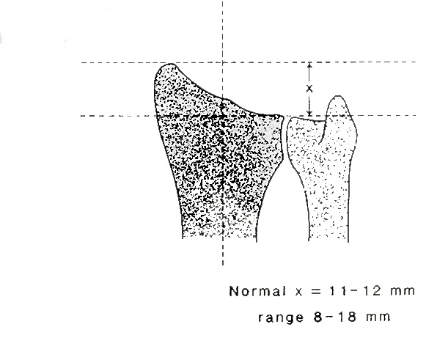
Measurement of Radial Length and Inclination
Inclination = 22-23°

Slide 13
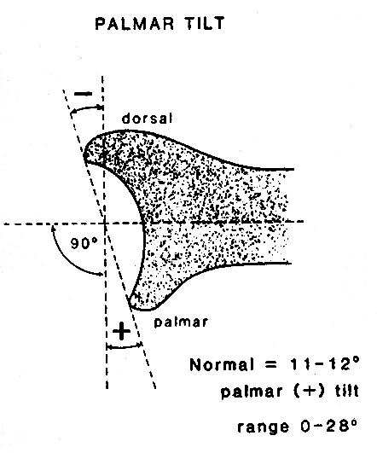
Measurement of Volar(palmar)-Dorsal Tilt

Slide 14
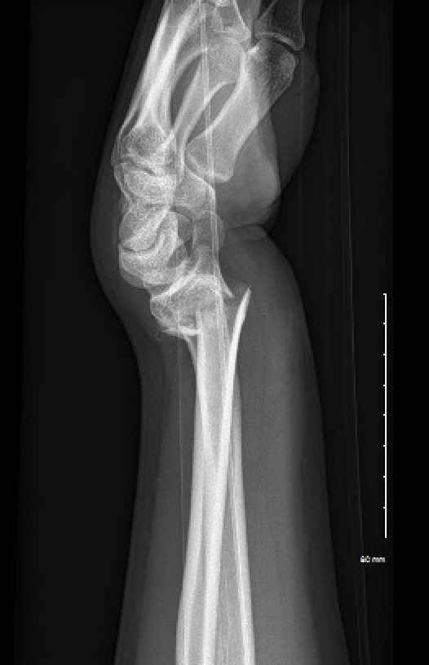
Assessment of x-rays
Assess articular involvement
Comminution of dorsal rim
Fracture of volar rim
Look for compression (die-punch) lesions of the scaphoid or lunate fossa
Assess shortening
Look for DRUJ involvement
Decide need for CT assessment

Slide 15
Dorsal (apex volar) angulation and comminution

Slide 16
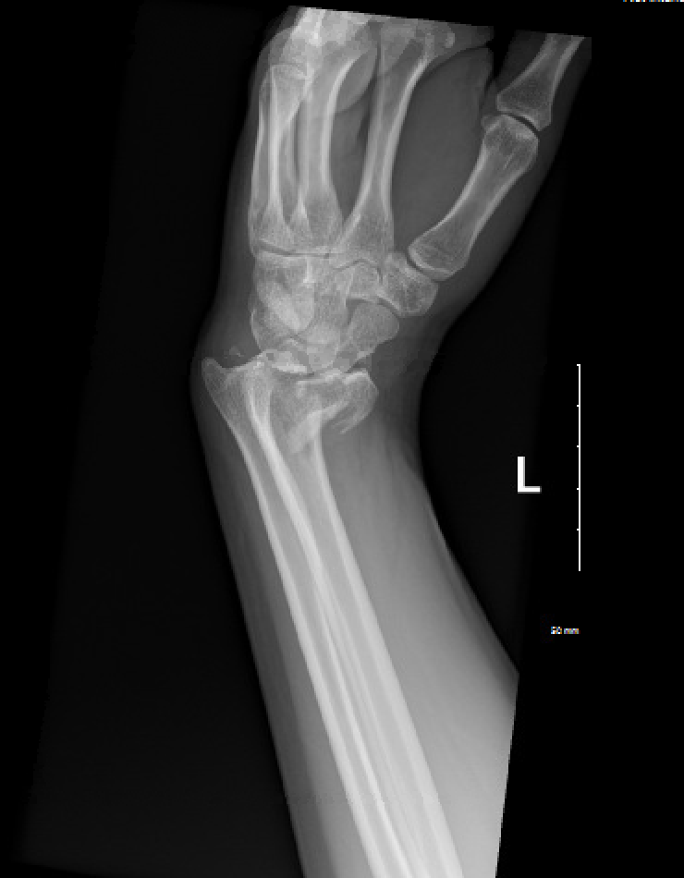
Volar subluxation of carpus with fracture fragment

Slide 17
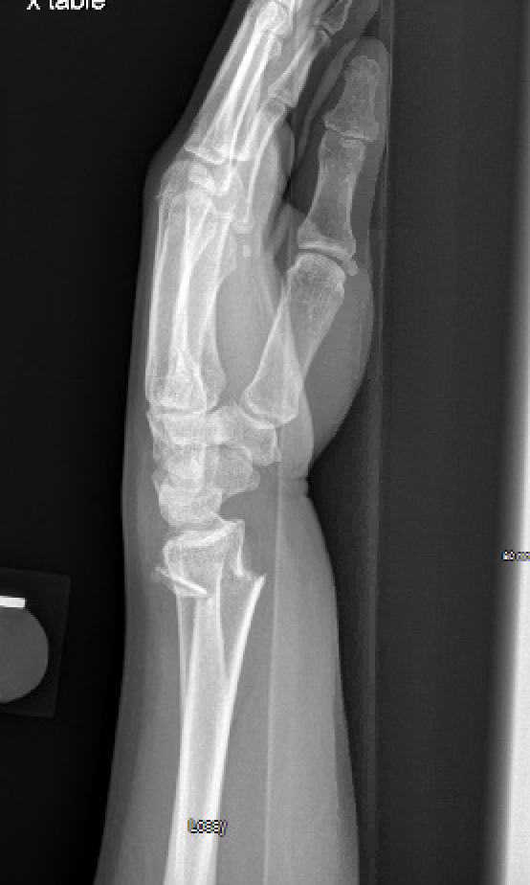
Scapholunate angle measured between lines 2 and 3
(normal 47 ± 15 degrees)
1: Line connecting dorsal and volar tip of lunate
2: Line perpendicular to lunate
3: Line along axis of scaphoid

Slide 18
Signs of possible DRUJ injury on x-ray
Fracture at base of ulnar styloid
Widening of DRUJ space on PA x-ray
>20° of dorsal angulation
>5mm of proximal displacement of the distal part of the radius

Slide 19
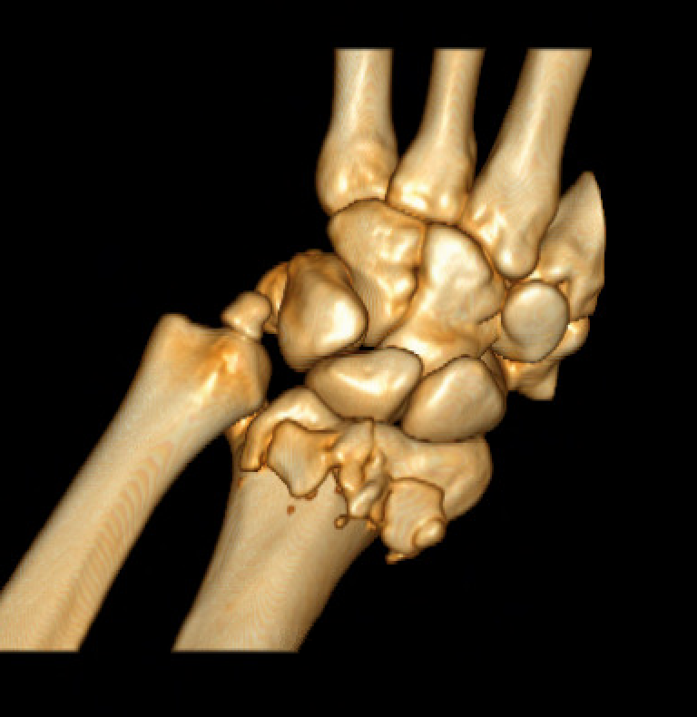
Indications for Obtaining CT Scan:
Intra-articular fxs with multiple fragments
Articular impaction
DRUJ incongruity

Slide 20
Classification of Distal Radius Fractures
Classified by:
Intra-articular involvement
degree of comminution
dorsal vs. volar displacement
involvement of the distal radioulnar joint.
Treatment decided by:
Type of injury
Severity Evaluation
Patient Discussion
Surgical Options
Prognosis

Slide 21
Common Classifications
Weber (AO/ASIF) – comprehensive but complex
Frykman – based on joint involvement, styloid involvement
Melone – divides intra-articular fractures into 4 types based on displacement
Fernandez – based on mechanism of injury

Slide 22
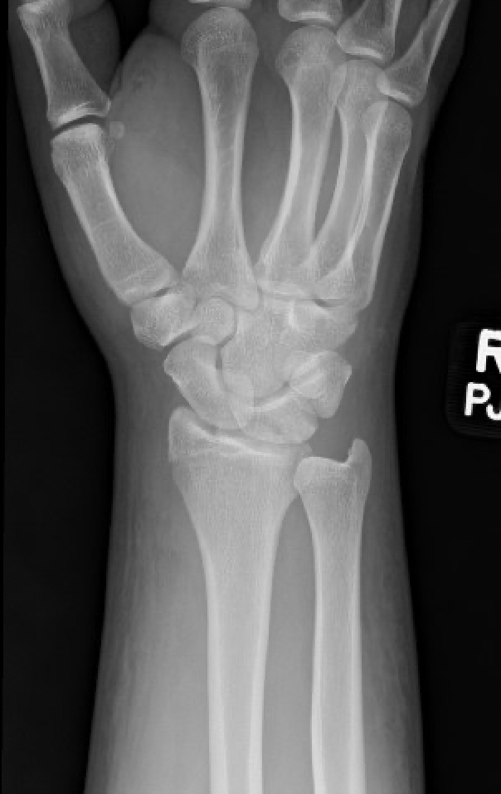
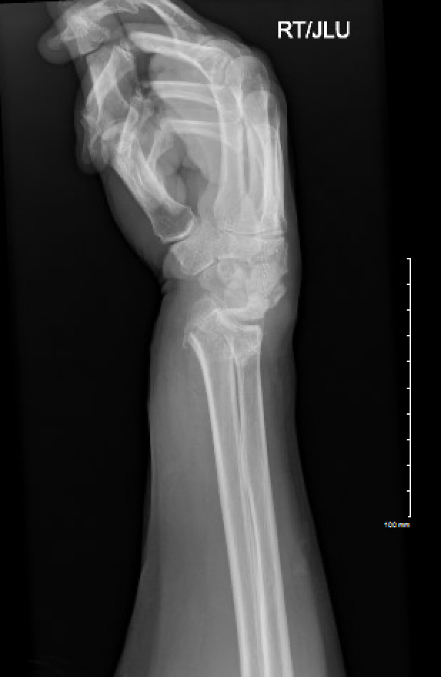
Eponyms
Die-Punch Fracture | Depressed fracture of lunate fossa of articular distal radius
Barton’s Fracture | Fracture dislocation of radial carpal joint involving volar or dorsal lip
Chauffer’s Fracture | Radial Styloid Fracture
Colles’ Fracture | Low energy dorsally displaced
Smith’s Fracture | Low energy volarly displaced
Die-Punch
Colles’
Chauffer’s

Slide 23
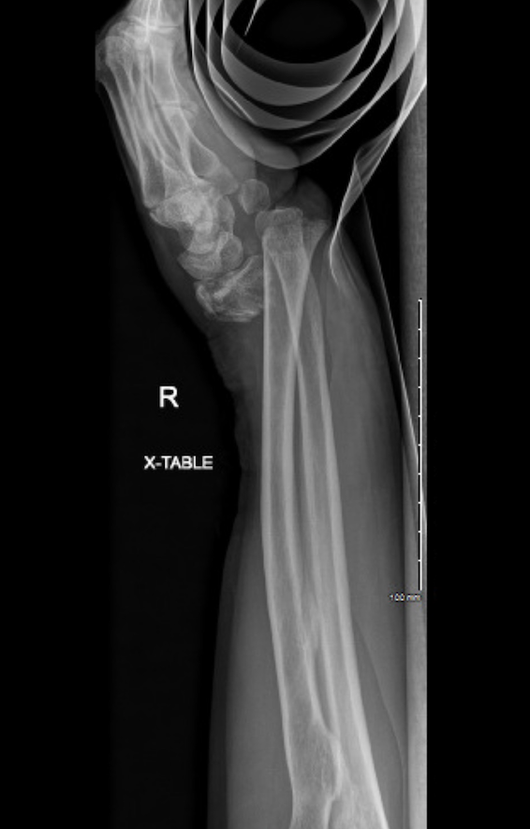
Radio-carpal fracture dislocation
Not your typical distal radius fracture
High energy
Needs early attention and reduction
Acute carpal tunnel
Stiffness
Images courtesy of Khare Wilson PA-C

Slide 24
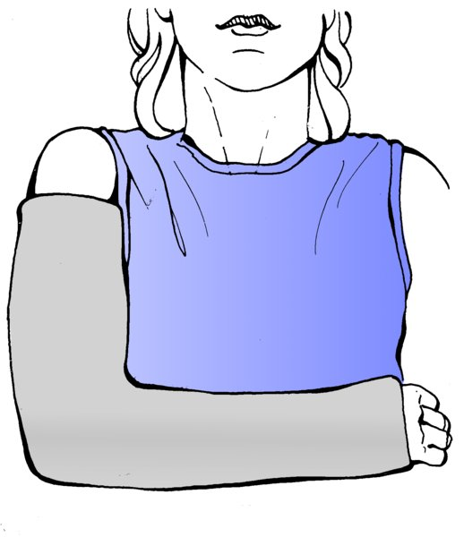
Options for Treatment
Casting/Splinting
Long arm vs. short arm
Sugar-tong or volar/dorsal splint
External Fixation
Joint-spanning
Non bridging
Percutaneous pinning
Internal Fixation
Dorsal plating
Volar plating
Combined dorsal/volar plating
Dorsal bridge plating
Focal (fracture specific) plating
Images from: https://otaonline.org/book/2573/chapter/207609774/principles-of-nonoperative-management-of-fractures#tornetta9-tornetta-9-tornetta-ch009-topic018
Notes:
Insert xray

Slide 25
Predictors of Instability:
Depends on assessment of fracture stability
LaFontaine Criteria https://pubmed.ncbi.nlm.nih.gov/2592094/
Indicators of instability are:
Patient age
Metaphyseal comminution
Shortening: ulnar variance
Consider patient level of function and medical comorbidities
https://www.trauma.co.uk/wristcalc
Mackenney, McQueen, Elbton, JBJS 2006 Sep;88(9):1944-51., Prediction of instability in distal radial fractures

Slide 26
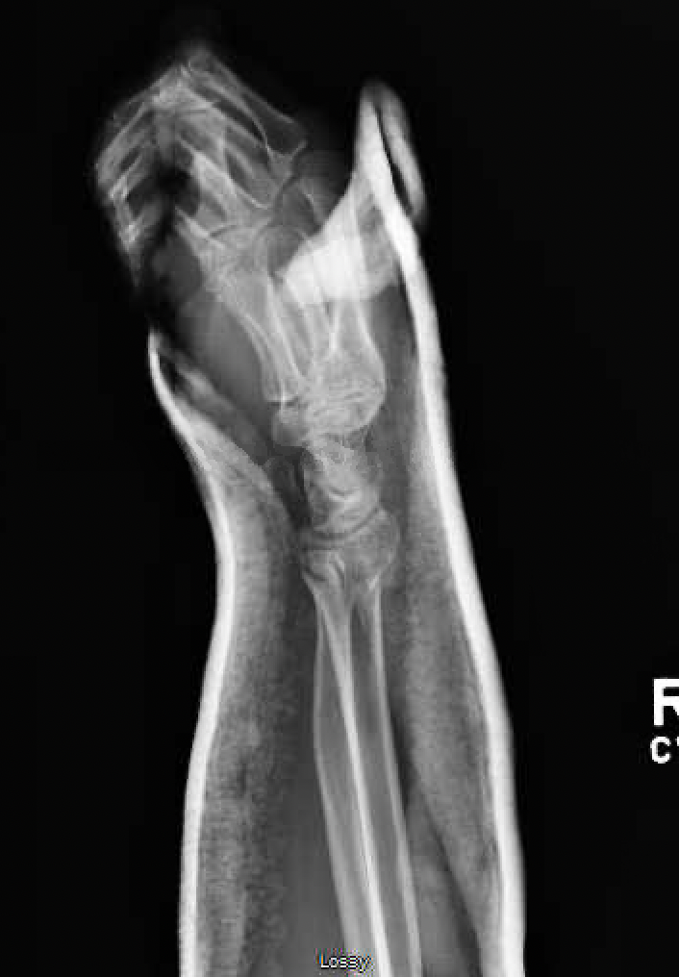
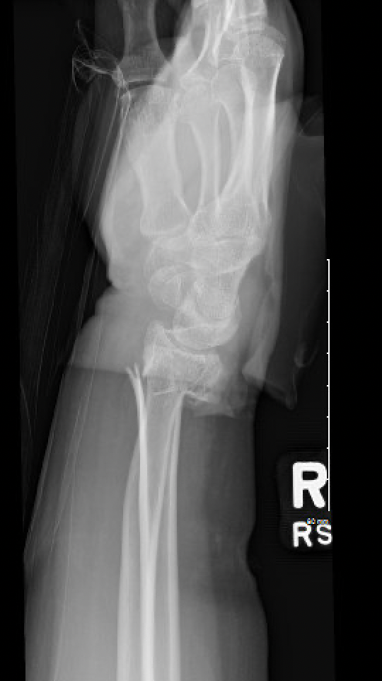
Standard of Care
Trial of nonop management after adequate reduction
ORIF if reduction is lost
Early collapse often predicts ongoing collapse
Images courtesy of Nicholas Elisseou MD

Slide 27
Malunion
Treatment depends on patient factors and alignment
Malunion can be functional and tolerated in some patient
> age 65, low demand
Poorly tolerated in young patients
Assess risk with McQueen/LaFontaine criteria https://pubmed.ncbi.nlm.nih.gov/2592094/

Slide 28
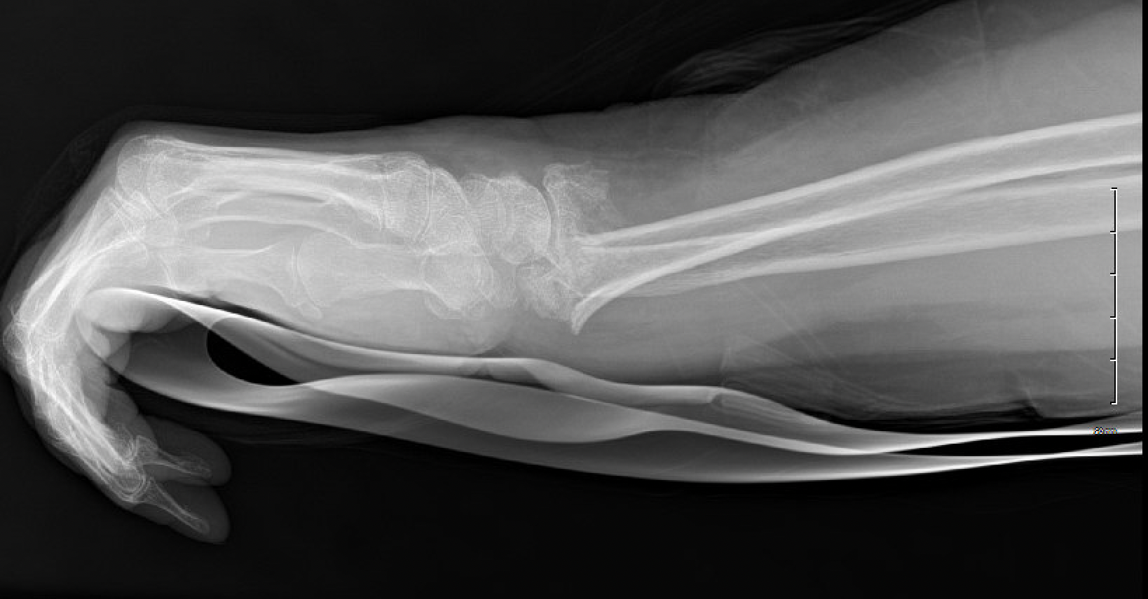
LaFontaine Criteria
Dorsal Angulation > 20
Dorsal Comminution > 50%
Palmar comminution
Intra-articular Comminution
Initial Displacement >1cm
Radial shortening >5mm
Associated ulnar fracture
Severe Osteoporosis

Slide 29
AAOS Guidelines
https://www.aaos.org/globalassets/quality-and-practice-resources/distal-radius/drfcpg.pdf
AAOS Appropriate Use Criteria Calculator
https://www.orthoguidelines.org/go/auc/auc.cfm?auc_id=224789

Slide 30
Indications for Closed Treatment
Low-energy fracture
Low-demand patient
Medical co-morbidities
Minimal displacement = acceptable alignment
Match treatment to demands of the patient
https://otaonline.org/video-library/45036/procedures-and-techniques/multimedia/16731335/closed-reduction-of-distal-radius-fractures

Slide 31
Closed Treatment of Distal Radial Fractures
Goal is to obtain and maintain an acceptable reduction
Immobilization:
initially maintained with splinting or a split cast to accommodate for swelling and prevent cast compartment syndrome
Citation: Management of Limb Injuries, during disasters and conflicts, Editor: Harold Veen, 2016, AO Foundation
short arm cast or splint often adequate
long arm (cast or sugar-tong) for high demand patients
Frequent follow-up necessary in order to diagnose re-displacement.
weekly for first 3-4 weeks to ensure maintained reduction

Slide 32
Technique of Closed Reduction
Anesthesia
Hematoma block
Intravenous sedation (ketamine + propofol, versed + fentanyl)
Bier block
Traction: finger traps and weights
Reduction Maneuver (dorsally angulated fracture):
hyperextension of the distal fragment (in direction of deformity)
Maintain traction and reduce the distal to the proximal fragment with 3 point moulding applied to the distal radius
Apply well-molded volar/dorsal splint or cast, with wrist in neutral to slight flexion.
https://otaonline.org/video-library/45036/procedures-and-techniques/multimedia/16731335/closed-reduction-of-distal-radius-fractures
Avoid extreme positions of splinting
Perform neurovascular exam after reduction and splinting

Slide 33
After-Reduction
Watch for median nerve symptoms
parasthesias can occur with blocks but should diminish over next few hours
If pain or parenthesis persist- release pressure on cast, take wrist out of flexion
Acute carpal tunnel: if symptoms progress; ORIF and CTR required
Follow-up x-rays needed in 1 week to evaluate reduction.
Transition to short-arm cast after 2-3 weeks, continue until fracture healing (est. 6 weeks for most)

Slide 34
Management of Redisplacement
Repeat reduction and casting
high rate of failure
Schermann H, Kadar A, Dolkart O, Atlan F, Rosenblatt Y, Pritsch T. Repeated closed reduction attempts of distal radius fractures in the emergency department. Arch Orthop Trauma Surg. 2018 Apr;138(4):591-596. doi: 10.1007/s00402-018-2904-2. Epub 2018 Feb 16. PMID: 29453642.
Repeat reduction and percutaneous pinning
External Fixation
ORIF
Discussion with patient regarding outcomes and risks of surgery vs nonop tx

Slide 35
Factors Affecting Functional Outcome
McQueen (1996): carpal alignment after distal radius fractures is the main influence on final outcome
malalignment = negative effect on function
failure to restore volar tilt predisposes to carpal collapse and carpal malalignment
Notes:
Include xrays
This slide should be moved up in the talk where you are discussing indications

Slide 36
Indications for Surgical Treatment
High-energy injury with instability
Open injury
Radial shortening >3mm
Articular step-off, or gap > 2mm
Dorsal angulation > 10 °
DRUJ incongruity
Carpal mal-alignment
American Academy of Orthopaedic Surgeons. The treatment of distal radius fractures. Guideline and evidence report. Rosemont, IL: American Academy of Orthopaedic Surgeons, 2020. https://www.aaos.org/globalassets/quality-and-practice-resources/distal-radius/drfcpg.pdf

Slide 37
Operative Management
of Distal Radius Fractures

Slide 38
OR setup
Position- Supine
Table- Jackson or standard table with radiolucent hand table
Height - Sitting or Standing
Standing when addressing other injuries as well
Fluoroscopy - Mini or full size c-arm
Pay attention to radiation dose with either
Tourniquet
WALANT technique shown to be effective
Blood loss same with and without tourniquet
Ahmad AA, Yi LM, Ahmad AR. Plating of Distal Radius Fracture Using the Wide-Awake Anesthesia Technique. J Hand Surg Am. 2018 Nov;43(11):1045.e1-1045.e5. doi: 10.1016/j.jhsa.2018.03.033. Epub 2018 Jun 14. PMID: 29866390.
Possible relationship between micro-vascular injury and CRPS
Coderre TJ, Bennett GJ. A hypothesis for the cause of complex regional pain syndrome-type I (reflex sympathetic dystrophy): pain due to deep-tissue microvascular pathology. Pain Med. 2010;11(8):1224-1238. doi:10.1111/j.1526-4637.2010.00911.x

Slide 39
External Fixation
An option for distal radius fractures with metaphyseal displacement but a congruous joint
Observed better functional, clinical and radiographic outcomes when treated with immediate ex-fix and optional k-wires vs casting
https://otaonline.org/video-library/45036/procedures-and-techniques/multimedia/16776579/external-fixation-of-the-distal-radius
Notes:
Might delete this slide. Might be true but doesn’t come up that often.

Slide 40
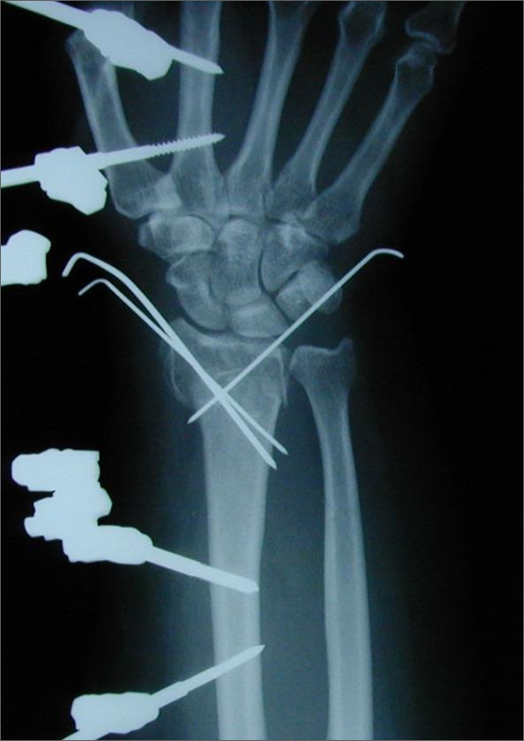
External Fixation
Good option for open, contaminated injuries, medically unstable patients, poly-trauma stabilization.
Relies on ligamentotaxis for stability.
Good for restoring length but not angulation or articular surface.
Can be supplemented with pins
Pitfalls
Overdistraction, assoc. with CRPS
Extensor Tendon Adhesion
Kaempfe FA, Wheeler DR, Peimer CA, Hvisdak KS, Ceravolo J, Senall J. Severe fractures of the distal radius: effect of amount and duration of external fixation distraction on outcome. J Hand Surg. 1993;18A:33-41.

Slide 41
Spanning Plate i.e. the "Internal Ex Fix"

Slide 42
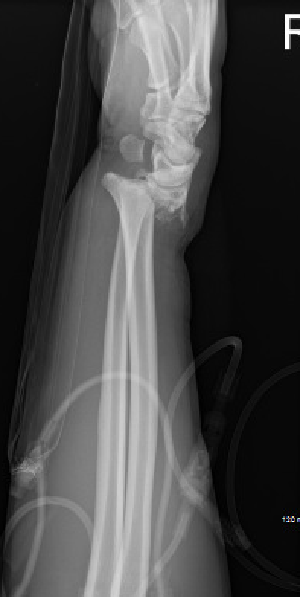
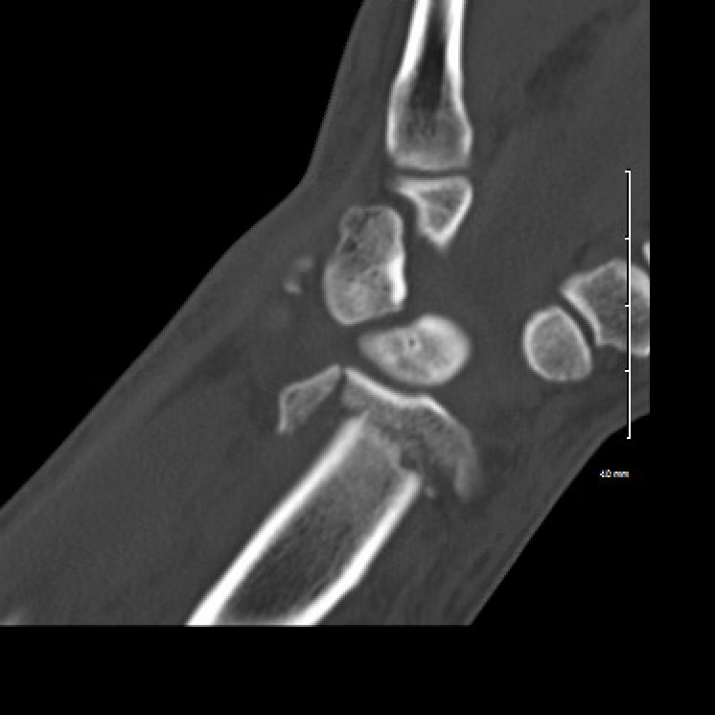
Indications for Wrist Spanning Plate:
High energy comminuted fractures
Radio-carpal fracture dislocation
Pilon/Impaction fractures
fragment elevation/grafting
ICU patients or others where perc pins are undesirable
Patients that will not tolerate an external fixator
Sarah Lewis, Amir Mostofi, Milan Stevanovic, Alidad Ghiassi,
Risk of Tendon Entrapment Under a Dorsal Bridge Plate in a Distal Radius Fracture Model,
The Journal of Hand Surgery, Volume 40, Issue 3, 2015, Pages 500-504,
ISSN 0363-5023,
https://doi.org/10.1016/j.jhsa.2014.11.020.
(https://www.sciencedirect.com/science/article/pii/S0363502314016086)

Slide 43
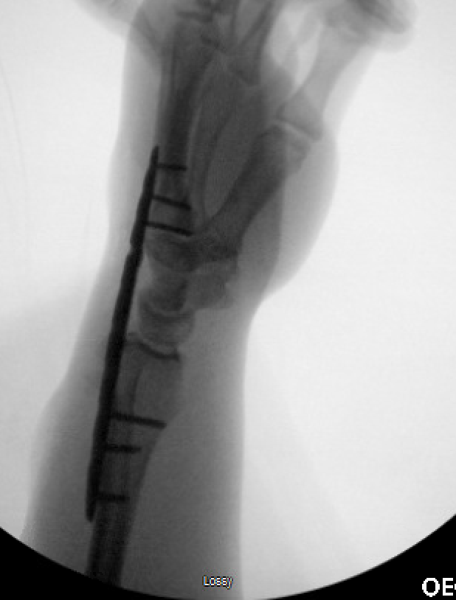
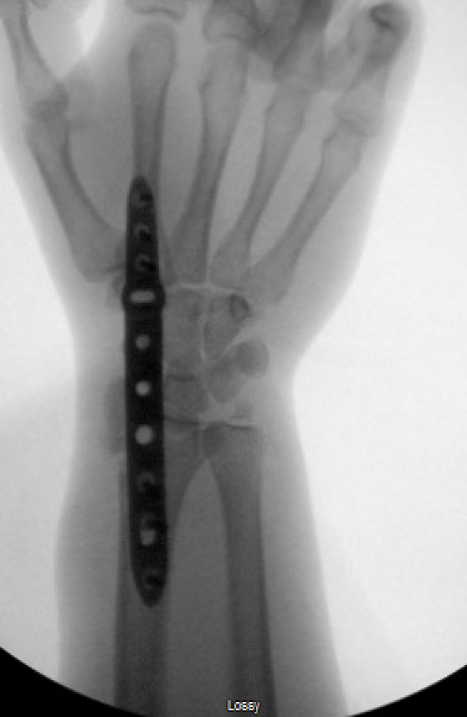

Slide 44
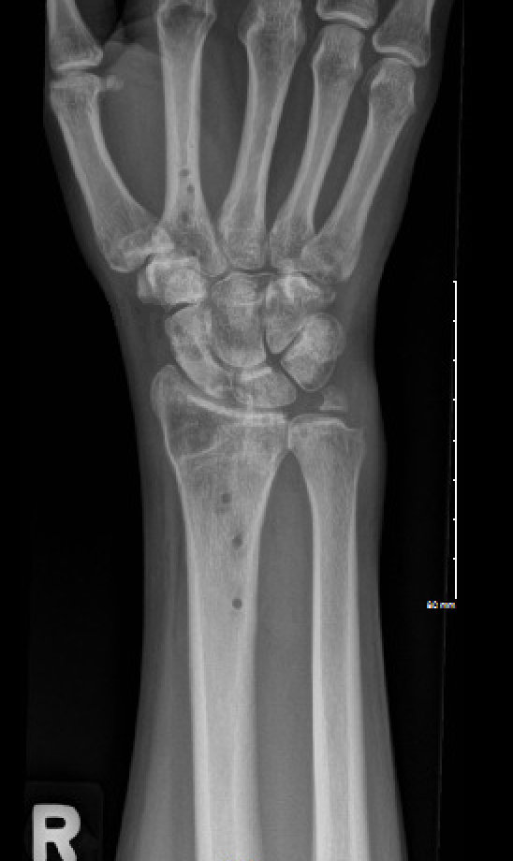
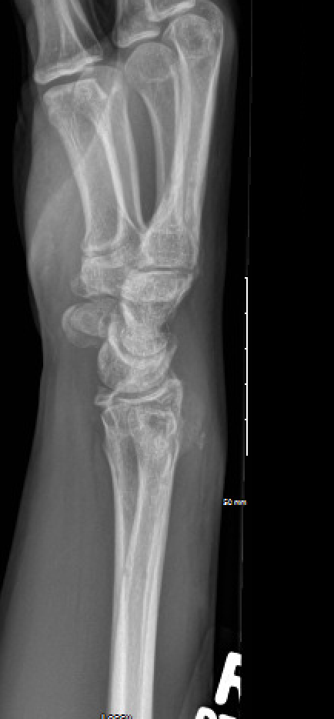
Plate out at 3-4 months

Slide 45
Percutaneous Pinning - Methods
Various techniques described
Most common radial styloid pinning + dorsal-ulnar corner of radius pinning
Supplemental immobilization with cast, splint
In conjunction with external fixation (Augmented external fixation)
Kapandji = Pinning through fracture site to aid reduction
Strohm PC, Müller CA, Boll T, Pfister U. Two procedures for Kirschner wire osteosynthesis of distal radial fractures. A randomized trial. J Bone Joint Surg Am. 2004 Dec;86(12):2621-8. doi: 10.2106/00004623-200412000-00006. PMID: 15590845.

Slide 46
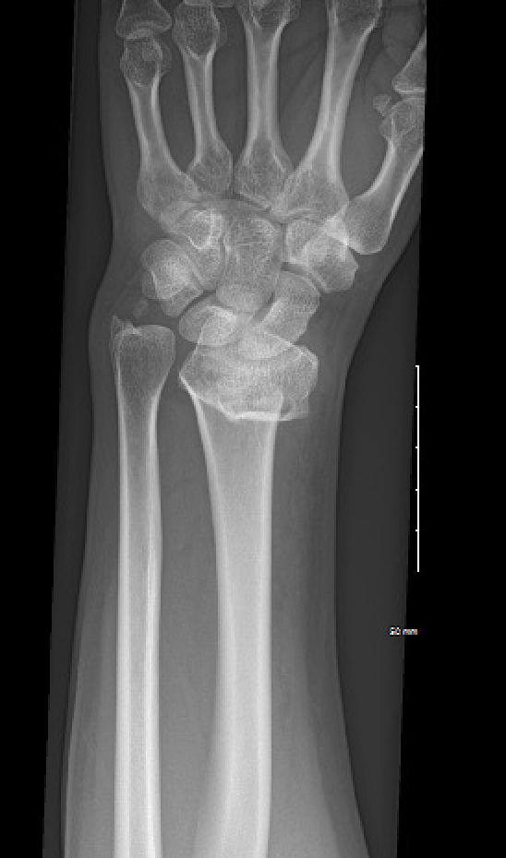
Percutaneous Pins

Slide 47
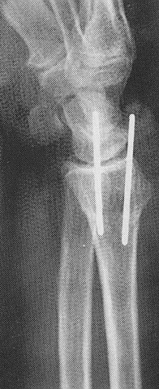
Percutaneous Pins

Slide 48
Open Reduction and Internal Fixation of Distal Radius Fractures
Better for elevation of depressed articular fragments
Required if articular fragments can not be adequately reduced with percutaneous methods
Volar approach is most common
*Primary means of treating displaced and unstable distal radius fractures

Slide 49
ORIF vs ExFix
Plate fixation is better than external fixation combined with perc pinning for the treatment of intra-articular distal radius fractures
ORIF yields better functional outcomes, DASH, supination, bony anatomy, less infection
Ex-Fix results in better grip strength and flexion

Slide 50
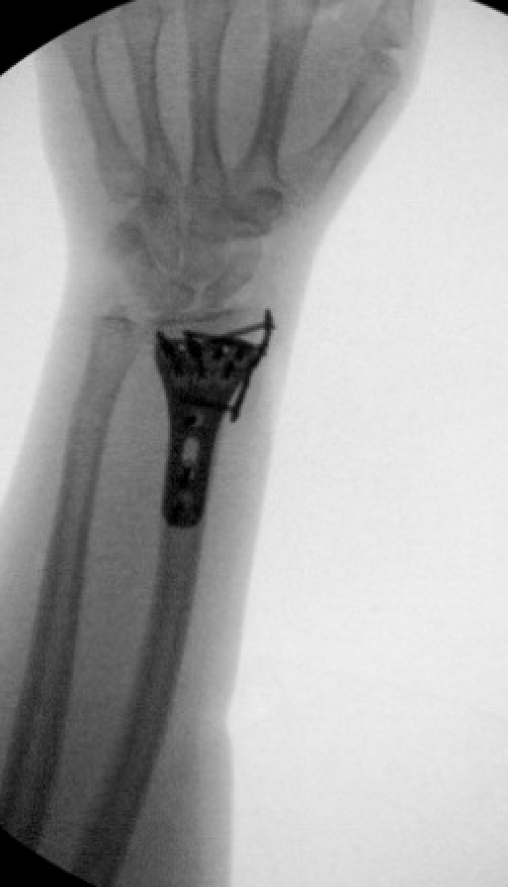
Selection of Approach
Based on location of fracture and displacement
Volar approach (most common) for volar rim fractures and comminuted fractures that can be reduced
Radial styloid approach for buttressing of styloid
Dorsal approach
Occasionally for dorsally displaced fractures that cannot be reduced or maintained from volar approach
Combined approaches needed for high-energy fractures with significant axial impaction

Slide 51
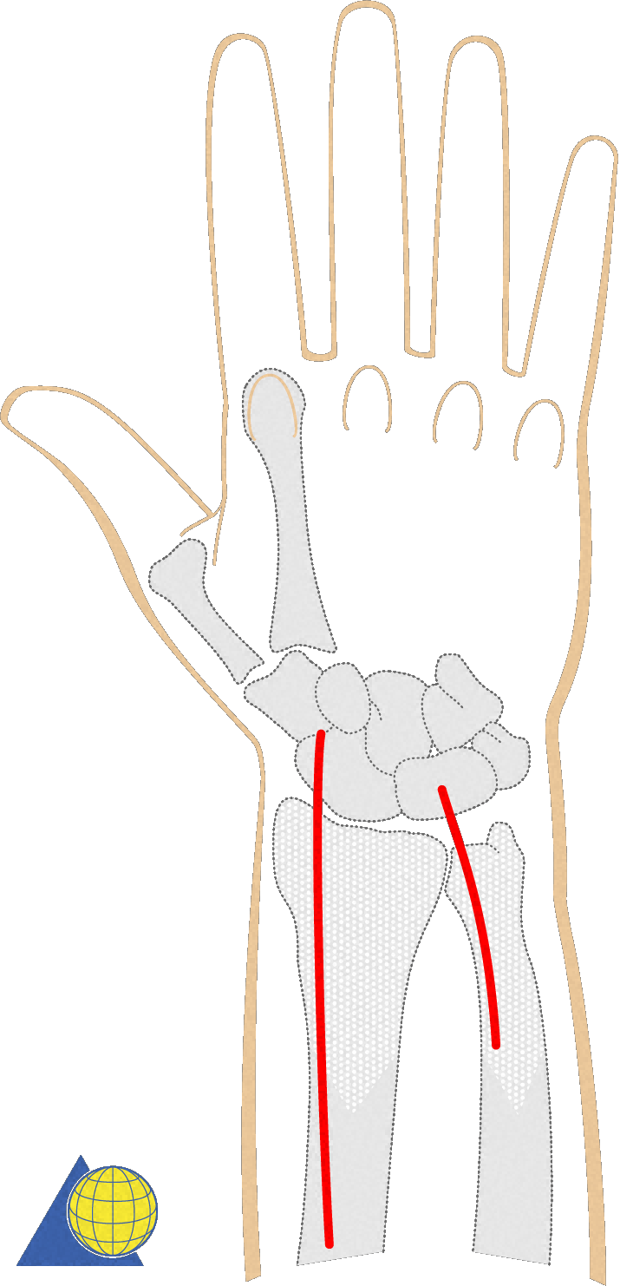
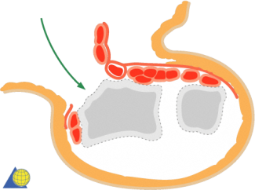
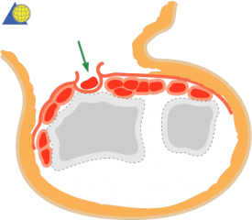
Dorsal Approach
1-2nd DC
3rd DC –EPL
(extensile)
-
Copyright AO Foundation
Interval used is best chosen based on what portion of the radius you are looking to see
1st and 2nd for radial styloid
3rd for metaphysis
5th and 6th for ulnar styloid

Slide 52
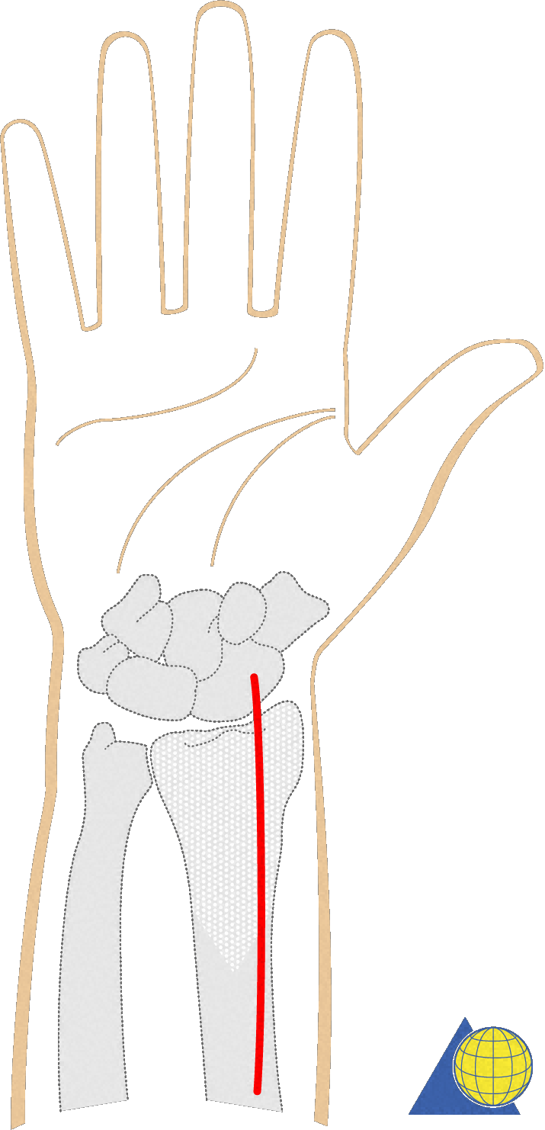
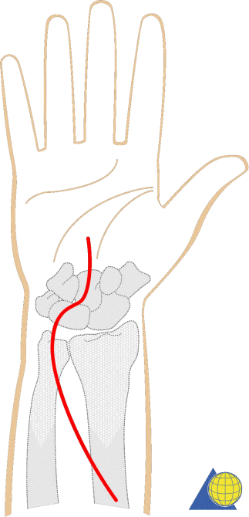
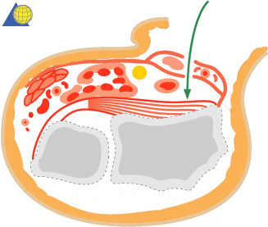
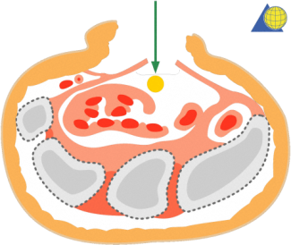
Volar Approaches
1. Classical Henry approach
2. Extended carpal tunnel approach
Useful for:
volar ulnar corner fragment
Fxs associated with CTS
Copyright AO Foundation

Slide 53
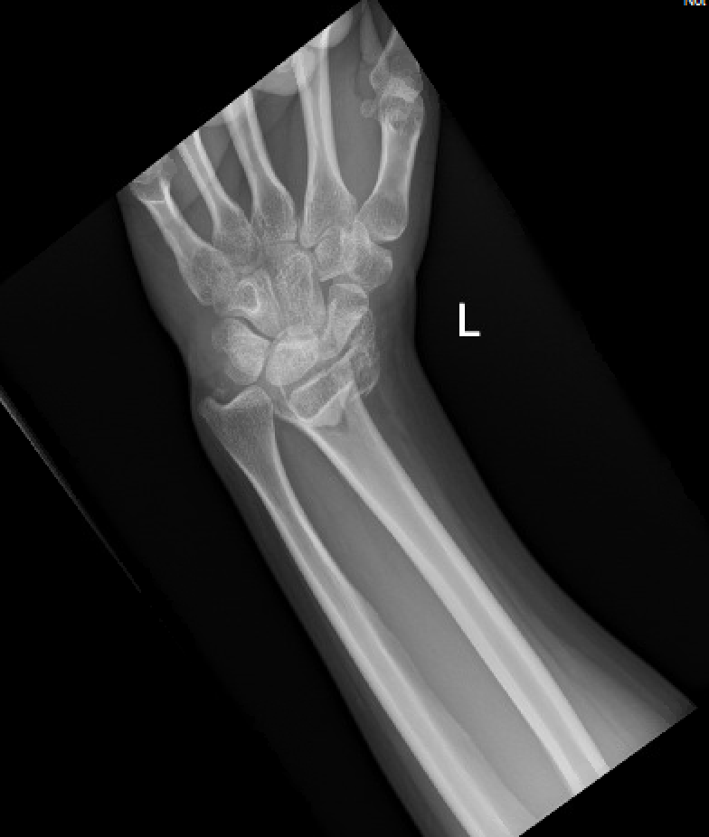
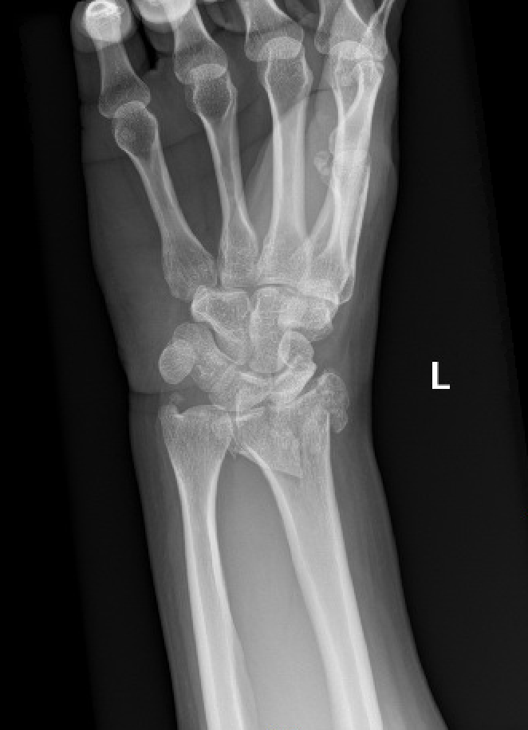
Distal Radius- volar Barton
35 y.o. M, MVC

Slide 54
Carpal subluxation

Slide 55
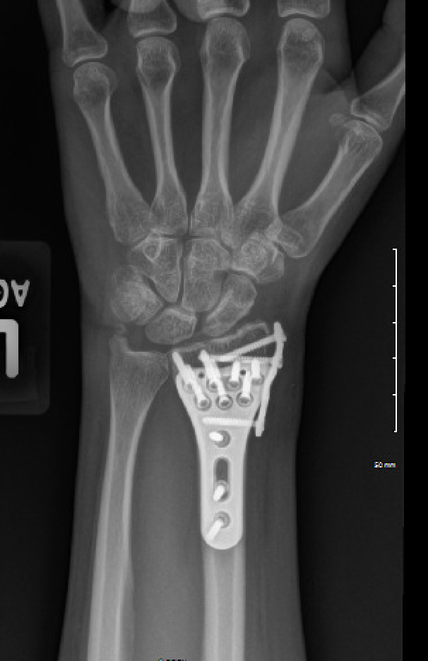
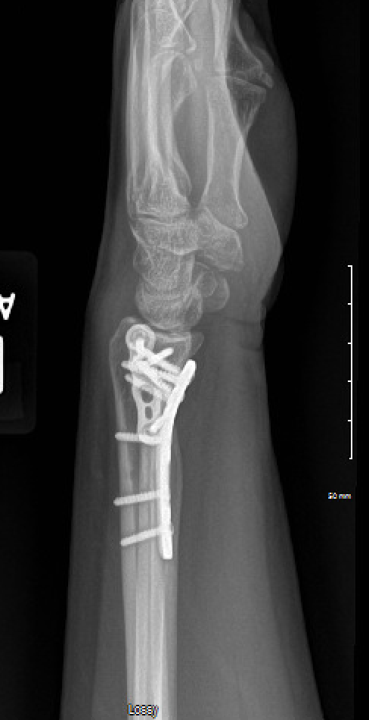
With volar Barton’s fracture, it is critical to place the buttress fixation ulnar enough to maintain located reduction of fragment and carpus.

Slide 56
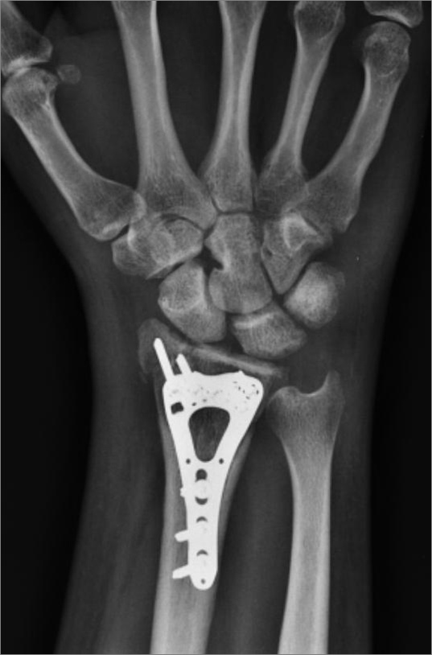
Volar Plating
Workhorse for ORIF of distal radius fractures
Reliable, reproducible outcomes
Lower complication rates when compared to other surgical options
Alter, Todd H. BS1; Ilyas, Asif M. MD1,a Complications Associated with Volar Locking Plate Fixation of Distal Radial Fractures, JBJS Reviews: October 2018 - Volume 6 - Issue 10 - p e7 doi: 10.2106/JBJS.RVW.18.00004
Good soft tissue coverage, low profile
Most plates offer variable angle locking with 15° spread
https://otaonline.org/video-library/45036/procedures-and-techniques/multimedia/16776671/volar-locked-plating-of-the-distal-radius

Slide 57
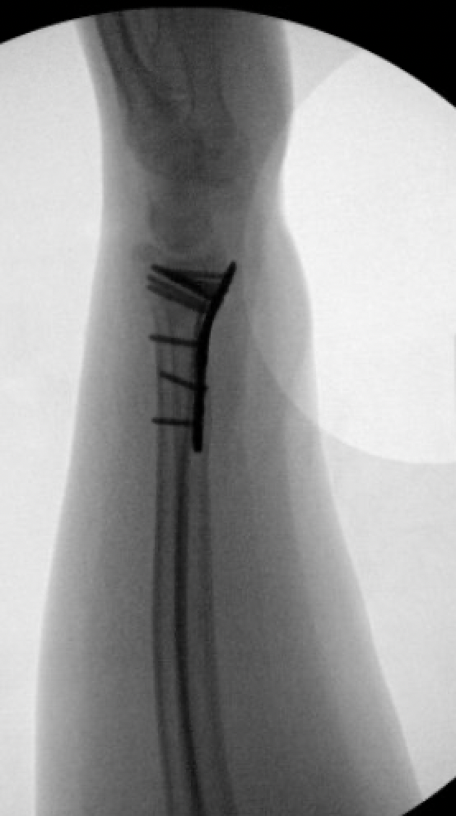
Volar Plating for Dorsal Fractures
Less tendon irritation than dorsal plating
Indirect reduction
Better tolerated than Ex fix

Slide 58
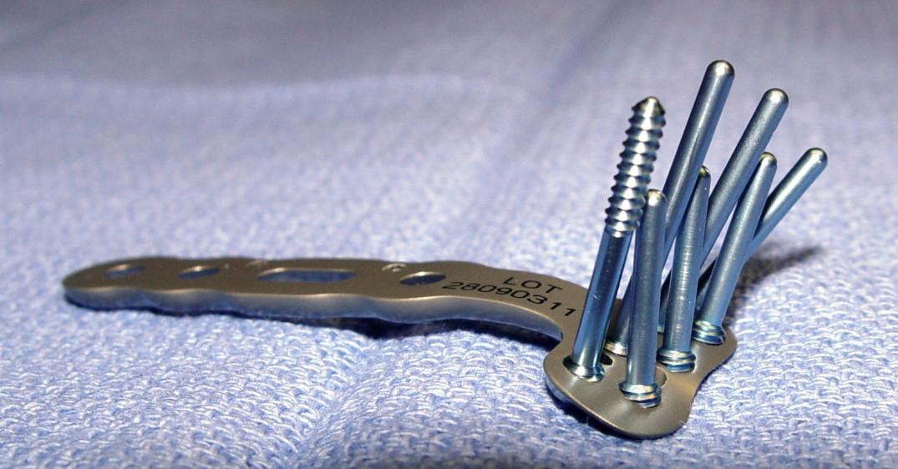
Capture of dorsal fragments enabled by locked screws or pegs
https://otaonline.org/video-library/45036/procedures-and-techniques/multimedia/16776647/dvr-plating

Slide 59
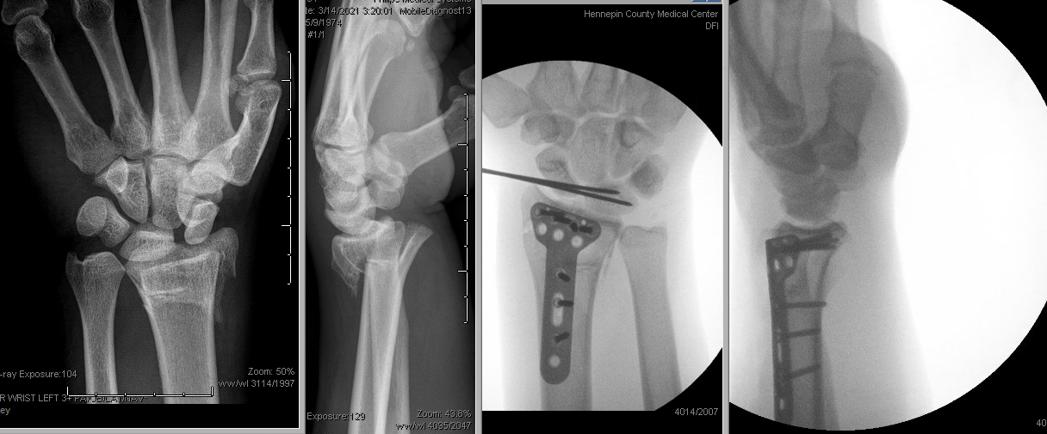
Dorsal Plating
Select cases with specific dorsal fractures/instability
Issues with tendon irritation and stiffness
Tendon rupture is possible complication
https://otaonline.org/video-library/45036/procedures-and-techniques/multimedia/18007831/dorsal-approach-for-dorsal-impaction-distal-radius
Credit: Jacqueline Geissler, MD

Slide 60
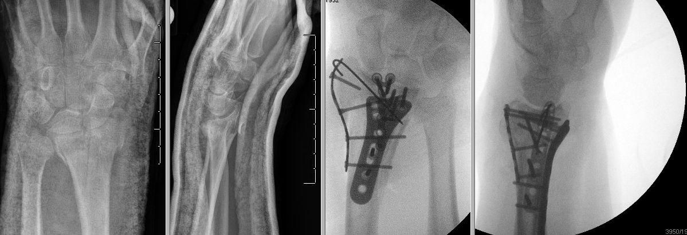
Fragment Specific and Focal systems
Credit: Jacqueline Geissler, MD
Fragment specific fixation via multiple incisions

Slide 61
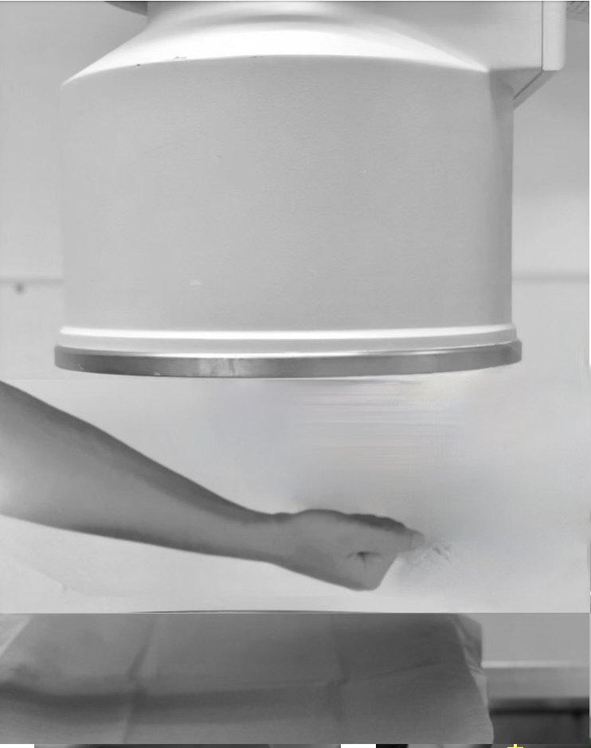
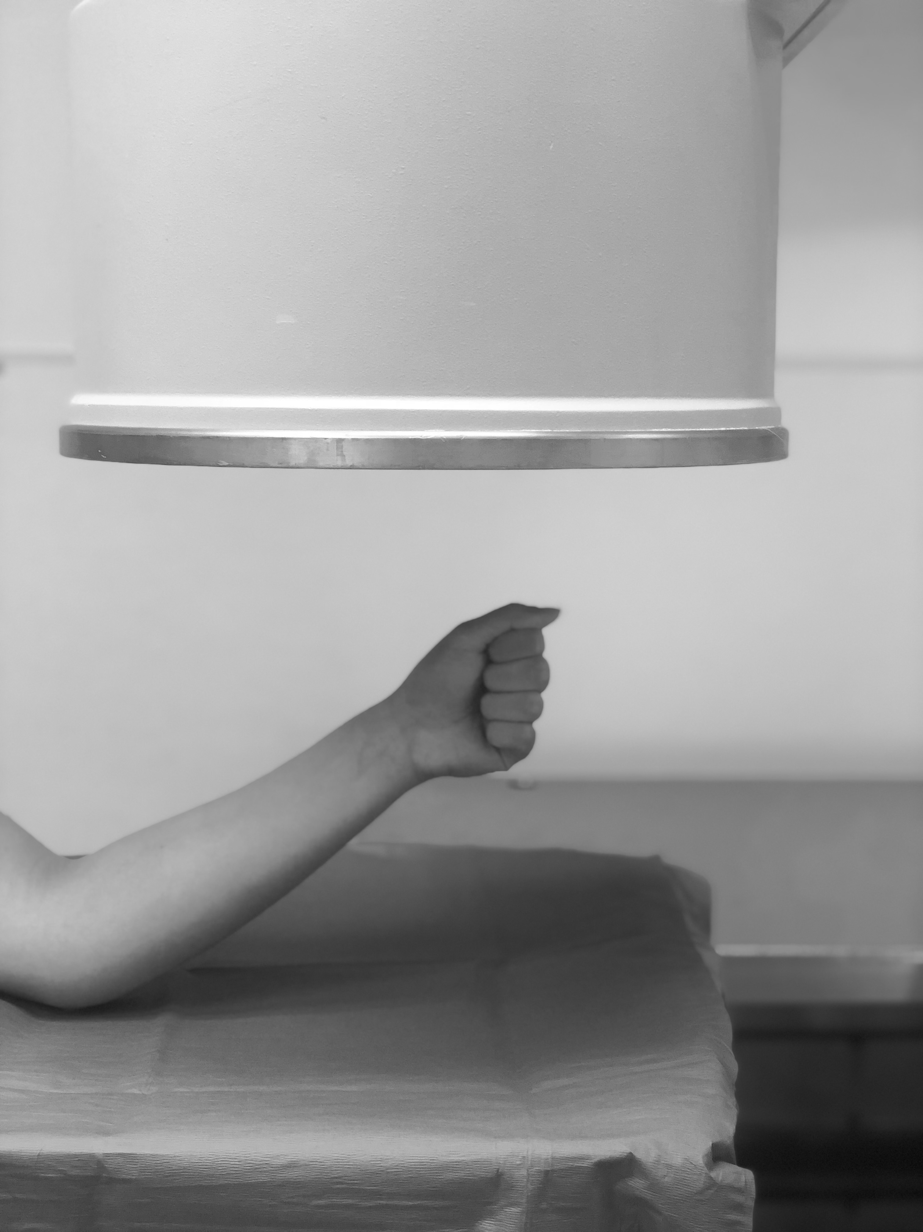
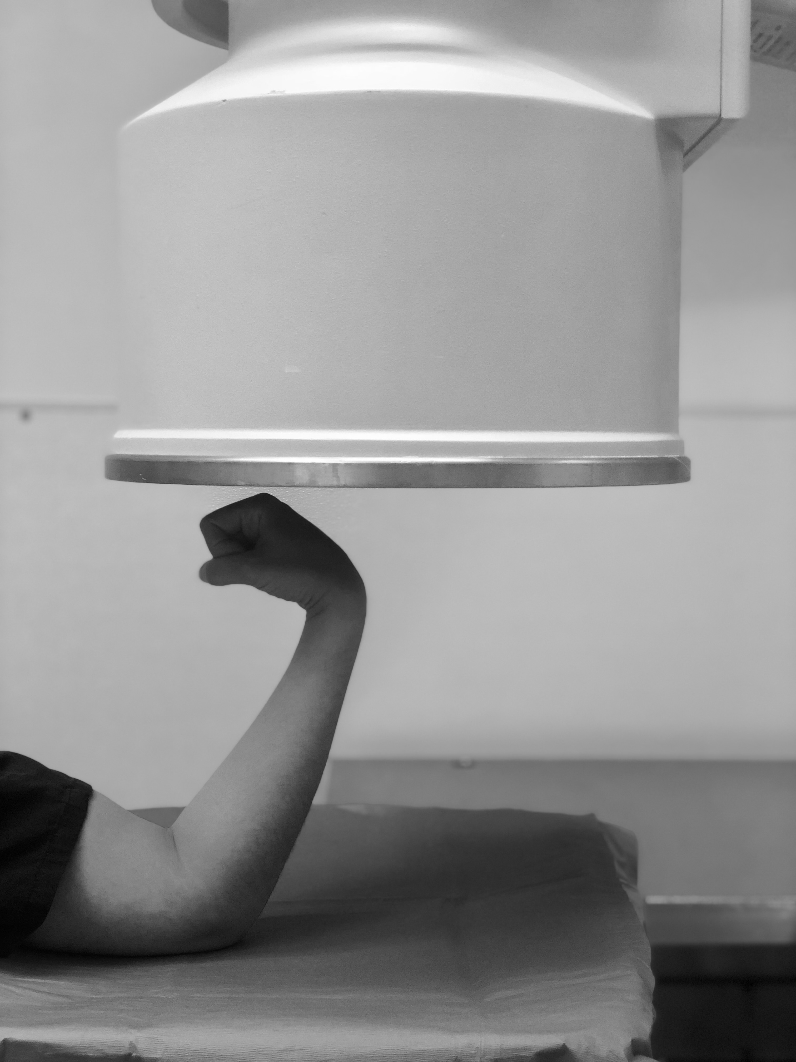
Plating Pearls
Check SL, DRUJ
Xrays
AP xray with elbow elevated in relation to the wrist
Lateral xray with wrist elevated in relation to the elbow
Tangential notch view to assess screw tips
Semi-supinated for volar ulnar corner, semi-pronated for dorsal ulnar corner

Slide 62
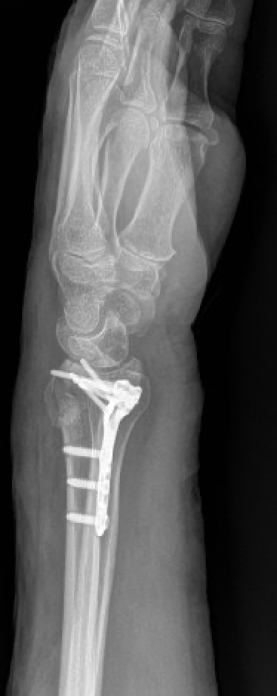
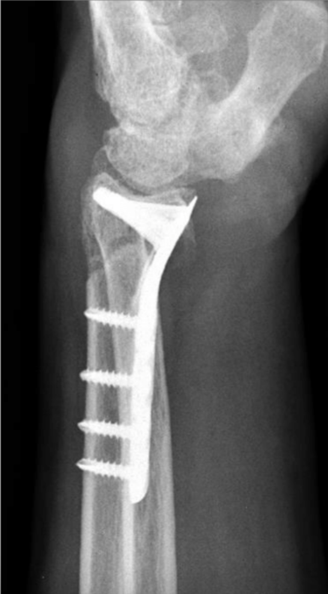
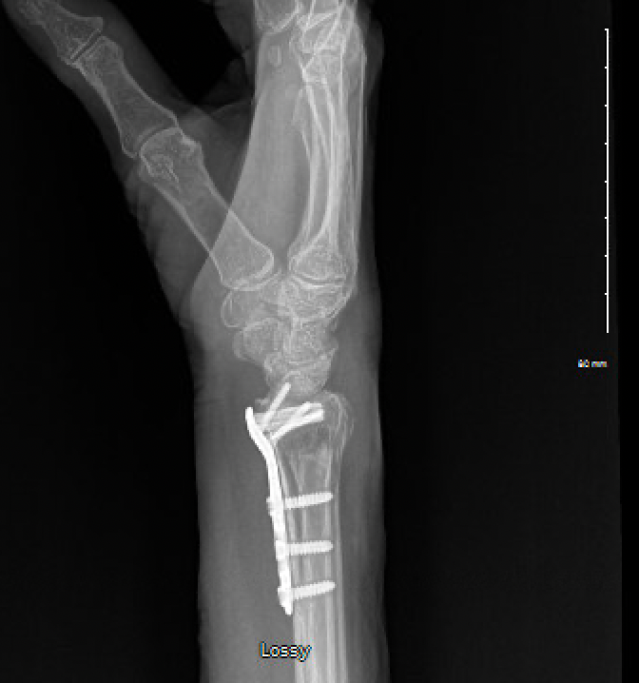
Plating pitfalls
Avoid plate proximal to watershed line
https://www.ncbi.nlm.nih.gov/pmc/articles/PMC3828490/
Unicortical screws distal, Bicortical proximal
Examples of plates distal to watershed line
Example of distal bicortical screws
Image courtesy of J Orbay MD

Slide 63
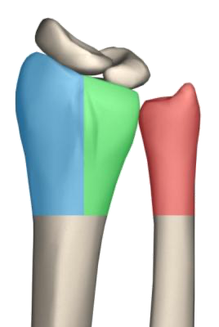
Based on Three Column Theory
Radial Column
Lateral side of radius
Intermediate Column
Ulnar side of radius
Ulnar Column
Distal ulna
Radial column
Ulnar column
Intermediate column

Slide 64
Intra-articular Fracture
Multi-fragmentary intra-articular fracture

Slide 65
Focal plating

Slide 66
Combined dorsal and volar plating
Reserved for very complex fractures
Second operation for implant removal is common
Increased risk of tendon rupture
Credit: Jacqueline Geissler, MD

Slide 67
Anchor Repair of Radiolunate Ligaments for: radiocarpal dislocation cases to restore stability
Credit: Jacqueline Geissler, MD
Kyle C. Bohm, Jacqueline A. Geissler, Christina M. Ward, Volar Radiocarpal Ligament Repair with Suture Anchors for Radiocarpal Fracture Dislocations: Case Series, J Wrist Surg , DOI: 10.1055/s-0040-1718915, Publication Date: 04 November 2020 (online)
https://www.thieme-connect.com/products/ejournals/abstract/10.1055/s-0040-1718915

Slide 68
Advanced Techniques Arthroscopy-assisted
Reduce articular incongruities
Diagnose and treat associated soft tissue lesions
Minimally invasive
Notes:
Minimally invasive vs. adjunct to usual techniques.

Slide 69
Malunion of Distal Radius Fractures
Changes load-bearing patterns on the distal radius and load sharing between the radius and ulna
Often leads to arthrosis
Diego L. Fernandez, Reconstructive Procedures for Malunion and Traumatic Arthritis, Orthopedic Clinics of North America, Volume 24, Issue 2,1993,Pages 341-363,ISSN 0030-5898,
https://doi.org/10.1016/S0030-5898(21)00022-5.
https://www.sciencedirect.com/science/article/pii/S0030589821000225

Slide 70
Malunion of Distal Radius Fractures
Not a considerable issue in older patients >60y/o
Functional outcomes not significantly different
May require osteotomy and revision fixation (younger patients)
Plating depending on malunion
+/- bone graft

Slide 71
Nonunion of Distal Radius Fractures
Rare
Internal Factors
Poor reduction or fixation
External Factors
Nutrition
Patient compliance
Prommersberger, Karl-Josef MD*; Fernandez, Diego L MD† Nonunion of Distal Radius Fractures, Clinical Orthopaedics and Related Research: February 2004 - Volume 419 - Issue - p 51-56

Slide 72
Smoking
Important part of the patient history
Best if patients can quit smoking
Low intensity ultrasound (bone stim) can accelerate healing in smokers

Slide 73
Specific complications of distal radius fracture ORIF
Tendon rupture
Extensor or flexor, most common EPL or FPL
Screw tips or volar plate within 3mm of articular surface
Nerve injury
Median or superficial radial
CRPS/RSD
Vitamin C may not be of benefit, though still AAOS guideline
Özkan, Sezai MD; Teunis, Teun MD, PhD; Ring, David C. MD, PhD; Chen, Neal C. MD What Is the Effect of Vitamin C on Finger Stiffness After Distal Radius Fracture? A Double-blind, Placebo-controlled Randomized Trial, Clinical Orthopaedics and Related Research: October 2019 - Volume 477 - Issue 10 - p 2278-2286 doi: 10.1097/CORR.0000000000000807

Slide 74
Conclusions
Many options for treatment of distal radius fractures
Patient factors must be included when considering treatment options
Important to maintain proficiency with and understand all of them as many have specific applications
Continuously evolving

Slide 75
Conclusions
Plating techniques allow for more accurate and rigid fixation of fragments with more reliable outcomes.
Plating allows for early wrist ROM
Volar, smaller and more anatomic plates are better tolerated
Combination treatment and wrist spanning options can be useful in specific instances.
If you would like to volunteer as an author for the Resident Slide Project or recommend updates to any of the following slides, please send an e-mail to ota@ota.org

Slide 76
Bibliography
1: Ruch DS, Ginn TA, Yang CC, Smith BP, Rushing J, Hanel DP. Use of a distraction plate for distal radial fractures with metaphyseal and diaphyseal comminution. J Bone Joint Surg Am. 2005 May;87(5):945-54.
2: Sammer DM, Shah HM, Shauver MJ, Chung KC. The effect of ulnar styloid fractures on patient-rated outcomes after volar locking plating of distal radius fractures. J Hand Surg Am. 2009 Nov;34(9):1595-602.
3: Liporace FA, Adams MR, Capo JT, Koval KJ. Distal radius fractures. J Orthop Trauma. 2009 Nov-Dec;23(10):739-48.
4: Koenig KM, Davis GC, Grove MR, Tosteson AN, Koval KJ. Is early internal fixation preferred to cast treatment for well-reduced unstable distal radial fractures? J Bone Joint Surg Am. 2009 Sep;91(9):2086-93.
5: Rozental TD, Blazar PE, Franko OI, Chacko AT, Earp BE, Day CS. Functional outcomes for unstable distal radial fractures treated with open reduction and internal fixation or closed reduction and percutaneous fixation. A prospective randomized trial. J Bone Joint Surg Am. 2009 Aug;91(8):1837-46.
6: Wei DH, Raizman NM, Bottino CJ, Jobin CM, Strauch RJ, Rosenwasser MP. Unstable distal radial fractures treated with external fixation, a radial column plate, or a volar plate. A prospective randomized trial. J Bone Joint Surg Am. 2009 Jul;91(7):1568-77.

Slide 77
7: Berglund LM, Messer TM. Complications of volar plate fixation for managing distal radius fractures. J Am Acad Orthop Surg. 2009 Jun;17(6):369-77.
8: Casaletto JA, Machin D, Leung R, Brown DJ. Flexor pollicis longus tendon ruptures after palmar plate fixation of fractures of the distal radius. J Hand Surg Eur Vol. 2009 Aug;34(4):471-4.
9: Mirza A, Jupiter JB, Reinhart MK, Meyer P. Fractures of the distal radius treated with cross-pin fixation and a nonbridging external fixator, the CPX system: a preliminary report. J Hand Surg Am. 2009 Apr;34(4):603-16.
10: Souer JS, Ring D, Matschke S, Audige L, Marent-Huber M, Jupiter JB; AOCID Prospective ORIF Distal Radius Study Group. Effect of an unrepaired fracture of the ulnar styloid base on outcome after plate-and-screw fixation of a distal radial fracture. J Bone Joint Surg Am. 2009 Apr;91(4):830-8
11: Arora R, Gabl M, Gschwentner M, Deml C, Krappinger D, Lutz M. A comparative study of clinical and radiologic outcomes of unstable colles type distal radius fractures in patients older than 70 years: nonoperative treatment versus volar locking plating. J Orthop Trauma. 2009 Apr;23(4):237-42
12: Capo JT, Rossy W, Henry P, Maurer RJ, Naidu S, Chen L. External fixation of distal radius fractures: effect of distraction and duration. J Hand Surg Am. 2009 Nov;34(9):1605-11.
13: Jupiter JB, Marent-Huber M; LCP Study Group. Operative management of distal radial fractures with 2.4-millimeter locking plates. A multicenter prospective case series. J Bone Joint Surg Am. 2009 Jan;91(1):55-65.

Slide 78
14: Thomas AD, Greenberg JA. Use of fluoroscopy in determining screw overshoot in the dorsal distal radius: a cadaveric study. J Hand Surg Am. 2009 Feb;34(2):258-61.
15: Soong M, Got C, Katarincic J, Akelman E. Fluoroscopic evaluation of intra-articular screw placement during locked volar plating of the distal radius: a cadaveric study. J Hand Surg Am. 2008 Dec;33(10):1720-3.
16: Kreder HJ, Hanel DP, Agel J, McKee M, Schemitsch EH, Trumble TE, Stephen D. Indirect reduction and percutaneous fixation versus open reduction and internal fixation for displaced intra-articular fractures of the distal radius: a randomised, controlled trial. J Bone Joint Surg Br. 2005 Jun;87(6):829-36.
17: Orbay JL, Fernandez DL. Volar fixed-angle plate fixation for unstable distal radius fractures in the elderly patient. J Hand Surg Am. 2004 Jan;29(1):96-102.
18: Orbay JL, Fernandez DL. Volar fixation for dorsally displaced fractures of the distal radius: a preliminary report. J Hand Surg Am. 2002 Mar;27(2):205-15.
19: Kreder HJ, Agel J, McKee MD, Schemitsch EH, Stephen D, Hanel DP. A randomized, controlled trial of distal radius fractures with metaphyseal displacement but without joint incongruity: closed reduction and casting versus closed reduction, spanning external fixation, and optional percutaneous K-wires.
J Orthop Trauma. 2006 Feb;20(2):115-21.

