Slide 1
Radiographic Evaluation & Classification of Acetabular Fractures
Laura Blum, MD
Orthopedic Trauma Surgeon
Atrium Health Cabarrus
Jeffery Chad Martin, DO
Assistant Professor
East Tennessee State University

Slide 2
Objectives
Intact Acetabulum: Standard radiographic evaluation
Obtaining and understanding standard views
Identifying and understanding Letournel’s six radiographic landmarks
Acetabular Fractures: Plain Radiographs
Classification of acetabular fractures
Elementary and associated patterns
Recognizing fracture patterns
Classification algorithm
Acetabular Fractures: CT evaluation
Associated injuries
Recognizing patterns on CT
Further characterization of fractures

Slide 3
Objectives
Intact Acetabulum: Standard radiographic evaluation
Obtaining and understanding standard views
Identifying and understanding Letournel’s six radiographic landmarks
Acetabular Fractures: Plain Radiographs
Classification of acetabular fractures
Elementary and associated patterns
Recognizing fracture patterns
Classification algorithm
Acetabular Fractures: CT evaluation
Associated injuries
Recognizing patterns on CT
Further characterization of fractures

Slide 4
Standard Radiographic Evaluation

Slide 5
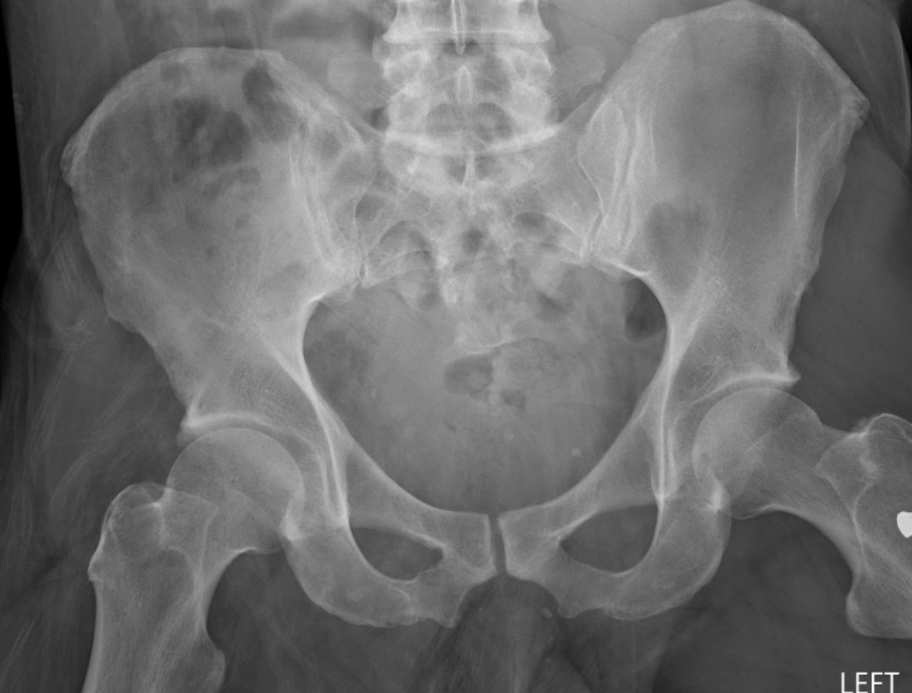
Standard Pelvic Radiographs
Three views should be routinely obtained¹:
AP
Judets (oblique)
Obturator oblique
Iliac oblique
Image courtesy of Dr. Raymond Wright, MD

Slide 6
AP Radiograph
Centered on symphysis¹
Neutral rotation^{1,2}
Symmetric obturator foramen
Spinous process in line with pubic symphysis
Neutral pelvic tilt³
Coccyx ~1-3cm above symphysis
Image courtesy of Dr. Raymond Wright, MD

Slide 7
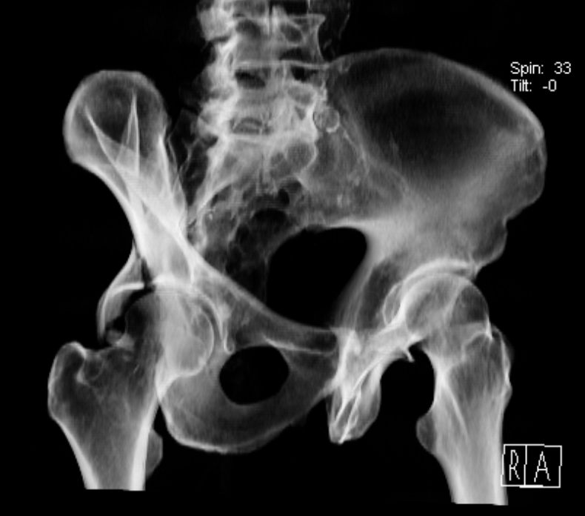
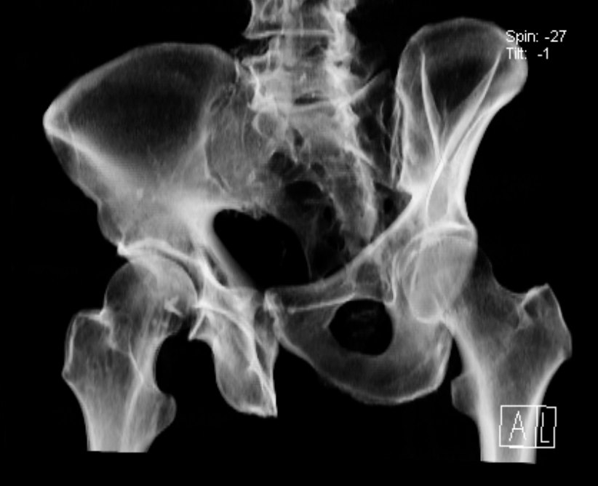
Judet Views
Oriented 45 degrees to coronal plane¹
Obturator ring is perpendicular (orthogonal) to iliac wing^{1,4}
Iliac oblique of one hip is obturator oblique of contralateral hip⁴
Coccyx should be centered over cotyloid fossa
Images courtesy of Dr. Raymond Wright, MD

Slide 8
Obturator Oblique
Injured hemipelvis bumped up, toward XR beam^{1,2}
Iliac cross section small as possible¹
Perfectly displays outline of the obturator ring¹
Best demonstrates
Anterior column
Posterior wall
Iliac oblique
Obturator oblique
Image courtesy of Dr. Raymond Wright, MD

Slide 9
Iliac Oblique
Contralateral (uninjured) hemipelvis bumped up, toward XR beam^{1,2}
Exposes surface of the iliac wing¹
Obturator foramen not visible, obturator ring as thin as possible¹
Best demonstrates¹
Posterior column
Anterior wall
Iliac wing in profile
Iliac oblique
Obturator oblique
Image courtesy of Dr. Raymond Wright, MD

Slide 10
Letournel’s Radiographic Landmarks

Slide 11
Letournel’s 6 Radiographic Landmarks
Iliopectineal line
Ilio-ischial line
Teardrop
Acetabular roof
Anterior wall
Posterior wall
*All identified on AP pelvis radiograph
Image courtesy of Dr. Raymond Wright, MD

Slide 12
Iliopectineal line
Landmark for anterior column¹
Anterior ¾: pelvic brim
Posterior ¼: sciatic buttress and roof of sciatic notch
Image courtesy of Dr. Raymond Wright, MD

Slide 13
Ilioischial line
Landmark for posterior column¹
Created by beam tangent to posterior portion of quadrilateral surface
Image courtesy of Dr. Raymond Wright, MD

Slide 14
Teardrop
Not a true anatomic structure¹
Medial limb
obturator canal and anteroinferior portion of quadrilateral surface¹
Lateral limb
Inferior aspect of anterior wall¹
Represents maintained relationship between columns²
Image courtesy of Dr. Raymond Wright, MD

Slide 15
Acetabular Roof
“Sourcil” = eyebrow¹
Created by beam tangent to subchondral bone of superior portion of acetabulum¹
Represents superior articular surface of the acetabulum²
Image courtesy of Dr. Raymond Wright, MD

Slide 16
Border of Anterior & Posterior Wall
Acetabulum slightly anteverted
Anterior wall appears medial to posterior wall¹
Anterior wall is more horizontal than posterior wall²
Radiographic landmark for anterior wall is contiguous w superior border of obturator foramen^{1,2}
Image courtesy of Dr. Raymond Wright, MD

Slide 17
Letournel’s 6 Radiographic Landmarks
Iliopectineal line
Anterior Column
Ilio-ischial line
Posterior column
Teardrop
Relationship between columns
Acetabular roof
Superior articular surface
Anterior wall
Posterior wall
Image courtesy of Dr. Raymond Wright, MD

Slide 18
Fracture Classification

Slide 19
Classification of Acetabular Fractures
Letournel’s Classification
Five elementary patterns & five associated patterns
Based on anatomic pattern
Determined by analyzing six radiographic landmarks
Determine which are disrupted
Variations from these patterns are common and well-recognized^{1,2}
Letournel’s Classification of Acetabular Fractures
Elementary Patterns
Anterior wall fracture Posterior wall fracture Anterior column fracture Posterior column fracture Transverse fracture
Associated Patterns
Transverse + posterior wall fracture Posterior column + posterior wall Anterior column + posterior hemitransverse fracture T-type fracture Both column fracture

Slide 20
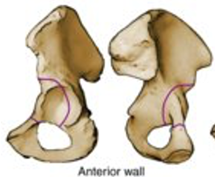
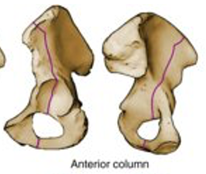
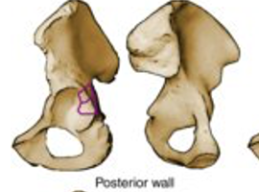
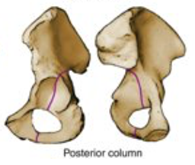
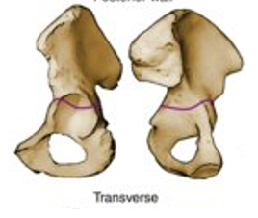
Classification of Acetabular Fractures
Elementary patterns
Separates part or entirety of single column from acetabulum¹
Transverse fractures are an exception¹
Both columns involved
Included in elementary family due to fundamental nature of fracture line¹
A
A
A
A
A
Tornetta III, P et al. Rockwood & Greens Fractures in Adults. Philadelphia: Lippincott Williams & Wilkins, 2019

Slide 21
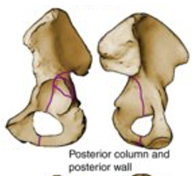
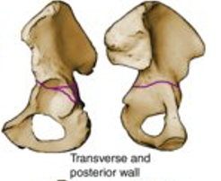
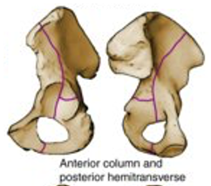
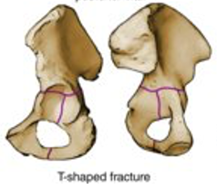
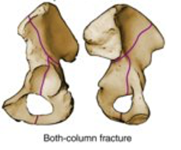
Classification of Acetabular Fractures
Associated patterns
Combination of elementary patterns¹
Elementary pattern + additional fracture component¹
A
A
A
A
A
A
A
Tornetta III, P et al. Rockwood & Greens Fractures in Adults. Philadelphia: Lippincott Williams & Wilkins, 2019

Slide 22
Elementary Fracture Patterns

Slide 23
Anterior Wall Fractures
Uncommon as isolated fractures¹
A
Tornetta III, P et al. Rockwood & Greens Fractures in Adults. Philadelphia: Lippincott Williams & Wilkins, 2019

Slide 24
Anterior Wall Fractures
AP
AIIS & pubis are not involved¹
Typically occurs along upper 1/3¹
Tornetta III, P et al. Rockwood & Greens Fractures in Adults. Philadelphia: Lippincott Williams & Wilkins, 2019

Slide 25
Anterior Wall Fractures
Obturator Oblique
Trapezoidal shaped fragment¹
Middle portion of anterior column
Driven medially by femoral head
Assess extent of articular surface involvement
How much is attached to the wall fragment¹
Tornetta III, P et al. Rockwood & Greens Fractures in Adults. Philadelphia: Lippincott Williams & Wilkins, 2019

Slide 26
Anterior Wall Fractures
Iliac Oblique
Posterior column intact¹
Establish point of rupture of anterior wall¹
Tornetta III, P et al. Rockwood & Greens Fractures in Adults. Philadelphia: Lippincott Williams & Wilkins, 2019

Slide 27
Posterior Wall Fractures
Common pattern
Commonly associated with
Posterior dislocation of femoral head¹
Significant marginal impaction¹
Tornetta III, P et al. Rockwood & Greens Fractures in Adults. Philadelphia: Lippincott Williams & Wilkins, 2019

Slide 28
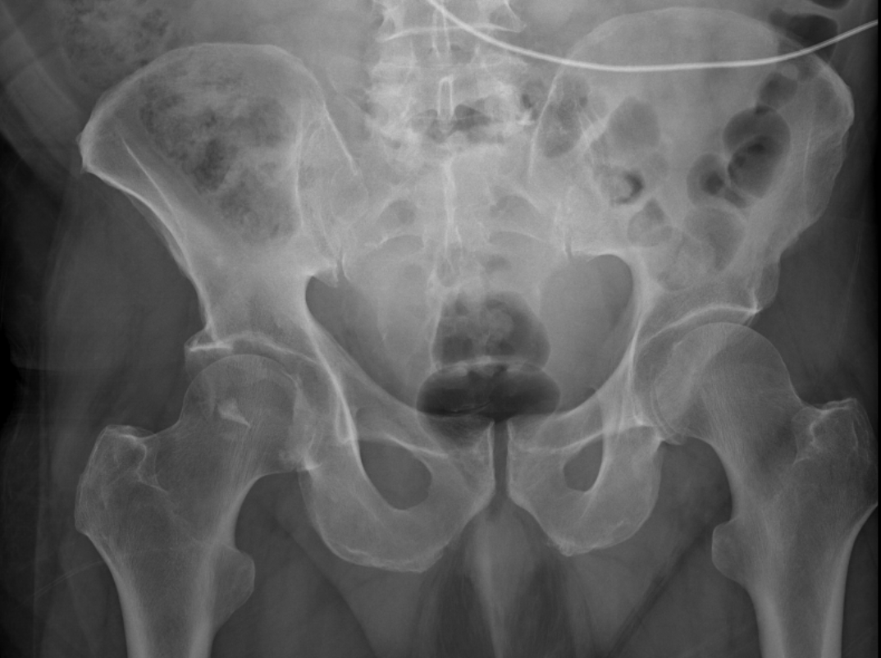
Posterior Wall Fractures
AP
Often associated with posterior dislocation of the femoral head¹
PW fragment appears as cap on dislocated head¹
Once reduced, fracture may be difficult to identify¹
Image courtesy of Dr. Raymond Wright, MD

Slide 29
Posterior Wall Fractures
Obturator oblique
Provides most information regarding posterior wall fracture¹
Depicts fragment size & displacement¹
Any residual subluxation of the femoral head¹
Image courtesy of Dr. Raymond Wright, MD

Slide 30
Posterior Wall Fractures
Iliac oblique
Typically not particularly useful in characterizing posterior wall fractures
Fracture may not be visualized at all
Image courtesy of Dr. Raymond Wright, MD

Slide 31
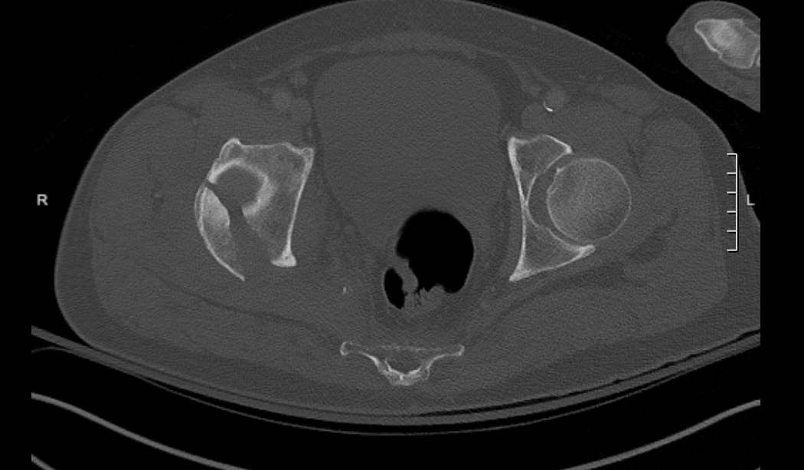
Posterior Wall Fractures
CT
Fracture line oblique, anteriorly and peripherally, at ~45 degrees¹
Characterizes marginal impaction¹
Rule out associated, minimally displaced transverse fractures not visible on plain radiographs¹
Image courtesy of Dr. Raymond Wright, MD

Slide 32
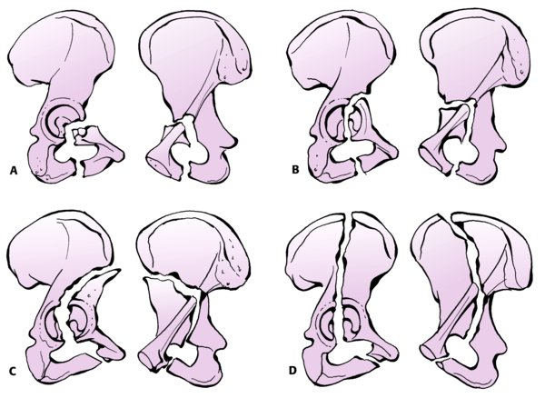
Anterior Column Fractures
Subclassified based on where cranial extent of fracture line exits ^{1,2}
A.) Very low: anteroinferior acetabulum
Large portion of acetabular roof usually left intact
Often reduces spontaneously, remains stable
B.) Low: Psoas gutter
Inferior to AIIS
C.) Intermediate: Anterior interspinous notch
Between AIIS and ASIS
D.) High: Iliac crest
Posterior to ASIS
Tornetta III, P et al. Rockwood & Greens Fractures in Adults. Philadelphia: Lippincott Williams & Wilkins, 2019

Slide 33
Anterior Column Fractures
AP
Disrupted iliopectineal line¹
Any involvement of iliac wing often visible¹
Tornetta III, P et al. Rockwood & Greens Fractures in Adults. Philadelphia: Lippincott Williams & Wilkins, 2019

Slide 34
Anterior Column Fractures
Obturator Oblique
Clearly shows location of disruption of iliopectineal line¹
Best demonstrates extent of medial displacement of anterior column by femoral head¹
Tornetta III, P et al. Rockwood & Greens Fractures in Adults. Philadelphia: Lippincott Williams & Wilkins, 2019

Slide 35
Anterior Column Fractures
Iliac oblique
Confirms integrity of posterior column¹
Best depicts any involvement of iliac wing¹
Tornetta III, P et al. Rockwood & Greens Fractures in Adults. Philadelphia: Lippincott Williams & Wilkins, 2019

Slide 36
Posterior Column Fractures
Fracture extends from posterior column near apex of greater sciatic notch²
Continues caudally through inferior ramus²
Separates entire ischioacetabular segment from innominate bone²
Tornetta III, P et al. Rockwood & Greens Fractures in Adults. Philadelphia: Lippincott Williams & Wilkins, 2019

Slide 37
Posterior Column Fractures
AP:
Loss of relationship of teardrop with iliopectineal line¹
Ilioischial line displaced medially by femoral head¹
Iliopectineal line intact¹
Tornetta III, P et al. Rockwood & Greens Fractures in Adults. Philadelphia: Lippincott Williams & Wilkins, 2019

Slide 38
Posterior Column Fractures
Obturator Oblique
Confirms integrity of iliopectineal line (Black arrow)^{1,2}
Ischiopubic segment disrupted (White arrow)^{1,2}
Tornetta III, P et al. Rockwood & Greens Fractures in Adults. Philadelphia: Lippincott Williams & Wilkins, 2019

Slide 39
Posterior Column Fractures
Iliac Oblique
Confirms disrupted ilioischial line, and extent of superior involvement¹
Typically angle of greater sciatic notch¹
Tornetta III, P et al. Rockwood & Greens Fractures in Adults. Philadelphia: Lippincott Williams & Wilkins, 2019

Slide 40
Posterior Column Fractures
CT
Fracture line has transverse (coronal) orientation on axial CT¹
Tornetta III, P et al. Rockwood & Greens Fractures in Adults. Philadelphia: Lippincott Williams & Wilkins, 2019

Slide 41
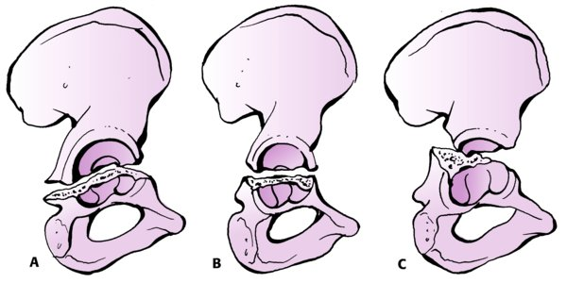
Transverse Fractures
Subclassified based on level of fracture relative to acetabular roof^{1,2}
A.) Infratectal
Inferior part of anterior and posterior walls
B.) Juxtatectal
Passes through highest point of cotyloid fossa
C.) Transtectal
At the level of the roof
Divides innominate bone into ilium and ischiopubic segments¹
Tornetta III, P et al. Rockwood & Greens Fractures in Adults. Philadelphia: Lippincott Williams & Wilkins, 2019

Slide 42
Transverse Fractures
AP
Both ilioischial and iliopectineal lines disrupted¹
Obturator ring intact¹
Scrutinize for associated SI joint injury¹
Tornetta III, P et al. Rockwood & Greens Fractures in Adults. Philadelphia: Lippincott Williams & Wilkins, 2019

Slide 43
Transverse Fractures
Obturator oblique
Confirms integrity of obturator ring¹
Aids in evaluation of relative displacement of the fragments¹
Helpful for decision making for choice of approach
Tornetta III, P et al. Rockwood & Greens Fractures in Adults. Philadelphia: Lippincott Williams & Wilkins, 2019

Slide 44
Transverse Fractures
Iliac oblique
Depicts point of rupture of greater sciatic notch (black arrow)¹
Tornetta III, P et al. Rockwood & Greens Fractures in Adults. Philadelphia: Lippincott Williams & Wilkins, 2019

Slide 45
Transverse Fractures
CT
Axial view
Fracture line has vertical (sagittal) orientation¹
Evaluate for concomitant SI joint widening¹
Coronal view
Useful for characterizing level of fracture⁴
ie. Trans/juxta/infra-tectal
Assess for associated marginal impaction⁴
Tornetta III, P et al. Rockwood & Greens Fractures in Adults. Philadelphia: Lippincott Williams & Wilkins, 2019

Slide 46
Associated Fracture Patterns

Slide 47
Posterior Column + Posterior Wall Fractures
Combination of two elementary patterns²
Posterior wall portion can be thought of as comminution of posterior rim where posterior column fracture traverses it²
Frequently associated with femoral head dislocation²
Tornetta III, P et al. Rockwood & Greens Fractures in Adults. Philadelphia: Lippincott Williams & Wilkins, 2019

Slide 48
Posterior Column + Posterior Wall Fractures
AP
Ilioischial line disrupted¹
“double” ilioischial line (black arrow)^{1,2}
Sometimes posterior column component is minimally displaced and not readily visible on AP view¹
Posterior wall fragment
Typically remains concentric with femoral head in setting of dislocation¹
Ischiopubic ramus typically fractured¹ (white arrowhead)
Iliopectineal line intact¹ (black arrowheads)
Tornetta III, P et al. Rockwood & Greens Fractures in Adults. Philadelphia: Lippincott Williams & Wilkins, 2019

Slide 49
Posterior Column + Posterior Wall Fractures
Obturator oblique view
Best demonstrates size and displacement posterior wall fragment¹ (white arrow)
Best delineates nature of inferior exit point of posterior column fracture¹ (white arrowhead)
Sometimes does not involve obturator foramen¹
Instead splits the ischium¹
Intact iliopectineal line¹ (black arrowhead)
Tornetta III, P et al. Rockwood & Greens Fractures in Adults. Philadelphia: Lippincott Williams & Wilkins, 2019

Slide 50
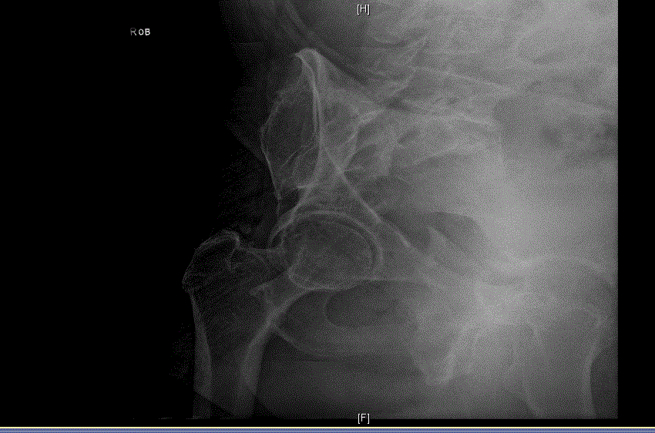
Posterior Column + Posterior Wall Fractures
Iliac oblique view
Best depicts displacement of posterior column fragment¹ (white arrow)
Disruption of greater sciatic notch¹
Posterior wall fragment appears superimposed on roof of acetabulum¹ (black arrow)
Image courtesy of J. Chad Martin, DO

Slide 51
Posterior Column + Posterior Wall Fractures
Axial CT
Posterior column fracture (black arrowheads)
Can have coronal or oblique (anterior and central) orientation¹
Posterior wall fracture (white arrow)
Orientation is typically oblique (anterior and peripheral) at approximately 45-60 degrees¹
Image courtesy of J. Chad Martin, DO

Slide 52
Transverse + Posterior wall
Transverse component
Transtectal
Juxtatectal
Infratectal
Tornetta III, P et al. Rockwood & Greens Fractures in Adults. Philadelphia: Lippincott Williams & Wilkins, 2019

Slide 53
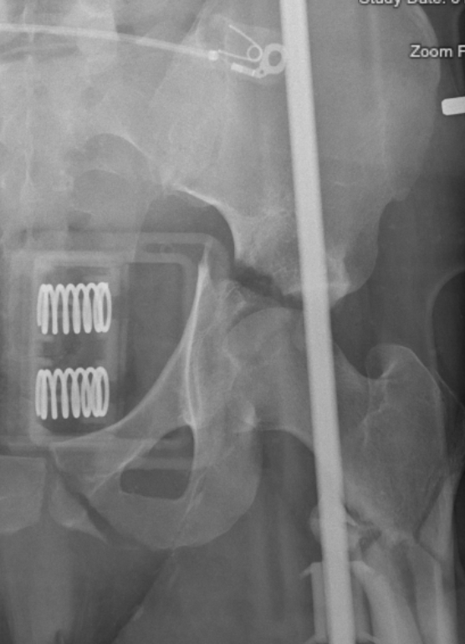
Transverse + Posterior wall
AP
Teardrop is only remaining intact radiographic landmark¹
Obturator ring intact¹
Ischiopubic segment driven medially by femoral head¹
Image courtesy of Dr. Raymond Wright, MD

Slide 54
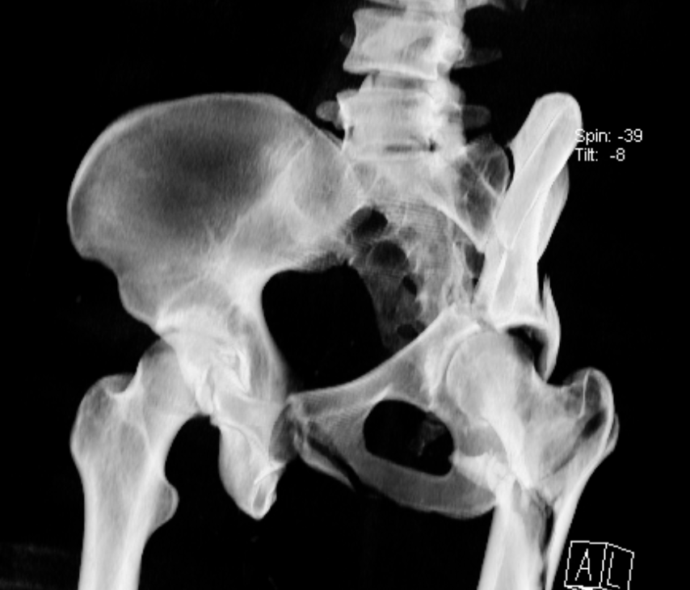
Transverse + Posterior wall
Obturator oblique
Best demonstrates posterior wall fragment size and displacement¹
Best way to evaluate for any persistent femoral head subluxation¹
Obturator ring intact¹
Image courtesy of Dr. Raymond Wright, MD

Slide 55
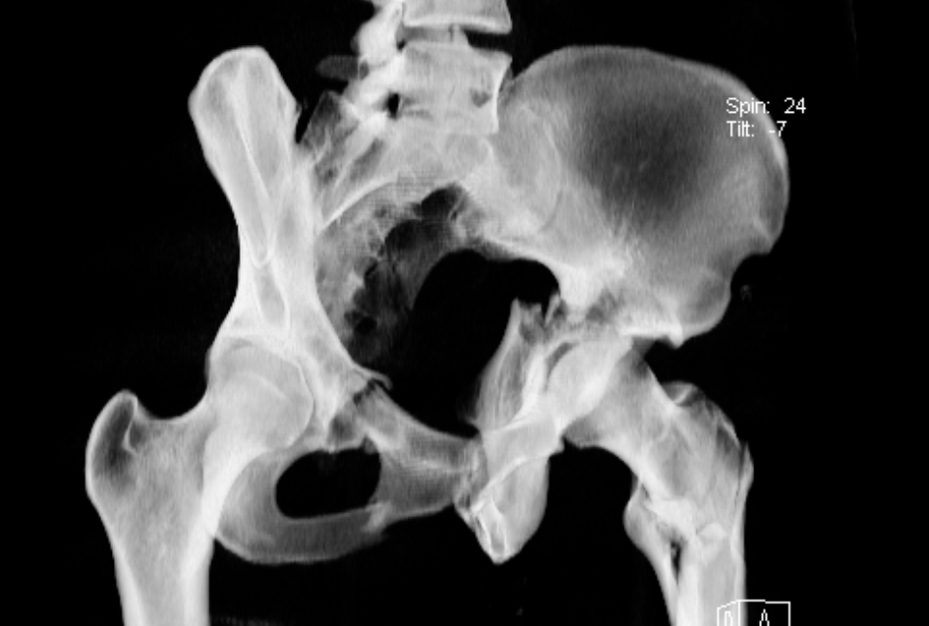
Transverse + Posterior wall
Iliac oblique
Fracture line exiting greater sciatic notch¹
Posterior wall fragment superimposed on roof of acetabulum¹
Image courtesy of Dr. Raymond Wright, MD

Slide 56
Transverse + Posterior wall
Axial CT
Transverse component
vertical (sagittal) fracture orientation¹ (black arrow)
Posterior wall component (white arrow)
typical oblique (anterior and peripheral) fracture orientation¹
Assess for associated pelvic ring injury¹
Tornetta III, P et al. Rockwood & Greens Fractures in Adults. Philadelphia: Lippincott Williams & Wilkins, 2019

Slide 57
Anterior Column (or wall) + Posterior Hemitransverse Fractures
Common in elderly patients^{2,6}
Osteopenia
Low energy mechanism
Often have associated impaction of the medial acetabular roof, or “gull sign”²
Majority involve anterior column rather than anterior wall²
Tornetta III, P et al. Rockwood & Greens Fractures in Adults. Philadelphia: Lippincott Williams & Wilkins, 2019
A
A

Slide 58
Anterior Column (or wall) + Posterior Hemitransverse Fractures
AP
Iliopectineal line disrupted
Medial subluxation of femoral head with segmental displacement of iliopectineal line¹
Ilioischial line preserved¹
Tornetta III, P et al. Rockwood & Greens Fractures in Adults. Philadelphia: Lippincott Williams & Wilkins, 2019

Slide 59
Anterior Column (or wall) + Posterior Hemitransverse Fractures
Obturator oblique
Iliopectineal line disrupted
Femoral head follows anterior column lesion¹
Fracture often multifragmentary with impaction¹
Tornetta III, P et al. Rockwood & Greens Fractures in Adults. Philadelphia: Lippincott Williams & Wilkins, 2019

Slide 60
Anterior Column (or wall) + Posterior Hemitransverse Fractures
Iliac oblique
Best demonstrates direction of posterior part of fracture¹
Disrupted posterior column
Typically exits through greater sciatic notch
Demontrates involvement of ilium when anterior column portion extends into it¹
Tornetta III, P et al. Rockwood & Greens Fractures in Adults. Philadelphia: Lippincott Williams & Wilkins, 2019

Slide 61
Anterior Column (or wall) + Posterior Hemitransverse Fractures
CT
Anterior column component has typical coronal orientation¹
Anterior fracture fragment often highly comminuted¹
Posterior hemitransverse fracture component typically has vertical (anterior-posterior) direction, reminiscent of transverse pattern¹
On axials, extends posteriorly from the coronal anterior column fracture
Tornetta III, P et al. Rockwood & Greens Fractures in Adults. Philadelphia: Lippincott Williams & Wilkins, 2019

Slide 62
T-Type Fractures
Transverse fracture with vertical fracture line through ischiopubic segment
On plain films, describe each component sequentially:
Transverse component¹:
Transtectal
Juxtatectal
Infratectal
Vertical fracture line variants¹
Vertical: splits obturator ring down center
Anterior: splits ring anteriorly
Posterior: splits ring posteriorly
*Obturator ring may maintain its integrity in anterior and posterior variants¹
AAAAAAAAA
Tornetta III, P et al. Rockwood & Greens Fractures in Adults. Philadelphia: Lippincott Williams & Wilkins, 2019

Slide 63
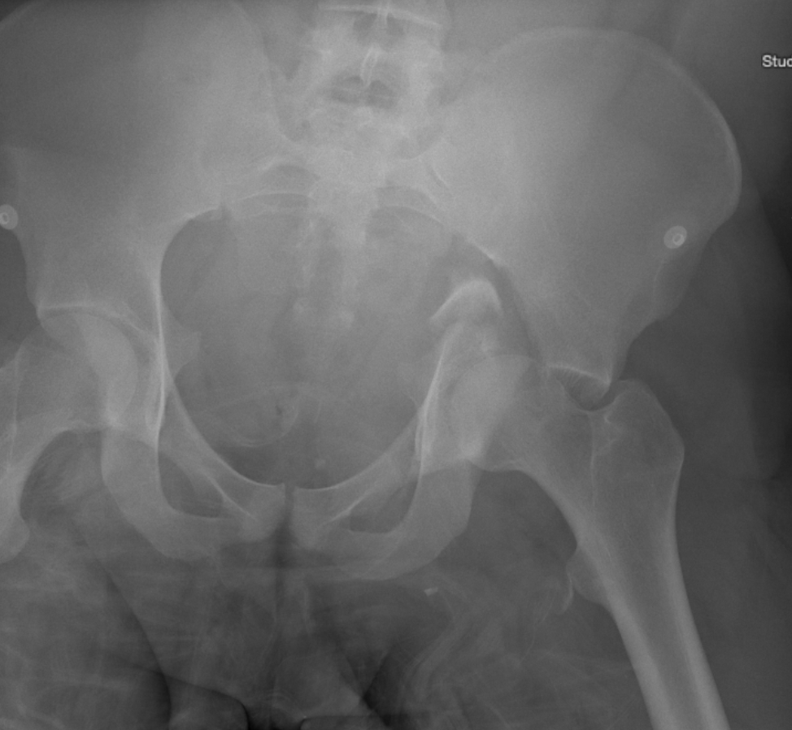
T-Type Fractures
AP
Transverse component almost always has significant displacement¹
Ilioischial line may appear duplicated^{1,2} (black arrowheads)
Displacement of vertical component
Obturator ring disrupted^{1,2} (white arrow)
Image courtesy of Dr. Raymond Wright, MD
Tornetta III, P et al. Rockwood & Greens Fractures in Adults. Philadelphia: Lippincott Williams & Wilkins, 2019

Slide 64
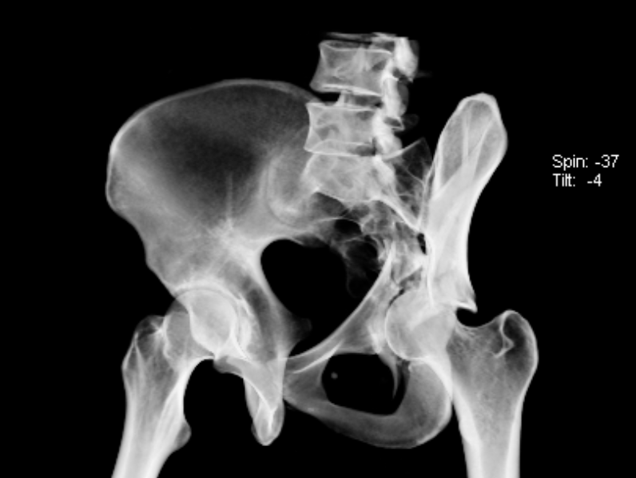
T-Type Fractures
Obturator oblique
Disruption of the anterior column
Best characterizes pattern of vertical (stem) component of the fracture ¹
Vertical
Anterior
Posterior
Best view to evaluate disruption of obturator ring when present¹
Image courtesy of Dr. Raymond Wright, MD

Slide 65
T-Type Fractures
Iliac oblique
Disruption of greater sciatic notch¹, or posterior column (red arrow)
Best depicts any subluxation of femoral head¹
Tornetta III, P et al. Rockwood & Greens Fractures in Adults. Philadelphia: Lippincott Williams & Wilkins, 2019

Slide 66
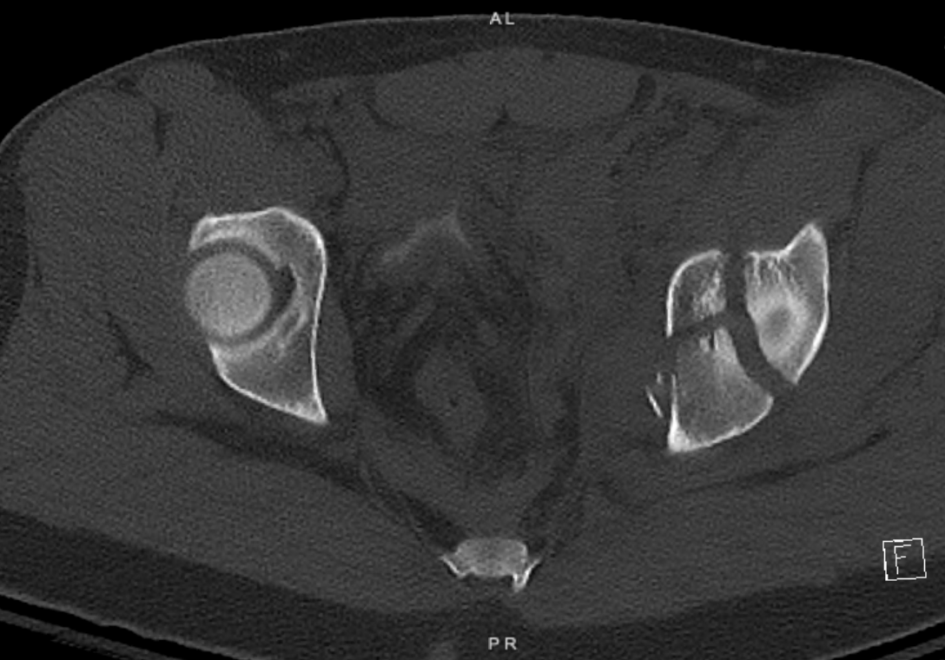
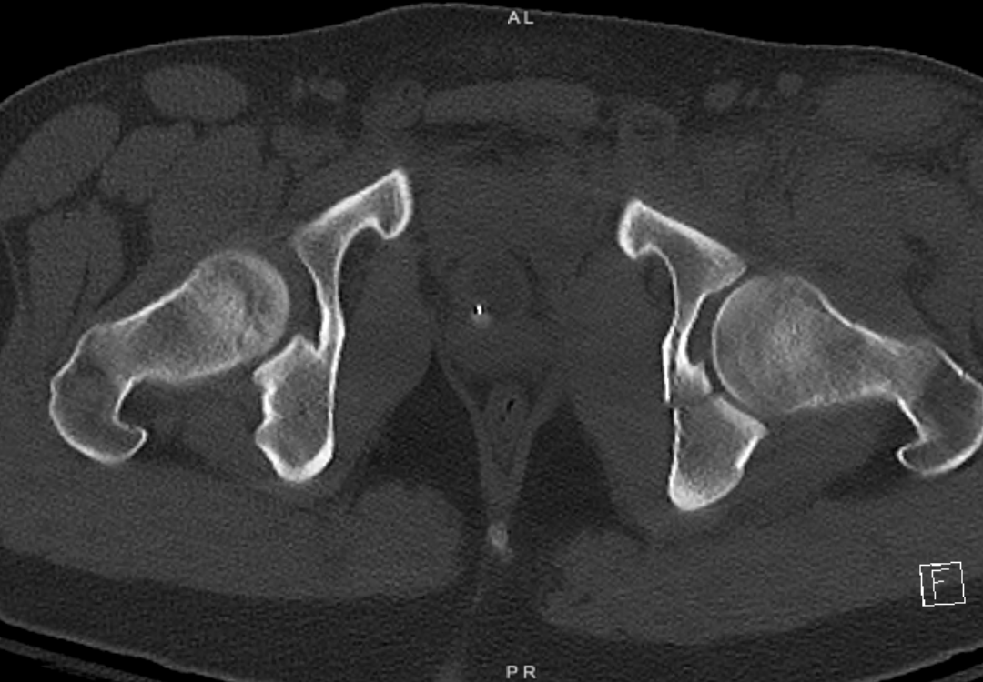
T-Type Fractures
CT
Transverse component vertically (sagittally) oriented on axial cuts¹
Best modality for diagnosing minimally displaced vertical components¹
Images courtesy of Dr. Raymond Wright, MD

Slide 67
T-Type vs. Anterior Column + Posterior Hemitransverse
Anterior Column +
Posterior Hemitransverse
A
T-Type
A
Tornetta III, P et al. Rockwood & Greens Fractures in Adults. Philadelphia: Lippincott Williams & Wilkins, 2019
Tornetta III, P et al. Rockwood & Greens Fractures in Adults. Philadelphia: Lippincott Williams & Wilkins, 2019
A
A

Slide 68
Both Column Fractures
No continuity between axial skeleton and articular surface of acetabulum^{1,2}
Typically very comminuted¹
Complexity is variable¹
Tornetta III, P et al. Rockwood & Greens Fractures in Adults. Philadelphia: Lippincott Williams & Wilkins, 2019

Slide 69
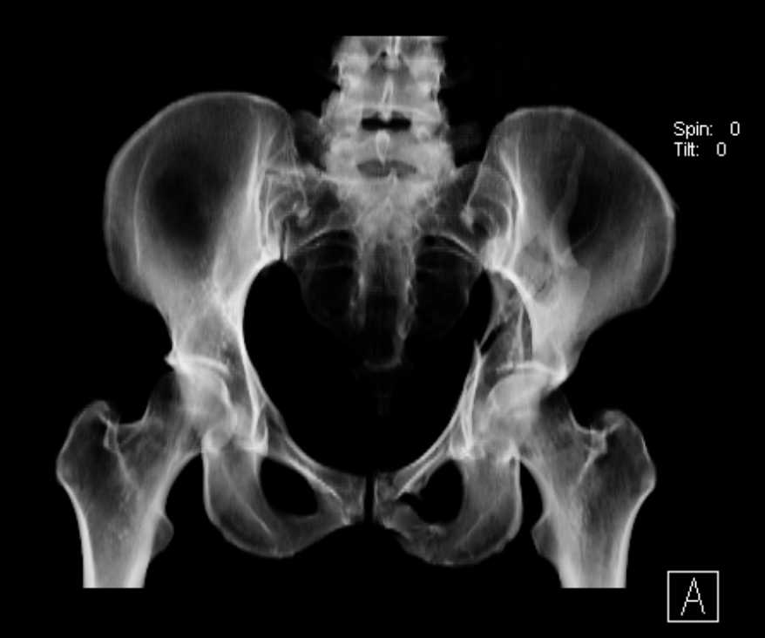
Both Column Fractures
AP
Disruption of all 6 of Letournel’s radiographic lines¹
Femoral head often remains congruent with roof & anterior column¹
Commonly associated with fracture of contralateral pubic body¹
Due to displacement of ipsilateral superior pubic ramus fragment noted.
Iliac wing fracture visualized when present¹
May be incomplete¹
Image courtesy of Dr. Raymond Wright, MD

Slide 70
Both Column Fractures
Obturator oblique
Spur sign^{1,2}
Spike of non articular intact ilium
Visible due to medial displacement of acetabulum
Confirms secondary congruence¹ between femoral head and acetabulum
Rupture of obturator ring¹
Image courtesy of Dr. Raymond Wright, MD

Slide 71
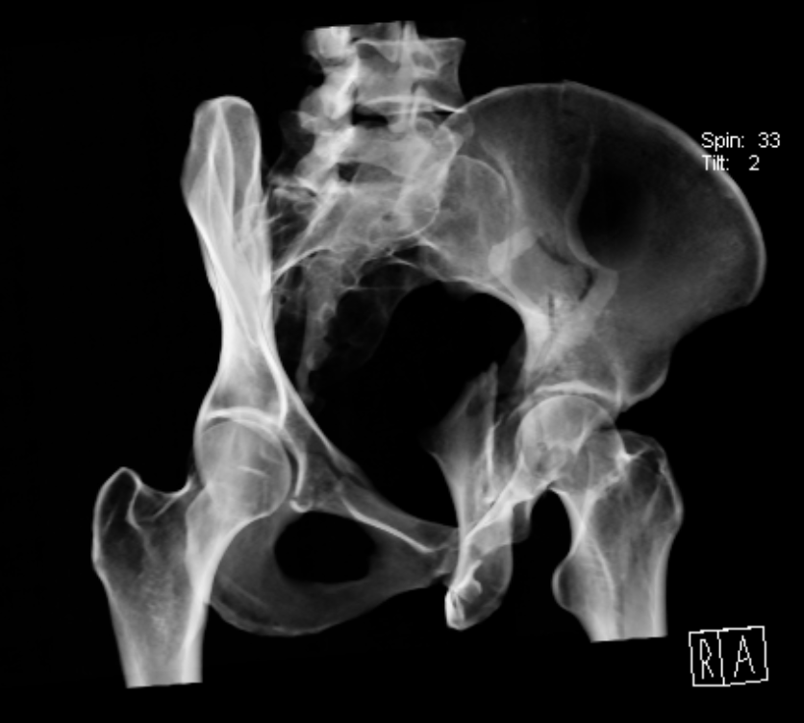
Both Column Fractures
Iliac oblique
Best depicts displacement of posterior column¹
Best depicts any fractures extending into the ilium of the ilium¹
Image courtesy of Dr. Raymond Wright, MD

Slide 72
Both Column Fractures
Axial CT
Evaluate for any intact strut of bone extending from sciatic buttress to articular acetabulum⁴
Spur sign of the iliac wing
At level of roof, fracture typically coronally oriented¹
Evaluate for associated
Marginal impaction
Intra-articular fragments
Sacral fracture or SI joint injury
Image courtesy of Dr. Raymond Wright, MD

Slide 73
Fracture Characteristics

Slide 74
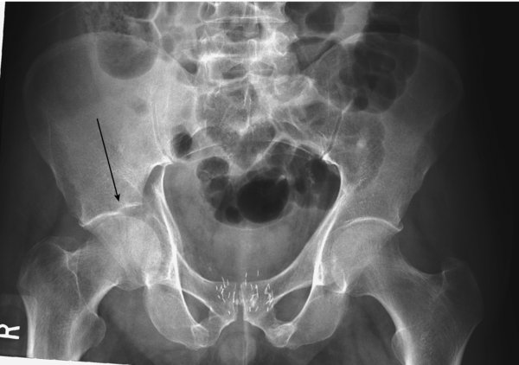
The Gull Sign
Represents impaction of the superomedial acetabular roof⁵
Reminiscent of gull’s wing
Indication of osteopenic bone⁵
Poor prognostic sign^{5,6}
Predicts failure in patients with acetabular fractures >60yo⁵
Inability to achieve anatomic reduction
Early loss of reduction
Tornetta III, P et al. Rockwood & Greens Fractures in Adults. Philadelphia: Lippincott Williams & Wilkins, 2019

Slide 75
Marginal Impaction
Impacted osteochondral fragment²
Displaced by femoral head as it dislocates²
Common in posterior wall fractures²
Sometimes visible on plain radiographs, but more easily visualized on CT²
Image from Laura Blum, MD

Slide 76
Incarcerated Fragments
Diagnosis
Post-reduction films: non-concentric joint space¹
Fragment often visualized either:
Extruded toward external border
Partly within cotyloid fossa
A
Tornetta III, P et al. Rockwood & Greens Fractures in Adults. Philadelphia: Lippincott Williams & Wilkins, 2019
B

Slide 77
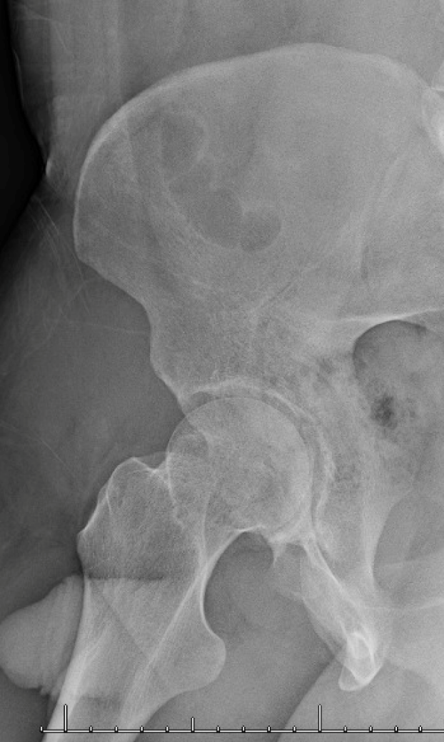
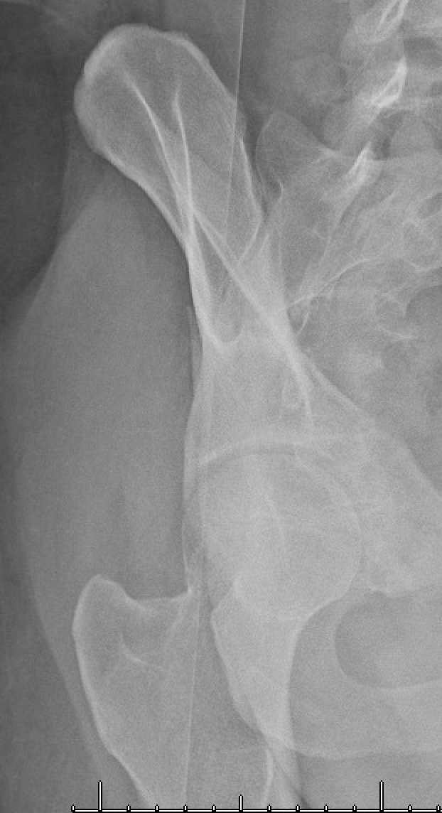
Roof Arc Angle
A
B
C
Three angles measured on AP (A), iliac oblique (B), and obturator oblique (C)⁷
Vertical line drawn through center of acetabulum
Another line, 45 degrees from that starting at the center of the acetabulum
If fracture falls within the angle drawn on any of the views, considered to be in weight-bearing dome⁷
Relative indication for surgery
Images from Laura Blum, MD

Slide 78
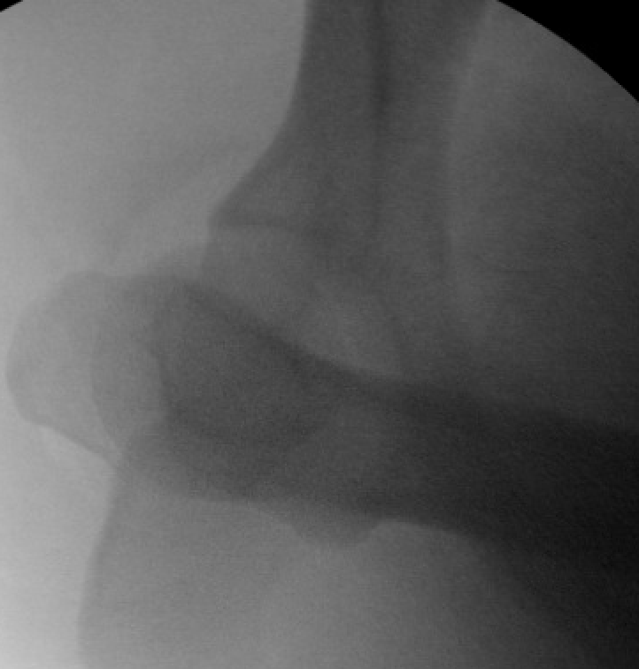
Stress Exam Under Anesthesia
Dynamic stress views
Typically used to evaluate stability of posterior wall fractures²
Assess for congruity while loading force through the femur longitudinally²:
Flex >90 degrees
Flex, internally rotate approximately 20 degrees → assess for congruity
stress
Images courtesy of Luke Harmer, MD

Slide 79
CT Evaluation

Slide 80
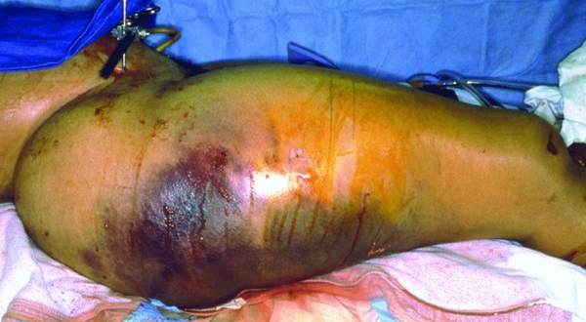
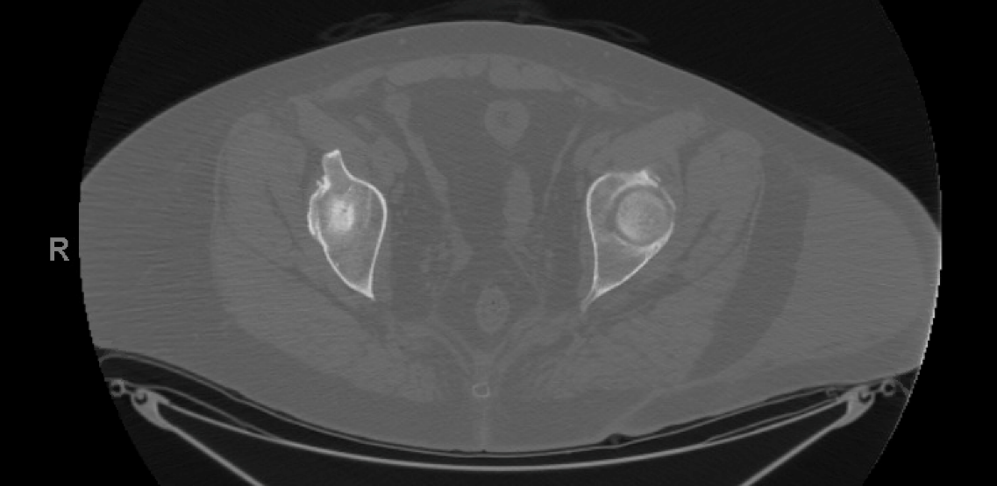
CT Evaluation: Associated Injuries
Soft tissue
Morel-Lavallee
Genitourinary
Orthopaedic
Pelvic hematoma
Bladder often shifts away from midline
Can indicate subtle pelvic ring or acetabular injury
Pelvic ring²
Sacral fracture
Sacroiliac joint disruption
Contralateral rami fractures
Proximal femur/femoral head²
Tornetta III, P et al. Rockwood & Greens Fractures in Adults. Philadelphia: Lippincott Williams & Wilkins, 2019
Image courtesy of Dr. Laura Blum, MD

Slide 81
CT Evaluation: Acetabulum
Dedicated pelvic CT
2-3mm cuts
Used only in conjunction with plain pelvic radiographs^{1,4}
Axial cuts provide the most information regarding relationship of fracture line to articular surface⁴
Image courtesy of Dr. Raymond Wright, MD

Slide 82
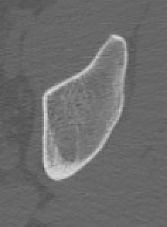
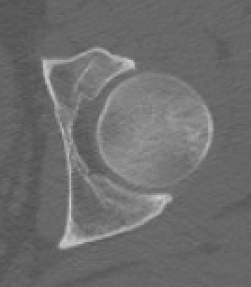
CT Evaluation: Acetabulum
A
B
Recognizing patterns
Axial view
A.) Column fractures: Horizontal (coronal) orientation^{1,4}
B.) Transverse: Vertical (sagittal orientation)^{1,4}
C.) Anterior wall: Oblique^{1,2}
Travels anteriorly and medially
~45 degrees
D.) Posterior wall: Oblique^{1,2}
Travels anteriorly and laterally
~45 degrees
C
D
Images from Laura Blum, MD

Slide 83
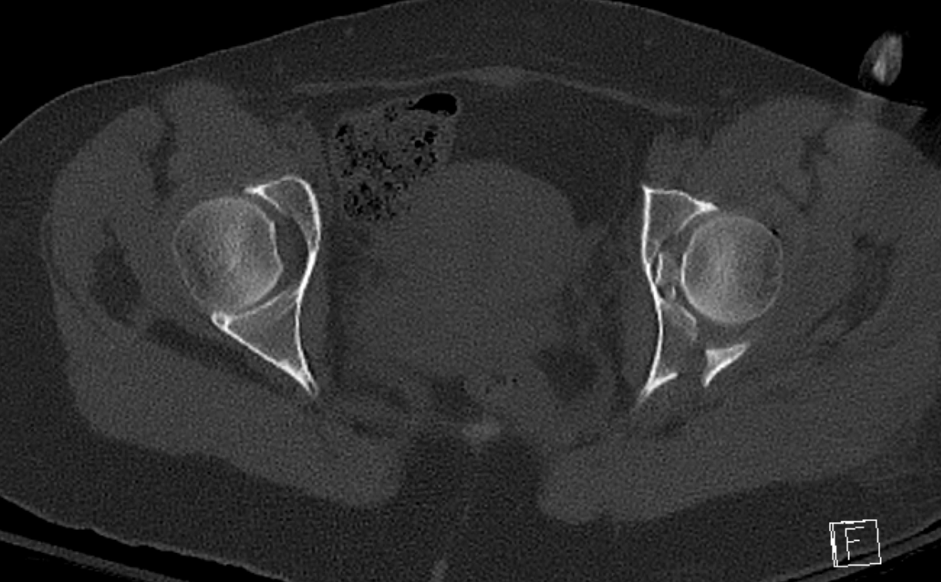
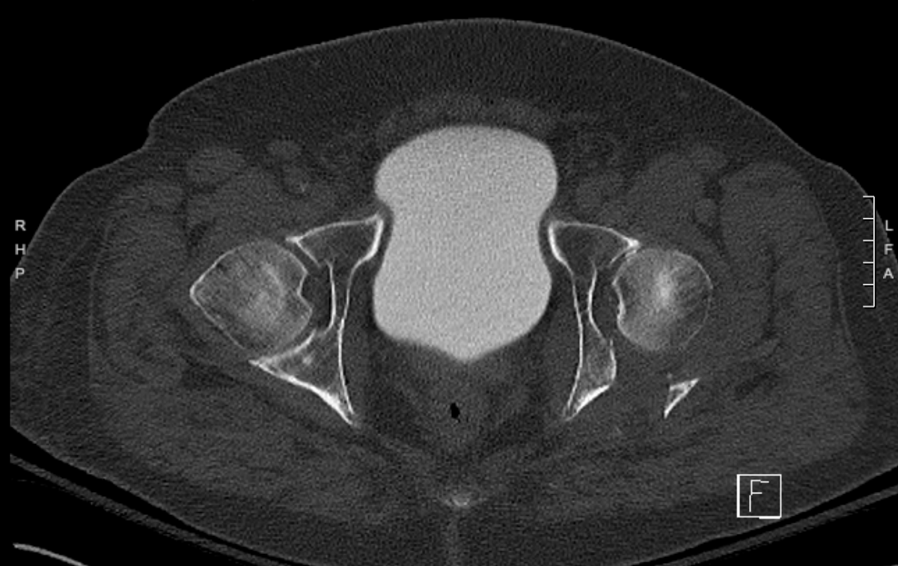
CT Evaluation: Acetabulum
Better characterizes fractures^{1,4}
Marginal impaction
Intra-articular fragments
Fragment size
Fragment displacement/rotation
Reduction of femoral head
Concentrically reduced, subluxed, dislocated
Better identify minimally displaced fractures
Femoral head impaction
Images courtesy of Dr. Raymond Wright, MD

Slide 84
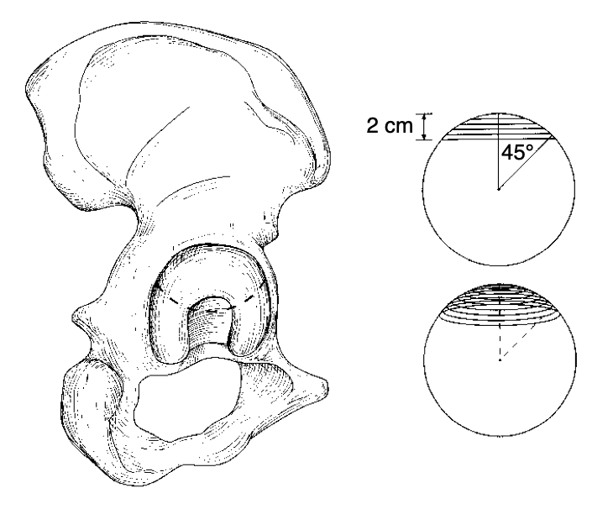
Suchondral Arc
Method used to assess articular continuity⁸
Superior 10mm of the acetabulum
Axial CT scan
Must know thickness of CT cuts⁴
ie. 2mm cuts → 5 “clicks” through the scan starting at the most superior portion of acetabular roof
Each line on the image represents 2mm cut on CT scan
Analogous to roof arc angle
If fracture visualized within top 10mm, considered to involve the weightbearing dome⁴
Tornetta P 3rd. Displaced acetabular fractures: indications for operative and nonoperative management. J Am Acad Orthop Surg. 2001 Jan-Feb;9(1):18-28. doi: 10.5435/00124635-200101000-00003. PMID: 11174160.

Slide 85
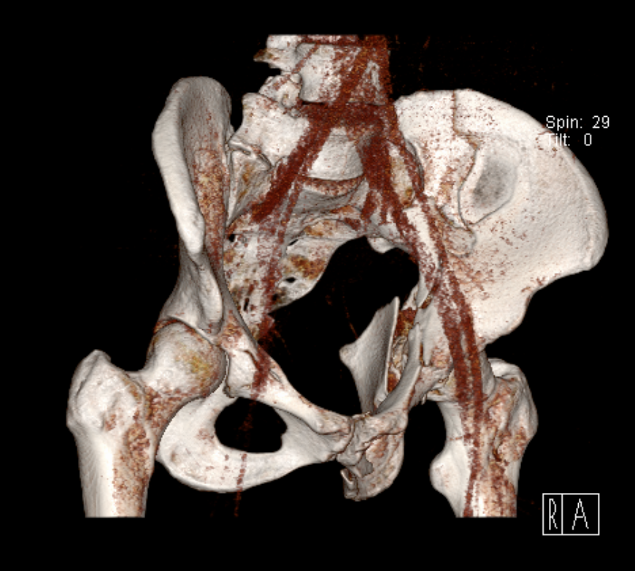
CT Evaluation: 3D Recons
Help to visualize how the fracture pattern will appear intra-operatively⁴
Can be helpful to plan reduction maneuvers and lag screw placement
Improves 3D understanding of fracture^{2,4}
Images courtesy of Dr. Raymond Wright, MD

Slide 86
Classification Algorithm

Slide 87
Classification Algorithm
Systematic approach for classifying acetabular fractures based on plain radiographs⁴
AP + judets
First step is determining the involvement of ilioischial and iliopectineal lines⁴
Both Disrupted | Transverse Transverse + posterior wall T-type Both column Anterior column + posterior hemitransverse
Only ilioischial disrupted | Posterior column Posterior column + posterior wall
Only iliopectineal disrupted | Anterior column
Neither disrupted | Posterior wall Anterior wall

Slide 88
Classification Algorithm: Both lines disrupted
2. Evaluate obturator ring⁴
Intact
Disrupted
3. Evaluate for involvement of the ilium⁴
Iliac oblique view
4. Evaluate for spur sign⁴
Obturator oblique view
1. Both lines disrupted
Fracture must be:
Transverse
Transverse + posterior wall
T-type
Both column
Anterior column + posterior hemitransverse
Mauffrey, et al⁴

Slide 89
Classification Algorithm: Both lines disrupted
Transverse + posterior wall
yes
Is there a posterior wall fracture? (obturator oblique)
no
yes
Transverse
Both iliopectineal and ilioischial lines disrupted
Is obturator
ring intact?
Both
column
Is there a
spur sign?
(obturator
oblique)
yes
no
yes
Is the ilium fractured?
no
no
Anterior column +
posterior
hemitransverse
T-type
Mauffrey, et al⁴

Slide 90
Classification Algorithm: Only iliopectineal line disrupted
Posterior column
If only the ilioischial line is disrupted⁴
Fracture must be either:
Posterior column
Posterior column + posterior wall
Differentiate based on presence of posterior wall fracture⁴
Obturator oblique view
no
Only ilioischial line disrupted
Is there a posterior wall fracture?
yes
Posterior column + posterior wall
Mauffrey, et al⁴

Slide 91
Classification Algorithm: Neither line disrupted
Anterior wall
If neither iliopectineal or ilioischial line is disrupted⁴
Both columns must therefore be intact
The fracture is either:
Anterior wall
Posterior wall
Evaluate judet views to determine which⁴
Fracture seen on iliac oblique
Neither ilioischial or iliopectineal lines disrupted
Fracture seen
on obturator
oblique
Posterior wall
Mauffrey, et al⁴

Slide 92
Classification Algorithm: Only iliopectineal line disrupted
If only the iliopectineal line is disrupted, the only possibility is an isolated anterior column fracture⁴!
Only iliopectineal
line disrupted
Anterior column
Mauffrey, et al⁴

Slide 93
Classification Algorithm: Put it all together
Both iliopectineal and ilioischial lines disrupted
Only ilioischial line disrupted
Neither ilioischial or iliopectineal lines disrupted
Only iliopectineal
line disrupted
Is obturator
ring intact?
Is there a posterior wall fracture?
yes
no
Anterior column
Fracture seen on iliac oblique
Fracture seen
on obturator
oblique
Is there a posterior wall fracture?
Is the ilium fractured?
no
yes
yes
Posterior column
Posterior column + posterior wall
yes
no
no
Transverse + posterior wall
Anterior wall
Posterior wall
Transverse
Is there a
spur sign?
T-type
yes
no
Both
column
Anterior column + posterior
hemitransverse
Mauffrey, et al⁴

Slide 94
Summary
Three radiographic views for every acetabulum
AP
Judet’s
Obturator oblique
Iliac oblique
Letournel’s six radiographic landmarks¹
Iliopectineal line → anterior column
Ilioischial line → posterior column
Teardrop
Acetabular roof
Anterior wall
Posterior wall
Image courtesy of Dr. Raymond Wright, MD

Slide 95
Summary
Judet Views
Obturator oblique
Anterior column
Posterior wall
Iliac oblique
Posterior column
Anterior wall
Iliac oblique
Obturator oblique
Image courtesy of Dr. Raymond Wright, MD

Slide 96
Summary
Classification
Elementary Patterns
Posterior wall
Posterior column
Anterior wall
Anterior column
Transverse
Associated Patterns
Posterior column + posterior wall
Transverse + posterior wall
T-type
Anterior column + posterior hemitransverse
Both column
A
A
A
A
A

Slide 97
Summary
Recognizing patterns
Column fractures: horizontal
Coronal plane
Transverse fractures: vertical
Sagittal plane
Anterior wall: anterior and midline
Posterior wall: anterior and peripheral
Tornetta III, P et al. Rockwood & Greens Fractures in Adults. Philadelphia: Lippincott Williams & Wilkins, 2019

Slide 98
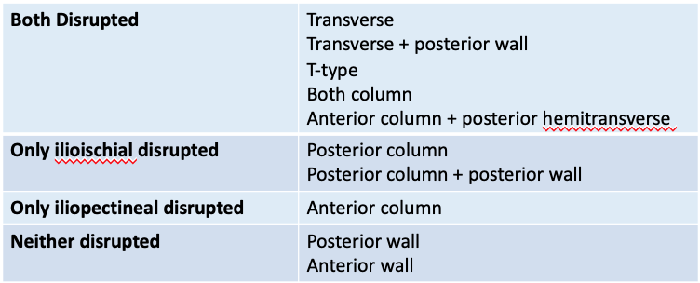
Summary
Classification algorithm
Develop a systematic process by which to evaluate imaging in order to accurately classify acetabular fractures.
Evaluate
Integrity of liopectineal & ilioischial lines
Integrity of obturator ring
Fracture extension into ilium
Judet views for associated wall fracture

Slide 99
References
Letournel E, Judet R: Fractures of the Acetabulum, ed 2. Berlin, Germany, Springer, 1993.
Tornetta III, P et al. Rockwood & Greens Fractures in Adults. Philadelphia: Lippincott Williams & Wilkins, 2019
Tannast M, Zheng G, Anderegg C, et al. Tilt and rotation correction of acetabular version on pelvic radiographs. Clin Orthop Relat Res. 2005;438:182–190.
Mauffrey C, Stacey S, York PJ, Ziran BH, Archdeacon MT. Radiographic Evaluation of Acetabular Fractures: Review and Update on Methodology. J Am Acad Orthop Surg. 2018 Feb 1;26(3):83-93. doi: 10.5435/JAAOS-D-15-00666. PMID: 29266045.
Anglen JO, Burd TA, Hendricks KJ, Harrison P. The "Gull Sign": a harbinger of failure for internal fixation of geriatric acetabular fractures. J Orthop Trauma. 2003 Oct;17(9):625-34. doi: 10.1097/00005131-200310000-00005. PMID: 14574190.
Butterwick D, Papp S, Gofton W, Liew A, Beaulé PE. Acetabular fractures in the elderly: evaluation and management. J Bone Joint Surg Am. 2015 May 6;97(9):758-68. doi: 10.2106/JBJS.N.01037. PMID: 25948523.
Matta JM, Anderson LM, Epstein HC, Hendricks P. Fractures of the acetabulum. A retrospective analysis. Clin Orthop Relat Res. 1986 Apr;(205):230-40. PMID: 3698382.
Olson SA, Matta JM. The computerized tomography subchondral arc: a new method of assessing acetabular articular continuity after fracture (a preliminary report). J Orthop Trauma. 1993;7(5):402-13. doi: 10.1097/00005131-199310000-00002. PMID: 8229376.
Tornetta P 3rd. Displaced acetabular fractures: indications for operative and nonoperative management. J Am Acad Orthop Surg. 2001 Jan-Feb;9(1):18-28. doi: 10.5435/00124635-200101000-00003. PMID: 11174160.

