Slide 1
Acute Management of Pelvic Ring Injuries
James Black, MD, FAAOS
Orthopaedic Trauma Service
Spartanburg Regional Healthcare System
*Images belong to James Black MD unless otherwise indicated

Slide 2
Objectives
Understand the treatment algorithm for the hemodynamically unstable patient with a pelvic ring injury
Review pertinent anatomy and injury patterns
Systematic evaluation of the trauma patient
Goals of initial resuscitation and necessary interventions
Acute stabilization methods

Slide 3
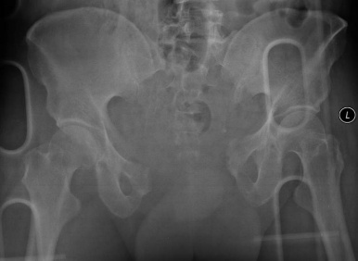
Background
Overall mortality 10-15%
Increasing mortality (up to 50%) with:
Hemodynamically unstable on arrival on ER
Concomitant head, chest and major abdominal injuries
Open pelvic fractures
Age >65

Slide 4
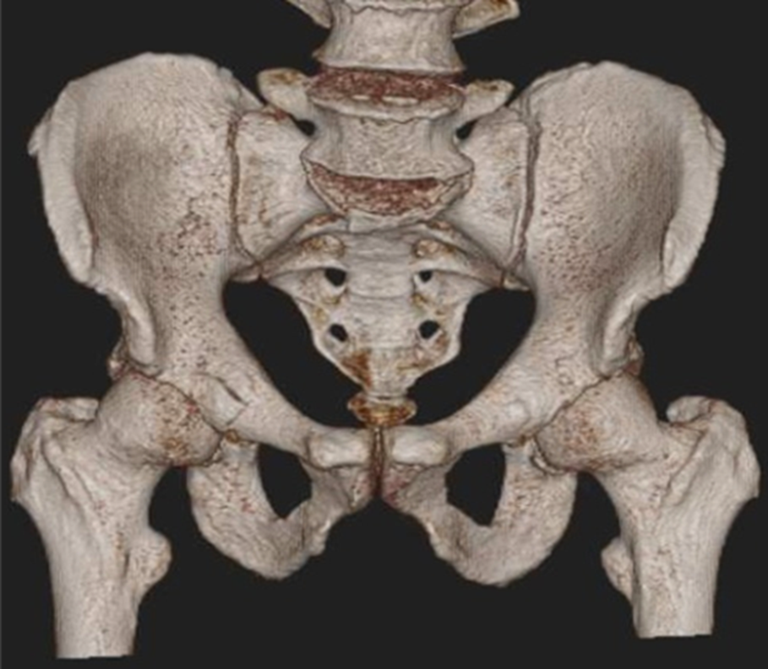
Pelvic Anatomy Review
Basic pelvic osteology
Pelvic ligaments
Pelvic vasculature
Courtesy of Joshua Gary, MD

Slide 5
Pelvic Anatomy Review - Osteology
Ilium
Sacrum
SI Joint
Acetabulum
Pubis
Ischium

Slide 6
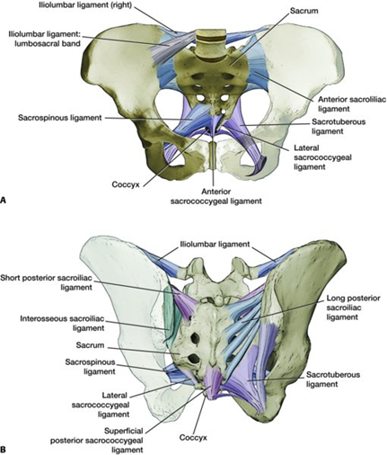
Pelvic Anatomy Review - Ligaments
Anterior view – ligaments intact on right side, with the sacrospinous and ILL (lumbosacral band) removed on the left side for better visualization of underlying structures (sacrotuberous, lateral coccygeal, and full visualization of anterior sacroiliac ligaments).
Posterior view – ligaments intact on right side, with the long posterior sacroiliac and sacrotuberous ligaments removed on left side for better visualization of underlying structures (sacrospinous, interosseous sacroiliac, and short posterior sacroiliac ligaments).
Agarwal A, 49:Pelvic ring injuries in Rockwood and Green’s Fractures in Adults, 9e, Tornetta et al (eds), Wolters Kluwer 2020.

Slide 7
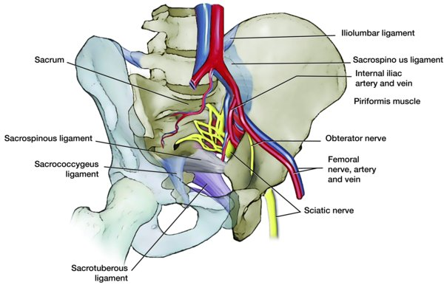
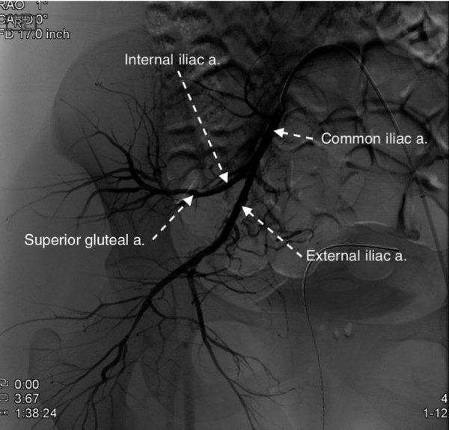
Pelvic Anatomy Review - Vasculature
A. The left hemipelvis is visualized with a transparent sacrum and L5 body. The internal iliac branches are seen anterior to the SI joint. The proximity of the bladder and urethra to the symphysis is appreciated. The nerve roots exiting the foramen are demonstrated with the L5 nerve root anterior on the sacral ala.
B. Arteriogram of pelvic arteries with common iliac and branches identified. Note the superior gluteal artery exiting the greater sciatic notch.
Agarwal A, 49:Pelvic ring injuries, Rockwood and Green’s Fractures in Adults, 9e, Tornetta et al (eds), Wolters Kluwer 2020.

Slide 8
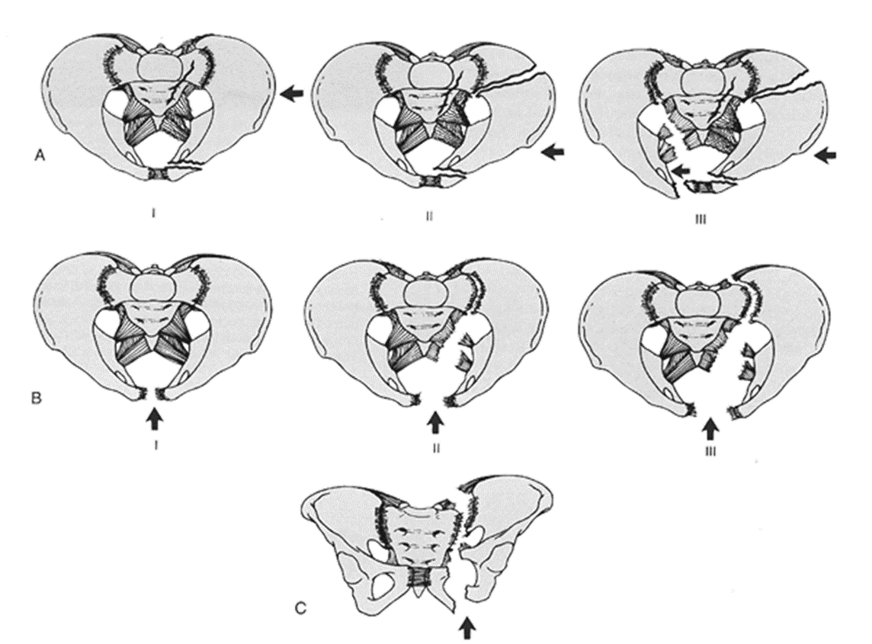
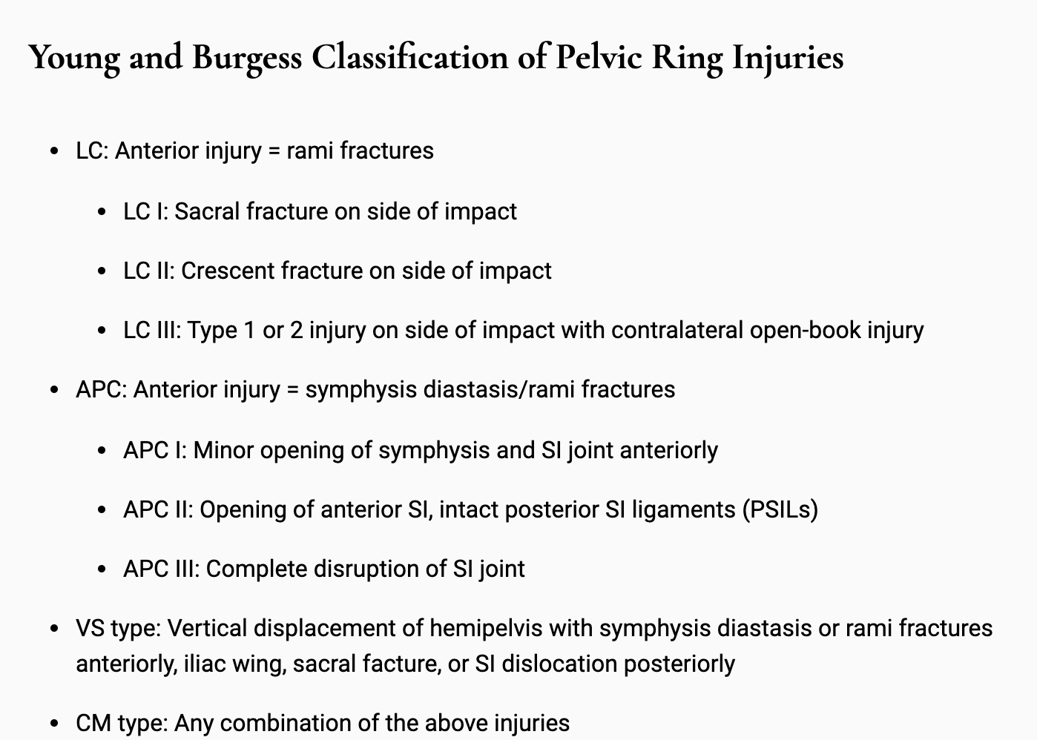
Young and Burgess Classification
LC
APC
VS
Agarwal A, 49:Pelvic ring injuries in Rockwood and Green’s Fractures in Adults, 9e, Tornetta et al (eds), Wolters Kluwer 2020.
Courtesy of Sean Nork, MD

Slide 9
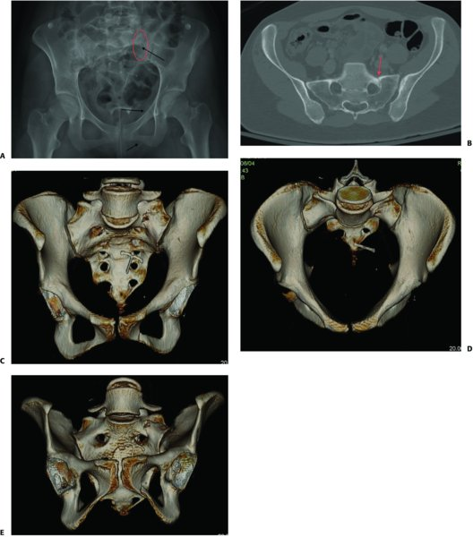
LC I
A: AP radiograph showing posterior lesion (red oval) and anterior lesions (rami fractures; arrows).
B: CT scan axial cut showing impaction fracture of sacrum (arrow).
C–E: 3D reconstructions of AP, inlet, and outlet views showing injury.
Agarwal A, 49:Pelvic ring injuries, Rockwood and Green’s Fractures in Adults, 9e, Tornetta et al (eds), Wolters Kluwer 2020.

Slide 10
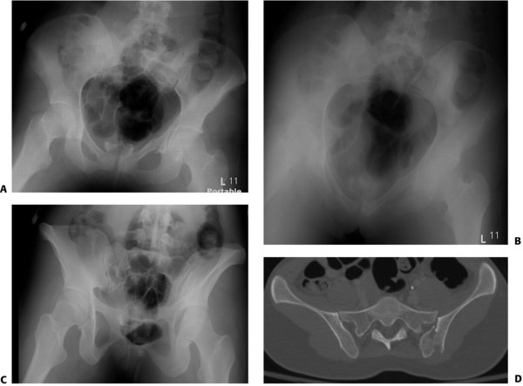
LC II: fracture-dislocation (crescent) through left SI Joint
A: AP radiograph showing anterior injury (ramus fracture, yellow arrow) and posterior injury (SI joint widening, red oval).
B: Inlet view radiograph.
C: Outlet view radiograph.
D: Axial CT scan showing posterior ilium crescent fracture (green arrow) and SI joint dislocation (red arrow).
Agarwal A, 49:Pelvic ring injuries, Rockwood and Green’s Fractures in Adults, 9e, Tornetta et al (eds), Wolters Kluwer 2020.

Slide 11
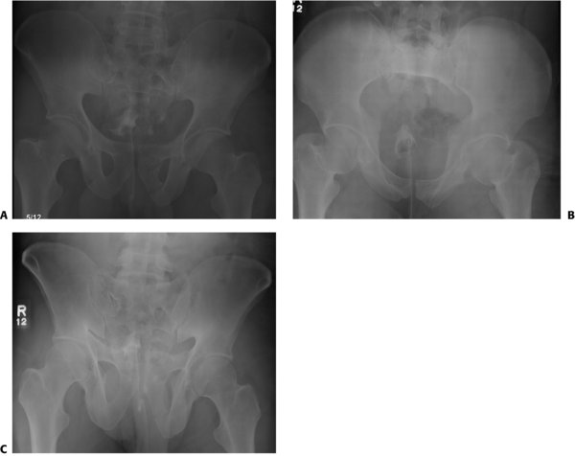
LC III: right-sided LC injury and left-sided APC injury
A: AP view radiograph showing left ramus fractures (yellow arrows)
B-C: Inlet and outlet view radiographs showing left posterior SI joint injury (red ovals)
Agarwal A, 49:Pelvic ring injuries, Rockwood and Green’s Fractures in Adults, 9e, Tornetta et al (eds), Wolters Kluwer 2020.

Slide 12
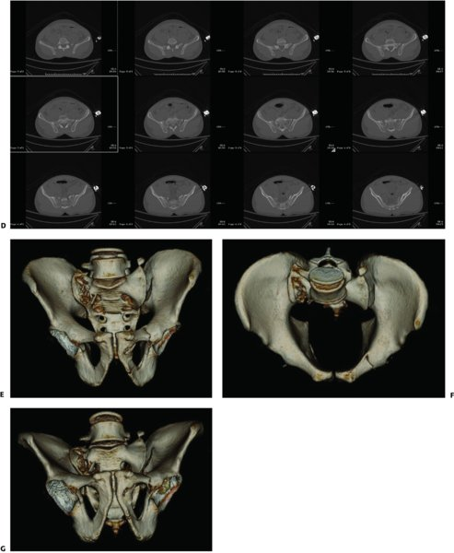
LC III: right-sided LC injury and left-sided APC injury
D: Multiple CT scan images showing right-sided LC injury with sacral fracture and left-sided APC injury with SI joint widening.
E–G: 3D CT scan reconstructions of AP, inlet, and outlet views with right sacral fracture (yellow arrows), left SI joint injury (red arrows), and left ramus fractures (green arrows).
Agarwal A, 49:Pelvic ring injuries, Rockwood and Green’s Fractures in Adults, 9e, Tornetta et al (eds), Wolters Kluwer 2020.

Slide 13
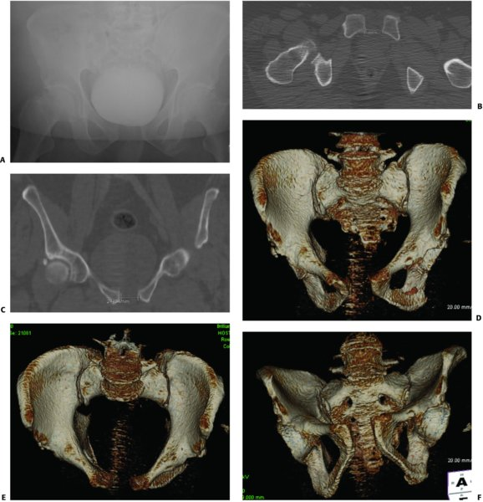
APC I
A: AP radiograph showing widened symphysis (red oval).
B, C: CT scan axial and coronal cuts showing measurement of <2.5 cm at symphysis.
D–F: 3D reconstructions of AP, inlet, and outlet views. Note the left ramus fracture with external rotation displacement.
Agarwal A, 49:Pelvic ring injuries, Rockwood and Green’s Fractures in Adults, 9e, Tornetta et al (eds), Wolters Kluwer 2020.

Slide 14
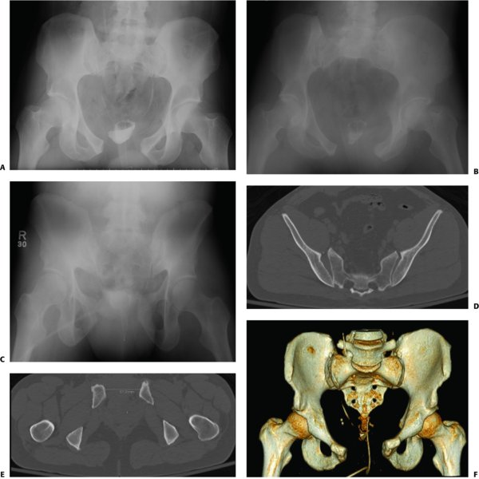
APC II
A–C: AP, inlet, and outlet view radiographs showing symphysis diastasis (yellow arrow) and right SI joint injury (red ovals).
D: CT scan posterior axial cut showing widening of right SI joint.
E: CT scan anterior axial cut showing more than 5.7 cm of widening.
F: A 3D reconstruction of AP view.
Agarwal A, 49:Pelvic ring injuries, Rockwood and Green’s Fractures in Adults, 9e, Tornetta et al (eds), Wolters Kluwer 2020.

Slide 15
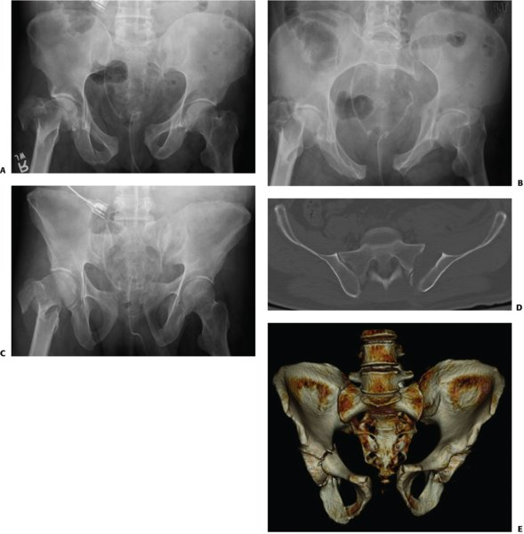
APC III
A–C: AP, inlet, and outlet view radiographs showing symphysis disruption and left SI joint dislocation (red oval).
D: CT scan showing complete left SI joint dislocation.
E: A 3D CT reconstruction of the AP view.
Agarwal A, 49:Pelvic ring injuries, Rockwood and Green’s Fractures in Adults, 9e, Tornetta et al (eds), Wolters Kluwer 2020.

Slide 16
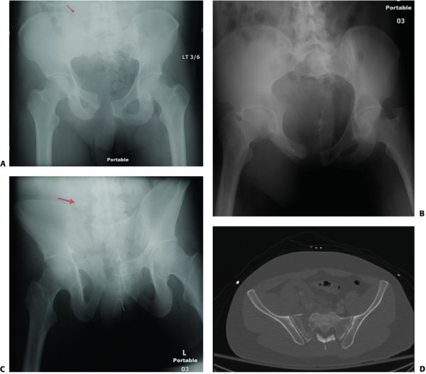
VS
A–C: AP, inlet, and outlet view radiographs showing vertical displacement of right hemipelvis through a complete sacral fracture and transverse process fracture avulsion (arrow).
D: Axial CT cut showing complete sacral fracture.
Agarwal A, 49:Pelvic ring injuries, Rockwood and Green’s Fractures in Adults, 9e, Tornetta et al (eds), Wolters Kluwer 2020.

Slide 17
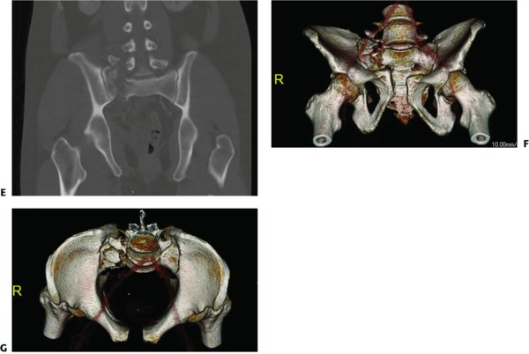
VS
E: Coronal CT cut showing complete sacral fracture with vertical displacement of hemipelvis
F, G: 3D CT scan reconstructions of inlet and outlet views.
Agarwal A, 49:Pelvic ring injuries, Rockwood and Green’s Fractures in Adults, 9e, Tornetta et al (eds), Wolters Kluwer 2020.

Slide 18
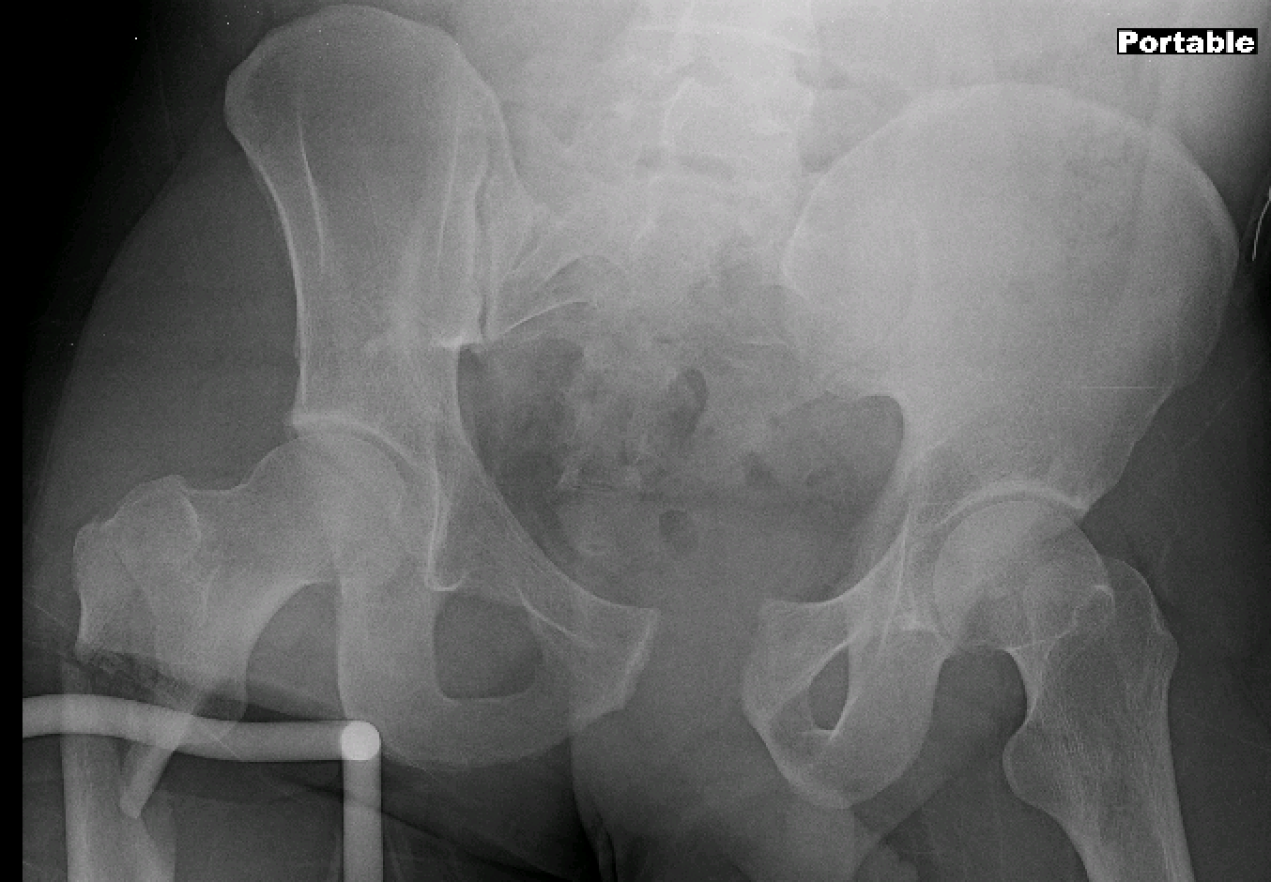
34 yo male s/p MVA

Slide 19
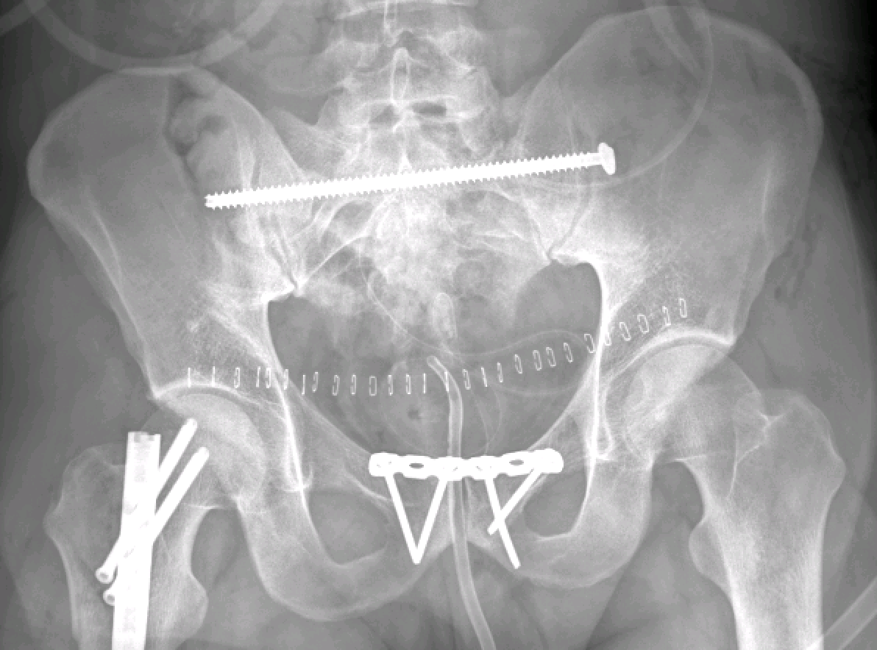
34 yo male s/p MVA
How do we get there?

Slide 20
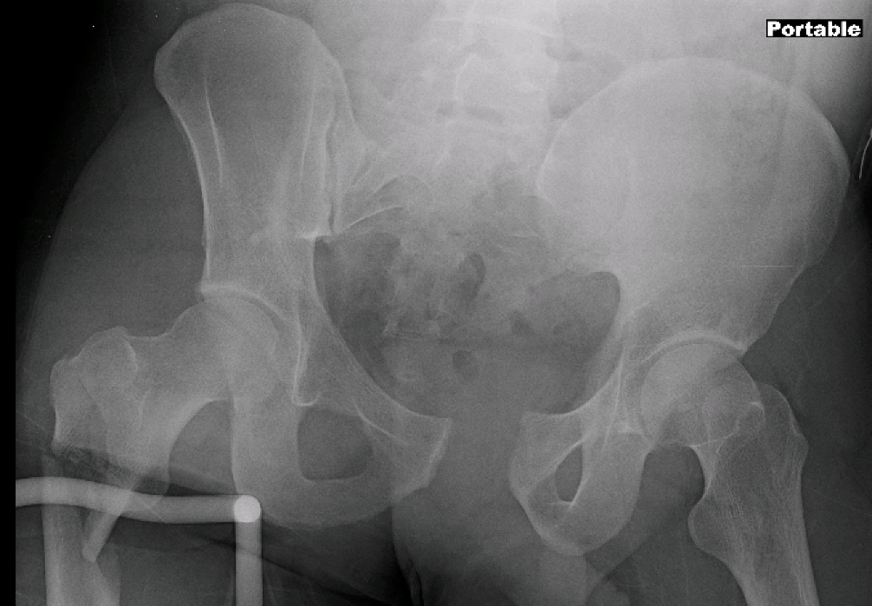
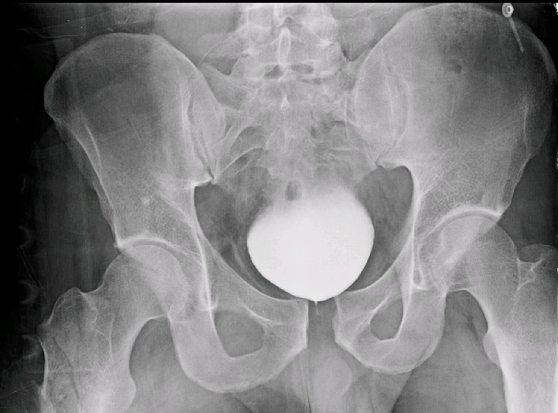
Patient arrives in Trauma Bay

Slide 21
Principles of ATLS
Primary Survey (ABCDE)
Resuscitation
Secondary Survey
Reassessment, Secondary Interventions
Definitive Care
Continuous Reassessment.
Unstable? Restart at primary survey.

Slide 22
Primary Survey – ABC, DE
Airway with cervical spine protection
Breathing – oxygenation and ventilation
Circulation – including hemorrhage control
Disability – neurologic status
Exposure/Environment – expose patient, avoid hypothermia

Slide 23
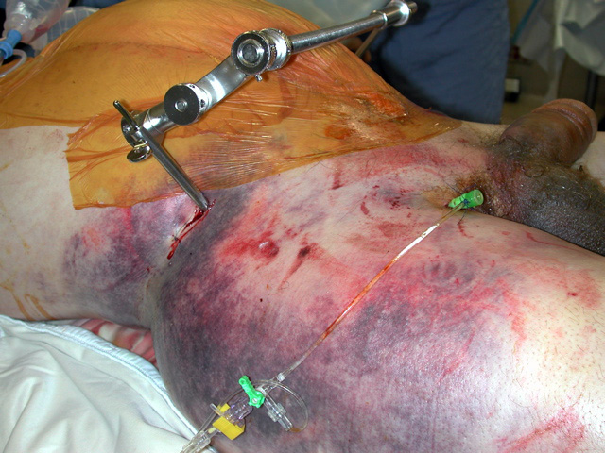
Physical Exam
Assess pelvic stability manually (once)
Contusions, ecchymoses, degloving injuries
Open wounds around pelvis, groin, perineum
Leg length inequality
Blood at urethral meatus, rectum or vagina
Scrotal edema
Lower extremity neurologic deficits
Courtesy of Sean Nork, MD

Slide 24
Open Pelvic Fractures
Increased mortality
Up to 50% with open injuries with fecal contamination
High index of suspicion with blood at rectum, vagina and perineal wounds
Control hemorrhage -> washout and pack wounds
Will need aggressive debridement once stable
Open fracture antibiotics
Early repair of vaginal lacerations
Proctoscopy to visualize rectal injury
Consider diverting colostomy with perineal wounds or communication with colon/rectum
Images courtesy of Sean Nork, MD

Slide 25
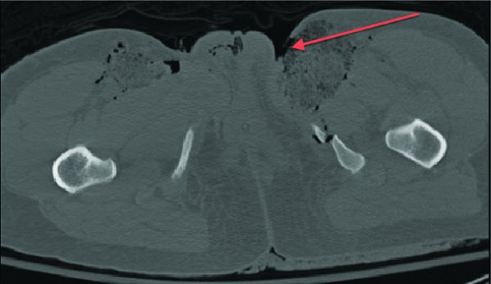
Open Pelvic Fractures
CT scan showing paralabial wound communicating with ramus fracture
Agarwal A, 49:Pelvic ring injuries, Rockwood and Green’s Fractures in Adults, 9e, Tornetta et al (eds), Wolters Kluwer 2020.

Slide 26
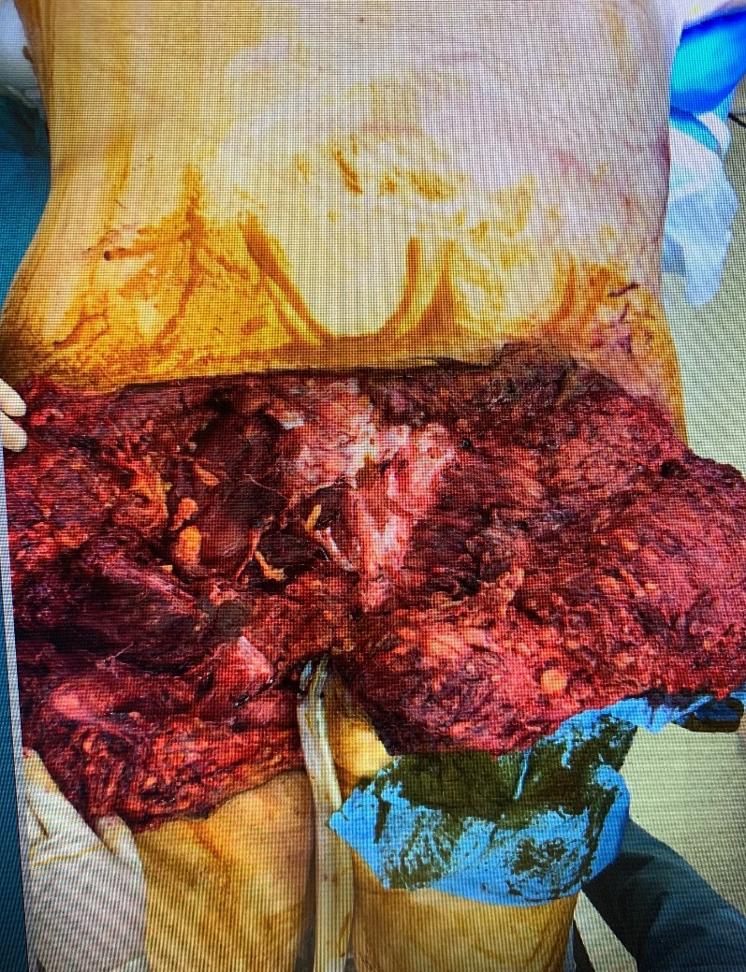
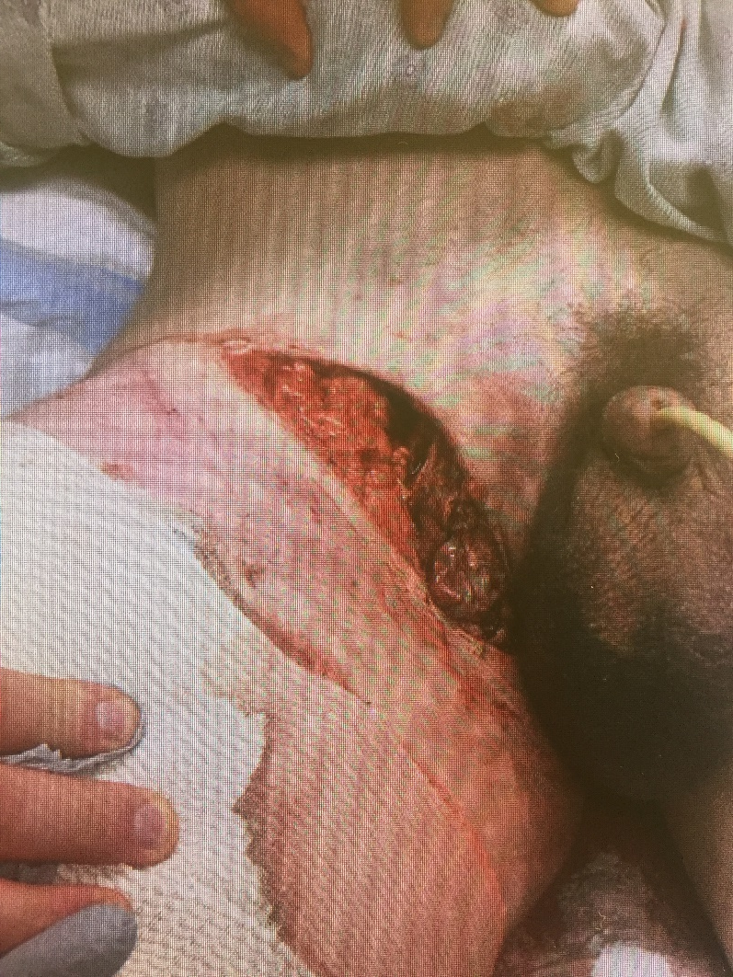
Open Pelvic Fractures
Patient prone. Degloving injury over posterior pelvis with exposed sacral fractures
Open wound in groin with APC injury

Slide 27
Urologic Injury
Incidence: 6-15%
Males have higher incidence of urethral injuries compared to females
Bladder injuries: 60% extraperitoneal, 30% intraperitoneal, 10% both
Increased mortality with bladder rupture
Microscopic or gross hematuria?
Cystogram
Blood at urethral meatus?
Retrograde urethrogram

Slide 28
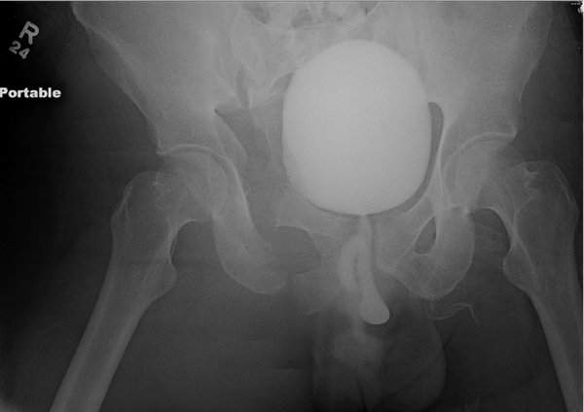
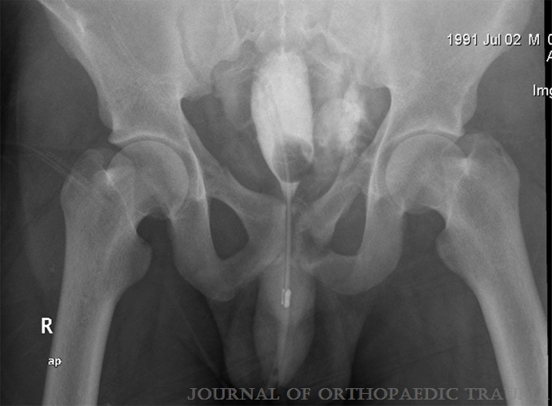
Urologic Injury
A. Proximal urethral disruption seen by contrast extravasation over the perineum
B. Cystogram showing bladder rupture with contrast extravasation
Figure A: Agarwal A, 49:Pelvic ring injuries, Rockwood and Green’s Fractures in Adults, 9e, Tornetta et al (eds), Wolters Kluwer 2020.
Figure B: Alexander G, et al. Septic arthritis of the hip after nonoperative treatment of a pelvic fracture associated with bladder rupture. J Orthop Trauma, 26(5):e40-e42, May 2012.

Slide 29
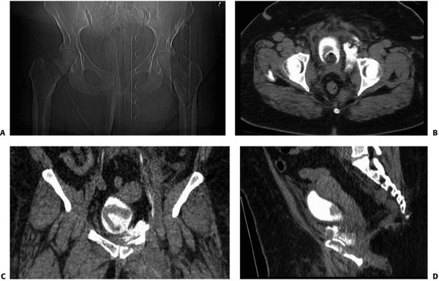
Urologic Injury
A: Contrast extravasation in obese female patient indicating bladder rupture.
B–D: Because of the size of the patient and poor plain imaging, suspected bladder rupture is confirmed with CT cystogram.
Agarwal A, 49:Pelvic ring injuries, Rockwood and Green’s Fractures in Adults, 9e, Tornetta et al (eds), Wolters Kluwer 2020.

Slide 30
Urologic Injury
Bladder rupture
Intraperitoneal = Ex-Lap and repair
Extraperitoneal = suprapubic catheter or direct repair. Must coordinate with urology for optimal catheter placement and/or repair in conjunction with definitive fixation
Urethral injuries
Initial treatment with foley followed by delayed repair

Slide 31
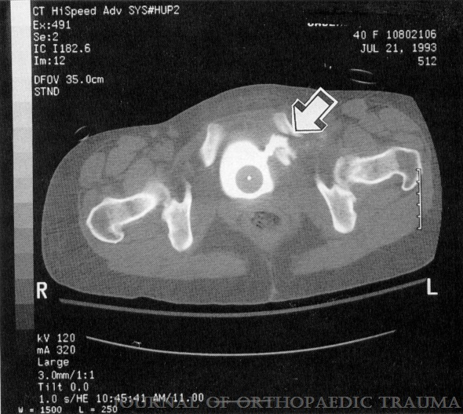
Urologic Injury
CT cystogram with arrow indicating bladder entrapment within ramus fracture and contrast extravasation.
Wright DG, et al. Case report: pelvic and bladder trauma: a case report and subject review. J Orthop Trauma, 10(5):351-354, July 1996.

Slide 32
Hemorrhage and Pelvic Fractures
Control of pelvic bleeding is integral in the management of a trauma patient with pelvic fractures
Arterial and venous structures at risk within the pelvis
Venous plexus most frequent source of hemorrhage
Mortality associated with arterial injury
Some degree of hemorrhage expected from fractured bone
Shock (SBP<90) on presentation
Early transfusion requirements
Increased Mortality

Slide 33
Hemorrhage and Pelvic Fractures
Fracture pattern is associated with risk of hemorrhage + transfusion requirements
Original Young and Burgess description:
LC – 3.6 units
APC – 14.8 units
VS – 9.2 units
Combine – 8.5 units
Highest risk with LC III, APC II, APC III and VS
Severe hemorrhage can occur in any pattern
LC
APC
VS

Slide 34
Hemorrhage Control
Pelvic Containment
Binder, Sheet, External Fixation, C-clamp, Internal Fixation
Angiography with embolization
Laparotomy with pelvic packing

Slide 35
Hemorrhage Control
Pelvic Containment
Binder, Sheet, External Fixation, C-clamp, Internal Fixation
Reduces pelvic volume to allow for tamponade effect
Stabilizes pelvic injury to allow for clot formation
** Uncontrolled arterial bleeding can overwhelm tamponade effect

Slide 36
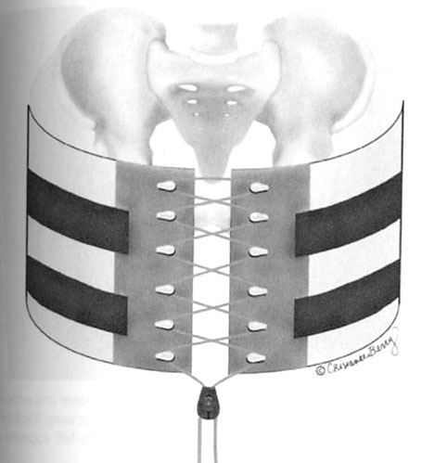
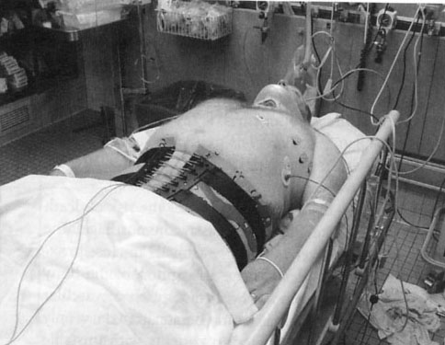
Pelvic Binder
Several commercially available options
Easily applied by EMS and ER providers
Must be properly positioned, centered on greater trochanters

Slide 37
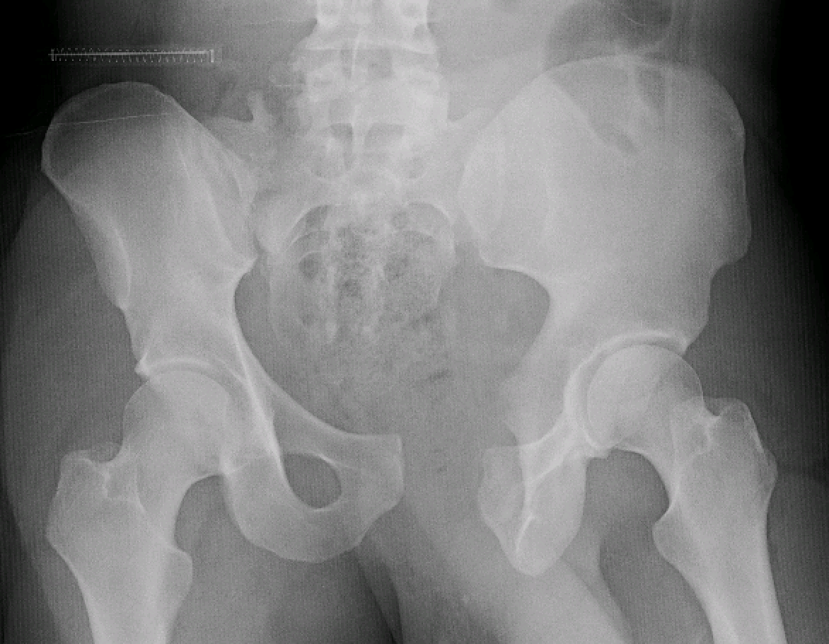
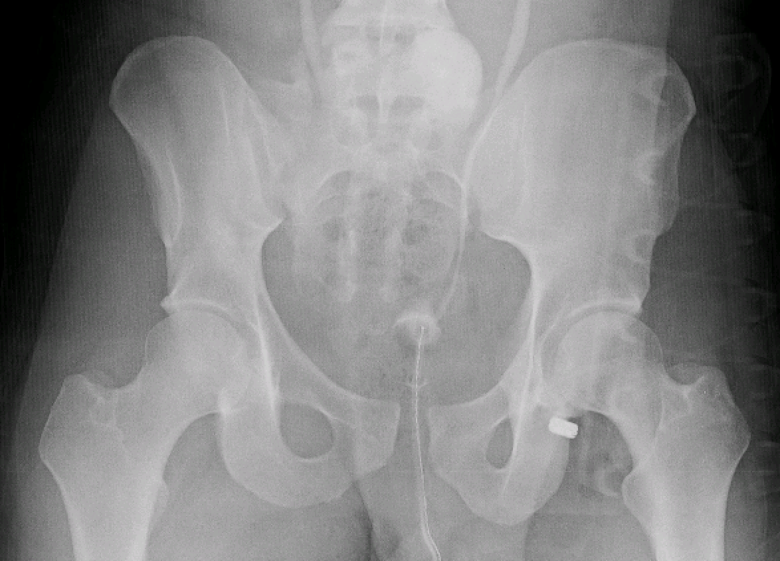
Pelvic Binder

Slide 38
Pelvic Antishock Sheet Binder
Circumferential pelvic antishock sheeting is applied in this example patient. The patient's clothing should be removed before application. Two people needed for application.
A. The sheet is positioned beneath the patient's pelvis smoothly.
B,C. The ends of the sheet are crossed in an overlapping manner anteriorly and are pulled taut.
D. Clamps secure the smooth and snug sheet.
Routt CM, et al. Circumferential pelvic antishock sheeting: a temporary resuscitation aid. J Orthop Trauma, 16(1):45-48, January 2002.

Slide 39
Pelvic Antishock Sheet Binder
Insert video from Harborview/Routt of sheeting technique
-Need to confirm how to do this and permissions
https://www.uwmedicine.org/provider-resource/videos/pelvic-sheeting-for-immobilization

Slide 40
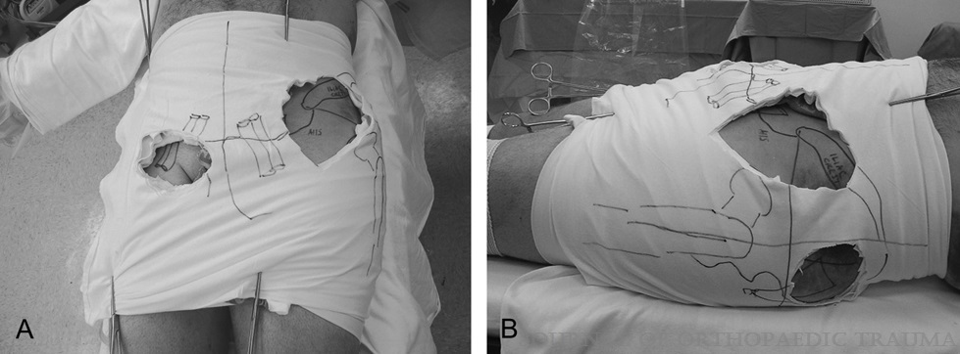
Pelvic Antishock Sheet Binder
Anterior view of the femoral vascular and anterior external fixation pin working portal (A), and lateral view demonstrating the iliosacral and antegrade ramus screw portals (B).
Routt CM, et al. Circumferential pelvic antishock sheeting: a temporary resuscitation aid. J Orthop Trauma, 16(1):45-48, January 2002.

Slide 41
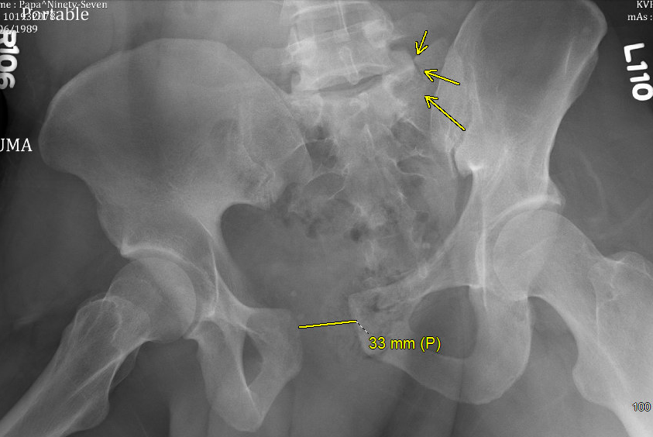
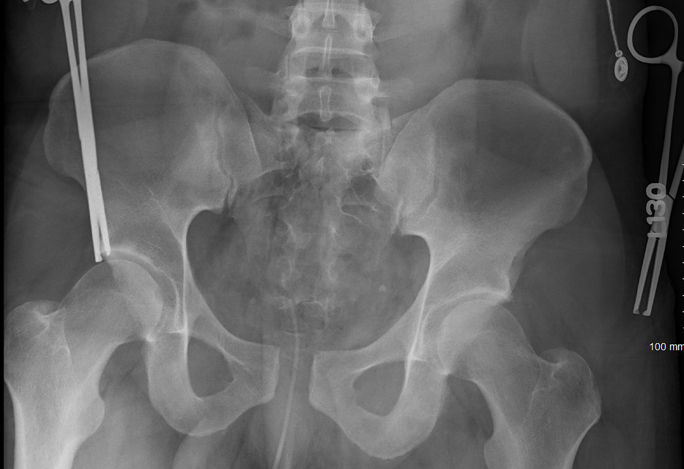
Pelvic Antishock Sheet Binder

Slide 42
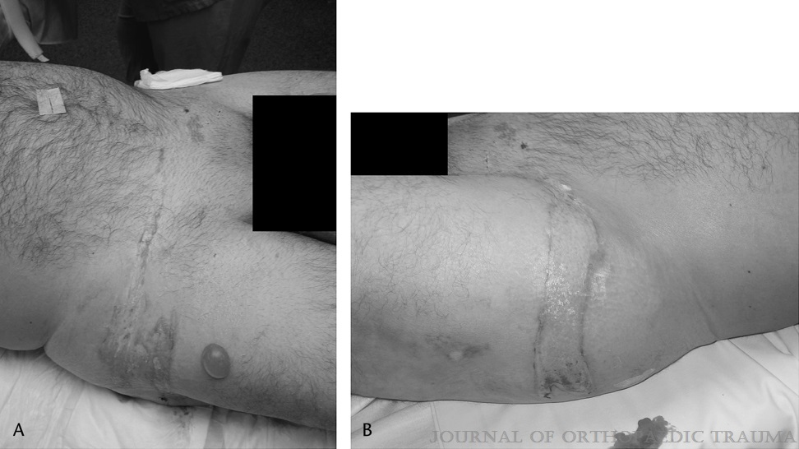
Beware of skin necrosis with binder or sheet placement
-Can occur as quickly as 24hrs
-Must formulate timely plan for removal and pelvic fixation
Images demonstrating skin necrosis following antishock pelvic sheeting
Schaller TM et al. Skin breakdown following circumferential pelvic antishock sheeting: a case report. J Orthop Trauma, 19(9):661-665, October 2005.

Slide 43
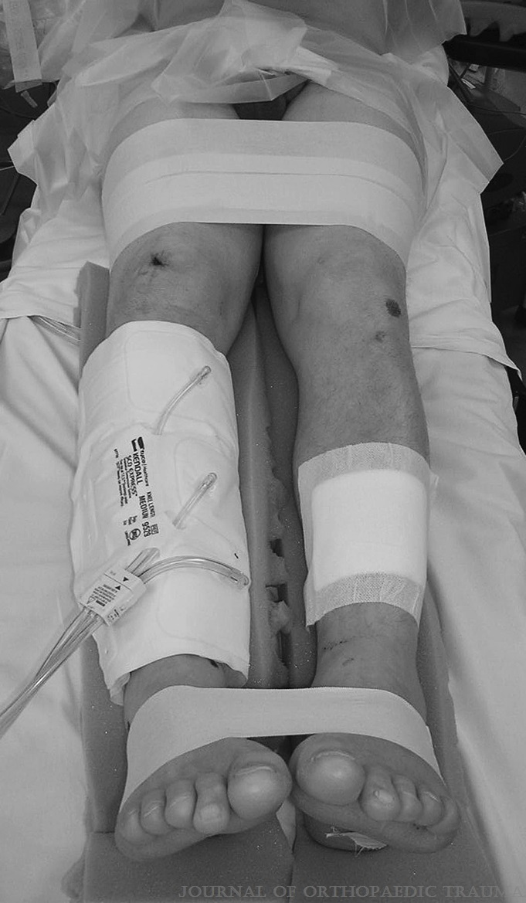
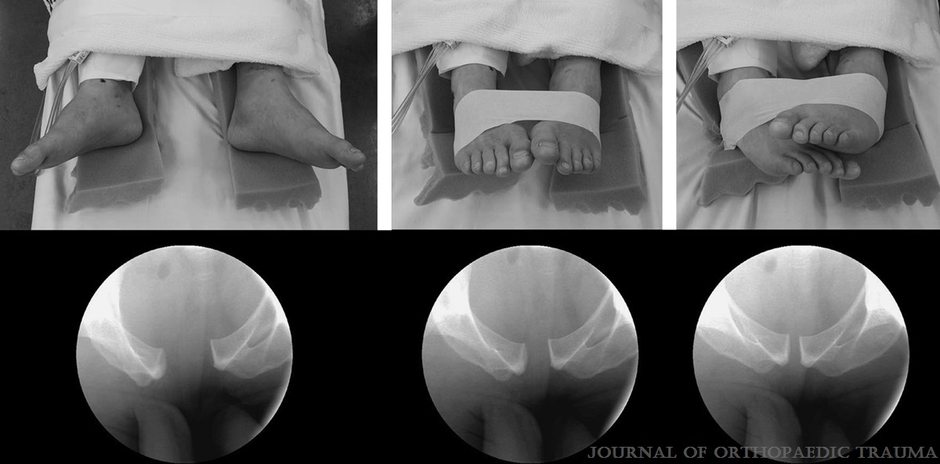
Taping lower extremities
Another method for stabilizing the pelvis and decreasing pelvic volume
As the lower extremities are taped in progressively more internal rotation, the pelvic reduction improves. The position of the feet in the upper row corresponds to the fluoroscopic images in the lower row.
Gardner MJ, et al. Internal rotation and taping of the lower extremities for closed pelvic reduction. J Orthop Trauma, 23(5):361-364, May-June 2009.

Slide 44
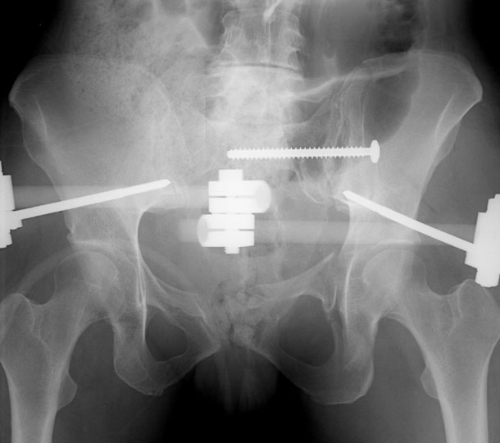
External Fixation
Placement Options
AIIS
ASIS
C-clamp
Clinical Application
Resuscitative
Augmentative
Definitive
All options can be very effective when posterior ring is intact
AIIS placement
Helpful with vertically and rotationally unstable patterns
Allows easier access to pelvis/abdomen
Tolerated better by patients – allows them to sit upright
Increased control of the ring
Courtesy of Sean Nork, MD

Slide 45
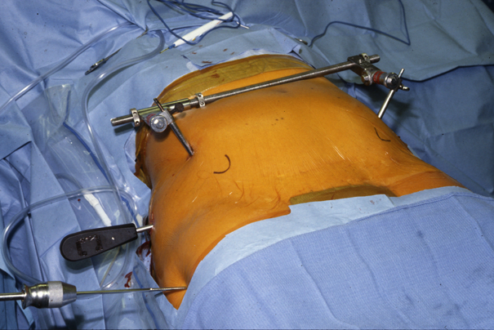
ASIS Technique
Fluoro guidance
3-5cm posterior to ASIS
Along gluteus medius pillar
Incisions directed toward final pin location
Pin entry at junction of lateral 2/3 and medial 1/3 of iliac crest
Aim 30-45 degrees towards hip joint
Pillar is “thin” – pin can easily violate medially or laterally or be “in-out-in”
Courtesy of Sean Nork, MD

Slide 46
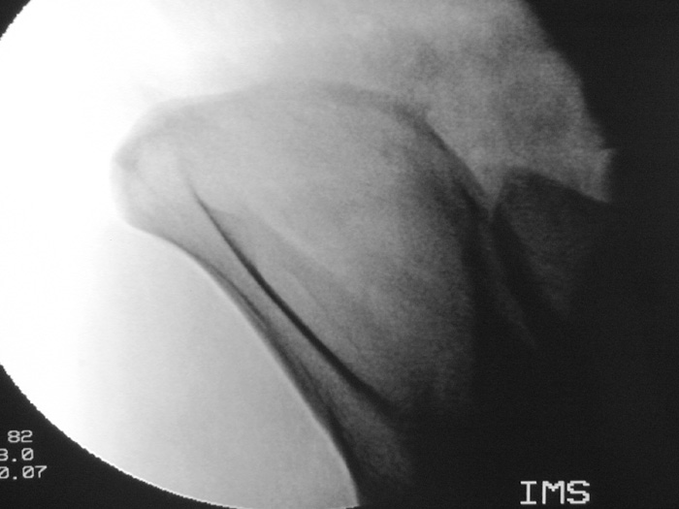
ASIS Technique
Outlet Oblique View
Inner Table
Outer Table
ASIS
Courtesy of Sean Nork, MD

Slide 47
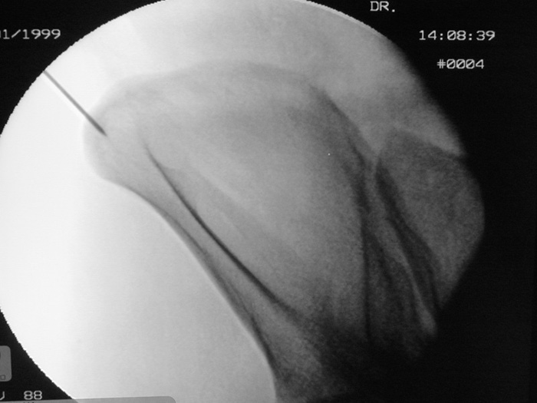
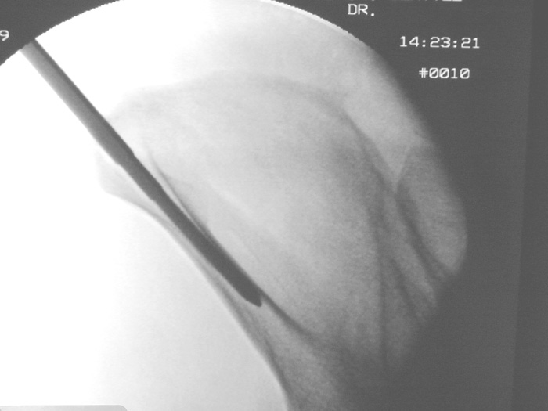
ASIS Technique
Tip: Localize with k-wire
Images courtesy of Sean Nork, MD

Slide 48
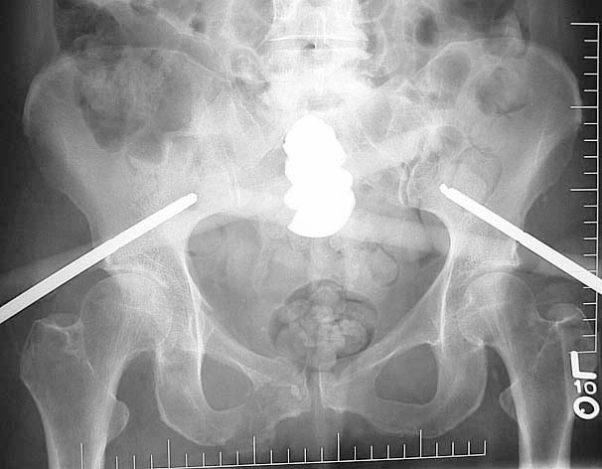
AIIS Technique
Fluoro dependent
Obturator outlet oblique – entry and direction
Iliac oblique – positioning superior to sciatic notch
Obturator inlet – confirm depth
Localize with k-wire
Incision directed towards final position
Blunt dissection down to AIIS
Incisions directed toward final pin location
Use fluoro views to direct path
Courtesy of Sean Nork, MD

Slide 49
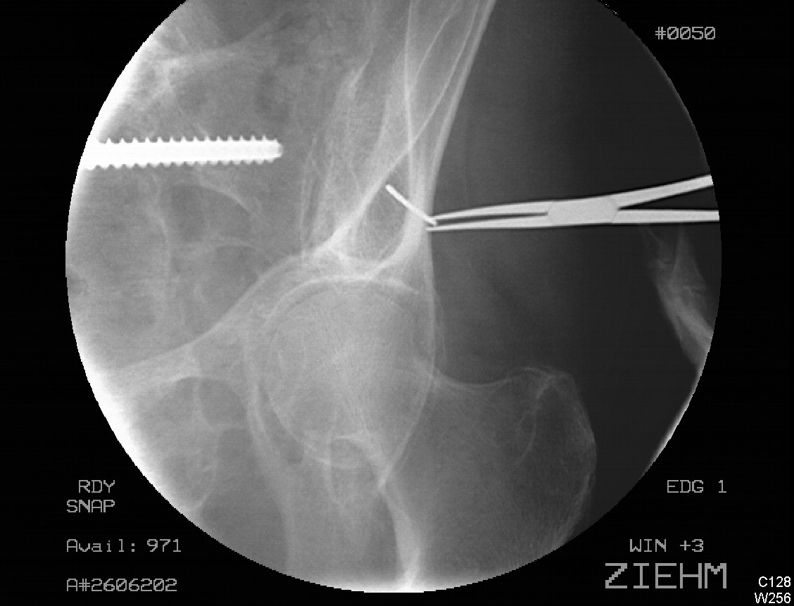
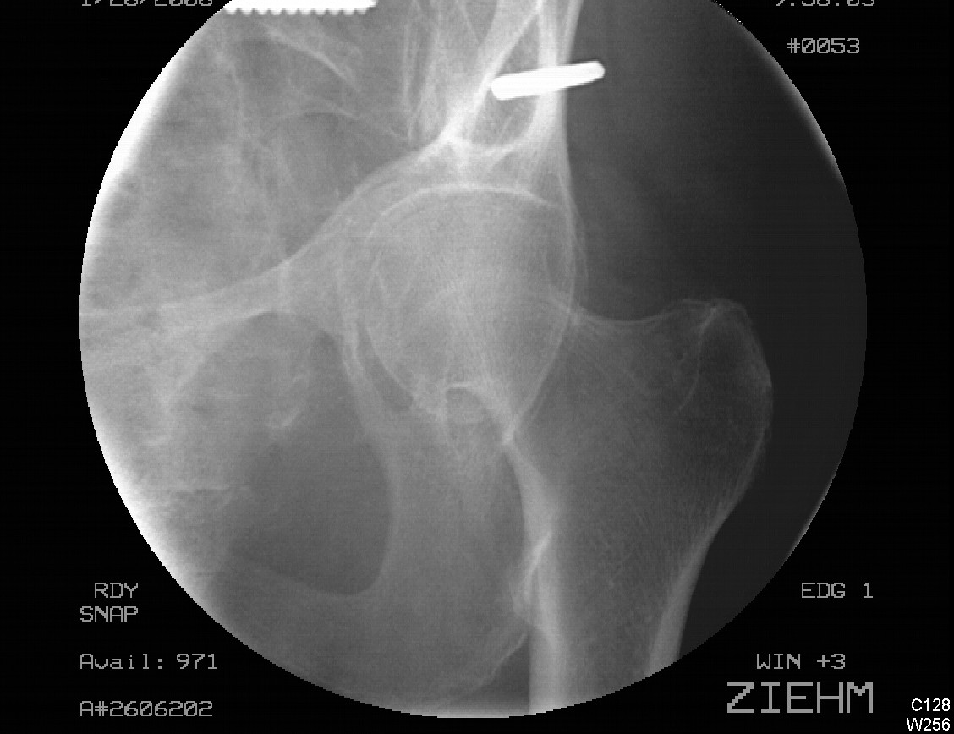
AIIS Technique
Outlet Obturator Oblique
Images courtesy of Sean Nork, MD

Slide 50
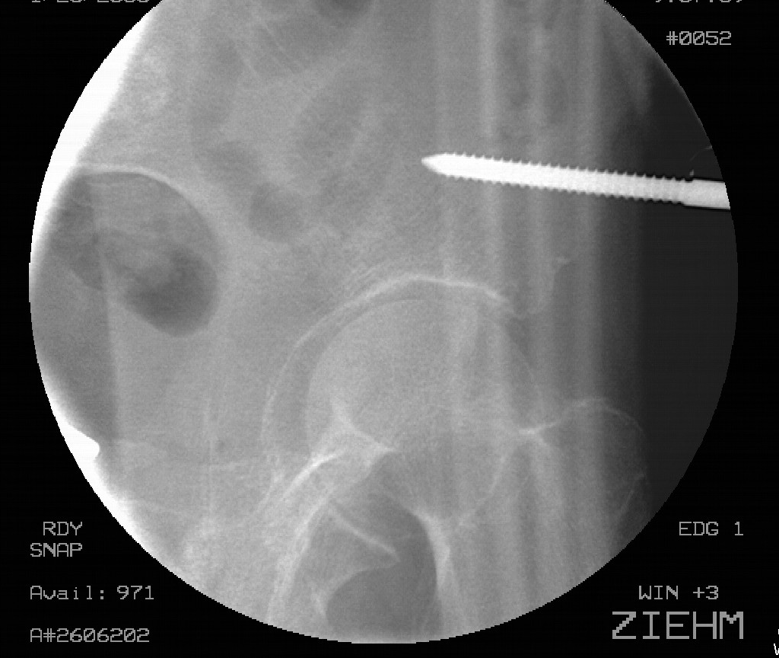
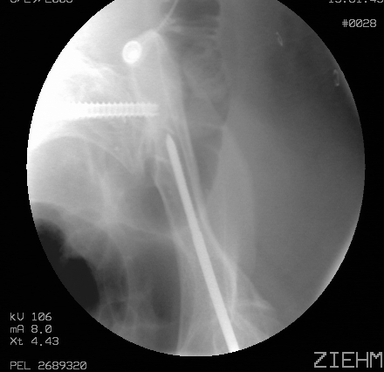
AIIS Technique
Iliac Oblique
Obturator Inlet Oblique
Images courtesy of Sean Nork, MD

Slide 51
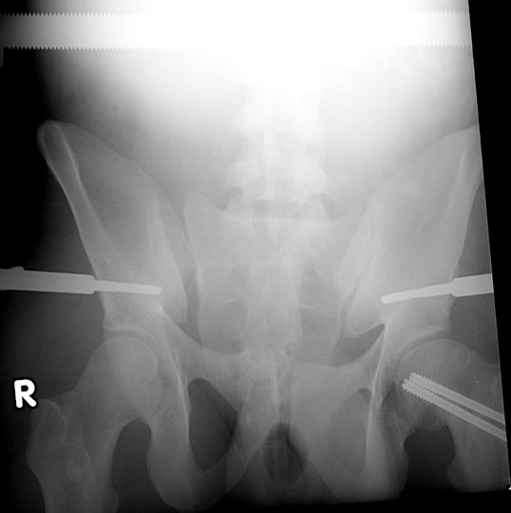
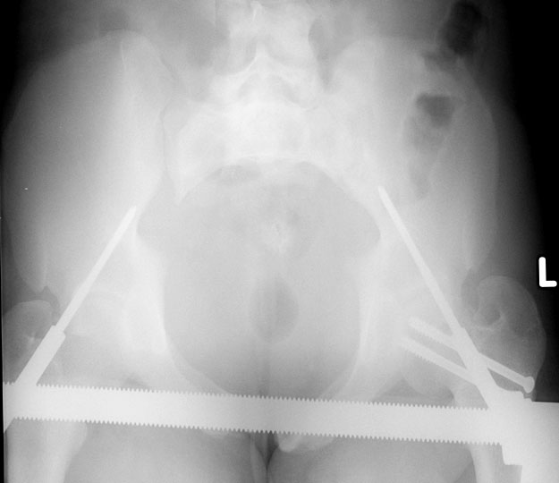
Images courtesy of Sean Nork, MD

Slide 52
AIIS Technique
Insert OTA video of supra-acetabular exfix placement
https://otaonline.org/video-library/45036/procedures-and-techniques/multimedia/16731357/percutaneous-supra-acetabular-external-pelvic

Slide 53
Anti-Shock C-Clamp
Improved control of posterior pelvic ring
Allows unrestricted abdominal access
Recommend fluoro guidance for placement, although can be placed blindly if emergently indicated
Pin placement on external iliac fossa
Iatrogenic injury due to mal-positioning is concern
Courtesy of Sean Nork, MD

Slide 54
Anti-Shock C-Clamp
Images courtesy of Thomas Moore Jr, MD

Slide 55
Anti-Shock C-Clamp
Images courtesy of Thomas Moore Jr, MD

Slide 56
Pelvic Packing
Can be done in conjunction with ExLap
To be effective, must have pelvic stability (ExFix or C-clamp)
Limited centers perform this routinely in USA
Pack in space of Retzius, paravesicular gutters, true pelvis
Courtesy of Sean Nork, MD
Notes:
From Nork PPT

Slide 57
Resuscitative SI Screw Placement
As alternative to external fixation, c-clamp or binders, can emergently place SI screws to effectively reduce pelvic volume
In experienced hands, can be done as quickly as other methods of stabilization

Slide 58
Resuscitative SI Screw Placement
Case example of patient with unstable pelvic fracture and pelvic hemorrhage. Both circumferential pelvic sheet and anterior pelvic compressor were ineffective in reducing the pelvis and controlling bleeding. Pelvic inlet fluoroscopic view demonstrates significant sacroiliac joint displacement (A). After placement of anterior pelvic compressor, reduction was improved but still inadequate (B).
Gardner MJ, et al. The antishock iliosacral screw. J Orthop Trauma, 24(10):e86-e89, October 2010.

Slide 59
The patient underwent antishock iliosacral screw procedure to reduce wide sacroiliac diastasis, as seen on pelvic inlet view (row A) and pelvic outlet view (row B). Starting points and orientations of two screws were planned to allow balanced reduction of sacroiliac joint and safe screw placement.
Gardner MJ, et al. The antishock iliosacral screw. J Orthop Trauma, 24(10):e86-e89, October 2010.

Slide 60
Role of Angiography
Institution dependent, but trend toward more utilization
Historic effectiveness questioned given pelvic bleeding more commonly venous
Evidence supports angiography in the persistently unstable patient with pelvic fracture
If CT shows contrast extravasation, proceed with angio
Majority of arterial injuries involve internal iliac and its branches
Superior gluteal, internal pudendal, obturator

Slide 61
Emergent angiography demonstrated left superior gluteal artery disruption (arrow) and multiple areas of petechial bleeding.
Gardner MJ, et al. Percutaneous pelvic fixation using working portals in a circumferential pelvic antishock sheet. J Orthop Trauma, 23(9):668-674, October 2009.

Slide 62
A. Angiography shows that the most brisk bleeding is from the left superior gluteal artery.
B. Status postembolization, with coil in the superior gluteal artery (solid arrow). Bleeding also noted from anterior division of the internal iliac artery (dashed arrow).
Schaller TM, et al. Skin breakdown following circumferential pelvic antishock sheeting: a case report. J Orthop Trauma, 19(9):661-665, October 2005.

Slide 63
Role of Angiography
Look for other source of hemorrhage
Proceed to laparotomy
Hypotensive with stable fracture pattern
Hypotensive with unstable fracture pattern
Transient responder after binder placement
CT evidence of contrast extravasation
Proceed to angio

Slide 64
Example of a Successful Pelvic Hemorrhage Protocol
Black SR, et al. Improved survival after pelvic fracture: 13-year experience at a single trauma center using a multidisciplinary institutional protocol. J Orthop Trauma, 30(1):22-28, January 2016.

Slide 65
A multidisciplinary approach at a Level 1 Trauma Center coordinated by trauma surgeons and orthopaedic traumatologists has resulted in improved patient survival.
Improved protocols and system resources
Reduced early deaths from exsanguination
Reduced late deaths from multiple organ failure

Slide 66
Summary
Understand fracture patterns and related anatomy
Combine knowledge of fracture, patient’s condition, physical exam and available resources to determine next step in care
Be prepared to intervene to stop hemorrhage
Use any method that is best suited for the patient, surgeon and institution
Management of hemodynamically unstable pelvic ring patient is a multi-disciplinary event with coordinated care between services

