Slide 1
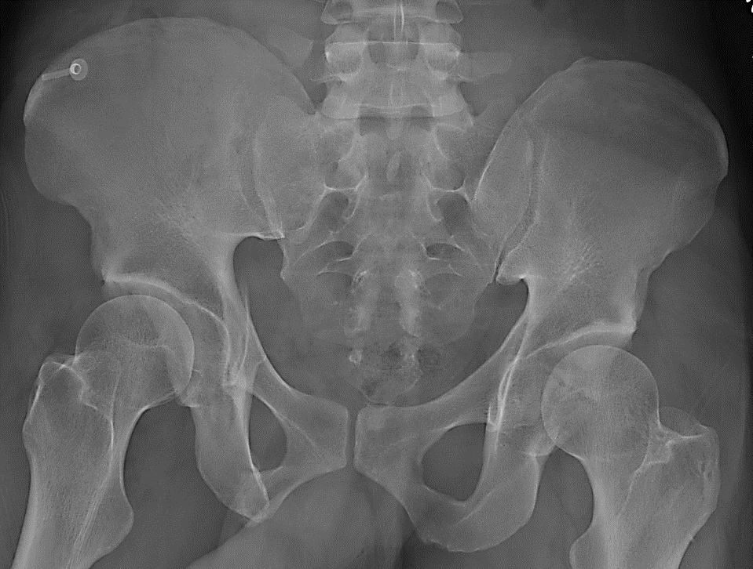
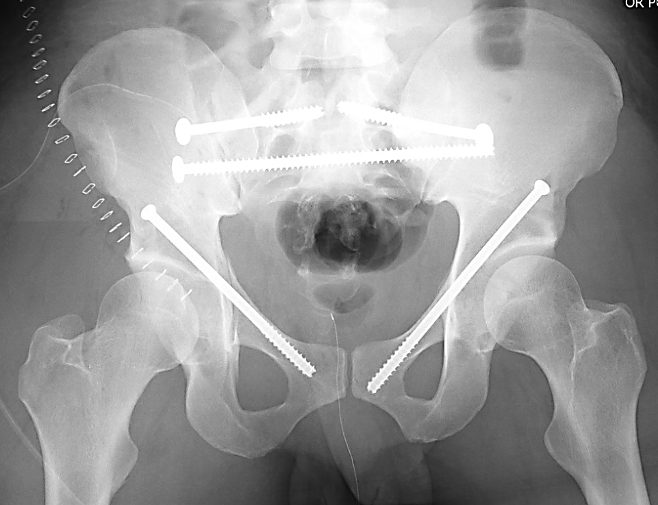
Definitive Treatment of Pelvic Ring Injuries
Jerad Allen, MD
Assistant Professor
Grady Memorial Hospital
Emory University Department of Orthopaedic Surgery

Slide 2
Objectives
Describe classification systems in regards to:
  Stability
  Treatment
Define classically operative and non-operative pelvic ring injuries
Be aware of controversy in determining proper management
Explain treatment strategies:
  Posterior pelvic ring
  Anterior pelvic ring
Describe outcomes

Slide 3
Treatment depends entirely on the stability of the pelvic ring
But…
What is stability?

Slide 4
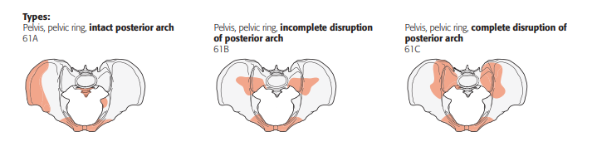
Stability
Pelvic stability is the ability to withstand physiologic loads
Loads from the trunk are distributed from the lumbar spine through the posterior pelvic ring to the bilateral acetabulae
Stability is therefore related to the degree of posterior ring injury:
Pelvic Ring. J Orthop Trauma. Jan 2018;32 Suppl 1:S71-S76.

Slide 5
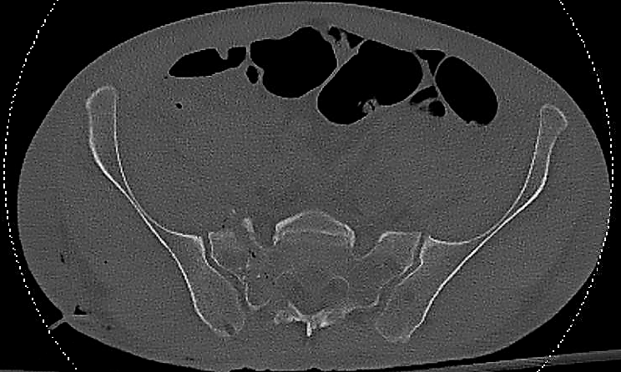
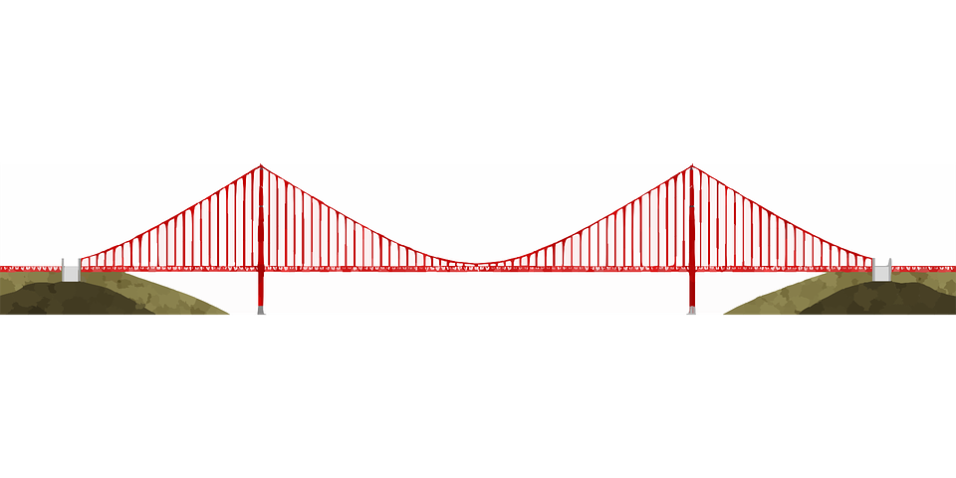
Stability
Posterior pelvic stability is analogous to a suspension bridge, with the posterior sacroiliac ligaments forming the cables and the posterior ilium and sacrum acting as towers.

Slide 6
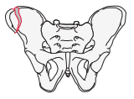
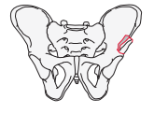
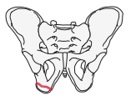
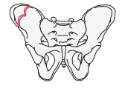
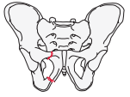
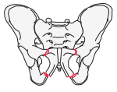
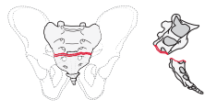
Stability – Axially Stable Fractures
Refer to “Radiographic Evaluation and Classification of Pelvic Ring Injuries” lecture
Tile “A” fractures and AO/OTA 61A fractures are inherently stable in terms of the posterior pelvic ring:
Generally, these are treated non-operatively…
Pelvic Ring. J Orthop Trauma. Jan 2018;32 Suppl 1:S71-S76.

Slide 7
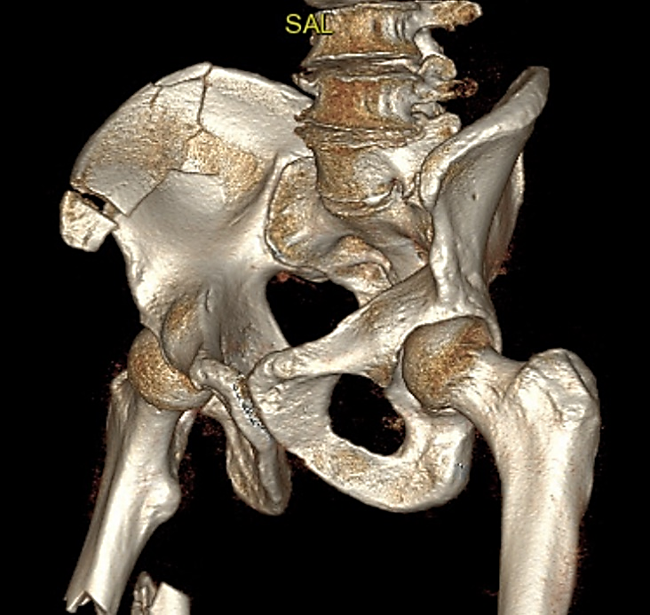
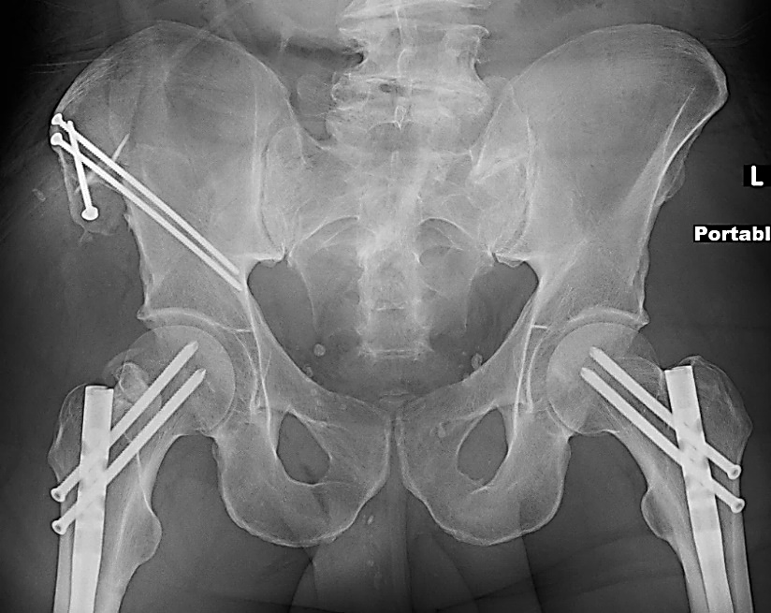
Stable Pelvic Ring ≠ Non-operative Treatment
Operative treatment may be considered when:
  Patient is polytraumatized
  Fracture pain severely limits mobilization
  Non-operative treatment has failed
Courtesy of Conor Kleweno, MD

Slide 8
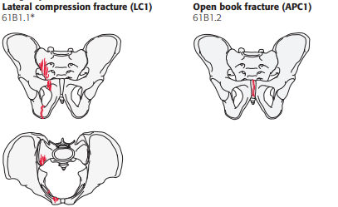
Stability – Rotationally Unstable Fractures
Tile “B” and AO/OTA 61B are rotationally unstable with incomplete posterior pelvic ring injuries:
Controversy exists as to treatment method in this category
Many 61B1 injuries can be
treated non-operatively, however…
Pelvic Ring. J Orthop Trauma. Jan 2018;32 Suppl 1:S71-S76.

Slide 9
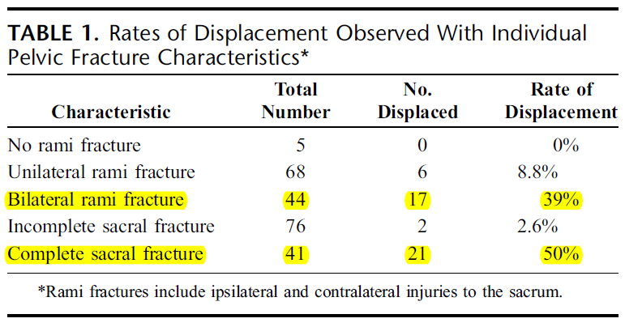
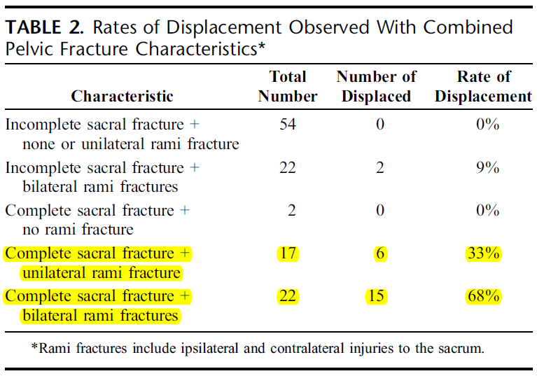
Stability – Rotationally Unstable Fractures
Bruce et al. (JOT 2010) studied 117 lateral compression pelvis fractures (AO/OTA 61B) which were managed non-operatively.
Distinguishing features of the pelvis fractures were correlated with late radiographic fracture displacement.
Bruce B, Reilly M, Sims S. OTA highlight paper predicting future displacement of nonoperatively managed lateral compression sacral fractures: can it be done? J Orthop Trauma. Sep 2011;25(9):523-7.

Slide 10
When in doubt → Obtain more data!
Sagi et al. (JOT 2011) performed an examination under anesthesia (EUA) for 68 patients with AO/OTA-61B injuries.
All patients received a standardized 15 fluoroscopic view EUA.
50% of APC-1 injuries were found to be occult APC-2 injuries which necessitated surgical intervention.
37% of LC-1 injuries were found to be unstable and were treated with surgical fixation.
Sagi HC, Coniglione FM, Stanford JH. Examination under anesthetic for occult pelvic ring instability. J Orthop Trauma. Sep 2011;25(9):529-36.

Slide 11
Examination Under Anesthesia
https://otaonline.org/video-library/45037/annual-meeting-and-conferences/multimedia/18524822/hip-dislocations-and-pelvic-injuries-eua-and-need

Slide 12
When in doubt → Obtain more data!
Sigel et al. (JBJS 2008) studied 38 injured patients with pelvic pain in a clinic setting.
Standard pelvic x-rays (AP, inlet, outlet) as well as single leg stance films (“flamingo” views) were obtained.
25/38 patients were found to have an unstable pelvic ring injury
Siegel J, Templeman DC, Tornetta P. Single-leg-stance radiographs in the diagnosis of pelvic instability. J Bone Joint Surg Am. Oct 2008;90(10):2119-25.

Slide 13
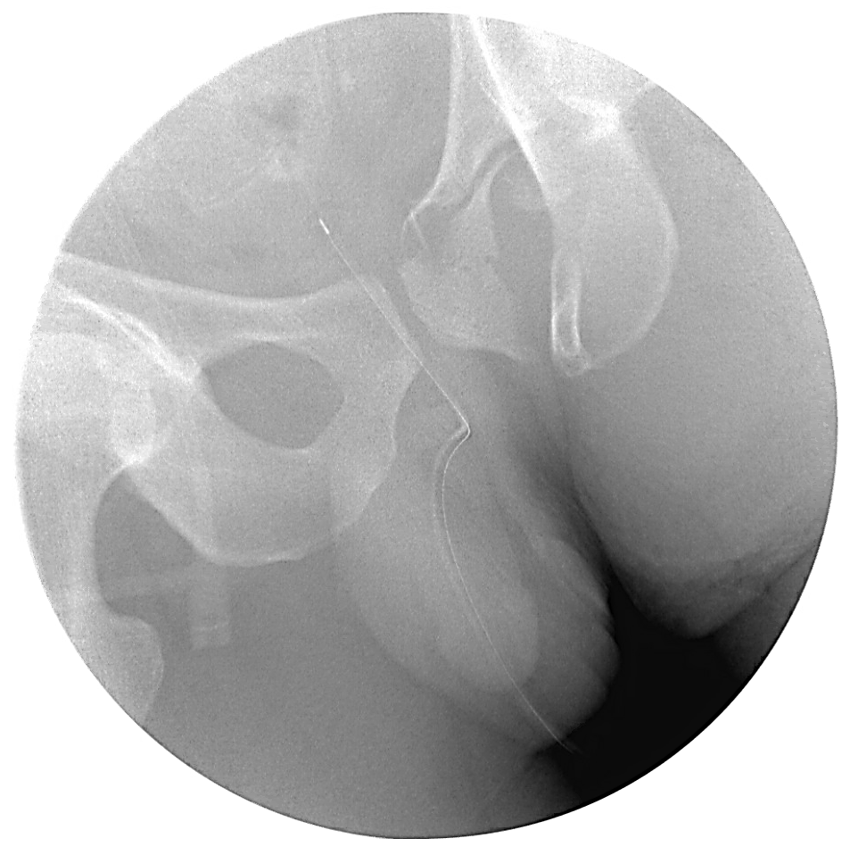
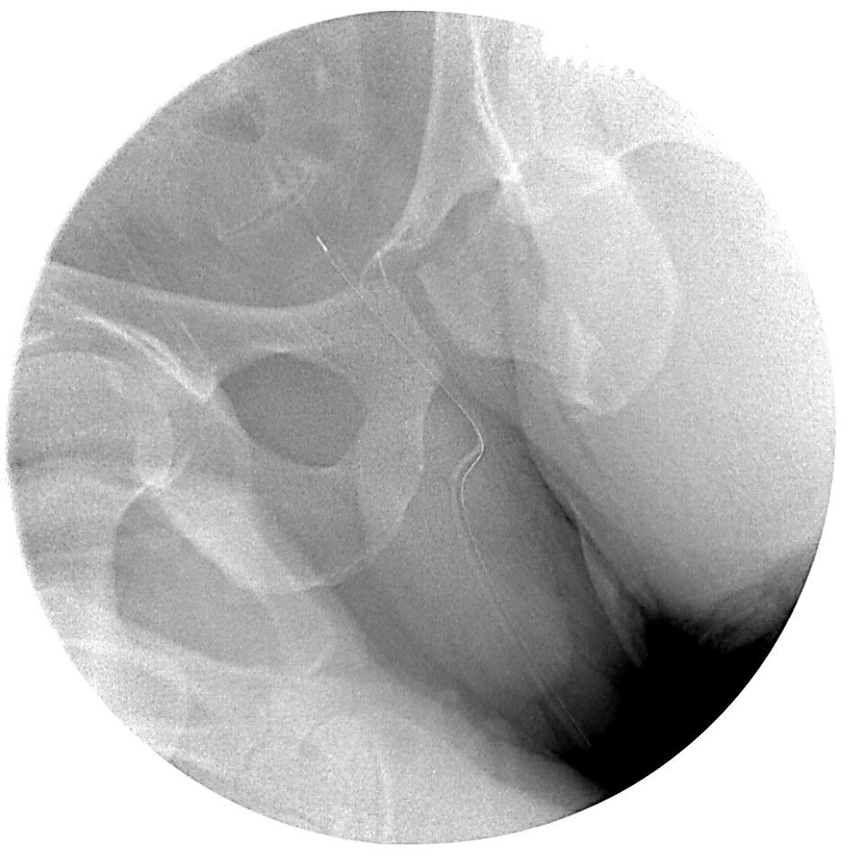
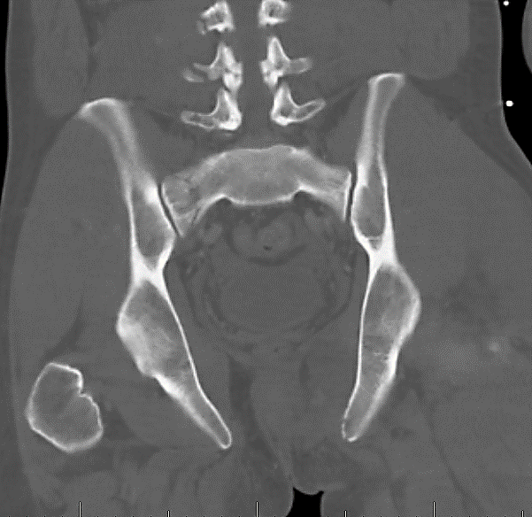
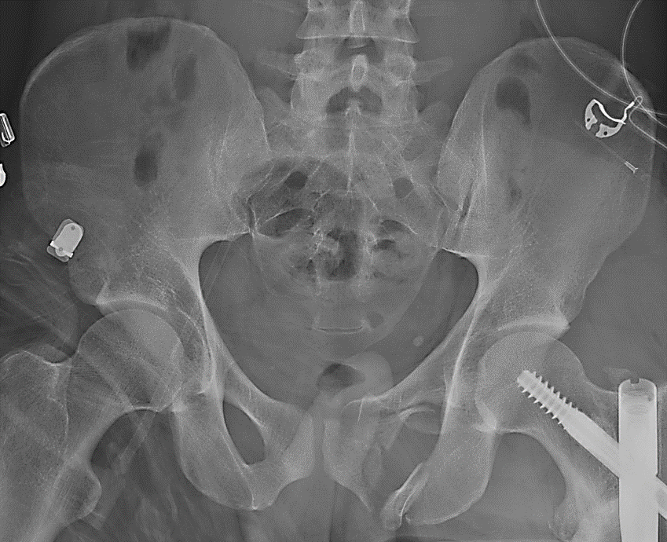
When in doubt → Obtain more data!
Assess for subtleties in pre-operative imaging:
  L5 transverse process fracture
  Avulsion fractures of ischial spine (not shown)
Examination under anesthesia
Pre-operative imaging

Slide 14
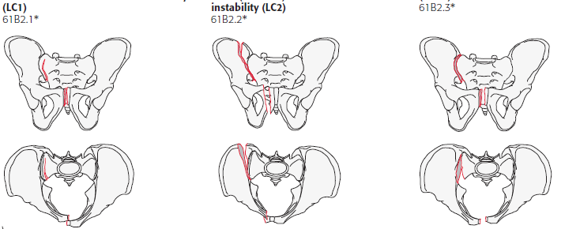
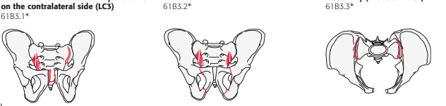
Stability – Rotationally Unstable Fractures
An increased burden of injury, as shown in the later 61B classifications signifies greater pelvic instability.
These are generally treated operatively.
Pelvic Ring. J Orthop Trauma. Jan 2018;32 Suppl 1:S71-S76.

Slide 15
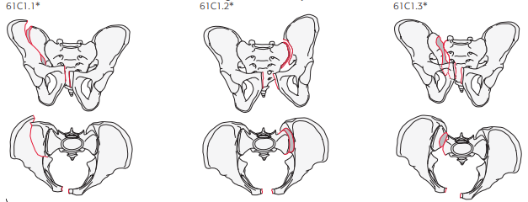
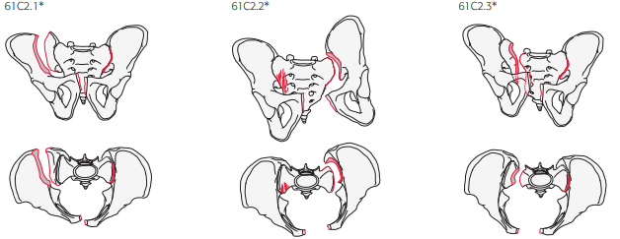
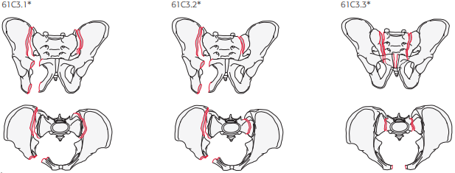
Stability – Complete
Posterior Instability
Tile “C” and AO/OTA 61C represent pelvic ring injuries with incompetent posterior structures necessitating operative intervention.
Pelvic Ring. J Orthop Trauma. Jan 2018;32 Suppl 1:S71-S76.

Slide 16
Treatment Strategy
Ultimate treatment is dependent upon…
  Amount of fracture displacement
  Physiologic status of patient
  Concurrent injuries which may preclude certain operative positions or approaches
  Angiographic embolization which may increase infection risks of certain approaches
  Prior abdominal surgeries (i.e. a prior hernia repair with mesh)
  Knowledge and comfort level of the operative surgeon

Slide 17
Treatment Strategy, continued
Available operative interventions exist in a spectrum of invasiveness.
Careful preoperative planning is essential. Use all imaging modalities available to include CT and 3D surface rendered imaging.
The surgeon must have the ability to alter the preoperative plan should a less invasive treatment not result in an accurate reduction.

Slide 18
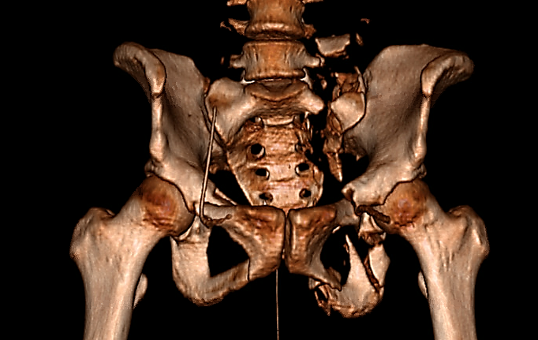
Posterior Pelvis Reduction and Fixation

Slide 19
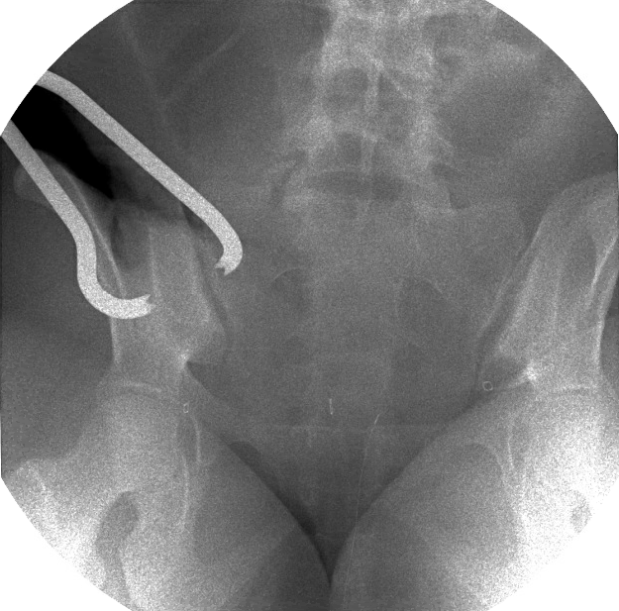
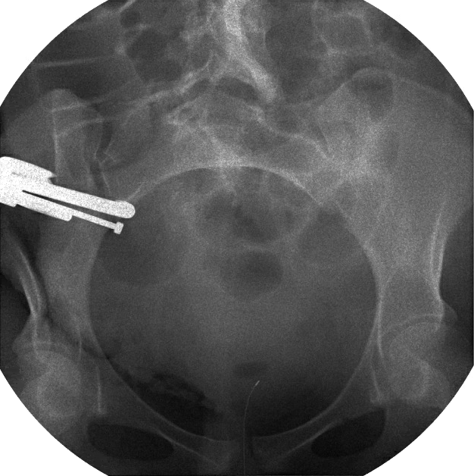
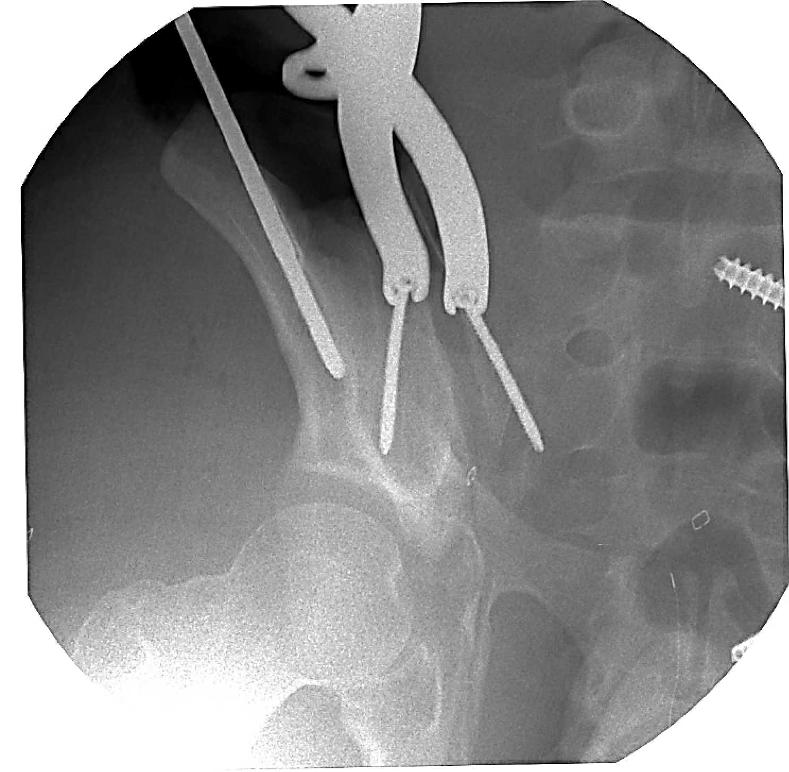
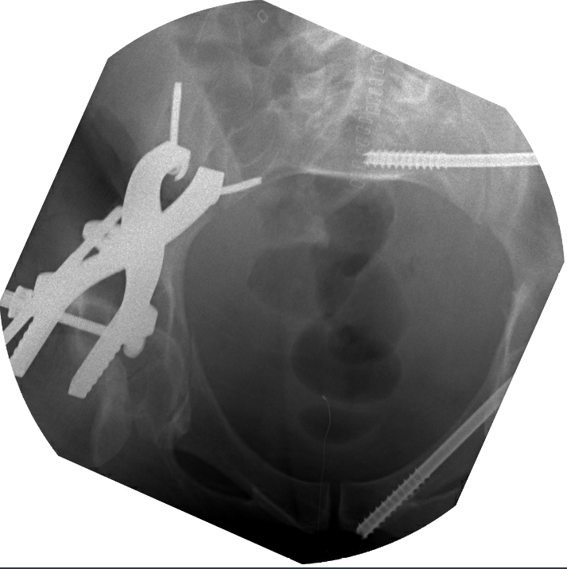
Sacroiliac Joint Reduction
Usually reduced indirectly with reduction of the anterior ring.
Can be performed open from the lateral window of an ilioinguinal approach or posteriorly through a paramedian approach.
Clamp tine placed posterior on the ilium and about the anterior sacral ala (top right).
Screw based clamp may be required (bottom right).

Slide 20
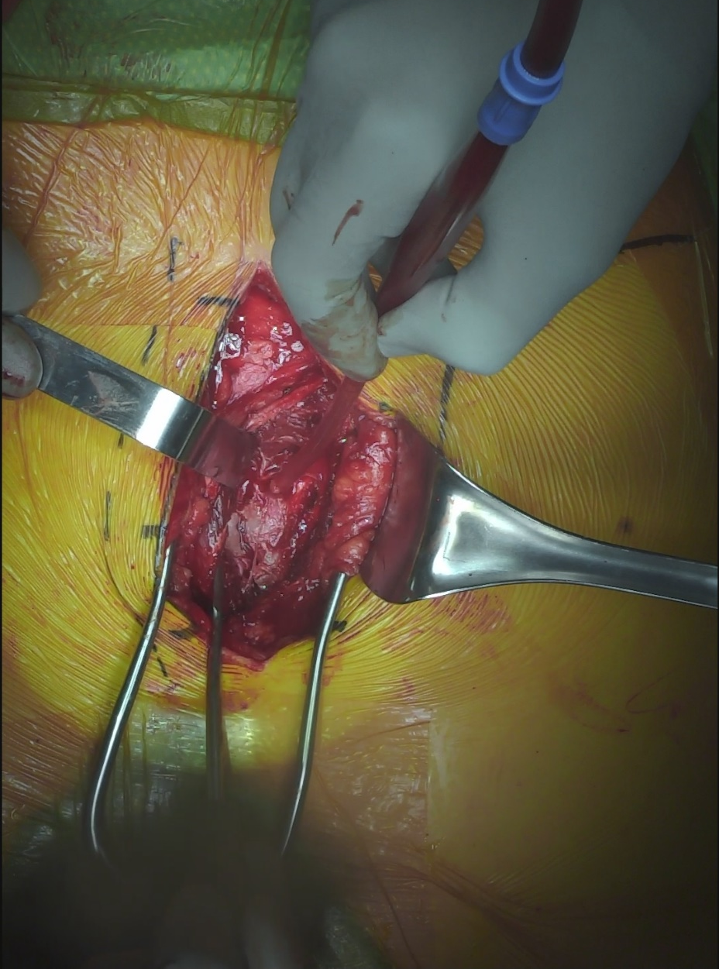
Sacral Fracture Reduction
Midline
Generally performed indirectly with external fixator, universal distractor, c-clamp, or reduction frame.
Open reduction through posterior paramedian approach.
  Reduce with schanz pins placed in each PSIS.
  Clamp tines placed on sacral spinous processes and PSIS.
Iliac crest
Right sacral fracture
Courtesy of Conor Kleweno, MD

Slide 21
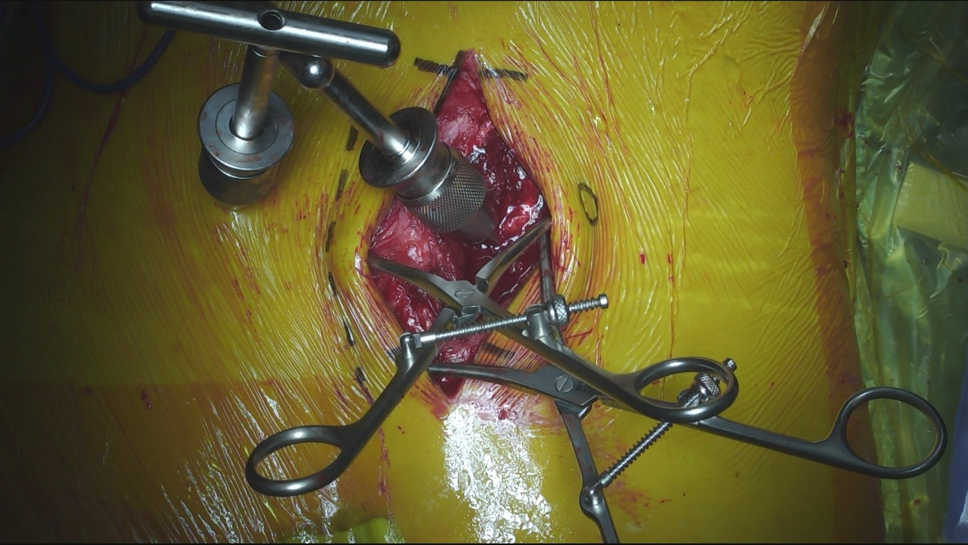
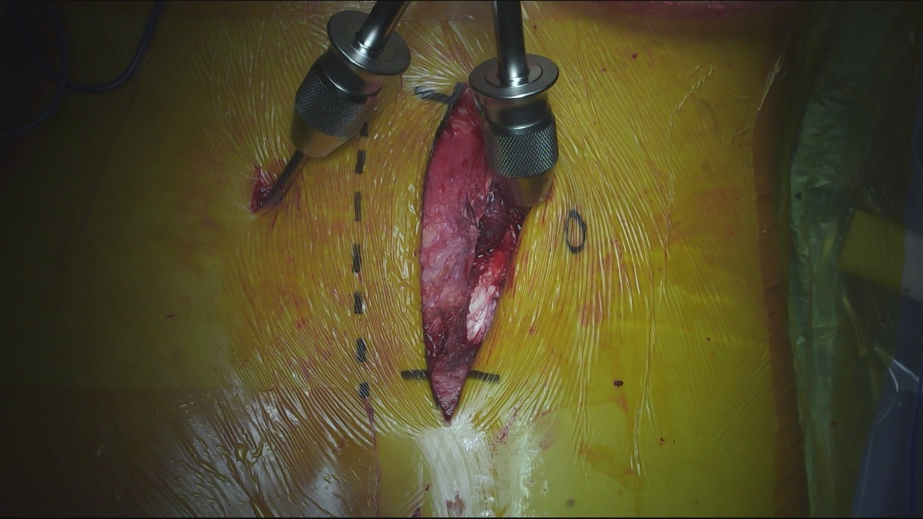
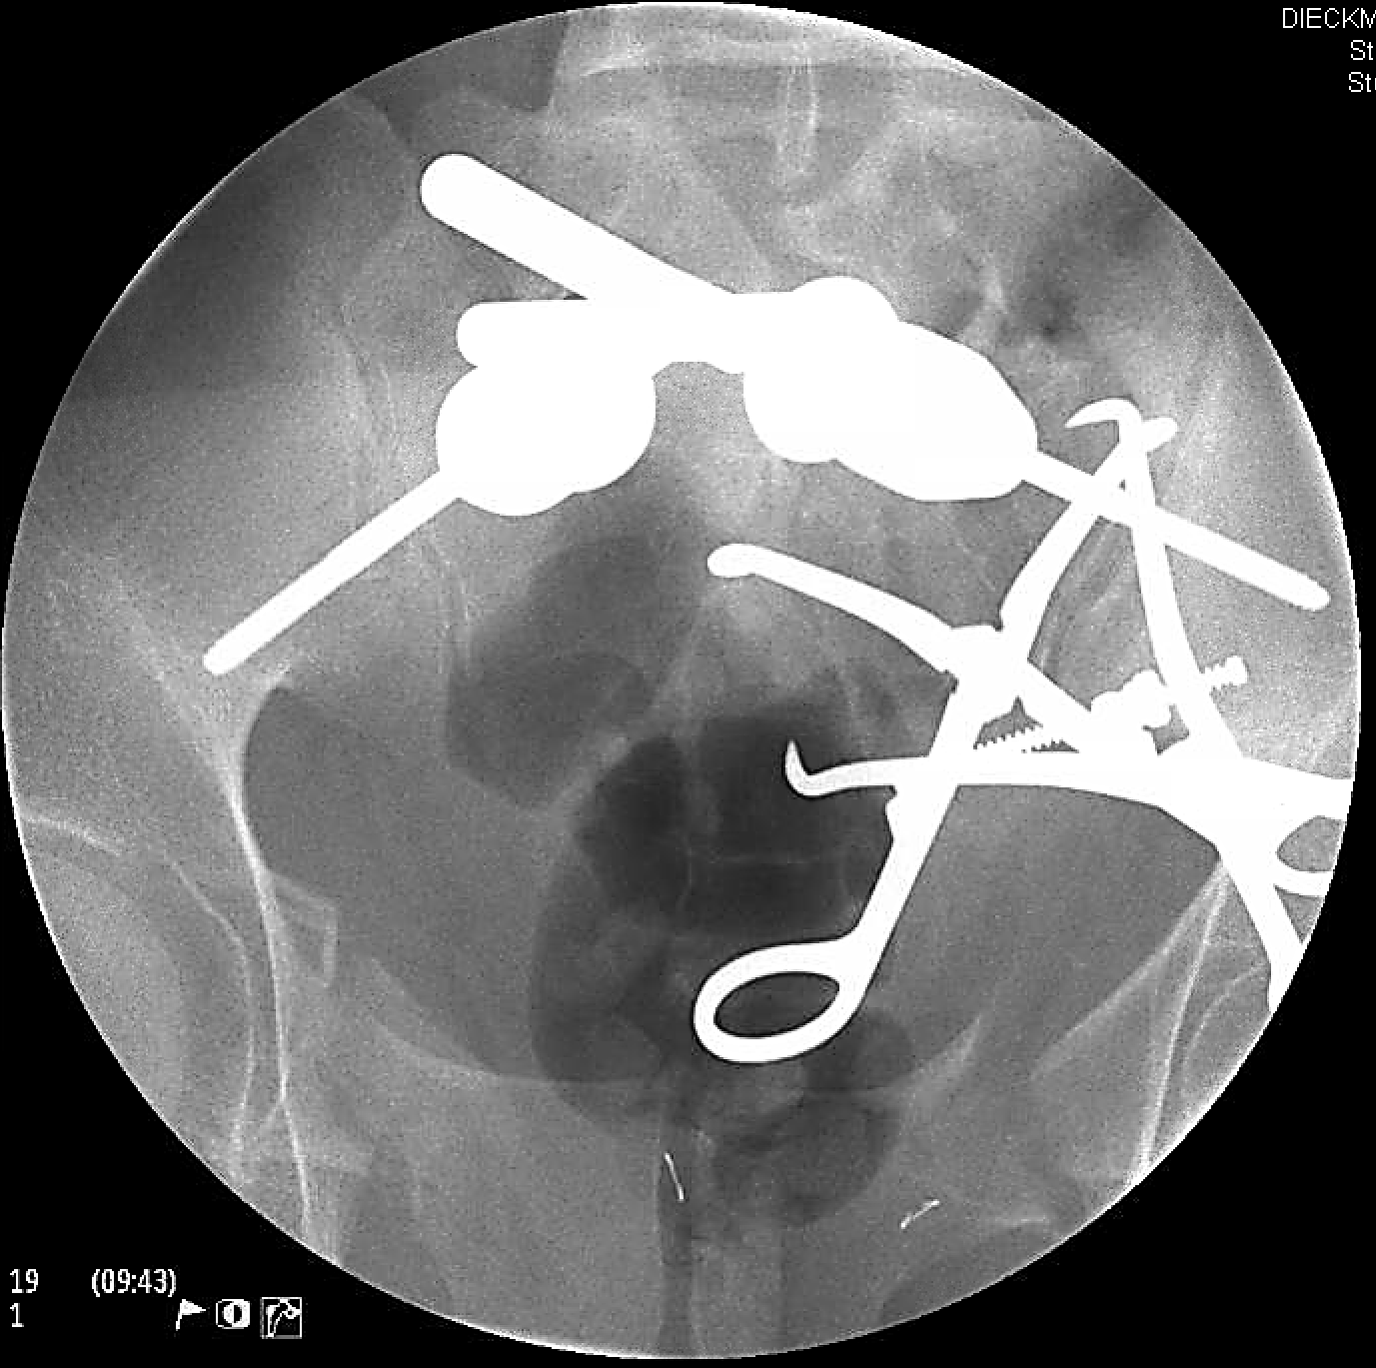
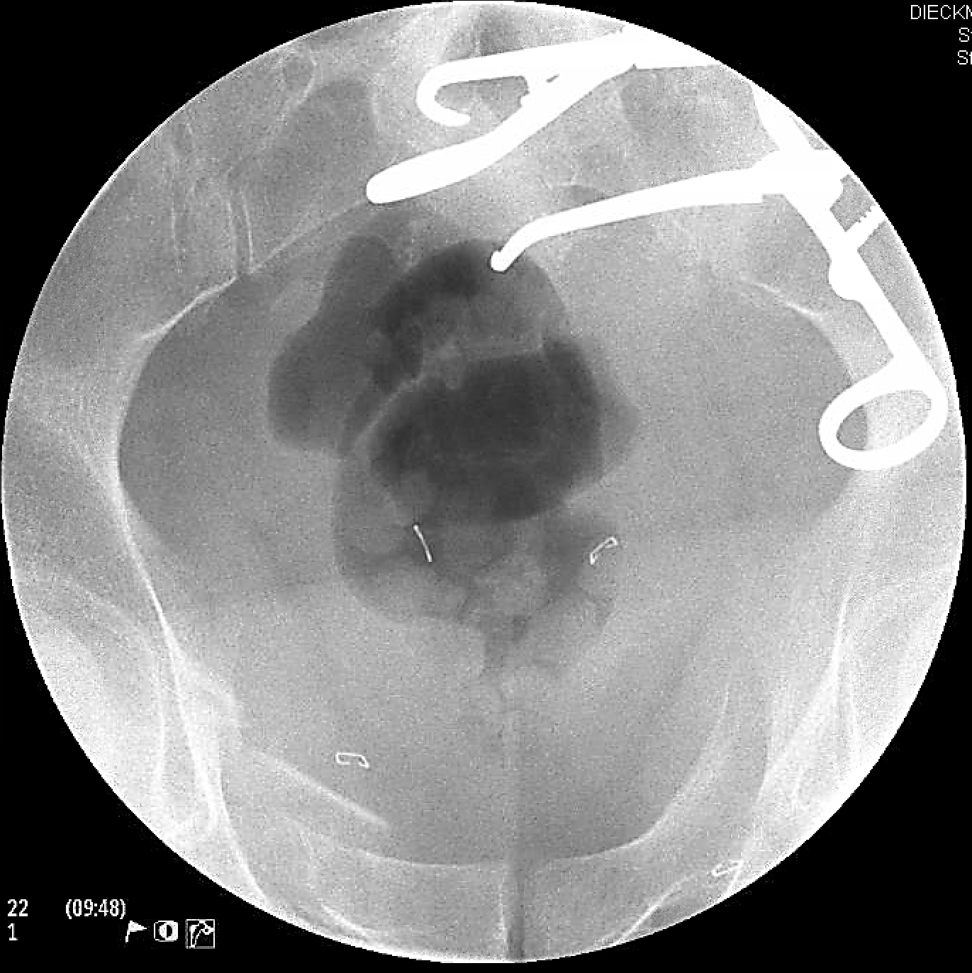
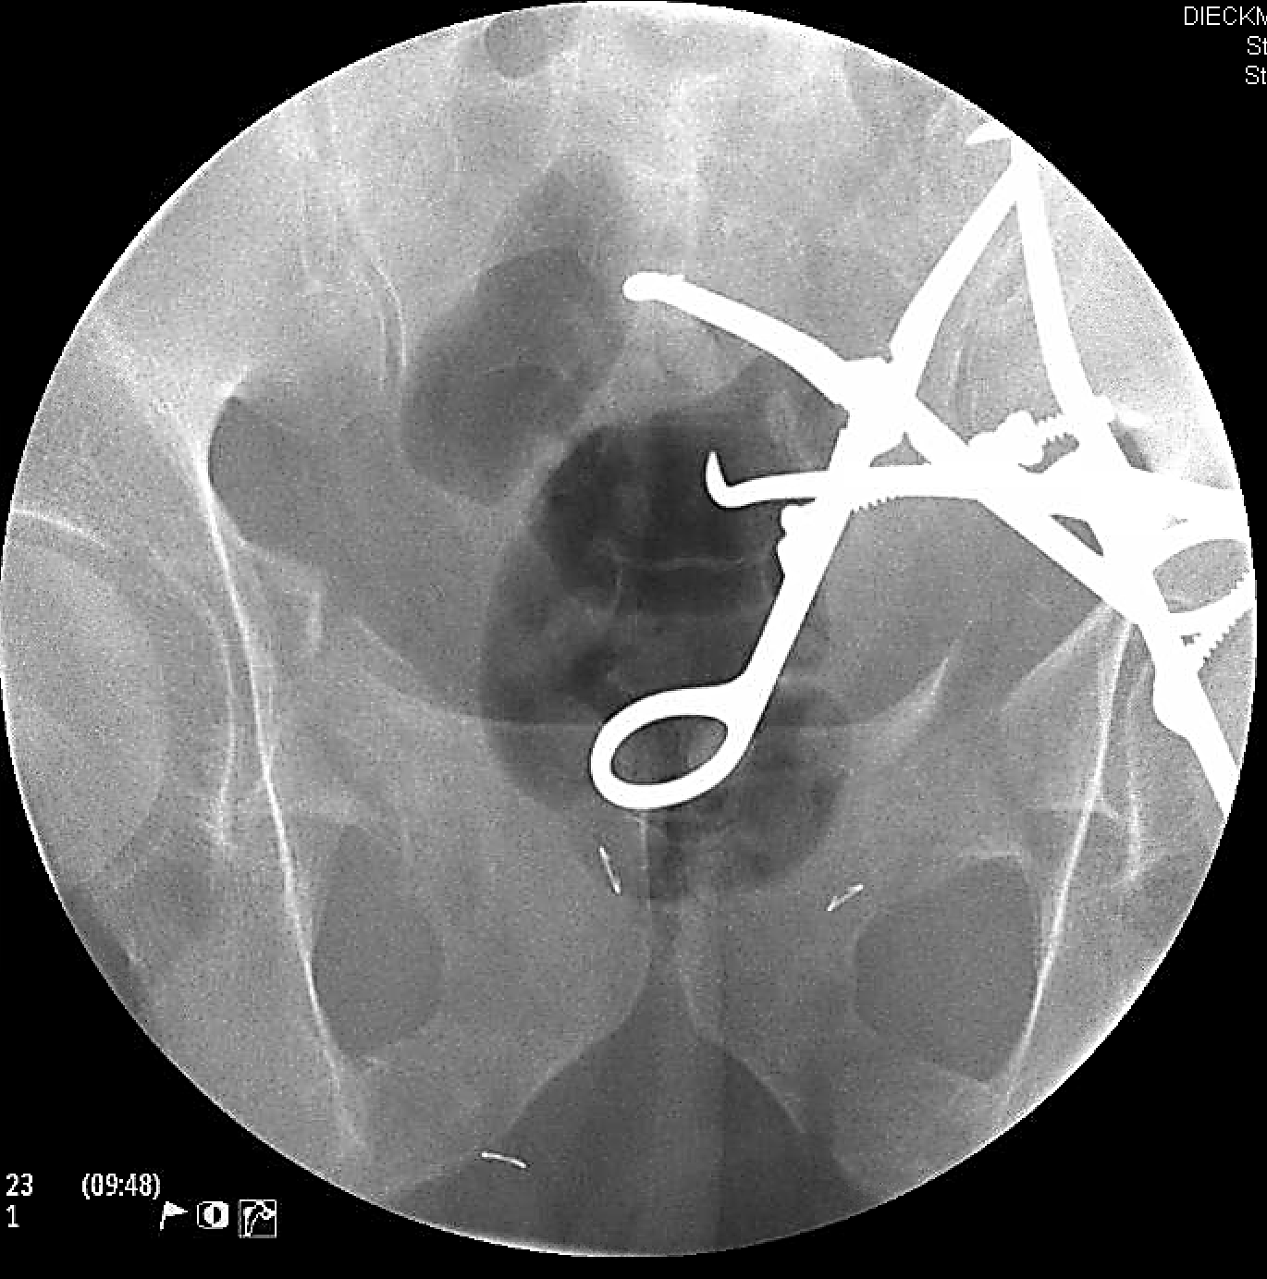
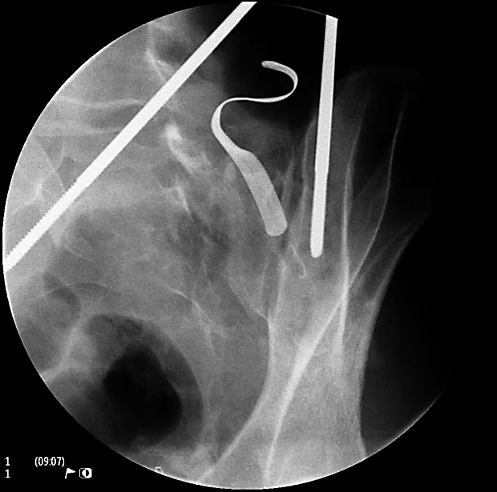
Sacral Fracture Reduction
Right sided paramedian approach with T-handled chucks attached to 5.0mm schanz pins placed in each PSIS. These are used to manipulate the injured hemipelvis.
After gross reduction is achieved, fine-tuning and compression are accomplished with 2 large Weber clamps with clamp tines placed on the PSIS and sacral spinous processes. Note 1 clamp provides lateral to medial compression while the other cranial to caudal.
Courtesy of Conor Kleweno, MD

Slide 22
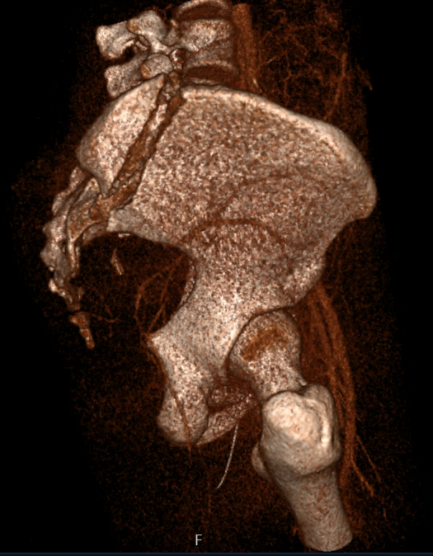
Crescent Fracture Reduction
These injuries are fracture / dislocations of the sacroiliac joint seen in the Young-Burgess “LC-2” patterns.
Indirect reduction is standard with traction, external/internal fixators, and/or reduction of anterior injuries.
May be opened through a lateral window of an ilioinguinal approach for clamp placement.

Slide 23
Treatment Options
Posterior Ring
  Percutaneous sacroiliac screws
  Percutaneous trans-iliac, trans-sacral screws
  Percutaneous lumbopelvic fixation
  Open sacroiliac joint plating
  Open sacral plating
  Lumbopelvic fusion
Anterior Ring
  External fixation
  Internal-external fixation (Infix)
  Percutaneous ramus screws
    Antegrade or retrograde
  Open plating of pubic symphysis
  Open plating of pubic ramus

Slide 24
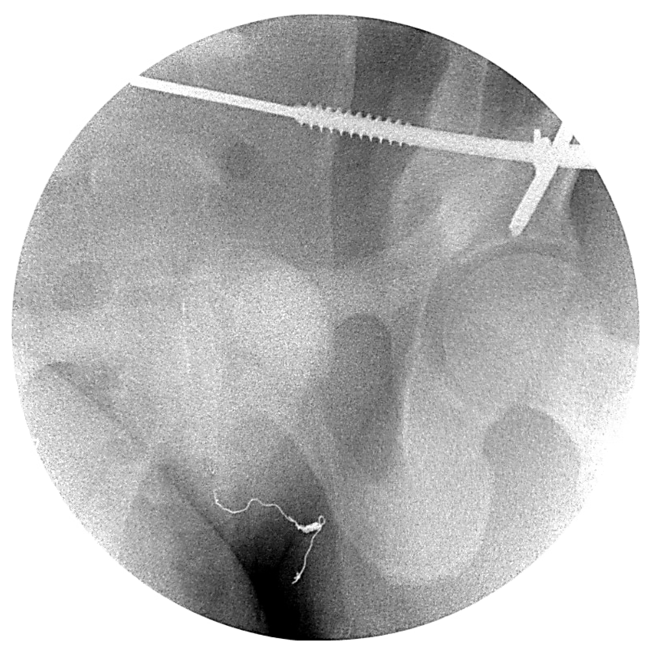
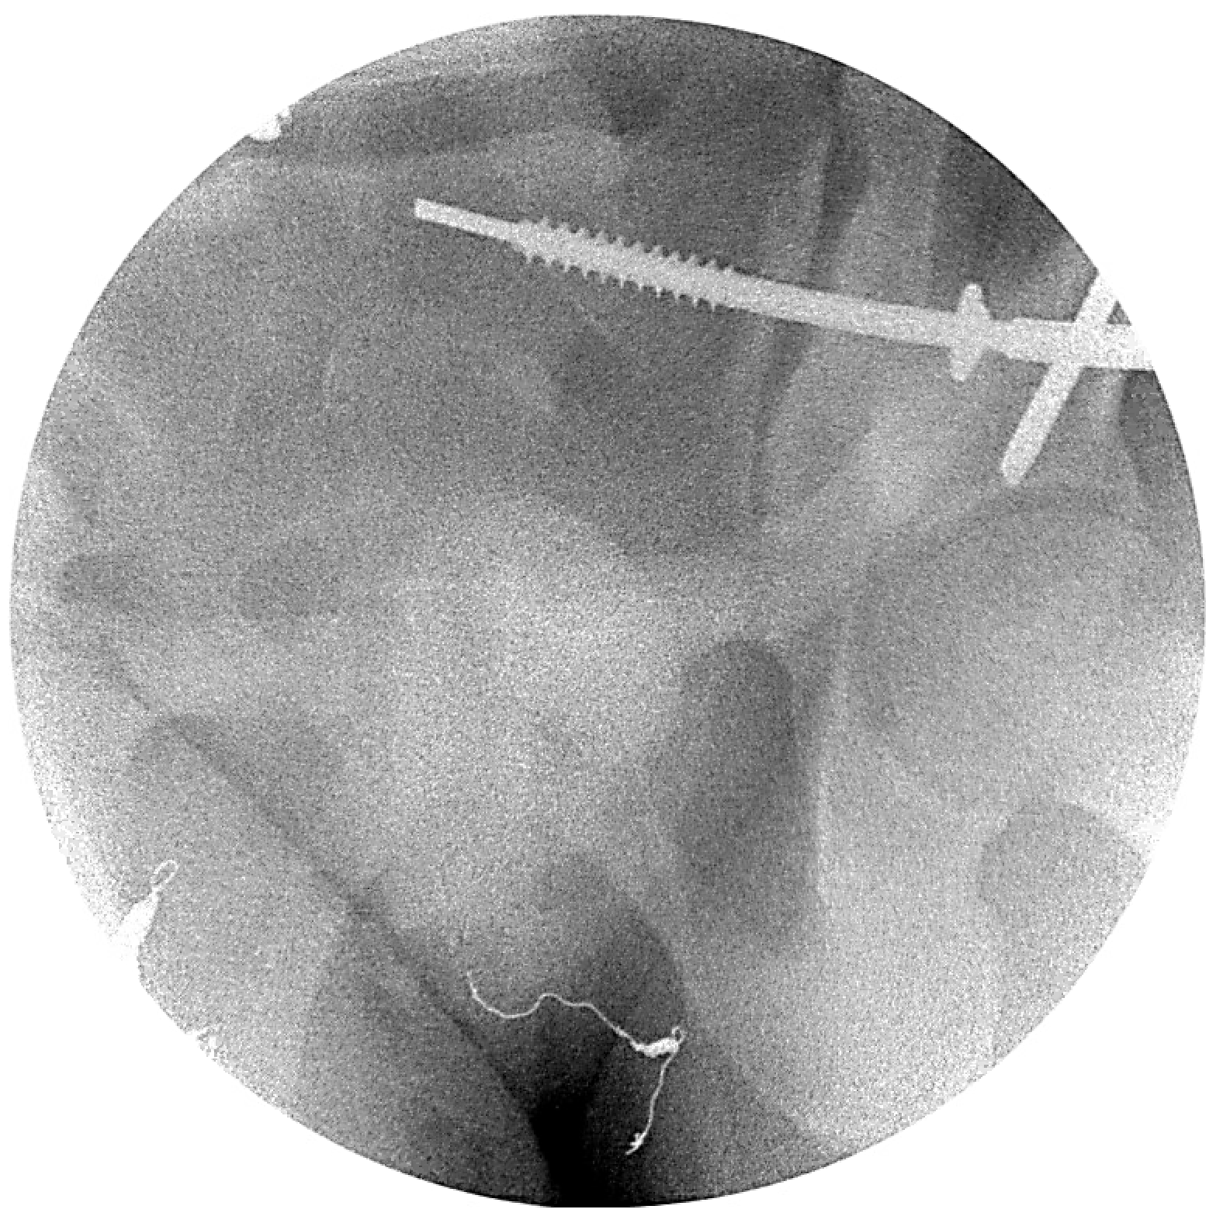
Treatment – Posterior Ring
Percutaneous fixation
  Minimally invasive
  Can be used as a reduction tool, resuscitative aid (shown below), or to stabilize comminution in the setting of a sacral fracture.

Slide 25
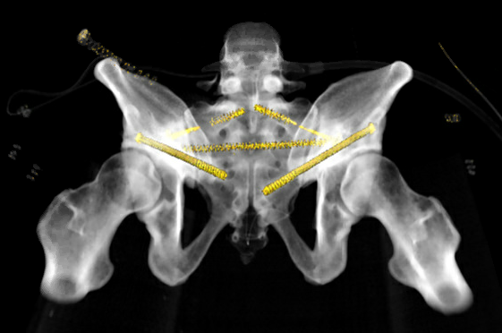
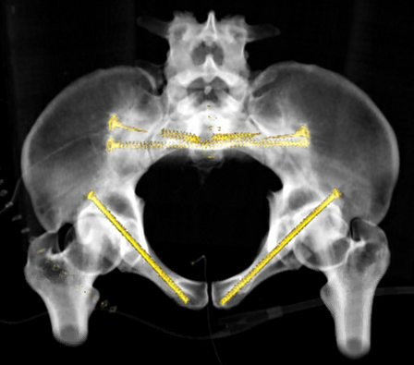
Percutaneous Iliosacral Screws
Sacroiliac screw (shown in upper sacral segment)
  Trajectory – Posterior and Caudal → Anterior and Cranial
Trans-iliac, trans-sacral screw (shown in second sacral segment)
  Trajectory – screw passes safely across 6 cortices perpendicular to the long axis of the sacrum

Slide 26
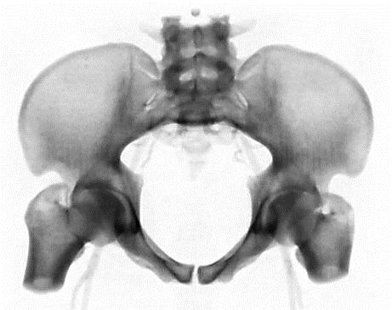
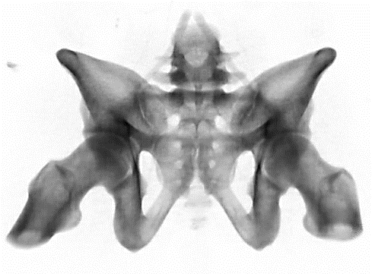
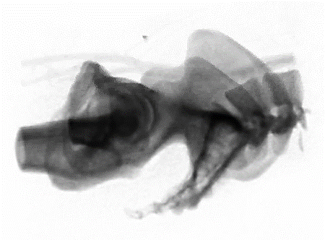
Iliosacral screw radiographic views
Inlet
Bodies of S1 and S2 are overlapped.
Will guide placement of screw in the anterior to posterior plane.
Outlet
Pubic symphysis bisects the body of S2.
Will guide placement of screw in the cranial to caudal plane.
Sacral Lateral
Iliac cortical densities are overlapped.
Will determine safe screw placement when the wire/drill bit is at the level of the L5 nerve root.

Slide 27
Iliosacral screw radiographic views
Inlet
Bodies of S1 and S2 are overlapped.
Will guide placement of screw in the anterior to posterior plane.
Outlet
Pubic symphysis bisects the body of S2.
Will guide placement of screw in the cranial to caudal plane.
Sacral Lateral
Iliac cortical densities are overlapped.
Will determine safe screw placement when the wire/drill bit is at the level of the L5 nerve root.

Slide 28
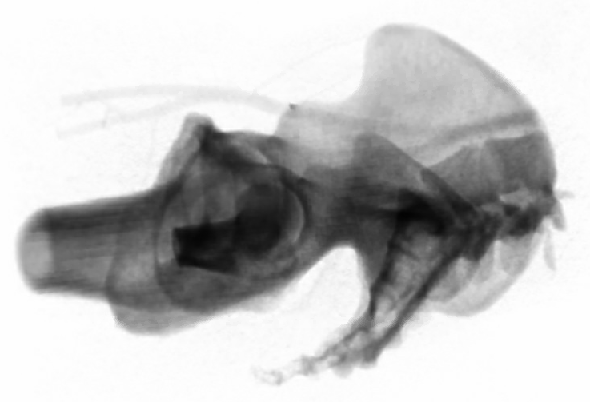
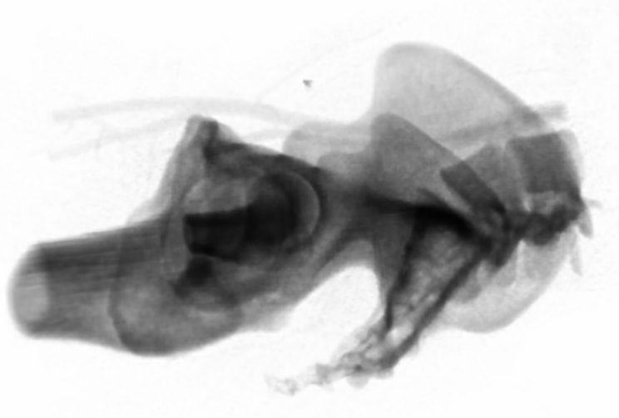
Sacral Lateral View
Will assist in determining if the L5 nerve root is in danger of becoming damaged.
Iliac cortical densities are the overlap of the true pelvis posterior to the acetabulum – this is used as a proxy for the slope of the sacral ala.
The bilateral iliac cortical densities must be overlapped to determine screw safety.
A wire or drill bit that is anterior to the iliac cortical density (at the level of the L5 nerve root) is too anterior and the nerve root is in danger.

Slide 29
Sacral Lateral View
Will assist in determining if the L5 nerve root is in danger of becoming damaged.
Iliac cortical densities are the overlap of the true pelvis posterior to the acetabulum – this is used as a proxy for the slope of the sacral ala.
The bilateral iliac cortical densities must be overlapped to determine screw safety.
A wire or drill bit that is anterior to the iliac cortical density (at the level of the L5 nerve root) is too anterior and the nerve root is in danger.
Not overlapped
Overlapped

Slide 30
Sacral Lateral View
Blue areas represent safe zones for screw placement. If more than one screw is to be placed in the same sacral segment, one should be anterior and caudal, while the other is posterior and cranial

Slide 31
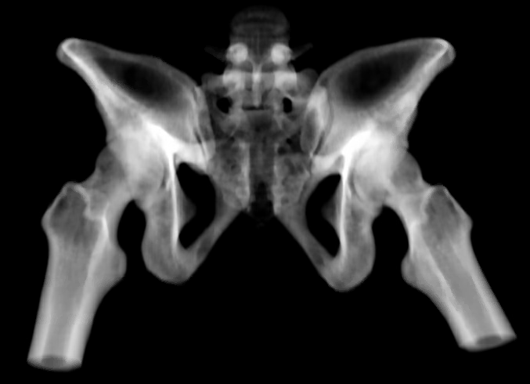
Sacral Dysmorphism
*Danger*
  The iliac cortical density, as seen on a sacral lateral, cannot be used to determine screw safety in a dysmorphic sacrum
Features of sacral dysmorphism:
  Acute upper sacral segment slope.
  Height of sacrum similar to that of iliac wing
  Mamillary processes
  Irregularly round shaped S1 nerve root tunnel
  Dorsally recessed upper sacral segment ala
  Residual S1 disc
  “Tongue-in-groove” sacroiliac joint

Slide 32
Sacral Dysmorphism
*Danger*
  The iliac cortical density, as seen on a sacral lateral, cannot be used to determine screw safety in a dysmorphic sacrum
Features of sacral dysmorphism:
  Acute upper sacral segment slope.
  Height of sacrum similar to that of iliac wing
  Mamillary processes
  Irregularly round shaped S1 nerve root tunnel
  Dorsally recessed upper sacral segment ala
  Residual S1 disc
  “Tongue-in-groove” sacroiliac joint

Slide 33
Sacral Dysmorphism
*Danger*
  The iliac cortical density, as seen on a sacral lateral, cannot be used to determine screw safety in a dysmorphic sacrum
Features of sacral dysmorphism:
  Acute upper sacral segment slope.
  Height of sacrum similar to that of iliac wing
  Mamillary processes
  Irregularly round shaped S1 nerve root tunnel
  Dorsally recessed upper sacral segment ala
  Residual S1 disc
  “Tongue-in-groove” sacroiliac joint

Slide 34
Sacral Dysmorphism
*Danger*
  The iliac cortical density, as seen on a sacral lateral, cannot be used to determine screw safety in a dysmorphic sacrum
Features of sacral dysmorphism:
  Acute upper sacral segment slope.
  Height of sacrum similar to that of iliac wing
  Mamillary processes
  Irregularly round shaped S1 nerve root tunnel
  Dorsally recessed upper sacral segment ala
  Residual S1 disc
  “Tongue-in-groove” sacroiliac joint

Slide 35
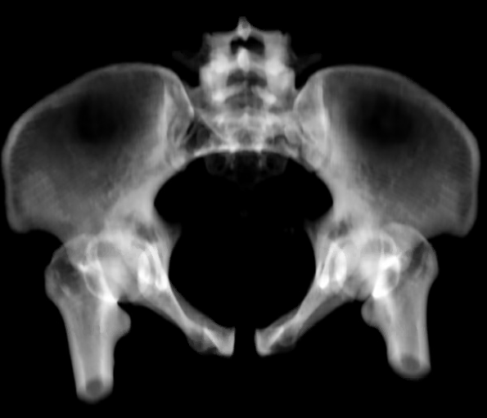

Sacral Dysmorphism
*Danger*
  The iliac cortical density, as seen on a sacral lateral, cannot be used to determine screw safety in a dysmorphic sacrum
Features of sacral dysmorphism:
  Acute upper sacral segment slope.
  Height of sacrum similar to that of iliac wing
  Mamillary processes
  Irregularly round shaped S1 nerve root tunnel
  Dorsally recessed upper sacral segment ala (S2 in blue)
  Residual S1 disc
  “Tongue-in-groove” sacroiliac joint

Slide 36
Sacral Dysmorphism
*Danger*
  The iliac cortical density, as seen on a sacral lateral, cannot be used to determine screw safety in a dysmorphic sacrum
Features of sacral dysmorphism:
  Acute upper sacral segment slope.
  Height of sacrum similar to that of iliac wing
  Mamillary processes
  Irregularly round shaped S1 nerve root tunnel
  Dorsally recessed upper sacral segment ala
  Residual S1 disc
  “Tongue-in-groove” sacroiliac joint

Slide 37
Pre-Operative Planning Iliosacral Screws
https://otaonline.org/video-library/45036/procedures-and-techniques/multimedia/16731381/pre-operative-planning-for-percutaenous-transiliac

Slide 38

Sacroiliac joint plating
Used when:
  Sacroiliac joint cannot be reduced by closed means
  Osseous fixation pathways do not allow safe screw placement
Performed through lateral window of ilioinguinal approach
  Can add inguinal ligament peel or ASIS osteotomy to improve visualization
Left sided SI joint plating shown by red arrows. This was necessary due to the crescent fracture propagating into the area of any iliosacral screw placement. Courtesy of Robert Wojahn, MD.

Slide 39
Sacral Fracture Plating
Used to restore posterior tension (refer to suspension bridge analogy)
Placed through bilateral paramedian approaches
Useful when existing hardware precludes iliosacral screw placement (shown) or no safe sacral osseous fixation pathway exists.

Slide 40


Lumbopelvic Instrumentation
Refer to “Lumbopelvic Fractures and Fixation” lecture.
Consider lumbopelvic fusion (above right) if sacral nerve roots require decompression or if no osseous fixation pathways exist for safe iliosacral screw placement.
Consider lumbopelvic fixation (below right) for highly comminuted sacral fractures and/or those with vertical displacement. Can be percutaneously placed, unilateral, or bilateral.
Courtesy of Reza Firoozabadi, MD and Conor Kleweno, MD

Slide 41
Posterior Pelvis Fixation Biomechanics
Overall, biomechanical data lacks in comparison studies.
Greater than 1 point of fixation (i.e. a single iliosacral screw) increases stability of an unstable posterior injury.
  Ideally, multiple screws at multiple sacral segments will increase construct stiffness.
Lumbopelvic fixation adds to posterior pelvic ring stiffness, especially with sacral comminution. A combination of an iliosacral screw and lumbopelvic fixation greatly increases construct strength.

Slide 42

Anterior Pelvis Reduction and Fixation

Slide 43
Treatment Options
Posterior Ring
  Percutaneous sacroiliac screws
  Percutaneous trans-iliac, trans-sacral screws
  Percutaneous lumbopelvic fixation
  Open sacroiliac joint plating
  Open sacral plating
  Lumbopelvic fusion
Anterior Ring
  External fixation
  Internal-external fixation (Infix)
  Percutaneous ramus screws
    Antegrade or retrograde
  Open plating of pubic symphysis
  Open plating of pubic ramus

Slide 44




External fixation
Applications:
  Temporize a patient in extremis (A)
  Provisionally reduce anterior and/or posterior pelvic ring (B)
  Definitively treat anterior pelvic ring comminution (C)
A
B
C

Slide 45


Subcutaneous fixator (“Infix”)
Applications:
  Long term definitive treatment of anterior pelvic ring
  Decreases pin site infections seen in external fixators
  Increased biomechanical strength compared to external fixator
  Requires additional surgery to remove
  May cause femoral nerve palsy if placed incorrectly
Courtesy of Thomas Moore Jr., MD

Slide 46



External fixation / Infix Radiographic views
Combined outlet, obturator oblique
Shows iliac “teardrop” – view down the osseous fixation pathway
Use this view to place pin specifically into a portion of the pathway
Iliac oblique
Highlights the cranial and caudal trajectory of the fixator pin
Combined inlet, obturator oblique
Shows medial and lateral border of the osseous fixation pathway.
If fixation is taken to the PSIS, a sacral lateral may be needed to ensure hardware is not proud posteriorly.

Slide 47
External fixation / Infix Radiographic views
Combined outlet, obturator oblique
Shows iliac “teardrop” – view down the osseous fixation pathway
Use this view to place pin specifically into a portion of the pathway
Iliac oblique
Highlights the cranial and caudal trajectory of the fixator pin
Combined inlet, obturator oblique
Shows medial and lateral border of the osseous fixation pathway.
If fixation is taken to the PSIS, a sacral lateral may be needed to ensure hardware is not proud posteriorly.

Slide 48
Ex-fix / Infix Technique Videos
External Fixator
  https://otaonline.org/video-library/45036/procedures-and-techniques/multimedia/16731357/percutaneous-supra-acetabular-external-pelvic
Infix
  https://otaonline.org/video-library/45036/procedures-and-techniques/multimedia/16731359/the-anterior-pelvic-internal-fixator-infix

Slide 49



“LC2” Channel Screw
Crescent fracture fixation may include a screw placed in the same corridor used by external / internal fixators.
Osseous fixation pathway is often large enough to accommodate more than one screw if desired (below right).
Courtesy of Reza Firoozabadi, MD

Slide 50


Pubic Symphysis Reduction
Indicated when disruption of anterior symphysis results in instability
  Historically, a disruption of greater than 2.5 cm indication for fixation
  Imaging may not represent the true disruption (e.g. application of binder, interval reduction) at time of acute trauma
Performed through Stoppa approach
Weber clamp with tines upon each pubic tubercle
Screw based clamp may be needed for difficult reductions

Slide 51

Pubic Symphysis Fixation
Superior plate with > 2 screws on either side of the symphysis
Anterior plate can be added to a superior plate for difficult reductions or revision surgery
Indirect reduction with percutaneous fixation has been described

Slide 52


Percutaneous ramus screws
The anterior and inferior superior pubic ramus bony morphology is undulating. This can lead to “in-out-in” screws if placed incorrectly.
A safe position for a ramus screw is therefore superior and posterior within the ramus.
The red outlines the obturator sulcus. The blue line represents a screw placed too inferiorly, causing an in-out-in screw.
The green curve outlines the pectineal recess. The blue line represents a screw placed too anteriorly, causing an in-out-in screw.

Slide 53

Retrograde Percutaneous Ramus Screw
*Danger* The spermatic cord passes approximately 3cm lateral to midline – near the starting point for a retrograde ramus screw. Use caution in young male patients.
Spermatic cords

Slide 54



Percutaneous ramus screw radiographic views
Combined outlet, obturator oblique
Allows visualization of the cranial and caudal borders of the osseous fixation pathway.
Inlet
Allows visualization of the anterior and posterior borders of the osseous fixation pathway.
Combined inlet, iliac oblique
Used as an alternative to the inlet to visualize the anterior and posterior borders of the ramus.

Slide 55
Percutaneous ramus screw radiographic views
Combined outlet, obturator oblique
Allows visualization of the cranial and caudal borders of the osseous fixation pathway.
Inlet
Allows visualization of the anterior and posterior borders of the osseous fixation pathway.
Combined inlet, iliac oblique
Used as an alternative to the inlet to visualize the anterior and posterior borders of the ramus.

Slide 56

Anterior Pelvic Ring Plating
Used for segmental or comminuted anterior ring injuries
Considered when an external fixator or ramus screws aren’t ideal
Careful plate contouring is essential

Slide 57


Anterior Pelvic Ring Plating
Lateral plate is anchored with
  Supra-acetabular cortical screws (*)
  Quadrilateral surface screws (*)
*
*
*

Slide 58




Quadrilateral surface screw radiographic views
Combined outlet, modified iliac oblique
Iliac oblique is adjusted to view the quadrilateral surface at its thinnest point
Allows visualization of the medial and lateral borders of the quadrilateral surface
Obturator oblique
Used to determine the anterior and posterior extent of the fixation pathway
Screw will end in the caudal ischium

Slide 59
Anterior Pelvis Fixation Biomechanics
Two screw construct for pubic symphysis plating is inferior to >2 screws.
Anterior pelvic ring fixation can increase stability of the pelvic ring up to ~20%
Retrograde pubic ramus screws have a higher incidence of failure than antegrade screws.
Anterior based external fixator may provide some posterior compression, although not as much as a c-clamp or iliosacral screw.

Slide 60
Pelvic Ring Injury Outcomes
Mortality
  8.6 – 9.1%, largely due to associated injuries
  Mortality and transfusion requirements increase with increasing Young-Burgess classification (i.e. an APC3 has a higher mortality and transfusion requirement than an APC2, etc.)
  Lateral compression type fractures carry higher chest related injuries than anterior-posterior fractures.
  Anterior-posterior injuries carry higher abdominal injuries than lateral compression injuries.

Slide 61


Anterior Pelvic Ring Outcomes
Hardware failure with loss of reduction of the anterior pelvic ring can occur in 11-88% of cases.
Examples include pubic symphysis plate breakage (figure above) and pullout of pubic ramus screws (figure below).
Most patients do not require a revision surgery however.

Slide 62
Outcomes by Sex
Women
Men
Dyspareunia reported up to 56%
Bladder rupture / lower extremity injury associated with worse outcomes.
Hardware retention not found to preclude vaginal delivery, however a greater rate of women with prior pelvis fracture have cesarean deliveries.
Erectile dysfunction as high as 30%

Slide 63
Summary
Thorough knowledge of normal, dysmorphic, and pathologic anatomy is critical for treating pelvic ring fractures.
The patient’s overall injury burden can often affect definitive management. Factors such as soft tissue envelope, prior embolization and prior abdominal/urologic surgery must be taken into account while pre-operatively planning.
Surgical treatment options exist in a spectrum of invasiveness. Choose the least invasive technique that will achieve an accurate reduction.
Ensure the posterior pelvic ring is well reduced. This will often require anterior pelvis fixation to “protect” the posterior ring.

Slide 64
References
1. Pelvic Ring. J Orthop Trauma. Jan 2018;32 Suppl 1:S71-S76. doi:10.1097/BOT.0000000000001066
2. Bishop JA, Routt ML. Osseous fixation pathways in pelvic and acetabular fracture surgery: osteology, radiology, and clinical applications. J Trauma Acute Care Surg. Jun 2012;72(6):1502-9. doi:10.1097/TA.0b013e318246efe5
3. Bruce B, Reilly M, Sims S. OTA highlight paper predicting future displacement of nonoperatively managed lateral compression sacral fractures: can it be done? J Orthop Trauma. Sep 2011;25(9):523-7. doi:10.1097/BOT.0b013e3181f8be33
4. Eastman JG, Chip Routt ML. Intramedullary Fixation Techniques for the Anterior Pelvic Ring. J Orthop Trauma. Sep 2018;32 Suppl 6:S4-S13. doi:10.1097/BOT.0000000000001250
5. Firoozabadi R, Stafford P, Routt M. Risk of Spermatic Cord Injury During Anterior Pelvic Ring and Acetabular Surgery: An Anatomical Study. Arch Bone Jt Surg. Oct 2015;3(4):269-73.
6. Langford JR, Burgess AR, Liporace FA, Haidukewych GJ. Pelvic fractures: part 2. Contemporary indications and techniques for definitive surgical management. J Am Acad Orthop Surg. Aug 2013;21(8):458-68. doi:10.5435/JAAOS-21-08-458
7. Lee C, Sciadini M. The Use of External Fixation for the Management of the Unstable Anterior Pelvic Ring. J Orthop Trauma. Sep 2018;32 Suppl 6:S14-S17. doi:10.1097/BOT.0000000000001251
8. Routt ML, Simonian PT, Agnew SG, Mann FA. Radiographic recognition of the sacral alar slope for optimal placement of iliosacral screws: a cadaveric and clinical study. J Orthop Trauma. 1996;10(3):171-7. doi:10.1097/00005131-199604000-00005
9. Sagi HC, Coniglione FM, Stanford JH. Examination under anesthetic for occult pelvic ring instability. J Orthop Trauma. Sep 2011;25(9):529-36. doi:10.1097/BOT.0b013e31822b02ae
10. Siegel J, Templeman DC, Tornetta P. Single-leg-stance radiographs in the diagnosis of pelvic instability. J Bone Joint Surg Am. Oct 2008;90(10):2119-25. doi:10.2106/JBJS.G.01559
11. Simonian PT, Routt ML. Biomechanics of pelvic fixation. Orthop Clin North Am. Jul 1997;28(3):351-67. doi:10.1016/s0030-5898(05)70294-7
12. Vaidya R, Woodbury D, Nasr K. Anterior Subcutaneous Internal Pelvic Fixation/INFIX: A Systemic Review. J Orthop Trauma. Sep 2018;32 Suppl 6:S24-S30. doi:10.1097/BOT.0000000000001248
13. Vallier HA, Cureton BA, Schubeck D. Pregnancy outcomes after pelvic ring injury. J Orthop Trauma. May 2012;26(5):302-7. doi:10.1097/BOT.0b013e31822428c5
14. Wright RD. Indications for Open Reduction Internal Fixation of Anterior Pelvic Ring Disruptions. J Orthop Trauma. Sep 2018;32 Suppl 6:S18-S23. doi:10.1097/BOT.0000000000001252

