Slide 1
Lumbopelvic Fractures and Fixation
Richard Bransford, MD
Professor of Orthopaedic Surgery
University of Washington, Harborview Medical Center
Jonathan Kark, MD
Assistant Professor of Orthopaedic Surgery
University of Kentucky

Slide 2
Objectives
Introduction to “spinopelvic dissociation”
Anatomy
Pathoanatomy
Epidemiology
Clinical evaluation
Radiographic evaluation
Fracture Classifications
Importance of kyphosis reduction / sagittal balance
Hardware placement and reduction techniques
Common pitfalls

Slide 3
Spinopelvic Dissociation
Bilateral longitudinal sacral fractures, connected with a transverse component, resulting in separation of the axial skeleton from the appendicular skeleton
Often times treated with Iliosacral or transiliac-transsacral screw fixation, however lumbopelvic fixation is utilized in specific instances due to anatomy of severity of injury
Sacral dysmorphism
Spinopelvic instability with displaced U-type variant

Slide 4
Anatomy
Transmission of the torso’s weight is directed via axial loading through the spine at the lumbosacral junction
Weight is transmitted from the lumbosacral junction, through the sacroiliac joints, and from the ilium to the lower extremities
Skeletal support and muscular forces keep the head centered over the pelvis in the coronal and sagittal planes, preventing imbalance

Slide 5
Pathoanatomy
Dissociation of the axial spine from the pelvis results in loss of osseous integrity
May lead to kyphotic deformity
Initial deforming force at time of injury
Psoas muscle (T12-L4 transverse process to lesser trochanter of femur) can flex through sacral fracture
Gravity can cause progressive kyphotic deformity in undiagnosed insufficiency fractures
Results in progressive positive sagittal balance, and/or neurologic deficits from nerve compression in the sacral canal

Slide 6
Epidemiology
Bimodal distribution
Young patients typically with high energy mechanisms
Fall from height (suicide jumper)
Auto vs pedestrian
Motorcycle accident
Automobile collisions
Older patients with lower energy / insufficiency fractures
Ground level falls
Trauma in setting of osteoporosis
Failure of conservative treatment

Slide 7
Epidemiology
Fractures of the pelvis represent less than 3% of skeletal injuries
Sacral fractures occur in 45% of pelvic fractures
Only 3-5% of sacral fractures are spinopelvic dissociations
4.5% of sacral fractures have transverse component
25% of sacral fractures have a neurologic component
No good data on the incidence of geriatric sacral insufficiency fractures requiring surgery

Slide 8
Clinical Evaluation
Always evaluate for lacerations, bruising, tenderness, swelling, crepitus, sacral prominence, or subcutaneous fluid collection/degloving (Morel-Lavelle lesion)
Any report of pain with AP or lateral compression of the pelvis should prompt imaging
Neurologic evaluation
Predisposed to bowel, bladder, and sexual dysfunction given the location of sacral fractures
If sacral injury is more caudal to S1, motor exam my appear normal
Rectal exam is needed to assess motor function more distal to S1
Urogenital examination to assess for urethral, bladder, rectal and/or vaginal injuries as well as open fractures

Slide 9
Radiography
AP x-ray obtained as part of standard trauma workup
Inlet and outlet views if concern for pelvic ring injury
Inlet – shows sacral canal and superior view of S1
Outlet – true AP of the sacrum
Either performed with standard radiography, or with CT reformats
CT pelvis reformats allow for visualization of transverse fracture lines, sacral kyphosis
MRI used to assess nerve root / cauda equina compression

Slide 10
Radiologic Findings
Plain radiography only identifies ~30% of sacral fractures. Advanced imaging is recommended
CT with 1-2mm cuts, as well as coronal and sagittal reconstruction to asses bony anatomy
MRI is better utilized to assess for areas of neural compression
Paradoxical inlet view of the upper sacrum on the standard AP pelvic radiograph
L5 transverse process fracture found in 61% of patients with sacral fracture
”stepladder sign” = anterior sacral foraminal disruption

Slide 11
Paradoxical Inlet XR

Slide 12
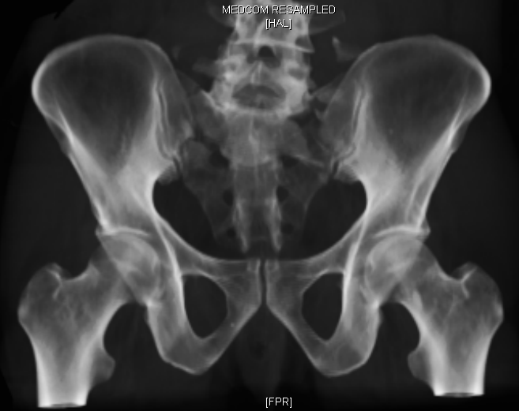
“ Step Ladder” sign

Slide 13
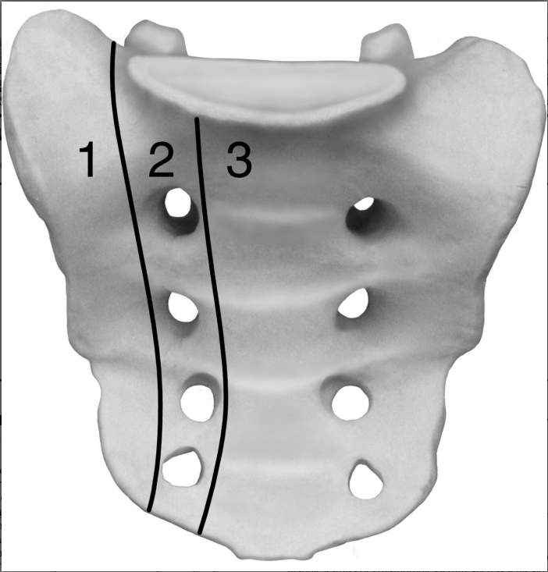
Fracture Classification
Denis Classification – Does not take spinopelvic stability into account
Based upon location of fractures relative to sacral foramen and associated risks of neurologic deficits
Zone I: 5.9% incidence of predominantly L5 nerve root injury
Zone II: 28.4% incidence of L5, S1 nerve root injury
Zone III (central canal fracture): 56.7% incidence of neurologic injury, usually sacral plexus or cauda equina

Slide 14
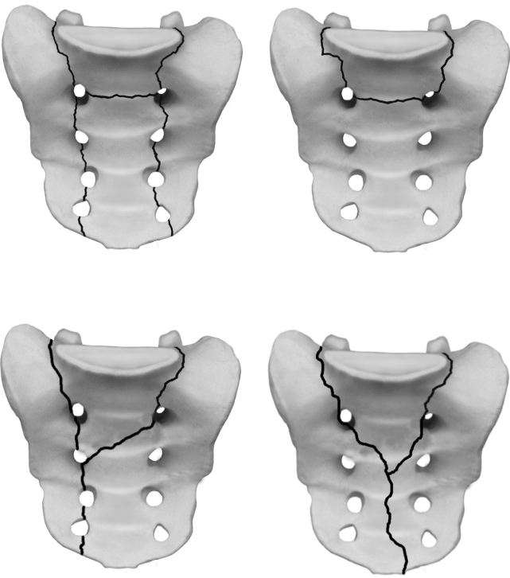
Denis Classification – Zone III
Not just purely longitudinal or transverse, but complex, multiplanar fractures
Any fracture that is transverse is, by definition a Denis Zone III, however when combined with bilateral longitudinal fractures, the resulting ”U”, “H”, “Y” and “Lambda” fracture patterns result in spinopelvic dissociation

Slide 15
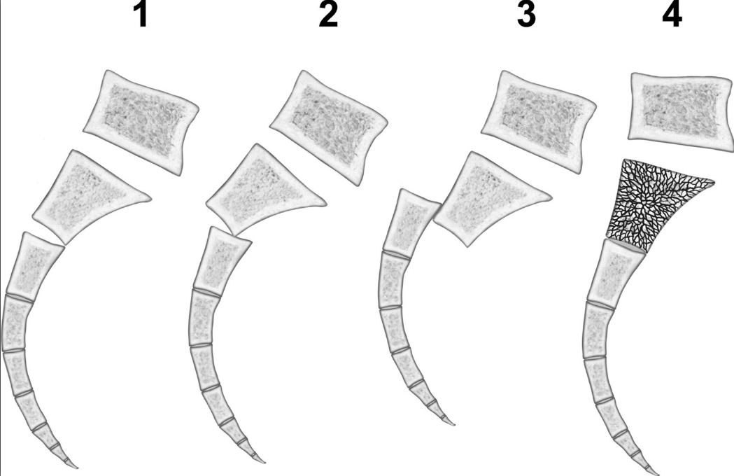
Modifications of Denis Classification
The Denis Classification did not allow for characterization of displacement and angulation patterns
Roy-Camille (1-3) and Strange Vognsen – Lebech (4) classified the type IIIs based upon displacement and angulation

Slide 16
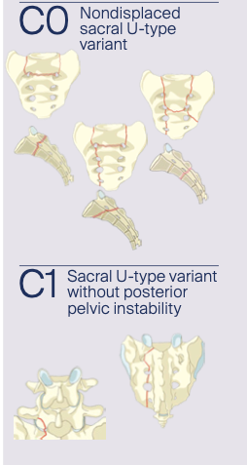
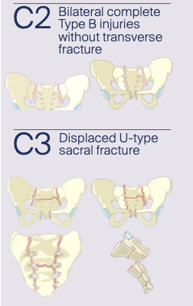
AO Sacral Fracture Classification

Slide 17
Importance of kyphosis reduction
Goal of fixation is to correct and prevent further displacement, which can lead to postural malalignment, chronic pain, and neurologic compromise
Restoration of appropriate sagittal alignment of the sacral fracture “decreases pain by preventing compensatory lumbar hyperlordosis, allowing for more physiologic alignment of the lumbar spine”
Normal pelvic incidence (~50 degrees +/- 10 degrees) can be used an objective measure of adequacy in reduction of sacral kyphosis

Slide 18
Hardware Placement
Anterior pelvic ring injuries and/or acetabular injuries must be addressed first, as the rigidity of lumbopelvic fixation will prevent any further reduction
Lumbopelvic fixation provides the most rigid fixation of sacral fractures, as compared to transacral screws
Obtained by pedicle screws placed at L5, and screw fixation in the ilium
If poor bone quality, L5 pedicle is involved, or preexisting L4-5 instability, extension to L4 is warranted
Allows for earlier mobilization, if other injures allow
S1 screws are not routinely placed due to poor purchase in fractured sacrum

Slide 19
Percutaneous vs Open
Percutaneous fixation has been shown to have similar restoration of pelvic incidence, lumbar lordosis, operative time, and length of stay, although not studied in severe displacement
Percutaneous does have less estimated blood loss, although both open and percutaneous fixation required transfusions at a similar rate
Percutaneous allows for indirect decompression of sacral nerve roots, whereas open allows for sacral laminectomy and direct decompression

Slide 20
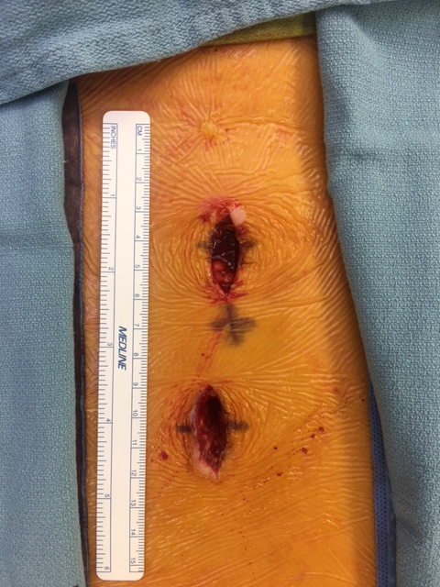
Percutaneous

Slide 21
Neurologic Decompression
When neurologic deficits are present, direct decompression by laminectomy may enhance neurologic recovery
Although, neurologic injuries secondary to sacral fractures are not considered neurologic emergencies, and surgical timing does not necessarily correlate with neurologic recovery
Sacral laminectomy should be performed cranial to caudal, decompressing S1-4, lateral to the sacral pedicles, to ensure thorough decompression
Up to 80% of patients experience improvement in neurologic function following spinopelvic instability fractures, regardless of treatment

Slide 22
Fracture Reduction – Indirect with traction
Restoration of length is required for successful fracture realignment
Bifemoral traction allows for dis-impaction of the cranial and caudal fracture fragments, and allows for restoration of fracture length and some sagittal alignment

Slide 23
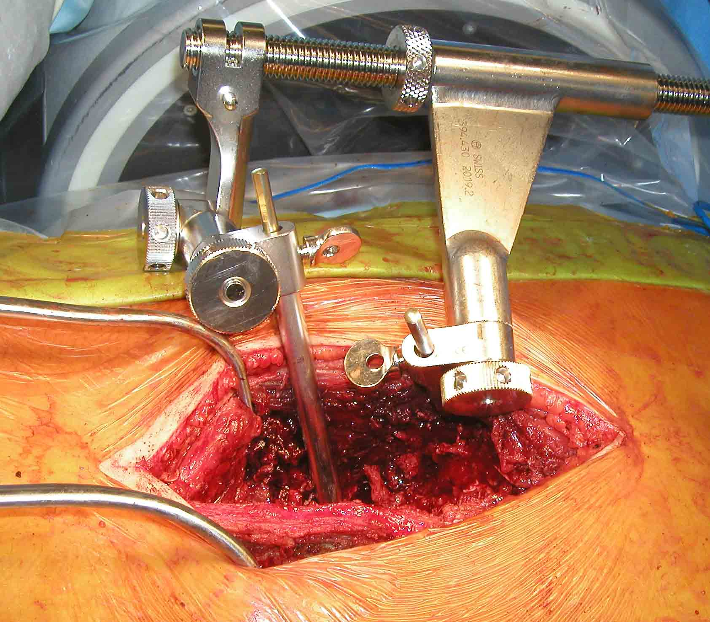
Fracture Reduction – Utilization of Distractor
Femoral distractor utilizes Schanz pins placed ipsilaterally in same trajectory as spinopelvic hardware to hold distraction
Allows for sacral laminectomy, and access to transverse fracture line by mobilization of sacral nerve roots
Elevator placed in to fracture line, and a Schanz pin placed in cranial sacral piece, for joysticking of fracture
Distraction can be decreased once reduction is obtained, and Iliosacral / transsacral screws can be placed

Slide 24
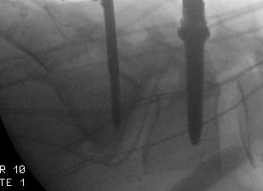
Fracture Reduction – Utilization of Cobbs and Schantz Pins
Elevator placed in to fracture line, and a Schanz pin placed in cranial or caudal sacral piece, for joysticking of fracture
Cobbs can also be places into fracture to tray and dis-impact
Cobbs to lever
Schanz Pin

Slide 25
Fracture Reduction – Indirect with Contouring of Rods
Once lumbar pedicle screw and iliac bolt placed, a temporary rod is locked in to place on once screw, allowing for distraction across the other
Once length is established, 2nd screw is locked down
Rod is then contoured with in situ benders to correct kyphosis
Once reduction is complete, contralateral rod is placed, and then initial rod is replaced with a new, unstressed, rod.

Slide 26
Fracture Reduction – Indirect with Contouring of Rods
Lumbo-pelvic Fixation
With Distraction and Rod Contouring

Slide 27
Complications
Often due to high energy mechanisms, with traumatized soft tissue envelope, predisposing to wound complications
Percutaneous screws may be preferable in this situation, however the nature of the injury may necessitate open treatment
Lack of soft tissue in this area may lead to painful prominent hardware, skin breakdown, and necessitate hardware removal
Broken hardware usually occurs after fracture has healed, due to micromotion at the SI joint

Slide 28
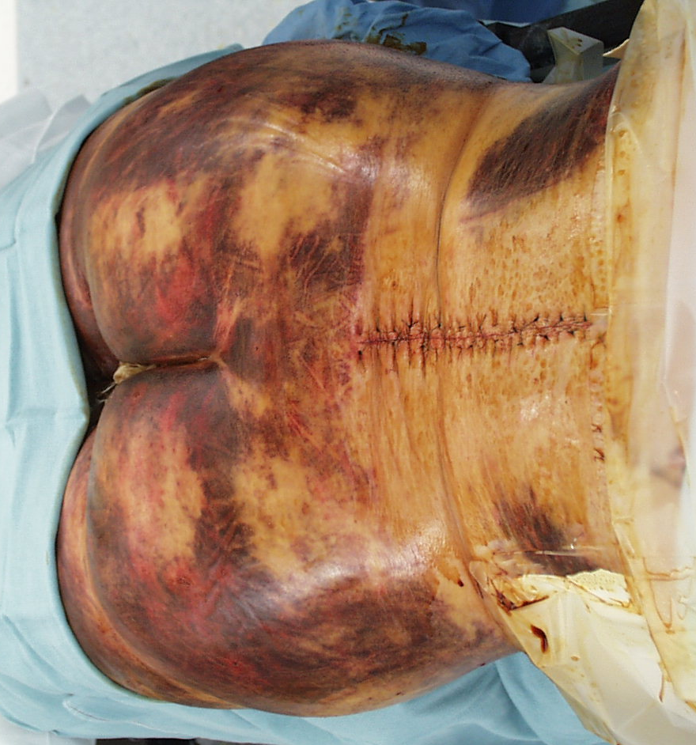
Complications
prominent hardware
traumatized soft tissue envelope

Slide 29
Common Pitfalls
Sacral fractures can be missed up to 30% of the time, especially insufficiency fractures
Neurologic compromise is often distal to S1, and will not be picked up on a motor examination
Distraction across fracture, may predispose to non-union, so caution should be taken when distracting across pedicle screws for reduction

Slide 30
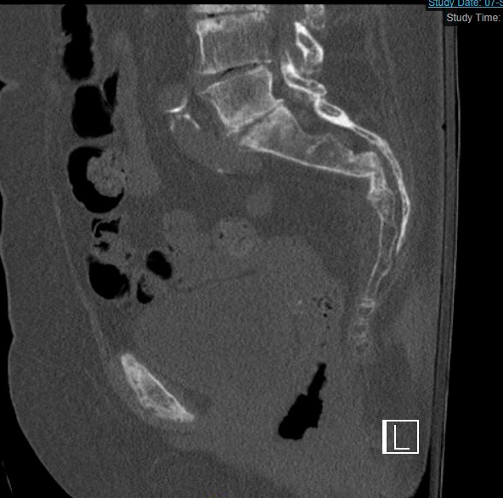
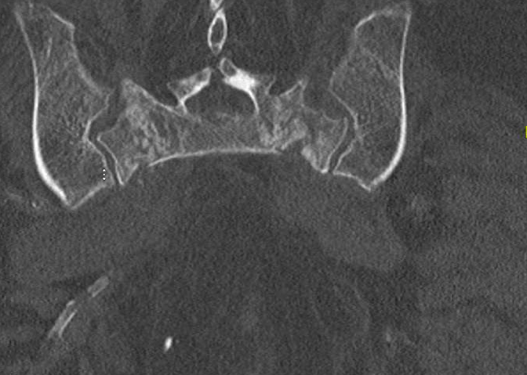
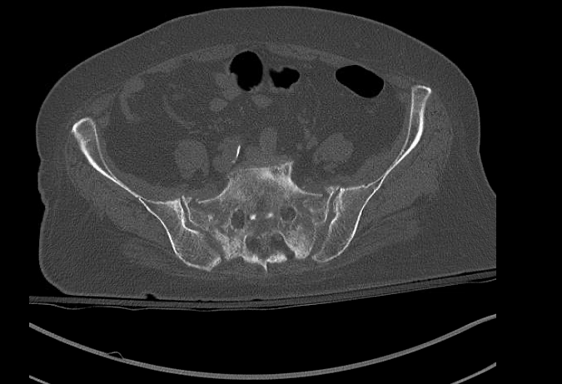
Case Example: Sacral Insufficiency
77 year old female, with 2 months of pain during ambulation, following a ground level fall, in the setting of osteoporosis. Neurologically intact

Slide 31
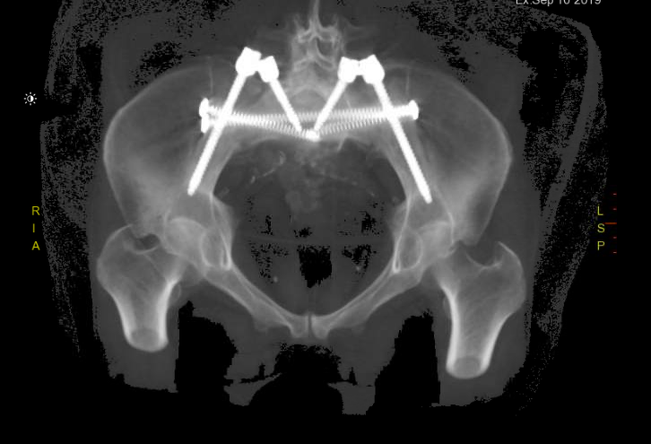
Case Example: Sacral Insufficiency

Slide 32
Case Example: Sacral Kyphosis with sacral nerve root dysfunction
18 year old female, struck by a motor vehicle, with loss of S2-4 function

Slide 33
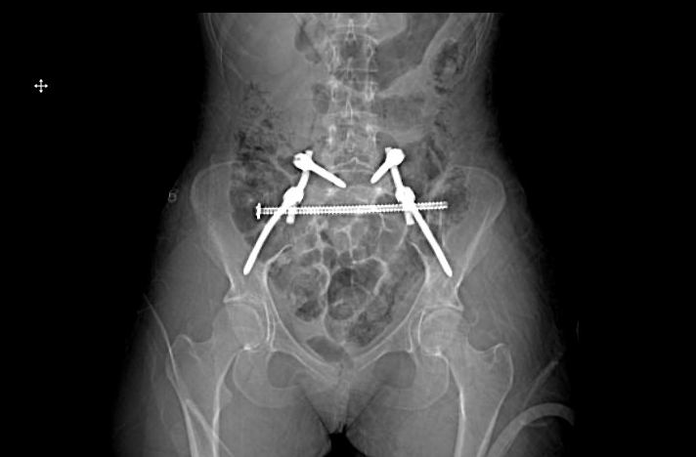
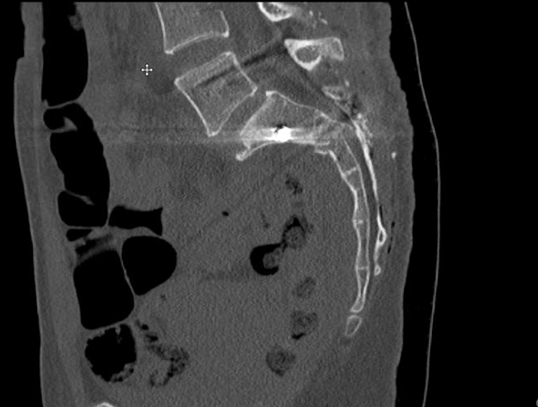
Case Example: Sacral Kyphosis with sacral nerve root dysfunction

Slide 34
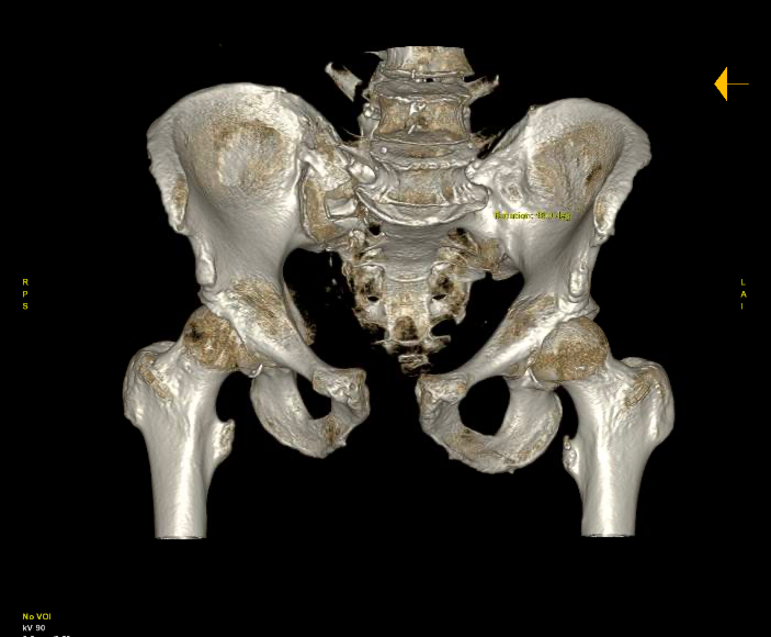
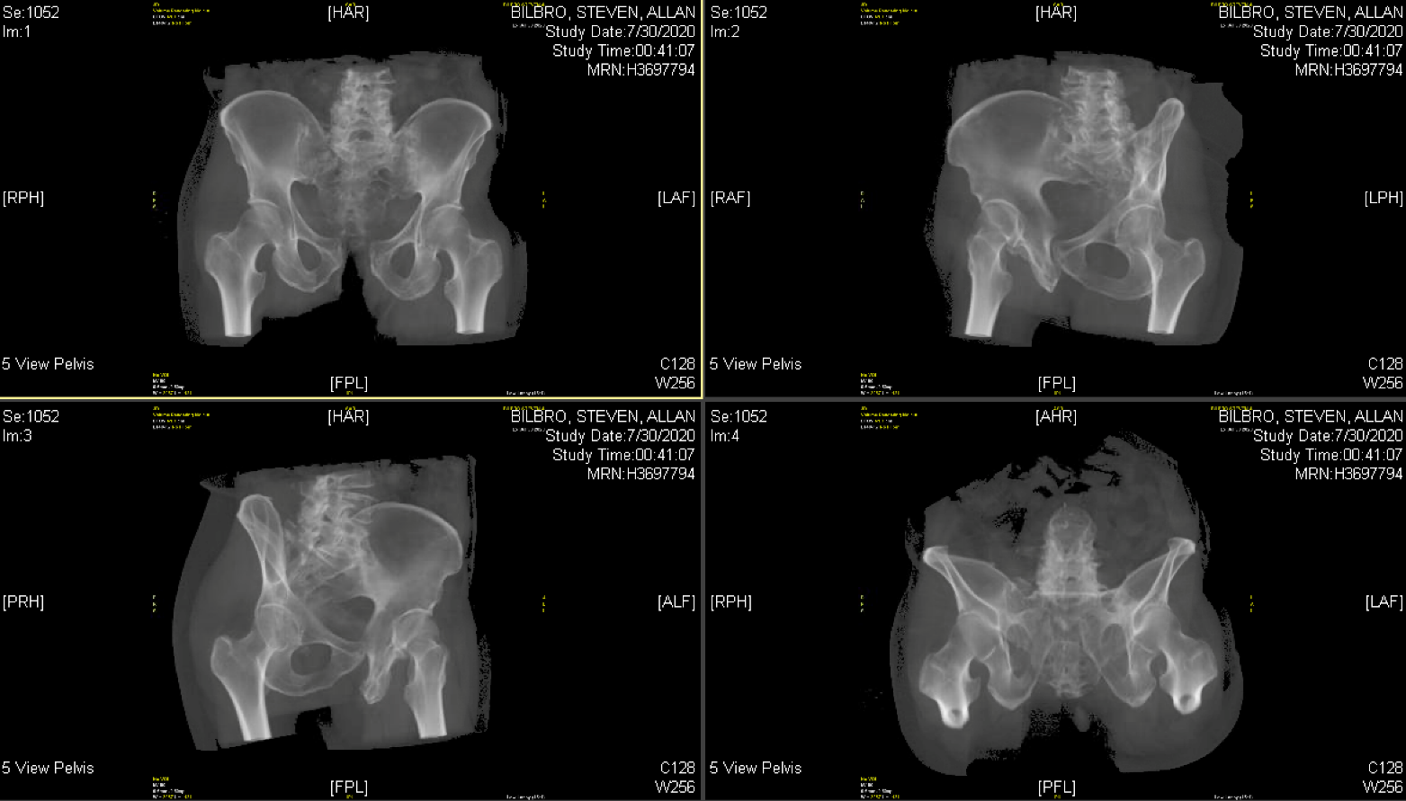
Case Example: Combined spinopelvic dissociation and pelvic ring
69 year old male, motorcycle wreck at high speeds, with concomitant pelvic ring injury

Slide 35
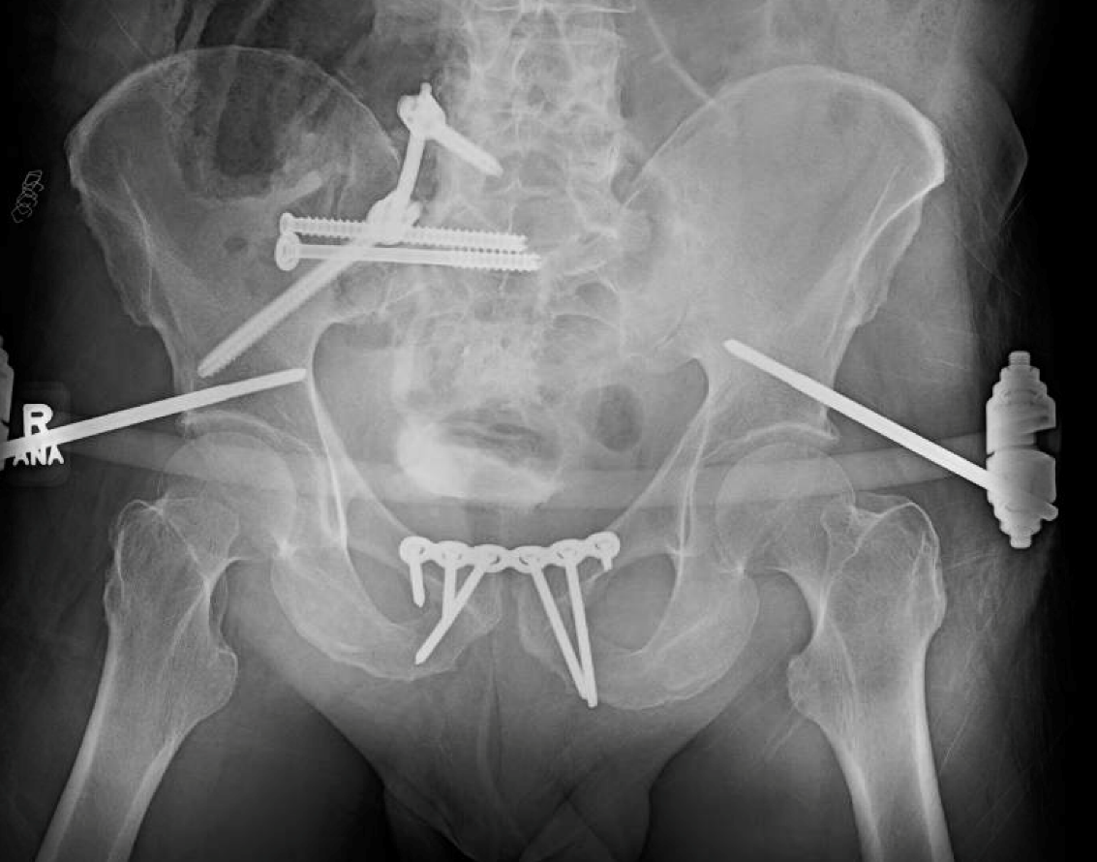
Case Example: Combined spinopelvic dissociation and pelvic ring
Pelvic ring injury treated 1st, with anterior plating, and right sided iliosacral screws. Due to poor corridors, lumbopelvic fixation was used

Slide 36
Summary
Spinopelvic dissociation is a rare, but devasting injury, whose instability can lead to progressive deformity and neurologic compromise if not addressed appropriately
Occurs in both the young and elderly populations, although due to different underlying mechanisms
Lumbopelvic fixation is an appropriate treatment option, should iliosacral or transiliac transscaral screw fixation not be an option
Sacral laminectomy is often needed, both for nerve root decompression, but also for direct fracture reduction

Slide 37
References
1. Chaiyamongkol W, Kritsaneephaiboon A, Bintachitt P, et al. Biomechanical Study of Posterior Pelvic Fixations in Vertically Unstable Sacral Fractures: An Alternative to Triangular Osteosynthesis. Asian Spine J. 2018;12(6):967–972.
2. Hart RA, Badra MI, Madala A, et al. Use of Pelvic Incidence as a Guide to Reduction of H-Type Spino-Pelvic Dissociation Injuries. J Orthop Trauma. 2007;21(6):369–374.
3. Gribnau AJG, Hensbroek PB van, Haverlag R, et al. U-shaped sacral fractures: Surgical treatment and quality of life. Inj. 2009;40(10):1040–1048.
4. Schildhauer TA, Ledoux WR, Chapman JR, et al. Triangular Osteosynthesis and Iliosacral Screw Fixation for Unstable Sacral Fractures: A Cadaveric and Biomechanical Evaluation Under Cyclic Loads. J Orthop Trauma. 2003;17(1):22–31.
5. Kaye ID, Yoon RS, Stickney W, et al. Treatment of Spinopelvic Dissociation. Jbjs Rev. 2018;6(1):e7.
6. Bents RT, France JC, Glover JM, et al. Traumatic Spondylopelvic Dissociation. Spine. 1996;21(15):1814–1819.
7. Yi C, Hak DJ. Traumatic spinopelvic dissociation or U-shaped sacral fracture: A review of the literature. Inj. 2012;43(4):402–408.
8. ROY-CAMILLE R, SAILLANT G, GAGNA G, et al. Transverse Fracture of the Upper Sacrum. Spine. 1985;10(9):838–845.
9. Bellabarba C, Schroeder GD, Kepler CK, et al. The AOSpine Sacral Fracture Classification. Global Spine J. 2016;6(1_suppl):s-0036-1582696-s-0036-1582696.
10. Kelly M, Zhang J, Humphrey CA, et al. Surgical management of U/H type sacral fractures: outcomes following iliosacral and lumbopelvic fixation. J Spine Surg. 2018;4(2):361–367.
11. König MA, Jehan S, Boszczyk AA, et al. Surgical management of U-shaped sacral fractures: a systematic review of current treatment strategies. Eur Spine J. 2012;21(5):829–836.
12. Pulley BR, Cotman SB, Fowler TT. Surgical Fixation of Geriatric Sacral U-Type Insufficiency Fractures. J Orthop Trauma. 2018;32(12):617–622.
13. Nonne D, Capone A, Sanna F, et al. Suicidal jumper’s fracture – sacral fractures and spinopelvic instability: a case series. J Medical Case Reports. 2018;12(1):186.
14. Routt MLC, Simonian PT, Swiontkowski MF. STABILIZATION OF PELVIC RING DISRUPTIONS. Orthop Clin N Am. 1997;28(3):369–388.
15. Sullivan MP, Smith HE, Schuster JM, et al. Spondylopelvic Dissociation. Orthop Clin N Am. 2014;45(1):65–75.
16. Pearson JM, Niemeier TE, McGwin G, et al. Spinopelvic Dissociation: Comparison of Outcomes of Percutaneous versus Open Fixation Strategies. Adv Orthop. 2018;2018:1–6.
17. Chou DTS, El-Daly I, Ranganathan A, et al. Spinopelvic Dissociation. J Am Acad Orthop Sur. 2018;26(14):e302–e312.

Slide 38
References
18. Schindler O, Watura R, Cobby M. Sacral Insufficiency Fractures. J Orthop Surg-hong K. 2007;15(3):339–346.
19. Hak DJ, Baran S, Stahel P. Sacral Fractures: Current Strategies in Diagnosis and Management. Orthopedics. 2009;32(10):752–757.
20. Denis F, Davis S, Comfort T. Sacral fractures: an important problem. Retrospective analysis of 236 cases. Clin Orthop Relat R. 1988;227:67–81.
21. Rodrigues-Pinto R, Kurd MF, Schroeder GD, et al. Sacral Fractures and Associated Injuries. Global Spine J. 2017;7(7):609–616.
22. Mehta S, Auerbach JD, Born CT, et al. Sacral Fractures. J Am Acad Orthop Sur. 2006;14(12):656–665.
23. DENIS F, DAVIS S, COMFORT T. Sacral Fractures. Clin Orthop Relat R. 1988;227(NA;):67–81.
24. Williams SK, Quinnan SM. Percutaneous Lumbopelvic Fixation for Reduction and Stabilization of Sacral Fractures With Spinopelvic Dissociation Patterns. J Orthop Trauma. 2016;30(9):e318–e324.
25. Chung N-S, Jeon C-H, Lee H-D, et al. Measurement of Spinopelvic Parameters on Standing Lateral Lumbar Radiographs. Clin Spine Surg. 2017;30(2):E119–E123.
26. Park Y-S, Baek S-W, Kim H-S, et al. Management of sacral fractures associated with spinal or pelvic ring injury. J Trauma Acute Care. 2012;73(1):239–242.
27. Kleweno C, Bellabarba C. Lumbopelvic Fixation for Pelvic Fractures. Operative Techniques Orthop. 2015;25(4):270–281.
28. Verhaegen MJA, Sauter AJM. Insufficiency fractures, an often unrecognized diagnosis. Arch Orthop Traum Su. 1999;119(1–2):115–116.
29. Lee H-D, Jeon C-H, Won S-H, et al. Global Sagittal Imbalance Due to Change in Pelvic Incidence After Traumatic Spinopelvic Dissociation. J Orthop Trauma. 2017;31(7):e195–e199.
30. Schildhauer TA, Chapman JR. Fragility Fractures of the Pelvis. 2017;175–189.
31. Lindahl J, Mäkinen TJ, Koskinen SK, et al. Factors associated with outcome of spinopelvic dissociation treated with lumbopelvic fixation. Inj. 2014;45(12):1914–1920.
32. Vaccaro AR, Kim DH, Brodke DS, et al. Diagnosis and management of sacral spine fractures. Instr Course Lect. 2004;53:375–85.
33. Schildhauer TA, Bellabarba C, Nork SE, et al. Decompression and Lumbopelvic Fixation for Sacral Fracture-Dislocations With Spino-pelvic Dissociation. J Orthop Trauma. 2006;20(7):447–457.
34. Barcellos ALL, Rocha VM da, Guimarães JAM. Current concepts in spondylopelvic dissociation. Inj. 2017;48:S5–S11.
35. Jones CB, Sietsema DL, Hoffmann MF. Can Lumbopelvic Fixation Salvage Unstable Complex Sacral Fractures&quest; Clin Orthop Relat R. 2012;470(8):2132–2141.

